Slide 1




HKROC: an integrated readout chip designed to facilitate the readout of a large number of photomultiplier tubes for the next generation of neutrino experiments
conforti@omega.in2p3.fr
S. CONFORTI DI LORENZO,
Antoine Beauchêne, Sara Bolognesi, Florent Bouyjou, Denis Carabadjac, Frederic Dulucq, Miroslaw Firlej, Tomasz Andrzej Fiutowski, Franck Gastaldi, Fabrice Guilloux, Marek Idzik, Christophe de La Taille, Aleksandra Molenda, Jakub Moron, Jerome Nanni, Benjamin Quilain, Rudolph Rogly, Damien Thienpont

Slide 2
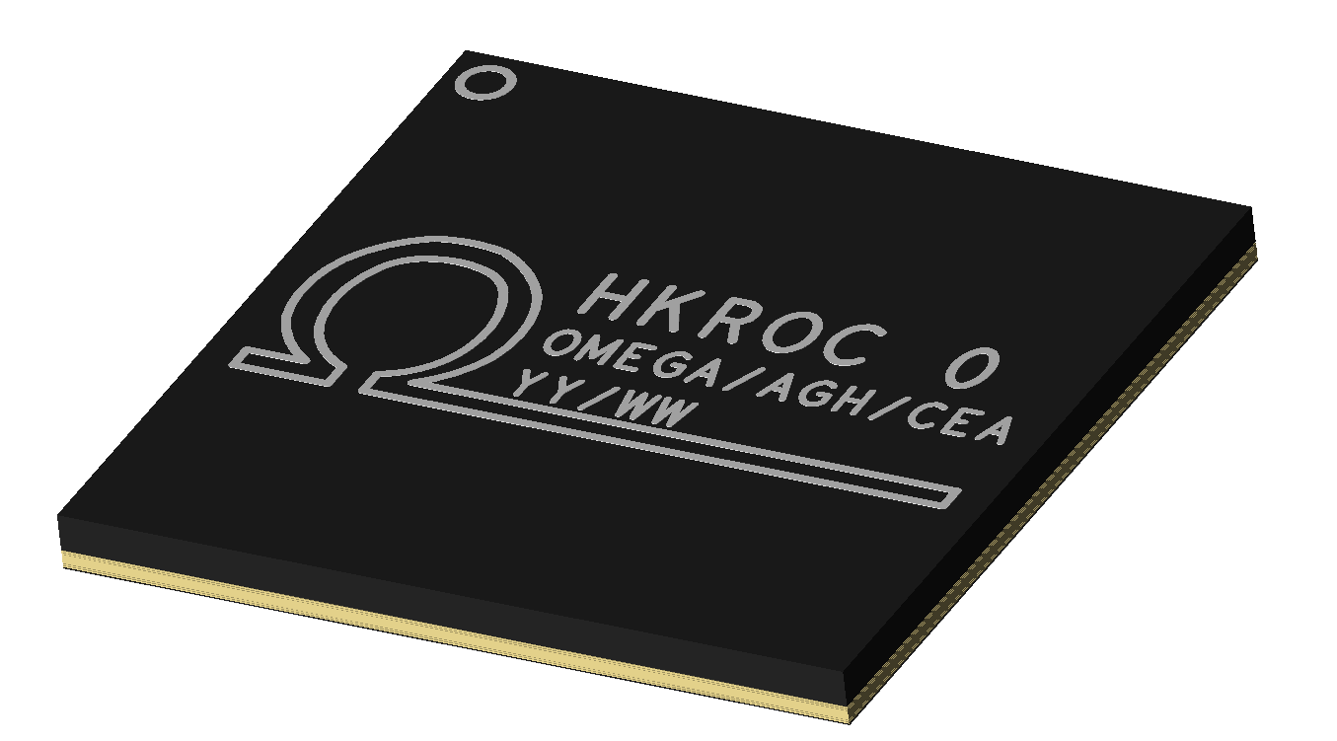
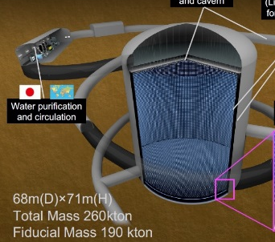
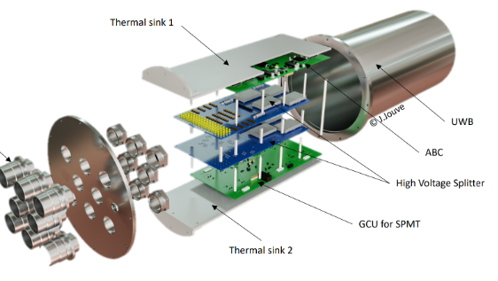
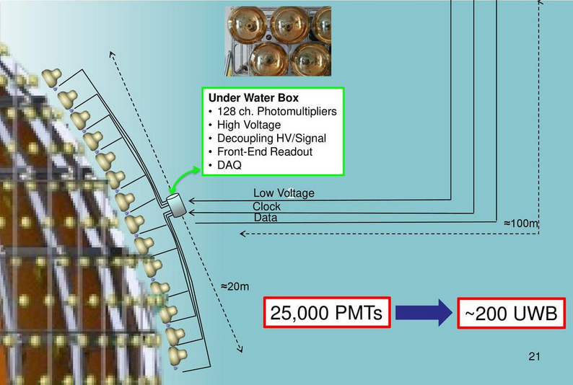
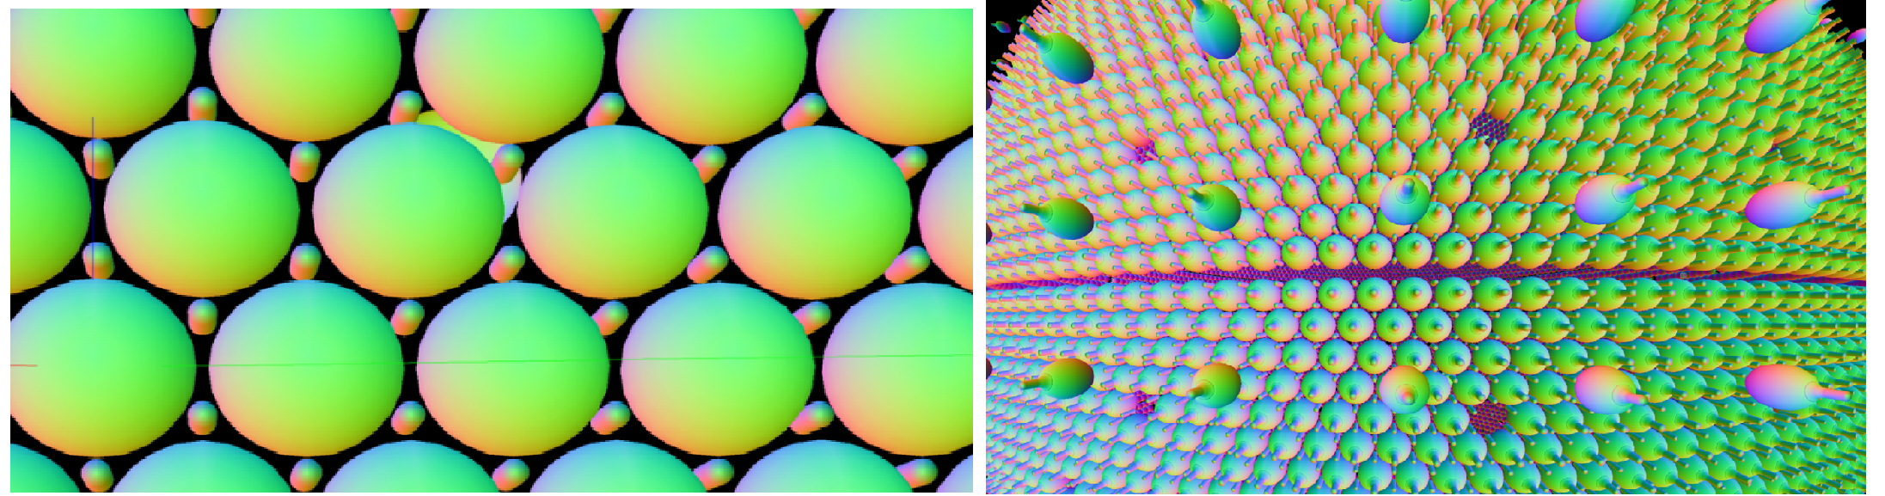
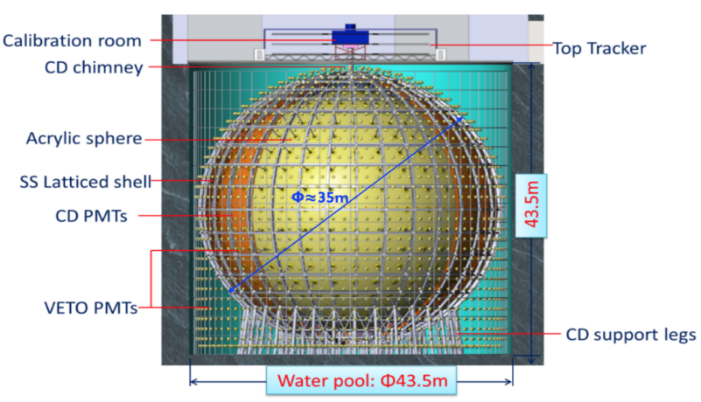
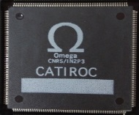
A read-out for multi-ton neutrinos experiments
The HKROC ASIC was originally designed to read out Photomultiplier Tubes (PMTs) for the Hyper-Kamiokande experiment.
As next-generation neutrino experiments continue to expand in scale, with an increasing number of PMTs,
there is a growing need for fully integrated electronic systems.
  Multichannel
  Auto-trigger acquisition mode
  High speed
  Low noise
  Large dynamic range
  Precise charge and time measurements
Omega has extensive experience in ASIC design for neutrino physics,
having developed several ASICs in recent years:
PARIROC 2007 | BiCMOS SiGe 350 nm | First ASIC that was a veritable SoC in auto-trigger mode
CATIROC 2015 | BiCMOS SiGe 350 nm | Based on the PARISROC ASIC, which will be installed in the SPMT system of the JUNO detector (China)
HKROC 2020 | CMOS 130 nm | Based on the ASIC HGCROC for the CMS High Granularity Calorimeter

Slide 3
From physics to electronics specifications
1 p.e. = 2 pC
Physics constraint | Impact on electronics requirement
Detect synchronous & asynchronous events (accelerator/atmospheric/solar/supernova neutrinos, p decay) | Self triggering for each channel
No event loss (e.g. crucial for SN neutrino) | High hit rate (e.g. 1 MHz)
Low energy events detection (e.g. SN or solar neutrino) | Low threshold triggering (e.g. <= 1/6 p.e.)
Charge reconstruction from low to high energy physics | Large dynamic charge range (𝟏 − 𝟏𝟑𝟎𝟎 p.e.) photoelectrons
Excellent charge reconstruction | High linearity (~ 1%) and resolution (~ 1%) 0.1 p.e. for < 10 p.e. < 1% for >10 p.e.
Electronics time resolution < PMT time resolution (1.3 ns) | Timing resolution (e.g. < 0.3 ns) 300 ps for 1 p.e. 200 ps for > 6 p.e.
Low power consumption | 50 mW/ PMT channel

Slide 4
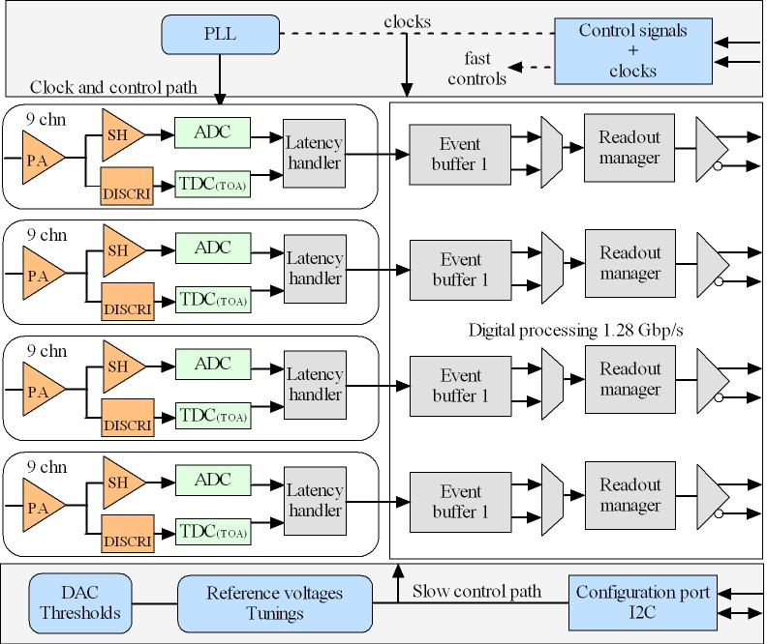
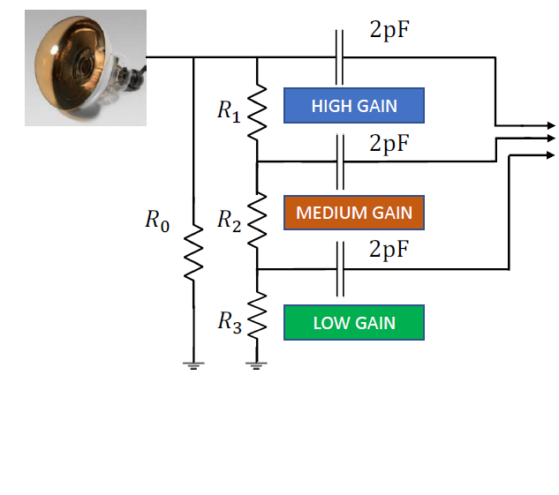
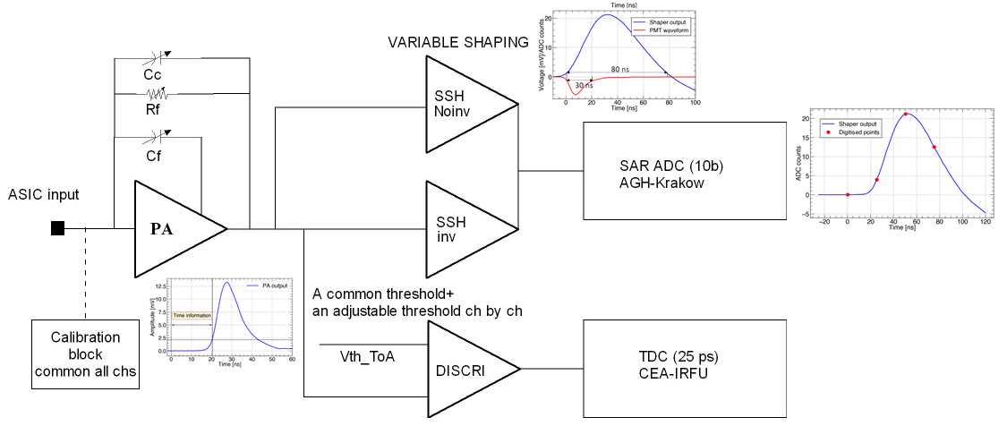
HKROC architecture
ASIC developed in 130 nm CMOS technology (1.2 Volts)
36 input channels → 12 PMT channels
Charge and time measurements:
Slow path: shaper+10b SAR-ADC @ 40MHz,
Fast path: discriminator + 10b TDC (LSB= 25 ps)
4 readout high-speed links (1.28 Gbps) → 1 read-out → 3 PMTs
I2C protocol to load ASIC parameters
320 MHz fast commands
Power consumption 10 mW / channel

Slide 5
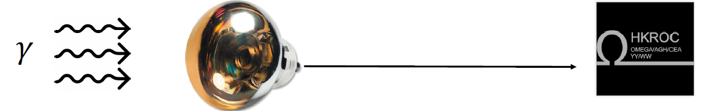
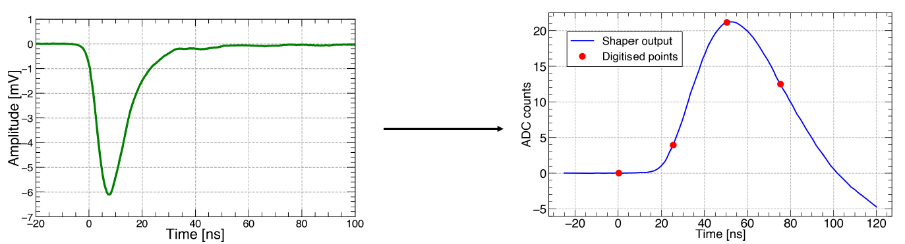
HKROC waveform digitizer
The shaper signal digitized at 40 MHz by a 10 bits SAR (Successive Approximation) ADC (AGH-Krakow group)(DOI 10.1088/1748-0221/18/11/P11013)
For each trigger: a coarse time-stamp (24 bits) common for all channels (at 40 MHz) and a fine timestamp for each channel using a 10 bits TDC (LSB=25ps) (CEA group) (DOI: 10.1109/TNS.2023.3335657)
The ASIC is a Waveform digitizer: when one trigger happens (ToA≠0) N sampling points separated by 25ns are captured and saved in the internal memory . N is variable by slow control (from 1 to 7)

Slide 6
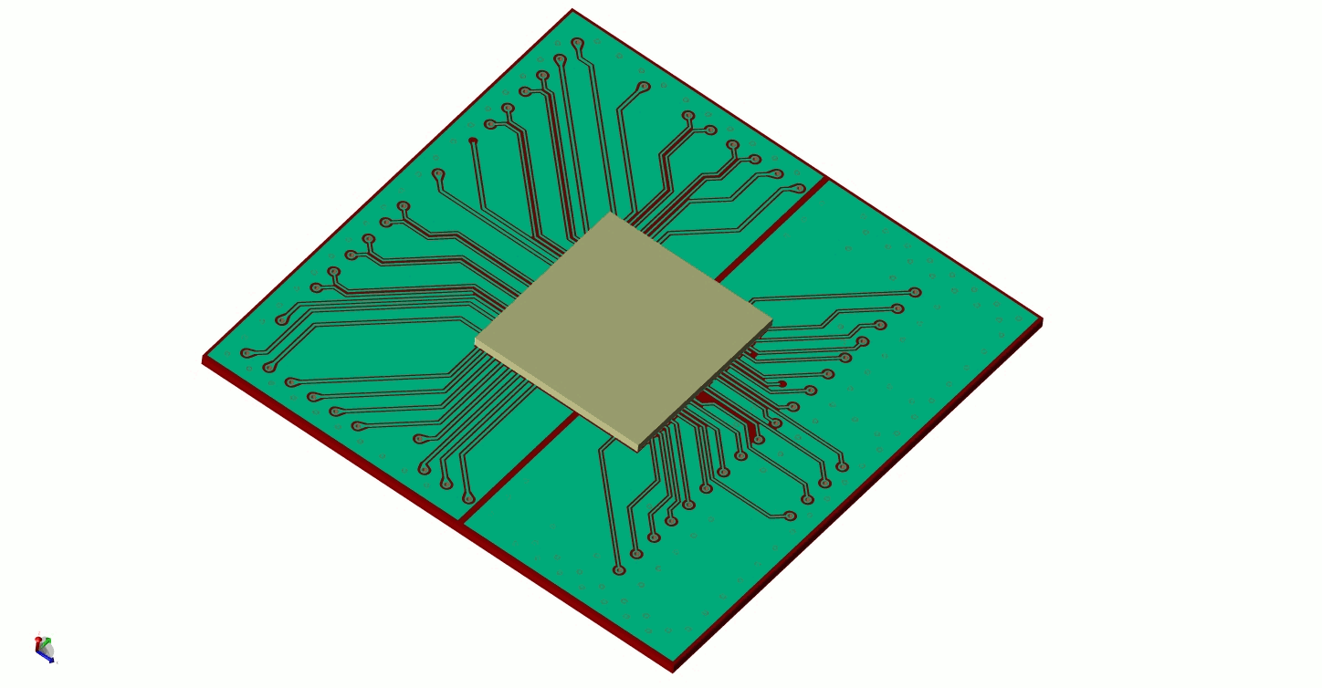
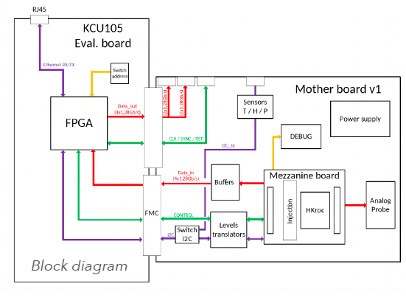
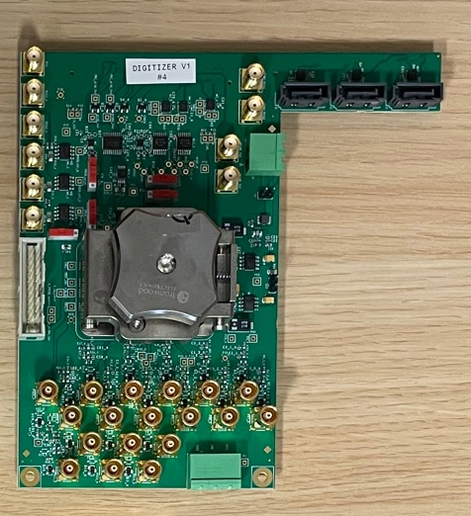
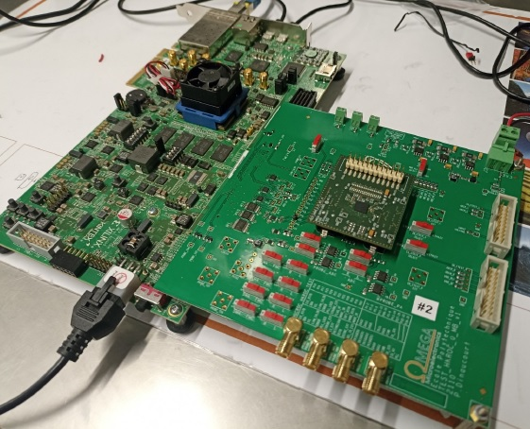
HKROC measurements
HKROC0, produced in 2020 (to see TWEPP 2022), showed good performance that fitted well with the Hyper-K requirements, except for an extra crosstalk that affected the charge measurements.
HKROC1B, produced in 2022, was designed to reduce the crosstalk observed in HKROC0. It demonstrated good overall performance, with a significant reduction in crosstalk (see next slides).
HKROC1C was produced in 2023 and received a few months ago. It is currently under test
  Diffuse crosstalk is being tested
  Global test are ongoing
Digitizer V1
First board with mezzanine

Slide 7
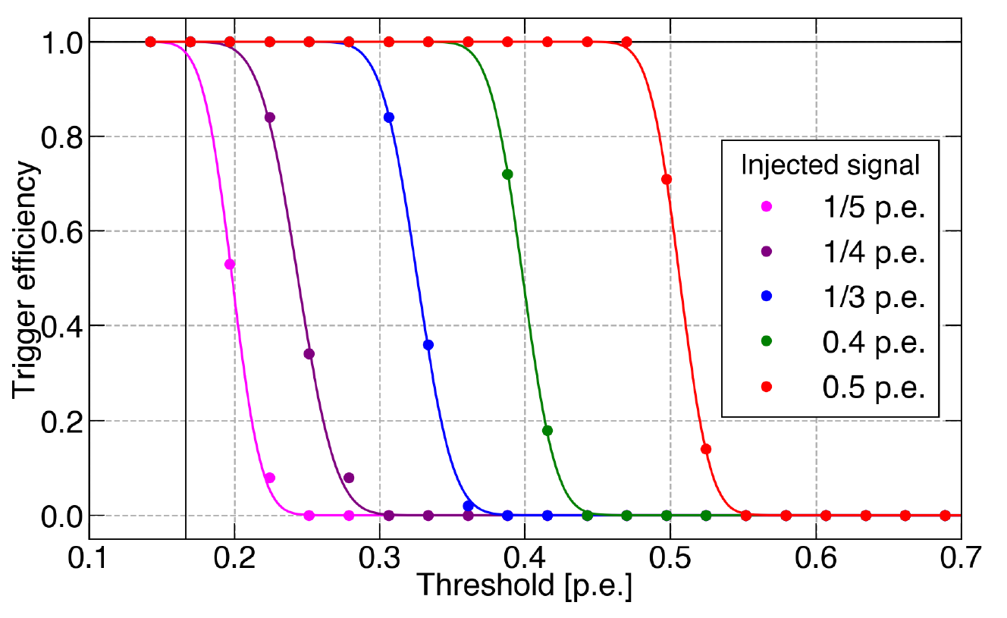
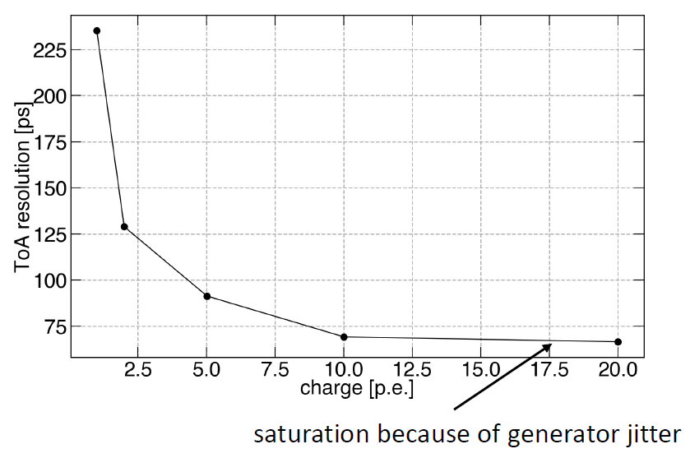
HKROC1B general performances
The second version of the ASIC (HKROC1B) is completely tested and it showed good overall performance, similar to the first version (HKROC0)
Trigger threshold = 1/6 p.e. > 90% efficiency for signal as low as 1/5 p.e.
Noise amplitude < 1/22 p.e.
TDC characterization with 1/6 p.e. threshold
TDC resolution:
225 ps std @ 1 p.e
60 ps std @ >10 p.e (intrinsic resolution 25 ps)

Slide 8
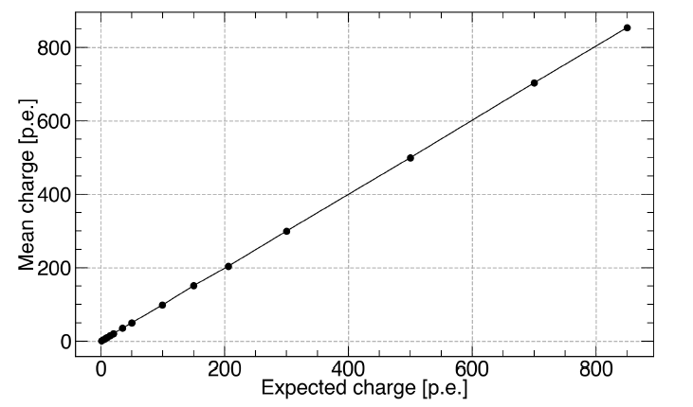
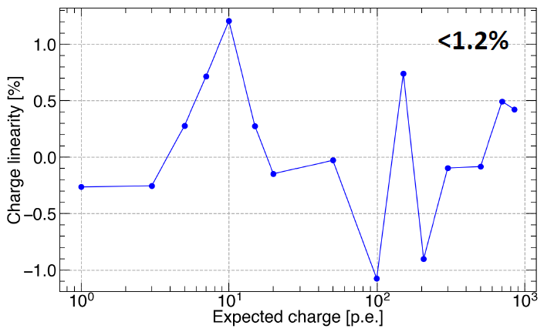
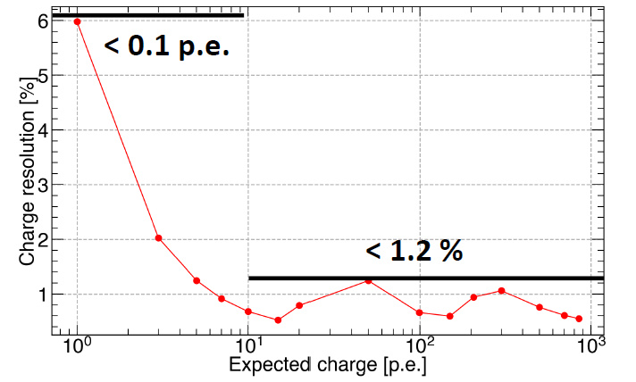
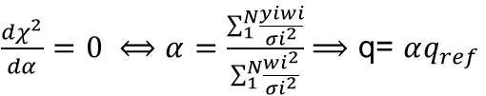
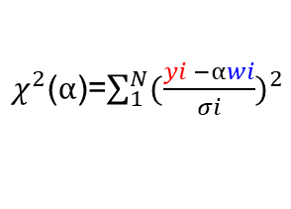
Charge reconstruction
The digitized charge must be reconstructed offline in the FPGA.
The charge reconstruction method consists of two steps:
Build a reference waveform to calibrate each channel:
  ➡ High gain channel : 1. p.e.
  ➡ Medium gain channel : 20 p.e.
  ➡ Low gain channel : 200 p.e. 2.
Given a digitized waveform, find the associated charge :
$χ^{2}$($α$)=$\sum_{1}^{N}{{(\frac{yi −αwi}{σi})}^{2}}$
$\frac{{dχ}^{2}}{dα}=0 ⟺α=\frac{\sum_{1}^{N}{\frac{yiwi}{{σi}^{2}}}}{\sum_{1}^{N}{\frac{{wi}^{2}}{{σi}^{2}}}}$ $⟹$ q= $αq_{ref}$
Charge linearity:
< 1.2 % in all charge range
Charge resolution:
< 0.1 p.e. for charge < 10 p.e
< 1.2 % for charges > 10 p.e.

Slide 9
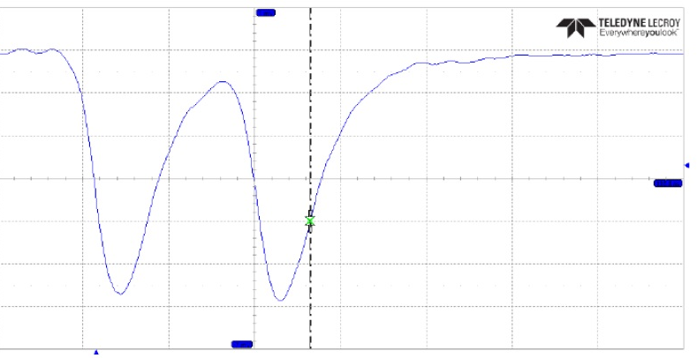
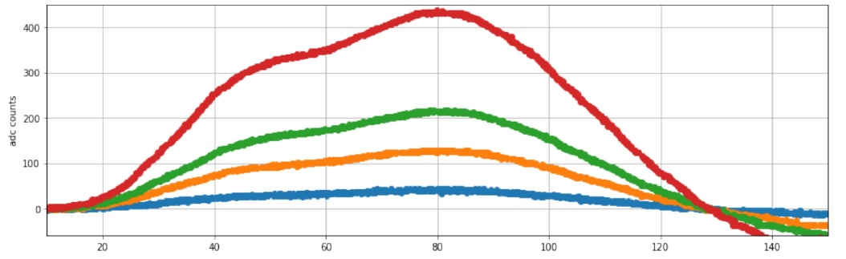
Pile-up et dead time
The HKROC saturation naturally appears when the chip internal memory is full.
The chip has one independent memory for each read-out link at 1.28 Gb/s
ASIC hit rate: ~400 kHz/PMT, up to 1 MHz/channel, but we have tested the ASIC with pile-up events at a 30 ns delay time.
The HKROC feature to be a waveform digitizer and the charge reconstruction method allow the differentiation of events at extremely high frequencies
Secondary peak
Primary peak
10 p.e.
1 p.e.
5 p.e.
3 p.e.
30 ns
1 p.e.
30 ns
Events with separate timestamps > 30 ns→ 2 trigger times
Dead time 30 ns
Accurate charge reconstruction of pile-up:
➡ Charge linearity ~ 1%
➡ Charge resolution:
< 0.1 p.e. for charges < 5 p.e.
< 0.17 p.e. @ 10 p.e.

Slide 10
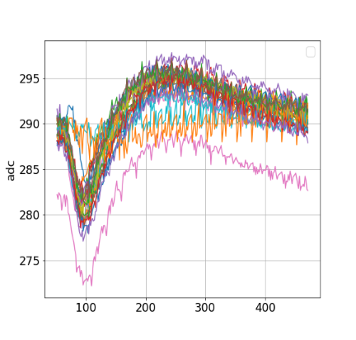
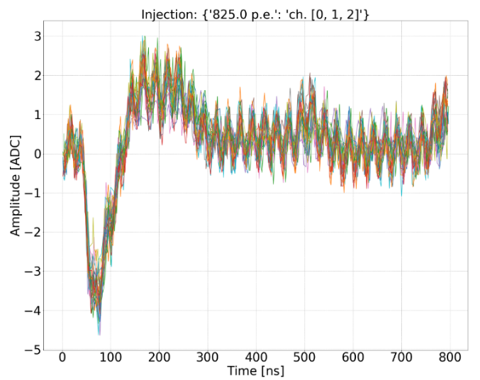
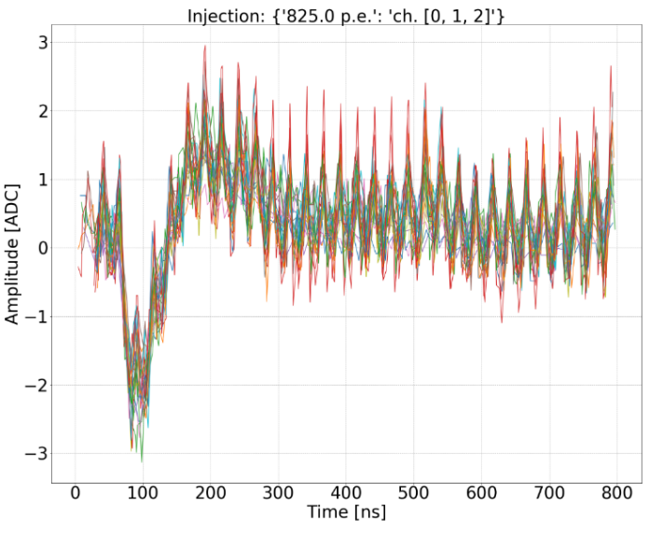
HKROC crosstalk – Diffuse crosstalk
Two crosstalk observed already in the first prototype HKROC0:
One defined “Diffuse crosstalk” → A negative crosstalk observed in all the channels
The second one defined “Close crosstalk” → A positive signal was observed in the close channels
The Diffuse Crosstalk
ADC for 1 p.e. signal is 22 ADC
HKROC0
850 p.e. injected in one channel → signal observed in all channels
HKROC1B
850 p.e. injected in one channel
HKROC1C
850 p.e. injected in one channel
Shown at
TWEPP2022
→ - 8 ADC (LSB ~ 1 mV)
→ - 4 ADC (LSB ~ 1 mV)
→ - 2,5 ADC (LSB ~ 1 mV)
Reproduced in simulations
Three main sources of crosstalk:
The PA bias,
The shaper references
The input calibration block
Schematic corrections
The more sensitive points of the PA bias and shaper references, were put on pins in order to add decoupling capacitances on the board.
A new input calibration block structure was implemented
Schematic corrections
The bias of the PA input stage (vbi_pa) was put on a pin in order to add decoupling capacitances on the board.

Slide 11
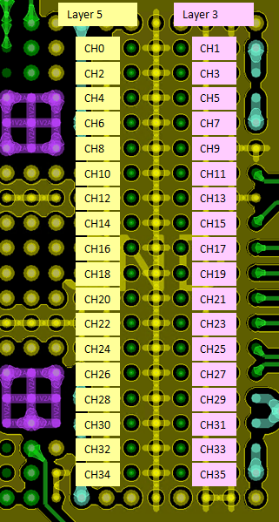
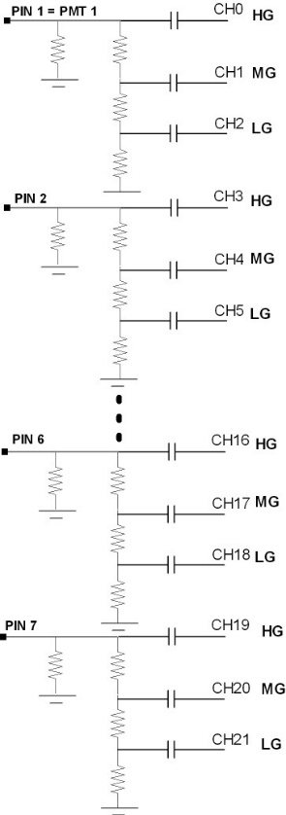
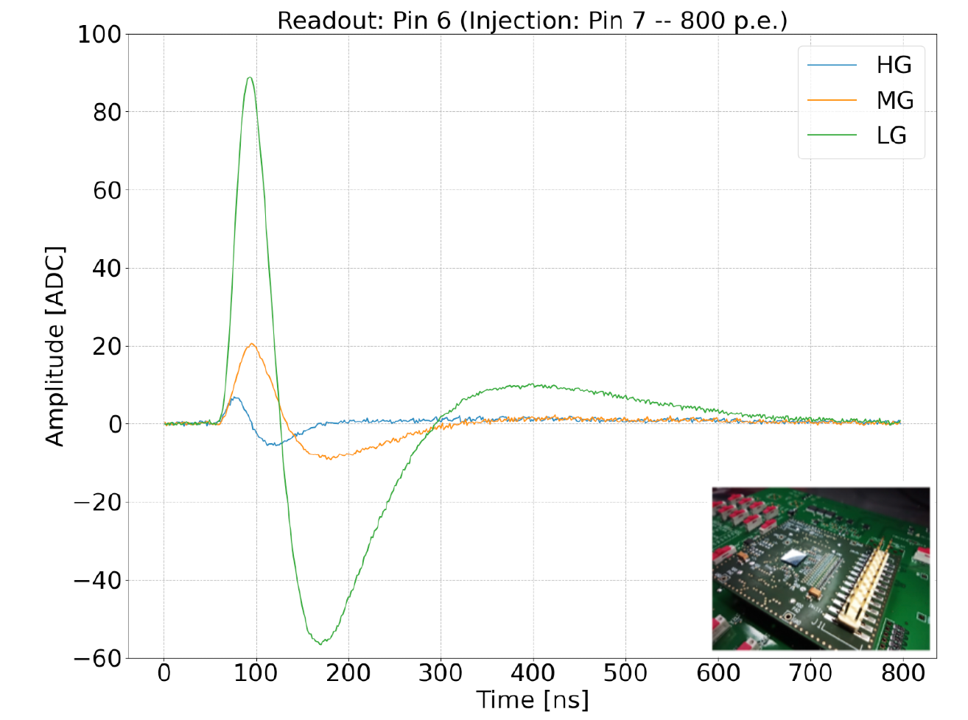
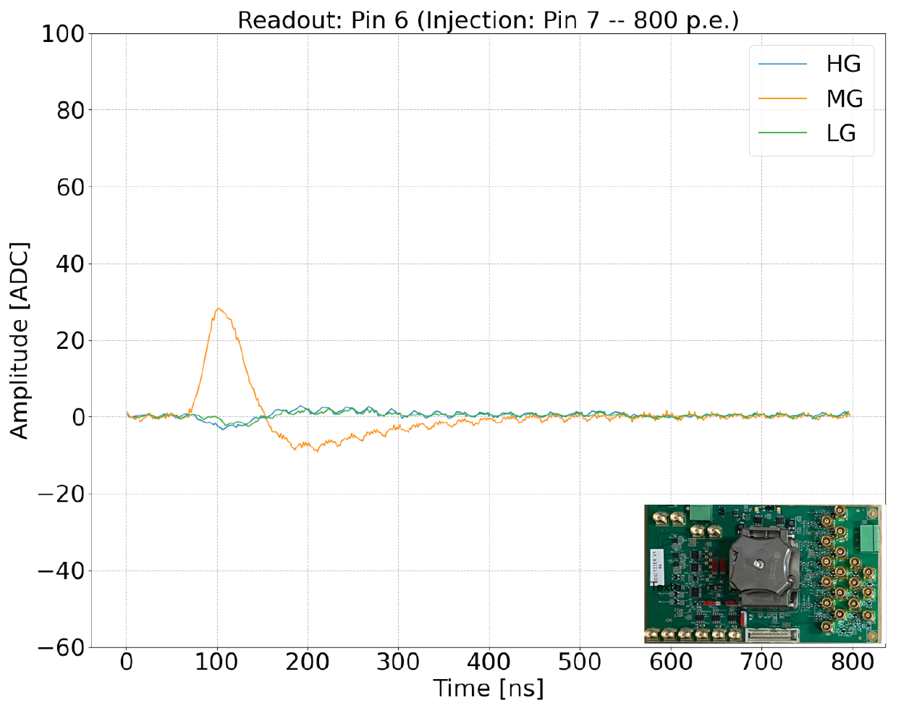
Close crosstalk
A large signal of 850 p.e. is injected into one pin (PIN7), affecting three ASIC channels, and an additional positive signal is observed only on the adjacent PIN6. This crosstalk was not reproduced in simulations, suggesting that it originates externally to the ASIC (in the BGA substrate and test board).
A BGA substrate was designed with additional layers to separate the input into EVEN and ODD channels
A new board for BGA packaging was also designed with two layers, dedicated to EVEN and ODD channels.
850 p.e. injected in PIN7 (saturated signal with 800 ADCu)
850 p.e. injected in PIN7 (saturated signal with 800 ADCu)
Crosstalk in read-out PIN6
Crosstalk in read-out PIN6
LG: ~ 90 ADCu (800 ADCu full amplitude) (11%)
MG: 24 ADCu (3%)
HG: few
LG: No positive crosstalk
MG: positive crosstalk (25 ADCu ~ 3 %)
HG: No positive crosstalk
MG
crosstalk
HG
input
Board v0 – mezzanine
(HKROC1B)
→ Channels in one layer
Board v1 – BGA
(HKROC1B)
→ Channels in two layers

Slide 12
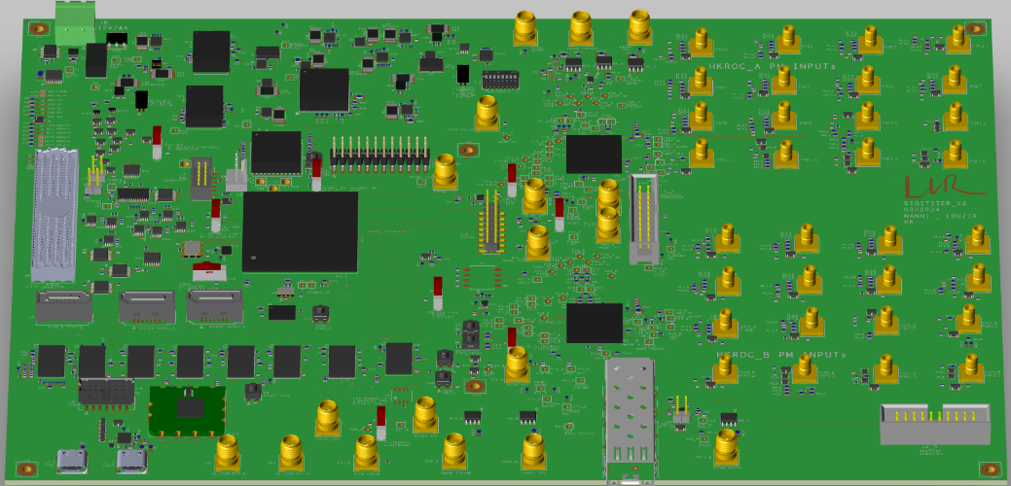
Conclusions and prospects
The HKROC1B, designed to reduce crosstalk, has demonstrated good overall performance, fitting the requirements of neutrino experiments. It has reduced 'diffuse crosstalk' by a factor of 2.
The HKROC1C, further optimized to reduce 'diffuse crosstalk,' has shown a reduction by a factor of 1.6 compared to HKROC1B and 3.2 compared to HKROC0. Crosstalk is now at the noise level, with only 2 mV remaining.
The new test board, designed to separate the channels into two layers, has completely eliminated 'close crosstalk' in the HG and LG channels and significantly reduced it in the MG channel.
An HKROC-based acquisition board (21 x 29 cm) is currently in production. It includes two HKROCs and an FPGA for DAQ and charge reconstruction. This board is specifically designed to further minimize 'close crosstalk' and will be tested by the end of this year
Although it was designed for the Hyper-Kamiokande experiment,
it will not be used for this detector.
However, its unique performance and flexibility could make it useful for various experiments

Slide 13
Backup

Slide 14
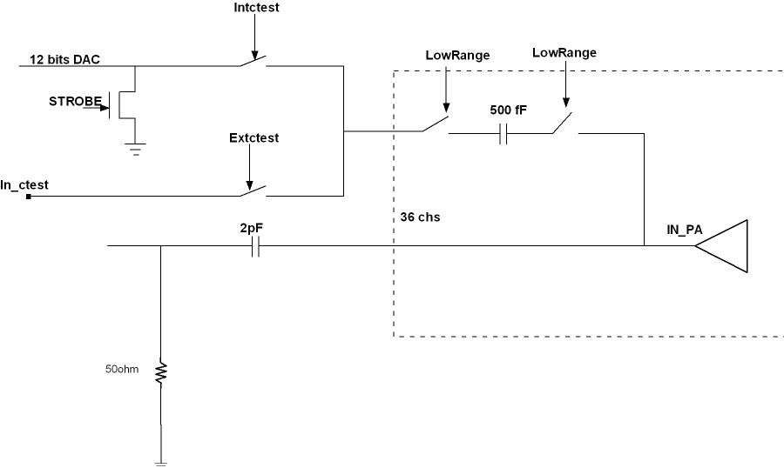
Diffuse crosstalk
For HKROC1C (2022 version):
The "diffuse crosstalk" was observed in measurements, verified through simulations, and understood.
Three main sources of crosstalk were identified:
PA bias → Cdecoupling + pins
Shaper references → Cdecoupling + pins
Ctest → New input calibration block structure
For HKROC1C (2023 version):
An additional PA bias was better decoupled in the layout and on the external board.
cmd
cmdb

Slide 15
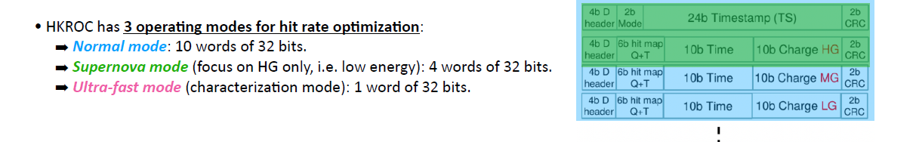
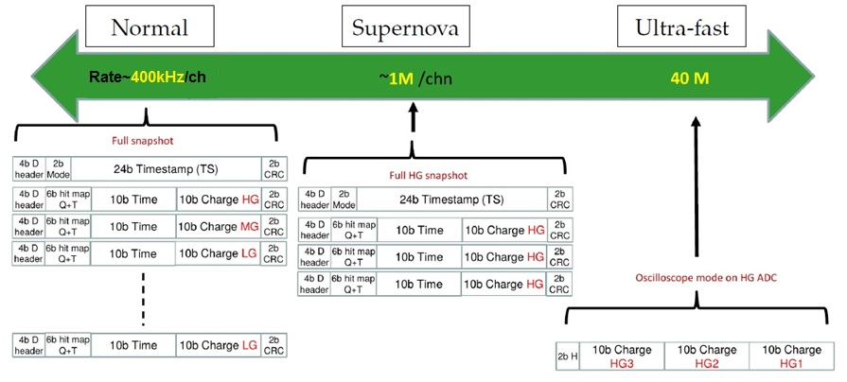
HKROC operating modes
SUPERNOVA MODE:
DATA FRAME for 9 chs:
4 words of 32bits
NORMAL MODE:
DATA FRAME for 9 chs:
10 words of 32bits
ULTRA FAST MODE:
DATA FRAME for 9 chs:
1 words of 32bits

Slide 16
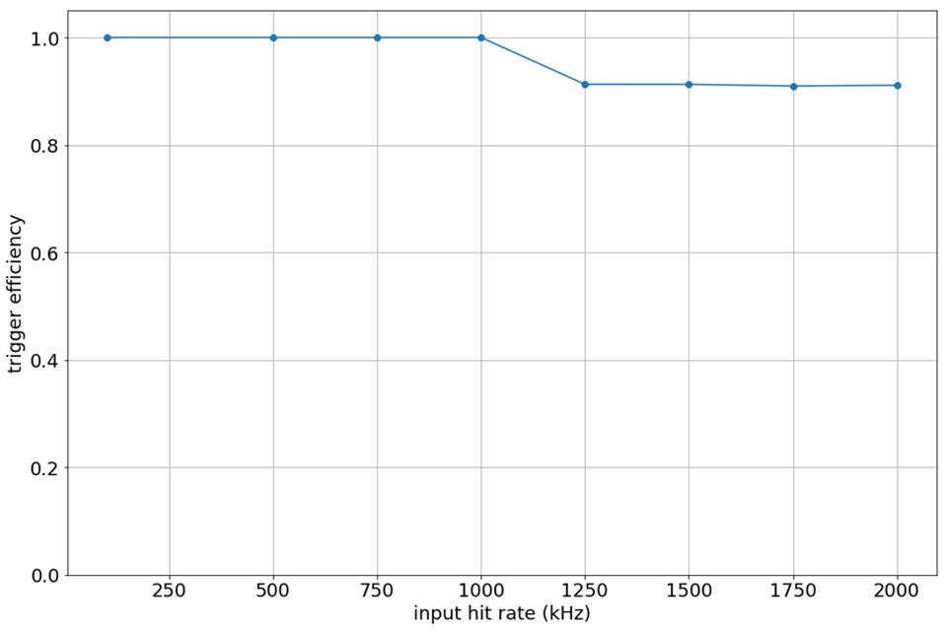
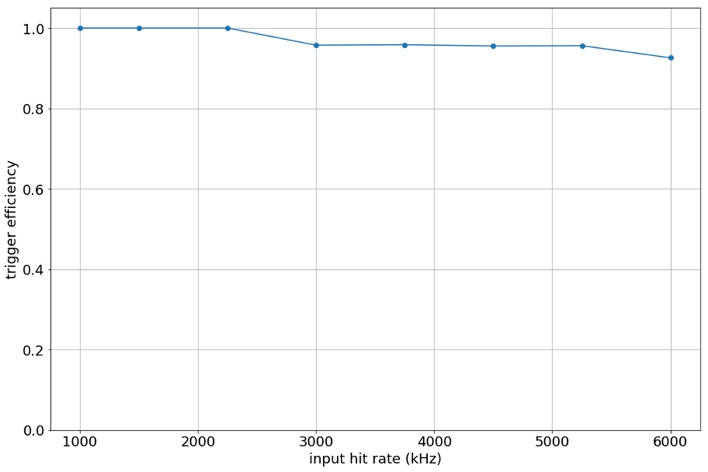
HKROC Trigger rate measurements
FAST hit rate (~ 1MHz) required for close Supernova signals (~ 1 p.e.)
Normal mode:
Super Nova mode
100% at 1 MHz one ch
100% at 2.2 MHz one ch
1 PMT channel →
3 HKROC channels tested in Normal Mode:
100% Trigger efficiency up to 415 kHz 3 chs
1 PMT channel →
3 HKROC channels tested in SuperNova Mode:
100% Trigger efficiency up to 950 kHz 3 chs
The HKROC saturation naturally appears when the chip internal memory is full. The chip has one independent memory for each read-out link at 1.28 Gb/s, which gather 3 PMTs.

Slide 17
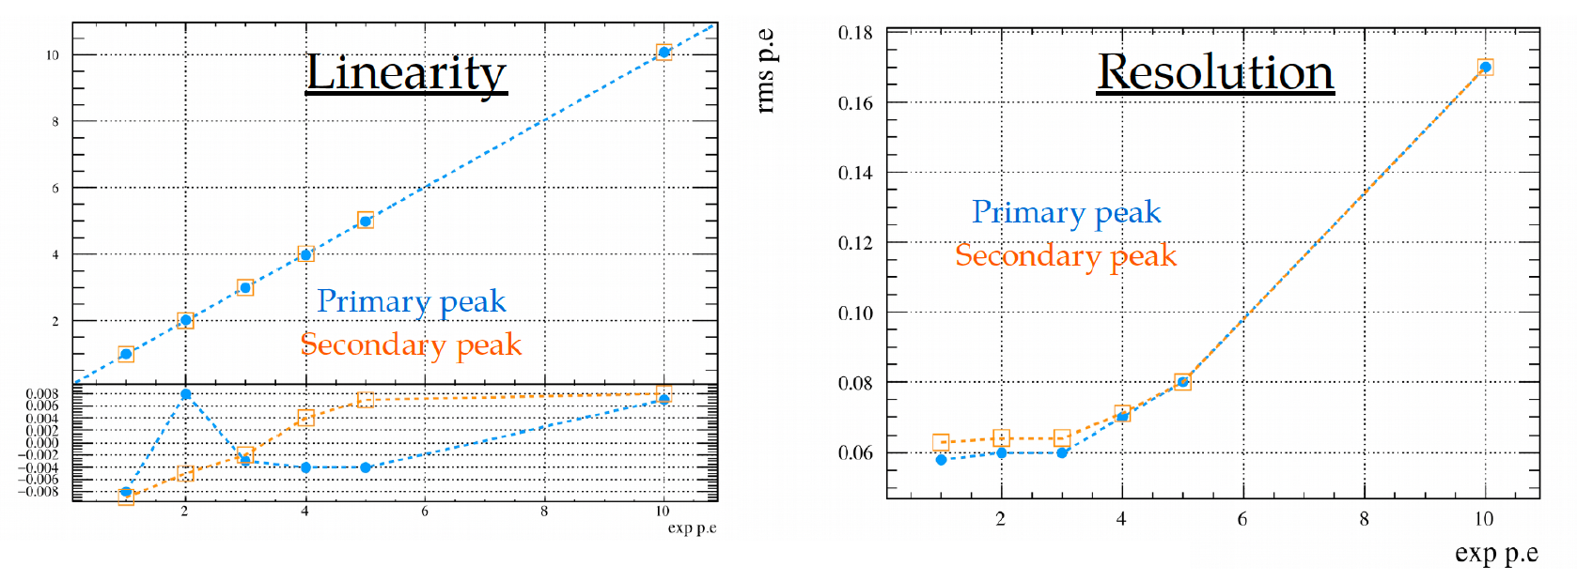

Slide 18
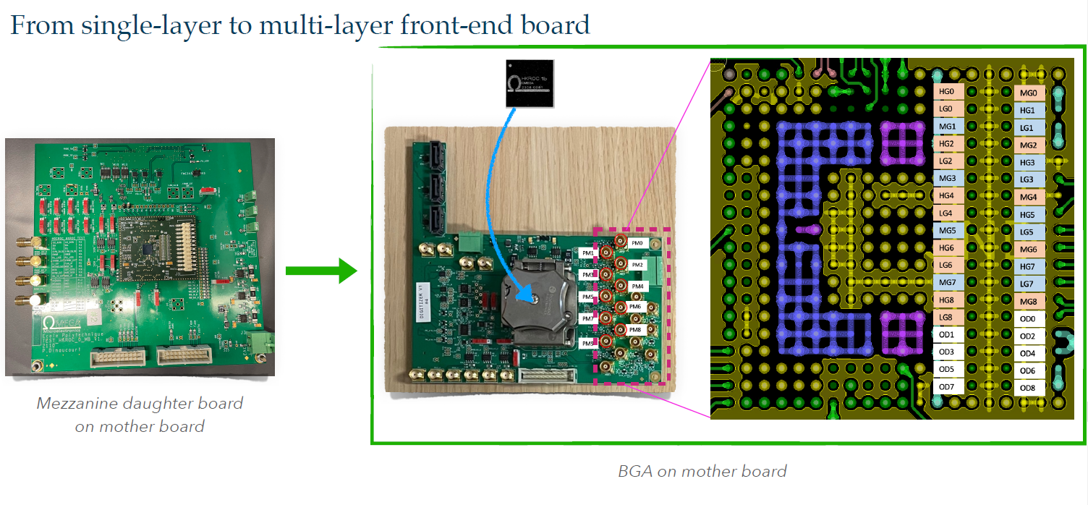

Slide 19
