Slide 1
Silicon Photonics Circuits for the optical readout of CERN detectors
Carmelo Scarcella, D. Alfiero, A. Cristiano, S. Detraz, H. Muthuganesan, L. Olantera, I. Quintana, C. Sigaud, C. Soos, J. Troska
CERN EP-ESE-BE
3rd October 2024
TWEPP 2024
carmelo.scarcella@cern.ch

Slide 2
Outline
Silicon Photonics links for High Energy Physics
Ring modulator design optimization and characterization
Radiation-tolerant ring modulator driver (DART28) demonstrator
Fiber coupling to Silicon Photonics circuits
Conclusions
TWEPP 2024
carmelo.scarcella@cern.ch 03 October 2024

Slide 3
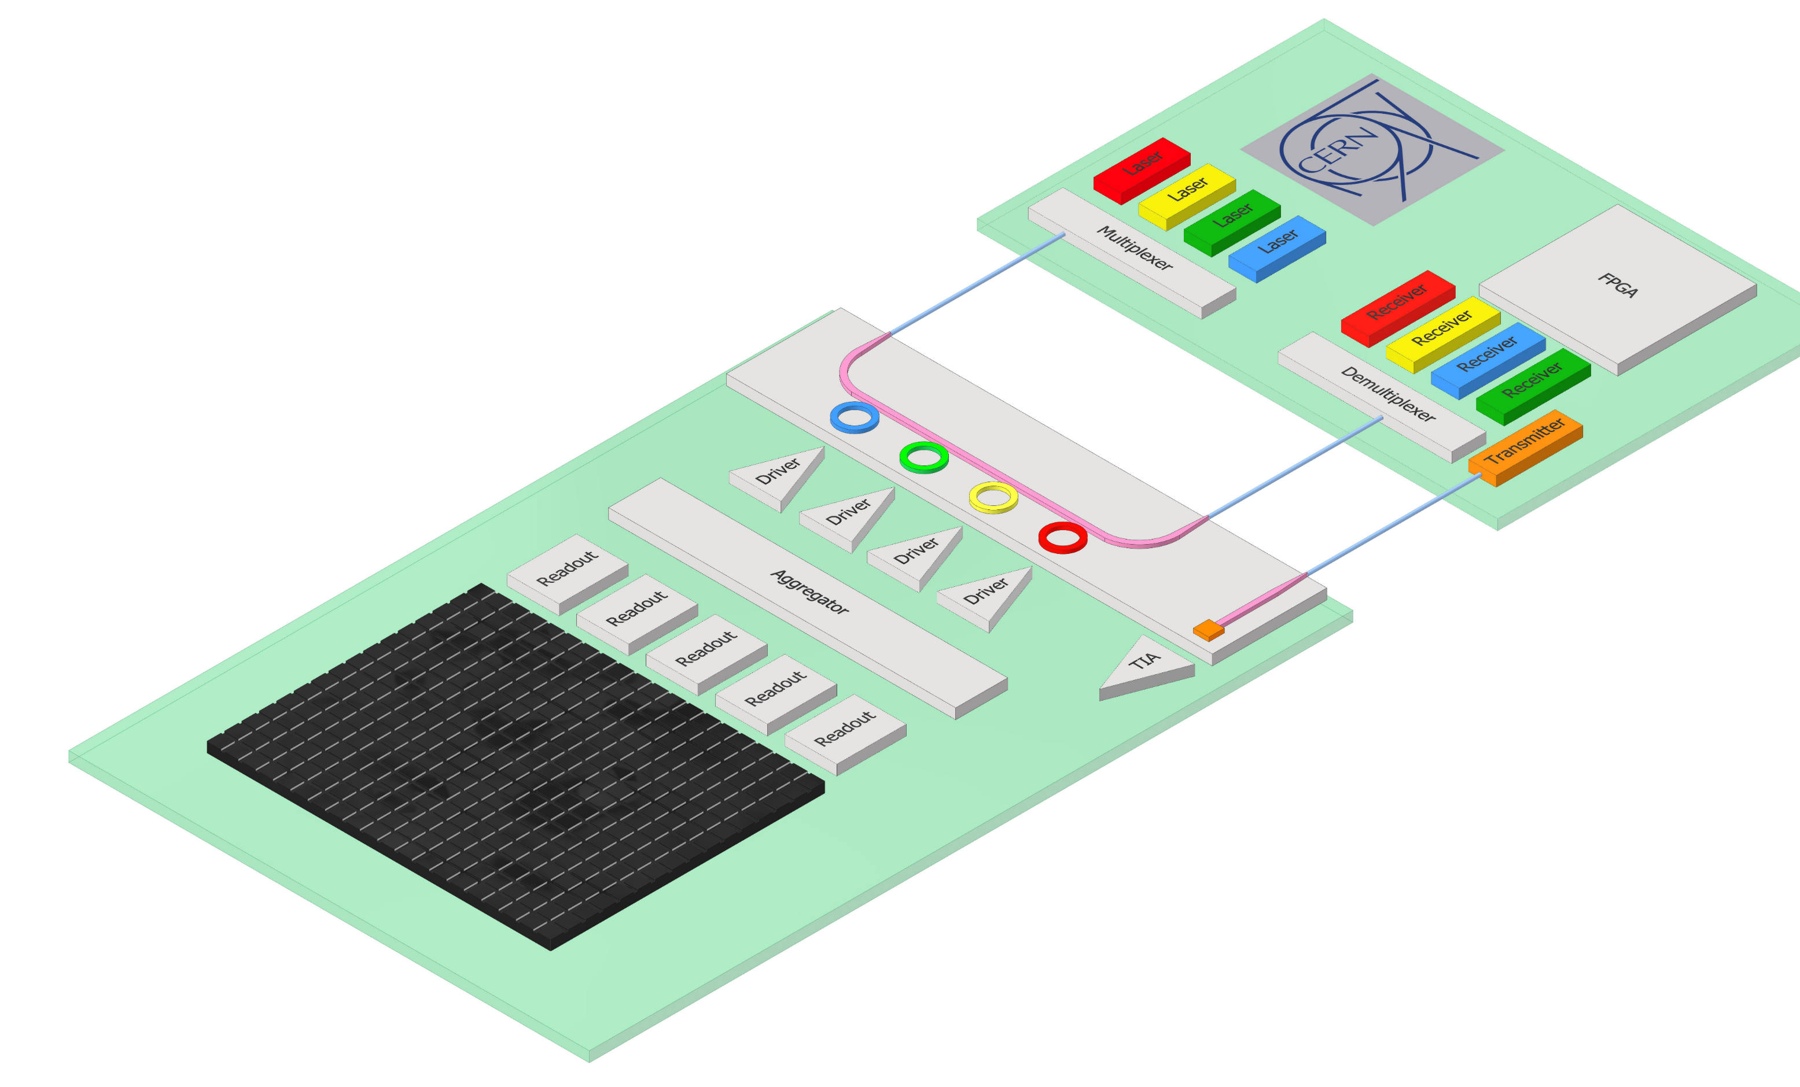


Silicon Photonics links for High Energy Physics
Photonic Integrated Circuits (PICs)
  Chiplet fabricated using CMOS process
  Fiber couplers, optical waveguides, modulators, photodiodes
  Radiation tolerant
Wavelength division multiplexing:
  Lane: 25 Gbps NRZ
  Fibre: 100 Gbps
Laser sits outside of radiation environment
  Wavelength 1300 nm
  Transparent window for Silicon
Low power / Low mass
Fiber coupler
PIC
Modulator
Photodiode
>> 100 m Single-mode fiber
Particle sensor
System concept
TWEPP 2024
carmelo.scarcella@cern.ch 03 October 2024

Slide 4
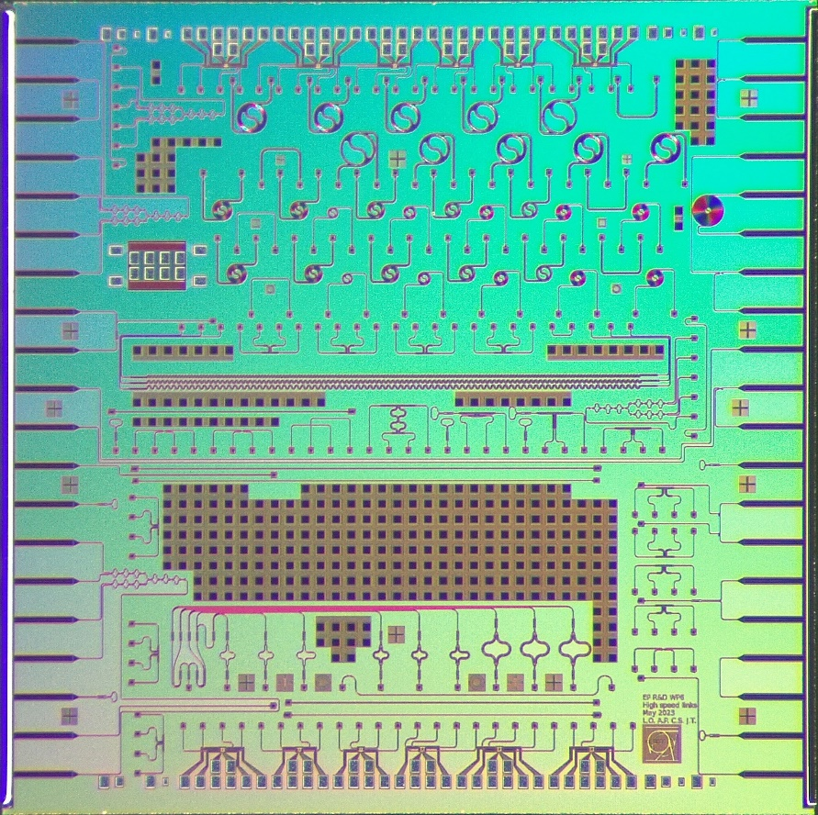
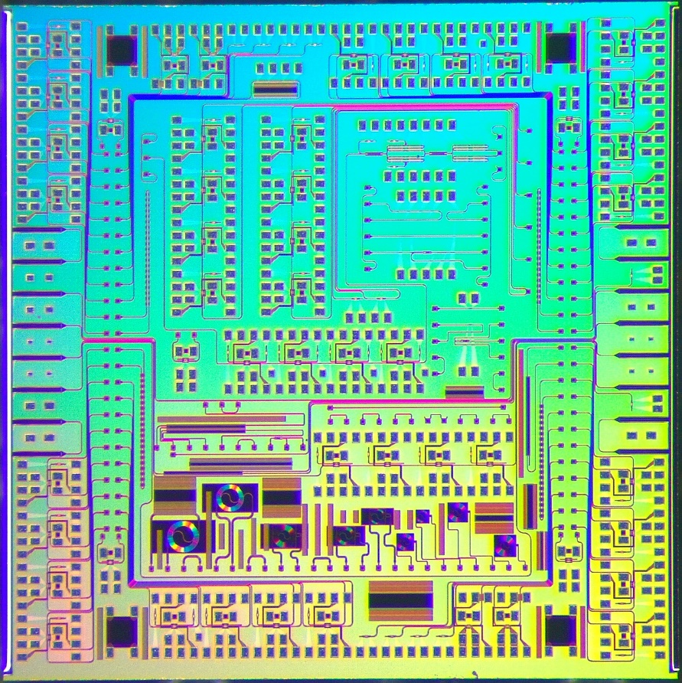
Silicon photonics integrated circuits (PICs)
Two test PICs, designed at CERN, and received in Q1 2024
PackagingPIC (IMEC SiPh Passive+)
  Fiber edge-coupling devices supporting photonic packaging activity
  Passive optical components: optical filters, waveguide structures, etc.
SystemPIC (IMEC SiPh iSiPP50G)
  Optical ring modulators, photodiodes
  4-channel wavelength division multiplexing (WDM) demonstrators
  Assess performance and radiation tolerance
Neutron and X-ray irradiation tests carried out in 2024, showing tolerance to
  High neutron fluence levels (> 3 ·10¹⁶ 20 MeV n/cm²)
  Total Ionizing Dose (TID) up to 1 Grad
  Most recent published results by Lauri Olantera at RADECS 2024
PackagingPIC
5 mm
SystemPIC
TWEPP 2024
carmelo.scarcella@cern.ch 03 October 2024

Slide 5
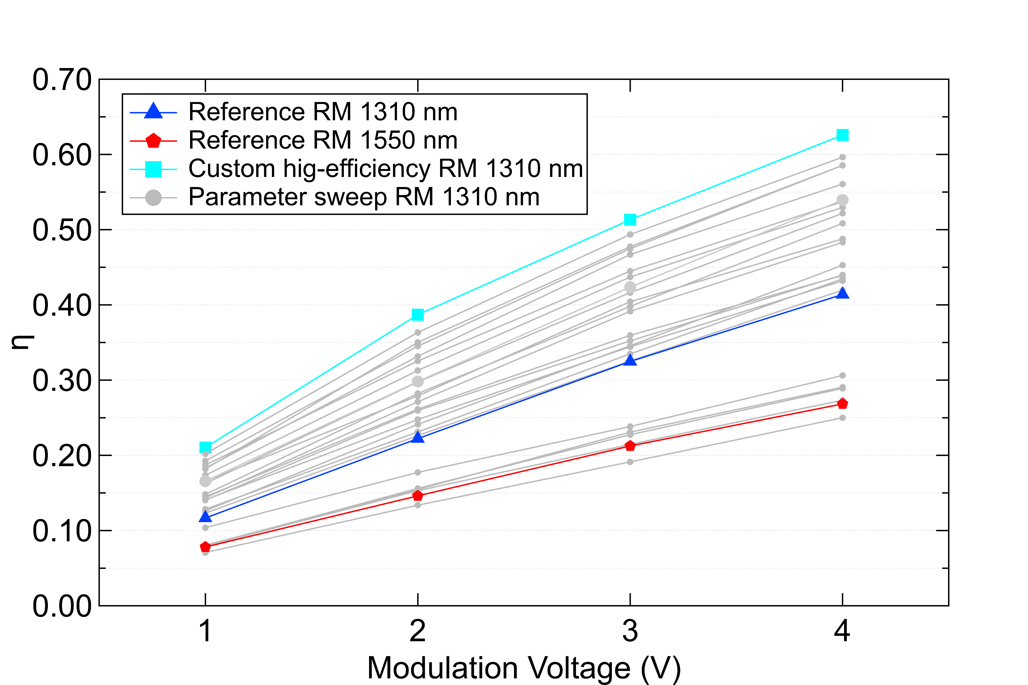
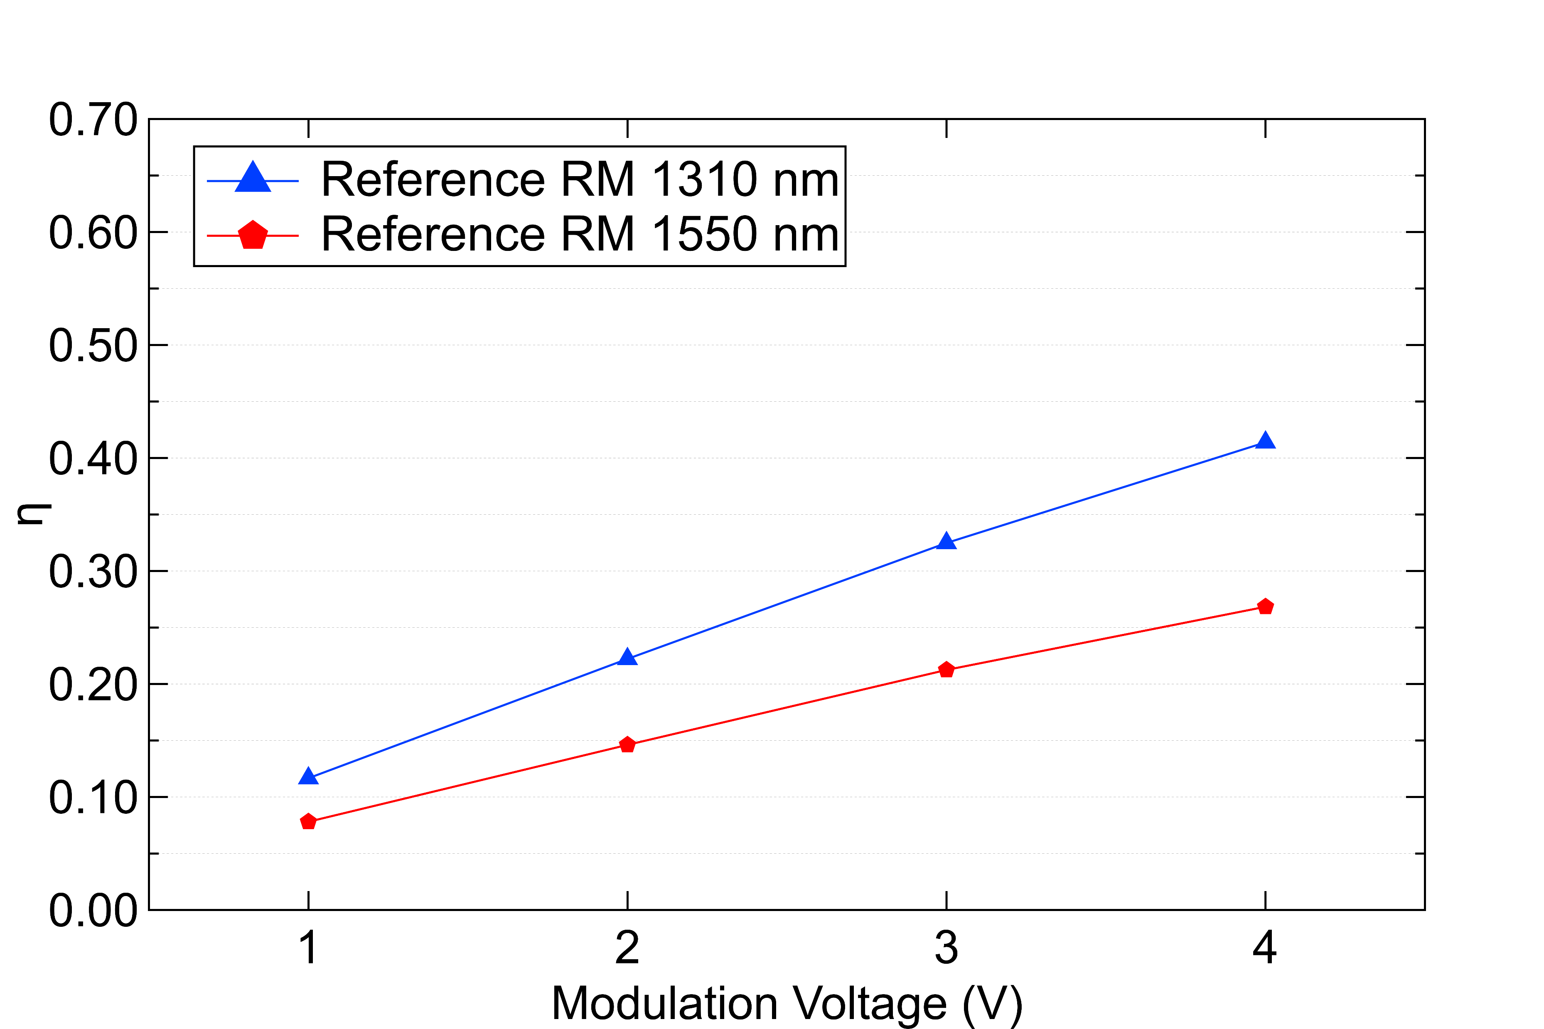
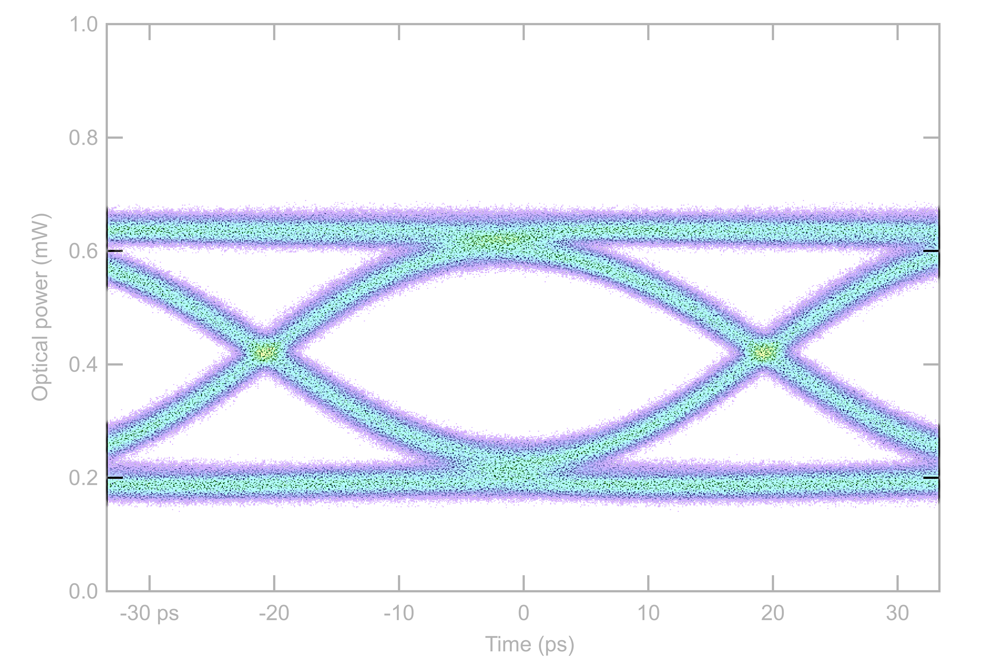





SystemPIC ring modulator characterization results
$$V_{mod}$$
CW laser
$$P_{in}$$
$$OMA$$
r
~ 3 dB
Coupling gap
p-n junction
1550 nm legacy PICv2
$$OMA=P_{in}∙ƞ(V_{mod})$$
28 nm CMOS driver provides limited modulation voltage swing V_{mod}
Need to increase modulator efficiency (ƞ) for margin in link power budget
Multiple ring modulators sweeping the design parameter space
  Radius (r), p-n junction type, coupling gap
  Trade-off between efficiency and bandwidth
TWEPP 2024
carmelo.scarcella@cern.ch 03 October 2024

Slide 6
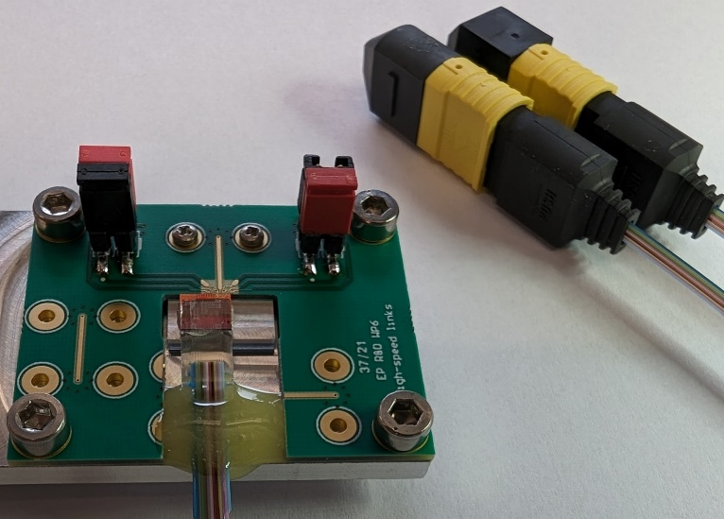
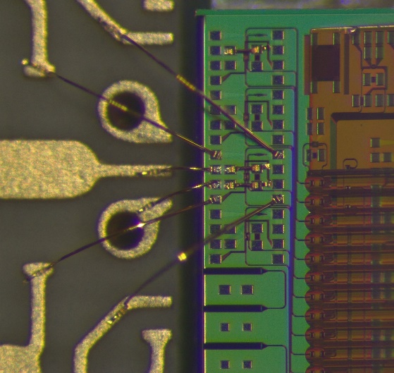
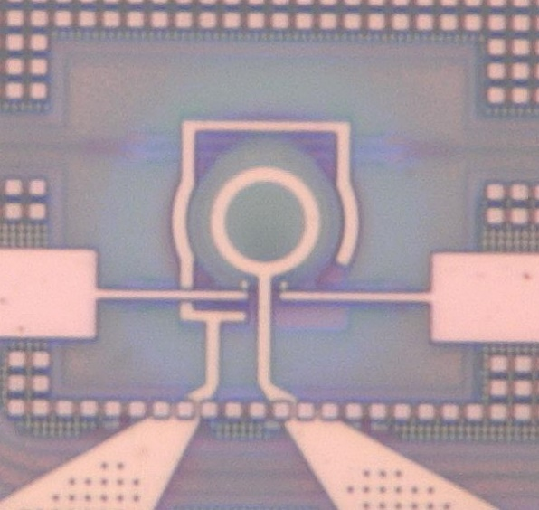

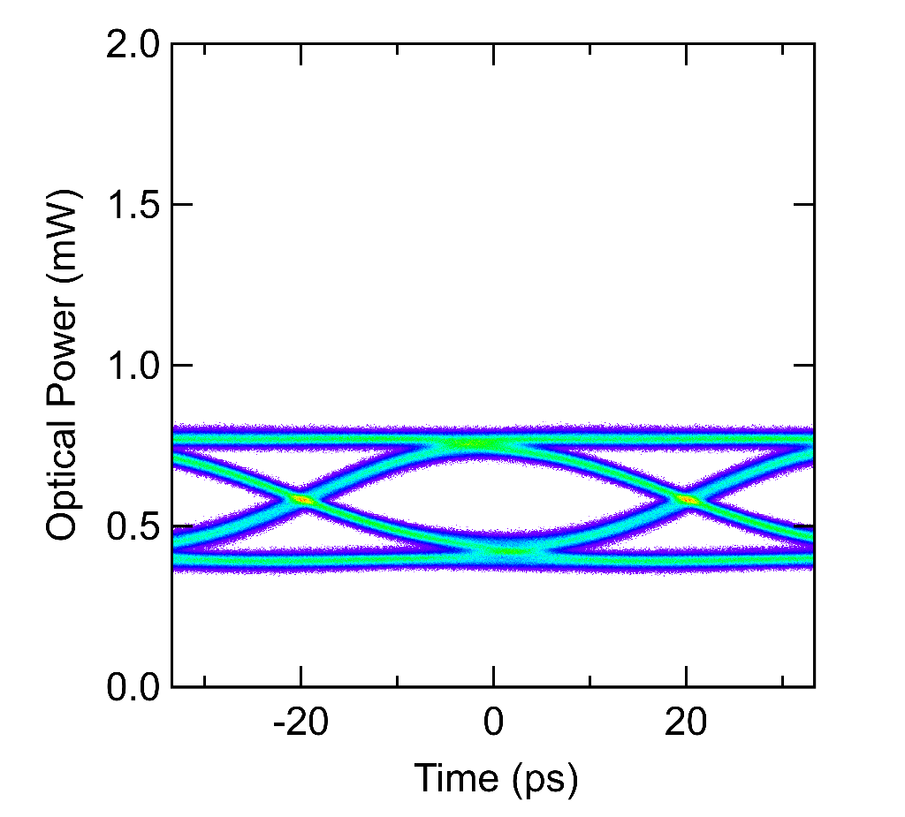
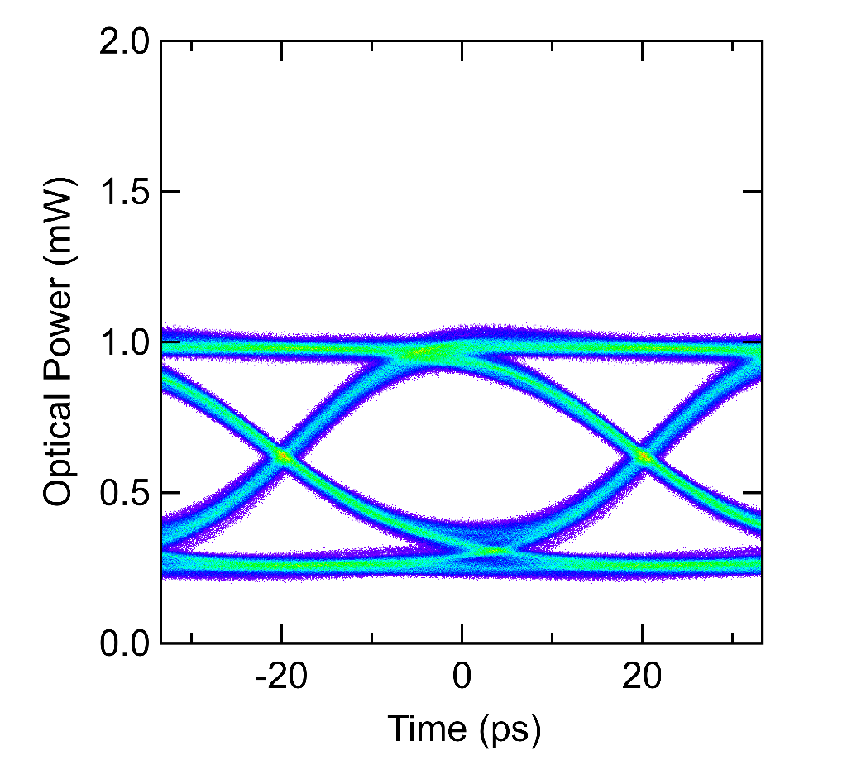
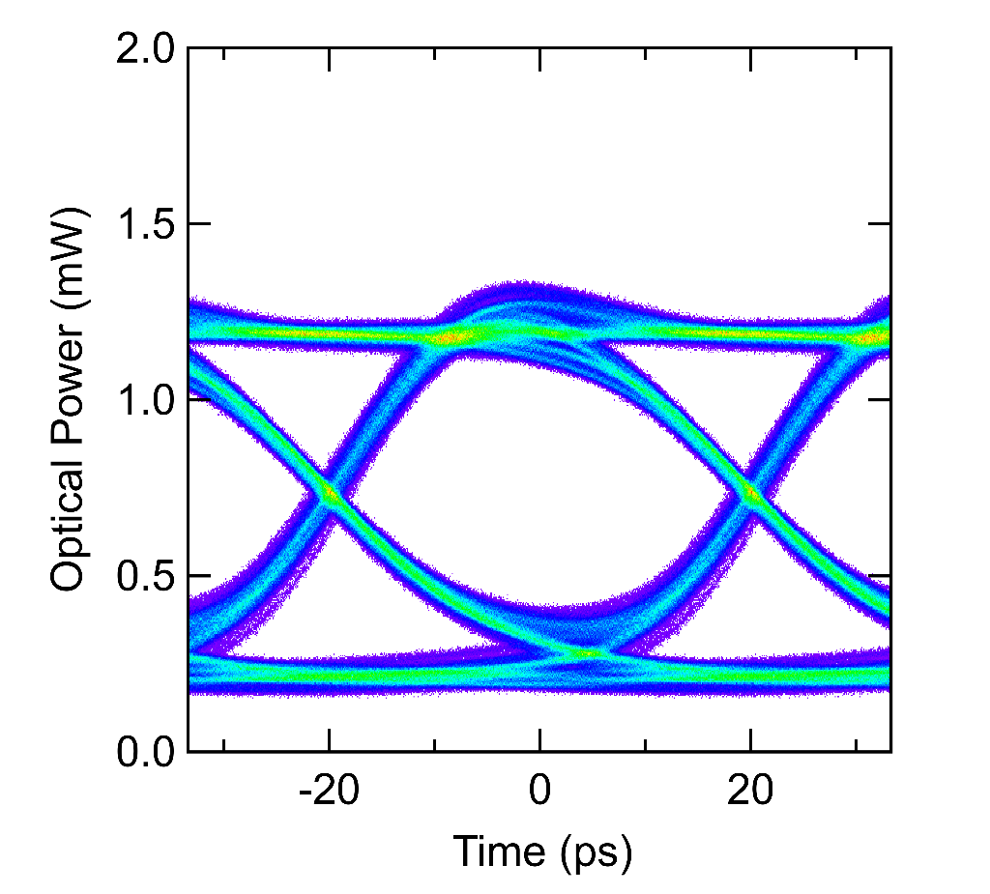
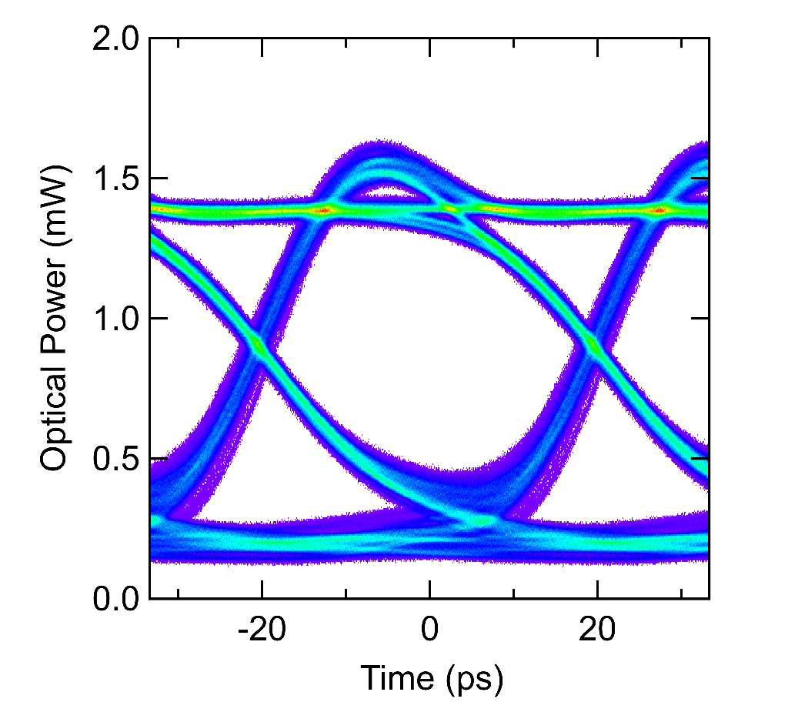
Ring modulator high-speed test
2.92 mm coaxial connector
CERN high-efficiency modulator supporting 25 Gb/s data rate
  Modulation voltage swing from 1 V_{pp} to 4 V_{pp}
  CW laser power P_{in} = 2 mW
EP R&D WP6 phase II
  Positive link power margin with ~ 0.8 mW OMA
  Driver targeting ~2 V_{pp} modulation voltage swing
PIC
CERN custom design
10 µm
1 V_{pp} ƞ ~ 20%
2 V_{pp} ƞ ~ 40%
3 V_{pp} ƞ ~ 50%
4 V_{pp} ƞ ~ 60%
OMA
TWEPP 2024
carmelo.scarcella@cern.ch 03 October 2024

Slide 7
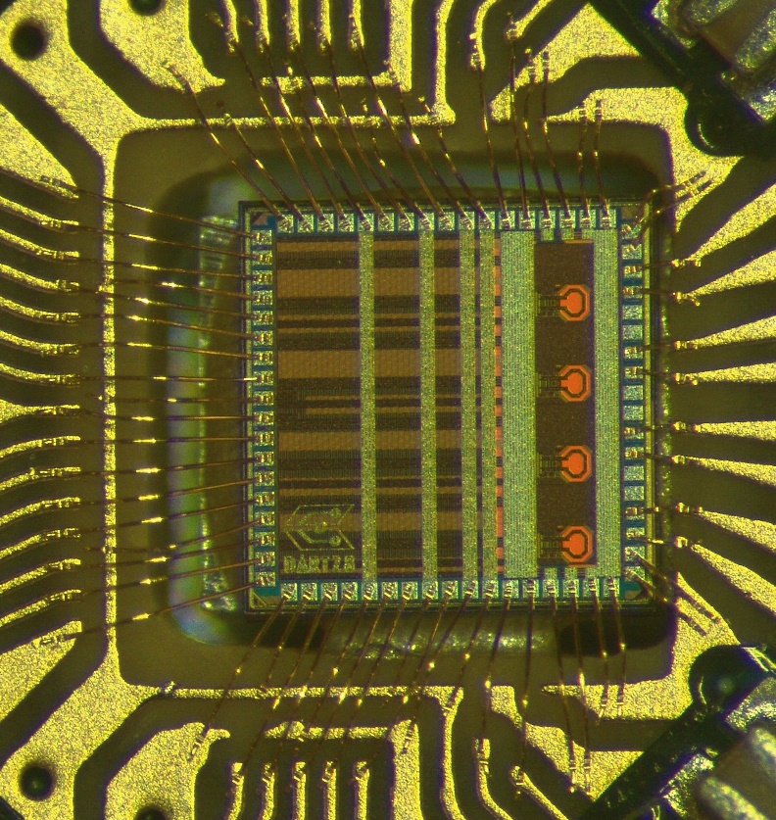
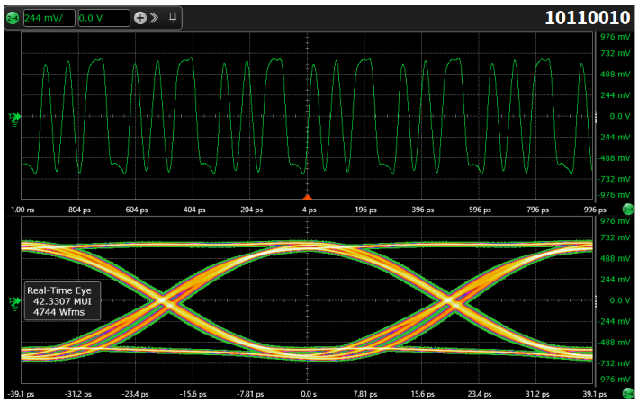
DART28-NRZ
Demonstrator ASIC for Radiation-Tolerant Transmitter in 28 nm CMOS
  Quad modulator driver 4x25.6 Gb/s NRZ
  Embedded data generators, no data inputs
Macrocell to be integrated in sensor Read-Out-Chips (ROCs)
4 High-speed
outputs
25.6 Gb/s - Electrical
TWEPP 2024
carmelo.scarcella@cern.ch 03 October 2024

Slide 8
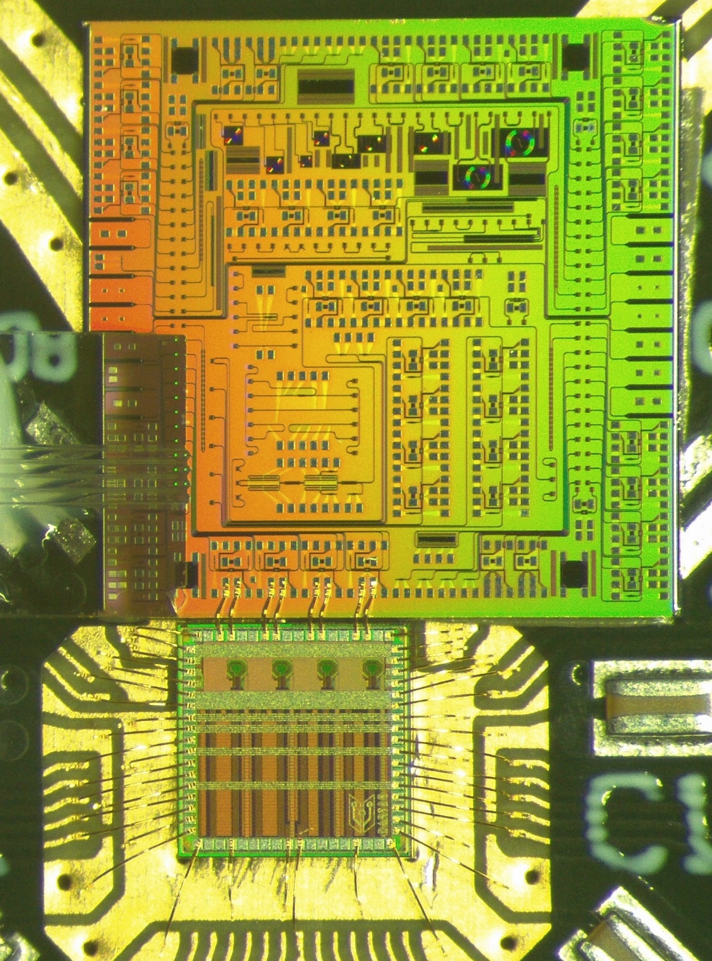
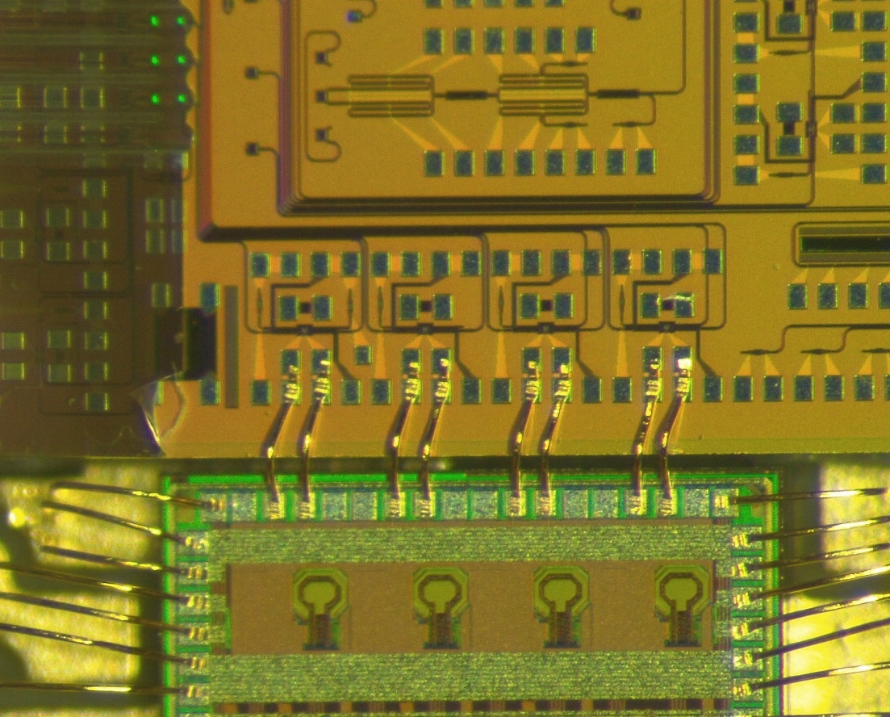
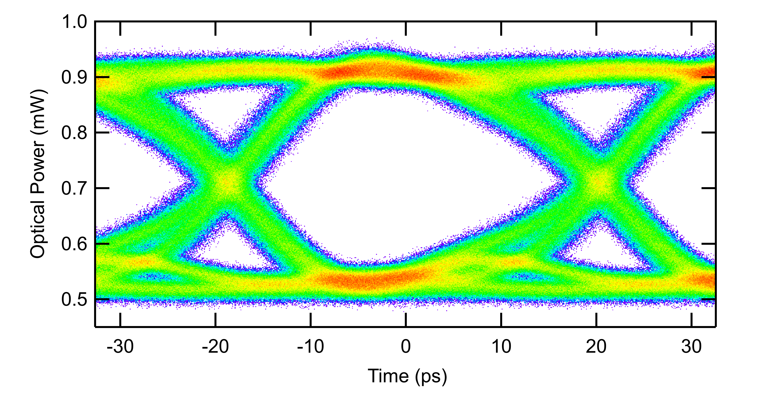
DART28 Driving SiPh Ring Modulator
Wire bond length is crucial for signal integrity at 25 Gb/s data rate
Connection inductance proportional to the wire bond length
  PIC thinned from the native 720 µm to ~ 300 µm
  Wire bond length reduced to ~ 500 µm
  Gold wire, 25 µm diameter, wedge-wedge bonding
Wide open optical eye diagram at 25.6 Gb/s with fast edges
SystemPIC
Fiber coupler
Ring modulator
Fibers
CW laser
25.6 Gb/s PRBS7 data
~ 500 µm
DART
TWEPP 2024
carmelo.scarcella@cern.ch 03 October 2024

Slide 9
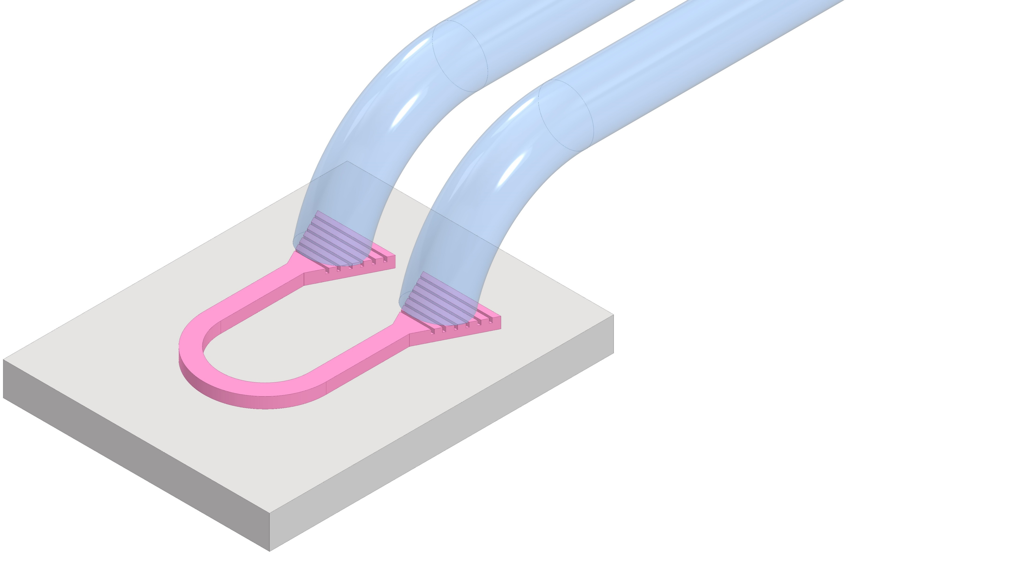
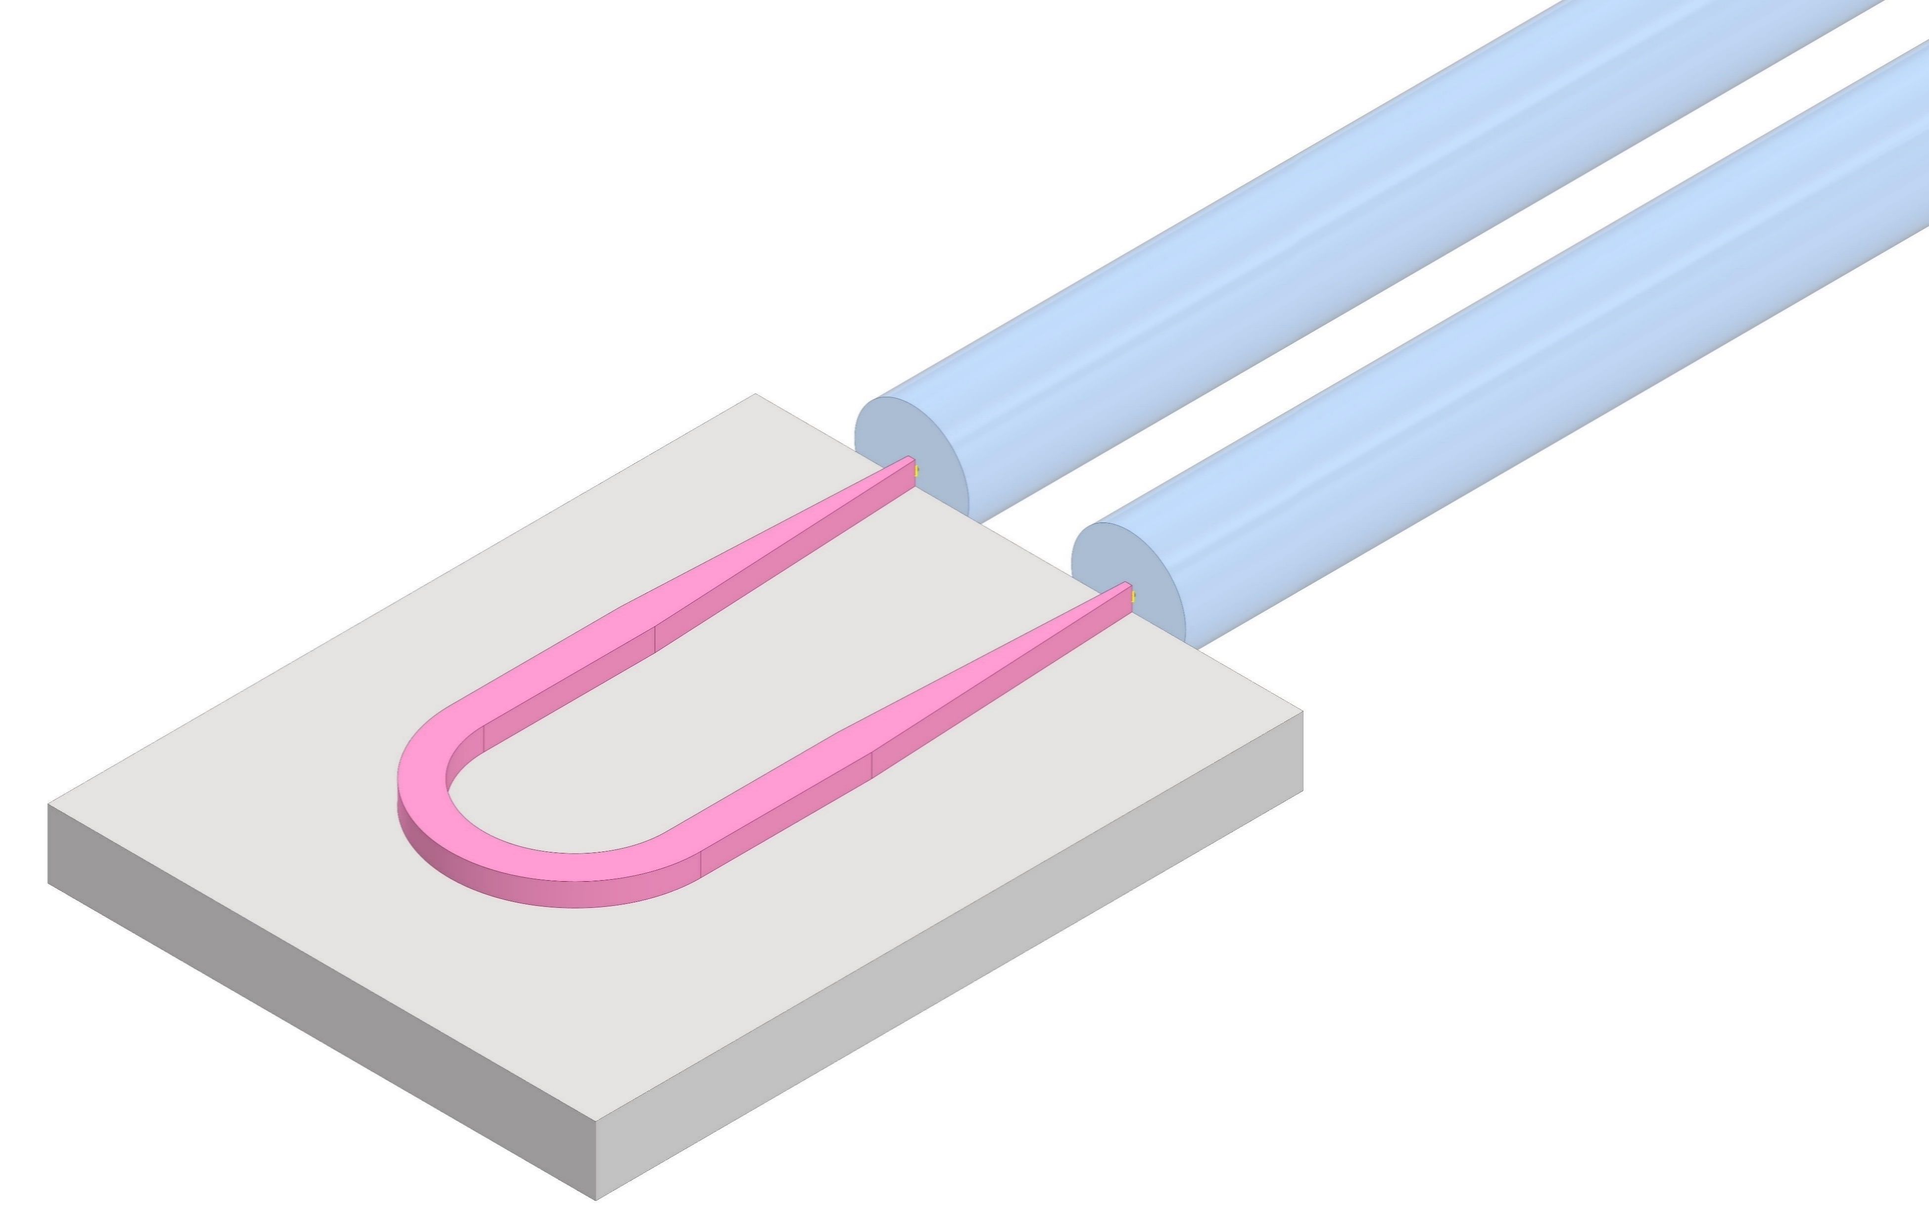
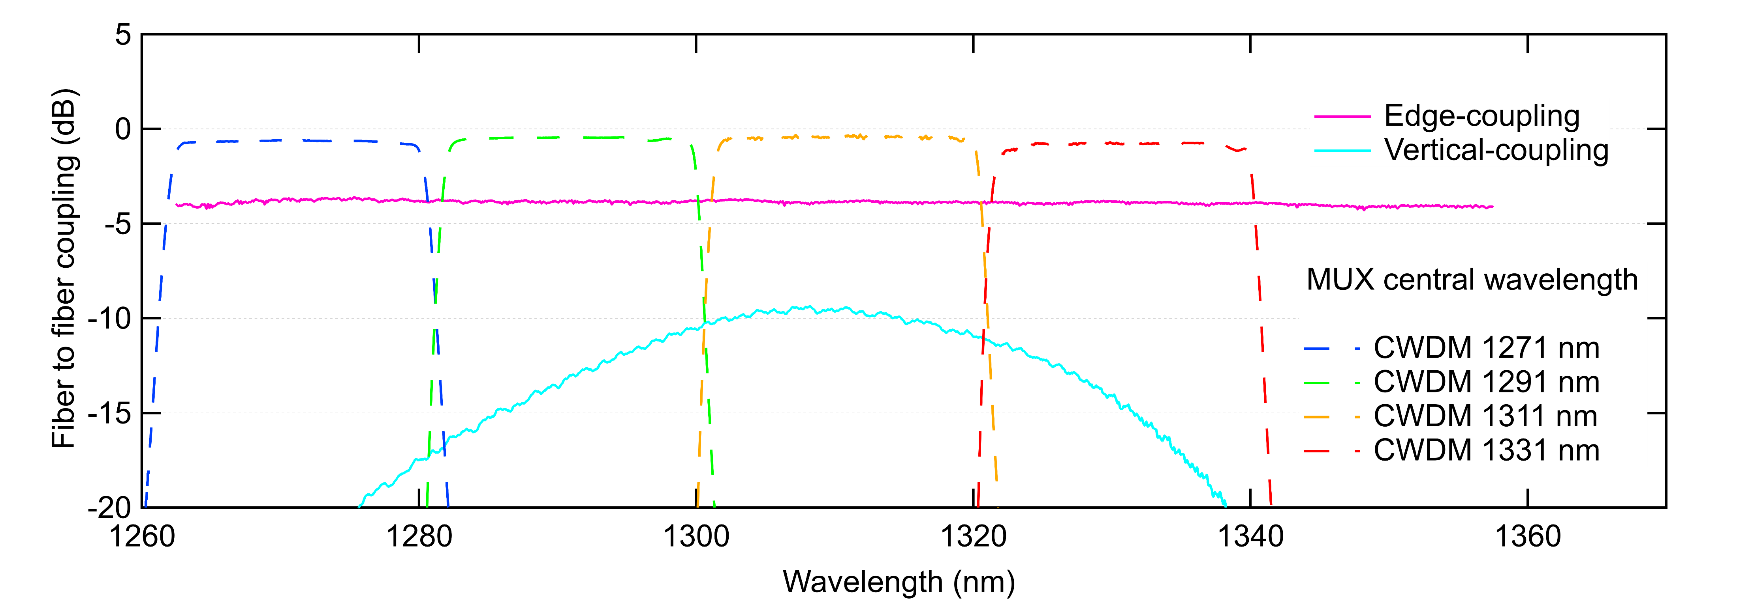
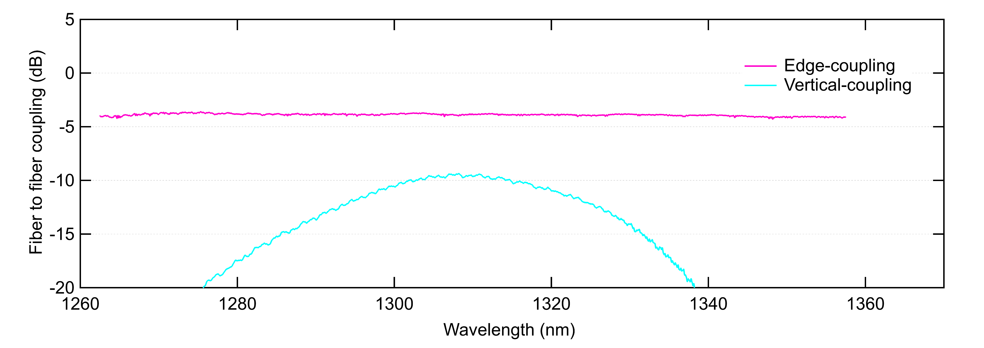
Fiber coupling to Silicon Photonics Circuits
Vertical-coupling: planar gratings etched into the Silicon
  Lithographic step not requiring post-processing
  Wavelength selective: bandwidth ~ 30 nm @ - 1 dB
Edge-coupling: requires chip singulation and facet finishing
  Wideband, flat response in the CWDM4 wavelength range
  Clear advantage in targeting edge-coupling in our project
Angle of incidence
~ 10° off-vertical
Optical fiber
Optical fiber
Grating coupler
Edge coupler
Si waveguide
TWEPP 2024
carmelo.scarcella@cern.ch 03 October 2024
Notes:
Add filter

Slide 10
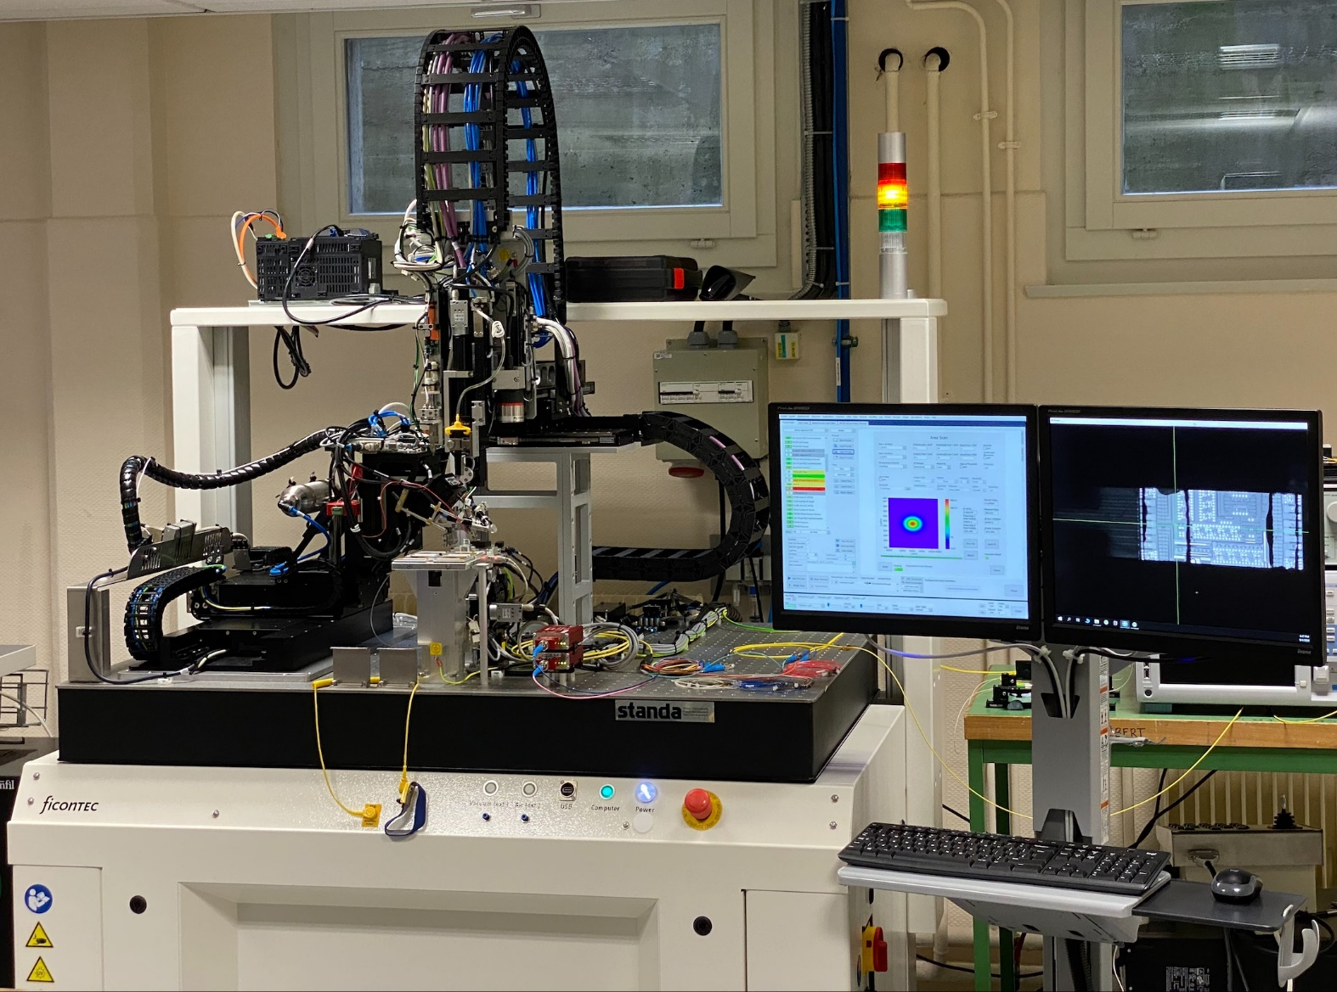
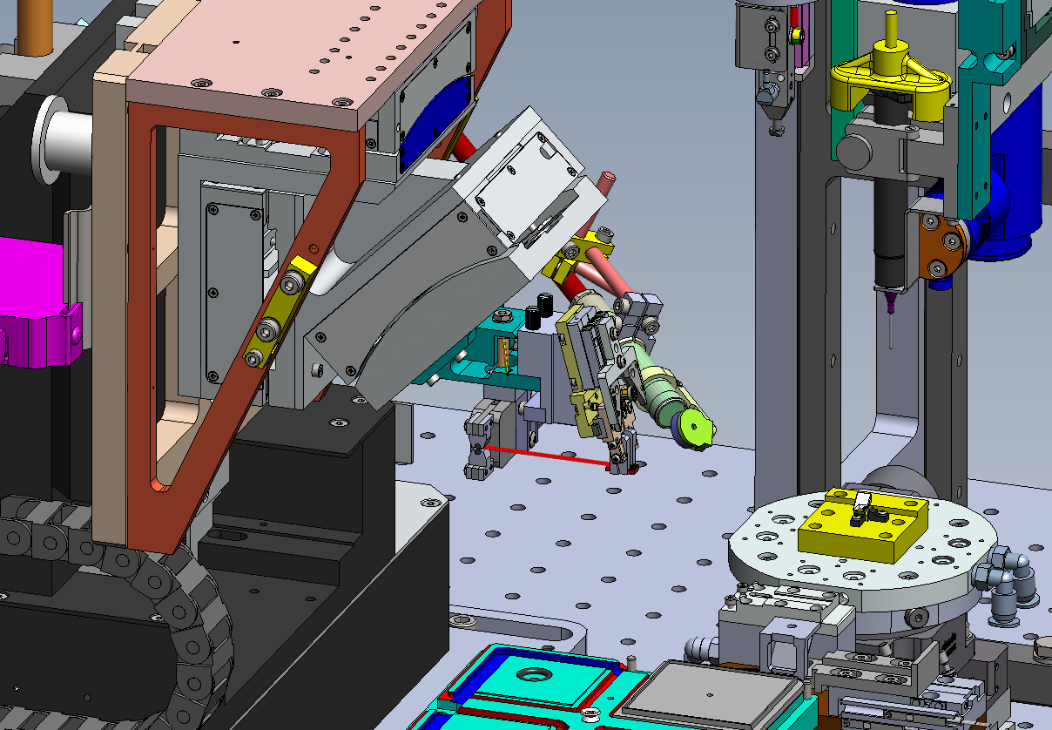
CERN fiber attachment machine for PICs
R&D fiber attachment machine for PICs purchased by CERN
  Installation and commissioning in May 2024
To support the R&D activity and build internal knowhow on photonic assembly
Fully automated station for optical probe testing on the die level
Active alignment and vision-based processes fully customisable by the user
Build assembly recipes to transfer to contract manufactures
6-axis alignment
engine
UV LED
Optical power meters
GUI
Camera
Fiber array
Epoxy dispenser
PIC
TWEPP 2024
carmelo.scarcella@cern.ch 03 October 2024

Slide 11
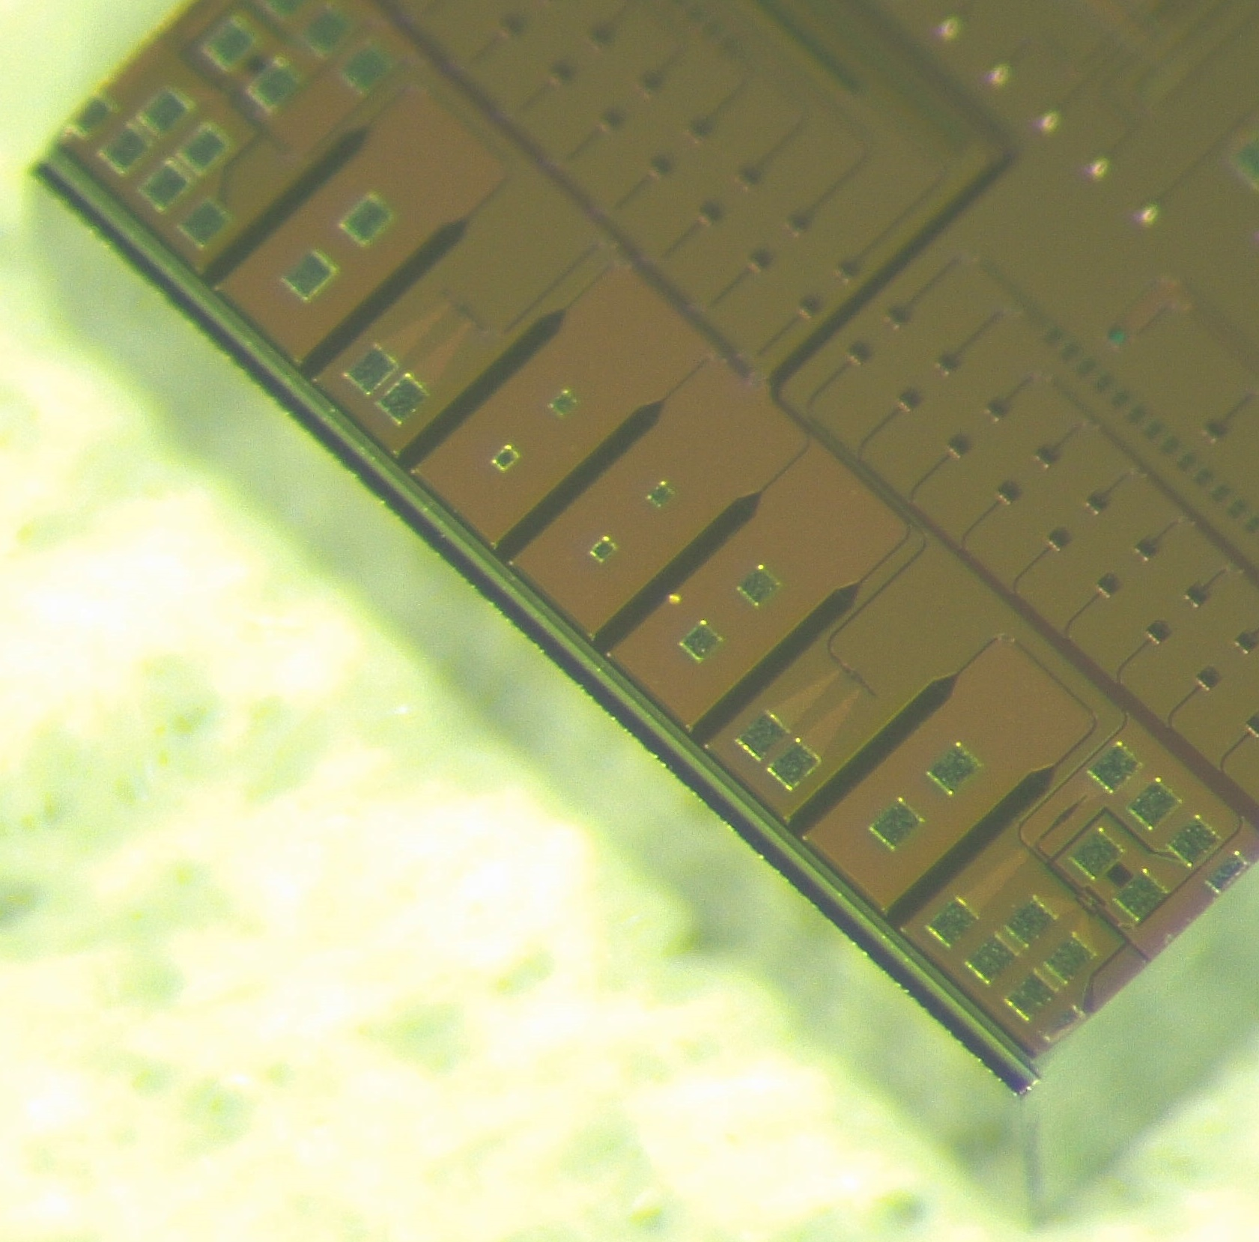
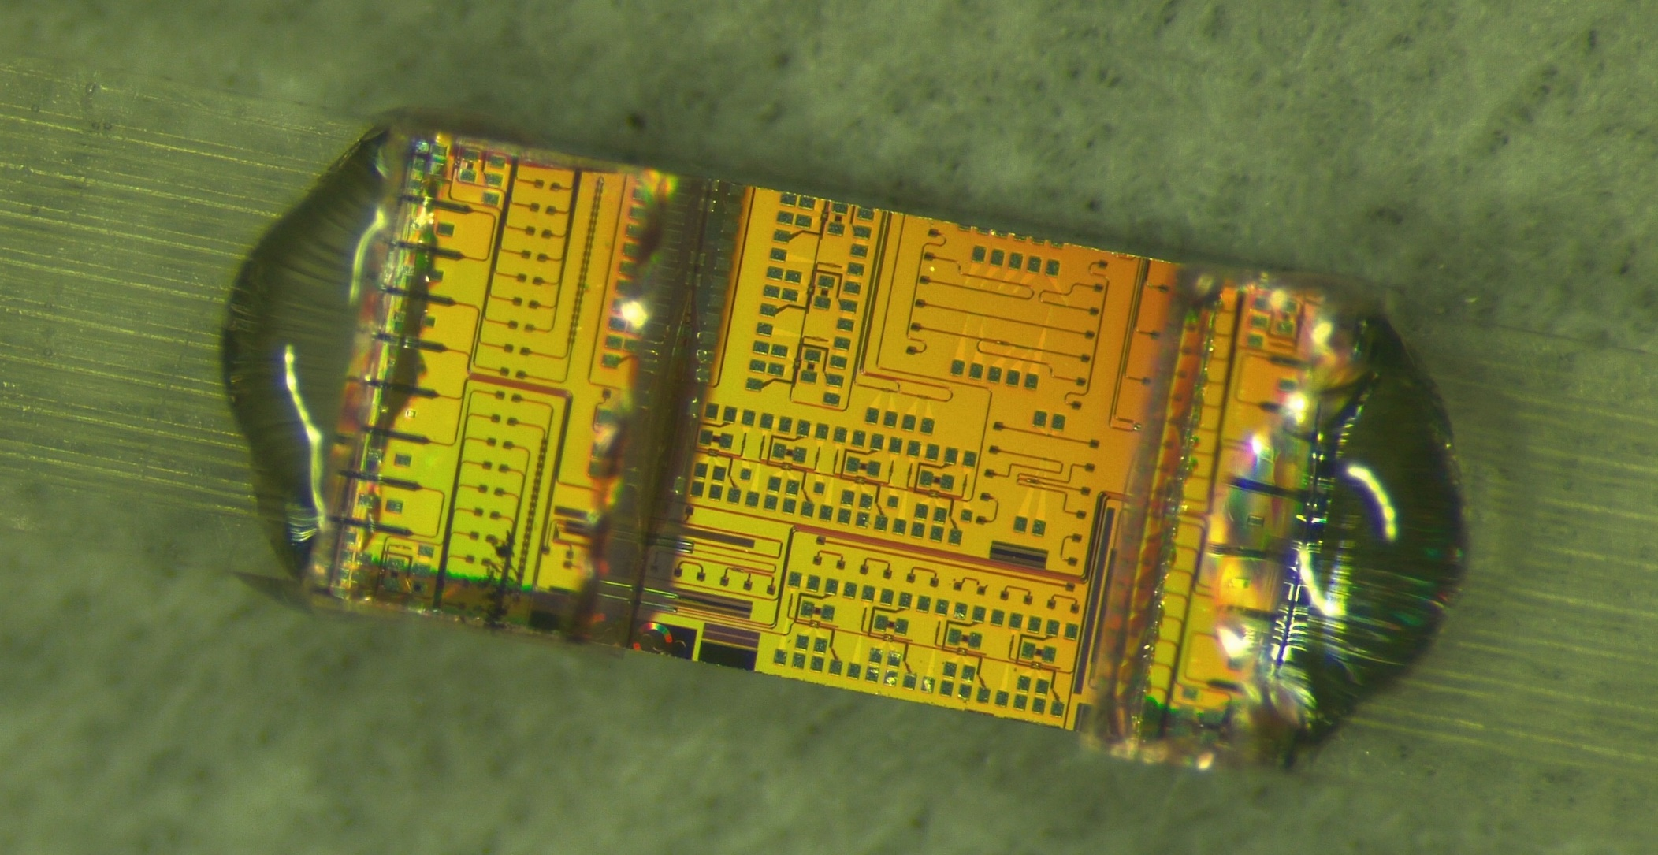
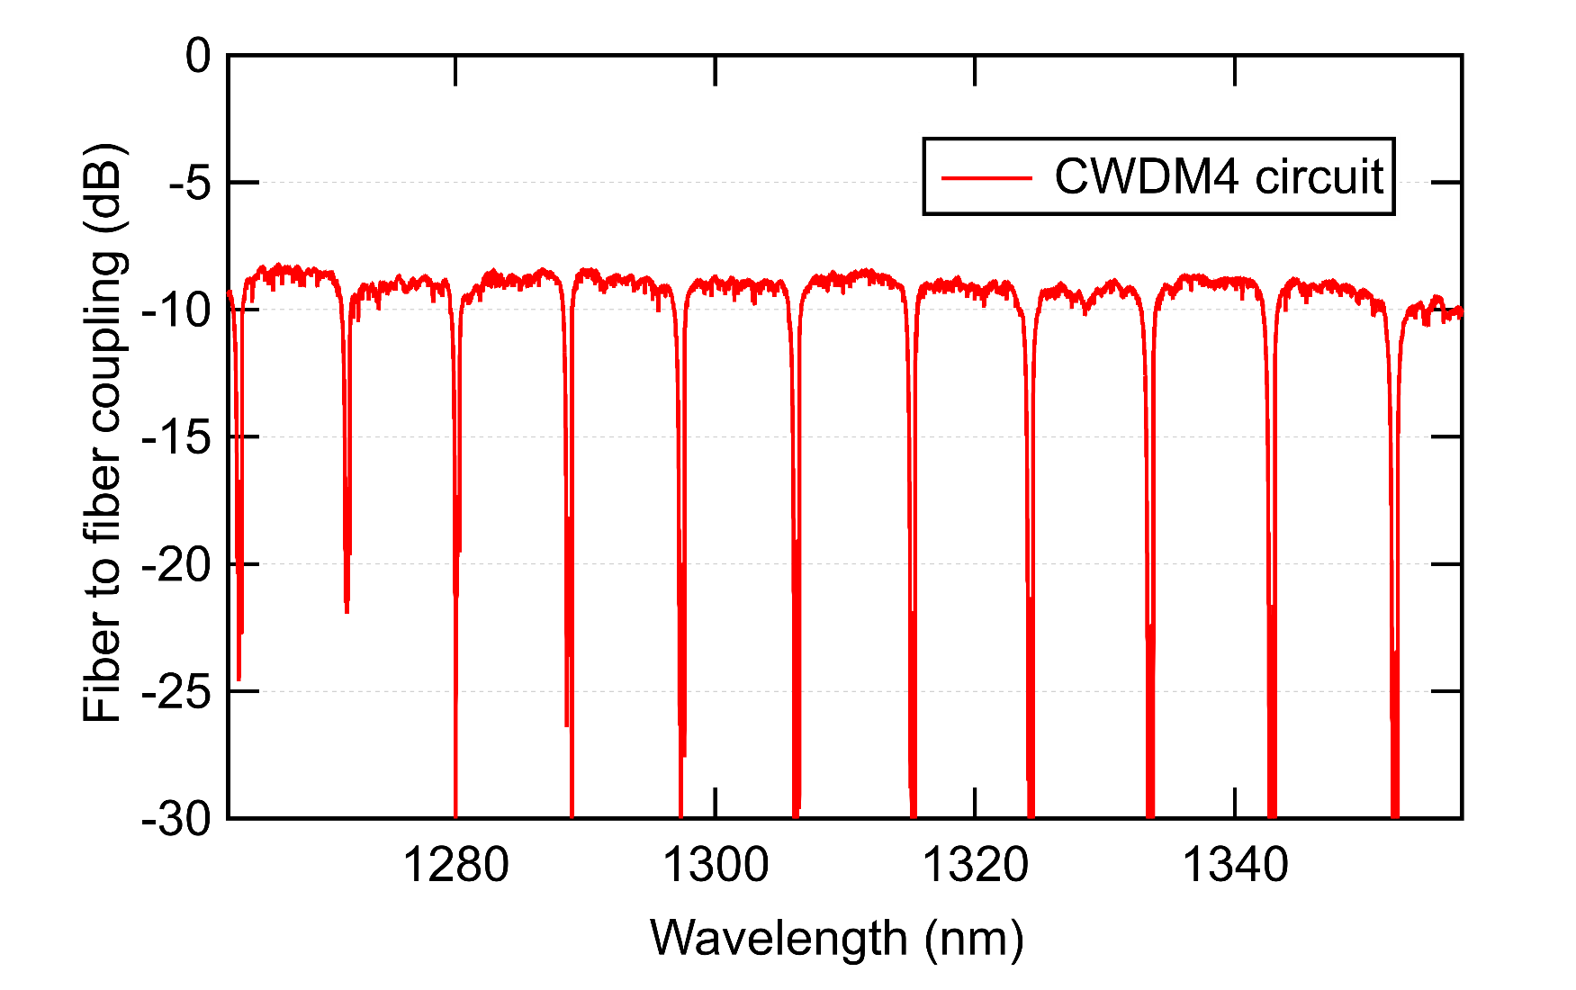
First fiber edge-coupled PICs at CERN
8-channel fiber arrays attached to the SystemPIC using UV-cure epoxy
Test vehicle for 4-channel coarse wavelength division multiplexing (CWDM4) transmitter
4 ring modulators in the O-band coupled to a single bus waveguide
Edge-couplers
8-channel
250 µm pitch
DC laser COMB
Modulated outputs
8-channel
fiber arrays
5 mm
TWEPP 2024
carmelo.scarcella@cern.ch 03 October 2024

Slide 12
Conclusions and next steps
Demonstrated custom ring modulators compatible with 28 nm CMOS driving circuits
Successful co-packaging of the SystemPIC with the radiation tolerant ring modulator driver (DART28)
  Wide open optical eye diagram at 25.6 Gb/s ‒ Wire bonding length minimized to ~ 500 µm
Fiber coupling to Silicon Photonics circuits activity
  Fiber attachment machine for PICs, installed and commissioned at CERN in Q2 2024
  First samples of SystemPIC using edge-coupling been assembled
DRD7: R&D Collaboration on Electronics and On-detector Processing, approved in June 2024
  WP7.1.a Silicon Photonics transceiver development
  About 14 universities and institutes joined the collaboration
TWEPP 2024
carmelo.scarcella@cern.ch 03 October 2024

Slide 13
Back-up slides

Slide 14
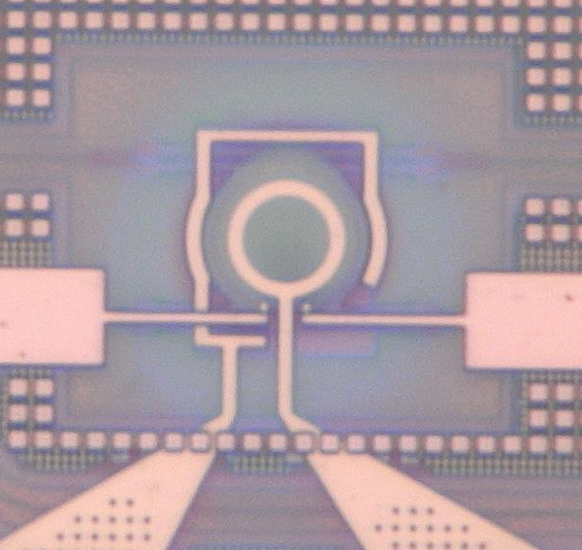
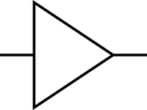
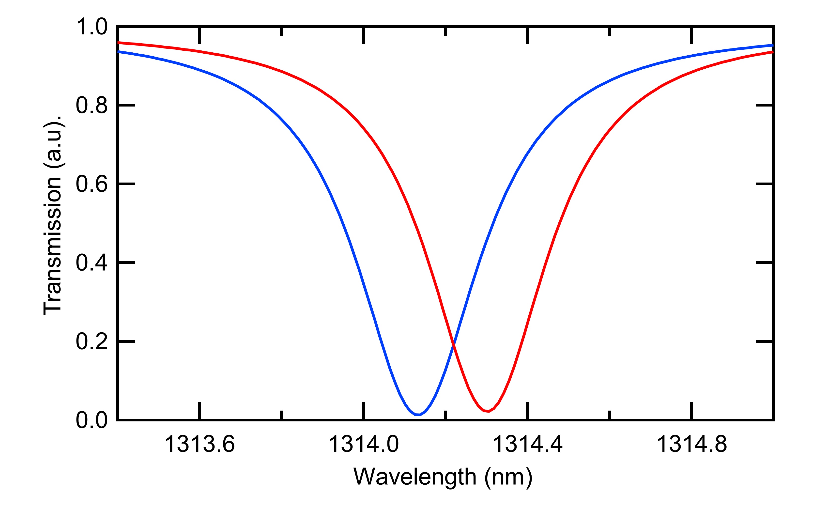
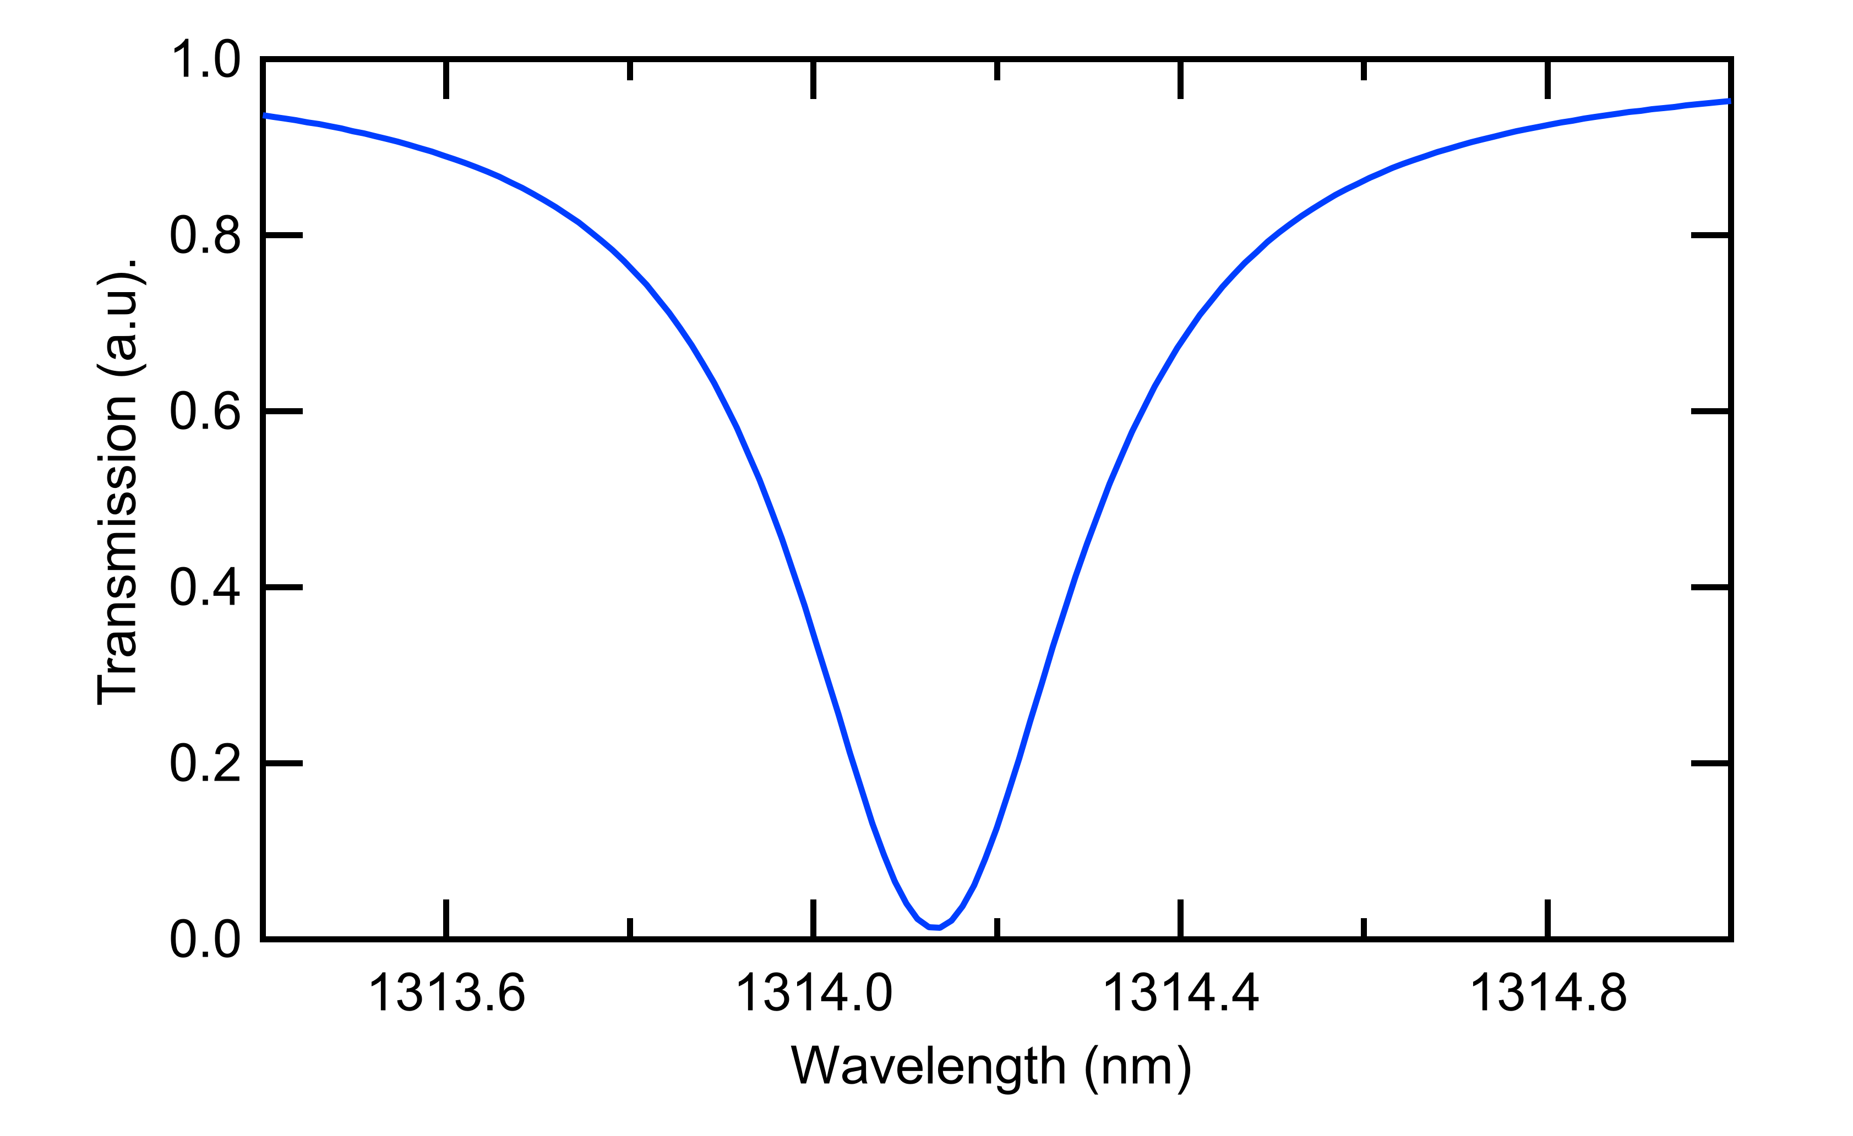
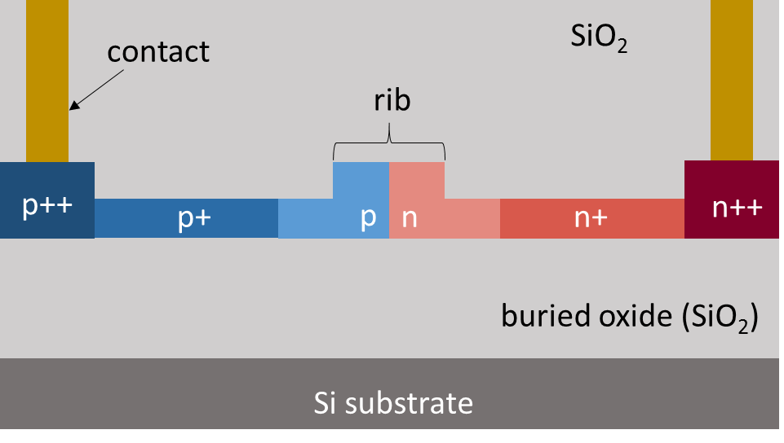
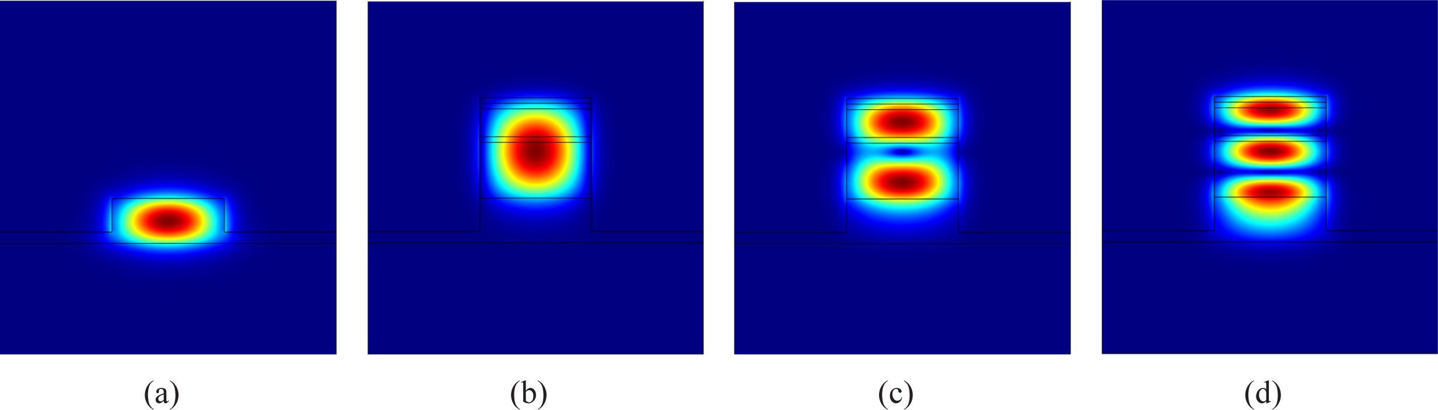
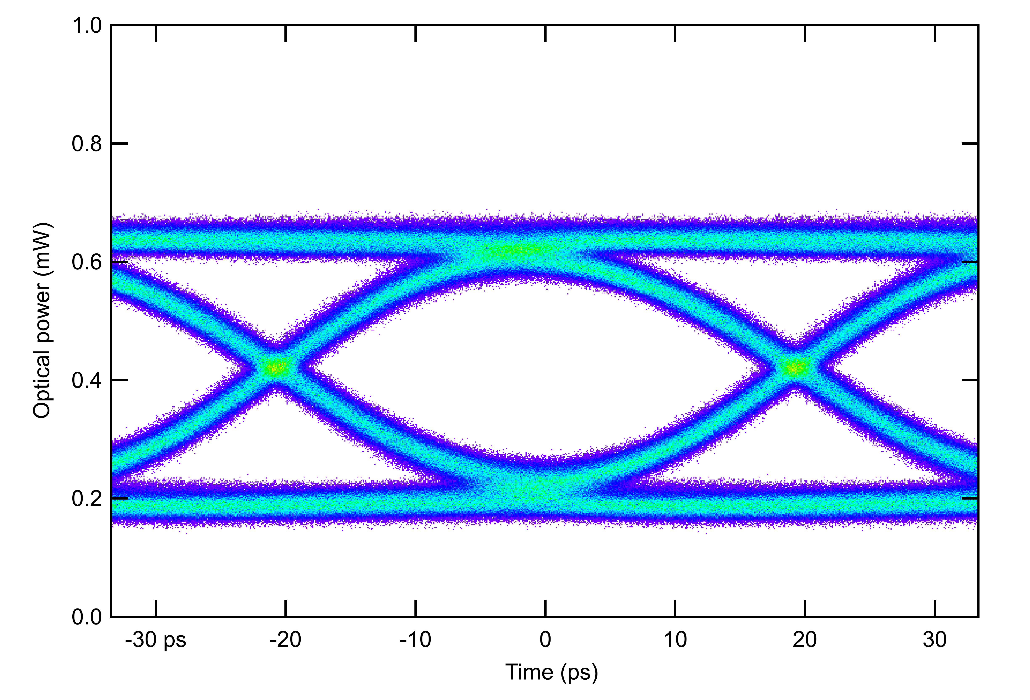
Si µ-ring modulator
Selective wavelength filters
Small footprint (radius ~ 5µm)
Small driving voltage amplitude (down to 1 Vpp)
Optically narrowband (< 1nm)
Thermally sensitive (< 1 K)
Input laser
Optical data
CERN custom design
10 µm
_{Δλ(V)}
Electrical
data
Waveguide
p-n junction
-
V
+
Electrical contacts
Input
laser
V₀
OMA
V₁
Waveguide cross-section
Reverse biased pn Junction
TWEPP 2024
carmelo.scarcella@cern.ch 03 October 2024

Slide 15
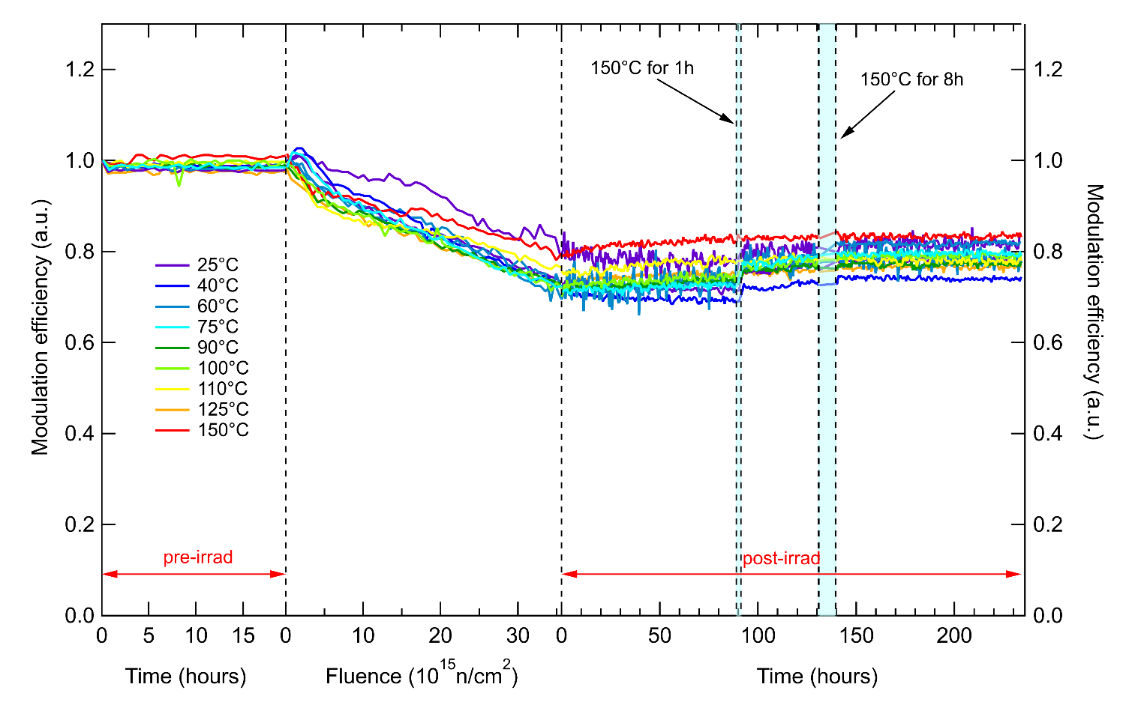
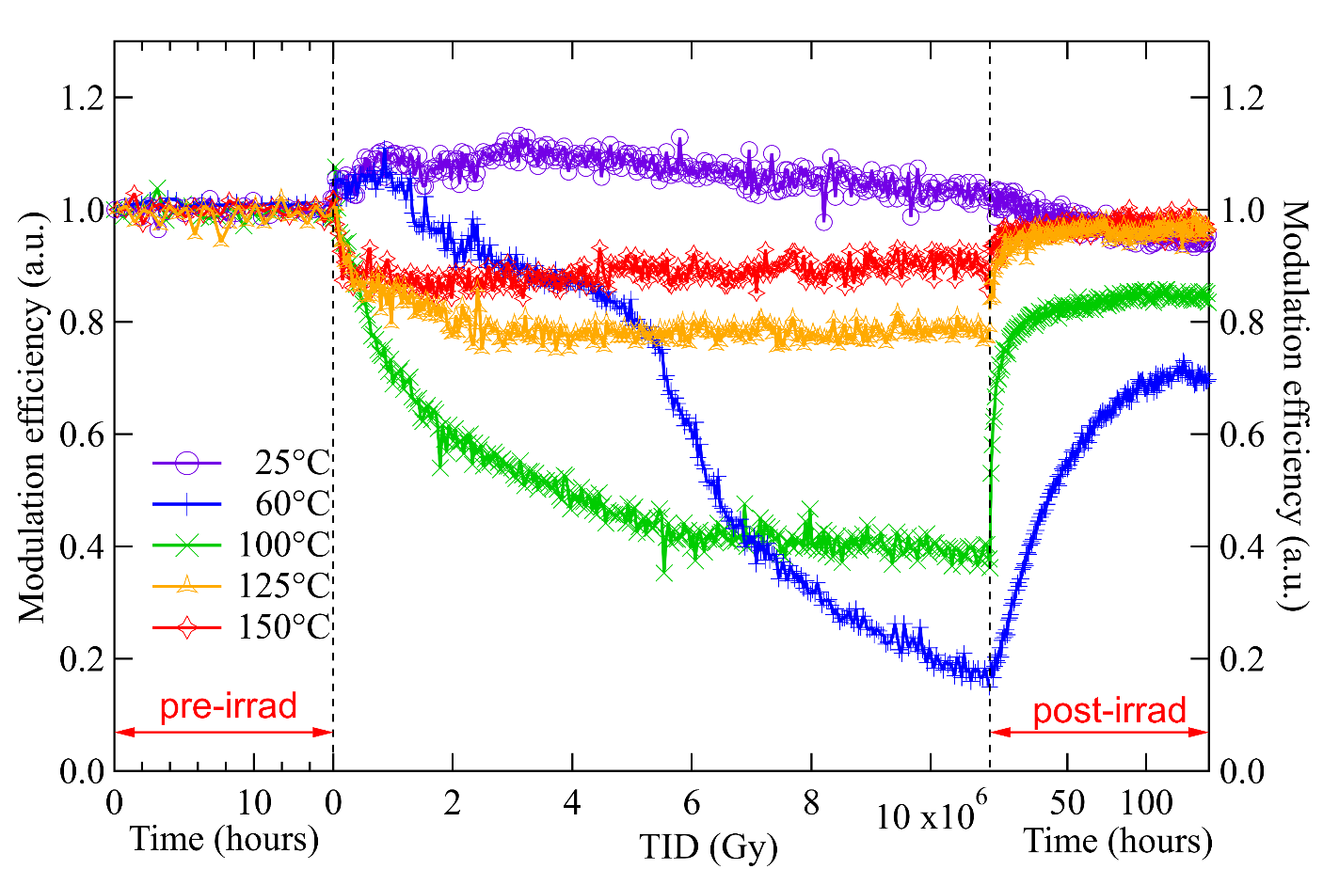
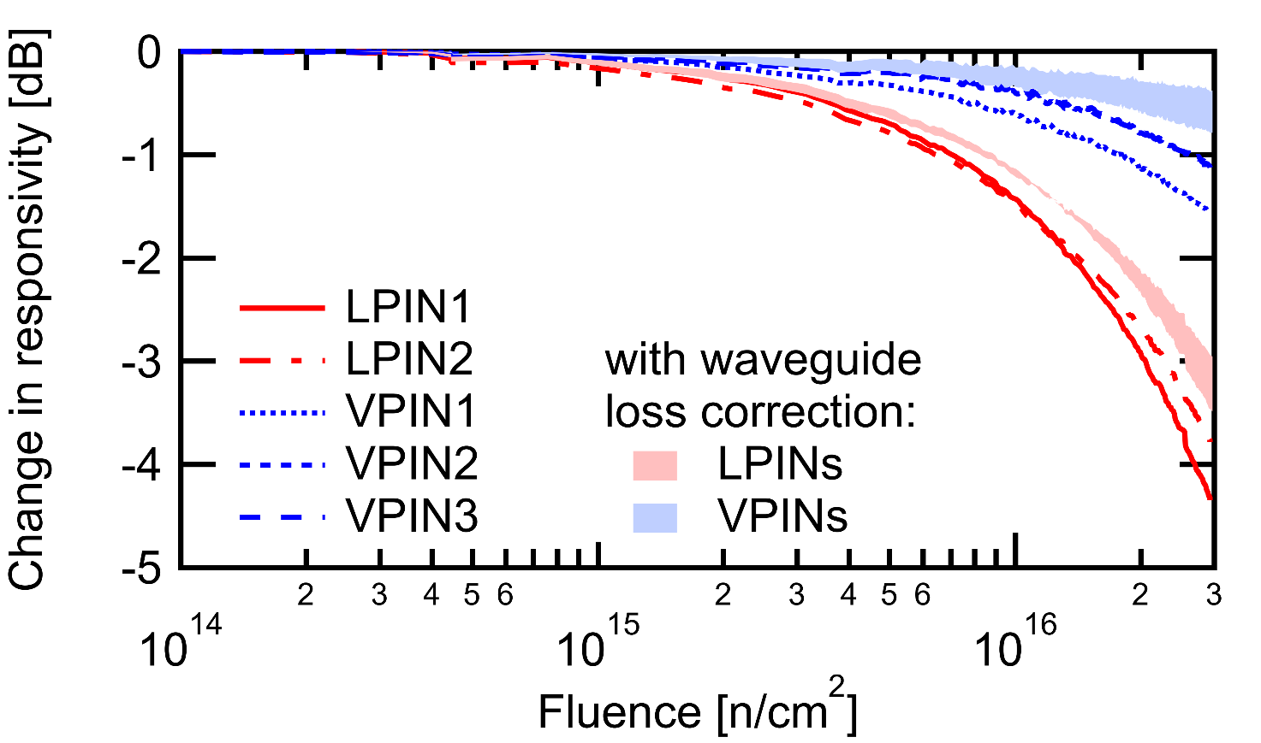
Radiation tolerance
Carried out X-ray & neutron irradiation test with varying ring modulator temperatures
  Neutron irradiation less damaging, independent of temperature
  TID potentially more damaging, can be fully annealed with elevated temperature using on-chip heaters
High-ﬂuence neutron irradiation of integrated Ge-photodiodes
    Limited impact, appear more tolerant than current discrete devices
Silicon photonics Ring Modulators
Integrated Ge Photodiodes
> 3.5x10¹⁶ n/cm²
> 10 MGy
> 3x10¹⁶ n/cm²
M. Lalović et al., "Ionizing Radiation Effects in Silicon Photonics Modulators," in IEEE Transactions on Nuclear Science, vol. 69, no. 7, pp. 1521-1526, July 2022
L. Olanterä et al., "Effects of High Fluence Particle Irradiation on Germanium-on-Silicon Photodiodes," in IEEE Transactions on Nuclear Science, vol. 71, no. 4, pp. 728-735, April 2024
TWEPP 2024
carmelo.scarcella@cern.ch 03 October 2024

Slide 16
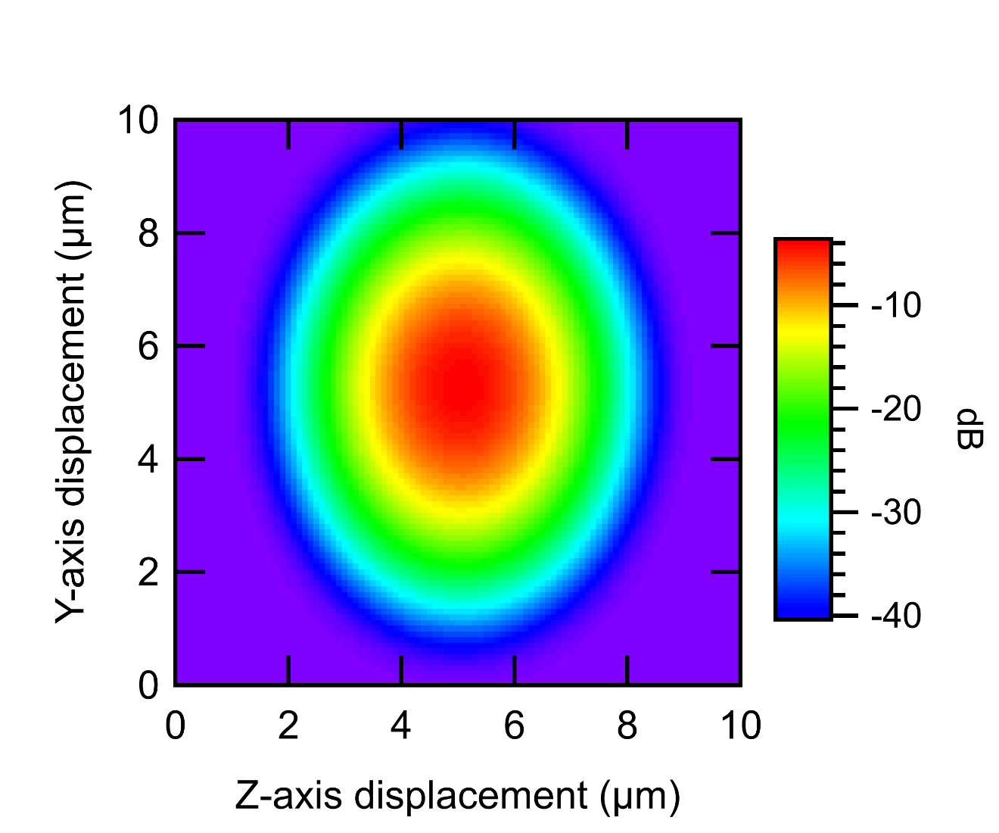
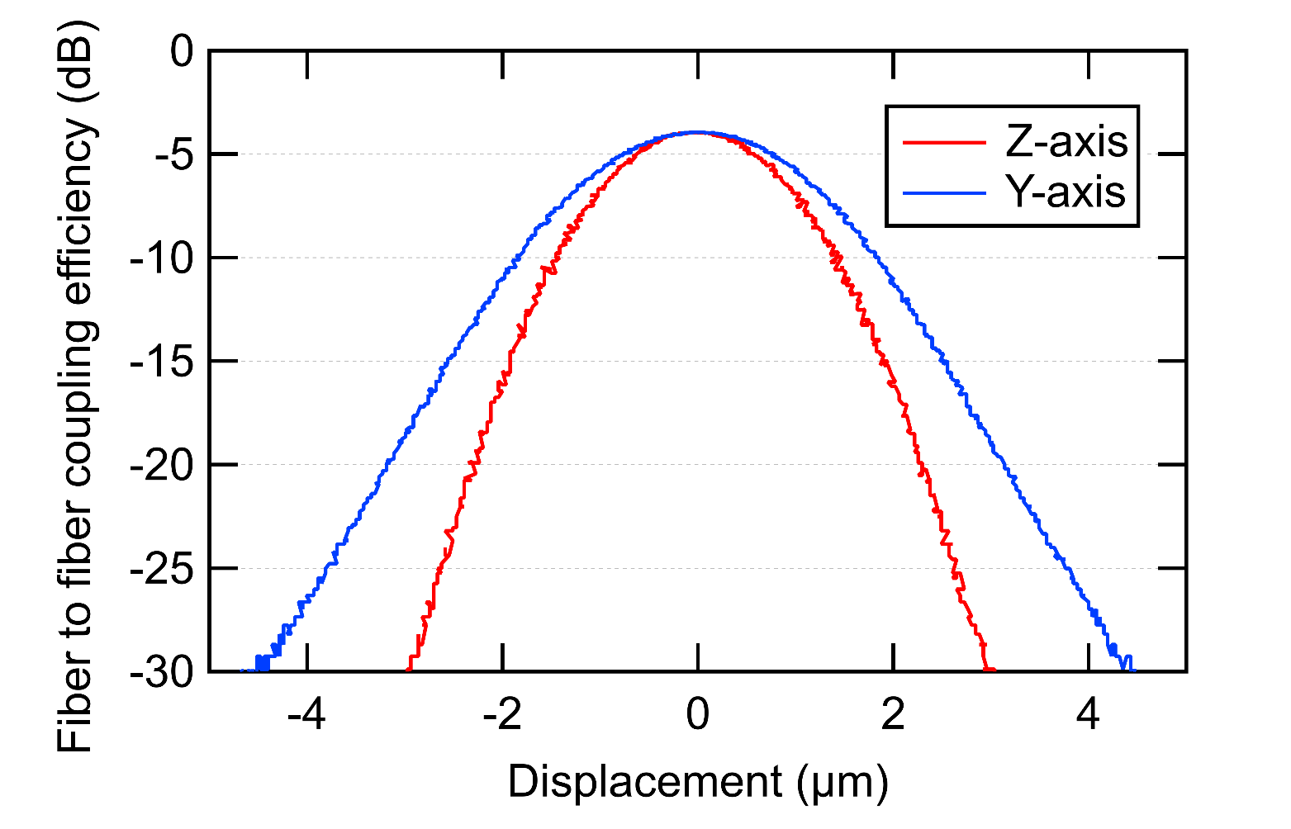
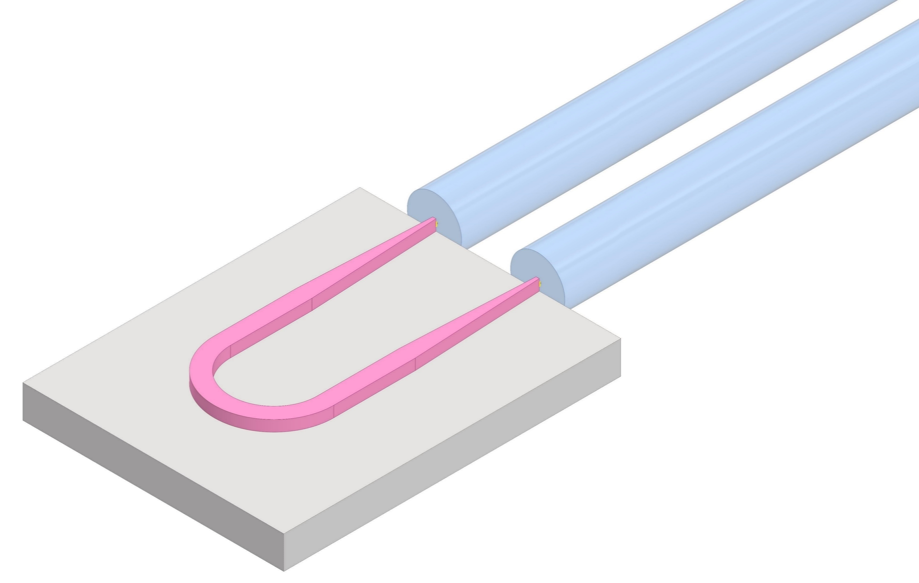
Fiber alignment tolerances
Mode field diameter (MFD) at the single-mode fiber (SMF) facet ~10 µm
Sub-micron MFD into the Si waveguide
Tapered waveguide adapting the two MFDs
Sub-micron alignment tolerances ± 0.6 µm for 1 dB insertion loss
Similar alignment tolerances for vertical coupling and edge coupling
Fiber attachment to PICs requires machines based on active alignment
single mode optical fiber core
~10 μm
Silicon waveguide
(o.22 μm x 0.45 μm)
Optical fiber
Edge coupler
Z
X
Y
TWEPP 2024
carmelo.scarcella@cern.ch 03 October 2024

