Slide 1







Design, Production and Testing of ATLAS ITk Strip Bus Tapes
TWEPP-24
Tony Weidberg for ATLAS ITk strips
DESY, LBL, Ljubljana, Oxford, Valencia, Yale

Slide 2
Outline
Introduction
  Staves and petals
Bus tape requirements
Challenges and technologies
Bus Tape Testing Robots (BTTR) for QC
Electrical results and data transmission
Dimension measurements
Radiation tolerance
Summary

Slide 3
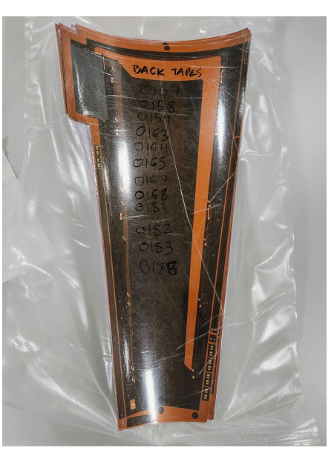
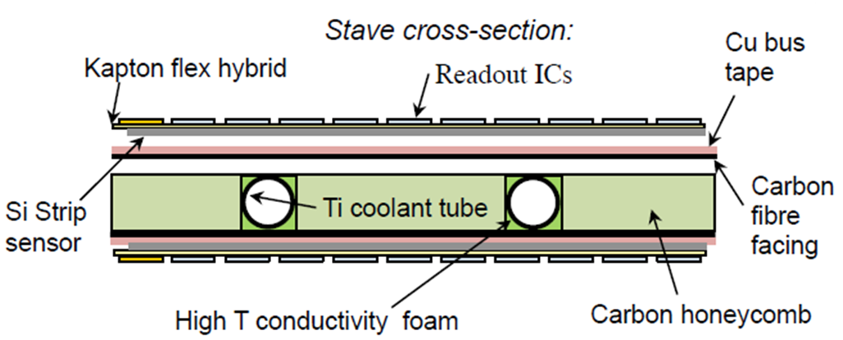
ATLAS Staves & Petals
Silicon strip modules mounted on cores
  Provide all electrical (LV, HV & data) and cooling services (CO₂)
  Integrated ➔ minimum radiation length.
  Same concept staves (barrel) and petals (End cap) different shapes
Petal co-cured tape

Slide 4
Outline
Introduction
  Staves and petals
Bus tape requirements
Challenges and technologies
Bus Tape Testing Robots (BTTR) for QC
Electrical results and data transmission
Dimension measurements
Radiation tolerance
Summary

Slide 5
Bus Tape Requirements
Electrical
  640 Mbps data from modules to End of Stave (EoS) card
  160 Mbps control data EoS ➔ modules (multi-drop)
  Impedance Z₀ = 100 ± 10 Ω
  LV (11V) to modules
  HV (up to -550V) to modules
Mechanical
  Minimal radiation length
  Silicon modules mounted on stave: bond pads need to match up ➔ spec on stretch/shrinkage
  HV clearances ➔ spec on distortions.
Radiation tolerance
  Barrel: 500 kGy(Si) : End Cap: 650 kGy(Si).
  Check adhesion of glue for cover layer to tape.

Slide 6
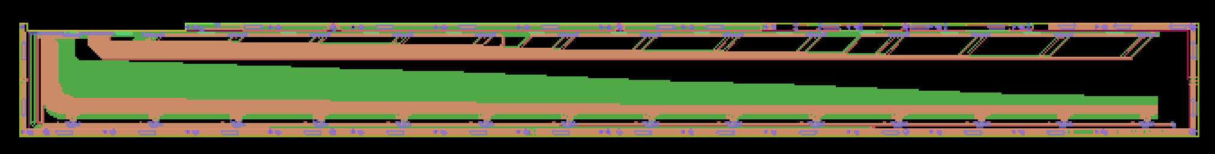
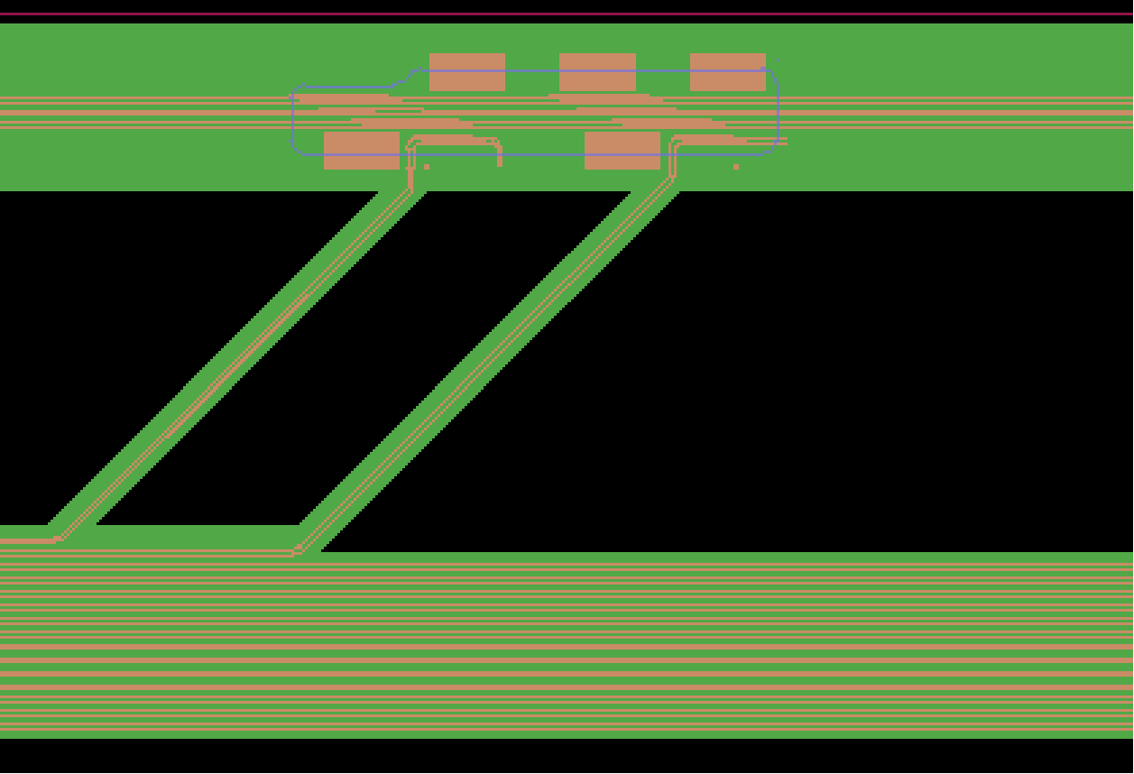
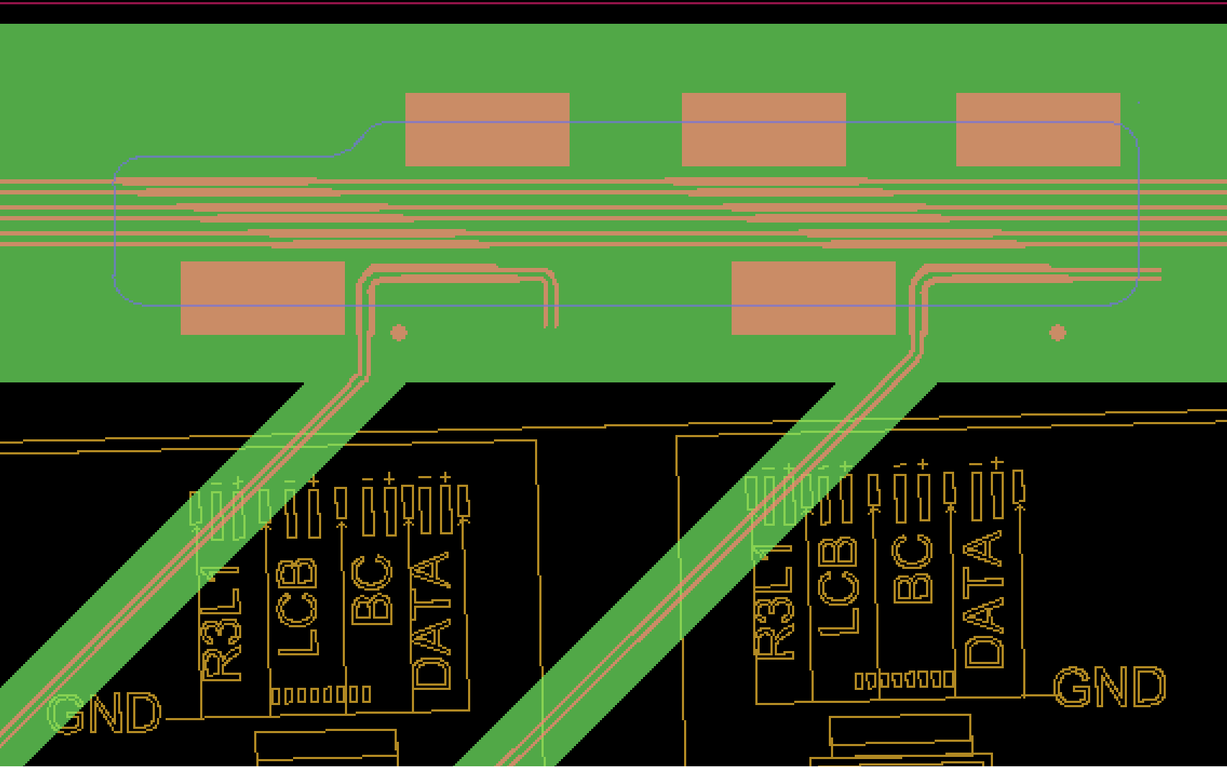
Geometrical Constraints
Bare stave tape (1.4 m long)
Modules wire bonded to bond pads on tape
Module located precisely wrt stave ➔ constraint on tape stretch
HV clearances would be compromised by large distortions in y direction.
y
x
Add module
➔

Slide 7
Outline
Introduction
  Staves and petals
Bus tape requirements
Challenges and technologies
Bus Tape Testing Robots (BTTR) for QC
Electrical results and data transmission
Dimension measurements
Radiation tolerance
Summary

Slide 8
Challenges
Long tapes (barrel) with 100 μm track & gap up to 1.4 m long (barrel).
  Precise etching. Control impedance Z₀ = 100 Ω.
  Getting high yield
    Up to 44 narrow (~ 100 μm) tracks on tape. One open circuit ➔ tape fails.
  Uniformity of NiAu plating
  Uniformity of Cu thickness for electro-plating.
Difficulty finding commercial manufacturers for long barrel tapes
  Company that made prototypes withdrew for commercial reasons
  Second company making progress but tapes failed radiation tests.
  Development and production at CERN (Rui’s workshop).
Petal tapes produced at Elgoline
  Tapes not as long as barrel tapes. Company couldn’t make 1.4 m long tapes for barrel.

Slide 9
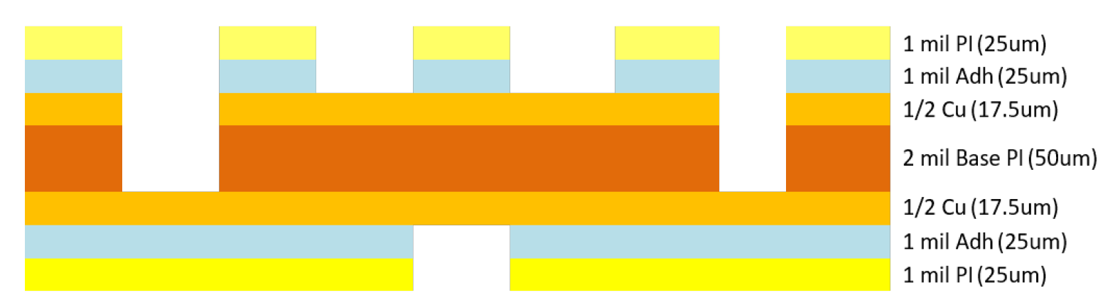
Tape Technologies
Two Cu layers on adhesiveless polyimide.
Polyimide + glue cover layer top and bottom.
Two technologies
Vias to connect top to bottom copper layers.
Laser ablation “skiving”
  Cut outs in top cover layer: access to top Cu wire bond pads
  Cut outs also in base polyimide: access to bottom Cu wire bonds
  Cut outs in bottom cover layer: allows grounding to carbon fibre facesheet.

Slide 10
Tape Technologies: Pros & Cons
Laser ablation(Elgoline) vs vias (CERN).
Laser ablation | Vias
Special processing for Cu pads before NiAu plating for wire bonding (“jet scrubbing”) | Vias connect bottom Cu to top Cu. Only wire bond to top Cu. Use large enough vias and have redundant vias. Validated with destructive tests.
Laser cuts very precise openings in cover layer. | Mechanical milling ➔ less precise openings ➔ larger openings.
Stretch sensitive to environmental parameters | Stretch constrained by milling holes for dowel pins
Cu thickness from material. | Cu thickness from electroplating ➔ difficult to control for large area flex

Slide 11
Outline
Introduction
  Staves and petals
Bus tape requirements
Challenges and technologies
Bus Tape Testing Robots (BTTR) for QC
Electrical results and data transmission
Dimension measurements
Radiation tolerance
Summary

Slide 12
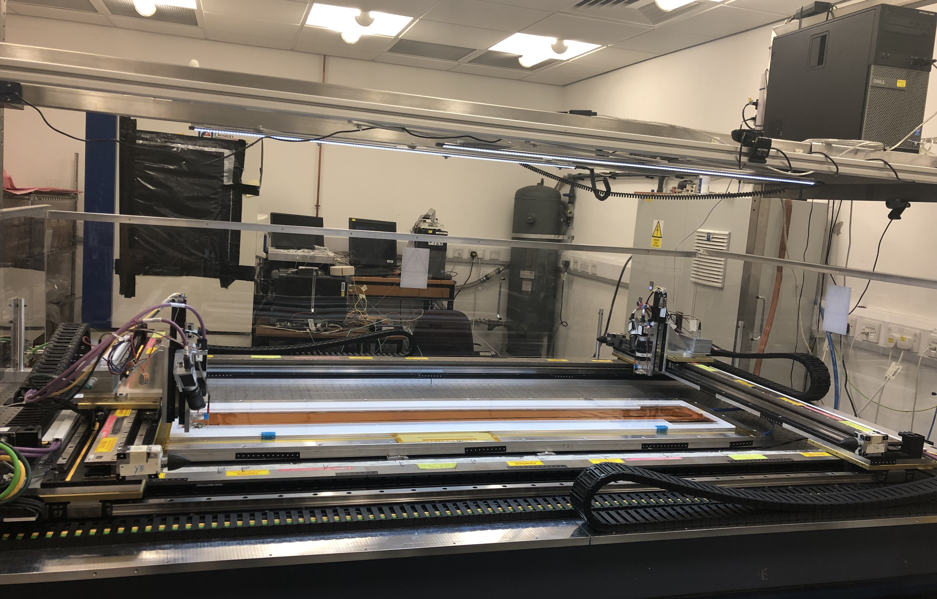
Bus Tape Testing Robot (BTTR)
Probes and cameras on two x/y/z stages.
BTTRs at DESY, Ljubljana, Oxford & Yale

Slide 13

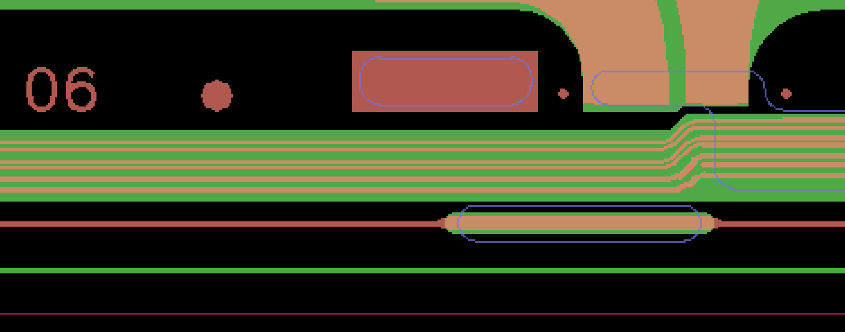
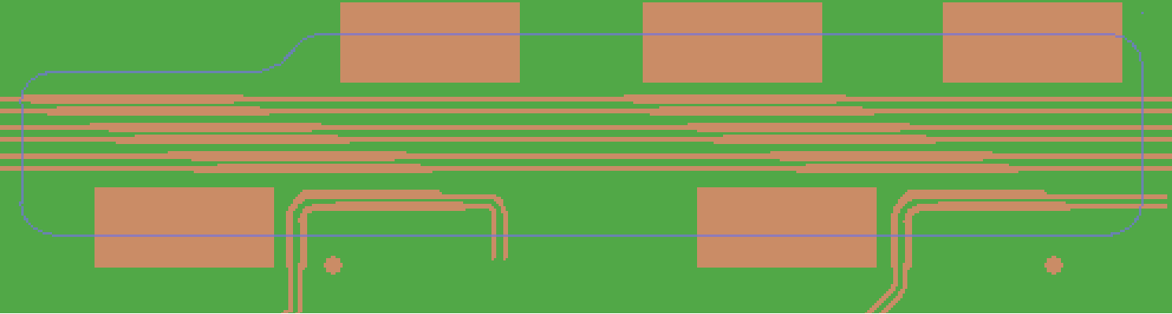
BTTR
Camera used to calibrate stages against Smartscope.
Camera finds 1 mm fiducials ➔ define axis
Camera finds 0.35 mm fiducials close to each bond pad field.
  enables BTTR probe accurately on bond pads, allowing for distortions in bus tape
  Metrology: stretch and distortion measured: Measured – CAD distances

Slide 14
Outline
Introduction
  Staves and petals
Bus tape requirements
Challenges and technologies
Bus Tape Testing Robots (BTTR) for QC
Electrical results and data transmission
Dimension measurements
Radiation tolerance
Summary

Slide 15
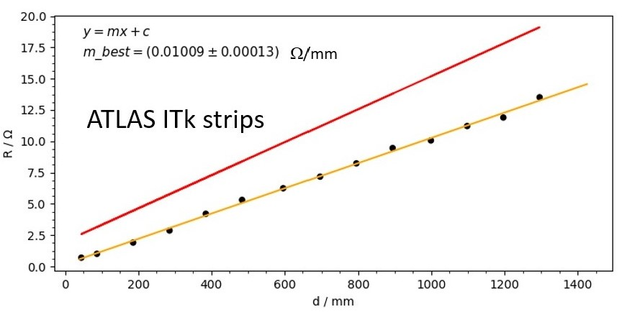
Tape Electrical Results (1)
Measure resistance versus distance (example long 100 μm line)
  Example plot
Check all values agree with expectations within tolerances
Fit straight line ➔ gradient.

Slide 16
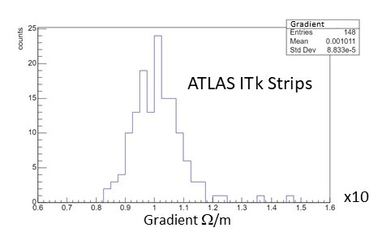
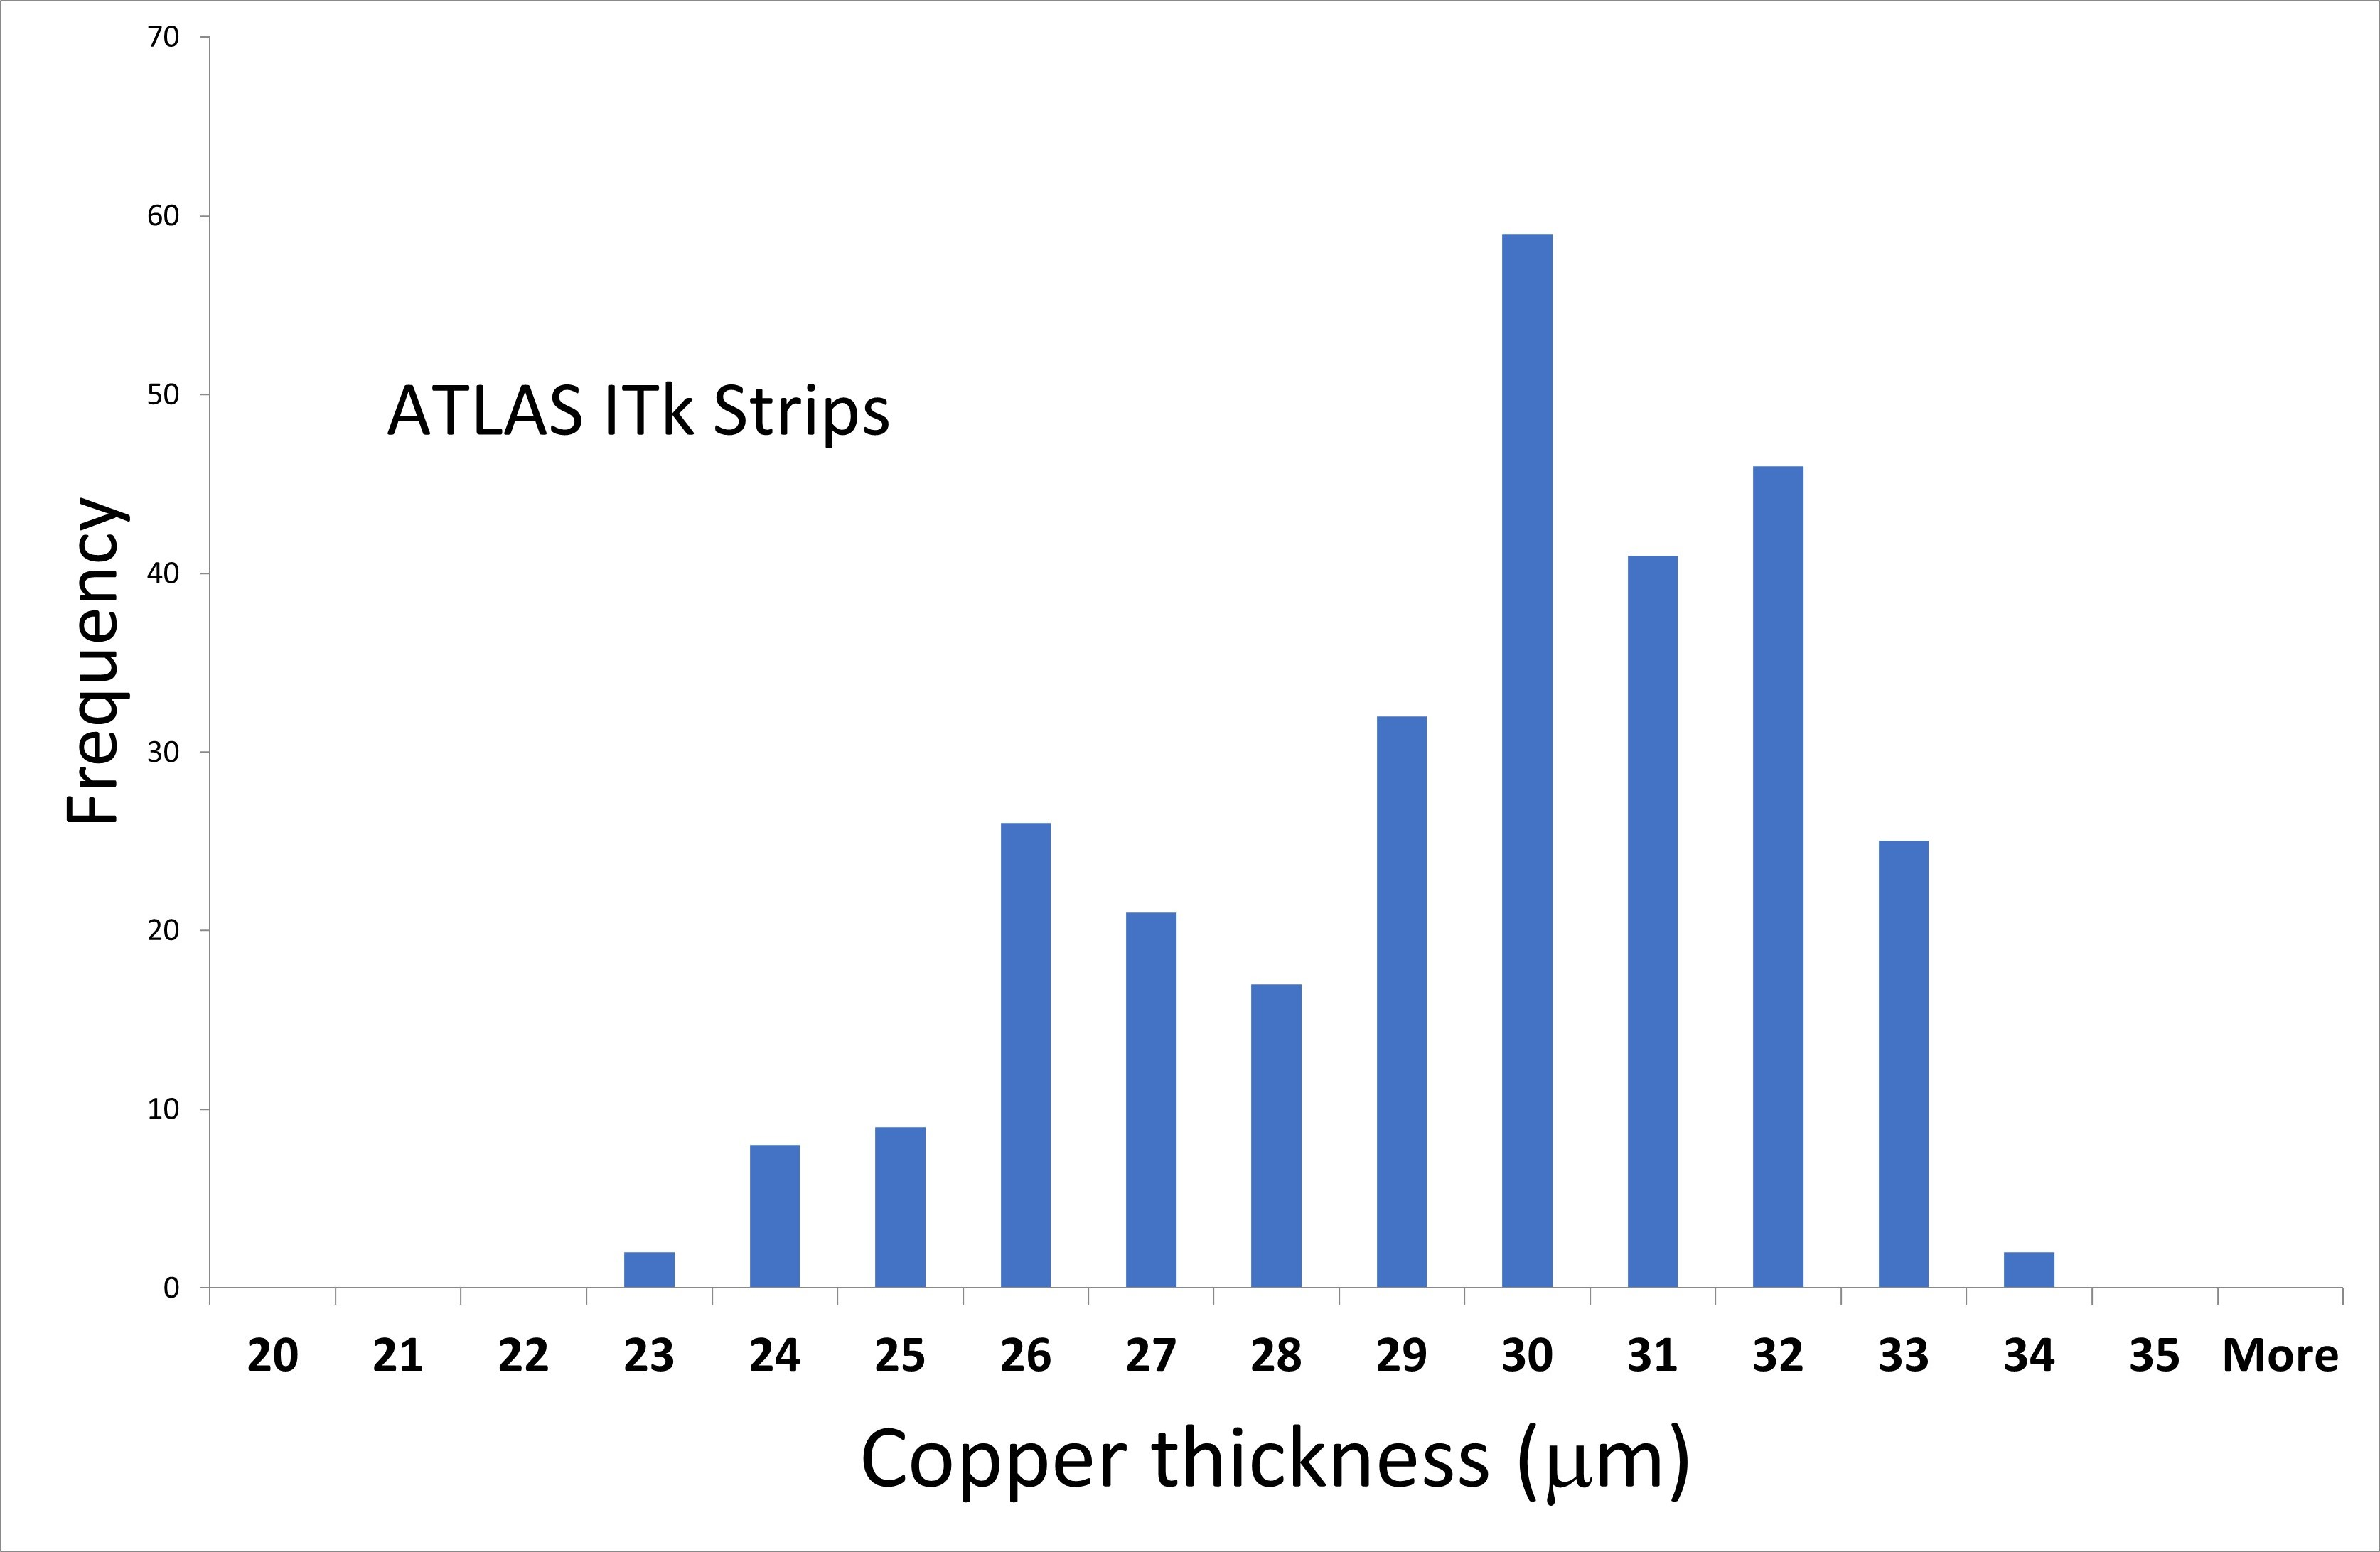
Tape Electrical Results (2)
Cu thickness
Histogram gradients for stave tapes
Spread in gradient due to variation in Cu thickness (electroplating).

Slide 17
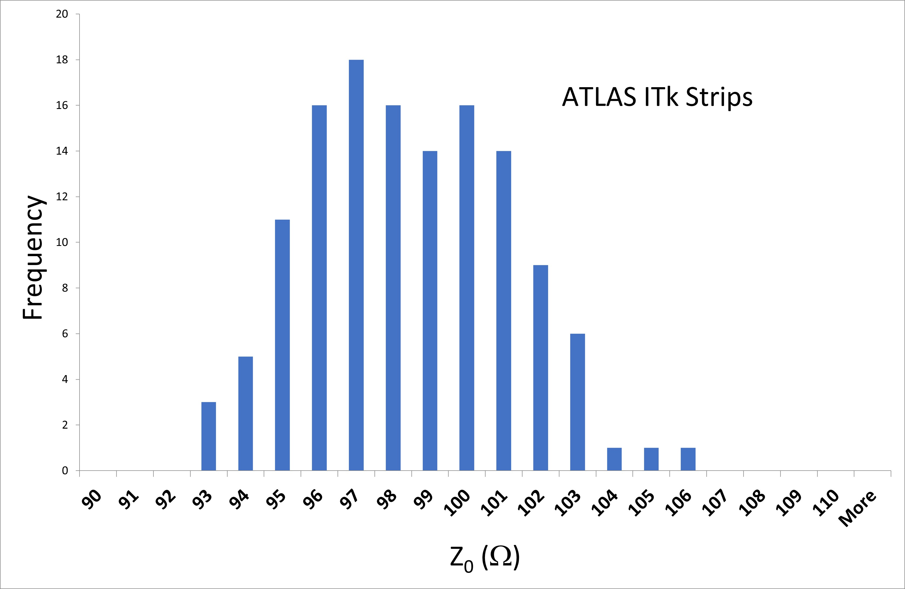
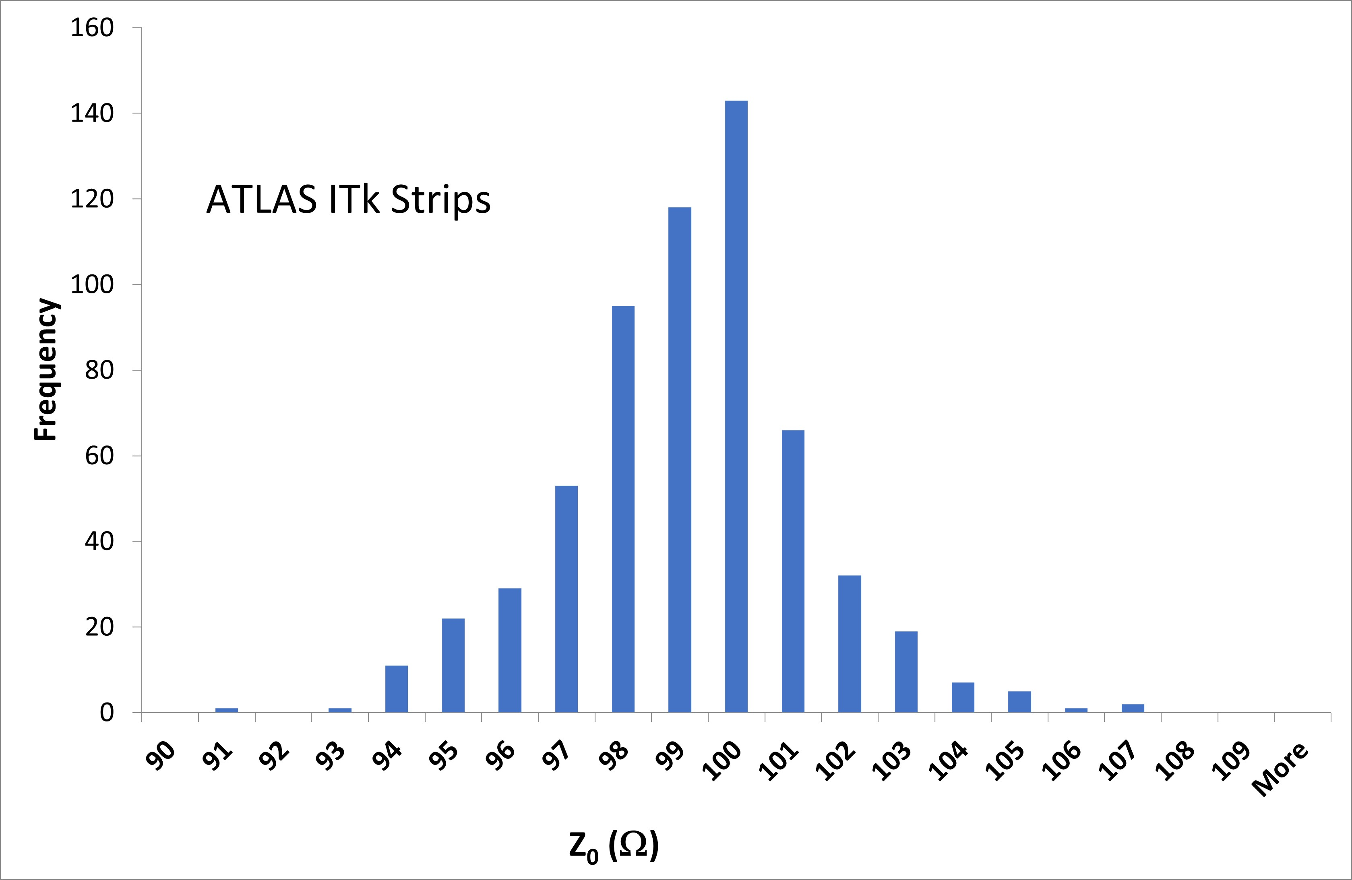

Tape Electrical Results (3)
Impedance Z₀ measured on test trace for each tape.
Distributions reasonably centred around 100 Ω.
Stave tapes (CERN)
Petal tapes (Elgoline)

Slide 18
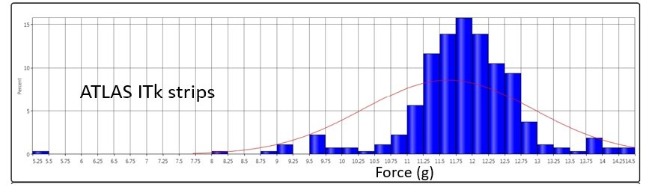
Tape Electrical Results (4)
Test bond pull strengths: require <pull strength> > 8 gm.
Long barrel tapes: challenge is uniformity of NiAu plating over full area.
  Initially very good bond pull strengths over most pads but worse results at edge of tape
  Many trials, finally key improvement: tapes horizontal on Ni plating bath (more uniform chemistry)
  Critical to check bond pads over area of tape.
  Sacrifice one tape per batch 60 tapes. Example tape. Mean 11.8 gm SD 1.0 gm.

Slide 19
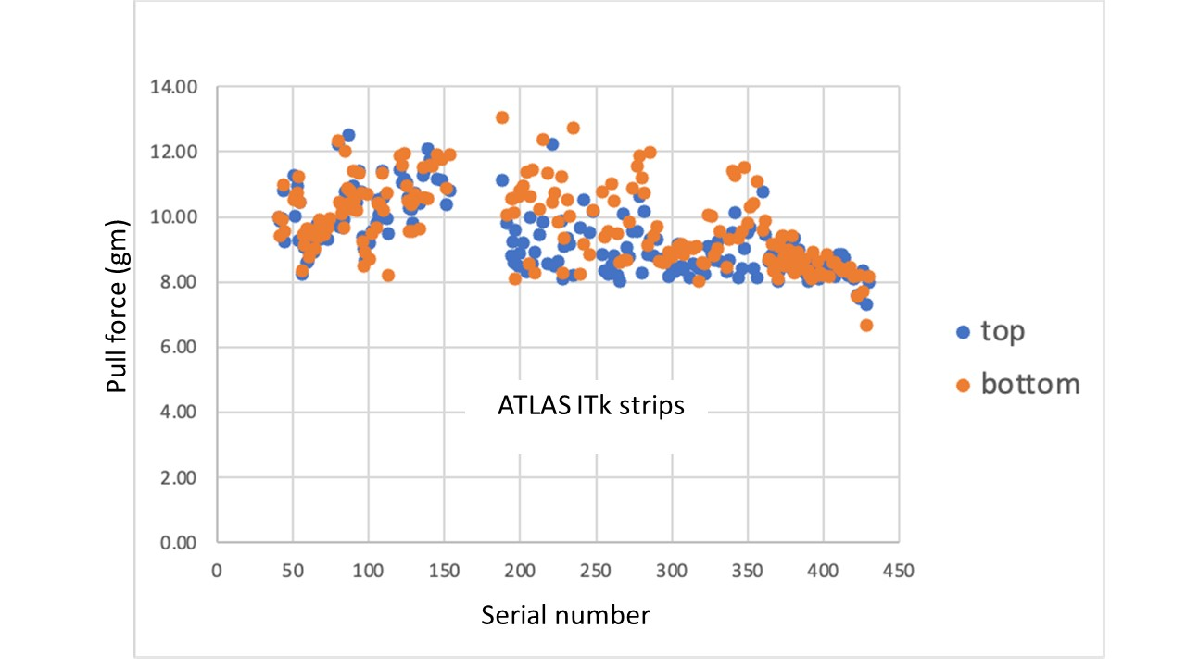
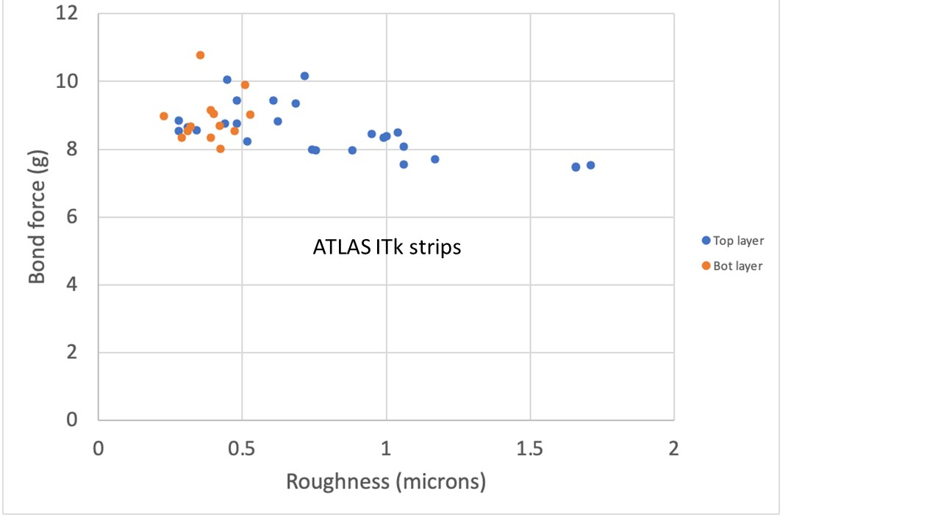

Tape Electrical Results (5)
Petal tapes: laser ablation for bond pad openings ➔ challenge is to achieve good surface roughness.
Pull strength correlated with surface roughness ➔ need surface roughness < 0.7 μm.

Slide 20
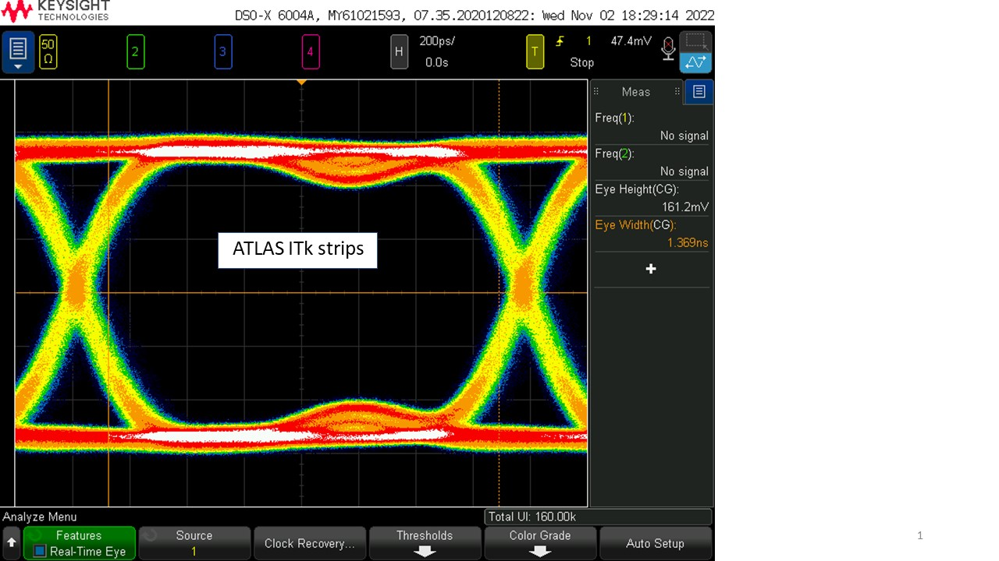
Data Transmission (1)
P2P Data transmission 640 Mbps long data line.
Longest line 1.4 m
Strong dispersion and attenuation but clean eye visible.

Slide 21
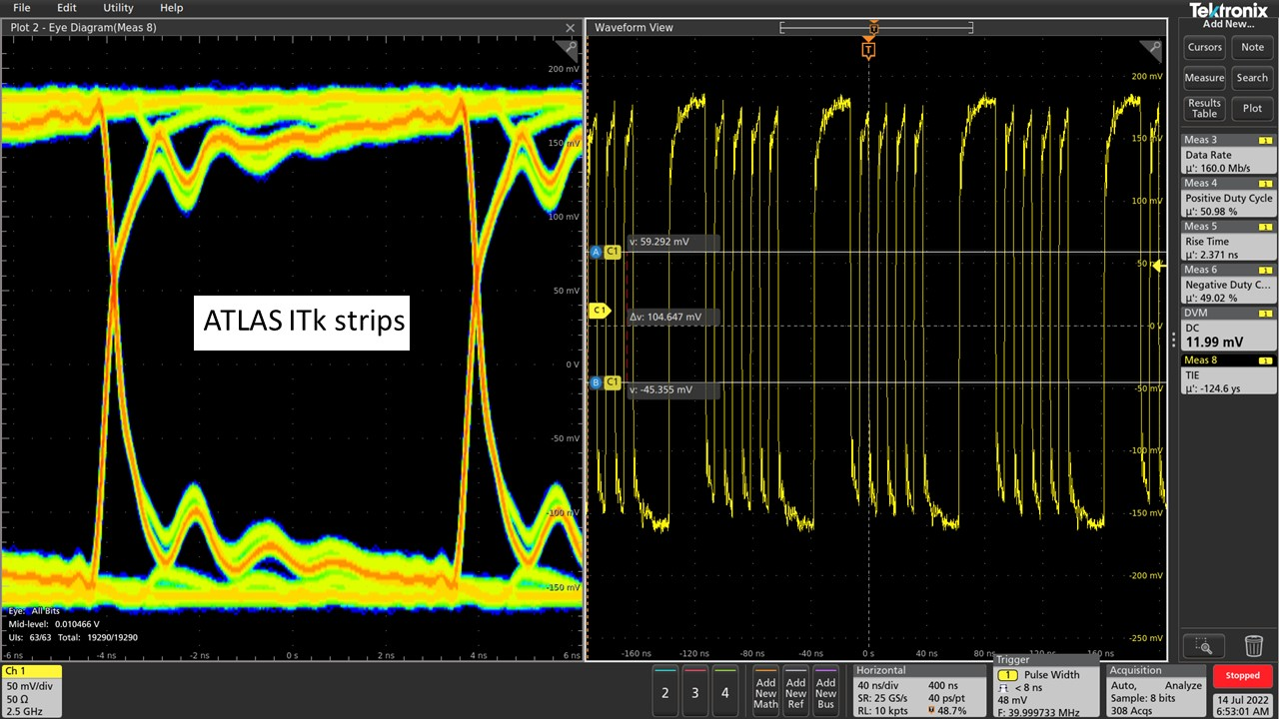
Data Transmission (2)
Worst case multi-drop: 10 receivers (HCCStar) @ 160 Mbps
  Reflections visible but clean eye.

Slide 22
Outline
Introduction
  Staves and petals
Bus tape requirements
Challenges and technologies
Bus Tape Testing Robots (BTTR) for QC
Electrical results and data transmission
Dimension measurements
Radiation tolerance
Summary

Slide 23
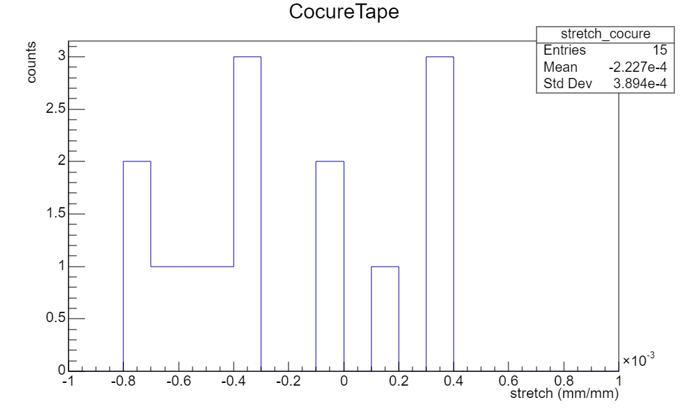
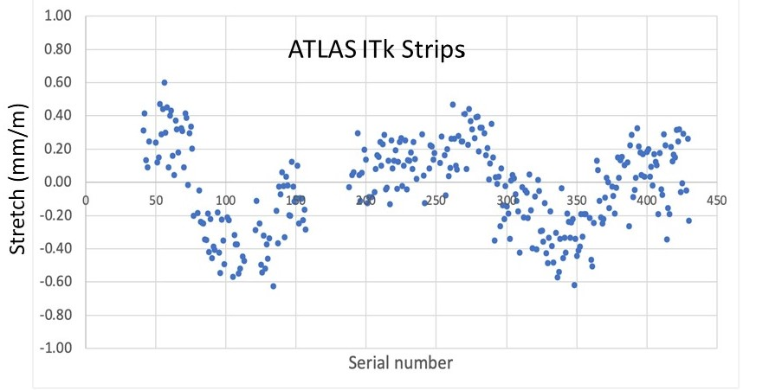
Tape Stretch
Fractional stretch in long direction (x 10⁻³)
Spec |stretch| < 10⁻³
Stretch Staves (m/m)
Don’t expect long term trends (TBC)
Stretch petals vs serial number number (proxy for time)
Drifts require regular change of gerbers.
ATLAS ITk strips

Slide 24
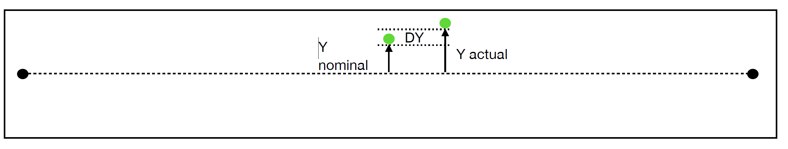
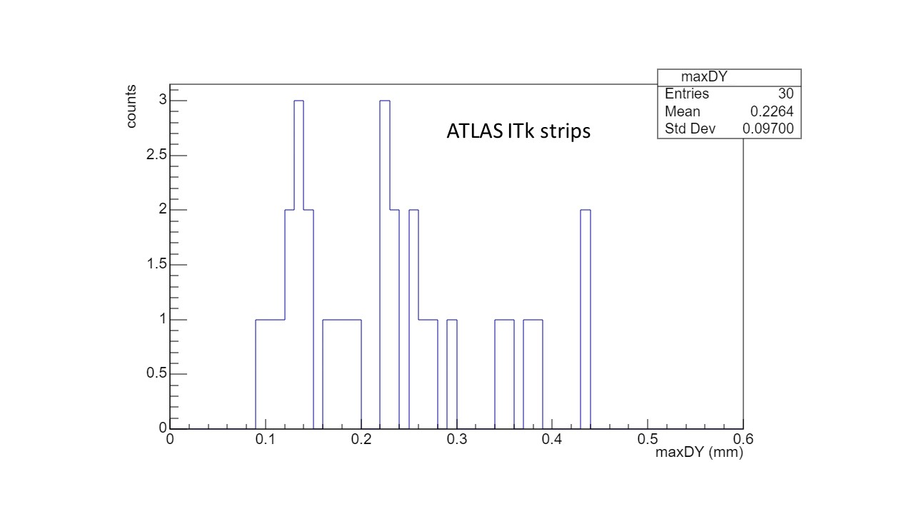
Distortions
Distance from nominal in short direction < 0.6 mm
Issue for stave tapes because of aspect ratio.
Measured on co-cured stave tapes (distortion not well defined bare tapes)
Maximum

Slide 25
Outline
Introduction
  Staves and petals
Bus tape requirements
Challenges and technologies
Bus Tape Testing Robots (BTTR) for QC
Electrical results and data transmission
Dimension measurements
Radiation tolerance
Summary

Slide 26
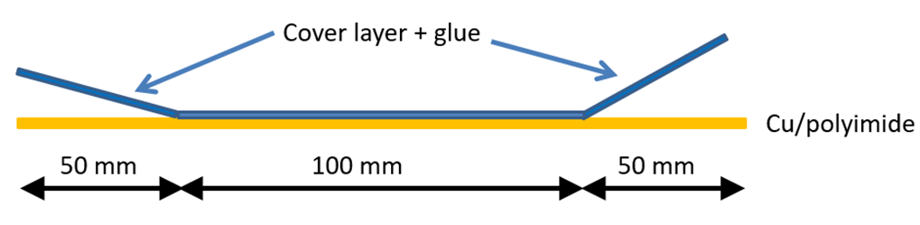
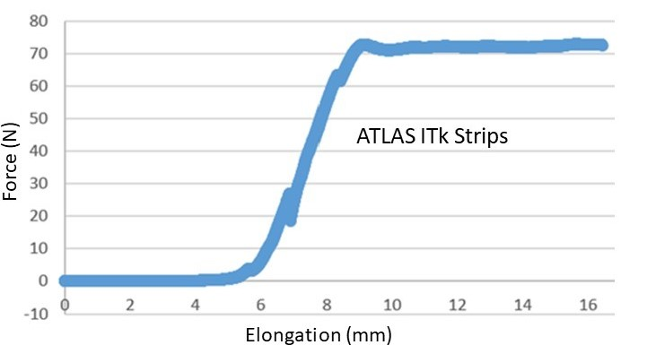
Radiation Tolerance (1)
Check peel strength cover layer to tape for samples with and without radiation (500 kGy(Si) for barrel, 650 kGy(Si) End cap).
Apical (base Cu/polyimide) + Krempel (Stave tapes)
  500 kGy(Si) INER Taiwan (array ⁶⁰Co sources)
Width 45 mm
Sample | Mean Pull strength (N)
Un-irradiated | 76 ± 5
Irradiated | 75 ± 3

Slide 27
Radiation Tolerance (2)
Good radiation tolerance validated with sources at Sandia (US) and 6 MeV Linac (Oxford oncology).
Very poor radiation tolerance for samples with Taiflex as used by proposed industrial partner for stave tapes.
  Surprise because earlier tests had shown good radiation tolerance.
  Material not qualified for radiation tolerance ➔ need to check every batch.
  Stave tapes (CERN) are using Apical + Krempel.
Similar tests with Kapton material used for petal tapes (Elgoline)
  Good radiation test results for 650 kGy(Si).

Slide 28
Outline
Introduction
  Staves and petals
Bus tape requirements
Challenges and technologies
Bus Tape Testing Robots (BTTR) for QC
Electrical results and data transmission
Dimension measurements
Radiation tolerance
Summary

Slide 29
Summary
Challenges for ATLAS ITk strip bus tapes
  Long tapes with narrow track and gap lines
  Electrical and dimensional requirements
  NiAu plating large area tapes
  Radiation tolerance
Pros and cons of laser ablation vs vias.
Stave and petal tapes long development time but now in production!
Questions Welcome!

Slide 30
Backup

Slide 31
Laser Ablation
Two Cu layers on adhesiveless PI.
PI + glue cover layer
Laser ablation “skiving” ➔
  Cut outs in top cover layer: access to top Cu wire bond pads
  Cut outs also in base PI: access to bottom Cu wire bonds
  Cut outs in bottom cover layer: allows grounding to carbon fibre facesheet.

Slide 32
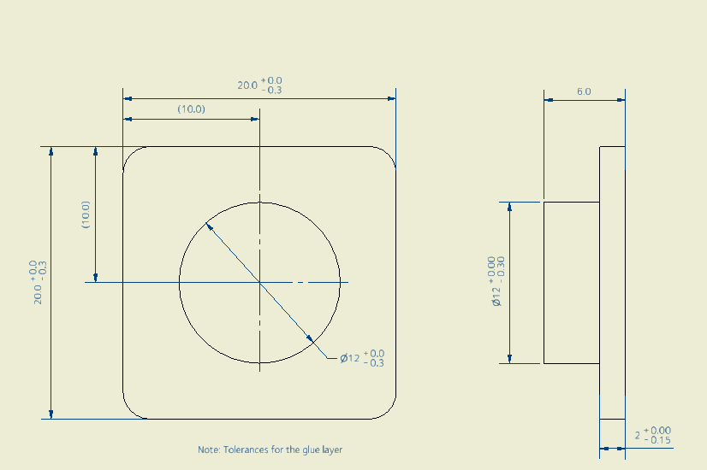
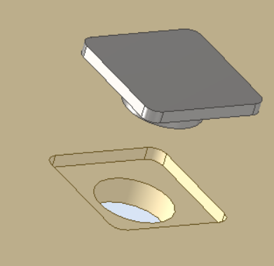
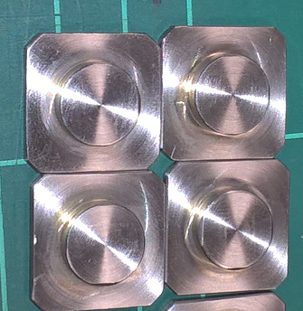
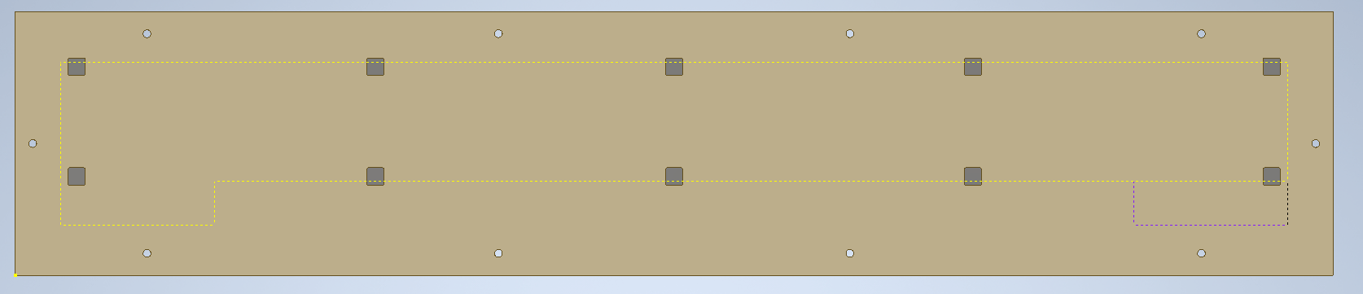
INVAR inserts in 6 mm thick carbon fibre jig
10 off 6mm dowel holes drilled after the inserts are glued.

Slide 33
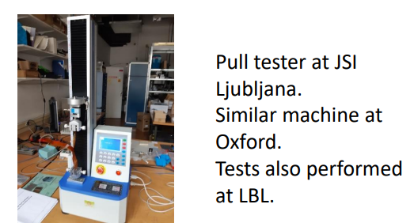
Pull tester for radiation hardness studies

Slide 34
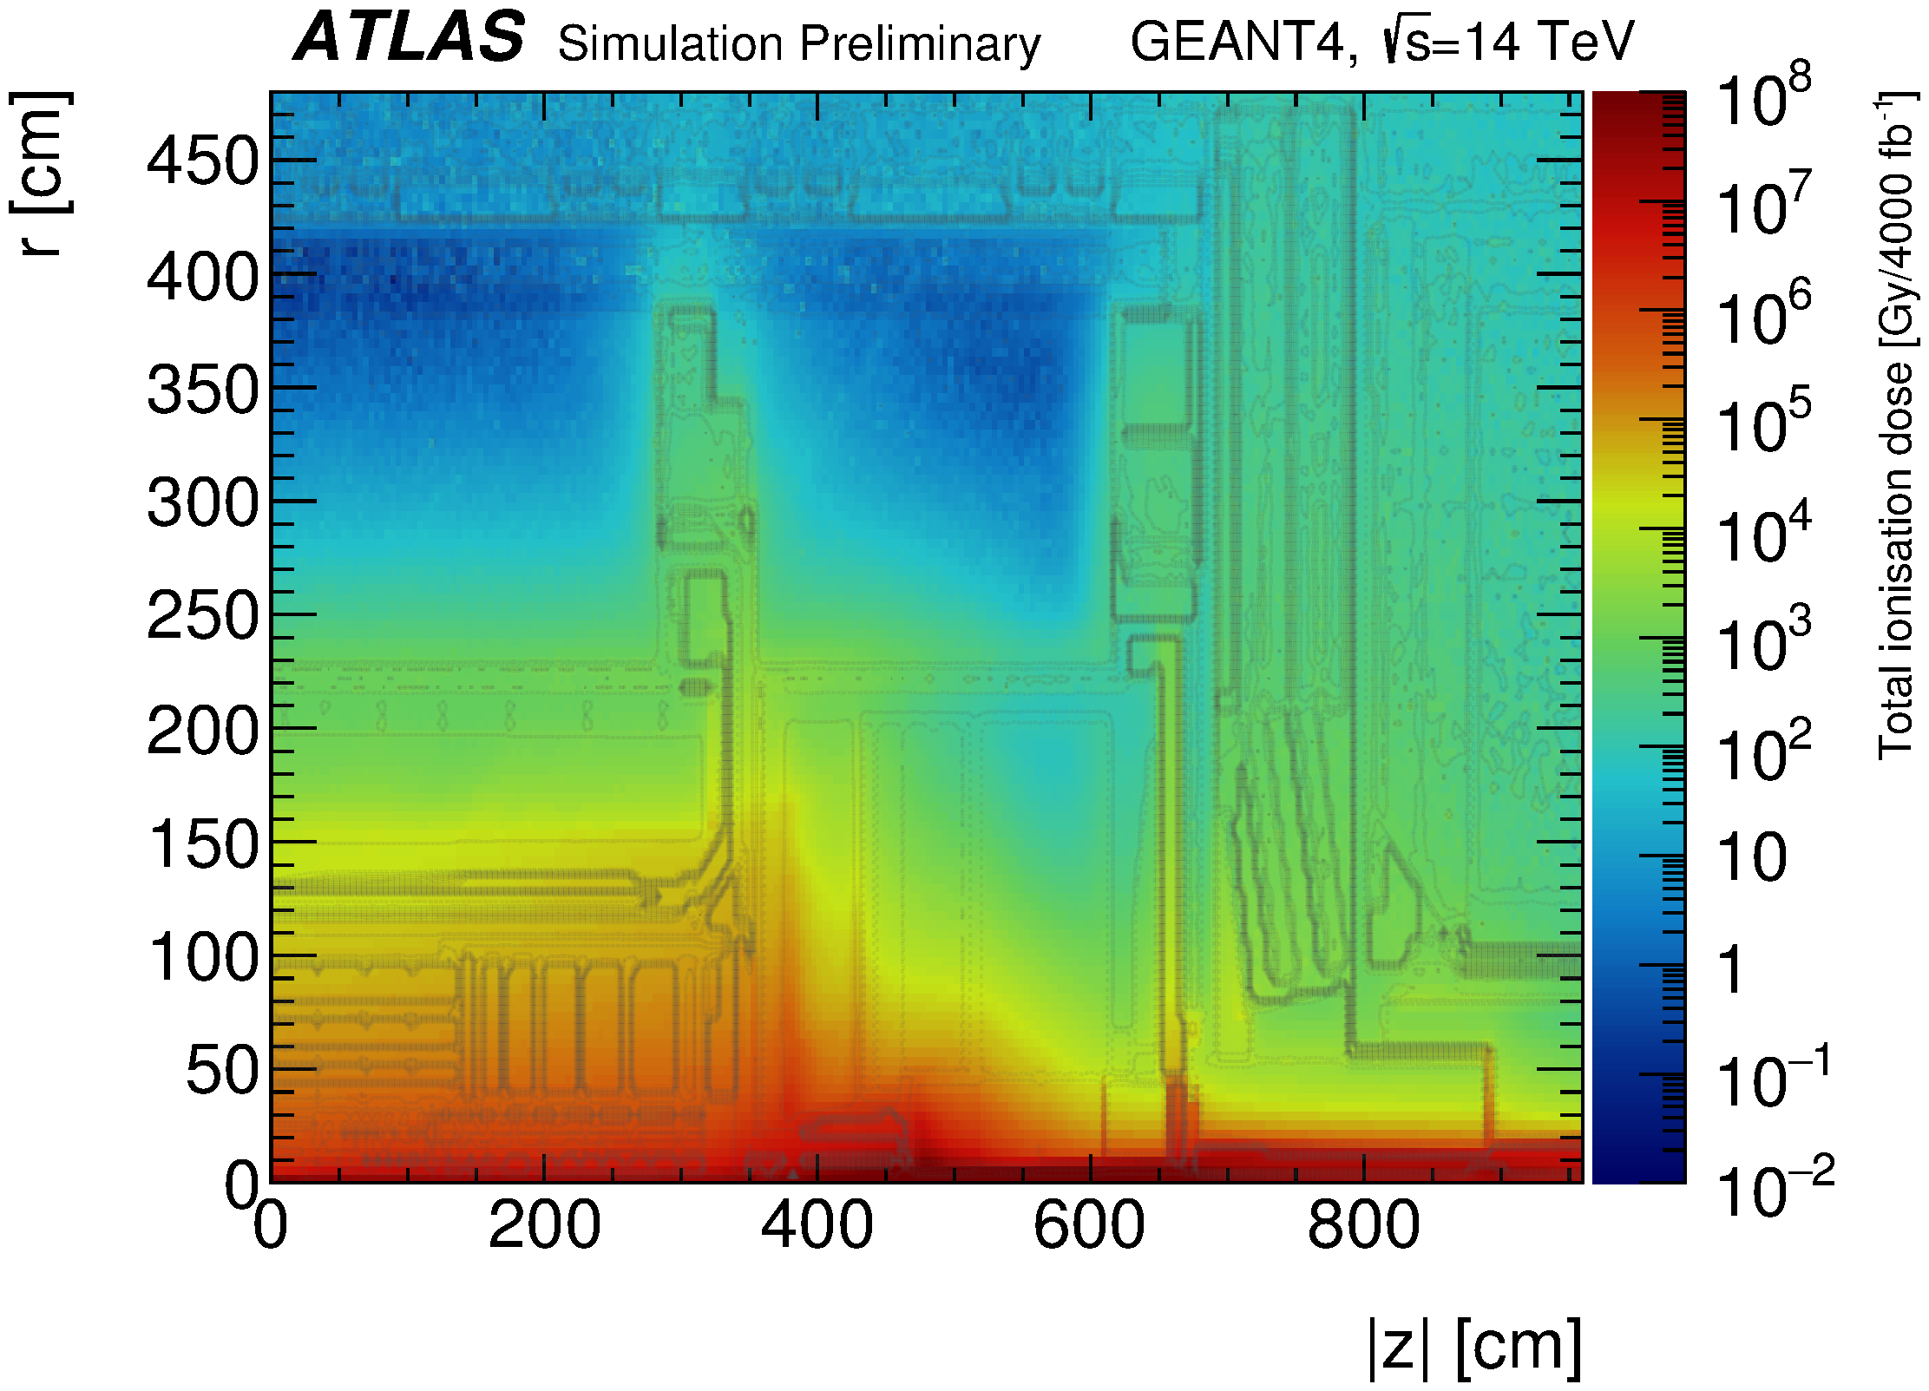

Slide 35
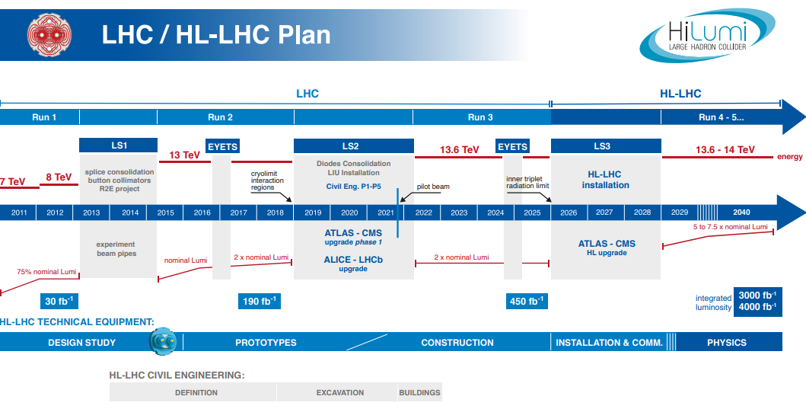

Slide 36
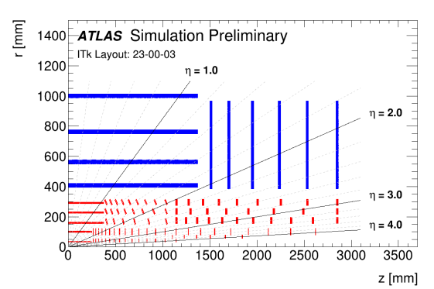

Slide 37
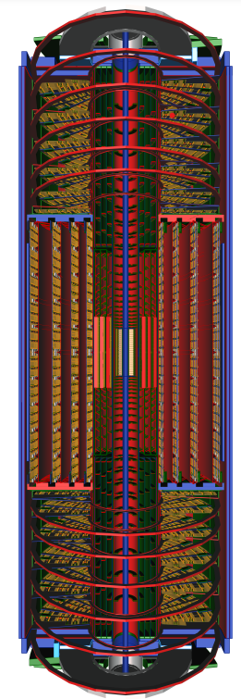
Strip End Cap
Strip barrel
Strip End Cap
~ 2m
Pixels
~ 6m

