Slide 1
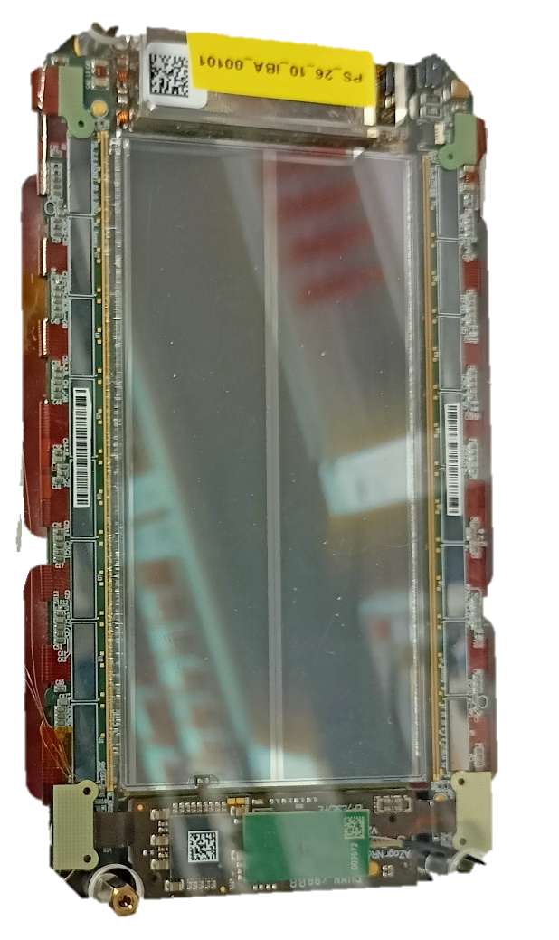
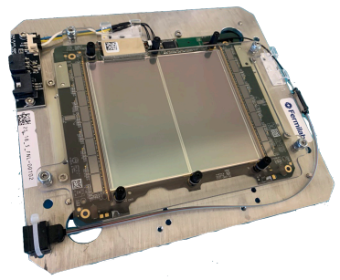
Hybrids pre-production results for the CMS Outer Tracker Phase-2 Upgrade
G. Blanchot^{✝1} , M. Abbas¹ , I. Ahmed¹ , B. Allongue¹ , D. Andreou¹ , R. Carnesecchi¹ , K. Klein² , M. Kovacs¹ , A. Lapornik³ , A. La Rosa¹ , M. Lipinski² , M. Mohammadi Najafabadi¹, A. Pauls², A. Sultan¹, P. Szydlik¹, A. Zografos¹
¹ CERN, Route de Meyrin, CH-1211 Geneva 23, Switzerland
² RWTH Aachen, I. Physikalisches Institut B, Sommerfeldstraße 14, 52056 Aachen, Germany
³ University of Southern Denmark, Alsion 2, 6400 Sønderborg, Denmark
✝
✝For the CMS Collaboration

Slide 2
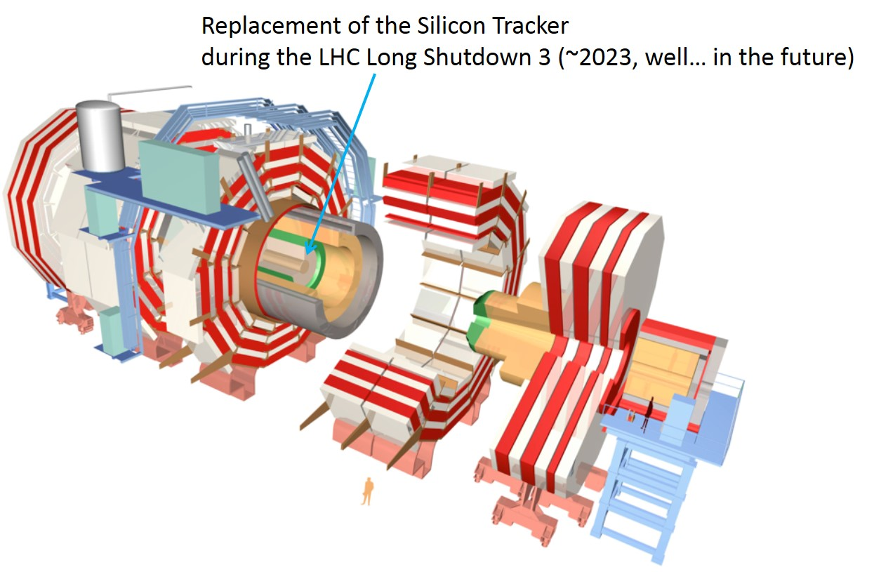
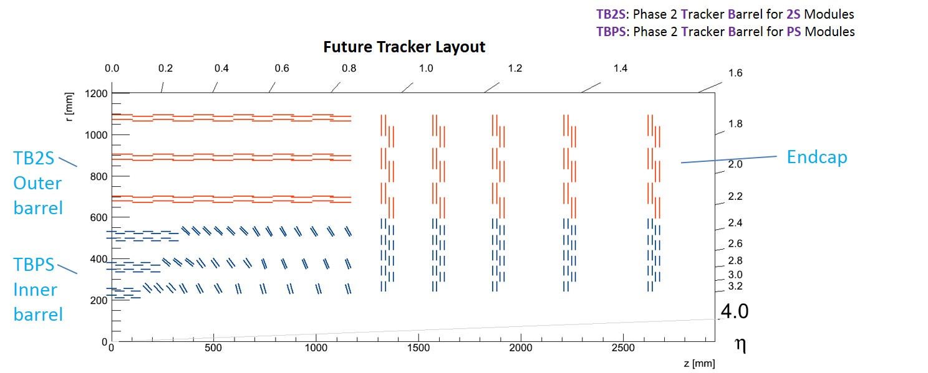
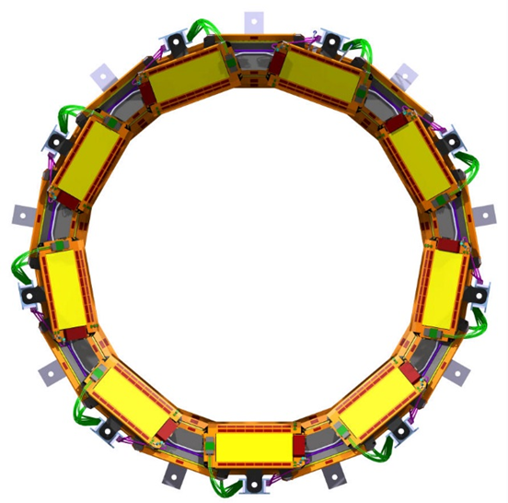
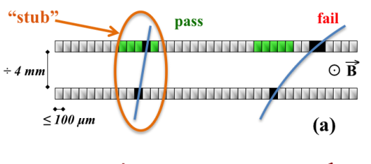
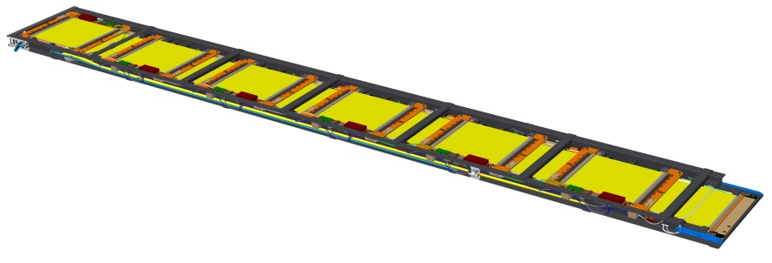
CMS Outer Tracker Upgrade
PS Tilted Ring
2S Ladder
Low p_{T} rejection using parallel sensors

Slide 3
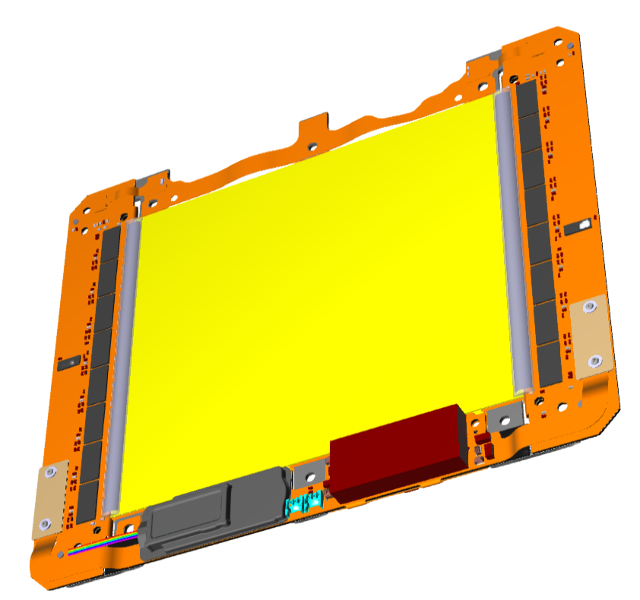
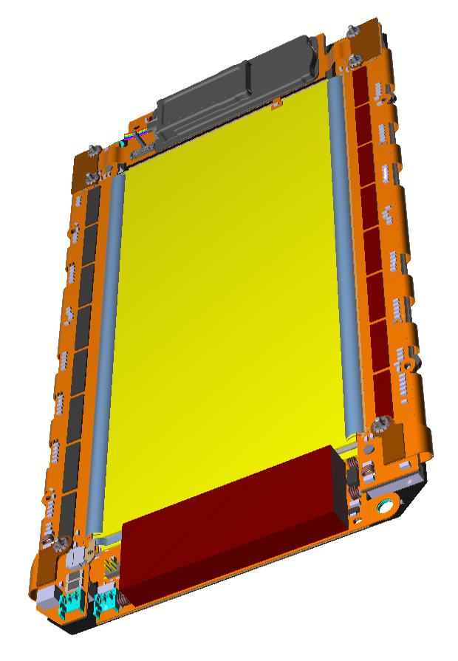
Modules and hybrids
2S Module
Two parallel silicon strip sensors.
  2 × 1016 strips, 90 µm pitch.
  90 cm² active area.
Left and Right side 2S-FEH front-end hybrids.
  Each based on eight CBC3.1 chips and one CIC2.1 chip.
One 2S-SEH service hybrid containing:
  DCDC converters based on one BPOL12.V6 and one BPOL2V5-V3.3 chip.
  Optical readout based on the lpGBT-V1 and the VTRx+.
2S-FEH-Right
2S-SEH (Service Hybrid)
2S-FEH-Left
PS Module
Silicon strip and macro-pixel sensors.
  2 × 960 strips, 100 µm pitch.
  32 × 960 macro-pixels, 1.5 mm × 100 µm.
  45 cm² active area.
Left and Right-side PS-FEH front-end hybrids.
  Each based on eight SSA2.1 chips and one CIC2.1 chip, wire bonded to MaPSA array.
Two service hybrids:
  PS-POH Power Hybrid based on one BPOL12-V6 and two BPOL2V5-V3.3 chips.
  PS-ROH Readout Hybrid based on one lpGBT-V1 chip and the VTRx+.
PS-ROH (Readout Hybrid)
PS-FEH-Left
PS-FEH-Right
PS-POH (Power Hybrid)
A total of 5 hybrid types in 18 different variants (sensor spacings, left or right sides, optical link speeds 5G or 10G).

Slide 4
Front-End Hybrids Challenging Design Constraint
2S Front-End Hybrid
PS Front-End Hybrid
High density interconnect: 42.5 µm tracks width and spacing.
Copper filled microvias on all layers: 25 µm to 50 µm laser drills, 110 µm smallest capture pads.
Tight fold.
Carbon fibre stiffener lamination.
High pin-count 250 µm pitch flip chips: CBC3.1, SSA2, CIC2.1.
High speed 90 Ω differential pairs in 150 µm thick flex.
All these constraints are on the technological edge for flexible circuit manufacturers.

Slide 5
Production objective
Kickoff batch to start production: 210 hybrids
  2S-FEH and 2S-SEH for 1.8 mm modules.
  PS-FEH, PS-ROH and PS-POH for 2.6 mm modules..
  Test two grounding variants for 2SSEH and PSPOH.
  Completed in September 2023.
  Objective: construction of 30 2S modules and 30 PS modules.
Pre-series batch: 1800 hybrids.
  All variants, all spacings, larger quantities.
  Improved designs and processes.
  Selected grounding variants for 2SSEH and PSPOH.
  Completed in September 2024.
  Objective: construction of 200 2S modules and 300 PS modules.
Series: 45510 hybrids
  All variants, all spacings, full volume.
  Production started in September 2024, completion expected Q1 2026.
Hybrid Variant | Pre-Series |  | Series Production
 | Kick-off batch | Rest of the batch
2S-FEH-18-L | 30 | 170 | 7350
2S-FEH-18-R | 30 | 170 | 7350
2S-FEH-40-L |  | 30 | 420
2S-FEH-40-R |  | 30 | 420
PS-FEH-16-L |  | 50 | 820
PS-FEH-16-R |  | 50 | 820
PS-FEH-26-L | 30 | 60 | 1450
PS-FEH-26-R | 30 | 60 | 1450
PS-FEH-40-L |  | 190 | 3280
PS-FEH-40-R |  | 190 | 3280
2S-SEH | 15 + 15 | 200 | 7770
PS-ROH_16_5G |  | 30 | 540
PS-ROH_16_10G |  | 20 | 280
PS-ROH_26_5G | 20 | 30 | 860
PS-ROH_26_10G | 10 | 30 | 590
PS-ROH_40_5G |  | 80 | 1400
PS-ROH_40_10G |  | 110 | 1880
PS-POH | 15 + 15 | 300 | 5550
Completed
Completed

Slide 6
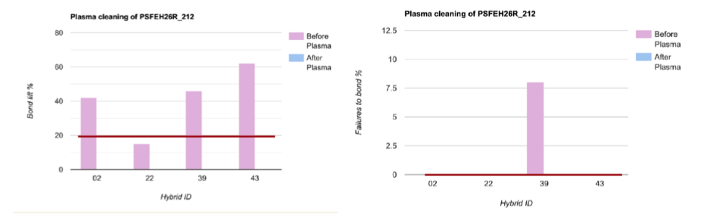
Addressing contamination issues
Contamination of 2S-FEH and PS-FEH bond pads appeared as major difficulty.
  Contamination is identified using polarized filters with coaxial light sources.
  Compromises the bondability of hybrids that must be automated.
  Cleanliness requirements were tuned with the assembly contractor,
    Reach a production compromise
    Stay acceptable for module assembly sites.
Prevention actions.
  Bare hybrids:
    Reinforced cleaning and control at flex manufacturer.
  Assembly contractor:
    Ultrasonic cleaning upon reception, controls to avoid cross-contamination.
    Plasma cleaning of hybrids before gluing and after reflow.
    Visual control, manual cleaning if needed.
Control at CERN.
  Exhaustive visual inspection., manual cleaning if needed.
  Wire bonding tests on sample basis.
  Ar/H₂ plasma cleaning improves bondability.
  Use of polarized filters for inspection.
  EDX analysis confirms organic content: C, Cl, Na, O, K

Slide 7
Dimensional control
Elongation of hybrids caused by CTE mismatch.
  CF CTE is close to zero: no elongation at gluing.
  PI CTE close to 16 ppm/ºC: hybrids elongates 250 µm during lamination made at 180 ºC.
  The flex cannot recover its nominal dimension after gluing: +150 µm is nornally observed at room temperature.
    Compromises the bonding arrays: pitch errors
    Compromises the tooling holes: misalignments.
  Compensation: 0.1% downscaling of designs for flex fabrication.
  Measurements on pre-series units showed a resulting elongation between 50 µm and 100 µm at room temperature.
    Matches the required specification ± 100 µm of nominal dimension to preserve automated bonding.
    Tooling holes cleared.

Slide 8
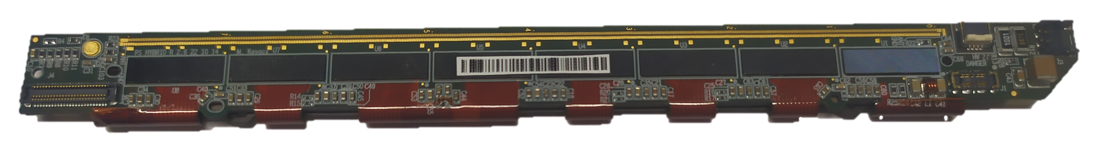
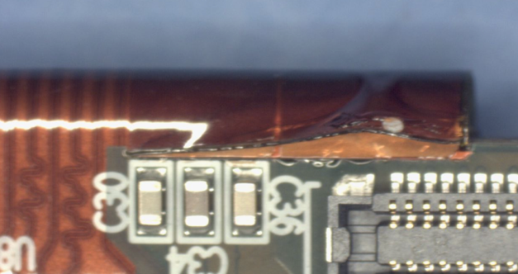
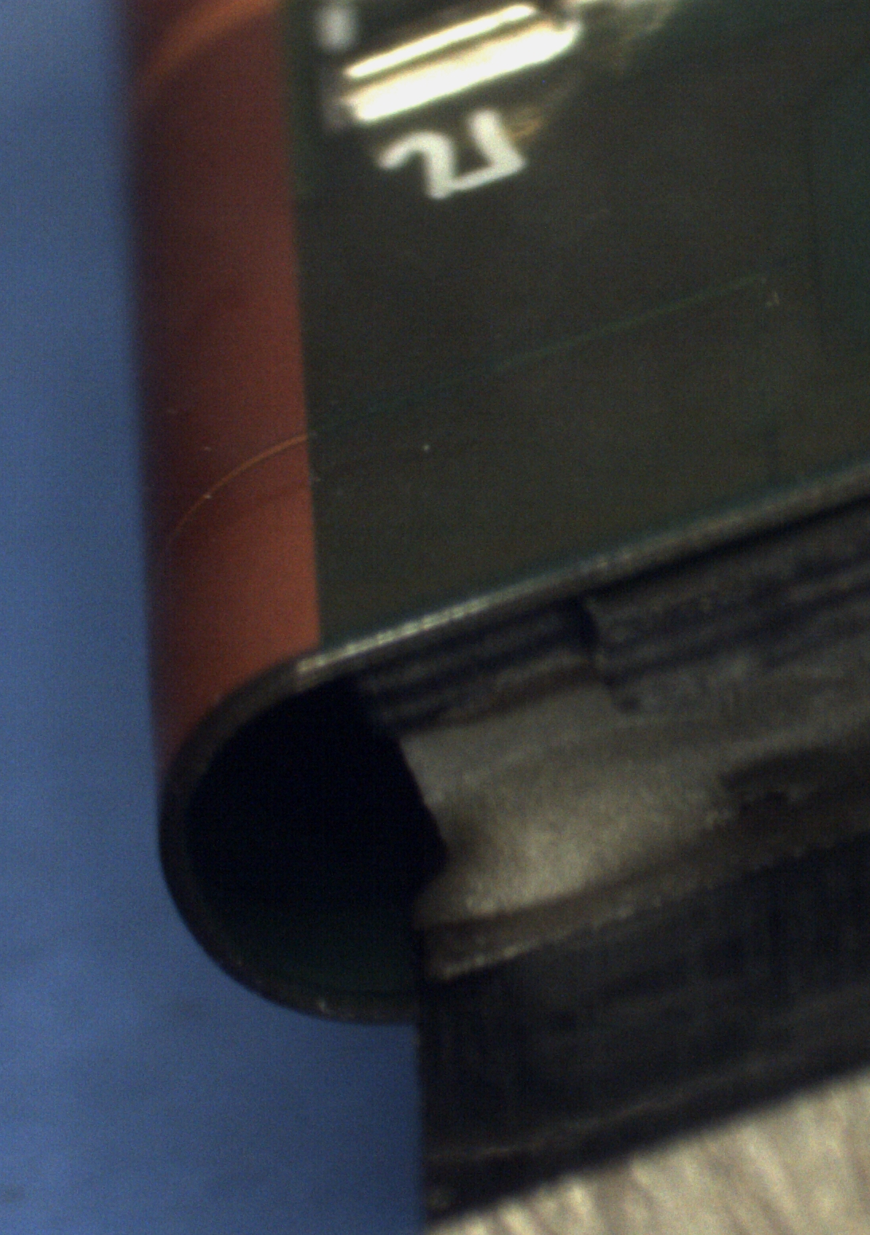
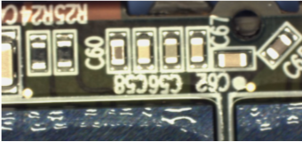
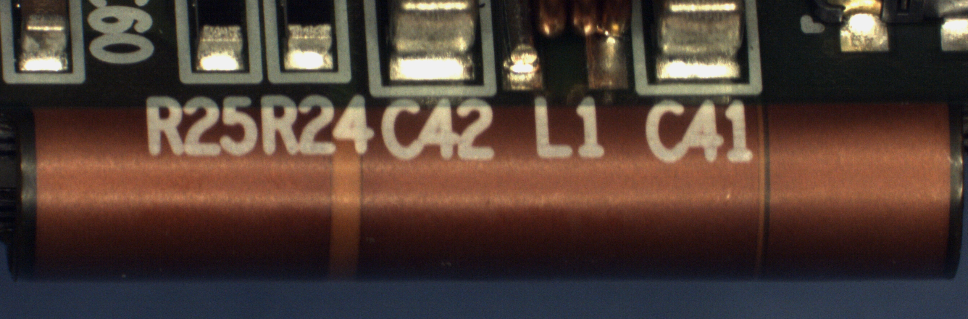
Coverlay chipping on PS-FEH
Kickof fold was cracked
The PS-FEH was initially designed as a four layers flex.
  Coverlay in the fold-over region to prevent cracks in the fold.
  Soldermask on the flat areas overlapping the coverlay.
  Overlap still too close of the fold on kickoff hybrids: coverlay chipping.
  Overlap could not be moved further: a more radical change was required for pre-series.
PS-FEH moved to a five layers flex for pre-series
  Eliminates the overlap.
    Robust solution, considered low risk.
    Required a major re-design of the six PS-FEH variants for pre-series.
No more delaminations observed on pre-series.
  Design change definitively validated.
Kickoff fold
Pre-series fold
Pre-series fold
Perfect fold integrity
Pre-series fold

Slide 9
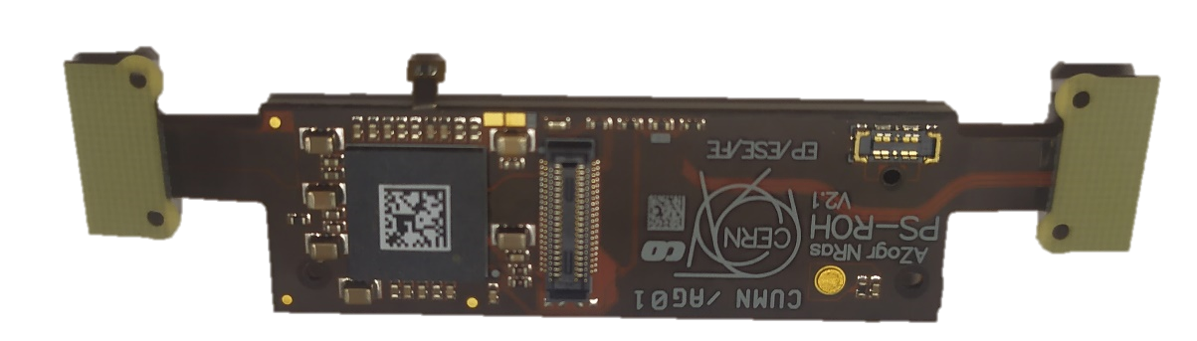
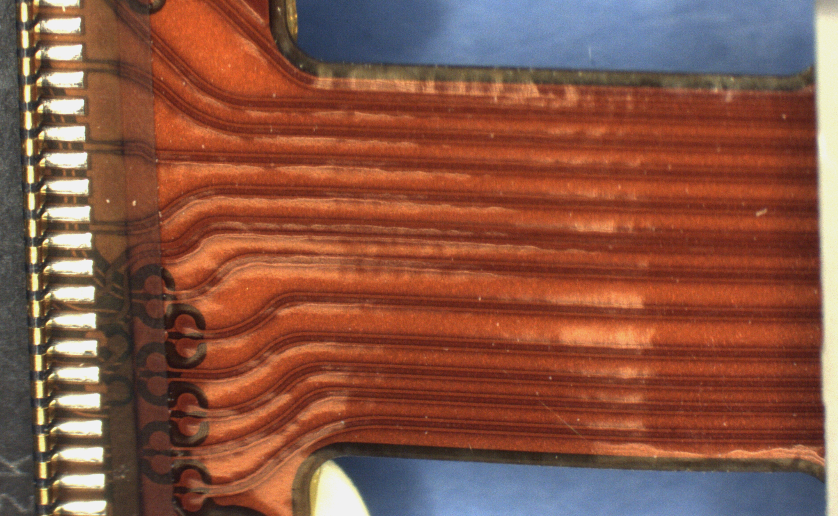
PS-ROH: brittleness of flexible tails
Cracks observed on Kickoff PS-ROH tails during module integration.
  Electrical discontinuities observed.
Exposition to high temperature cycles during fabrication process fragilizes the soldermask.
  This circuit is more exposed to high temperature cycles than the other variants.
Action for pre-series: replaced soldermask with coverlay in bottom tail area.
  No damages observed anymore.
  Fully validated in pre-series units.
Cracks on Kickoff units
Connector
ROH
FEH
Perfect fold integrity on pre-series
Typical tail bending
Bending tests on Kickoff PS-ROH
New tail with coverlay

Slide 10
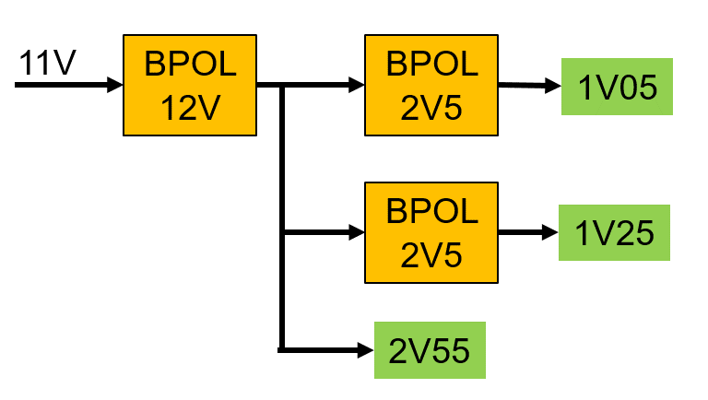
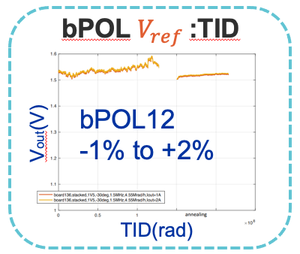
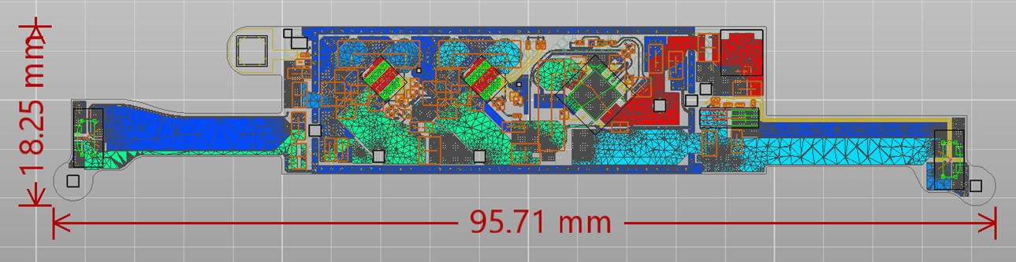

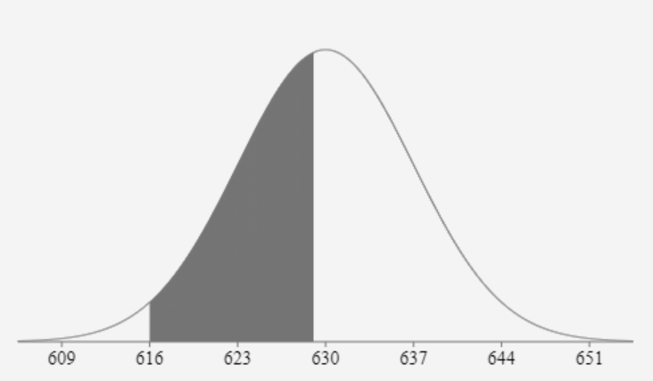
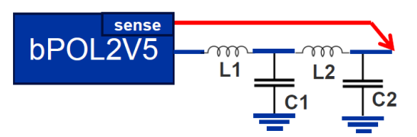
BPOL12 Tuning
bPOL
12V
bPOL
2V5
1V05
Front-End ASICs
lpGBT
bPOL
2V5
1V25
IR Drops
2V55
2V55
VTRX+
TID variability
Tight supply voltage range required for ASICs and lpGBT.
  Limited by tolerances on bandgap voltage and resistors.
  For all temperatures, radiation, voltage drops within hybrids and all operation margins.
  2.5V is the minimum voltage for VTRx+ and maximal voltage for BPOL2V5: colliding requirements
Implementation of accurate voltage setting on the 2.55V rail.
  Binning of the BPOL12 in two groups for 2S and PS variants, on basis of their bandgap voltages.
  Use of 0.1% tolerance resistors for accurate output voltage setting.
  Voltage dispersion reduced and measured to 175 mV ± 20 mV in a range from 2.38V min. to 2.67V max..
Remote sensing on PS hybrids.
  To compensate voltage drops on PS-POH hybrids.
PS Range
2S Range
BPOL12 Binning
Remote sensing for PS

Slide 11
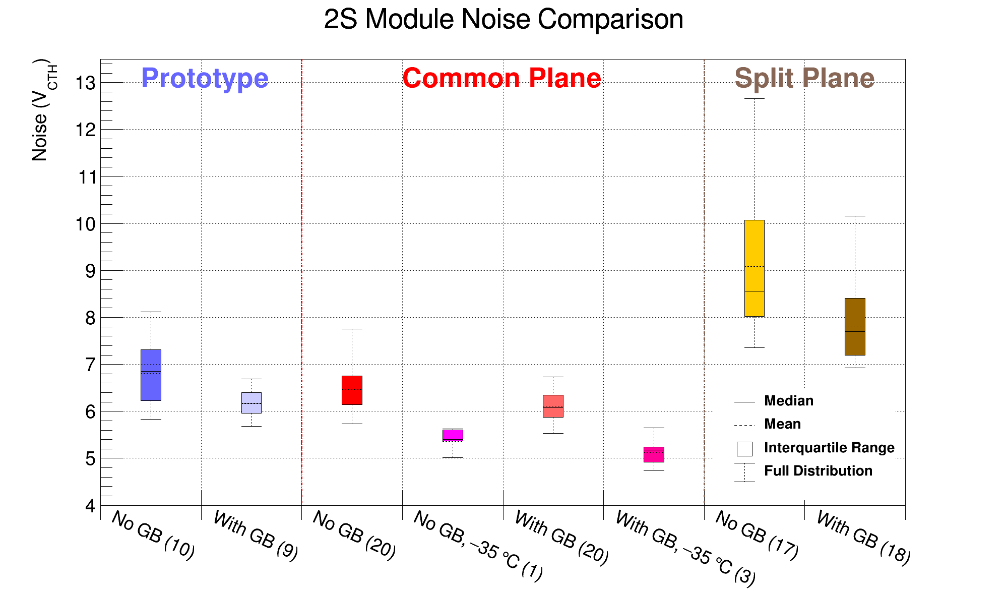
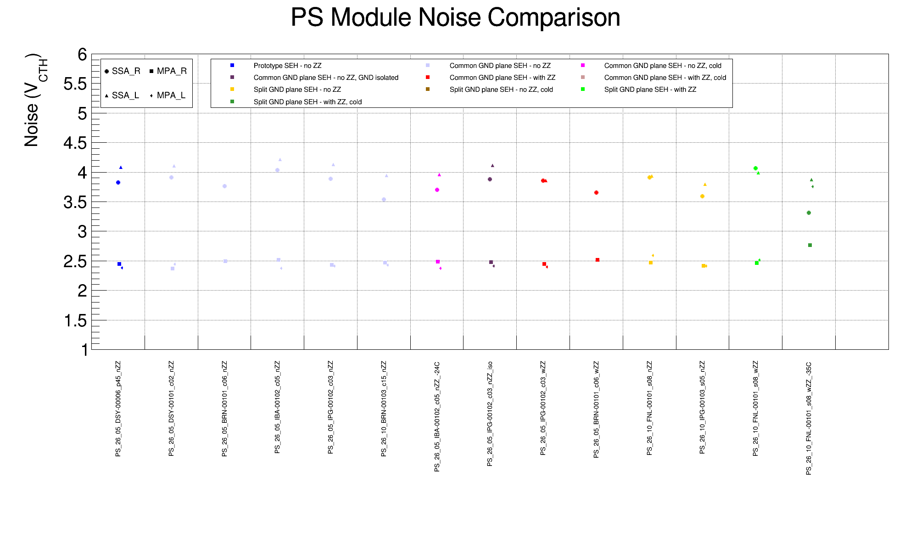
Grounding on PS-POH and 2S-SEH
Two grounding configurations tested on Kickoff.
  Unique ground plane for switching nodes and DC output nodes.
  Split planes (switching versus DC) interconnected at one location.
2S: lower noise with common plane.
  Common plane design adopted for pre-series and series.
  A ground balancer that interconnects the grounds on left and right sides of the 2S module, helps reducing the noise.
  PS: no major difference.
    Common plane design adopted for pre-series and series.
GB: Ground Balancer
Strips
Common plane
Pixels
Split-plane

Slide 12
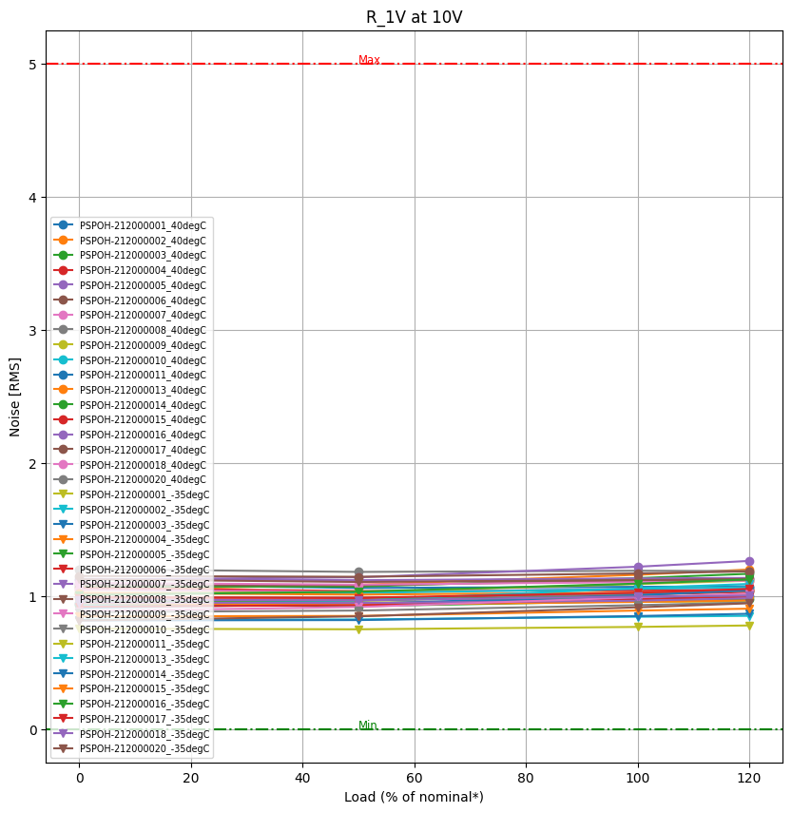
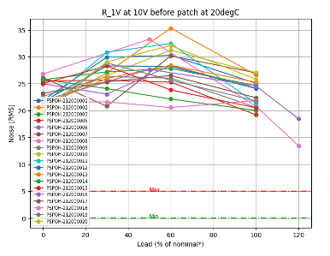
PS-POH: oscillations
Excess of ripple observed on BPOL2V5 outputs on Kickoff PS-POH hybrids.
  Increased noise at cold operation.
  Concern for long term operation.
  PS-POH implements remote sensing on BPOL2V5 after its output filter to reduce voltage drops.
    This scheme turned out to induce oscillations in the BPOL2V5 regulation loop.
  Correction: increase filter capacitors (C1, C2) and short the filter coil (L2).
    Ripple reduced to 1 mVpp (instead of 30 mVpp).
    Noise performance at cold for macro-pixels fully recovered.
    Correction applied for pre-series and series.
30 mV pp before correction
Target: 5 mVpp
≈ 1 mVpp after correction
Target: 5 mVpp
Ripple at cold on Kickoff PS-POH

Slide 13
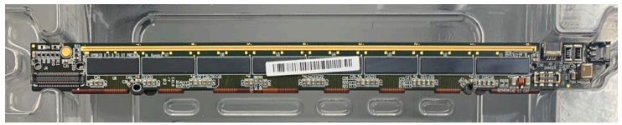
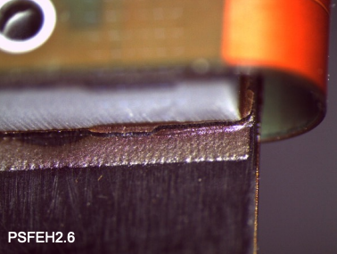
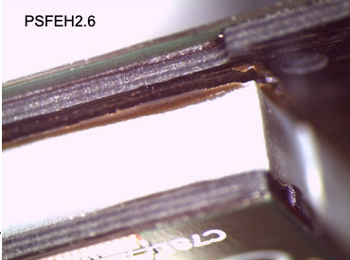
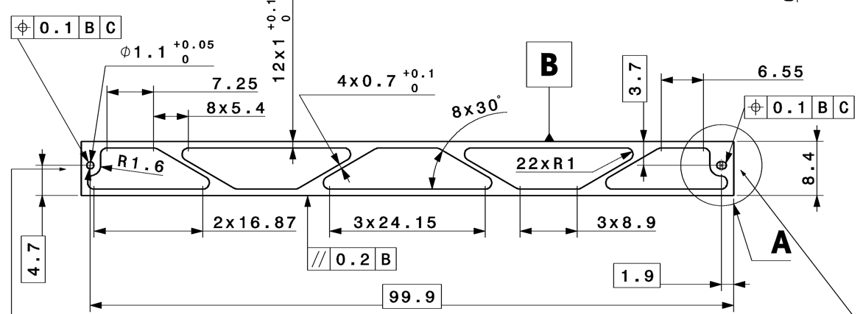
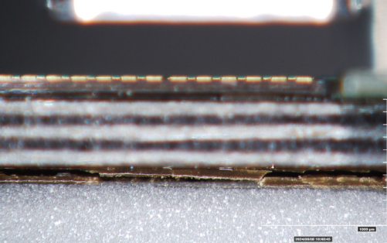
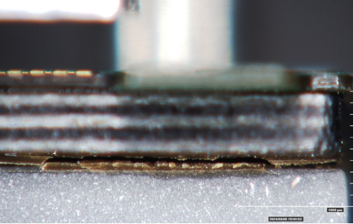
Gluing delaminations on PSFEH
Glue cracks on the fold-over gluing joints of pre-series PSFEH26 and PSFEH40 variants.
  Adhesive cracks between carbon fiber stiffener and AlN spacer.
  Carbon fiber sometimes peeled away.
  Risk of crack propagation.
  Bond array not supported anymore.
Issue under investigation for the continuation of series:
  Temperature profile of the reflow process.
  Thickness and curing profile for the adhesive.
  Choice of adhesive material.
  Adhesive coverage on AlN spacer area.
  Spacer geometry.
Crack
Crack
Crack
PSFEH40
PSFEH40

Slide 14
Pre-series acceptance
Visual control and functional test at contractor facilities and then at CERN.
  Refer to dedicated presentation from Patryk Szydlik on this topic.
  “Insights gained from test system preparation for the hybrids production for the CMS Outer Tracker Phase-2 Upgrade”.
Only hybrids that passed the visual control are functionally tested.
Rejects: contamination, delamination or assembly issues on 2SFEH40 and PSFEH, caused a significant reduction of deliverables.
Visual control yield: 89%.
Functional testing yield: 96.

Slide 15
Conclusion
The kickoff and pre-series batches for outer tracker hybrids were completed by summer 2024 on a duration of 18 months.
The Kickoff batch on reduced set of hybrids helped resolving several issues, to achieve stable designs for pre-series:
  Better specification of cleanliness requirements.
  PSFEH change to five layers to prevent soldermask to coverlay delamination.
  PSROH replacement of soldermask with coverlay to prevent cracks in fold area.
  Improved supply voltage accuracy through BPOL12 binning and tight tolerance setpoint resistors.
  Selection of optimal grounding schemes on 2SSEH and PSPOH to achieve the target noise performance on modules.
  Elimination of BPOL2V5 oscillations.
The pre-series batch was validated with all these changes, but new issues were identified that are now being resolved:
  Need for improvements on cleanliness, and visual control is very time consuming.
  Delamination on PSFEH gluing joints imposing design and fabrication process reviews.
The series production is now started.
  Bare hybrids in production and assembly ongoing for 2S hybrids.

Slide 16
Backup slides

Slide 17
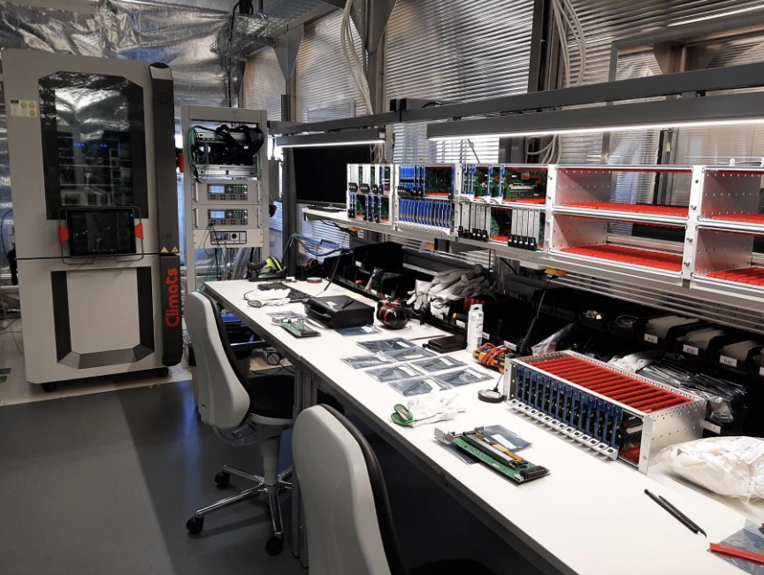
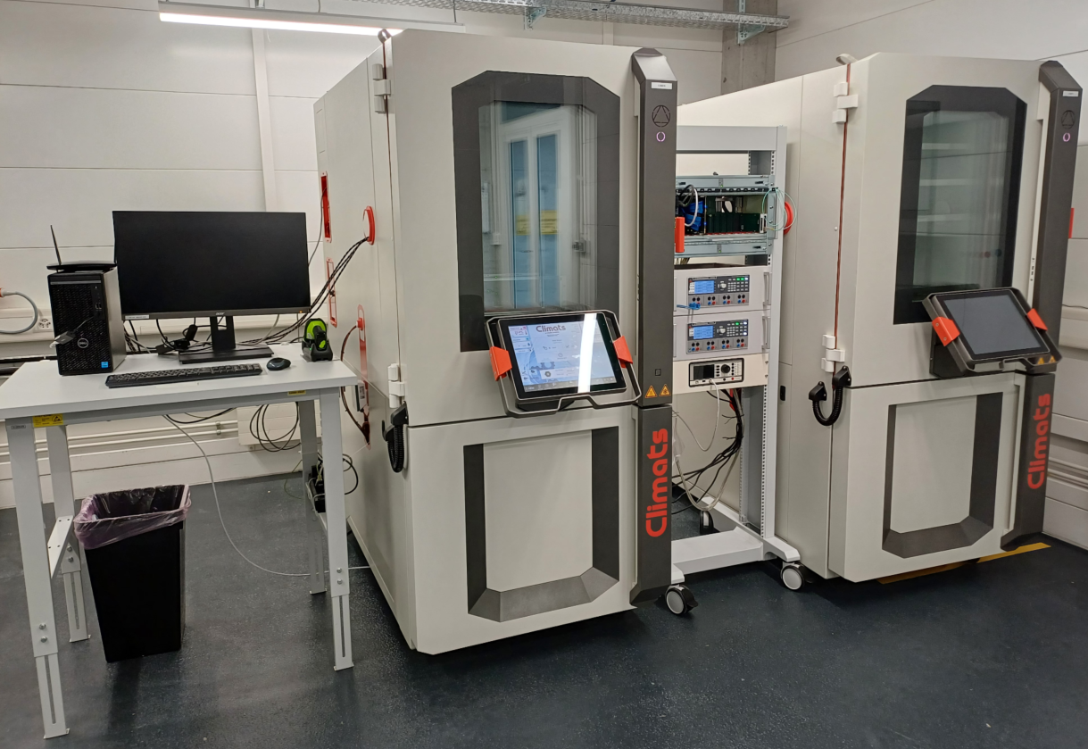
Test system
Hybrids are tested 100% at contractor facilities, and as much as possible at CERN.
  The test system uses multiplexed test cards and is a major project on its own.
  Tests performed warm (+40 ºC) and cold (-35 ºC) in a climatic chamber.
  Results archived in production database.
  Only good hybrids are delivered to CERN.
  Refer to dedicated presentation from Patryk Szydlik on this topic.
  “Insights gained from test system preparation for the hybrids production for the CMS Outer Tracker Phase-2 Upgrade”.
The test system was commissioned at contractor facilities.
  Pre-series hybrids could be tested at contractor facilities and at CERN.
  Hardware and software issues were identified and were or are still being resolved.
    Hardware issues: connectivity problems, optical links stability.
    Software issues: DAQ procedures, uncertain results, repeatability of tests.
Sustained support from CERN to the contractor is required.
  Improvements and optimization of test procedures (all ongoing).
  On-site resolution of issue discovered while using the test system.
  The test system reached readiness for volume testing.
CERN
Contractor

Slide 18
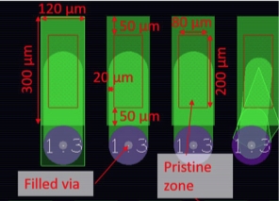
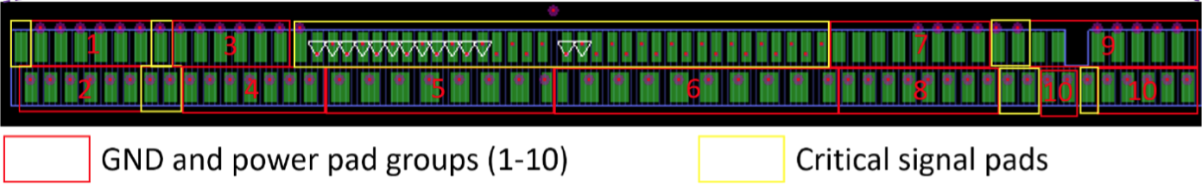
Cleanliness requirement
Definitions and acceptance criteria.
  Definition of a pristine zone in the center of the bond pads.
    Categorization of the cleanliness levels: clean, light, medium or heavy.
    Categorization of pads cleanliness: acceptable, conditionally acceptable, rejected.
  Accept up to 10 refused bond pads on 2SFEH and PSFEH strip sensor bondpad arrays.
  Accept up to 1 refused pad on each power group (redundant pads), 10 per hybrid in total.
  No refused pads on digital signals.
  Do not exceed a combination of up to 30 conditionally accepted pads and refused pads as defined above.
These requirement were used by the assembly contractor for pre-series.
  Time consuming inspections at their location but also at CERN.
  Additional cleaning was sometimes still required at CERN.
  Yield reached 91% for 2SFEH (including cleaning at CERN).
  Good yield also on PSFEH, but still impacted from other problems.

Slide 19
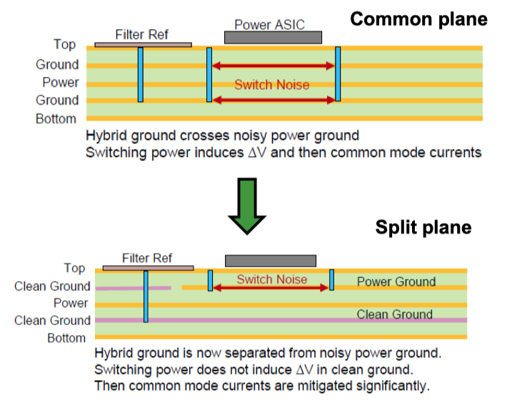
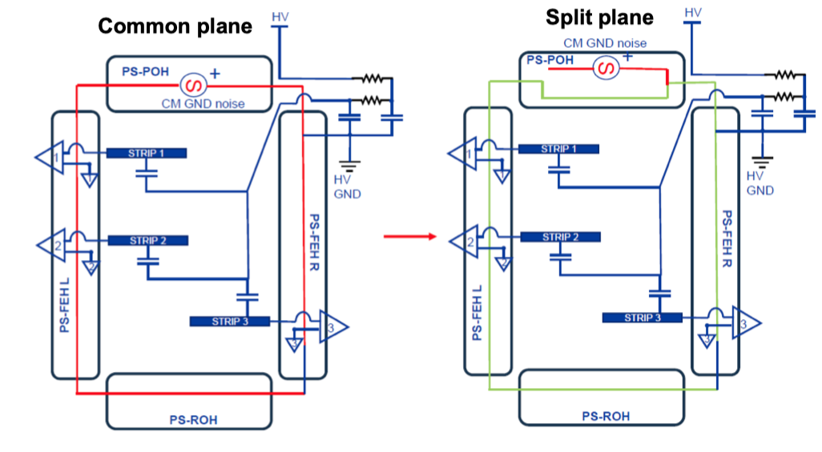
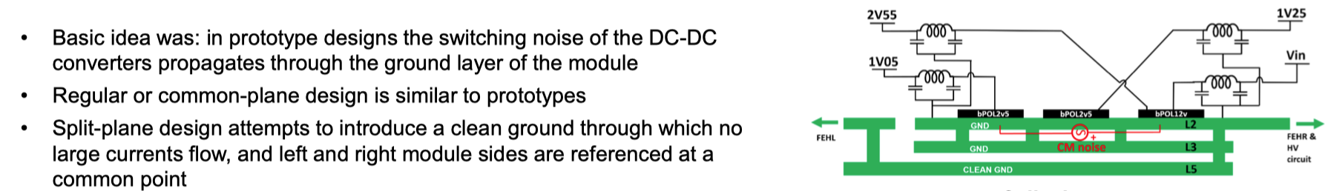
Two grounding schemes for 2SSEH and PSPOH
Split Plane

