Slide 1

Versatile Link Plus Status Report
WP5 – Passive Components
Jorge Rodriguez Fernandez
02 October 2024
CERN EN-EL-FO

Slide 2
Summary
Introducing WP5
Contract readiness.
Update from the subdetectors.
Subdetector planning update.
QC.
Modification Requests.
02/10/2024

Slide 3
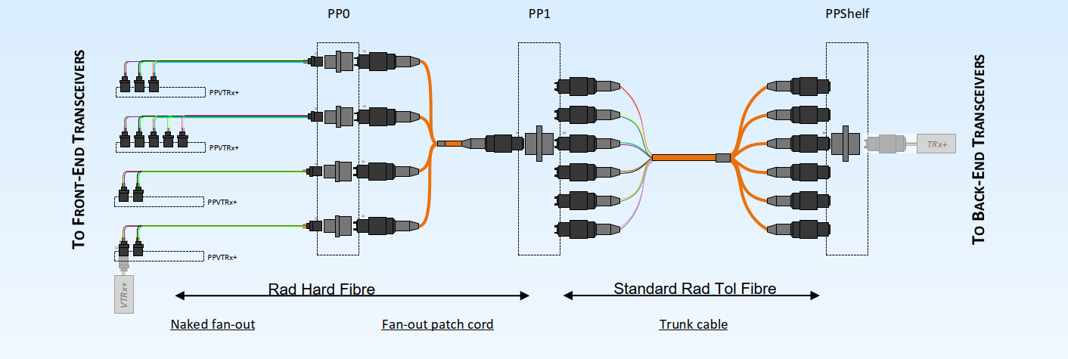
Introducing WP5
Defining a cabling plant optimized to meet the specific requirements of the CMS and ATLAS subdetectors
Versatile Link Plus project requires the development of a radiation resistant data link:
  Up to 10 Gb/s data rate upstream and 2.5 Gb/s downstream over ~100m
  Based on Multi-Mode Fibres (MMF) operating with a centre wavelength of 850 nm
  Concatenation of different types of fibres suited for different radiation levels
Harsh environment
  Temperature down to -35C
  Magnetic field up to 4T
  Radiation dose up to 1 MGy
Standard industrial environment

Slide 4
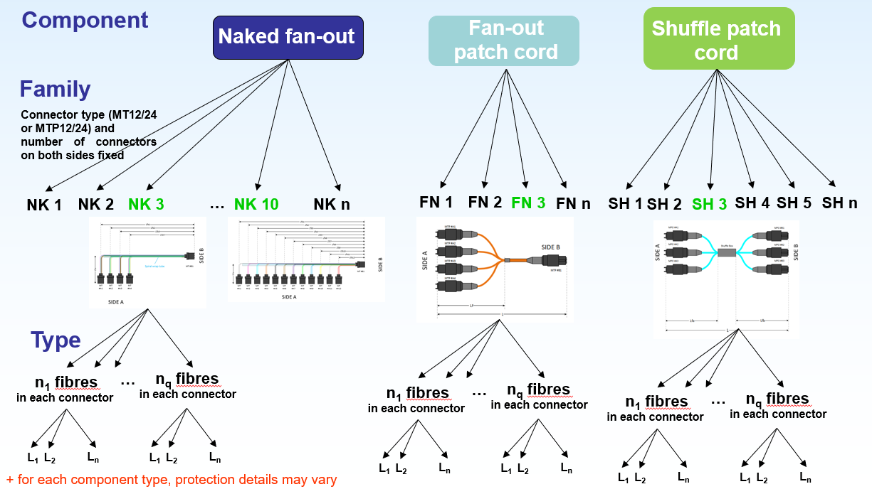
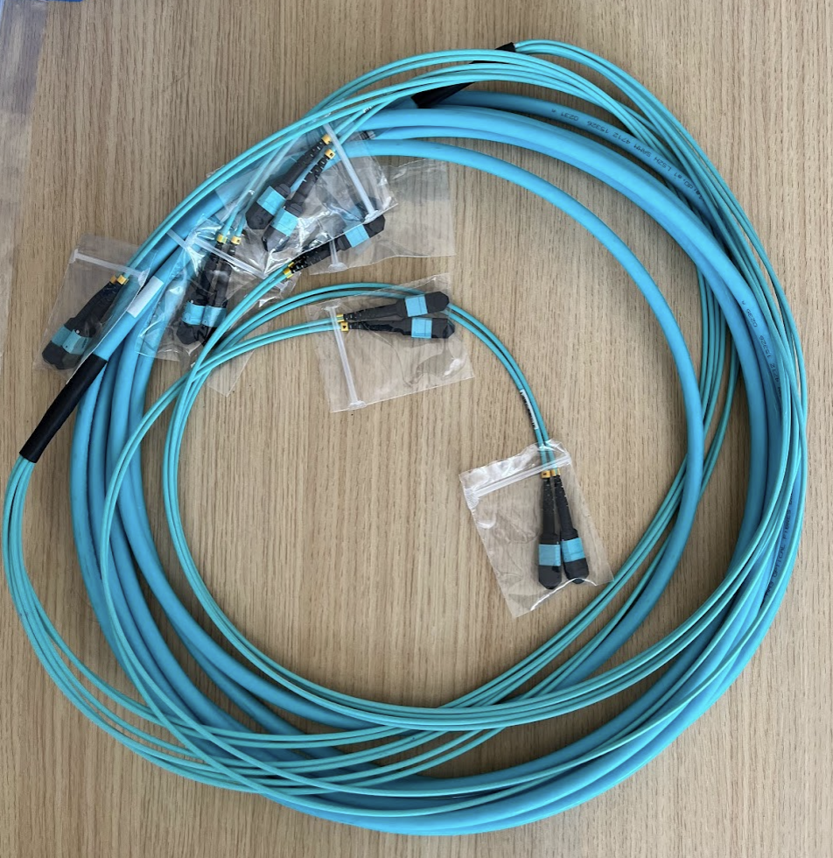
Procurement Strategy
Patch Cords supplied through Dedicated contract awarded in Sept 2022
  Flexible catalogue to take into account the diverse and specific needs of each subdetectors... still trying to be as standard as possible.
  Competitive prices
  US Conec connectors, convention & radiation resistant fibres
Trunk cables supplied through the CERN frame contracts
  US Conec connectors, convention fibres

Slide 5
Readiness
Dec 23
Mar 24
Oct 24
Q4 deliverables:
  Pre-series validation completed
  Start series production
Q1 deliverables:
  Series production follow up
  Request subdetectors planning
Q3 deliverables:
  Series production follow up
  Analyse subdetector replies
First CERN final series orders have been placed to OPTEC:
  10 orders for final series placed.
Final series production request arriving slowly, request for information sent to the subdetectors:
  Date of readiness for ordering series production.
  Latest delivery dates of material to be delivered.
02/10/2024

Slide 6
Update from the subdetectors
Almost every subdetector completed pre-series:
*Subdetectors out of the VL+ project procurement.
CMS GEM requested procurement of new fibre optical components for detector upgrade:
  Requested radiation resistant OM3 and OM4 trunk cables and pcord.
  Analysis in progress to see if this request can be added to the VL+ project
02/10/2024

Slide 7
Subdetector planning update
Most subdetectors filled the excel file and specify their expected planning:
Thank you for the effort and the time invested.
 |  |  |  |  |  |  |  |  |  | 1st batch |  |  | Expected orders
 |  |  |  |  |  |  |  |  |  | Series |  |  | Latest delivery
Subdetector | Qty total |  | 2023 |  |  |  |  |  |  |  |  |  |  |  | 2024 |  |  |  |  |  |  |  |  |  |  |  | 2025 |  |  |  |  |  |  |  |  |  |  |  | 2026 |  |  |  |  |  |  |  |  |  |  |  | 2027
 |  | Qty ordered | Q1 |  |  | Q2 |  |  | Q3 |  |  | Q4 |  |  | Q1 |  |  | Q2 |  |  | Q3 |  |  | Q4 |  |  | Q1 |  |  | Q2 |  |  | Q3 |  |  | Q4 |  |  | Q1 |  |  | Q2 |  |  | Q3 |  |  | Q4 |  |  | Q1
 |  |  | Jan-23 | Feb-23 | Mar-23 | Apr-23 | May-23 | Jun-23 | Jul-23 | Aug-23 | Sep-23 | Oct-23 | Nov-23 | Dec-23 | Jan-24 | Feb-24 | Mar-24 | Apr-24 | May-24 | Jun-24 | Jul-24 | Aug-24 | Sep-24 | Oct-24 | Nov-24 | Dec-24 | Jan-25 | Feb-25 | Mar-25 | Apr-25 | May-25 | Jun-25 | Jul-25 | Aug-25 | Sep-25 | Oct-25 | Nov-25 | Dec-25 | Jan-26 | Feb-26 | Mar-26 | Apr-26 | May-26 | Jun-26 | Jul-26 | Aug-26 | Sep-26 | Oct-26 | Nov-26 | Dec-26 | Jan-27 | Feb-27 | Mar-27
ATLAS HGTD
ATLAS ITK Pixel | 430 | 198 |  |  |  |  |  |  |  |  |  |  |  |  |  | PARTIAL
ATLAS ITK Strip (Barrel) | 168 | 14 |  |  |  |  |  |  |  |  |  |  |  | PARTIAL |  |  |  |  |  |  |  | Partial |  |  |  |  |  |  |  |  | Partial
ATLAS ITK Strip (End Caps) | 80 | 66 |  |  |  |  |  |  |  |  |  |  |  | PARTIAL |  |  |  |  |  |  |  | Partial |  |  |  |  |  |  |  |  | Partial
ATLAS Lar | 838
ATLAS Muon
ATLAS TDAQ
CMS ETL | 345
CMS BTL | 191 | 80 |  |  |  |  |  |  |  |  |  |  |  |  |  |  |  |  |  | Partial
CMS ECAL | 387 | 3 |  |  |  |  |  |  |  |  |  |  |  |  |  |  |  |  |  |  |  |  |  | Partial |  |  |  |  |  |  |  |  |  |  | Partial |  |  | Partial
CMS HGCAL | 2640
CMS IT Pixel | 433 |  |  |  |  |  |  |  |  |  |  |  |  |  |  |  |  |  |  | Partial |  |  | Partial
CMS Muons
CMS OT Barrel (TB2S) | 789
CMS OT Barrel (TBPS flat) | 211
CMS OT Barrel (TBPS tilted) | 368
CMS OT TEDD | 3146 | 294 |  |  |  |  |  |  |  |  |  |  |  | PARTIAL |  |  |  |  | Partial |  |  |  |  |  |  |  | Partial |  |  |  |  |  |  |  |  |  |  |  |  |  |  |  |  |  | Partial |  |  |  |  | Partial
Total: | 10026 | 655
Delivery times sometimes quite close to expected procurement → Under analysis.
Information still missing from:
  ATLAS ITK PIXEL
  ATLAS LAR
  CMS BTL
  CMS HGCAL
  CMS OT BAREL
02/10/2024

Slide 8
QC
Courtesy of
R. Carnesecchi
QC performed on 27 orders:
118 hours of QC testing for 170 samples:
  Important to understand when the order will be place to guarantee QC can be performed within provided deadline.
  QC results meeting our expectations and requirements.
10% min. sample rate optically tested.
02/10/2024

Slide 9
Modifications request.
Received modifications requests:
    Supply of different coloured fibre cables → REJECTED.
    Supply of ribonized cables → REJECTED.
    Length modification → APPROVED UNDER CONDITIONS.
    Connector modification → APPROVED UNDER CONDITIONS.
Small modifications are allowed (length, connector type,…) but only as long as it is included in the frame of the contract.
Every modification requires update of the component datasheet
    Bigger number of components:
      Increases chances of productions mistakes.
      Longer delivery time.
      Longer QC time.
02/10/2024

Slide 10
Conclusions
Prototype phase is complete, ready for series production.
  Orders are slowly arriving and are under analysis.
Still missing vision on the series production of some subdetectors:
  ATLAS ITK PIXEL
  ATLAS LAR
  CMS BTL
  CMS HGCAL
  CMS OT BAREL
  Required to prepare a well-organised plan and allocate resources appropriately.
  Necessary to understand what are the showstoppers in order to find possible solutions.
Good quality of the components highlighted by the QC performed at CERN.
Too many length and connector modifications received, subdetector should start to freeze the designs.
02/10/2024

