Slide 1
Optimizing ESD Protection for Thin-Oxide Transistors in the Latest Semiconductor Processes
TWEPP – October 2024
Wouter Faelens, Sofics

Slide 2
Introduction
  Electrostatic Discharge
  Impact for IC industry
Advanced CMOS / FinFET nodes
Local clamp approach
Conclusions

Slide 3
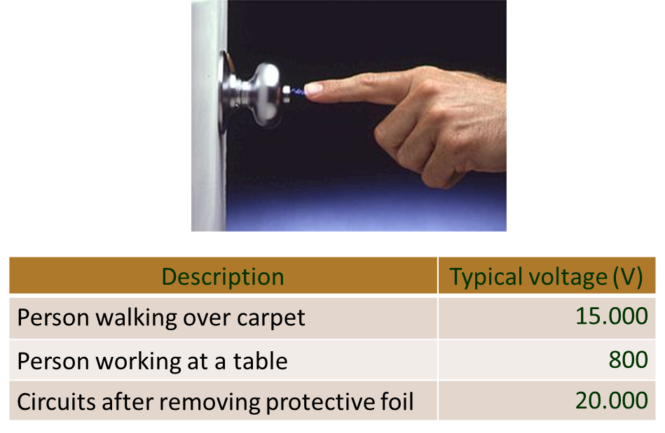
What is ElectroStatic Discharge (ESD)
What is Electrostatic Discharge (‘ESD’)?
  The sudden discharge of a charged body
    Short time (<1us)
    Short rise time (<10ns)
    High current levels (1-10A)
      and beyond...
  Tribo-electric and induced charging
Damages caused by
  Charged human
  Charged machinery/robotic
  Charged IC’s

Slide 4
Solution: on-chip ESD protection
On-chip ESD protection
  ESD clamp/diode devices at IO interfaces, power pads
  Different concepts are used in the industry
V_{DD}
Core
IN
OUT
V_{SS}

Slide 5
Solution: Design window
Requirements for ESD protection switches
  Protecting during ESD
    Effective clamping voltage to safe value
    V_{max} defined by sensitive element:
      Core
      GOX
      MOS devices
  Minimal impact on circuit performance
    Leakage
    Capacitance
Current
ESD
Spec.
V_{DD}
+ 10%
+ 50%
-10%
Vmax
Normal
operation
Circuit
Damage
Voltage

Slide 6
Introduction
Advanced CMOS / FinFET nodes
  Sensitive circuits
  Design complexity
  Cost
  CDM
  Traditional ESD approach no longer effective
Local clamp approach
Conclusions

Slide 7
Challenges for on-chip ESD protection for advanced nodes
Many challenges for advanced CMOS and FinFET designs
  Advanced circuits fail easily under ESD stress – smaller ESD design window
  Traditional ESD solutions are no longer effective
  Increased design complexity
  Cost of failure is very high
  CDM challenge for large size SoC’s
  ESD complexity rising with many different IP sources

Slide 8
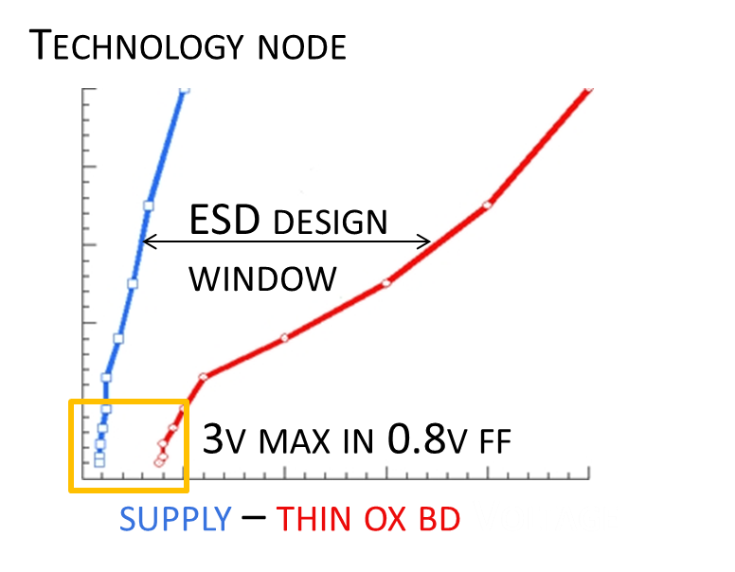
ESD Design Margin evaporates for advanced CMOS
Drastic reduction in failure voltage
  Transient breakdown of gate oxides
  Burn-out of output drivers
  Core failure voltage
16nm FinFET – core transistor
  Vmax 25% lower compared to 28nm
  Vmax 33% lower compared to 90nm
7nm FinFET – core transistor
  Vmax 35% lower compared to 28nm
  Vmax 57% lower compared to 90nm

Slide 9
Introduction
Advanced CMOS / FinFET nodes
  Sensitive circuits
  Design complexity
  Cost
  CDM
  Traditional ESD approach no longer effective
Local clamp approach
Conclusions

Slide 10
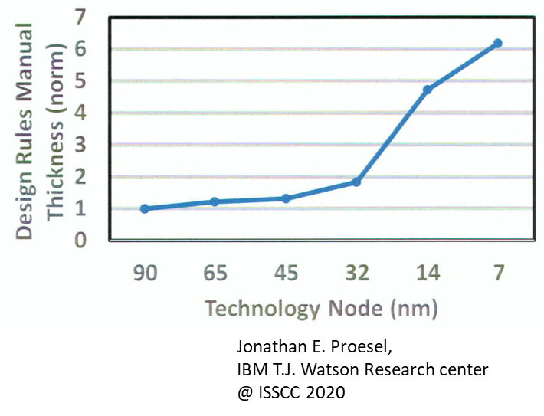
Increased design complexity
FinFET design complexity
  Number of design rules increased drastically
  Complexity of the rules increased
  Mentor Graphics:
    “Required processing power for verification
    doubled compared to 28nm”
  Design time increased a lot
  Sofics experience
Design time | 28nm | 16nm
Optimized ESD | 1 day | 2 weeks

Slide 11
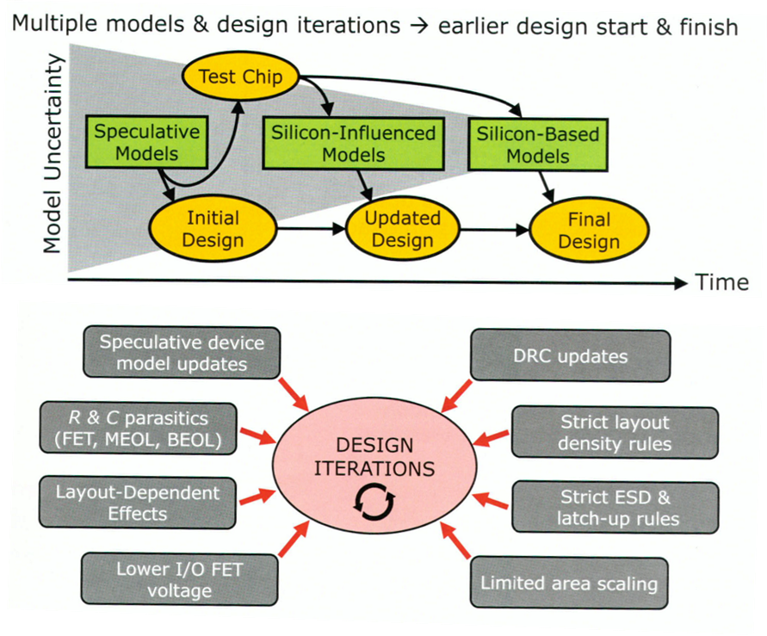
Increased design complexity
TSMC @ ISSCC 2020
  Uncertainty at design stage
    “Process at tape out ever more immature in each new node”
    “Design concurrently developed with technology to shorten time to market”
  Pre/post layout simulation gaps
    “Accept more iterations in each new node”
  More restrictive layout
    “1000s of DRCs, many very tough to pass, always getting more restrictive”
    Density checks

Slide 12
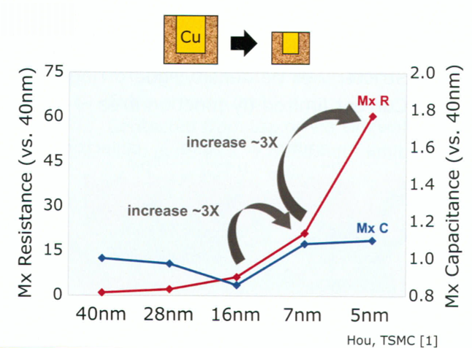
Increased design complexity - metallization
RC parasitics of interconnects
  2 groups of metallization
    Local Metals get thinner: R increases!
    Top metal thickness remains
  TSMC @ ISSCC 2020
    “Resistance is arguably
    THE defining agony of FinFET era design”
    “Capacitance-only post-layout
    simulation virtually useless”

Slide 13
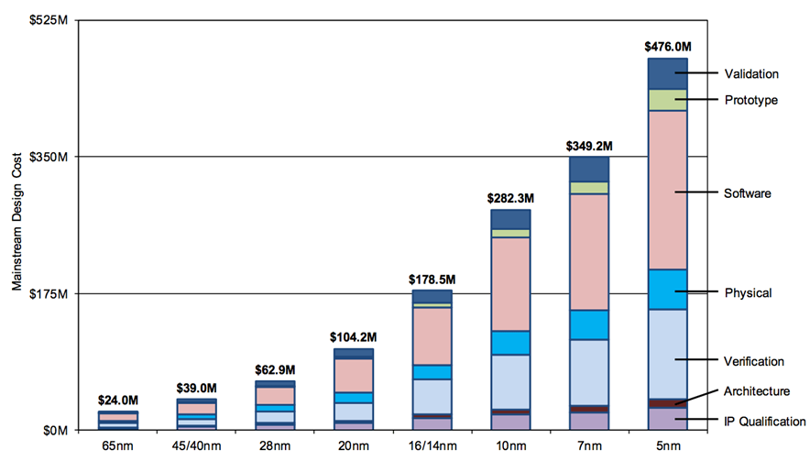
Cost of failure
IC design is expensive
  Mask cost rising quickly
    ‘first time right...’ requirement
    Multiple million $ to resolve the problem (new full mask set).

Slide 14
Introduction
Advanced CMOS / FinFET nodes
  Sensitive circuits
  Design complexity
  Cost
  CDM
  Traditional ESD approach no longer effective
Local clamp approach
Conclusions

Slide 15
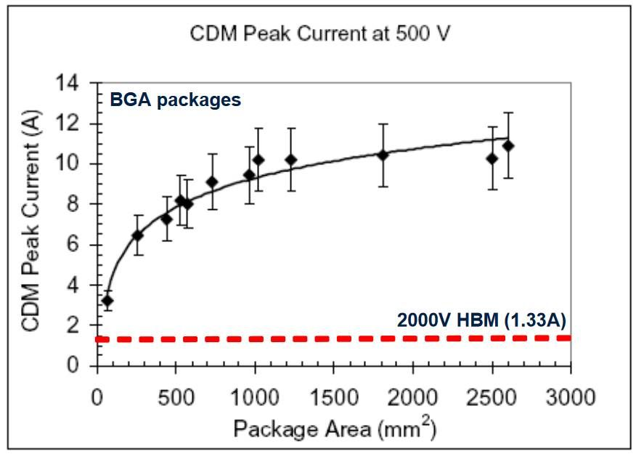
FinFET SoC’s are frequently large, complex chips
CDM challenge
  CDM peak current depends on chip/package size
  Large chip means higher peak current during CDM stress
Example:
  ESD solution proven for 4 A peak current
  Integrated in small (100mm²) chip:
    pass 500V CDM
  Same ESD/IO integrated in large chip:
    Fail 500V CDM
    Pass 250V CDM

Slide 16
Introduction
Advanced CMOS / FinFET nodes
  Sensitive circuits
  Design complexity
  Cost
  CDM
  Traditional ESD approach no longer effective
Local clamp approach
Conclusions

Slide 17
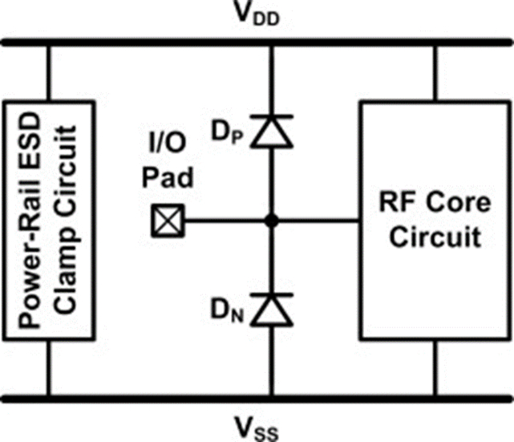
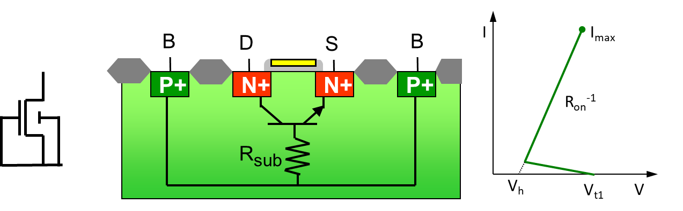
Traditional I/O ESD solutions
ggNMOS or self-protective driver
  Perfect solution in mature CMOS
  Integrated in drivers
  Diodes integrated
Diode based I/O protection
  Simple concept
  Good characteristics (leak, cap)
  Small area

Slide 18
But: ggNMOS clamp cannot protect thin oxide below 65nm
Technology scaling obsoletes traditional protection approaches
V_{dd}
+
IN
V_{ss}

Slide 19
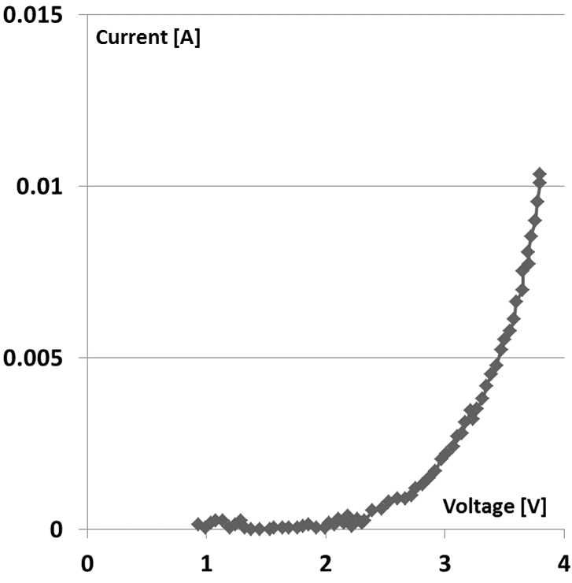
Traditional ggNMOS solution not functional
16nm Core (0.8V) NMOS / PMOS
  Does not survive snapback
  Cannot be used as ESD clamp
16nm IO (1.8V) NMOS/PMOS
  Does not survive snapback
  Junction failure at 4.5V
  Cannot be used as ESD clamp
  Cannot be made self-protective

Slide 20
Dual diode solution
Protection using diode up and power clamp
  Voltage drop over diode, bus, Power clamp
  Requirement: Total voltage drop below Vcritical
Current
Vmin
Vmax
ESD
Spec.
V_{dd}
Design
Window
Normal
operation
GOX
damage
+
IN
Vcritical
V_{ss}
Voltage

Slide 21
Dual diode: Influence of bus resistance
IV curves of all elements in the current path
Diode
Resistance of Vdd bus line
Power Clamp
I
I
I
V
V
V
V_{dd}
I
ESD
Spec.
+
IN
GOX
damage
V_{ss}
Vmin
Vmax
V

Slide 22
Dual diode: Influence of bus resistance
IV curves of all elements in the current path
Diode
Resistance of Vdd bus line
Power Clamp
I
I
I
V
V
V
V_{dd}
I
ESD
Spec.
+
IN
GOX
damage
V_{ss}
Vmin
Vmax
V

Slide 23
Dual diode: Influence of bus resistance
IV curves of all elements in the current path
Diode
Resistance of Vdd bus line
Power Clamp
I
I
I
V
V
V
V_{dd}
I
ESD
Spec.
+
IN
GOX
damage
V_{ss}
Vmin
Vmax
V

Slide 24
Dual diode: Influence of bus resistance
IV curves of all elements in the current path
Diode
Resistance of Vdd bus line
Power Clamp
I
I
I
V
V
V
V_{dd}
I
ESD
Spec.
+
Robustness: OK
Effectiveness: NOT OK
IN
GOX
damage
V_{ss}
Vmin
Vmax
V

Slide 25
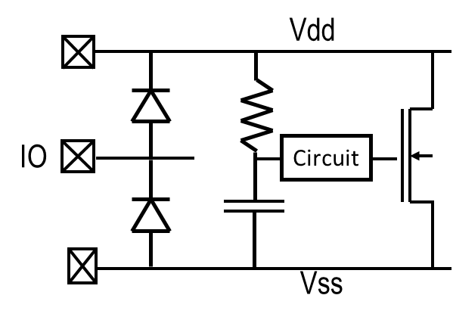
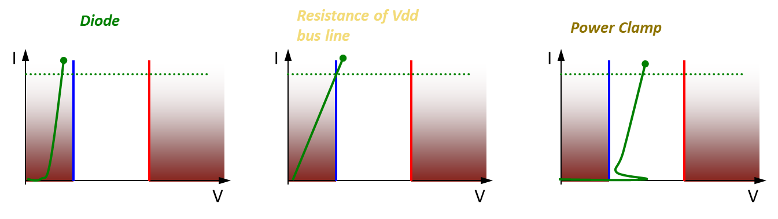
Traditional diode based approach gets worse too
ESD performance of diodes reduced
  35mA/um up to 65nm
  25mA/um in 40nm
  20mA/um in 28nm, 16nm
‘Solution’?
  Diode scaling required
    But capacitive loading increases
  Reduced distance between VDD – IO pads
  Larger power / rail clamps

Slide 26
Challenges for on-chip ESD protection for advanced nodes
Many challenges for advanced CMOS and FinFET designs
  Advanced circuits fail easily under ESD stress – smaller ESD design window
  Traditional ESD solutions are no longer effective
  Increased design complexity
  ESD complexity rising with many different IP sources
  Cost of failure is very high
  CDM challenge for large size SoC’s

Slide 27
Introduction
Advanced CMOS / FinFET nodes
Local clamp approach
  Principle
  Examples from Sofics
    Low leakage, capacitance, ESD levels, …
Conclusions

Slide 28
Local ESD protection at I/O
Full local protection
  Safe local clamping
  Bus resistance is
  NOT critical
  Larger area
  (needed for
  every I/O pin)
  Possibly higher
  capacitance
Semi local protection
  Safe local clamping
  Bus resistance is
  LESS critical
  Open drain circuits
  Larger area
  Higher capacitance
Vdd
IO
IO
Vss

Slide 29
Decade of cooperation CERN – Sofics
I/O libraries for 1.2V, 0.9V
Projects
  2013 – TSMC 65nm ESD
  2015 – TSMC 130nm ESD
  2016 – IBM/GF 130nm ESD
  2020 – TSMC 28nm ESD
  2021 – TSMC 28nm I/O
Focus
  Without thick oxide transistors
  Low leakage ESD protection cells
  Small area
  Over-voltage tolerant option
  Low capacitance local clamp (<200fF, <130fF options)

Slide 30
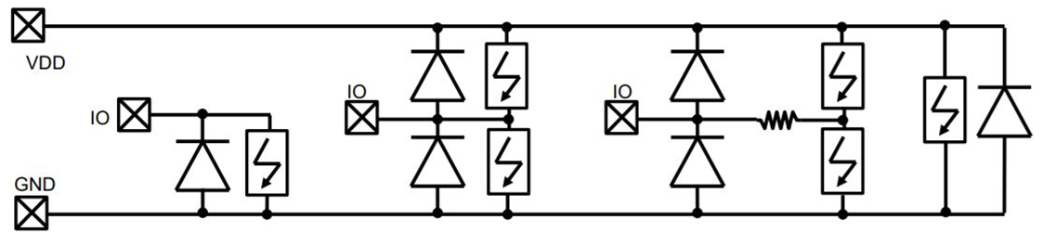
Decade of cooperation CERN – Sofics
Library contents
  1.2V Power/GND
  1.2V Analog I/O versions
    Full local ESD protection
    Integrated CDM secondary protection
    Over-voltage tolerant ESD protection
  Power cut cell
    Separate 1.2V / TSMC GPIO sections

Slide 31
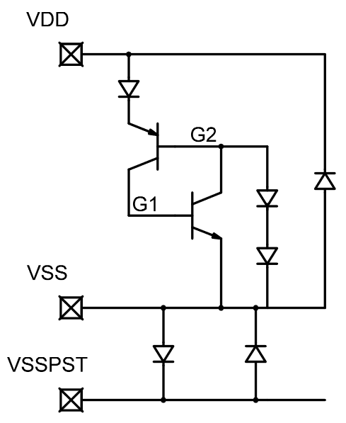
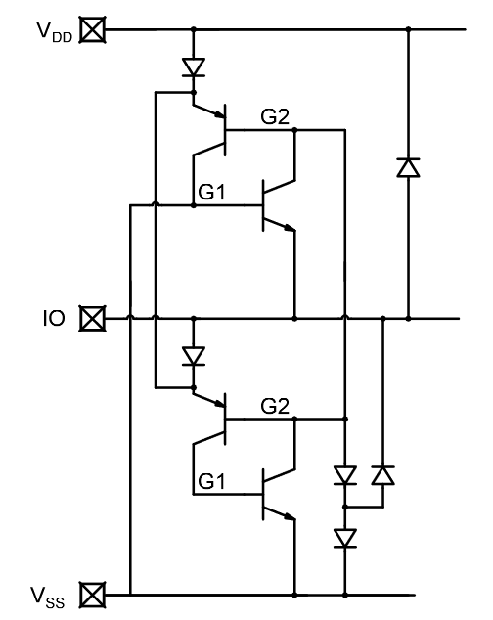
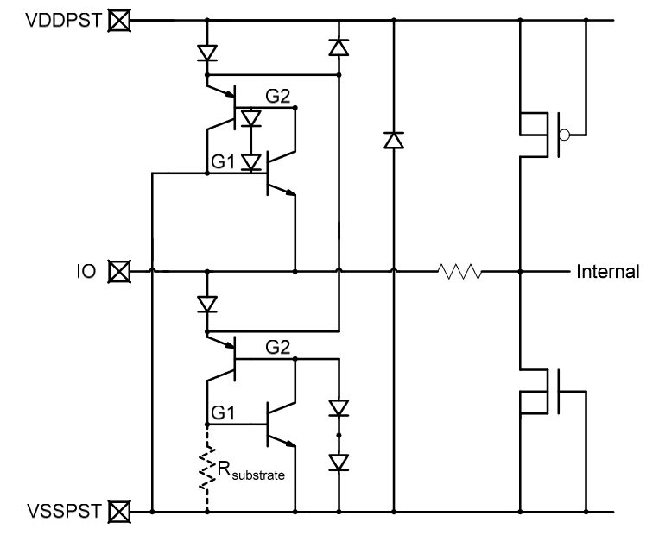
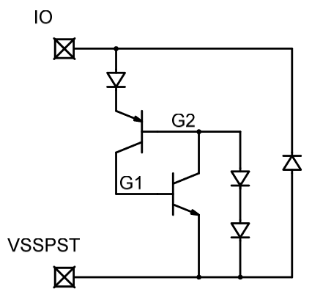
1.2V pads
Power and ground
Overvoltage tolerant IO
Full local I/O protection
Full local I/O protection + CDM

Slide 32
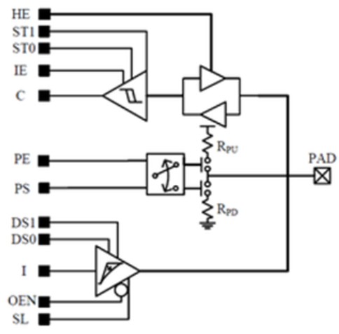
TSMC 28nm 1.2V I/O based on 0.9V thin oxide devices
1.2V GPIO
  Only thin-gate, 0.9V devices.
Supported features
  Programmable drive strength
  Input/output enable
  Pull select, pull enable
  Compatible with TSMC I/O ring
  Integrated 2kV HBM ESD
  Bias circuit shared over I/Os

Slide 33
Local ESD protection: examples
High-speed I/O
  <15fF cap
  TSMC N22
Ultra low leakage
  <20pA
  TSMC N40
Overvoltage tolerant
  1.8V protection without thick oxides
  TSMC N28
High ESD robustness
  8kV HBM (5.33A ESD current)
  Smaller footprint
  TSMC N22

Slide 34
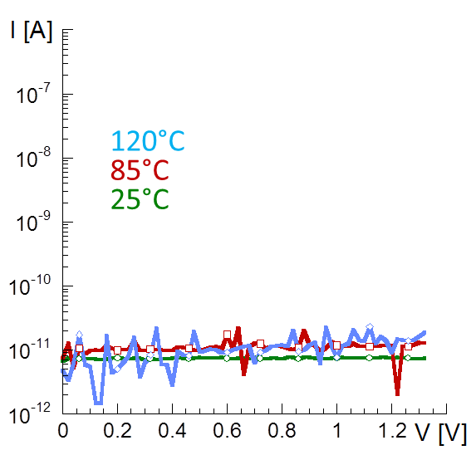
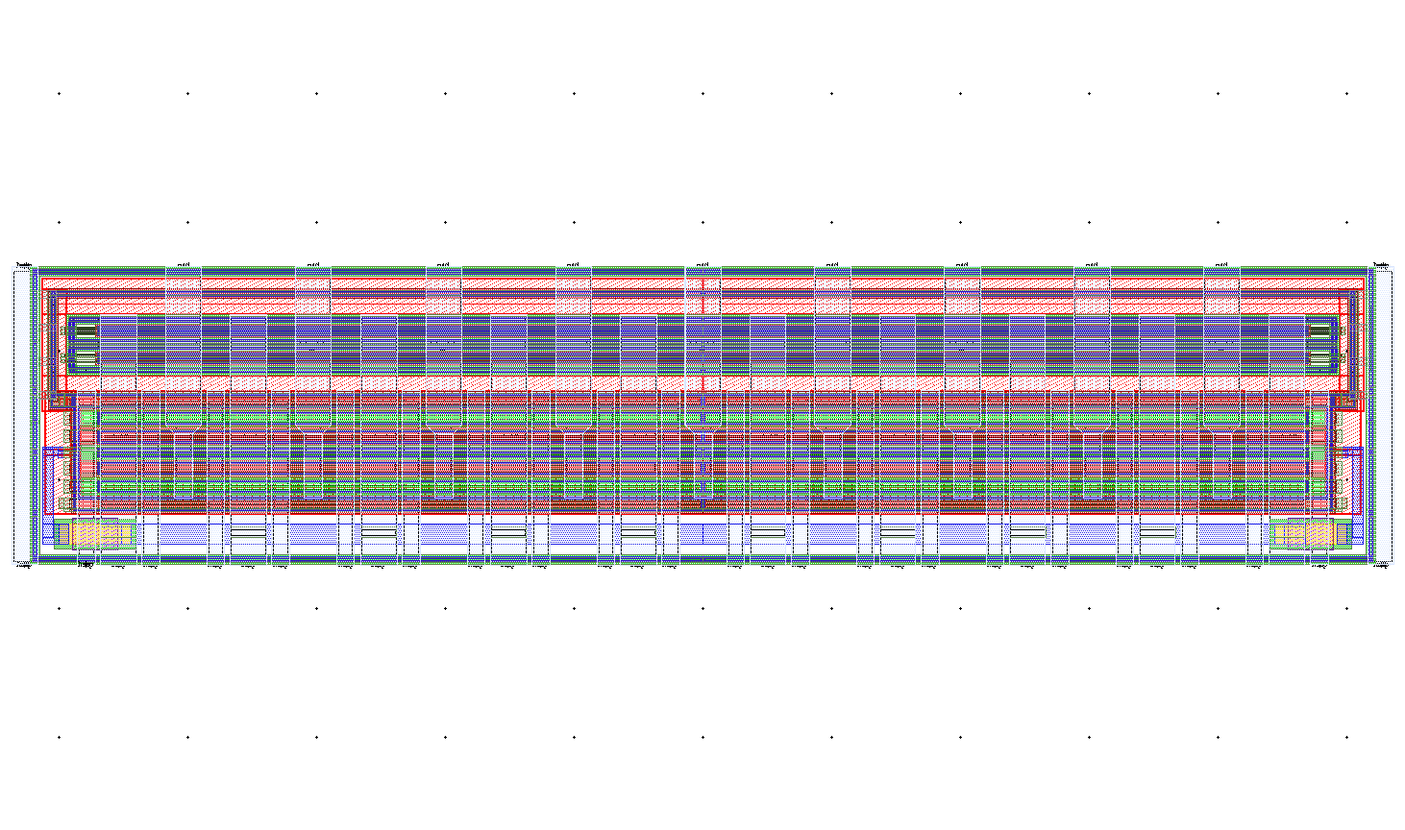
Analog I/O with ultra-low leakage
Bluetooth – TSMC 40nm
  ESD >5kV HBM
  High Q factor, low capacitance
    177fF total capacitance
  Low leakage:
    20pA at 1.2V accross temperature
    Compare: 100nA at RT – conventional
53.66 um
  area: 621 um²
11.59um

Slide 35
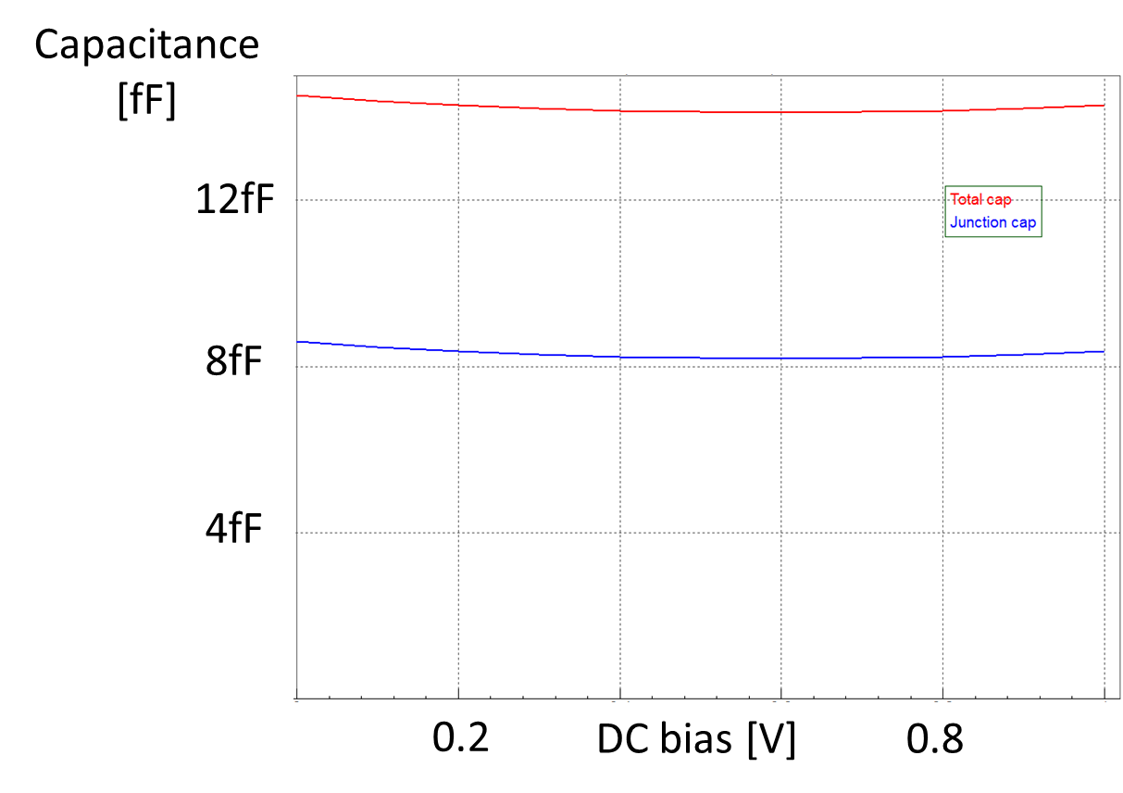
High-speed I/O with ultra-low capacitance
Silicon photonics – 22nm
  Parasitic capacitance
    Junction
    Metal connections
  Across DC bias at input

Slide 36
Low-capacitance interfaces (FinFET case)
Solution for:
  High-speed interfaces
  High frequency interfaces
Typical specs:
  Low RC
    No input resistor
    Low capacitive load
  Protection of core interface
    Narrow ESD design window
+38% ESD level
100%
-30% load
> higher Sofics performance
> lower Sofics cap load

Slide 37
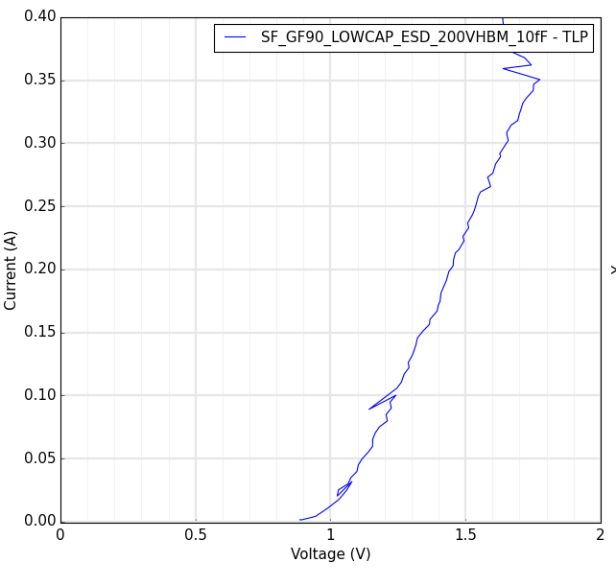
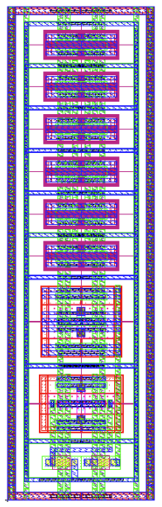
Sofics ESD concept for very high-speed I/O
Full local clamp – 2.5V reference
  SiGe BiCMOS
  Parasitic cap at I/O: ~7fF
  ESD up to 500V HBM
  I/O runs at max 1.0V
  Area: 412 µm²
    11.02um x 37.30um
SOFICS © Proprietary & Confidential
37

Slide 38
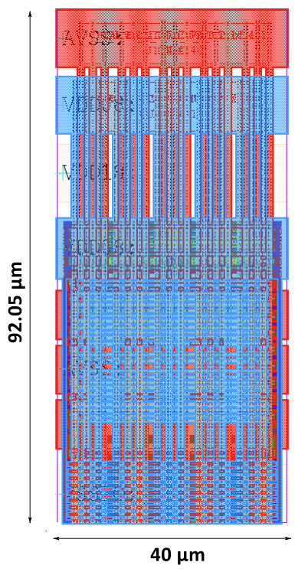
Area efficient – high robustness solutions
TSMC 22nm ULL
  0.8V power clamp
    8kV HBM in 3682 um² area
    Vt1 = 2.5V, Vh = 1.2V, Ron = 0.8 Ohm
  1.8V power clamp
    8kV HBM in 3086 um² area
    Vt1 = 3.8V, Vh = 2.8V, Ron = 0.8 Ohm
  3.3V power clamp
    8kV HBM in 4935 um² area
    Vt1 = 6.6V, Vh = 3.9V, Ron = 0.4 Ohm
    8kV IEC I/O available in 4770 um² area

Slide 39
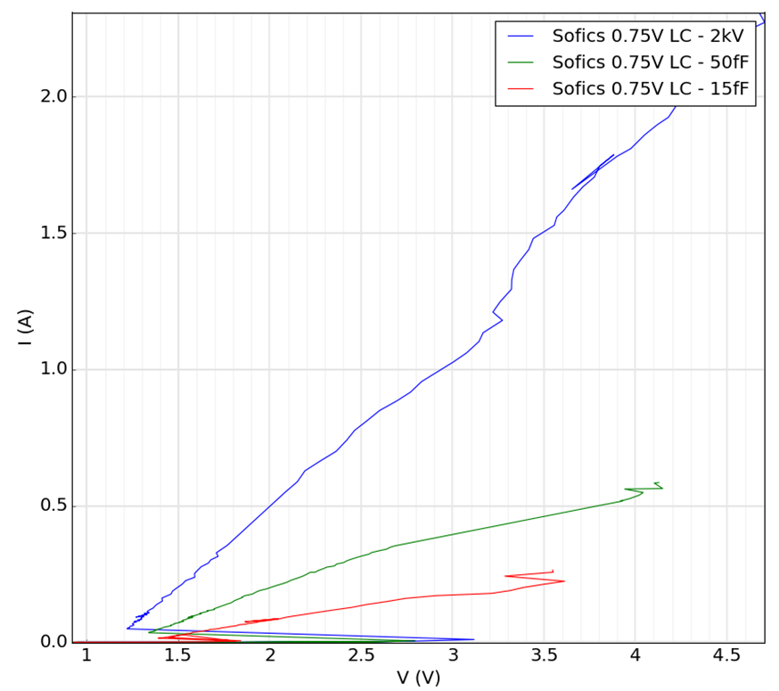
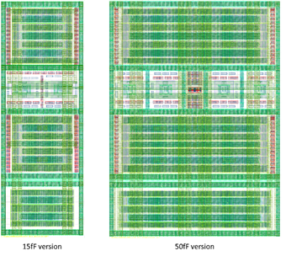
Enabling thin oxide gates in the I/O – 7n FinFET silicon proven
Sensitive “core interfaces”
ESD robustness as needed
  2kV HBM – thin oxide interface
  400/150V HBM – 50/15fF cap
157 um²
729 um²

Slide 40
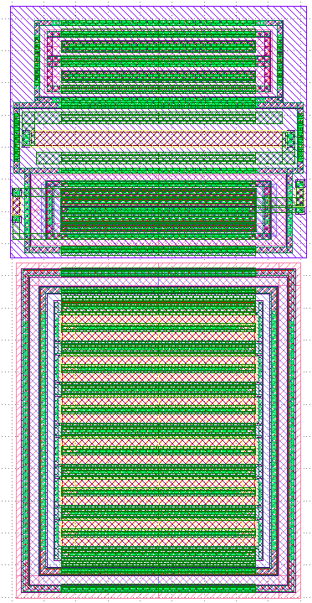
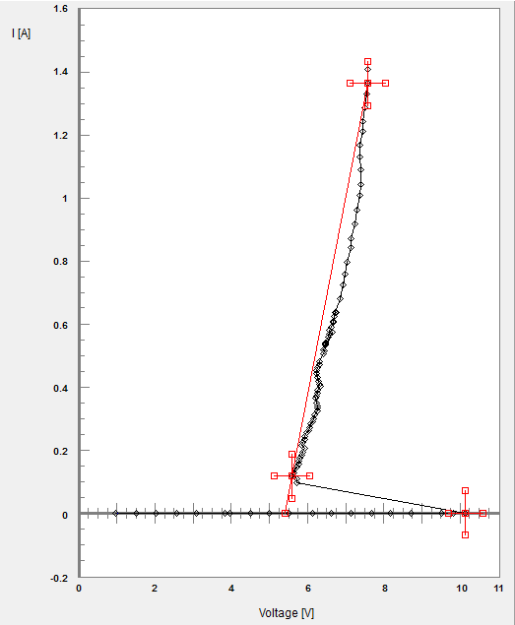
5V tolerant solutions
110nm CMOS
  2kV HBM, 4300um²
    Vh > 5V, Vt1 ~10V
    Leakage: 2pA
  9kV HBM, 6000um²
    Vh = 2V, Vt1 = 6.5V
    Leakage: 115pA
2kV version
SOFICS © Proprietary & Confidential
40

Slide 41
Introduction
Advanced CMOS / FinFET nodes
Local clamp approach
Conclusions

Slide 42
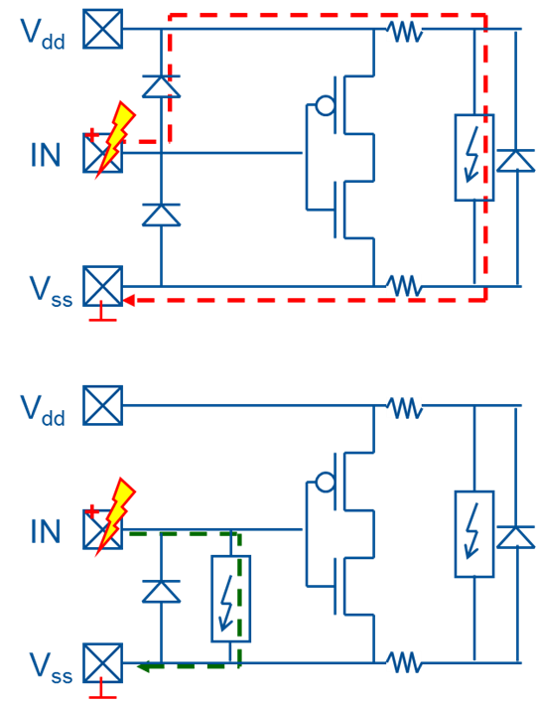
Conclusions
Conventional ESD protection
  Dual diode approach
  Not optimal for advanced CMOS/FinFET
Solution: (Semi) Local clamp
  Proprietary ESD-on-SCR devices
  Reduced influence of bus resistance
  Reduced clamping voltage
  Optimize every analog I/O separately.

Slide 43
Extra: Good practice
Avoid bus resistance between victim circuit and clamp
Avoid resistance between clamp and busses

Slide 44
Extra: bus resistance
Bus resistance is not always problematic
If resistance is not part of the ESD path it will not determine stress case
Resistance in ESD current path for local protection at IO
  Is bad when it increases voltage drop over circuit
    R1 and R2 are problematic for stress between VDD and IO (both pos and neg)
  Has no influence when not causing voltage over circuit
    Can limit total current
    R3 is no problem

Slide 45
Extra: Metal resistance – influence on design window
Resistance at input gate will typically not make a difference
  Resistance only builds up voltage if current runs through it
  R1 and R2 don’t change design window
Resistance at output can be beneficial if some current flows through
  Often current is very small so large resistor would be necessary to build up voltage
  R3 can improve design window
    Driver must conduct some ESD current => has to be robust

Slide 46
Introduction
Advanced CMOS / FinFET nodes
Local clamp approach
Conclusions
About Sofics

Slide 47
Solutions beyond Foundry Libraries for (Bi)CMOS, FF, GAA
ESD protection solutions
  RF
  High-speed
  Low power
  Over-voltage tolerant
  Small area
  Extreme/IEC robustness
  + EOS
  + EOS + EMC
Specialty I/O circuits
  Over-voltage
  Multi-voltage
  Chiplets
  Core transistor I/Os
  Rad-hard
  High-speed
  RF
  +EOS

Slide 48
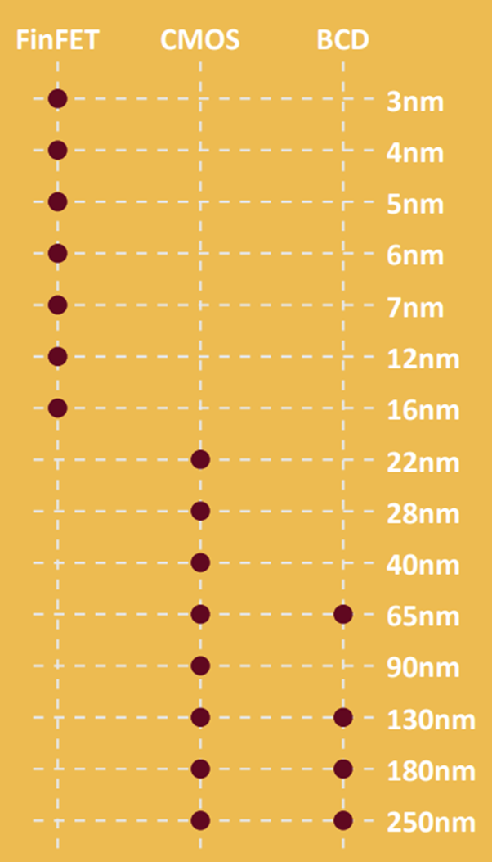
Sofics’ IP is proven on 50+ processes
CMOS
  Mature: 0.5um to 180nm
  Mainstream: 130nm to 65nm
  Advanced: 40nm to 22nm
FinFET and GAA technology
  16nm to 3nm – 2nm (on-going test chip)
BCD technology
  250nm to 55nm
BiCMOS technology

Slide 49






















































100+ customers across the globe and application space

Slide 50




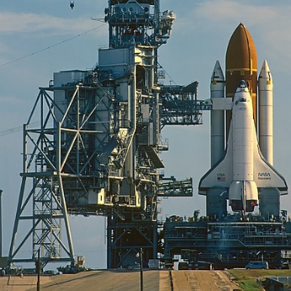

Just a few Sofics IP applications…
Internet of Things, wearables
15+ customers
Battery-less processors
Health monitoring
Automotive
15+ customers
LIN, CAN
Car keys
Artificial Intelligence
5+ customers
Data processing – compute
Inference
Medical
5+ customers
Hearing aids
Imaging (endo/arhtroscopy)
Space
5+ customers
Radiation hardness
CERN – particle research
Datacenter and wireless
40+ customers
Silicon-photonics interfaces
40% of Bluetooth market

Slide 51

More about us…
Get more information
  Sofics website
  Blog
Stay informed
  Follow us on LinkedIn
Connect in person
  Ehsan Fallah
  Bart Keppens

