Slide 1
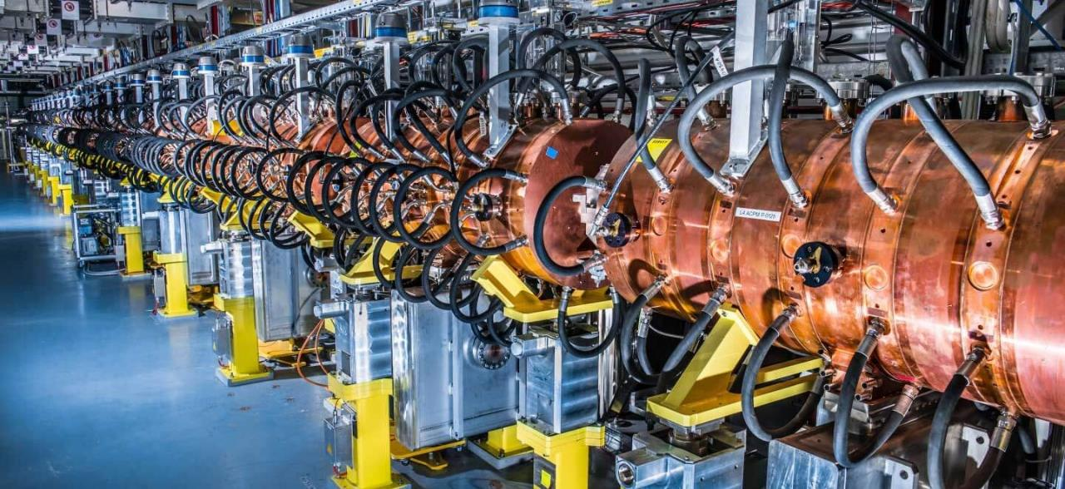
Applications of Accelerators
LECTURE 7
Maurizio Vretenar CERN RTU/CERN May 2024

Slide 2
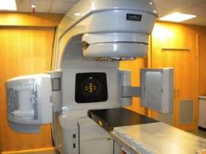
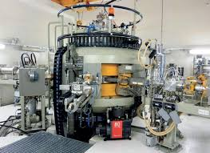
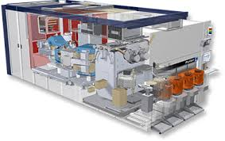
Accelerators for Society
Over 35’000 particle accelerators are in operation world-wide.
Only ~1% are used for fundamental research.
Medicine is the largest application with more than 1/3 of all accelerators.
Research |  | 6%
 | Particle Physics | 0,5%
 | Nuclear Physics, solid state, materials | 0,2 - 0,9%
 | Biology | 5%
Medical Applications |  | 35%
 | Diagnostics/treatment with X-ray or electrons | 33%
 | Radio-isotope production | 2%
 | Proton or ion treatment | 0,1%
Industrial Applications |  | <60%
 | Ion implantation (semiconductors) | 34%
 | Cutting and welding with electron beams | 16%
 | Polymerization | 7%
 | Neutron testing | 3.5%
 | Non destructive testing | 2,3%
Radiotherapy electron linac
Proton cyclotron for radioisotope production
2
Commercial system for ion implantation

Slide 3
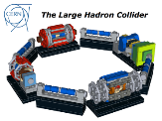
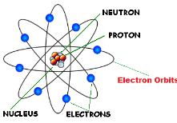
Particle Accelerators concentrate energy
A particle accelerator is an instrument capable of concentrating large amounts of energy at subatomic dimensions
A particle beam creates a high concentration of energy in a small volume
The accelerated particle can:
kick an electron out of the atom (ionization) – breaking of molecular bonds, generation of free chemical radicals.
Excite the electron to a higher energy level, that comes back generating an X-ray (photon).
be deflected by the nucleus giving energy to the atom - increase of temperature, etc.
be absorbed by the nucleus bringing it to an excited state that can generate secondary particles (radiation).
Cancer treatment
Polymerization
Sterilization
Cancer treatment
Security
Diagnostics
Cutting, welding
Isotope production
Neutron production
proton
Note that particle beams are efficient only in driving microscopic processes. They can interact only with small amounts of matter (mg/s, vs. kg/s for other processes).

Slide 4
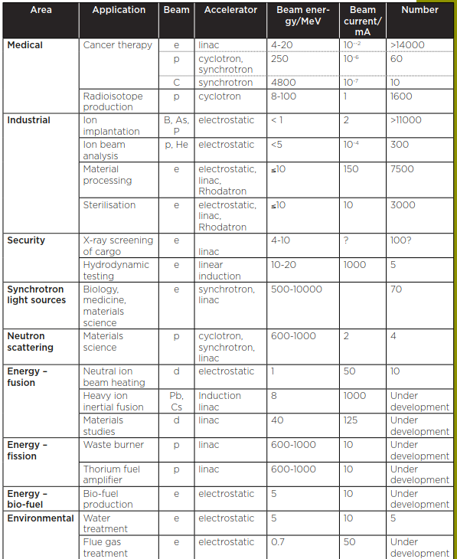
An inventory of most popular accelerator applications
Photon and Neutron Sources
Security (X-rays, neutrons)
Industry
Energy
Medicine

Slide 5
The applications map - electrons
material processing
Current (mA)
direct electron beam application
150
polymerisation
conversion to X-rays application
100
beam power
50
flue gas
detection
sterilisation
photon sources
water treat.
cancer therapy
5
10
15
20
Energy (MeV)
electrostatic
Rhodotron
RF linac

Slide 6
The applications map – protons and ions
material studies
10
waste burning, energy production
Current (mA)
beam power
5
ion implantation
neutron sources
radioisotope production
cancer therapy
cancer therapy
ion beam analysis
100
200
300
500-1000
electrostatic
Energy (MeV)
protons
heavier ions
cyclotron
RF linac
synchrotron

Slide 7
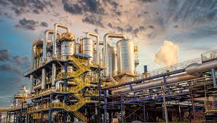
Industrial applications

Slide 8
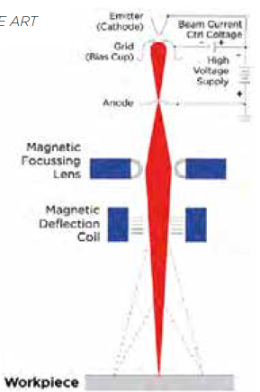
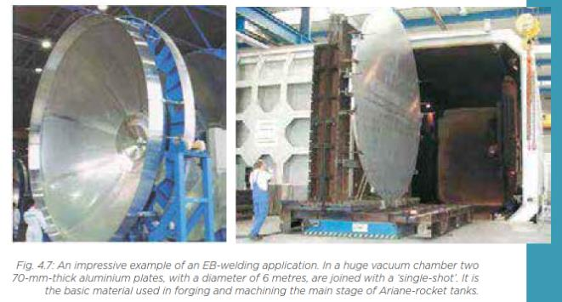
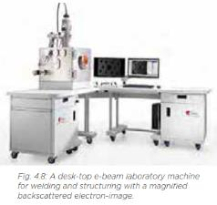
Very low energy electrons
 | Energy | Applications
Very low energy electrons | <350 keV | detection, welding, 3D-sintering, sterilisation, seed and grain treatment
Low-energy electrons | <10 MeV | polymer modification, sterilisation, treatment of flue-gas, wastewater, sewage
Non-thermal: breaking molecular bonds, chemical modifications of organic materials, creation of radicals.
Thermal: melting, evaporation, welding, joining, drilling, hardening, sintering,…

Slide 9
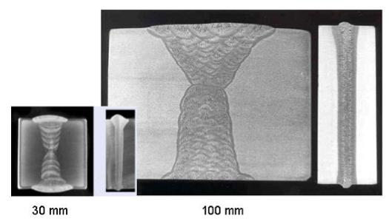
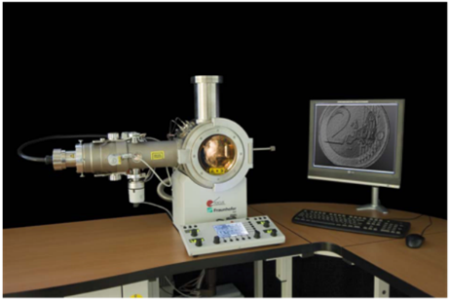
Electron beam welding
Cross-sections - Comparison of extensive TIG-welding with a lot of weld seams with the single-weld seam of EB-welding at the same material thickness

Slide 10
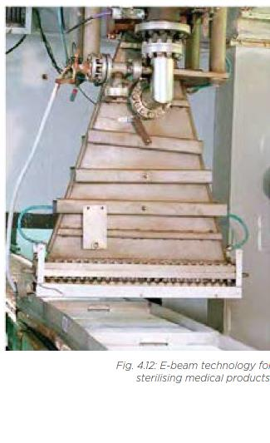
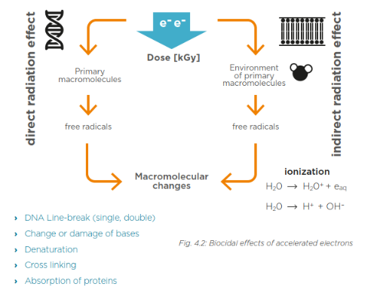
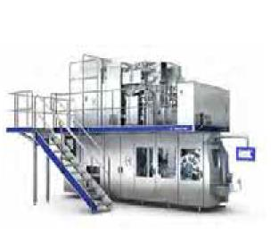
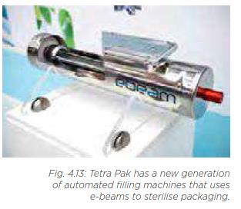
Sterilisation
Sterilisation processes caused by the breaking of molecular bonds associated with the water and DNA in microbial cells.
Medical products (implants and instruments), food, and pharmaceutical packaging can be sterilised.
Energy between 1 and 10 MeV, all surfaces must be accessible (small penetration depth).
The world market-leader in the aseptic carton packaging of liquid foods is currently undergoing the installation of e-beam sterilisation machines in the majority of its production facilities.

Slide 11
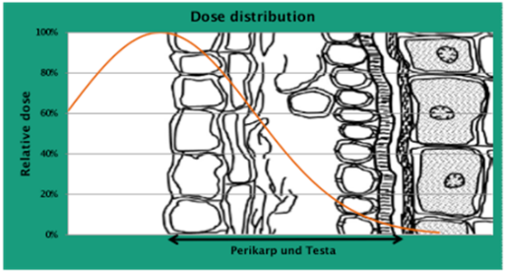
Food sterilisation and radiophobia
Seed and crop treatment – 20 to 30% of food harvested is lost to rotting and insect infestation
Crop seeds must be free from pathogens (fungi, bacteria and viruses) that can endanger health and food security. Standard treatment: chemical seed dressing that can result in the contamination of soil and ground water with waste products, drifting of dressing agents across ﬁelds, killing of probiotic microorganisms.
Alternative: physical disinfection of seed using the biocidal effect of accelerated electrons. By precisely
adjusting the energy of the e-beam, contamination on the seed surface can be treated without damaging
the DNA of the seed grain.
Advantages:
no change in taste, texture of colour;
no toxic residue;
less energy consumption than e.g. steaming;
E-beam treatment diffusion is limited by low social acceptance of any association between “radiation” and “food”, which results as well in stringent regulatory constraints.
Crop treatment companies never use the word “radiation”…

Slide 12
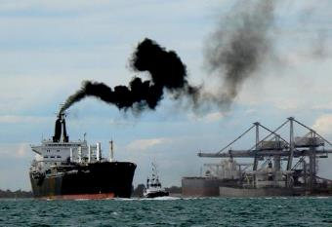
Environmental applications of low-energy electrons
Low-energy electrons can break molecular bonds and be used for:
Flue gas treatment (cleaning of SOx from smokes of fossil fuel power plants)
Wastewater and sewage treatment
Treatment of marine diesel exhaust gases (removal of SOx and NOx).
Maritime transport is the largest contributor to air pollution: a cruise ship emits as much sulphur oxides as 1 million cars!
Ships burn Heavy Fuel Oil, cheap but rich in Sulphur. Diesels (high efficiency) emit Nitrogen oxides and particulate matter.
New legislation is going to drastically limit SOx and NOx emissions from shipping, with priority to critical coastal areas.
So far, technical solutions exist to reduce SOx or NOx, but there is no economically viable solution for both.
150 kV electron accelerator to break the high order molecules that are then cleaned by a water jet (scrubber)
To air
Hybrid Exhaust Gas Cleaning Retrofit Technology for International Shipping (HERTIS)
A project based on a patent from INCT Warsaw promoted by a collaboration of research institutions (including CERN), accelerator industry, shipyards, maritime companies, maritime associations (Germany, UK, Switzerland, Poland, Latvia, Italy).
From engine

Slide 13
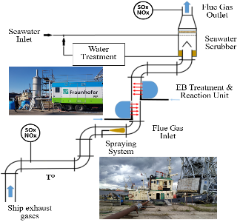

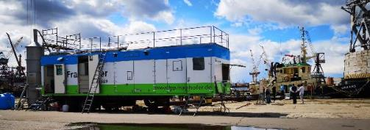
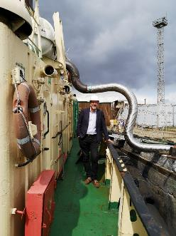
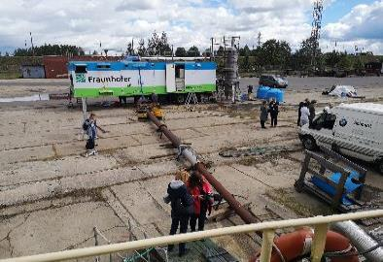
Test of HERTIS at Riga Shipyard, July 2019
Mobile electron accelerator system from FAP Dresden commonly used to treat crops connected to the exhaust funnel of the Orkāns, an old Soviet-built tugboat. The fumes then passed through a small water scrubber before being released in the air.
The tests confirmed the laboratory measurements and the overall effectiveness of the system.
Measured NOx removal rate 45% at full engine power with the available scrubber and accelerator. Estimated removal with optimised scrubber and homogeneous e-beam 98%.
SOx removal only measured in laboratory (no Sulphur allowed in port) with similar removal rates.

Slide 14
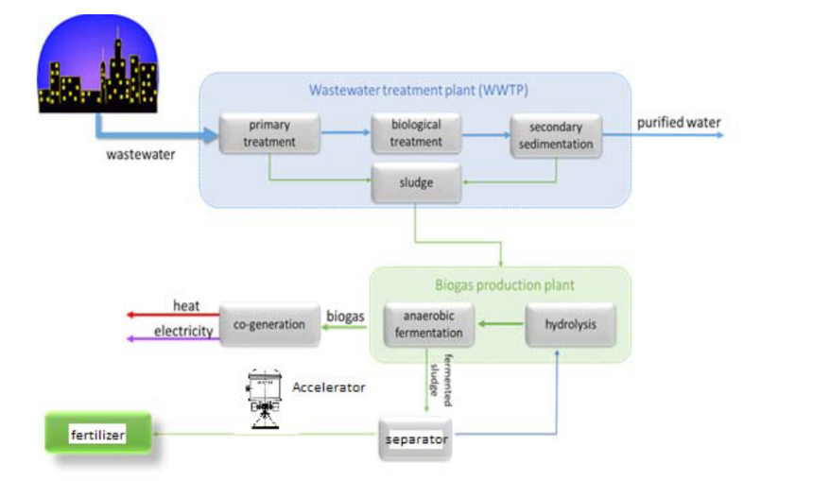
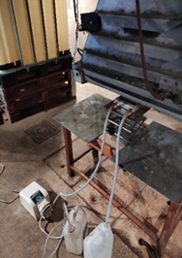
Environmental applications of accelerators - 2
Design of an advanced electron accelerator plant for biohazards treatment
Sludge produced in municipal sewage treatment plants is highly contaminated with parasite eggs.
An expensive hygienization process is needed before agricultural utilization, with the consequence that in most cases the sludge is dumped.
Treatment with an electron accelerators provides a simple and inexpensive way to sanitize sludge and directly convert it into fertiliser, using the energy produced onsite.

Slide 15
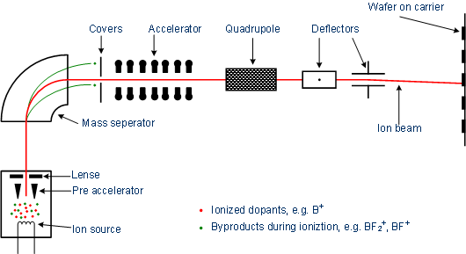
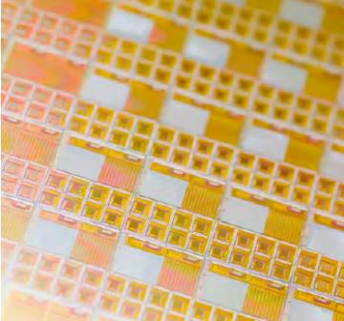
Ion implantation
The semiconductor industry requires
ion implantation to introduce atoms into semiconducting materials to alter
their electronic properties (doping).
Huge industry and one of the most important uses of particle accelerators.
Developing into research for quantum computing (single ions with nanometre-scale spatial accuracy) and novel opto-electronic devices (nano-precipitates in silicon-dioxide layers for light-emitting devices).
15
15
Commercial system for ion implantation

Slide 16
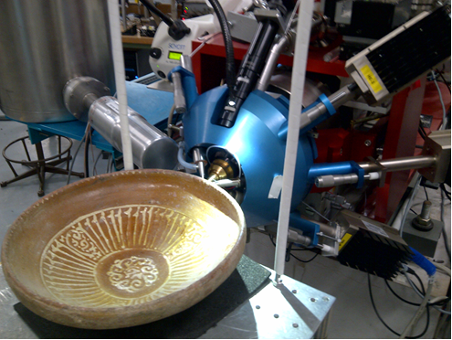
Surface analysis applications

Slide 17
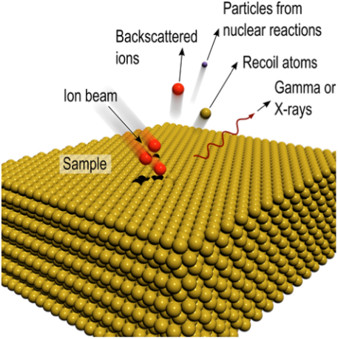
Ion Beam Analysis
Analytical techniques that exploits the interactions of MeV protons or heavier ions with matter in order to determine the elemental composition and structure of the surface regions of solids (to depths of about 100 μm), from measured quantities such as the characteristic spectra of the resulting X-rays, gamma-rays or charged particles emitted.
Elastic or Rutherford backscattering (EBS or RBS), with a particle detector at a backscattering angle;
Particle-induced X-ray emission (PIXE), with an X-ray detector;
Particle-induced gamma-ray emission (PIGE), with a gamma detector;
Elastic recoil detection analysis (ERDA) with a particle detector at a forward recoil/scattering angle.

Slide 18
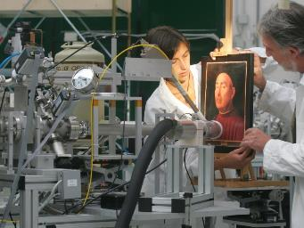
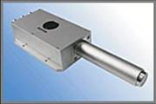

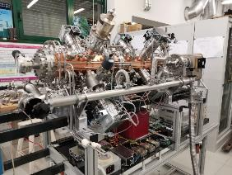
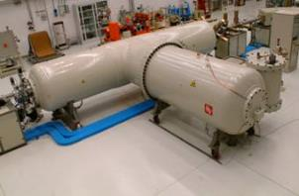

Accelerators for art
PIXE, Proton Induced X-ray Emission
A beam of particles (protons) from an accelerator is sent on a sample (e.g. a painting)
The atoms are excited and emit different types of radiation (X-rays, gammas, etc.)
Different atomic elements emit X-rays at different energies – Spectral analysis from one or more detectors allows determination of the chemical composition (e.g. of the pigments).
Radiation detection and spectral analysis
Emission of radiation of characteristic energies (X-rays, γ, particles…)
Ritratto Trivulzio by Antonello da Messina, 1476 – analysis at INFN-LABEC (Florence)
particle beam
particle accelerator
Portable PIXE system based on an RFQ linac being built by CERN and LABEC
2 m

Slide 19
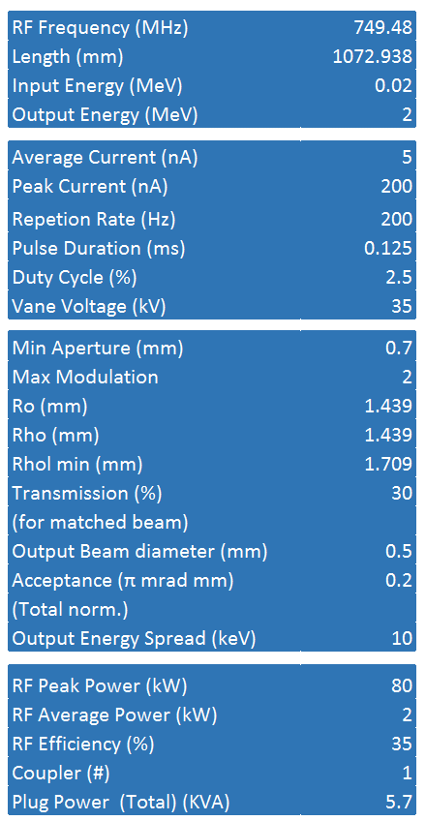
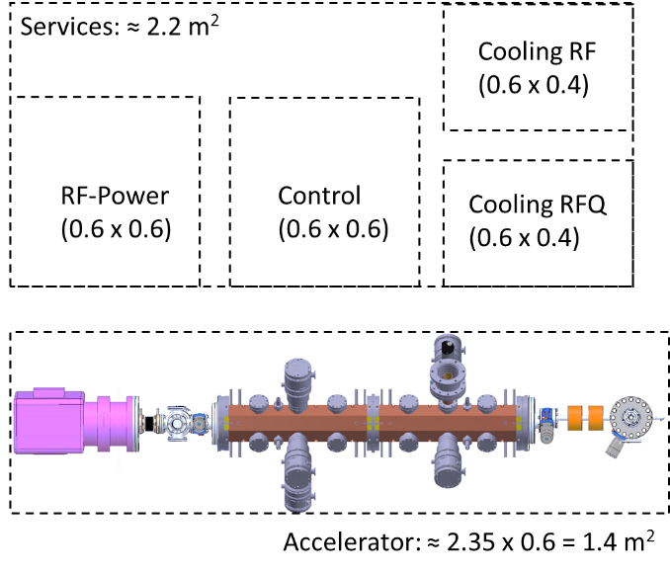
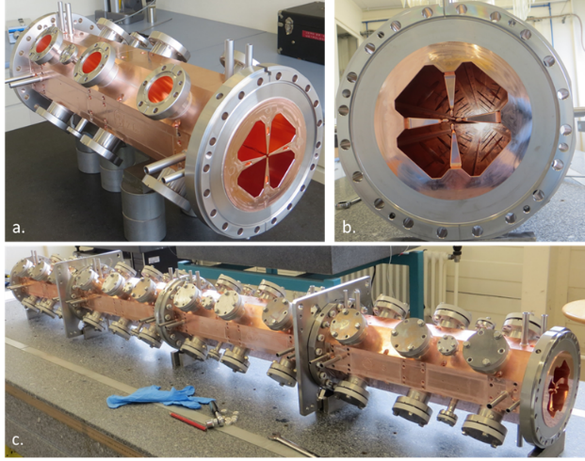
The MACHINA project
MACHINA (Movable Accelerator for Cultural Heritage In situ Analysis) project of CERN and INFN.
Construction of a transportable RFQ (PIXE-RFQ) optimized for the analysis of material with a 2 MeV proton beam.
Will be installed in the Opificio delle Pietre Dure in Florence (Italian central institution for artwork analysis)

Slide 20


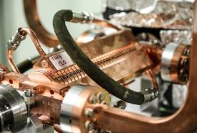
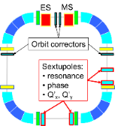
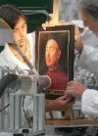
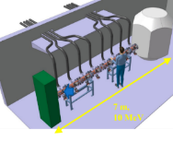
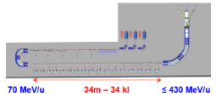
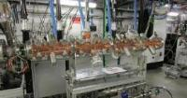
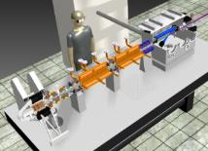
Towards the miniature accelerator?
Important trend towards miniaturization of accelerators, for use in medicine and industry
Here are presented only three examples of recent developments at CERN:
The mini-RFQ
X-band structures
Compact accelerators for ion therapy
750 MHz
92 mm diameter
2.5 MeV/m
12 GHz
100 MeV/m
Superconducting C-ion synchrotron
Bmax 3.5 T
27m circumference
Proton therapy injector (in operation)
Artwork PIXE analysis (in construction, transportable)
Isotope production (design)
Neutron radiography (conceptual stage)
Developed for CLIC, in operation at CLIC test stand
- Compact XFEL (CompactLight Design Study)
- VHEE and FLASH therapy linac (design)
- SmartLight (table top inverse Compton scattering light source, design)
Folded C-ion linac,
Tot. length 53 m
Tot. RF power 260 MW

Slide 21
Screening and security

Slide 22
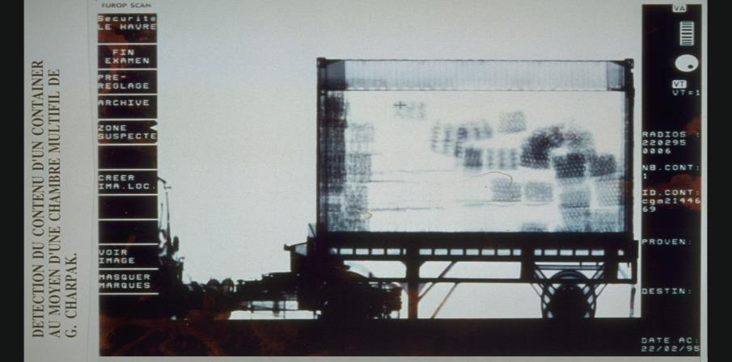
Cargo screening – X-ray
X-RAY IMAGING
Established screening technique in border
control.
Source of electrons accelerated to several
MeV, usually in a linac. Production of X-rays by bremsstrahlung (electrons decelerated by scattering inside a solid target).
Signiﬁcant dose rates according to the
penetration and regulation requirements for a particular transport method and
objects to be scanned.

Slide 23
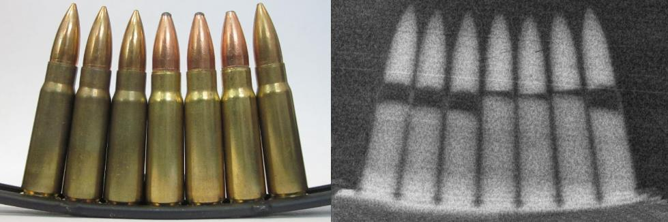
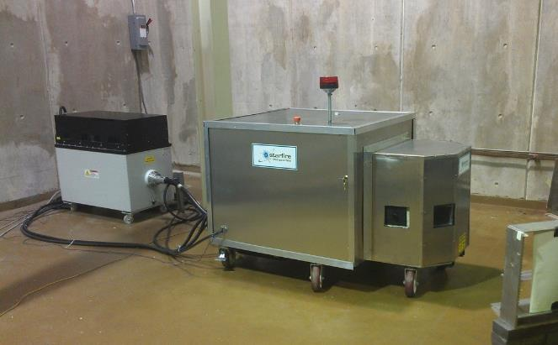
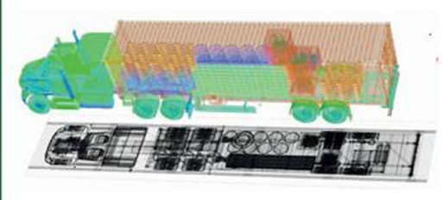
Cargo screening – neutrons
Neutron radiography: detecting the neutrons transmitted through an object;
Neutron-induced gamma spectroscopy: gamma-rays produced by neutron interactions with the cargo are detected.
Application to nuclear detection, e.g. of highly shielded nuclear materials. Neutron sources stimulate detectable fission in nuclear material.
Accelerators: acceleration of protons or deuterium to targets made of deuterium or tritium.
Pictures courtesy of Starfire Industries, USA

Slide 24
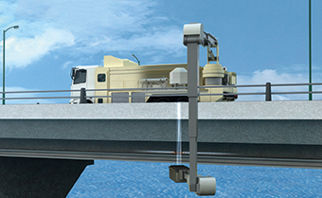
Neutron sources for material testing
3 fields of application:
Compact neutron radiography → cargo screening, concrete analysis
Advanced organic material analysis (spallation sources)
Test of nuclear materials (e.g. for fusion)
RIKEN (Japan):
Concept of a a truck-mounted device sending neutrons from a source (accelerator + target) aboard the truck to the detector attached to the arm.
The system can non-invasively inspect the structural soundness of bridges by detecting steel fractures and their water content (rust). Neutrons have much better penetration than X-rays that are blocked by the steel structure inside the concrete.

Slide 25
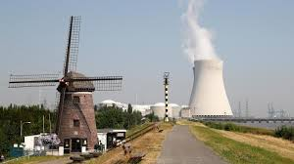
Accelerators for energy

Slide 26
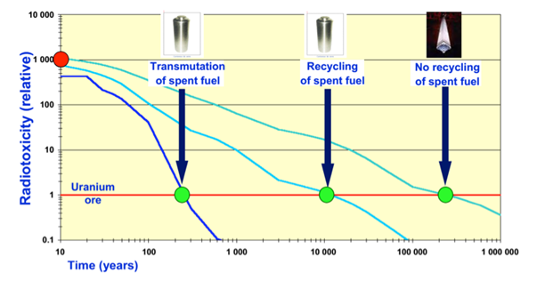

Accelerators addressing the issues of nuclear power
Main public concerns with nuclear power:
Risk of critical accidents
Long-term waste disposal
Risk of nuclear proliferation
The accelerator answer:
Accelerator-driven sub-critical operation
Waste treatment (transmutation) with accelerators
Thorium-based reactors
Transmutation of Minor Actinides (heavier radioactive isotopes of neptunium, americium and curium) requires a fast-neutron system, possibly not reactor-based.

Slide 27

Accelerator Driven Systems
A linac coupled to a spallation source provides the missing neutrons to maintain the reaction in a subcritical reactor.
Could be used for energy production allowing alternative fuel cycles (thorium) and with no safety concerns (subcritical).
Pros | Cons
Safety: subcritical reaction, allows for immediate switch-off | High reliability (→cost) required for the accelerator, to protect structures from thermal shocks
Possibility to operate below criticality opens the way to new reactor concepts | Reduction in net plant power efficiency due to power consumption of accelerator
Simple reactor control by modulating accelerator current | Increased complexity (and cost)

Slide 28




The MYRRHA project
SCK-CEN project at Mol, Belgium
Layout of the MYRRHA reactor vessel
General layout of the 17 MeV MYRRHA Medium Energy Beam Transport section, that links the two injectors with the higher energy “fault-tolerant” main superconducting linac

Slide 29

The reliability challenge
Beam trips longer than 1 sec are forbidden to avoid thermal stresses & fatigue on the ADS target, fuel & assembly & to provide good plant availability.
Present SPECIFICATIONS
Less than 5-10 beam trips (>1-3sec) per 3-month operation cycle
Reliability guidelines have been followed during the ADS accelerator design
  1. Strong component design (“overdesign”)
  All components are derated with respect to technological limitations
  2. Inclusion of redundancies in critical areas
  Doubled front-end (hot stand-by injector), solid-state RF power amplifiers where possible…
  3. Enhance the capability of fault-tolerant operation
  “Fault-tolerance” = ability to pursue operation despite some major faults in the system
  Expected in the independently-phased superconducting linac, especially for RF faults (RF systems = critical reliability area)

Slide 30

Roadmap of ADS project in China
2014.06, 2.1 MeV/10 mA/CW
Goal in 2015.06, 5 MeV
Injector II, 162.5 MHz
Goal in 2015.12, 10 MeV
Goal in 2016.09, 25 MeV
Injector I, 325 MHz
Stage 1: Research facility (CIADS)
(250 MeV, 10 mA, 10 MWt)
Y2017-2022, 2.25 B CNY
“Strategic Technology Pilot Project”
of the Chinese Academy of Sciences
Key technology R&D
Y2011-2017, 1.78 B CNY
Stage 2: Demo facility (CDADS)
(1.2~1.5GeV, 10~25 mA, 100 MWt)
Y2030

Slide 31


Advanced materials on the critical path to fusion
DEMO = Fusion Power Plant Demonstrator (after ITER)
Fusion Power: 2.5 GW ( x 5 ITER )
Reactor Efficiency: 37-45%

Slide 32

The IFMIF-DONES Principle

Slide 33


The IFMIF-DONES Project (Granada, Spain)

Slide 34
Accelerators for neutron production

Slide 35

Secondary particle beams
(courtesy of JPARC)
. Energy production (Accelerator Driven Systems), > 2 GeV
. Radiactive Ion Beams (ISOL), > 1 GeV

Slide 36


Neutron scattering: Spallation Neutron Sources
Neutrons are ideal probes to map the molecular and magnetic structure and behavior of materials (high-temperature superconductors, polymers, metals), and biological samples → Application to fundamental physics, structural biology and biotechnology, magnetism and superconductivity, chemical and engineering materials, nanotechnology, complex fluids, ...
Traditionally, neutrons were produced by nuclear reactors; nowadays, are used linear accelerators at energy ≥ 1 GeV
2 linac-based facilities operational (SNS at Oak Ridge – USA and J-PARC at Tokai – Japan) and a third is in construction (European Spallation Source at Lund – Sweden).

Slide 37

Beam power
Figure of merit for accelerators at the intensity frontier is beam power P=W×I×duty cycle
Production rate (cross-section) for most of the particles in high-intensity applications is independent on the energy (above a certain threshold) but proportional to beam power.
The new generation of accelerators under project or construction aims at moving the power from the 100 kW’s range to the MW’s range.
A MW-class machine presents a large number of challenges and requires the development of specific technologies.
Jie Wei, IPAC 2014

Slide 38

US Spallation Neutron Source
US Spallation Neutron Source (Oak Ridge)
World’s highest power proton source (1 MW)
1 GeV, 5% duty

Slide 39

SNS - layout

Slide 40


European Spallation Source
The ESS is being built in Lund (Sweden).
Will provide the EU neutron science community with a modern facility
5 MW long-pulse: no need of an accumulator/compressor like SNS.
He-cooled rotating tungsten wheel target (to avoid management of activated Hg as in SNS).

Slide 41
ESS accelerator technical performance
Key parameters:
    -2.86 ms pulses
    -2 GeV
    -62.5 mA peak
    -14 Hz
    -Protons (H+)
    -Low losses
    -Minimize energy use
    -Flexible design for mitigation and future upgrades
Design Drivers:
High Average Beam Power
5 MW
High Peak Beam Power
125 MW
High Availability
> 95%
352.21 MHz
704.42 MHz
2.4 m
4.6 m
3.8 m
39 m
56 m
77 m
179 m
Target
Source
LEBT
RFQ
MEBT
DTL
Spokes
Medium β
High β
HEBT & Contingency
75 keV
3.6 MeV
90 MeV
216 MeV
571 MeV
2000 MeV

Slide 42

Acknowledgement and further reading
Many of the pictures and some text of this lecture have been taken from the
2017 EuCARD2 Report on Accelerator Applications in Europe (112 pages):
http://apae.ific.uv.es/apae/wp-content/uploads/2015/04/EuCARD_Applications-of-Accelerators-2017.pdf
Other useful resources are:
The TIARA site on accelerators for society:
http://www.accelerators-for-society.org/
The US action on Accelerators for America’s future: http://www.acceleratorsamerica.org/report/index.html

Slide 43

End of Lecture 7
DISCLAIMERS:
Accelerators for medicine will be the subject of Lecture 8
Synchrotron light sources, another important application, have been covered by another lecturer
Elwood Smith

