Slide 1
Radiation Fields at CERN
Christoph Schäfer
With many thanks to Helmut Vincke

Slide 2
Contents
Introduction to CERN’s accelerators
Radiation Fields around High Energy Accelerators
Dose to humans: shielding used to reduce dose in high-energy accelerators
Radiation detector systems used to measure mixed radiation fields at workplaces

Slide 3
CERN’s main accelerator chain
Introduction to CERN’s accelerators

Slide 4
Goal of this chapter
We will obtain an introduction to our accelerators
Introduction to the radiological critical points at CERN’s accelerator complex

Slide 5
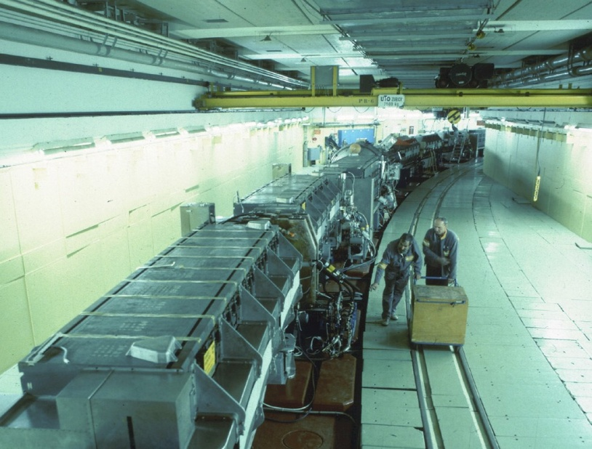
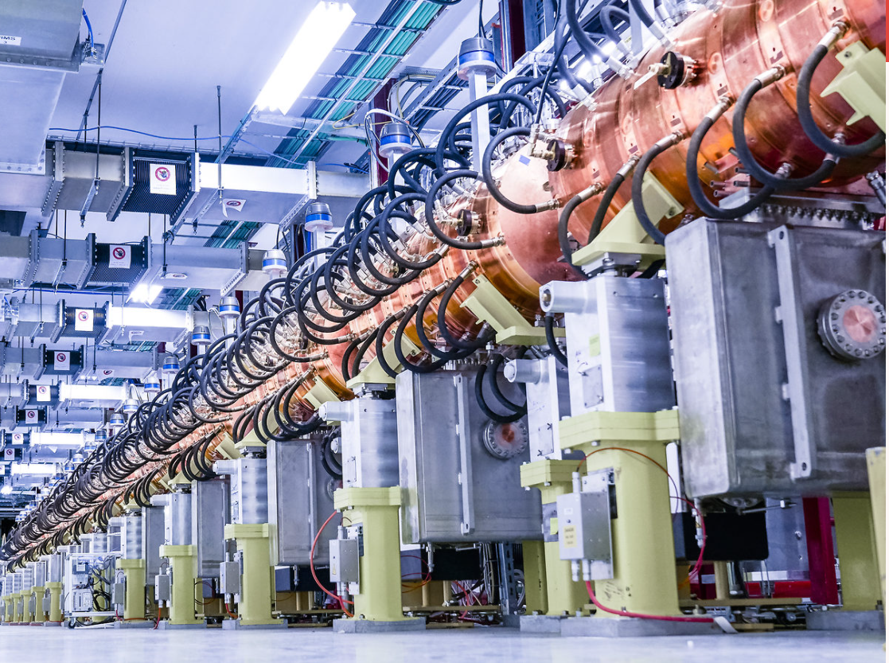
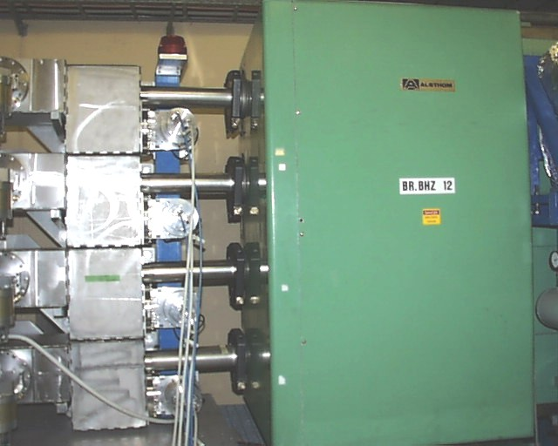
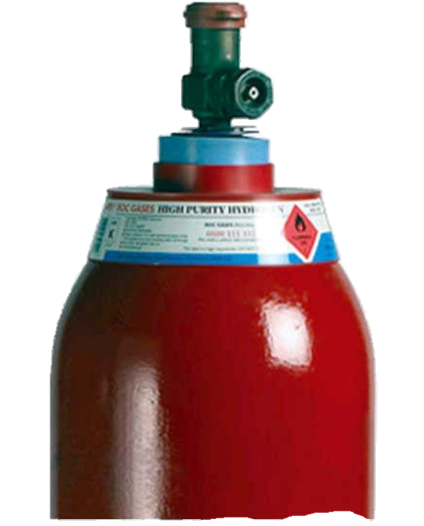
Main accelerator chain at CERN
(low-energy part)
Booster (1.6 GeV)
Proton Synchrotron (26 GeV/c)
LINAC 4 (160 MeV)
Hydrogen bottle
200 m

Slide 6
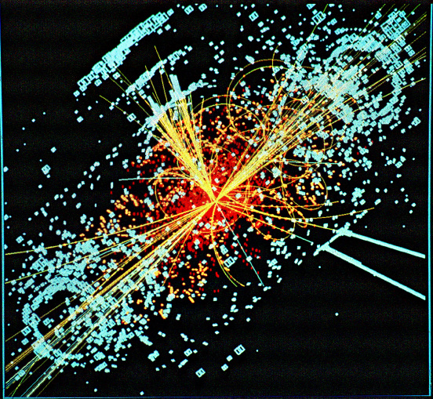
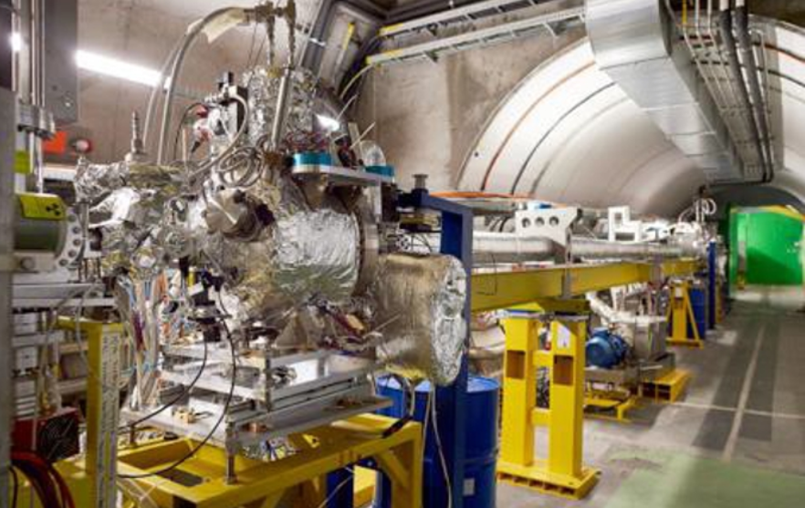
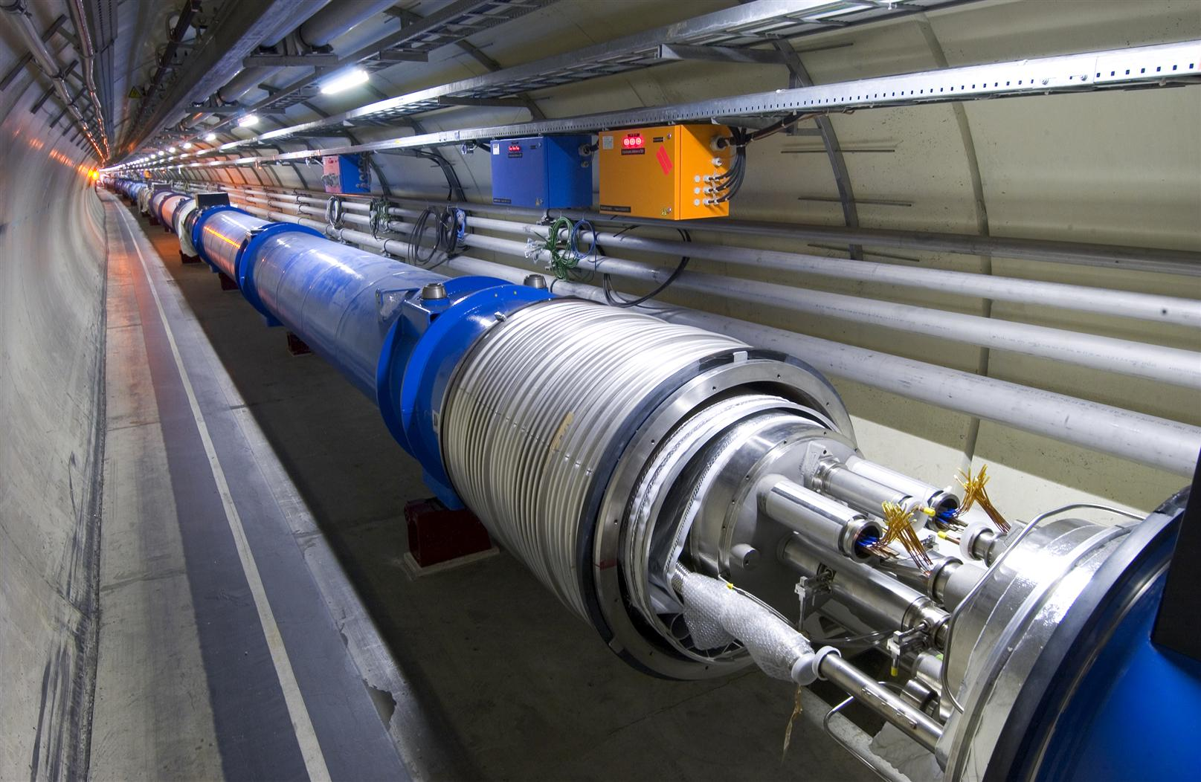
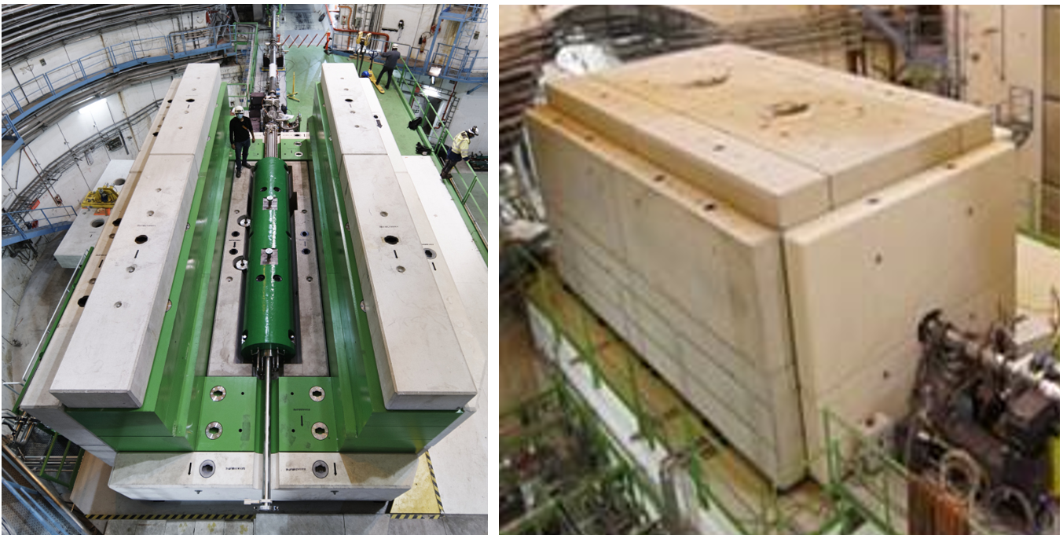
Accelerators at CERN
(high-energy part)
LHC (2 x 7 TeV)
SPS
Circumference: 7 km
Intensity per filling of the ring: 6E13 protons
SPS beam
FT
Fixed target experiments
Super Proton Synchrotron
(450 GeV/c)
LHC
AWAKE
AWAKE
1 km

Slide 7
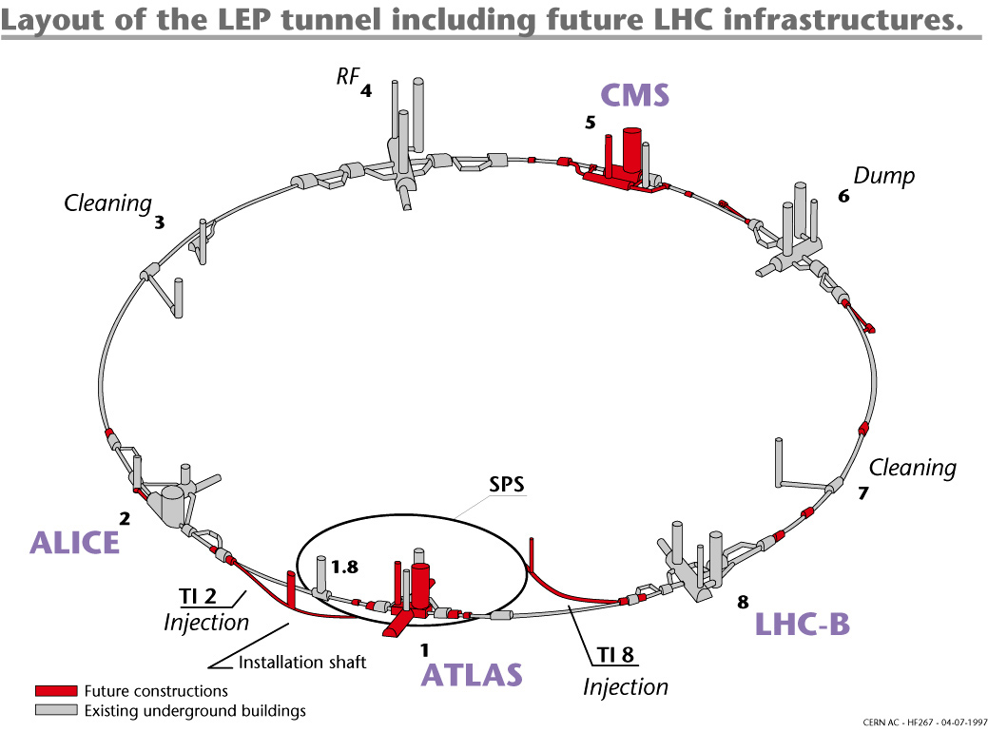
Large Hadron Collider (LHC)
Particle type: Protons
Beam energy: 7 TeV
Number of stored particles: 2×4·10¹⁴
Stored energy: ~ 2×450 MJ
Mass at rest:
~ 1 ng

Slide 8

The same amount of energy as in one LHC beam is stored in:
High Speed Train
Notes:
11 GJ stored in magnets

Slide 9
Radiologically problematic points at accelerator facilities
(Locations of elevated beam losses)
Target areas
  Examples: SPS target area (TCC2) and HIRADMAT area
Dump areas
  Example: all dumps from low to high energies
Collimation regions (beam cleaning)
  Examples: Point 3 and 7 of the LHC
Beam injection and extraction regions
  Example: PS and SPS beam extraction
Beam splitting regions:
  Example: TDC2 area in the SPS
Areas around beam collision points
  Examples: Areas around CMS and ATLAS

Slide 10
Radiation Fields around High-Energy Accelerators

Slide 11
Goal of this chapter
We will learn something about
The different radiation fields occurring at CERN (beam-on versus beam-off)
Impact of ionizing radiation in accelerators

Slide 12
Radiation Fields around High Energy Accelerators
Prompt ionizing radiation – beam on
Whole particle zoo with E up to initial beam energy
Ionizing Radiation due to induced radioactivity – beam off
α, β-, γ-radiation,
Main γ energies: < 2.76 MeV

Slide 13
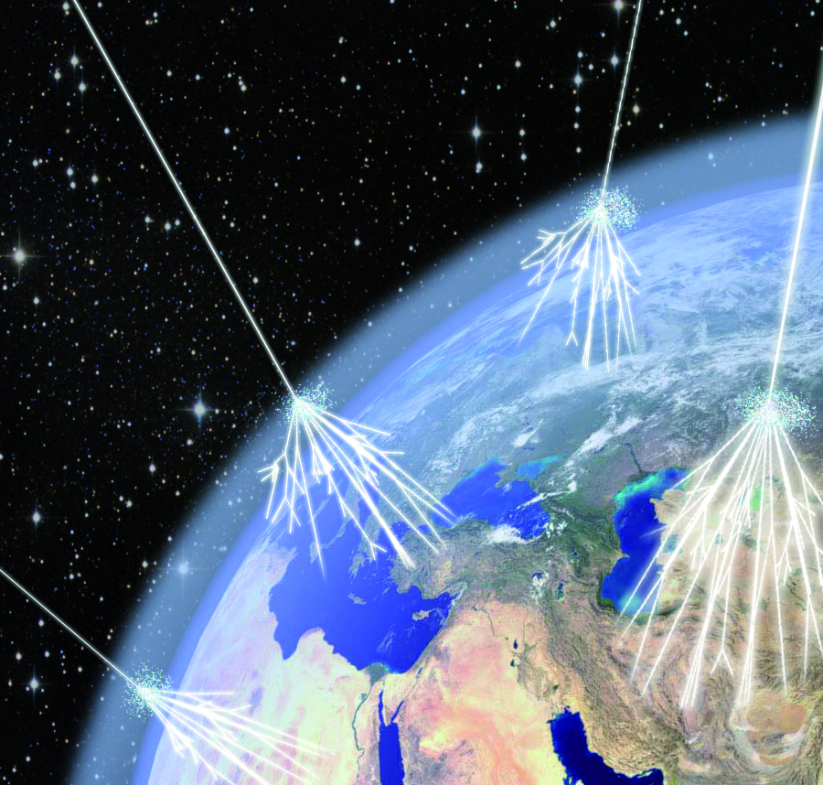
Prompt Ionising Radiation
Highest particle energy measured: 3.2×10²⁰ eV
up to 7 TeV
Hadron accelerator
Cosmos
Particle impact creates high-energy particle cascades

Slide 14
Ionizing particles on matter: Impact and consequences
Prompt Ionizing Radiation in Accelerators
Focused energy deposition in material ➔ heat development, shockwaves➔ destruction of materials
  Radiation triggered failure of electronics
  Dose to people
  Aging of organic materials like insulations
  Activation of material

Slide 15
Radiation impact
Relation between absorbed dose and damage caused by radiation
Gy
Problems with
electronics
equipment occur
Annual dose limit (Sv) for radiation workers in Switzerland
Problems with cable insulation occur
Problems with magnet coil insulation occur
LD 50/30

Slide 16
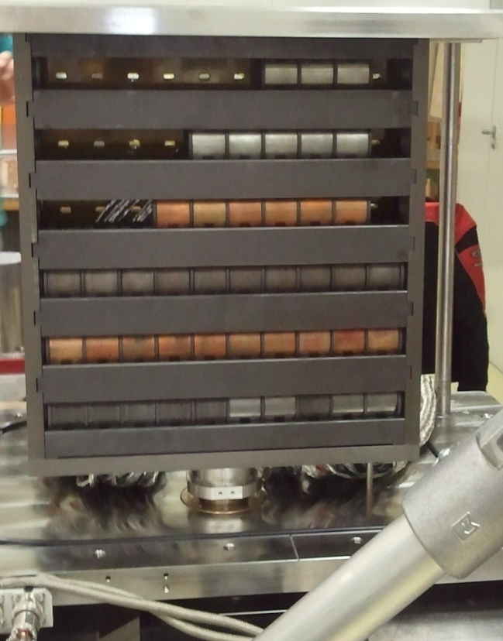
CERN operates powerfull (and dangerous) beams: full impact of a typical high-energy beam on metall (~ 0.16 % of the LHC beam energy)
Beam energy 440 GeV/c (SPS beam momentum)
1.08×10¹³ protons on tungsten alloy (Inermet 180)
Beam impact within ~ 8 us
Question: How will the three 3 cm long tungsten alloy blocks digest the beam impact?
By courtesy of A. Bertarelli

Slide 17
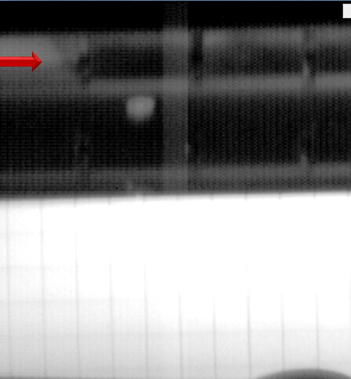
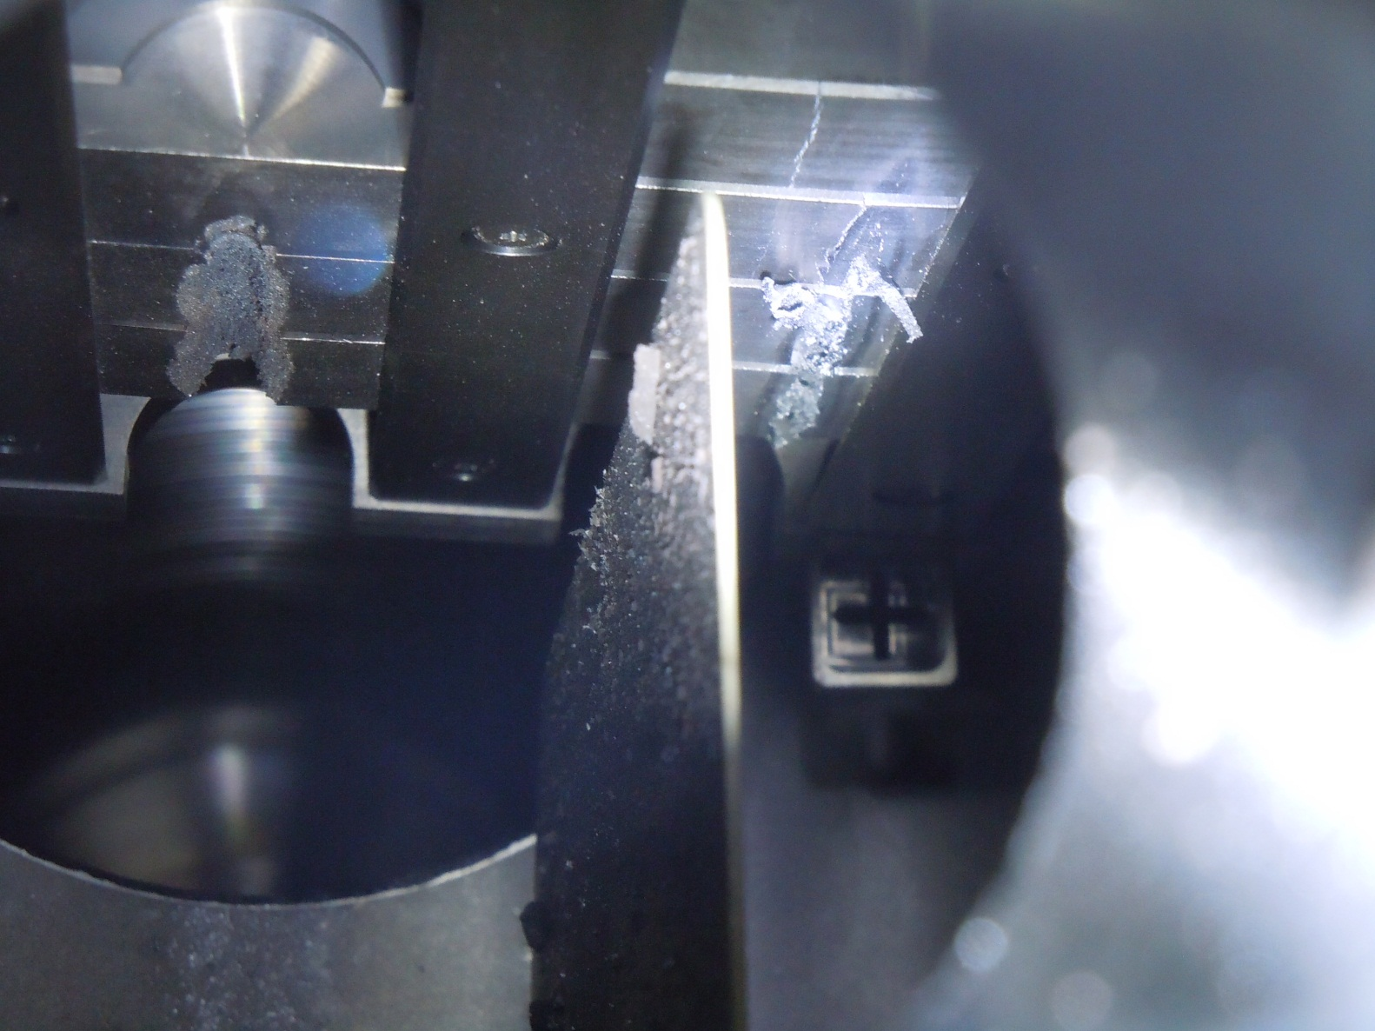
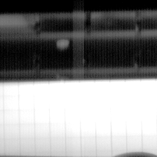
High speed camera catching the beam impact
Beam
Beam
~10.5 mm
Details: Bertarelli et al., An experiment to test advanced materials impacted by intense proton pulses at CERN HiRadMat facility, Nucl. Instr. Meth. B (2013) http://dx.doi.org/10.1016/j.nimb.2013.05.007

Slide 18
  Aging of organic materials like insulations in radiation environments

Slide 19
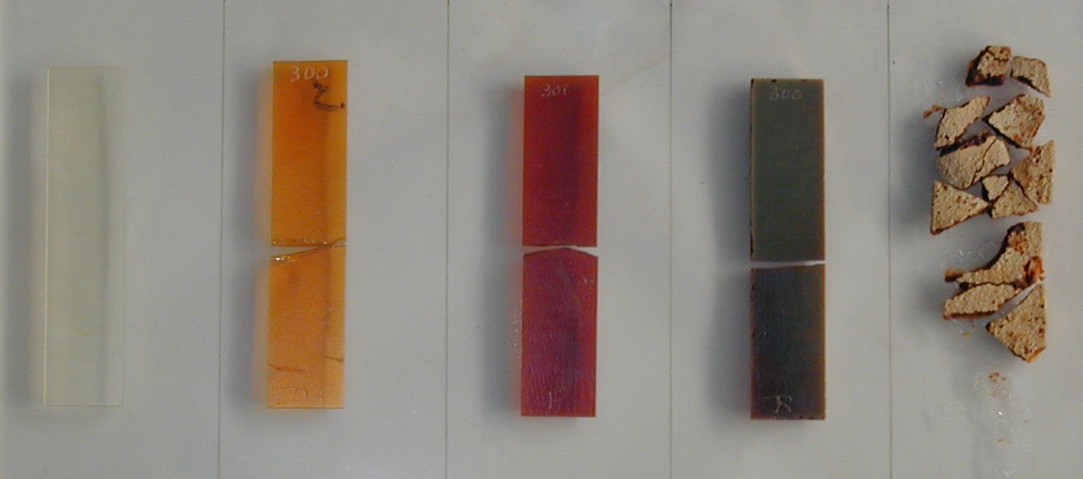
Examples for radiation damage
Resin used for magnet coil insulation
D (Gy)
0 5x10⁶ 10⁷ 2.5x10⁷ 5x10⁷
Notes:
La dosimétrie à haute dose
Les points de mesures
Le long de accélérateur
La fréquence des mesures
Les ancienne répartition de dose des années passer

Slide 20
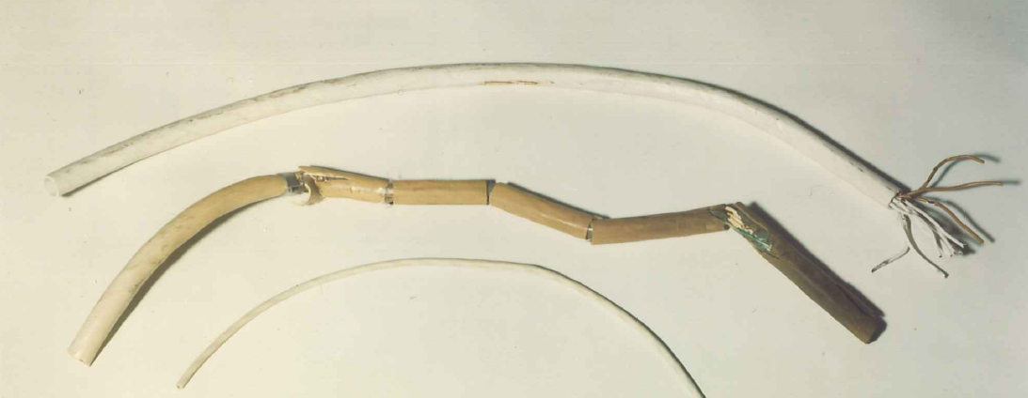
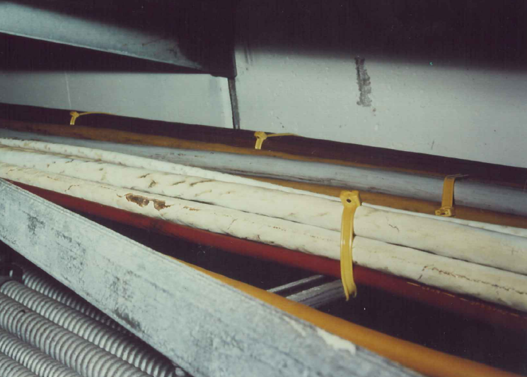
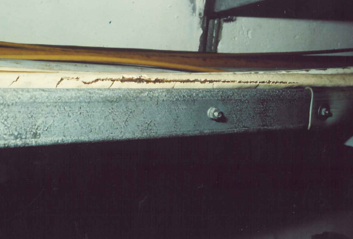
Radiation damage on cable insulations

Slide 21
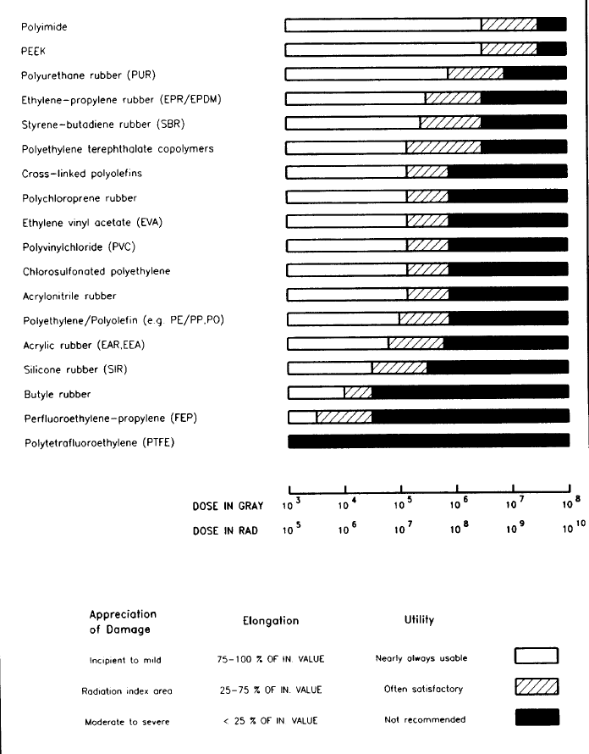
Radiation damage is mainly caused by braking hydrogen bridge bounds in molecules
Radiation resistance of cable materials
In radiation facilities insulation material shall be chosen according to the radiation level in the area.
In the last century, many radiation hardness tests were carried out and documented at CERN.
Material catalogues from the past are available and should be used

Slide 22
Summary of
“Introduction to Radiation Fields around High-Energy Accelerators”
  It has to be distinguished between radiation field during “beam off” and radiation field during “beam on”
  Impact of ionizing radiation
    Dose to people
    Activation of material
    Focused energy deposition in material ➔ heat development, shockwaves ➔ destruction of materials
    Radiation triggered failure of electronics
    Aging of organic materials like insulations

Slide 23
Dose to people:
Radiation Shielding in Proton Accelerator Environments

Slide 24
Goal of this chapter
We will learn something about
Dose to people, shielding
  Radiation fields lateral to beam impact points
  Radiation fields downstream of beam impact point
  Shielding strategies

Slide 25
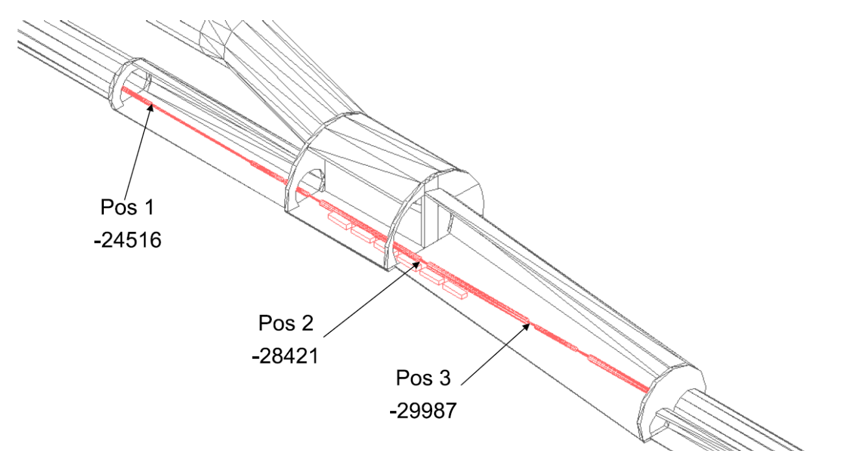
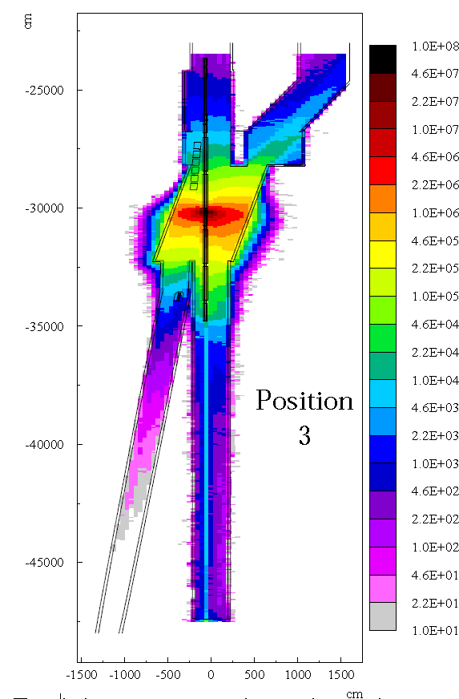
Example of full beam loss (7 TeV) in the LHC
mSv/full beam loss
Dose caused by a full beam loss (4E14 protons@7TeV) reaches levels of tens of thousands of Sv close to the loss point.
➔ strong shielding required to significantly reduce dose

Slide 26
Which radiation fields are produced around beam loss points at high-energy proton accelerators?
The characteristics of radiation fields produced around loss points of proton accelerators depends on:
Energy (E) of the lost particle:
Dose ~ E^{0.8} – E^{0.9}
Location of exposure with respect to the loss point
  Downstream
  Lateral/upstream
Amount and type of shielding material
E

Slide 27
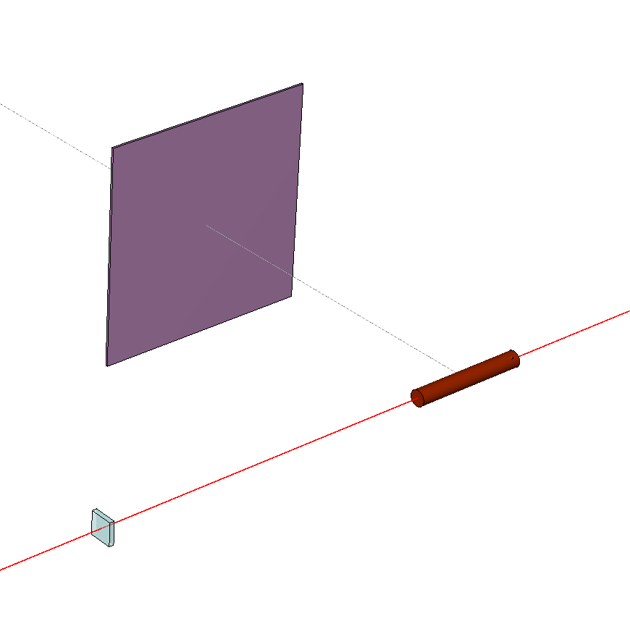
Spectra lateral and downstream of a target hit by a beam of 450 GeV/c
(all particles)
1.5 m
Beam
1.5 m
50 cm copper target

Slide 28
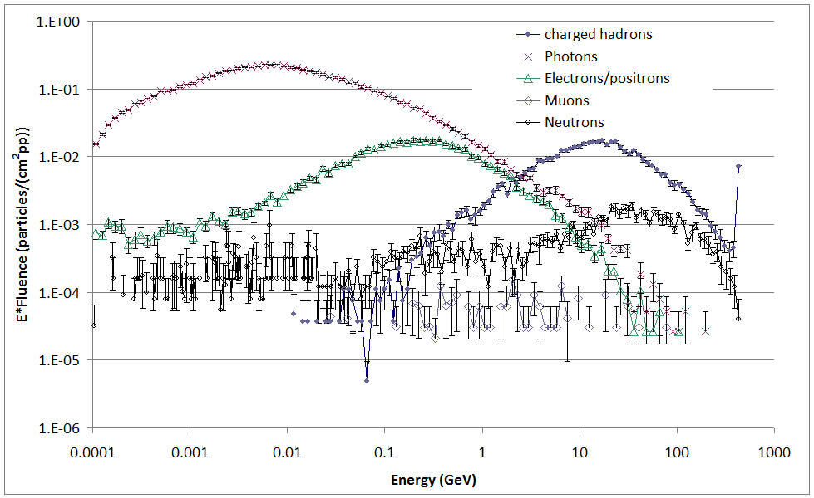
Fluence spectra at the downstream position
Spectra reach very high energies

Slide 29
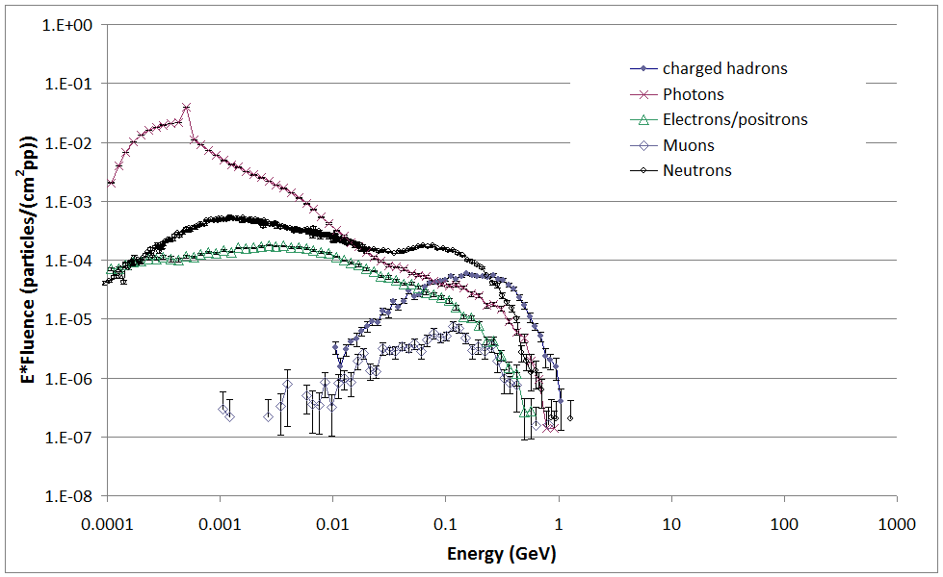
Fluence spectra at the lateral position
Maximum energies of spectra are in the GeV range; for high-E beam particle almost independent from its initial energy. Higher beam energy results in higher intensity of secondary spectrum. Shape remains almost unchanged

Slide 30
How can we shield these kind of radiation fields?

Slide 31
Lateral shielding

Slide 32
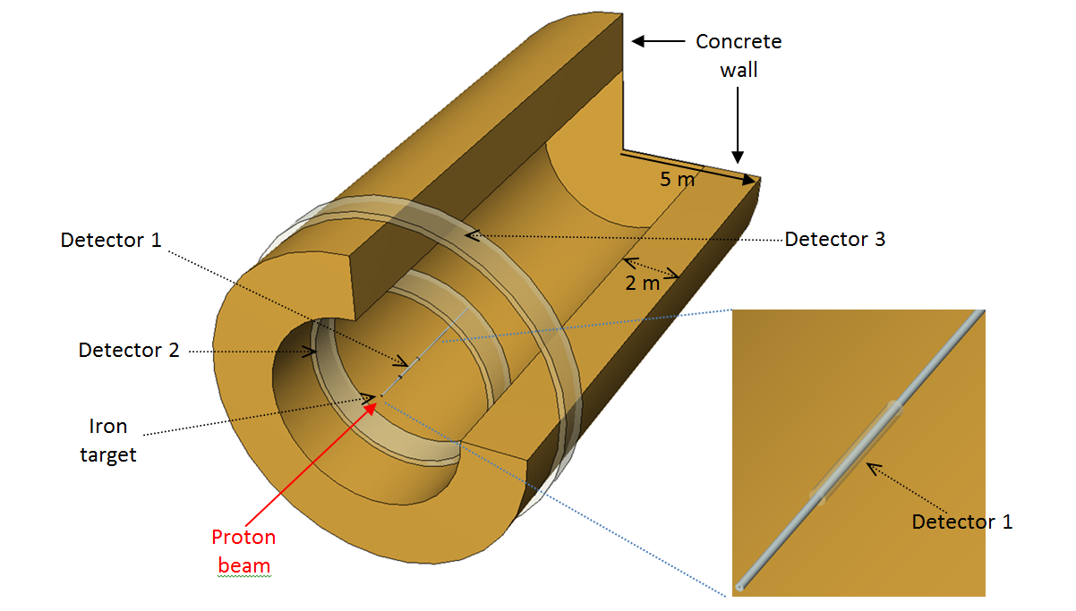
Simple Simulation Geometry (cylinder-symmetric) to calculate lateral radiation propagation through a shielding wall
One quarter clipped for viewing the inner structure of geometry
A 450 GeV proton beam is sent onto a 5 m long target with a diameter of 5 cm.
Target is surrounded by particle detectors

Slide 33
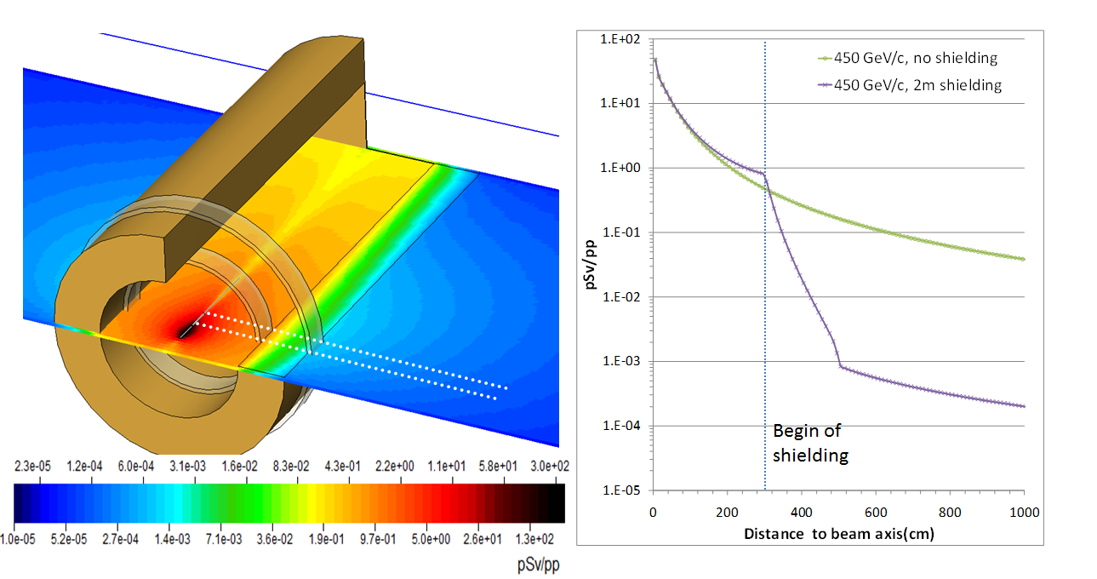

Dose analysis
Buildup
Attenuation
~e^{-d/λ}
$$H\sim \frac{1}{r^{2}}$$
Radiation attenuation through shielding walls shows various characteristic phenomena.

Slide 34
Exemplarly fluence spectra outside a lateral shielding
Total dose rate
86% n 7 % p 4% π 3% γ

Slide 35

Calculation method for “point-source like” cases of lateral dose attenuation
$$H≈\frac{1}{r^{2}}∙e^{−\frac{d}{λ}}$$
Source
H … dose
r …. Distance from point source
λ… hadronic interaction length
Point of interest
λ has a strong effect on the final dose result
d
Hadronic interaction length (λ) for high-energy particles in cm*
Iron | 16.9 cm
Concrete | ~40 cm
r
Rule of thumb:
Shielding requirements for a dose attenuation of a factor of 10:
40 cm of iron or 1 m of concrete.
Shielding
* Physical data group: Review of particle physics

Slide 36
How to build lateral shieldings at high-energy accelerators

Slide 37
Strategies for lateral shielding around high-energy proton machines
Radiation attenuation
Activation of material
Costs of shielding
Minimizing hadronic interaction length (λ):
Avoid High Z material and high neutron x-section materials leading to radionuclide production
Cheap material:
1 m³ concrete: 150 Euro
1 m³ steel: 8000 Euro
Shielding walls: concrete
Local shielding if space is an issue: iron
In case of high levels of activation: marble should to be used to shield radioactive components around beam line
Please note: shielding philosophies at low energy facilities can be different.

Slide 38
Shielding downstream of beam impact points

Slide 39
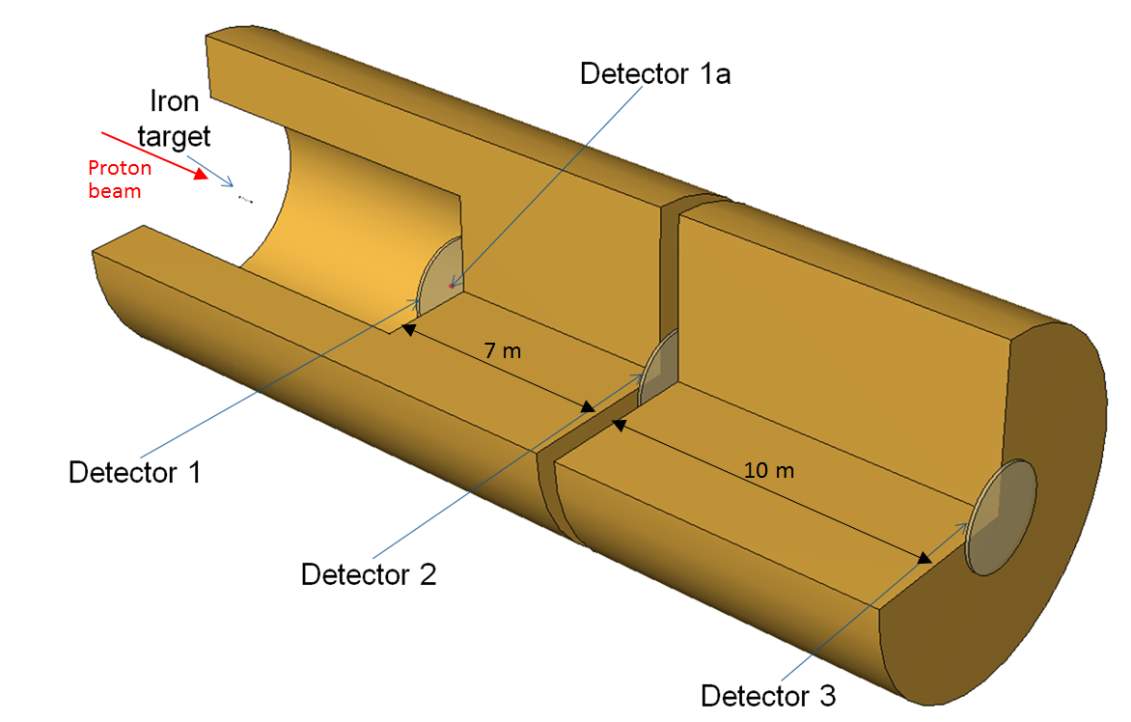
Simulation example to calculate radiation fields downstream an impact point of an high-energy proton beam
450 GeV proton beam on 50 cm long iron target
One quater of geometry is clipped in picture

Slide 40
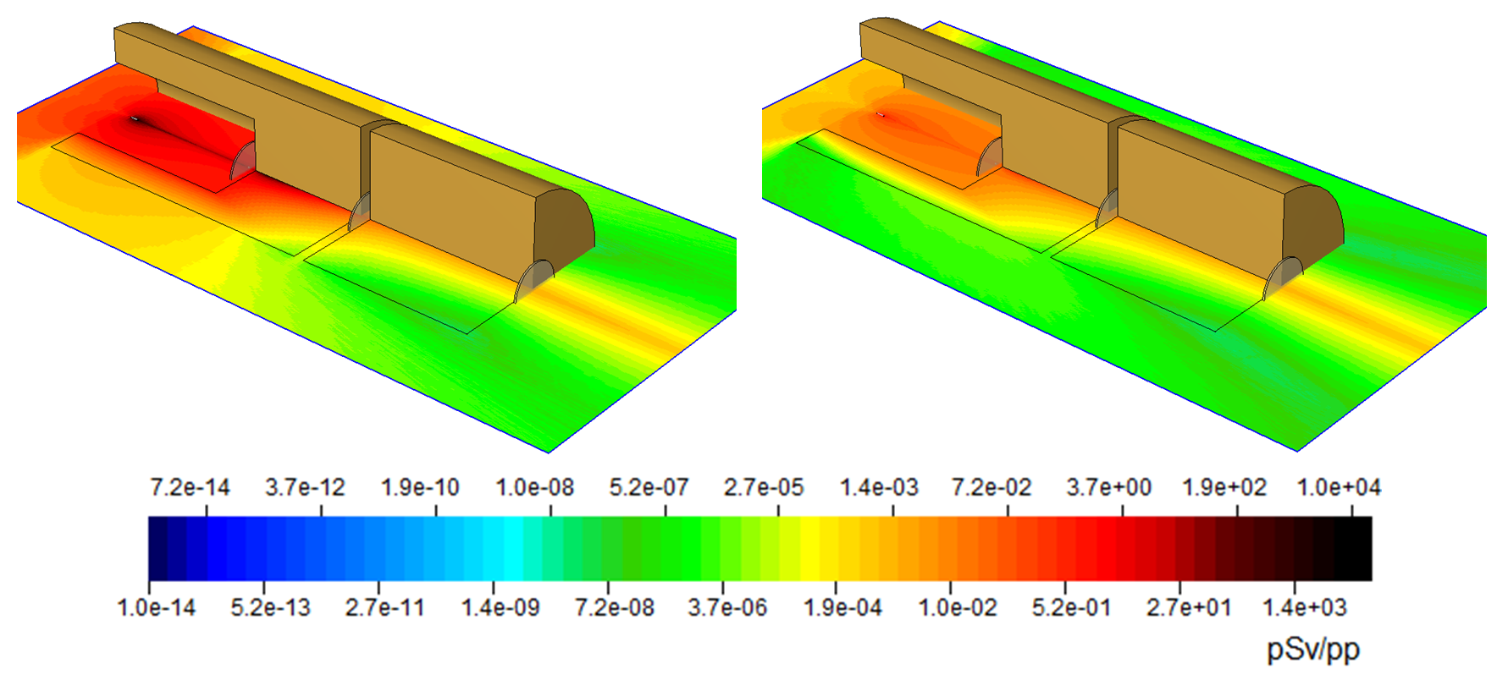
Dose simulation results
Dose of all particles
Dose by muons only
Muons strongly dominate the dose seen downstream the heavy shielding

Slide 41
Energy reduction of high-energy muons
Muons are interacting very rarely via hadronic interactions in matter.
➔ They mainly lose their energy by electromagnetic interactions in matter
In order to reduce a high-energy muon (several GeV and above) by 1 GeV one needs 0.7 m of iron shielding or 1.8 m of concrete shielding. Valid up to a muon energy of ~100 GeV. Above this energy, radiative losses increase the energy loss in matter.
Muons emerging from beam losses of the PS (25 GeV maximum) are shieldable.
Muons emerging from the SPS and LHC are barely shieldable with a reasonable amount of shielding.
This is one of the reason why the SPS and the LHC are built deeply underneath the surface.

Slide 42
Best way to limit muon radiation
Muon attenuation in shielding does not follow an exponential attenuation law. They only can be slowed down via electromagnetic energy losses (dE/dx).
The best way to eliminate muon radiation is the early capture of their hadronic parents (pions and kaons), preventing their decay into muons.
Target
DUMP
High-E protons
Reduction of distance between beam loss point and shielding: High-energy pions and kaons will be captured in dump before they decay into muons

Slide 43
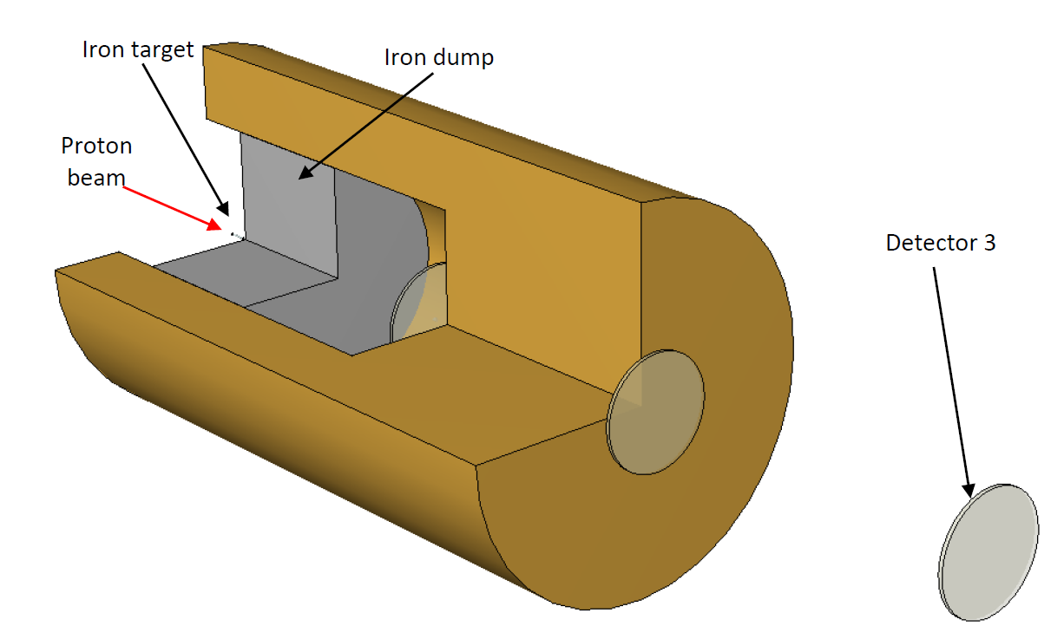
Modification of previous example (450 GeV protons on target): we replace the 10 m block of concrete by 4 m of iron, being placed close to target (resulting in the same shielding strenght for hadrons).

Slide 44

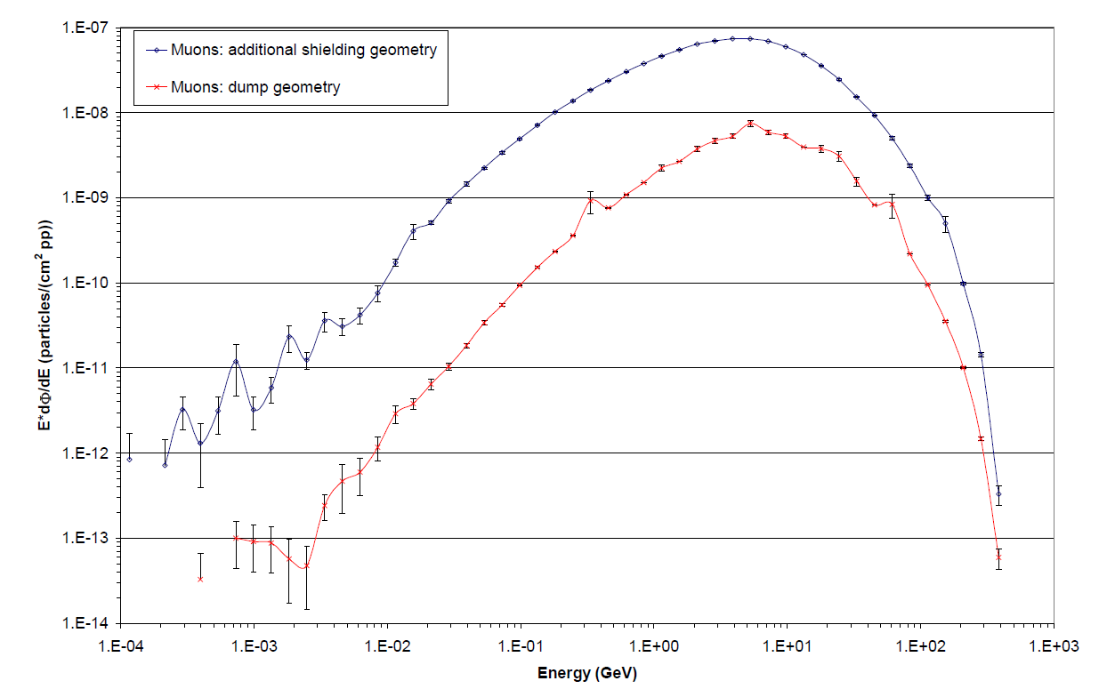

Comparison of muon fluence behind the two shielding configurations being equivalent in hadronical attenuation
Although the hadronic shielding power remained unchanged the muon fluence could be significantly reduced

Slide 45
Additional possibilities to reduce muon dose
Dispersion of muons with magnetic fields
  Does not reduce total number of muons but it reduces the high flux density along the center of the beam axis
  Very difficult since high-energy muons are very rigid ➔ strong magnets are needed.
Tons of shielding (as demonstrated before)

Slide 46
Summary of
“Dose to people” and “Radiation Shielding in Proton Accelerator Environments”
Behind lateral shielding: ambient dose equivalent is dominated by neutrons below 1 GeV.
Dose attenuation in lateral shielding follows an exponential law.
Strategies for lateral shielding around high-energy proton machines consider effectiveness of shielding, activation of shielding materials and costs of shielding
At high energy proton accelerator muons are the dominant radiation constituent behind thick shielding located downstream the beam loss point.
Muon attenuation in shielding does not follow an exponential attenuation law. They only can be slowed down via electromagnetic energy losses (dE/dx).
To reduce the energy of high-energy muons by 1 GeV 0.7 m of iron or 1.8 m of concrete is needed.
Hence, most effective way to reduce muon radiation: their production should be minimized by capturing high-energy pions and kaons prior their decay.

Slide 47
Radiation detector systems used to measure mixed radiation fields at workplaces

Slide 48
Goal of this chapter
We will introduce three different radiation detector types which are mainly used as fixed detector systems at CERN
We will learn about their main fields of application in terms of radiation fields.

Slide 49
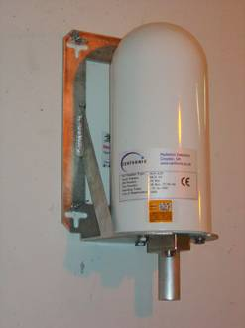
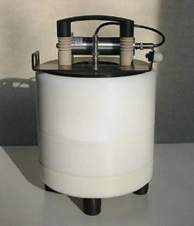
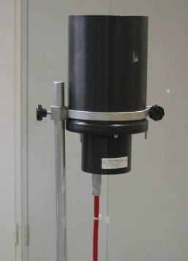
Typical radiation detectors used at CERN for high-energy particle fields
High pressure ionization chamber
REM counter
Air filled ionization chamber

Slide 50
IG5 monitor (high pressure ionization chamber)
Used mainly in accessible areas during machine operation
Comes in two flavours
H-filled type: Calibrated to neutron sources
Ar-filled type: Calibrated to photon sources

Slide 51
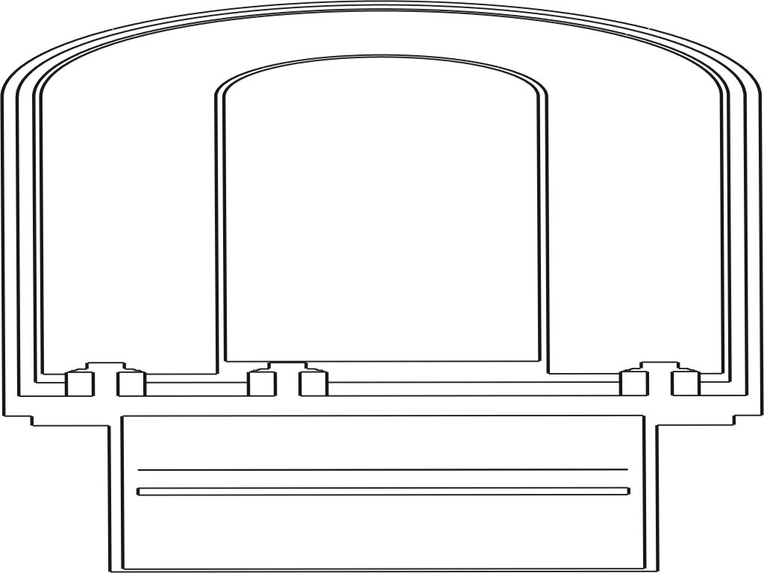
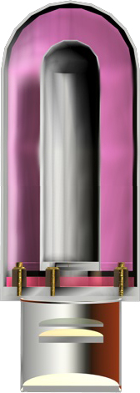
IG5 - Design
Properties
2 types (Ar or H filled)
5,2 l active volume
pressurized at 20 bar
1200 V high-voltage
electrodes
Dimensions
diameter – 18.33 cm
height – 45.6 cm
active medium
electronics
board
Notes:
Electronics = 60% epoxy resin, 35% silicon, 2.5% copper, 2.5% carbon

Slide 52
Summary of IG5 chamber responses (Ar versus H)
IG5 argon type
10 times stronger sensitivity to charged particles and photons when being compared to H-type
➔Detector response in mixed fields is strongly triggered by charged particles (e.g. muons) and photons
IG5 hydrogen type
Strong sensitivity to neutrons at energies relevant behind thick shielding.
Reduced sensitivity to charged particles compared to the Ar type➔ total detector response in a neutron dominated field is dominated by neutron triggered counts

Slide 53
Locations of IG5 chambers in our accelerator environment
IG5 Argon type
IG5 hydrogen type
To be used at locations where the dose is dominated by photons or charged particles:
Close to gamma sources (e.g.: ion exchangers of cooling water)
Behind massive beam dumps or shielding downstream high-energy beam loss points (muons dominating dose)
To be used at locations where the dose is dominated by neutrons:
Behind lateral shielding (e.g.: LHC experiments)
upstream of beam loss points
at the end of mazes
Target or loss point
Target or loss point
beam
IG5-Ar
Shielding
beam
dump
IG5-H

Slide 54
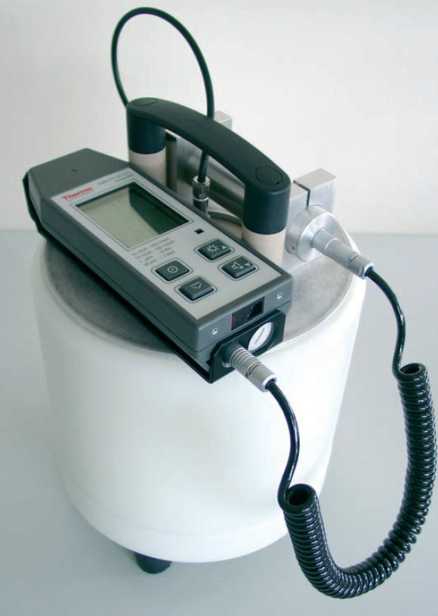
REM counters adapted to high-energy neutron fields (WENDI2 detector)
To be used in neutron dominated areas (beam-on)

Slide 55
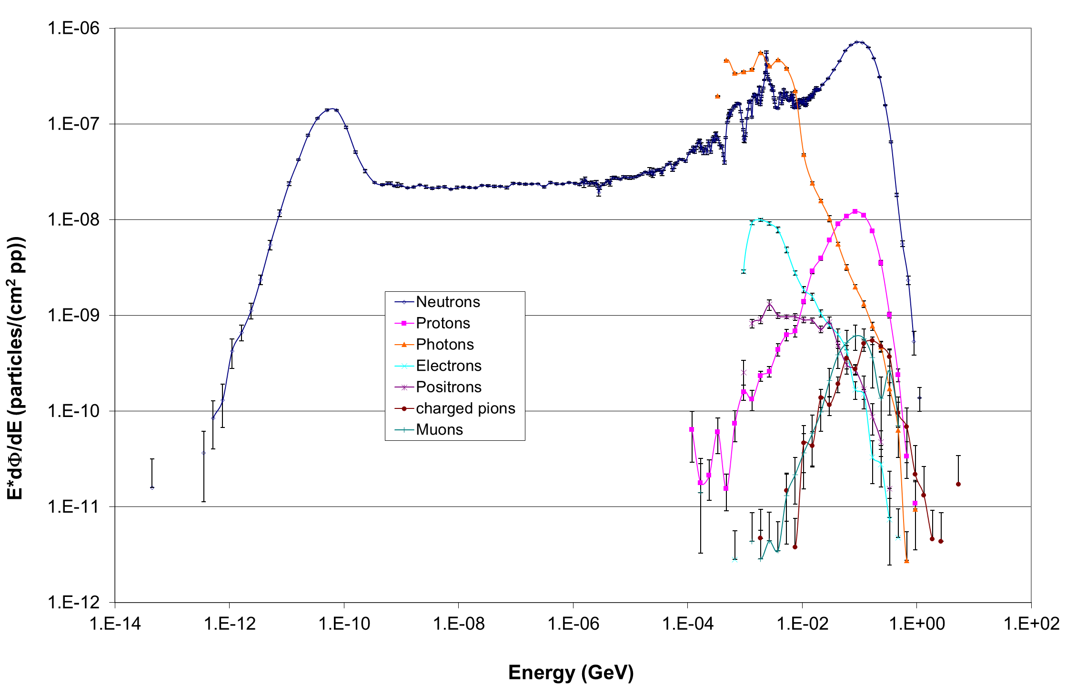
Reminder to our typical radiation fields behind lateral shielding in accelerators
Target or loss point
Majority of dose originates from neutrons in the energy range of a few hundred of keV to a few hundred of MeV
beam
Shielding
Radiation Detector
Detector is sensitive to neutrons only!!!

Slide 56
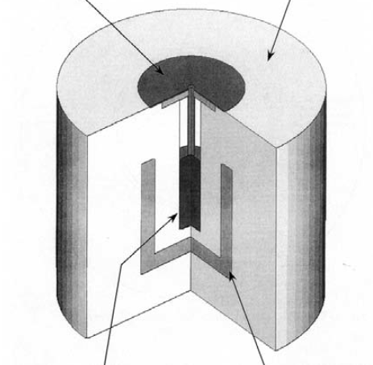
Neutron detector used at CERN:
FHT 762 Wendi-2
Wide Energy Neutron Detector (Thermo)
Borated rubber
PE cylinder
He-3 counter
W-layer
Reference: Olsher et al, Health Physics, 79(2): 170ff, 2000
This instrument is sensitive up to high neutron-energies but blind to all other particles.
Equivalent instruments exist also from other companies

Slide 57
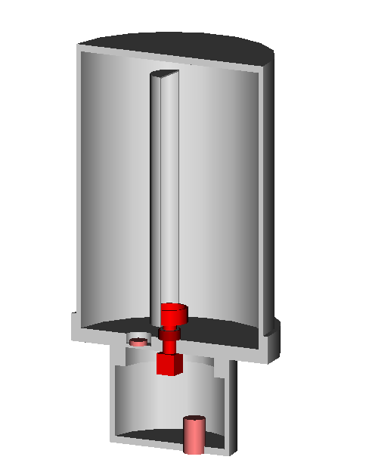
PMI detector (ionization chamber)
PE wall (4mm) / inside graphite coated
15.8 cm
Wall composition: C-H₂
Active volume
Filling gas: air atmospheric pressure
Anode: PE / graphite coated
21.5 cm
Active volume: 3l
28.5 cm
Working voltage: ~460 V
Main installation place: radioactive equipment inside accelerator tunnel.
Various connectors

Slide 58
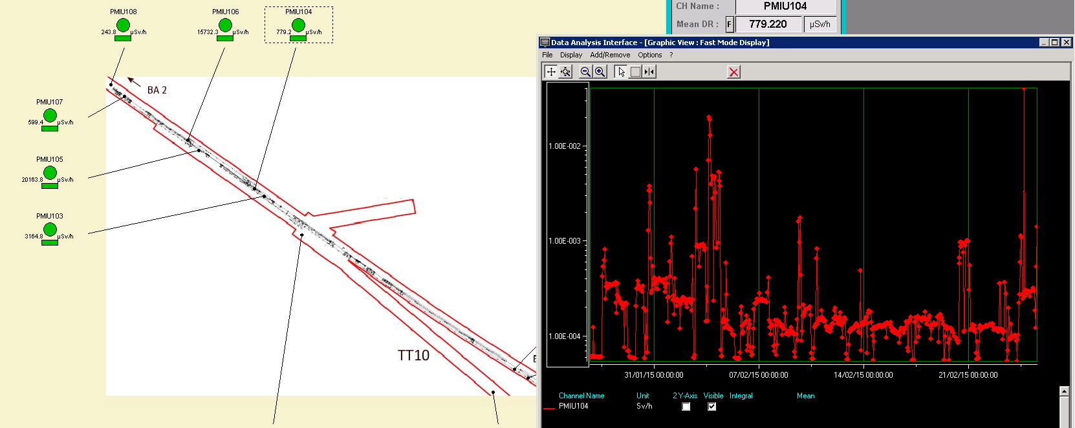
Use of PMI monitors in RAMSES
Main use: remote readout of monitors prior machine intervention when beam is off. ➔ Monitor measures residual dose rate (ambient dose equivalent) coming from activated material in Sv/h.
Secondary use: remote readout of monitors during machine operation. ➔ Monitor measures prompt dose rate (in Gy/h!!! not Sv/h) of the cascade originating from lost particles. The measured value can be interpreted as dose rate in air within an accuracy of 20%.

Slide 59
Monitoring system RAMSES
(RAdiation Monitoring System for Environment and Safety)
CERN Networks
(Ethernet)
Internet
RP Data Base
long term storage
Configuration and
Supervision
Manager
LHC point
(local Network)
RP User
Interface
Remote User
Interface
RP User
Interface
with
location ID
Monitor
Controller
Tap box
Radiation
Monitor
Direct
hardware
connection
Termination
with
ID + local
database
Basic Area
Controller
Display
Control box
Radiation
Display
Termination
Conceptual proposal
Monitor
Controller
Network-based
Area Controller

Slide 60
Summary of
“Radiation detector systems used to measure mixed radiation fields at workplaces”
The IG5 chambers are used mainly to monitor accessible areas during beam-on There are two types available:
  The hydrogen type is used mainly behind lateral shielding during beam-on
  The argon type is used mainly to monitor dose behind dumps or close to gamma sources (e.g.: ion exchangers)
REM counters provide a clear discrimination to other particles than neutrons ➔ measuring only the neutron component of a radiation field
The PMI (sometimes called IAM) detector is used to measure residual ambient dose equivalent rate (Sv) during “beam-off”. During beam-on it provides a very good indication for the dose in air (Gy) caused by the given mixed radiation fields

Slide 61
END

