Slide 1
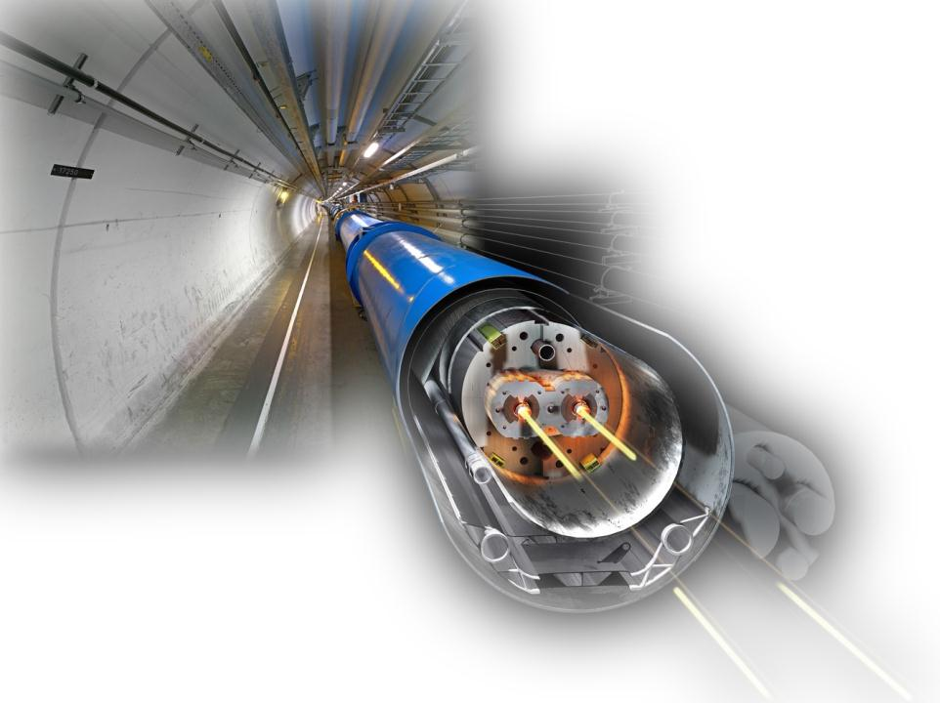
Introduction to activation physics
Christoph Schäfer (many thanks to the HSE RP team)
RSO committee – 1/3/2012

Slide 2
Contents
Basics of activation physics
Hands-on example

Slide 3

J
Basics of activation processes

Slide 4
Basics of activation physics
What is activation?
Activation can be described as the imposed change of nuclear composition of given isotopes resulting in the production of radioactivity
At which particle accelerators can activation occur?
In principle at all high-energy accelerators. However, the radionuclide production rate is much higher at hadron or ion accelerators than those experienced at electron/positron accelerators.
Where does activation occur at accelerators?
At locations with (high) particle losses like:
  Target area
  Dump area
  Beam cleaning sections like collimators and scraper areas
  High-energy physics experiments

Slide 5
Activation processes
Which production mechanisms of activation occur at high-energy accelerators?
At high-energy accelerators primary particles interact with matter. The primary particle itself or secondary particles interacting with nuclei can produce radioactive isotopes. Main production channels of activation at high-energy accelerators are:
  Spallation and other inelastic hadronic interactions ( (n,n’γ), (n,2n), (n,p), (n,α) …)
  Particle capture (mainly neutrons)
  Photodisintegration especially (γ,n)-reactions (important for electron accelerators)
proton
neutron

Slide 6
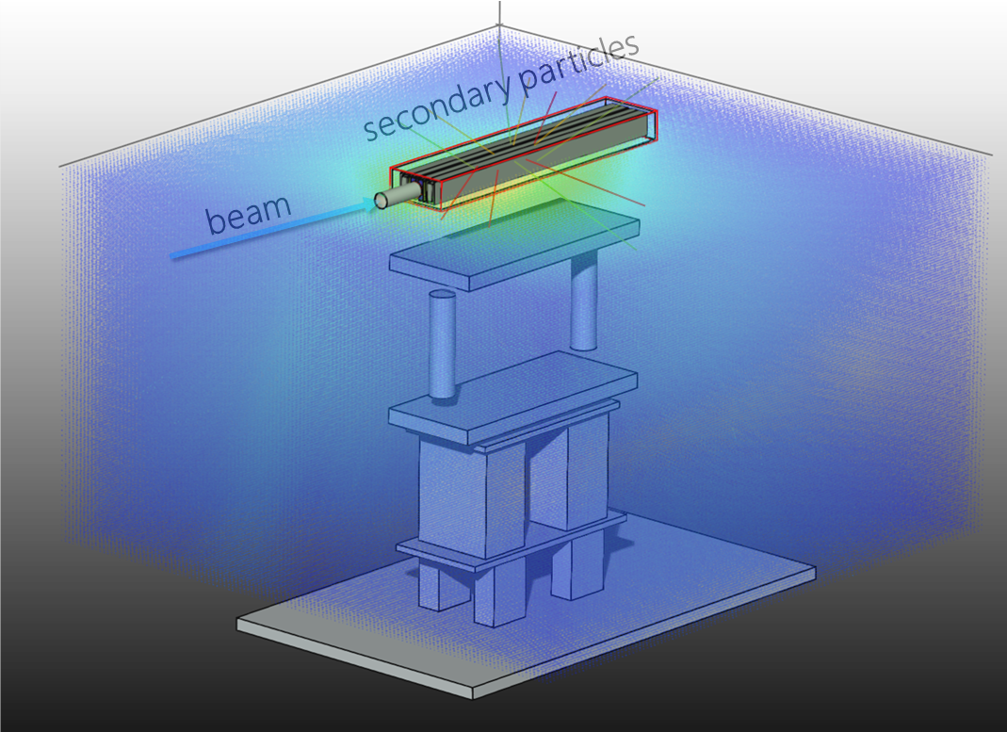
Isotope production
Activation depends on:
chemical composition of target material
incident particle type
incident particle energy
irradiation & cooling time

Slide 7
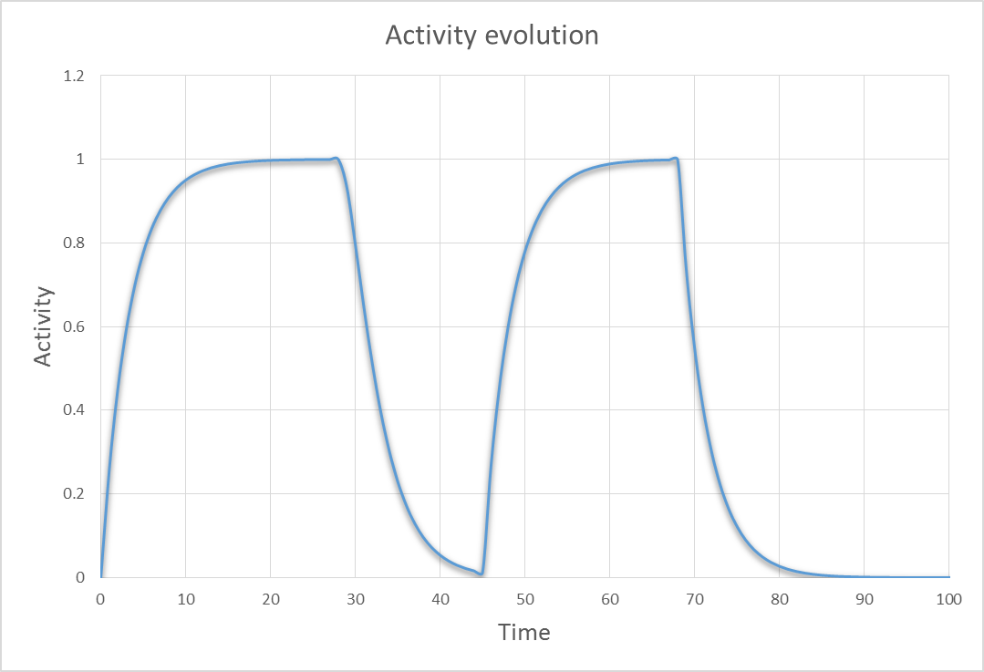




Creation of isotopes at an accelerator
^{110m}Ag
¹¹⁰Ag
Operation
Cool-down
Operation
Cool-down
¹¹⁰Pd
¹¹⁰Cd
¹¹⁰Cd
decay-chains with branching
Operation: direct production + decay
Cool-down: indirect production via decay

Slide 8

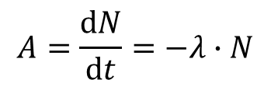
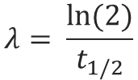
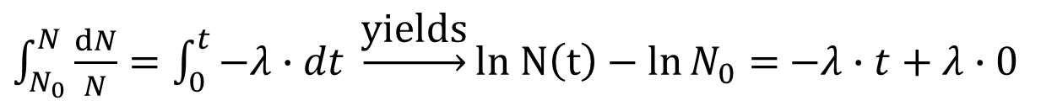

Buildup & decay of isotopes
Decay of a mono-isotopic source described via an ordinary differential equation:
$$A=\frac{dN}{dt}=−λ∙N$$
N … Number of isotopes
… Decay constant of isotope
N₀ … Number of isotopes at t = 0
t_{1/2} … Half life
A … Activity (Bq)
N₀ … Number of isotopes at t = 0
$$λ= \frac{ln⁡(2)}{t_{1/2}}$$
$\int_{N_{0}}^{N}{\frac{dN}{N}}=\int_{0}^{t}{−λ∙dt} \underset{→}{\text{yields}}ln N\left(t\right)−\ln{N_{0}}=$ $−λ∙t+λ∙0$
$$N(t)=N_{0}e^{−λt}$$
$$A(t)=N\left(t\right)∙λ$$

Slide 9
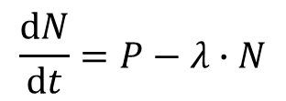
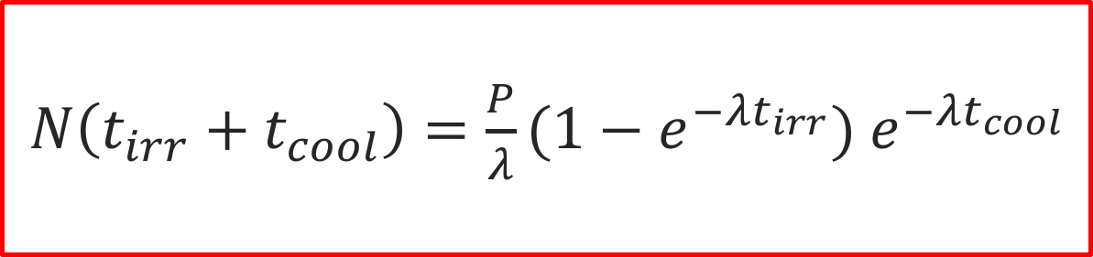
Buildup & decay of isotopes (simple case)
At an accelerator we also need to consider buildup → we need to solve a
differential equations, considering beside the decay also a production term P.
$$\frac{dN}{dt}=P−λ∙N$$
Solution for this simple case:
$N\left(t_{irr}+t_{cool}\right)=\frac{P}{λ}(1−e^{−λt_{irr}})$ $e^{−λt_{cool}}$
!!!
!!!
the production rate P [nuclides/second] is constant
decay chains are neglected
consider only one irradiation & one cooling period

Slide 10

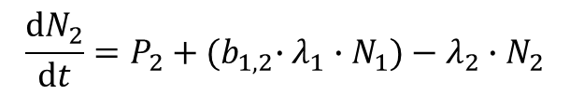
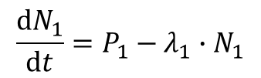
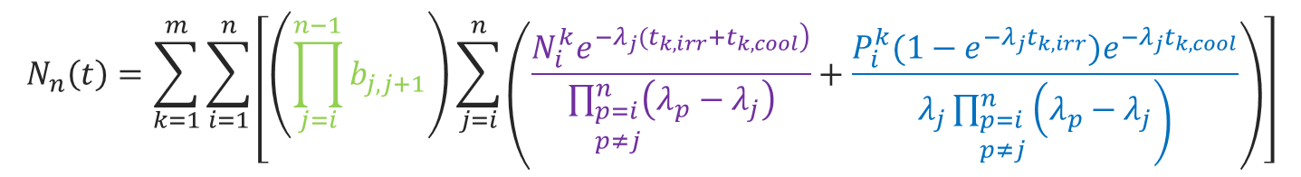
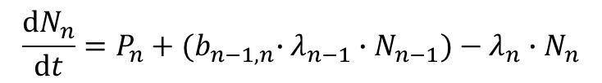
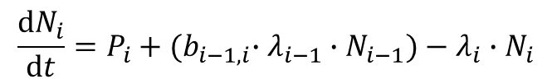
Buildup & decay of isotopes considering decay chains and multiple irradiation+cooling cycles
At accelerators the production & decay described via Bateman equations:
$$\frac{dN_{1}}{dt}=P_{1}−λ_{1}∙N_{1}$$
$$\frac{dN_{2}}{dt}=P_{2}+{{(b}_{1,2}∙λ}_{1}∙N_{1})−λ_{2}∙N_{2}$$
N_{n} … Number of isotope n
P_{n} … Production rate of isotope n
l_{n …} Decay constant of isotope n
b_{n} … Branching ratio from isotope n-1 into n
k … index of irradiation/cooling cycle
…
…
$$\frac{dN_{i}}{dt}=P_{i}+{{(b}_{i−1,i}∙λ}_{i−1}∙N_{i−1})−λ_{i}∙N_{i}$$
Use
…
…
$$\frac{dN_{n}}{dt}=P_{n}+{{(b}_{n−1,n}∙λ}_{n−1}∙N_{n−1})−λ_{n}∙N_{n}$$
or FLUKA
To solve these problems
build-up
decay
… Laplace transform + some algebra
$$N_{n}\left(t\right)=\sum_{k=1}^{m}{\sum_{i=1}^{n}{\left[\left(\prod_{j=i}^{n−1}{b_{j,j+1}}\right)\sum_{j=i}^{n}{\left(\frac{N_{i}^{k}e^{\left.−λ_{j}({t_{k,irr}+t}_{k,cool}\right)}}{\prod_{\begin{aligned}&p=i \\ &p≠j\end{aligned}}^{n}{\left(λ_{p}−λ_{j}\right)}}+\frac{P_{i}^{k}(1−e^{−λ_{j}t_{k,irr}})e^{−λ_{j}t_{k,cool}}}{\left.λ_{j}\prod_{\begin{aligned}&p=i \\ &p≠j\end{aligned}}^{n}{\left(λ_{p}−λ_{j}\right.}\right)}\right)}\right]}}$$
branching
cool-down → decay
operation → build-up & decay

Slide 11
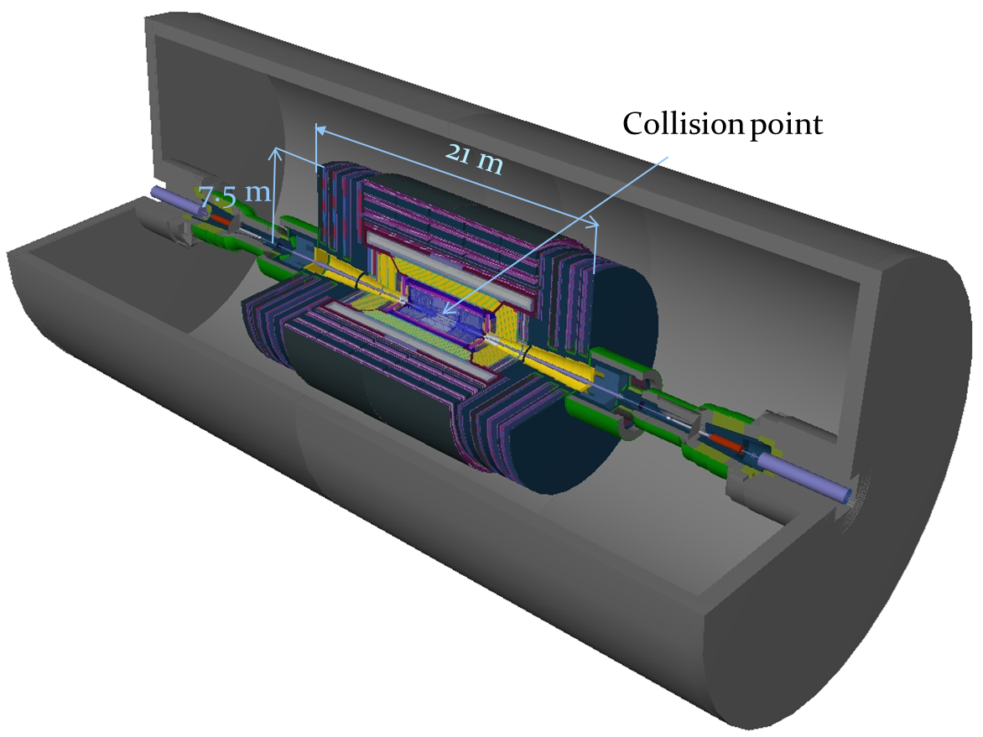
Example of residual activation @ CMS

Slide 12
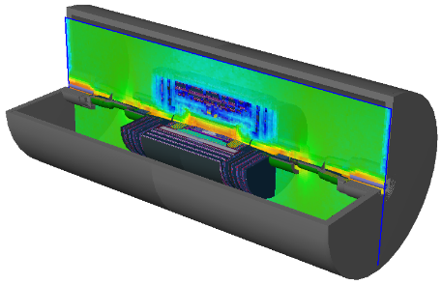
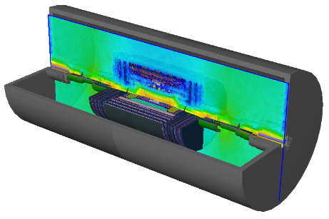
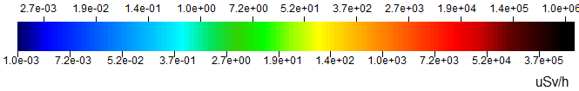
Example of residual activation @ CMS
180 days of irradiation,
10⁹ pp/s, 1h of cooling
180 days of irradiation,
10⁹ pp/s, 1d of cooling

Slide 13
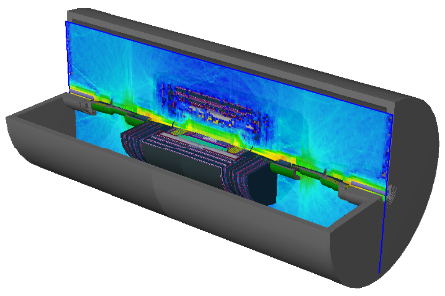
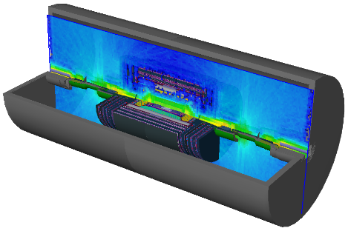
Example of residual activation @ CMS
180 days of irradiation,
10⁹ pp/s, 1w of cooling
180 days of irradiation,
10⁹ pp/s, 1m of cooling

Slide 14
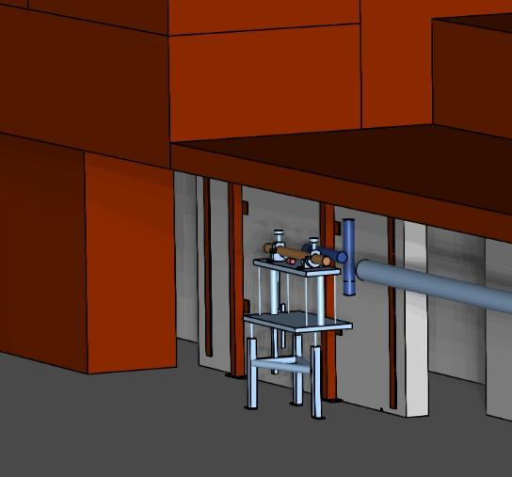
Air activation
Beam traversing air
High-energy particles and neutrons are crossing the air which is surrounding beam impact points
Target
Beam pipe
Production of radioactive air.
Problems to be considered:
People entering the area are exposed to and inhale the radioactive air
Release of airborne radioactivity to the environment

Slide 15
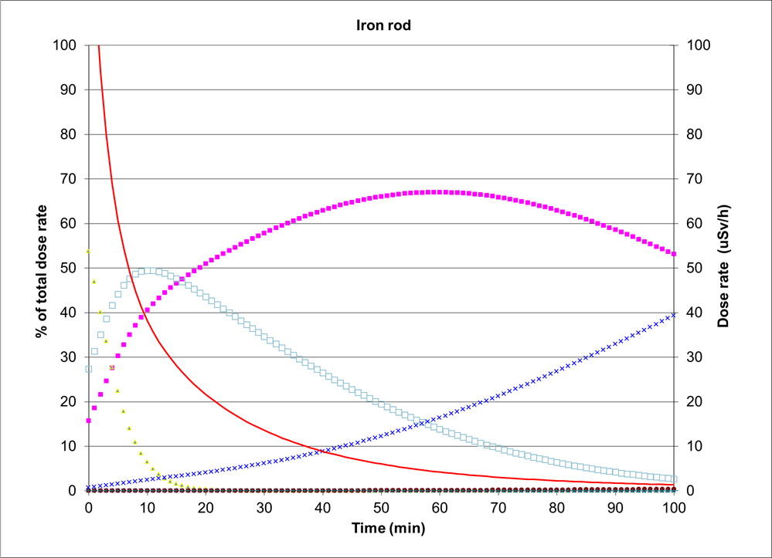
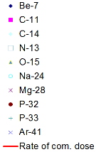
Air activation example
Example: Beam loss on an unshielded object in the SPS tunnel
(short term irradiation of air)
Different main contributors to airborne radioactivity at different cooling times
Long lived isotopes (e.g. Be-7) become important for confined spaces for longer irradiation and cooling times

Slide 16

Exercise
Saturation level
Operation
After which irradiation time (expressed in multiples of half-lives) do we reach 90%
of the maximum saturation activity? (No cooling!)
Hints:
$N\left(t_{irr}+t_{cool}\right)=\frac{P}{λ}(1−e^{−λt_{irr}})$ $e^{−λt_{cool}}$

Slide 17

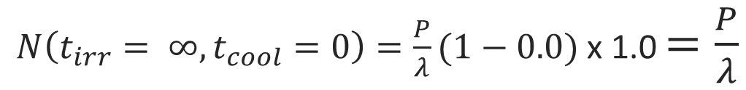








Solution of the excercise
$N\left(t_{irr}+t_{cool}\right)=\frac{P}{λ}(1−e^{−λt_{irr}})$ $e^{−λt_{cool}}$
We talk about irradiation only, hence t_{cool} is 0.
Full saturation occurrs after infinite time.
Hence the full saturation level is given with:
$N\left(t_{irr}= ∞,t_{cool}=0\right)=\frac{P}{λ}(1−0.0)$ x 1.0 $=\frac{P}{λ}$
We are looking now for 90% of the saturation level
$0.9×\frac{P}{λ}=\frac{P}{λ}(1−e^{−λt_{irr}})$
$0.9= 1−e^{−λt_{irr}}$
$0.1= e^{−λt_{irr}}$
/ ln
$$−2.3=−λt_{irr}$$
$$2.3/λ=t_{irr}$$
with
$$λ= \frac{ln⁡(2)}{t_{1/2}}$$
$$t_{irr}=2.3/\ln\left(2\right)×t_{1/2}$$
$$t_{irr}=3.3×t_{1/2}$$

Slide 18
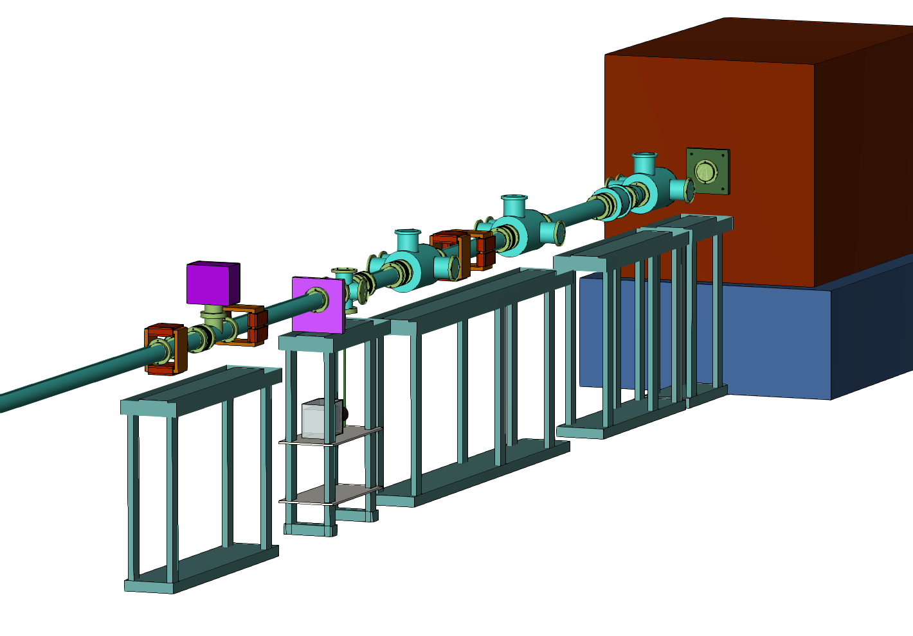
Reduction of radioactive waste
Optimization already crucial during the design phase
Beside other aspects also the radiological consequences of the implementation of a material have to be considered
Level of activation depends on the type of the material
Safety benefit
Operational benefit
End of life-cycle benefit
  Lower dose rates and committed doses
  Reduced downtime due to faster access
  Less restrictions for manipulation & access
  Smaller amount and less critical radioactive waste
  Smaller financial burden
S. Myers initiated the project concerning the radiological classification of materials

