Slide 2
Collective effects Part I:
Introduction and space charge effect
Giovanni Rumolo
In Doctoral studies course “Accelerator Technologies” (HEP700) 2024
https://indico.cern.ch/event/1381698/

Slide 3
Outline
In this introductory part, we will first provide a qualitative description of collective effects and their impact on particle beams.
We will then introduce one first collective effect, known as space charge and will show its possible effects. This will be the first step towards other types of collective effects involving the parasitic interaction of the beam with its surrounding (next lectures).
Part 1: Introduction + space charge
  Introduction to collective effects
  Examples of coherent and incoherent effects
  Space charge
    Basic concepts
    Tune shift and tune spread
Notes:
Perhaps other way round

Slide 4
What are collective effects?
We will study the dynamics of charged particle beams in a particle accelerator environment, taking into account the beam self-induced electromagnetic fields, i.e. not only the impact of the machine onto the beam but also the impact of the beam onto the machine.

Slide 5
What are collective effects?
We will study the dynamics of charged particle beams in a particle accelerator environment, taking into account the beam self-induced electromagnetic fields, i.e. not only the impact of the machine onto the beam but also the impact of the beam onto the machine.
First step → Coordinates system we will use throughout this set of lectures
  The origin O is moving along with the “synchronous particle”, i.e. a reference particle that has the design momentum and follows the design orbit
  Transverse coordinates x (Horizontal) and y (Vertical) relative to reference particle (x,y << R), typically x is in the plane of the bending
  Longitudinal coordinate z relative to reference particle
  Position along accelerator is described by independent variable s = vt

Slide 6
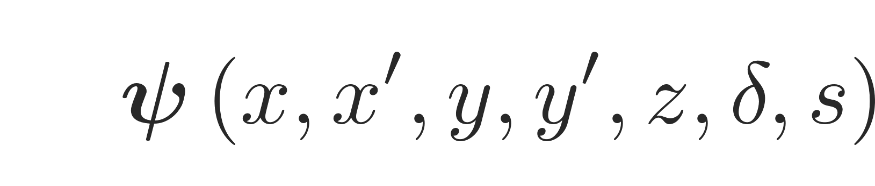
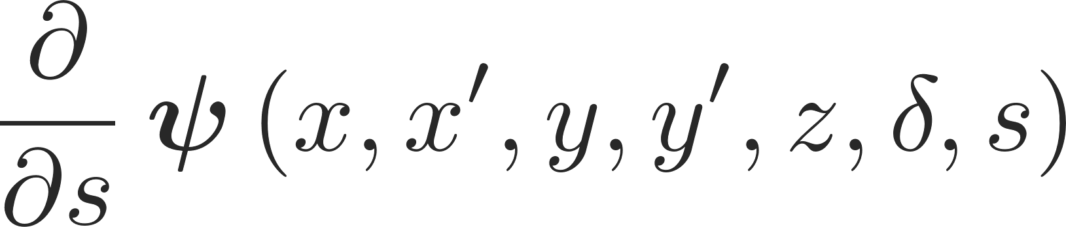
What are collective effects?
A charged particle beam is generally described as a multiparticle system via the coordinates and the canonically conjugate momenta of all of its particles – this makes up a distribution in the 6-dimensional phase space which can be described by a particle distribution function.
Hence, we will study the evolution of the phase space occupied by this particle distribution (and described by its particle distribution function):

Slide 7
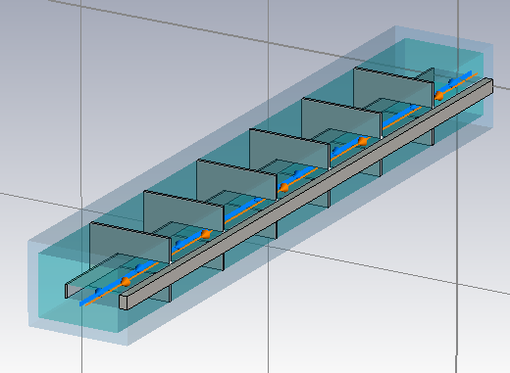
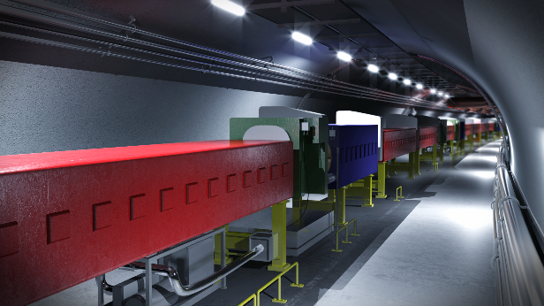
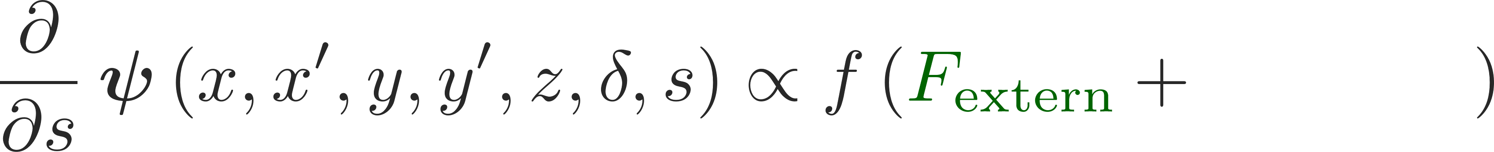
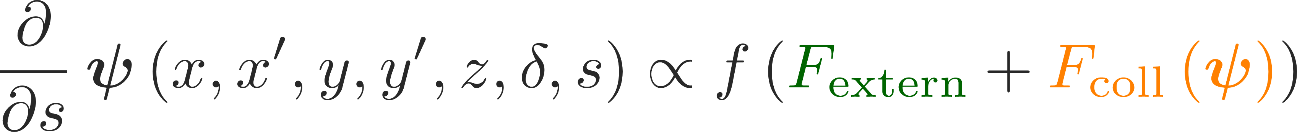
What are collective effects?
A charged particle beam is generally described as a multiparticle system via the coordinates and the canonically conjugate momenta of all of its particles – this makes up a distribution in the 6-dimensional phase space which can be described by a particle distribution function.
Hence, we will study the evolution of the phase space occupied by this particle distribution (and described by its particle distribution function):
  Optics defined by the machine lattice provides the external force fields (magnets, electrostatic fields, RF fields), e.g. for guidance and focusing
  Collective effects add to this distribution dependent force fields (space charge, wake fields)

Slide 8
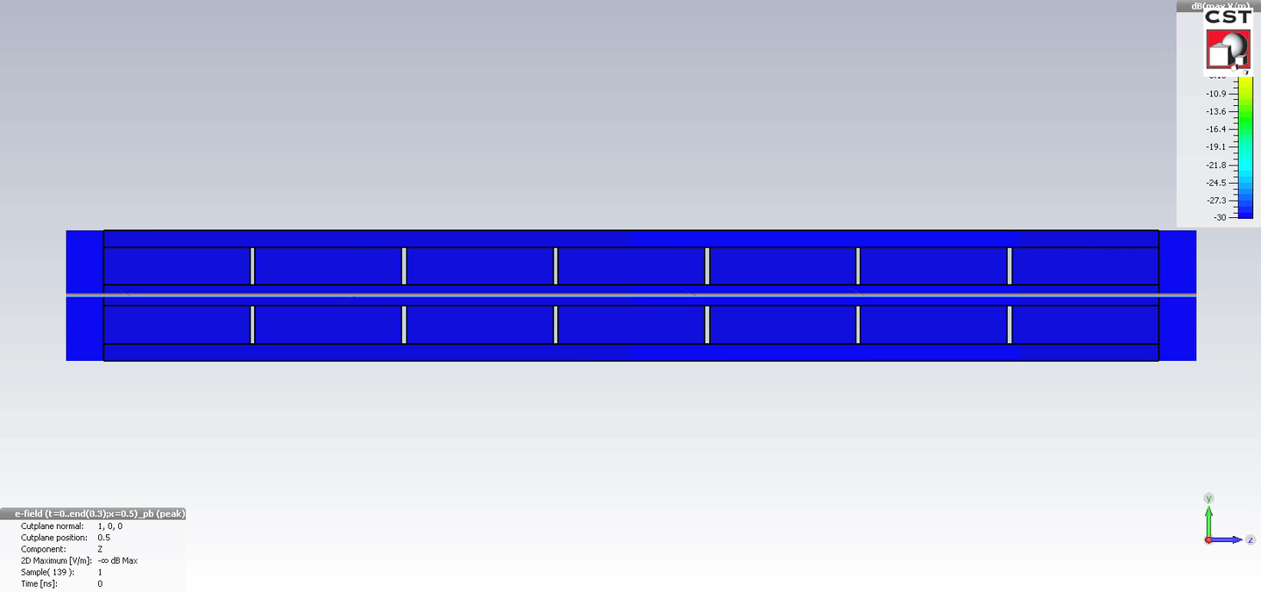

What are collective effects?
A charged particle beam is generally described as a multiparticle system via the coordinates and the canonically conjugate momenta of all of its particles – this makes up a distribution in the 6-dimensional phase space which can be described by a particle distribution function.
Hence, we will study the evolution of the phase space occupied by this particle distribution (and described by its particle distribution function):
  Optics defined by the machine lattice provides the external force fields (magnets, electrostatic fields, RF fields), e.g. for guidance and focusing
  Collective effects add to this distribution dependent force fields (space charge, wake fields)
For a multiparticle system this self-consistent equation becomes arbitrarily complex and practically impossible to solve
Obtaining the multiparticle dynamics very often requires computer simulation codes

Slide 9
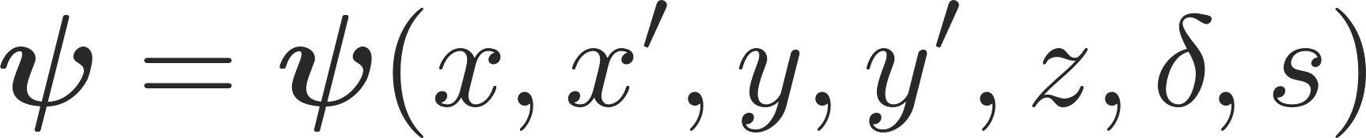
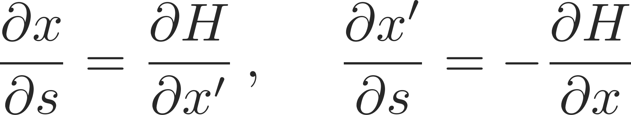
Formal description of collective beam motion
Formally, instead of investigating the full set of equations for a multiparticle system, we typically instead describe the latter by a particle distribution function:
where
The accelerator environment together with the multiparticle system forms a Hamiltonian system for which the Hamilton equations of motion hold:

Slide 10
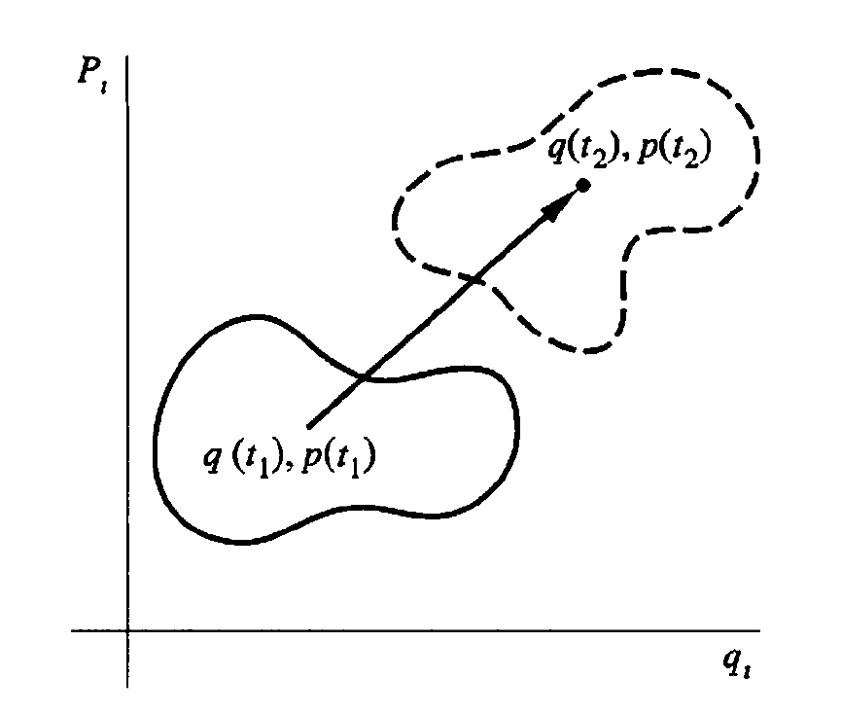
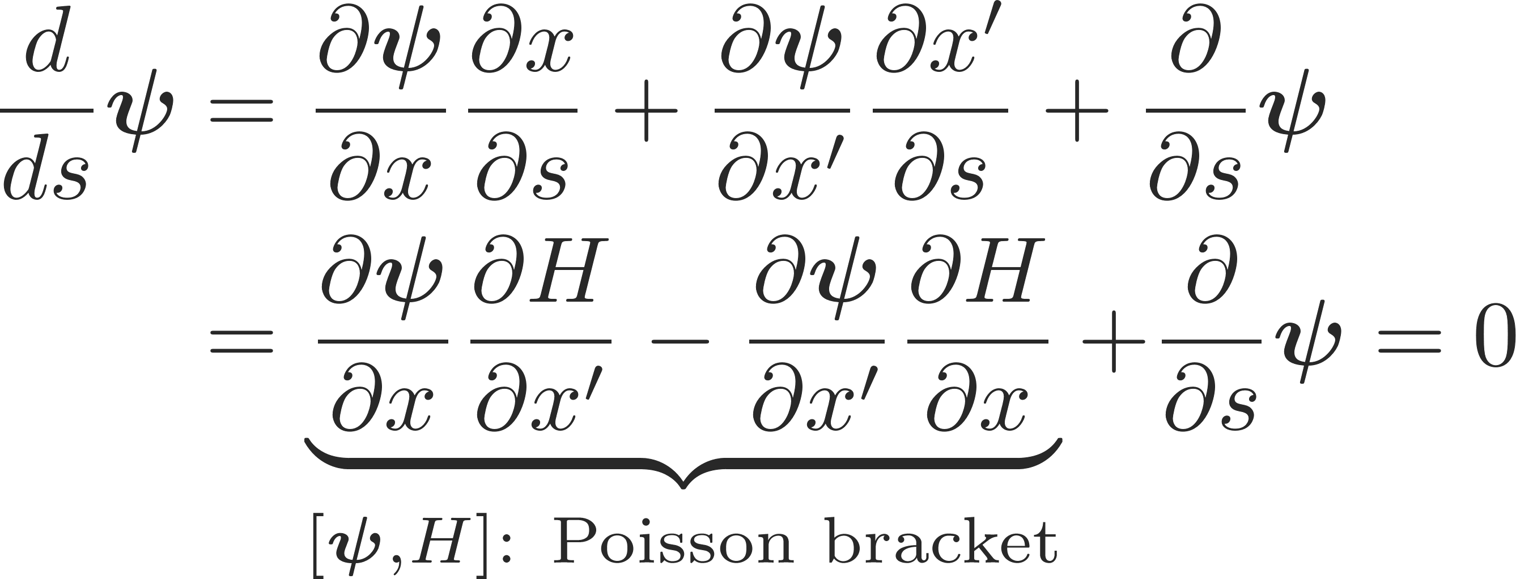
Formal description of collective beam motion
Formally, instead of investigating the full set of equations for a multiparticle system, we typically instead describe the latter by a particle distribution function:
where
The accelerator environment together with the multiparticle system forms a Hamiltonian system for which the Hamilton equations of motion hold:
We can now derive the Vlasov equation which forms the foundation of the theoretical treatment of beam dynamics with collective effects:
Consider an infinitesimal volume element dΩ containing a finite number of particles dN in phase space which evolve in time
  dN is conserved as no particles can enter or leave the area (Picard-Lindelöf)
  dΩ is conserved by means of the Hamilton equations of motion
It follows that:

Slide 11
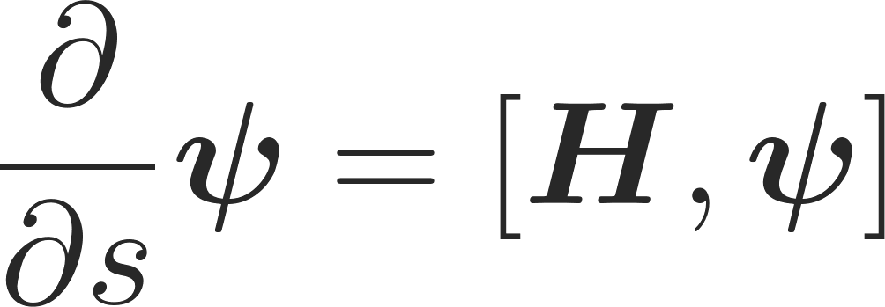
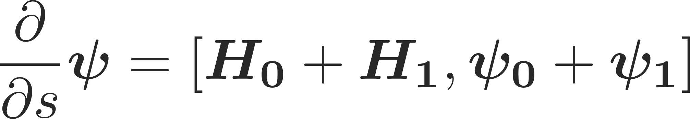
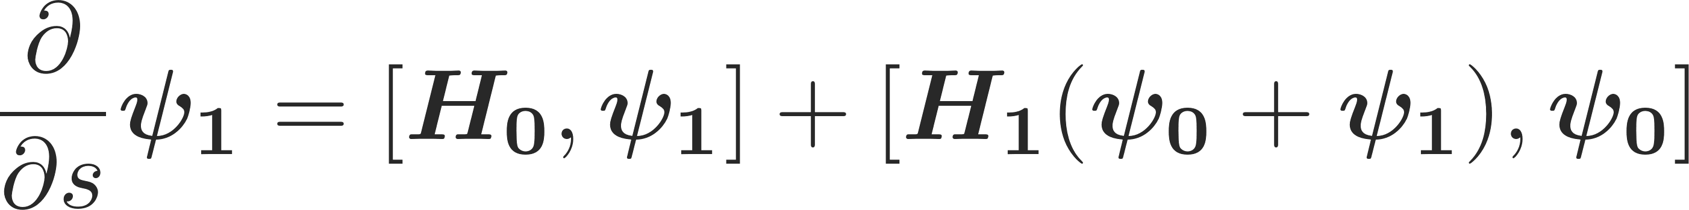
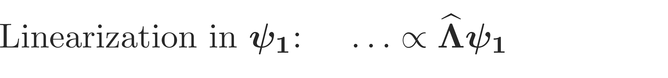
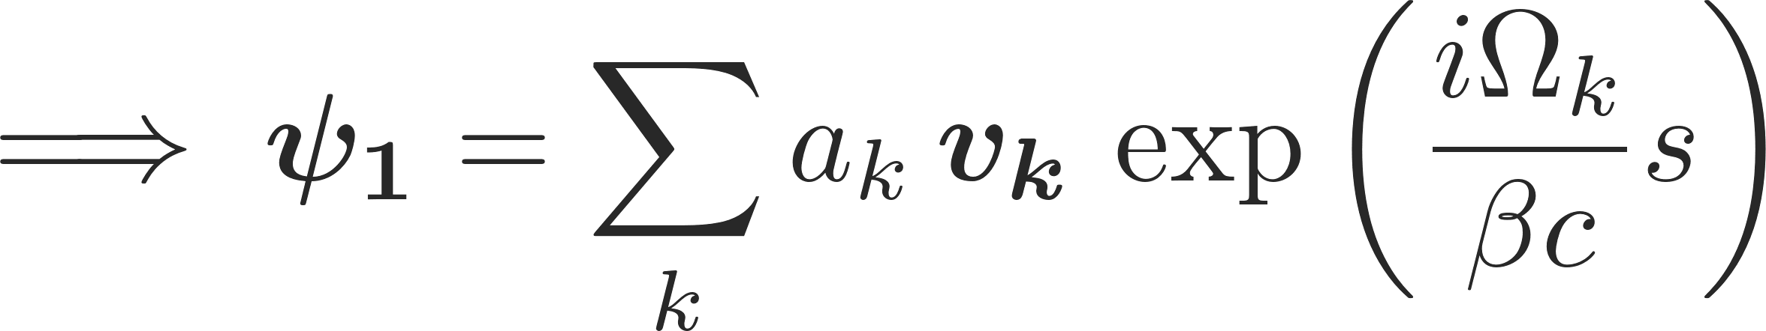
Formal description of collective beam motion
The evolution of a multiparticle system is given by the evolution of its particle distribution function
With the Hamiltonian composed of an external and a collective part, and the particle distribution function decomposed into an unperturbed part and a small perturbation one can write
This becomes to first order
Spatial component
Temporal component
We are looking for the EV of the evolution → becomes an EV problem!

Slide 12
Formal description of collective beam motion
The evolution of a multiparticle system is given by the evolution of its particle distribution function
With the Hamiltonian composed of an external and a collective part, and the particle distribution function decomposed into an unperturbed part and a small perturbation one can write
This becomes to first order
  We call these distinct eigenvalues ψ_{k} the coherent k-mode.
  The mode and thus for example also an instability is fully characterized by a single number:
  the complex tune shift Ω_{k}
Spatial component
Temporal component
We are looking for the EV of the evolution → becomes an EV problem!

Slide 13
Formal description of collective beam motion
The evolution of a multiparticle system can also be studied via direct macro-particle simulation
  Number of macro-particles needs to be chosen to have results statistically significant but in reasonable execution times within the available computing power
Here we need to solve numerically a set of equations of motion corresponding to macro-particles representing the beam
  The driving terms of these equations are the EM fields externally applied as well as the EM fields generated by the macro-particle distribution itself
  Therefore, we typically need to couple with an EM solver
y
z
x
Solutions of Maxwell’s equations

Slide 14

Signpost
We have seen the difference between external forces and self-induced forces and how these lead to collective effects.
We have seen schematically how these collective effects can induce coherent beam instabilities and some knobs to avoid them.
We have briefly sketched the theoretical framework within which the beam dynamics of collective effects is usually treated – we have encountered the Vlasov equation, bunch / beam eigenmodes and the complex tune shift.
Part 1: Introduction + space charge
  Introduction to collective effects
  Examples of coherent and incoherent effects
  Space charge
    Basic concepts
    Tune shift and tune spread
Notes:
Now we need to learn ho to describe/model these effects

Slide 15
Coherent effects
Coherent effects, characterized by centroid motion, are mainly associated with beam instabilities
  The onset of a beam instability usually determines the maximum beam intensity that a machine can store/accelerate (performance limitation)
  Understanding the type of instability limiting the performance, and its underlying mechanism, is essential because it:
    Allows identifying the source and possible measures to mitigate/suppress the effect
    Allows providing the specifications of an active feedback system to prevent the instability

Slide 16
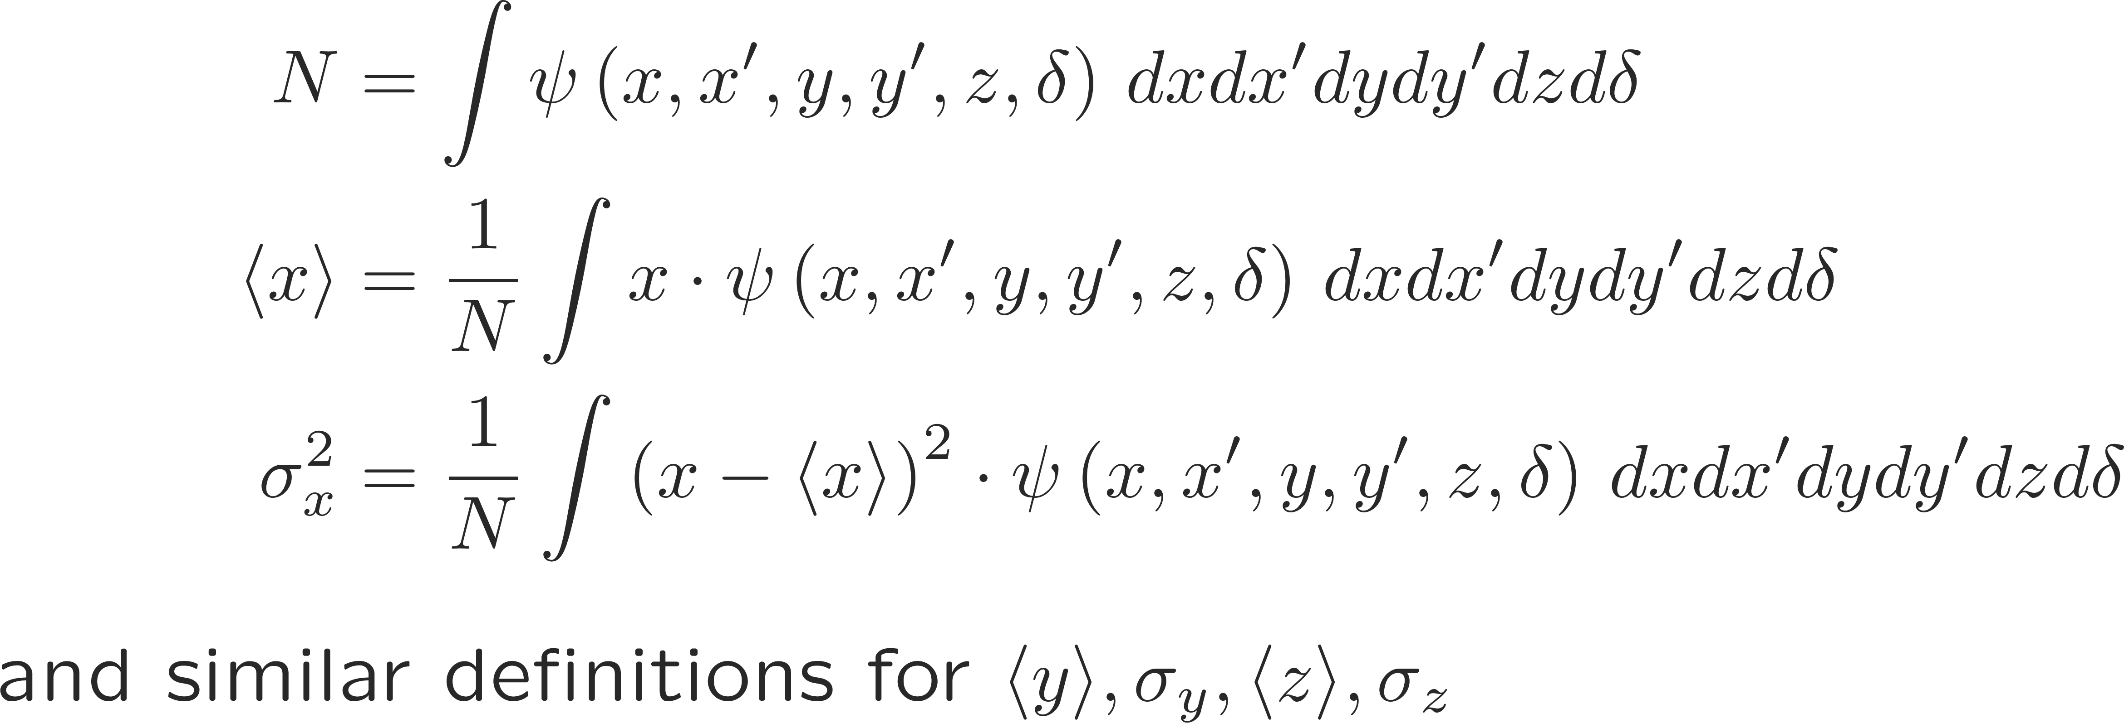
What is a beam coherent instability?
A beam becomes unstable when a moment of its distribution exhibits an exponential growth (e.g. mean positions, standard deviations, etc.), resulting into beam loss or emittance growth!

Slide 17
The instability loop
Multi-bunch beam
s = vt
Equations of motion of the beam particles
Interaction with the external environment
Additional electromagnetic field acting on the beam, besides RF and external magnetic fields

Slide 18
The instability loop
Multi-bunch beam
s = vt
Equations of motion of the beam particles
Interaction with the external environment
Additional electromagnetic field acting on the beam, besides RF and external magnetic fields
When the loop closes, either the beam will find a new stable equilibrium configuration …

Slide 19
The instability loop
Multi-bunch beam
s = vt
Equations of motion of the beam particles
Interaction with the external environment
Additional electromagnetic field acting on the beam, besides RF and external magnetic fields
… or it might develop an instability along the bunch train …

Slide 20
The instability loop
Multi-bunch beam
s = vt
Equations of motion of the beam particles
Interaction with the external environment
Additional electromagnetic field acting on the beam, besides RF and external magnetic fields
… or also an instability affecting different bunches independently of each other

Slide 21
The instability loop
Multi-bunch beam
s = vt
Act on the right side of the loop
→ Minimise the creation of EM fields potentially detrimental to the beam
Equations of motion of the beam particles
Interaction with the external environment
Additional electromagnetic field acting on the beam, besides RF and external magnetic fields
This will translate eventually into reducing/controlling/optimising the impedance of the single components of an accelerator ring

Slide 22
The instability loop
Multi-bunch beam
s = vt
Act on the left side of the loop
→ Introduce stabilising terms in the equations of motion
Equations of motion of the beam particles
Interaction with the external environment
Additional electromagnetic field acting on the beam, besides RF and external magnetic fields
This will translate eventually adding cooling/damping terms or nonlinear driving terms that can provide stabilisation of the system through frequency spread

Slide 23
The instability loop
Multi-bunch beam
s = vt
… or we actively create another loop in which we first detect a selected moment of the beam distribution and we then kick the particles accordingly to cancel deviations from the desired steady state
Equations of motion of the beam particles
Interaction with the external environment
Additional electromagnetic field acting on the beam, besides RF and external magnetic fields
Kick beam particles
Detect
moments

Slide 24
Incoherent effects
Incoherent effects, in which typically no centroid motion is detectable, are mainly associated with emittance growth, halo and tail formation, slow losses
  The strength of the excitation is not sufficient, or sufficiently resonant, to build up into a coherent centroid motion
  They also result in performance limitations, as they can lead to intolerable loss of beam brightness due to emittance blow-up or intolerable level of losses in a machine leading to equipment activation or even damage

Slide 25
Coherent and incoherent effects
Observation of a transverse coherent instability
  The beam centroid, detected by a beam position monitor (BPM), exhibits an exponential growth on the scale of tens to thousands of turns (typically μs-ms)
BPM
y
Unstable beam
z
Beam Current Transformer
x
I(t)

Slide 26
Coherent and incoherent effects
Observation of a transverse incoherent effect
  The beam exhibits slow losses (on the time scale of the cycle or store) and emittance growth visible on beam profile monitors
Beam Profile Monitor
Beam Position Monitor
Beam Profile Monitor
Stable beam
I(t)
Beam Current Transformer
Several seconds or several hours

Slide 27
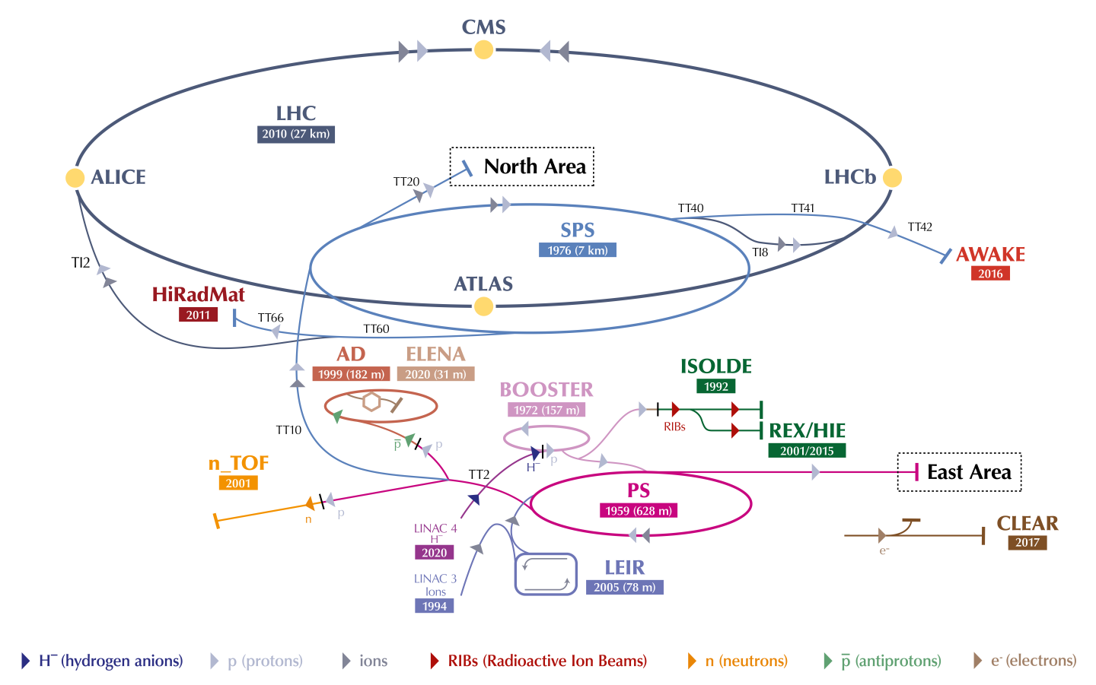
The CERN accelerator complex

Slide 28
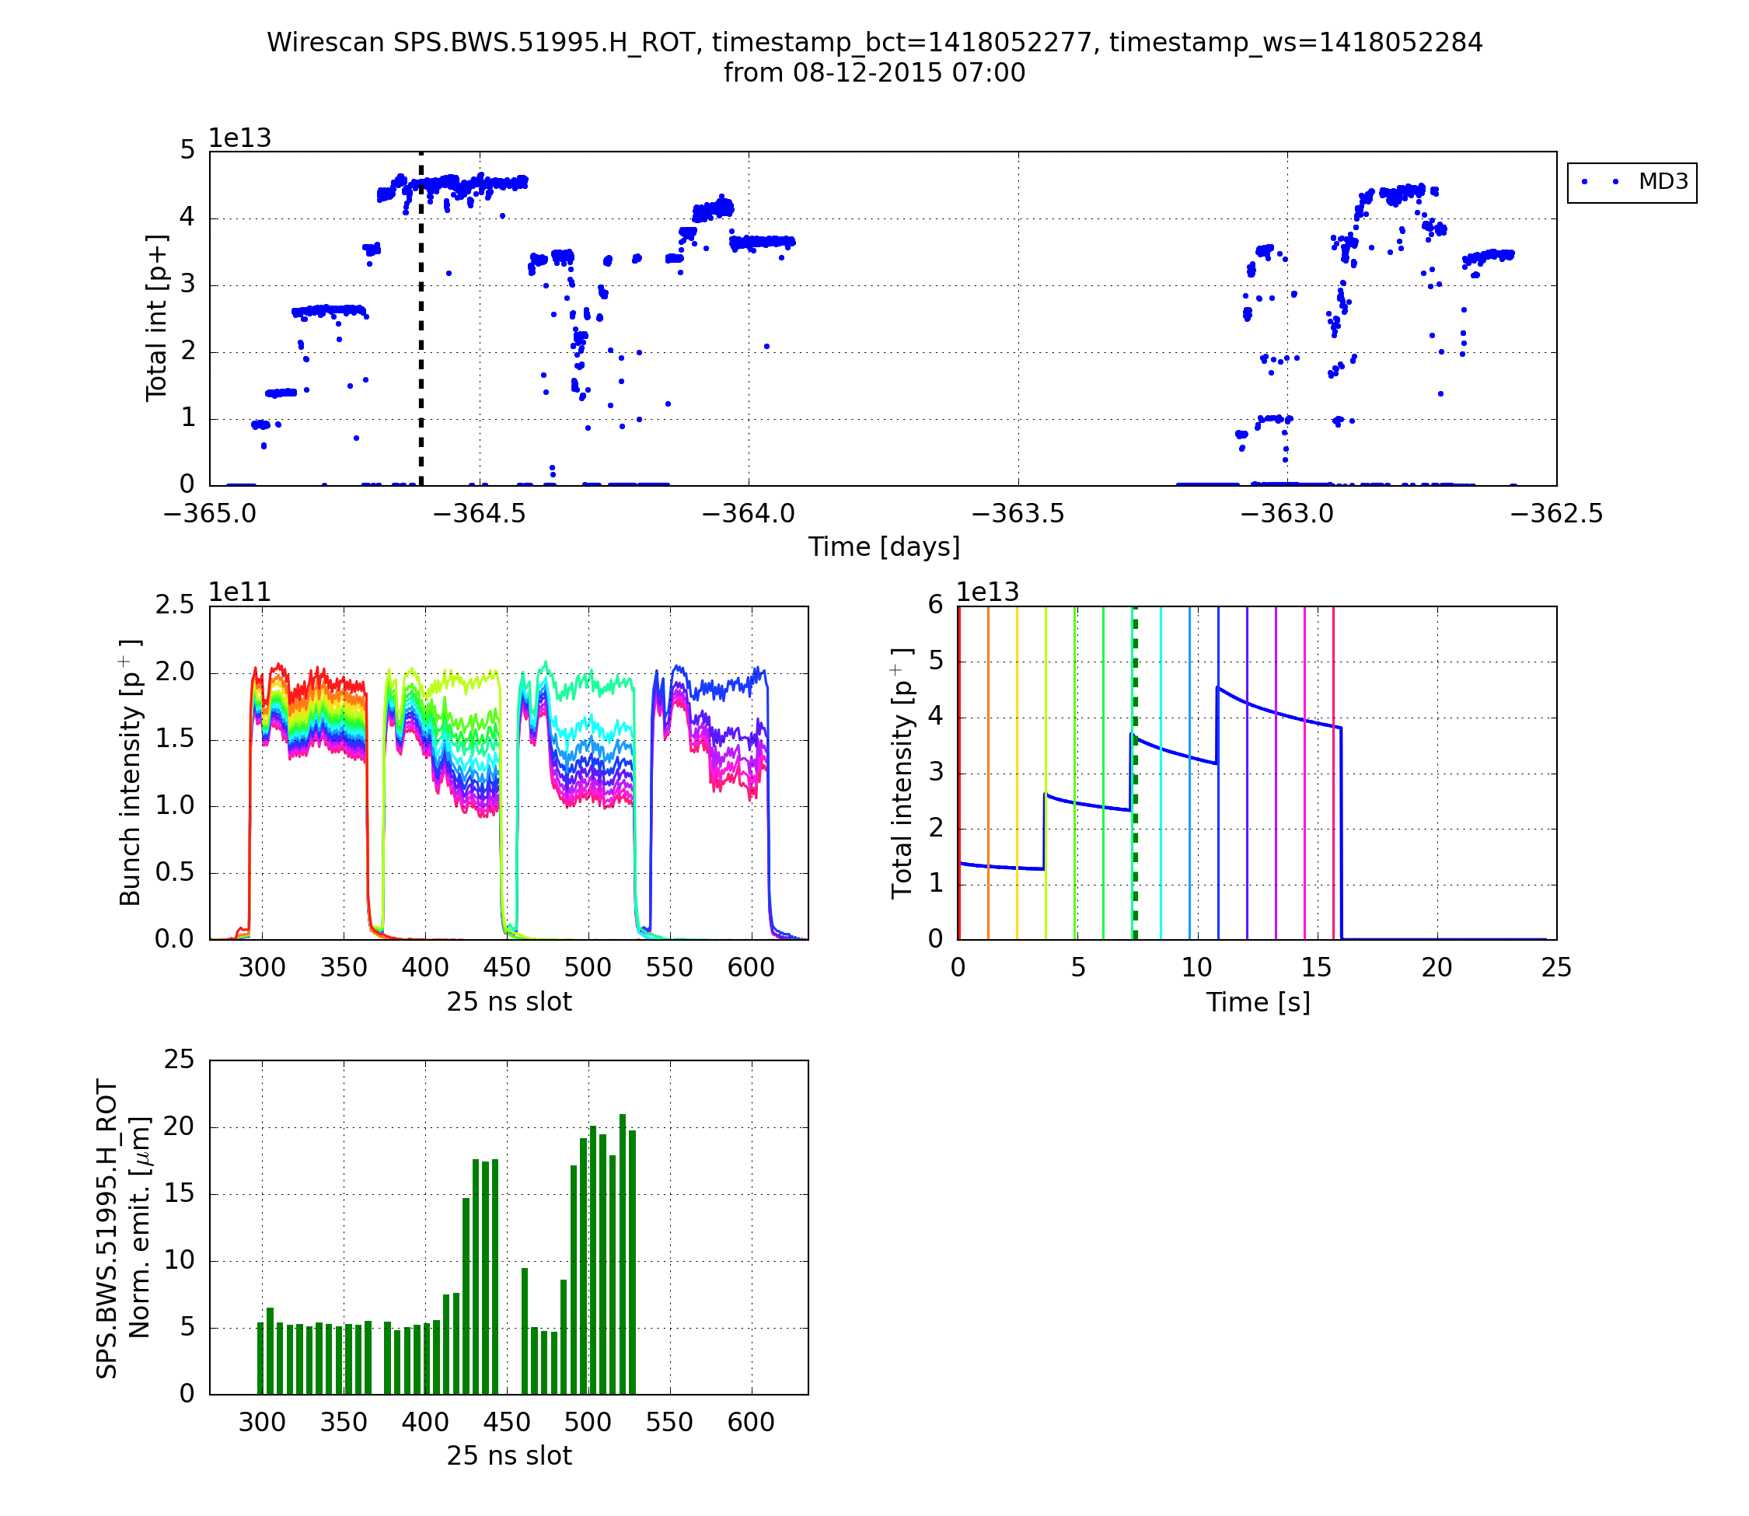
Coupled bunch instability in the SPS
72 bunches per injection
Injection of 4 batches of 72 bunches trains into the SPS
Later trains feature strong losses (intensity) and large blow-up (emittance) – this leads to a strong loss of beam brightness
Intensity
Beam size

Slide 29
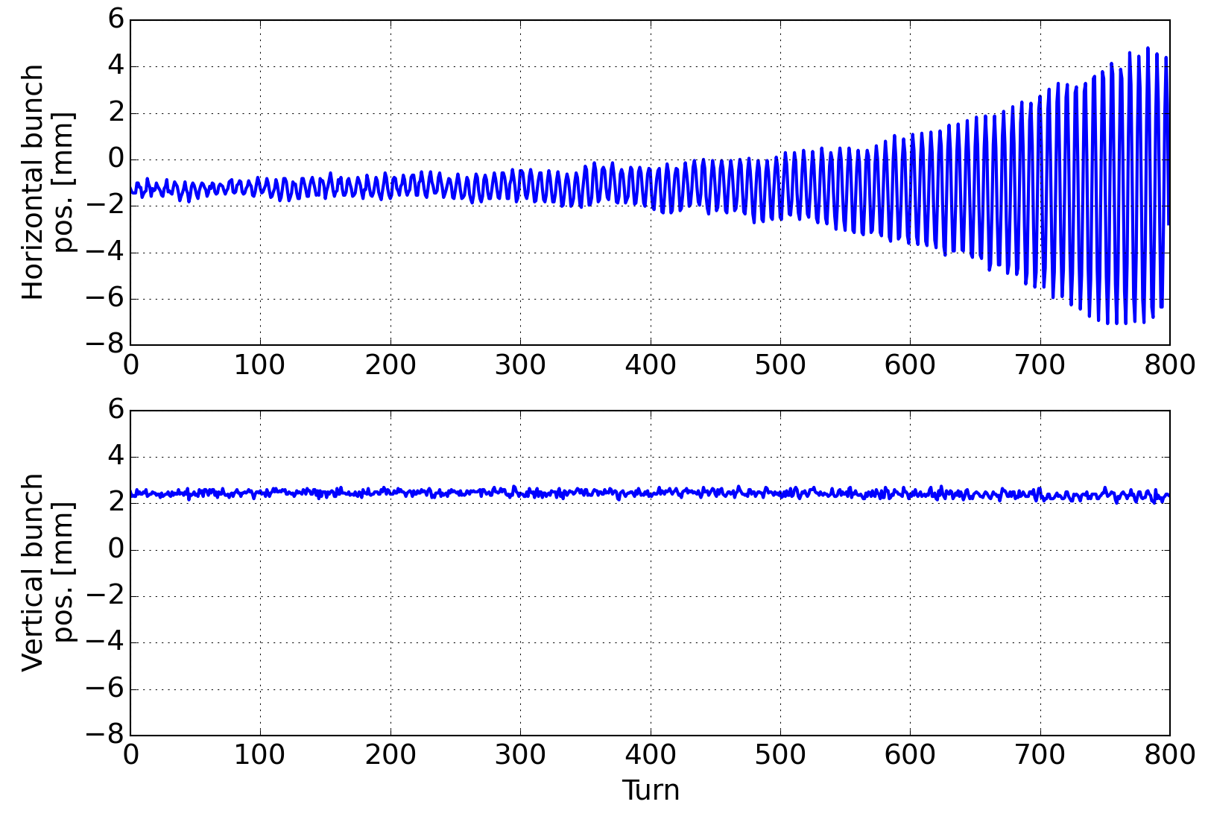
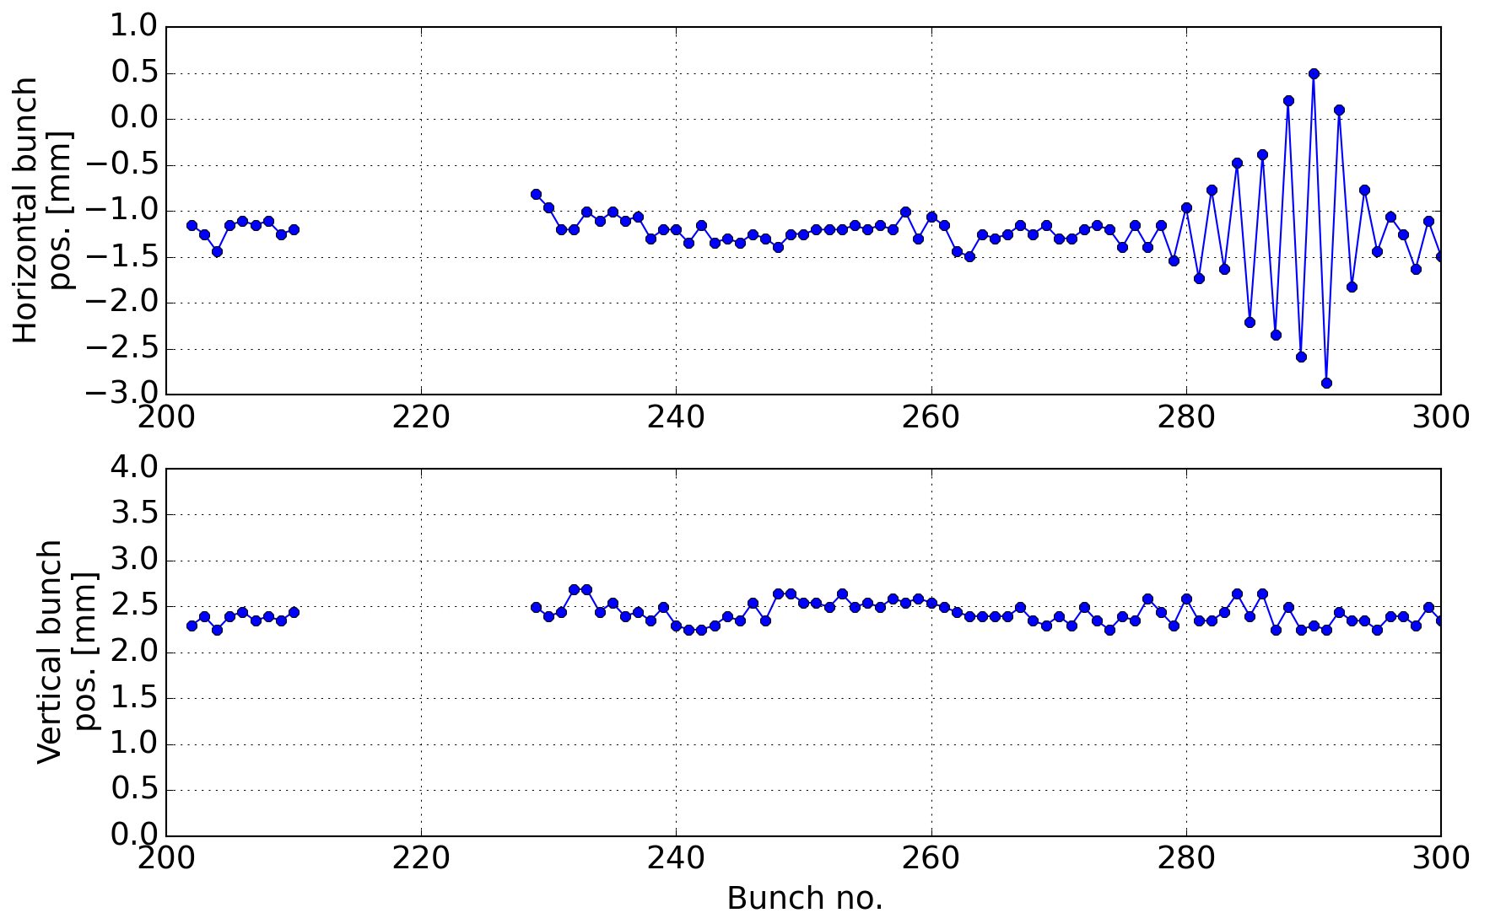
Coupled bunch instability in the SPS
Bunch # 60
Injection of 4 batches of 72 bunch trains into the SPS
A closer look into one train exhibits strong coherent coupled bunch oscillations
72 bunches

Slide 30
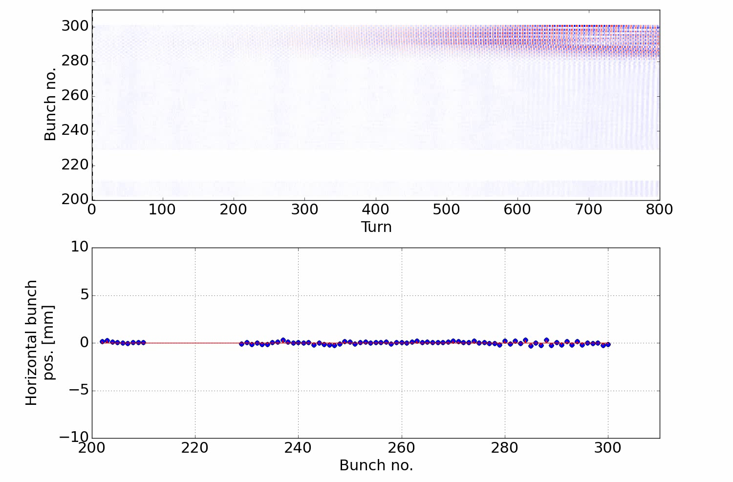
Coupled bunch instability in the SPS
Bunch # 60
Injection of 4 batches of 72 bunch trains into the SPS
A closer look into one train exhibits strong coherent coupled bunch oscillations
72 bunches

Slide 31
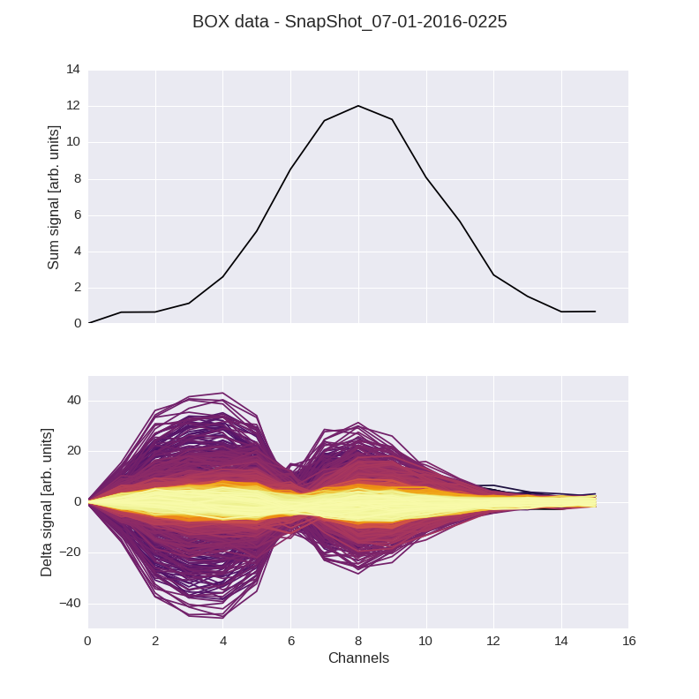
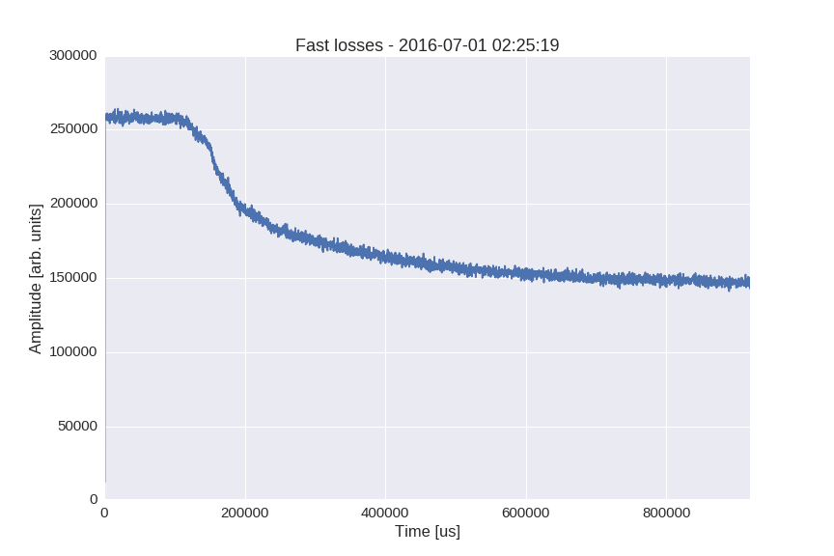
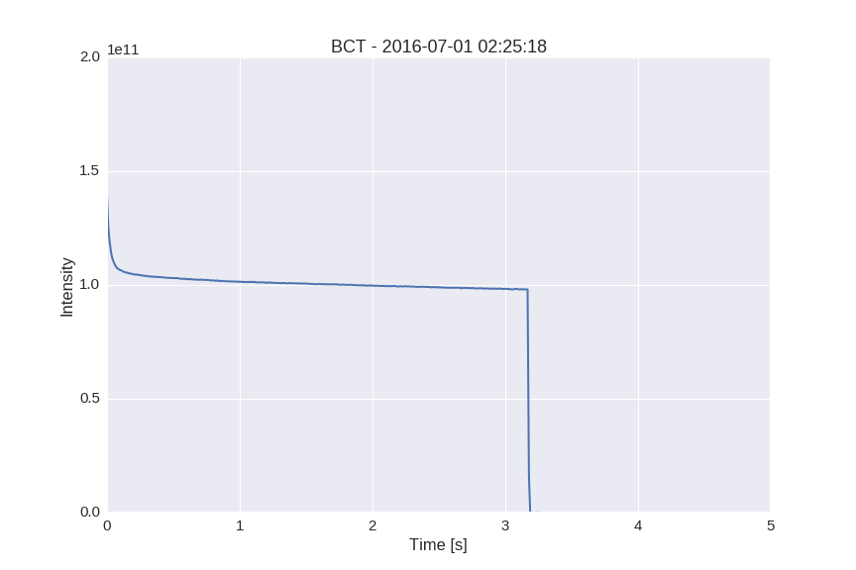
Single bunch instability in the SPS
No feedback
Bunch charge profile
Vertical intra-bunch motion
Loss of more than 30% of the bunch intensity due to a slow transverse mode coupling instability (TMCI).

Slide 32
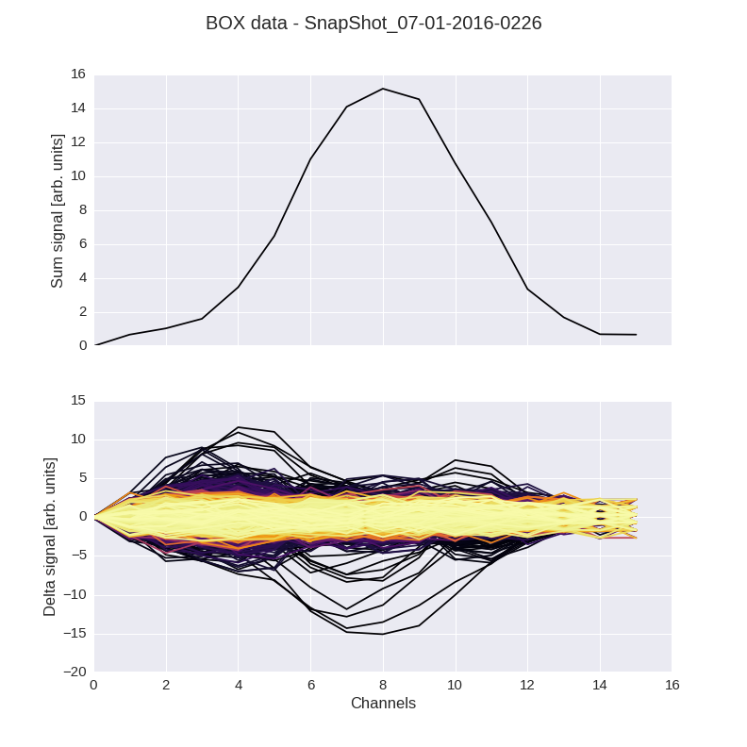
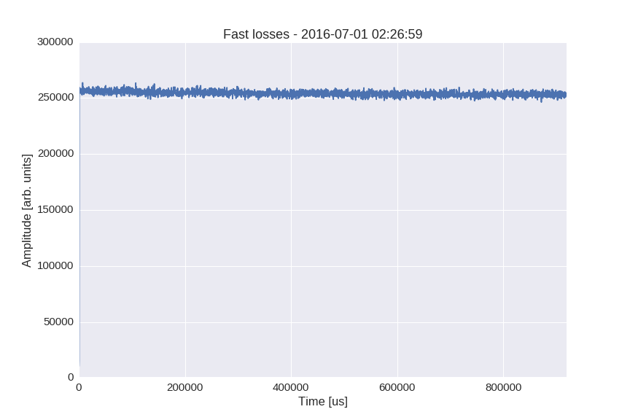
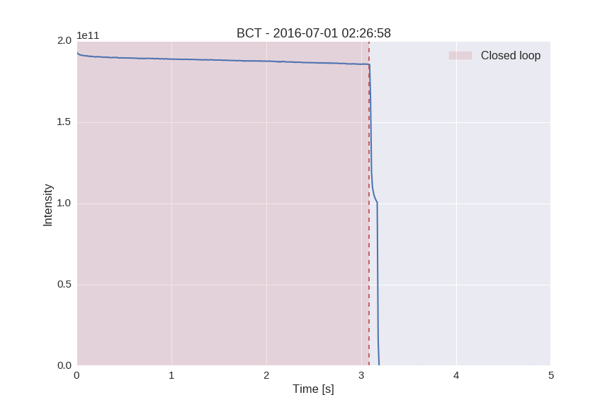
Single bunch instability in the SPS
Feedback on
Bunch charge profile
Vertical intra-bunch motion
Loss of more than 30% of the bunch intensity due to a slow transverse mode coupling instability (TMCI) → can be mitigated by a wideband feedback system.

Slide 33
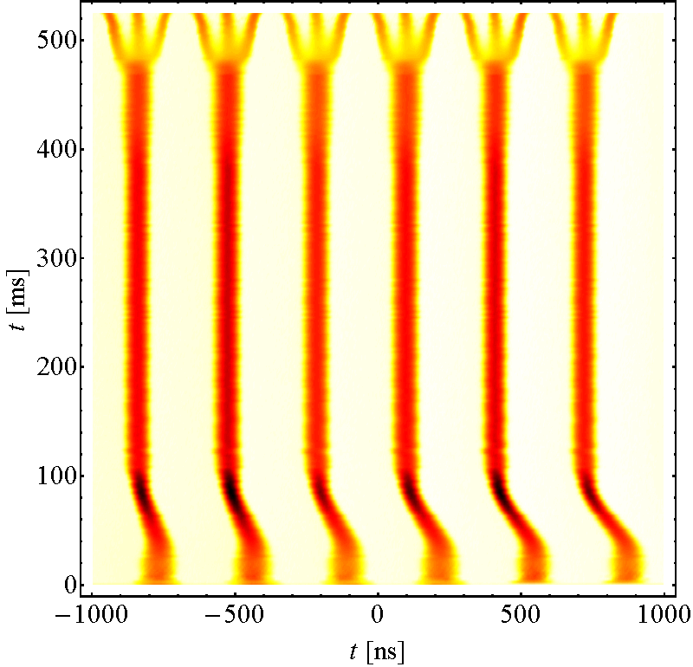
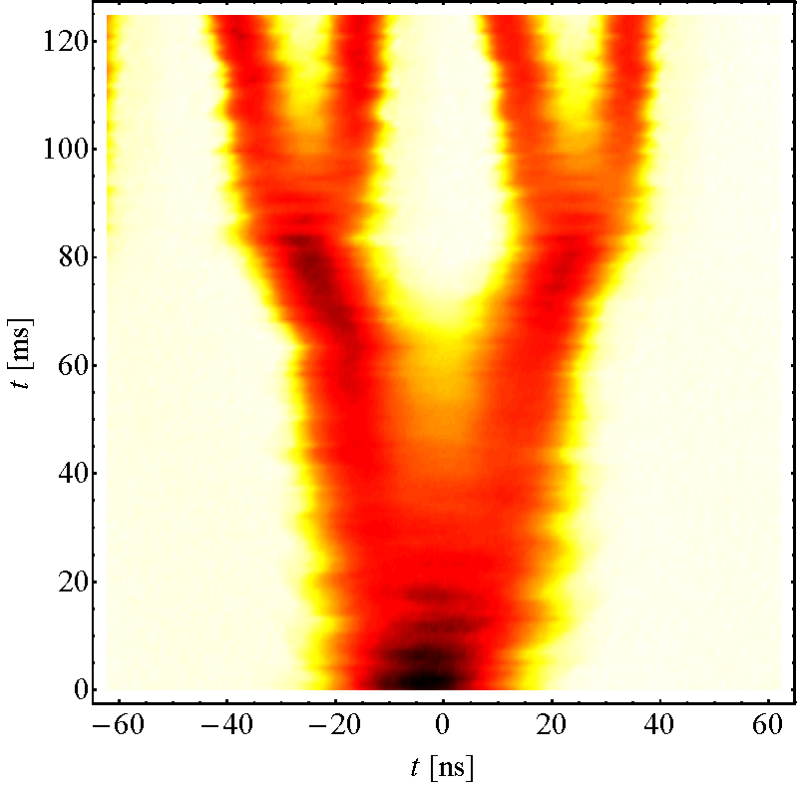
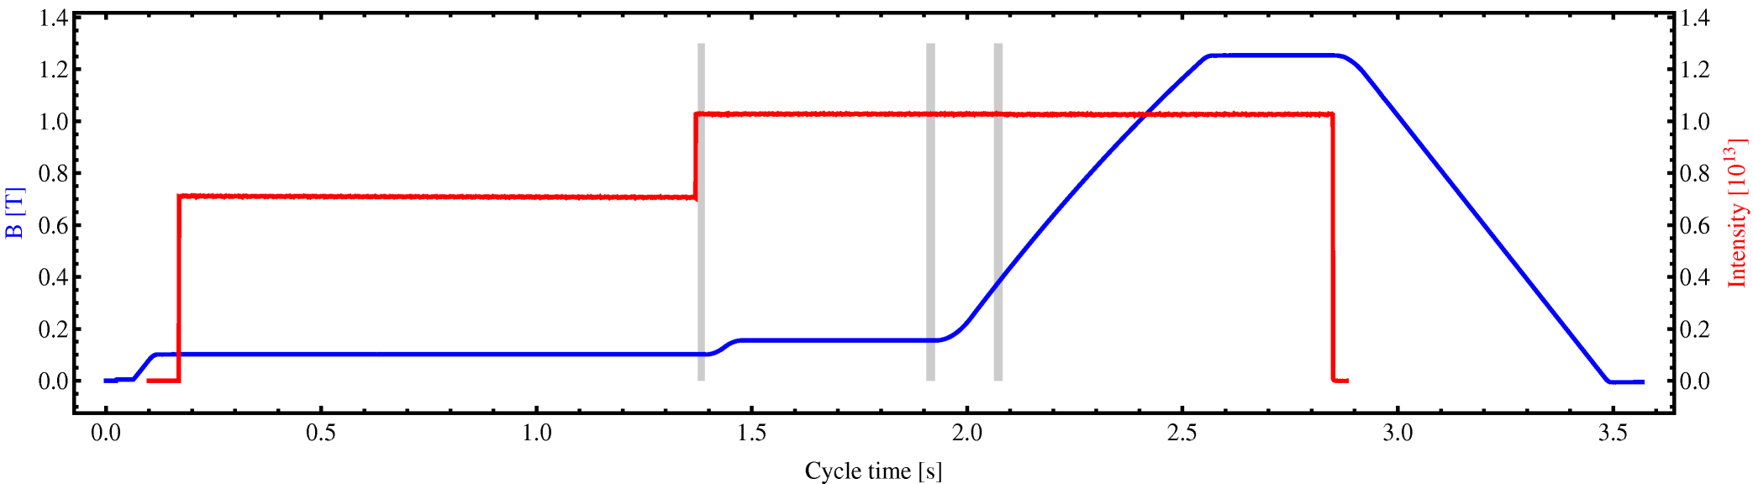
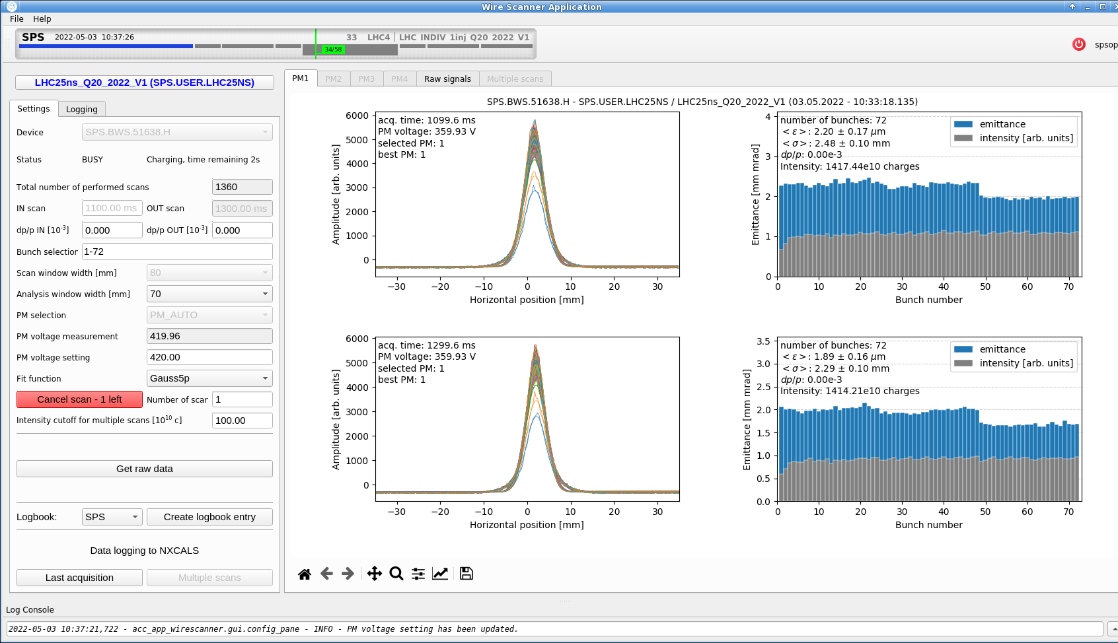
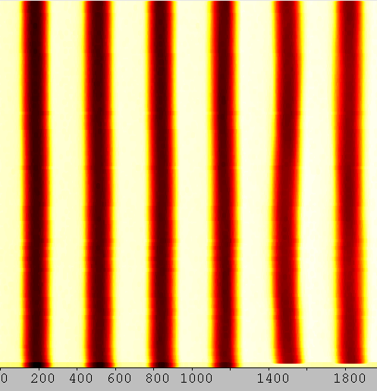
Space charge at injection energy in the PS
The bunches injected 1.2 s earlier from the PSB suffer of emittance growth visible in the bunch-by-bunch emittance profile measured at high energy

Slide 34
Signpost
We now understand that collective effects can have a huge potentially detrimental impact on the machine performance and why, therefore, the study and the understanding of the underlying mechanism is important.
We have encountered some real world examples of collective effects observed throughout the CERN accelerator chain.
Next step is now having a look at the effect on the beam of the self-generated EM field, i.e. what we call direct space charge.
Part 1: Introduction + space charge
  Introduction to beam instabilities
  Examples of coherent and incoherent effects
  Space charge
    Basic concepts
    Tune shift and tune spread
Notes:
Now we need to learn ho to describe/model these effects

Slide 35
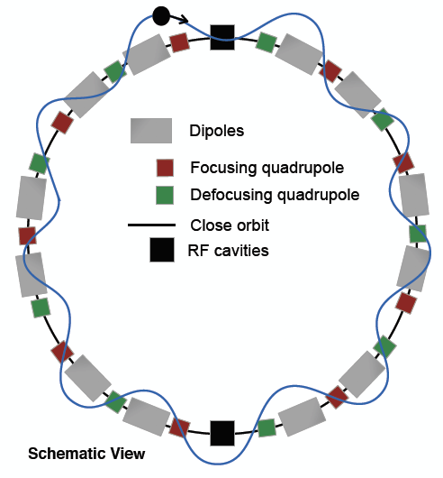
Space charge
Particles within a bunch moving at any speed lower than speed of light generate a repulsive force acting on other particles
Additional defocusing force on single particles with variable strength along the ring causing a decrease of their oscillation frequencies around the accelerator (tunes)
Furthermore, particles feel different space charge defocusing forces according to their positions → Spread of tunes within the bunch
y
z
x

Slide 36
Space charge
Particles within a bunch moving at any speed lower than speed of light generate a repulsive force acting on other particles
Space charge includes typically two aspects
Expected dependence on
  Beam current (intensity) and particle distribution
  Geometry and material of the surrounding vacuum chamber and machine elements
Direct space charge:
interaction of charged particles in free space
Indirect space charge:
interaction with image charges and currents
induced in perfect conducting walls and ferromagnetic materials close to the beam pipe

Slide 37
Space charge (direct)
Coasting beam of circular cross section with radius a and uniform charge density η=λ/πa² [Cb/m³] moving at constant velocity v=βc
  Calculate the electric field using Gauss’ law
  Calculate the magnetic field using Stokes’ law
Maxwell equation
Maxwell equation
Stokes’ law
Gauss’ law
due to symmetry the electric field has only a radial component
with current density
and
with line density
(for r < a)
(for r < a)

Slide 38
Space charge (direct)
Coasting beam of circular cross section with radius a and uniform charge density η=λ/πa² [Cb/m³] moving at constant velocity v=βc
Calculate the resulting force on a test particle with charge e
Lorentz force for the geometry studied
Electric and magnetic components have opposite signs and scale between them with β² → there is perfect compensation when β=1
writing the force in x and y:

Slide 39
Space charge (direct)
Coasting beam of circular cross section with radius a and uniform charge density η=λ/πa² [Cb/m³] moving at constant velocity v=βc
In this case the direct space charge force is linear in x and y
  direct space charge is like a defocusing quadrupole…
  however, direct space charge is always defocusing in both planes, while quadrupole is focusing in one and defocusing in the other plane

Slide 40
Space charge tune shift
The direct space charge force for a beam with uniform charge distribution is linear in x and y → results in the direct space charge tune shift
  We derive it here for the vertical plane …
  Express y’’ in terms of F_{y} using Newton’s law
  Generalize Hill’s equation including defocusing space charge term
  Calculate the tune shift treating space charge like a focusing error
classical particle radius
  Generalized Hill’s equation

Slide 41
Space charge tune shift
After some reshuffling we notice that the direct space charge tune shift
  is negative, because space charge transversely always defocuses
  is proportional to the line density and thus to the number of particles in the beam
  decreases with energy like β^{‐1}γ^{‐2} (when expressed in terms of normalized emittance) and therefore vanishes in the ultrarelativistic limit
  does not depend on the local beta functions or beam sizes but is inversely proportional to the normalized beam emittance

Slide 42
Space charge: Nonlinear
For the (quite realistic) case of a beam with a transverse bi-Gaussian distribution the space charge force becomes nonlinear
  Beam field over the beam cross section is nonlinear
  Particles will see different tune shifts according to their betatron amplitudes. This causes a tune spread rather than a tune shift!
  We can calculate the maximum tune shift, i.e. the tune shift in the beam center …

Slide 43
Space charge: Gaussian beam
We consider first the case of a circular beam with rms beam size σ
  The following fields satisfy Maxwell’s equations
  We obtain the radial Lorentz force and linearize it for small r to calculate the tune shift for particles around the beam center
with rms beam size
  maximum tune shift for a Gaussian beam distribution

Slide 44
Space charge effect on the tune
without space charge
with space charge
uniform distribution
with space charge
Gaussian distribution
+
+
zero intensity working point
tune shift
Q_{y}
Q_{y}
Q_{y}
particles in the tails
→ tune spread!
particles in the center
Q_{x}
Q_{x}
Q_{x}
All particles have the tunes Q_{x} and Q_{y} determined by the machine quadrupoles
All particles have the tunes Q_{x} and Q_{y} determined by the machine quadrupoles and the linear defocusing from space charge
Particles have a different tunes, since the space charge defocusing depends on the particles’ amplitude
The tune shift is largest for particles in the beam center

Slide 45
Space charge: Bunched beams
If the beam is bunched and has an s‐dependent line density
  The relativistic field has an opening angle of 1/γ
  Bunched beam as locally continuous if the density λ(s) changes smoothly (i.e. does not change much over Δs=a/γ which means if γ >> a/Δs)
  Can still use the formulas derived for coasting beams but use the s (or in fact z) dependent line density → the tune shift will also depend on the position of the particle along the bunch
  This translates into tune modulation with twice the synchrotron period, because particles execute longitudinal oscillations and sample different line densities

Slide 46
Space charge: Bunched beams
If the beam is bunched and has an s‐dependent line density
  The relativistic field has an opening angle of 1/γ
  Bunched beam as locally continuous if the density λ(s) changes smoothly (i.e. does not change much over Δs=a/γ which means if γ >> a/Δs)
  Can still use the formulas derived for coasting beams but use the s (or in fact z) dependent line density → the tune shift will also depend on the position of the particle along the bunch
  This translates into tune modulation with twice the synchrotron period, because particles execute longitudinal oscillations and sample different line densities
Maximum tune shift (circular Gaussian)

Slide 47
Space charge tune spread
In case a Gaussian bunched beam, the maximum tune spread is associated to particles close to the peak line density
Due to the Gaussian transverse distribution the tunes of these particles are also spread around the point of maximum shift
y
x
Q_{y}
z
Particles close to the peak line density (often in the bunch center) will have the largest tune spread
Q_{x}

Slide 48
Space charge tune spread
In case a Gaussian bunched beam, the maximum tune spread is associated to particles close to the peak line density
  As we move away from the peak density the ‘longitudinal’ shift decreases
Due to the Gaussian transverse distribution the tunes of these particles are also spread around the point of maximum shift
y
x
Q_{y}
z
The tune spread is reduced for particles
further away from the peak line density
Q_{x}

Slide 49
Space charge tune spread
In case a Gaussian bunched beam, the maximum tune spread is associated to particles close to the peak line density
  As we move away from the peak density the ‘longitudinal’ shift decreases
Due to the Gaussian transverse distribution the tunes of these particles are also spread around the point of maximum shift
y
x
Q_{y}
z
The tune spread is reduced for particles
further away from the peak line density
Q_{x}

Slide 50
Space charge tune spread
In case a Gaussian bunched beam, the maximum tune spread is associated to particles close to the peak line density
  As we move away from the peak density the ‘longitudinal’ shift decreases
Due to the Gaussian transverse distribution the tunes of these particles are also spread around the point of maximum shift
y
x
Q_{y}
z
The tune spread is reduced for particles
further away from the peak line density
Q_{x}

Slide 51
Space charge tune spread
In case a Gaussian bunched beam, the maximum tune spread is associated to particles close to the peak line density
  As we move away from the peak density the ‘longitudinal’ shift decreases
Due to the Gaussian transverse distribution the tunes of these particles are also spread around the point of maximum shift
y
x
Q_{y}
z
The tune spread is reduced for particles
further away from the peak line density
Q_{x}

Slide 52
Space charge tune spread
In case a Gaussian bunched beam, the maximum tune spread is associated to particles close to the peak line density
  As we move away from the peak density the ‘longitudinal’ shift decreases
Due to the Gaussian transverse distribution the tunes of these particles are also spread around the point of maximum shift
Globally, the bunched beam will exhibit a tune spread occupying almost all the space between bare tune and maximum shifted tune
y
x
Q_{y}
  The tune footprint is also called the space charge necktie due to its shape
z
For bunched beams the tune spread
is as big as the maximum tune shift!
Q_{x}

Slide 53
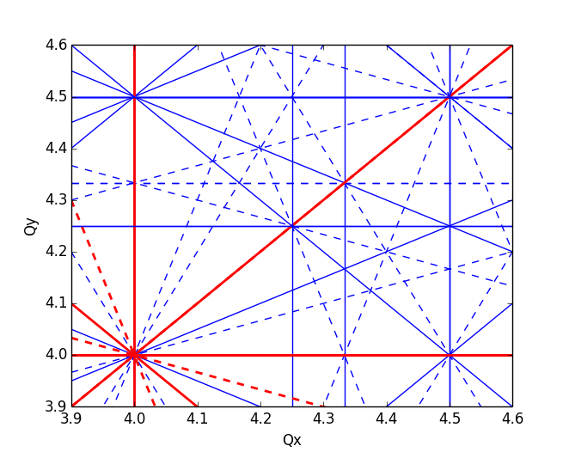
Brightness limitation from space charge
A space charge tune spread beyond 0.5 cannot be tolerated without excessive emittance blow-up and/or particle loss due to resonances
  Dipole errors in the machine excite the integer resonances (Q=n)
  Quadrupole errors excite the half integer resonances (Q=n+1/2)
  Higher order resonances can be excited due to sextupoles and multipole errors
Imagine that a beam with a tune spread of beyond 0.5 is injected

Slide 54
Brightness limitation from space charge
A space charge tune spread beyond 0.5 cannot be tolerated without excessive emittance blow-up and/or particle loss due to resonances
  Dipole errors in the machine excite the integer resonances (Q=n)
  Quadrupole errors excite the half integer resonances (Q=n+1/2)
  Higher order resonances can be excited due to sextupoles and multipole errors
Imagine that a beam with a tune spread of beyond 0.5 is injected
Particles in the beam core will cross the integer resonance resulting in emittance blow-up and a reduction of the tune spread

Slide 55
Brightness limitation from space charge
A space charge tune spread beyond 0.5 cannot be tolerated without excessive emittance blow-up and/or particle loss due to resonances
  Dipole errors in the machine excite the integer resonances (Q=n)
  Quadrupole errors excite the half integer resonances (Q=n+1/2)
  Higher order resonances can be excited due to sextupoles and multipole errors
Imagine that a beam with a tune spread of beyond 0.5 is injected
Particles in the beam core will cross the integer resonance resulting in emittance blow-up and a reduction of the tune spread
Particles in the beam tails can be pushed onto the half integer resonance resulting in losses due to aperture restrictions

Slide 56
Brightness limitation from space charge
To cope with space charge
  Minimise tune charge tune spread
Maximum tune shift (circular Gaussian)
Using a double RF system ..
.. or creating a hollow bunch distribution

Slide 57
Brightness limitation from space charge
To cope with space charge
  Minimise tune charge tune spread
Maximum tune shift (circular Gaussian)
Increase the beam energy
Examples: Increase of injection energy into PSB (50 → 160 MeV) and into PS (1.4 → 2 GeV) during Long Shutdown 2
  The scope is to eventually increase the brightness of the LHC beams!

Slide 58
Brightness limitation from space charge
To cope with space charge
  Minimise tune charge tune spread
  Compensate resonances
    Some can be efficiently compensated by means of magnetic multipoles – and this frees up regions of the tune space in which larger tunes spreads can be accommodated without significant emittance growth and/or losses
    Some may be however excited by space charge itself!
Space charge compensation as well as longitudinal shape tailoring are essential beam dynamics knobs (sometimes requiring additional hardware, e.g., multipoles or 2nd harmonic RF system), especially in low energy machines, to preserve the high brightness needed for ex. in colliders

Slide 59
Signpost
Space charge is an additional defocusing force that leads to, e.g., negative tune shift and tune spread depending on transverse and longitudinal amplitudes.
This tune spread can intercept to resonance lines in the tune diagram.
Space charge can therefore lead to are emittance growth and/or particle loss – in either case loss of beam quality.
Notes:
Now we need to learn ho to describe/model these effects

Slide 60
Signpost
We have learned about some of the peculiarities of collective effects. We have also introduced multi-particle systems and have seen how these can be described and treated theoretically/numerically.
We have seen some real-world example of collective effects manifesting themselves as coherent beam instabilities.
We have looked at some specific features of space charge and how it can influence beam dynamics and lead to beam quality degradation.
Part 1: Introduction + space charge
  Introduction to collective effects
  Examples of coherent and incoherent effects
  Space charge
    Basic concepts
    Tune shift and tune spread
Notes:
Perhaps other way round

Slide 61

End part 1

Slide 62
Backup

Slide 63
Signpost
We have learned about the particle description of a beam.
We have seen macroparticles and macroparticle models.
We have seen how macroparticle models are mapped and represented in a computational environment.
Part 1: Introduction – multiparticle systems, macroparticle models and wake functions
  Introduction to beam instabilities
  Basic concepts
    Particles and macroparticles – macroparticle distributions
    Beam matching
    Multiparticle effects – filamentation and decoherence
    Wakefields as sources of collective effects
Notes:
Perhaps other way round

Slide 64
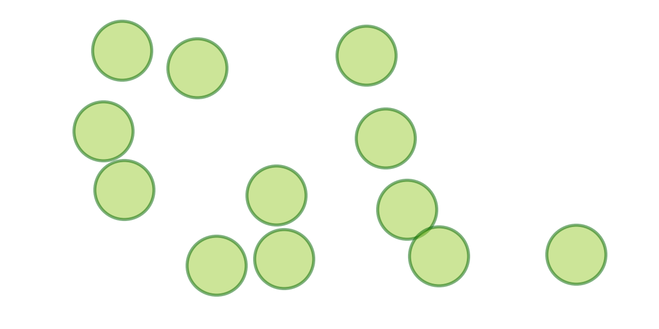

The particle description
As seen earlier, and especially for the analytical treatment, we can represent a charged particle beam via a particle distribution function.
In computer simulations, a charged particle beam is still represented as a multiparticle system. However, to be compatible with computational resources, we need to rely on macroparticle models.
A macroparticle is a numerical representation of a cluster of neighbouring physical particles.
Thus, instead of solving the system for the N (~10¹¹) physical particles one can significantly reduce the number of degrees of freedom to N_{MP} (~10⁶). At the same time one must be aware that this increases of the granularity of the system which gives rise to numerical noise.

Slide 65
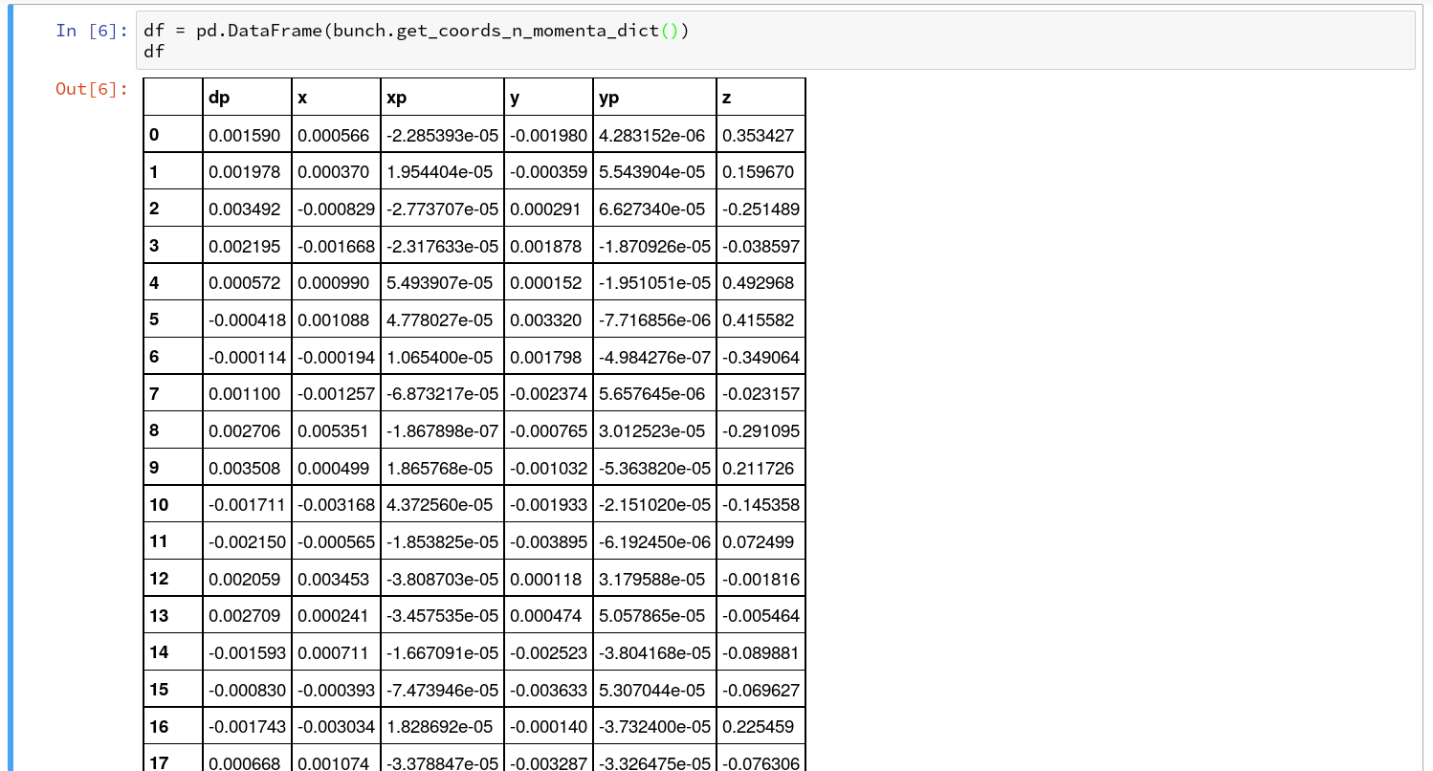
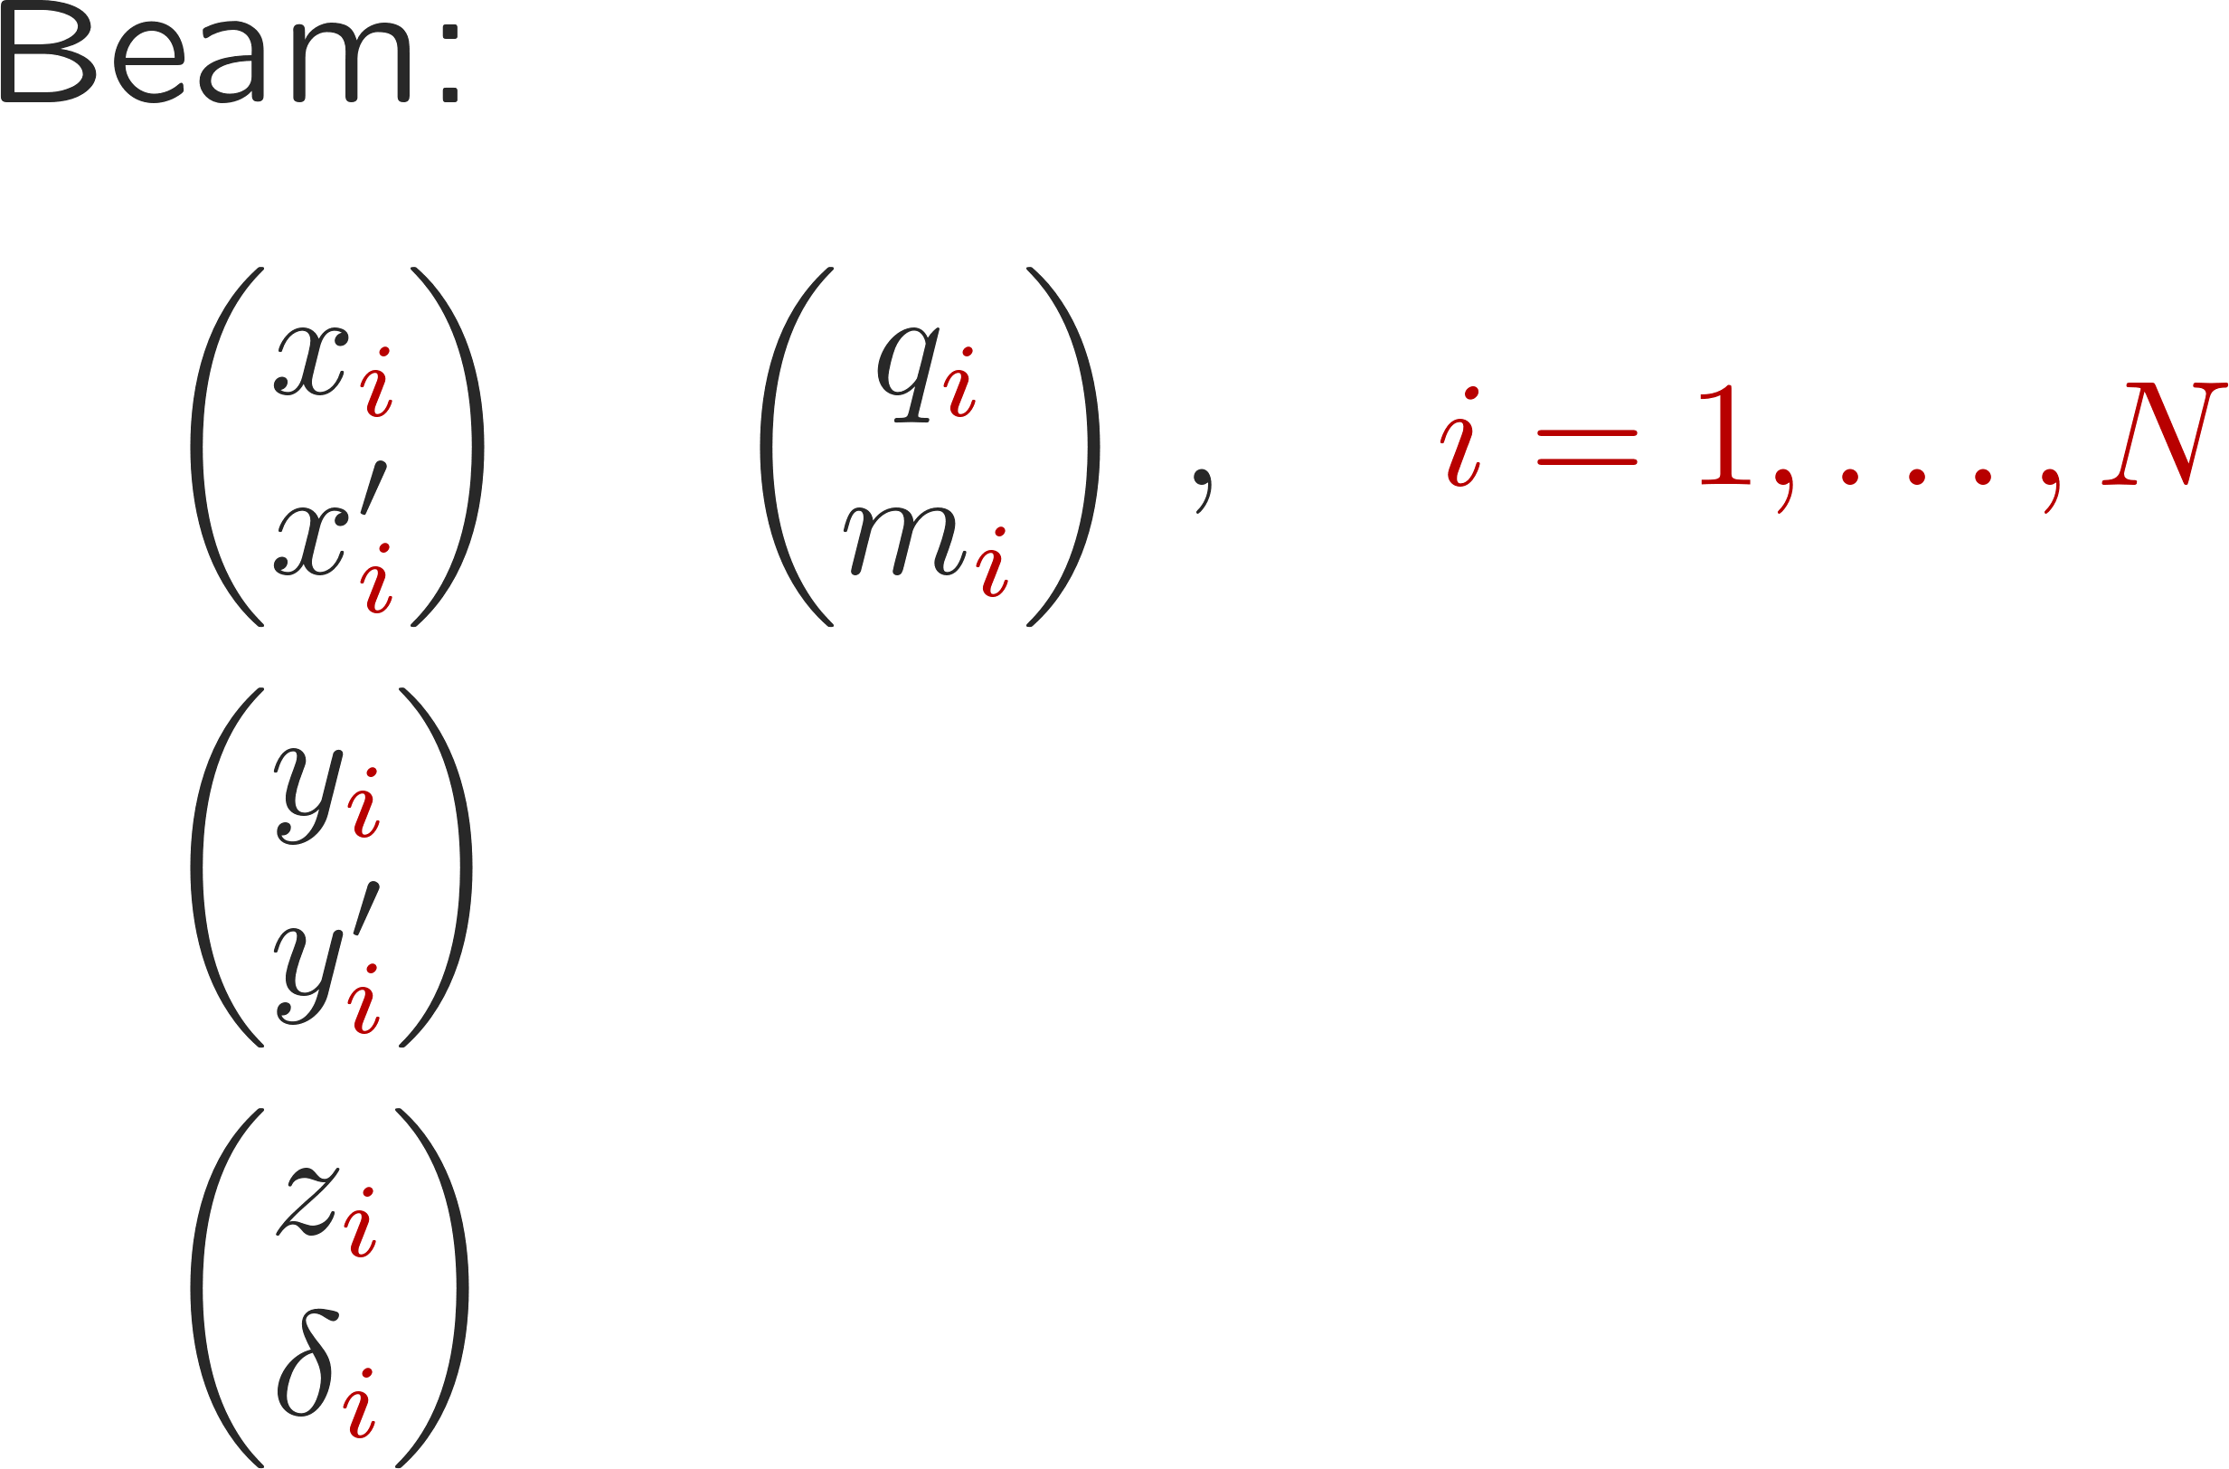
Macroparticle representation of the beam
Macroparticle models permit a seamless mapping of realistic systems into a computational environment – they are fairly easy to implement
Macroparticlenumber
Canonically conjugate coordinates and momenta

Slide 66
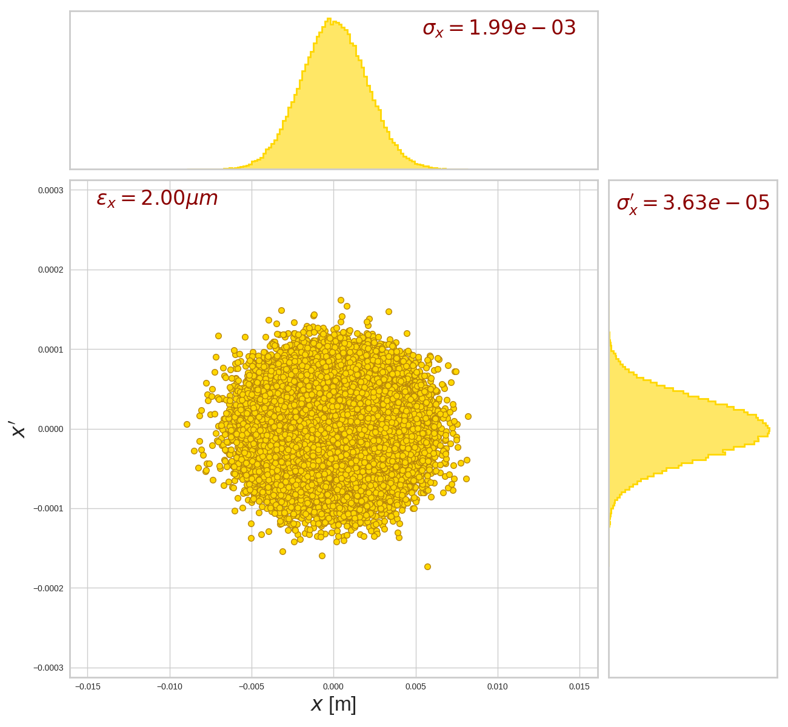
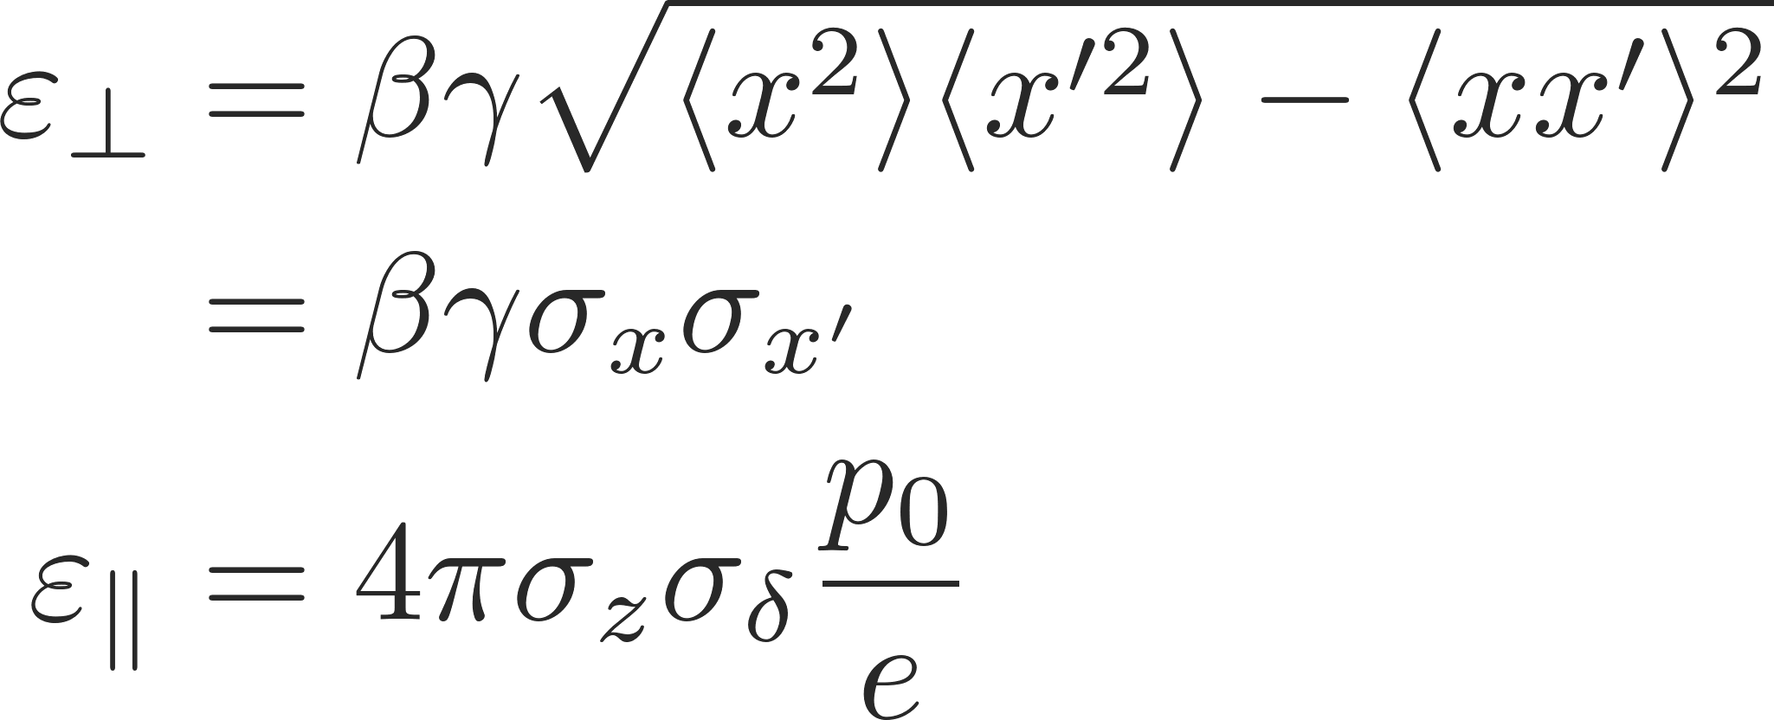
Macroparticle representation of the beam
Initial conditions of the beam/particles
We use random number generators to obtain random distributions of coordinates and momenta
Example transverse Gaussian beam in the SPS with normalized emittance of
2 um (0.35 eVs longitudinal)
Profile | Size | Matching
Gaussian | Emittance | Optics
Parabolic
Flat
…
Notes:
Animates this

Slide 67
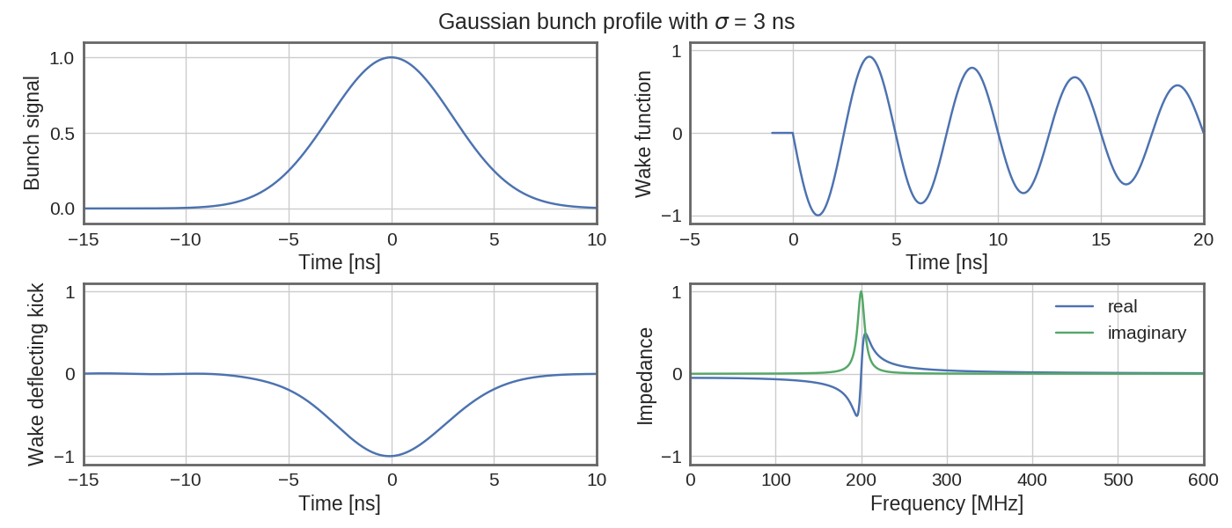
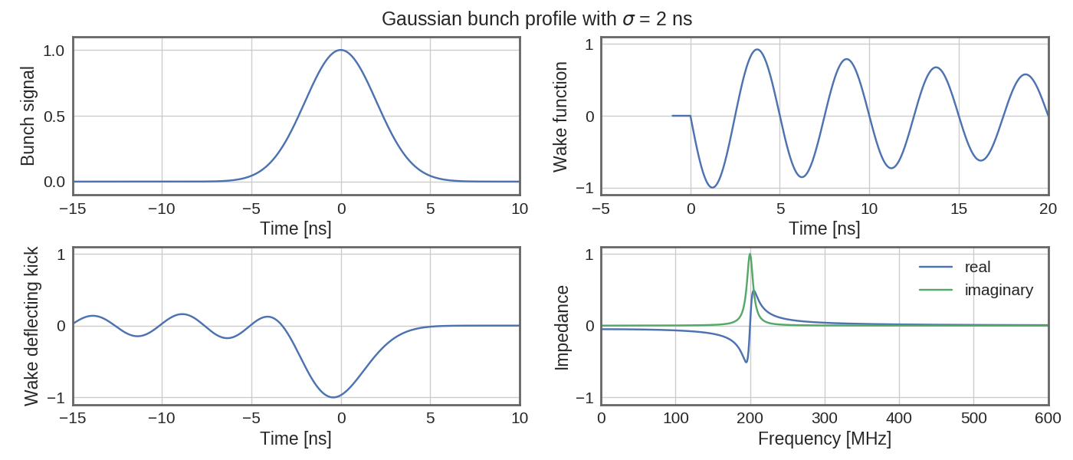
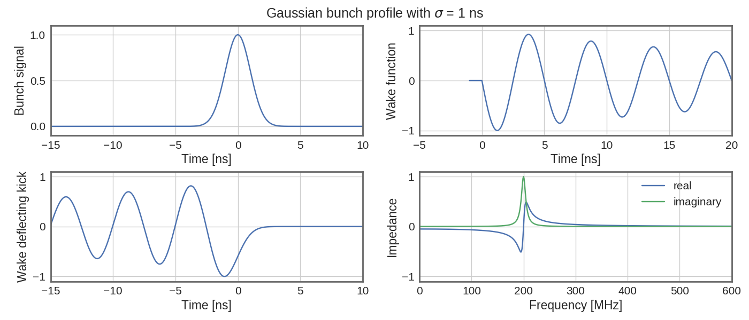
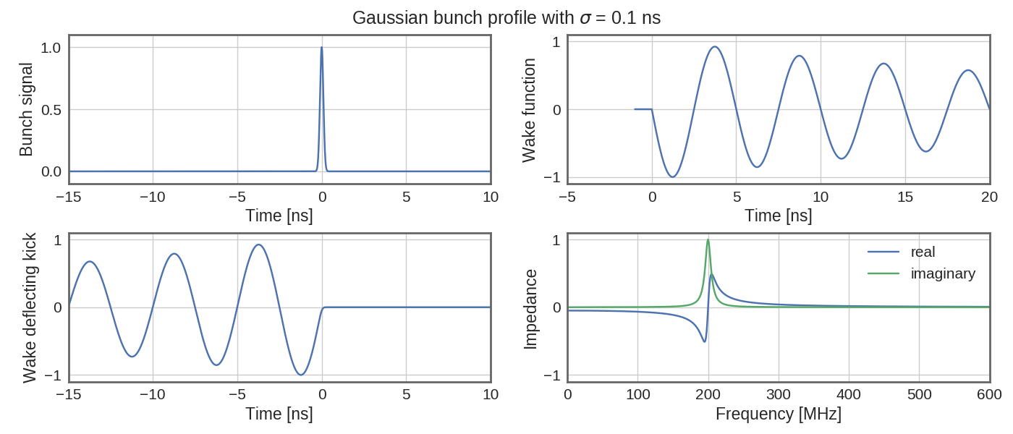
Wake fields illustrative examples
Resonator wake: fr = 200 MHz, Q = 20 – Gaussian bunch charge profile
The plots show how the bunch moments and the wake function convolve into an integrated deflecting kick at the different positions along the bunch

Slide 68
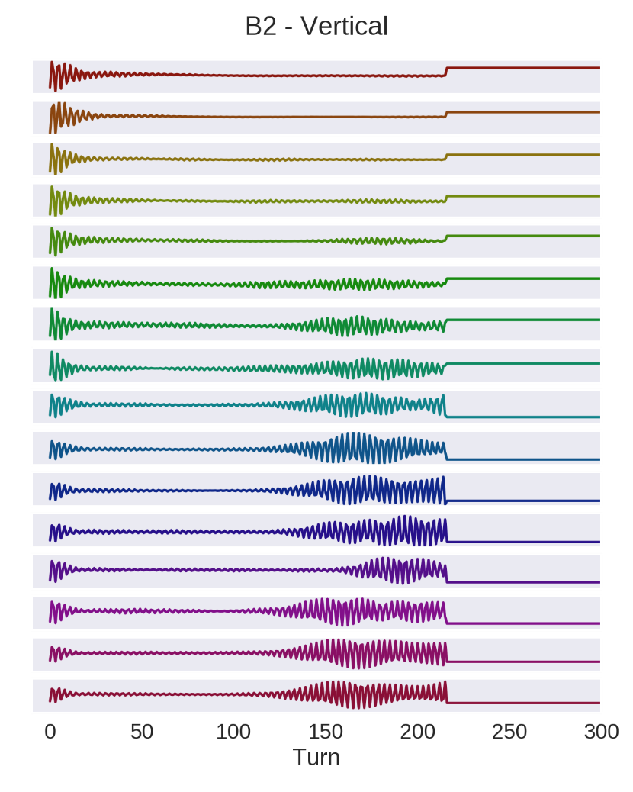
E-cloud instabilities in the LHC
Scrubbing run in 2015 – early stage
Head of batch
Injection of multiple bunch batches from the SPS into the LHC.
Violent instabilities during initial stages of scrubbing – clear e-cloud signature
Very hard to control in the beginning – slow and staged ramp-up of intensity
(24 → 36 → 48 → 60 → 72 → 144 bpi)
every 4th bunch just after injection
Tail of batch

Slide 69
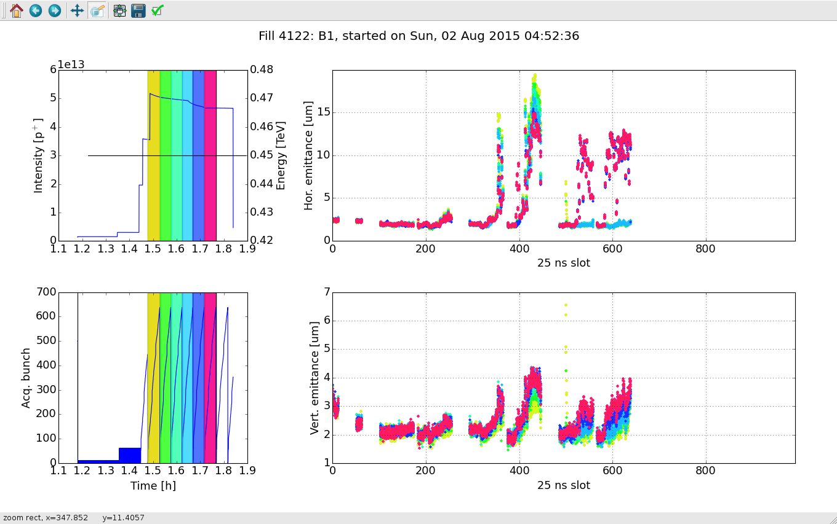
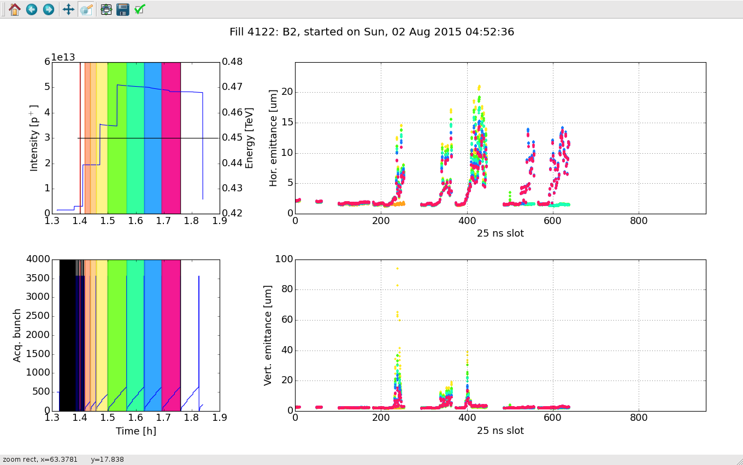
E-cloud instabilities in the LHC
Scrubbing run in 2015 – second stage
Head of batch
At later stages dumps under control but still emittance blow-up and serious beam quality degradation.
Beam and e-cloud induced heating of kickers and collimators.

Slide 70
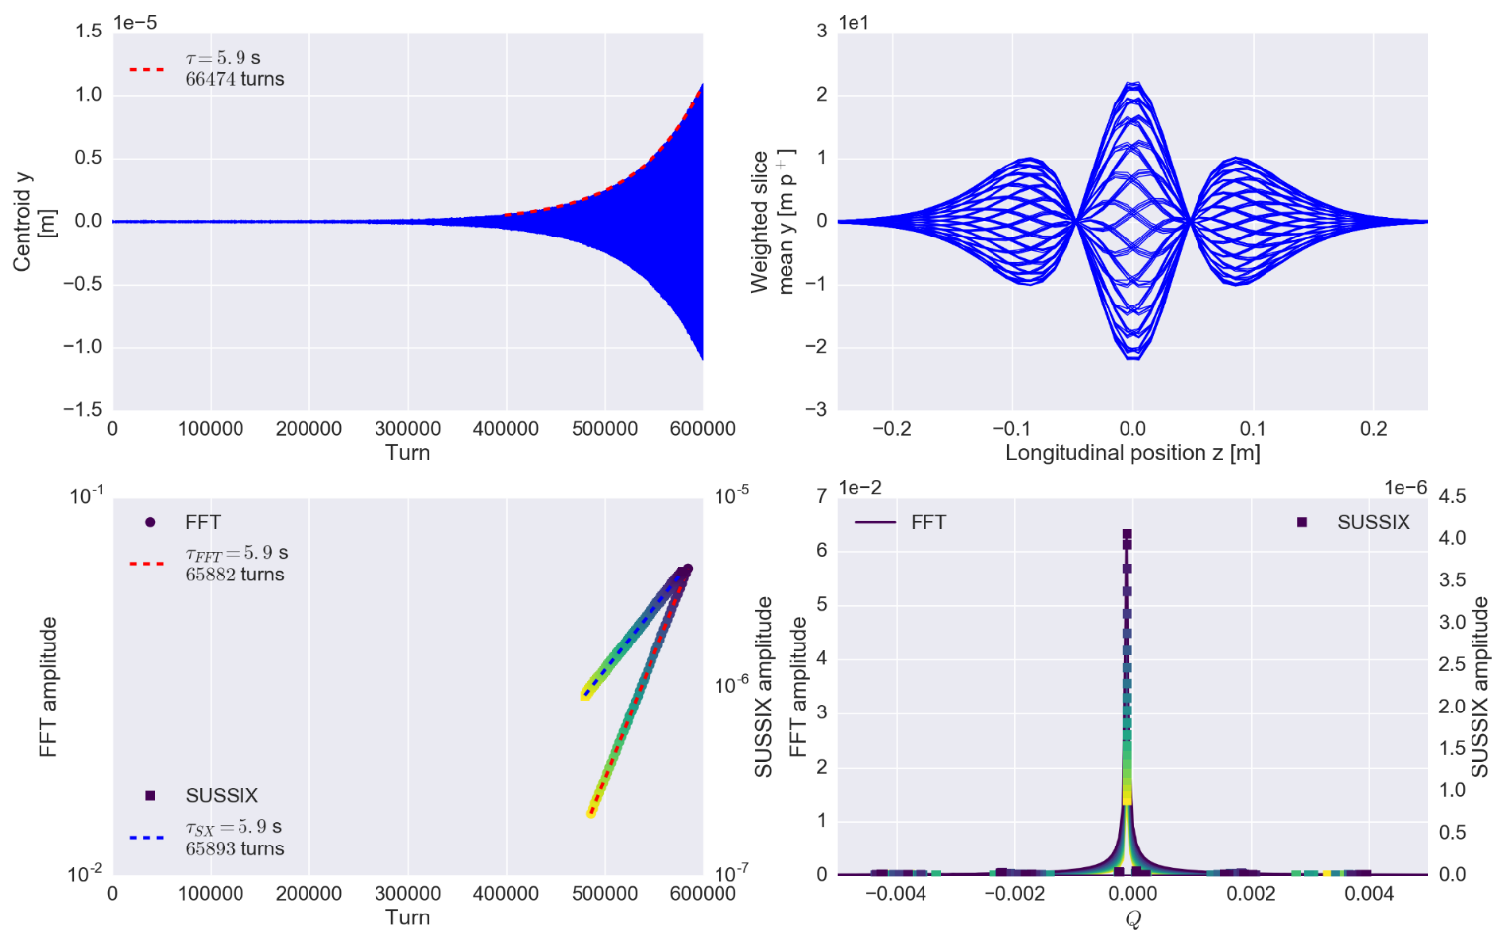
Headtail instabilities in the LHC
The impedance in the LHC can give rise to coupled and single bunch instabilities which, when left untreated, can lead to beam degradation and beam loss.
As an example, headtail instabilities are predicted from macroparticle simulations using the LHC impedance model.
These simulations help to understand and to predict unstable modes which are observed in the real machine.
tail
head

Slide 71
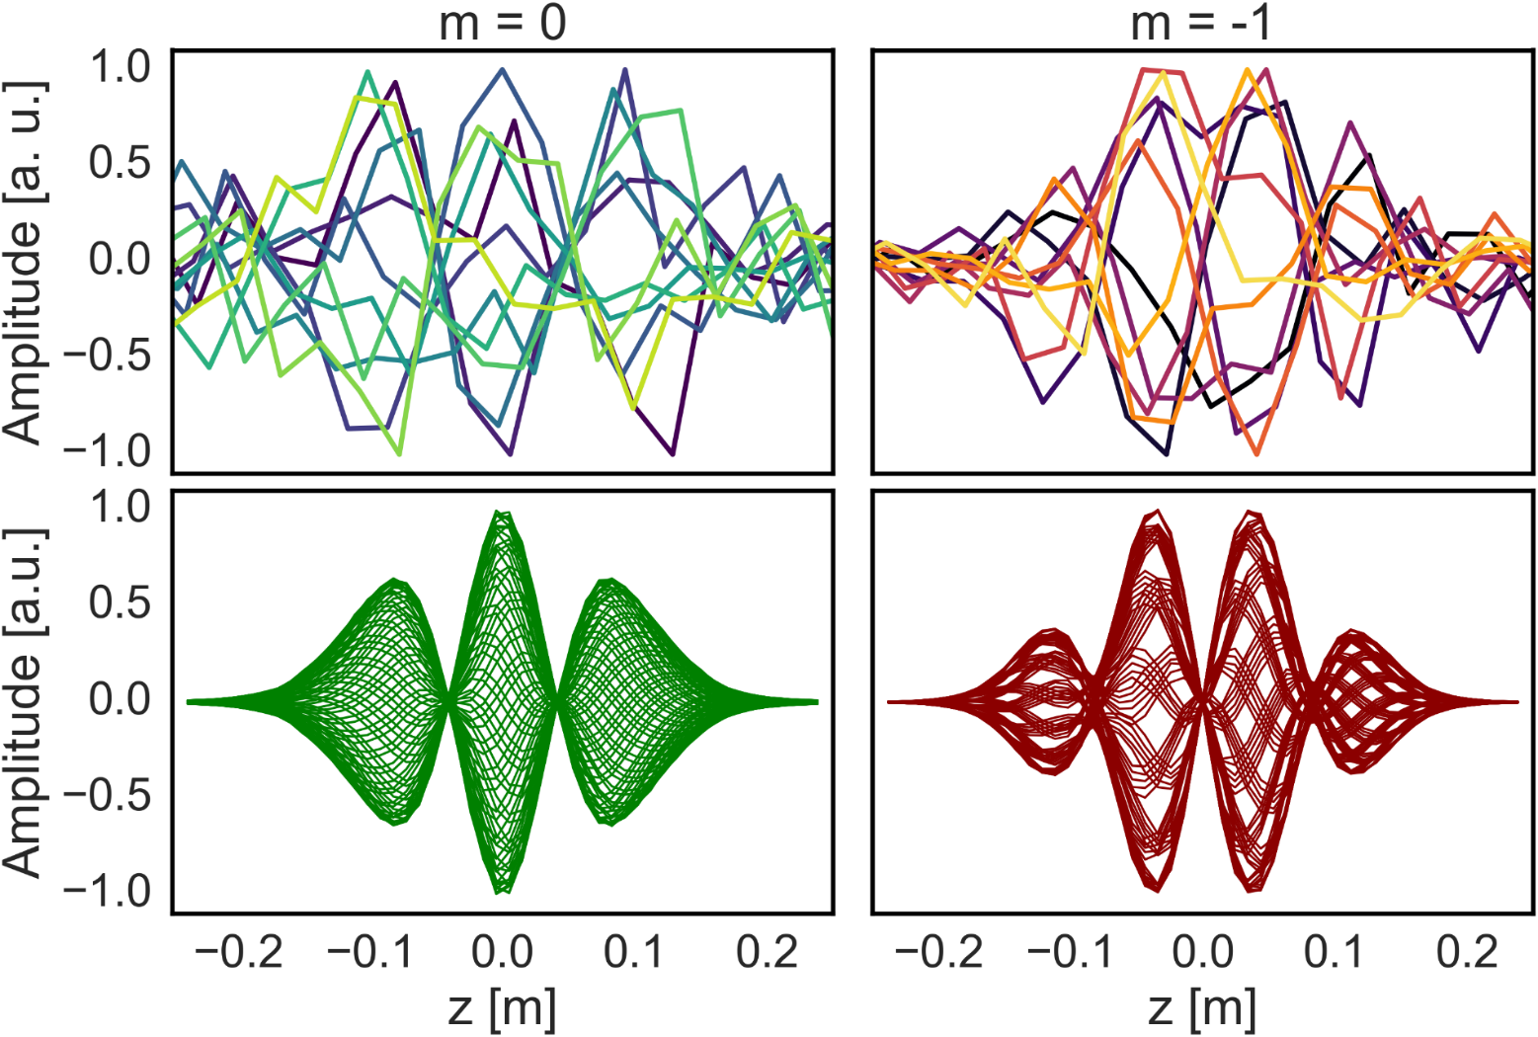
Headtail instabilities in the LHC
Macroparticle simulations (PyHEADTAIL)
These simulations help to understand and to predict instabilities which are observed in the real machine.

Slide 72
Wakefields as sources of collective effects
The wake function is the electromagnetic response of an object to a charge pulse. It is an intrinsic property of any such object.
The wake function couples two charge distributions as a function of the distance between them.
The response depends on the boundary conditions and can occur e.g. due to finite conductivity (resistive wall) or more or less sudden changes in the geometry (e.g. resonator) of a structure.

Slide 73
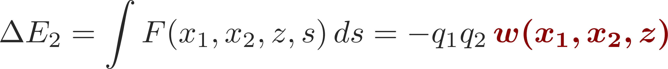
Wake functions in general
L
Source, q₁
Witness, q₂
Δx₁ (or Δy₁)
2b
z
Δx₂ (or Δy₂)
Definition as the integrated force associated to a change in energy:
In general, for two point-like particles, we have
w is typically expanded in the transverse offsets of source and witness particles. This yields the different types of wake fields (dipole, quadrupole, coupling wakes)

Slide 74

Wake potential for a distribution of particles
L
Source, q₁
Witness, q₂
Δx₁ (or Δy₁)
2b
Δx₂ (or Δy₂)
z
z₁
Definition as the integrated force associated to a change in energy:
For an extended particle distribution this becomes
  Forces become dependent on the particle distribution function

Slide 75
Wake fields – impact on the equations of motion
We include the impact of wake field into the standard Hamiltonian for linear betatron (or synchrotron motion):
The equations of motion become:
  The presence of wake fields adds an additional excitation which depends on
  The moments of the beam distribution
  The shape and the order of the wake function

Slide 76
How are wakes and impedances computed?
Analytical or semi-analytical approach, when geometry is simple (or simplified)
  Solve Maxwell’s equations with the correct source terms, geometries and boundary conditions up to an advanced stage (e.g. resistive wall for axisymmetric chambers)
  Find closed expressions or execute the last steps numerically to derive wakes and impedances
Numerical approach
  Different codes have been developed over the years to solve numerically Maxwell’s equations in arbitrarily complicated structures
  Examples are CST Studio Suite (Particle Studio, Microwave Studio), ABCI, GdFidL, HFSS, ECHO2(3)D. Exhaustive list can be found from the program of the ICFA mini-Workshop on “Electromagnetic wake fields and impedances in particle accelerators”, Erice, Sicily, 23-28 April, 2014
Bench measurements based on transmission/reflection measurements with stretched wires
  Seldom used independently to assess impedances, usefulness mainly lies in that they can be used for validating 3D EM models for simulations

