Slide 2
Radiation Protection at CERN
Christoph Schäfer
Many thanks to Stefan Roesler

Slide 3
Overview
CERN Radiation Protection Legal Framework
General principles of Radiation Protection – Implementation at CERN
Mandate and responsibilities of the Radiation Protection Group
Radiation Protection Experts (RPE) for experiments
Radiation Safety Support Officers (RSSO)

Slide 4

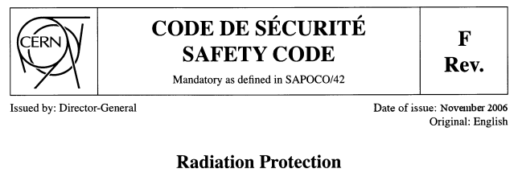
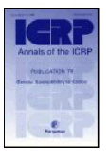





CERN Radiation Protection Legal Framework
CERN is an intergovernmental Organization subject not to national but international law. Its status has been recognized by its host states where it must ensure their safety and security.
CERN has the right to establish its own rules as necessary for the proper functioning of the Organization, among others, Safety Rules.
CERN agrees to follow best practices in matters of radiation protection and radiation safety taking into account the legislation of its host states, as well European and international standards. Their implementation is discussed between the host states authorities, ASN (F) and OFSP (CH), and CERN according to a "Tripartite Agreement” signed in 2010.
CH
IAEA
EU
F

Slide 5
General Principles of Radiation Protection
Justification
Any exposure of persons to ionizing radiation has to be justified
Limitation
The personal doses have to be kept below the legal limits
Optimization
The personal doses and collective doses have to be kept as low as reasonably achievable (ALARA)

Slide 6
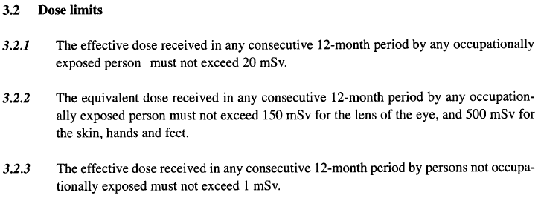
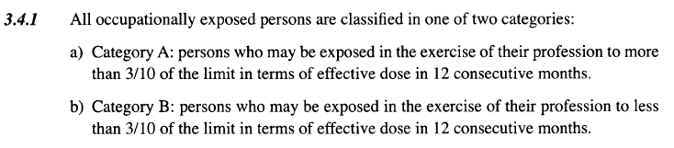
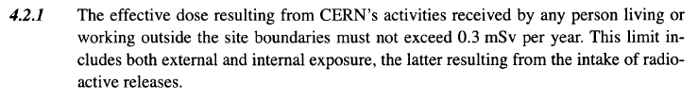
Limitation – Safety Code F
Occupationally exposed persons (Radiation Workers)
Category A: 20 mSv / yr ⁽*⁾
Category B: 6 mSv / yr ⁽*⁾
Not occupationally exposed persons
⁽*⁾ Apprentices and students (age 16-18): 6 mSv/yr
Pregnant women: 1mSv/yr
1 mSv / yr
Environment (Public)
0.3 mSv / yr

Slide 7
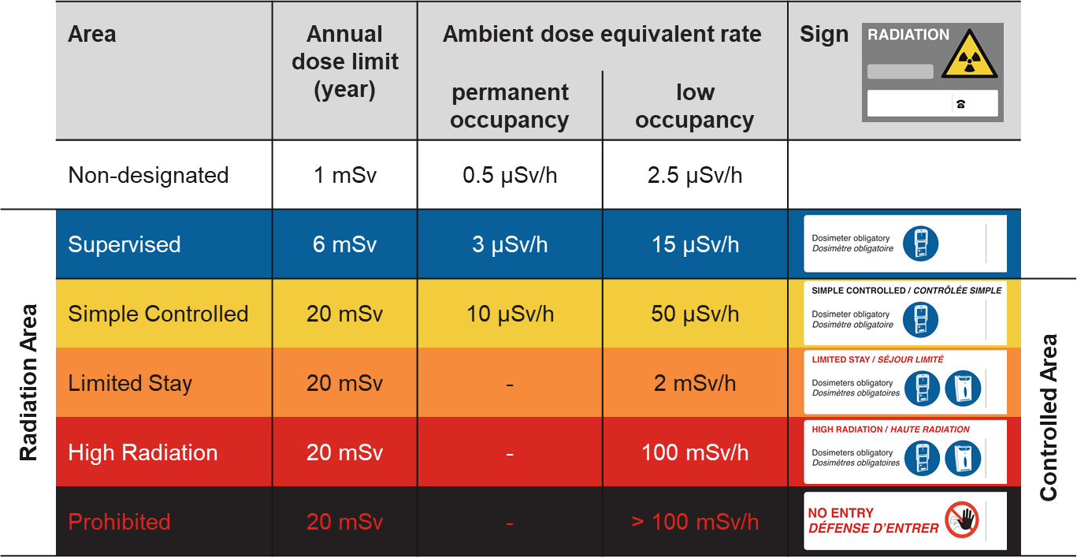
Limitation – Area Classification (external exposure)
Safety Instruction S3-GSI1 (EDMS 810149)
http://cern.ch/raisin
Total number of working hours per year: 2000 hrs
Example:
Supervised Area 3 µSv/h × 2000 hrs = 6 mSv
Low-occupancy: < 20% of working time

Slide 8
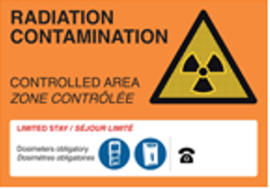
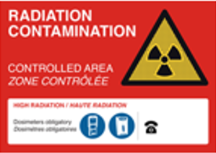
Limitation – Area Classification (internal exposure)
Safety Instruction S3-GSI1 (EDMS 810149)
http://cern.ch/raisin
 | Area | Annual dose limit (year) | Specific airborne radioactivity | Specific surface contamination
 | Non-designated | 1 mSv | 0.05 CA | 1 CS
Radiation Area | Supervised | 6 mSv | 0.1 CA | 1 CS
 | Simple Controlled | 20 mSv | 0.1 CA | 1 CS | Controlled Area
 | Limited Stay | 20 mSv | 100 CA | 4000 CS
 | High Radiation | 20 mSv | 1000 CA | 40000 CS
 | Prohibited | 20 mSv | > 1000 CA | > 40000 CS
CS, CA: Nuclide-specific Guidance values from Swiss legislation
Specific airborne radioactivity
1 CA = effective committed dose of 20 mSv for a stay of 2000 hours/year
Specific surface contamination
1 CS = 1/10th of dose limit to skin and/or 0.5 mSv/year for daily ingestion of contamination on 10 cm²
“No contamination”
  < 1 CS for identified isotopes
  < 1 Bq/cm² for non-identified gamma and beta emitters
  < 0.1 Bq/cm² for non-identified alpha emitters

Slide 9
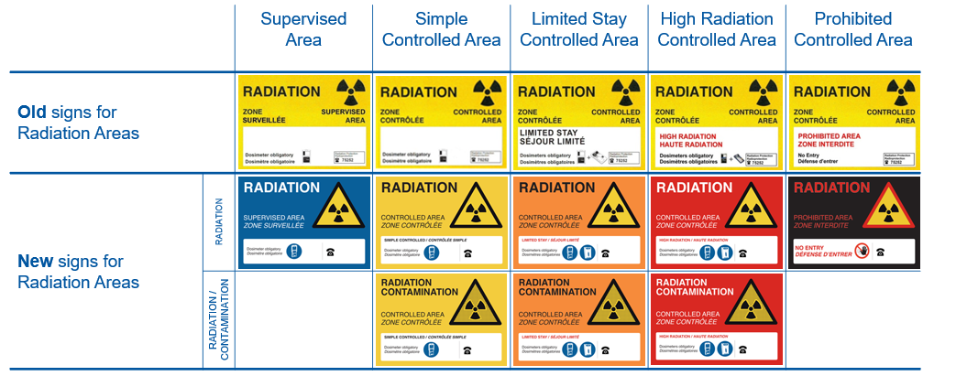
Limitation – Area Classification (new signage scheme)

Slide 10
Limitation – Area Classification
PSB, PS, SPS
accelerator areas
LHC LSS1, 3, 5, 7, dumps
Target areas (East, North, HiRadMat, nTof, ISOLDE, AD)
PS, SPS and LHC
experimental areas
LHC Arcs, LSS2, 4, 6, 8
non-designated
Simple Controlled
Limited Stay
High Radiation
Prohibited
Supervised
2.5 µSv/h
15 µSv/h
50 µSv/h
2 mSv/h
100 mSv/h

Slide 11
General Principles of Radiation Protection
Justification
Any exposure of persons to ionizing radiation has to be justified
Limitation
The personal doses have to be kept below the legal limits
Optimization
The personal doses and collective doses have to be kept as low as reasonably achievable (ALARA)

Slide 12
Optimization
Publication ICRP 103 (2007)
The Principle of Optimisation of Protection: The likelihood of incurring exposure, the number of people exposed, and the magnitude of their individual doses should all be kept as low as reasonably achievable, taking into account economic and societal factors.
The revised Recommendations emphasise the key role of the principle of optimisation. This principle should be applied in the same manner in all exposure situations. Restrictions are applied to doses to a nominal individual (the Reference Person), namely dose constraints for planned exposure situations and reference levels for emergency and existing exposure situations.
Directive 2013/59/Euratom
Planned exposure:
"dose constraint" means a constraint set as a prospective upper bound of individual doses, used to define the range of options considered in the process of optimisation for a given radiation source in a planned exposure situation
Emergency / existing exposure:
"reference level" means in an emergency exposure situation or in an existing exposure situation, the level of effective dose or equivalent dose or activity concen­tration above which it is judged inappropriate to allow exposures to occur as a result of that exposure situation, even though it is not a limit that may not be exceeded

Slide 13
Dose Optimization at CERN
CERN workers
Population
Unacceptable risk
Radiation
Workers
Other
Workers
Dose limit
20 mSv/yr*
1 mSv/yr
300 µSv/yr
Tolerable risk
Dose constraint
3 mSv/yr
100 µSv/yr
10 µSv/yr
Individual risk level
Optimization process
ALARA Level
100 µSv/yr
10 µSv/yr
10 µSv/yr
Acceptable risk
* Apprentices and students (age 16-18): 6 mSv/yr
Pregnant women: 1mSv/yr

Slide 14
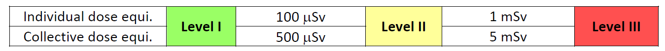
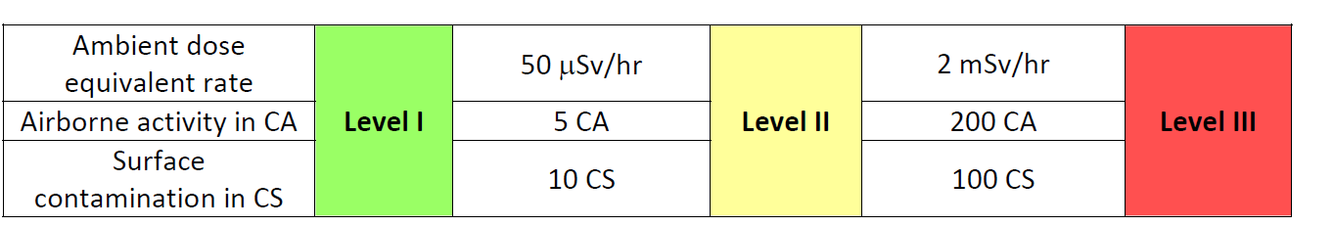
ALARA Criteria and Levels
Optimization is legal requirement if accumulated dose exceeds 100 μSv (ALARA)
Optimization includes different areas/aspects: work coordination, work procedures, handling tools, design, material choices
Reference: “ALARA Rule applied to interventions at CERN”, EDMS 1751123
Group 1 criteria define the ALARA level
ALARA Committee
Group 2 criteria are the bases of a radiological risk assessment (including accidents and incident scenarios) by the RSO and HSE-RP prior to the final ALARA level classification of the intervention.

Slide 15

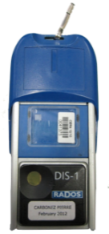
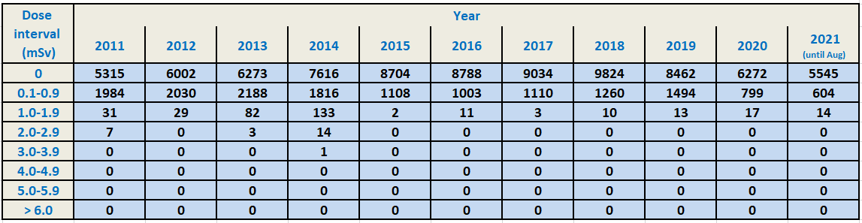
Personal Dosimetry
Distribution of annual personal doses over dose intervals

Slide 16
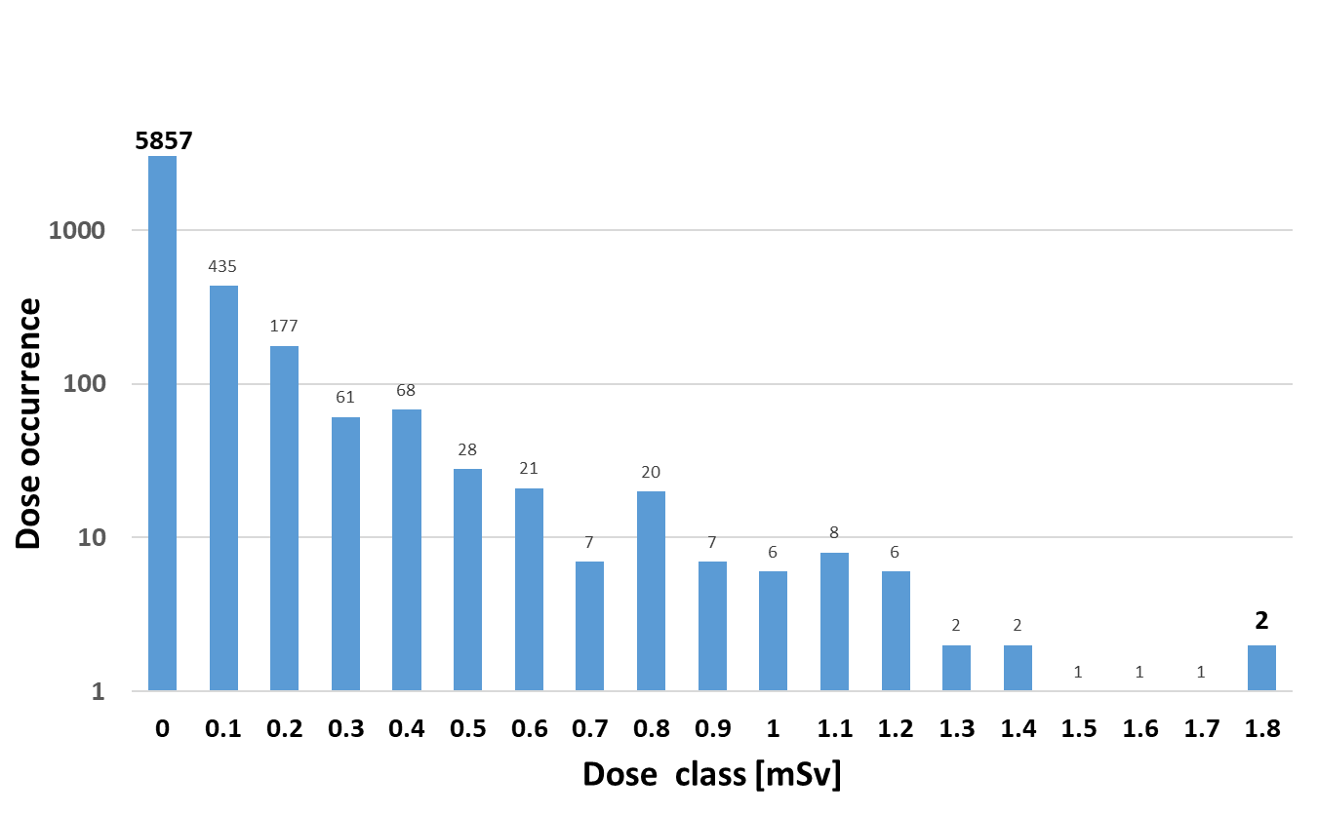
Personal Dosimetry – Example: LS2
Maximum individual dose
(for any 12-months period between
1st of January 2019 – 30th of April 2021)
2.0 mSv
Collective personal dose
(1st of January 2019 – 30th of April 2021)
550.1 person · mSv
(well within the CERN dose constraint of 3 mSv/yr for Radiation Workers)
Dose distribution per category of personnel
(person · mSv)
Individual dose distribution
for the last 12 months, 1st of May 2020 – 30th of April 2021
Total number of monitored persons: 6710
Others
Staff
Contractors
Users
94% of all doses below “ALARA level” of 100 µSv/yr

Slide 17
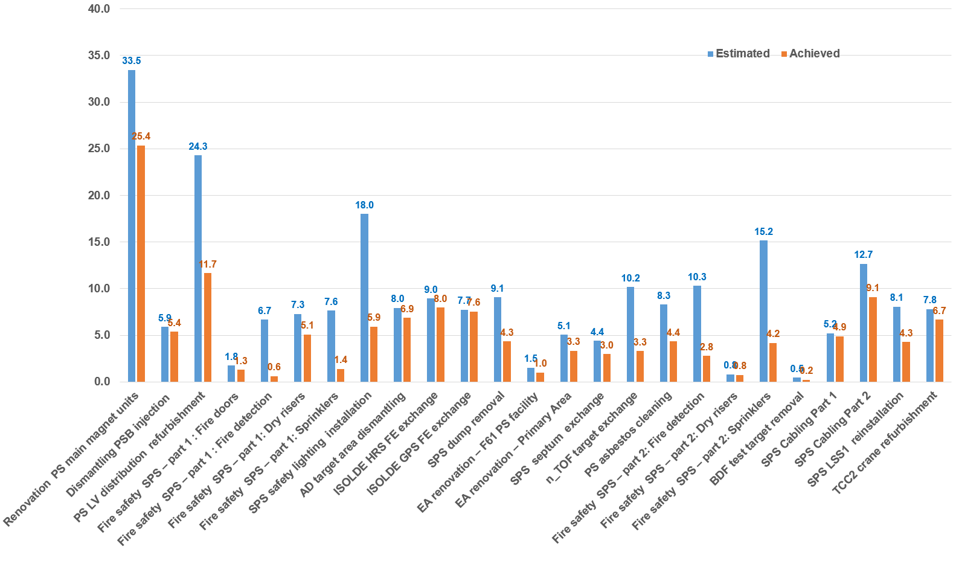
ALARA Level 3 Interventions during LS2
Collective Dose (person mSv)
Some dose estimates very conservative
Largest deviations due to overestimation of work durations
  Notably for long interventions: start from less radioactive area, gaining experience, development of optimized procedures
  Sometimes misunderstanding between work durations and hours written in the contract
Converging to good granularity of IMPACT activities for DIMRs and WDP
see lecture on DIMR/WDP
ALARA Level 3

Slide 18
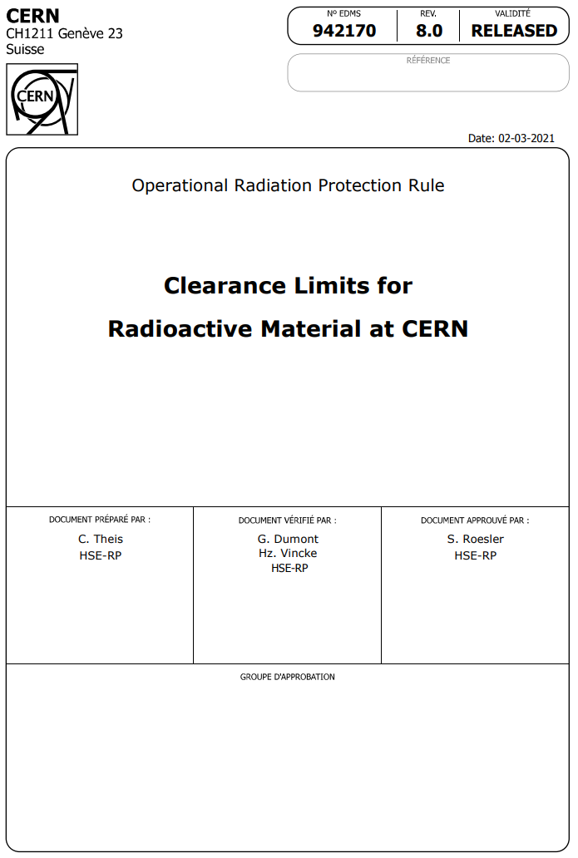


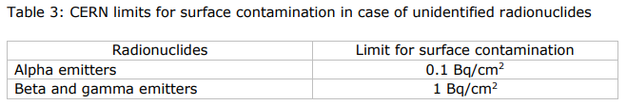
Radioactive Material
When is a material radioactive?
Specific and total activity exceed clearance limits (LL values)
as given in the Annex of EDMS 942170 (adopted from Swiss legislation)
OR
Net ambient dose equivalent rate > 0.1 µSv/h in 10 cm distance
OR
Surface contamination exceeds limits
as given in the Annex of EDMS 942170 (> 1 CS)
Examples: 0.1 Bq/g for ²²Na, ⁵⁴Mn, ⁶⁰Co
1000 Bq/g for ⁵⁵Fe
Sum rule for mixture
of radionuclides:
Sum rule for mixture
of radionuclides:

Slide 19
The HSE Unit
HSE
Occupational Health & Safety and Environmental Protection Unit
DH: B. Delille / DDH: S. Roesler
HSE-ENV
Environment
HSE-OHS
Occupational Health & Safety
HSE-RP
Radiation Protection
HSE-TS
Transversal Services
HSE-FRS
CERN Fire & Rescue Service
GL: S. Kleiner
DGL: L. Ulrici
GL: Y. Loertscher
DGL: S. La Mendola
GL: S. Roesler
DGL: H. Vincke
GL: P. Bonnal
DGL: O. Deschamps –
S. Gunning - M. Nas
GL: A. Goehring-Crinon
DGL: C. Delamare
DG
Reports to

Slide 20
Radiation Protection Group
Mandate
“The Radiation Protection Group (HSE-RP) of the HSE Unit ensures that personnel on the CERN sites and the public are protected from potentially harmful effects of ionizing radiation linked to CERN activities. The HSE-RP Group fulfils its mandate in collaboration with the CERN departments owning or operating sources of ionizing radiation and having the responsibility for Radiation Safety of these sources.”
Operational Radiation Protection
  Risk assessments for personnel and public
  Definition of protective measures, authorization of operation
  Lead in implementation of ALARA principle
  Studies for projects and upgrades
  R&D for tools and methods, operation of shielding benchmark facility
Individual Dosimetry
  Monitoring of external and internal doses and reporting (CERN dosimetry service carries official accreditation in Switzerland)
  Operation of calibration facility
Instrumentation
  Development, Installation and operation of radiation monitoring system
Radioactive Waste Management
  Operation of pre-conditioning and interim storage facility
  Waste disposal towards host states
  Support to departments in radioactive waste minimization and treatment
Services
  Inter/intra-site radioactive transport
  Shipping (import/export) of radioactive goods
  Radiological characterization of material and waste, operation of analytical laboratory
  Radioactive sources service

Slide 21
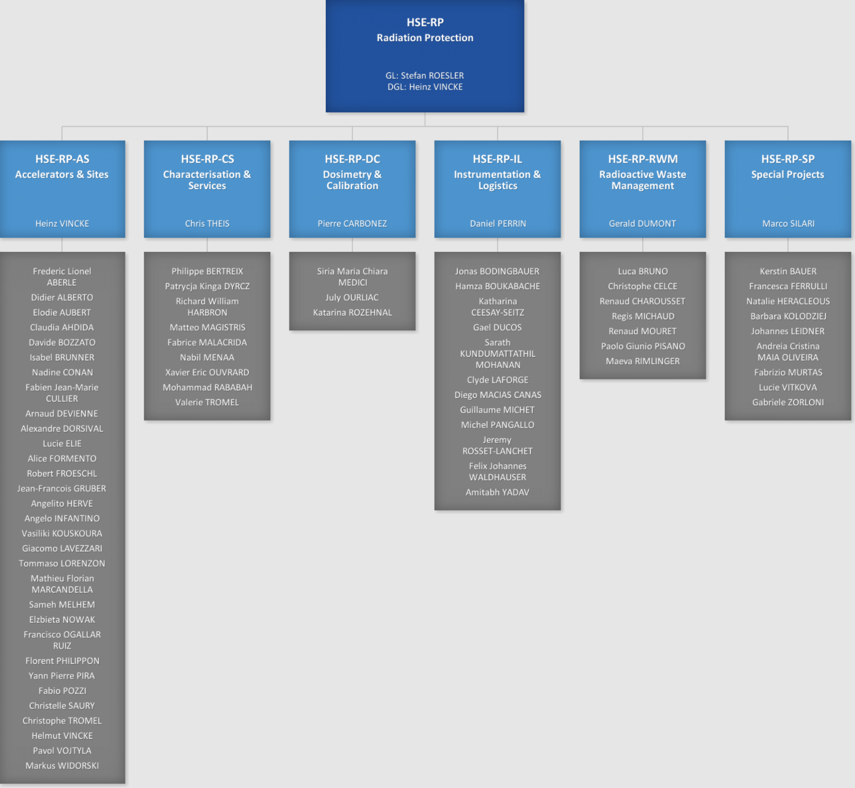
Radiation Protection Group

Slide 22
Key facts related to Radiation Protection
About 50 km of accelerator infrastructure and over 160 physics experiments, all areas classified as Radiation Areas
Radioactive Ion Beam facility (ISOLDE)
Spallation Source (n-TOF),
Several experimental halls for fixed target experiments
Radioactive laboratories
Radioactive Waste Treatment Center and radioactive waste interim storage facility
Over 10000 Radiation Workers
Low radiological risks (more than 90% of annual individual doses are lower than 100 nSv, see above)
External exposure mostly due to gamma irradiation (handling of activated equipment during shutdown periods)
Most of the accelerator infrastructure is located underground (LHC up to 100m), thus very low external exposure during operation
Absence of radioactive contamination risks in most accelerator and experimental areas
Radioactive material and waste mostly with very low activation (French radioactive waste classification: Très Faible Activité TFA, Faible ou Moyenne Activité FMA), 400 m³ radioactive waste produced per year (more during LS), currently about 6000 m³ of radioactive waste stored

Slide 23
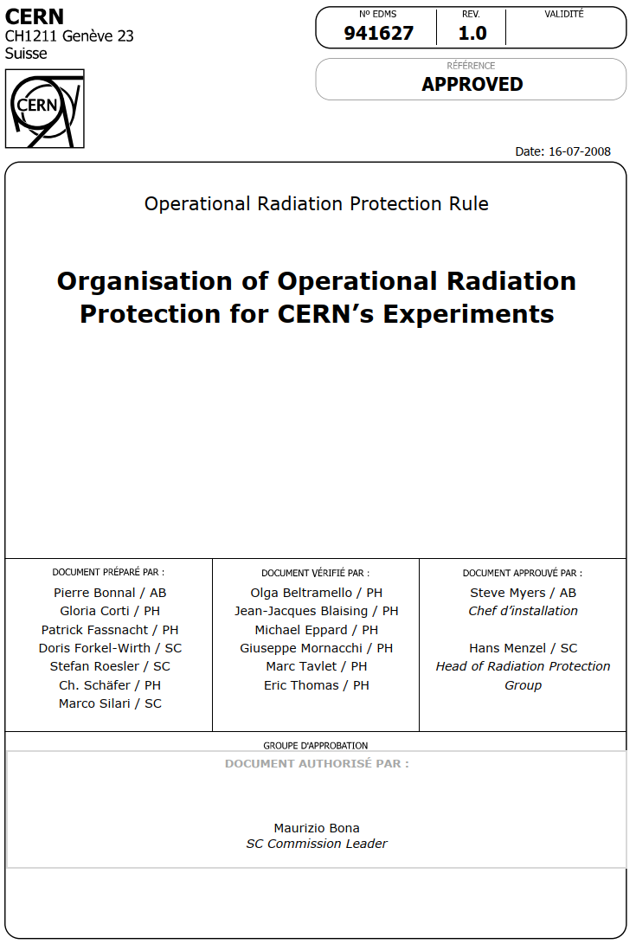
CERN Radiation Protection Experts
Motivation
  Introduced with start of the LHC since LHC experiments need considerable RP availability and flexibility
  Need for having RP link persons in experiments with both deeper understanding of RP rules and practices as well as knowledge of the respective experiment who can contribute to RP tasks
  Scheme defined in EDMS 941627 and agreed on with ASN and OFSP
Requirements
  University degree or technical training
  Good knowledge in working with ionizing radiation or in Radiation Areas
  A certificate received after a successful participation in an RPE course given by a body certified by a national authority. The course includes information on CERN specific radiation protection aspects (CERN specific risks, CERN’s RP rules and regulations)
  Successful completion of “on-the-job” training - accompanied by RP
  Joint nomination by the Technical Coordinator and HSE-RP
RPE activities in LHC Experiments today
  Activities are limited to Supervised Radiation Areas
  Monitoring of radiation levels
  Lifting of RP veto
  Radiation surveys in experimental area
  Contribution to implementation of ALARA during interventions
  Radiological control of material from areas without activation risk
HSE-RP delegates tasks but not the responsibility
RPE teams are part of the CERN RP team
The RPE scheme has proven to be very successful thanks to excellent collaboration between RPE and HSE-RP

Slide 24
Radiation Protection – Radiation Safety
Radiation Protection
  Responsibility of HSE-RP
  The duties of CERN’s Radiation Protection Group include operational radiation protection which comprises assessment of radiological risks, classification of work places in radiation zones, implementation of control measures, monitoring radiation levels for different radiation areas and impact of radiation on the environment, monitoring the implementation of regulations and of specific rulings, approval of ALARA plans, control and characterization of radioactive material and waste
Radiation Safety
  Responsibility of every CERN Department owning radiation sources or using radiation sources put at its disposition.
  These Departments are in charge of implementing the requirements laid down in CERN’s Safety rules and documents or specified by HSE-RP in order to ensure the safe operation of their existing and future installations (accelerators, beams, experiments). The Departments are also in charge of training their personnel in matters of Radiation Protection according to the rules specified by HSE-RP.

