Slide 1
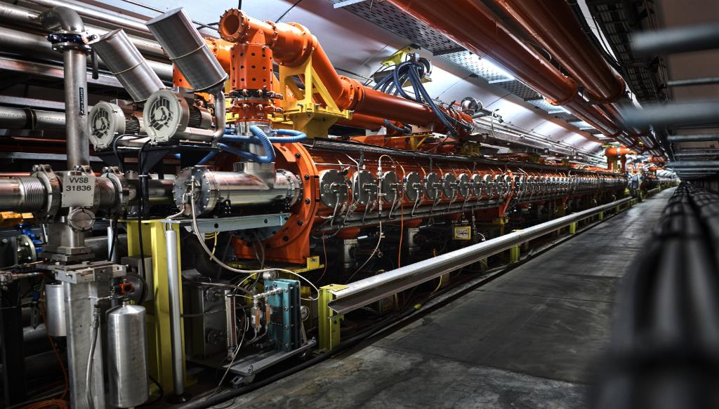
Radio Frequency Systems
LECTURE 6
Maurizio Vretenar CERN RTU/CERN May 2024

Slide 2

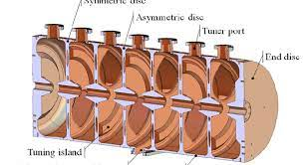
Reminder: Radio Frequency System building blocks
HV AC/DC power converter
AC to DC conversion efficiency ~90%
Main oscillator
RF feedback
system
DC to RF conversion efficiency ~50%
High power RF amplifier (tube or klystron)
RF to beam voltage conversion efficiency = SHUNT IMPEDANCE
ZT² ~ 20 - 60 MΩ/m
ion beam, energy W
vacuum
system
water
cooling
system
Accelerating Cavity
cryogenic
system

Slide 3
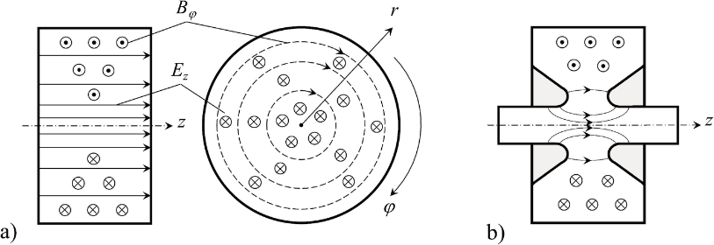
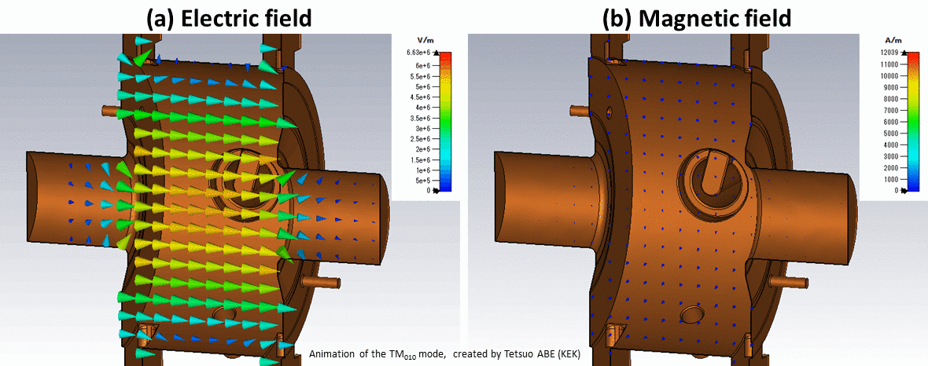
The basic («pillbox») Radio Frequency cavity

Slide 4
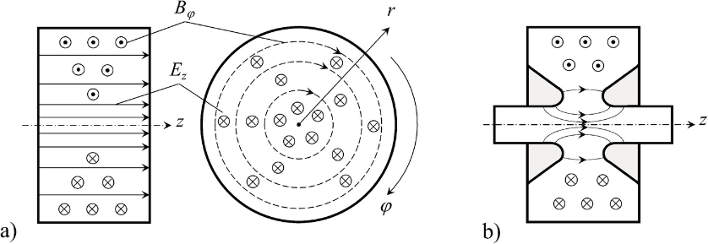
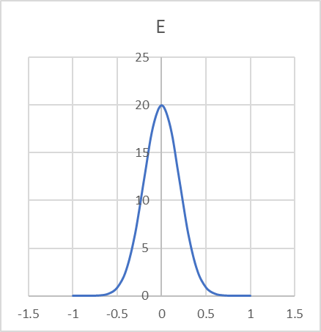
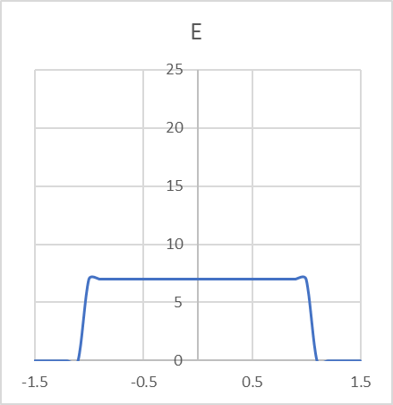
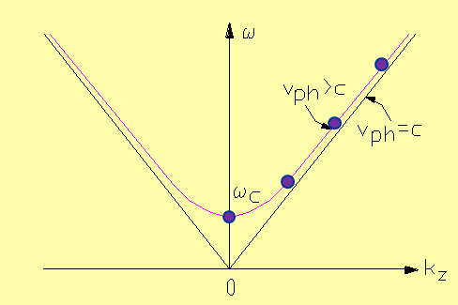
The basic («pillbox») Radio Frequency cavity
E-field on axis
E-field on axis
A particle traveling on the axis of a simple pillbox will have a low energy gain.
To improve we add some “noses” around axis, to increase the Transit Time factor, via:
An increase of electric field in the centre (Faraday law: integral of E = flux of B);
A decrease of the time spent by the beam in the maximum field region.
The simplest cavity mode with longitudinal electric field on axis is the TM010 (=0 space periods in Φ, 1 variation / half period in r, 0 space periods in z), the first one that we find on the dispersion curve.
TM010

Slide 5
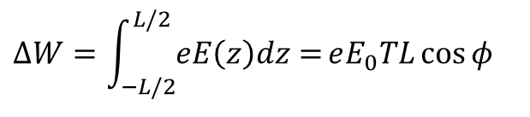
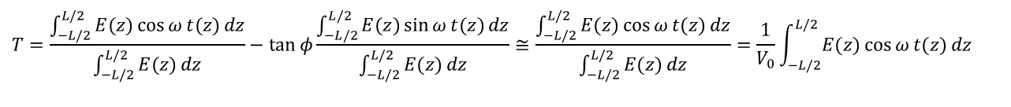
Transit time factor (reminder)
$$ΔW=\int_{−L/2}^{L/2}{eE\left(z\right)dz=}eE_{0}TL\cos{φ}$$
Panofsky equation: energy gain of a particle crossing a gap
The Transit Time Factor T tells us how much of the E-field that we have provided on the gap has been really seen by a particle moving at velocity v=βc. Is the ratio between 2 integrals (0 ≤T ≤ 1)
$$T=\frac{\int_{−L/2}^{L/2}{E(z)\cos{ω}t(z)}dz}{\int_{−L/2}^{L/2}{E(z)}dz}−\tan{φ}\frac{\int_{−L/2}^{L/2}{E(z)\sin{ω}t(z)}dz}{\int_{−L/2}^{L/2}{E(z)}dz}≅\frac{\int_{−L/2}^{L/2}{E(z)\cos{ω}t(z)}dz}{\int_{−L/2}^{L/2}{E(z)}dz}=\frac{1}{V_{0}}\int_{−L/2}^{L/2}{E(z)\cos{ω}t(z)}dz$$
Neglecting the increase in velocity in the gap
For the simplest case E(z)=E₀
E
E(z)
energy gain by a particle in the middle of the gap at t=0
E(z)cosωt(z)
energy gain by a particle crossing the gap with infinite velocity at t=0
z
T is a characteristic of the cavity design; can be easily calculated by RF design codes
-g/2
g/2

Slide 6
Shunt Impedance (reminder)
Design of an accelerating system → goal is to maximize acceleration ΔW for a given power delivered to the cavity P_{c} . Can we define a figure of merit to compare different designs?
We define a « shunt impedance » Z as ; exactly twice the shunt resistance in the equivalent parallel circuit
The figure of merit is (considering maximum acceleration at φ=0 and taking the square of the energy gain in volts, to give consistancy to the units):
ZT² is the effective shunt impedance, depends only on the geometry (and on RF frequency and particle velocity). Unit is ohms (usually MΩ, or MΩ/m if referred to the unit length). Can be easily calculated by computer codes, and then used to calculate the cavity power and the final power efficiency:
ATTENTION!!!
Usually in linacs we use Z, while for other RF systems and in other literatures is used R_{p}: difference by a factor 2 !
R_{p}

Slide 7

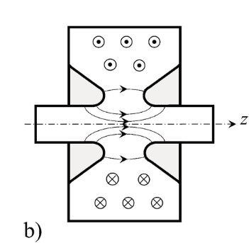
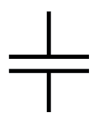
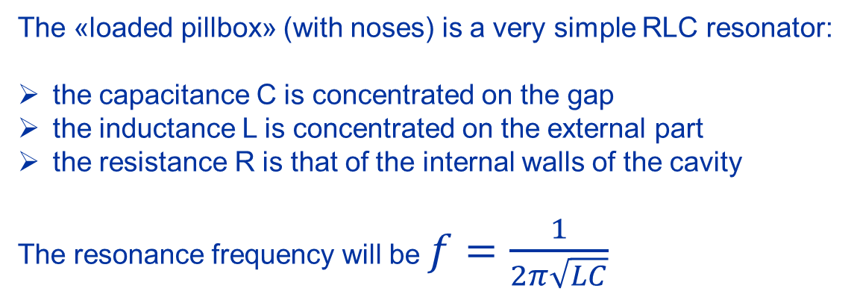
Capacity and Inductance: the equivalent circuit
The «loaded pillbox» (with noses) is a very simple RLC resonator:
the capacitance C is concentrated on the gap
the inductance L is concentrated on the external part
the resistance R is that of the internal walls of the cavity
The resonance frequency will be $f=\frac{1}{2π\sqrt{LC}}$

Slide 8
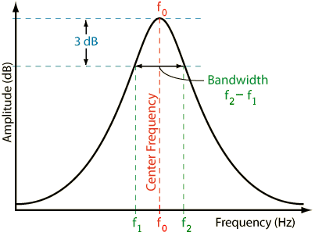
The 3 cavity parameters
A resonator (= a mode in the accelerating cavity) is always defined by a set of 3 parameters.
They can be:
(Capacitance, Inductance, Resistance)
(Frequency, Q-value, R/Q)
R/Q is a geometrical parameter, the ratio between current and voltage in a system
L₀
R_{p}
C₀
An RF transmission measurement can easily allow to get (f, Q) from the 3db bandwidth.
(precaution: to measure Q₀; we need a sufficiently low ioupling. If input coupling is too large, is measured the Q loaded (Q_{l}), given by the parallel of the cavity R and the transformed output impedance of the measurement device).
resonator
RF in
RF out

Slide 9
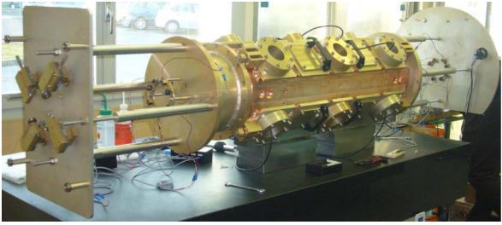
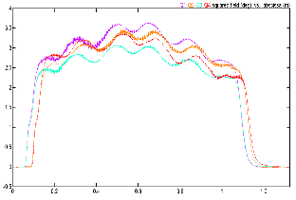
Measurement of electric field distribution – the RFQ
Motor
“bead-pull” perturbative measurement.
A small metallic bead is slowly moved inside the resonator.
Slater’s perturbation theorem: the variation in resonant frequency is proportional to the difference between square of electric field and square of magnetic field at the position of the bead.
Bead in regions of pure E or pure B field: easy way to plot the longitudinal field distribution.
It is a relative measurement (or needs calibration of the bead)
Bead
Cavity
PC+controller
RF power in
RF out
Generator Network Analyzer Detector

Slide 10
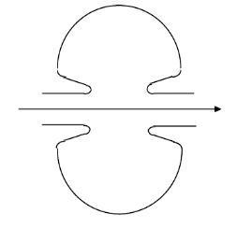
Cavity optimization
L₂
Nose cone
B
L₁
E
R₁
R₂
B
Step 1: pillbox cavity
Step 2: reentrant cavity
E field is concentrated near beam axis and gap become shorter: T and gap capacitance increase. C_{gap} a function of L1 and R1.
Magnetic field is confined on the outer walls and inductance is function of L2 and R2-R1.
To get the same frequency it is possible to reduce cavity radius, increasing Q and Z.
Step 3: optimization
Rounding off edges close to beam axis allows to increase the ratio E0/Epeak. The protrusion inside the cavity (nose cone) increase T and ZT². A spherical shape of the inductive zone improve Q.
(courtesy of F. Grespan)

Slide 11
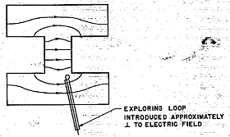
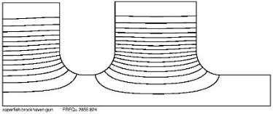
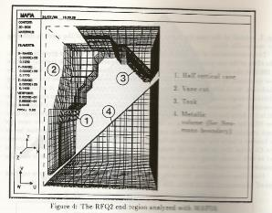
Mapping cavity fields and calculating cavity parameters
Knowledge of the field distribution and definition of the correct dimensions for the required frequency is essential to finalise the mechanical design, to compute the accelerating voltage, to dimension the ancillary elements coupler, etc.
1. The good old way: build a model and then measure frequency and explore fields with a probe.
(illustration from the original Alvarez paper on DTL)
2. From the beginning of the 80’s, modern computers allow to calculate frequency and fields in 2D (axis-symmetric cavities): SUPERFISH, URMEL.
3. At the end of the 80’s comes the first 3D software: the MAFIA package (DESY and LANL). Constantly improved, 3D packages allow nowadays to calculate complex shapes with amazing precision.
(1st 3D simulation of the CERN RFQ2 – 1987, 6000 mesh points)
Notes:
Important to close the loop and go to models after simulations! Feeling of mechanical fabrication and mechanical errors (most typical mistake of a new RF designer is to compute a shape precise at the 6th decimal digit, when fabrication errors affect already the 1st digit…

Slide 12
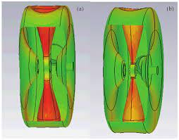
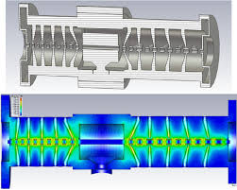
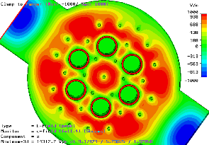
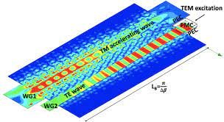
Modern cavity simulation software
Modern 3d simulation software (e.g. CST Studio Suite) can analyse every geometry made with a large variety of materials (metallic and dielectric), providing you with information like:
Frequency, field distribution, acceleration parameters, shunt impedance, sensitivities, etc.
The codes are integrated into modern CAD systems and interfaced with thermo-mechanical simulation software.
CST Studio Suite contains finite integration technique (FIT), finite element method (FEM), transmission line matrix (TLM), multilevel fast multipole method (MLFMM) and particle-in-cell (PIC).

Slide 13
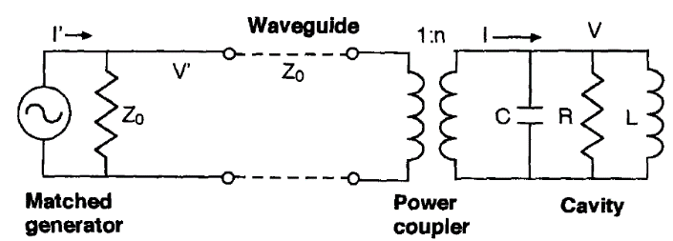
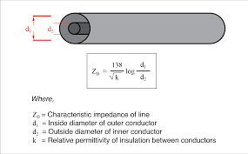
Coupling RF power to a cavity
Transmission lines (coaxial, waveguides):
Each line has a characteristic impedance Z₀ (ratio energy in electric and magnetic fields) that depends on its dimensions.
Examples:
Z₀ = 75 Ω (TV cables, low loss)
Z₀ = 50 Ω (accelerators, high voltage)
To avoid reflections of the transmitted wave, a transmission line must always be terminated on its characteristic impedance!
At resonance, the cavity behaves like a pure resistance R. A coupler is required to:
allow RF power to flow into the cavity, and
transform the cavity impedance R into the characteristic impedance of the transmission line, Z₀, to avoid power reflections.

Slide 14
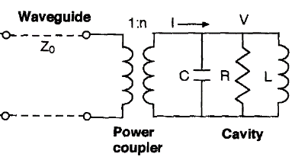
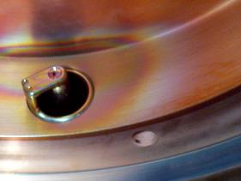
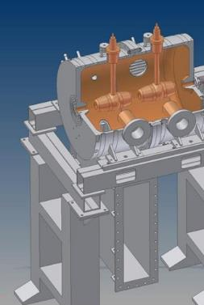
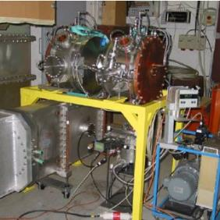
Power couplers: loops and waveguide slots
Small loop coupler to a 400 MHz buncher after 15 years of operation (traces of multipactoring)
We need to inductively couple 2 magnetic field distributions.
Two options:
A coaxial line is terminated in a small loop immersed in the cavity magnetic field;
A waveguide is terminated in a small slot that allows some magnetic field to enter the cavity.
Waveguide coupling slot to the Linac4 CCDTL accelerating structure

Slide 15
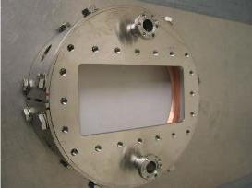
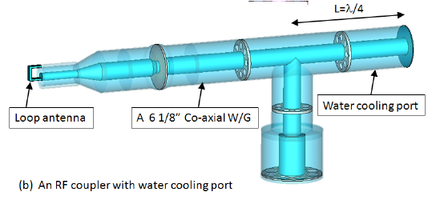
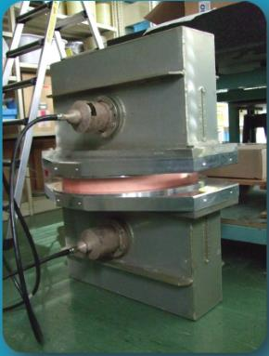
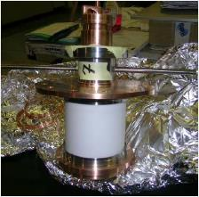
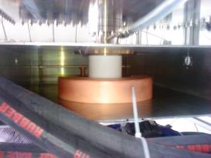
RF windows
RF windows provide the barrier for vacuum between transmission line (coaxial or waveguide) and cavity. Made of ceramic material.

Slide 16
Examples of cavities

Slide 17
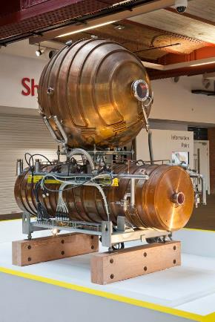
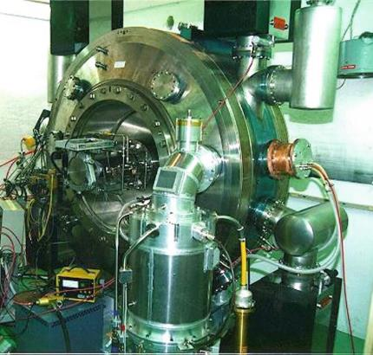
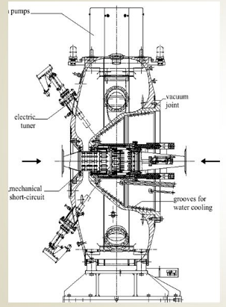
Synchrotron cavities (high energy)
The pillbox becomes quite complex…
CERN PS 80 MHz cavity (for LHC beams)
One of the 16 cavities installed in the old LEP collider: 352.2 MHz, 5 coupled cells, equipped with a spherical storage cavity on top to reduce losses

Slide 18
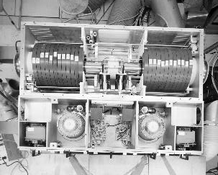
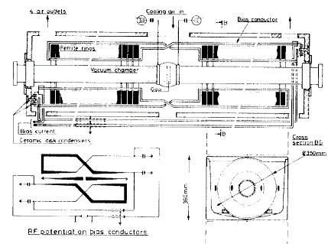
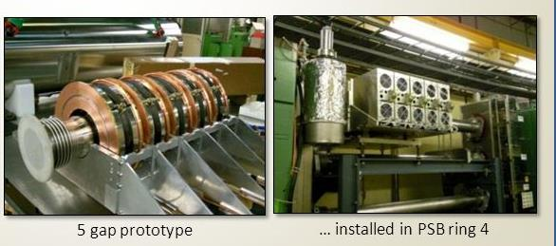
Synchrotron cavities (low energy, tunable)
CERN PS Booster:
4 rings with a single accelerating cavity.
2 quarter-wave ferrite-loaded resonators: 2 figure-of-eight loops on the ferrite loads for tuning the frequency throughout the acceleration cycle, from 3 to 8 MHz (from 50 MeV at injection to the original Booster energy of 800 MeV).
Finemet cavities
new type of magnetic alloy with wideband frequency response.
State-of-art technology for modern small synchrotrons (e.g. medical)

Slide 19
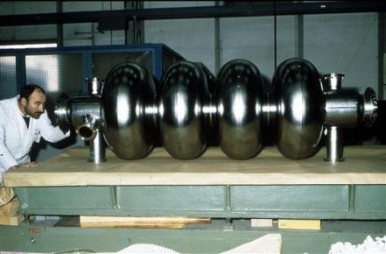
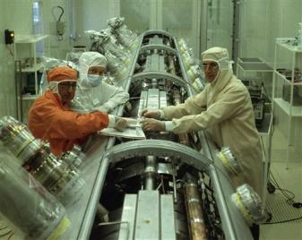
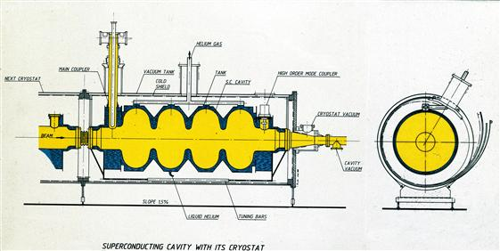
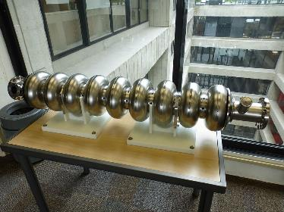
Superconducting cavities
Used in high-energy synchrotrons (protons and electrons) and in linacs (fixed frequency, not tunable).
Made in niobium or niobium-sputtered copper immersed in a liquid helium bath at 4 degK.

Slide 20
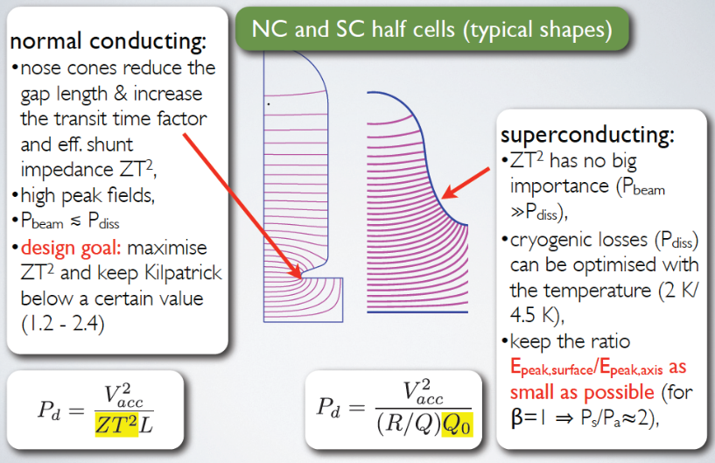
Comparing normal conducting and superconducting
This and next 2 slides courtesy of F. Gerigk, CERN
This and the next few slides courtesy of F. Gerigk, CERN

Slide 21
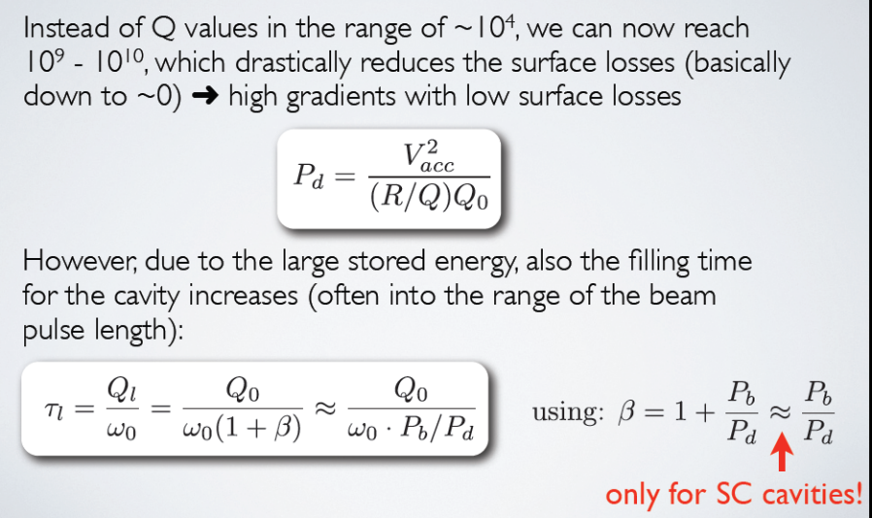
When are SC cavities attractive?

Slide 22
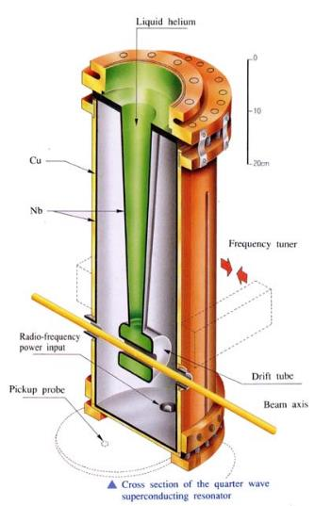
Superconducting Quarter Wave Resonators
Simple 2-gap cavities commonly used in SC version (lead, niobium, sputtered niobium) for low beta protons or ion linacs, where ~CW operation is required.

Slide 23
The Spoke cavity
Another option:
Double or triple-spoke cavity, can be used at higher energy (100-200 MeV for protons and triple-spoke).
HIPPI Triple-spoke cavity prototype built at FZ Jülich, now under test at IPNO
Notes:
Preaching to the converted…

Slide 24
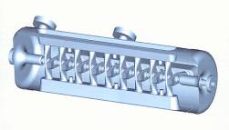
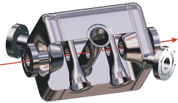



The superconducting zoo
Spoke (low beta)
[FZJ, Orsay]
CH (low/medium beta)
[IAP-FU]
QWR (low beta)
[LNL, etc.]
Re-entrant
[LNL]
HWR (low beta)
[FZJ, LNL, Orsay]
Superconducting linacs for low and medium beta ions are made of multi-gap (1 to 4) individual cavities, spaced by focusing elements.

Slide 25

Cavity construction technologies
Set of parts joined together; needs to have:
A well defined vacuum envelope (no trapped volumes, special vacuum joints)
A well defined RF envelope (no leaking RF, good RF contacts between parts)
A stable mechanical structure under vibrations and thermal deformations
An effective cooling of the heat produced by the RF.
Construction technology depends on dimensions (￫on frequency):
  ☞ brazed copper elements (>500 MHz) commonly used for electron linacs.
  ☞ copper or copper plated welded/bolted elements commonly used for ion linacs (<500 MHz).
In most of the cases,
it is on the mechanical construction that you will win or lose your project…

Slide 26




Example: Linac4 DTL Tank1
a puzzle of several thousand elements…

Slide 27



Cavity coatings
Skin depth:
In the reflection of a wave from a metallic surface, if the resistivity of the metal is not zero the wave will penetrate in the metal with an amplitude that decreases exponentially.
The depth at which the amplitude is 1/e (37%) of the original amplitude is called “skin depth”.
Because at high frequencies the power dissipation in a cavity occurs only in a thin layer below the surface, this property is used to realize cavities that are not entirely made in copper (expensive and difficult to machine) but made of a stainless-steel substrate electrochemically plated with a thin layer of copper.
Example: at 200 MHz, skin depth is 4.5 μm. A 30 μm layer of copper (about 5 skin depths) will intercept 99.9% of RF current.
In a similar way, often SC cavities are made in copper sputtered with a thin layer of niobium (resistivity in this case is very low and only few atomic layers are sufficient!)

Slide 28
The RF power system

Slide 29
The RF system – the complete circuit diagram
A closer insight of what the RF does is given by the equivalent circuit of an amplifier/cavity system
RF is the art of transporting energy at given frequency by matching impedances
RF amplifier
transmission line
RF cavity
beam
Z_{i}
Z₀
From the electrical point of view, the beam is a “perturbation”, in the form of an additional parallel resistance and a (dephased) current generator!
Z₀
transmitter output coupler
resonator input coupler
active unit (RF tube or klystron):
current generator with internal impedance
output resonator of the transmitter (klystron): filters higher order harmonics and coupes to the line
transmission line (coaxial or waveguide)
Cavity resonator
Beam: additional resistance (power given to the beam) + current generator out of phase

Slide 30


RF and construction technologies
Type of RF power source depend on frequency:
  ☞ Klystrons (>350 MHz) for electron linacs and modern proton linacs. RF distribution via waveguides.
  ☞ RF tube (<400 MHz) or solid state amplifiers for proton and heavy ion linacs. RF distribution via coaxial lines.
3 GHz klystron
(CERN LPI)
200 MHz triode amplifier
(CERN Linac3)

Slide 31




RF tubes
High power triodes and tetrodes :
Used as active elements to amplify an RF signal (typical gain 10-30 dB).
To reach peak powers in the MW range are used cascades of RF amplifiers using different types of tubes.
Courtesy JAES company

Slide 32



Klystrons
High frequency RF power amplifier :
High efficiency and high gain.
Need bunching length of a few wavelength, used only at frequencies > 350 MHz.

Slide 33


Solid State
New solid-state RF amplifier system built by Thales for the CERN SPS, to provide the power for the high-luminosity LHC upgrade, commissioned in 2020.
Transistors are assembled in sets of four on 2 kW modules.
A total of 2560 modules (10 240 transistors) are spread across 32 towers. Power from 16 towers is combined to reach two times 1.6 MW.
3.2-kW RF amplifier module with two-way divider and combiner
H. Song, S. Lee, J. Chai, Modular 20 kW, 83.2-MHz Solid-State RF Amplifier for a 10-MeV Cyclotron

Slide 34


Comparing different RF power sources
(from R. Carter’s book)

Slide 35







Transmission lines
Power has to be transported to the cavity without reflections (matching), with minimum loss and reliably (no arcs!).
Coaxial (rigid or cable) or waveguide.
Rigid coaxial lines for the CERN TW 400 MHz RF system at the SPS
Semi-rigid coaxial cable
Rectangular waveguide
Rigid coaxial lines

Slide 36

Traveling wave building blocks
« Energy doubler », SLED

Slide 37
Operational limitations for RF systems

Slide 38



The breakdown limit (in vacuum)
The maximum surface electric field that can be reached in an RF cavity is limited by BREAKDOWN (RF breakdown in vacuum). The origin of breakdowns is FIELD EMISSION:
Tunneling of electrons through the potential barrier at the boundary metal/vacuum in presence of an applied voltage. Increasing the surface electric field reduces the barrier and increases the number of escaping electrons. The temperature enhances the emitted current (field assisted thermoionic emission).
Quantum mechanics phenomenon, can be calculated, Fowler-Nordheim relation:
Current density (A/cm²) emitted by a metal of extraction potential Φ with an applied electric field E, in the limit case of T→0 (with some additional approximations).
The current goes up very quickly (exponential); a F.-N. behaviour is characterised by a linear ln(I/V)=f(1/V)

Slide 39
Breakdown and impurities
Looking at the numbers, for copper the F.E. current starts to become important only for fields in the region of few GV/m, well beyond normal operating fields in the order of 10-40 MV/m.
(E=1 GV/m → J=5e-17 A/m², E=5 GV/m → J=7e11 A/m² !!)
But: the theory is valid for smooth and perfect surfaces. A real electrode has marks coming from machining (finite surface roughness) and contains impurities incrusted on the surface (grains). Both these elements increase the surface field (edges for the roughness and dielectric constant for the impurities).
“Mountain and snow”: The real field on the surface is βE, adding an “enhancement” factor β.
F.-N. formula for copper, with the enhancement factor
Field emission current is a pre-breakdown phenomenon. When the current at a certain spot goes beyond a certain limit a breakdown starts (the real physics of the phenomenon is still under discussion).
Field emission current is often called « dark current » and can be measured.
Copper, β=60

Slide 40
Measurement of dark current
Plotting RF power measured at the input of the cavity as function of cavity voltage square (arbitrary units, measures on a pick-up loop at the cavity) we see above a certain power the appearance of dark current accelerated on the gap and absorbing power.
Considering that the dark current power is proportional to gap voltage and to current intensity, we can plot ln(I/V)=f(1/V); the slope of the curve is the enhancement factor.
CERN RFQ2:
β=220 electrodes as out of the workshop
β=920 after a heavy pollution from hydrocarbons from the vacuum system
β=67 after long conditioning

Slide 41


Breakdowns and conditioning
Increasing the voltage, in one or few points the F.-E. current will go above the threshold and start a breakdown.
But the breakdown will reconfigure the surface and there is a certain probability that the new surface will be better (melted spikes, degazed impurities) → we can continue and condition the cavity.
At some point, the number of emitting spots will be so high that we will always find a sparking point → limit of conditioning.
Note that breakdown is a statistic phenomenon. We cannot define a breakdown threshold, instead we can speak of sparking rate (number of breakdown per unit time) as funtion of voltage. The rate is decreased by conditioning; it will decrease asymptotically towards a limiting value.

Slide 42
The Kilpatrick field
W. Kilpatrick in 1956 fitted some experimental data on breakdown “levels” in RF regime with a F.-N. type formula, assuming that the breakdown is ignited by the impact on the surface of an ion accelerated on the gap, with energy W:
In the late 60’s at Los Alamos they introduced a calculation of the ion velocity based on gap and frequency (the ion has a transit time factor!) → frequency dependant version of the Kilpatrick criterion:
This formula is still used as a reference in the design of linear accelerators! For a given frequency, allows to calculate the “Kilpatrick field”.
Very useful and a good reference, with some caveats:
It gives the famous result that maximum field goes as √f ; although demonstrated in several cases, now it is not considered as a fixed law and in particular does not hold >10 GHz, where other phenomena take place.
It is not valid for small gaps and low frequencies, where we approach instead the limits for DC field;
It gives the wrong message that there is a breakdown threshold;
The experimental data were taken in the 50’s with bad vacuums, nowadays a cavity can operate at a few times the Kilpatrick limit.
Usual maximum fields range from about 1 Kilpatrick (CW systems high reliability) to 2.5 Kilpatrick (RFQ2)

Slide 43


Multipactoring
Electron resonance due to secondary emitted electrons from the surfaces.
Occurs at low voltages and can completely stop normal operation of a cavity.
Some causes of multipactoring:
Dirty surfaces (impurities emitting electrons)
Air pockets (providing ions and electrons)
Parallel plate and coaxial geometries (well-defined electron path)
High pulsing rates (remaining electrons)
Presence of silver (secondary emission >1)
Vicinity of a ceramic insulator (high sec. emission)
Bad luck…
Some cures:
Conditioning: long times in the mp. region, possibly at higher repetition frequency, heating the surfaces to oxidize them and thus reduce the secondary emission coefficient below 1. Adding a frequency modulation increases the conditioned surface.
Some paints (aquadag) were used in the past but are not very good for vacuum.
The inner conductor of a coaxial coupler that was (probably by mistake) silver plated and then installed in a CERN linac cavity in 1978. Multipactoring went on for 25 years during normal operation sputtering silver on the window, until it eventually short circuited a Friday night in 2003 stopping all CERN accelerators…

Slide 44

End of Lecture 6
Elwood Smith

