Slide 1
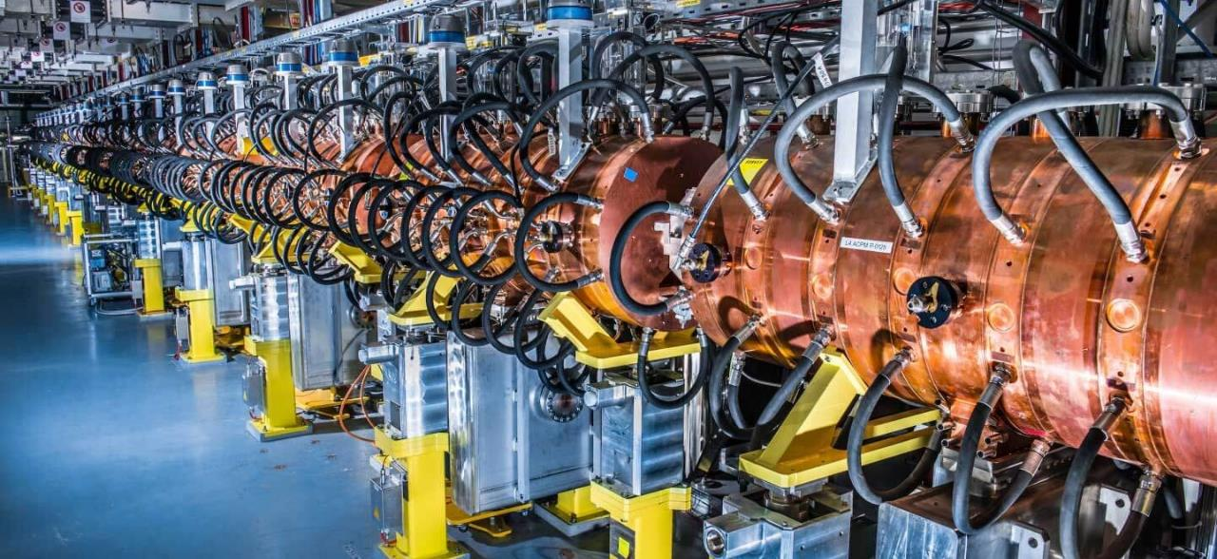
RF Linear Accelerators
LECTURES 3 & 4
Maurizio Vretenar CERN RTU/CERN May 2024

Slide 2
Module 1
Why linear accelerators
Basic linac structure
Acceleration in periodic structures

Slide 3
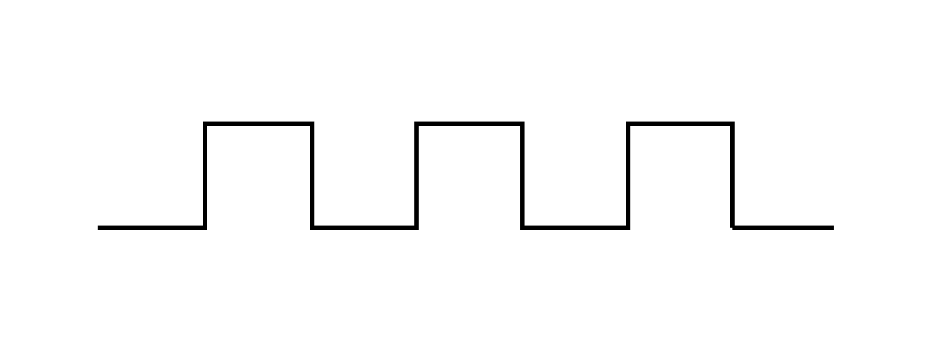
Definitions
Linear accelerator: a device where charged particles acquire energy moving on a linear path
RF linear accelerator: acceleration is provided by time-varying electric fields (i.e. excludes electrostatic accelerators)
A few definitions:
CW (Continuous wave) linacs when the beam bunches come continuously out of the linac;
Pulsed linac when the beam is produced in pulses: τ pulse length, f_{r} repetition frequency, beam duty cycle τ × f_{r} (%)
Main parameters: E kinetic energy of the particles coming out of the linac [MeV]
I average current during the beam pulse [mA] (different from average current and from bunch current !)
P beam power = electrical power transferred to the beam during acceleration
P [W] = V_{tot} × I = E [eV] × I [A] × duty cycle
1/f_{rep}
τ
Beam current, I
Time, t

Slide 4
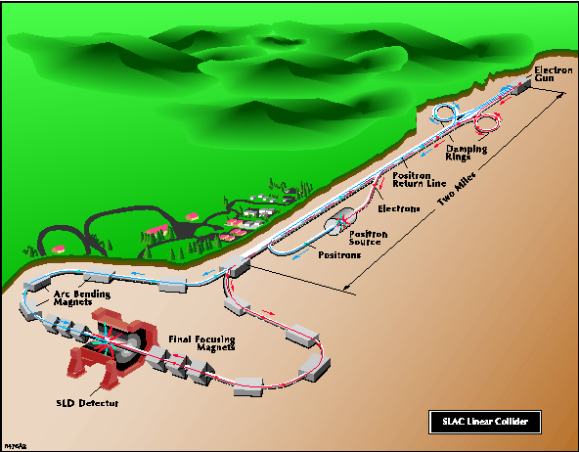
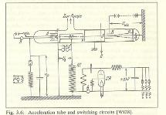
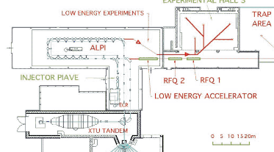
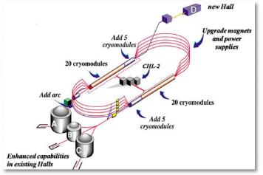
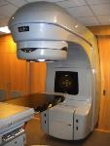
Variety of linacs
The first and the smallest: Rolf Widerøe thesis (1923)
The largest: Stanford Linear Collider (2 miles = 3.2 km)
One of the less linear: ALPI at LNL (Italy)
A limit case, multi-pass linacs: CEBAF at JLAB
The most common: medical electron linac (more than 14’000 in operation around the world!)
Notes:
What these machines have in common and why do we need linear accelerators

Slide 5




Why linear accelerators ?
Energy
Linear Accelerators (linacs) for protons and heavier ions are used for:
Low-Energy acceleration (injectors to synchrotrons or stand-alone): for protons and ions, linacs can be synchronous with the Radio Frequency (RF) fields in the range where velocity increases with energy. When velocity is ~constant, synchrotrons are more efficient (multiple crossings of the RF gaps instead of single crossing). Protons : β = v/c = 0.51 at 150 MeV, 0.95 at 2 GeV.
High-Energy acceleration in the case of production of high-intensity proton beams: in comparison with synchrotrons, linacs can go to higher repetition rate (up to CW), are less affected by resonances and have more distributed beam losses.
7 TeV
Synchrotrons
2 GeV
Linacs
500 MeV
Cyclotrons
2 MeV
electrostatic
Average Beam current
Proton and ion particle accelerators (energy refers to protons)

Slide 6
Why Linear Accelerators
 | LINACS |  | SYNCHROTRONS
 | Low Energy | High Energy | High Energy
Protons, Ions | Injectors to synchrotrons, stand alone applications synchronous with the RF fields in the range where velocity increases with energy. Protons : β = v/c =0.51 at 150 MeV, 0.95 at 2 GeV. | Injection at higher intensity Production of secondary beams (n, ν, RIB, …) higher cost/MeV than synchrotron but: - high average beam current (high repetition rate, less resonances, easier beam loss). - higher linac energy allows for higher intensity in the synchrotron. | very efficient when velocity is ~constant, (multiple crossings of the RF gaps). limited mean current (limited repetition frequency, instabilities)
Electrons | Injector to synchrotrons, stand-alone applications simple and compact | Linear colliders do not lose energy because of synchrotron radiation | Light sources, factories can accumulate high beam intensities
« traditional » linac range
« new » linac range

Slide 7
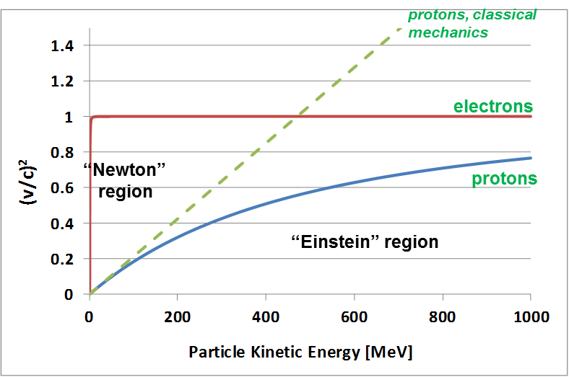


Proton Velocity: “Newton” and “Einstein”
In linear accelerators the beam crosses only once the accelerating structures. The distance between accelerating elements can be adjusted to follow the increase in the velocity of the particle beam. The periodicity of the RF structure must match the particle velocity → development of a complete panoply of accelerating structures with different features.
Classic (Newton) relation:
Relativistic (Einstein) relation:
Protons (rest energy 938.3 MeV) follow “Newton” mechanics up to some tens of MeV (Δv/v < 1% for W<15 MeV) then slowly become relativistic (“Einstein”). From the GeV range velocity is nearly constant (v~0.95c at 2 GeV).
Linacs can cope with the increasing particle velocity, synchrotrons cover the range where v nearly constant.
Linacs
Synchrotrons
β²=(v/c)² as function of kinetic energy T for protons and electrons.
Notes:
Accelerating gradients that we can provide with a linac is nearly constant (2 MeV/m) --- synchrotron radiation ((beta*gamma)**4)/(r**2)

Slide 8
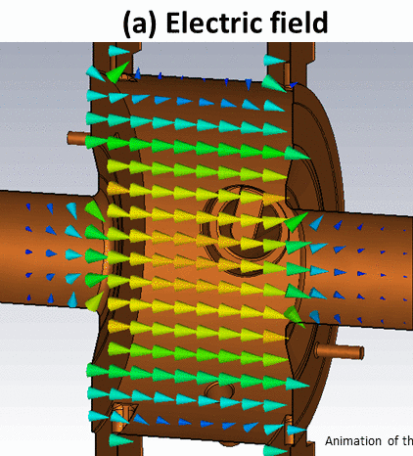
Radio Frequency linear accelerator structures
Radio Frequency cavity
Focusing magnet
B-field
DC
particle
injector
bunching
section
?
E-field
d
Energy ~ 50-100 keV/u
β= v/c ~ 0.01
Accelerating gap: E = E₀ cos (ωt + φ)
en. gain ΔW = eV₀Tcosφ
Acceleration → the beam has to pass in each cavity on a phase φ near the crest of the wave
The beam must to be bunched at frequency ω
distance between cavities and phase of each cavity must be correlated
Phase change from cavity i to i+1 is
For the beam to be synchronous with the RF wave (“ride on the crest”) phase must be related to distance by:
… and on top of acceleration, we need to introduce in our “linac” some focusing elements
… and on top of that, we will couple a number of gaps in an “accelerating structure”
Notes:
How must be spaced the gaps? How should they be connected to the source of the wave? How many quadrupoles should we have?
Idea by 2 norwegians: Wideroe for the gap and the RF, Bill Hansen for the cavity

Slide 9
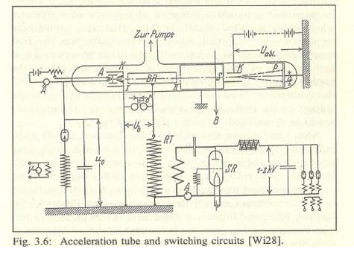
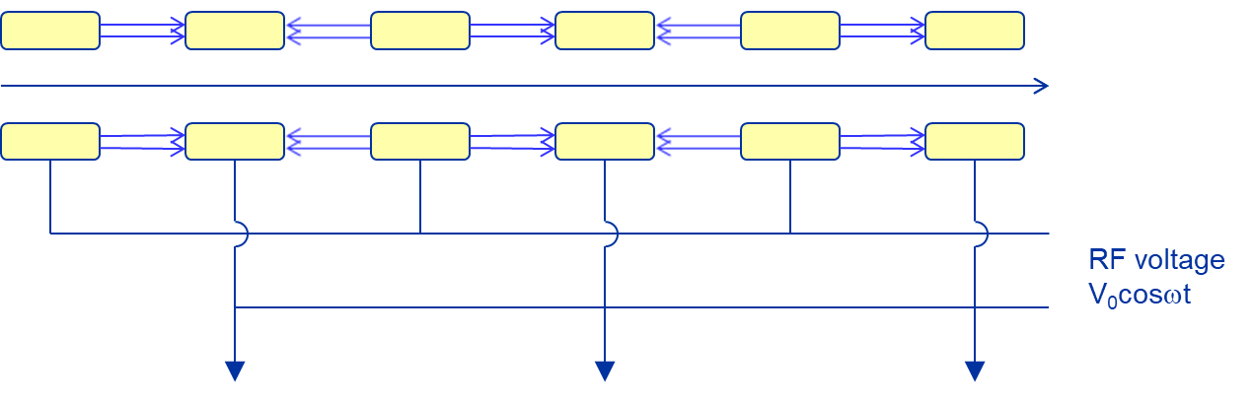
Synchronism condition for the Wideröe
Please note that for the particular case of the Wideröe seen in the previous lectures, Δφ=π
The general relation for synchronicity
becomes π / d = 2π / βλ or d = βλ / 2

Slide 10
Accelerating structure architecture
When β increases during acceleration, either the phase difference between cavities Δφ must decrease or their distance d must increase.
d = const.
φ variable
d
Individual cavities – distance between cells constant, each cavity fed by an individual RF source, phase of each cavity adjusted to keep synchronism, for linacs operating with different ions or at different energies. Flexible but expensive!
Better, but 2 problems:
create a “coupling”;
create a mechanical structure with increasing cell length.
φ = const.
d variable
d ∝ βλ
Coupled cell cavities - a single RF source feeds many cells (up to ~100!) - phase between adjacent cells is fixed (from coupling), distance between cells increased to keep synchronism. Can accelerate only one type of ion for a given energy range. Effective but not flexible.
When particles become relativistic, the two architectures become the same!
Notes:
How must be spaced the gaps? How should they be connected to the source of the wave? How many quadrupoles should we have?

Slide 11
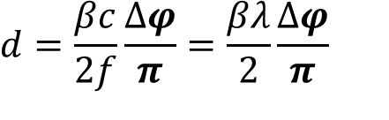
Linear and circular accelerators
accelerating gaps
d
accelerating gap
d
d=βλ/2=variable
f=constant
$$d=\frac{βc}{2f}\frac{∆φ}{π}=\frac{βλ}{2}\frac{∆φ}{π}$$
d=2πR=constant
f=βc/2d=variable
Linear accelerator:
Particles accelerated by a sequence of gaps (all at the same RF phase).
Distance between gaps increases proportionally to the particle velocity, to keep synchronicity.
Used in the range where β increases. “Newton” machine
Circular accelerator:
Particles accelerated by one (or more) gaps at given positions in the ring.
Distance between gaps is fixed. Synchronicity only for β~const, or varying (in a limited range!) the RF frequency.
Used in the range where β is nearly constant. “Einstein” machine

Slide 12
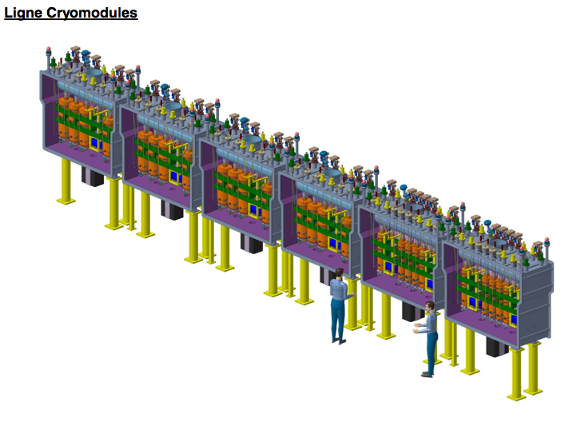
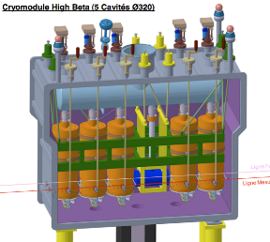
Case 1: a single-cavities linac
The goal is flexibility: acceleration of different ions (e/m) at different energies → need to change phase relation for each ion-energy
RF cavity
focusing solenoid
REX-HIE linac at CERN
(superconducting)
Post-accelerator of radioactive ions
2 sections of identical equally spaced cavities
Quarter-wave RF cavities, 2 gaps
12 + 20 cavities with individual RF amplifiers, 8 focusing solenoids
Energy 1.2 → 10 MeV/u, accelerates different A/m
beam

Slide 13
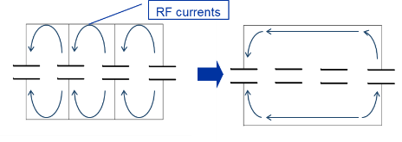
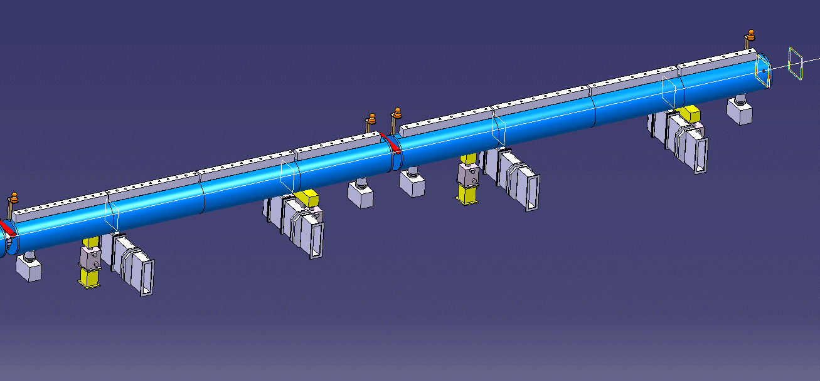
Case 2 : a Drift Tube Linac
Tank 2 and 3 of the new Linac4 at CERN:
57 coupled accelerating gaps
Frequency 352.2 MHz, λ = 85 cm
Cell length (d=βλ) from 12.3 cm to 26.4 cm (factor 2 !).
d
10 MeV,
β = 0.145
50 MeV,
β = 0.31
Direction of electric
field at a given time
To achieve the maximum possible coupling, in a DTL the walls between cells are absent – possible thanks to the particular DTL operating mode with 2π phase difference between cells

Slide 14
Intermediate cases
But:
Between the 2 “extremes” there are many “intermediate” cases, because:
  Single-gap cavities are expensive (both cavity and RF source!).
  Structures with each cell matched to the beta profile are mechanically complicated and expensive.
→ as soon as the increase of beta with energy becomes small (Δβ/ΔW) we can accept a small error and:
Use multi-gap cavities with constant distance between gaps.
Use series of identical cavities (standardised design and construction).
14

Slide 15
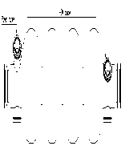
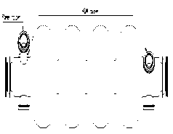
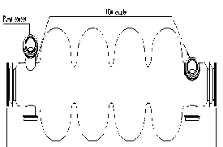
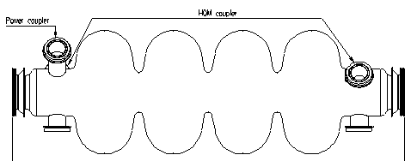
Phase slippage (asynchronicity) in a multicell cavity
Multi-cell superconducting cavities can be only produced in batches of cavities with cells of identical length
(technological reason, cannot afford the complications of increasing cell length).
The cell length is calculated with the usual formula for the beta at the centre of the cavity, but the phase of the beam (with respect to the crest of the wave) will not be “correct” in all other cells.
β=0.52
β=0.7
β=0.8
d=distance between centres of consecutive cells
superconducting 4-cell accelerating structure
β=1
The linac is made of «sections» of identical cavities
For each cavity we accept a «slippage» of the phase around the design phase

Slide 16
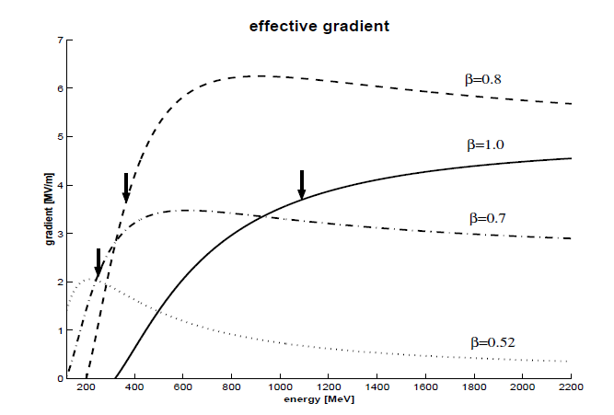
Effects of phase slippage
When sequences of cells are not matched to the particle beta → phase slippage
The effective gradient seen by the particle is lower.
The phase of the bunch centre moves away from the synchronous phase → can go (more) into the non-linear region, with possible longitudinal emittance growth and beam loss.
Very large at small energy (γ~1) becomes negligible at high energy (~2.5 °/m for γ~1.5, W=500 MeV).
Curves of effective gradient (gradient seen by the beam for a constant gradient in the cavity) for the previous case (4 sections of beta 0.52, 0.7, 0.8 and 1.0).

Slide 17
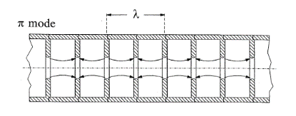
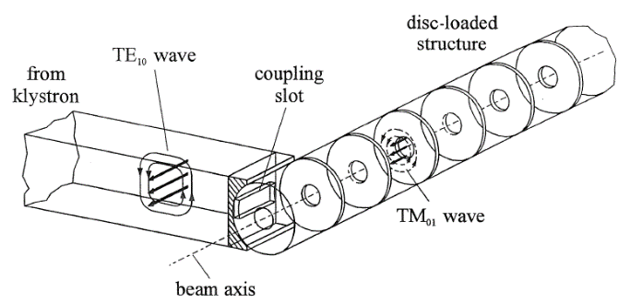
Electron linacs
In an electron linac velocity is ~ constant. To use the fundamental accelerating mode cell length must be d = βλ / 2.
the linac structure will be made of a sequence of identical cells. Because of the limits of the RF source, the cells will be grouped in cavities operating in travelling wave mode.
Pictures from K. Wille, The Physics of Particle Accelerators

Slide 18
Acceleration in periodic structures - wave propagation
RF input
In a cylindrical waveguide different modes can propagate (=Electromagnetic field distributions, transmitting power and/or information). The field is the superposition of waves reflected by the metallic walls of the pipe → velocity and wavelength of the modes will be different from free space (c, λ)
To accelerate particles, we need a mode with longitudinal E-field component on axis: a TM mode (Transverse Magnetic, B_{z}=0). The simplest is TM01.
We inject RF power at a frequency exciting the TM01 mode: sinusoidal E-field on axis, wavelength λ_{p} depending on frequency and on cylinder radius. Wave velocity (called “phase velocity”) is v_{ph}= λ_{p}/T = λ_{p}f = ω/k_{z} with k_{z}=2π/λ_{p}
The relation between frequency ω and propagation constant k is the DISPERSION RELATION (red curve on plot), a fundamental property of waveguides.
TM01 field configuration
λ_{p}
E-field
B-field
Brillouin diagram
Notes:
We will now build our own linac, and we will see how we can use the same principle for both proton and electron linacs. Propagation by multiple reflections, means that the velocity and wavelength will not be the same as in vacuum.

Slide 19
Wave velocity: the dispersion relation
The dispersion relation ω(k) can be calculated from the theory of waveguides: ω² = k²c² + ω_{c}² Plotting this curve (hyperbola), we see that:
There is a “cut-off frequency”, below which a wave will not propagate. It depends on dimensions (λ_{c}=2.61a for the TM01 mode in the cylindrical waveguide).
At each excitation frequency is associated a phase velocity, the velocity at which a certain phase travels in the waveguide. v_{p}=∞ at k=0, ω=ω_{c} and then decreases towards v_{p}=c for k,ω￫∞.
To see at all times an accelerating E-field a particle traveling inside our cylinder has to travel at v = v_{ph} → v > c !!!
Are we violating relativity? No, energy (and information) travel at group velocity dω/dk, always between 0 and c.
To use the waveguide to accelerate particles, we need a “trick” to slow down the wave.
k=2π/λ_{p}
v_{ph}=ω/k = (c²+ω_{c}²/k²)^{1/2}
v_{g}=dω/dk

Slide 20
Slowing down waves: the disc- loaded waveguide
Discs inside the cylindrical waveguide, spaced by a distance l , will induce multiple reflections between the discs.

Slide 21
Dispersion relation for the disc-loaded waveguide
Wavelengths with λ_{p}/2~ l will be most affected by the discs. On the contrary, for λ_{p}=0 and λ_{p}=∞ the wave does not see the discs → the dispersion curve remains that of the empty cylinder.
At λ_{p}/2= l , the wave will be confined between the discs, and present 2 “polarizations” (mode A and B in the figure), 2 modes with same wavelength but different frequencies → the dispersion curve splits into 2 branches, separated by a stop band.
In the disc-loaded waveguide, the lower branch of the dispersion curve is now “distorted” in such a way that we can find a range of frequencies with v_{ph} = c → we can use it to accelerate a particle beam!
We have built a linac for v~c → a TRAVELING WAVE (TW) ELECTRON LINAC
mode B
open waveguide dispersion curve
mode A
Notes:
Stop bands are typical of every periodic system (phonon in crystals, etc.)

Slide 22
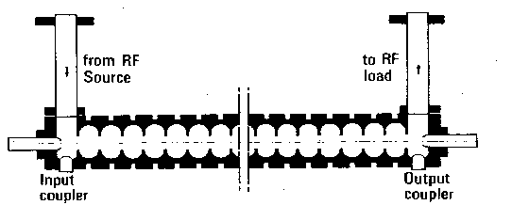
Traveling wave linac structures
beam
Disc-loaded waveguide designed for v_{ph}=c at a given frequency, equipped with an input and an output coupler.
RF power is introduced via the input coupler. Part of the power is dissipated in the structure, part is taken by the beam (beam loading) and the rest is absorbed in a matched load at the end of the structure. Usually, structure length is such that ~30% of power goes to the load.
The “traveling wave” structure is the standard linac for electrons from β~1.
Can not be used for protons at v<c:
1. constant cell length does not allow synchronism
2. structures are long, without space for transverse focusing

Slide 23
Standing wave linac structures
To obtain an accelerating structure for protons we close our disc-loaded structure at both ends with metallic walls → multiple reflections of the waves.
Boundary condition at both ends is that electric field must be perpendicular to the cover → Only some modes on the disc-loaded dispersion curve are allowed → only some frequencies on the dispersion curve are permitted.
In general:
the modes allowed will be equally spaced in k
The number of modes will be identical to the number of cells (N cells → N modes)
k represents the phase difference between the field in adjacent cells.

Slide 24
More on standing wave structures
STANDING WAVE MODES are generated by the sum of 2 waves traveling in opposite directions, adding up in the different cells.
For acceleration, the particles must be in phase with the E-field on axis. We have already seen the π mode: synchronism condition for cell length l = βλ/2.
Standing wave structures can be used for any β (→ ions and electrons) and their cell length can increase, to follow the increase in β of the ions.
Standing wave modes are named from the phase difference between adjacent cells: in the example above, mode 0, π/2, 2π/3, π.
In standing wave structures, cell length can be matched to the particle velocity !
Synchronism conditions:
0-mode : l = βλ
π/2 mode: 2 l = βλ/2
π mode: l = βλ/2

Slide 25
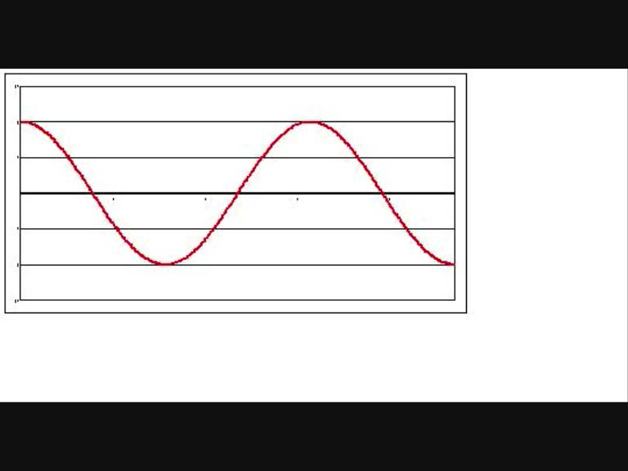
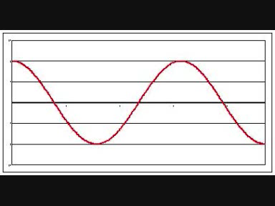
Acceleration on traveling and standing waves
TRAVELING Wave
STANDING Wave
E-field
position z
position z

Slide 26

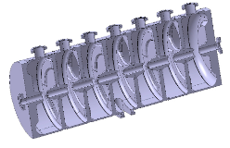
Practical standing wave structures
From disc-loaded structure to a real cavity (Linac4 PIMS, Pi-Mode Structure)
To increase acceleration efficiency (=shunt impedance ZT²!) we need to concentrate electric field on axis (Z↑) and to shorten the gap (T↑) → introduction of “noses” on the openings.
The smaller opening would not allow the wave to propagate → introduction of “coupling slots” between cells.
The RF wave has to be coupled into the cavity from one point, usually in the center.

Slide 27
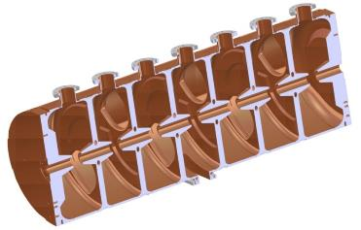
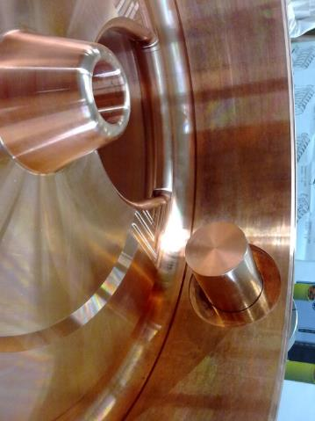
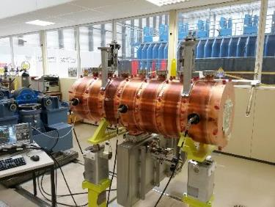
The PIMMS Accelerating structure

Slide 28
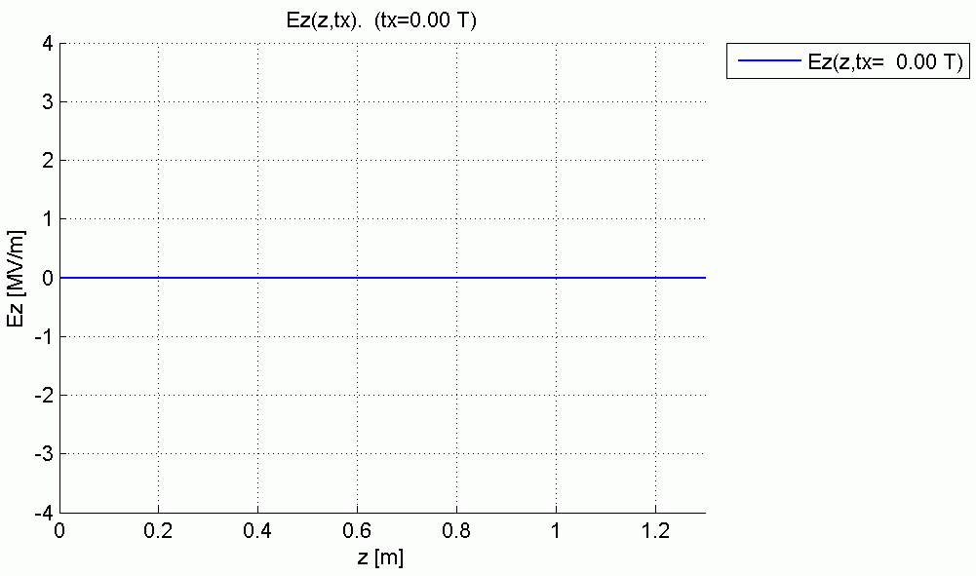
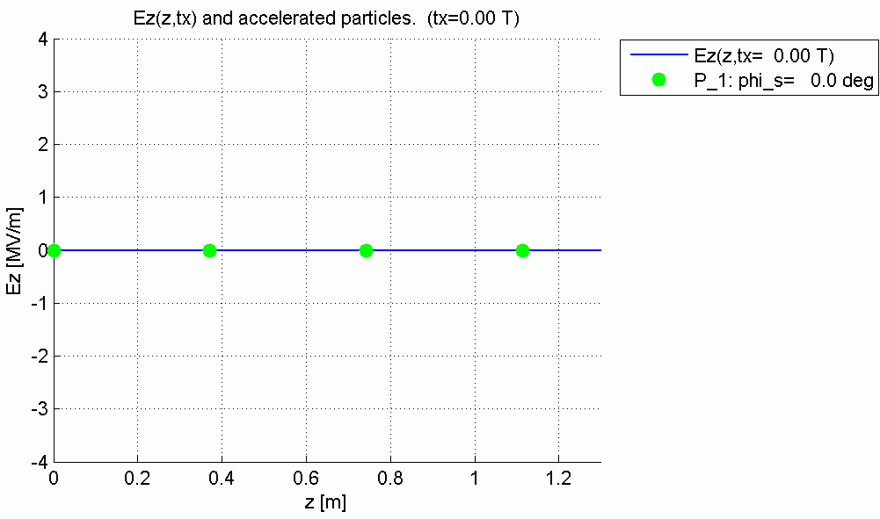
Synchronism in the PIMS
Animations by
R. Wegner, CERN

Slide 29
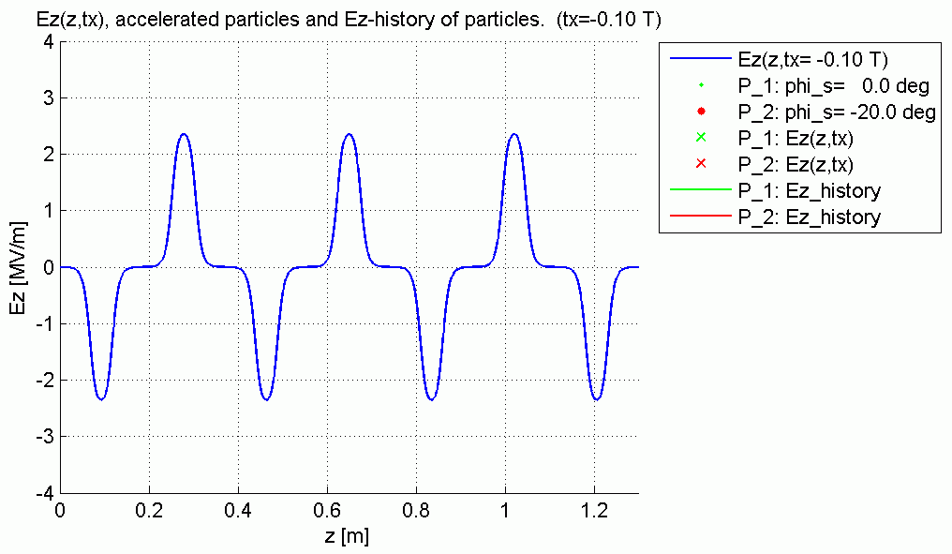
Acceleration in the PIMS
Animations by
R. Wegner, CERN

Slide 30
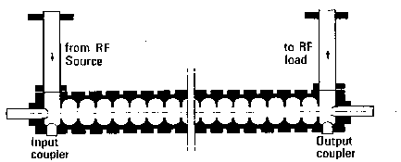
Comparing traveling and standing wave structures
Standing wave
Traveling wave
Chain of coupled cells in SW mode.
Coupling (bw. cells) by slots (or open). On-axis aperture reduced, higher E-field on axis and power efficiency.
RF power from a coupling port, dissipated in the structure (ohmic loss on walls).
Long pulses. Gradients 2-5 MeV/m
Used for Ions and electrons, all energies
Chain of coupled cells in TW mode
Coupling bw. cells from on-axis aperture.
RF power from input coupler at one end,
dissipated in the structure and on a load.
Short pulses, High frequency (≥ 3 GHz).
Gradients 10-20 MeV/m
Used for Electrons at v~c
Comparable RF efficiencies

Slide 31
Module 2
Coupled resonator chains
Stability and stabilization
Acceleration in periodic structures
Special accelerating structures
Superconducting linac structures

Slide 32
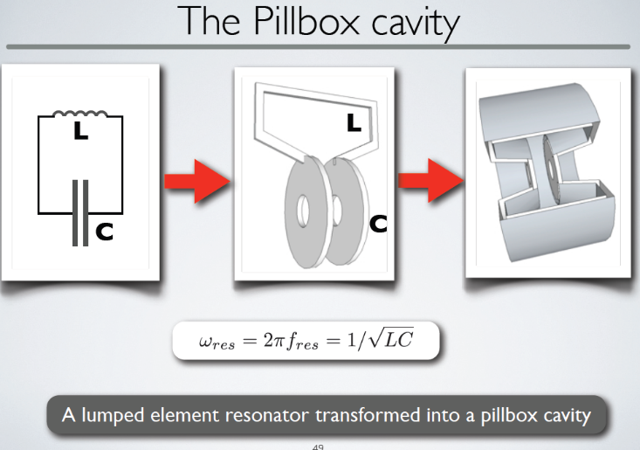
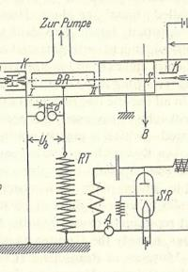
From the Wideröe gap to the linac cell
Notes:
The cavity resonator introduced by Hansen at SLAC

Slide 33
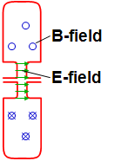
Coupling cavities
1. Magnetic coupling:
open “slots” in regions of high magnetic field → B-field can couple from one cell to the next
2. Electric coupling:
enlarge the beam aperture → E-field can couple from one cell to the next
How can we couple together a chain of n reentrant (=loaded pillbox) accelerating cavities ?
The effect of the coupling is that the cells no longer resonate independently, but will have common resonances with well defined field patterns.

Slide 34
Chains of coupled resonators
What is the relative phase and amplitude between cells in a chain of coupled cavities?
M
R
M
A linear chain of accelerating cells can be represented as a sequence of resonant circuits magnetically coupled.
Individual cavity resonating at ω₀ → frequenci(es) of the coupled system ?
Resonant circuit equation for circuit i (neglecting the losses, R≅0):
L
L
L
I_{i}
L
C
Dividing both terms by 2jωL:
General response term, ∝ (stored energy)^{1/2,}
can be voltage, E-field, B-field, etc.
Contribution from adjacent oscillators
General resonance term

Slide 35
The Coupled-system Matrix
A chain of N+1 resonators is described by a (N+1)x(N+1) matrix:
or
This matrix equation has solutions only if
Eigenvalue problem!
System of order (N+1) in ω → only N+1 frequencies will be solution of the problem (“eigenvalues”, corresponding to the resonances) → a system of N coupled oscillators has N resonance frequencies → an individual resonance opens up into a band of frequencies.
At each frequency ω_{i} will correspond a set of relative amplitudes in the different cells (X₀, X₂, …, X_{N}): the “eigenmodes” or “modes”.

Slide 36
Modes in a linear chain of oscillators
We can find an analytical expression for eigenvalues (frequencies) and eigenvectors (modes):
the index q defines the number of the solution → is the “mode index”
Frequencies of the coupled system :
ω₀/√1-k
Each mode is characterized by a phase πq/N. Frequency vs. phase of each mode can be plotted as a “dispersion curve” ω=f(φ):
each mode is a point on a sinusoidal curve.
modes are equally spaced in phase.
ω₀
ω₀/√1+k
0
π/2
π
The “eigenvectors = relative amplitude of the field in the cells are:
STANDING WAVE MODES, defined by a phase πq/N corresponding to the phase shift between an oscillator and the next one → πq/N=Φ is the phase difference between adjacent cells that we have introduces in the 1st part of the lecture.

Slide 37
Acceleration on the normal modes of a 7-cell structure
Remember the phase relation!
0
ω = ω₀/√1+k
q=0
0 (or 2π) mode, acceleration if d = βλ
Intermediate modes
π/2
ω = ω₀
q=N/2
π/2 mode, acceleration if d = βλ/4
…
Note: Field always maximum in first and last cell!
π
ω = ω₀/√1-k
π mode, acceleration if d = βλ/2,
q=N

Slide 38
Practical linac accelerating structures
Note: our equations depend only on the cell frequency ω, not on the cell length d !!!
→ As soon as we keep the frequency of each cell constant, we can change the cell length following any acceleration (β) profile!
Example:
The Drift Tube Linac (DTL)
Chain of many (up to 100!) accelerating cells operating in the 0 mode. The ultimate coupling slot: no wall between the cells!
Each cell has a different length, but the cell frequency remains constant → “the EM fields don’t see that the cell length is changing!”
d↑ → (L ↑ , C↓) → LC ~ const → ω ~ const

Slide 39
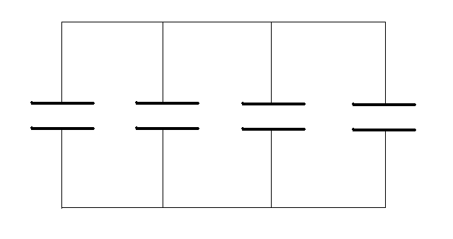
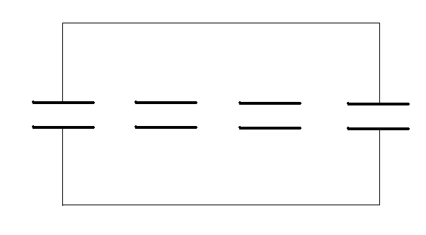
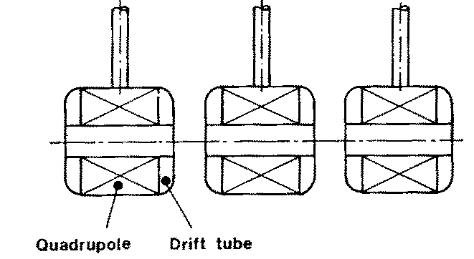
0-mode structures: the Drift Tube Linac (“Alvarez”)
RF currents
Disc-loaded structures operating in 0-mode
Add tubes for high shunt impedance
Maximize coupling between cells → remove completely the walls
2 advantages of the 0-mode:
the fields are such that if we eliminate the walls between cells the fields are not affected, but we have less RF currents and higher power efficiency (“shunt impedance”).
The “drift tubes” are long (~0.75 βλ). The particles are inside the tubes when the electric field is decelerating, and we have space to introduce focusing elements (quadrupoles) inside the tubes.
Disadvantage (w.r.t. the π mode): half the number of gaps per unit length!

Slide 40
The Drift Tube Linac
A DTL tank with N drift tubes will have N modes of oscillation.
For acceleration, we choose the 0-mode, the lowest of the band. All cells (gaps) are in phase, then Δφ=2π
Distance between gaps must be βλ
The other modes in the band (and many others!) are still present.
If mode separation >> bandwidth, they are not “visible” at the operating frequency, but they can come out in case of frequency errors between the cells (mechanical errors or others).
operating 0-mode
mode distribution in a DTL tank (operating frequency 352 MHz, are plotted all frequencies < 600 MHz)

Slide 41
DTL construction
Standing wave linac structure for protons and ions, β=0.1-0.5, f=20-400 MHz
Drift tubes are suspended by stems (no net RF current on stem)
Coupling between cells is maximum (no slot, fully open !)
The 0-mode allows a long enough cell (d=βλ) to house focusing quadrupoles inside the drift tubes!
(at 90deg)
E-field
B-field

Slide 42
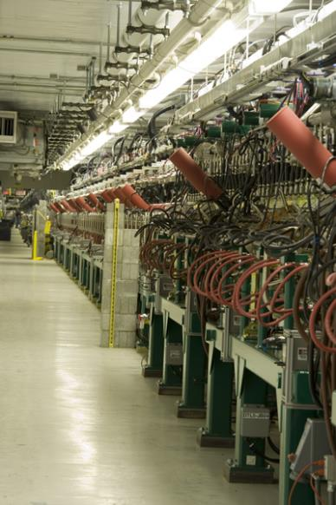
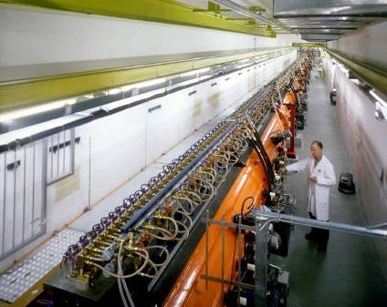
Examples of DTL
Top; CERN Linac2 Drift Tube Linac: 1978, 202.5 MHz, 3 tanks, final energy 50 MeV, tank diameter 1 meter.
Left: The Drift Tube Linac of the SNS at Oak Ridge (USA): 402.5 MHz, 6 tanks, final energy 87 MeV.

Slide 43
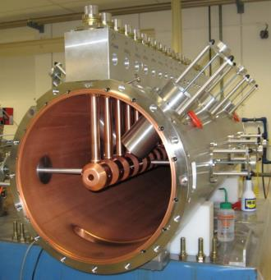
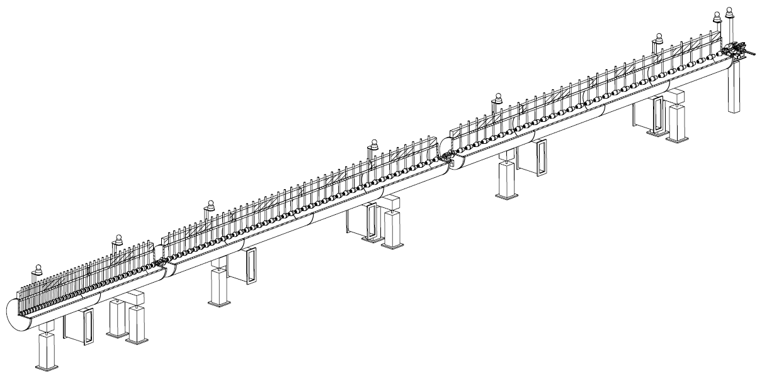
The Linac4 DTL
DTL tank 1 fully equipped: focusing by small permanent quadrupoles inside drift tubes.
352 MHz frequency
Tank diameter 500mm
3 resonators (tanks)
Length 19 m
120 Drift Tubes
Energy 3 MeV to 50 MeV
Beta 0.08 to 0.31 → cell length (βλ) 68mm to 264mm
→ factor 3.9 increase in cell length
beam

Slide 44

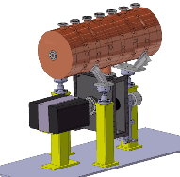
Pi-mode structures: the PIMS
PIMS = Pi-Mode Structure, will be used in Linac4 at CERN to accelerate protons from 100 to 160 MeV (β > 0.4)
7 cells magnetically coupled, 352 MHz
Operating in π-mode, cell length βλ/2.
RF input
Cells in a cavity have the same length.
When more cavities are used for acceleration, the cells are longer from one cavity to the next, to follow the increase in beam velocity.

Slide 45
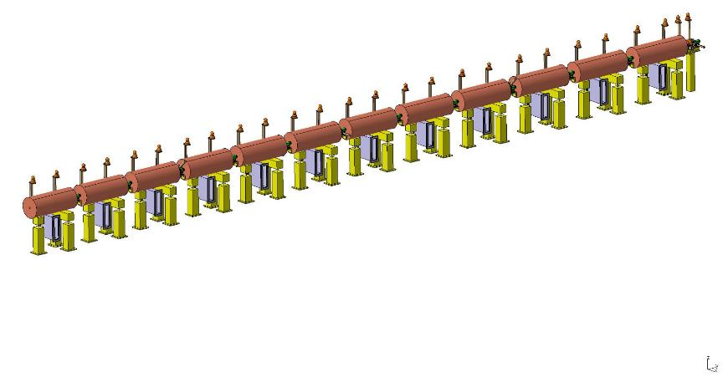
Sequence of PIMS cavities
Cells have same length inside a cavity (7 cells) but increase from one cavity to the next. At high energy (>100 MeV) beta changes slowly and phase error (“phase slippage”) is small.
160 MeV,
155 cm
Focusing quadrupoles between cavities
100 MeV,
128 cm
PIMS range

Slide 46
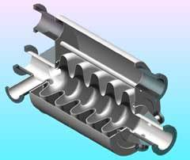
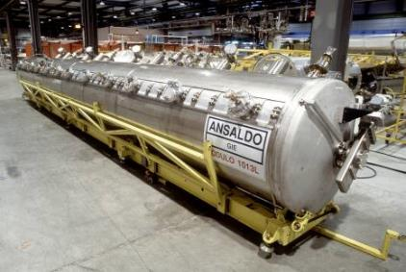
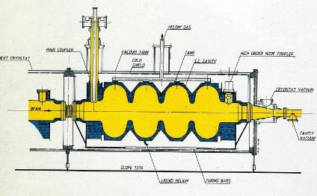
Pi-mode superconducting structures (elliptical)
Standing wave structures for particles at β>0.5-0.7, widely used for protons (SNS, etc.) and electrons (ILC, etc.) f=350-700 MHz (protons), f=350 MHz – 3 GHz (electrons)
Chain of cells electrically coupled, large apertures (ZT² not a concern).
Operating in π-mode, cell length βλ/2
Input coupler placed at one end.

Slide 47
Long chains of linac cells
☞ To reduce RF cost, linacs use high-power RF sources feeding a large number of coupled cells (DTL: 30-40 cells, other high-frequency structures can have >100 cells).
☞ But long linac structures (operating in 0 or π mode) become extremely sensitive to mechanical errors: small machining errors in the cells can induce large differences in the accelerating field between cells.

Slide 48
Stability of long chains of coupled resonators
Mechanical errors → differences in frequency between cells →
to respect the new boundary conditions the electric field will be a linear combination of all modes, with weight
(general case of small perturbation to an eigenmode system,
the new solution is a linear combination of all the individual modes)
The nearest modes have the highest effect, and when there are many modes on the dispersion curve (number of modes = number of cells, but the total bandwidth is fixed = k !) the difference in E‑field between cells can be extremely high.

Slide 49
Stabilization of long chains: the π/2 mode
Long chains of linac cells can be operated in the π/2 mode, which is intrinsically insensitive to mechanical errors = differences in the cell frequencies.
In presence of errors, the E-field will have components from the adjacent modes, with amplitude proportional to the error and to the mode separation.
Perturbing mode
Perturbing mode
Operating mode
→ Contribution from adjacent modes proportional to with the sign !!!
The perturbation will add a component ΔE/(f²-f_{o}²) for each of the nearest modes.
Contributions from equally spaced modes in the dispersion curve will cancel each other !!

Slide 50
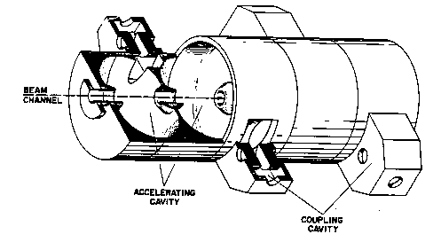



Pi/2 mode structures: the Side Coupled Linac
To operate efficiently in the π/2 mode, the cells that are not excited can be removed from the beam axis → they are called “coupling cells”, as for the Side Coupled Structure.
Example: the Cell-Coupled Linac at the SNS linac, 805 MHz, 100-200 MeV, >100 cells/module
E-field
A short Side-Coupled Linac structure at 3 GHz is the accelerating module of all modern radiotherapy accelerators used for X-ray treatment of cancer.

Slide 51

Ion sources
Electron sources:
give energy to the free electrons inside a metal to overcome the potential barrier at the boundary.
Used for electron production:
thermoionic effect
laser pulses
surface plasma
Ion sources:
create a plasma and optimise its conditions (heating, confinement and loss mechanisms) to produce the desired ion type. Remove ions from the plasma via an aperture and a strong electric field.
CERN Duoplasmatron proton Source
Photo Injector Test Facility - Zeuthen
262nm Laser
51

Slide 52

Energy gain in a gap
-L/2
L/2
E-field on axis
Particle crossing an RF gap in a linac cell of length L:
E-field is
Voltage is
Energy gain by a particle crossing the gap at phase φ is:
The shape of E_{z} depends on gap length and aperture radius
E₀ mean field
with a Transit Time Factor defined as:
The Transit Time Factor is 0 < T < 1 and describes how much the field changes with time while the particle crosses the gap.
« Panofsky equation » very simple, but the physics is in the transit time factor!

Slide 53
Transit time factor
energy gain by a particle in the middle of the gap at t=0
design parameter, (see Module 6)
cell length, βλ or βλ/2
energy gain by a particle crossing the gap with infinite velocity at t=0
from frequency, gap geometry and particle velocity
synchronous phase angle, from beam dynamics (longitudinal stability)
The Transit Time Factor T tells us how much of the E-field that we have provided on the gap has been really seen by a particle moving at velocity v=βc.
Is the ratio between 2 integrals (0 ≤T ≤ 1)
Neglecting the increase in velocity in the gap:
E
E(z)
E(z)cosωt(z)
For the simplest case E(z)=E₀ (-g/2, g/2):
T is a characteristic of your design; it can be easily calculated by the RF design codes
z
-g/2
g/2

Slide 54
Shunt Impedance
Design of an accelerating system → goal is to maximize acceleration ΔW for a given power delivered to the cavity P_{c} . Can we define a figure of merit to compare different designs?
We define a « shunt impedance » Z as ; exactly twice the shunt resistance in the equivalent parallel circuit
The figure of merit is (considering maximum acceleration at φ=0 and taking the square of the energy gain in volts, to give consistancy to the units):
ZT² is the effective shunt impedance, depends only on the geometry (and on RF frequency and particle velocity). Unit is ohms (usually MΩ, or MΩ/m if referred to the unit length). Can be easily calculated by computer codes, and then used to calculate the cavity power and the final power efficiency:
ATTENTION!!!
Usually in linacs we use Z, while for other RF systems and in other literatures is used R_{p}: difference by a factor 2 !
R_{p}

Slide 55
Power efficiency
Main design parameters: beam current and effective gradient
synchronous phase
Shunt impedance per unit length
For a normal conducting linac with low beam loading, the RF power efficiency (proportional to the wall plug efficiency) is proportional to peak beam current, shunt impedance, and cosine of the synchronous phase. It is inversely proportional to the effective gradient → long linacs with low gradient have a higher efficiency (but higher construction cost…)

Slide 56



Linac building blocks and energy flow
heat
grid
HV AC/DC power converter
AC to DC conversion efficiency ~90%
1
Main oscillator
RF feedback
system
High power RF amplifier (tube or klystron)
DC to RF conversion efficiency ~50%
2
RF to beam voltage conversion efficiency = SHUNT IMPEDANCE
ZT² ~ 20 - 60 MΩ/m
(max. 10-20%)
3
ion beam, energy W
heat
beam
NORMAL CONDUCTING
magnet
powering
system
vacuum
system
water
cooling
system
LINAC STRUCTURE
accelerating gaps + focusing magnets
designed for a given ion, energy range, energy gain

Slide 57
Linac building blocks - Superconducting
Main oscillator
Cryogenic loss:
static + dynamic
Theoretical Carnot efficiency:
66 W/W @ 4.5K
(usually ≈200-400 W/W)
DC power supply
RF amplifiers (Solid-state)
Helium refrigerator
heat
RF feedback
system
ion beam, energy W
magnet
powering
system
vacuum
system
LINAC STRUCTURE
accelerating gaps + focusing magnets
In a liquid helium bath at 2K or 4.5 K
SUPER CONDUCTING

Slide 58
Module 3
A quick overview of beam dynamics in linear accelerators

Slide 59
Introduction
A linear accelerator requires an accurate beam optics design, in order to:
Minimize emittance growth (next slide);
Minimize beam loss, to: a) avoid activation of the accelerator (of the linac and of the following machine!) and b) reduce the requirements on the ion source.
Note that operating regimes in linacs can be very different, between
μa peak currents for heavy ion linacs (~ 10⁵ particles / bunch)
mA peak currents for proton linacs (~ 10⁸ particles / bunch)
100’s mA peak currents for high-power proton linacs (~ 10¹¹ particles / bunch)
A’s peak currents for electron linacs

Slide 60

Beam emittance
Recall some basic definitions that we will need in the following:
Beam emittance: is the volume in the phase space occupied by the particle beam. The space is 6-dimensional (x,x’,y,y’,W,φ) but are important the projections in the 3 dimensions: transverse emittance in x and y (ε_{x}, ε_{y}) and longitudinal emittance (ΔW, φ).
Liouville theorem: under the action of linear forces, the beam emittance is constant. (BUT: in presence of non-linear forces, it increases). Consequence: in an accelerator, where non-linear forces are often present, the emittance will progressively increase.
Beam brightness: beam current/transverse emittance.
Corresponds to the “density” in phase space. Preserving brightness means minimizing emittance growth.

Slide 61
Longitudinal dynamics
Ions are accelerated around a (negative = linac definition) synchronous phase.
Particles around the synchronous one perform oscillations in the longitudinal phase space.
Frequency of small oscillations:
Tends to zero for relativistic particles γ>>1.
Note phase damping of oscillations:
At relativistic velocities phase oscillations stop, and the beam is compressed in phase around the initial phase. The crest of the wave can be used for acceleration.
Notes:
This happens for every value of phi

Slide 62
Longitudinal dynamics - electrons
Electrons at v=c remain at the injection phase.
Electrons at v<c injected into a TW structure designed for v=c will move from injection phase ϕ₀ to an asymptotic phase ϕ, which depends only on gradient and β₀ at injection.
The beam can be injected with an offset in phase, to reach the crest of the wave at β=1
Capture condition, relating E₀ and β₀ :
Example: λ=10cm, W_{in}=150 keV and E₀=8 MV/m.
In high current linacs, a bunching and pre-acceleration sections up to 4-10 MeV prepares the injection in the TW structure that occurs already on the crest
Notes:
Again obtained solving the equation of motion dp/dt=eEcos(phi(z,t)).

Slide 63
Transverse dynamics - Space charge
Large numbers of particles per bunch ( ~10¹⁰ ).
Coulomb repulsion between particles (space charge) plays an important role and is the main limitation to the maximum current in a linac.
But space charge forces ~ 1/γ² disappear at relativistic velocity
Force on a particle inside a long bunch with density n(r) traveling at velocity v:
B
E
Notes:
Gauss law

Slide 64
Transverse dynamics - RF defocusing
RF defocusing experienced by particles crossing a gap on a longitudinally stable phase.
In the rest frame of the particle, only electrostatic forces → no stable points (maximum or minimum) → radial defocusing.
Lorentz transformation and calculation of radial momentum impulse per period (from electric and magnetic field contribution in the laboratory frame):
Bunch position at max E(t)
Transverse defocusing ~ 1/γ² disappears at relativistic velocity (transverse magnetic force cancels the transverse RF electric force).
Notes:
Particles experience a higher field in the 2nd half of a gap. Defocusing forces (2nd half of gap) are stronger than focusing forces (1st half).

Slide 65
Focusing
Defocusing forces need to be compensated by focusing forces → alternating gradient focusing provided by quadrupoles along the beam line.
A linac alternates accelerating sections with focusing sections. Options are: one quadrupole (singlet focusing), two quadrupoles (doublet focusing) or three quadrupoles (triplet focusing).
Focusing period=length after which the structure is repeated (usually as Nβλ).
The accelerating sections have to match the increasing beam velocity → the basic focusing period increases in length (but the beam travel time in a focusing period remains constant).
The maximum allowed distance between focusing elements depends on beam energy and current and change in the different linac sections (from only one gap in the DTL to one or more multi-cell cavities at high energies).

Slide 66
Transverse beam equilibrium in linacs
The equilibrium between external focusing force and internal defocusing forces defines the frequency of beam oscillations.
Oscillations are characterized in terms of phase advance per focusing period σ_{t} or phase advance per unit length k_{t}.
Ph. advance = Ext. quad focusing - RF defocusing - space charge
q=charge
G=quad gradient
l=length foc. element
f=bunch form factor
r₀=bunch radius
λ=wavelength
…
Approximate expression valid for:
F0D0 lattice, smooth focusing approximation, space charge of a uniform 3D ellipsoidal bunch.
A “low-energy” linac is dominated by space charge and RF defocusing forces !!
Phase advance per period must stay in reasonable limits (30-80 deg), phase advance per unit length must be continuous (smooth variations) → at low β, we need a strong focusing term to compensate for the defocusing, but the limited space limits the achievable G and l → needs to use short focusing periods N βλ.
Note that the RF defocusing term ∝f sets a higher limit to the basic linac frequency (whereas for shunt impedance considerations we should aim to the highest possible frequency, Z ∝√f) .
66

Slide 67
Electron linacs
Ph. advance = Ext. quad focusing - RF defocusing - space charge – Instabilities
Electron Linac:
Ph. advance = Ext. focusing + RF defocusing + space charge + Instabilities
For γ>>1 (electron linac): RF defocusing and space charge disappear, phase advance ￫0. External focusing is required only to control the emittance and to stabilize the beam against instabilities (as wakefields and beam breakup).
Notes:
If phase advance is too large, we run into instabilities. If it is too small beam becomes too large in size.

Slide 68

Phase advance – an example
Beam optics of the Linac4 Drift Tube Linac (DTL): 3 to 50 MeV, 19 m, 108 focusing quadrupoles (permanent magnets).
Oscillations of the beam envelope (coordinates of the outermost particle) along the DTL (x, y, phase)
Corresponding phase advance per period
Design prescriptions:
Tranverse phase advance at zero current always less than 90°.
Smooth variation of the phase advance.
Avoid resonances (see next slide).

Slide 69
Instabilities in linacs – the Hoffman plot
The “tune diagram” of a linac
Ratio between transverse phase advance and zero current phase advance (a measure of space charge)
Ratio between longitudinal and transverse phase advance
Linac4 DTL: the operating point(s) for all possible current levels are far from the resonances between transverse and longitudinal oscillations which are enhanced by space charge.
Effect of the resonances: emittance exchange, transverse emittance growth, migration of particles into the beam halo → particularly dangerous for high intensity machines (beam loss).

Slide 70
Focusing periods
Focusing usually provided by quadrupoles.
Need to keep the phase advance in the good range, with an approximately constant phase advance per unit length → The length of the focusing periods has to change along the linac, going gradually from short periods in the initial part (to compensate for high space charge and RF defocusing) to longer periods at high energy.
For Protons (high beam current and high space charge), distance between two quadrupoles (=1/2 of a FODO focusing period):
- βλ in the DTL, from ~70mm (3 MeV, 352 MHz) to ~250mm (40 MeV),
- can be increased to 4-10βλ at higher energy (>40 MeV).
- longer focusing periods require special dynamics (example: the IH linac).
For Electrons (no space charge, no RF defocusing):
focusing periods up to several meters, depending on the required beam conditions. Focusing is mainly required to control the emittance.
Notes:
Beta 7% at 3 MeV

Slide 71
High-intensity protons – the case of Linac4
Transverse (x) r.m.s. beam envelope along Linac4
Example: beam dynamics design for Linac4@CERN.
High intensity protons (60 mA bunch current, duty cycle could go up to 5%), 3 - 160 MeV
Beam dynamics design minimising emittance growth and halo development in order to:
1. avoid uncontrolled beam loss (activation of machine parts)
2. preserve small emittance (high luminosity in the following accelerators)

Slide 72
Beam Optics Design Guidelines
Prescriptions to minimise emittance growth and halo formation:
1. Keep zero current phase advance always below 90º, to avoid resonances
2. Keep longitudinal to transverse phase advance ratio 0.5-0.8, to avoid emittance exchange
3. Keep a smooth variation of transverse and longitudinal phase advance per meter.
4. Keep sufficient safety margin between beam radius and aperture
Transverse r.m.s. emittance and phase advance along Linac4 (RFQ-DTL-CCDTL-PIMS)

Slide 73

Halo and beam loss
Additional challenge on beam dynamics:
Beam loss has to be avoided not because it reduces current, but because activation due to beam loss could come to levels preventing access to the machine.
Commonly accepted loss limit for hands-on maintenance is 1 W/m.
For example, in the case of the SPL design at CERN (5 GeV, 20 mA, 5% duty cycle) this corresponds to a maximum loss at 5 GeV of 0.2x10⁻⁶/m, or 4 nA/m !!
In usual linacs, the beam distribution can be quite complicated, and presents a core surrounded by a “halo”. Halo formation has to be studied and controlled, but is at the limit of capability for modern computers

Slide 74

High brightness
Current and emittance are defined by the ion source: common ion sources have maximum currents ~ 80 mA for H-, ~ 200 mA for protons, in emittances of >0.02 π mm mrad.
In the linac, non-linearities in the focusing channel and in the space charge forces tend to increase the emittance and to decrease brightness.
Beam brightness: beam current/transverse emittance.
Corresponds to the “density” in phase space. Preserving brightness means minimizing emittance growth.

Slide 75
space charge – non linear effects
the more the beam is compressed in real space, the more the space charge effect is non linear
non linear space charge effect generates emittance growth
at low energy space charge is the limiting factor for the minimum emittance that can be produced out of an accelerator
(CHASMAN PLOT) FOR CERN RFQ2 (200MHz., 200 mA PROTONS)
Minimum emittance from space charge

Slide 76

emittance growth due to filamentation
velocity of rotation in the transverse phase space with no space charge doesn’t depend on the amplitude.
with linear space charge it is lowered but it still doesn’t depend on the amplitude
with non linear space charge it does depend on amplitude and therefore there are areas of the phase space move at different velocity. This generates emittance growth.

Slide 77

Filamentation: emittance increase
Evolution of the emittance along an accelerator under the influence of linear forces only (blue line) or non-linear forces (red line)
Linear force
Non linear force

Slide 78
Module 4
Linac architecture (and limitations)

Slide 79

Comparison of structures – Shunt impedance
Main figure of merit is the shunt impedance
Ratio between energy gain (square) and power dissipation, is a measure of the energy efficiency of a structure.
Depends on the beta, on the energy and on the mode of operation.
However, the choice of the best accelerating structure for a certain energy range depends also on beam dynamics and on construction cost.
Comparison of shunt-impedances for different low-beta structures done in 2005-08 by the “HIPPI” EU-funded Activity.
In general terms, a DTL-like structure is preferred at low-energy, and π-mode structures at high-energy.
CH is excellent at very low energies (ions).

Slide 80

Proton linac architecture – cell length, focusing period
EXAMPLE: Linac4 at CERN, 160 MeV, 352 MHz.
3 MeV injector + 22 multi-cell standing wave accelerating structures of 3 types>
Section | Output Energy [MeV] | Lattice | Number of RF gaps between quadrupoles | Number of RF gaps per period | Number of consecutive identical cells
DTL | 50 | F0D0 | 1 | 2 | 1
CCDTL | 102 | F0D0 | 3 | 6 | 3
PIMS | 160 | F0D0 | 12 | 24 | 12
DTL: every cell is different, focusing quadrupoles in each drift tube
CCDTL: sequences of 2 identical cells, quadrupoles every 3 cells
PIMS: sequences of 7 identical cells, quadrupoles every 7 cells
Two basic principles to remember:
1. As beta increases, phase error between cells of identical length becomes small → we can have short sequences of identical cells (lower construction costs).
2. As beta increases, the distance between focusing elements can increase (more details in 2nd lecture!).
Injector
Notes:
Forget about the acronyms, important are 2 elements

Slide 81
Shunt impedance
A third basic principle:
Every proton linac structure has a characteristic curve of shunt impedance (=acceleration efficiency) as function of energy, which depends on the mode of operation.
The choice of the best accelerating structure for a certain energy range depends on shunt impedance, on beam dynamics and construction cost.
Effective shunt impedance ZT²: ratio between voltage (squared) seen by the beam and RF power.

Slide 82


High Energy Linacs
Superconducting Proton Linac a CERN project for extending Linac4 up to 5 GeV energy
low-beta: 20 cryo-modules with 3 cavities/cryo-module
high-beta -FD: 13 cryo-modules with 8 cavities/module
high-beta -FODO: 10 cryo-modules with 8 cavities/module
Section | Output Energy [MeV] | Lattice | Number of RF gaps between quadrupoles | Number of RF gaps per period | Number of consecutive identical cells
DTL | 50 | F0D0 | 1 | 2 | 1
CCDTL | 102 | F0D0 | 3 | 6 | 3
PIMS | 160 | F0D0 | 12 | 24 | 12
Low β | 750 | FD | 15 | 15 | 300
High β / 1 | 2500 | FD | 35 | 35 | 920
High β / 2 | 5000 | F0D0 | 35 | 70

Slide 83
Heavy Ion Linac Architecture
EXAMPLE: the REX upgrade project at CERN-ISOLDE. Post-acceleration of radioactive ions with different A/q up to energy in the range 2-10 MeV.
An injector (source, charge breeder, RFQ) + a sequence of short (few gaps) standing wave accelerating structures at frequency 101-202 MHz, normal conducting at low energy (Interdigital, IH) and superconducting (Quarter Wave Resonators) at high energy → mix of NC-SC, different structures, different frequencies.
21.9 m
Notes:
Mixed NC-SC, different structures and frequencies,

Slide 84



Examples: a heavy ion linac
Particle source
The REX heavy-ion post accelerators at CERN. It is made of 5 short standing wave accelerating structures at 100 MHz, spaced by focusing elements.
Accelerating structures

Slide 85


Electron linac architecture
EXAMPLE:
injector linac of the ALBA Synchrotron Light Facility (Barcelona):
100 MeV electron linac supplied by Thales in 2008. Produces a beam up to 4 nC/bunch in either single or multi-bunch mode at repetition rate up to 5 Hz. Normalized beam emittance below 30 π mm mrad.
Injector + sequence of identical multi-cell traveling wave accelerating structures.
Linac scheme courtesy of R. Muñoz, ALBA-CELLS

Slide 86

Examples: an electron linac
RF input
RF output
Focusing solenoids
Accelerating structure (TW)
The old CERN LIL (LEP Injector Linac) accelerating structures (3 GHz). The TW structure is surrounded by focusing solenoids, required for the positrons.

Slide 87

Linac architecture: superconductivity
Advantages:
- Much smaller RF system (only beam power) → prefer low current/high duty
Large aperture (lower beam loss in the SC section).
Lower operating costs (electricity consumption).
Disadvantages:
Need cryogenic system (in pulsed machines, size dominated by static loss → prefer low repetition frequency or CW to minimize filling time/beam time).
Need cold/warm transitions to accommodate quadrupoles → becomes more expensive at low energy (short focusing periods).
Individual gradients difficult to predict (large spread) → need large safety margin in gradient at low energy.
Conclusions:
1. Superconductivity gives a large advantage in cost at high energy / high duty cycle.
2. At low energy / low duty cycle superconducting sections become expensive.

Slide 88

Comparing NC and SC
This and the next few slides courtesy of F. Gerigk, CERN

Slide 89

When are SC cavities attractive?

Slide 90

Pulsed operation for SC cavities

Slide 91
Transition warm/cold
The RFQ must be normal conducting (construction problems / inherent beam loss).
Modern high-energy (>200 MeV) sections should be superconducting.
But where is the optimum transition energy between normal and superconducting?
The answer is in the cost → the economics has to be worked out correctly !
Overview of warm/cold transition energies for linacs (operating and in design)
Energy [MeV]
90
Duty cycle [%]

Slide 92
The choice of the frequency
approximate scaling laws for linear accelerators:
RF defocusing (ion linacs) ~ frequency
Cell length (=βλ/2) ~ (frequency)⁻¹
Maximum surface electric field ~ (frequency)^{1/2}
Shunt impedance (power efficiency) ~ (frequency)^{1/2}
Accelerating structure dimensions ~ (frequency)⁻¹
Machining tolerances ~ (frequency)⁻¹
Higher frequencies are economically convenient (shorter, less RF power, higher gradients possible) but limitation comes from mechanical precision in construction (tight tolerances are expensive!) and beam dynamics for ion linacs at low energy.
Electron linacs tend to use higher frequencies (0.5-12 GHz) than ion linacs. Standard frequency 3 GHz (10 cm wavelength). No limitations from beam dynamics, iris in TW structure requires less accurate machining than nose in SW structure.
Proton linacs use lower frequencies (100-800 MHz), increasing with energy (ex.: 350 – 700 MHz): compromise between focusing, cost and size.
Heavy ion linacs tend to use even lower frequencies (30-200 MHz), dominated by the low beta in the first sections (CERN lead ion RFQ at 100MHz, 25 keV/u: βλ/2=3.5mm !)

Slide 93
Linac architecture: optimum gradient (NC)
Note that the optimum design gradient (E₀T) in a normal-conducting linac is not necessarily the highest achievable (limited by sparking).
The cost of a linear accelerator is made of 2 terms:
a “structure” cost proportional to linac length
an “RF” cost proportional to total RF power
C_{s}, C_{RF} unit costs (€/m, €/W)
Overall cost is the sum of a structure term decreasing with the gradient and of an RF term increasing with the gradient → there is an optimum gradient minimizing cost.
Total cost
breakdown limit
RF cost
optimum gradient
Example: for Linac4
C_{s} … ~200 kCHF/m
C_{RF}…~0.6 CHF/W (recuperating LEP equipment)
E₀T … ~ 3 – 4 MV/m
structure cost

Slide 94

End of Lectures 3 & 4
Elwood Smith

Slide 95
Appendix: breakdowns, conditioning, multipacting
This block of 6 slides can go either in the linac or in the RF lectures – depends on timing

Slide 96



On the breakdown limit…
The origin of breakdowns is FIELD EMISSION:
Tunneling of electrons through the potential barrier at the boundary metal/vacuum in presence of an applied voltage. Increasing the surface electric field reduces the barrier and increases the number of escaping electrons. The temperature enhances the emitted current (field assisted thermoionic emission).
Quantum mechanics fenomenon, can be calculated: Fowler-Nordheim relation:
Current density (A/cm²) emitted by a metal of extraction potential Φ with an applied electric field E, in the limit case of T→0 (with some additional approximations).
The current goes up very quickly (exponential); a F.-N. behaviour is characterised by a linear ln(I/V)=f(1/V)

Slide 97
Breakdown and impurities
Looking at the numbers, for copper the F.E. current starts to become important only for fields in the region of few GV/m, well beyond normal operating fields in the order of 10-40 MV/m.
(E=1 GV/m → J=5e-17 A/m², E=5 GV/m → J=7e11 A/m² !!)
But: the theory is valid for smooth and perfect surfaces. A real electrode has marks coming from machining (finite surface roughness) and contains impurities incrusted on the surface (grains). Both these elements increase the surface field (edges for the roughness and dielectric constant for the impurities).
“Mountain and snow”: The real field on the surface is βE, adding an “enhancement” factor β.
F.-N. formula for copper, with the enhancement factor
Field emission current is a pre-breakdown phenomenon. When the current at a certain spot goes beyond a certain limit a breakdown starts (the real physics of the phenomenon is still under discussion).
Field emission current is often called « dark current » and can be measured.
Copper, β=60

Slide 98
Measurement of dark current
Plotting RF power measured at the input of the cavity as function of cavity voltage square (arbitrary units, measures on a pick-up loop at the cavity) we see above a certain power the appearance of dark current accelerated on the gap and absorbing power.
Considering that the dark current power is proportional to gap voltage and to current intensity, we can plot ln(I/V)=f(1/V); the slope of the curve is the enhancement factor.
CERN RFQ2:
β=220 electrodes as out of the workshop
β=920 after a heavy pollution from hydrocarbons from the vacuum system
β=67 after long conditioning

Slide 99


Breakdowns and conditioning
Increasing the voltage, in one or few points the F.-E. current will go above the threshold and start a breakdown.
But the breakdown will reconfigure the surface and there is a certain probability that the new surface will be better (melted spikes, degazed impurities) → we can continue and condition the cavity.
At some point, the number of emitting spots will be so high that we will always find a sparking point → limit of conditioning.
Note that breakdown is a statistic phenomenon. We cannot define a breakdown threshold, instead we can speak of sparking rate (number of breakdown per unit time) as funtion of voltage. The rate is decreased by conditioning; it will decrease asymptotically towards a limiting value.

Slide 100
The Kilpatrick field
W. Kilpatrick in 1956 fitted some experimental data on breakdown “levels” in RF regime with a F.-N. type formula, assuming that the breakdown is ignited by the impact on the surface of an ion accelerated on the gap, with energy W:
In the late 60’s at Los Alamos they introduced a calculation of the ion velocity based on gap and frequency (the ion has a transit time factor!) → frequency dependant version of the Kilpatrick criterion:
This formula is still used as a reference in the design of linear accelerators! For a given frequency, allows to calculate the “Kilpatrick field”.
Very useful and a good reference, with some caveats:
It gives the famous result that maximum field goes as √f ; although demonstrated in several cases, now it is not considered as a fixed law and in particular does not hold >10 GHz, where other phenomena take place.
It is not valid for small gaps and low frequencies, where we approach instead the limits for DC field;
It gives the wrong message that there is a breakdown threshold;
The experimental data were taken in the 50’s with bad vacuums, nowadays a cavity can operate at a few times the Kilpatrick limit.
Usual maximum fields range from about 1 Kilpatrick (CW systems high reliability) to 2.5 Kilpatrick (RFQ2)

Slide 101

Multipactoring
Electron resonance due to secondary emitted electrons from the surfaces.
Occurs at low voltages and can completely stop normal operation of a cavity.
Some causes of multipactoring:
Dirty surfaces (impurities emitting electrons)
Air pockets (providing ions and electrons)
Parallel plate and coaxial geometries (well-defined electron path)
High pulsing rates (remaining electrons)
Presence of silver (secondary emission >1)
Vicinity of a ceramic insulator (high sec. emission)
Bad luck…
Some cures:
Conditioning: long times in the mp. region, possibly at higher repetition frequency, heating the surfaces to oxidize them and thus reduce the secondary emission coefficient below 1. Adding a frequency modulation increases the conditioned surface.
Some paints (aquadag) were used in the past but are not very good for the vacuum.
The inner conductor of a coaxial coupler that was (probably by mistake) silver plated and then installed in a CERN linac cavity in 1978. Multipactoring went on for 25 years during normal operation sputtering silver on the window, until it eventually short circuited a Friday night in 2003 stopping all CERN accelerators…

Slide 102
Additional slides on coupling

Slide 103

Coupling between two cavities
In the PIMS, cells are coupled via a slot in the walls. But what is the meaning of coupling, and how can we achieve a given coupling?
Simplest case: 2 resonators coupled via a slot
Described by a system of 2 equations:
or
E-field mode 1
E-field mode 2
If ω₁=ω₂=ω₀, usual 2 solutions (mode 0 and mode π):
with
and
with
Mode + + (field in phase in the 2 resonators) and mode + - (field with opposite phase)
Taking the difference between the 2 solutions (squared), approximated for k<<1
or
The coupling k is equal to the difference between highest and lowest frequencies.
→ k is the bandwidth of the coupled system.

Slide 104
More on coupling
Solving the previous equations allowing a different frequency for each cell, we can plot the frequencies of the coupled system as a function of the frequency of the first resonator, keeping the frequency of the second constant, for different values of the coupling k.
- “Coupling” only when the 2 resonators are close in frequency.
- For f₁=f₂, maximum spacing between the 2 frequencies (=kf₀)
f₁
f₀
maximum separation when f1=f2
case of 3 different coupling factors (0.1%, 5%, 10%)
For an elliptical coupling slot:
F = slot form factor
l = slot length (in the direction of H)
H = magnetic field at slot position
U = stored energy
The coupling k is:
Proportional to the 3rd power of slot length.
Inv. proportional to the stored energies.

Slide 105
The IH and CH: a special case
The IH and CH structures used at GSI are based on a special beam dynamics called the KONUS dynamics.
There is no stable particle. The beam from a relatively low energy goes through a series of accelerating gaps WITHOUT FOCUSING ELEMENTS.
The RF defocusing could completely destroy the beam: to avoid it, a gymnastics in the longitudinal plane is applied, where the beam rotates around a stable point corresponding to acceleration on the crest of the wave (phase=0).

Slide 106
IH-CH rebunching
A rebunching section at the beginning of each period (few gaps)

