Slide 1
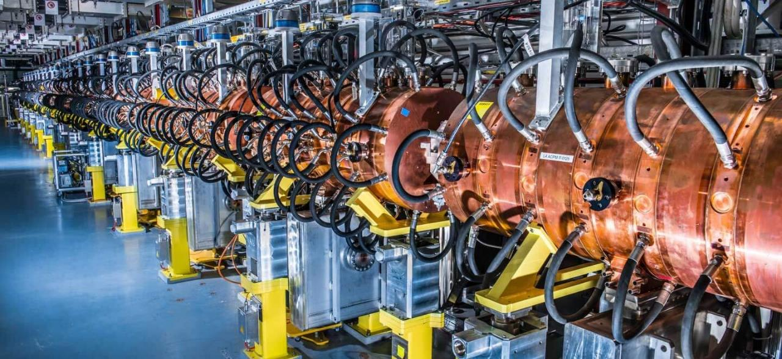
An Introduction to Particle Accelerators
LECTURES 1 & 2
Maurizio Vretenar CERN RTU Doctoral School April 2024

Slide 2
Content of this module (lecture 1 and 2)
The accelerator as a scientific instrument, basic principles
History of accelerators 1 (linacs and cyclotrons)
Building blocks 1 – linacs
History of accelerators 2 – the synchrotron
Building blocks 2 – synchrotrons
History of accelerators 3 – colliders
Building blocks 3 – colliders and storage rings
The present – particle accelerators in the XXI century

Slide 3

Spiralling in the particle accelerator world
Increasing complexity
Ion sources
Magnets
Beam optics
Accelerator types
Applications
Vacuum
Targets and materials
Radio-Frequency systems
Engineering

Slide 4

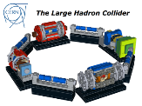
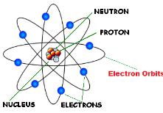
What is a particle accelerator ?
Particle accelerators are instruments that can concentrate large amounts of energy at subatomic scale
Accelerators are huge “energy concentrators”
Particle accelerators are our door to access the subatomic dimension… to study and exploit the atom and its components
Beam of subatomic particles
Where will this energy go? An accelerated subatomic particle sent towards an atom will:
Deliver some energy to the electrons.
Deliver some energy to the nucleus (if the particle has sufficient energy to penetrate the atom.

Slide 5
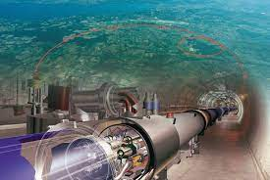
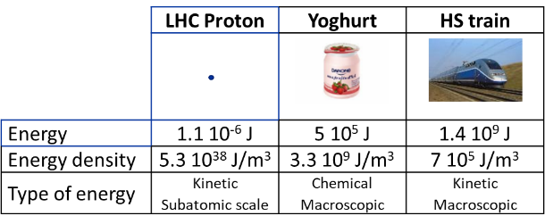
How large is the energy of a particle beam?
Comparing the energy of a single proton out of the CERN Large Hadron Collider, the largest particle accelerator ever built.
The energy is small, but the energy density is enormous!
Full LHC bunch (1.15 10¹¹ protons) at interaction point (30 cm, 16x16 μm²):
energy 1.3 10⁵ J,
energy density ≈ 0.5 10¹² J/m³
For comparison:
Li-ion battery 6 10⁹ J/m³,
Diesel fuel 4 10¹⁰ J/m³
Accelerator energies in eV (energy acquired by an electron in a potential of 1V)
1 eV = 1.6 x 10⁻¹⁹ Joules
TGV train:
400 tons, 200 m, 150 km/h

Slide 6
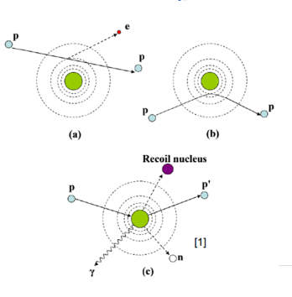
Where does the energy go?
Scattering of an accelerated beam
The accelerated particle can:
kick an electron out of the atom (ionization) or to a higher orbital (excitation) – breaking of molecular bonds or generation of X-rays (photons).
be deflected by the nucleus and give energy to the atom - increase of temperature, melting.
be absorbed by the nucleus bringing it to an excited state that can generate radiation or secondary particles (neutrons, etc.).
Collide with another subatomic particle with sufficient energy to generate new subatomic particles.

Slide 7

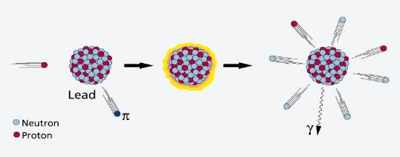
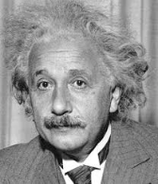
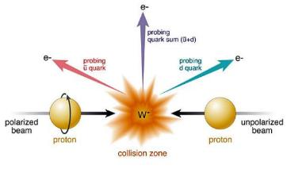
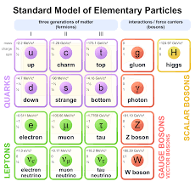
Accelerators can modify the nuclei and create new particles
If the energy is sufficiently high, the particles in the beam transfer energy to the nucleus and its components (and are then scattered, reflected or absorbed).
The dream of the ancient alchemists coming true!
NUCLEAR PHYSICS
Particles in the beam can break and modify the nucleus (and then generate new elements and transform the matter!)
PARTICLE PHYSICS
In the collisions can be generated new particles.
E = m c²

Slide 8
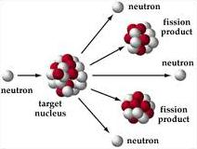
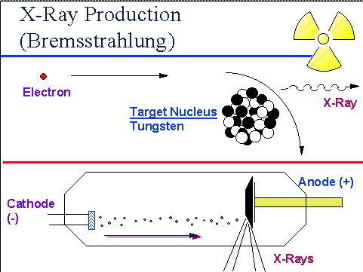
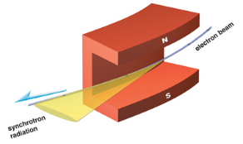
Accelerators can produce intense secondary beams
Accelerated electrons produce X-ray beams by interaction with a metal target (bremsstrahlung) or by synchrotron radiation in accelerator magnets)
Accelerated protons produce neutron beams by spallation reactions in a heavy metal target
X-rays generated by accelerators are commonly used in medicine
Both X-rays and neutrons generated from accelerators are used for advanced imaging in many fields: life sciences, condensed matter, energy, material science, cultural heritage, life sciences, pharmaceuticals,…
Additional applications are appearing for other types of secondary beams.

Slide 9
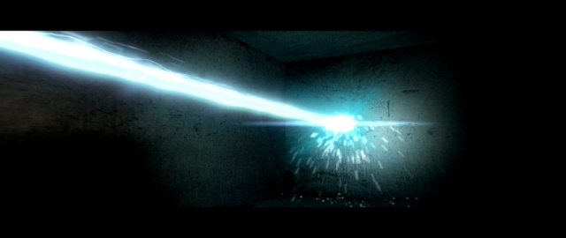
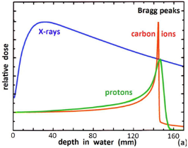
Accelerators can precisely deliver energy
A «beam» of accelerated particles is like a small “knife” penetrating into the matter
A particle beam can deliver energy to a very precisely defined area, interacting with the electrons and with the nucleus.
Particles can penetrate in depth
(different from lasers!).
Particle beams are used in medical and industrial applications,
e.g. to cure cancer, delivering their energy at a well-defined depth inside the body (Bragg peak)

Slide 10
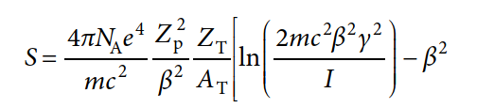
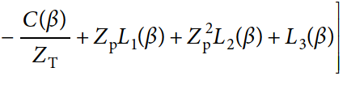
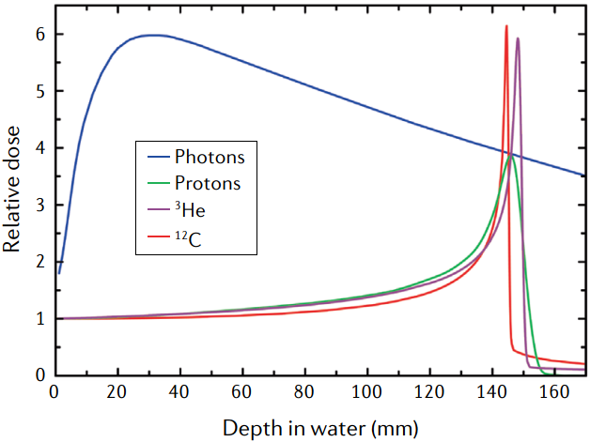
Bethe-Bloch equation
S = stopping power (energy loss per unit mass and length)
e electronic charge
N_{A} Avogadro number
m mass of the electron
c speed of light
Z_{p} effective charge of the projectile
Β, γ relative velocity and Lorentz factor of projectile
Z_{T} atomic number of target material
A_{T} mass number of target material
I mean excitation energy
C shell correction, L₁ Barkas correction, L₂ Bloch term,
L₃ Mott and density corrections.
Main term goes with 1/β² → characteristic Bragg peak.

Slide 11
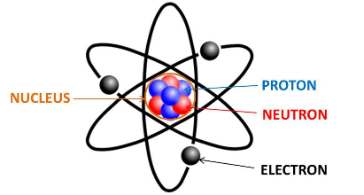
Combined effect on particles: the Lorentz force
We extract the particles from the atoms and then:
give them energy using electric fields,
guide them using magnetic fields
Newton-Lorentz force:
Can be accelerated only particles that have an electric charge: electrons, protons, ions (= charged nuclei)
 | Charge | Mass
Electrons | -1 e | 1 m_{e}
Protons | +1 e | 1 m_{p}
Ions | +1 / +82 e | 1 – 238 m_{p}
2nd term always perpendicular to motion => no acceleration
Unit charge 1 e = 1.6 × 10⁻¹⁹ Coulombs
Electron mass 1 m_{e} = 9.1 × 10⁻³¹ kg = 511 keV/c²
Proton mass 1 m_{p} = 1.67 × 10⁻²⁷ kg = 938 MeV/c²

Slide 12
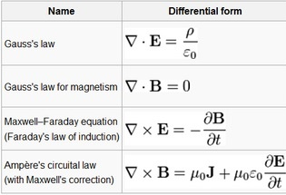
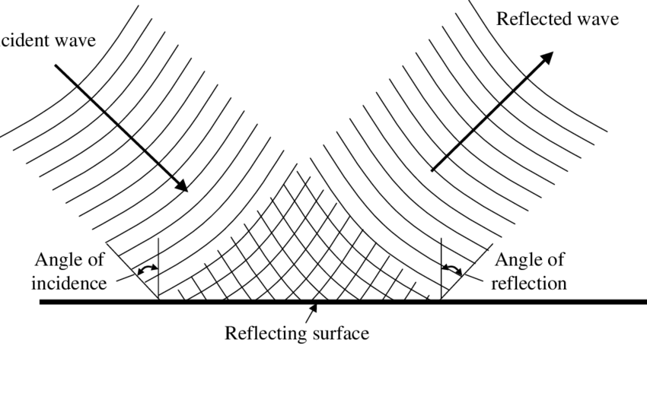


Maxwell’s equations and the electromagnetic field
Time varying electric and magnetic fields are closely related
In particular, sinusoidal fields are described by wave equation.
Electromagnetic «waves» propagate, and are reflected by metallic walls.
Electromagnetic Waves
Maxwell’s equations applied to empty space give the “wave equation”.
Solutions are electromagnetic sinusoidal waves
Speed of the electromagnetic wave in empty space is the speed of light

Slide 13
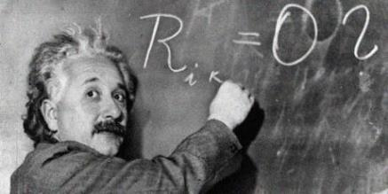
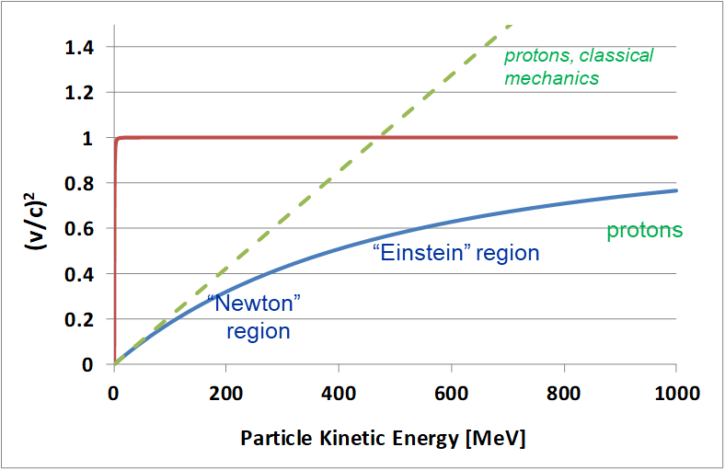
Relativity
When we accelerate, we give energy to the particles that become faster and faster.
But a hard limitation is given by special relativity: we cannot exceed the speed of light.
Before reaching the speed of light, the energy goes to increasing the mass and not the velocity!
β²=(v/c)² as function of kinetic energy T for protons
electrons
Relation kinetic energy / velocity:
Classic (Newton) relation Relativistic (Einstein) relation

Slide 14
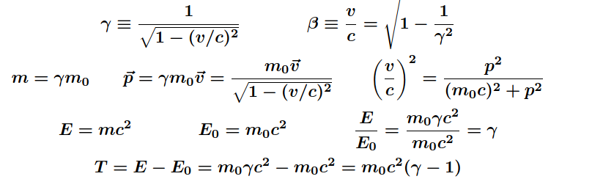
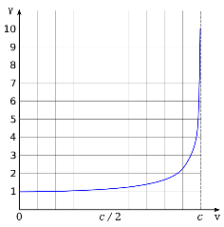
Useful relativistic relations
We are observers at rest, looking at particles travelling near the speed of light.
The particle properties that we observe are defined by the “Lorentz transformations”
β “relativistic velocity” is the fraction of the speed of light reached by a particle: v = βc
γ “Lorentz factor” measures the change of time and length for a moving particle. Ratio between relativistic mass and rest mass: γ = m / m₀
p (relativistic) momentum
Total energy E = mc² is the sum of rest energy E₀ and kinetic energy T : E = E₀ + T
Lorentz factor γ as a function of velocity. Its initial value is 1 (when v = 0); and as velocity approaches the speed of light (v → c) γ increases without bound (γ → ∞).

Slide 15

History of particle accelerators 1 – linacs and cyclotrons

Slide 16
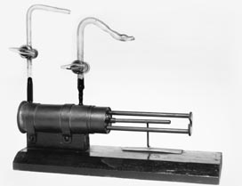
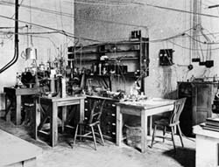
From Rutherford to the Particle Accelerator
1919: Ernest Rutherford’s historical experiment: some nitrogen nuclei are disintegrated by α-particles coming from radioactive decay of Ra and Th → start of a new era for science! But only few light atoms can be modified using particles from radioactive decays .
Men can transform the matter, the dream of the ancient alchemists!
1927: Rutherford in a famous speech at the Royal Society asks for “accelerators” capable to disintegrate heavy nuclei. Theory predicts the threshold for penetration of the nucleus at ~500 keV → from 1929, various labs start developing “particle accelerators” for >500 keV.
Reproduction of the Rutherford chamber: Bombardment of nitrogen atoms with alpha particles, producing oxygen and hydrogen nuclei.
Notes:
The dream of the alchemists from middle age, transform an element into something else…

Slide 17
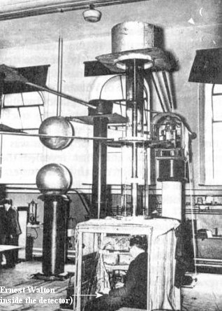
Early Accelerators
1927 to 1932, development of electrostatic accelerators:
Cockcroft and Walton (Cavendish Lab, Cambridge) → extend to higher voltages the “voltage multiplier” used for X-ray production.
Van de Graaf (Princeton) → develops the belt-charged static generator.
Others explore pulsed techniques, capacitor discharges, transformers, etc.
And the winners of the accelerator race are… Cockcroft and Walton, who in 1932 obtain disintegration of lithium by 400 keV protons. But:
higher energies are necessary to disintegrate heavier nuclei in quantities;
DC technologies are limited by breakdown to few MeV.
→ A new technology is needed...

Slide 18
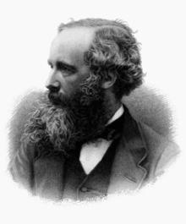
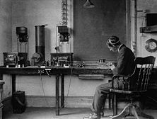
An alternative road: radio waves!
1864: Maxwell’s equations.
1873, Maxwell: Theoretical basis of wave propagation.
1888, Hertz: Experimental generation/reception of e.m. waves.
1891, N. Tesla, G. Marconi and others: wireless telegraph.
1905-14: early vacuum tubes (De Forest, triode in 1907).
1914-18: large quantities of tubes produced because of war effort, cost goes down.
1919-20: first attempts to broadcast with vacuum tubes using AM modulation, in the kHz range.
1920-25: start of regular radio broadcasting in most countries (1920: Argentina, US; 1923: Germany).
Notes:
1912: Titanic distress message, spark gap + crystal receiver
High Cgp capacitances prevented use at high frequencies, in 1916-26 improved (plate opposite to cathode, separate heating) and started to be used in all radio apparatus, up to few MHz frequency.

Slide 19
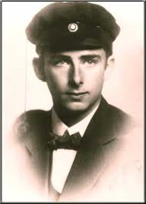
Marrying radio technology and accelerators
Who was the first to have the idea of using modern radio technology to build (linear) particle accelerators?
Remember:
the radio was around since 1920, and the technology became largely used in the 20’s
since 1927 the scientific community was looking for ideas to build high-energy particle accelerators…
?
A 26 year old PhD student…

Slide 20
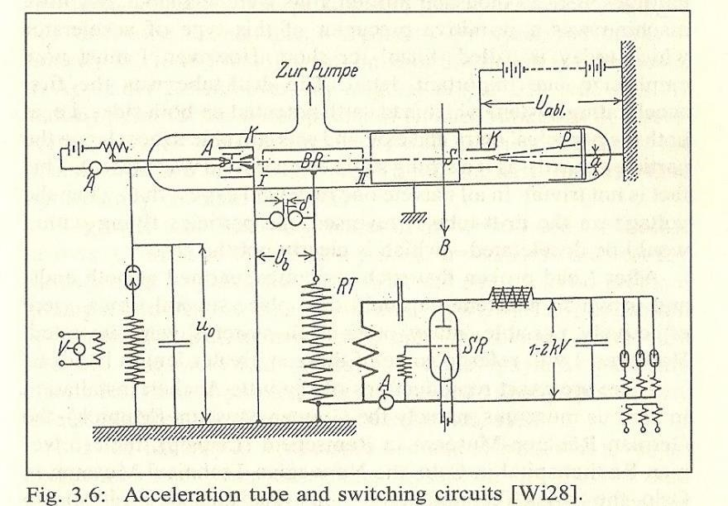
The first Radio-Frequency linac: Rolf Wideröe’s thesis
Rolf Wideröe: a Norwegian student of electrical engineering at Karlsruhe and Aachen.
The X-ray transformer that he had chosen for his PhD Thesis at Aachen University did not work, and he was forced to choose quickly another subject. Inspired by a 1924 paper by Ising, a Swedish professor (acceleration of particles using “voltage pulses”), in 1928 he put together for his thesis a device to demonstrate the acceleration of particles by RF fields:
Acceleration of potassium ions 1+ with 25kV of RF at 1 MHz → 50 keV acceleration in a 88 cm long glass tube) “at a cost of four to five hundred marks”, less than 2’000 € today!
use of a triode and of radio technology (at the time limited to 1-2 MHz) → marrying radio technology and accelerators.
Use of a drift tube separating 2 accelerating gaps → invention of synchronous RF accelerators.
complete accelerator: ion source, RF accelerator, detector, all in vacuum
Notes:
Necessity is the mother of invention

Slide 21

The invention of the linear accelerator
ELECTROSTATIC acceleration
The voltage can be applied only to one gap
+
-
DC voltage V₀
RADIOFREQUENCY acceleration
The voltage adds up over several gaps
RF voltage
V₀cosωt

Slide 22
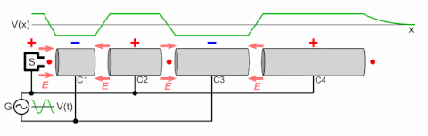
Higher energies in a Wideröe linac
The Wideröe structure can be used to reach higher energies, if the tubes are made longer and longer as the energy and velocity of the particle increase
d
T / 2 = d / v_{particles}
f_{RF} = v_{p} / 2d
d = v_{p} / 2f_{RF}
(Wikipedia)
d=βc/(2c/λ)=bλ/2
This is a “linear accelerator” (linac). Linacs are used as injectors to larger accelerators and as stand-alone when large beam intensities are required

Slide 23
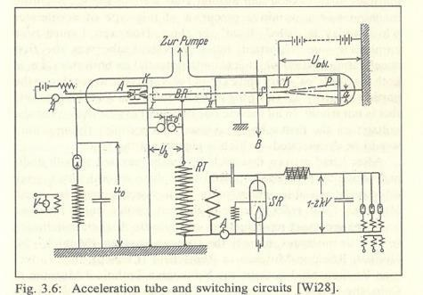
After the start, a stop…
Limitation of the Wideröe device:
for protons, needs high frequencies
(d=βλ/2, → taking d~10 cm, W=500 keV → f~50 MHz, λ~6 m)
☞ But a) higher frequency were not possible with the tubes of the time;
b) losses from a conventional circuit would have been too large!
→ after the PhD, Rolf Wideröe works for AEG to build HV circuit breakers and his thesis, published in the “Archiv für Elektrotechnik”, remains unnoticed.
... But the topic was hot!
Notes:
Deforest did not realize that his patent for the triode could be used for an oscillator – he used it as a detector with less Cpk.

Slide 24
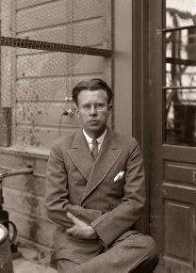
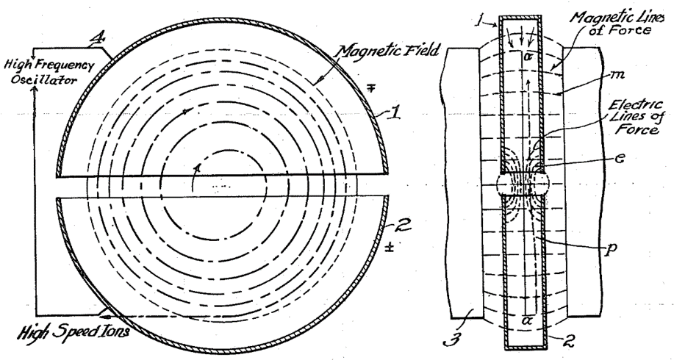
Ideas travel: from Aachen to Berkeley…
In the 1920’s, Ernest O. Lawrence (born 1901), young professor of physics at Berkeley, wants to join the “energy race”, and is looking for a new idea...
In 1929, during a conference, he goes to the university library and finds Wideröe’s thesis in the 1928 “Archiv für Elektrotechnik” (but he did not speak German...).
Immediately, he realised the potential of the idea of Radio-Frequency acceleration, and starts working with his PhD students on 2 parallel activities:
A Wideröe “linear accelerator” (linac) with several drift tubes, to accelerate heavy ions (Sloan and Lawrence).
A “cyclic” accelerator, bending the particles on a circular path around Wideröe’s drift tube (Livingston and Lawrence) → the cyclotron.
Notes:
Lucky not to understand German… in the text of Wideroe there was a chapter on why cyclic accelerators would not work…
Lawrence invented also a colour television tube, and the EM separation of isotopes that helped building the atom bomb.

Slide 25
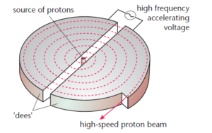
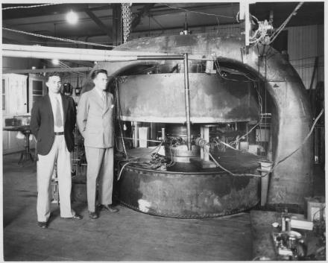
A compact low-energy accelerator: the cyclotron
Immediately after R. Wideoroe’s invention of the linear accelerator, Ernest O. Lawrence at Berkeley proposes to perform radio-frequency acceleration in a circular system, inserted in a big magnet.
Basic principle: Use RF electric field to accelerate, magnetic field to keep particle in a circular orbit
The cyclotron is born!
Acceleration in the gap between two “D” → long path of the particles in the D, frequencies ~1 MHz can be effectively used (3.5 MHz, 1st Berkeley cyclotron).
Fortunate “coincidence”: the revolution frequency does not depend on the beam energy → RF frequency is constant !
Protons are produced by a “source” in the centre
They are accelerated in the gap between 2 electrodes fed with RF
The protons go in larger and larger spirals, and their velocity increases proportionally to the spiral radius, keeping revolution frequency constant.
f revolution frequency

Slide 26
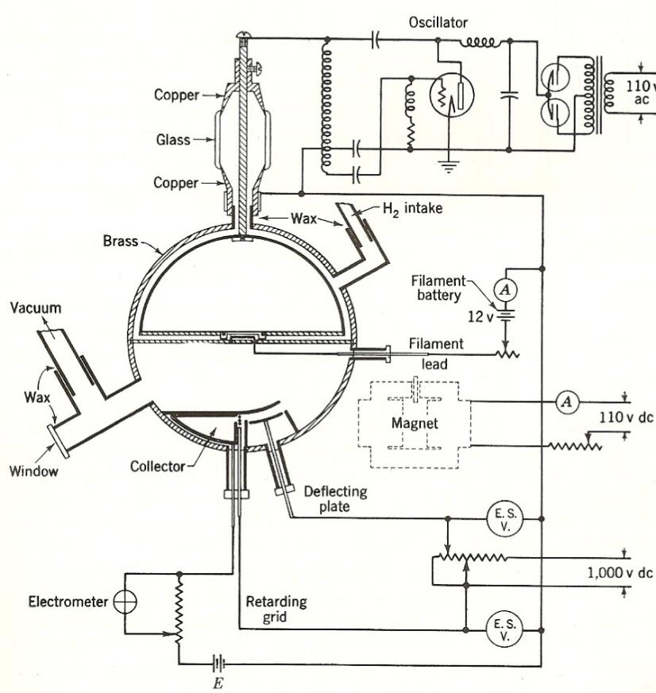
The first cyclotron
Scheme of the first Berkeley cyclotron, from S. Livingston’s PhD Thesis.
revolution frequency
Notes:
Another PhD thesis… again basically a radio transmitter plugged to a drift tube.

Slide 27
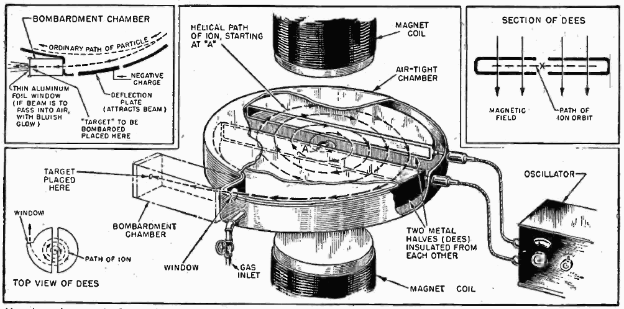
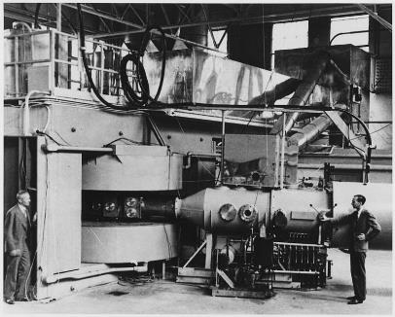
Cyclotrons give a boost to nuclear physics
1931: the Berkeley cyclotron reaches 1.2 MeV with protons. First atom disintegrations in 1932.
1934: 5 MeV reached on a new larger machine accelerating protons and deuterons (used for the production of neutrons, discovered in 1932).
Many institutes worldwide start the construction of cyclotrons. This technology made artificial production of heavy elements possible and paved the way for the discoveries in nuclear physics that provided the background for the US (and URSS) nuclear programmes.
revolution frequency
Notes:
Another PhD thesis… again basically a radio transmitter plugged to a drift tube.

Slide 28
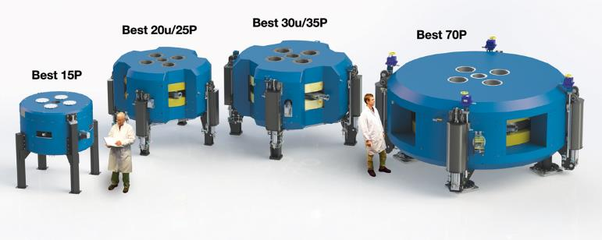
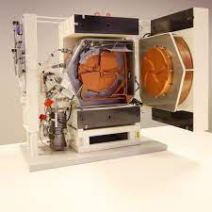
Examples of modern cyclotrons
The range of BEST cyclotrons, from 15 to 70 MeV output energy
A compact cyclotron for production of PET radioisotopes (GE Healthcare)
Very compact, can accelerate large particle intensities, but their construction and operation are simple only when the particle energy is low (non relativistic).

Slide 29
Basic limitations of Wideröe linac and cyclotron
Limitation to cyclotrons: relativity
The cyclotron principle is valid only for non-relativistic particles:
When the mass start to increase accordingly to m = γ m₀, the revolution frequency increases and the particles are no longer in phase with the RF excitation frequency.
Some corrections (modulation of the excitation frequency or shaping of the magnet field) can be applied, but conventional cyclotrons are limited in energy to ~ 70 MeV
Some special cyclotrons (synchrocyclotrons) can go higher (~ 500 MeV) but with high complexity and cost
→ invention of the synchrotron.
Limitation to Widerøe linacs: frequency
As velocity increases, to keep a reasonable distance between gaps the RF excitation frequency must increase:
f_{RF} = v_{p} / 2d
When the RF excitation frequency becomes so high that the dimensions of the accelerator are comparable to the RF wavelength, the gaps start to generate electromagnetic waves and to radiate their energy

Slide 30
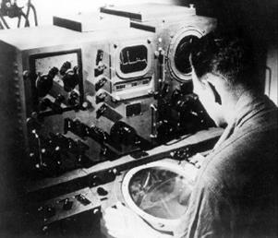
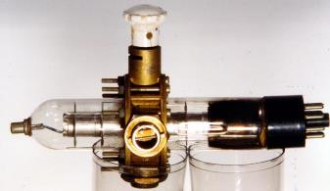
Higher frequencies – the WWII technology leap
Early RF systems (LC-based) were limited by leakage of RF power at high freq.
→ W. Hansen (b. 1909) at Berkeley starts to work on “cavity resonators” for higher frequency and after moving to Stanford starts developing a new source of RF power, the klystron. But the progress is slow.
After the start of WWII, the war effort recruited the best UK and US scientists. In 1940 is established the Radiation Laboratory at MIT, which will develop the modern radar technology.
The great boost to Radio Frequency technology that made modern particle accelerator possible came from the radar development of WW II.
All the US radar research was made public after the war and helped developing Radio-Frequency technologies for a new generation of accelerators.
A WW2 3 Ghz klystron
Note that early radars were based on the magnetron, developed at Birmingham in 1930-40 (3-30 GHz). UK radar technology was shared with US from 1940.

Slide 31
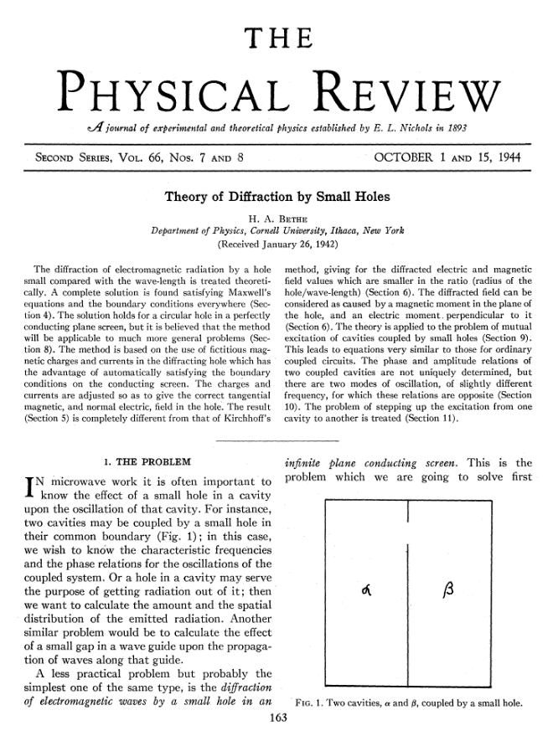
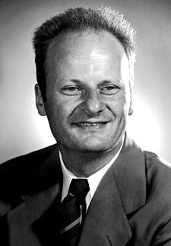
Scientists at war… an interesting example
Hans Bethe and the coupling cavity-waveguide
Theoretical physicist (nuclear physics, interaction particles/matter, ...)
Escaped to UK and then USA in 1933.
In 1941/42 was asked to contribute to the MIT work on radar, and given the problem of calculating the coupling from a hole between 2 cavity resonators.
The result was this paper, still the basis for understanding coupling problems in RF.
From 1942 Bethe left the RF field for the Manhattan Project, becoming one of the fathers of the atom bomb.
Notes:
From Cornell university (Livingstone).

Slide 32
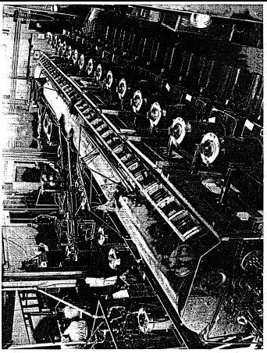
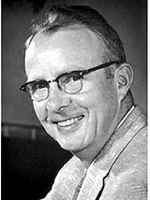
After the war, the big jump: linac technologies
Luis Alvarez and the Drift Tube Linac
The war effort gave the competences and the components to go to higher frequencies (in the MHz – GHz range) and to try acceleration of a proton beam to the MeV range using a modified Wideröe principle.
The 1st Drift Tube Linac by L. Alvarez and his team at Berkeley, reaches 32 MeV in 1947.
Alvarez, an experimental physicists, worked at MIT on radar during the war. In 1945 had the tools and the competences to build his own accelerator.
The “drift tubes” are inside a cavity resonator.
Frequency : Alvarez receives from the US Army a stock of 2’000 (!) surplus 202.56 MHz transmitters, built for a radar surveillance system. 26 were installed to power the DTL with a total of 2.2 MW. They were soon replaced because unreliable, but this frequency remained as a standard linac frequency.
Notes:
Consequence of the Pearl Harbour shock was that the US stocked thousands of antiaircraft systems in case of an invasion of California.

Slide 33
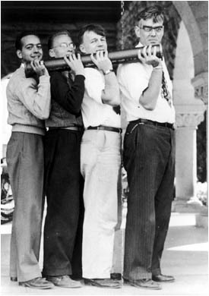
Another jump: higher frequencies and higher power
The Stanford Linear Accelerator
Development of the first electron linac (Ginzton, Hansen, Kennedy, 1948) at Stanford University.
Travelling-wave structures, iris loaded.
Important decision to separate the vacuum of the accelerator from the vacuum of the klystron through the use of “windows”.
3 GHz chosen as the highest frequency for which power sources were available (magnetron, 1 MW).
The Stanford team develops in 1946-49 a high-power klystron (8 MW) for its new linac.
William Hansen (right) and colleagues with a section of the first electron linear accelerator that operated at Stanford University in 1947. It was 3.6 meters long and could accelerate electrons to 6 MeV.
Notes:
Note that the problem of the windows was very difficult – Hansen died of a pulmonary disease due to the beryllium used for the windows.

Slide 34


A visual comparison between high and low frequencies…
The previous photograph was advertising the advantages of the 3 GHz frequency… compared to a famous photo of Alvarez’s 1st tank at 202 MHz!
Berkeley Laboratory group seated on top of the vacuum tank of their 40-foot 32-MeV proton linear accelerator on the back of a flatbed truck, probably in 1947.
Notes:
1st cavity resonator built by Hansen (Stanford) for the klystron (lower power dissipation). 2nd by Alvarez for DTL, 3rd (actually TW) for the 3 GHz MarkII

Slide 35
Going to higher energies with linacs? Not so easy
The focusing problem: in the first linacs, most of the particles were lost during acceleration → Alvarez used in his linac grids placed at the end of the drift tube hole, to avoid the RF defocusing: no defocusing, but losses on the grid → solution only after the invention of alternating-gradient focusing (1952) and the use of small quadrupole magnets (from 1954-55).
The technology problem: initial proton and ion linacs had a separate vacuum and RF envelope (a light sheet copper structure inside a big vacuum-tight cylinder). In the 70’s appeared the first linacs made of copper-clad stainless steel tanks with common RF and vacuum envelope. Copper-clad is not reliable, and at the beginning of the 80’s copper plating of steel (first mild, then stainless) made possible reliable structures with common envelopes.
The beam intensity problem: although alternating-gradient focusing allowed for beam transmissions coming close to 100%, several applications considered in the cold-war 70’s called for top beam intensity from linacs (fusion material irradiation, military tritium production, star wars,…) → development of sophisticated beam simulation codes and of the Radio Frequency Quadrupole (removes the intensity bottleneck at low energy!).

Slide 36

Linacs becoming gigantic: an unfortunate attempt
The Material Testing Accelerator (MTA) built in the early 50’s by Alvarez and his team at the site that would later become the Lawrence Livermore Laboratory.
50 MeV deuteron accelerator, 400 m long, 18 m diameter, drift tubes weighing 40 tons.
Intended to produce large quantities of uranium for the US programme to produce 30’000 nuclear weapons, by generating spallation neutrons to transform natural into fissile uranium.
Never worked because of sparking problems in the bad vacuum.

Slide 37


Building blocks 1 - linacs

Slide 38




A modern accelerator: ion sources
Scheme of the ion source delivering protons to all CERN accelerators
Protons are obtained heating a hydrogen gas into a plasma and then extracting the protons with a high voltage
Electrons are obtained by heating of a filament (like an electric bulb)
In both cases, after production we need to give a first small acceleration (< 100 keV) with an electrostatic section

Slide 39

The origin of all CERN protons
A 5 kg bottle of hydrogen contains 3’000’000’000’000’000’000 billions of protons!
And the LHC needs only 1’200’000 billions of protons per day.

Slide 40



The initial acceleration stage
Electrostatic: use a DC voltage between 2 tubes
Corresponds to a capacitor
Limitations: few 100 kV are possible but difficult, few MeV possible but require huge installations
The old (1975-92) CERN 750 keV pre-accelerator, fed by a Cokroft-Walton generator.

Slide 41



The old CERN Cockroft-Walton 750 keV pre-injector
instrumentation cabinet
Ion source (inside a voltage shield)
high-voltage electrode (750 kV)
Accelerating column (between 750 kV and ground)
high-voltage generator
Limitation:
Electric discharge (arc) between HV surfaces

Slide 42



And then? Use Wideröe’s idea: Radio-Frequency (RF) fields
Innovation by cross-fertilization: use the radio transmission technology that was rapidly developing in the 20’s and connect a radio transmitter to a system of tubes to obtain incremental acceleration.
V = V₀ cos ωt
Drift tube
2 gaps, one on each side
Spectrometer
Transverse electric field
Ion Source
Ionised potassium atoms
System in vacuum
To avoid losing particles on air molecules
-
+
-
+
Radio generator
1 MHz, 25 kV
Demonstrated acceleration of potassium ions 1+ at 50 keV with 25kV of RF at 1 MHz
42

Slide 43

The principle of radio-frequency acceleration
ELECTROSTATIC acceleration
The voltage can be applied only to one gap
RADIOFREQUENCY acceleration
The voltage adds up over several gaps
+
-
DC voltage V₀
RF voltage
V₀cosωt
tube
gap

Slide 44


Two important consequences of using variable RF electric fields
The beam of particles cannot be continuous. Particles must be grouped in “bunches” at the period of the radio-frequency
2. The length of the tubes must be proportional to the velocity of the particle
Time to travel L = period / 2
L / v = T / 2 = 1 / 2 f
L = v / 2f
v = velocity of the particle
f = frequency of our generator
Consequence:
The tubes must become longer and longer as the energy and velocity of the particle increase
L = cell length

Slide 45

We have built a linear particle accelerator!
Linear accelerators are used as injectors to larger accelerators and as stand-alone when large beam intensities are required

Slide 46

The Drift Tube Linac of Linac4, the new linear injector
for the LHC

Slide 47


In modern accelerators, we use high frequencies and cavity resonators around our gaps and tubes
Single-gap cavity 88 MHz
Multi-cell cavity 3 GHz

Slide 48




Synchronism in the PIMS cavity of Linac4
The beam is synchronous with the accelerating field
7-gap cavity (6 tubes and 2 half-tubes)

Slide 49

The new Linac4 (looking from the ion source)
100-m long linear accelerator
160 MeV proton energy
Built 2008-2016
Connected to the LHC injector chain in 2021.

Slide 50





Energy flow: from the power grid to the beam
HV AC/DC power converter
AC to DC conversion efficiency ~90%
Main oscillator
DC to RF conversion efficiency ~50%
High power RF amplifier (tube or klystron)
RF to beam voltage conversion efficiency = SHUNT IMPEDANCE
ZT² ~ 20 - 60 MΩ/m
ACCELERATING STRUCTURE
accelerating gaps + focusing magnets
magnet
powering
system
vacuum
system
water
cooling
system
The LHC needs about 80 MW of electricity from the grid!

Slide 51


Can we use a linac to go to very high energy?
A quick calculation:
With tubes we can make about 2 MeV per meter. At higher fields we have electric arcing between the tubes.
A linear LHC (7 GeV) would be long 3’500 km !
We need to go back to the cyclotron principle and think of how to adapt it to relativistic particles.

Slide 52
History of particle accelerators 2 – the synchrotron

Slide 53

The invention of the synchrotron
Initial idea: Sir Marcus Oliphant, UK scientist, when working at Oak Ridge for the US Manhattan project in 1943:
Particles should be constrained to move in a circle of constant radius thus enabling the use of an annular ring of magnetic field ... which would be varied in such a way that the radius of curvature remains constant as the particles gain energy through successive accelerations by an alternating electric field applied between coaxial hollow electrodes.

Slide 54

Basic relations for a synchrotron
1. Constant orbit during acceleration
2. B must increase with time (proportionally to the momentum!) to keep the particles on the closed orbit:
R = p / eB
3. The RF frequency must increase with time (proportionally to the velocity!) to keep the particles on the stable phase:
T_{rev} = 2πR / v
f = h/T_{rev} = v/2πR

Slide 55


Magnetic cycle

Slide 56


Phase stability
Oliphant’s idea was greeted with skepticism. Among the objections, the problem to keep the beam “bunched” enough to allow its acceleration during the short accelerating periods of the RF cavity.
A solution to this problem came from the parallel invention of phase stability by V. Veksler (USSR, 1944) and E. McMillan (US, 1945) – McMillan is the first to use the term “synchrotron”.

Slide 57

After the invention, slow progress…
Huge problems to be solved in the first generation of proton synchrotrons, aiming at the GeV energy (1 GeV Birmingham 1953, 3 GeV Cosmotron Brookhaven 1954, 6 GeV Bevatron Berkeley 1954)
The Cosmotron, 1954-1966)
Large frequency swing required for the RF system (fast variable inductors);
High pulsed power to be fed to the magnets;
Large magnet apertures (1.22x0.22m in the Cosmotron!) are required at very high cost, to control the beam using only the weak focusing provided by shaping of the magnet poles;
Fast magnets for injection (from a linac) and extraction of the beam are required.

Slide 58


The last missing element: strong focusing
E. Courant at BNL checks the effect of “turning” some of the Cosmotron magnets… and discovers the strong focusing effect of alternating gradients! This results in a famous paper by Courant, Livingston and Snyder published in 1952. The same idea had been independently patented in 1950 by N. Christofilos.
Strong focusing allows a smaller magnet aperture at much lower cost
In 1953 a delegation from CERN arrived in Brookhaven (O. Dahl, F. Goward and R. Wideröe) and immediately abandoned the idea of a 10 GeV weak focusing PS for the newly established CERN laboratory, in favour of a 25 GeV strong focusing PS for the same price. Brookhaven had already made similar plans for their AGS. But more problems were feared with strong focusing, and all other labs remained on weak focusing.
In 1959 the CERN PS was completed, and the first beam was accelerated to full energy on 24.11 – after W. Schnell introduced a circuit to change phase at transition, placed in a Nescafe tin.
The CERN PS,
200 m diameter

Slide 59
Building blocks 2 - synchrotrons

Slide 60



Alternating gradient strong focusing in a nutshell
From the initial idea of alternate orientation of the focusing/defocusing magnet poles, to the introduction inside the ring of alternate focusing/defocusing quadrupole magnets that “control” the transverse dimensions of the beam.
The main advantage is in reducing the size of the magnet aperture, with a strong reduction in magnet cost!

Slide 61



Some examples of quadrupole magnets
A quadrupole magnet installed in the CERN SPS
Electromagnets are used because changing the current and the field in the magnet allows changing the frequency and period of the transverse beam oscillations (“betatron oscillations”), thus protecting the beam from dangerous resonances due to errors and misalignments.

Slide 62

A complete synchrotron
The HIMAC carbon ion therapy synchrotron (Japan)
The synchrotron is made of a long vacuum chamber where the beam circulates, which goes through a large number of different elements arranged in a “lattice”:
Dipole magnets for bending (18 in this case for 20⁰ each)
Quadrupole magnets for focusing
Septum magnets for injection and extraction
Sextupoles for correcting perturbation in orbits
Correctors and pickups
RF caviti(es) for acceleration
Beam diagnostics and measurement devices
Bump magnets for beam manipulations

Slide 63



The CNAO synchrotron for carbon ion therapy

Slide 64


The smallest CERN synchrotron: LEIR

Slide 65
Linear and circular accelerators
accelerating gaps
d
accelerating gap
d
d=βλ/2=variable
d=2πR=constant
Linear accelerator:
Particles accelerated by a sequence of gaps (all at the same RF phase).
Distance between gaps increases proportionally to the particle velocity, to keep synchronicity.
Used in the range where β increases. “Newton” machine
Circular accelerator:
Particles accelerated by one (or more) gaps at given positions in the ring.
Distance between gaps is fixed. Synchronicity only for β~const, or varying (in a limited range!) the RF frequency.
Used in the range where β is nearly constant. “Einstein” machine

Slide 66
History of particle accelerators 3 – colliders

Slide 67

Colliding particle beams
What counts for physics is the centre of mass energy developed in the collision.
Because of relativity, the energy available at centre of mass in fixed target collisions is much lower than the energy of the particle beam.
Instead, for heads-on collisions of two beams traveling in opposite directions, the available energy is exactly twice the energy of the particle beams.
Accelerators capable of colliding beams are much more efficient than accelerators sending their beam to a fixed target !

Slide 68


Fixed Target Accelerators vs. Colliders
Fixed Target
Collider
Much of the energy is lost in the target and only part is used to produce secondary particles
All energy will be available for particle production

Slide 69


The long road to modern colliders
Who was the first to propose using particle colliders?
Again, Rolf Wideröe !
After inventing RF acceleration, he went to building betatron accelerators for electrons.
During the war years spent in Germany Widerøe patented his idea to use colliding beams to maximise the energy available (against the advice of his assistant Bruno Touschek, who found the idea too trivial to publish).

Slide 70




AdA – the first collider
Bruno Touschek in 1961 together with a team of Italian scientists and engineers was the first to use the collider principle in AdA (Anello di Accumulazione), a small e+e– storage ring in Frascati - the first collider of the world !
Diameter 1.6 m
Electrons 200 MeV

Slide 71



More colliders: electrons and hadrons
In parallel to the INFN AdA project, two other colliders were built:
At Stanford, by a Stanford-Princeton team (W.C.Barber, B. Gittelman, G. O’Neill, B. Richter)
At Novosibirsk (URSS), the VEP-1 electron-electron collider (Gersh Budker).
The first observations of particle reactions in the colliding beams were reported almost simultaneously by the three teams in mid-1964 - early 1965.
In 1966, work began on the proton-proton Intersecting Storage Rings at CERN, and in 1971, this collider was operational. The ISR was a pair of storage rings that accumulated and collided protons injected by the CERN Proton Synchrotron. This was the first hadron collider.

Slide 72



SppbarS collider
1976: C. Rubbia proposes to modify the CERN accelerator complex to transform the 400 GeV SPS (commissioned the same year!) into a collider, injecting antiprotons and colliding them with protons.
1978: project is approved, start preparation of the antiproton production, accumulation, and cooling (stochastic cooling by S. Van der Meer).
1981: start operation.
1983: discovery of the W and Z bosons.
1984: Rubbia and van der Meer receive the Nobel prize.

Slide 73
Building blocks 3 – colliders and storage rings

Slide 74


Technical challenges for particle colliders
There are only 2 options to make a synchrotron with two circulating beam in opposite directions:
The particles have same mass but opposite sign and circulate in the same vacuum chamber and magnetic field (ex.: electron-positron and proton-antiproton colliders).
The particles are the same and they circulate in separate vacuum chambers and opposite magnetic fields (Ex.: the LHC).
Problem with 1) is the need to create intense beams of unstable particles (positrons, antiprotons).
Problem with 2) is the need to use twin-bore dipole magnets or separate magnets
2-in-1 magnet configuration of LHC

Slide 75

Electron – positron colliders
The KEK-B collider (Japan)

Slide 76


The Large Hadron Collider
The 1232 LHC magnets contain two pipes, one for each of the counterrotating beams.

Slide 77



Superconductivity and particle accelerators
Some materials present a zero electrical resistance when cooled below a characteristic temperature.
Discovered in 1911, explained in 1958, started to be used for accelerators in the 1970’s.
Allows to build magnets that can stand higher electric currents and higher fields (not limited by water cooling) and accelerating RF cavities that do not dissipate power and have higher electrical efficiency.
Materials used in accelerators are
Niobium-Titanium for magnets
Niobium for RF cavities.
BUT: a superconducting accelerator requires a huge cooling system
That keeps all elements at liquid helium temperature
The LHC magnet superconducting cable
Clean room assembly of superconducting RF cavities
One of the 8 compressor units of the 4.5 K refrigerator for LHC

Slide 78





The CERN chain of accelerators
Linear Accelerator (50 MeV)
plus a chain of synchrotrons of increasing energy and radius:
Booster 1.4 GeV
PS 25 GeV
SPS 450 GeV
LHC 7 TeV

Slide 79



The magnets
Superconducting
Normal conducting
15 metres length, maintained at -269 degrees by a flow of liquid helium. Magnetic field 8 T, 5 times more than conventional magnets and 10’000 times a small house magnet

Slide 80

The magnetic field limitation
The final limitation to the size and to the energy of a synchrotron comes from the magnetic field that can be achieved.
Technological limit:
about 2 T normal conducting magnets
8 T Nb-Ti superconducting magnets
12 T future Nb3Sn superconducting magnets

Slide 81
Dealing with Energy
The energy in one LHC beam at high energy is about 320 Million Joules
This corresponds to the energy of a TGV engine going at 150 km/h
...... but then concentrated in the size of a needle

Slide 82



Beam collimators and dumps
Linac4 Main Dump
Even a tiny fraction of the LHC beam lost in a magnet can cause a dangerous quench
HL-LHC collimators

Slide 83

Luminosity, the Collider Figure of Merit
Number of bunches
Intensity per bunch
Geometrical
Correction
factors
Beam dimensions
More or less fixed:
  Revolution period
  Number of bunches
High-Luminosity LHC
Parameters to optimise:
  Number of particles per bunch
  Beam dimensions
  Geometrical correction factors
X 2

Slide 84


The High-Luminosity LHC Project
Is the major ongoing accelerator project at CERN – to be completed in 2026
New IR-quads (inner triplets)
  New 11T short dipoles
  Collimation upgrade
  Cryogenics upgrade
  Crab Cavities
  Cold powering
  Machine protection
  …
Major interventions on more than 1.2 km of the LHC

Slide 85


The LHC injectors for higher luminosity
LINAC4 – PS Booster:
  New LINAC 4 with H⁻ injection
  Higher injection energy
  New Finemet® RF cavity system
  Increase of extraction energy
PS:
  Injection energy increase from 1.4 GeV to 2 GeV
  New Finemet® RF Longitudinal feedback system
  New RF beam manipulation scheme to increase beam brightness
SPS
  Machine Impedance reduction (instabilities)
  New 200 MHZ RF system
  Vacuum chamber coating against e-cloud
Courtesy of A. Huschauer
These are only the main modifications and this list is not exhaustive

Slide 86

The present – particle accelerators in the XXI century

Slide 87

Progress in accelerator technology: Livingston plot
Exponential growth of particle accelerator top energy with time thanks to a series of enabling technologies

Slide 88






Innovation in the particle accelerator field
1931………….1945/48….1952…………..1965/90’s….…
XXI century
?
Cyclotron: cyclic acceleration with magnets (Lawrence)
Strong focusing (Courant, Livingston, Snyder, Christofilos)
Superconducting magnets and acc. cavities
2008: the Large Hadron Collider
Application of WW2 radar technology to accelerators (Hansen, Alvarez)
Succession of enabling technologies (technology leaps)
Energy*
2009 Livingston plot, Symmetry magazine
*: for colliders, energy to reach same c.o.m. energy in collision with proton at rest
S. Livingston, 1959:
Accelerator energy increases by a factor of 10 every 6 years
(Moore’s law of accelerators)

Slide 89




Particle Accelerators in 2024 – a paradox?
We have reached the end of exponential growth…
but the field has never been so flourishing!
TIARA Need for Accelerator Scientists report, 2013: 3’700 people engaged in accelerator science in Europe, growing to 5’000 by 2020.
?
As many as 70 ongoing accelerator construction or upgrade projects listed at the 2023 IPAC Conference (33 Europe, 17 America, 20 Asia) – up from 50 in 2017.
Annual market for medical and industrial accelerators estimated (2018) at US$5.0 Billion/year, growing at 5%/year.
Updated Livingstone-type chart (Wikipedia 2014, uploaded by J.Nash, Imperial College)

Slide 90
Multiple challenges for accelerator science
There are more than 35’000 particle accelerators in operation around the world:
For all XXth century, fundamental science has been the driving force for the development of new accelerators, with its continuous quest for high energies required to discover new particles.
In this early XXI century, we are moving to a new paradigm where together with particle physics applied science (photon and neutron science) and healthcare appear as driving forces for innovation.
Advanced medicine and new materials are key technology drivers of the XXIst century.
Research |  | 6%
 | Particle Physics | 0,5%
 | Nuclear Physics, solid state, materials | 0,5%
 | Biology | 5%
Medical Applications |  | 35%
 | Diagnostics/treatment with X-ray or electrons | 33%
 | Radio-isotope production | 2%
 | Proton or ion treatment | 0,1%
Industrial Applications |  | 60%
 | Ion implantation | 34%
 | Cutting and welding with electron beams | 16%
 | Polymerization | 7%
 | Neutron testing | 3.5%
 | Non destructive testing | 2,3%
What is the role of accelerators in this transition?
90

Slide 91




Accelerators in transition – for physics and for society
Transition to new more affordable and sustainable technologies for basic science
Transition from basic science as main technology driver to a multiple system where basic and applied science, medicine and industry will together drive accelerator development.
Transition from a centralised configuration based on large laboratories to a distributed scheme (project clusters of small and large laboratories and industry)
innovation
Limitations related to size, cost, energy.
New ideas and technologies
Fundamental science
Societal applications (medicine, industry, environment, etc.)
Applied science (photon and neutron sources)
The electron linac for cancer radiotherapy, the most widespread accelerator in the world (> 12000 units)

Slide 92


Sustainability challenges for large research accelerators
Particle physics has been from the very beginning the technology driver for the development of particle accelerators: the quest for new particles at increasingly higher energies has motivated the development, construction and financing of increasingly large accelerators. But an exponential growth (Livingston diagram) is never sustainable over the long term.
Physics:
After the discovery of the Higgs boson the Standard Model is complete – many questions remain open (origin of dark matter and energy, antimatter asymmetry, etc.) and their solutions may be related to new unknown particles, but so far no clear predictions exist to be verified by an accelerator.
Accelerators:
The size, cost and energy consumption of the accelerators required to go beyond the standard model rise questions on the long term sustainability of accelerator-based particle physics.
Difficulty to justify new large projects
Difficulty to implement new large projects
The recent international crisis has shown that energy reduction is a must for future project, and that governance models based on science globalisation will be increasingly difficult to implement.
«Nature», July 2014

Slide 93

The big challenges for accelerator science
Making accelerator-based particle physics research sustainable over the long-term, increasing at the same time the benefits of particle accelerators for society are the main challenges to the accelerator community in this XX century.
Sustainability translates into considering from an early design phase that resources are finite and use them conservatively and wisely with a view to long-term priorities, for the entire life cycle.
Reducing the overall environmental footprint of particle accelerators means reducing their impact as large consumers of energetical, environmental, financial, and human resources.
Any new accelerator project requires a complete Life Cycle Assessment to take into consideration use of resources and emissions from construction to operation and decommissioning.
From the LHC (27 km) to the Future Circular Collider (100 km)

Slide 94



Design for sustainability

Slide 95



Example: RUEDI at STFC Daresbury Laboratory (UK)
Relativistic Ultrafast Electron Diffraction and Imaging
Facility to be built at STFC’s Daresbury Laboratory
  4 MeV; diffraction at 10-100 fs; imaging at 10-100 nm; fC-pC bunches
Recommendations:
Carbon Inventory based on some assumptions (no processing, transport, end of life)
All information courtesy of B. Shepherd, STFC (presented at IFAST 2024)

Slide 96
Multiples directions for accelerator R&D in the XXI century

Slide 97

The energy sustainability frontier
Total electricity consumption (GWh/y)
PSI | 125
ESRF | 60
ISIS | 70
KVI | 4
INFN | 25
ALBA-CELLS | 20
GSI | 60
CERN | 1200
SOLEIL | 37
ESS | 317
MAX IV | 66
DESY | 150
Future large projects require huge amounts of electrical power
Example: the ILC needs about 1/3 of a Fukushima-type nuclear reactor, or in alternative 200 large windmills (80m diameter, 2.5 MW, 50% efficiency) covering a 100 km distance.
A particle accelerators is a device that converts electrical energy from the grid into high-quality kinetic energy at sub-atomic scale (beam energy).
After a series of transformations, most of the energy is lost into low-quality heat.
Efficiency can be increased using special devices (e.g. permanent magnets, high-efficiency RF sources, SC RF cavities, etc.) but there is an intrinsic efficiency limit related to the “high-quality” of the energy produced by the accelerator and to its use.
Recuperation of heat is possible, but very inefficient because of low temperatures and distance.
Power flow of PSI cyclotron: grid to beam efficiency 13%
Electrical power consumption (MW) for LHC and future projects (estimated)
 | normal | Stand-by
LHC | 122 | 89
HL-LHC | 141 | 101
ILC | 230
CLIC 500 GeV | 235 | 167
CLIC 1.5 TeV | 364 | 190
FCC hh | 580 | 300?
Most of the electricity used by a particle accelerator goes to heating water and air – intrinsic limitation due to the “quality” of the energy stored in the beam

Slide 98



Some initiatives to improve energy efficiency
Tunable high-gradient permanent magnet quadrupoles
Development of high-efficiency RF power sources.
Klystrons to extend efficiency from industrial standards to utlimate theoretical limits

Slide 99


Limitations to energy efficiency of accelerators
Energy flow in a linear accelerator system
Normal conducting
Main limitation comes from concentrating electric field in the gap region
Superconducting
Main limitation comes from the Carnot efficiency of the refrigerator
Fundamental limitations to the overall accelerator efficiency, related to the strong local decrease of entropy related to the concentration of energy into the particle beam.

Slide 100

Economic sustainability and innovation
Moving along this line was made possible by new technologies
(colliders – antiproton production and storage – superconductivity)
FCC-ee
collider
p-pbar
collider
superconducting
collider
FCC-pp
scaling of present technology
reduction in cost with new technologies
Plot courtesy of P. Lebrun
The economic environment and the priorities of a society define the budget that can be invested in large scientific infrastructure (“Big Science”).
To remain within the present limits, an effort is needed to produce innovative technologies.

Slide 101


Reducing environmental footprint: smaller accelerators
Synchrotrons: p/q=Bρ
Need to maximise magnetic field
Superconductivity is mandatory, the limitations is the critical current density Jc for SC magnets
Linear accelerators: W=El
Need to maximise electric field
Limitations: arcing between electrodes, field emission, etc.
(and RF power, proportional to V² !)

Slide 102





The magnetic field frontier in superconducting magnets
Three technologies under consideration
1. NbTi (Niobium Titanium as in the LHC): mature but limited to about 9T field.
2. Nb₃Sn (Niobium Tin) technology has seen a great boost in the past decade (factor 3 in J_{C} w/r to ITER) but is not yet used in an accelerator – The HL-LHC upgrade will be the first one.
3. HTS (High-Temperature Superconductor) technology still in the experimental phase (Production quantities, homogeneity and cost need to evolve!) but can be a disruptive technology for future high-field magnets.
Courtesy L. Rossi, CERN
R&D towards a 20 T HTS dipole magnet, develop 10 kA cable.
REBCO (rare earth barium copper oxyde) deposition on stainless substrate, tape arranged in Roebel cables.
values of 900-1200 A/mm2 at 4.2 K , 18-20 T have been obtained
Right: layered structures with sections of different conductors
Left: new magnet designs are required for HTS

Slide 103




HTS magnets – reducing cost is the main challenge
HTS allows reducing the size of the accelerator but not (yet) the cost.
HTS is presently about 5 times the cost of Nb3Sn, but other communities (e.g. fusion) could contribute to reducing the price in the next years.
(courtesy of P. Lebrun)
100 CHF (=100$) of YBCO HTS tape built by Bruker HTS for CERN
Is superconducting magnet technology approaching saturation ? Large increase in cost for small performance improvements

Slide 104



The electric field frontier – superconducting cavities
TRENDS:
Nitrogen infusion process (FNAL) and other doping techniques: high Q operation, gradients ∼45 MV/m
Coating of Nb with a thin layer of Nb₃Sn (allows operation at larger $T$, improved cryogenic efficiency)
Coating of Cu cavites with Nb by HiPIMS (High Power Impulse Magnetron Sputtering,
Multi-layer
SRF Thin Film
Bulk Nb
Long-term goal: 60 → 90 MV/m

Slide 105


The electric field frontier – normal conducting cavities
Most advanced results by the Compact Linear Collider (CLIC) study based at CERN (X-band, 12 GHz)
Large international collaboration to understand the physics of breakdown phenomena.
Pulsed systems, characterised by a BreakDown Rate (BDR), pulses lost because of vacuum arcing in the structure
100 MV/m gradient can be achieved (and exceeded)
… but power scales as the square of gradient! High gradient means smaller dimensions but higher power consumption.

Slide 106



New acceleration techniques using lasers and plasmas
Accelerating field of today’s RF cavities or microwave technology is limited to <100 MV/m
  Several tens of kilometers for future linear colliders
Plasma can sustain up to three orders of magnitude much higher gradient
  SLAC (2007): electron energy doubled from 42GeV to 85 GeV over 0.8 m → 52GV/m gradient
Lasers can produce huge transverse electric fields (TV/m !)
Can we convert the transverse fields into longitudinal and use them for acceleration?
(1) Micro/Nano-Accelerators
(2) Plasma Accelerators
Use a plasma to convert the transverse electrical field of the laser (or the space charge force of a beam driver) into a longitudinal electrical field, by creating plasma waves.
Send THz Laser into Dielectric Waveguide (Micro-Accelerator)
The «accelerator on a chip»

Slide 107




Towards a plasma-based linear collider?
Main challenges
W.P. Leemans & E. Esarey, Physics Today, March 2009

Slide 108



Other options for high energy: muon collider
Colliding muons:
Muons are leptons, similar to electrons but heavier (207 times),
produced by pion decay or electron/positron annihilation, have a lifetime of only 2.2 μs.
Critical components:
Muon production complex (proton or positron beam, MAP or LEMMA)
Muon acceleration complex
Neutrino radiation
Excellent in term of power/luminosity, potential for cost savings
Many critical technical challenges requiring R&D

Slide 109

New ideas: the HALHF concept
HALHF: A Hybrid, Asymmetric, Linear Higgs Factory
New concept, aiming for pre-CDR end 2024:
500 GeV for electrons with plasma acceleration
31 GeV positrons with RF based linac, used also to provide electron drivebeam for the plasma acceleration
Reach 250 GeV collision energy, luminosity 10³⁴
https://arxiv.org/pdf/2303.10150.pdf
Asymmetric technologies, energies and bunch charges
Small footprint, lower cost
Several key plasma acc. challenges:
Multi-staging, emittances, energy spread, stabilities, spin polarisation preservation, efficiencies, rep rate, plasma cell cooling and more
Conventional beam(s) challenges:
Positron production, damping rings, RF linac, beam delivery system
18.04.24
Steinar Stapnes
109

Slide 110



Comparing for sustainability - LCA
Form ARUP Report, CLIC and ILC Life Cycle Assessment Final Report,
https://edms.cern.ch/document/2917948/1
Resource optimization as “normally” done for accelerators:
  Length/complexity → construction cost
  Power/energy consumption → operating costs
  Traditionally we optimize for energy reach and luminosity w.r.t. to cost and power
Sustainability in a wider sense adds new construction and operation optimization criteria:
  Energy use not only costs but also CO₂, embedded CO₂ in construction materials (including tunneling) and components, rare earth usage, responsible sourcing in general for all parts, landscaping, integration in local communities, life cycle assessments including decommission and many more issues

Slide 111

End of Lectures 1 & 2
Elwood Smith

