Slide 2
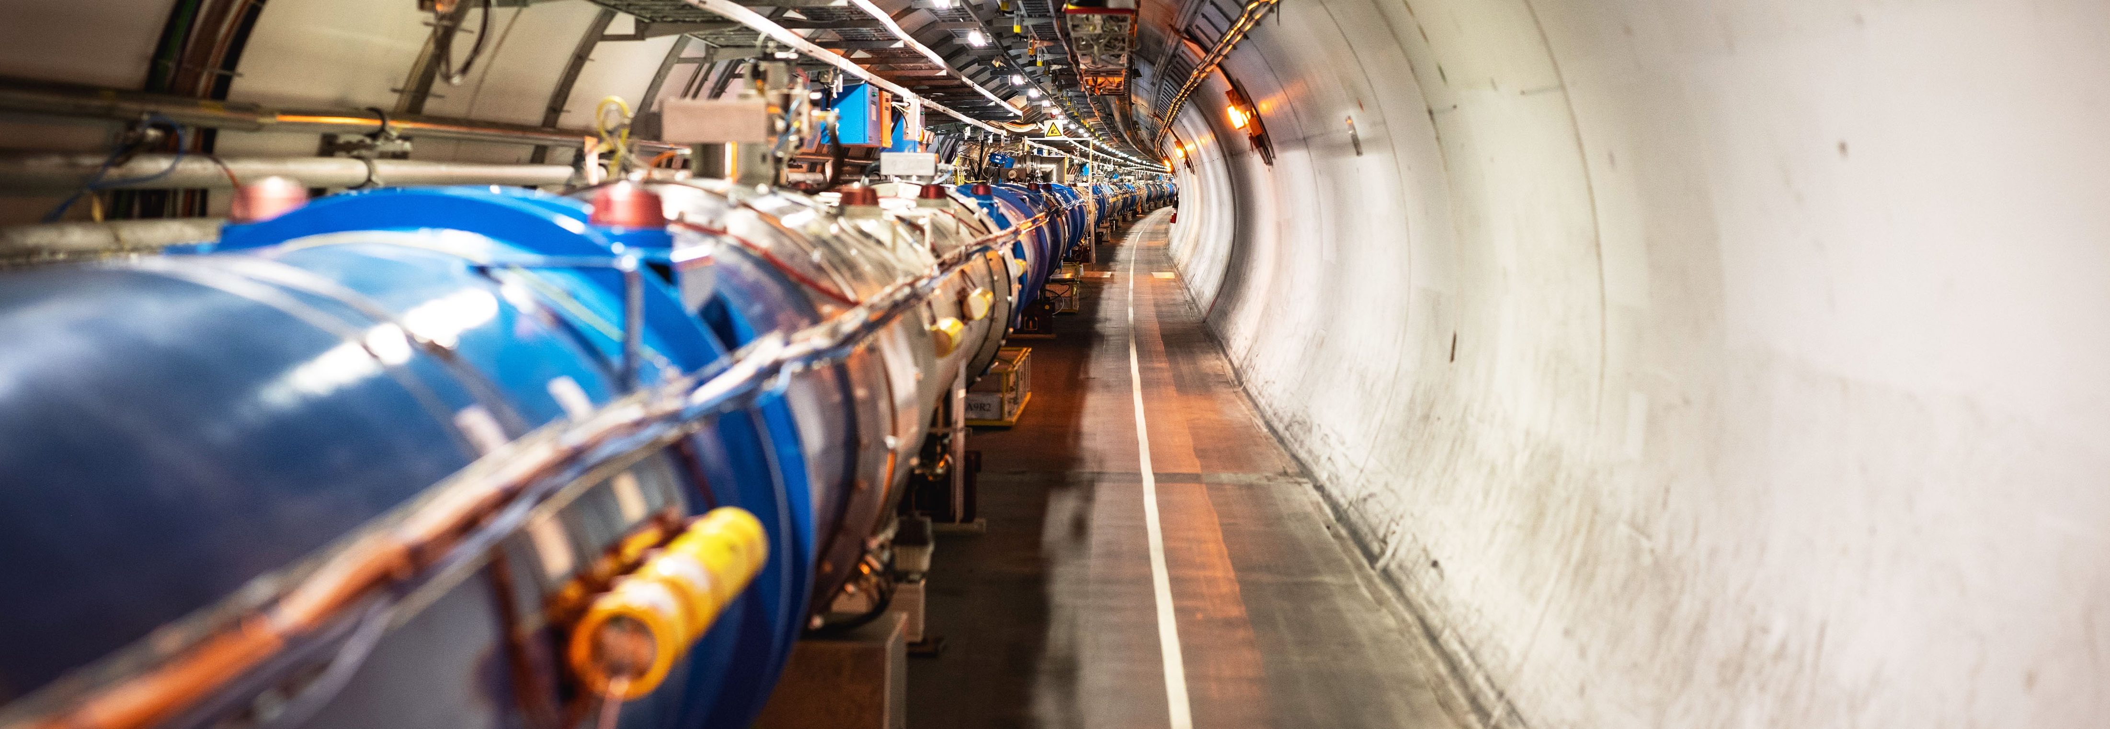
“The history, breakthroughs and future goals”
UiA, CERN, 2 May 2024
Jens.Vigen@cern.ch
CERN librarian and IUPAP Secretary-General
Notes:
THE WELCOME SLIDE
With this slide the speaker:
Introduces him/herself
Describes how this brief presentation aims to give an overview of CERN, as an introduction to the visit that will follow.

Slide 3
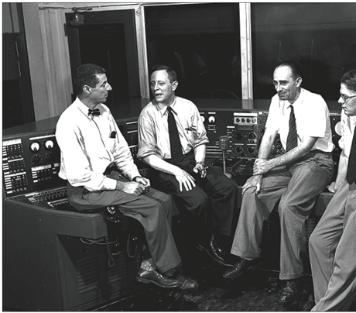
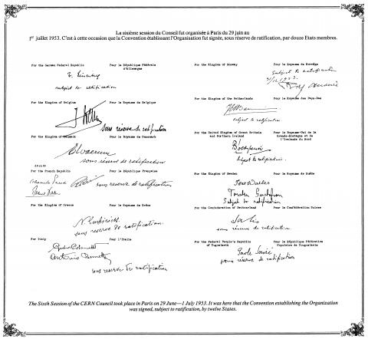
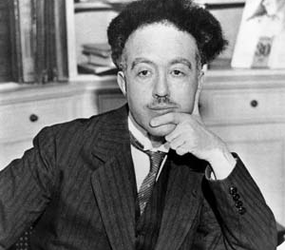
Establishment of a multi-national laboratory
Originator of the ideas
Louis de Broglie
George Collins (BNL) with the provisional CERN delegation in 1952, Odd Dahl, Rolf Widerøe and Frank Goward
Signatures on the CERN Convention 1 July 1953

Slide 4
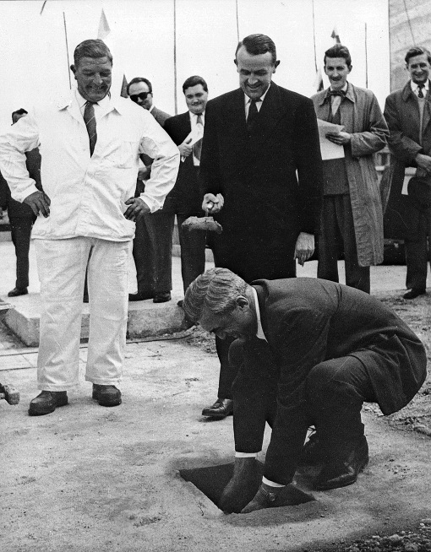

History
UNESCO conferense
  Lausanne 1949
Pre-CERN 1952
CERN 1954
Do you recognize these people?

Slide 5

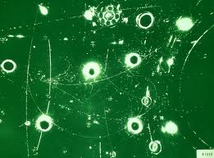
Pre-CERN
C
Centre …
Hefty discussion in Copenhagen back in 1952 …

Slide 6
The abbreviation CERN
C
Centre …
Cabale
Casino
Concubinage
Cirque

Slide 7
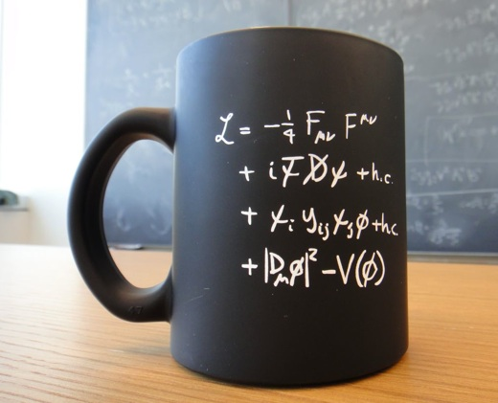
European Organization for Nuclear Research
Nuclear physics
The theory of everything …
“The God particle”

Slide 8


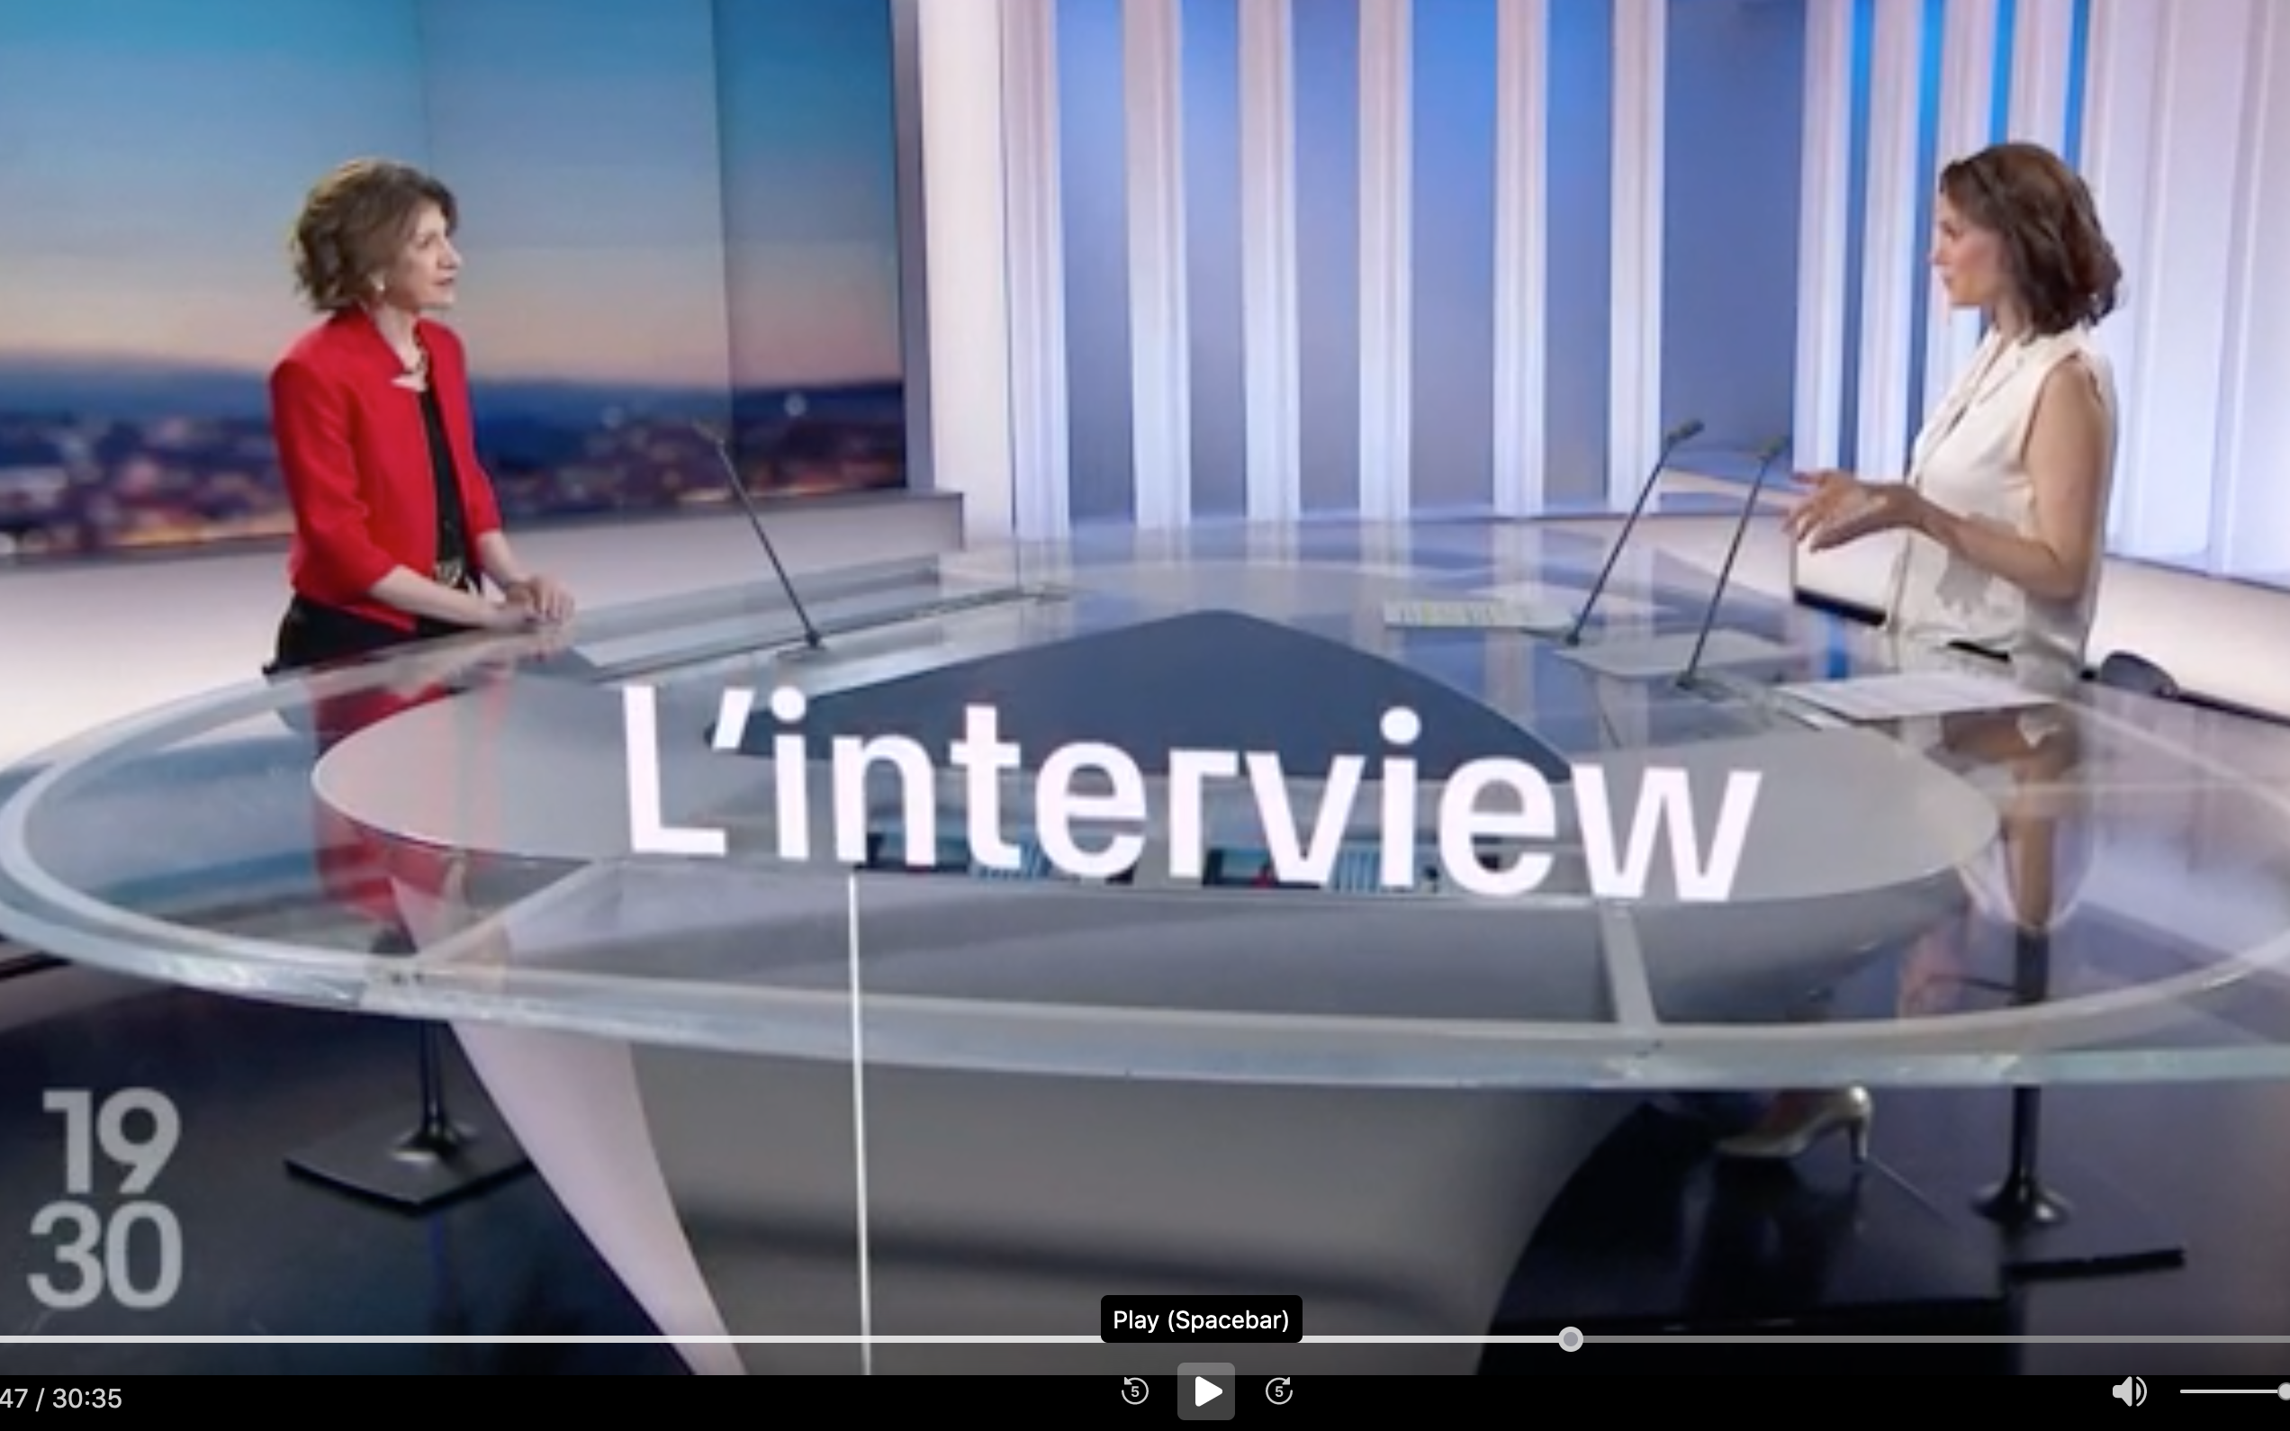
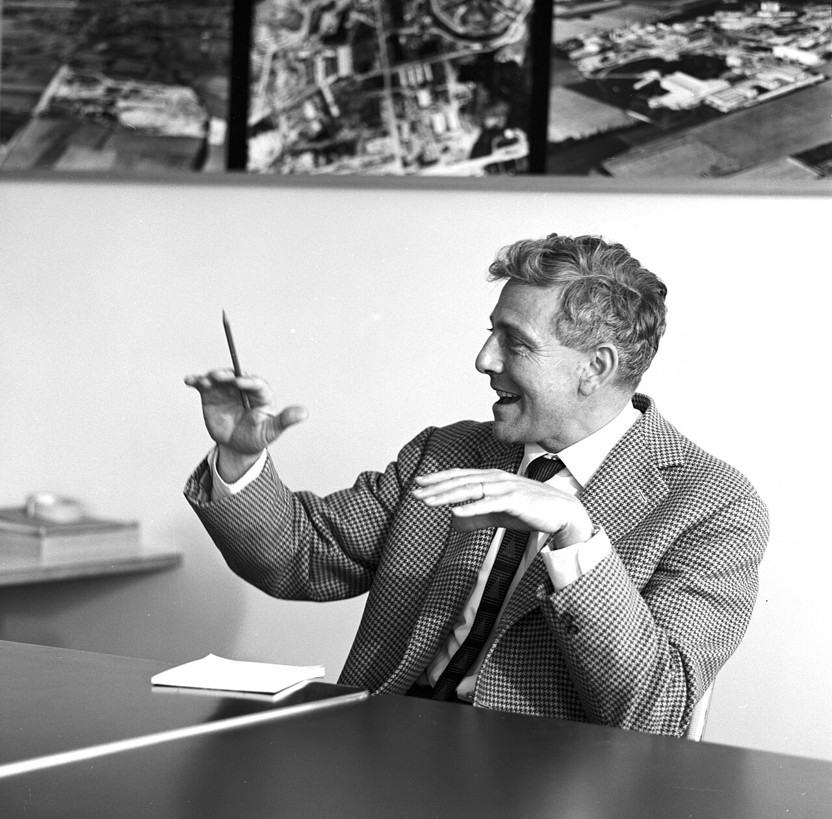
https://careers.cern/director-general

Slide 9
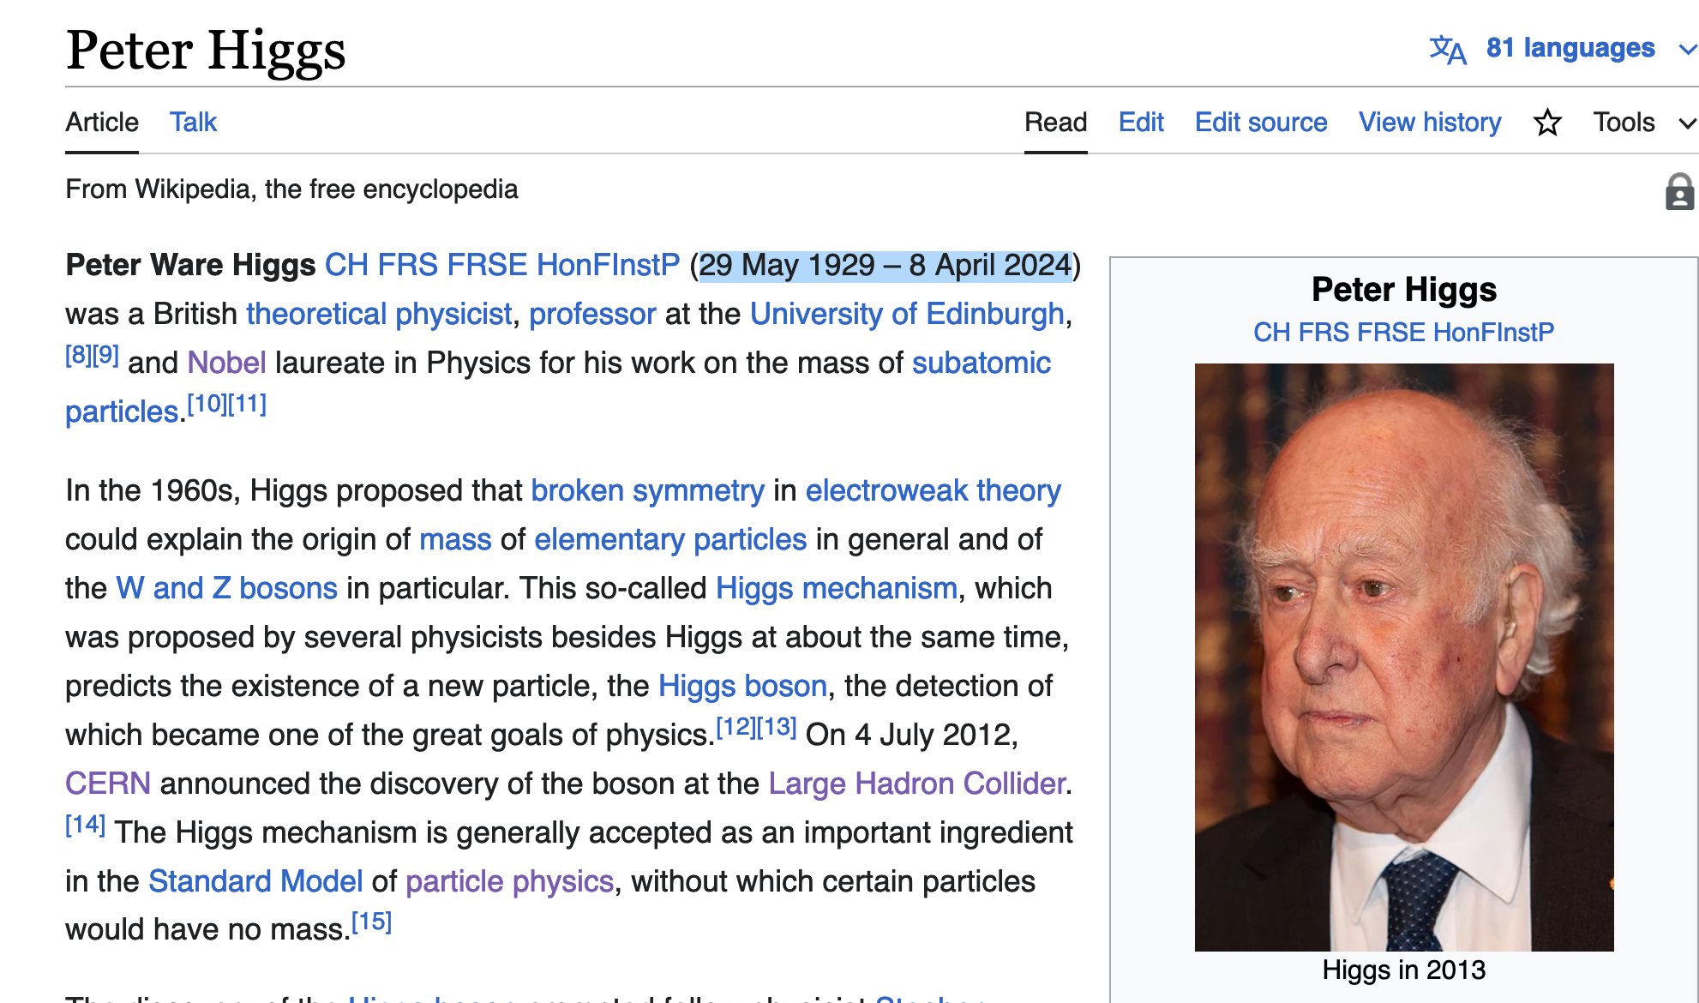
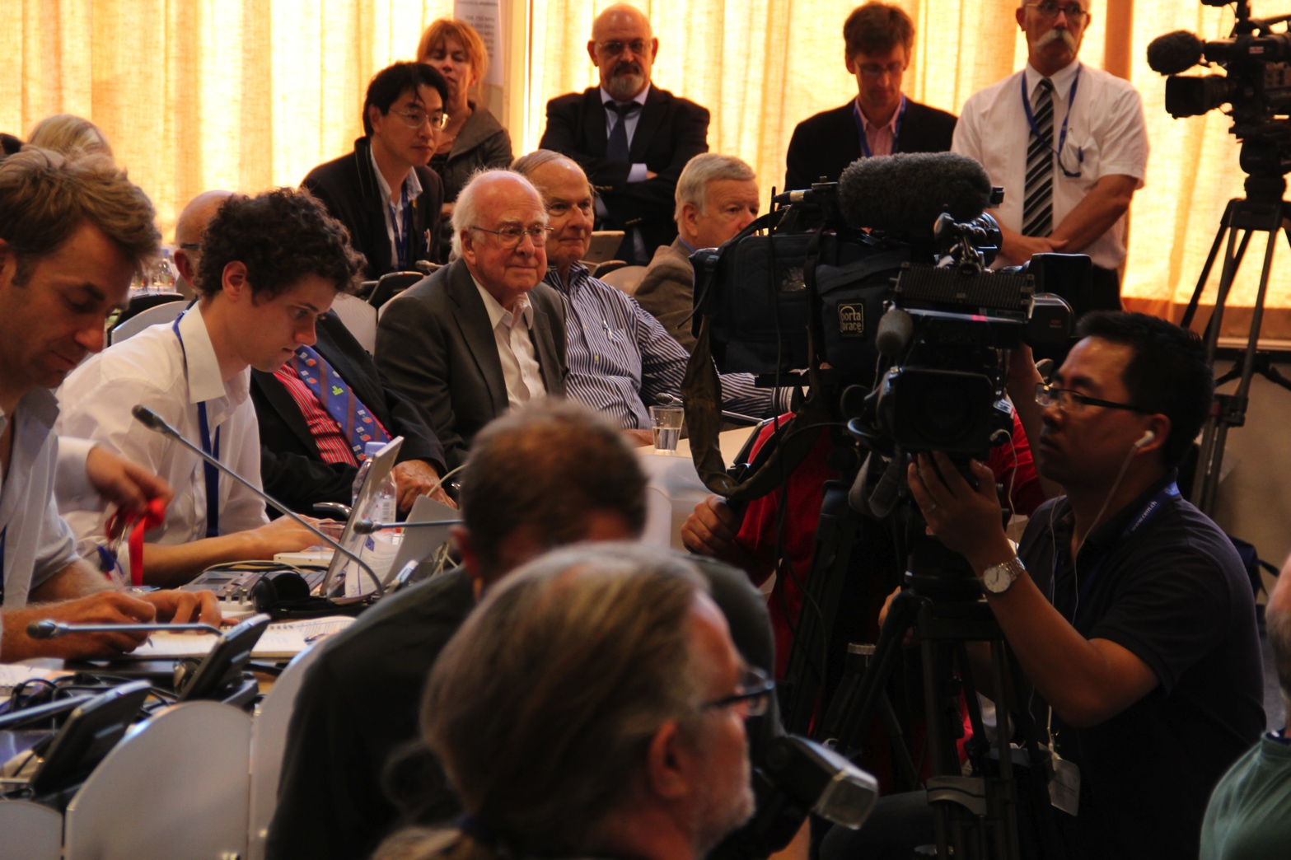
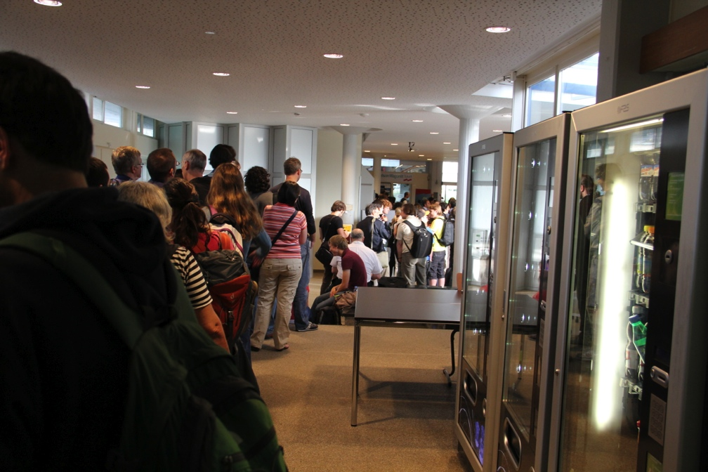
Searching for Higgs

Slide 10
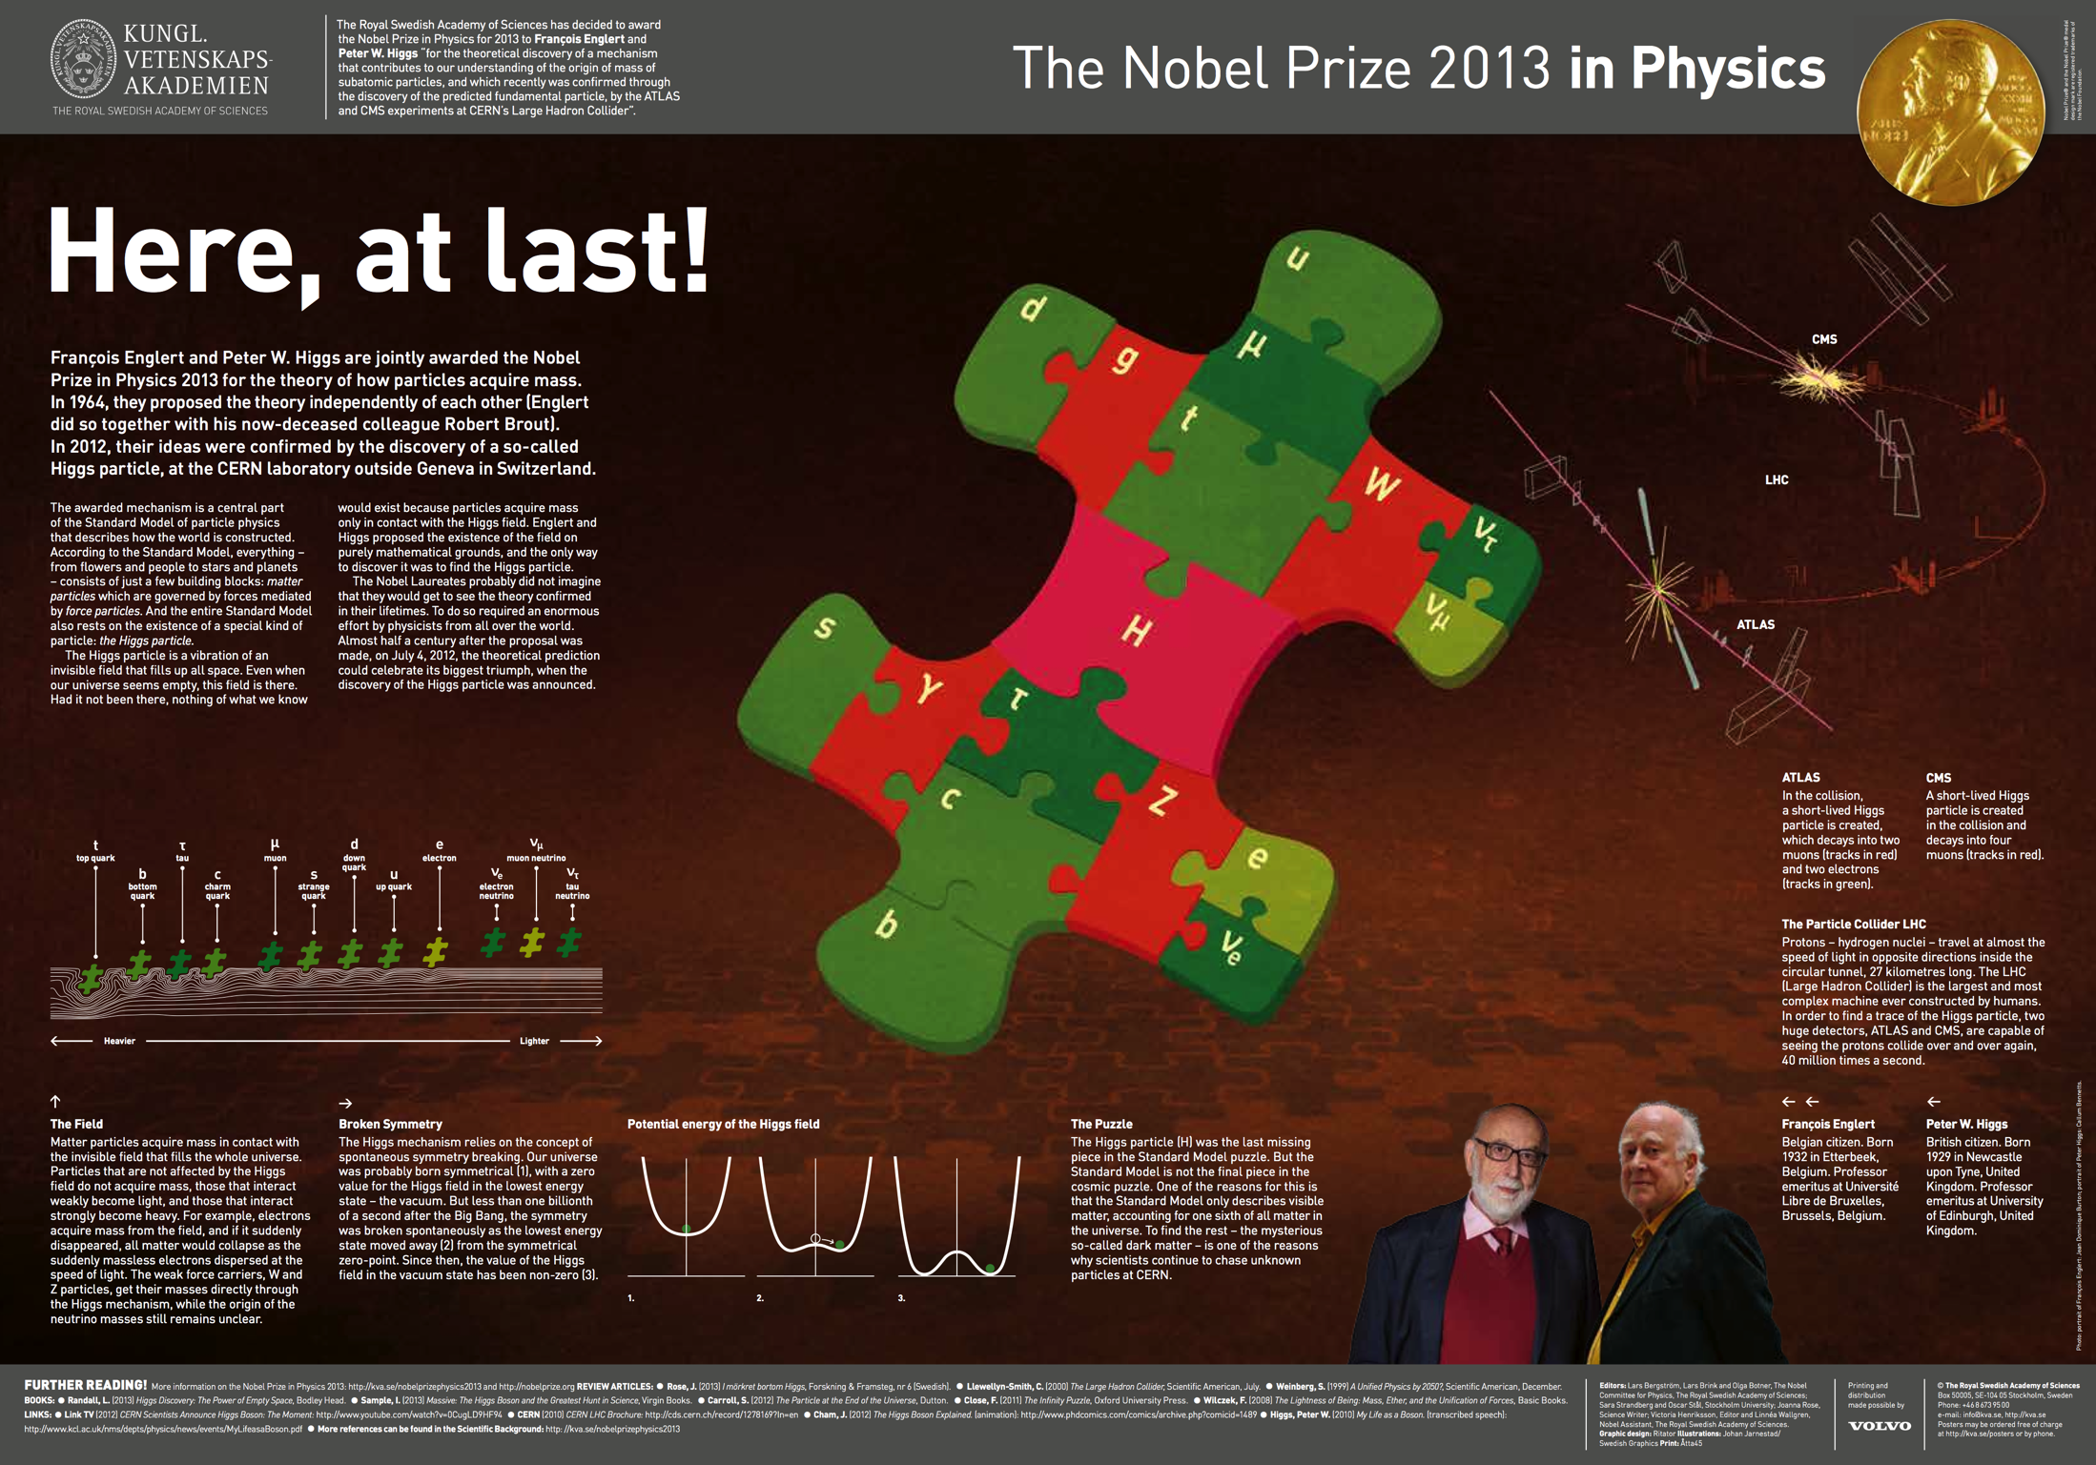

Slide 11

: illustrating the BEH Mechanism

Slide 12
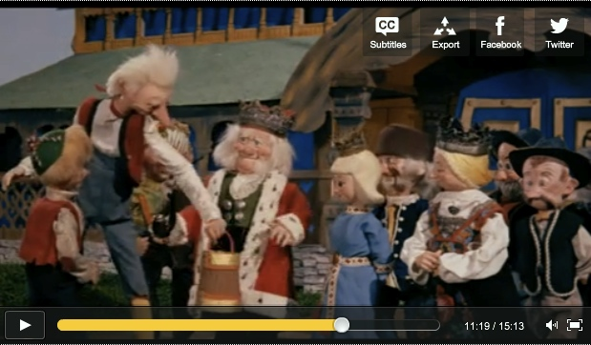
“Get me water, within 3 minutes, from the end of the world!”

Slide 13
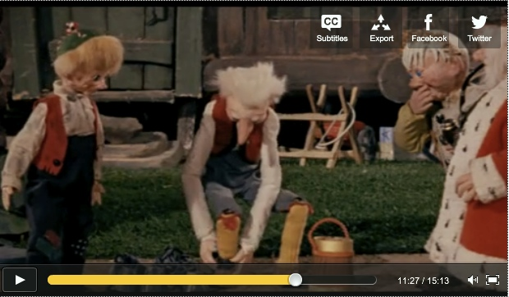
Hold on – what is happening? The man removes his weights!

Slide 14
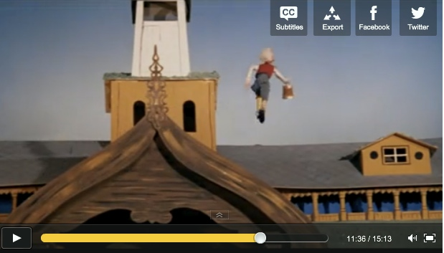
“Your Majesty, I will be straight back!”

Slide 15
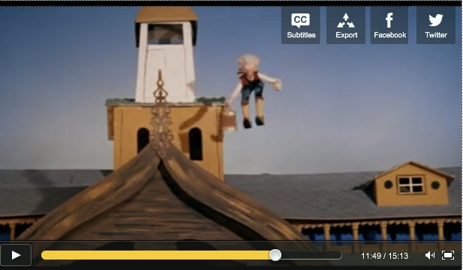
Some 15 seconds after departure our friend is back!
This man is certainly not made by matter influenced by the
Brout-Englert-Higgs (BEH) mechanism.

Slide 16
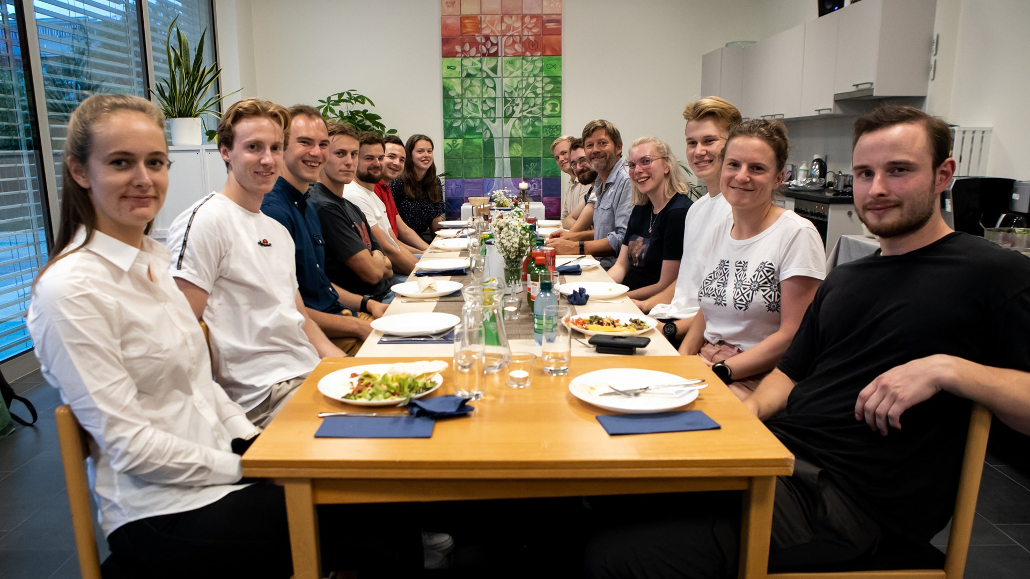
Norge and CERN
Medlem siden starten i 1954
Bidrag 2023
  Norge: 2,15 %
CERNs totale budsjett:
1,3 milliarder CHF
Norske studenter på tacotirsdag i Sjømannskirka

Slide 17
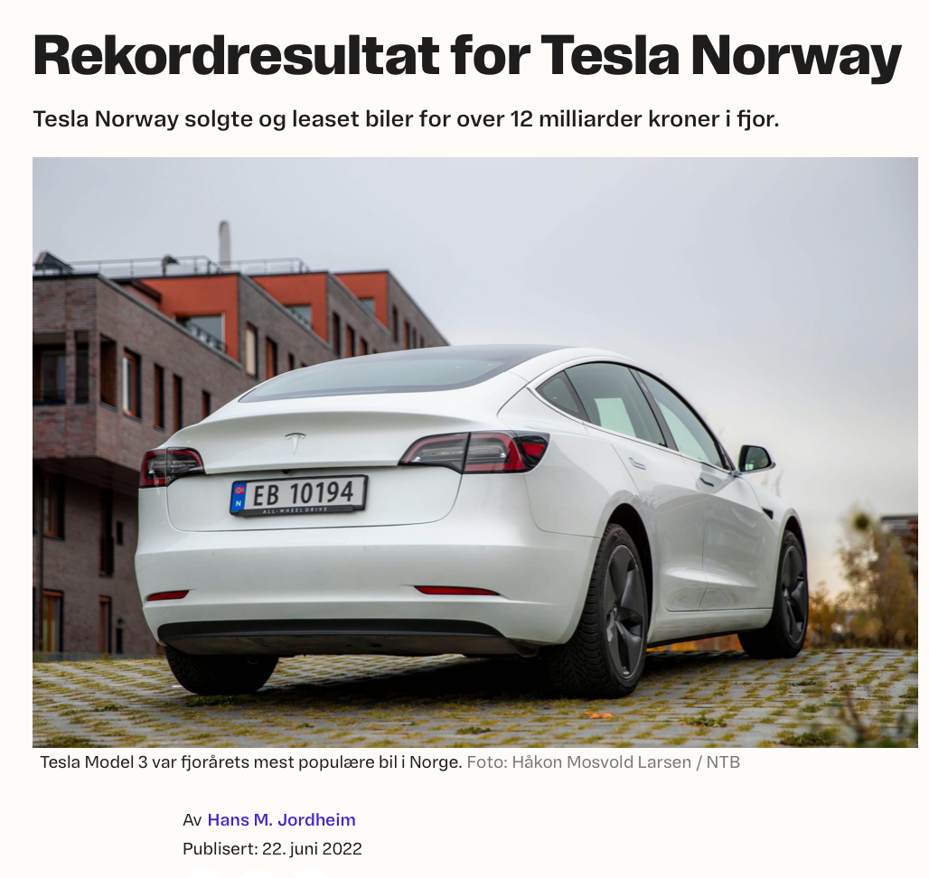

How large is actually the CERN-budget?

Slide 18
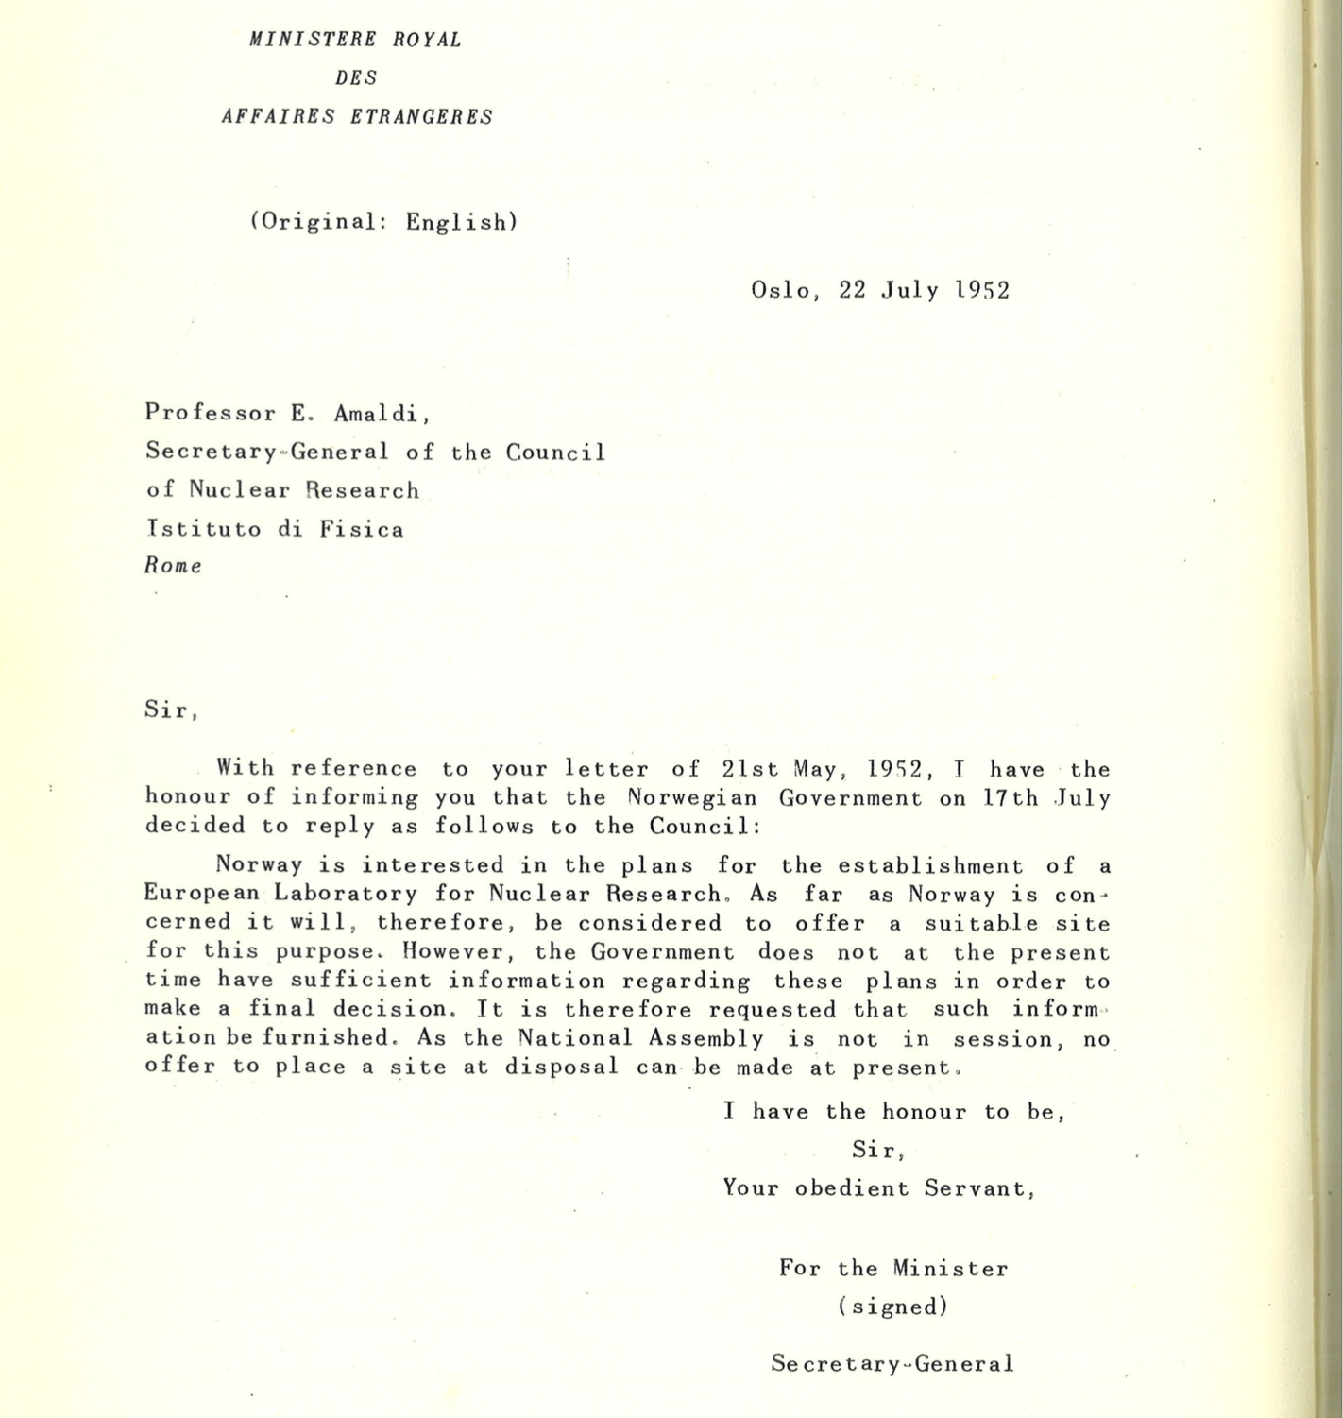

Slide 20
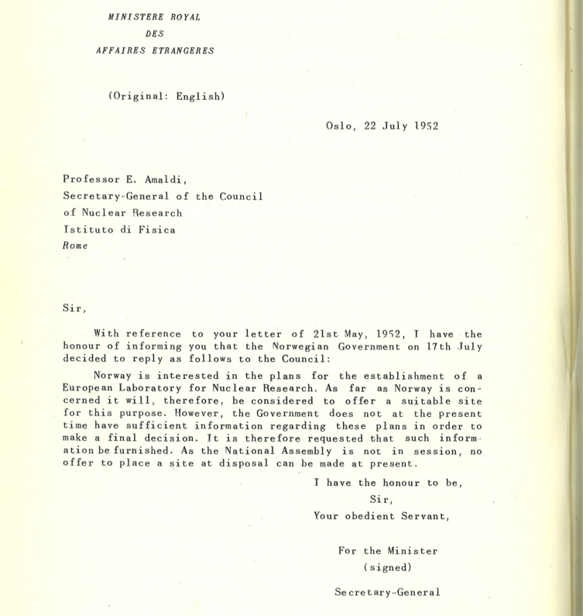

So if the Parliament had not been on holiday,
CERN could have ended up in Norway.
Better so for France and Switzerland ;-)

Slide 21
Energy consumption
The laboratory has had to innovate to keep up with electrical demands.
CERN uses 1.3 terawatt hours of electricity annually. That’s enough power to fuel 300,000 homes for a year in the United Kingdom. But the energy needed changes from month to month, as the seasons shift and the experimental requirements are adjusted.
At peak consumption, usually from May to mid-December, CERN uses about 200 megawatts of power, which is about a third of the amount of energy used to feed Geneva. The Large Hadron Collider (LHC) runs during this period of the year, using the power to accelerate protons to nearly the speed of light.
CERN's power consumption falls to about 80 megawatts during the winter months.
Til sammenligning:
I et normalår produserer Norge om lag 156 TWh elektrisk energi
— nok til “120 CERN” om man kunne bruke all strømmen på fysikk ;-)

Slide 22
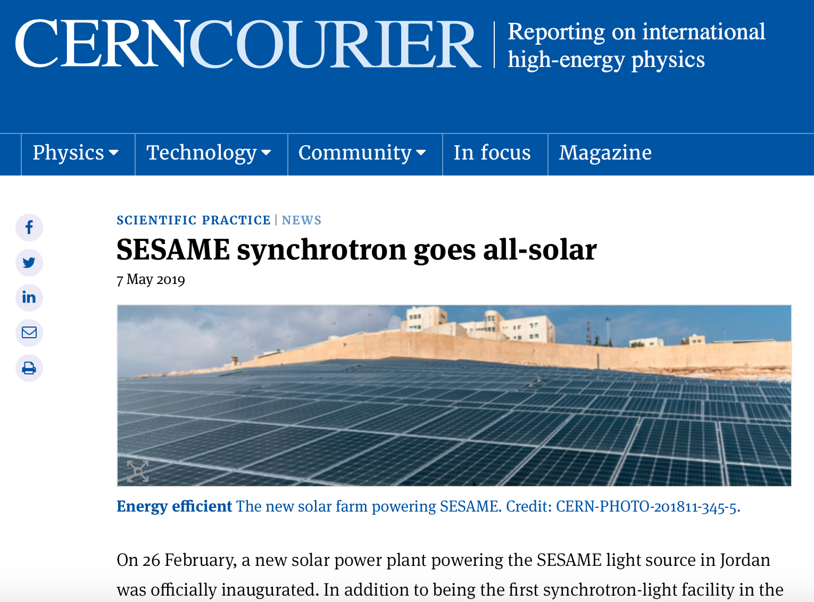
SESAME has eight full Members
Cyprus
Egypt
Iran
Israel
Jordan
Pakistan
Palestine
Türkiye
Associate Member
Iraq
17 Observers
Including CERN

Slide 23
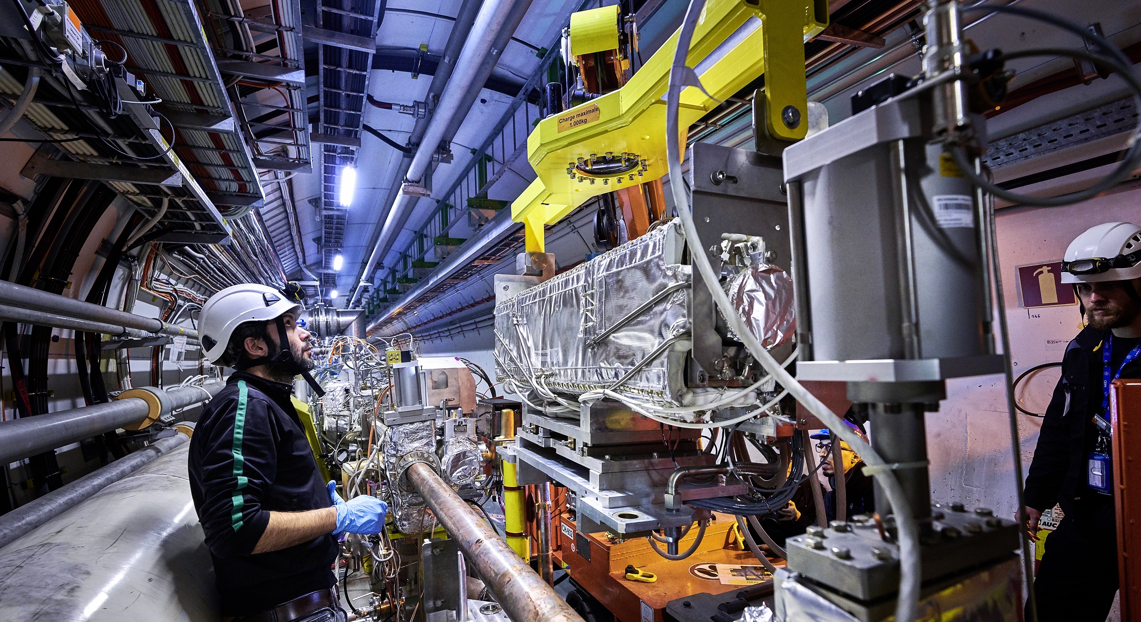
Upgrade to the
High-Luminosity LHC is under way
NEXT
The HL-LHC will use new technologies to provide
10 times more collisions
than the LHC.
It will give access to rare phenomena, greater precision and discovery potential.
It will start operating in 2027, and run until 2040.
Includes major detector upgrades
Notes:
Additional information (OPTIONAL, TIME PERMITTING)
Key innovations in HL-LHC:
1) Powerful superconducting quadrupole magnets (12 Tesla) will be installed on either side of the ATLAS and CMS experiments to focus the particle bunches. These magnets will be made using niobium-tin (Nb₃Sn), used for the first time in an accelerator (instead of niobium-titanium)
2) Crab cavities for tilting the beams (16 in total) - give the head and tail of the particle bunches opposite-sign transverse momentum before they meet, enlarging the overlap area of the two bunches and thus increasing the probability of collisions.
3) One hundred new, more effective collimators will be installed: these devices absorb particles that stray from the beam trajectory and might otherwise damage the machine.
4) More compact and powerful bending magnets (11 Tesla), also made using the niobium-tin superconductor.
5) Innovative superconducting power lines will connect the power converters to the accelerator; will be able to carry currents of record intensities, up to 100 000 amps!
Also large detector upgrades for (among others ATLAS and ALICE)

Slide 24

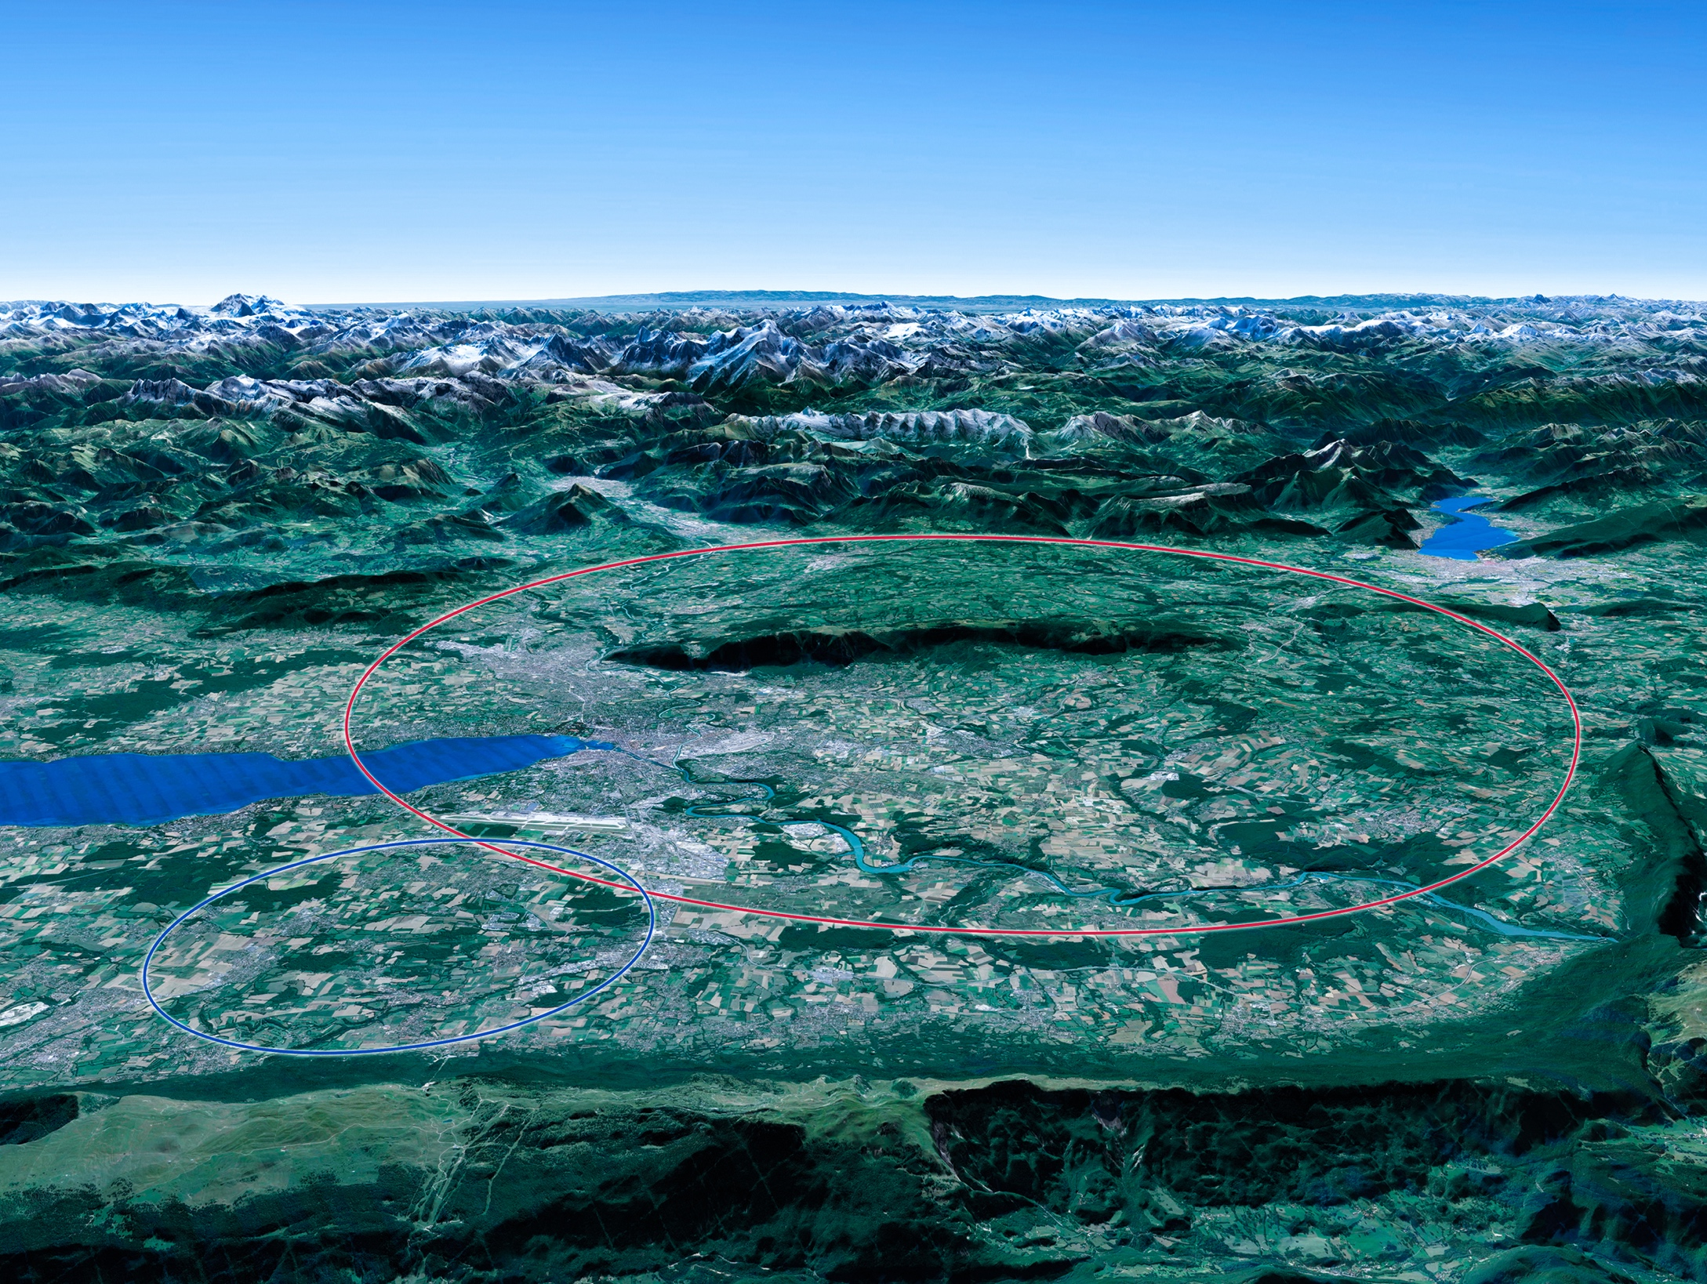

Scientific priorities for the future
Implementation of the recommendations
of the 2020 Update of the European Strategy
for Particle Physics:
• Fully exploit the HL-LHC
• Build a Higgs factory to further understand this unique particle
• Investigate the technical and financial feasibility of a future energy-frontier 100 km collider at CERN
• Ramp up relevant R&D (including muon collider and plasma acceleration)
• Continue supporting other projects around
the world
LHC
Notes:
For information, the ESPPU recommendations in more detail:
Full exploitation of the HL-LHC
An electron-positron Higgs factory is the highest priority after the LHC
Ramp up R&D efforts for advanced accelerator technologies
Support long-baseline neutrino projects in Japan and US
Investigation of feasibility of a future 100 TeV hadron collider at CERN
THIS IS THE LAST SLIDE IN THE “RESEARCH” SECTION

Slide 25
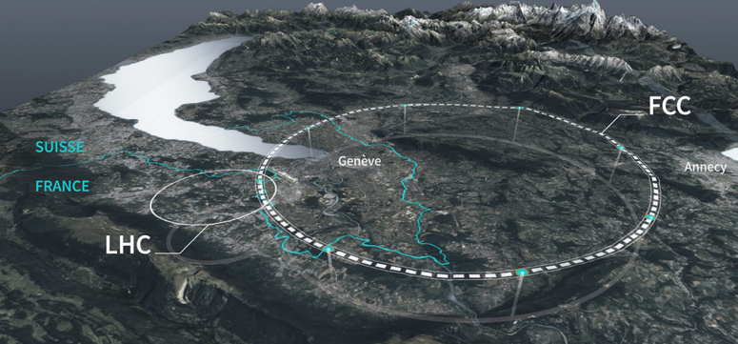

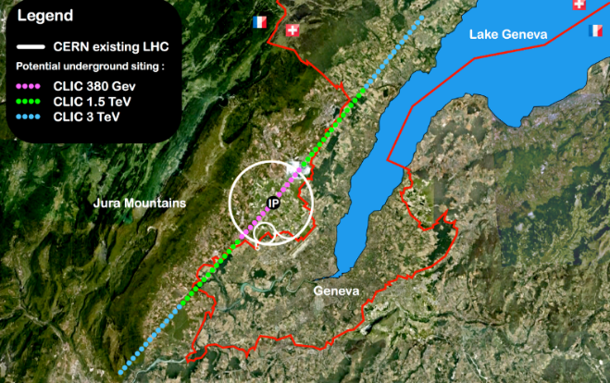
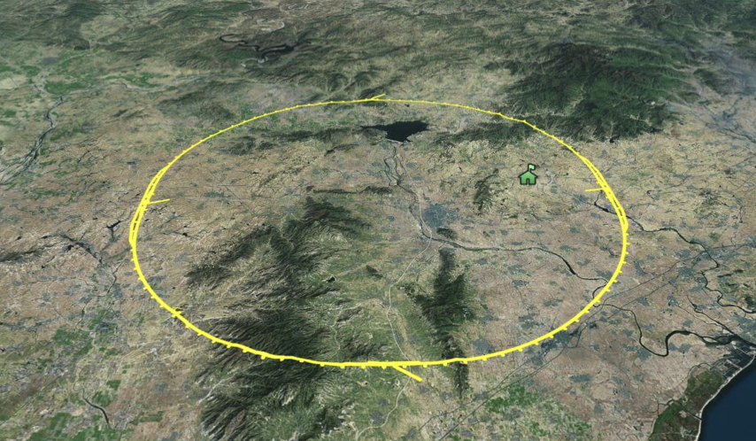
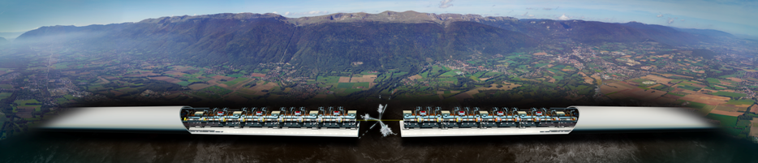
Next: A Higgs factory
Need e+e- collisions at least at 250 GeV,
four alternatives:
ILC in Japan (linear) FCC at CERN (ring)
CLIC at CERN (linear) CEPC in China (ring)
Linear colliders: 13 (Higgs) -> 50 (max)
km for higher energies later
Rings ~100km, can be used for protons
after. This require R&D on High Field
Magnets
An interesting alternative to a proton-
proton collider is a muon collider, also
being studied
Notes:
FCC feasibilty study already mentined, mention CLIC, and also R&D for hadrons in FCC later (magnets), a muon collider and plasma acceleration
Associared detectors
Applications of technolgooies for small medical and industrial accelerators

Slide 26









Slide 27


Film

