Slide 1
BNL – Google Technical Discussion
Alexei Klimentov
March 11, 2024

Slide 2
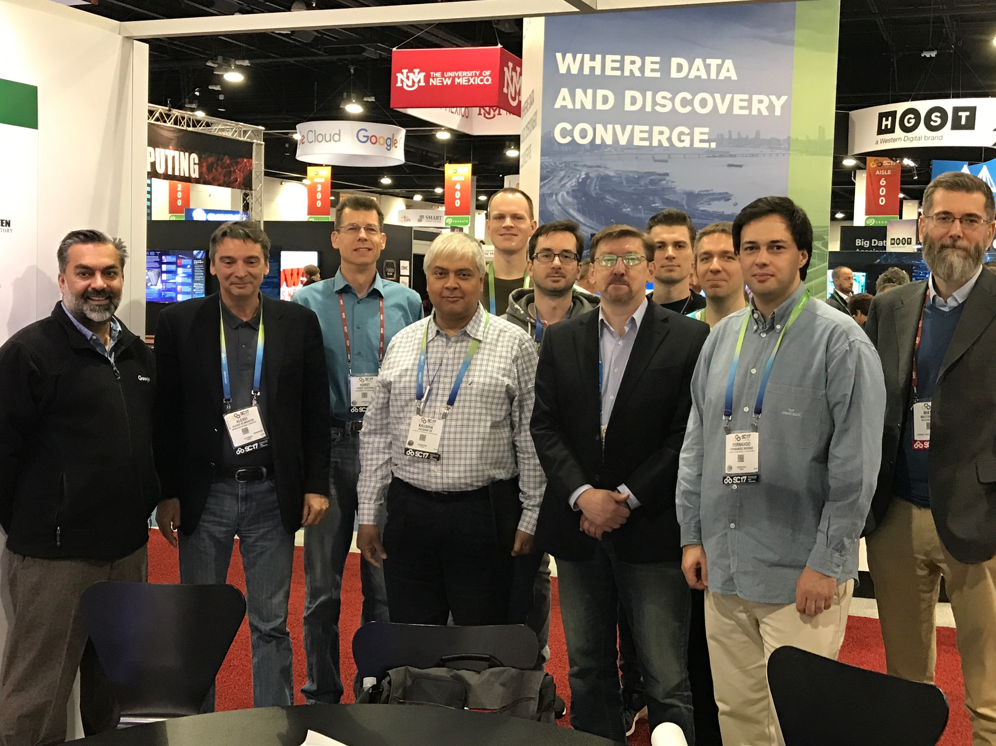
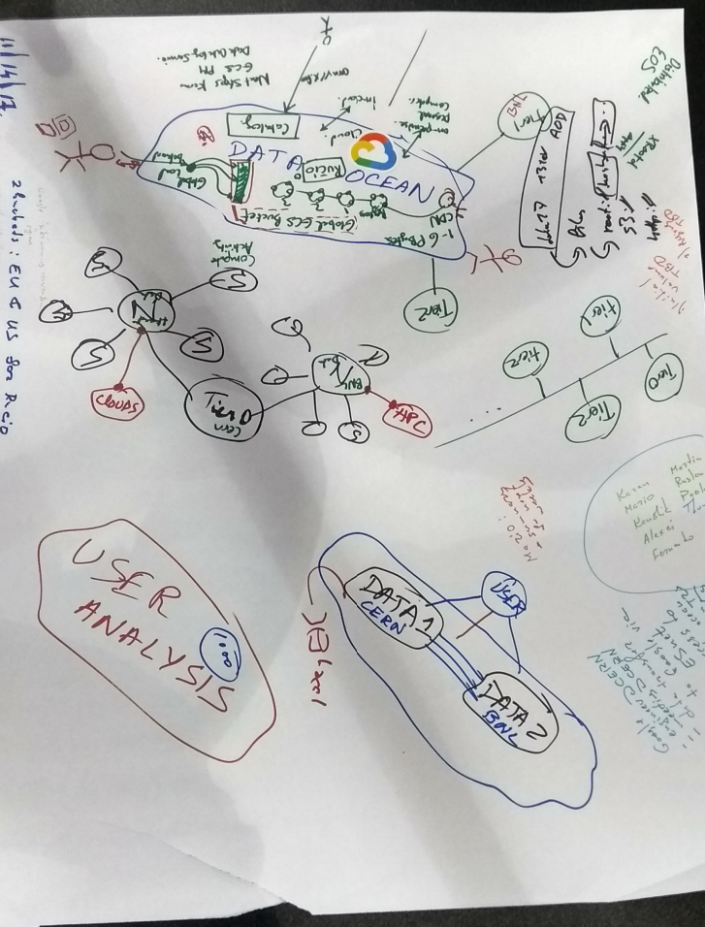
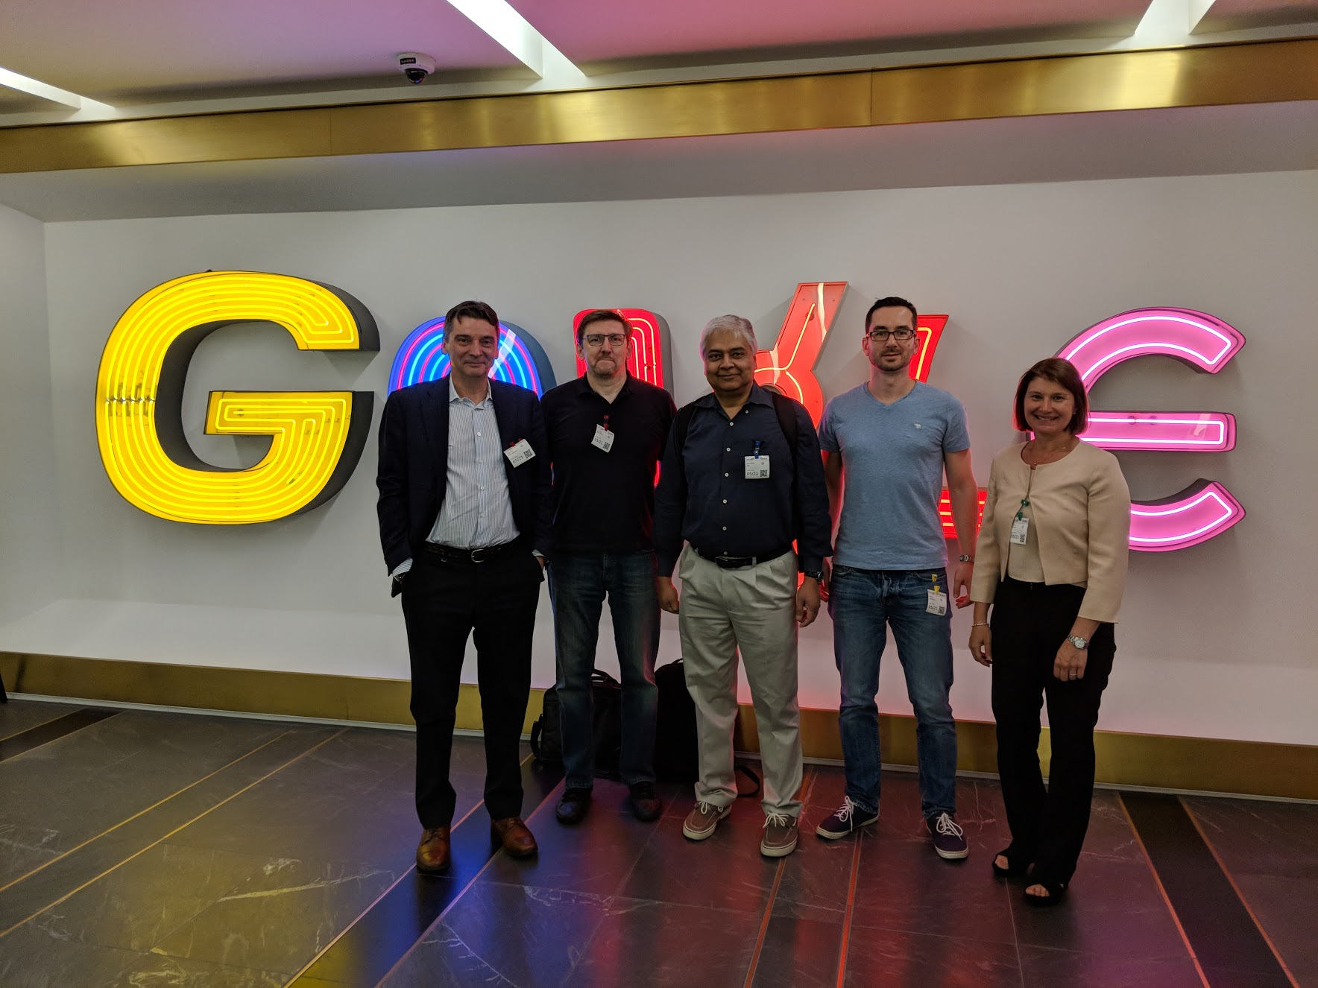
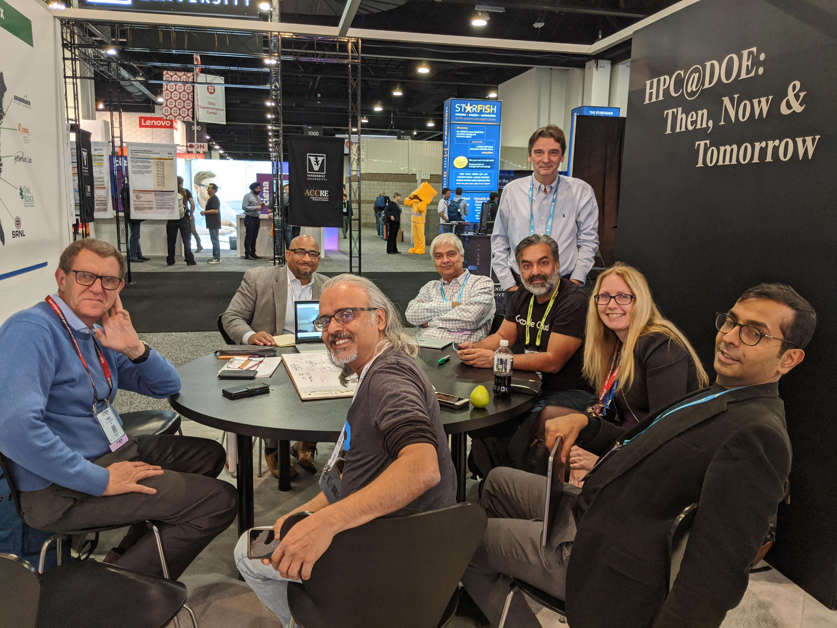
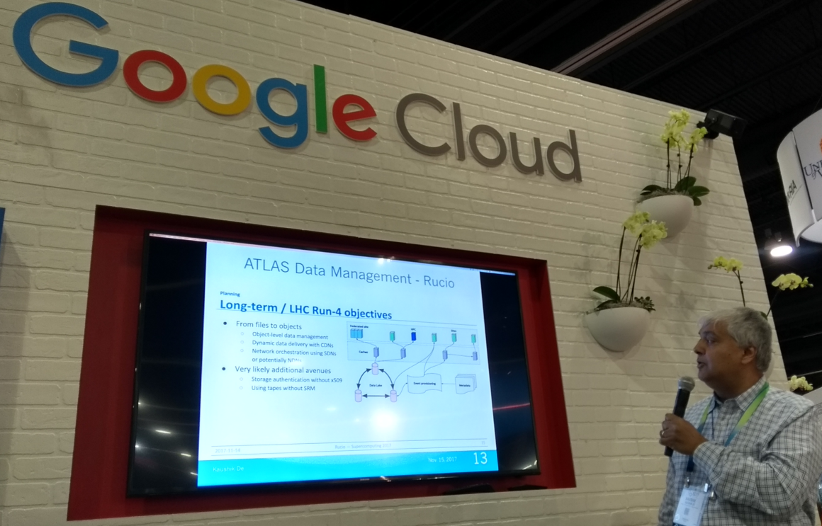
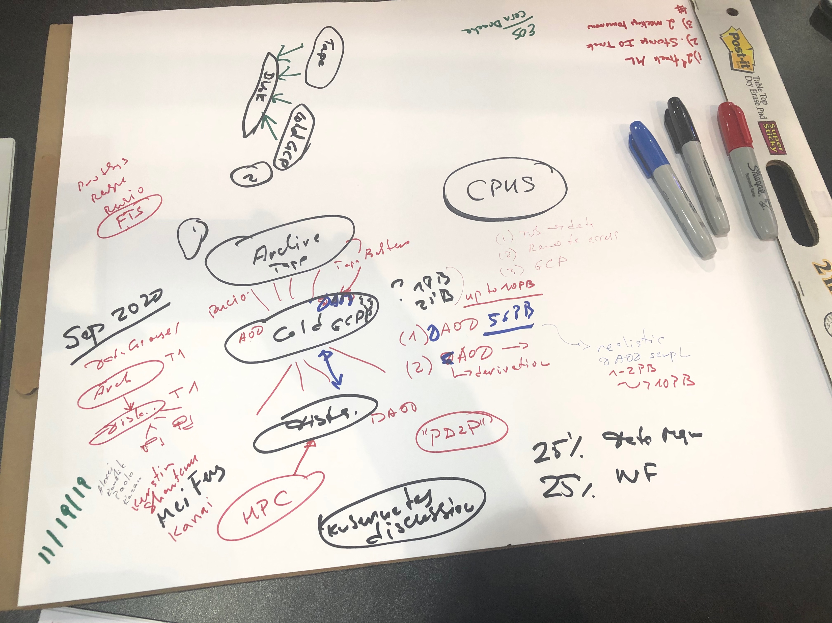
ATLAS-Google Project
In 2018 WLCG, IRIS-HEP, HEP-CCE and experiments
have launched R&D projects to address HL-LHC challenges
White paper was submitted to DOE HEP in Oct 2018
Followed by DOE-HEP head (J.Siegrist) meeting with US ATLAS and Google in June 2019
US-ATLAS Collaboration with Google for High Energy
Physics Applications in the HL-LHC Era (whitepaper)

Slide 3
Many successful stories since 2019
Vera C. Rubin (LSST) experience of using Google cloud for ~4 years
ATLAS – Google Projects (2019-2023)
  Total Cost of Ownership evaluation
  Google cloud resources as extension to on-prem resources
  Evaluation of new technologies
    Foster partnerships with US industries in research and development – and not just as late stage product adopters
      ATLAS R&D projects with AWS, Lancium, SEAL
CERN IT paradigm shift
  Google, Amazon, Azzure

Slide 4
Today’s Meeting
Technical session
  Learn and discuss ATLAS experience and current development
Executive session
Ongoing discussion about computing evolution at BNL, computing strategy and data science

