Slide 1
Annual meeting of the
CERN Astronomy Club.
Jan Buytaert.
26 february 2024

Slide 2
Agenda
Overview of club activities 2023. (Jan)
Presentation of the club account (Matthias)
Election of the members of the committee.
Outlook for 2024 & proposals, discussion.

Slide 3
Overview of club activities 2023.
Observations at club barrack (Prevessin site) :
  We had several sessions, usually on Fridays. Announced by email.
  Good attendance (3 to 5) from new interested persons and always with enthusiastic response.
  Mostly around half/full moon (to leave the few precious clear nights around new moon for members to do their astrophotography.
  Aim :
    introduction of interested people to astronomy, and possibly ‘recruit’ new members.
    Explain how to setup and operate telescopes, in particular dobsons and equatorial mounts.
    Show astrophotography techniques (guiding, polar alignment).

Slide 4
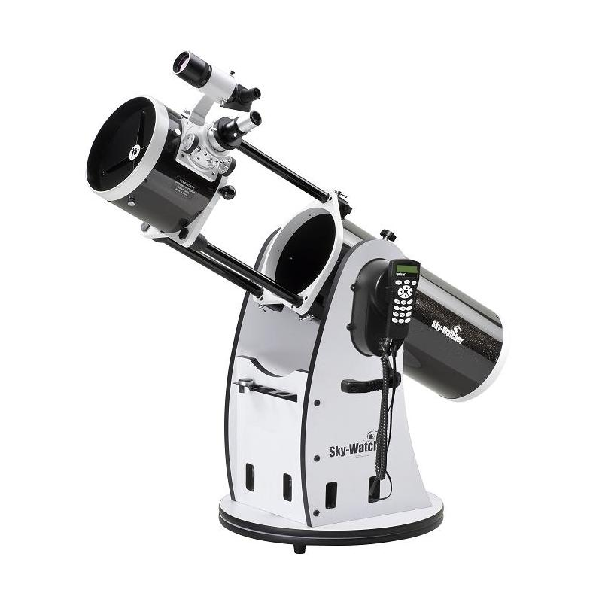
New 8’’ Dobson.
Skywatcher flex-tube 200.
Motorised:
  go-to and tracking capability.
Lighter weight and « telescopic ».
  Can easily be handled by 1 person.
Built-in wifi and remote control through synscan and skysafari.
  Bought a small tablet Samsung A7lite. Fully configured and « ready to go ».
  Wrote some pages with instructions as setup guide.
We will organise training sessions for new members to use it independently.

Slide 5
La nuit est belle 4th edition .
https://home.cern/fr/news/news/cern/cern-supports-la-nuit-est-belle-initiative-third-year-running
Was advertised by CERN as a public event. Inscriptions were quickly full !
On parking near the globe (external to CERN) and combined with globe exhibition.
We were prepared with several telescopes and volunteer members.
Unfortunately, it was cancelled a few days before due to rain …
We will organize again in 2024, if enough volunteers.

Slide 6
Other activities 2023.
Website
  Drupal upgrade done by Martine Buytaert.
  Next year, Drupal will be replaced by Wordpress …
Renewal of the electric installation in barrack done by Matthias.
Water infiltration in barrack through roof.
  Fixed: due to accumulation of leaves blocking drainage.
Key lock for access to barrack.
Talk and expo by Xavier Peillon on astrophotography, organised by Staff association (April 5).
  Very large attendance in council room.
  We added a display of telescope setups during the cocktail party afterwards.
  See : https://indico.cern.ch/event/1258032/ and recording in https://cds.cern.ch/record/2855818

Slide 7
Survey of members interest.
Received 6 responses on following ‘closed’ questions:
Have you already done some astronomical observations (visual or photographic) in the past ? Yes 6 / No 0
Do you own a telescope ? If so what type ? Yes 5/ No 1
What are the reasons or your expectations by becoming a member of the astronomy club ?
  Do you want to learn how to setup a telescope ? Yes 2 / No 4
  Obtain advice on what telescope to purchase ? Yes 1 /No 5
  Join others amateurs to do go out for a night of observation ? Yes 5 /No 1
  Observe occasional particular events like moon eclipse or new comet appearance ? Yes 6 / No 1
  Other ?
Are you mostly interested in visual or photographic observation ? Visual 6 /photo 5
What objects are you most interested in : sun, moon, planets, milky way or deep-sky object (nebula and galaxies) ?
Various, no particular preferences.
Summary : The members that did reply :
have telescopes,
are interested to go out for a night observation with others
equally visual and photographic interest.
no particular preference : planetary, DSO, solar
These questions were mostly aimed at new “interested” people, but unfortunately none have replied …

Slide 8
Survey of member’s interest.
More ‘open’ questions gave interesting replies, again mostly from “active” members
What activity would you like that the club organises ?
- More trips to nearby dark sites, talks on different astronomy topics, "get togethers" in CERN Prevessin (which is also a not bad observational site with moderate light pollution, could see planetary nebulas with a 80mm ED refractor).
- I think organizing trips to dark places for visual obs sounds the most appealing to me. Prevessin observations can be nice too if the weather is good but I might be a bit unmotivated if it's cloudy. Sun observations are also something I would like to do. And these should be easier to organize.
- conferences with specialists in extraterrestrial life, unidentified aerial phenomena PAN, black holes, etc.
- Just more observations so I can finally join one.
- Observations (sun, DSO’s, …), get togethers, discussing interesting observation targets and objects.

Slide 9
Survey of member’s interest.
How many evenings or nights per year are willing or can you dedicate to astronomy ? less then 5, up to 10 or even more ? Answers:
- up to 10
- Whenever opportunity presents (work schedule, overall mood, weather) would appreciate opportunities to go to darker sites 3-4 times per year.
- I think on average 1-2 nights per month for astro club activities is reasonable.
- Whenever opportunity presents (work schedule, overall mood, weather) I am always on my balcony (perhaps minimum 3 nights every month), but would appreciate opportunities to go to darker sites 3-4 times per year (subject to private/professional schedules).
- About one evening a month would be great, so 12 per year.
- Tough question. I have to admit that very often on Friday evening I was too tired to participate in anything. But I see that observing during the week is also difficult, as we have to work the day after. And the weekend is reserved for family activities, or people are even far away…
Any other suggestions ? Answers:
- Organize a cocktail one evening in June or July to get to know better each other. Each person would bring snacks and drinks.
- Organize a cocktail during the year with another astronomy clubs The meeting could take place in the premises of one of the clubs and everyone brings drinks and snacks.
- Introductions how to use the club equipment for day (sun) and night observing.
- A report from Matthias about his roof-top observatory ;)
- A report from Matthias about his experience with Astroberry ;)
Thanks to all the members that have replied !

Slide 10
Take away from survey:
Prevessin observation once/month.
Occasional trips to nearby dark sites (Jura) for visual.
Sun observations.
Talks : by members on subjects.
  Astroberry, personal observatory, 3D printed mount, NINA, SIRIL, Pix insight.
Lessons on equipment:
  New dobson, others.
Once a get together in Prevessin.
  Weekend afternoon: Sun observation, snack, personal telescopes.

Slide 11
Club accounts.
Matthias presentation.

Slide 12
Election of members of commitee.
President : Jan Buytaert
Treasurer : candidates ? (+Matthias Haase).
  Many thanks to Matthias for his commitment to our club as a treasurer (x years), driving force in the club, inspiring some (like me) to pick up Astrophoto !
Secretary :
VOTE

Slide 13
Outlook for 2024.
Plan monthly observation at club barrack during half/full moon.
Occasional outing to a darker site in the Jura.
Event « la nuit est belle 2024».(date not yet announced).
Planetary astrophotography on prevessin site. Jupiter is very favourable now.
Solar observations. During weekend.
Zoom presentations/discussions.
  Astroberry, personal observatory, 3D printed mount, NINA, SIRIL, Pix insight.
I was invited to give a presentation on astrophotography in the photography club next Wednesday 28th at 18h30.
Create whatsapp group; not yet done ☹
  Easy & fast communication.
  I will invite people by email to provide coordinates.

Slide 14
Proposals/suggestions for discussion

Slide 16
Useful information.
Our barrack on prevessin site: 6326
Our website : https://astro.web.cern.ch/
Our flickr account : https://www.flickr.com/groups/cern-astro-club/

