Slide 1
Multi-Objective Reinforcement Learning
Kishansingh Rajput
Jefferson Lab, Newport News, VA, USA

Slide 2


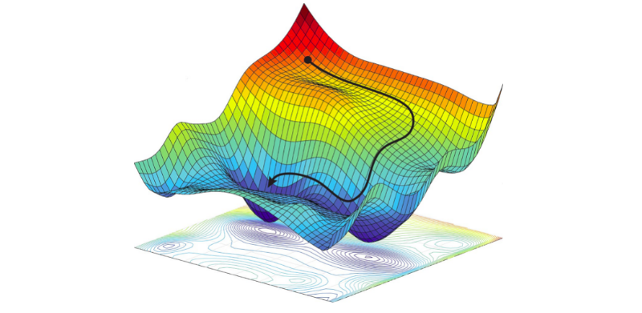


Outline
01
02
03
04
05
Introduction
to multi-objective Optimization
Introduction to RL
MORL
MORL with conditional policy
Summary and coding example

Slide 3
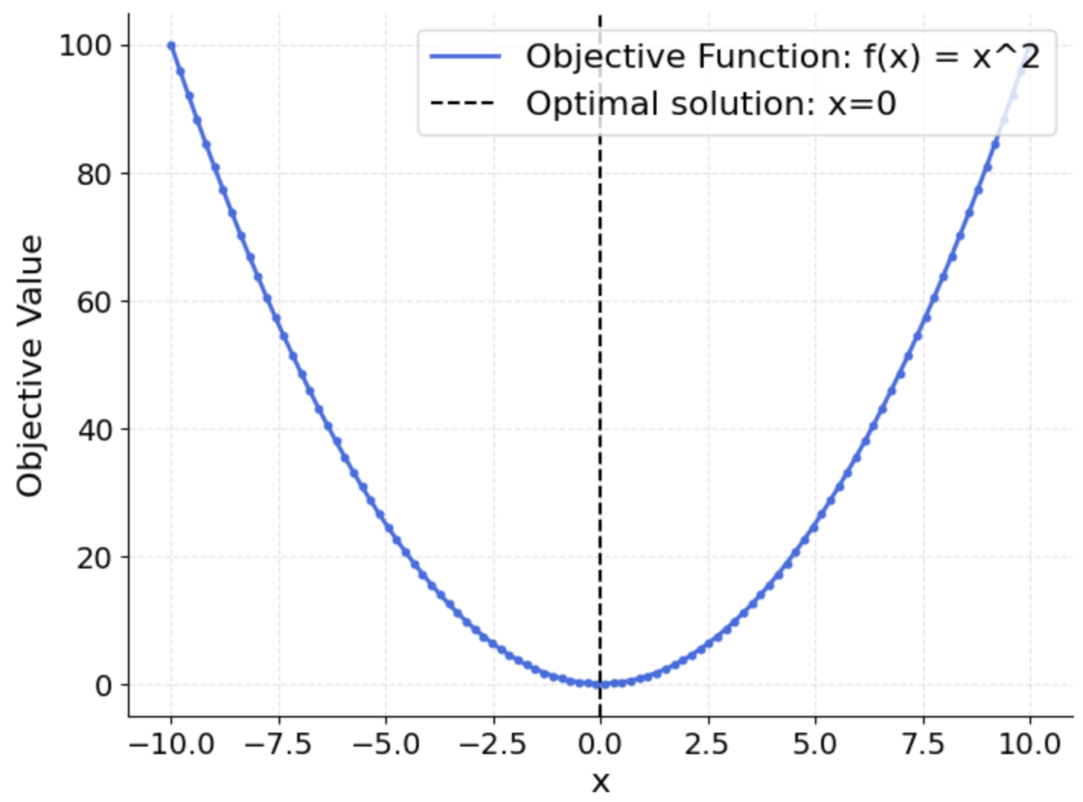

Introduction
What is Optimization?
Finding the best solution to a problem, given certain constraints
Can be maximization or Minimization problem
For example: minimize RF heat load
Key Components of Optimization
Objective Function: The function to maximize or minimize
  Example: heat loss function
Decision Variables: The variables you can control or adjust
  Example: RF cavity gradient set-points
Constraints: The restrictions or limits that the solution must satisfy
  Example: Operational limits on individual cavity gradients, total beam energy requirement
Objective function: minimize $x^{2}$
Decision Variables: $x$
Constraints: $−10≤x≤10$

Slide 4
Multi-objective Optimization
Multi-Objective Optimization (MOO)
Optimizing two or more conflicting objectives simultaneously
MOO seeks to balance trade-offs between multiple objectives
Key Concepts
Multiple Objective Functions: Two or more objective functions
  Example: heat loss function, and trip rates
Decision Variables: The variables you can control or adjust
  All or subset of decision variables may affect two or more objectives
  Example: RF cavity gradient set-points
Constraints: The restrictions or limits that the solution must satisfy
  This may also include minimum/maximum thresholds on one or more objectives
  Example: Operational limits on individual cavity gradients, total beam energy requirement

Slide 5
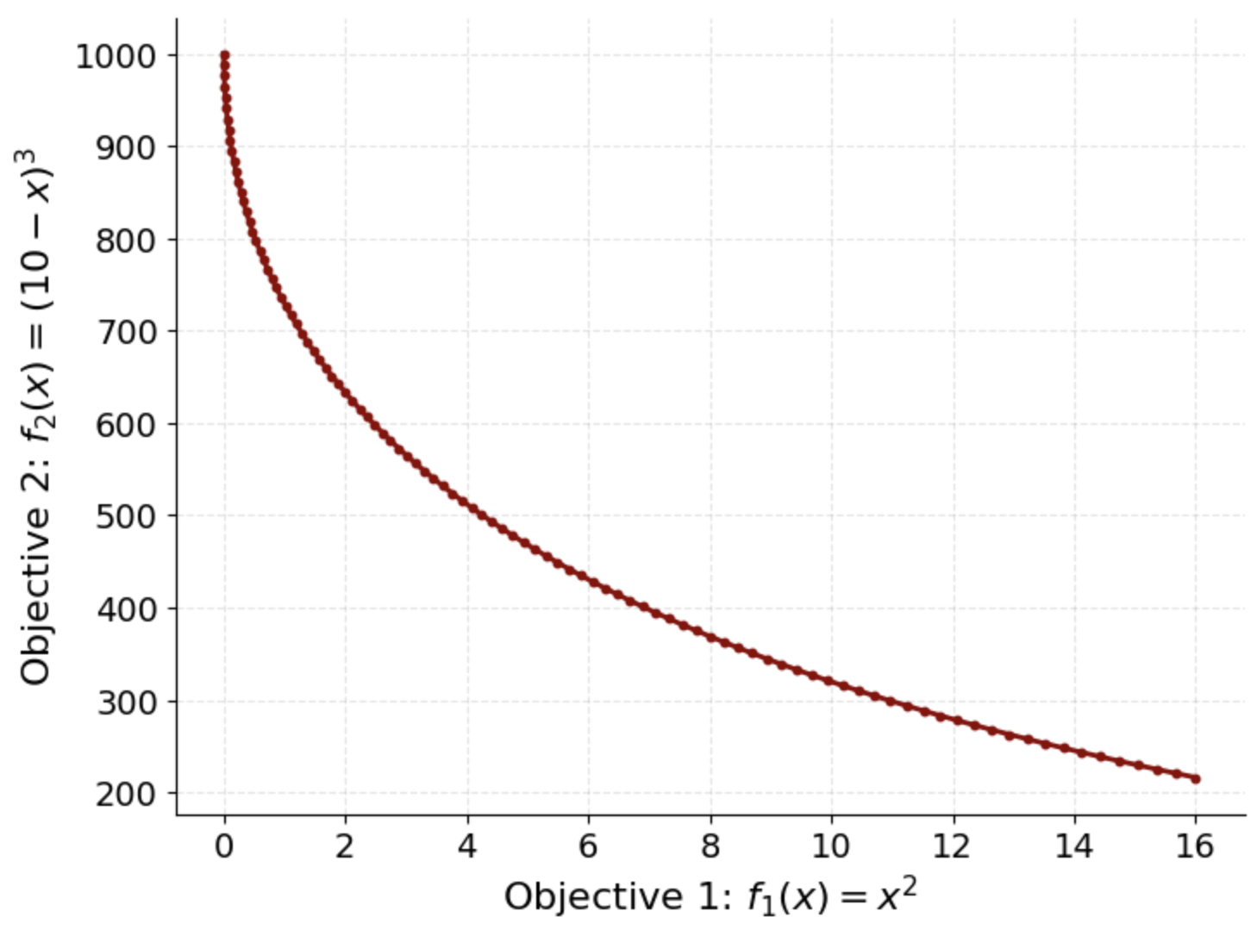
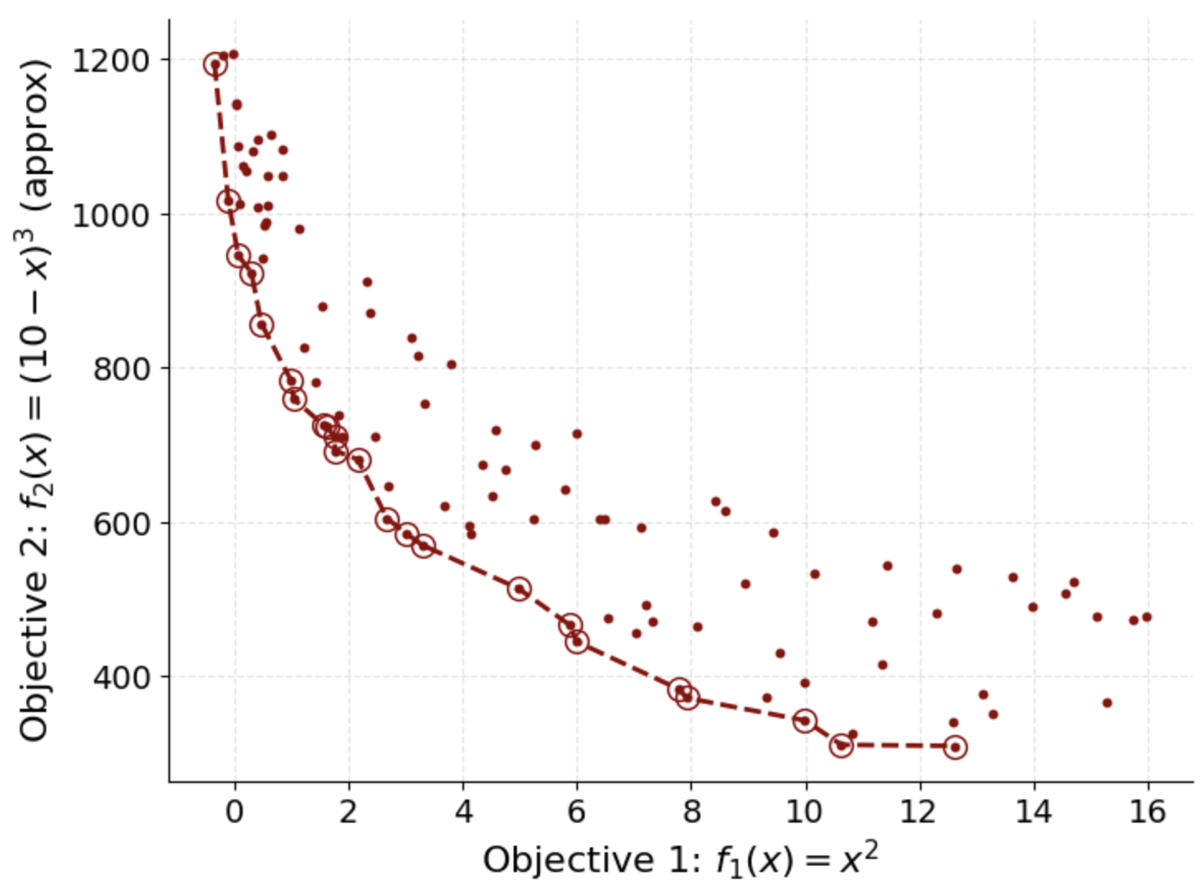

Multi-objective Optimization
Objective functions: minimize $x^{2}$ and $(10−{x)}^{3}$
Decision Variables: $x$
Constraints: $−4≤x≤0$

Slide 6
Pareto optimality
The Pareto front represents the set of Pareto optimal solutions in a multi-objective optimization problem
There is no other solution that improves one objective without sacrificing another
Cannot be "dominated" by any other solution (no other solution is better in all objectives)
Pareto-front represent trade-offs between multiple objectives
Provides multiple optimal solutions, allowing selection based on preferences/requirements
Tricky to visualize higher dimensional Pareto fronts
Hypervolume can be used to quantify the quality of Pareto fronts

Slide 7




















Hypervolume
Hypervolume measures the volume of the objective space that is dominated by a set of Pareto optimal solutions
  with respect to a reference point (usually a worst-case point)
Quality Metric: Hypervolume provides a clear measure of how well the solutions approximate the Pareto front and how large the dominated region is.
Diversity & Convergence: It captures both the convergence (how close solutions are to the ideal) and diversity (how well solutions cover the objective space).
Reference point
2D → Area under/over the curve
Higher Dim → Volume

Slide 8
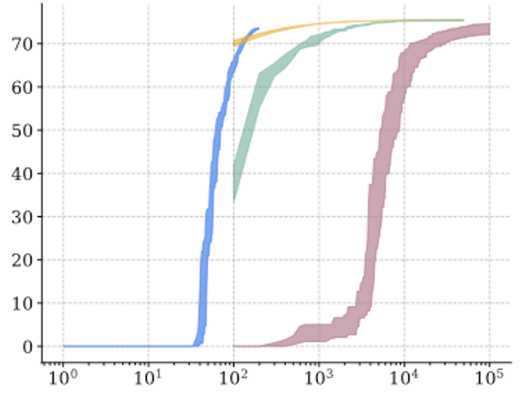
Hypervolume as a metric
Method #1
Method #2
Method #3
Method #4
Hypervolume
Evolution (steps/time)

Slide 9
Outline
01
02
03
04
05
Introduction
to multi-objective Optimization
Introduction to RL
MORL
MORL with conditional policy
Summary and coding example

Slide 10
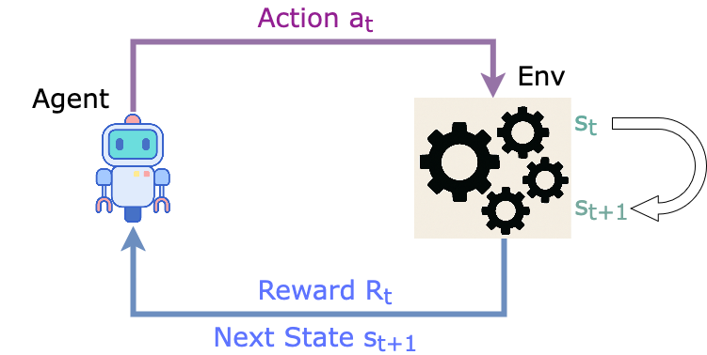
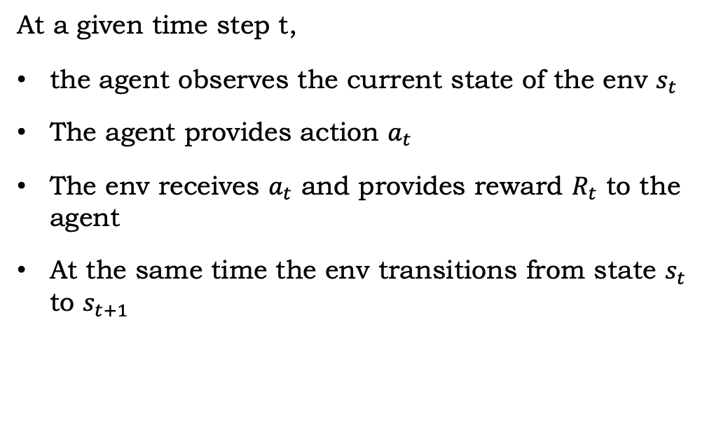
Reinforcement Learning
Reinforcement Learning (RL) is a sequential controls algorithm by design
Two parts – Agent, and environment
At a given time step t,
the agent observes the current state of the env $s_{t}$
The agent provides action $a_{t}$
The env receives $a_{t}$ and provides reward $R_{t}$ to the agent
At the same time the env transitions from state $s_{t}$ to $s_{t+1}$

Slide 11
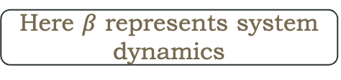
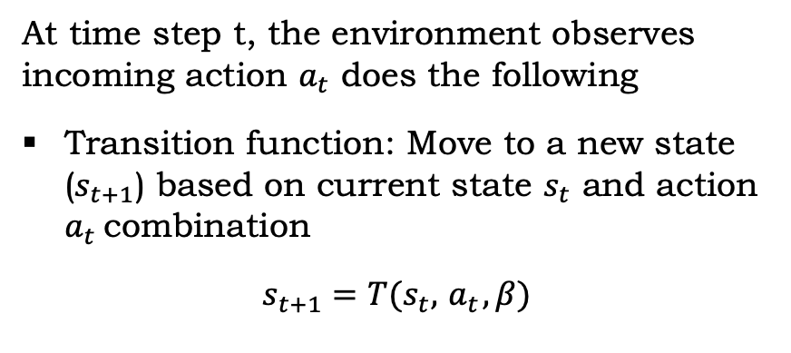
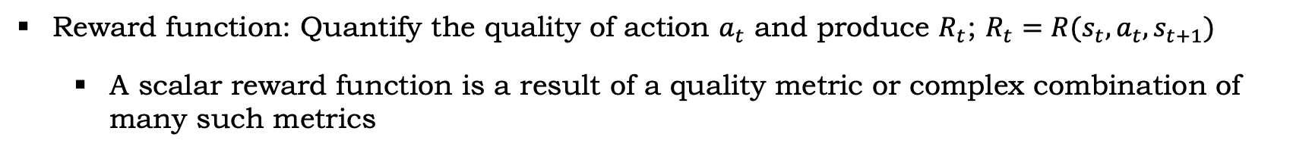
Reinforcement Learning
At time step t, the environment observes incoming action $a_{t}$ does the following
Transition function: Move to a new state ($s_{t+1}$) based on current state $s_{t}$ and action $a_{t}$combination
$$s_{t+1}=T(s_{t},{ a}_{t}, β)$$
Here $β$ represents system dynamics
Reward function: Quantify the quality of action $a_{t}$ and produce $R_{t}$; $R_{t}=R(s_{t},a_{t},s_{t+1})$
  A scalar reward function is a result of a quality metric or complex combination of many such metrics

Slide 12
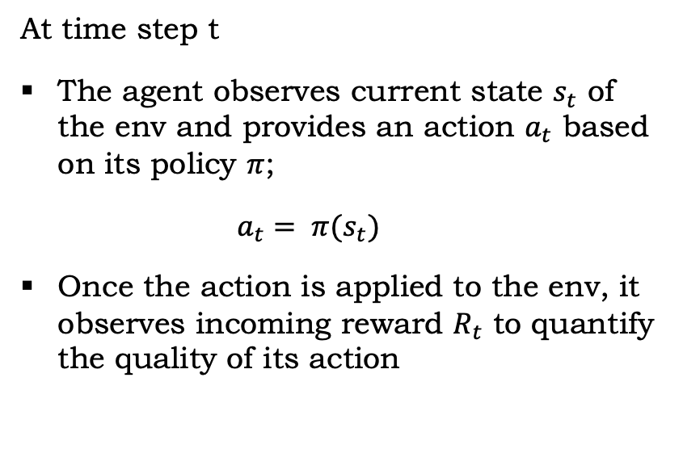
Reinforcement Learning
At time step t
The agent observes current state $s_{t}$ of the env and provides an action $a_{t}$ based on its policy $π$;
  $$a_{t}= π(s_{t})$$
Once the action is applied to the env, it observes incoming reward $R_{t}$ to quantify the quality of its action
Deep RL algorithms typically stores combinations of state, action, reward, next state and any additional relevant information to train its policy

Slide 13
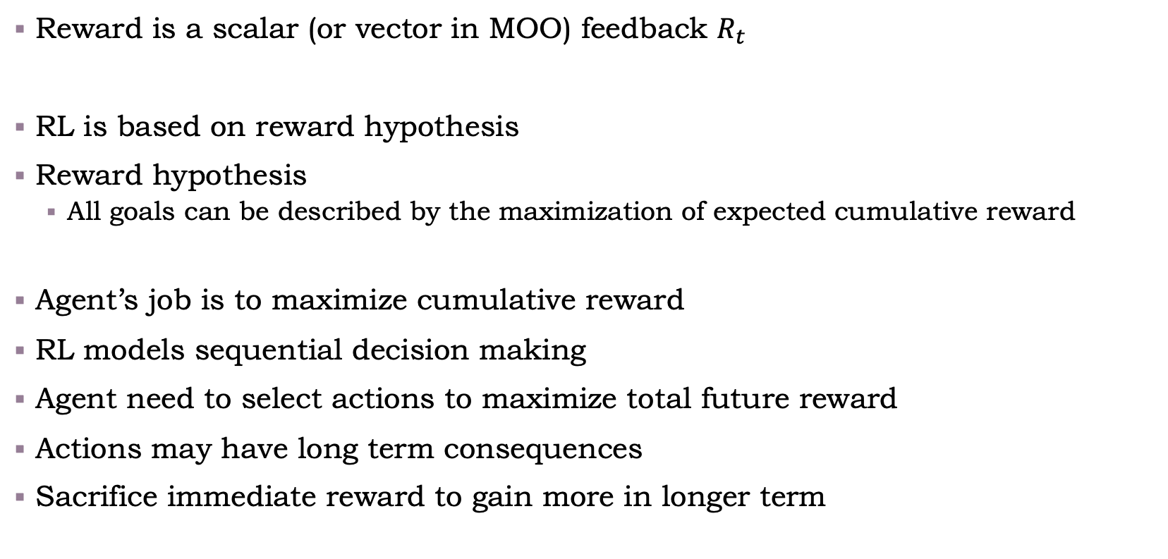
Reward
Reward is a scalar (or vector in MOO) feedback $R_{t}$
RL is based on reward hypothesis
Reward hypothesis
  All goals can be described by the maximization of expected cumulative reward
Agent’s job is to maximize cumulative reward
RL models sequential decision making
Agent need to select actions to maximize total future reward
Actions may have long term consequences
Sacrifice immediate reward to gain more in longer term

Slide 14

Bellman equation
$Q^{∗}\left(s_{t},a_{t}\right)$ = $R\left(s_{t},a_{t}\right)$ + $γ$ . $R\left(s_{t+1},a_{t+1}\right)+ γ^{2}$ . $R\left(s_{t+2},a_{t+2}\right)+ …$
$R\left(s_{t},a_{t}\right)$is an immediate reward for action $a_{t}$ at state $s_{t}$
This indicate how good the action $a_{t}$ is at state $s_{t}$
The goal of the agent is to maximize the cumulative reward
$Q^{∗}\left(s_{t},a_{t}\right)$ = $R\left(s_{t},a_{t}\right)$ + $γ$ ($R\left(s_{t+1},a_{t+1}\right)+ γ$. $R\left(s_{t+2},a_{t+2}\right)+ …)$
$$Q^{∗}\left(s_{t},a_{t}\right)=E[R\left(s_{t},a_{t}\right) + γ{}_{a_{t+1}}^{max}{Q^{∗}(s_{t+1},a_{t+1})}]$$
Modeled by a neural network in DRL
RL builds history
Exploration vs exploitation
Sample efficiency

Slide 15
Outline
01
02
03
04
05
Introduction
to multi-objective Optimization
Introduction to RL
MORL
MORL with conditional policy
Summary and coding example

Slide 16
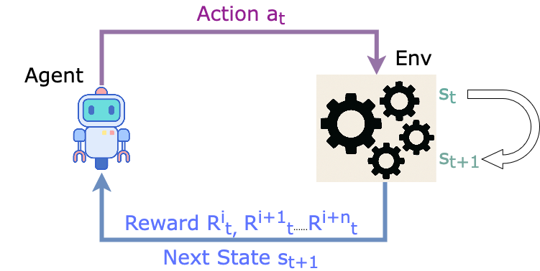
Multi-Objective RL
Multi-Objective RL (MORL) extends traditional RL to handle problems with multiple conflicting objectives
MORL involves optimizing a vector of rewards, each corresponding to different objectives

Slide 17
MORL vs Multi goal RL
Multi goal RL setup is different from MORL
Multi goal RL has multiple states that are optimal
  Number of objectives can be one or more
MORL explicitly have multiple objectives
S
 |  |  |  | G
 |  |  |  | G
S
 |  |  |  | G
Multiple goal states
Single goal with multiple objectives to balance

Slide 18
MORL Strategies: Scalarization
MORL has two main strategies
Scalarization approach: find a single policy that optimizes a weighted sum of rewards
  Simplifies the problem by combining multiple objectives into a single scalar value
  Transforms a multi-objective problem into a single-objective problem
  making it easier to solve using traditional reinforcement learning techniques

Slide 19
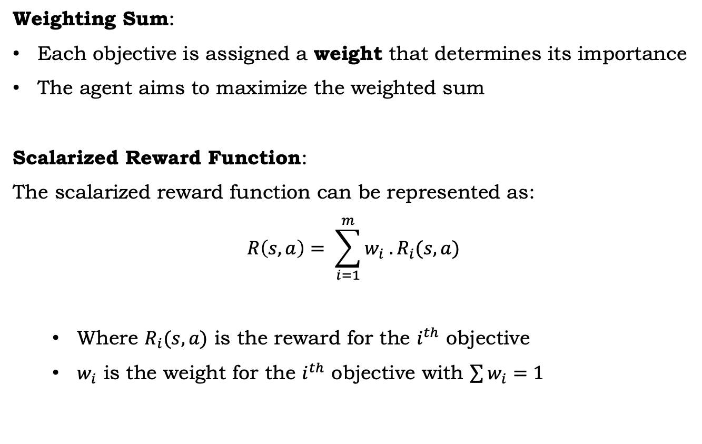
MORL Strategies: Scalarization
Weighting Sum:
Each objective is assigned a weight that determines its importance
The agent aims to maximize the weighted sum
Scalarized Reward Function:
The scalarized reward function can be represented as:
$$R\left(s, a\right)= \sum_{i=1}^{m}{w_{i} . R_{i}(s, a)}$$
  Where $R_{i}(s, a)$ is the reward for the $i^{th}$ objective
  $w_{i}$ is the weight for the $i^{th}$ objective with $\sum{w_{i}=1}$
Other methods
For example, Chebyshev Scalarization
Adjusts the relative importance of objectives based on the worst-case deviation from the ideal values

Slide 20
MORL Strategies: Scalarization
Challenges:
The choice of weights significantly impacts the solution
If the weights are not chosen properly, it can lead to suboptimal trade-offs
Optimal Weights are not known
Deterministic policy with a single solution on pareto front
Do not provide full Pareto front
Can become increasingly difficult as the number of objectives grows
Single solution

Slide 21
MORL Strategies: Pareto Approach
MORL has two main strategies
2. Pareto Approach: Find multiple policies that cover the Pareto front
  Instead of searching for a single optimal policy, the agent searches for a set of Pareto optimal policies
  These solutions represent different trade-offs between the objectives
  The agent explores different regions of the objective space to discover the Pareto front.
  Each policy on the Pareto front represents a unique balance between competing objectives

Slide 22
MORL Strategies: Pareto Approach
Pareto Q-Learning:
  A modification of traditional Q-learning where multiple Q-values are maintained, each corresponding to a different objective
  The agent learns to balance these Q-values to select a policy that approximates the Pareto front
Pareto Policy Iteration
  Similar to policy iteration but applied to multiple objectives
  The algorithm iterates through policies, improving them to cover more of the Pareto front
Scalarization Methods:
  Although the Pareto approach does not focus on scalarizing the rewards, scalarization techniques like weighted sums can be used to guide the search toward the Pareto front – Conditional Policy
  This method balances trade-offs between objectives by adjusting the weights dynamically

Slide 23
MORL Strategies: Pareto Approach
Challenges:
Exploration Complexity:
  Computationally expensive and time-consuming
Diversity of Solutions:
  Generating diverse solutions that cover the Pareto front requires careful exploration to avoid converging to suboptimal areas
Scalability:
  As the number of objectives increases, the size of the Pareto front grows, making the search space exponentially larger

Slide 24
Outline
01
02
03
04
05
Introduction
to multi-objective Optimization
Introduction to RL
MORL
MORL with conditional policy
Summary and coding example

Slide 25




MORL Strategies: Conditional Policy
$$(1, 0)$$
Produce Pareto front via reward scalarization
Scan the possible reward weights
Simpler to implement for lower dimensional problems
Gets more complex as number of objectives increase
$${(1−w}_{1},w_{1})$$
Train a conditional policy
Conditioned on reward scalarization weights
Randomly (or cleverly) switch between conditions per epoch
$${(1−w}_{n},w_{n})$$
$$(0, 1)$$

Slide 26
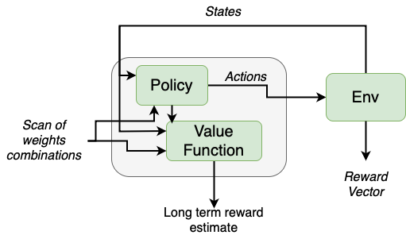
MORL Strategies: Conditional Policy
Easy to implement for large dimensional multi objective problems
Works well for optimization problems
May require extensive training and tuning on sequential control problems

Slide 27
Outline
01
02
03
04
05
Introduction
to multi-objective Optimization
Introduction to RL
MORL
MORL with conditional policy
Summary and coding example

Slide 28
Summary
Multi-objective optimization can be significantly challenging compared to single-objective optimization
RL seeks to maximize long term cumulative reward
MORL uses a vector of rewards to optimize multiple objectives
Scalarization can convert your multi-objective RL problem to a single-objective RL problem
Scalarization may not provide full suite of solutions on the Pareto front
Explicit Pareto approaches are more complex to implement and train but provides multiple solutions on a Pareto front
Scalarization can be used to guide the agent to produce full Pareto front

Slide 29
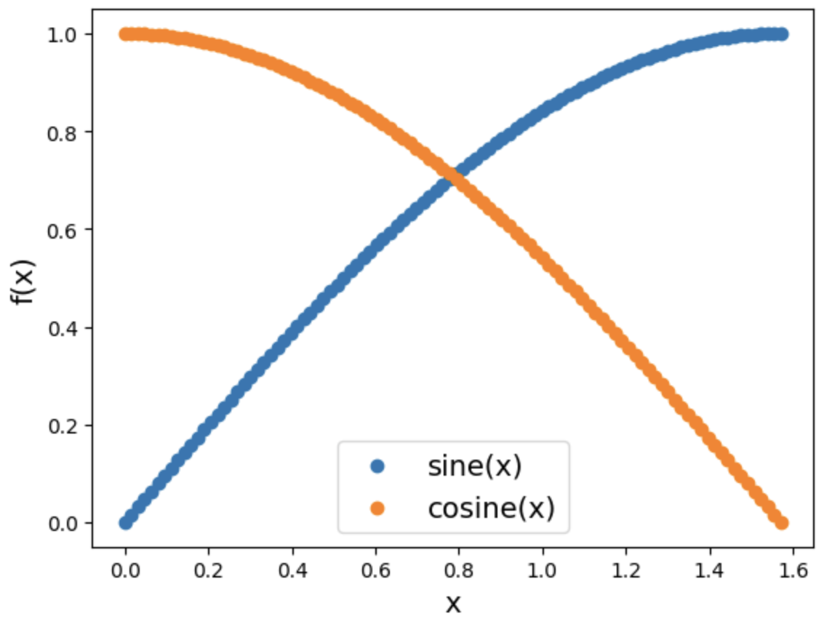
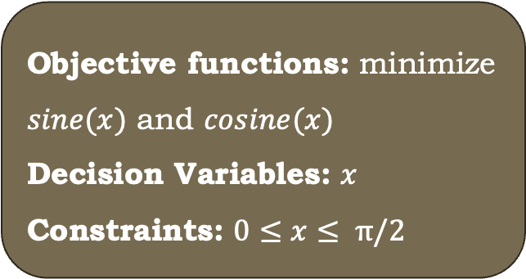
Hands on examples – implements a simple env and conditional MORL agent based on TD3:
#1 Scalarized
https://colab.research.google.com/drive/18JoA-8je2U3QG9ro7RDoH5SwOkREC_Vi?usp=sharing
#2 MORL with conditional policy https://colab.research.google.com/drive/10vBhNpGCbE0DL6xLe9D8gpH7AeYp3edc?usp=sharing
Requires basic understanding of python, and reinforcement learning ☺
Objective functions: minimize $sine(x)$ and $cosine(x)$
Decision Variables: $x$
Constraints: $0≤x≤ π/2$

Slide 30
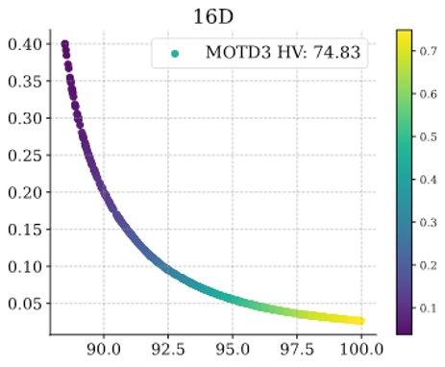
Hands on examples – implements a simple env and conditional MORL agent based on TD3:
#1 Scalarized
https://colab.research.google.com/drive/18JoA-8je2U3QG9ro7RDoH5SwOkREC_Vi?usp=sharing
#2 MORL with conditional policy https://colab.research.google.com/drive/10vBhNpGCbE0DL6xLe9D8gpH7AeYp3edc?usp=sharing
Requires basic understanding of python, and reinforcement learning ☺
The algorithm in the notebooks is similar to the one used to produce these real-life results
  May not include all the components for pareto-modeling
FSD Trip Rates
Full version will be released soon at
https://github.com/JeffersonLab/SciOptControlToolkit
RF Heat Load

Slide 31
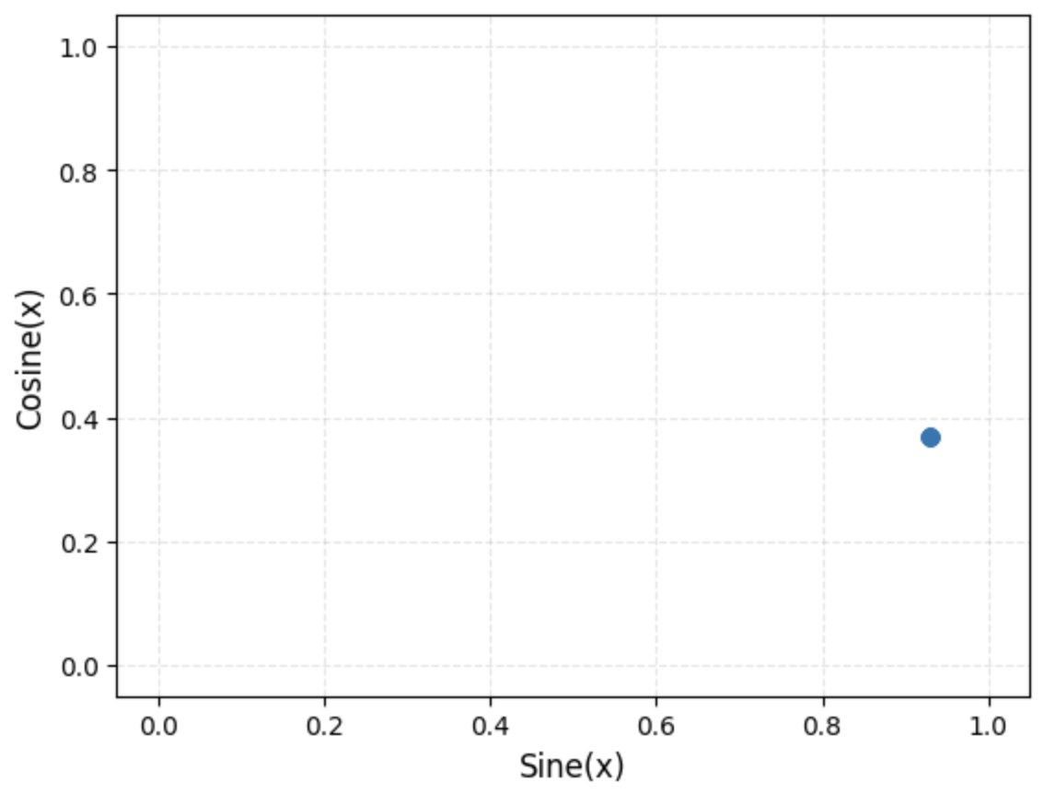
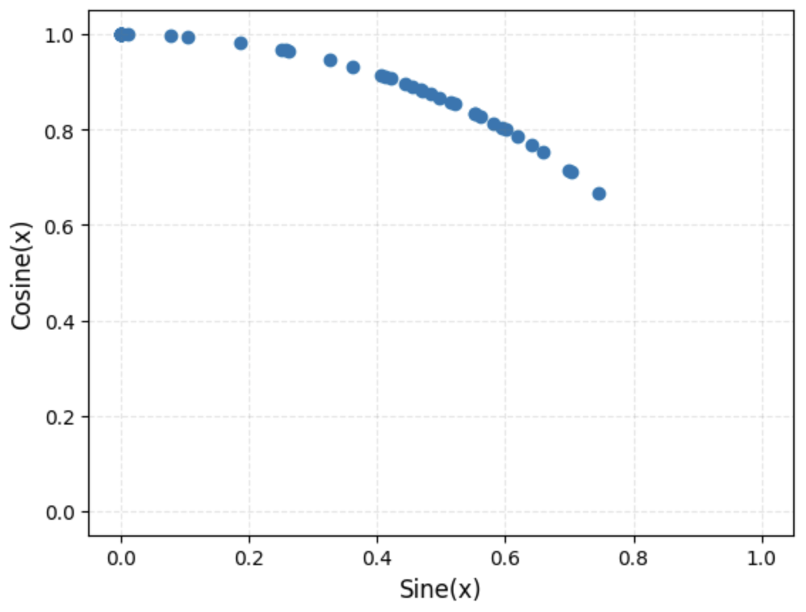
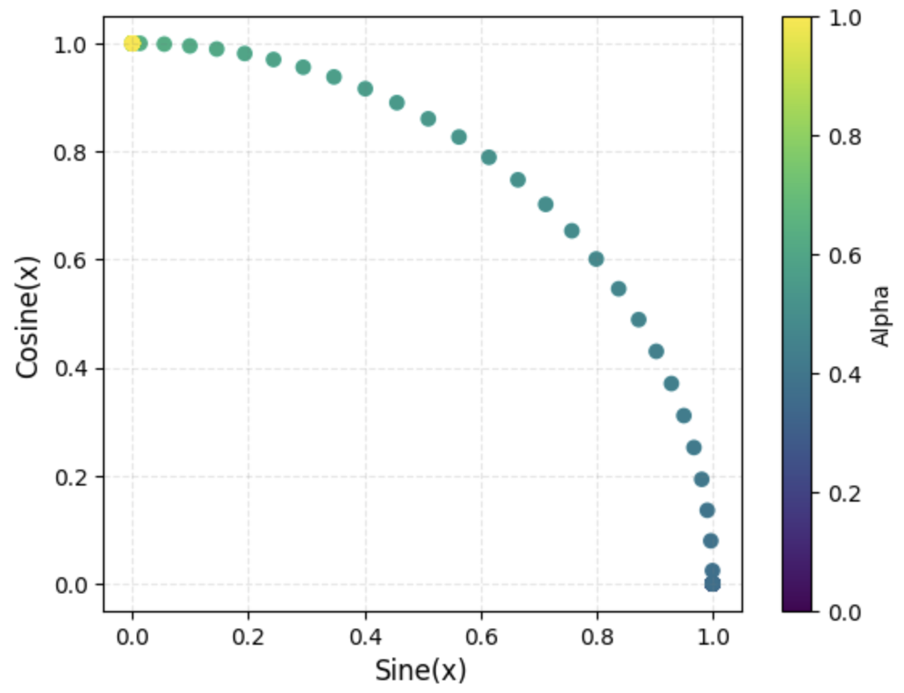
Expected Output: Scalarized Method
With no stochasticity
With stochasticity
MORL with conditional policy

