Slide 1
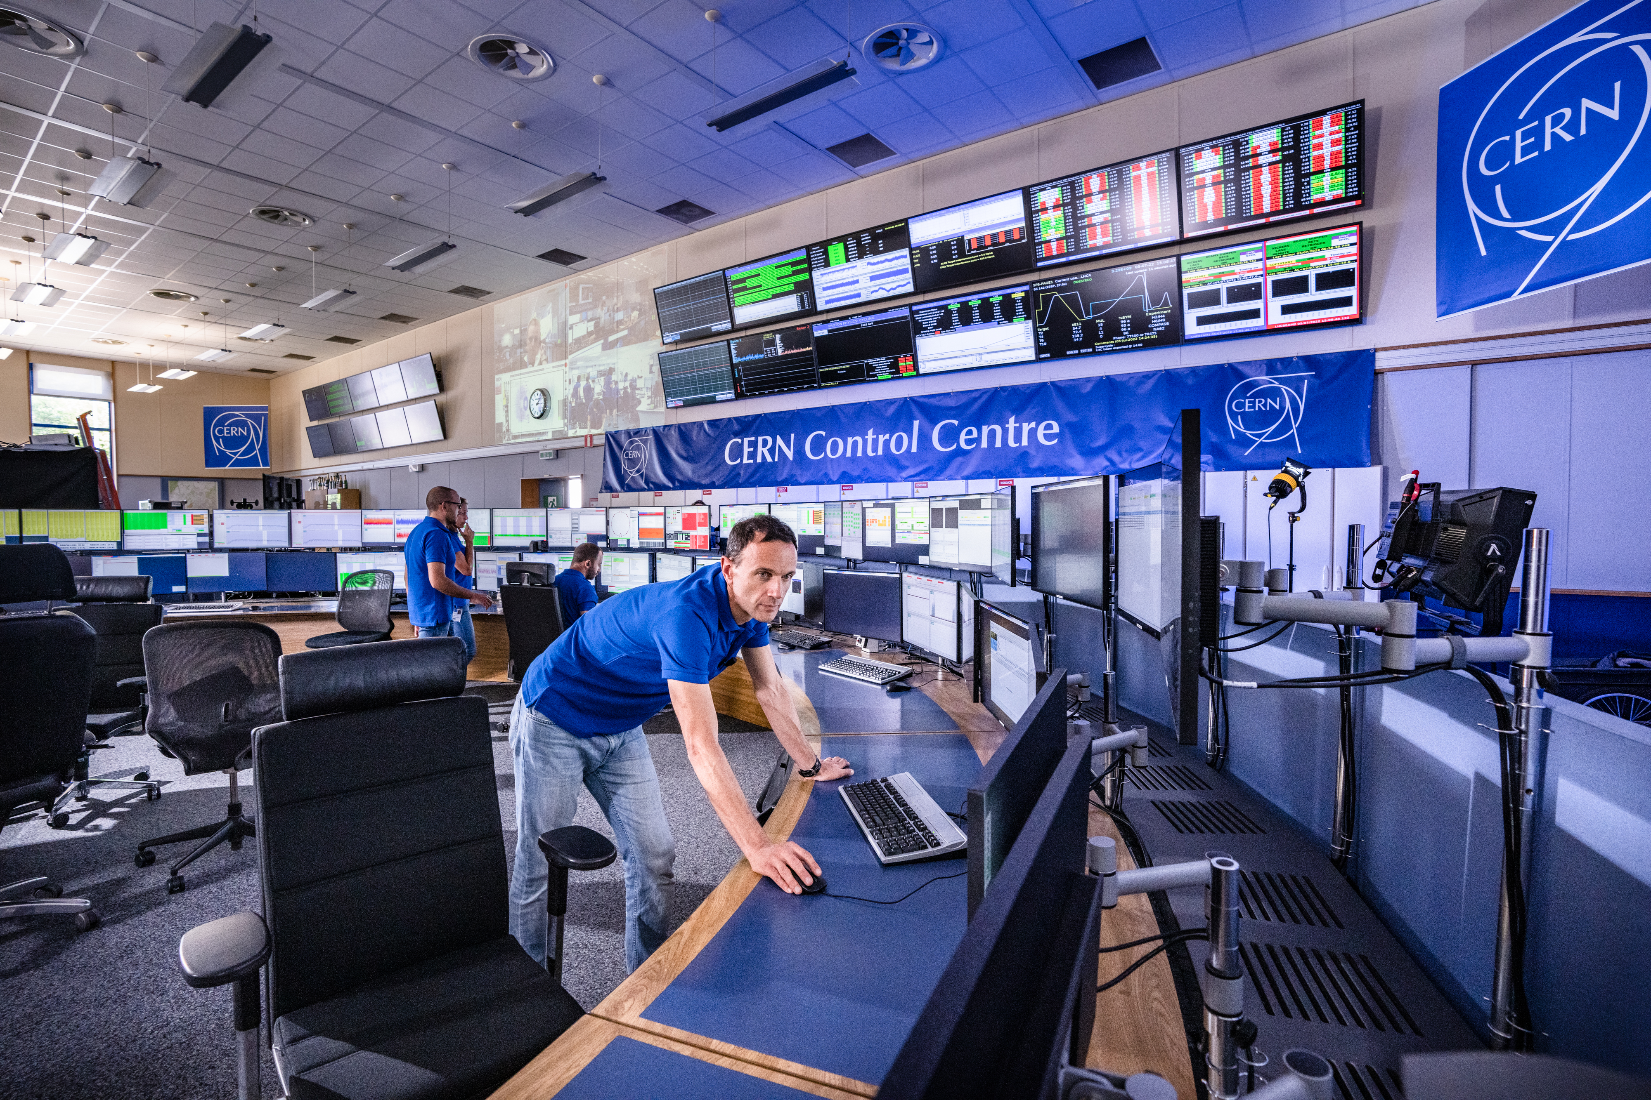
CERN Visits
ICFA MaLAPA Mini-Workshop
2025-04-11

Slide 2
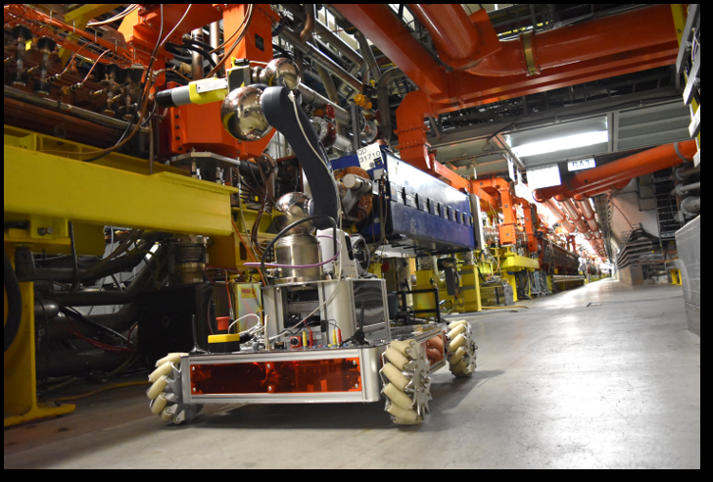
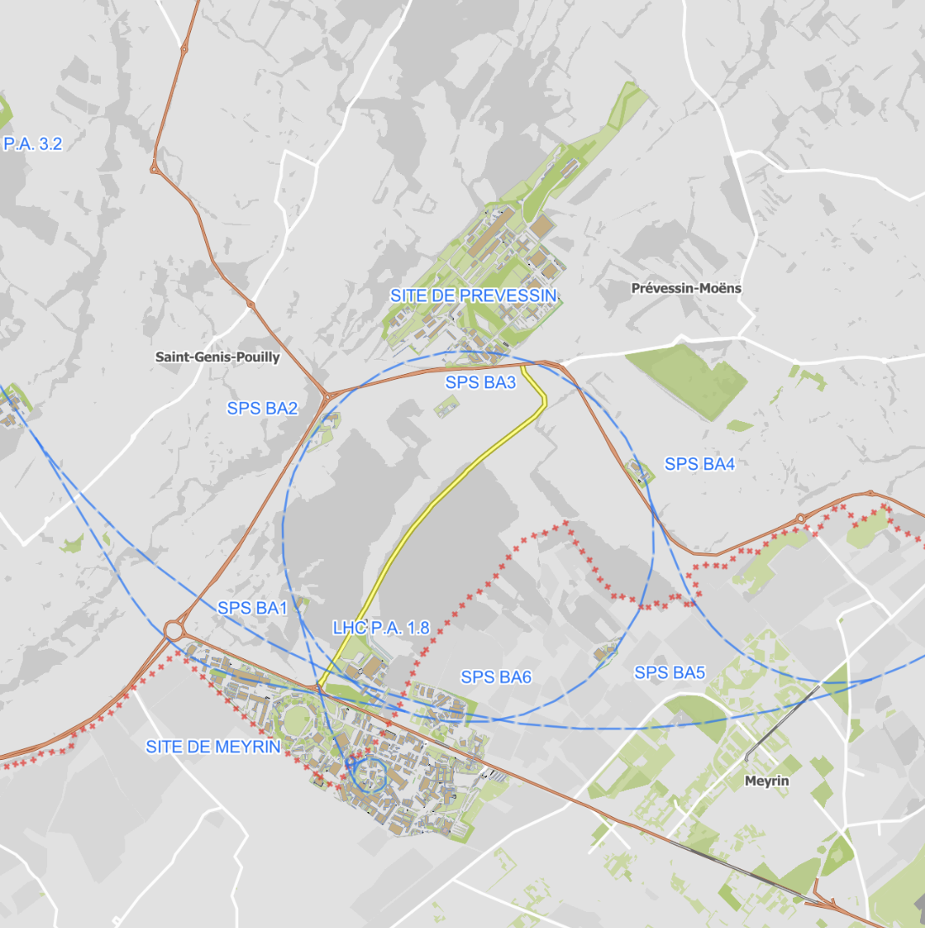
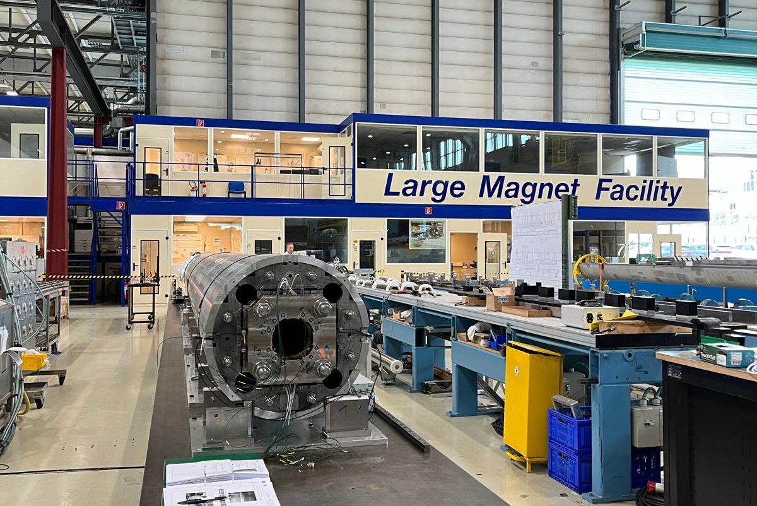
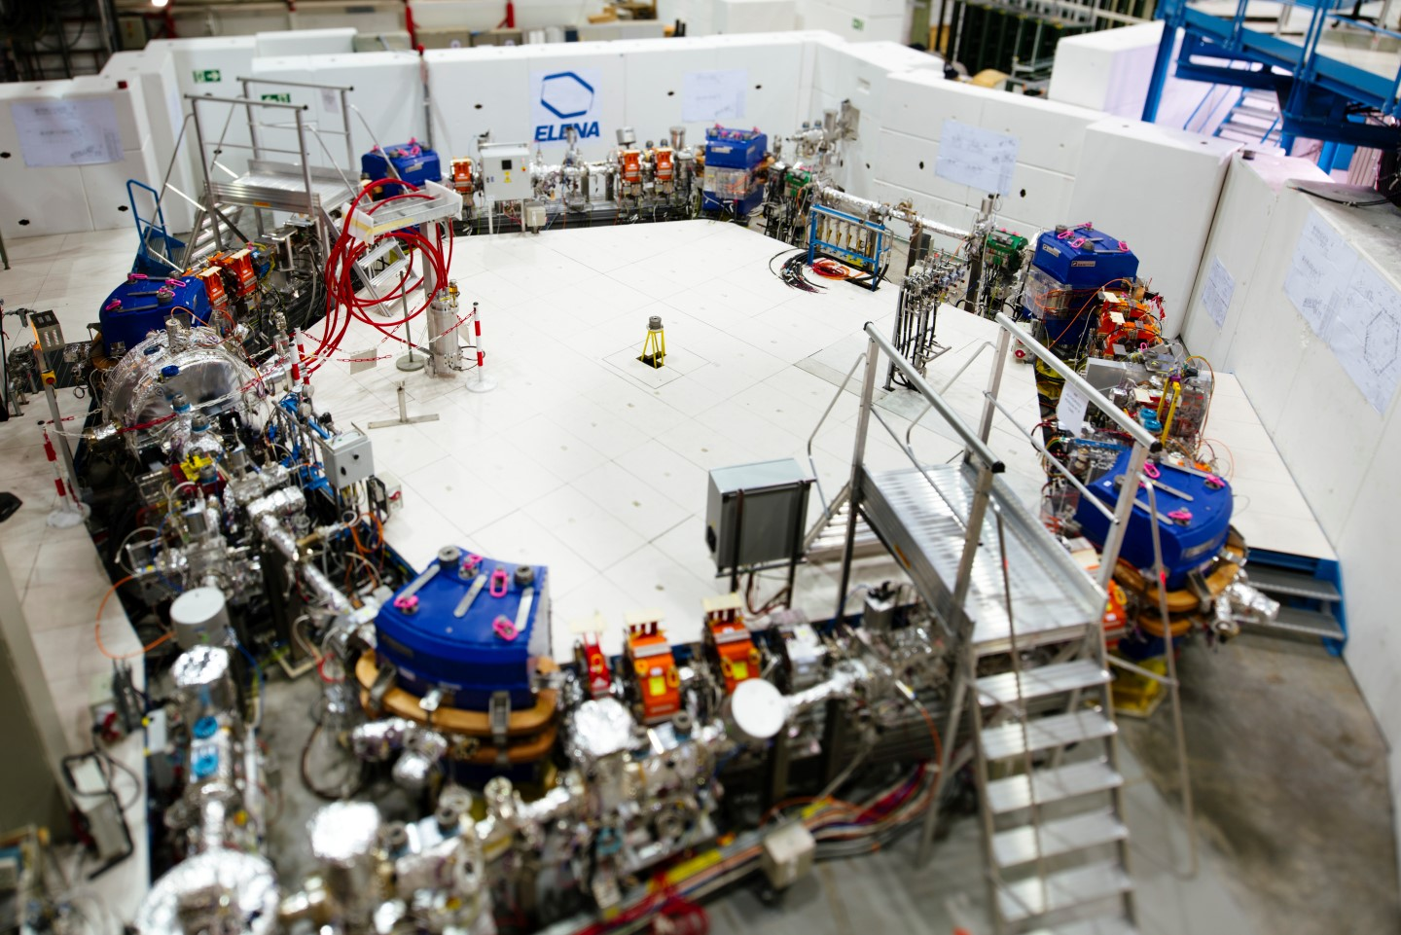
Visit Points
Robotics lab
📍
📍
CCC
LMF
📍
📍
AD

Slide 3
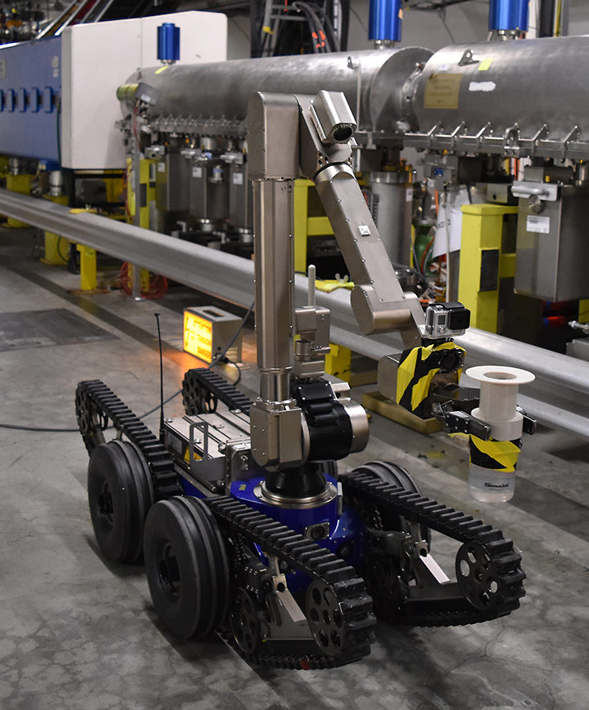
Visit schedule
Shuttle departure: 13:10 from CERN Hotel / R1
Group 1
13:30 - 14:15: Antiproton Decelerator (AD)
14:30 - 15:15: CERN Control Center (CCC)
15:30 - 16:15: Robotics Lab
Group 2
13:30 - 14:15: CCC
14:30 - 15:15: Robotics Lab
15:30 - 16:15: AD
Group 3
13:30 - 14:15: Large Magnet Facility (LMF)
14:30 - 15:15: AD
15:30 - 16:15: CCC
Shuttle return: 16:30 at CERN Hotel / R1
Opportunity to leave
Opportunity to leave
Opportunity to leave

Slide 4
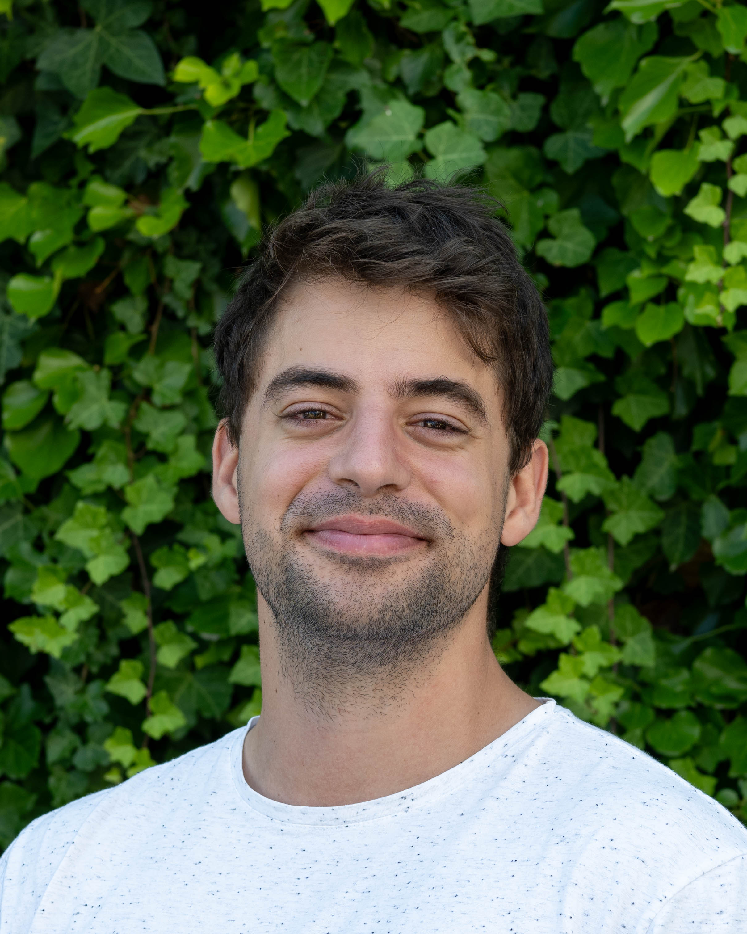
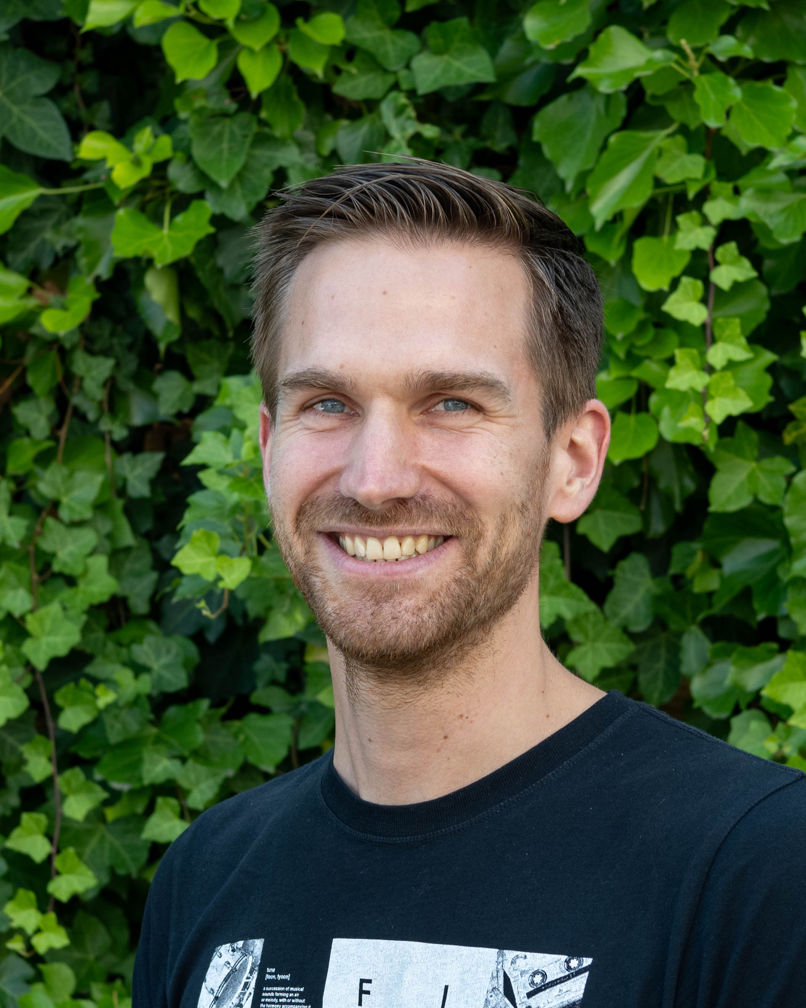
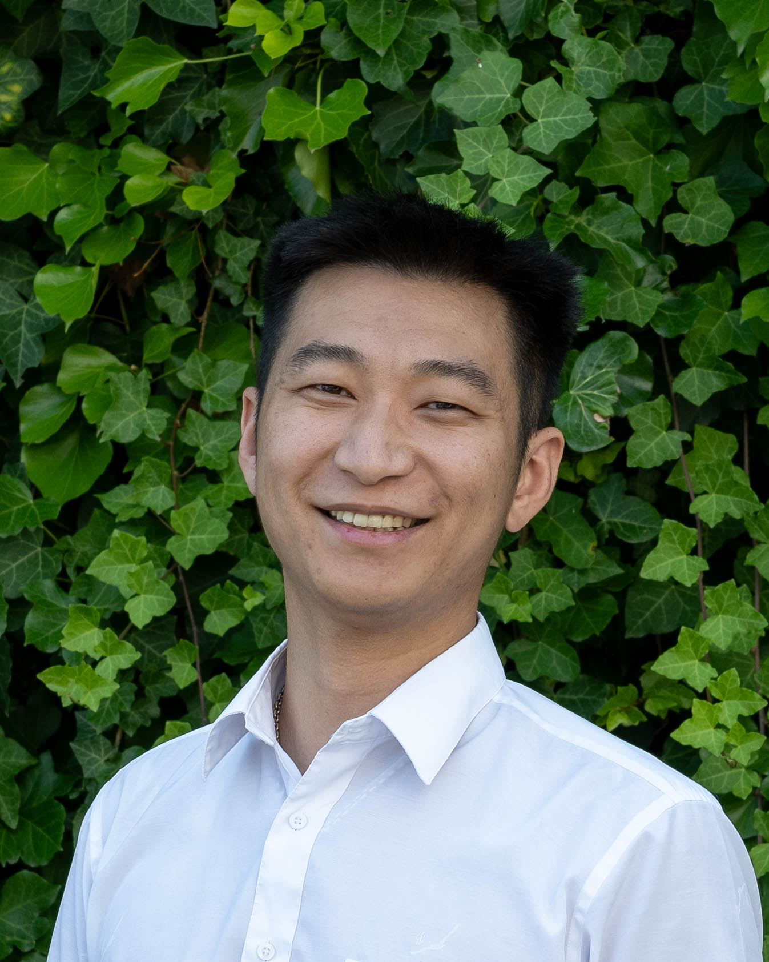
Your guides for this afternoon
Group 1
Group 2
Group 3
Borja
Michael
Anton
Please stick to us, and and if you have any problems or need to leave early, let us know! ☺

Slide 5
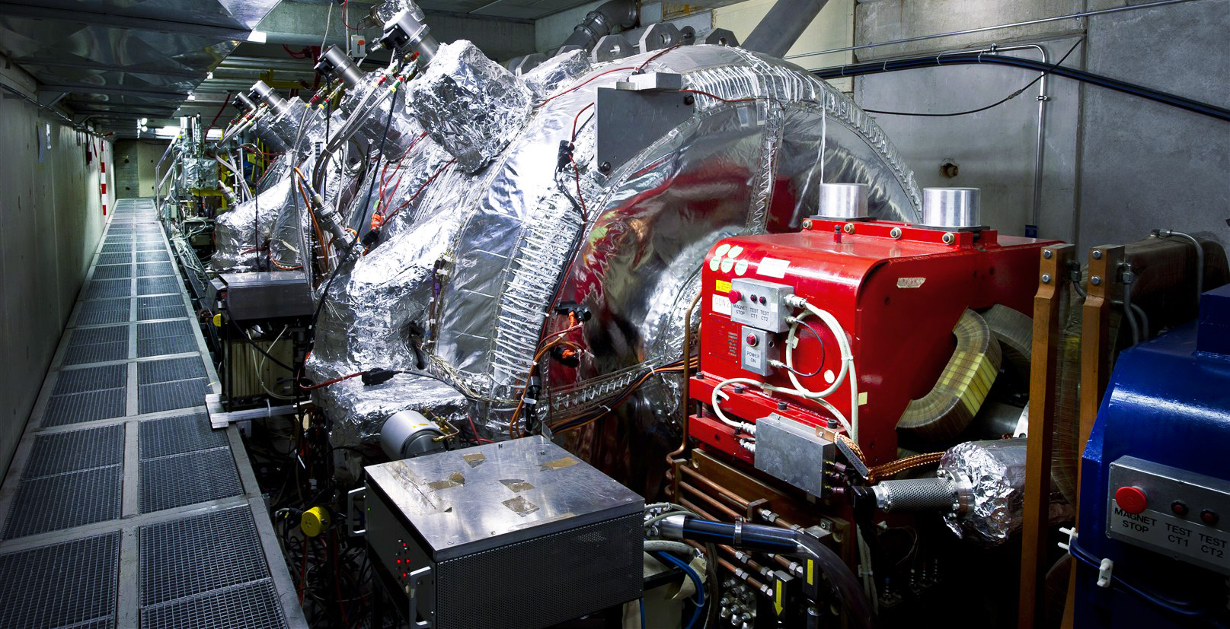




Visit restrictions
Antiproton Decelerator hall
P.S.A. Access restrictions apply to AD visits
AD hall is a supervised area
Please let us know if you cannot attend this part of the visit!

Slide 6
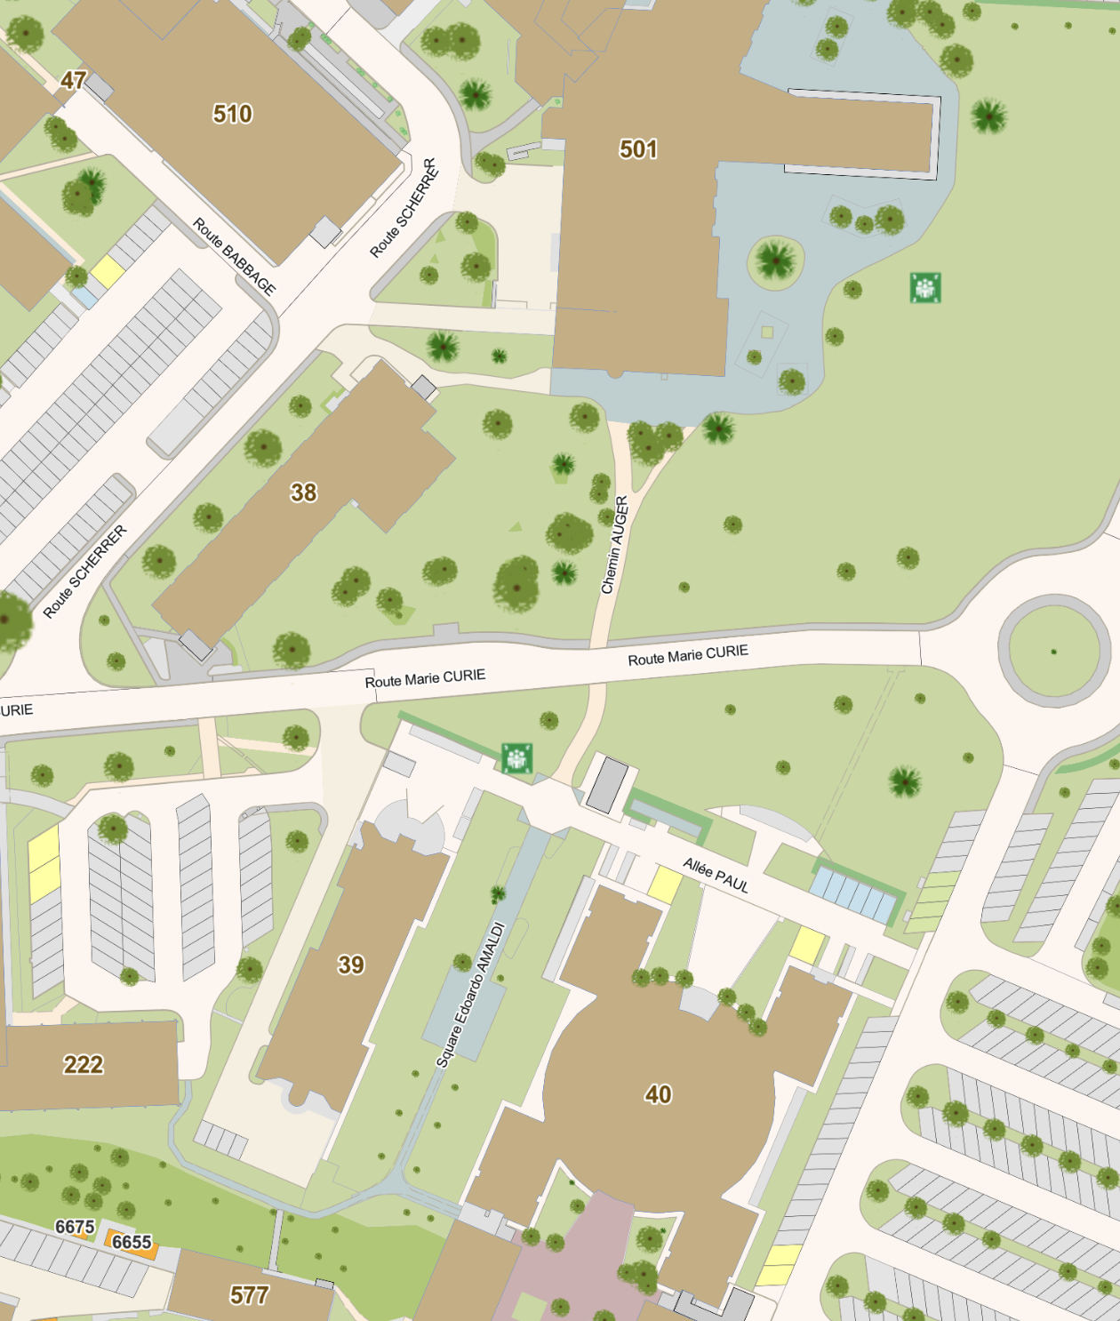
Gathering point for visits after lunch
And important points
Meet outside the CERN hotel shuttle stop
  Shuttles depart at 13:15!
  Lunchers will be brought from R1 to shuttle stop
Each visit group is capped to 24 people
  Choose the visit you want to attend / fits your departure schedule
Important points
  Please stick to the group
  You can take as many photos as you want, but avoid photos containing peoples faces as much as possible
  Don’t touch anything you don’t know ☺
🍽️
🛏️
🚌
🛏️

