Slide 1
Progress on Automating Experiments at the Argonne Wakefield Accelerator Using Advanced Bayesian Optimization Algorithms
Ryan Roussel
rroussel@slac.stanford.edu

Slide 2
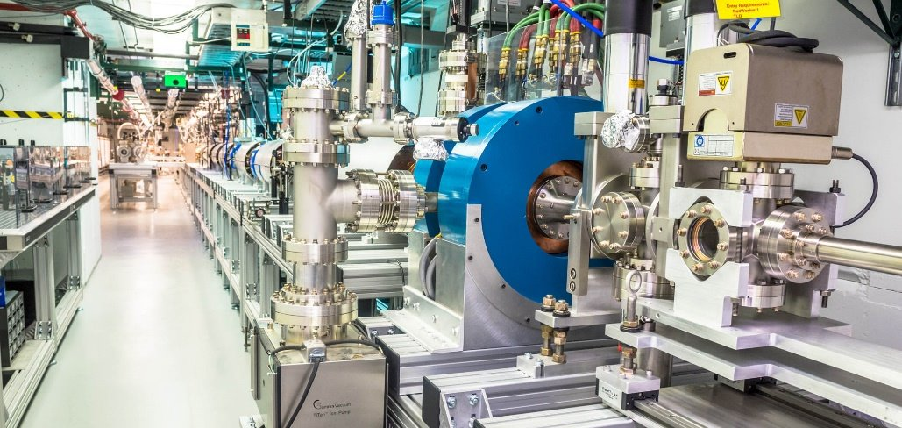
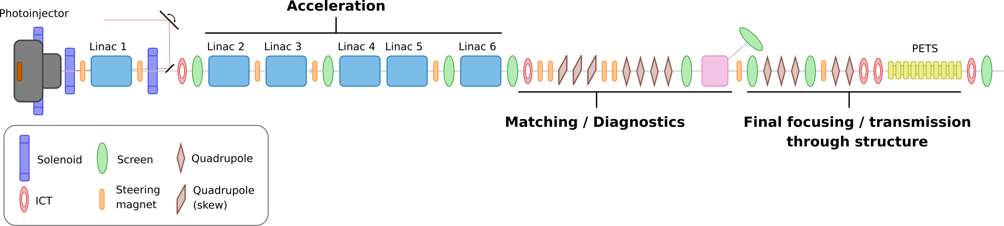
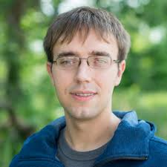
Automation Challenges at AWA
The Argonne Wakefield Accelerator (AWA) facility is an accelerator physics test facility at Argonne National Laboratory.
The accelerator does not run continuously, and is restarted and retuned from scratch every day → a major obstacle for the small team of operators
Sad operator during his PhD
(circa. 2019)

Slide 3
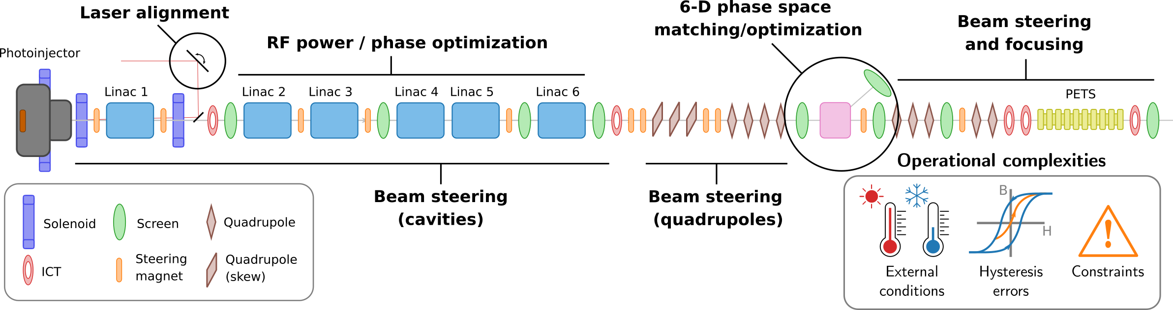
Goals of this work:
The goal of this work is sequential start-to-end, autonomous configuration of the drive beamline from the photoinjector to a wakefield experiment:
Requires solving multiple different online optimization subtasks with varying objectives, constraints → multiple algorithms / strategies
Where possible, should leverage prior physics information to accelerate optimization convergence

Slide 4
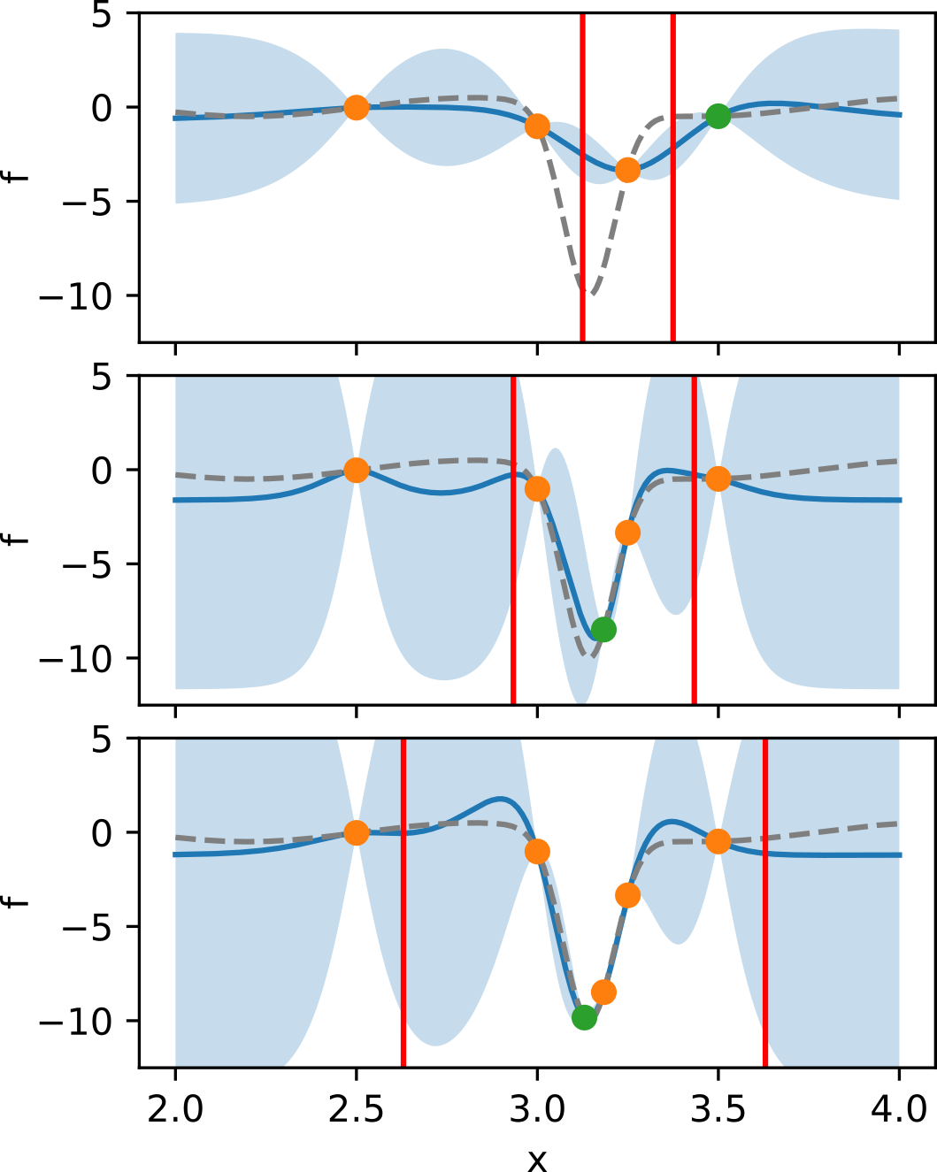
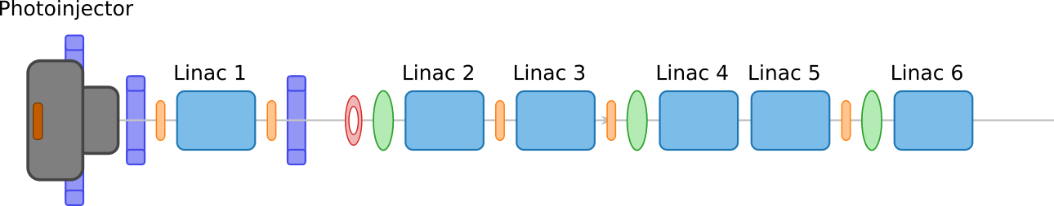
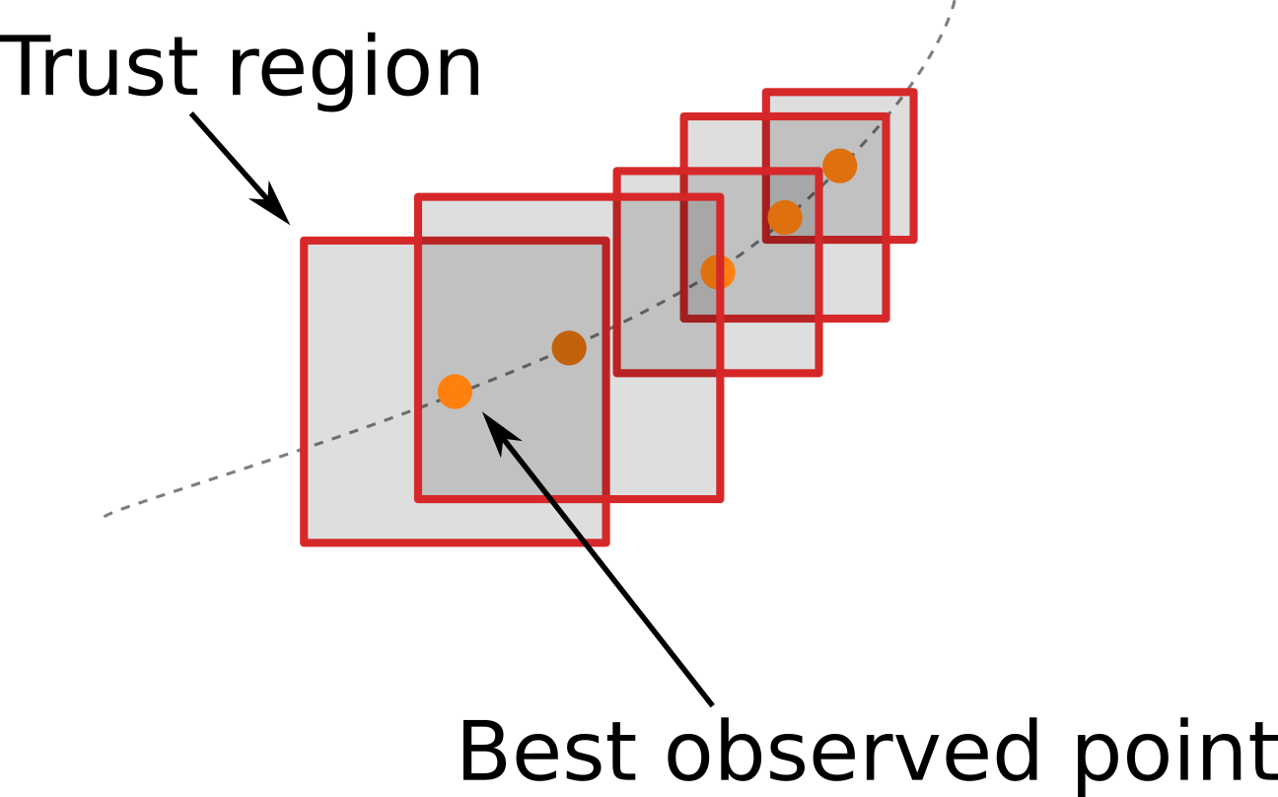
Trust Region + Constrained BO
Beam steering through linac cavities
Log-Expected improvement w/ trust region Bayesian optimization (TuRBO)
Constraints on beam bounding box extent in screen
Polynomial kernel to leverage physics info
Diagnostic screens
Reinforcement learning approach will also be investigated

Slide 5
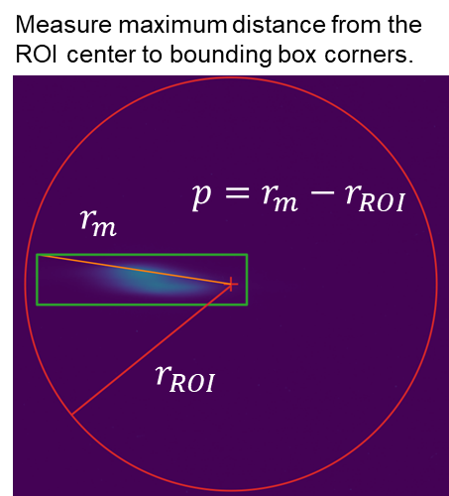
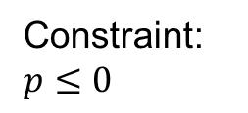
Trust Region + Constrained BO
Beam steering through linac cavities
Log-Expected improvement w/ trust region Bayesian optimization (TuRBO)
Constraints on beam bounding box extent in screen
Polynomial kernel to leverage physics info
Diagnostic screens
Reinforcement learning approach will also be investigated
Constraint:
$p≤0$

Slide 6
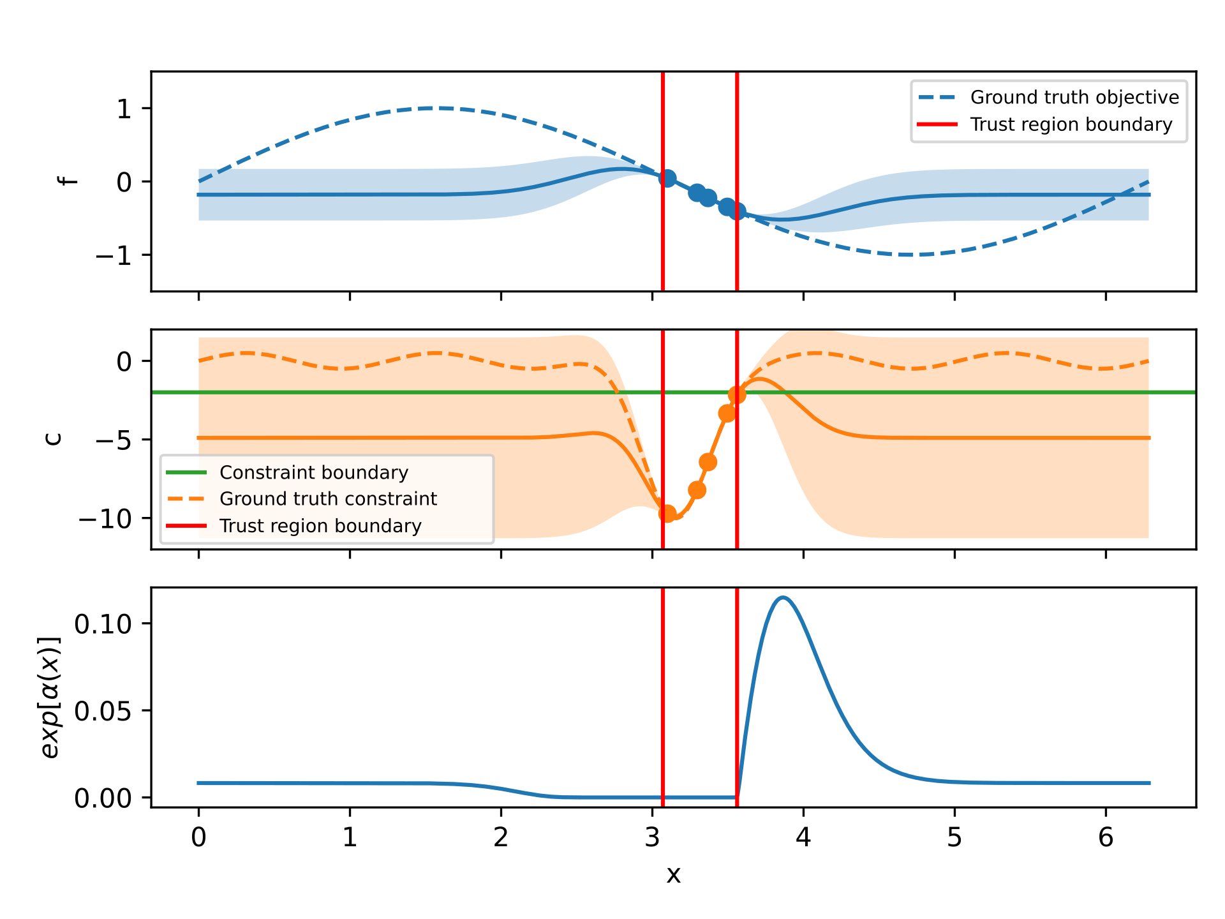
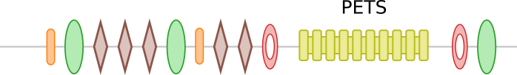
“Safety” Trust Region + Constrained BO
Beam focusing / transport through structures
Log-Expected improvement to maximize extracted power w/ “safety” TuRBO
Constraints on transmission (small valid region of parameter space)
Transmission
Steering magnets
Quadrupoles
Extracted power

Slide 7
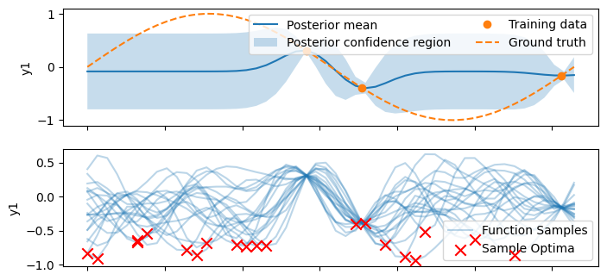
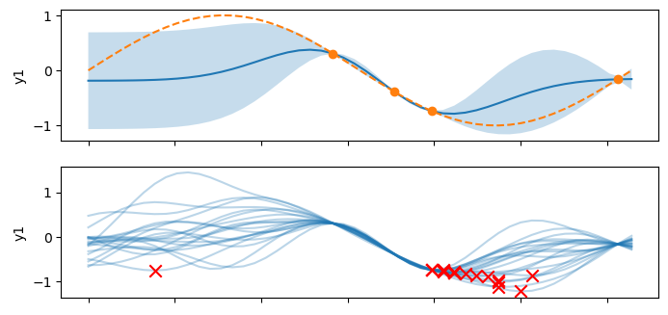
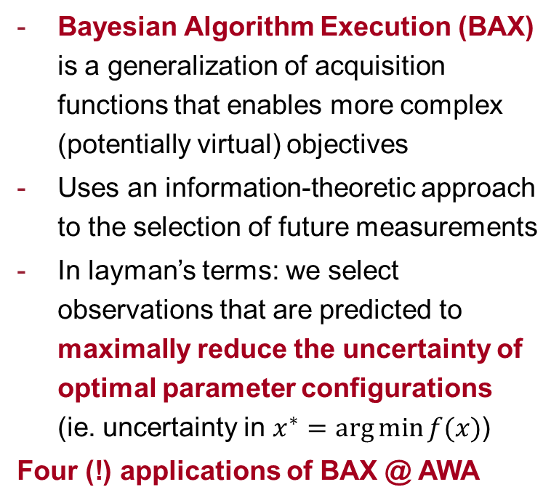
Bayesian Algorithm Execution
Bayesian Algorithm Execution (BAX) is a generalization of acquisition functions that enables more complex (potentially virtual) objectives
Uses an information-theoretic approach to the selection of future measurements
In layman’s terms: we select observations that are predicted to maximally reduce the uncertainty of optimal parameter configurations (ie. uncertainty in $x^{∗}=\arg{\min{f(x)}}$)
Four (!) applications of BAX @ AWA

Slide 8
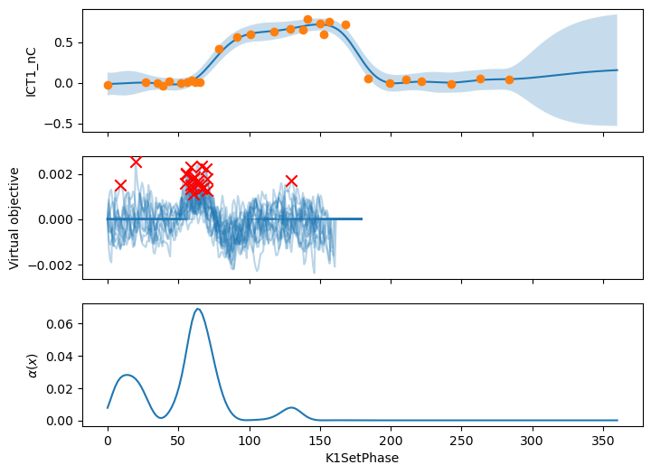
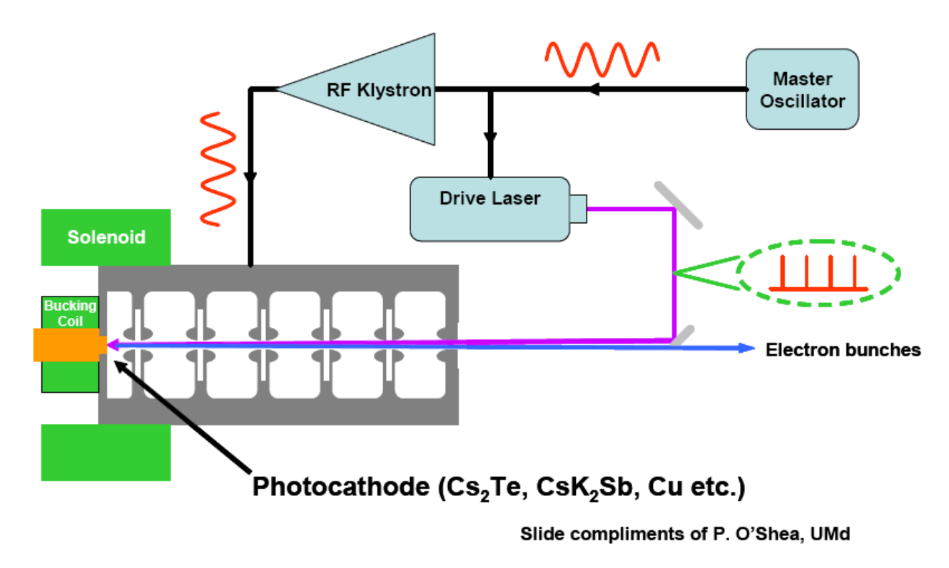

RF Phasing Inside Photoinjectors (Schottky Scan)
Goal: Determine the RF phase where photoemitted electrons start to be accelerated – set photoinjector gun phase to +50 deg this value
Entropy based TuRBO
BAX Algorithm: $x^{∗}=\arg{\max{\frac{d^{2}}{dx^{2}}f(x)}}$

Slide 9
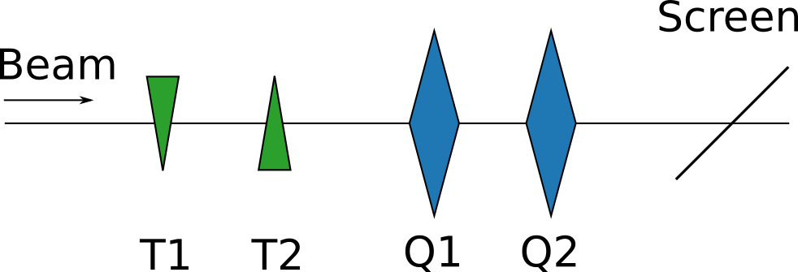
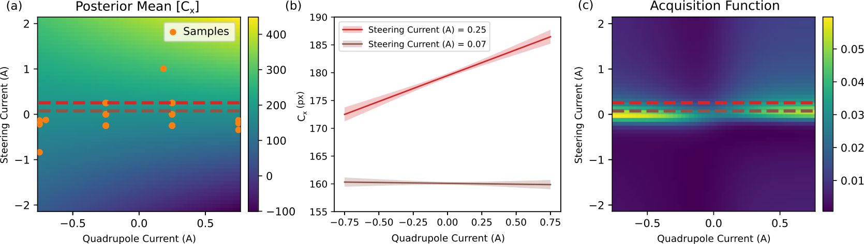
Beam Alignment Through Quadrupoles
Goal: Steer beam through the center of N quads
BAX Algorithm: $T_{1}^{∗}=\arg_{T_{1}}{\min{∂_{Q_{1}}C_{x}(T_{1},Q_{1})}}$
BAX Algorithm (English): Find the steering current that minimizes the beam deflection as the quadrupole current is scanned
Note: also subject to beam position / size constraints
R. Roussel, et. Al., LINAC2024-THPB066

Slide 10
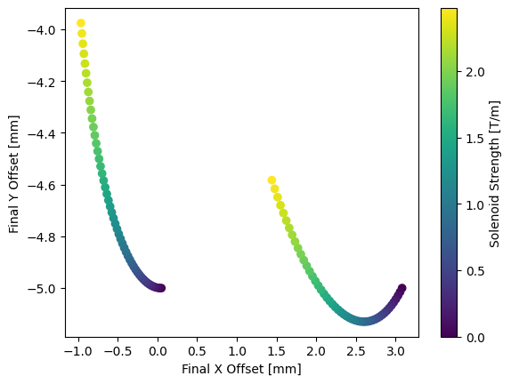
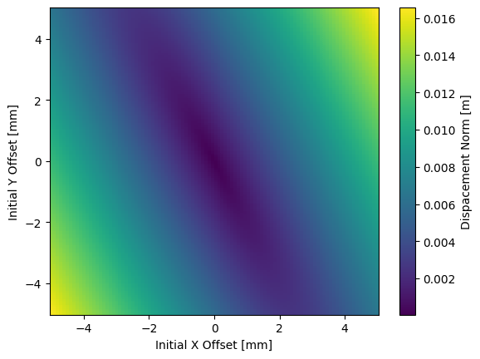
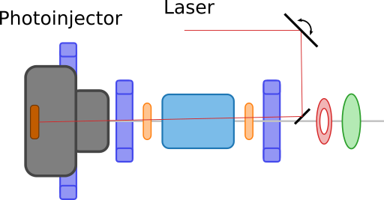

Aligning the Laser in the Solenoid
Goal: Align laser spot / steer electron beams through the center of a solenoid magnet
Laser spot
BAX Algorithm: $x^{∗}=\arg{\min{\sqrt{Δ_{x}^{2}+Δ_{y}^{2}} } }$
Note: also subject to beam position / size constraints

Slide 11
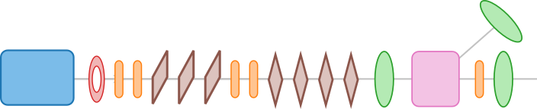
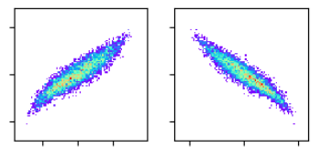
Towards 6D Phase Space Distribution Control
Usually most challenging step of online control
Necessary as a starting point for various experiments
Dipole
Cavity
Staged R&D Approach:
RMS Control (4D)
  Autonomous phase space measurements
  Uncertainty quantification
  BAX emittance optimization
Exact beam distribution control (4D)
  GPSR
6D phase space control (future)
Normal / skew quadrupoles
Current distribution
Target distribution

Slide 12
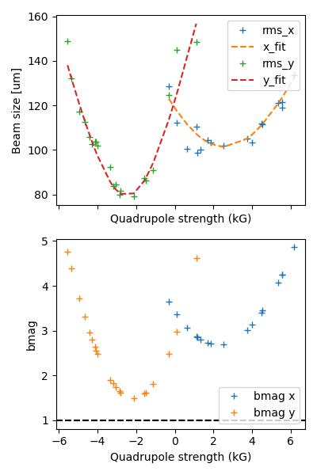
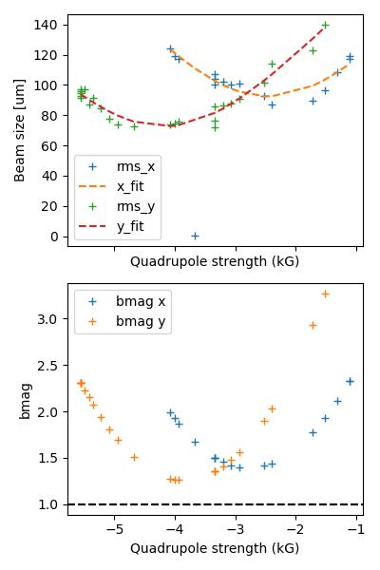
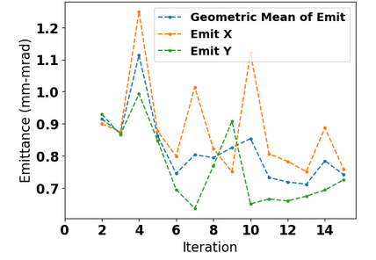
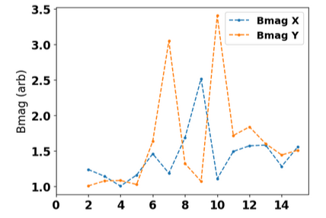
Autonomous Emittance Measurements
Varying upstream parameters changes the valid region of quadrupole scan strengths needed for a successful measurement
Autonomously sample quadrupole strengths based on exploration-weighted UCB + constraints
Demonstrated and refined at SLAC → transfer to AWA
9D optimization of LCLS injector
D. Kennedy

Slide 13
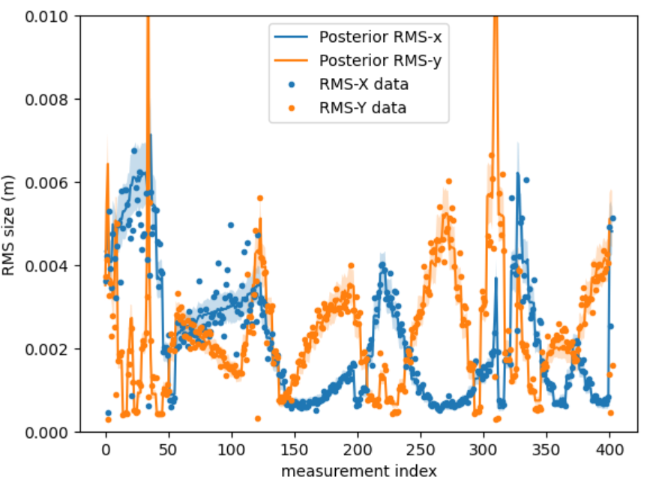


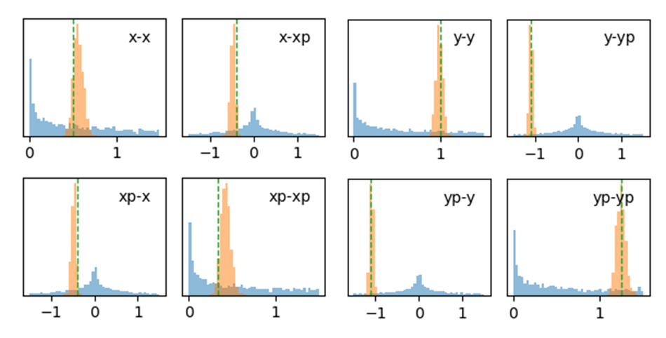
Uncertainty Quantification Based Control
Use measurements collected from beamline alignment / optimization to reconstruct the beam distribution w/ uncertainties using VI / HMC
Uncertainty-aware reconstructions
+
Feed reconstructed distribution into cheetah to predict optimal control params → twiss matching etc.
Online control

Slide 14
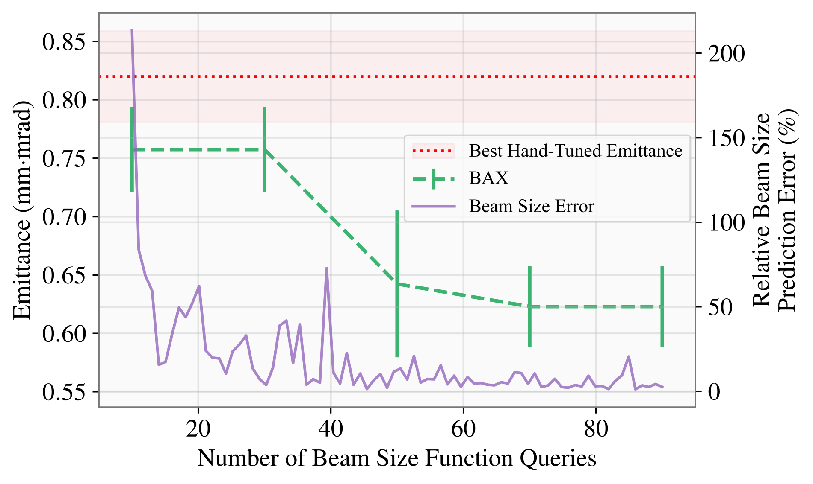
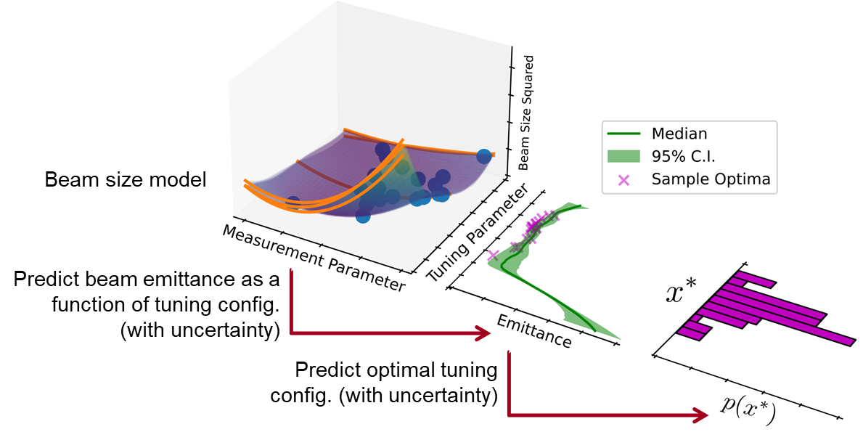
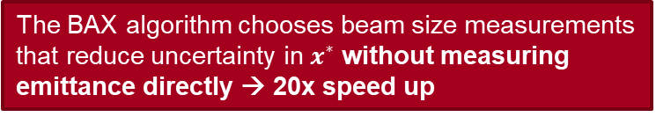

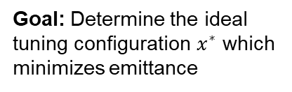
BAX Application: RMS Emittance Optimization
Goal: Determine the ideal tuning configuration $x^{∗}$ which minimizes emittance
Miskovich, Sara Ayoub, et al. MLST 5.1 (2024): 015004.
The BAX algorithm chooses beam size measurements that reduce uncertainty in $x^{∗}$ without measuring emittance directly → 20x speed up
BAX Algorithm: $x^{∗}=\arg_{x}{\min{ε(x)}}$

Slide 15
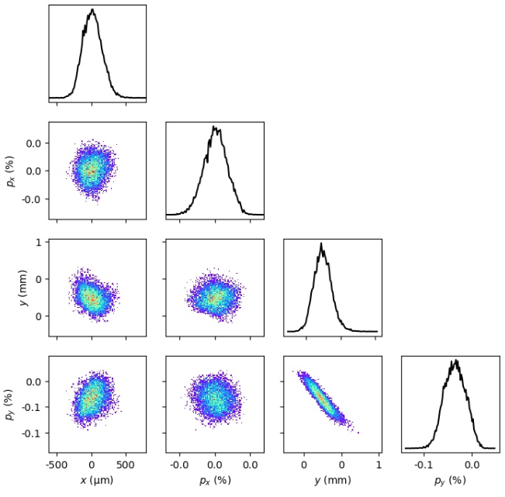
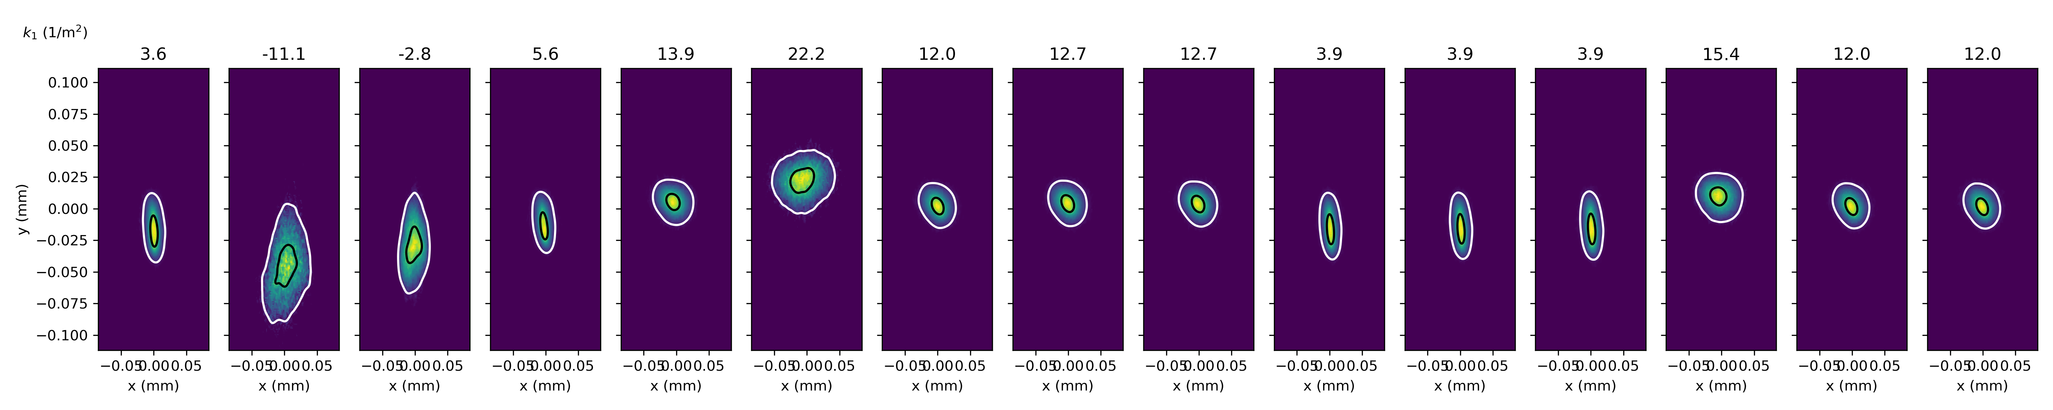
4D Generative Phase Space Reconstruction
Use data collected from autonomous emittance measurements to reconstruct the 4d distribution during operations (< 1 min)
Example from LCLS
pip install gpsr https://github.com/roussel-ryan/gpsr
Roussel, Ryan, et al. PRL 130.14 (2023): 145001.

Slide 16
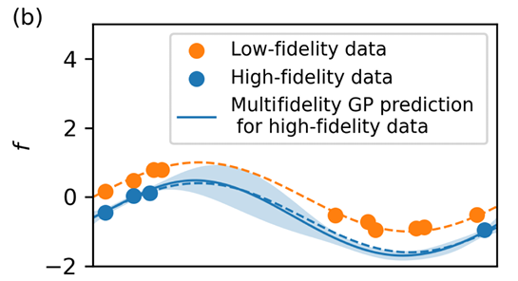

6D Generative Phase Space Control
Scan cavity phase and dipole state to manipulate longitudinal phase space + quadrupole scan
6D phase space measurement
(See talk by S. Kim on Thursday)
Dipole
Cavity
Normal / skew quadrupoles
Similar approach to 4D case
Combine measurements with cheetah simulation to estimate beam parameters
Solve for beamline params to tailor phase space distribution
Use multi-fidelity approach to optimization of upstream parameters
Roussel, Ryan, et al. PRAB 27.8 (2024): 084801.
Ferran Pousa, Angel, et al PRAB 26.8 (2023): 084601.

Slide 17
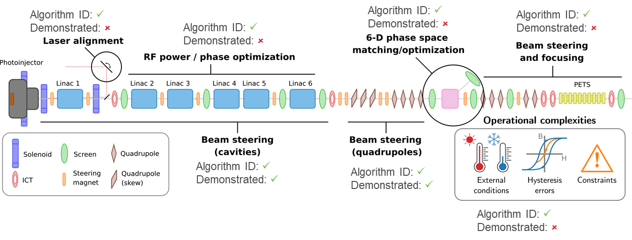
Outlook
Autonomous configuration of the AWA drive beamline and experimental beamlines
  4-8 hour tuning time → < 2 hour tuning time (w/o expertise)
Integrate GPSR measurements into online operations, detailed analysis of complex beam distributions

Slide 18



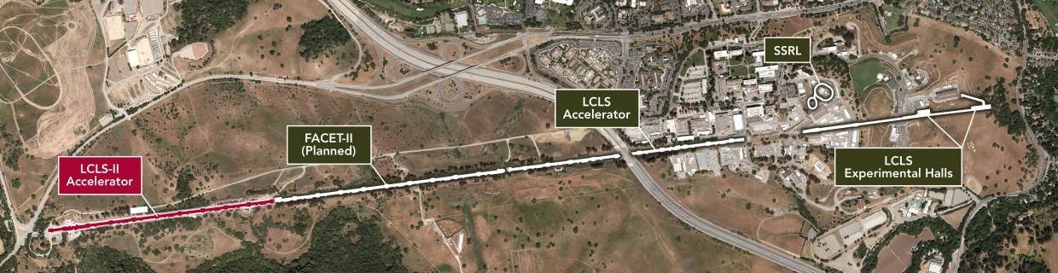
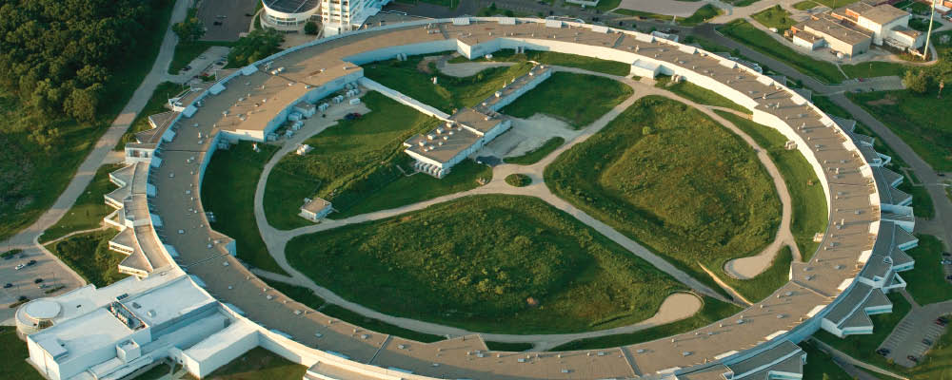
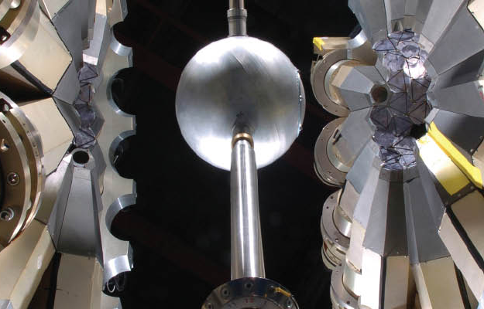



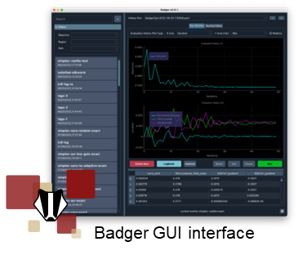
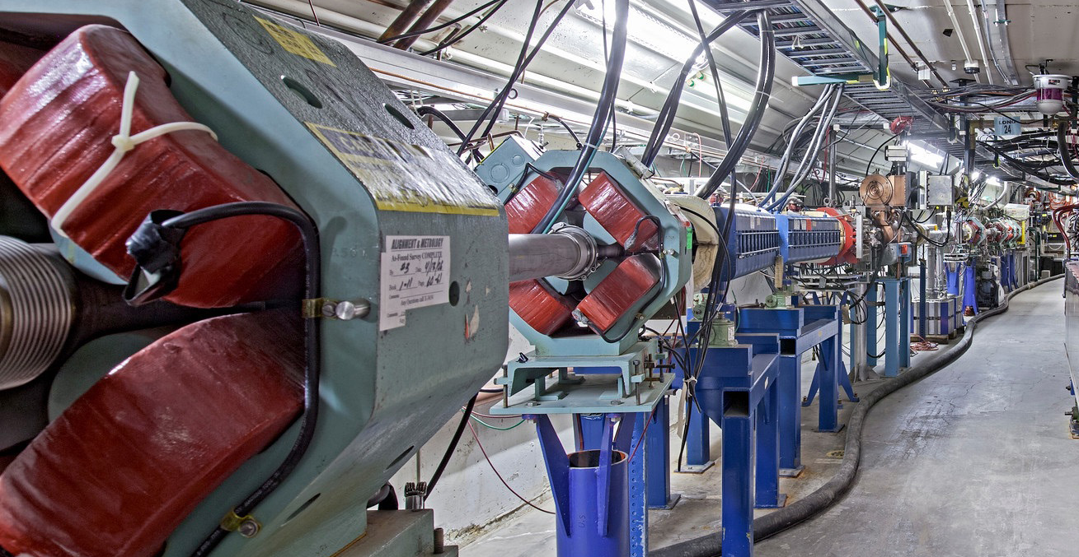
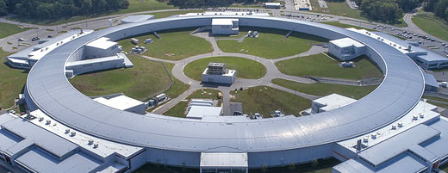




Xopt
AI/ML R&D @ AWA

Slide 19
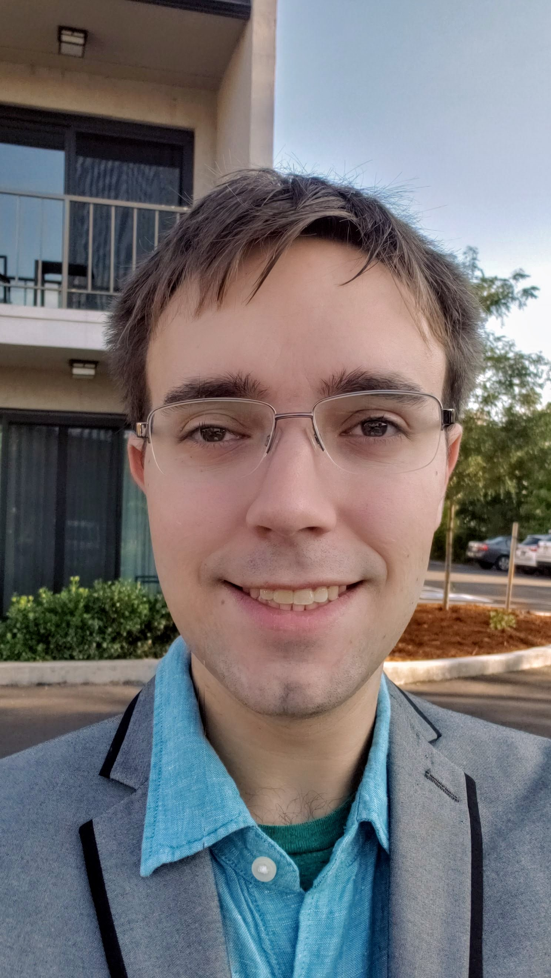
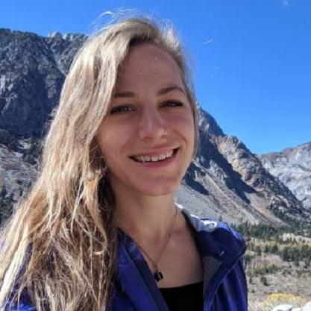
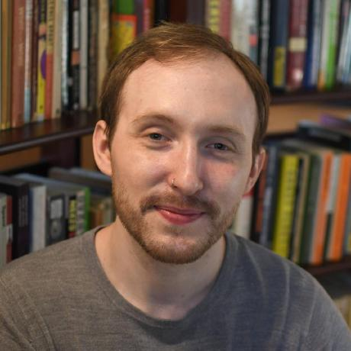
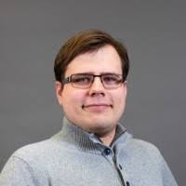
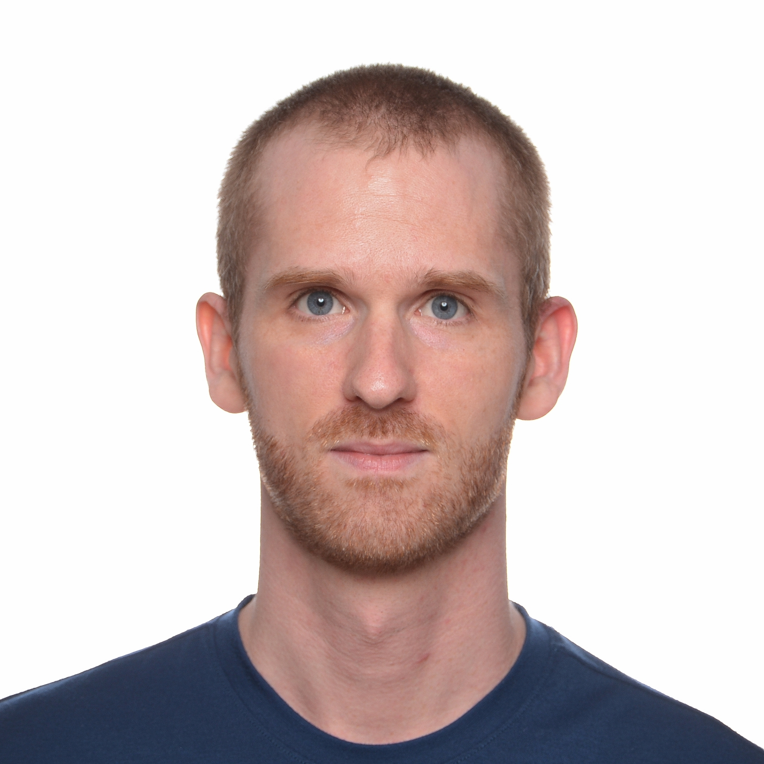
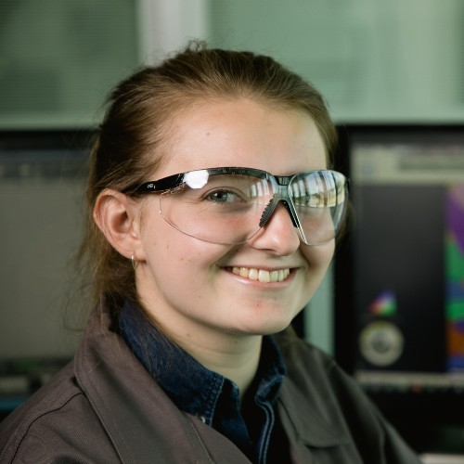

Questions?
Thanks to the team!

Slide 20
Backup

Slide 21
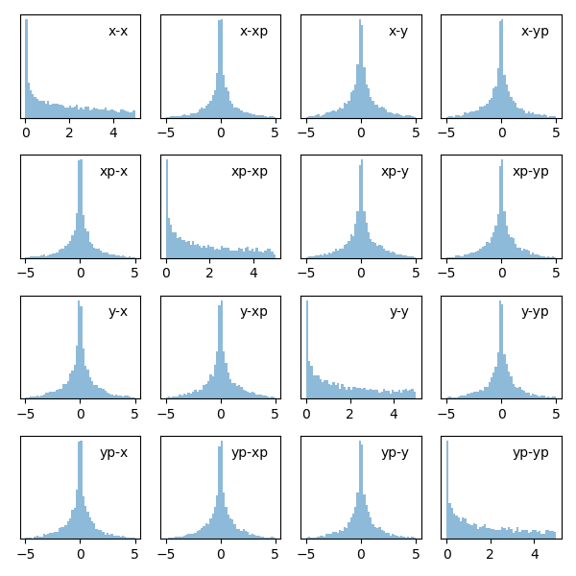



Bayesian Statistical Analysis for Beam Matrix Components
$$p\left(B|A\right)=\frac{p\left(A|B\right)p(B)}{p(A)}$$
p(B): the prior
p(A|B): the likelihood (evidence)
P(B|A): the posterior
$${10}^{−6}$$

Slide 22


Beam Matrix Uncertainty Quantification
Bayesian inference
Data
Posterior distribution
Prior distribution

Slide 23




Emittance Posterior + Beamsize Fit
$$ε=0.10±0.02 mm mrad$$
$$ε=0.20±0.05 mm mrad$$
Calculate mean, median, variance, quantiles etc.

Slide 24


Hysteresis Modeling
Modeling w/o Hysteresis
Modeling w/ Hysteresis
Roussel R. et al., Accepted by PRL

