Slide 1
Dynamic/Momentum Aperture Optimization with MultipointBAX
Apr 9, 2025
D. Ratner on behalf of Z. Zhang, X. Huang
SLAC National Accelerator Laboratory

Slide 2
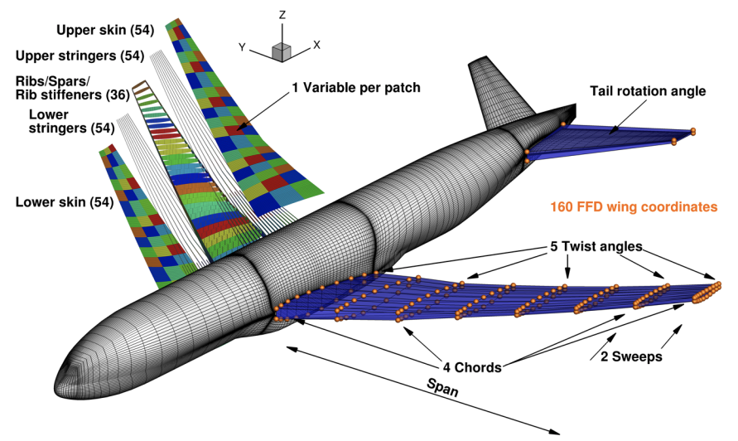
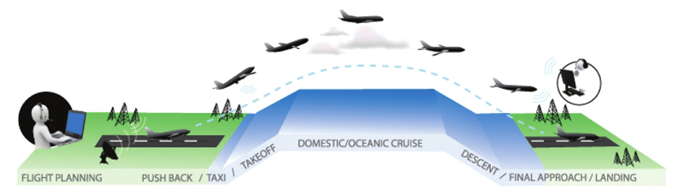
Multi-point optimization
Classic problem from aeronautics design:
how to optimize an airplane wing?
Choose a design
Simulate range of conditions
Combine into single metric / multiple metrics
Loop to step 1
Kenway, Martins (2014)
Very slow process!
Very information inefficient!
Image courtesy FAA

Slide 3
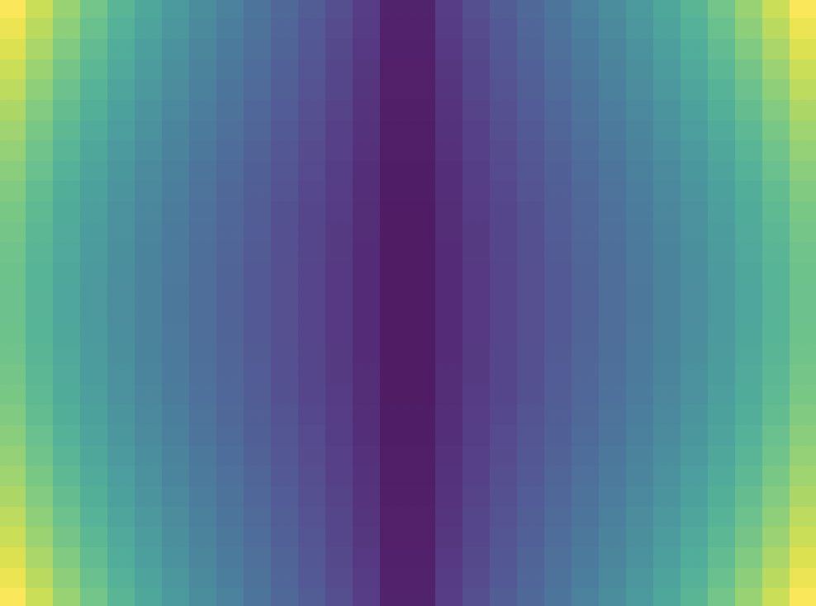
Emittance example
Accelerator example: emittance optimization
Beam size measurement
Beam size measurement
Tuning param (e.g. solenoid)
Tuning param (e.g. solenoid)
Measurement parameter
(e.g. matching quadrupole)
Measurement parameter
(e.g. matching quadrupole)
Calculate emittance
BO has multiple problems:
Sampling inefficient
Information inefficient
Difficult to model
Models beam size efficiently…
…but we want to minimize emittance, not beam size
W. Neiswanger, S. Miskovich, A. Edelen
S. Miskovich et al., MLST, 2024

Slide 4



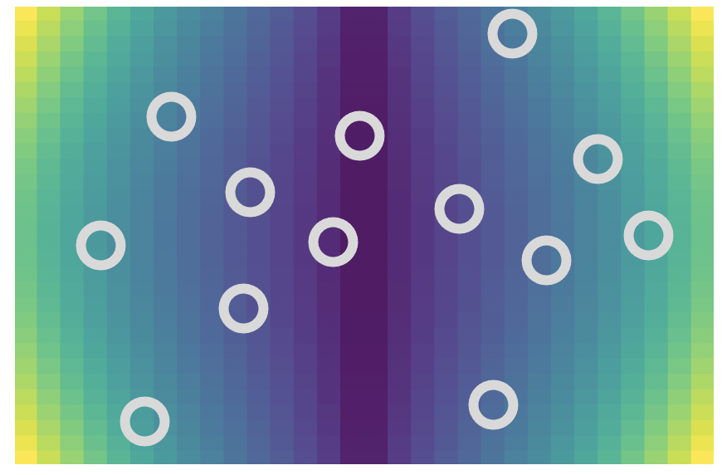
Emittance example
Bayesian Algorithmic Execution (BAX)
Standard BO: model and find optimal point in black box function
BAX: model , and find optimal output of , for known algorithm
Emittance example:
Model beam size behavior,
Algorithm, , outputs minimum emittance from
Measure new beam size that has the biggest impact on output of
Note: We never actually measure emittance… just calculate from a virtual model!
(For computer scientists, infoBAX acquisition function calculated from mutual information of algorithm output and model posterior)
➔ BAX: https://willieneis.github.io/bax-website/
W. Neiswanger et al., ICML, 2021

Slide 5
Emittance example
Accelerator example: emittance optimization
Simulated optimization, LCLS Injector
Experimental optimization, LCLS Injector
~2 minutes
S. Miskovich et al., MLST, 2024

Slide 6
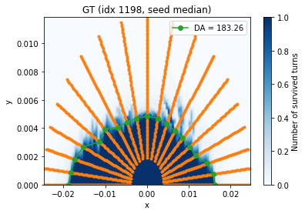
Application to dynamic/momentum aperture
Now consider dynamic aperture (DA) optimization for storage rings
Goal: maximize dynamic aperture (i.e. the dark area):
Y-pos
DA is a hard problem for two reasons:
High dimensional optimization (typically 10s to 100s of parameters)
Acquisition is expensive: Each calculation of the objective function requires tracking 100s -1000s of particles for 1000s of turns
X-pos

Slide 7
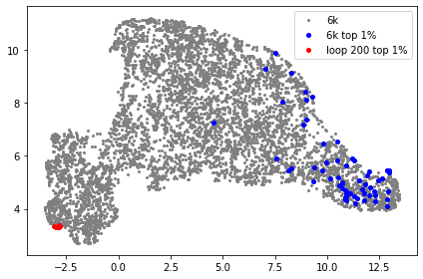
ML for DA/MA Optimization
ML can address both challenges:
Simulate new DA map (config)
Update objective model
(config → DA area)
Select new map to simulate
Model-driven optimization can improve search efficiency:
  Eg. Bayesian Optimization (BO) more efficient than genetic algorithms
  ➔ surrogate guides search by modeling the Objective
  But each acquisition is slow
BestConfig = Argmax(AreaModel)
Surrogate models (e.g. NN) can accelerate slow simulations:
  But how to train surrogate models? Pre-training on random simulations eats-away at simulation savings.
Physics sim ➔ NN surrogate

Slide 8
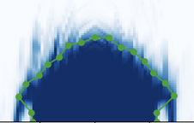
Application to dynamic/momentum aperture
multipointBAX combines both advantages:
Standard BO: model and find optimal point in black box function
BAX: model , and find optimal output of , for known algorithm
DAMA example:
Model full DA/MA maps
Algorithm, , outputs area of surviving particles from
Simulate new particle that has the biggest impact on output of

Slide 9
Application to dynamic/momentum aperture
MultipointBAX for DA:
  Each acquisition is a single point (1 config, 1 particle)
  Surrogate model predicts the DA map
  Algorithm calculates the blue area of the map
  BAX acquisition: picks the most informative acquisition point
BAX
BO
Simulate single point (config, x, y)
Retrain DA Map Surrogate
Calculate objective from surrogate
Select new point to simulate
Simulate new DA map (config)
Update objective model
(config → DA area)
Select new map to simulate
BestConfig = Argmax(Area(MapModel))
BestConfig = Argmax(AreaModel)

Slide 10
SSRL-X example
Test problem: Ring design for SSRL-X
  Tuning 6 sextuple families
Traditional approach
  Parallel particle tracking to evaluate DA and MA
    1.3k particle tracking for DA
    1.0k particle tracking for MA
  MOPSO:
    200+ pop/generation
    100+ generations
    3-4M+ trackings for both DA and MA
Z. Zhang

Slide 11
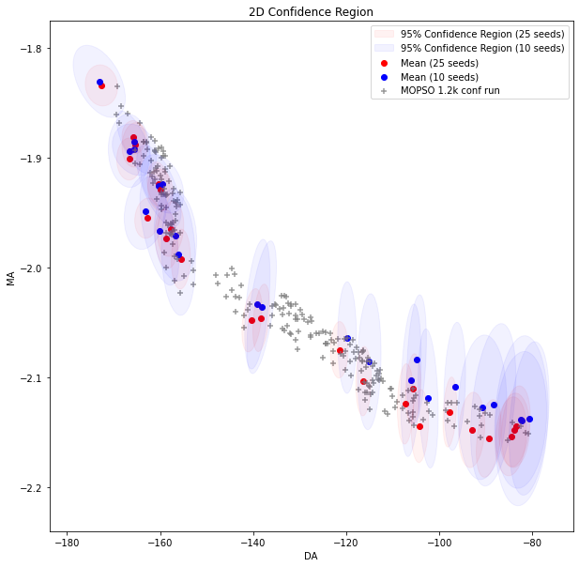
SSRL-X example
Full BAX procedure
Initialize NN with 3000 points from random configs
Run 100 generations NSGA-II on NN
Select Pareto front
Select simulate 200 configs/points to simulate with random error seed for each point
Run 10 epochs retraining
Return to step 2
Final loop run full DA/MA simulations on selected points
Simulate 200 points (config, x, y)
Retrain DAMA NNs
Run GA on surrogate
Select pareto front (PF)
Update training set
Select border points from PF
Last loop run full simulations on 10 configs
Pre-train 100 epochs
Initialize 3000 random points
BestConfig = ParetoFront(Area(NN))

Slide 12
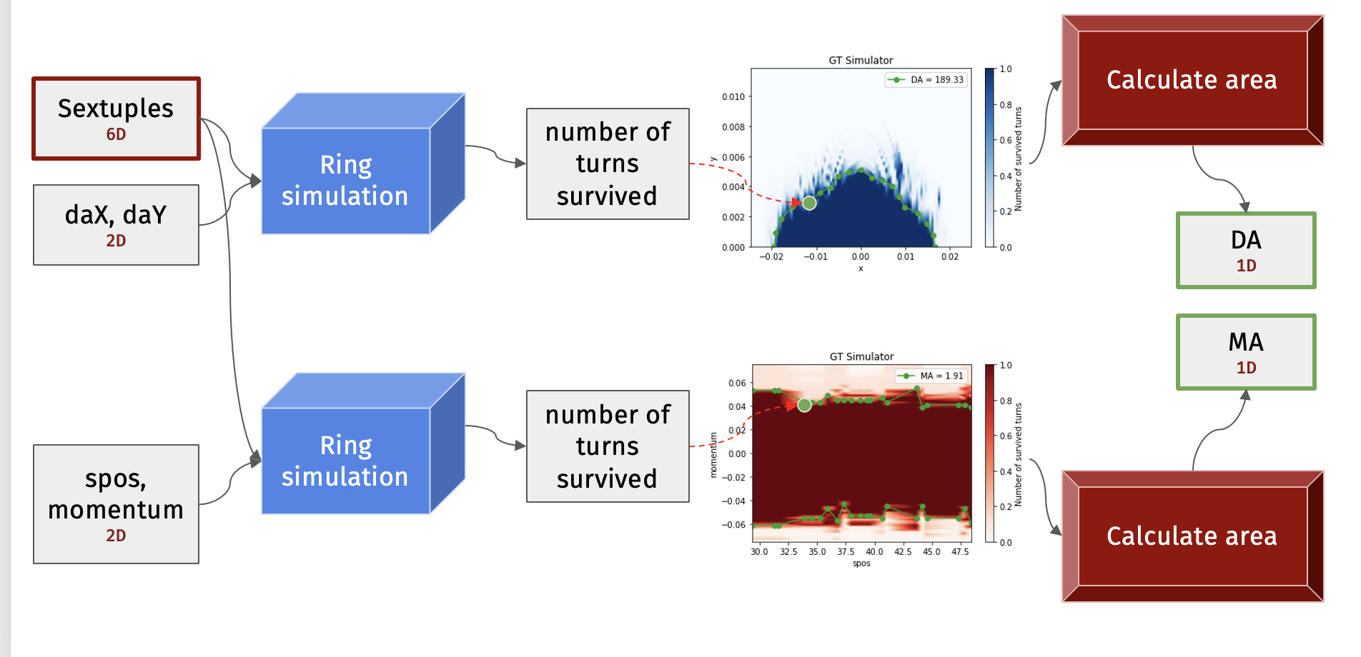
SSRL-X example
NN architecture:
Neural field: config + coordinate ➔ # of turns survived
Moderate size: 6 layers, ~8M parameters, not heavily optimized
DA pipeline
NN
NN
MA pipeline
Z. Zhang

Slide 13
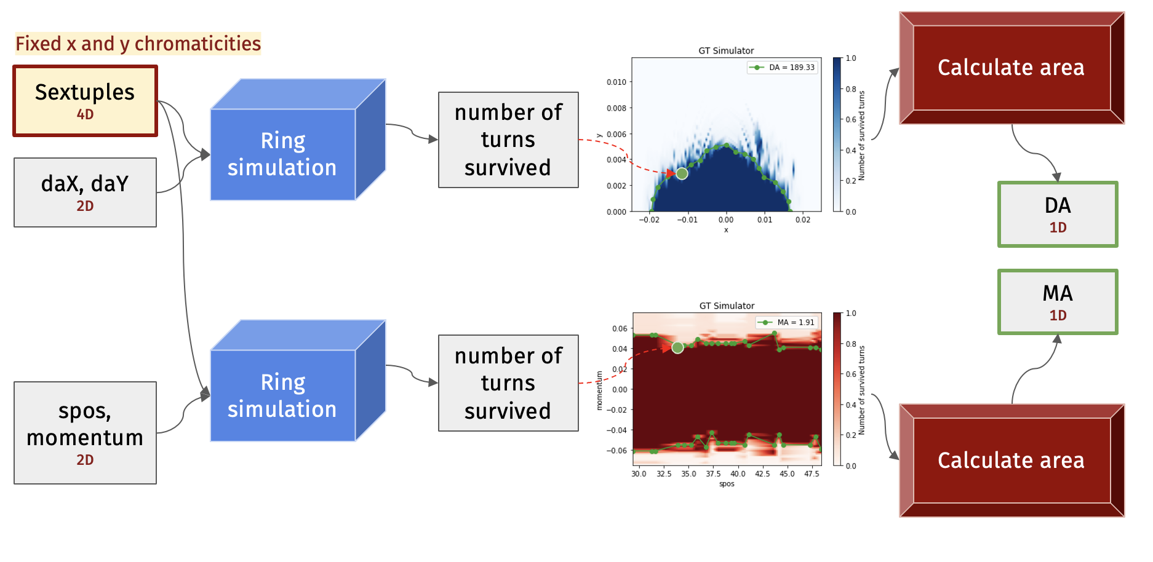
SSRL-X example
NN architecture:
Neural field: config + coordinate ➔ # of turns survived
Moderate size: 6 layers, ~8M parameters, not heavily optimized
DA pipeline
NN
NN
MA pipeline
Z. Zhang

Slide 14
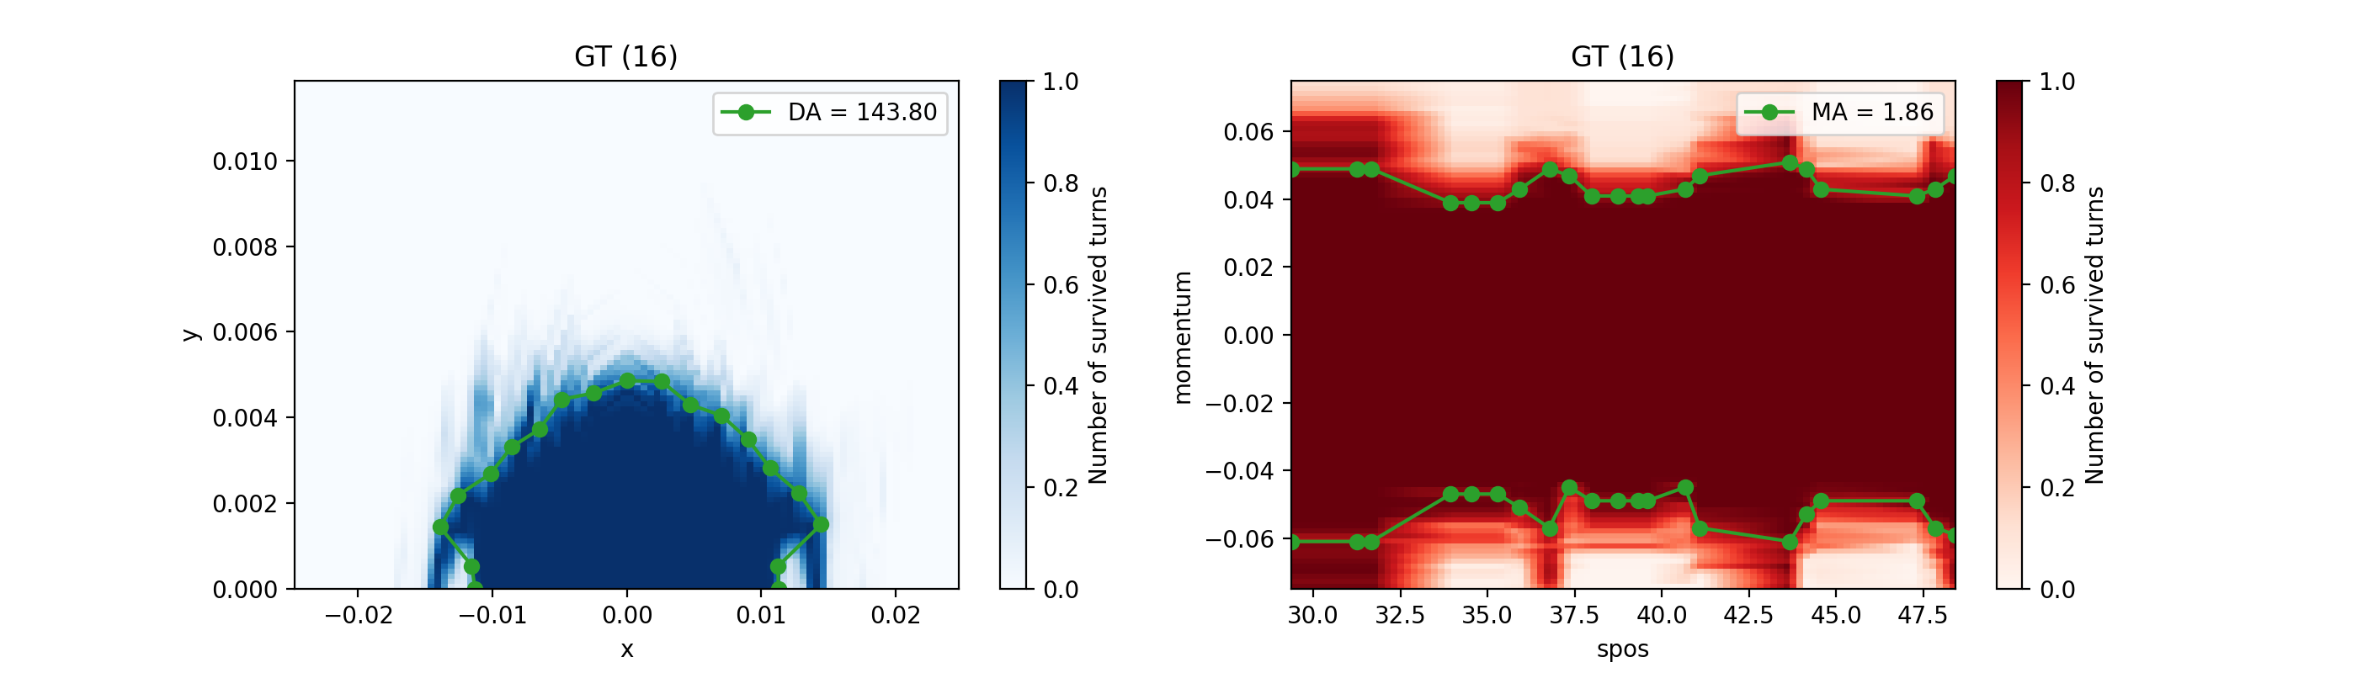
SSRL-X example
Evolution of the NN prediction vs. BAX loop
y
NN prediction
momentum
y
momentum
GT Simulation
x
s-pos
Z. Zhang

Slide 15
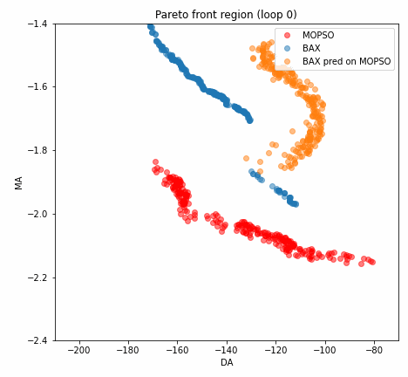
SSRL-X example
Our goal: optimize Pareto-front hyper volume:
Red: MOPSO baseline run
Blue: BAX model prediction
Yellow: BAX model on MOPSO simulations
Momentum aperture score
Yellow predictions give sense of model accuracy… but need full simulation to confirm
Dynamic aperture score
Z. Zhang

Slide 16
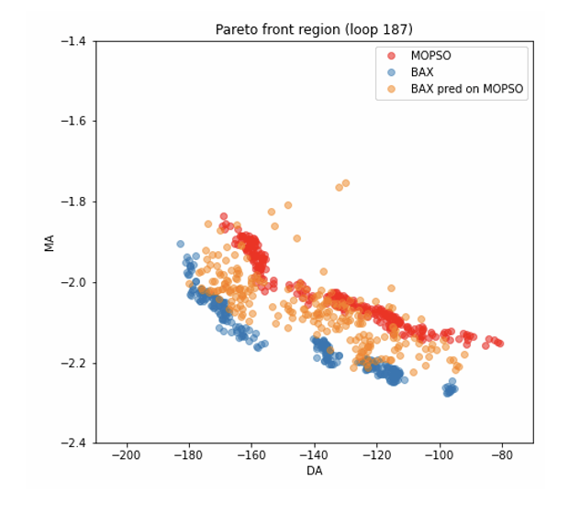
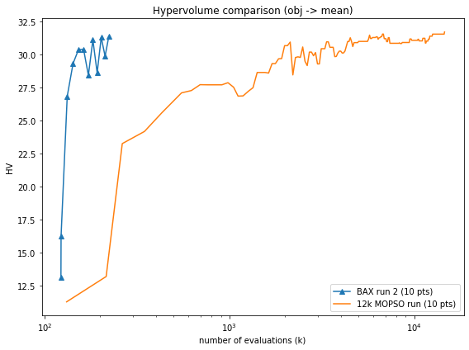
SSRL-X example
BAX vs. MOPSO Hypervolume
Select 10 configurations on PF
Run full simulations (10 error seeds) for each configuration
Calculate hypervolume
20x speedup
Cost includes final simulation!
BAX
MOPSO
Hypervolume
Number of acquisitions
Z. Zhang

Slide 17
Conclusion
Current status:
Proof-of-principle study on 4-dimension optimization at SSRL-X
Factor of 20x speed-up compared to MOPSO
Next steps:
Shift NN from predicting mean to distribution
Introduce robustness, e.g. minimizing sensitivity to error seeds
Tackle more challenging problems, e.g. FCCee?
Thanks for listening!
Work completed by Zhe Zhang (main author)
Thanks to Ilya Agapov, Sathya Chitturi, Sean Gasiorowski, Thorsten Hellert, Xiaobiao Huang, and Willie Neiswanger for helpful discussions

Slide 18
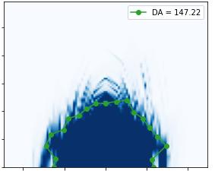

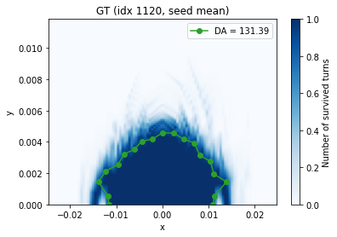
Next steps
Scoring: mean(objective) vs. objective(mean map)
Maps for each seed
Area for each seed
Final score
DA-1
MOPSO score
DA-2
Mean DA
DA-3
…
Maps for each seed
Average map
Final score
BAX Score
NN
Mean DA
Z. Zhang

Slide 19
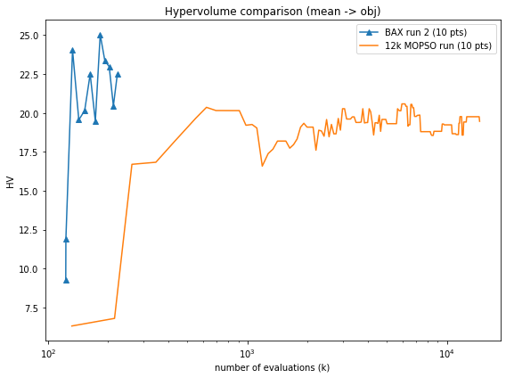
Next steps
Scoring: mean(objective) vs. objective(mean map)
Better solution found when using the BAX algorithm objective
➔ matching the true objective will improve results
Requires NN to predict map distribution, not mean map
Using BAX Score
Using MOPSO Score
BAX
BAX
MOPSO
MOPSO
Hypervolume
Hypervolume
Number of acquisitions
Number of acquisitions
Z. Zhang

Slide 20
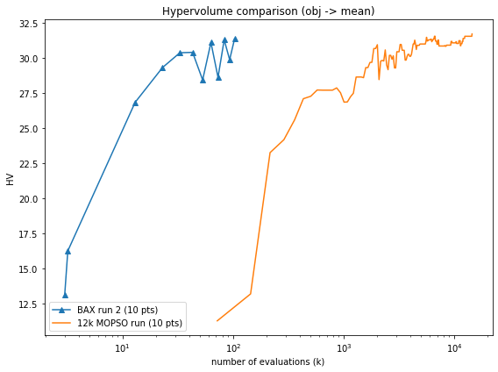
SSRL-X example
BAX vs. MOPSO Hypervolume
Select 10 configurations on PF
Run full simulations (10 error seeds) for each configuration
Calculate hypervolume
40x speedup
Cost without final simulation!
BAX
MOPSO
Hypervolume
Number of acquisitions
Z. Zhang

Slide 21
Application to dynamic/momentum aperture
Two ways to estimate advantage of BAX:
  BO models 1 scalar for each 1000 simulations ➔ up to 1000x gains
  BO simulations are redundant, i.e. could predict map with fewer sims ➔ more than 10x gains.
  ➔ Expect somewhere 10x to 1000x gain in efficiency from BAX
BAX
BO
Simulate single point (config, x, y)
Retrain DA Map Surrogate
Calculate objective from surrogate
Select new point to simulate
Simulate new DA map (config)
Update objective model
(config → DA area)
Select new map to simulate
BestConfig = Argmax(Area(MapModel))
BestConfig = Argmax(AreaModel)

