Slide 1

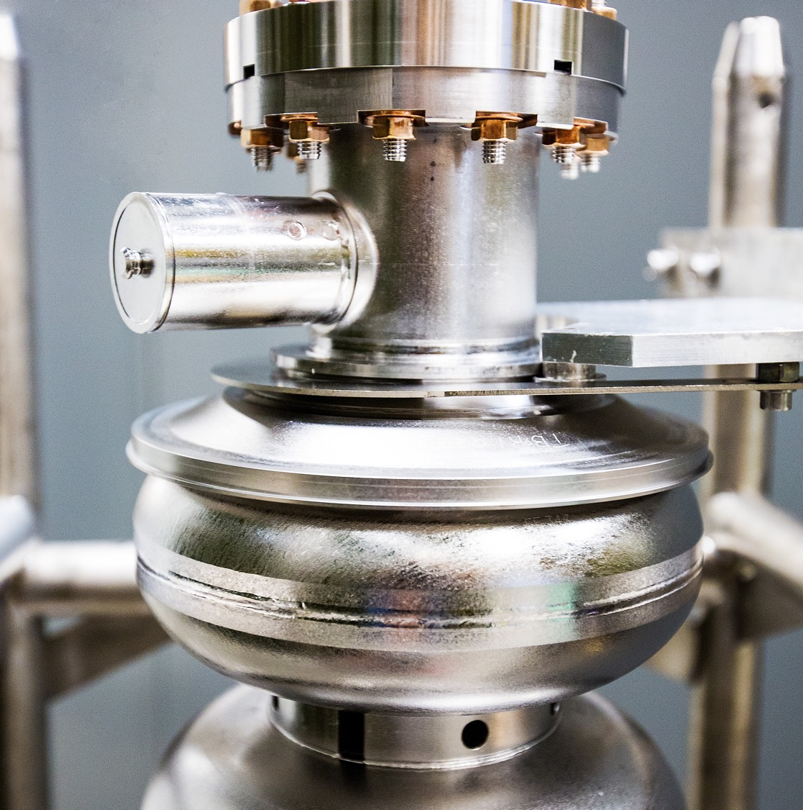
Multi-Objective Optimization in Particle Accelerators
Harnessing the Power of Gradient-Based Simulations
Mar 24, 2025
Kishansingh Rajput
This research was supported by the U.S. Department of Energy, through the “Data-Driven Decision Control for Complex Systems (DnC2S)” project under the Advanced Scientific Computing Research program and the ”Next Generation Compact SRF Accelerators for Industrial Applications” project under the Nuclear Physics program. Contributions from Auralee Edelen and Ryan Roussel were supported by the Department of Energy, Laboratory Directed Research and Development program at SLAC National Accelerator Laboratory, under contract DE-AC02-76SF00515.
Notes:
Tip: Keep titles under 60 characters for readability
To change the photo: Right-click on photo and select change photo

Slide 2
Outline
Multi-Objective Optimization (MOO) with trade offs
Background on optimization algorithms
  Genetic Algorithms
  Bayesian Optimization
  Reinforcement Learning
Deep Differential Reinforcement Learning algorithms to leverage differential simulations
Problem Setup: A MO constrained optimization problem
MOO without Differential Simulation
Results and insights
Conclusion
Notes:
Guidelines: 6-8 bullets per slide; Use sentence fragments for bullets

Slide 3
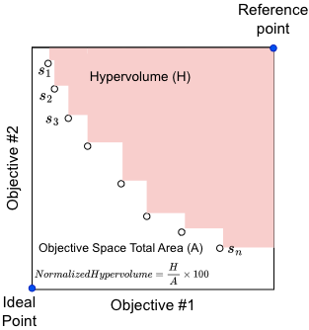
Multi-Objective Optimization: balancing trade-offs
Simultaneously optimizing two or more objectives (usually conflicting)
Find set of solutions where no solution dominates another; Pareto front
Constrained Multi-objective Optimization (MOO) problems include constrains on states that a system can take (controls may include: constraints on actions, or both)
Avoid any solutions that may violate the constraints
Notes:
Guidelines: 6-8 bullets per slide; Use sentence fragments for bullets

Slide 4
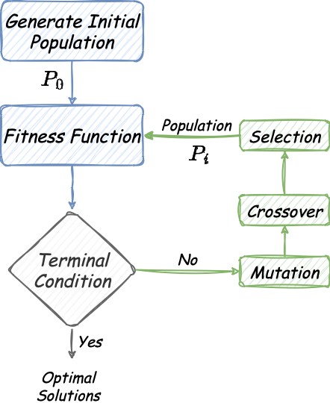
Genetic Algorithm (GA)
Requires running fitness function (simulation) for each individual in population at each step!
Can not leverage gradient propagation through simulations.
Mimics natural selection and evolution.
Works with a group of potential solutions – individuals in a population
Evolutionary Process:
  Fitter individuals (solutions) are chosen for reproduction – based on fitness function
  Combines genetic material (information) from selected individuals.
  Introduces random changes to enhance diversity.
Repeats the process (selection, crossover, mutation) to find better solutions over generations.
Used to solve optimization problems in various fields including particle accelerators[2].
Notes:
Guidelines: 6-8 bullets per slide; Use sentence fragments for bullets

Slide 5
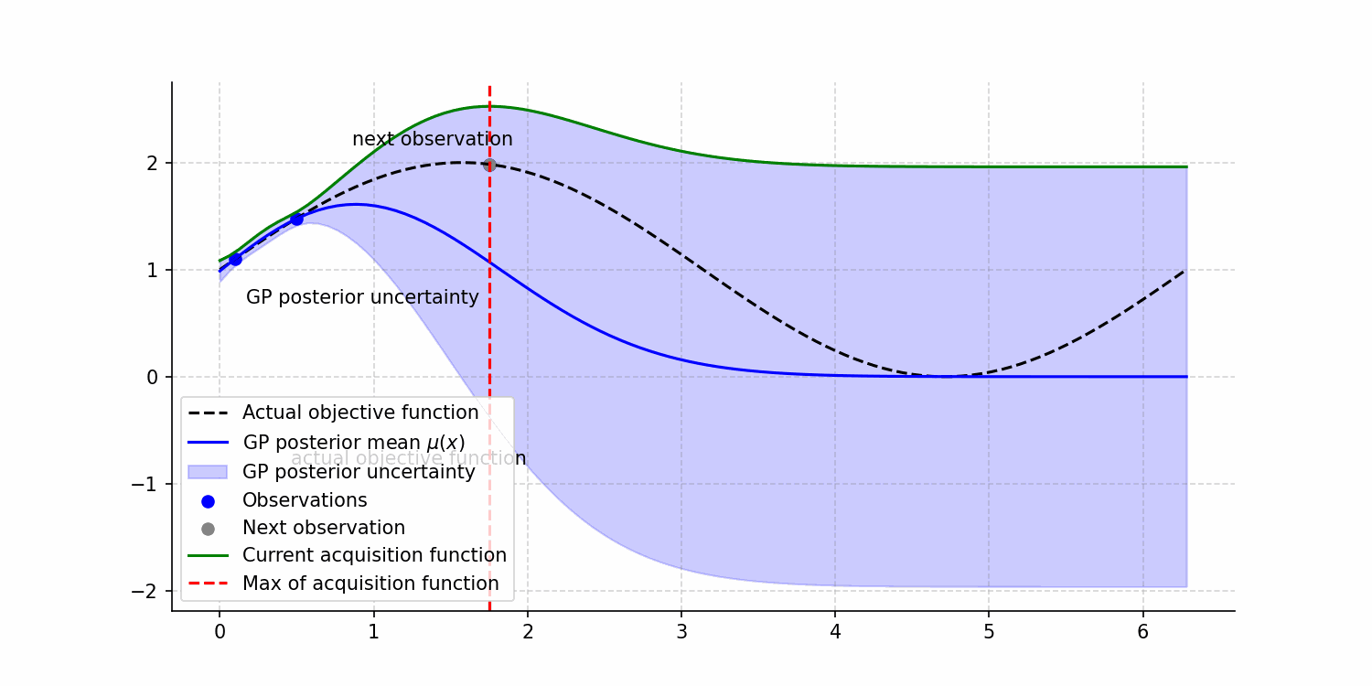
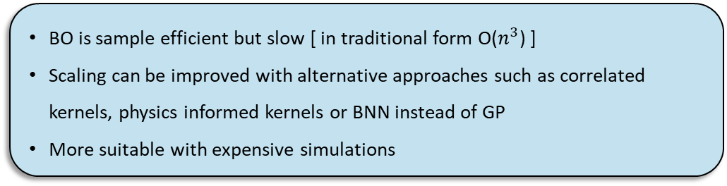
Bayesian Optimization
A probabilistic surrogate model to approximate the unknown objective function
Balances exploration and exploitation
An acquisition function guides the search for the next point to evaluate
Few examples of acquisition functions are Expected Improvement (EI), Probability of Improvement (PI), and Upper Confidence Bound (UCB)
At each step, the model suggests the next point to evaluate based on past evaluations and the acquisition function
Surrogate model is updated with new data gathered and refine the search for global optimum
Widely used for optimization in particle accelerator application[3] and have robust frameworks available, ex. Xopt[4]
BO is sample efficient but slow [ in traditional form O($n^{3}$) ]
Scaling can be improved with alternative approaches such as correlated kernels, physics informed kernels or BNN instead of GP
More suitable with expensive simulations

Slide 6
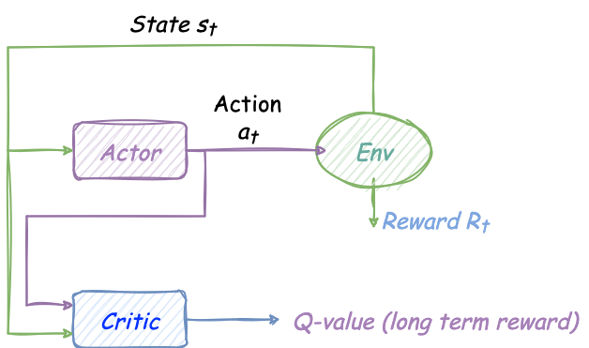
Reinforcement Learning
Actor-Critic setup
Reinforcement Learning (RL) is a controls algorithm by design
It iteratively interacts with the environment to learn
The agent produces an action and applies to the environment
The environment provides a reward (similar to fitness in GA),
Reward quantifies how good a given action was
Balances between exploration and exploitation to learn global optimal
A few examples of deep RL algorithms are, Deep Q-network, Deep Deterministic Policy Gradient (DDPG), Twin-Delayed DDPG (TD3)
SOCT: Scientific Optimization and Control Toolkit; a robust RL toolkit designed with a focus on scientific applications (actively maintained; addition of new recent algorithms) [5]
In its traditional form deep RL is not sample efficient
Requires many interactions with the simulation
More suitable with fast and less expensive simulations
RL can be modified to leverage differential simulations to be sample efficient
Notes:
Guidelines: 6-8 bullets per slide; Use sentence fragments for bullets

Slide 7
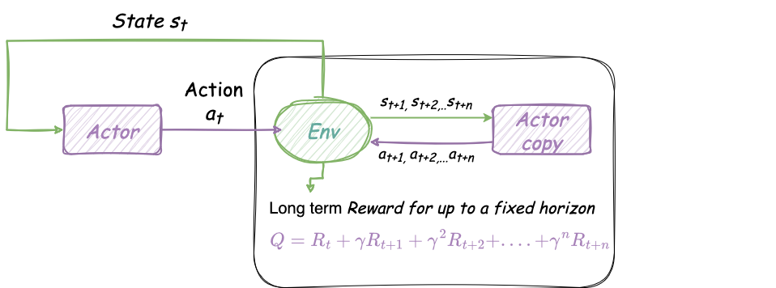
Deep Differential Reinforcement Learning
Deep Differential Reinforcement Learning (DDRL) requires differential environment
Learns quickly by leveraging back-propagation via environment
Notes:
Guidelines: 6-8 bullets per slide; Use sentence fragments for bullets

Slide 8
Problem Setup

Slide 9
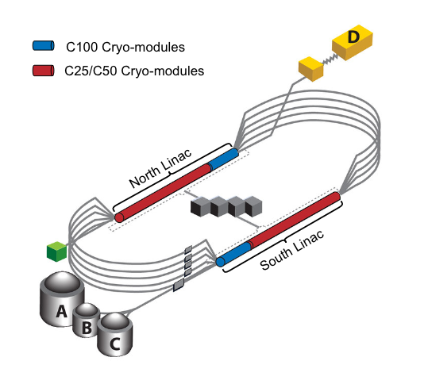
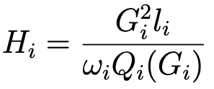
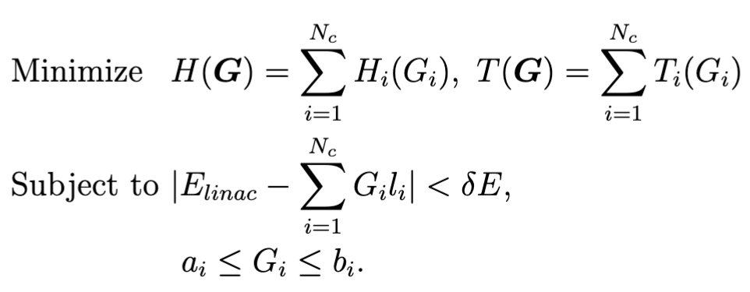





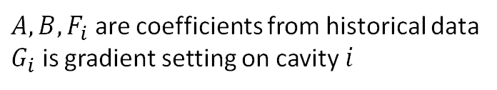
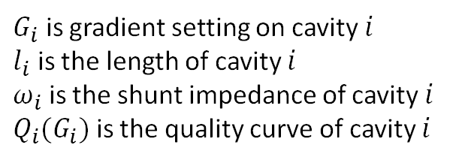
Multi-Objective Optimization at CEBAF
Continuous Electron Beam Accelerator Facility uses super conducting RF cavities
The facility uses total 25 cryo-modules with roughly 200 cavities in each linac
Challenge: Distribution of gradients to simultaneously optimize both heat load on cryo-system and number of trips while maintaining required beam energy
$$E_{linac}= \sum_{i=1}^{n}{G_{i}l_{i}}$$
Heat load of cavity $i$
$G_{i}$ is gradient setting on cavity $i$
$l_{i}$ is the length of cavity $i$
$ω_{i}$ is the shunt impedance of cavity $i$
$Q_{i}(G_{i})$ is the quality curve of cavity $i$
$$a_{i}≤G_{i}≤b_{i}$$
Individual cavity gradient is bounded
Multi-Objective Optimization Problem
Fast Shut Down (FSD) Trips
Trip rate of cavity $i$
$A, B,F_{i}$ are coefficients from historical data
$G_{i}$ is gradient setting on cavity $i$
Notes:
Guidelines: 6-8 bullets per slide; Use sentence fragments for bullets

Slide 10
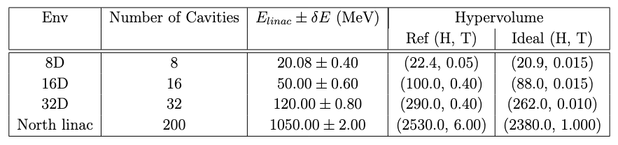
Simulation (Environment)
Simulated environment is built in python using the ideal equations
Devised four environments to gradually increase the problem complexity
OpenAI gymnasium standards for plug and play
TensorFlow implementation for auto-gradient calculation and back-propagation
Notes:
Guidelines: 6-8 bullets per slide; Use sentence fragments for bullets

Slide 11
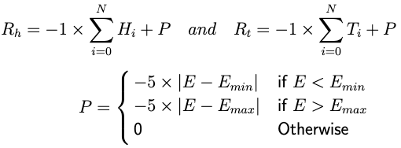
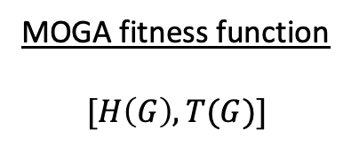
Optimization without differential Simulation
GA, BO, and traditional RL algorithms (here TD3) do not require differential simulations
We used Constrained multi-objective variants, i.e. MOGA, MOBO, MORL
MOGA implementation from NSGA-II
MOBO implementation from Xopt
MORL implementation with conditional policy
MOGA fitness function
$$[H\left(G\right), T(G)]$$
MOBO acquisition function
expected hypervolume improvement (EHVI)
Constraints modeled as separate GP and used in acquisition function
MORL Reward Function
Notes:
Guidelines: 6-8 bullets per slide; Use sentence fragments for bullets

Slide 12
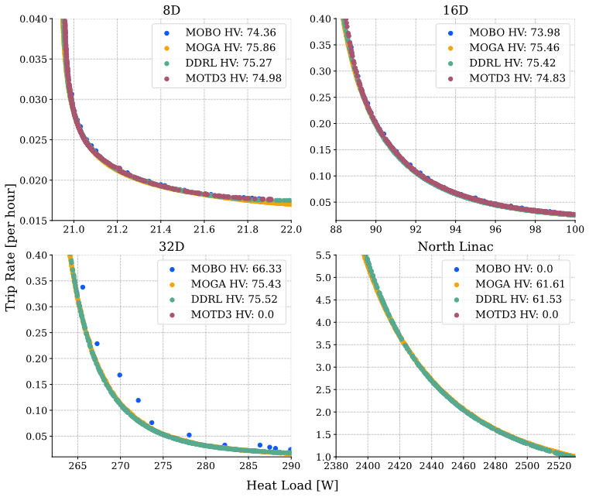
Results: Pareto Front
15 Trials for each combination of algorithms and env
Best Pareto fronts after convergence from 15 trials
On 8D, and 16D, all algorithms find similar solutions
On higher dimensional problems MOGA, and DDRL beats traditional MOBO, and TD3
Notes:
Guidelines: 6-8 bullets per slide; Use sentence fragments for bullets

Slide 13
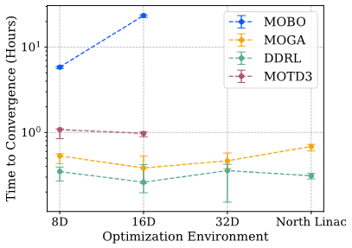
Results: Convergence Time
DDRL is fastest to converge on all the environments
MOGA is second best in convergence time (and performance)
MOGA, DDRL do not demonstrate significant increase in time to convergence from 8D to North linac
MOBO and TD3 did not converge on 32D and North linac within 24 hours (upper limit)

Slide 14
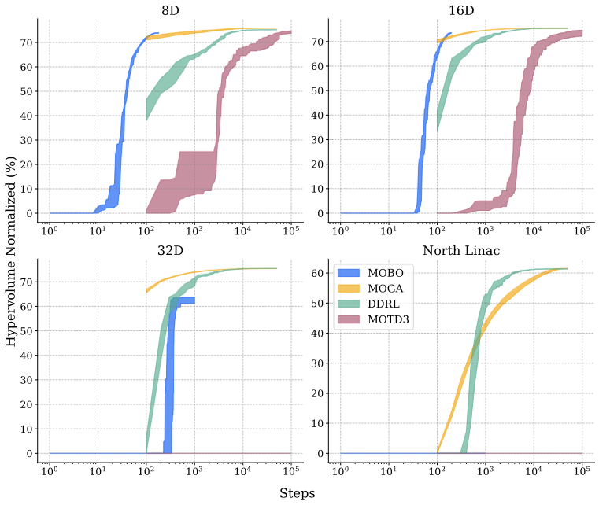
Results: Hypervolume Evolution
MOBO is best in being sample efficient on low dimensional problems
DDRL and MOGA are faster to converge in time but takes significantly more simulation runs
MOBO is to be preferred with smaller problems where simulation is slow
Notes:
Guidelines: 6-8 bullets per slide; Use sentence fragments for bullets

Slide 15
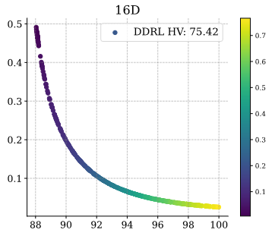
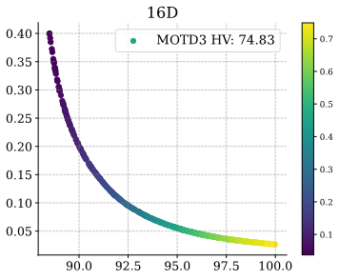
Results: Conditional Policy
Conditional inputs to the RL algorithms
Conditional input used with the actor model to gain control over solutions in pareto front
Can become tunable parameters for operators to choose optimal point on a Pareto front given current requirements
Notes:
Guidelines: 6-8 bullets per slide; Use sentence fragments for bullets

Slide 16
Conclusion
Compared Constrained MOTD3, MOGA, MOBO, and MO-DDRL algorithms
Devised four optimization environments to demonstrate how the comparison depends on problem complexity
Demonstrated DDRL leverages differentiability of the environment to outperform other algorithms in convergence speed on high dimensional problems
On smaller scale problems all the algorithms in comparison reached similar solution, but MOBO is slowest even being sample efficient (attributed to fast simulation)
MOBO, MOTD3 did not converge on higher dimensional problems, suspected to be due to high dimensionality and combination of local and global hard-constraints
Future work:
  Enhance MOTD3 warmup to converge on higher dimensional problems
  Optimize MOBO to deal with the high dimensional constrained problems
  Evaluate DDRL in sequential control and dynamic environment settings
Notes:
Guidelines: 6-8 bullets per slide; Use sentence fragments for bullets

Slide 17
Acknowledgement
Presentation based on: https://doi.org/10.1088/2632-2153/adc221
I would like to thank my co-authors Malachi Schram, Auralee Edelen, Jonathan Colen, Armen Kasparian, Ryan Roussel, Adam Carpenter, He Zhang, and Jay Benesch.
This research was supported by the U.S. Department of Energy, through the Office of Advanced Scientific Computing Research’s “Data-Driven Decision Control for Complex Systems (DnC2S)” project. Contributions from A.E. and R.R. were supported by the Department of Energy, Laboratory Directed Research and Development program at SLAC National Accelerator Laboratory, under contract DE-AC02-76SF00515. This manuscript has been authored by Jefferson Science Associates (JSA) operating the Thomas Jefferson National Accelerator Facility for the U.S. Department of Energy under Contract No. DE-AC05-06OR23177. The authors acknowledge support by the
U.S. Department of Energy, Office of Science. The US government retains and the publisher, by accepting the article for publication, acknowledges that the US government retains a nonexclusive, paid-up, irrevocable, worldwide license to publish or reproduce the published form of this manuscript, or allow others to do so, for US government purposes. DOE will provide public access to these results of federally sponsored research in accordance with the DOE Public Access Plan (http://energy.gov/downloads/doe-public-access-plan)
Notes:
Guidelines: 6-8 bullets per slide; Use sentence fragments for bullets

Slide 18
QUESTIONS?

Slide 19
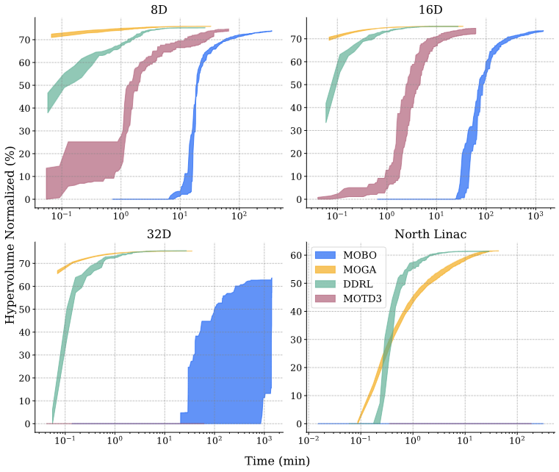
Appendix
Notes:
Guidelines: 6-8 bullets per slide; Use sentence fragments for bullets

