Slide 1
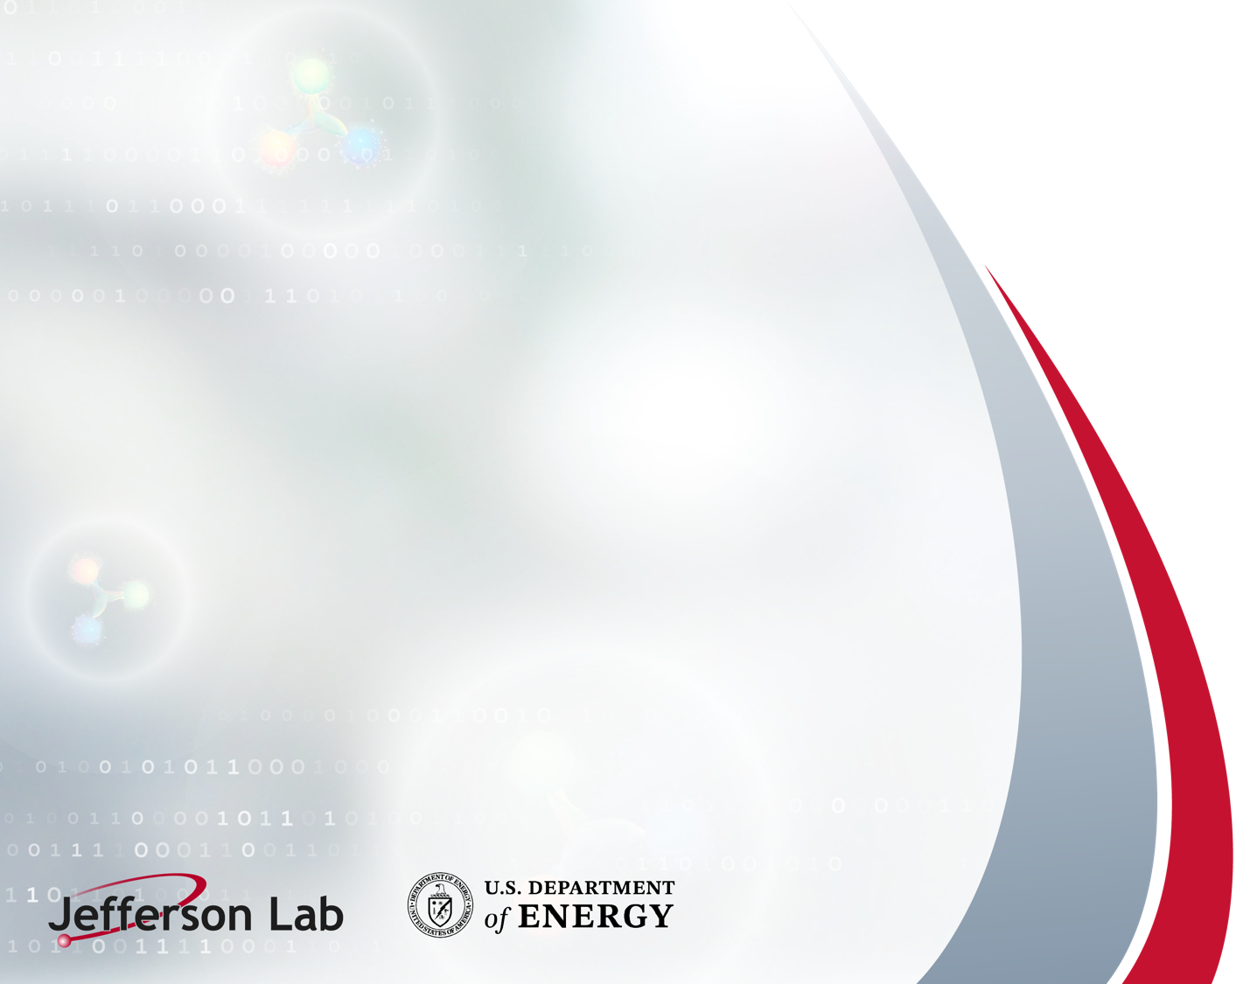
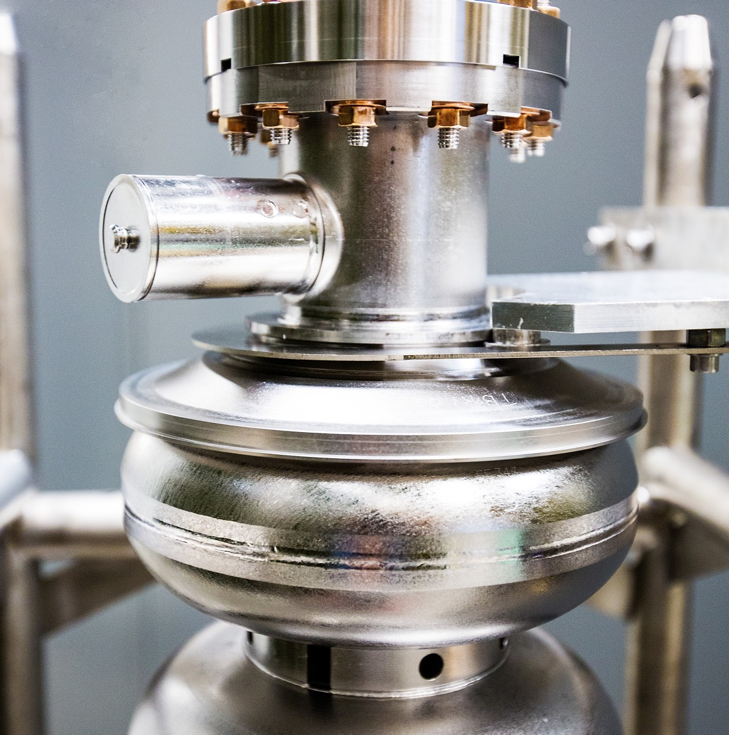

Virtual to Physical
Reinforcement Learning to Optimize SNS Particle Accelerator Controls
April 9th 2025
Armen Kasparian

Slide 2
Acknowledgment
This research used resources at the Spallation Neutron Source and Jefferson Laboratory and is supported by the DOE Office of Science, United States under Grant No. DE-SC0009915
ORNL is managed by UT-Battelle, LLC for the US Department of Energy
JLab is managed by Jefferson Sc. Assoc., LLC for the US Department of Energy

Slide 3
Mission Statement
Create an automated control system using Reinforcement Learning that can respond to the dynamics of a complex accelerator through continuous interaction
4/9/2025

Slide 4
Outline
Background Knowledge
  a. What is Reinforcement Learning (RL)
  b. SNS accelerator
  c. Virtual Accelerator (VIRAC)
What is our challenge?
What do we have to work with?
Our approach
  a. Scientific Optimization and Controls Toolkit
  b. Environment
Initial Results
Current work

Slide 5
Background

Slide 6
What is Reinforcement Learning?
Learning from interaction with an environment to achieve/maximize a long-term goal related to the state
Agent
Learns to make decisions and take actions to achieve a specific goal or maximize a reward signal
Environment
Represents the world or system in which the agent operates and learns
Encompasses everything external to the agent that the agent interacts with, observes, and receives feedback from
In summary: Instead of learning how we’ve played the game historically, teach the rules and learn by experience
4/9/2025

Slide 7
Reinforcement Learning Practically: Chess
State: Position of all pieces on board, Whose turn it is, move count etc.
Action: A legal move of a piece
Traditional Machine Learning
Analyze millions+ historical chess games to identify patterns between board positions (states) and moves (actions) that lead to successful outcomes
Mimics skilled players of the past
Reinforcement Learning
Learns by playing millions+ games against itself, receiving rewards for winning positions, gradually improving its strategy through trial and error rather than studying human games
Unique style to humans
Historical Data
Action
Model Training
Policy
Environment
Fixed Model
Predictions
State
Reward
4/9/2025

Slide 8
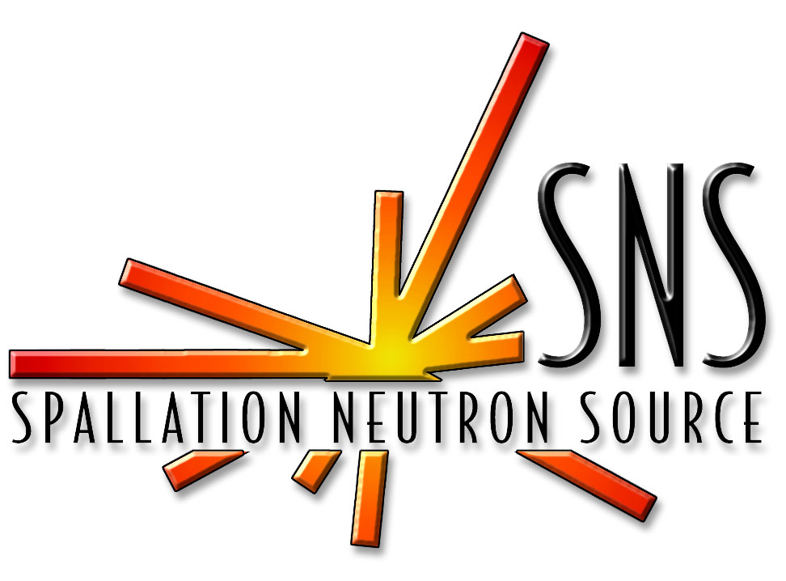
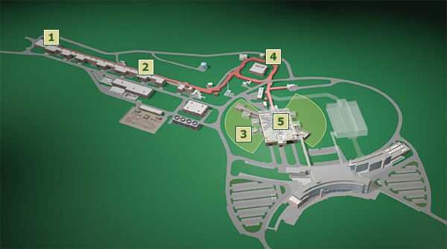
Spallation Neutron Source (SNS)
DOE research facility operating at 1.7 Megawatts
Propels bunches (pulsed) protons that collide with a target to create neutrons
Our initial research focuses on the medium energy beam transport line (MEBT)
MEBT found in linac
4/9/2025
Notes:
MegaWatts!

Slide 9
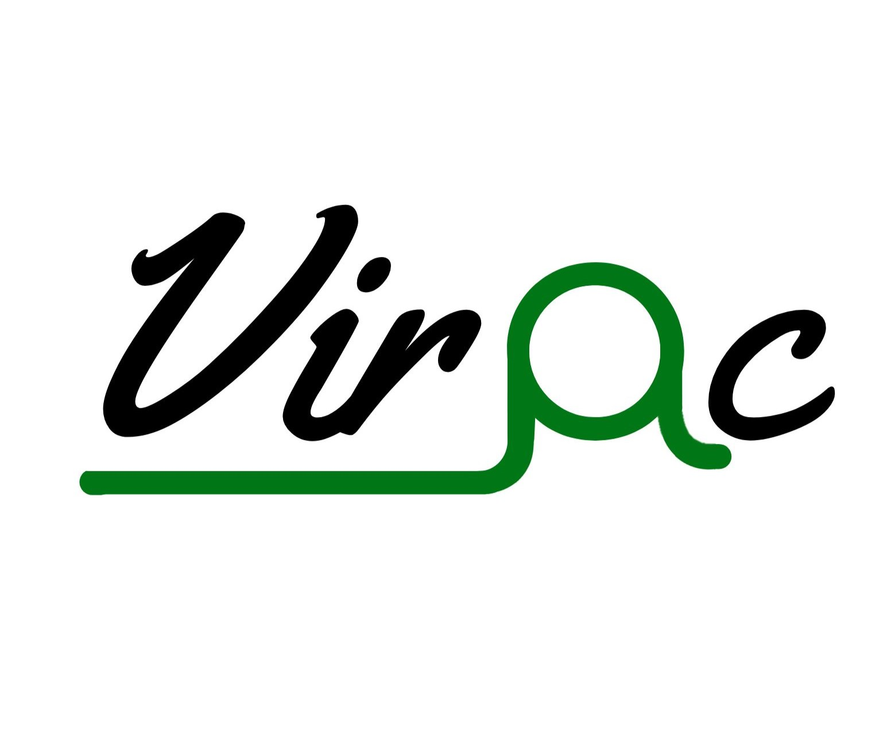
Virtual Accelerator (VIRAC)
Built and developed by the team at ORNL
Developed in Python
  Using PyORBIT
Particle-In-Cell (PIC) models and simulates the dynamics of individual or groups of particles
Interfaced via the Experimental Physics and Industrial Control System (EPICS)
4/9/2025

Slide 10
Our Challenge

Slide 11
What is our challenge?
Reinforcement learning agents begin with randomly instantiated models
Real environments are expensive to train in
  Starting with a randomly instantiated model may be too costly
  RL is not sample efficient
Real environments may not be available to train in
  Real system may not be running
  May be a long lead time until training runs could be available
Virtual environments are not perfect
  Great for exploration but may fall short in certain areas
4/9/2025

Slide 12
What do we have to work with?
Historical run data may be available
  How can we utilize this data to train our agent?
Virtual Accelerator is available
  Unknown differences between real and virtual
    How close is the VIRAC to the real machine?
What options do we have available?
  Can we train our agent to mimic to current control solution?
  Can we pretrain on the VIRAC?
  Can we make a surrogate based of the historical data and train the agent there? (transfer learning)
    Limiting factors with uncertainty quantification in state spaces out of distribution
4/9/2025

Slide 13
Our Approach and Tools

Slide 14
Our Approach
Create an environment mirrored on both the VIRAC and the real accelerator
  State, action, rewards are defined to be the equivalent between the virtual and real system
Train the RL agent on the virtual environment
  Expose the agent to a similar state space it will see on the real accelerator
  Pretraining models
Apply RL agent to the real accelerator
  Inference first to see how well agent is pretrained
  Model retraining as needed
VIRAC
SNS Accelerator
MEBT Environment
MEBT Environment
Train Random Agent
Test Agent
Test Agent
Retrain Agent
4/9/2025
*MEBT Environment does not change, only the system it integrates with changes
Notes:
How much speedup
- what do we do if the first test fails

Slide 15
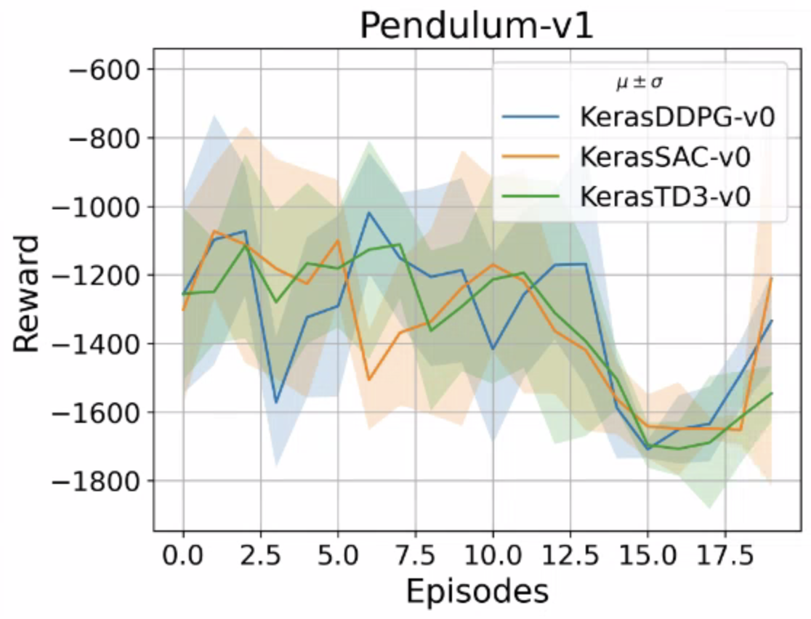
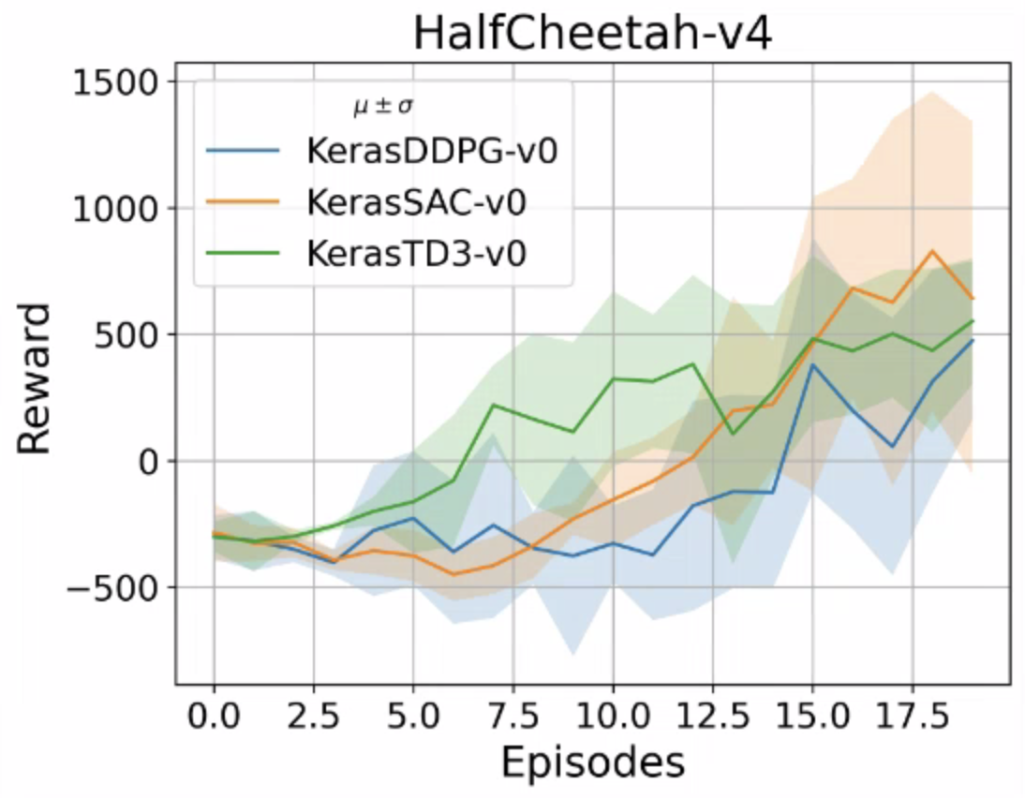
Scientific Optimization Control Toolkit (SOCT)
https://github.com/JeffersonLab/SciOptControlToolkit
Composable
  Easy to add new agents and environments
  Registration mechanism
    Allows for easy development and use of new components
Standard Gymnasium API
  Utilize industry standard environment specification
Visualizations
  Tensorboard integration allows for live monitoring of training
Reproducible
  Models and configurations are saved and stored for inference/retraining
  Easily pull in previous runs for continued research
4/9/2025

Slide 16

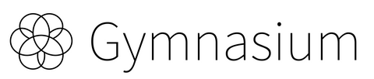

Single Plane MEBT Orbit Correction Environment
Custom Gymnasium environment designed and built for communication between RL agent and SNS/VIRAC accelerators
Goal: Flatten orbit
  State (6): Correctors (2), BPM (3), BPM Amplitude (1)
  Action (2): Correctors (DCH04, DCH05)
  Reward: Maximize the final amplitude reading
SOCT
PACES
4/9/2025
Notes:
Flattening orbit (zero out BPM readings)

Slide 17
Initial Results

Slide 18
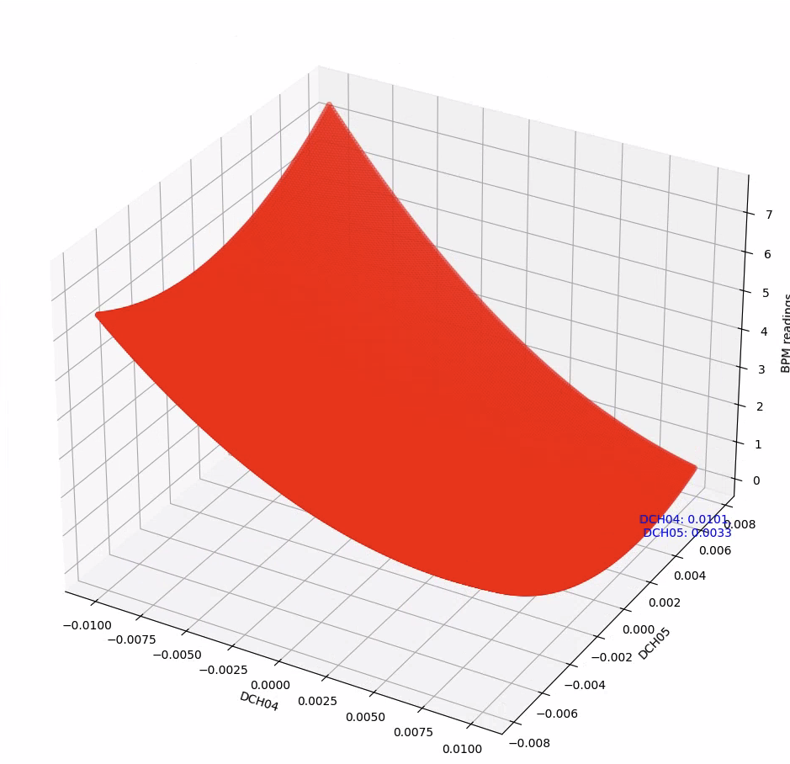
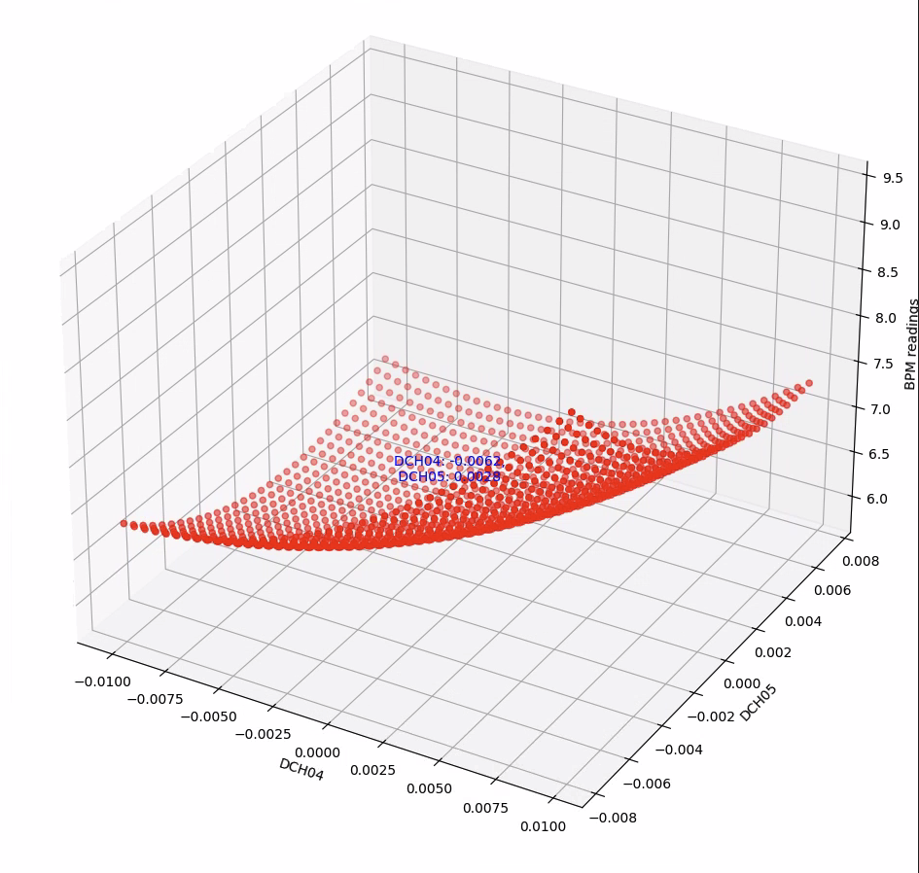
Parameter Sweep
To understand the landscape of our reward a parameter sweep was done of the VIRAC and the real accelerator
  Sweep DCH04/05 and log the reward value
BPM Amplitude
DCH05
DCH04
VIRAC
SNS
4/9/2025

Slide 19
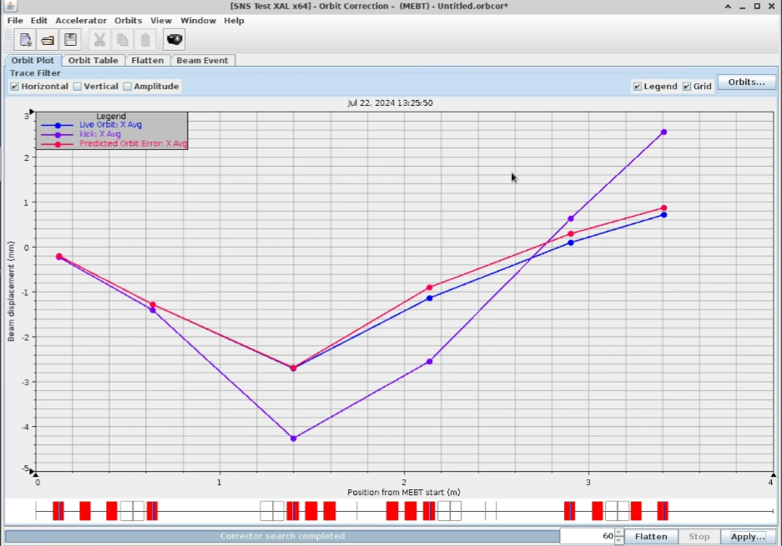
Inference on SNS Accelerator
Traditional
Model pretrained on VIRAC applied in inference to the real accelerator
Purple line shows initial conditions
Red line shows traditional optimization values
Blue line shows the RL agents solution
Our pretrained RL model matched the traditional strategies approach
Center
4/9/2025
Initial
RL Agent
Notes:
Bigger label for the curve
- LABEL THE LINES!
Put them close to the traces
Line at zero is the goal!

Slide 20
Future Work

Slide 21
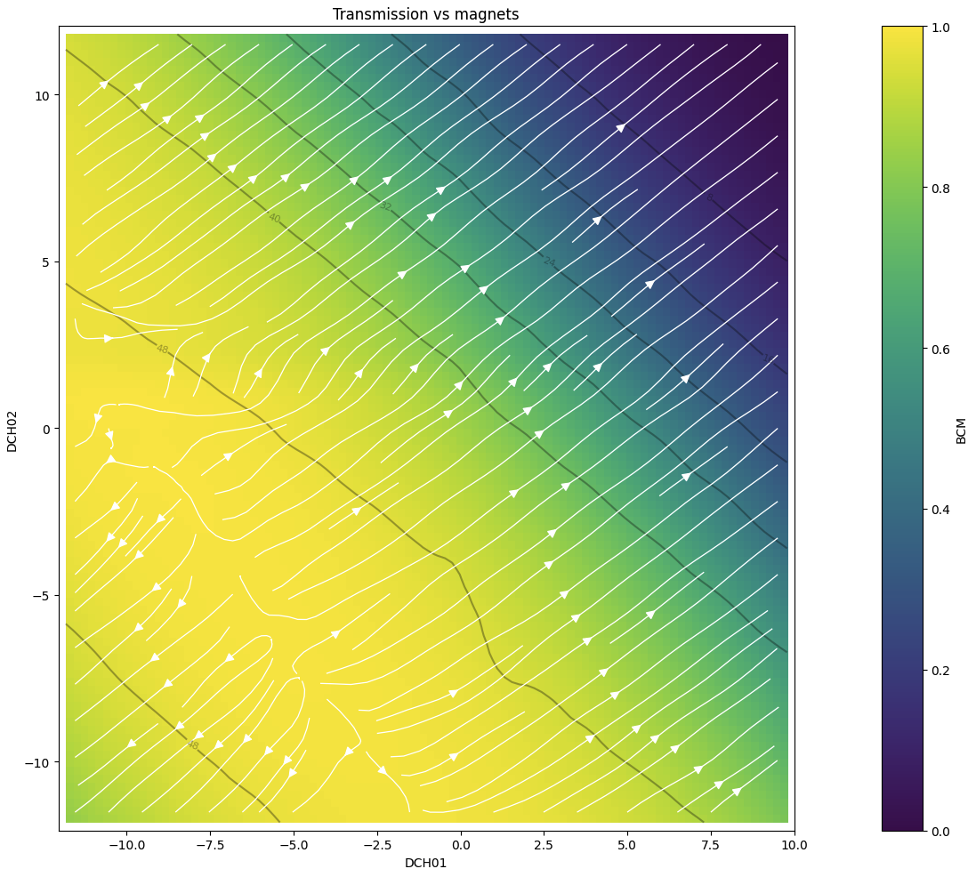
Beam Test Facility (BTF)
Smaller system designed to run many tests at lower energy level
Linac (similar to MEBT)
Currently manually tuned with known setpoints
Can build similar environments to SNS
VIRAC has a BTF model
Control vs Optimization
Optimal Setpoints
(-4.5, -7.0)
Real parameter sweep of BTF in test environment
4/9/2025

Slide 22
QUESTIONS?

Slide 23
Appendix

Slide 24
Imitation Learning
Imitation learning is the act of training an agent to mimic the behaviors of an existing systems
Existing control behaviors can be captured in historical data
If our agent can learn to act like the existing machine, it can start at a decent initial point and continue exploration from a pre-existing decent solution
How can we pretrain our model to act as the existing control system?
4/9/2025

