Slide 1
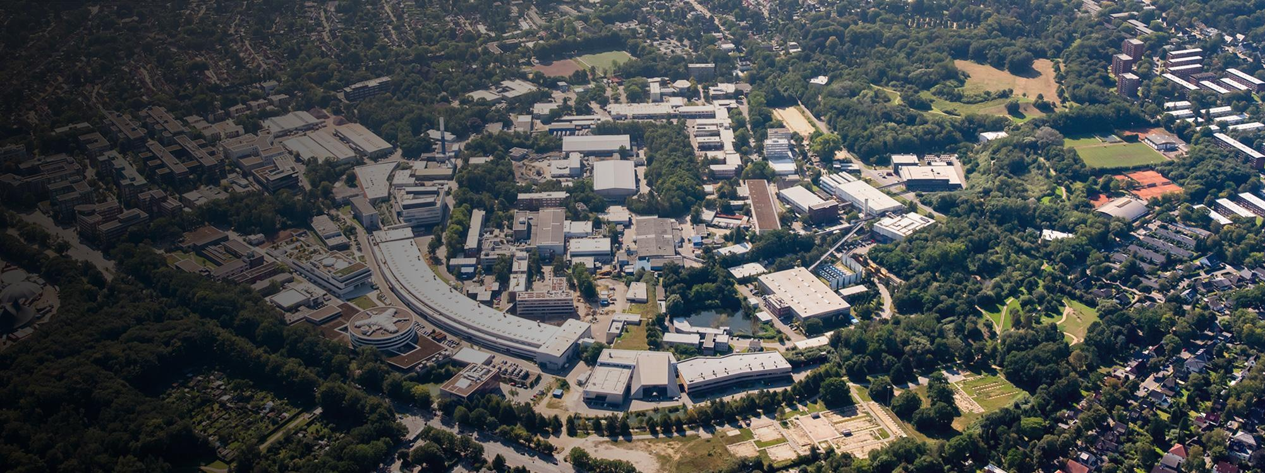



Towards Agentic AI on Particle Accelerators
5th ICFA Beam Dynamics Mini-Workshop on Machine Learning for Particle Accelerators
Raimund Kammering (DESY),
Hayden Houscher, Jason St. John (Fermilab)
Thorsten Hellert, Antonin Sulc (LBNL)

Slide 2
What are Agents
What They Are: AI helpers that don't just respond (LLMs) but actively work to solve your problems
How They Work:
  Autonomy - agents are able to make decisions
  State - they often have memory
  Use other tools and services when needed
  Communicate with other agents to solve problems
Why They Matter: Moving from "AI that answers questions" to "AI that accomplishes goals"
💬
Human
🤖
LLM
🤖
LLM
🤖
LLM
…
💬
Human

Slide 3
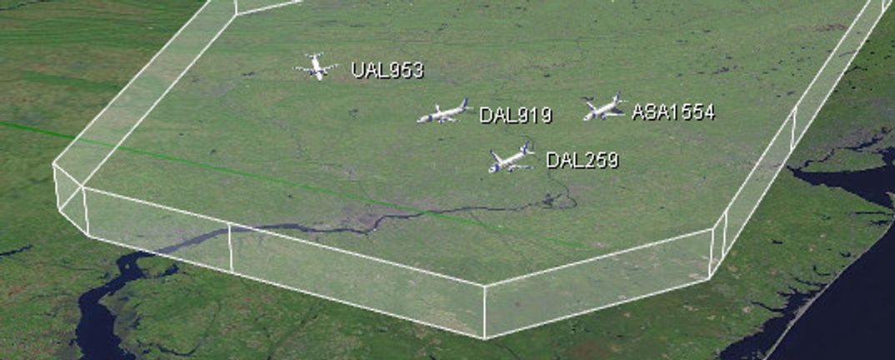
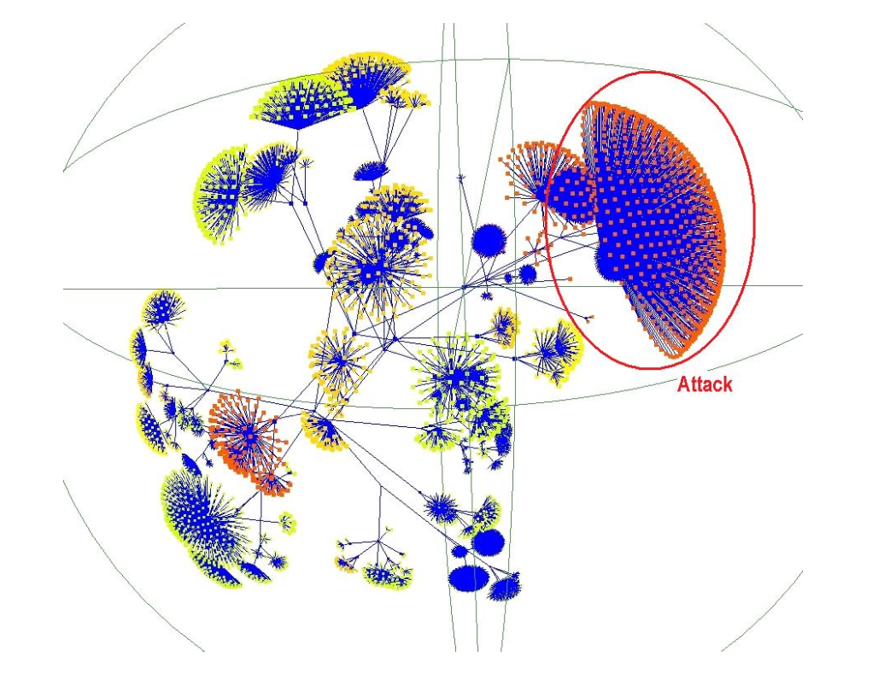
Agents - What is it about?
There is almost unlimited list of possible agent combinations
Multi-agent systems are well known for decades
AgentFly (https://www.agentfly.com/)
Network Intrusion Detection
But we never had such tools available
(especially autonomy!)
Notes:
TODO: AUTONOMY, Importance of holistic approach
Agentic systems have long history, but LLMs made them very useful.
Usually the large part of the challenge was to optimise the agents to communicate right to promote aut

Slide 4
Agents - What is it about?
Multiagent frameworks: A decades-old concept with new capabilities
Multiagent systems have existed since the 1980s in distributed AI research
Traditional limitations:
  Rigid communication protocols
  Limited reasoning capabilities
  Constrained to narrow, predefined tasks
What's genuinely new:
Large language models enable natural language communication
Emergent capabilities for complex problem-solving
Dynamic task decomposition and coordination
Agents that can learn, adapt, and negotiate in real-time
Autonomy
Communication
Distributed

Slide 5
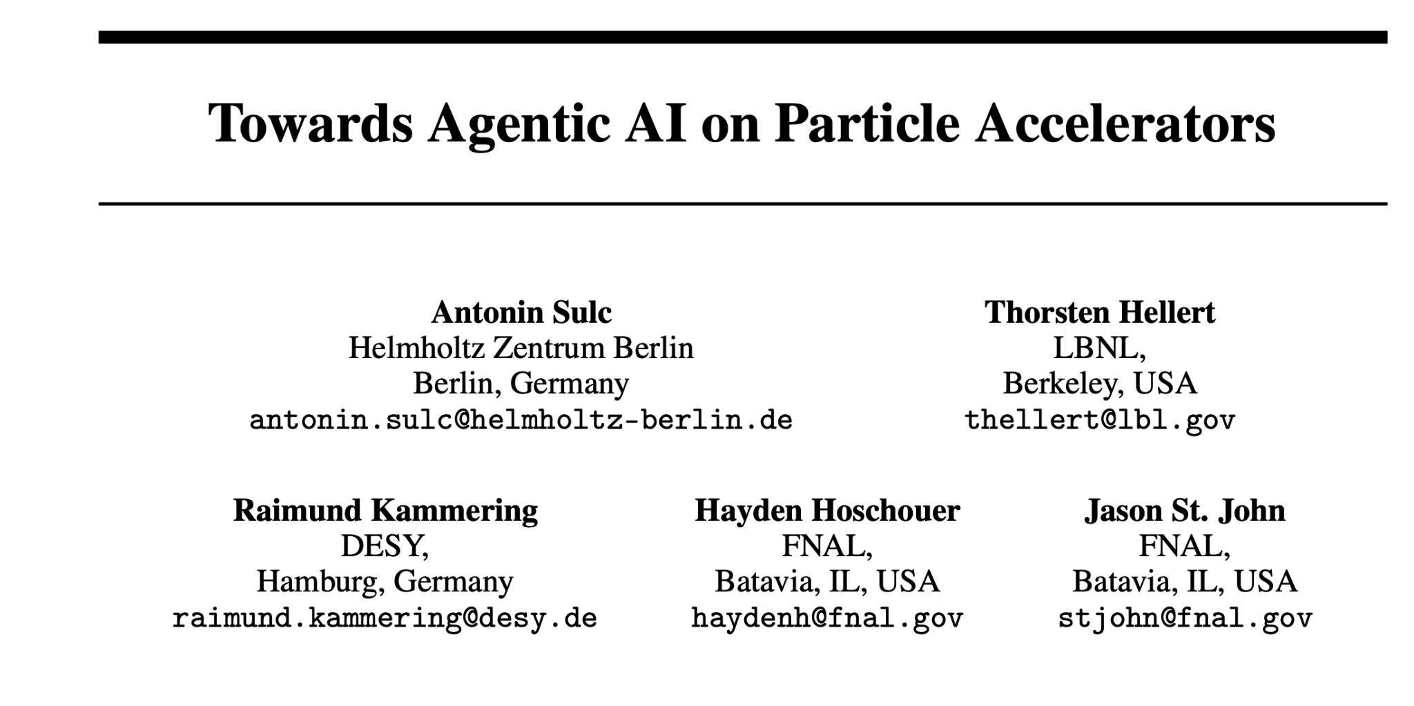
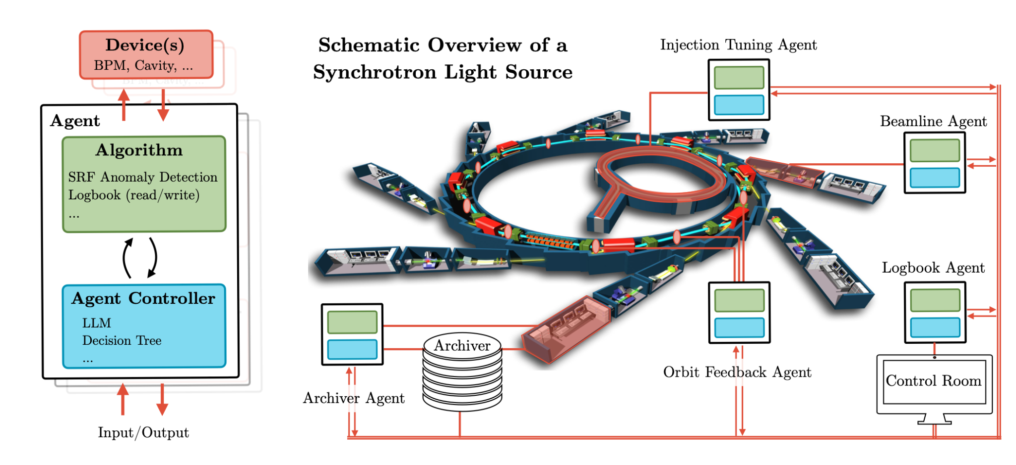
Autonomous Accelerators
Are we getting somewhere close to it?
There is an impressive work in subparts of accelerators
How to put these subparts together and run together?
Sulc, A., Hellert, T., Kammering, R., Hoschouer, H., & John, J. S. Towards Agentic AI on Particle Accelerators. ML4AI 2024

Slide 6
State-of-the-art of agent(ic) frameworks
Agent Frameworks
  Agents to collaborate autonomously on complex problems
  (AutoGen: framework for building AI agent)
  Multi-agent debate approaches improve reasoning and factual accuracy for reliable operations
Planning & Control
  Planing complex tasks that require coordination of multiple systems (LLM+P: LLM with planning)
  Verbal reinforcement learning without traditional weight updates (Reflexion: e.g. self-reflexion, chain-of-though)
Code Generation
  LLMs demonstrate capabilities as coding assistants, problem solvers, and data scientists

Slide 7
Examples of Agents
So we can engineer autonomous agents for instance for
Anomaly detection Uses some standard off-the-shelf anomaly detection algorithms like isolation forests to monitor certain subparts of control system
Archiver Agent The agent that knows how the machine behaved in the past and can quickly retrieve relevant data from the system
Coding assistant agent The agent can put together multi-lingual repositories and can write code or assist creating one
Machine state agent Allows us to query the control system about the current state
Logbook agent Can provide information about the past and current state of the machine and can for instance reason about it

Slide 8
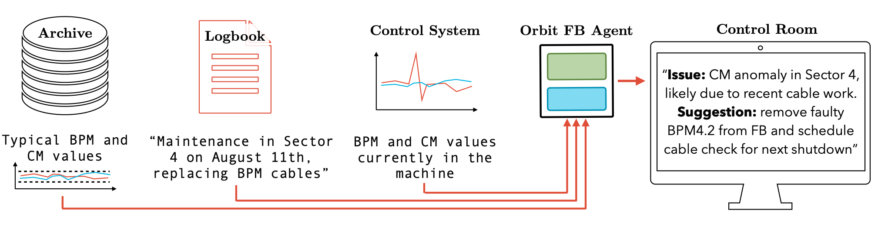
Example - Orbit Feedback Agent
Imagine following scenario:
An orbit feedback (FB) agent observes orbit anomalies
1. FB agent checks the typical orbit by prompting Archiver Agent
“Give me typical orbit of BPM4.2”
2. FB agent checks if there were any known issues on the BPM from Logbook Agent
“Any known issue about BPM4.2”
3. Control Room Agent gets an update:
“Anomaly due to cable work that took place on August 11”

Slide 9
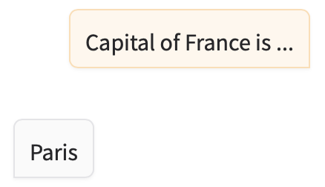
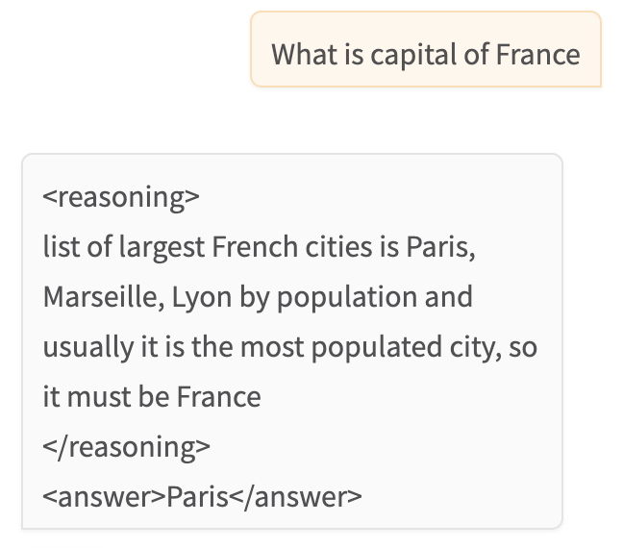
System Prompt - Key to Control LLMs
You are useful chatbot.
You are a chatbot that
reasons about user
questions
<reasoning>
reasoning about the question
</reasoning>
<answer>
place for answer
</answer>

Slide 10
How is it done then?
You have your knowledge, e.g. about specific orbit behaviour
If you have e.g. model of requirement
  e.g. FODO lattice,
  anomaly detection routines on specific component,
  search the logbook
Example:
  You tell an LLM how to use the model in system prompt
You are an anomaly detection agent, you continuously monitor BPMs and in case of anomaly, you trigger an alarm and inform OperatorAgent and eLogAgent
  You develop
    a separate thread that can communicate with others
    if anomaly is detected (manually defined by e.g. isolation forests) and decides to perform specific actions

Slide 11
Conclusion
You have seen some potential use cases of an multi-agent AI architecture for collaborative particle accelerator control
  Orbit agent @ ALS
  Coding agent @ Fermilab
Agents can observe, recommend actions, and eventually automate operations
You can come up with large variety of agents that can communicate
Represents a massive potential shift in methodology and deployment of known algorithms due to its modularity
There are inherent risks (e.g. alignment) associated with it’s autonomy

Slide 12
Thank You
And sure we are open for collaborations!
Hayden R. Hoschouer haydenh@fnal.gov,
Jason Michael St.John stjohn@fnal.gov
Antonin Sulc asulc@lbl.gov
Kammering Raimund raimund.kammering@desy.de

