Slide 1
Multi-modal LLMs at EuXFEL
Knowledge Assistants, Data Exploration, and Policy
L. Brodersen, I. Derevianko, D. E. Ferreira De Lima, L. Gelisio, S. Hauf, M. Manetti, R. Rosca, F. Sohn, K. Wrona, et al.
5th ICFA Beam Dynamics Mini-Workshop on Machine Learning for Particle Accelerators
CERN, Friday, 11.04.2025
Contact: steffen.hauf@xfel.eu

Slide 2

Introduction
Use cases and policy drafts in this presentation are the outcome of a task force to suggest a policy for general LLM usage at the European XFEL
2024: Charge: Evaluate the opportunities and risks associated with using AI Large Language Models at EuXFEL over a six months period and provide a report to EuXFEL Management.
  Evaluate legal and technical implications
  Evaluate use cases
2025 - I: Develop a policy for the facility, and technical means for generic access

Slide 3
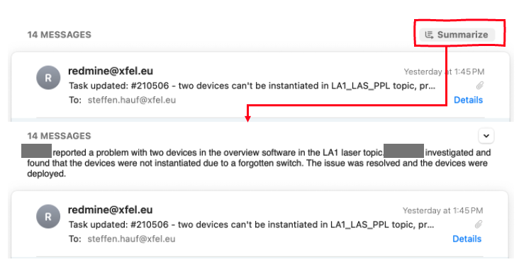
Text summarization, Editing & Text Composition
Likely most prominent use case of LLMs in the public perception
Current state-of-the-art models generally very capable, but
  What about sensitive data?
  What about proprietary data?
Where we are likely going
  Integrated capabilities in Windows and Mac OS
  More on-device/edge processing
While a generic interface (HAWKI) will be provided to staff, recommendation
to EuXFEL management was to consider integrated tools as well.
An email thread of 14 messages summarized
by Apple Intelligence as integrated in
the Mac OS Sequoia Beta

Slide 4

DOCbot Knowledge Assistant
Staff from various Data Department teams rotate shifts in the Data Operation Center (DOC) to monitor and support Data services, with 2nd level on-call support available to handle complex issues.
Resolved issues are documented in Redmine tickets, creating a knowledge base over time that includes problem descriptions and solutions.
A knowledge assistant bot, integrated into the Zulip chat tool, uses tickets information (Retrieval Augmented Generation, RAG) to assist in issues classification and resolution through text-based interaction.
Comic style light warm colors watercolor - two people free electron
laser brightly lit friendly atmosphere control room many screens
control software normal desks

Slide 5
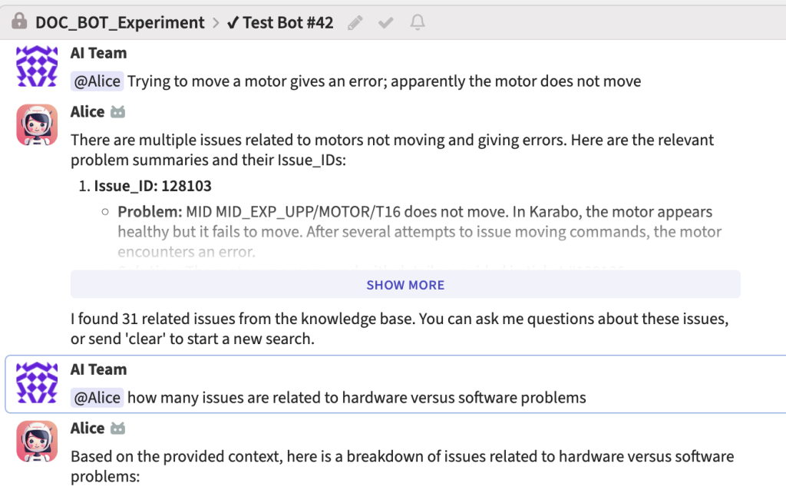
DOCbot Knowledge Assistant
An experiment involving Data staff was conducted to assess the practical applicability of such knowledge assistant.
Staff members were invited to participate in a survey and interact with the knowledge assistant to resolve one of three problems, each varying in clarity, domain relevance, and level of detail.
The experiment provided an opportunity to compare a state of the art commercial service (GPT-4o, bot Alice) against a locally hosted open source LLM (Vicuna, bot Bob): experiment participants interacted with one of the two bots.
Interaction with bot Alice (linked to a state of the art commercial LLM)
via the Zulip chat tool

Slide 6
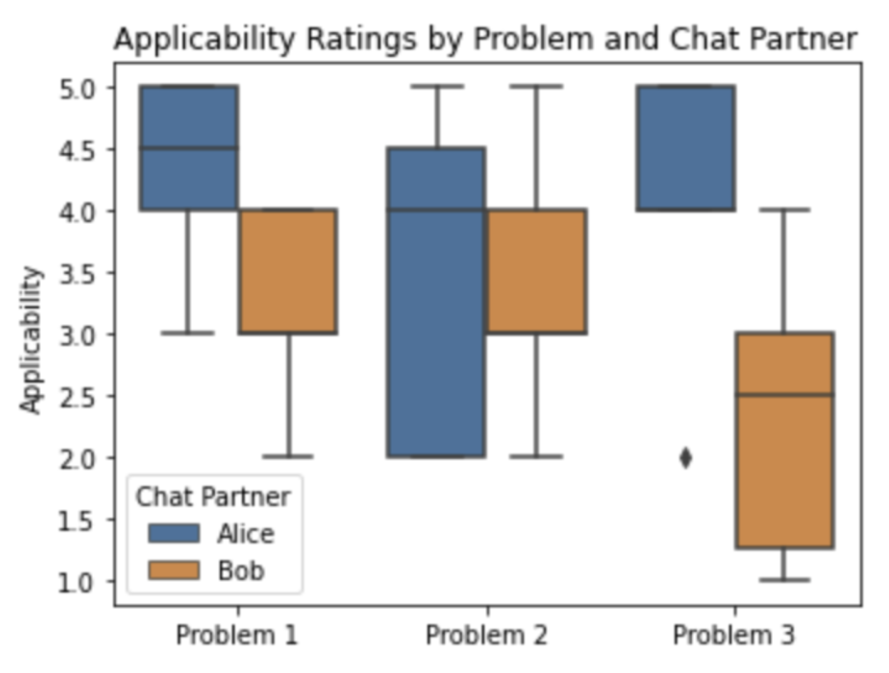
DOCbot Knowledge Assistant
Perceived Value: AI knowledge assistants are viewed as beneficial for technical tasks and managing semi-structured information, making their development worthwhile.
Trust & Caution: Users tend to overtrust AI responses, pointing out the need for usage policies that limit AI to low-risk domains, where errors have minimal impact.
LLM Comparison: The commercial GPT-4o performs better than the local, open-source Vicuna for generic or lower-quality inputs, though users noted a smaller performance gap than expected.

Slide 7
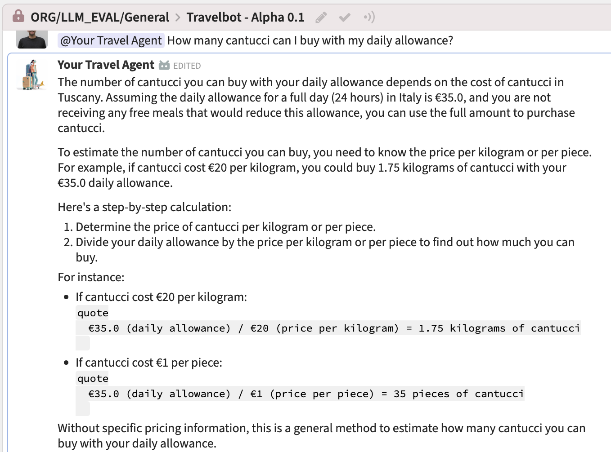
Travelbot Knowledge Assistant
Staff participating in this experiment utilized a RAG Chatbot to plan and file expenses for a business trip.
The prompt was crafted to enable the Language Model (LLM) to access general knowledge on travel regulations and planning.
The bot’s primary knowledge base was the EuXFEL travel guidelines.
Two bots, Adira and Paul, were implemented. Adira interfaced with the European Mistral Large model from Mistral.AI, while Paul interfaced with OpenAI’s GPT-4o model.
Interaction with a first prototype Travelbot (linked to OpenAI’s GPT-4o) via the Zulip chat tool: the bot can be queried about topics beyond the EuXFEL travel guidelines.

Slide 8
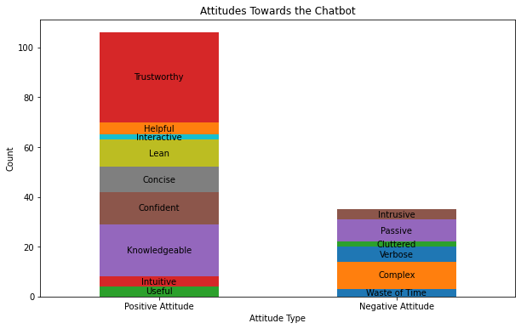
Travelbot Knowledge Assistant
Experiment participants were presented with one of two scenarios:
  planning a business trip to a conference in Grenoble, which included a private stay in the city
  filing travel expenses for this trip.
Participants were required to provide demographic information and feedback on the AI tools utilized.
Staff members who have undertaken at least one business trip for the facility tend to utilize the chatbot responses for their answers more frequently.
Overall, participants expressed a positive attitude, as shown in the picture.
Attributes associated to the chatbot by participants

Slide 9
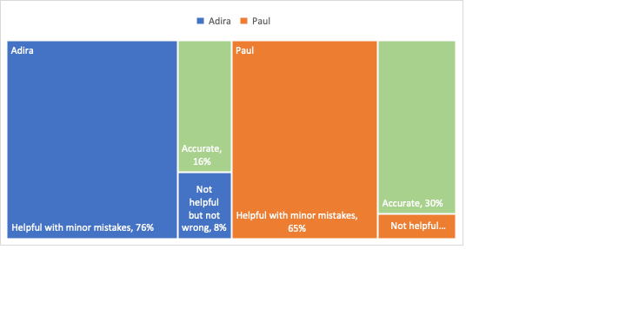
Travelbot Knowledge Assistant
Travel office staff categorized the bot answers in the chat log in order to assess the accuracy of the bot responses in relation to actual regulations.
None of the responses from the bots were rated as extremely good or problematic.
Based on the GPT-4o model, Paul’s responses exhibited an average of twice as many accurate answers compared to Adira’s responses generated by Mistral.AI.
(Mistral Large)
(GPT-4o)
Answer classification by the travel office for the two models.
Adira: Mistral.AI
Paul: GPT-4o

Slide 10
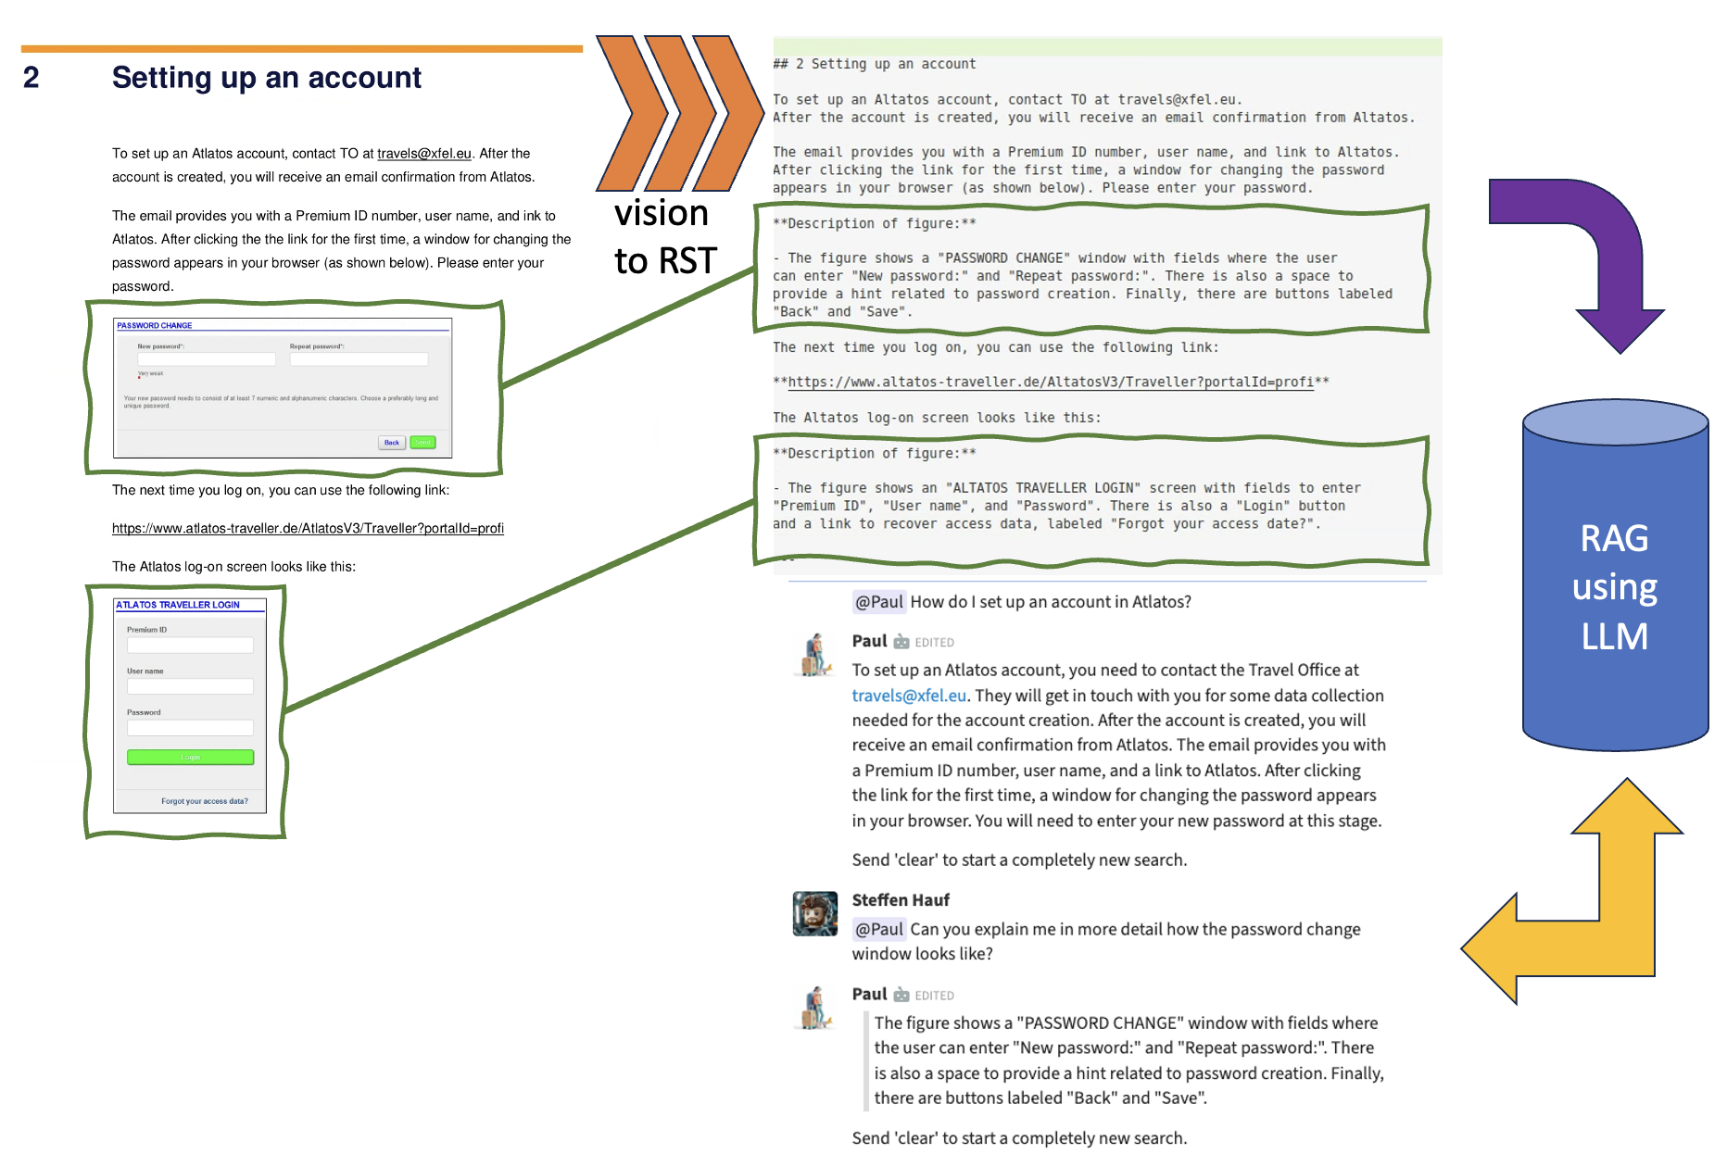
Information Exploration
A lot of information at EuXFEL is in form of PDFs and Word documents
While practical, these are opaque information stores
  Cannot efficiently search across many documents
  Content is usually not very structured
Vision-enabled LLMs are very efficient in converting this data into structured data that is Findable, Accessible, Interoperable, Reusable

Slide 11
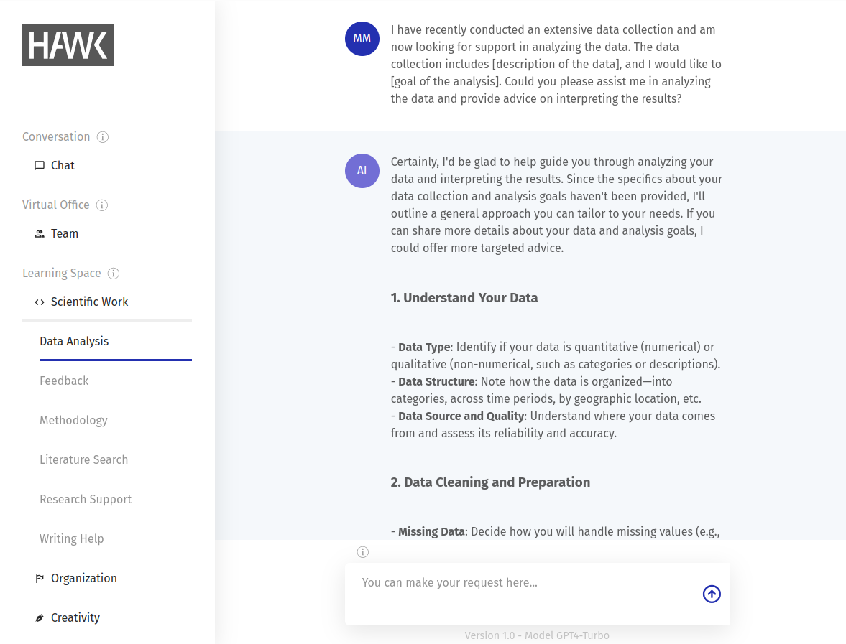
General Access: HAWKI
Tool used by many universities in Germany to provide generic access to generative AI systems. Key priorities include social accessibility, data privacy, and adapting AI tools to academic needs.
Initially developed at the Hildesheim University of Applied Sciences, HAWKI is an open source web interface allowing to access GPT models via OpenAI’s API with no link to personal accounts
HAWKI acts as a proxy to any requests to the providers, such that it is relatively straight-forward to change to the services of a provider other than OpenAI should a need arise.

Slide 12
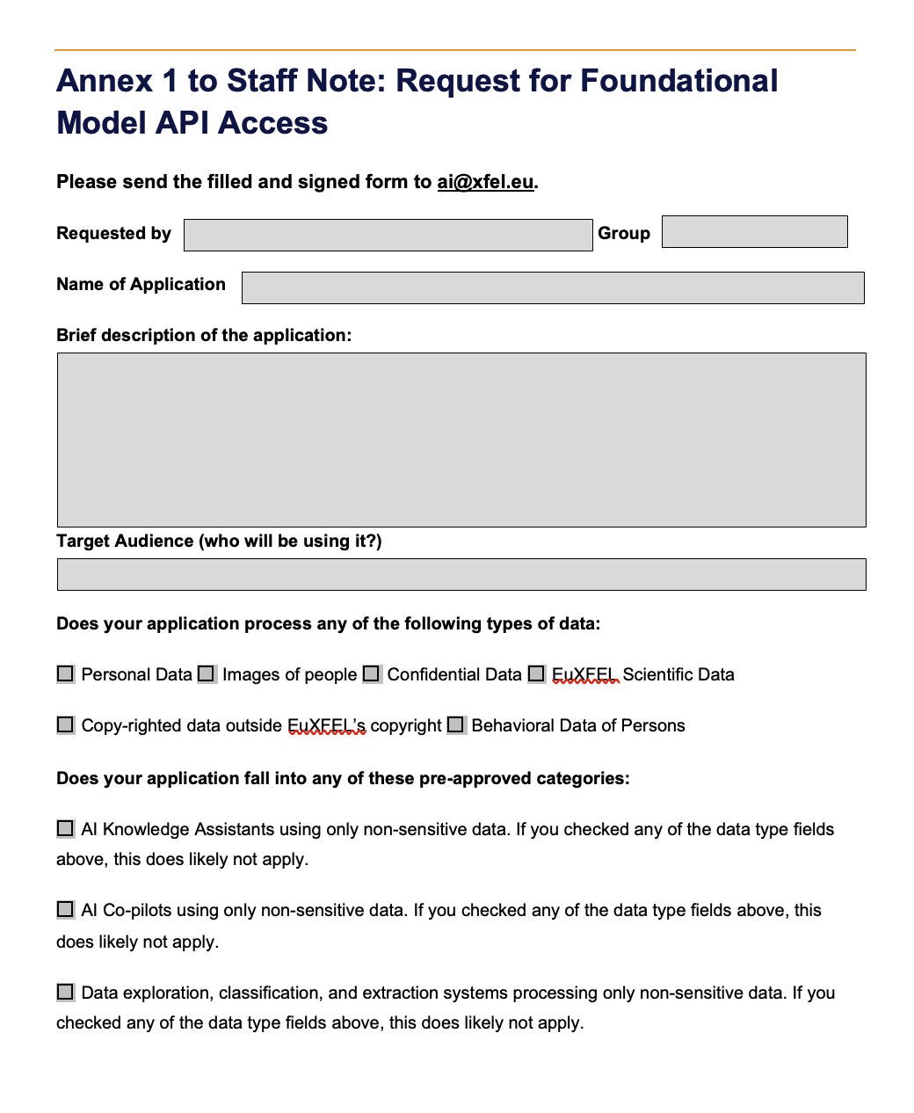
Specific Applications requiring API Access
Most of the presented use cases use the service-supplier API
  Tailored solutions & batch processing
  Integration with existing services
Suggestion: request form for such access to be granted
  Technical vetting by DATA
  Regulatory vetting by Legal
  EuXFEL management pre-approves common use cases for non-sensitive data
Estimate token-costs, and if high contribute to LLM budget of facility

Slide 13

Suggested Implementation – Local Hosting
Small models are becoming more capable especially for constrained tasks
  Google Gemma 1.5
  Microsoft Phi 3.5
  Flux.Dev & Flux.Schnell
Plan is to maintain a GPU node hosting the most capable models possible for specific applications to test against
A 8-bit game view of the physisist James Maxwell sitting on top of number
of servers, with the Maxwell equations in the foreground

Slide 14
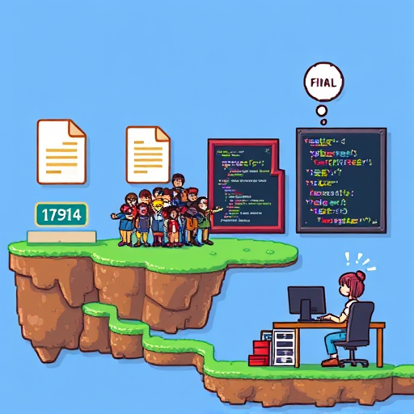
Outlook
Working deadline for policy and generic access tools is May 2025
Specific applications are expanding
Contact: steffen.hauf@xfel.eu

Slide 15
Additional slides

Slide 16
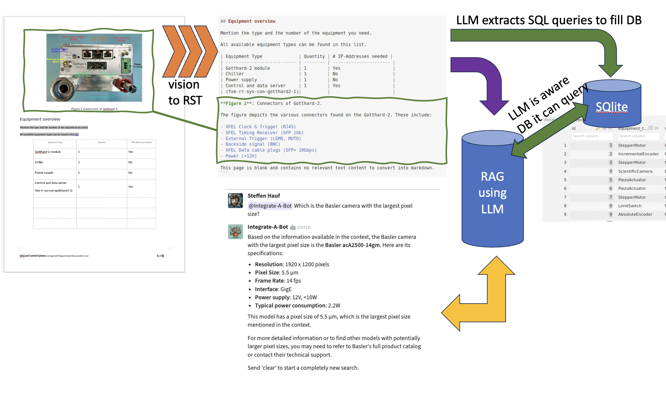
Information Exploration
A lot of information at EuXFEL is in form of PDFs and Word documents
While practical, these are opaque information stores
  Cannot efficiently search across many documents
  Content is usually not very structured
Vision-enabled LLMs are very efficient in converting this data into structured data that is Findable, Accessible, Interoperable, Reusable

Slide 17
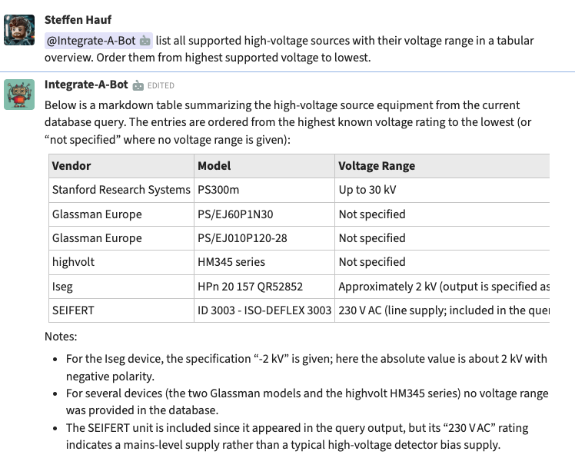
Information Exploration
Early prototype bot to enquire hardware available in the control system
A lot of information at EuXFEL is in form of PDFs and Word documents
While practical, these are opaque information stores
  Cannot efficiently search across many documents
  Content is usually not very structured
Vision-enabled LLMs are very efficient in converting this data into structured data that is Findable, Accessible, Interoperable, Reusable

Slide 18
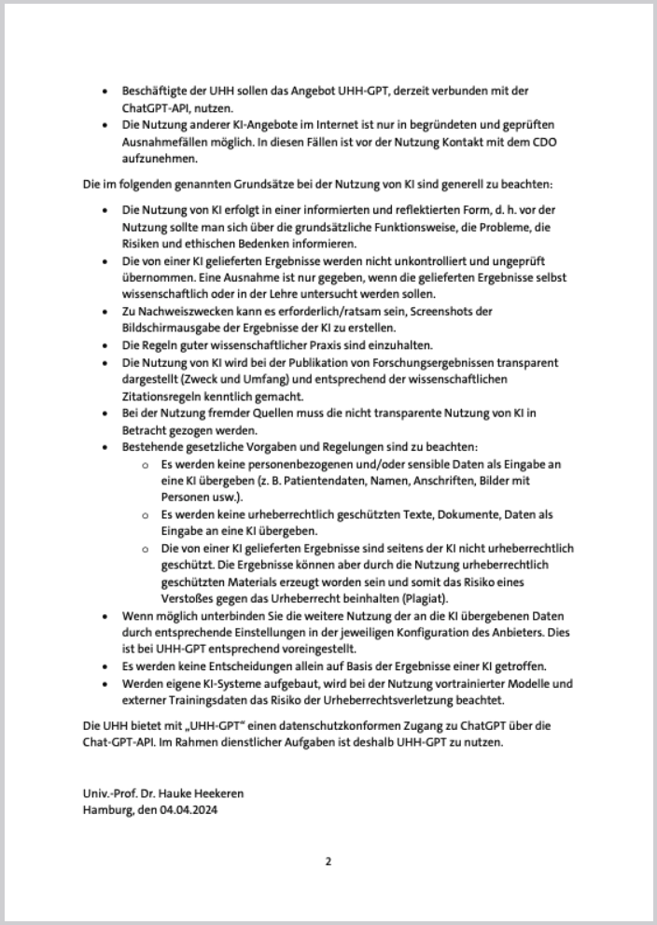
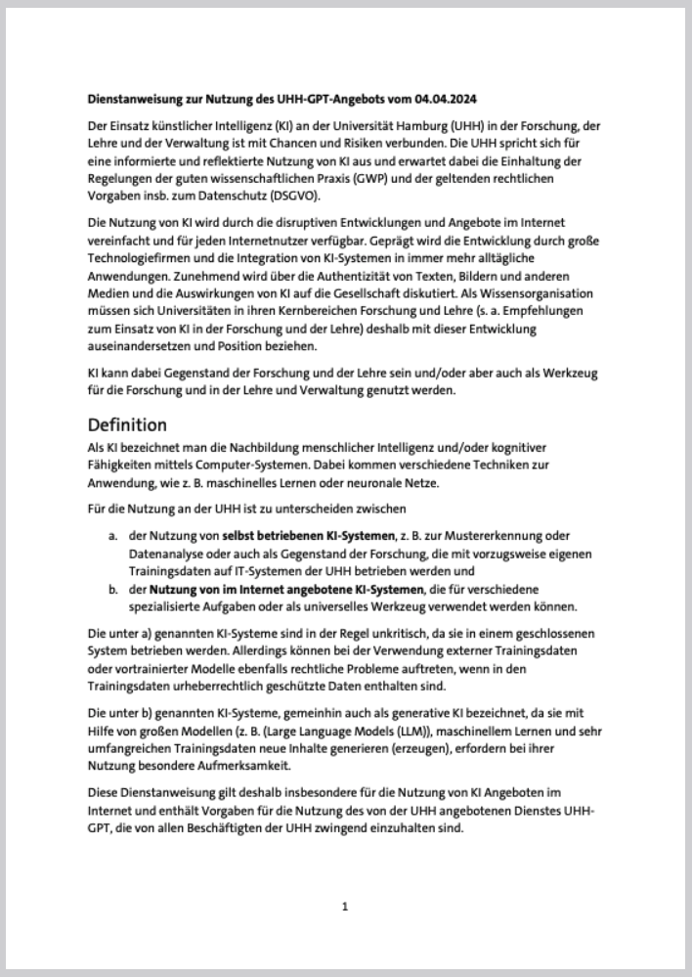
Suggested Policy: Lean & Draw From What’s Working (at UniHH)
There’s rapid evolution going on in the field of LLMs
  be lean and don’t over-specify
The University of Hamburg is providing LLM access to its students and staff based on a lean policy worked out together with the Landesdatenschutzbeauftragte of Hamburg
  no need to reinvent the wheel for general access
  fits onto 2(!) pages
Foresee applications that will require direct API access
Functional accounts anonymize input data
Users may not enter and are trained to not enter sensitive and personal data. A classification system will help in this.

