Slide 1
Poly-Lithic: Standardising model deployment
Mateusz Leputa, Kathryn Baker, Mihnea Romanovschi, Raunakk Bannerjee
5th ICFA Beam Dynamics Mini-Workshop on Machine Learning for Particle Accelerators, CERN
9th of April 2025

Slide 2
Outline
Common ML project challenges
Project History
Inside the package
Deployment Example
Current and Future developments
Conclusions and Questions

Slide 3
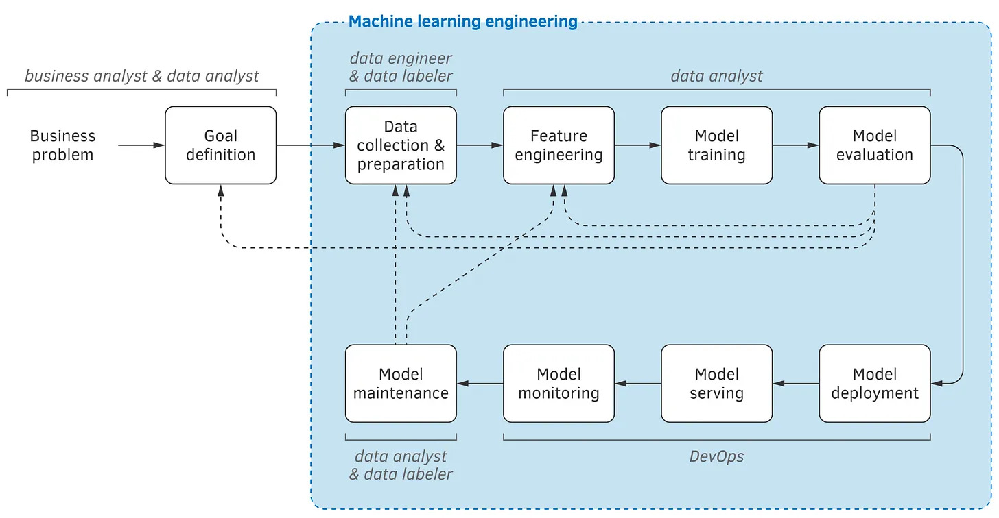
Common ML challenges
As ML engineers we want to:
Maximise time spent improving the model performance
Minimse the time spent on non-ML tasks
Maxmise the value delivered from a model as R&D is expensive.
Ensure stable and maintainable deployments.
Machine learning lifecycle. Source: Machine Learning Engineering by Andriy Burkov p.17

Slide 4

Common ML challenges
All code rots – security updates, unsupported hardware, unsupported features between versions
ML models rot faster – system parameter drift and underlying system changes!
Other Considerations:
High Availability – How quickly can we getting up and running in case of failure.
Knowledge siloing – Few people will know how code/systems operate and once left the knowledge tends to leave with them.
Long tail of project effort – Projects are never really "complete”, especially ML projects which tend to drift over time. Not code rot but tweaks and bug fixes. Tweaks to algorithms etc
We want deliver fast, of good quality and making it easy to maintain. Allow each specialist to focus on their area of expertise.
Reduce hand-offs, partially done work, compromises, task switching etc.

Slide 5

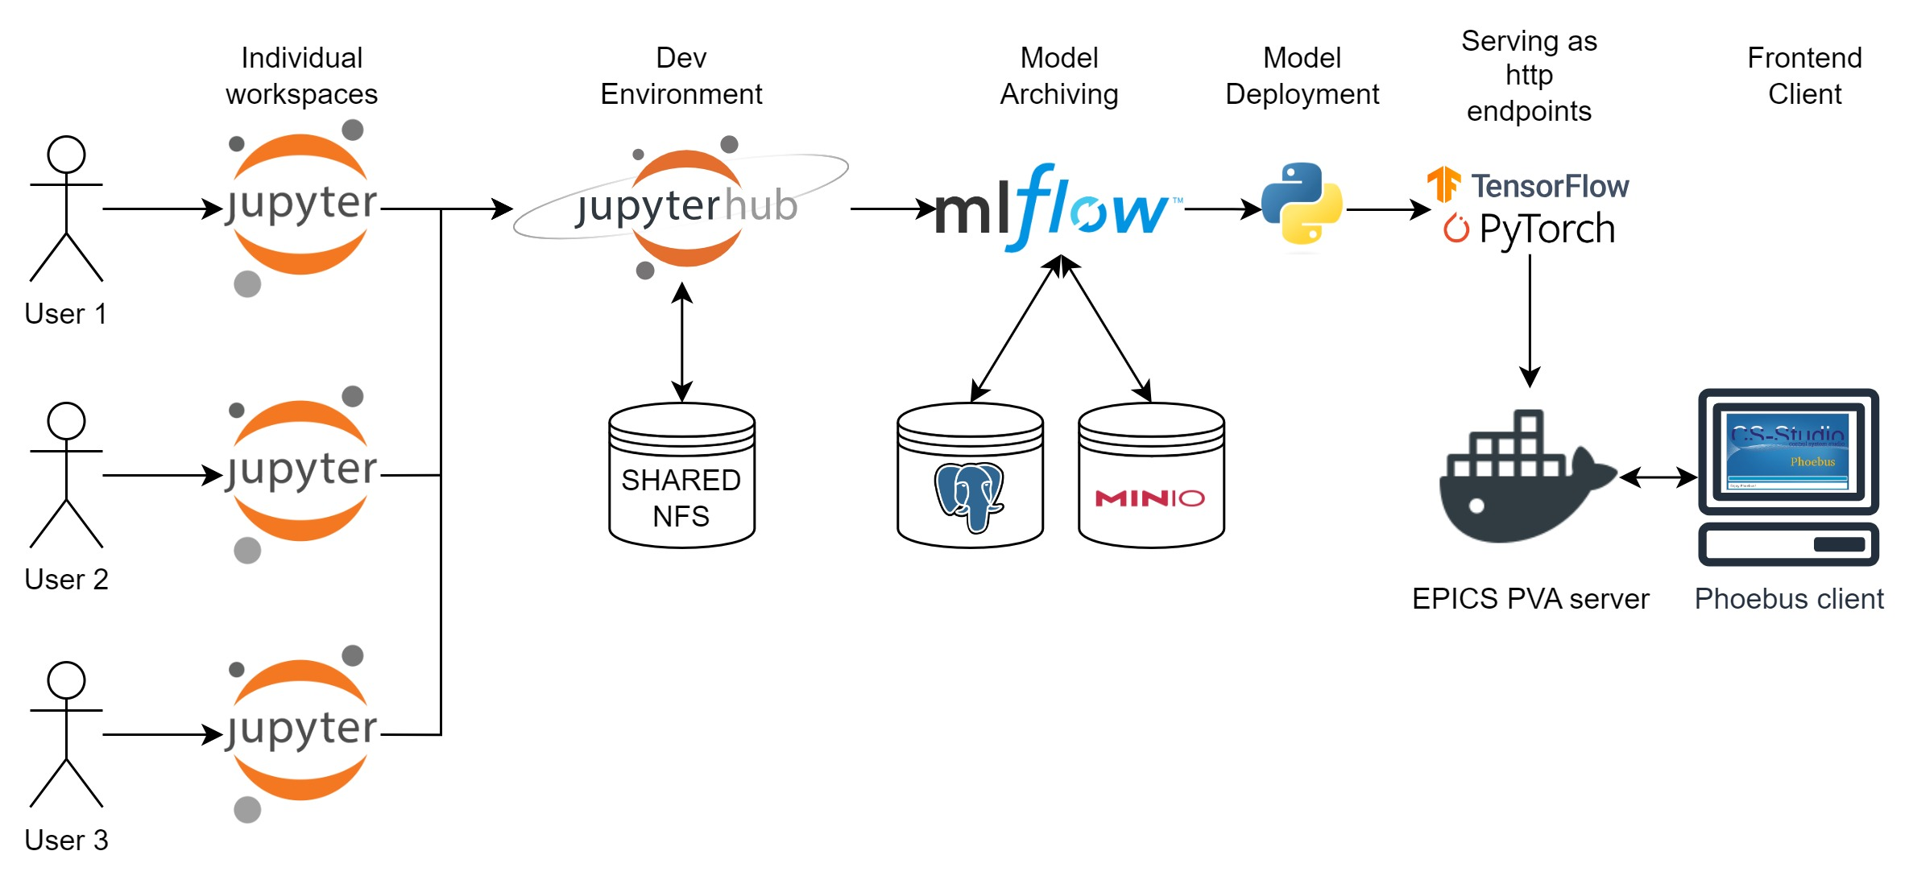



Project History
Need to store models
Can we auto deploy from the model store?
What process can we use to make the most with what we have

Slide 6


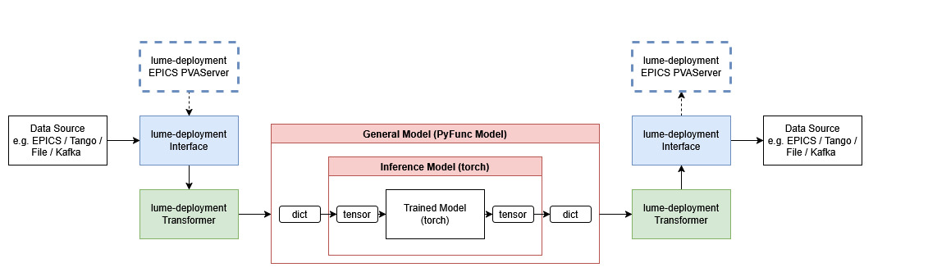
Project History
LUME-deployment
Make it more flexible, extensible and package it up.
LUME-model
Make it modular and generalisable to accelerator applications? Work on other accelerators

Slide 7
Poly-Lithic
Messages – In the context of Poly-Lithic they, are structured data units used for standardised communication between the framework components
Messages
Modules
Deployment
{
"topic": "my_topic", # Where am I sending the data
"source": "my_emmiter", # Who sent it
"value": { # contents of the data
"some_key": { # standard message
"value": 123.12, # required: Any
"metadata": "some meta-data", # optional
"timestamp": 1743161390.0252874 # optional
}
},
"timestamp": 1743161390.0252874,
"allow_unsafe": false # should I enforce "value” format?
}

Slide 8
Poly-Lithic
p4p getter
p4p-server
Kafka-epics
Simple transformer
Passthrough transformer
Array to image – Kafka specific
Compound transformer (legacy)
Ml Flow model getter
Local model getter
Modules – Independent components that handle specific functionalities within the deployment context. They ingest and emit data in the message standard message structure.
Messages
Modules
Deployment
System or Extraction
Layer
Transformation Layer
Model (Load) Layer
Connect to the controls system
Load data from a database
Load data from a file
Collect samples into a data frame.
Basic transformations
Window time-series data
Evaluate data sample against an algorithm
Not the only types but more about that later

Slide 9
Poly-Lithic
Modules – Independent components that handle specific functionalities within the deployment context. They ingest and emit data in the message standard message structure.
Messages
Modules
Deployment
System or Extraction
Layer
Transformation Layer
Model (Load) Layer
p4p getter
p4p-server
Kafka-epics
Simple transformer
Passthrough transformer
Array to image – Kafka specific
Compound transformer (legacy)
Ml Flow model getter
Local model getter
Connect to the controls system
Load data from a database
Load data from a file
Collect samples into a data frame.
Basic transformations
Window time-series data
Evaluate data sample against an algorithm

Slide 10
Poly-Lithic
Deployment – Consists of a configuration file defining the deployment type, its parameters as well as the modules and their respective parameters.
Messages
Modules
Deployment
deployment:
type: "continuous"
rate: 1 #seconds
modules:
p4p_server:
name: "p4p_server"
type: "interface.p4p_server"
pub: "in_interface"
sub:
- "update"
- "out_transformer"
module_args: None
config:
EPICS_PVA_NAME_SERVERS: "localhost:5075"
variables:
LUME:MLFLOW:TEST_B:
proto: pva
name: LUME:MLFLOW:TEST_B
LUME:MLFLOW:TEST_A:
proto: pva
name: LUME:MLFLOW:TEST_A
LUME:MLFLOW:TEST_S:
proto: pva
name: LUME:MLFLOW:TEST_S
input_transformer:
name: "input_transformer"
type: "transformer.SimpleTransformer"
pub: "in_transformer"
sub: "in_interface"
module_args: None
config:
symbols:
- "LUME:MLFLOW:TEST_B"
- "LUME:MLFLOW:TEST_A"
variables:
x2:
formula: "LUME:MLFLOW:TEST_B"
x1:
formula: "LUME:MLFLOW:TEST_A"
model:
name: "model"
type: "model.SimpleModel"
pub: "model"
sub: "in_transformer"
module_args: None
config:
type: MlflowModelGetter
args:
model_name: mebt_hypergan
model_version: 3
output_transformer:
name: "output_transformer"
type: "transformer.SimpleTransformer"
pub: "out_transformer"
sub: "model"
module_args:
unpack_data: True
config:
symbols:
- "y"
variables:
LUME:MLFLOW:TEST_S:
formula: "y"

Slide 11
Poly-Lithic
deployment:
type: "continuous"
rate: 1 #seconds
modules:
p4p_server:
name: "p4p_server"
type: "interface.p4p_server"
pub: "in_interface"
sub:
- "update"
- "out_transformer"
module_args: None
config:
EPICS_PVA_NAME_SERVERS: "localhost:5075"
variables:
LUME:MLFLOW:TEST_B:
proto: pva
name: LUME:MLFLOW:TEST_B
LUME:MLFLOW:TEST_A:
proto: pva
name: LUME:MLFLOW:TEST_A
LUME:MLFLOW:TEST_S:
proto: pva
name: LUME:MLFLOW:TEST_S
input_transformer:
name: "input_transformer"
type: "transformer.SimpleTransformer"
pub: "in_transformer"
sub: "in_interface"
module_args: None
config:
symbols:
- "LUME:MLFLOW:TEST_B"
- "LUME:MLFLOW:TEST_A"
variables:
x2:
formula: "LUME:MLFLOW:TEST_B"
x1:
formula: "LUME:MLFLOW:TEST_A"
model:
name: "model"
type: "model.SimpleModel"
pub: "model"
sub: "in_transformer"
module_args: None
config:
type: MlflowModelGetter
args:
model_name: mebt_hypergan
model_version: 3
output_transformer:
name: "output_transformer"
type: "transformer.SimpleTransformer"
pub: "out_transformer"
sub: "model"
module_args:
unpack_data: True
config:
symbols:
- "y"
variables:
LUME:MLFLOW:TEST_S:
formula: "y"
Deployment – Consists of a configuration file defining the deployment type, its parameters as well as the modules and their respective parameters.
Messages
Modules
Deployment

Slide 12
Poly-Lithic
deployment:
type: "continuous"
rate: 1 #seconds
modules:
p4p_server:
name: "p4p_server"
type: "interface.p4p_server"
pub: "in_interface"
sub:
- "update"
- "out_transformer"
module_args: None
config:
EPICS_PVA_NAME_SERVERS: "localhost:5075"
variables:
LUME:MLFLOW:TEST_B:
proto: pva
name: LUME:MLFLOW:TEST_B
LUME:MLFLOW:TEST_A:
proto: pva
name: LUME:MLFLOW:TEST_A
LUME:MLFLOW:TEST_S:
proto: pva
name: LUME:MLFLOW:TEST_S
input_transformer:
name: "input_transformer"
type: "transformer.SimpleTransformer"
pub: "in_transformer"
sub: "in_interface"
module_args: None
config:
symbols:
- "LUME:MLFLOW:TEST_B"
- "LUME:MLFLOW:TEST_A"
variables:
x2:
formula: "LUME:MLFLOW:TEST_B"
x1:
formula: "LUME:MLFLOW:TEST_A"
model:
name: "model"
type: "model.SimpleModel"
pub: "model"
sub: "in_transformer"
module_args: None
config:
type: MlflowModelGetter
args:
model_name: mebt_hypergan
model_version: 3
output_transformer:
name: "output_transformer"
type: "transformer.SimpleTransformer"
pub: "out_transformer"
sub: "model"
module_args:
unpack_data: True
config:
symbols:
- "y"
variables:
LUME:MLFLOW:TEST_S:
formula: "y"
Deployment – Consists of a configuration file defining the deployment type, its parameters as well as the modules and their respective parameters.
Messages
Modules
Deployment

Slide 13
Poly-Lithic
deployment:
type: "continuous"
rate: 1 #seconds
modules:
p4p_server:
name: "p4p_server"
type: "interface.p4p_server"
pub: "in_interface"
sub:
- "update"
- "out_transformer"
module_args: None
config:
EPICS_PVA_NAME_SERVERS: "localhost:5075"
variables:
LUME:MLFLOW:TEST_B:
proto: pva
name: LUME:MLFLOW:TEST_B
LUME:MLFLOW:TEST_A:
proto: pva
name: LUME:MLFLOW:TEST_A
LUME:MLFLOW:TEST_S:
proto: pva
name: LUME:MLFLOW:TEST_S
input_transformer:
name: "input_transformer"
type: "transformer.SimpleTransformer"
pub: "in_transformer"
sub: "in_interface"
module_args: None
config:
symbols:
- "LUME:MLFLOW:TEST_B"
- "LUME:MLFLOW:TEST_A"
variables:
x2:
formula: "LUME:MLFLOW:TEST_B"
x1:
formula: "LUME:MLFLOW:TEST_A"
model:
name: "model"
type: "model.SimpleModel"
pub: "model"
sub: "in_transformer"
module_args: None
config:
type: MlflowModelGetter
args:
model_name: mebt_hypergan
model_version: 3
output_transformer:
name: "output_transformer"
type: "transformer.SimpleTransformer"
pub: "out_transformer"
sub: "model"
module_args:
unpack_data: True
config:
symbols:
- "y"
variables:
LUME:MLFLOW:TEST_S:
formula: "y"
Deployment – Consists of a configuration file defining the deployment type, its parameters as well as the modules and their respective parameters.
Messages
Modules
Deployment

Slide 14
Poly-Lithic
deployment:
type: "continuous"
rate: 1 #seconds
modules:
p4p_server:
name: "p4p_server"
type: "interface.p4p_server"
pub: "in_interface"
sub:
- "update"
- "out_transformer"
module_args: None
config:
EPICS_PVA_NAME_SERVERS: "localhost:5075"
variables:
LUME:MLFLOW:TEST_B:
proto: pva
name: LUME:MLFLOW:TEST_B
LUME:MLFLOW:TEST_A:
proto: pva
name: LUME:MLFLOW:TEST_A
LUME:MLFLOW:TEST_S:
proto: pva
name: LUME:MLFLOW:TEST_S
input_transformer:
name: "input_transformer"
type: "transformer.SimpleTransformer"
pub: "in_transformer"
sub: "in_interface"
module_args: None
config:
symbols:
- "LUME:MLFLOW:TEST_B"
- "LUME:MLFLOW:TEST_A"
variables:
x2:
formula: "LUME:MLFLOW:TEST_B"
x1:
formula: "LUME:MLFLOW:TEST_A"
model:
name: "model"
type: "model.SimpleModel"
pub: "model"
sub: "in_transformer"
module_args: None
config:
type: MlflowModelGetter
args:
model_name: mebt_hypergan
model_version: 3
output_transformer:
name: "output_transformer"
type: "transformer.SimpleTransformer"
pub: "out_transformer"
sub: "model"
module_args:
unpack_data: True
config:
symbols:
- "y"
variables:
LUME:MLFLOW:TEST_S:
formula: "y"
Deployment – Consists of a configuration file defining the deployment type, its parameters as well as the modules and their respective parameters.
Messages
Modules
Deployment

Slide 15
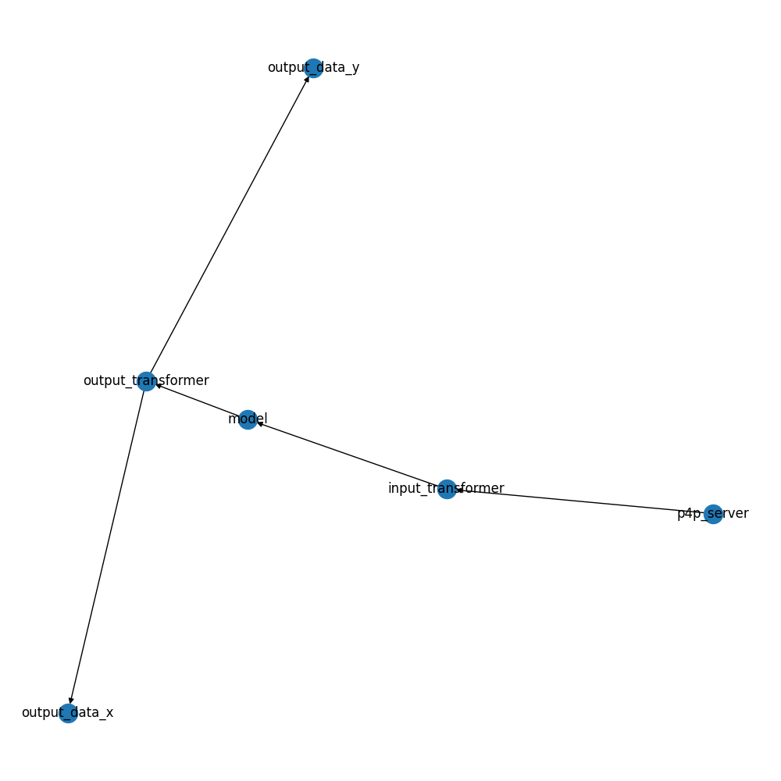
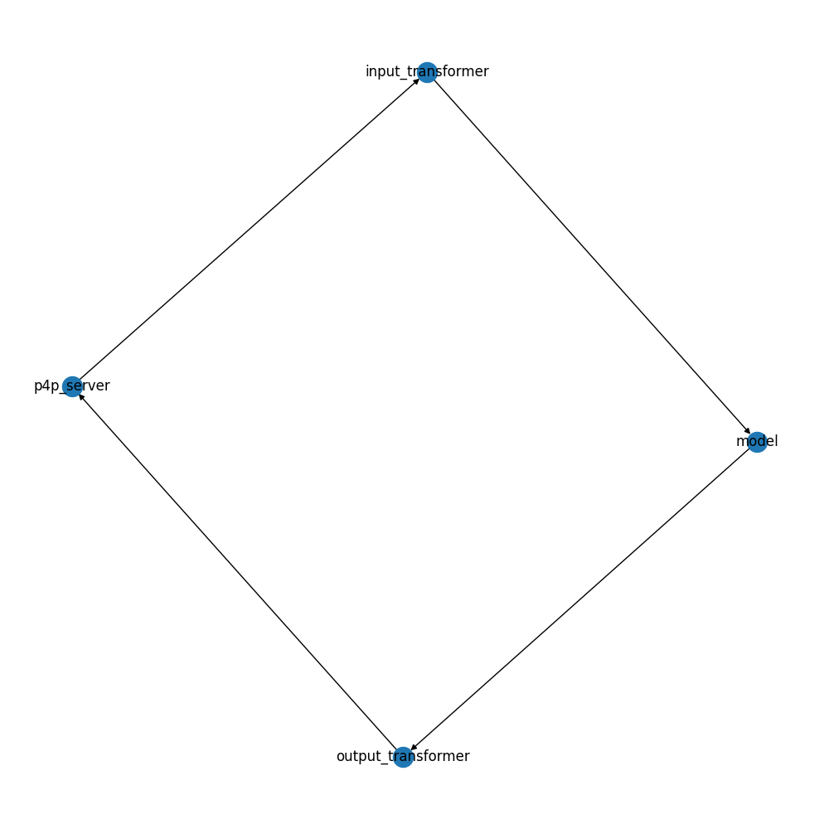
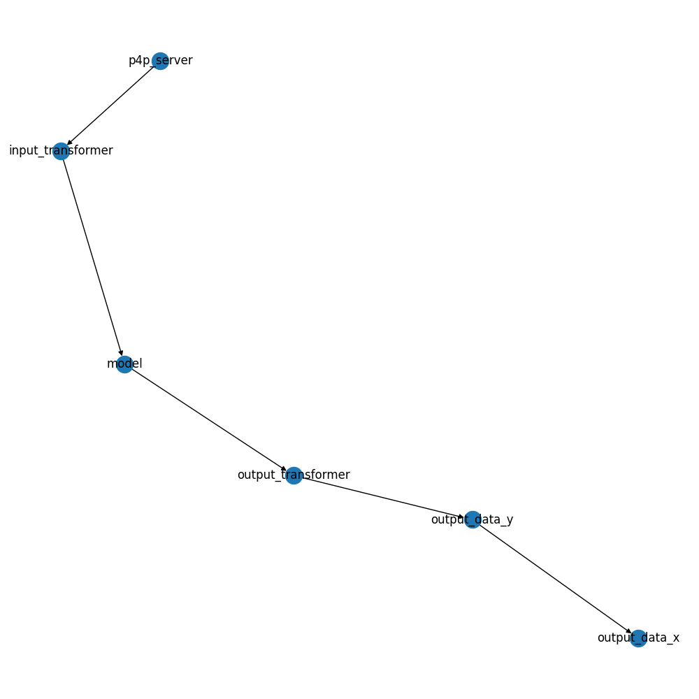
Poly-Lithic
Deployment – Consists of a configuration file defining the deployment type, its parameters as well as the modules and their respective parameters.
Messages
Modules
Deployment
deployment:
type: "continuous"
rate: 1 #seconds
modules:
p4p_server:
name: "p4p_server"
type: "interface.p4p_server"
pub: "in_interface"
sub:
- "update"
- "out_transformer"
module_args: None
config:
EPICS_PVA_NAME_SERVERS: "localhost:5075"
variables:
LUME:MLFLOW:TEST_B:
proto: pva
name: LUME:MLFLOW:TEST_B
LUME:MLFLOW:TEST_A:
proto: pva
name: LUME:MLFLOW:TEST_A
LUME:MLFLOW:TEST_S:
proto: pva
name: LUME:MLFLOW:TEST_S
input_transformer:
name: "input_transformer"
type: "transformer.SimpleTransformer"
pub: "in_transformer"
sub: "in_interface"
module_args: None
config:
symbols:
- "LUME:MLFLOW:TEST_B"
- "LUME:MLFLOW:TEST_A"
variables:
x2:
formula: "LUME:MLFLOW:TEST_B"
x1:
formula: "LUME:MLFLOW:TEST_A"
model:
name: "model"
type: "model.SimpleModel"
pub: "model"
sub: "in_transformer"
module_args: None
config:
type: MlflowModelGetter
args:
model_name: mebt_hypergan
model_version: 3
output_transformer:
name: "output_transformer"
type: "transformer.SimpleTransformer"
pub: "out_transformer"
sub: "model"
module_args:
unpack_data: True
config:
symbols:
- "y"
variables:
LUME:MLFLOW:TEST_S:
formula: "y"

Slide 16
Poly-Lithic
deployment:
type: "continuous"
rate: 1 #seconds
modules:
p4p_server:
name: "p4p_server"
type: "interface.p4p_server"
pub: "in_interface"
sub:
- "update"
- "out_transformer"
module_args: None
config:
EPICS_PVA_NAME_SERVERS: "localhost:5075"
variables:
LUME:MLFLOW:TEST_B:
proto: pva
name: LUME:MLFLOW:TEST_B
LUME:MLFLOW:TEST_A:
proto: pva
name: LUME:MLFLOW:TEST_A
LUME:MLFLOW:TEST_S:
proto: pva
name: LUME:MLFLOW:TEST_S
input_transformer:
name: "input_transformer"
type: "transformer.SimpleTransformer"
pub: "in_transformer"
sub: "in_interface"
module_args: None
config:
symbols:
- "LUME:MLFLOW:TEST_B"
- "LUME:MLFLOW:TEST_A"
variables:
x2:
formula: "LUME:MLFLOW:TEST_B"
x1:
formula: "LUME:MLFLOW:TEST_A"
Deployment – Consists of a configuration file defining the deployment type, its parameters as well as the modules and their respective parameters.
Messages
Modules
Deployment
model:
name: "model"
type: "model.SimpleModel"
pub: "model"
sub: "in_transformer"
module_args: None
config:
type: "mock"
variables:
y:
type: "scalar”
output_transformer:
name: "output_transformer"
type: "transformer.SimpleTransformer"
pub: "out_transformer"
sub: "model"
module_args:
unpack_data: True
config:
symbols:
- "y"
variables:
LUME:MLFLOW:TEST_S:
formula: "y"

Slide 17
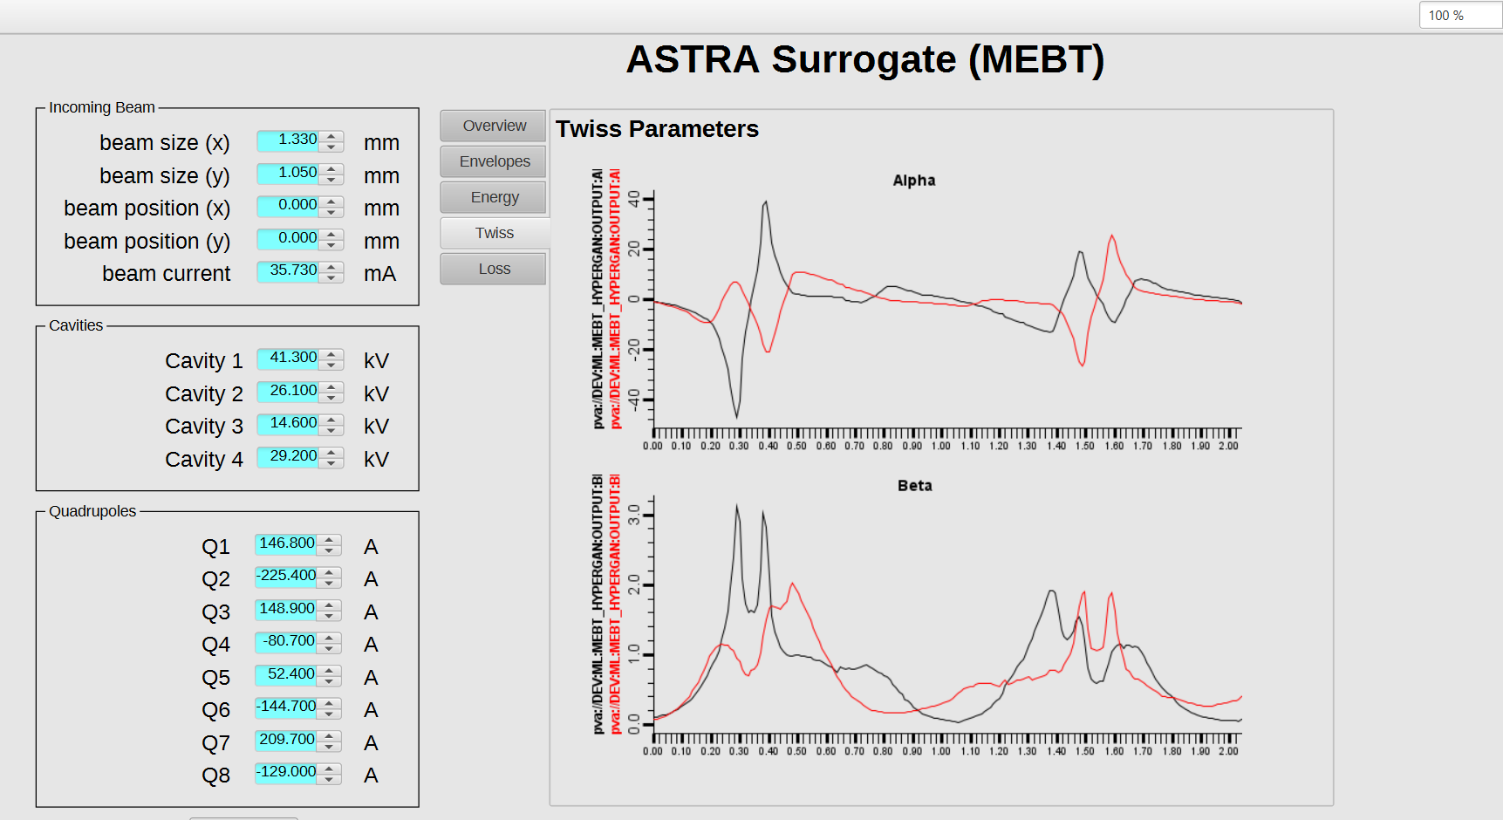
Deployment example – Astra Deployment

Slide 18
Deployment example – Astra Deployment
16 inputs
88 outputs
910 lines of .yaml
Since we have well-defined structures and a standard deployment format the process can be automated with a Cookie-cutter template!

Slide 19
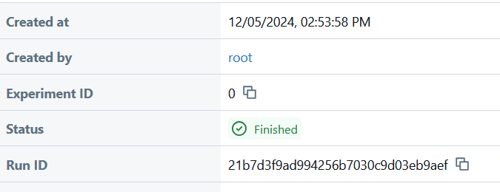

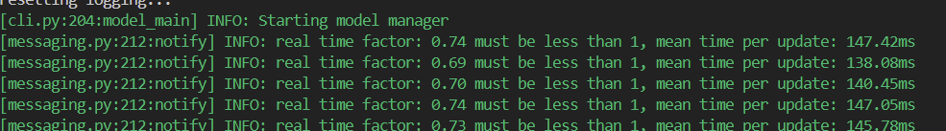
Deployment example – Astra Deployment
With cookie-cutter the typical deployment process is:
Save a trained model to MlFlow
Clone and populate the template.
Define an inference.py file. Here we define inputs and outputs that are used to generate the config.yaml
Upload the model with the template upload script.
Generate a config file with script.
Deploy!
cookiecutter https://github.com/... --overwrite-if-exists
[1/5] folder_name (deployment): test_deployment
[2/5] model_name (test): test_model
[3/4] run_id (abcd12345): cde678
[4/4] experiment_name (test): test_experiment
python upload.py --upload --register --experiment "my-experiment"
python upload.py --generate
model_manager -p -c config.yaml -e path/to/env.json

Slide 20
Roadmap
Rework repo and docker images
HTTPS endpoints with toy examples
IntegratedModel integration (AsTEC)
Lume-model re-integration
Model evaluation module
Auto-re-training trigger
Tracing for usage (power and usage estimates)
Investigate compliance with relevant ISO/BSI codes.

Slide 21
Questions?
Thanks to the ISIS Controls ML Team and SLAC ARD Team!
https://github.com/MatInGit/lume-deployment
https://github.com/ISISNeutronMuon/cc-ml-surrogate-template
https://github.com/ISISNeutronMuon/poly-lithic

