Slide 1
Phase Space Reconstruction of CSR-affected Beams
MaLAPA Workshop
CERN, Switzerland
April 10th, 2025
Juan Pablo Gonzalez-Aguilera
Department of Physics and Enrico Fermi Institute
University of Chicago
jpga@uchicago.edu

Slide 2



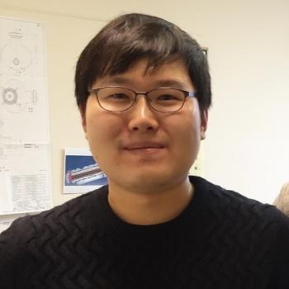

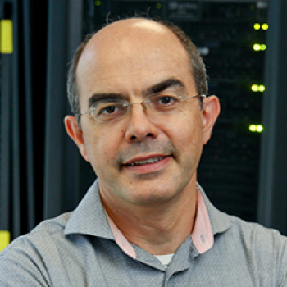



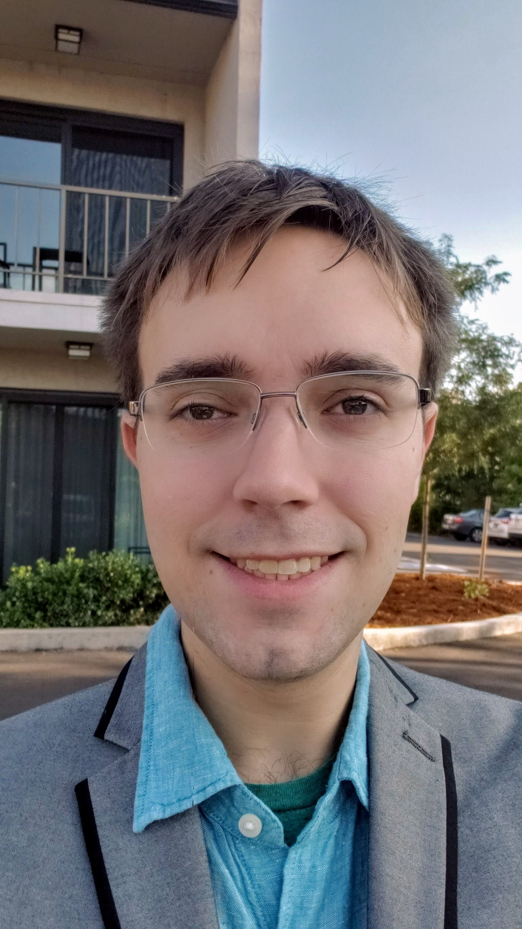



Team
Young-Kee Kim
J.P. Gonzalez-Aguilera
Seong-Yeol Kim
(now at PAL, Korea)
John Power
Philippe Piot
PhD Advisors
Eric Wisniewski
Wanming Liu
Alexander Ody
Ryan Roussel
Auralee Edelen
This work was supported by:
NSF award PHY-1549132, the Center for Bright Beams
DoE contract No. DE-AC02-05CH11231, NERSC award BES-ERCAP0023724
This work was supported by:
NSF award PHY-1549132, the Center for Bright Beams
DoE contract No. DE-AC02-05CH11231, NERSC award BES-ERCAP0023724

Slide 3
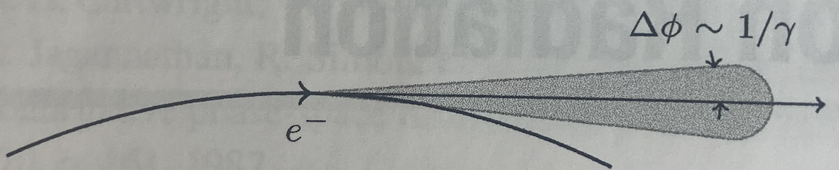
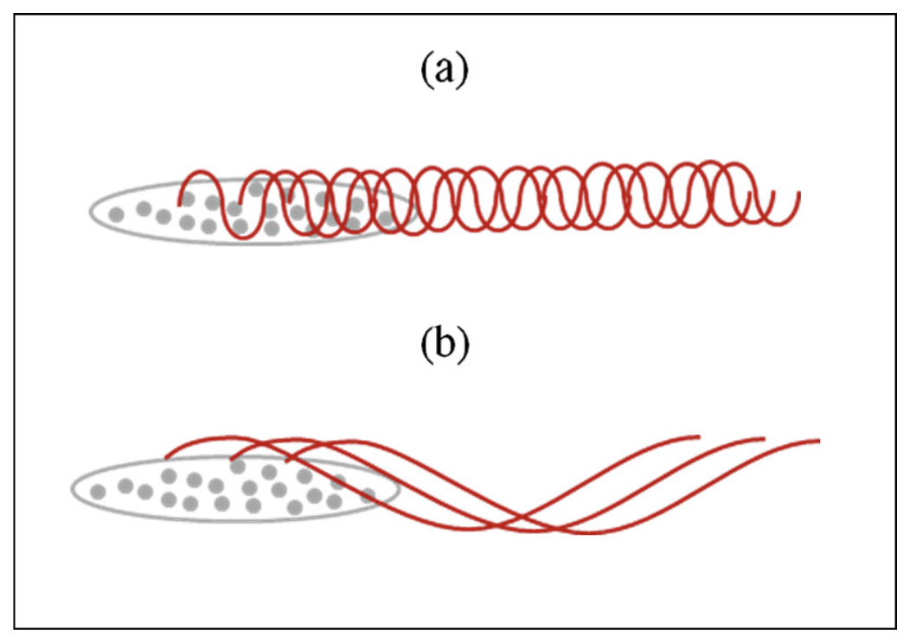
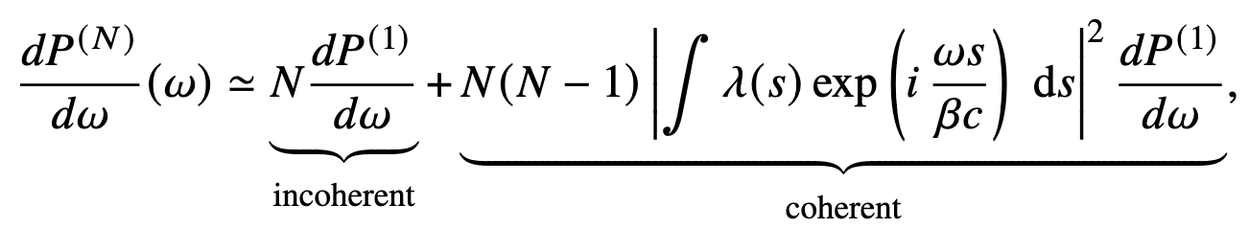
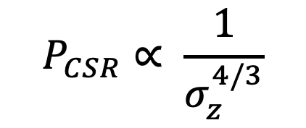
Synchrotron Radiation
Radiation produced by relativistic charged particles moving along curved trajectory
Coherent / incoherent
K.-J. Kim et al.,2017
$$P_{CSR}∝ \frac{1}{σ_{z}^{4/3}}$$

Slide 4
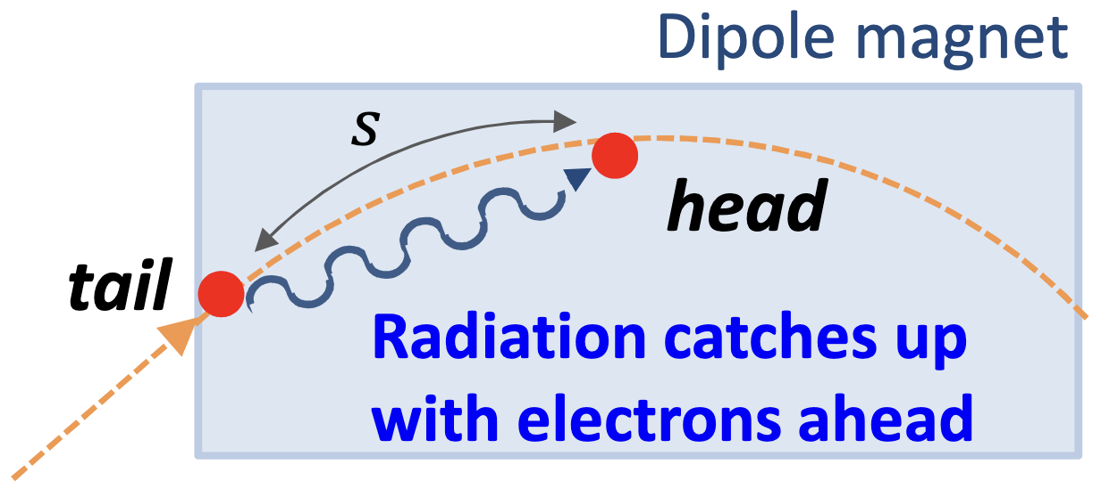
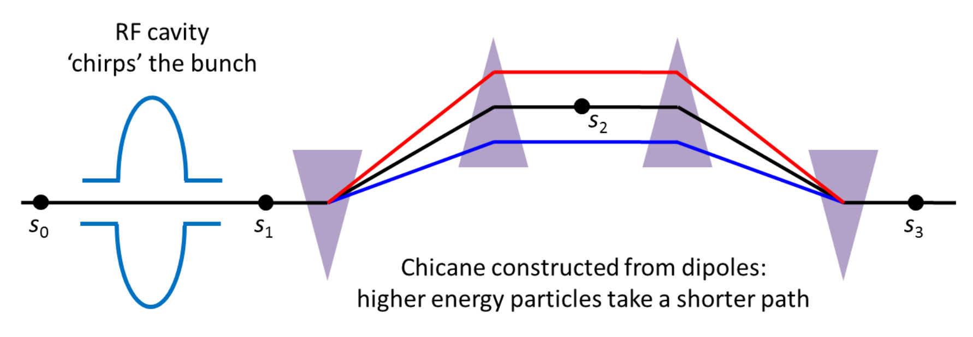
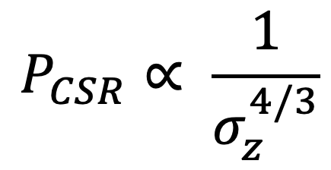
Coherent synchrotron radiation in compressed beams
CSR is produced when bending beam trajectory
Radiation emitted by tail of beam kick particles ahead
FEL applications need highly compressed beams longitudinally
Dispersive lattices are used to compress the beams (e.g., chicanes)
S. Di Mitri, USPAS 2015
$$P_{CSR}∝ \frac{1}{σ_{z}^{4/3}}$$
H. Bartosik, 2022. arXiv:2201.01532

Slide 5
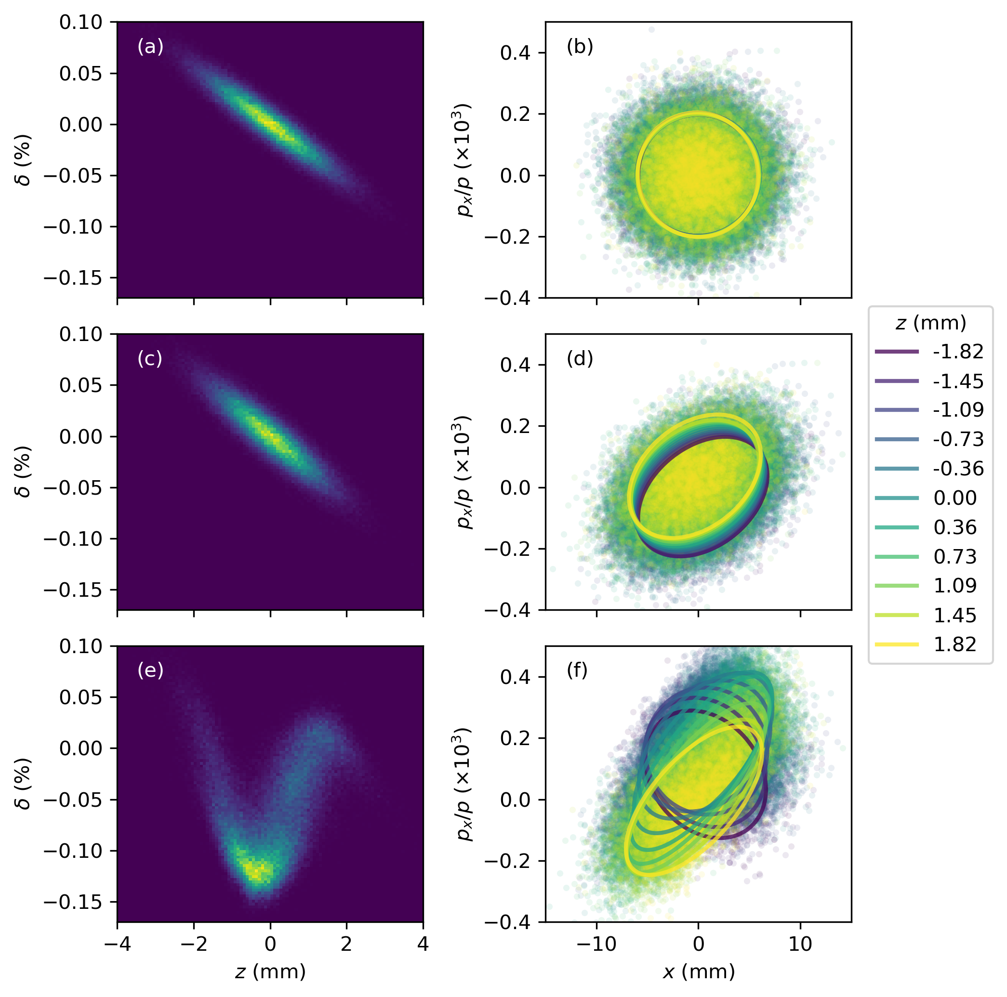
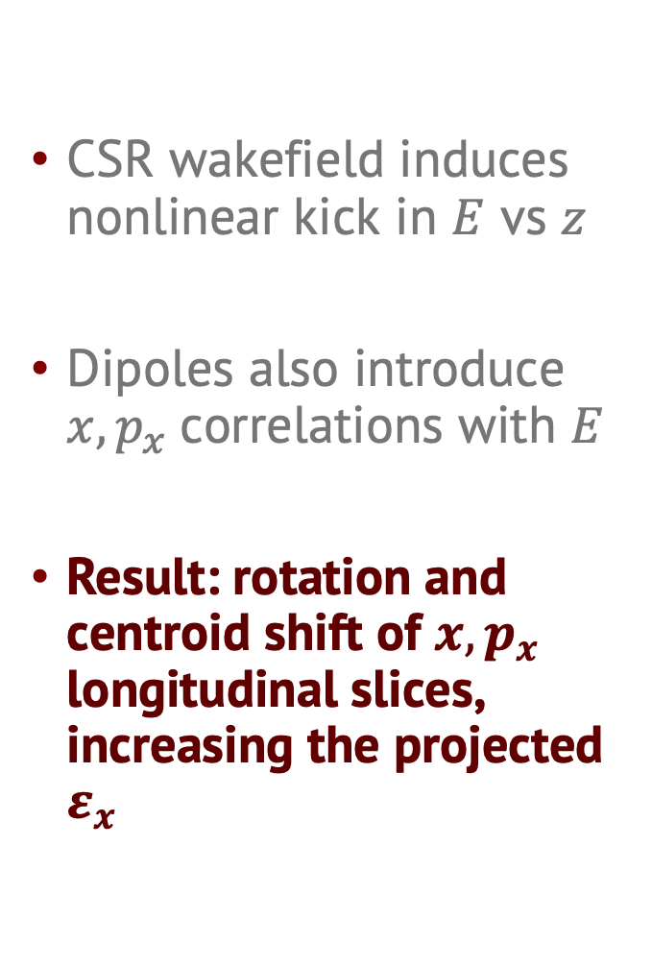
CSR Degrades Beam Quality
CSR wakefield induces nonlinear kick in $E$ vs $z$
Dipoles also introduce $x, p_{x}$correlations with $E$
Result: rotation and centroid shift of $x, p_{x}$ longitudinal slices, increasing the projected $ε_{x}$
initial
initial
final
final

Slide 6
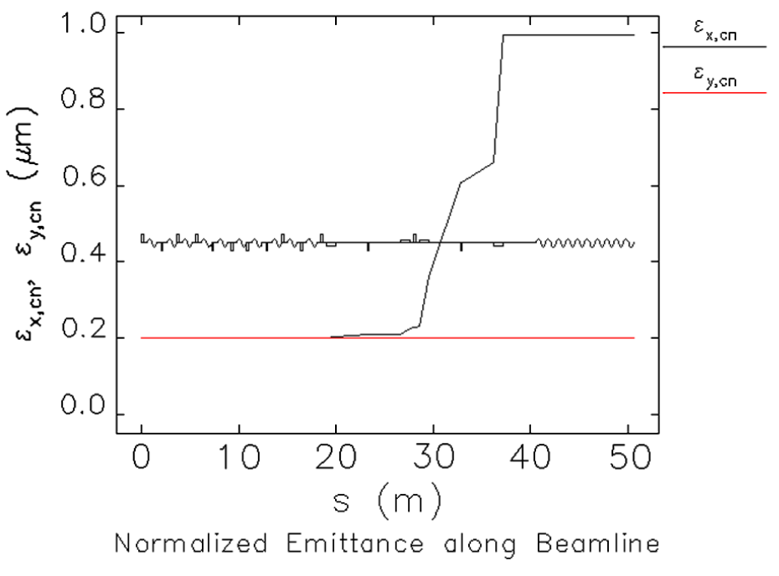
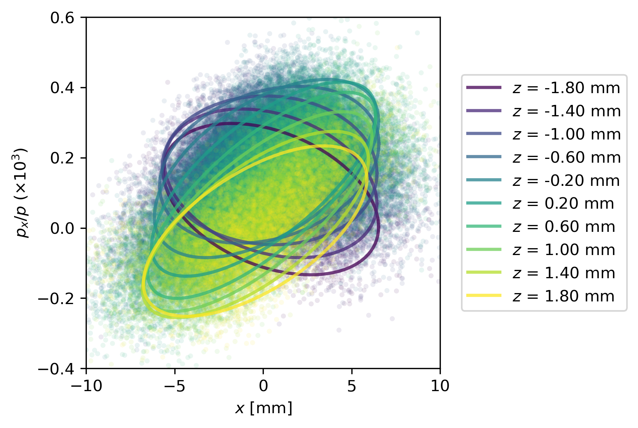
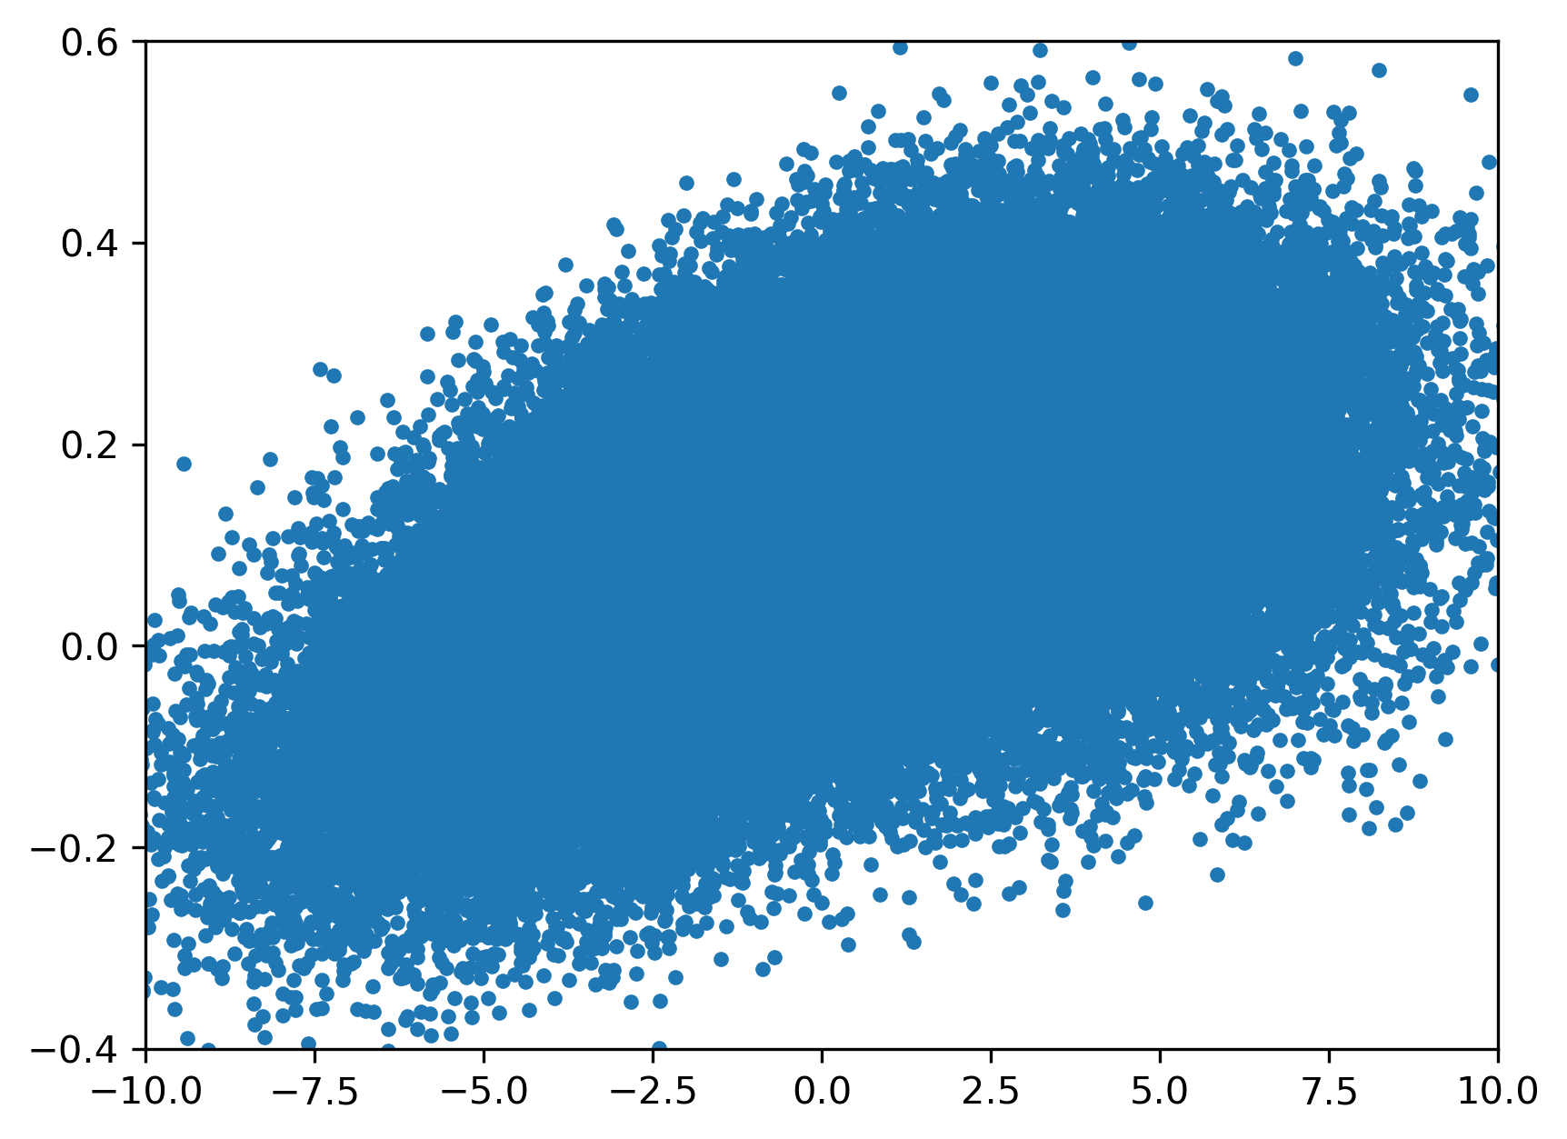
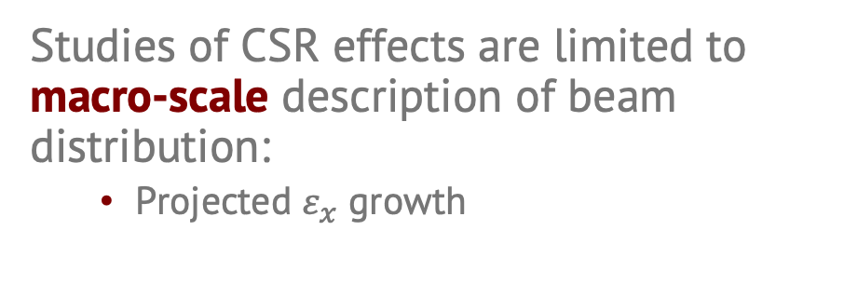
Measurement of CSR Effects
Studies of CSR effects are limited to macro-scale description of beam distribution:
  Projected $ε_{x}$ growth
Y. Jing et al., Phys. Rev.
ST Accel. Beams. 2013
Does not resolve detailed beam structure!
Projection
misses detail!
Full picture.
We want this!

Slide 7
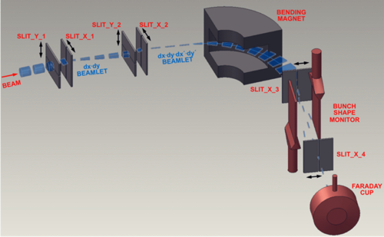
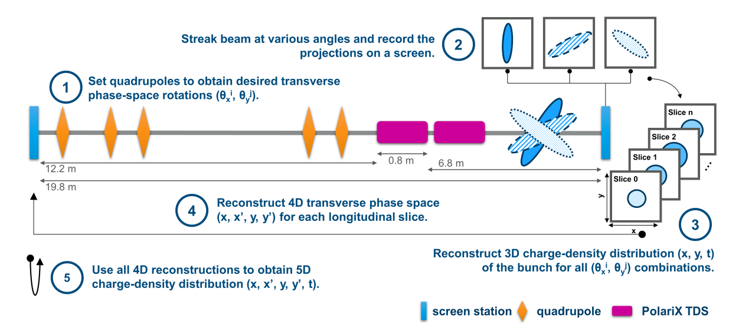
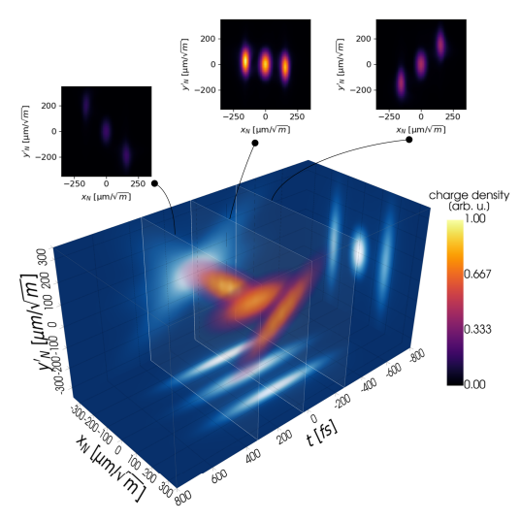
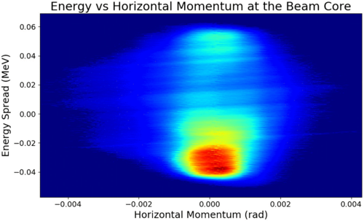
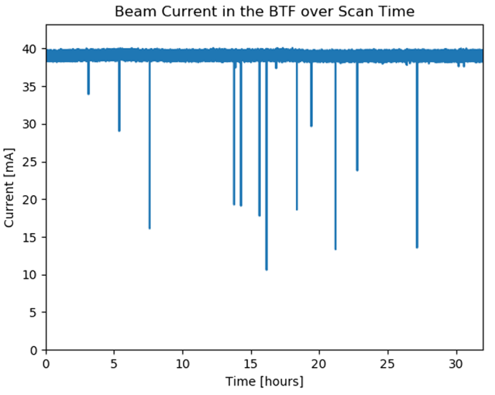
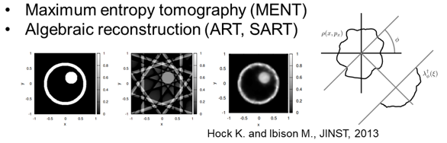
Measuring high-dimensional beam distributions
Multiple scanning slits with dipole and bunch shape monitor @ SNS (ORNL)
5D tomography with polarizable X-band TDC @ ARES (DESY)
Jaster-Merz, S., et al Proc. IPAC’22 (2022): 279-283.
Cathey, Brandon, et al. PRL 121.6 (2018): 064804.
960 measurements ~ 28 hrs
Tomographic reconstruction ~ 24 hrs
5 million (!) measurements ~ 32 hrs
7

Slide 8

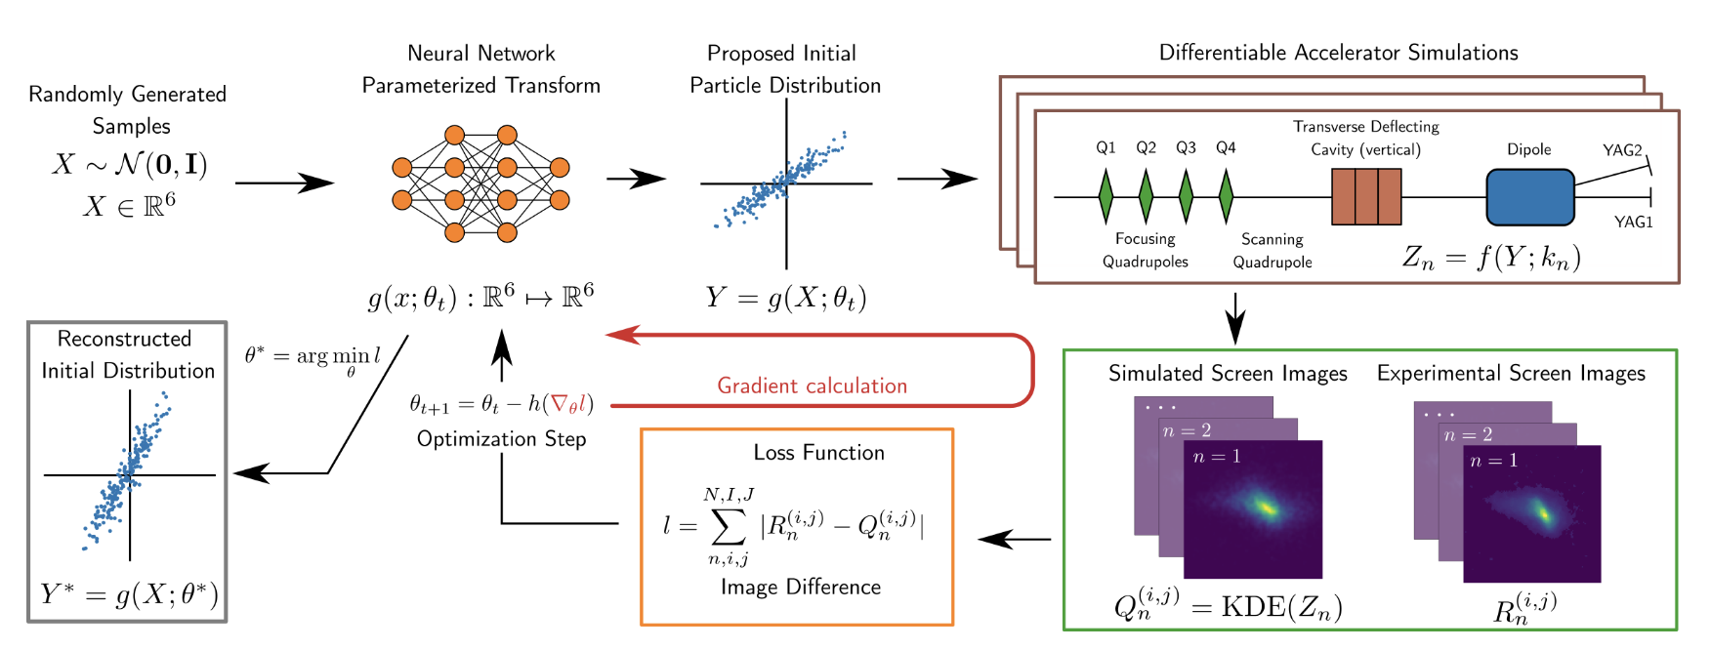
Generative Phase Space Reconstruction (GPSR)
    R. Roussel et al. PRAB 2024

Slide 9
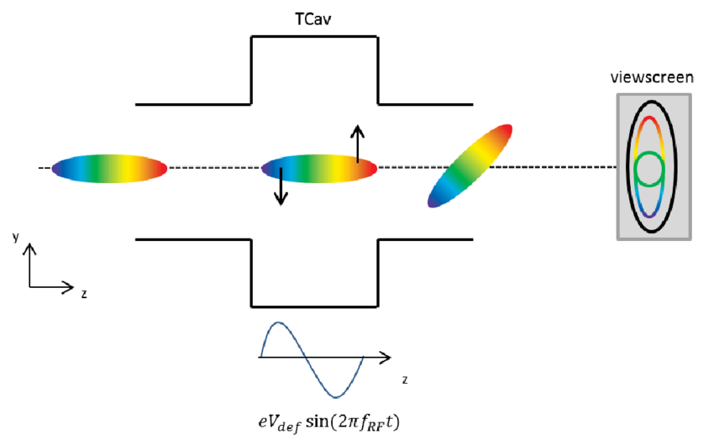
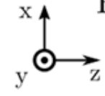
GPSR Scan
quad
YAG 1
transverse deflecting cavity
dipole
OFF/ON
OFF/ON
higher energy
YAG 2
5 quad strengths
lower energy
Total training images: 20

Slide 10
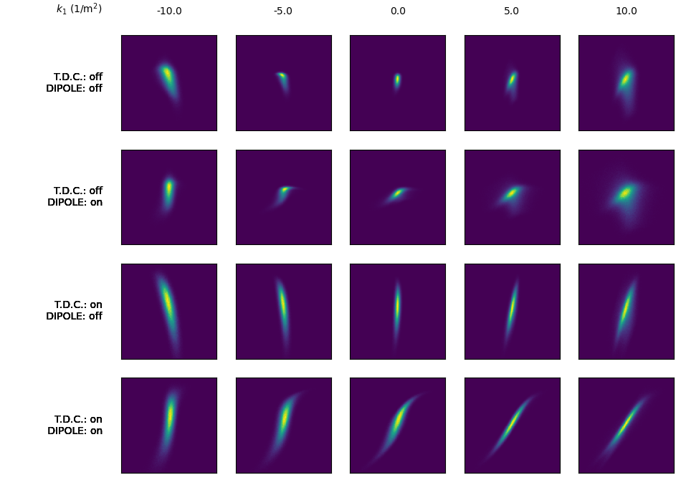
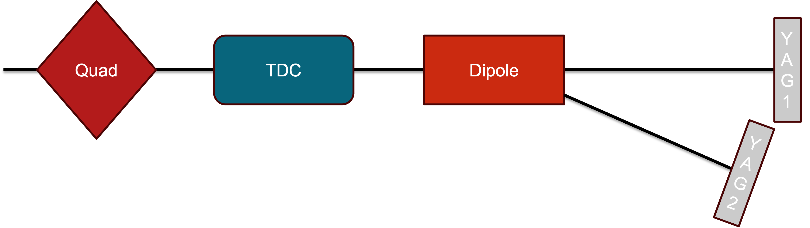
GPSR Scan
5 quad strengths
OFF/ON
OFF/ON
    R. Roussel et al. PRAB 2024

Slide 11
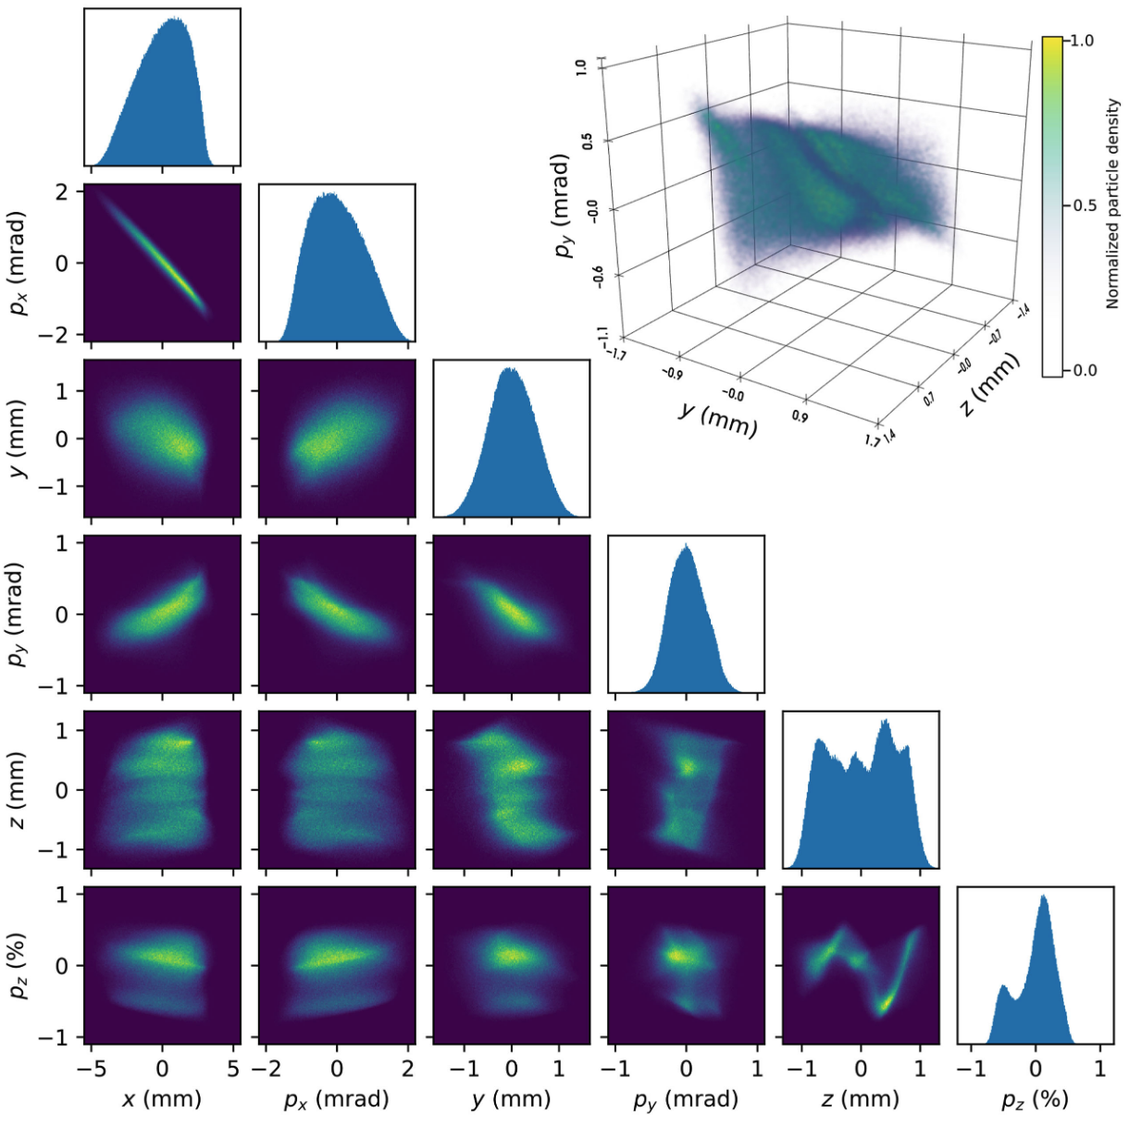
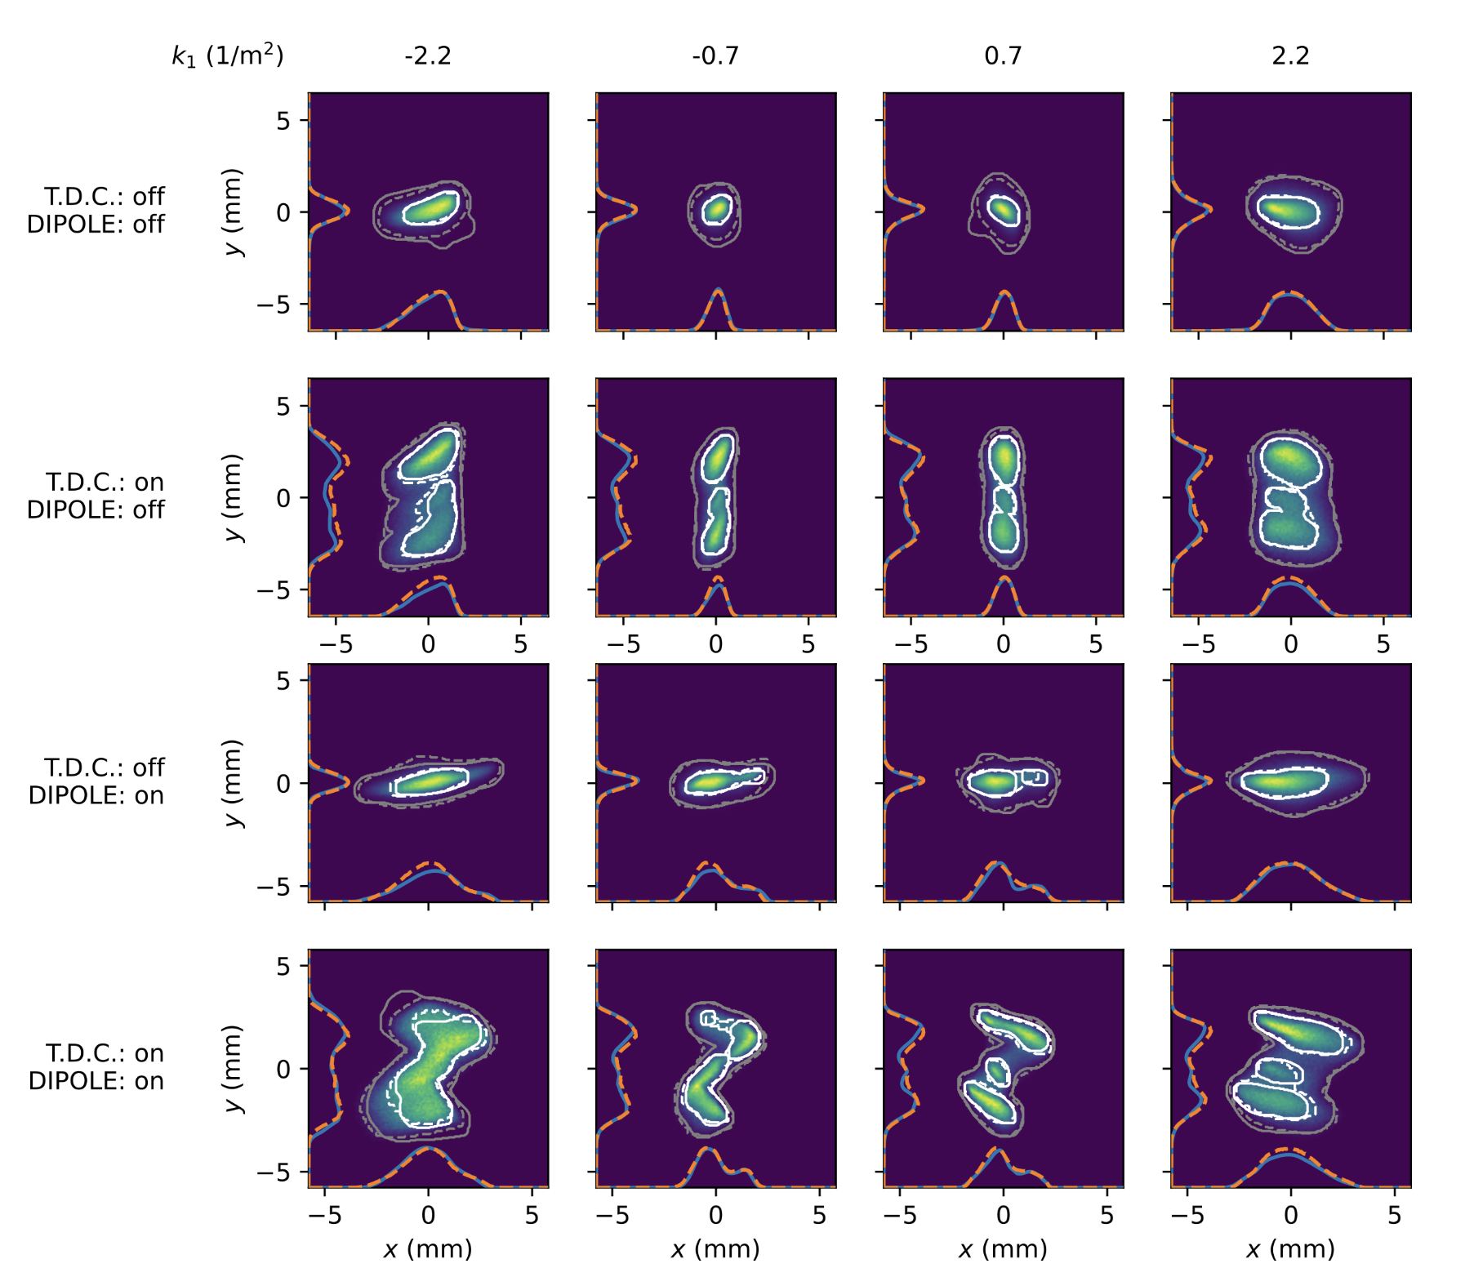
Experimental 6D GPSR at AWA
Magnetization due
to solenoid focusing
6D reconstruction from
  20 measurements
  15 minutes analysis time
  No pre-training needed
Temporal structure
likely from laser
homogenization optics
    R. Roussel et al. PRAB 2024

Slide 12
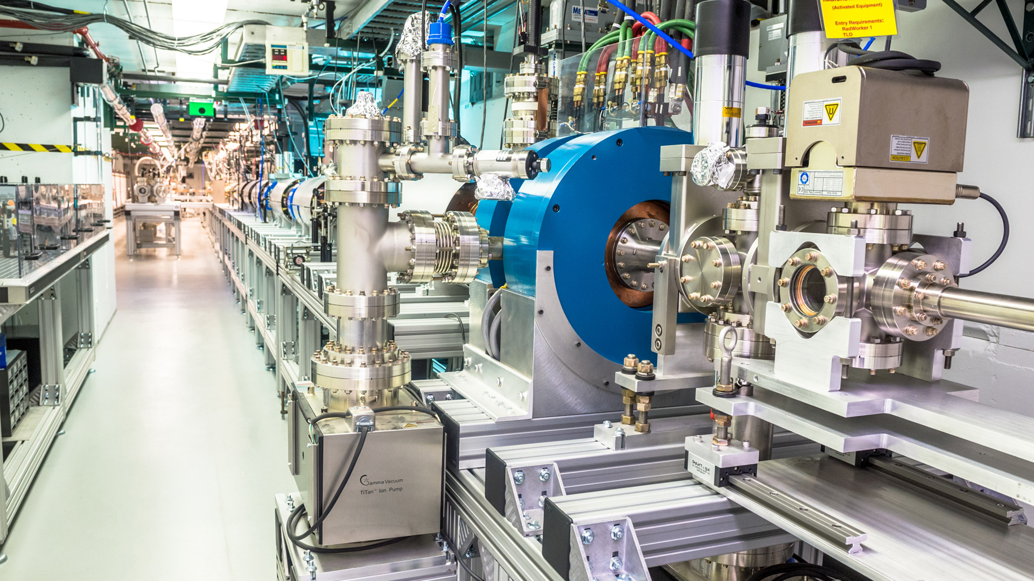
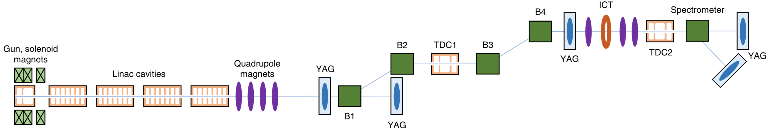
CSR at the Argonne Wakefield Accelerator
Generate a beam influenced by CSR in double dogleg
Measure phase space after 4th dipole with beam diagnostics
diagnose CSR effects
Beam
1 nC, 43 MeV
generate CSR effects
Adapted from N. Majernik et al., PRAB, 2023.

Slide 13
Simulated CSR Effects: $E−z$ and $x−p_{x}$
CSR off
`
CSR on

Slide 14
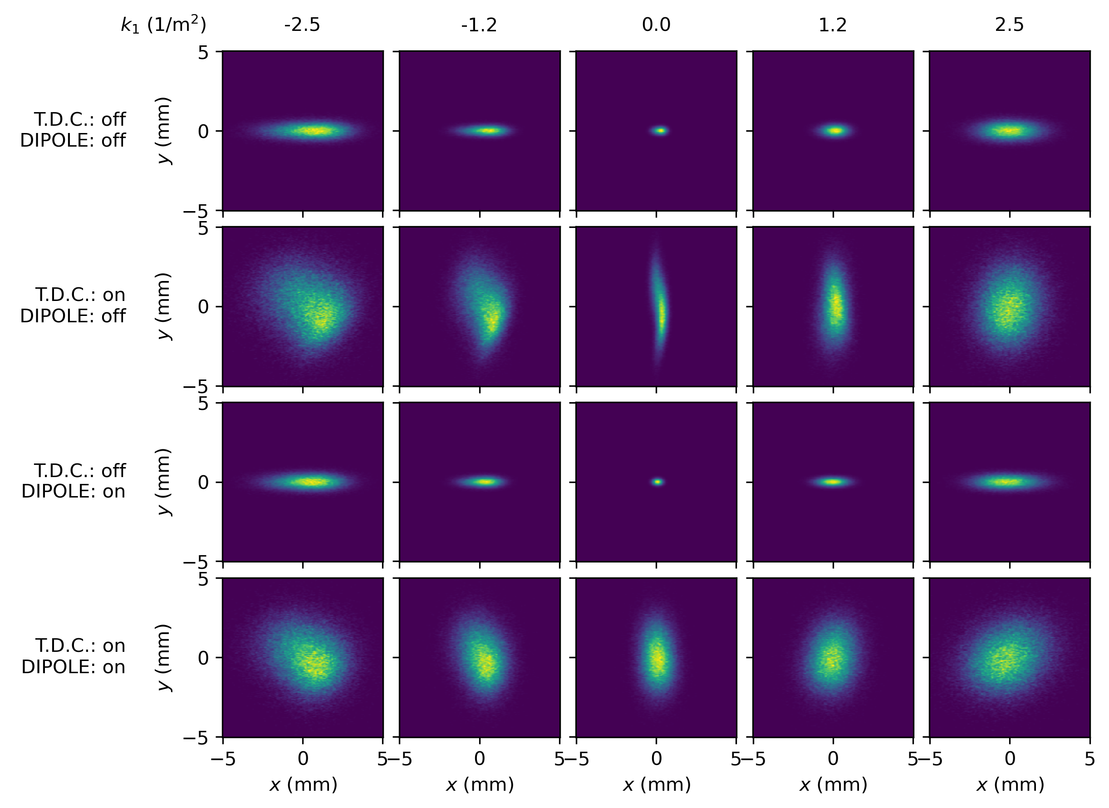
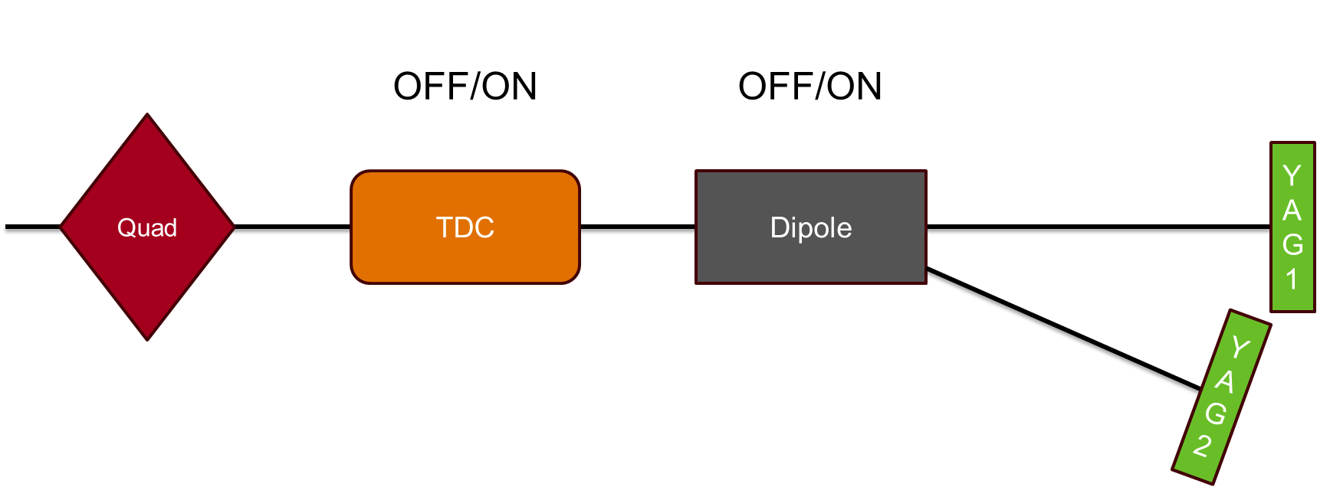
Simulated GPSR Training Data
Diagnostics lattice
Screen sizes: 30mm

Slide 15
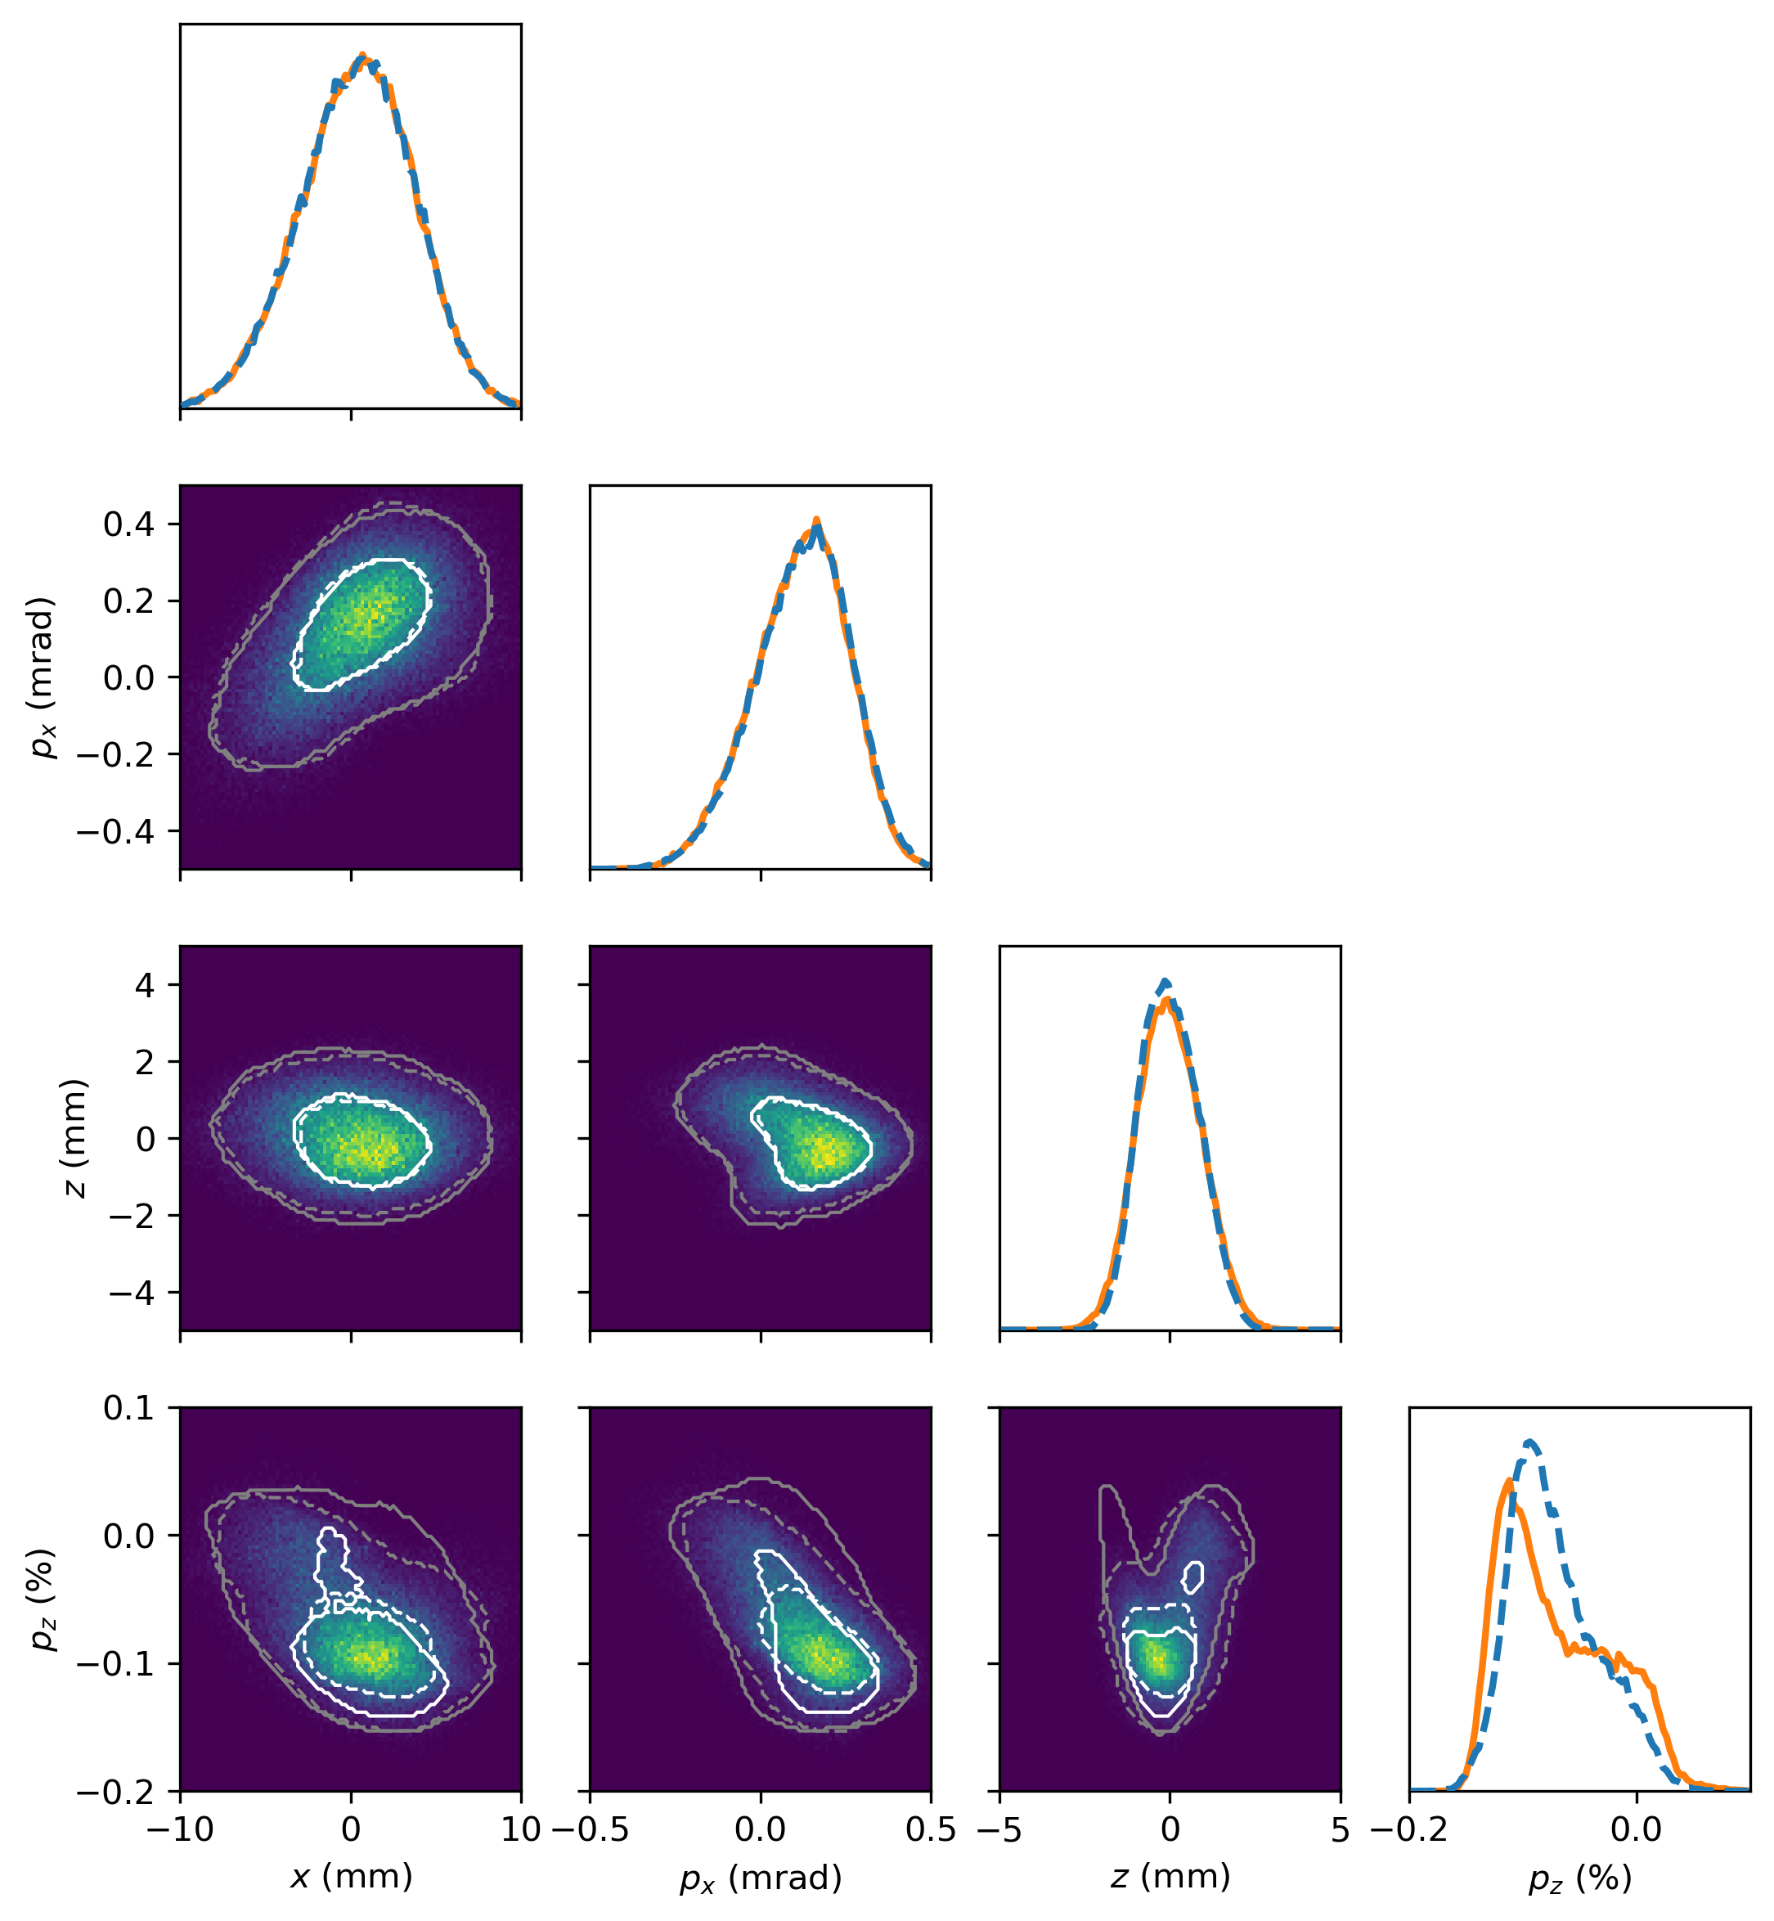
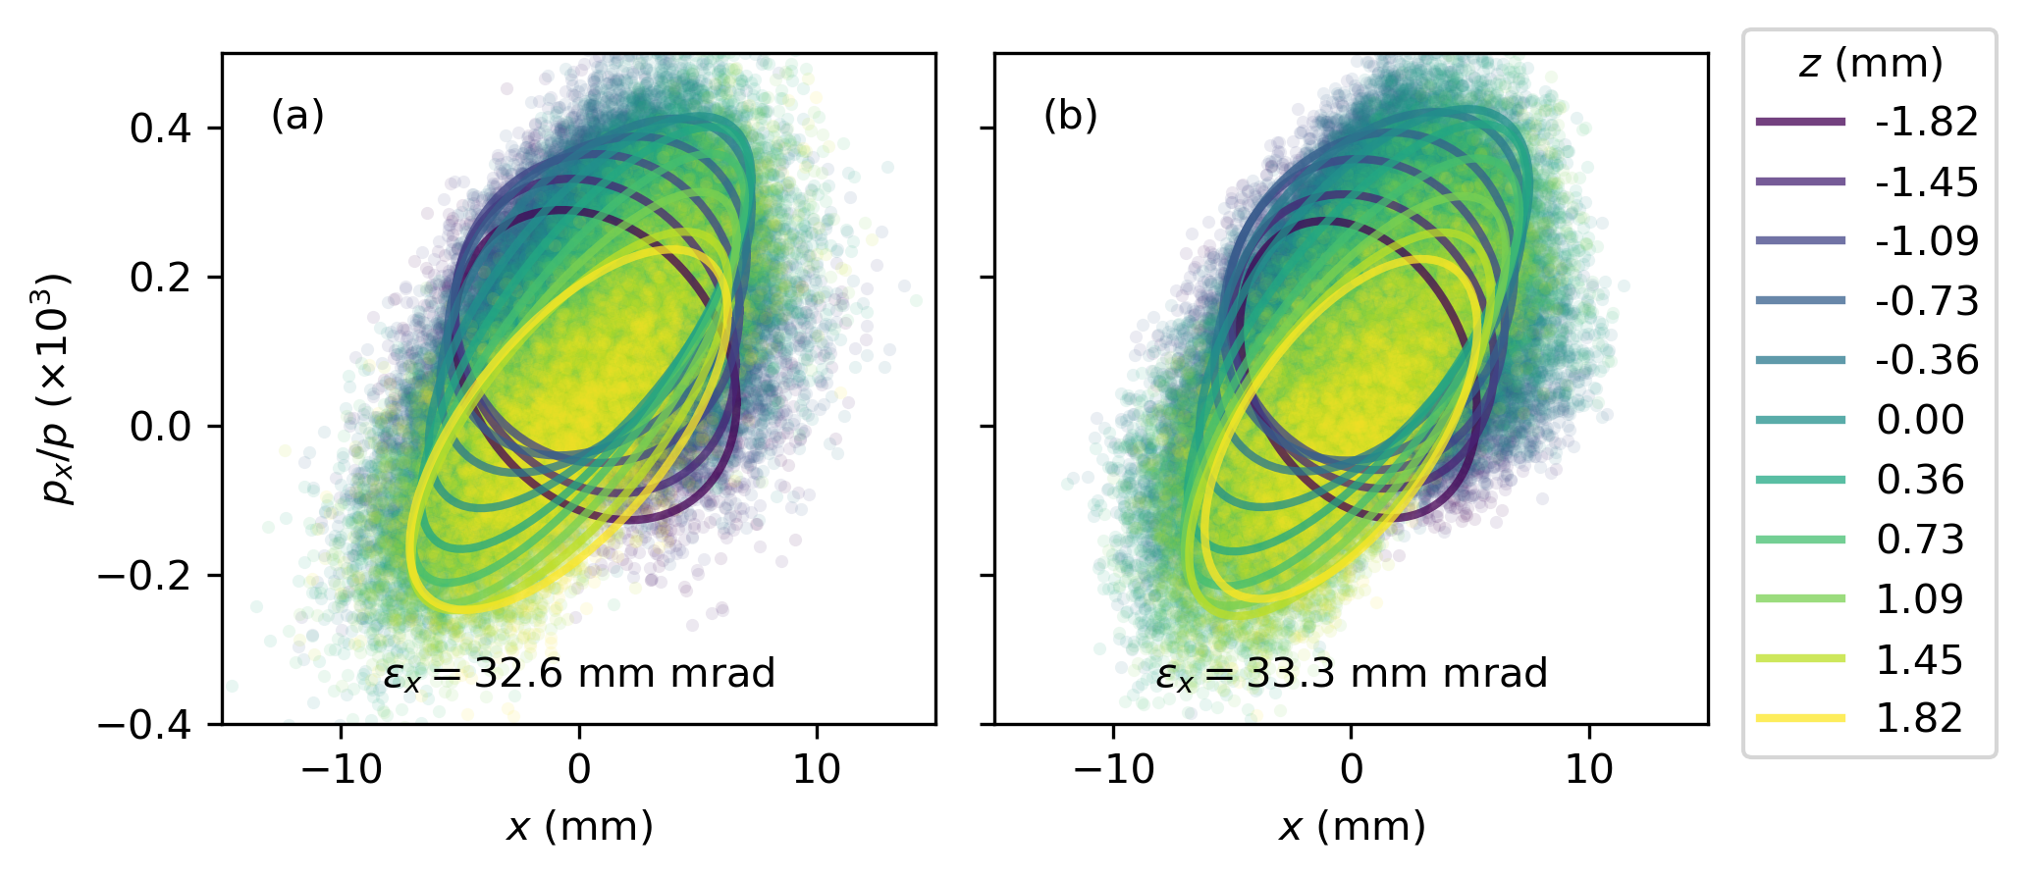
Simulated GPSR Results
ground truth
reconstruction
      50th percentile reconstructed
      50th percentile ground truth
      95th percentile reconstructed
      95th percentile ground truth
Gonzalez-Aguilera et. al., Proc. IPAC’24

Slide 16
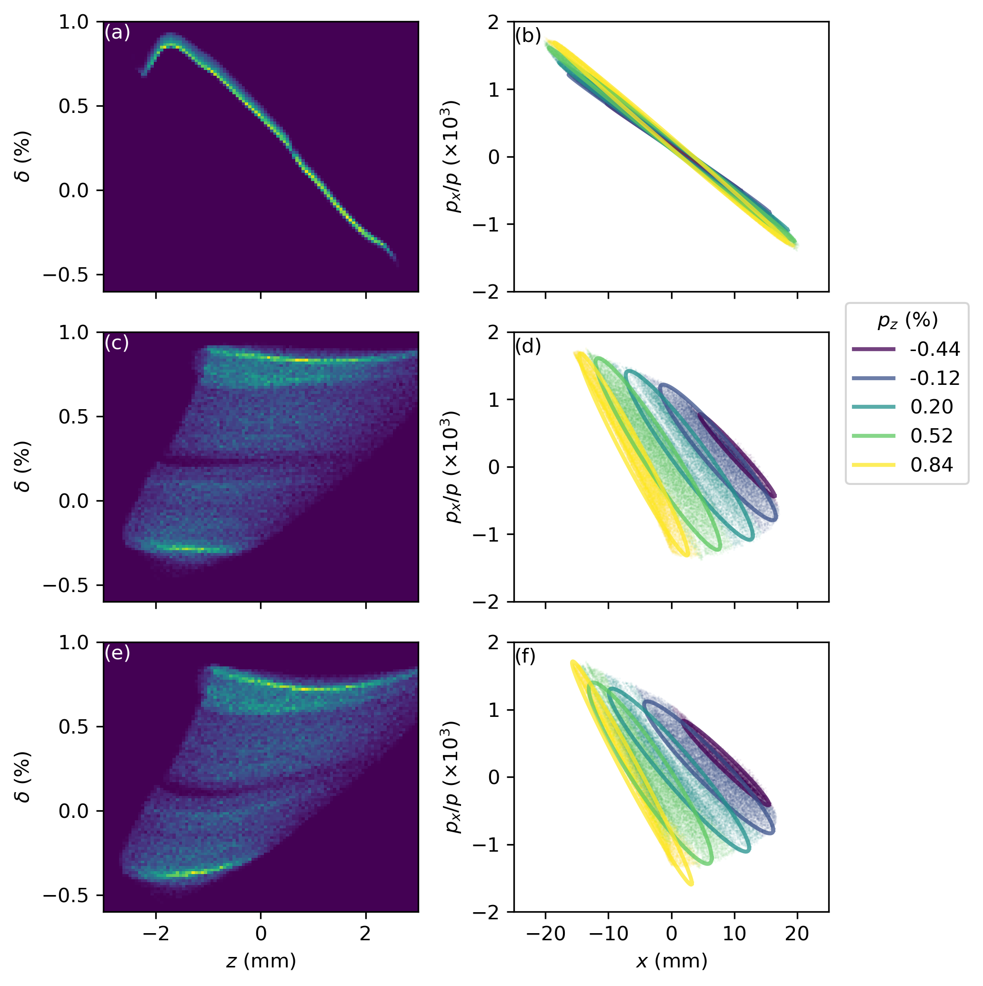
Dispersion dominates for larger energy spread
Dispersive:
Emittance growth dominated
by dispersion
initial
CSR
off
Non-dispersive
Emittance growth dominated
by CSR
CSR
on
Flip x

Slide 17
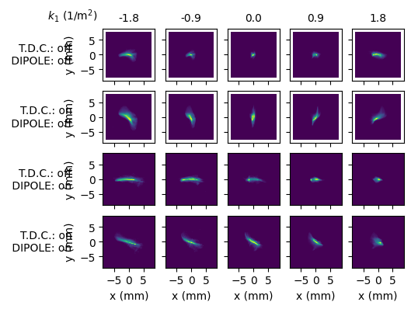
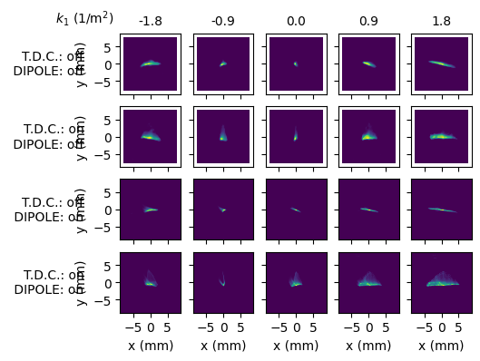
Experiment data
Masked beam (0.05 nC)
Masked along x before first dipole
Expect: less CSR effects
Full beam (1nC)
Expect: significant CSR effects

Slide 18
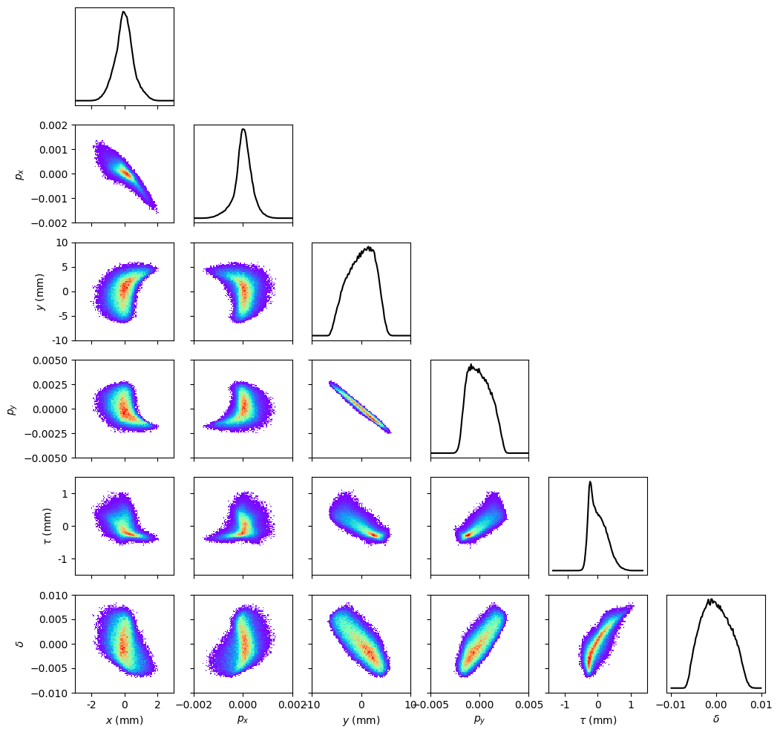
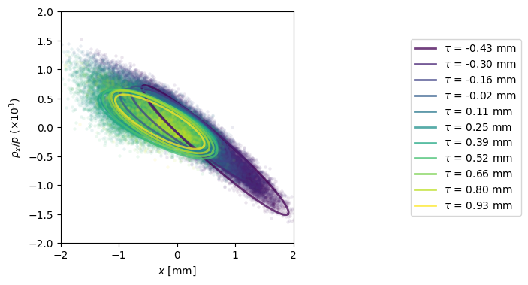

Experiment full beam (1 nC)
$ε_{x}=9.5 μm$

Slide 19
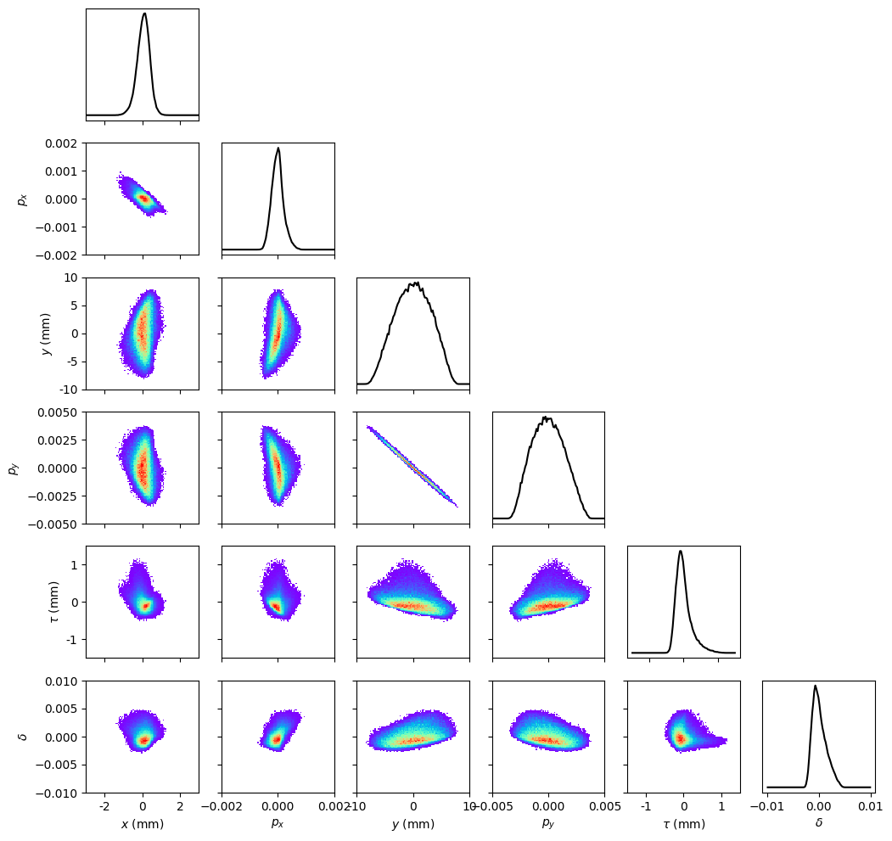
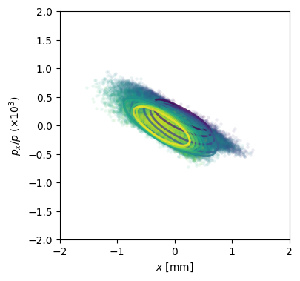

Experiment masked beam (0.05 nC)
$ε_{x}=4.6 μm$

Slide 20
Conclusions
Experiments at AWA look promising
  Reconstructed beam show indication of CSR effects at 1nC
  Must compare with more accurate simulations
GPSR can reconstruct structure of CSR-affected beams
  Fast
  Accurate
  Detailed
GPSR is a very powerful tool
  6D phase space information gives the full physical picture

Slide 21
Thanks! Questions?
Young-Kee Kim
J.P. Gonzalez-Aguilera
Seong-Yeol Kim
(now at PAL, Korea)
John Power
Philippe Piot
PhD Advisors
Eric Wisniewski
Wanming Liu
Alexander Ody
Ryan Roussel
Auralee Edelen
This work was supported by:
NSF award PHY-1549132, the Center for Bright Beams
DoE contract No. DE-AC02-05CH11231, NERSC award BES-ERCAP0023724
This work was supported by:
NSF award PHY-1549132, the Center for Bright Beams
DoE contract No. DE-AC02-05CH11231, NERSC award BES-ERCAP0023724

Slide 22
Bckp, reversing quads

Slide 23
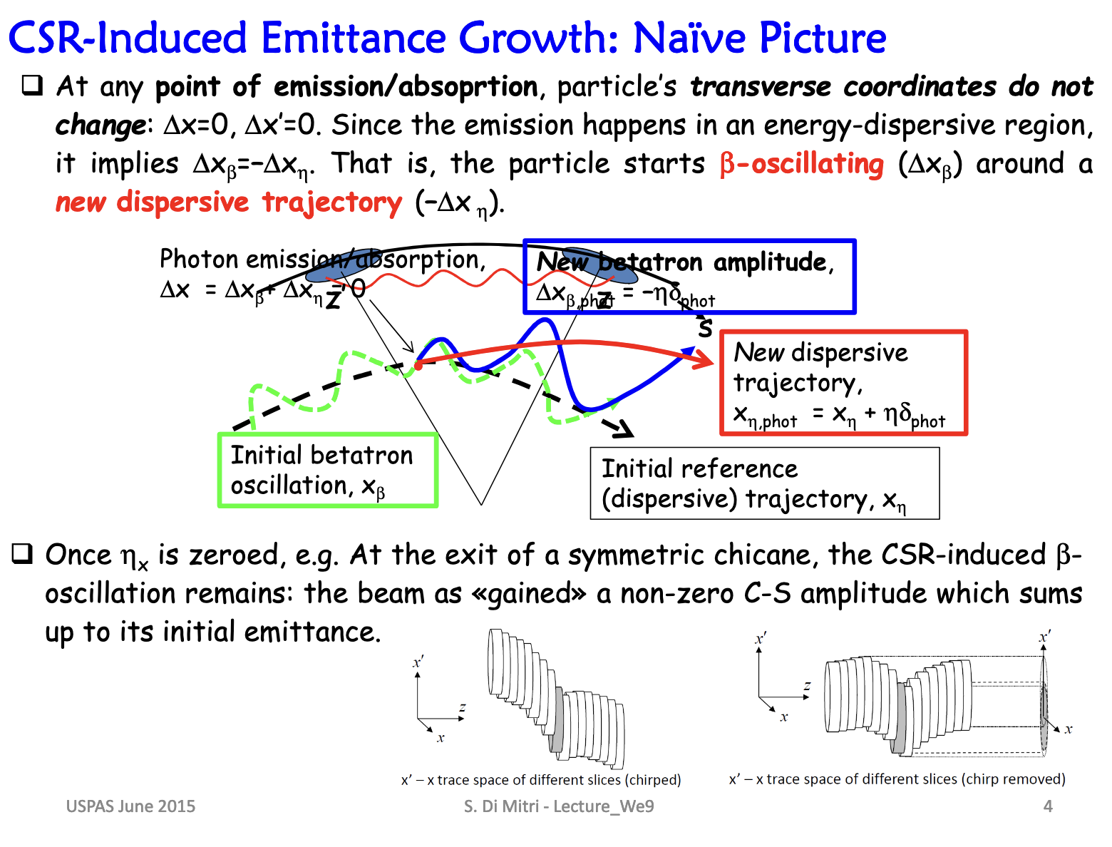
Bckp, CSR-induced emittance growth

Slide 24
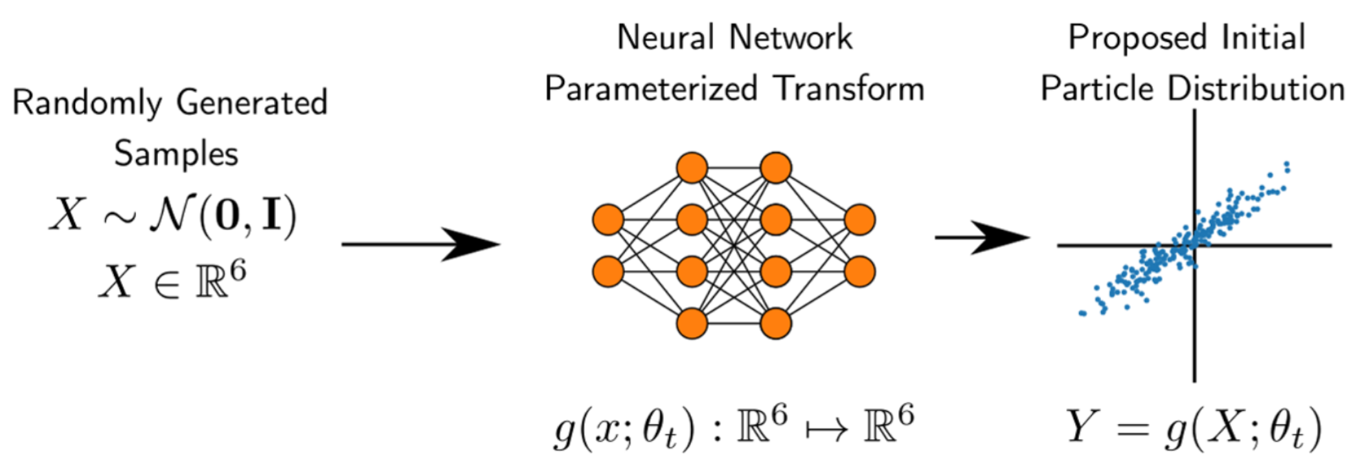
Bckp, NN Generator
6D phase space distribution parametrization that is
  flexible
  learnable
Fully connected NN with ~ O(1k) parameters

