Slide 1





Graph Learning for Explainable Operation of Particle Accelerators
Chris Tennant, Theo Larrieu, Daniel Moser, Song Wang, Jundong Li
April 8-11, 2025
5th ICFA Beam Dynamics Mini-Workshop on Machine Learning for Particle Accelerators

Slide 2
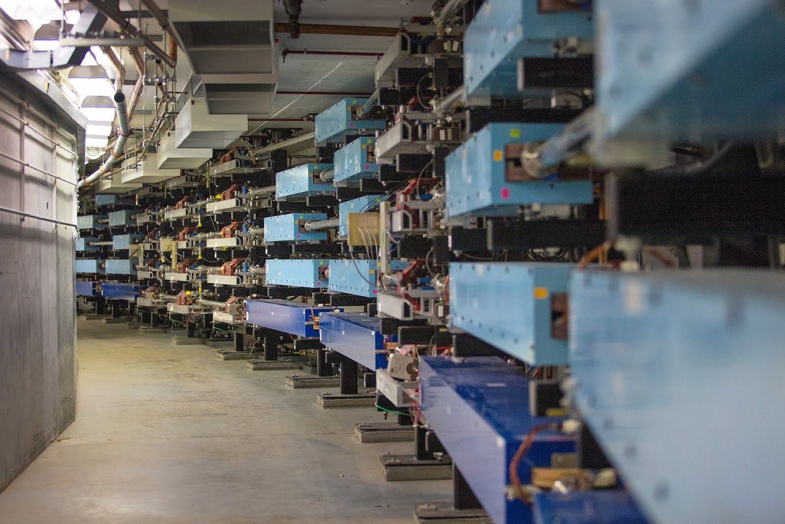
Outline
Introduction
Motivation
Method
Explainability
Example: Data Exploration
Summary
leverage deep learning on graph representations of a beamline for greater insights into complex systems
Notes:
Guidelines: 6-8 bullets per slide; Use sentence fragments for bullets
To change the photo: Right-click on photo and select change photo

Slide 3
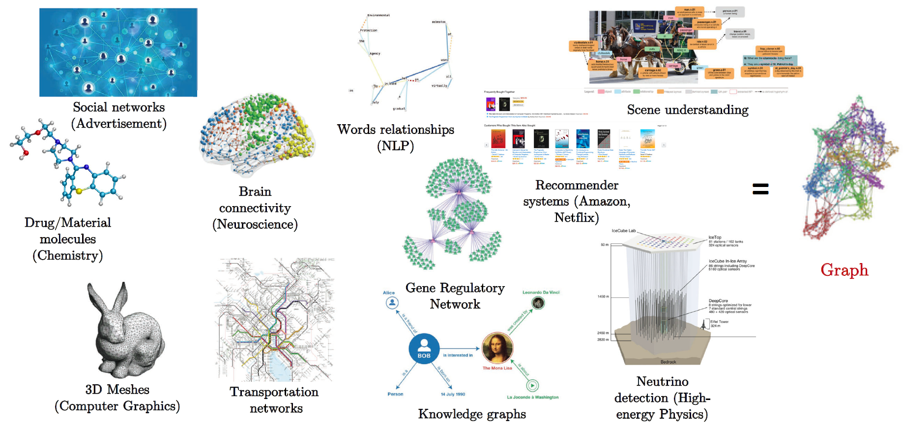
Introduction: What is a Graph?
graphs are a general language for describing and analyzing entities with relations
(courtesy X. Bresson)

Slide 4
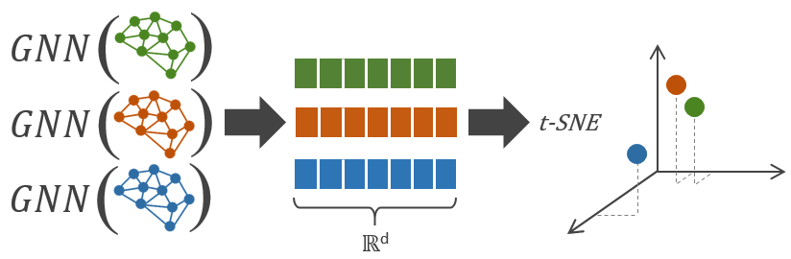
Introduction: Whole-Graph Embedding
represent the state of a beamline at a specific date and time as a graph
embed graph into 2- or 3-dimensions using a graph neural network (GNN)
  a GNN provides a framework for defining a deep neural network on arbitrary graph data
PCA

Slide 5
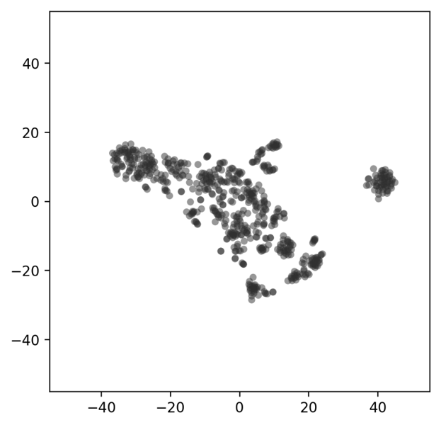
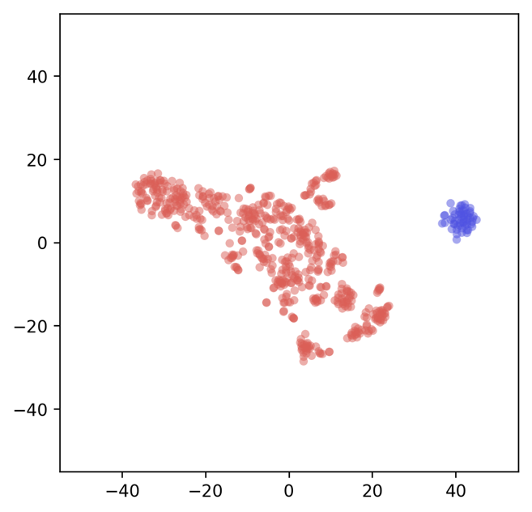
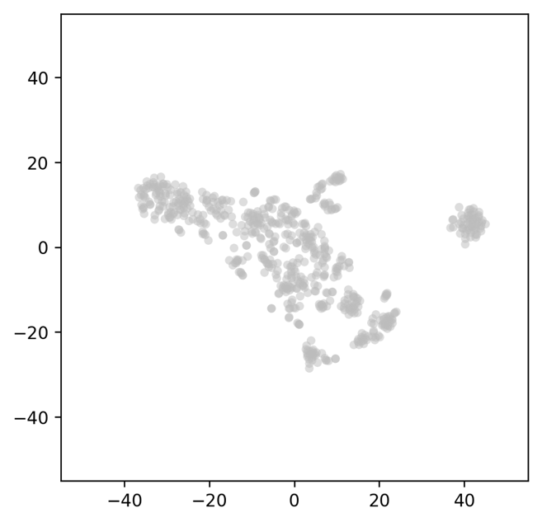
Motivation: Application for Beam Operations
4
5
good
3
B
bad
1
A
1
visualize the underlying distribution/pattern of beamline states
use cluster analysis to identify regions of parameter space
monitor changes in the machine and observe trajectory in latent space
  more quickly converge to known optimal beamline configurations

Slide 6
Method: Beamline-to-Graph
quad A
cavity A
BPM A
quad B
quad C
BPM B
BEAMLINE
GRAPH
X position | -1.4685e+00
Y position | 1.0382e+00
A
A
strength | 2.612e+04
strength | 4.6428e+02
C
A
gradient | 7.0000e+00
phase | -1.5601e+02
B
B
= quadrupole magnet
= accelerating cavity
strength | -7.6428e+02
X position | 0.9543e+00
Y position | 1.0034e+00
= beam position monitor (BPM)

Slide 7
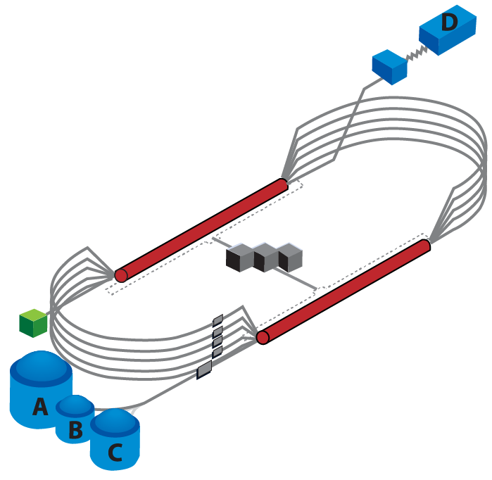
Method: Beamline-to-Graph
CEBAF is a CW recirculating linac utilizing 418 SRF cavities to accelerate electrons up to 12 GeV through 5-passes
consider a 95 m portion of the injector
software developed so that:
  given a date and time stamp, a beamline is defined from the CEBAF Element Database
  node features are populated by process variables stored in the operational archiver
  each graph: 11 node types, 206 nodes, 296 node features, and 409 edges
have generated over 100K graphs from the last few years of operational data for model training and analysis
injector
info.dat
defines the node types
meta.dat
lists the number of each node type in the graph
node.dat
[node ID, node name, node type, node attributes]
link.dat
[start node ID, end node ID, edge type, edge weight]

Slide 8
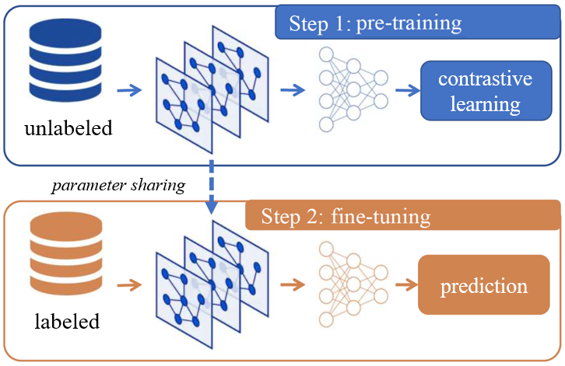
Method: GNN Model Training
pre-training the model on a large set of unlabeled data using self-supervised learning
  tries to learn as much as possible from the data alone
  take advantage of years of operational data stored in the archiver without having to do the expensive task of hand labeling the data
  a special class of loss function, known as contrastive loss, maximizes agreement between latent representations from similar graph pairs while minimizing agreement from unlike pairs
fine-tune the model on the downstream task of classifying good and bad setups using a smaller labeled dataset
a dimensionality reduction to visualize the results in 2D
this same basic workflow is being leveraged to produce state-of-the-art results in natural language processing and vision tasks

Slide 9
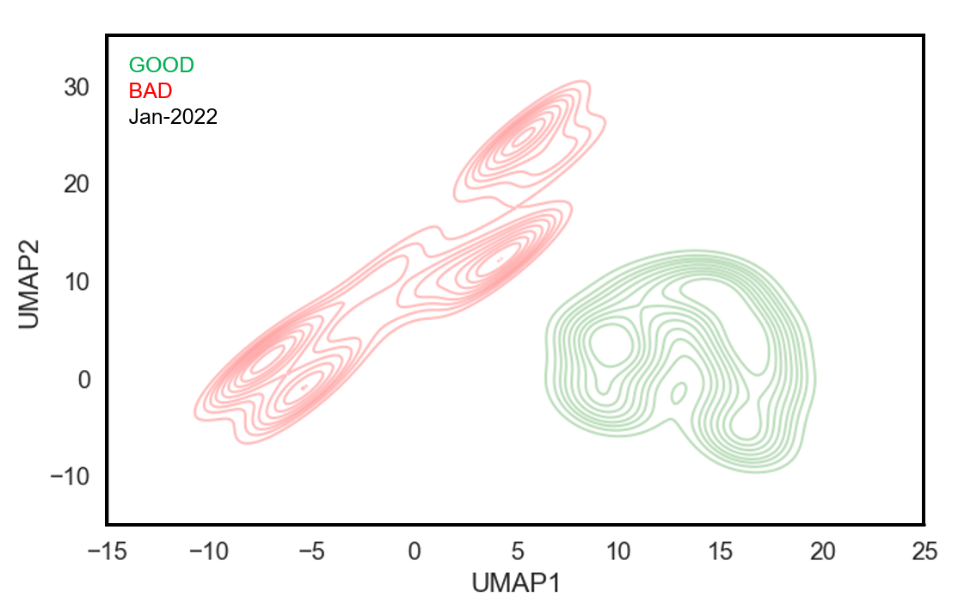
Identifying Regions of Parameter Space
a GNN encoder pre-trained on the 2,129 unlabeled graphs from 2021
fine-tune model on the smaller set of labeled (354 good, 324 bad) graphs

Slide 10
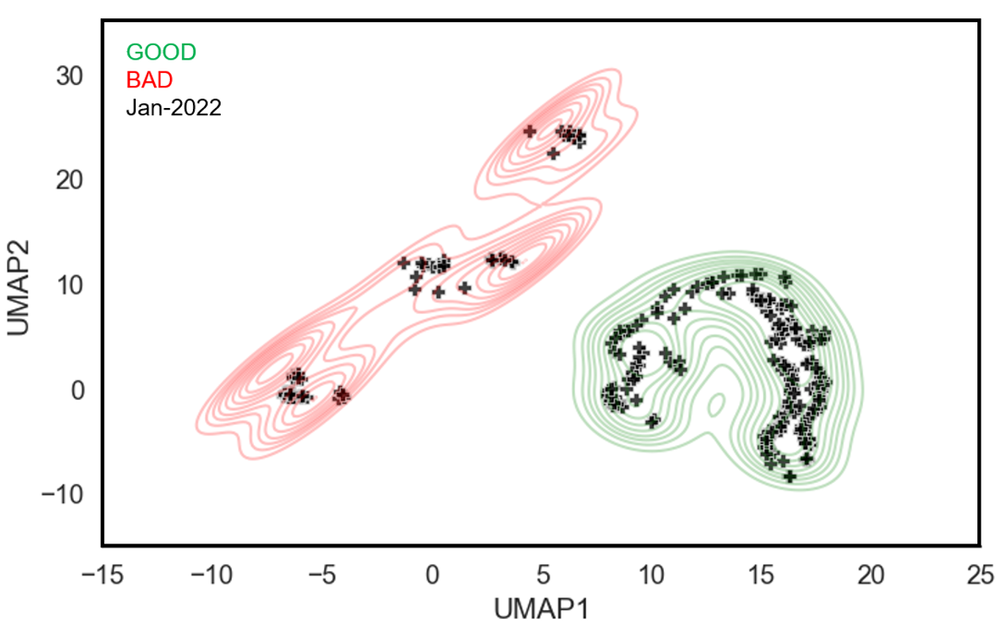
Identifying Regions of Parameter Space
a set of 352 unlabeled graphs representing operations in January 2022 were input to the model and their resulting latent representations plotted
S. Wang, et al., Front. Big Data, Sec. Data Mining and Management, vol 7 (2024).

Slide 11
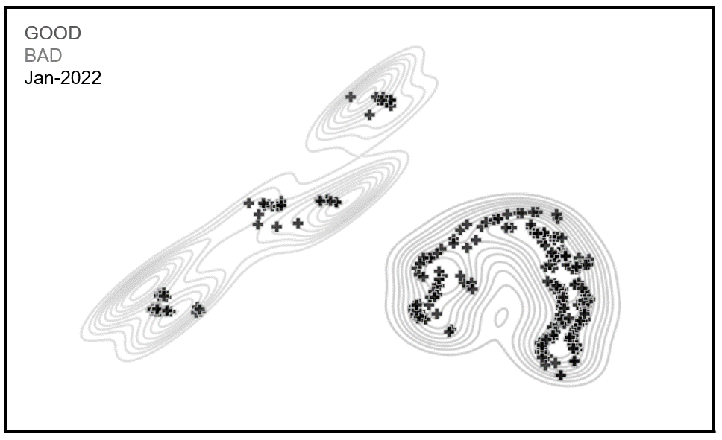
Explainability
GOAL: what setting node is most important (i.e. best explains) the move from point A to B in latent space?
the downstream impact of changing an element depends on the:
element type
  a quadrupole affects the beam differently than a corrector than an RF phase
element location
  a change further upstream provides a bigger lever arm, but it also depends on beam properties at location of change
magnitude of the change
  all other things being equal, a larger magnitude will have a bigger affect, however, even if we compare two of the same type of element, location matters
B
A

Slide 12
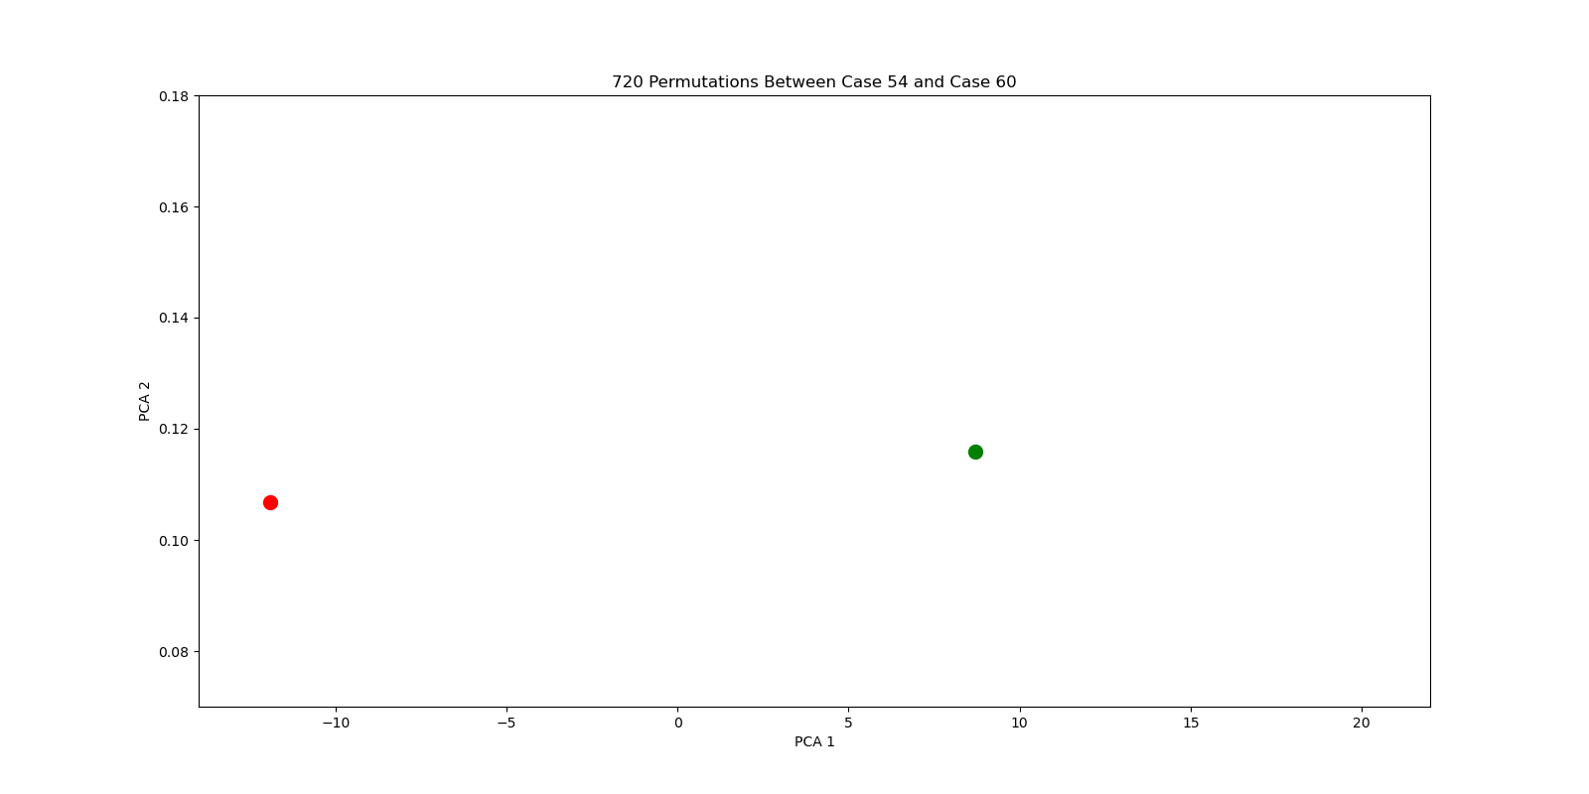
Explainability Example: Graph A → Graph B
beam-based experiment transitioning from one injector configuration to another
Graph A
Graph B

Slide 13
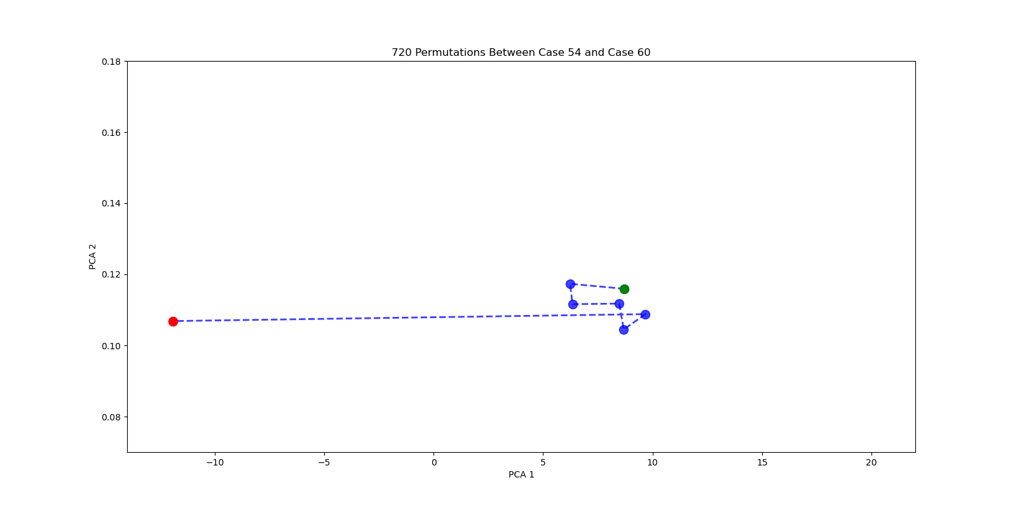
Explainability Example: Graph A → Graph B
make methodical, incremental changes to go from one state to the other
Quad
V Corr.
H Corr.
H Corr.
Quad
V Corr.

Slide 14
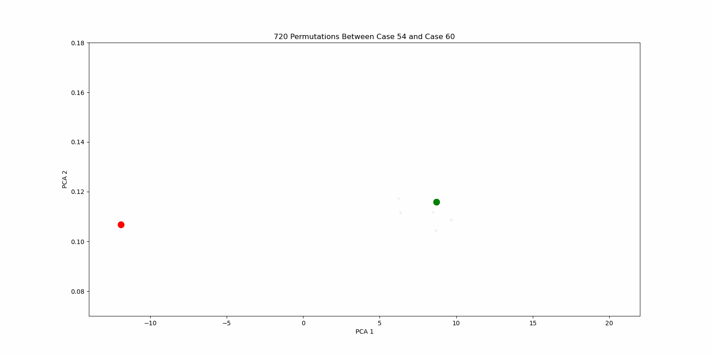
Explainability Example: Graph A → Graph B
the order in which you make changes can impact how you interpret importance
6 changes → 720 possible permutations

Slide 15
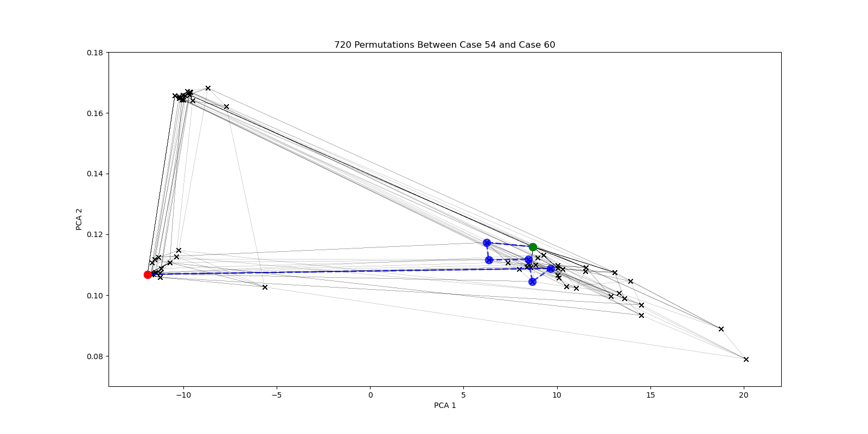
Explainability Example: Graph A → Graph B
cannot assume the node that causes the largest displacement in latent space corresponds to the most important node

Slide 16
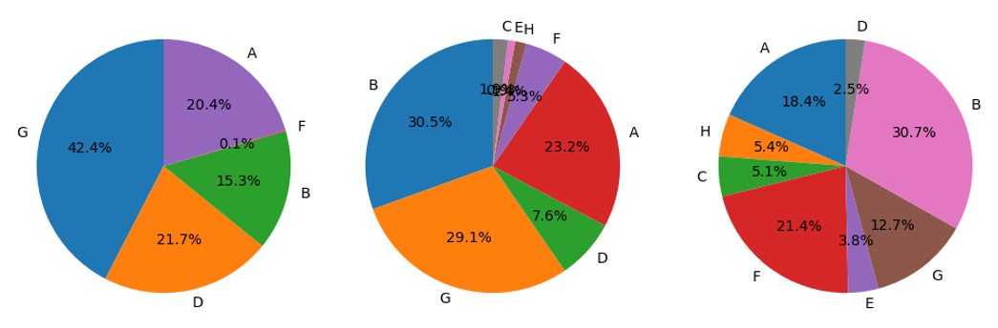
Explainability Framework
we define the most important node as the one which makes Graph A look most like Graph B
quantitatively, we define the most important node as the one which most lowers the MAE between the readings of Graph A and B
we train a prediction model that given setting node features, predicts reading node features
ideally we need to do this for every permutation
  this can get computationally expensive
  not uncommon to have several dozen setting nodes
  change between embeddings
a good proxy is to evaluate effect of each setting node change independently and rank the nodes according to how much they lower the MAE

Slide 17
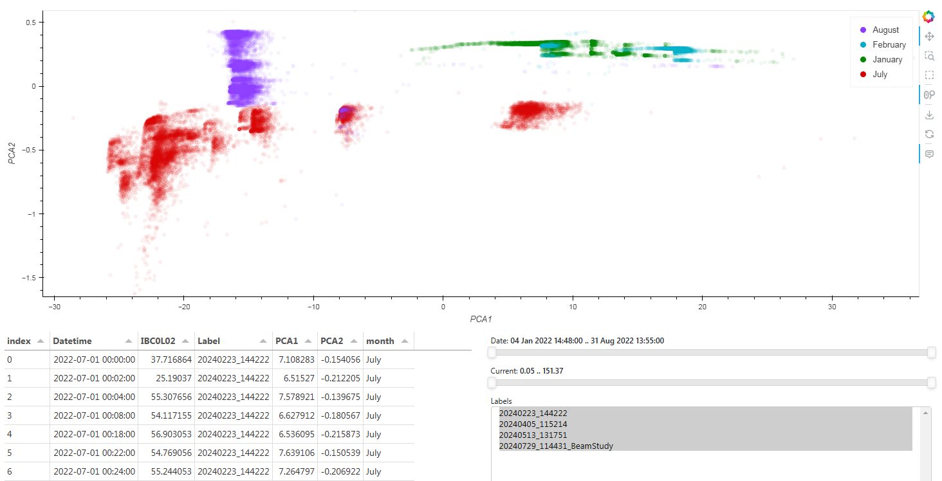
Spring 2022 Run: 51,781 Embeddings
13,678

Slide 18
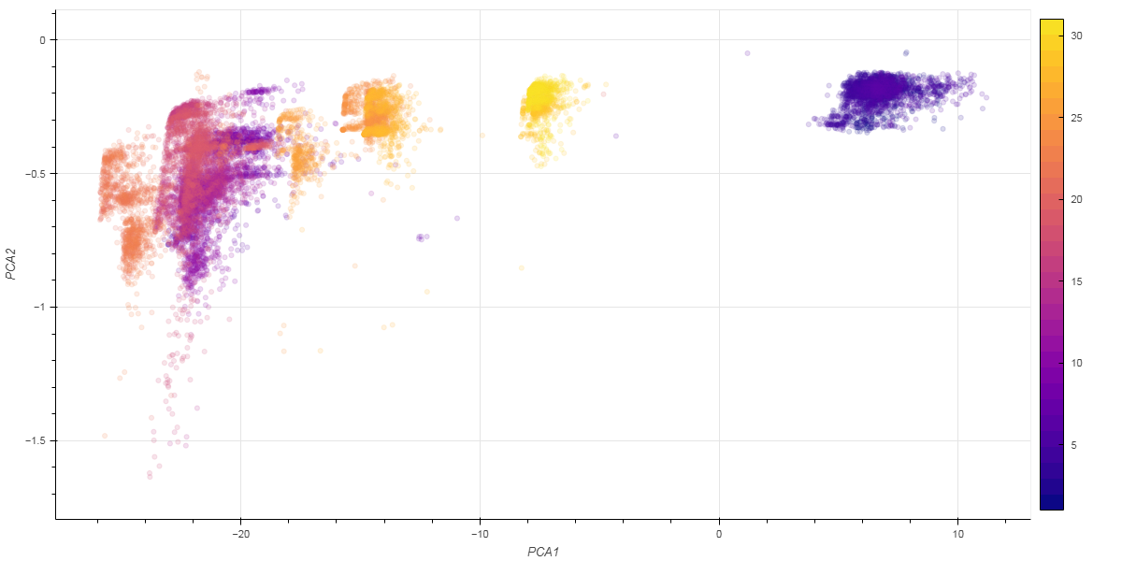
Embeddings: by Day

Slide 19
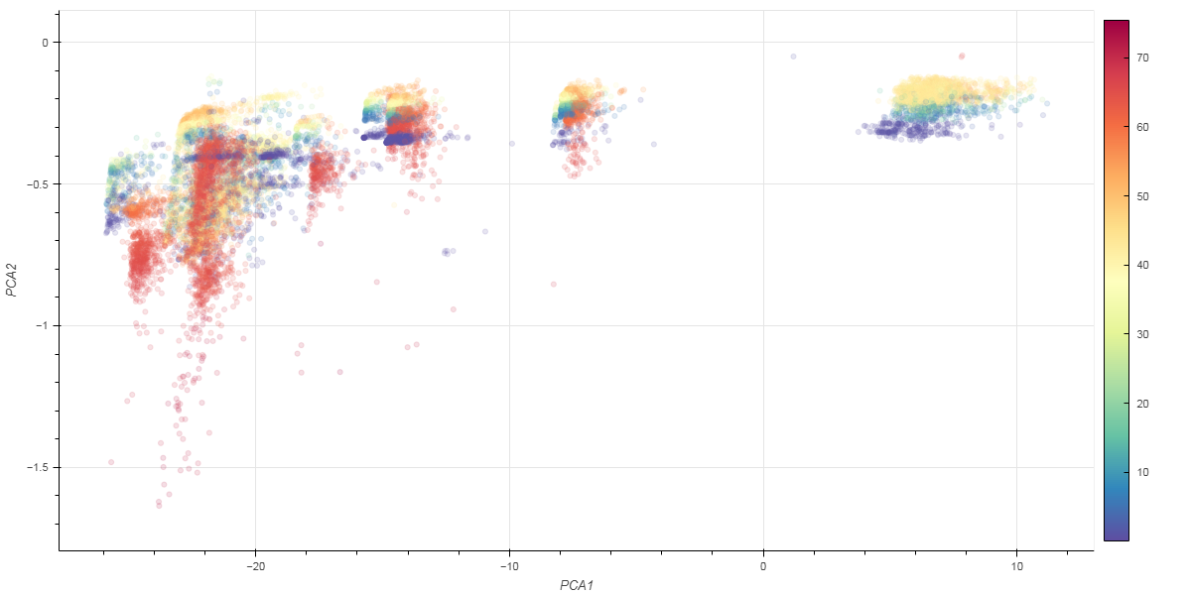
Embeddings: by Current

Slide 20
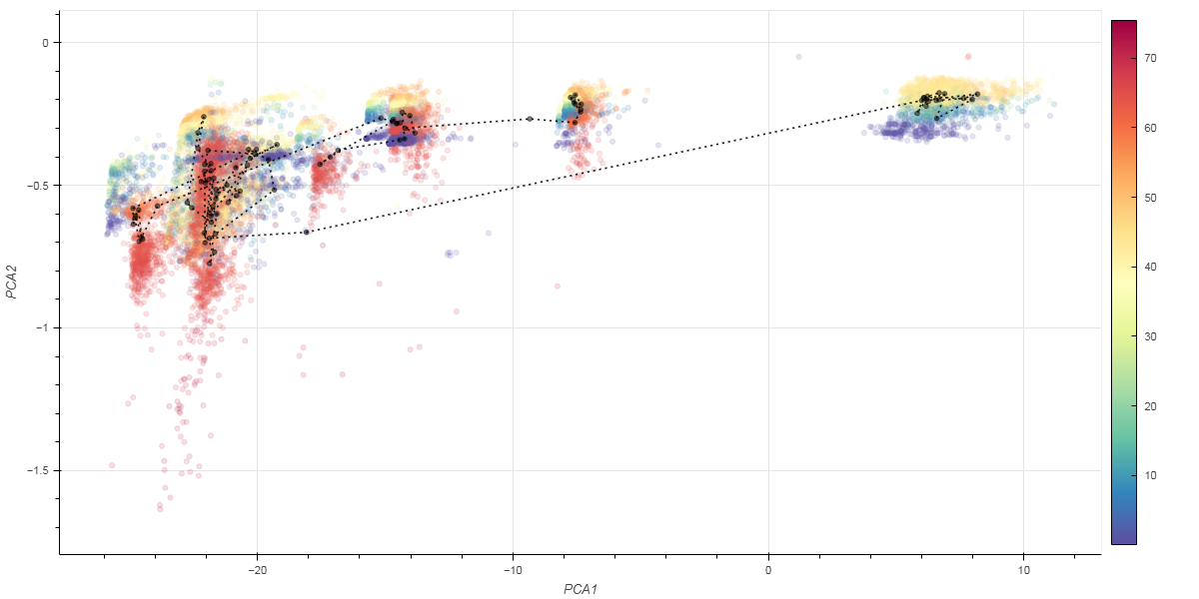
Embeddings: Current + Changes by Shift
2022-07-06 16:50:00
2022-07-06 18:30:00
black markers represent the average of embeddings from each 8-hour operational shift

Slide 21
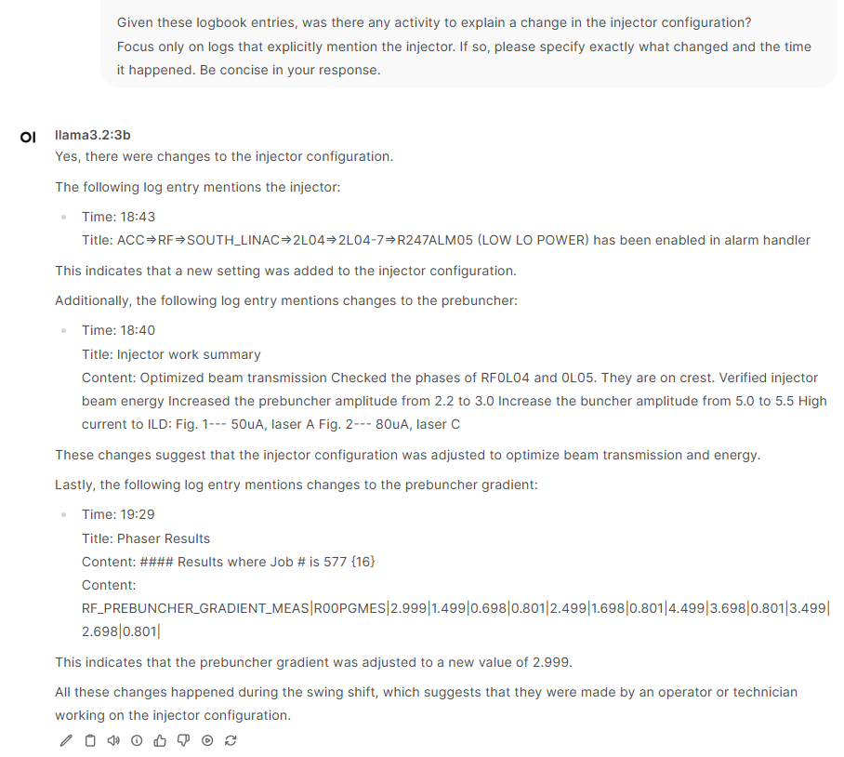
Embeddings: Explainability
explainability results
  MDB0L06H
  MBH0I06V
  MDJ0L07V
  MHB0L02AH
  MAT0R03H
simple example of LLMs providing additional context
importance

Slide 22
Embeddings: Data Exploration

Slide 23
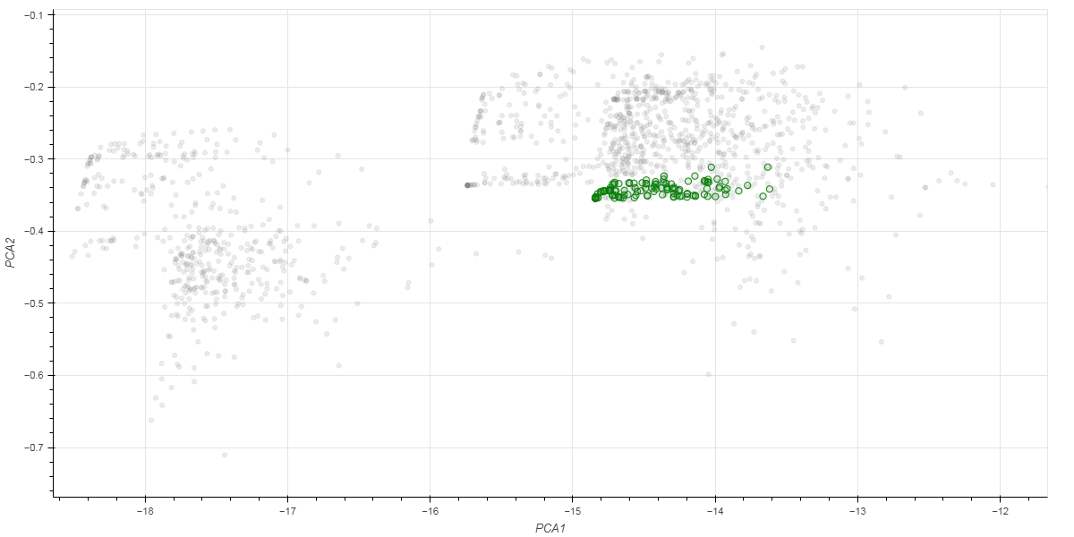
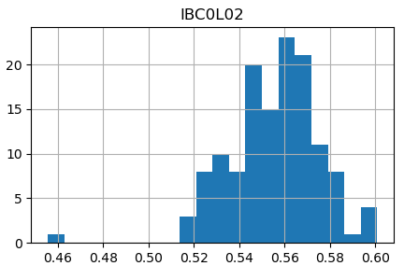
Embeddings: System Jitter/Noise
identified a 7 hour period where the settings remained constant
distribution of embeddings provides insights into jitter/noise in readings
same settings
Beam Current

Slide 24
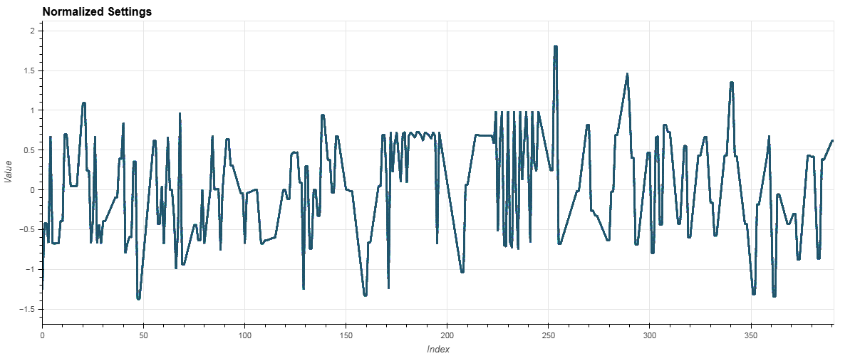
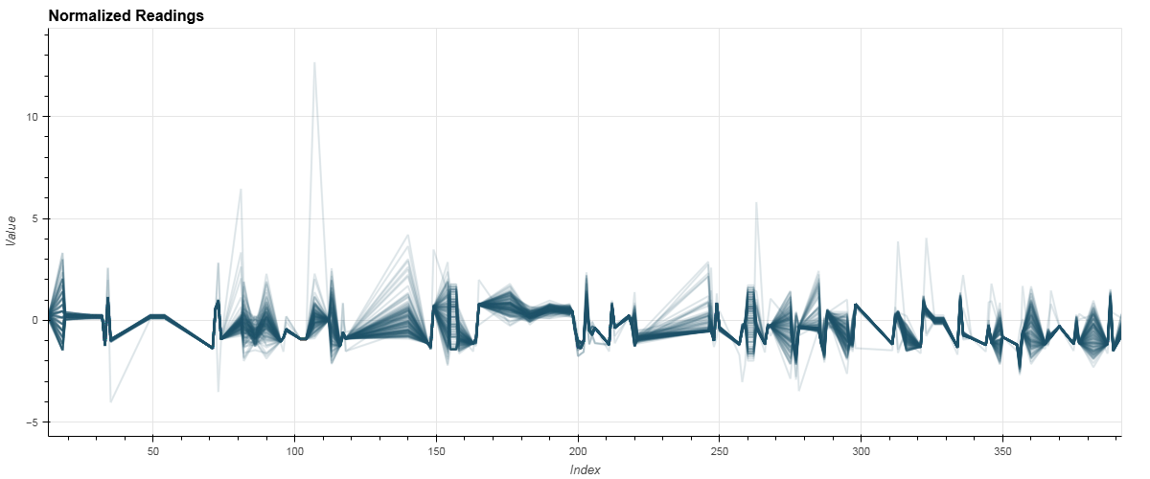
Embeddings: System Jitter/Noise
Settings
Readings
Node Index
Node Index

Slide 25
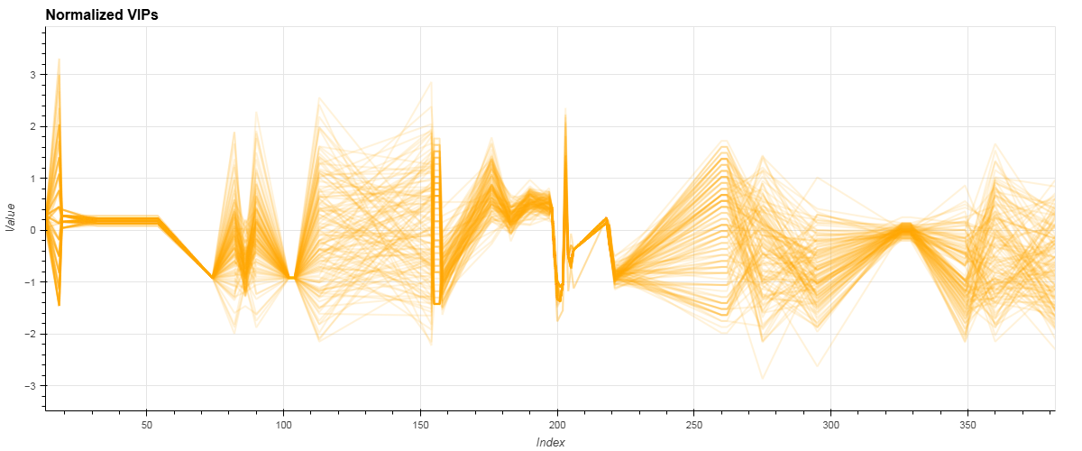
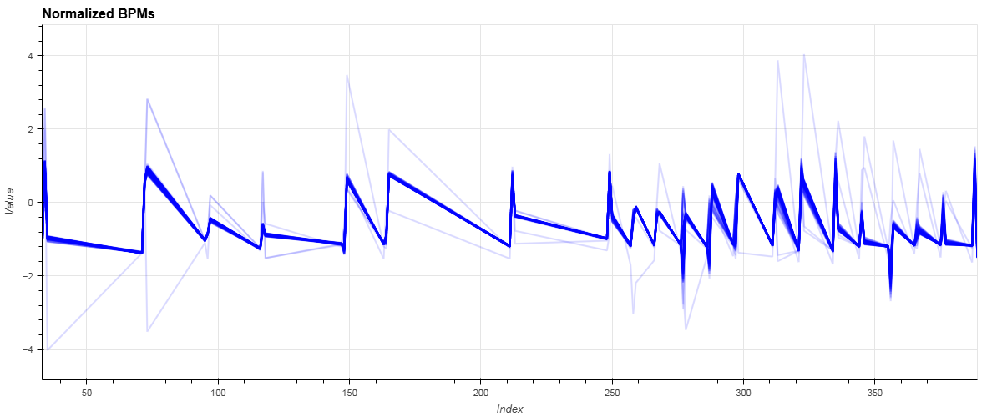
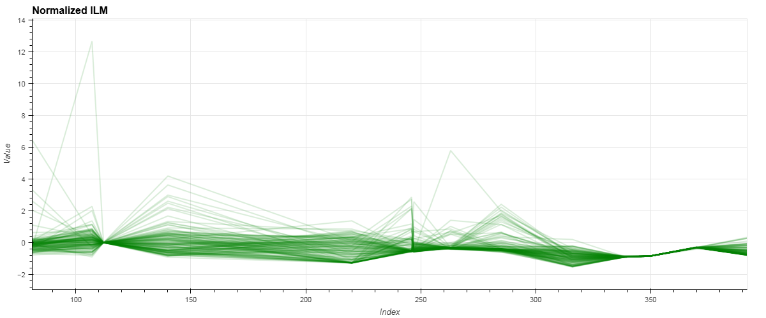
Embeddings: System Jitter/Noise
Vacuum
inspect contributions from individual beamline components (node types)
Beam Position Monitors
Beam Loss Monitors

Slide 26
Embeddings: Data Exploration

Slide 27
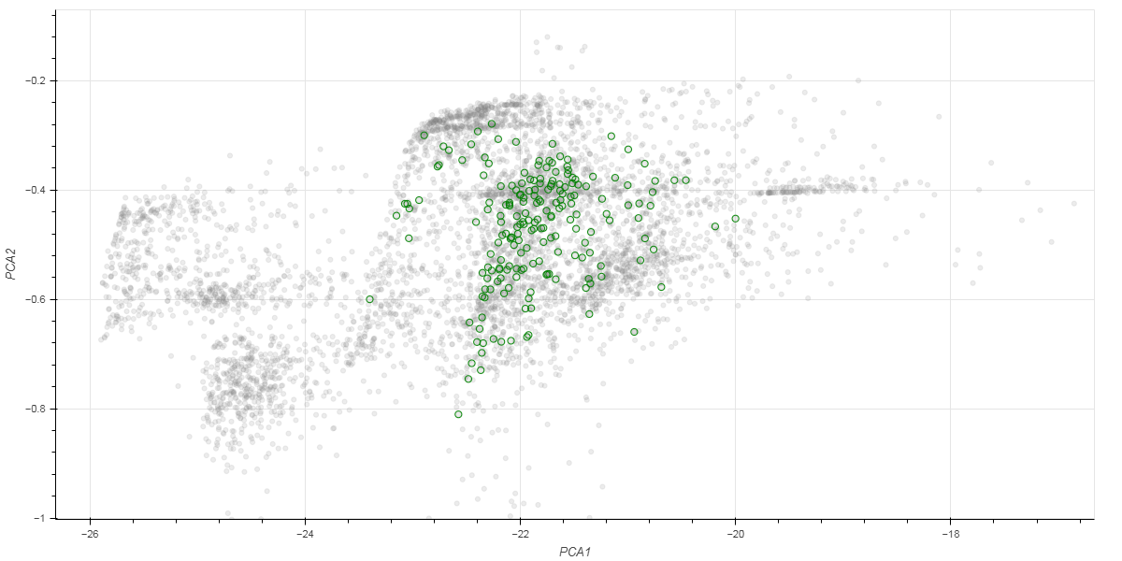
Embeddings: System Stability
an operator identified stable 8-hour period of operation
  look for shift summaries with few issues to report
  with no noted changes in the injector
  and beam delivery to the Halls (beam was delivered and was of acceptable quality)
stable period

Slide 28
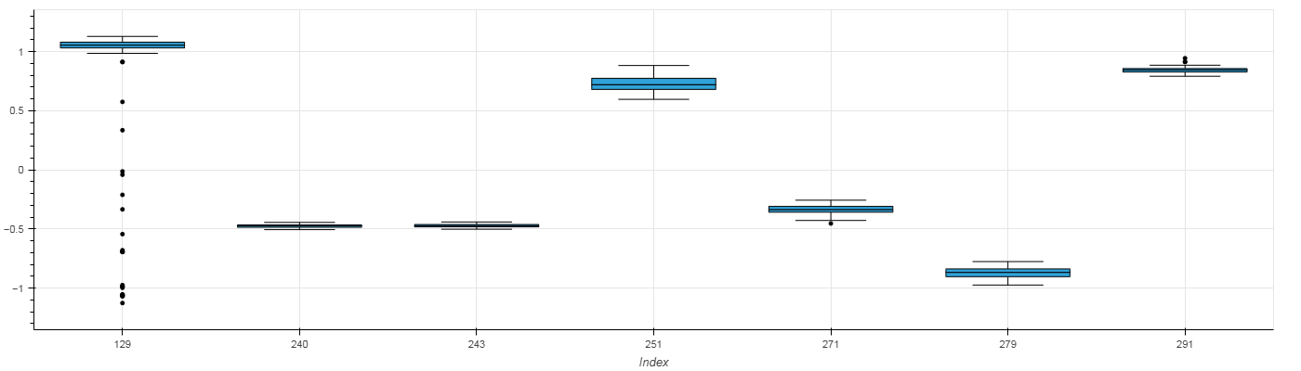
Embeddings: System Stability
beamline components showing the most variation during this time
energy lock cavities
orbit lock correctors
IBC0L02 0L04-7 GSET 0L04-8 GSET MDB0L06H MDB0L07V MDB0L08H MDJ0L09V

Slide 29
Summary
all the analysis I’ve presented is looking back (post mortem)
ideally this would be incorporated for real-time analysis
  monitor stability
  track and provide explanations for changes
  provide visual feedback for beam tuning tasks
having more real-time diagnostics available would make the system more robust
  BPMs are our most information-rich, continuous diagnostic
  therefore, important nodes tend to be settings that effect beam orbit (i.e. correctors)
exercising archiver database in a new ways
  collecting hundreds of PVs every 2 minutes over many months
injector underwent an upgrade in 2023 → graph structure will change

Slide 30
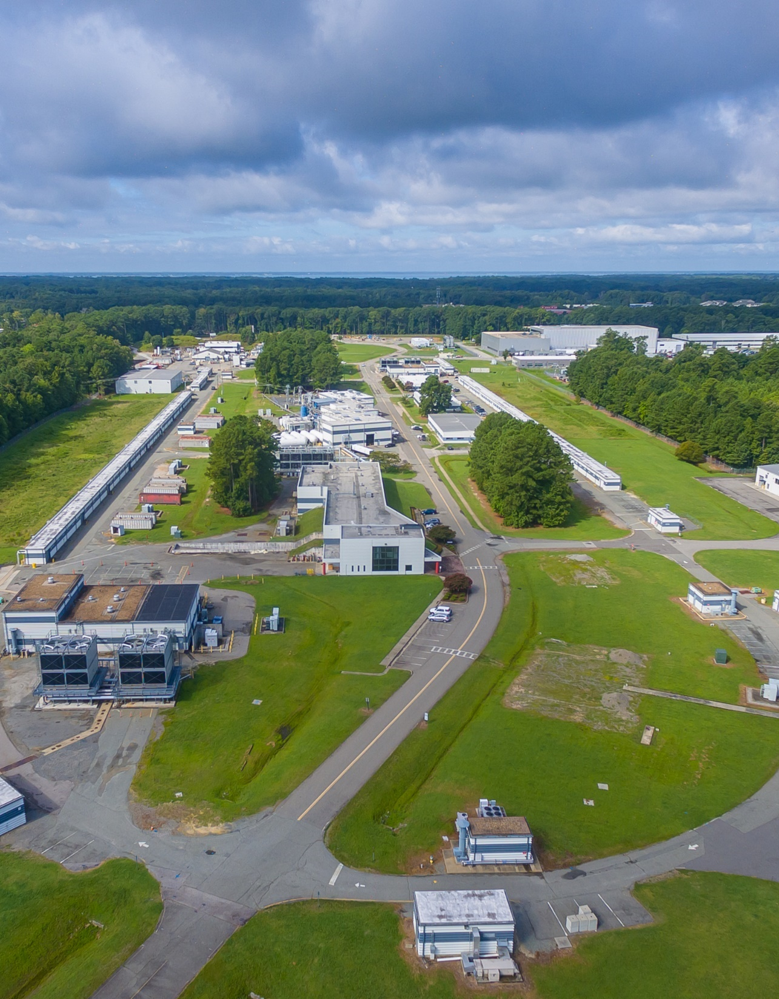
Thank you.
This work is supported by the U.S. Department of Energy, Office of Science, Office of Nuclear Physics under Contract No. DE-AC05-06OR23177.

