Slide 1

Improving Fast Beam Transport Simulations Using Transfer Learning
Presented by Paul Stanik III
5th ICFA Beam Dynamics Mini-Workshop on Machine Learning for Particle Accelerators
This work was done by Mission Support and Test Services, LLC, under Contract No. DE-NA0003624 with the U.S. Department of Energy and the National Nuclear Security Administration’s Office of Defense Programs, and supported by the Site-Directed Research and Development Program. DOE/NV/03624--2138.

Slide 2
Authors
Paul Stanik III ^{1, 2} – stanikp@nv.doe.gov
Brendan T. Morris ¹
Evan R. Scott ²
Trevor J. Burris-Mog ²
Piotr Wiewior ²
University of Nevada-Las Vegas, Las Vegas, NV 89154
Nevada National Security Sites, North Las Vegas, NV 89030
Notes:
Bridge between UNLV and NNSS
Brendan is in ML
Evan, Trevor, and Piotr are in the physics and pulse power group

Slide 3
Outline
Introduction
Objective
Data
  Low Fidelity Simulations
  High Fidelity Simulations
Machine Learning
  Results
  Pruning
Future Works

Slide 4
Introduction
Fast simulations of intense relativistic electron beams are sufficient for tuning an accelerator’s magnetic transport field.
  Can’t capture all relevant beam physics.
  Not sufficient for optimization problems due to model limitations.
Simulations that capture all relevant beam physics are significantly more computationally expensive.
  Less useful for optimization problems.
Transfer learning for optimization problems using both types of simulations.
Notes:
Fast simulations of intense relativistic electron beams can be sufficient for tuning an accelerator’s magnetic transport field, but are incapable of capturing all relevant beam physics due to the limitations in the model.
Because methods that do capture these effects are significantly more computationally expensive, they are fundamentally less useful for optimization problems.
Our approach for optimization problems was to use transfer learning to make use of both low-fidelity and high-fidelity sims

Slide 5
Objective
Replace a high-fidelity simulation with a machine learning model using limited data
Low-fidelity simulations → large amount
High-fidelity simulations → very little
  Experimental “surrogate” data
Transfer learning from low-fidelity to high-fidelity
Simulated data to be used → Beam envelope
Why beam envelope?
  Importance for linear induction accelerators (e.g., Scorpius)
  Precursor for magnetic transport lattice optimizations
Notes:
Here the high-fidelity data is the experimental surrogate data as it represents the experimental data we will get in the future
Very little high-fidelity data, representative of how much real experimental data we could get. That is why perform transfer learning from low-fidelity sims to high-fidelity sims.
The simulated data is the beam envelope because it is an important parameter as we are trying to transport this beam through a small pipe all the way through Scorpius and other Linear induction accelerators
It is also a precursor to general optimization techniques for magnetic transport lattice optimizations

Slide 6
Data

Slide 7
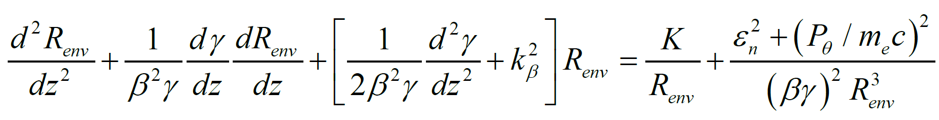
Low-Fidelity Simulations
Radius using beam envelope equation¹
Runtime: 0.0171 seconds
1. Ekdahl Jr., C. A., “The beam envelope equation and practical applications”, LANL, 2019-08-2021
Notes:
Low fidelity sims are generated by solving for the radius using the beam envelope equation. I am borrowing information by Carl Ekdahl’s presentation at Los Alamos National Lab
Certain assumptions are also made about the beam, for example the emittance being constant
The runtime is pretty fast

Slide 8
Beam Envelope Equation
External Forces
Internal Forces (Defocusing*)
Adiabatic dampening by axial electric field
Centripetal force
Focusing by radial electrical field
Emittance (“temperature”)
Focusing by solenoidal magnetic field
Space-charge force
*Defocusing in LIA vacuum
1. Ekdahl Jr., C. A., “The beam envelope equation and practical applications”, LANL, 2019-08-2021
Notes:
High-level overview of the beam envelope equation
CS background → for anyone else here with just CS background

Slide 9
High Fidelity Simulations
Large Scale Plasma (LSP)
  Particle-in-cell code
  Calculates forces on particles per timestep
  Includes more relevant physics
  Runtime: ~30 minutes
“Surrogate” experimental data
Notes:
The high fidelity sims are done on Large Scale Plasma, also known as LSP.
It is a particle-in-cell code
That calculates the forces on particles partitioned in a 2D or 3D grid per timestep
It can include lots of relevant physics, but the sims are more computationally expensive
Runtime
As I covered before, we want this data to represent the experimental data

Slide 10
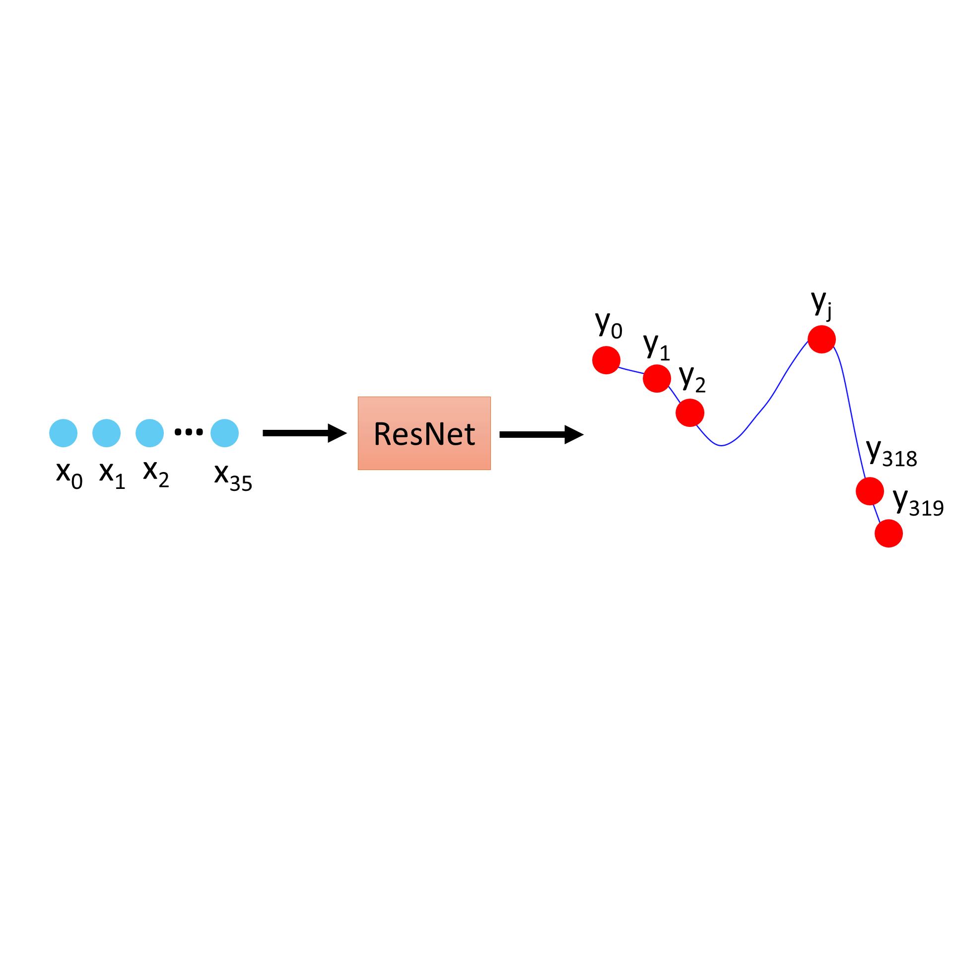
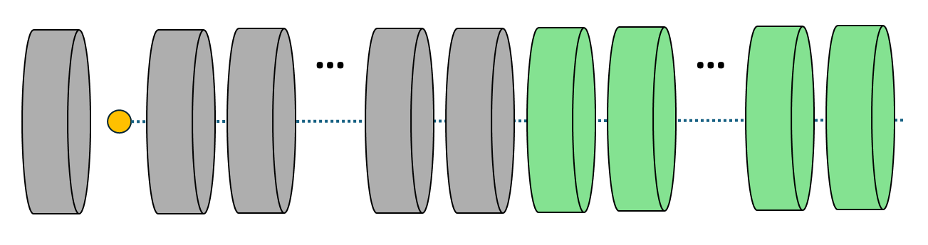
Data
Dataset sizes (# of shots)
  Low-fidelity: 73,773
  High-fidelity: 971
Data shape:
  Input: 36 (randomized currents)
  Output: 320 (control points of beam envelope)
    Step length where dz ≈ 2cm
Data splits
  Test = 30%
  Train + Validation = 70%
    Train = 70%
    Validation = 30%
12 magnets
with fixed currents
36 magnets
with variable currents
Notes:
We have two types of data come that from two different simulations
Low fidelity and high fidelity
Each datapoint = shot in LIA
As we can see in the figure on the bottom right, there are 48 magnets. The first 12 (in gray) have fixed currents and the last 36 (in green) have more randomized, or variable, currents. These 36 currents will be our input for the model.
The goal is to use to input of the given currents and output the beam envelope radius,
Data splits

Slide 11
Machine Learning

Slide 12
Machine Learning
PyTorch
Model architecture
  Residual network² using dense layers
  Optimizer
    AdamW with L2 regularization
Evaluation metrics
  Mean squared error (MSE)
Input: magnet currents
Output: beam envelope
Train: Low-Fidelity
Transfer learn: High Fidelity
Magnet Structure
2. He, K. et al., “Deep Residual Learning for Image Recognition”, CVPR, 2016.
Notes:
Pytorch framework
Architecture
We tested a few architectures, like LSTMs and fully connected networks, and the one that best worked for us was a residual network using dense layers
As we can see here in the diagram, the input will be the 36 magnet currents. We want the ResNet model to simulate the physics that will output the control points that make up the beam envelope
The Evaluation metrics is the Mean squared error. We get the MSE between the low and high fidelity data versus the machine learning output

Slide 13
Quantitative Results
 | Train on Lo-Fid | Train on Lo-Fid & Test on Hi-Fid | Train on Lo-Fid & Transfer on Hi-Fid | Hi-Fid MSE % Decrease
MSE (Test) | 0.00263 | 3.14 | 0.00906 | 99.7%
 | Lo-Fid | Hi-Fid | ML Model | ML Speed Increase vs Hi-Fid
Speed | 0.0171 s | ~30 minutes | 0.0793 s | 99.9%
Using INTEL(R) XEON(R) GOLD 5520+ Processor
Lo-Fid = Low-Fidelity
Hi-Fid = High-Fidelity
ML = Machine Learning
Notes:
Legend
Trade off is to be expected as the machine learning model is much faster than the LSP sims, but not as accurate
** Note that we only ran the sims and ML model on a CPU. The model is potentially faster on a GPU

Slide 14
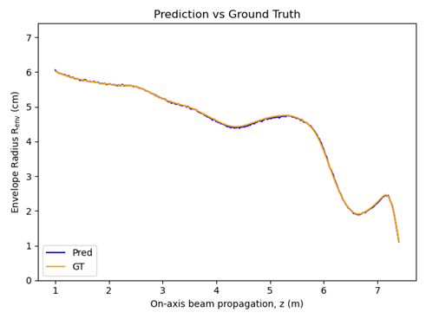
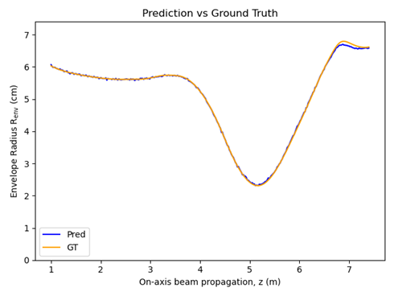
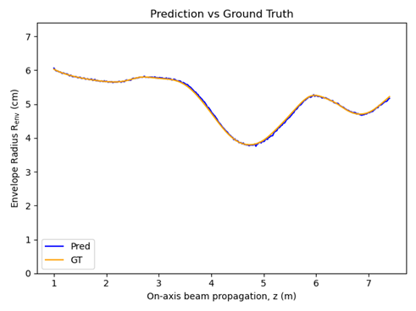
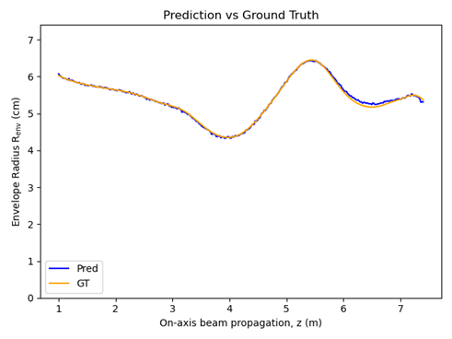
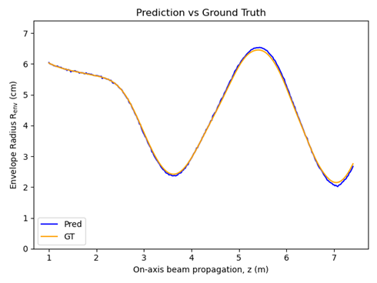
Train on Lo-Fid
Test MSE: 0.00263
Strong agreement between model output and ground truth
Notes:
Here are some visualized results on the low-fidelity data with the model trained on low-fidelity
Blue represents the model output, and orange is the ground truth
As we can see, there is a strong agreement between the model output and the ground truth

Slide 15
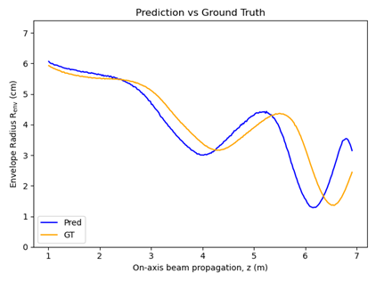
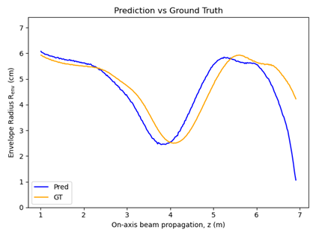
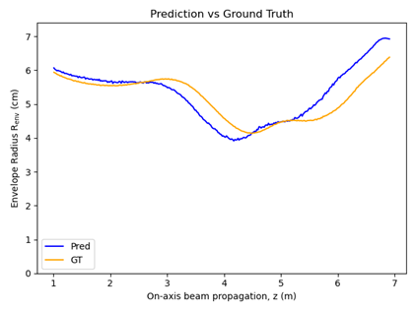
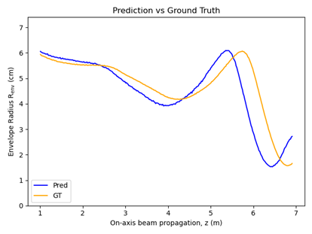
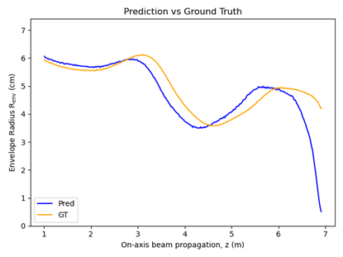
Train on Lo-Fid & Test on Hi-Fid
Forward pass of high-fidelity data on model pretrained on low-fidelity data
Test MSE: 3.14
Shape generally same but shifted
Notes:
Before transfer learning on the high-fidelity data, we wanted to see how well the pretrained model performs on it
as we can see here the shape is generally the same but shifted
While they are different, this is what we were expecting as this is the surrogate experimental data

Slide 16
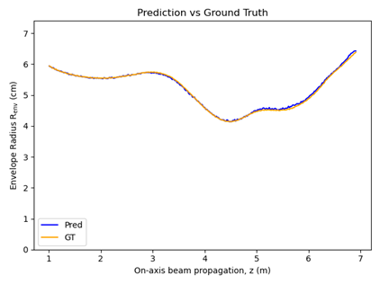
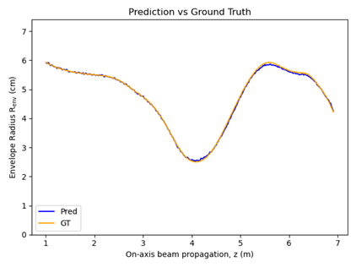
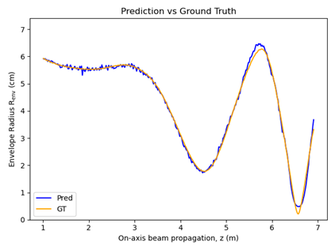
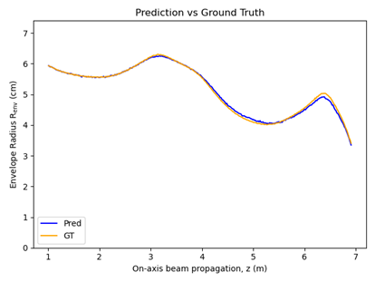
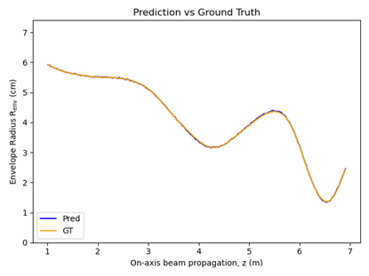
Train on Lo-fid & Transfer on Hi-Fid
Test MSE: 0.00906
Acceptable results despite noise and gaps
Notes:
The noise and gaps the predictions make as circled in red
Results are acceptable to us

Slide 17
Pruning
Over 3.4 billion parameters
Drop unimportant parameters to see how it affects model’s performance
L1 Regularization
Pruning: 5%, 10%, 15%
 | 0% Pruned | 5% Pruned | 10% Pruned | 15% Pruned
MSE | 0.00263 | 0.00313 | 0.00729 | 0.0172
Weights dropped | 0 | 174M | 348M | 523M
Notes:
Since our model had a lot of parameters, we wanted to try pruning the unimportant ones to see if it will make any large effects on the model’s performance
We perform L1 pruning by dropping a percentage of the lowest L1 valued weights. We tested out 5, 10, and 15%. We pruned the model pretrained on the high-fidelity data.
In the table below on row 1 are the MSE results on the test set on the model after being pruned
Here are also the number of weights that were dropped after each pruning

Slide 18
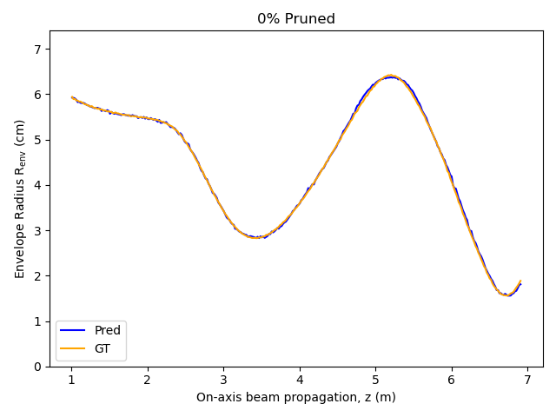
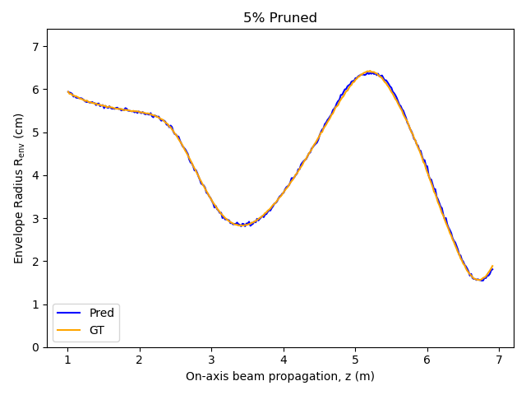
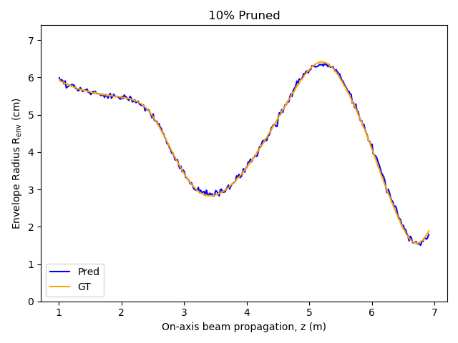
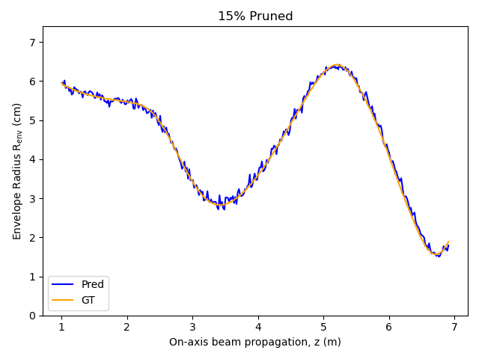
Pruning
Model output becomes noisier with as more weights are pruned
Notes:
Model output gets nosier the more weights are pruned
5% - not too noisy
10-15% - too noisy for us

Slide 19
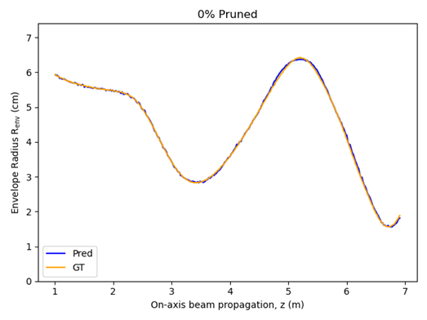
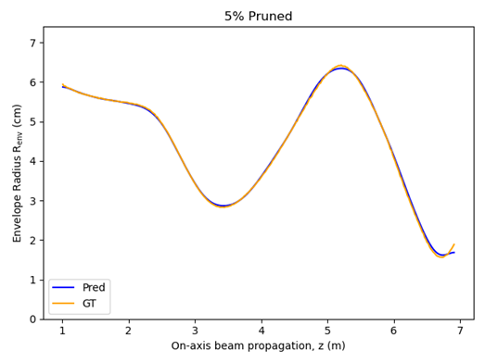

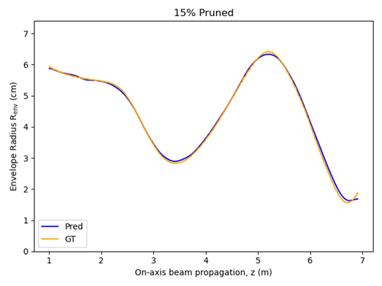
Pruning
Gaussian filter, σ = 5
Notes:
To get a better look at the overall shape, we used a gaussian filter to smooth the output and as you can see <NEXT SLIDE>
In the 5% pruning, we see that we start to lose some of the general shape in green, but the results are still acceptable.
From 10-15%, we lose too much of the general shape which is important for us for optimization problems.
So from what we can tell, pruning somewhere between 0 and 10% is a good spot to be at

Slide 20
Future Work
Extend for variable parameters for 12 fixed magnet currents
Experimental data from LIAs
Replace high-fidelity LSP simulation for magnetic lattice optimization
First step for other optimization problems
12 magnets
with fixed currents
36 magnets
with variable currents
Notes:
For future works
We would like to extend the variable currents to the 12 fixed magnet currents <SEE FIGURE>
The beam envelope code required the parameters to be constant in order for the data to be produced, and it was easy as we already had the sims tested for these parameters (basically out of convenience)
If we were to make all the magnets have randomized parameters, then we will need to test the sim
We would like to get actual experimental data from linear induction accelerators and work with them
We also will replace the high-fidelity LSP sim with the machine learning model for magnetic lattice optimization
While this work was pretty simple, this is a first step for other optimization problems for us at the Nevada National Security Sites

Slide 21
References
Ekdahl Jr., C. A., “The beam envelope equation and practical applications”, Los Alamos National Laboratory, 2019-08-2021
He, K. et al., “Deep Residual Learning for Image Recognition”, Computer Vision Pattern Recognition, 2016.

Slide 22
Thank you!
Any questions?

