Slide 1
Transformers for field compensation
In the CERN SPS main magnets
Anton Lu
V. Kain, C. Petrone, V. Di Capua, M. Bonora, M. Schenk, A. Bellelli, M. Taupadel, A. Ganesh
BE-CSS-DSB Data Science for Beam Operation
TE-MSC-MMM Magnetic Measurement and Modeling
Notes:
Ongoing efforts to model and compensate magnetic hysteresis at CERN

Slide 2
Bayesian Optimization for field compensation
Transformers
In the CERN SPS main magnets
Anton Lu
V. Kain, C. Petrone, V. Di Capua, M. Bonora, M. Schenk, A. Bellelli, M. Taupadel, A. Ganesh
BE-CSS-DSB Data Science for Beam Operation
TE-MSC-MMM Magnetic Measurement and Modeling

Slide 3
Outline
Hysteresis in accelerator magnets and impact on operation in CERN injectors
Transformers for hysteresis prediction
  Pre-training and transfer learning
Validation, and Operational results in the CERN SPS
Outlook and conclusions

Slide 4
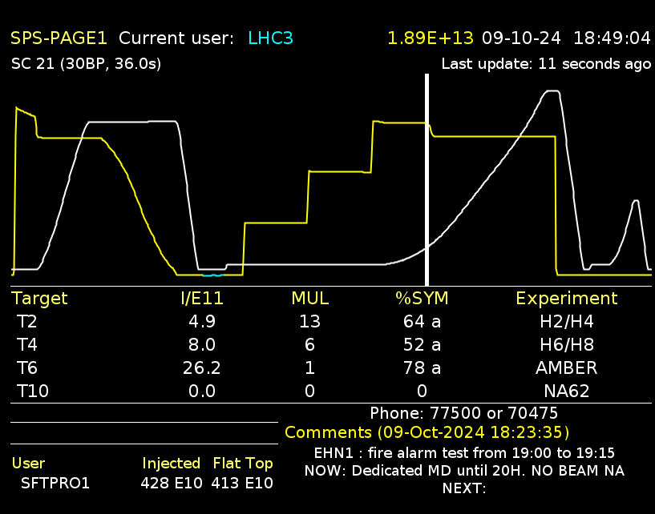
Hysteresis in the accelerator magnets
And the need for reproducible fields
The CERN SPS is a fast multi-cycling synchrotron
  3.6 - 24+ seconds long cycles, producing proton and ion beams at 30 GeV – 450 GeV
  Cycle / magnetic sequences are often consistent …
  … but manual changes to beam parameters are often required when sequences change
In multi-cycling synchrotrons at CERN
  Degaussing cycles, constrained cycle sequences and beam degradation due to hysteresis
In general, operations treat hysteresis through symptom management without addressing the root problem
  Hysteresis is not a problem unique to CERN!
! Only CERN PS and PSB dipoles have field feedback
! Feed-back control requires online high-precision field measurements for each magnetic circuit
Injection losses
Eddy current decay
Hysteresis
Waste of energy
5 kWh every cycle
… for quasi-degauss
… and for reproducible eddy current decays
(Extracted) beam quality degradation
Changing spill macrostructure
Notes:
A headache for multi-cycling machines
In the PS which feeds the SPS, the SPS is sensitive to the cycle that preceeded the injected beam
In general, cycles and operations are designed around keeping predictable and reproducible hysteretic states of the magnets, but still end up with non-reducible beam quality
How can we achieve reproducible fields with minimally invasive methods?

Slide 5
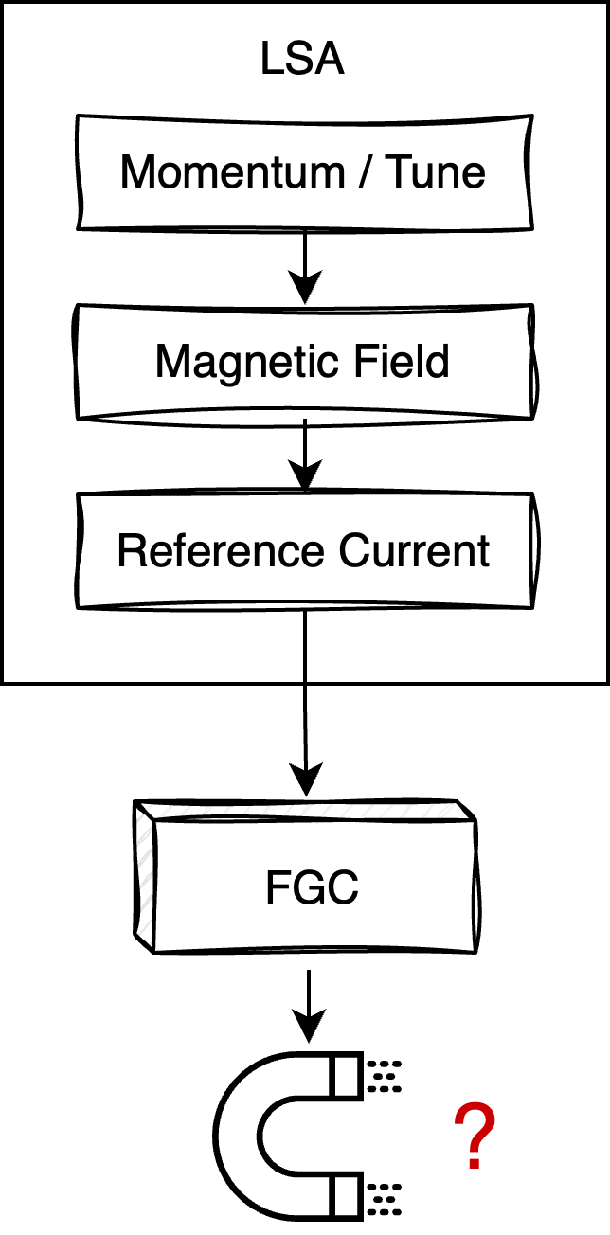
What if we could have reproducible fields…
Through feed-forward field compensation
Most magnetic circuits are controlled in current by translating momentum / tune / correction etc.

Slide 6
What if we could have reproducible fields…
Through feed-forward field compensation
Most magnetic circuits are controlled in current by translating momentum / tune / correction etc.
  Control system is agnostic to actual field response in the machine

Slide 7
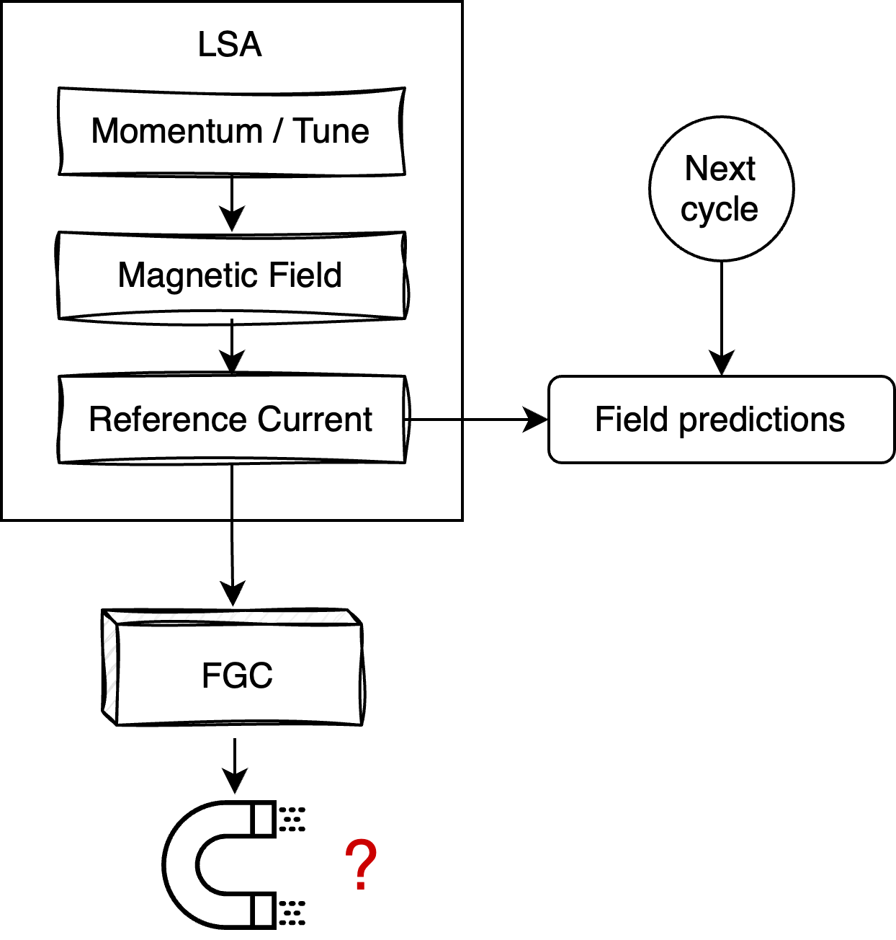

What if we could have reproducible fields…
Through feed-forward field compensation
Most magnetic circuits are controlled in current by translating momentum / tune / correction etc.
  Control system is agnostic to actual field response in the machine
Instead: model magnetic field response $I→B$ from magnetic field measurements
Notes:
Field measurements can be done flexibly in a lab

Slide 8
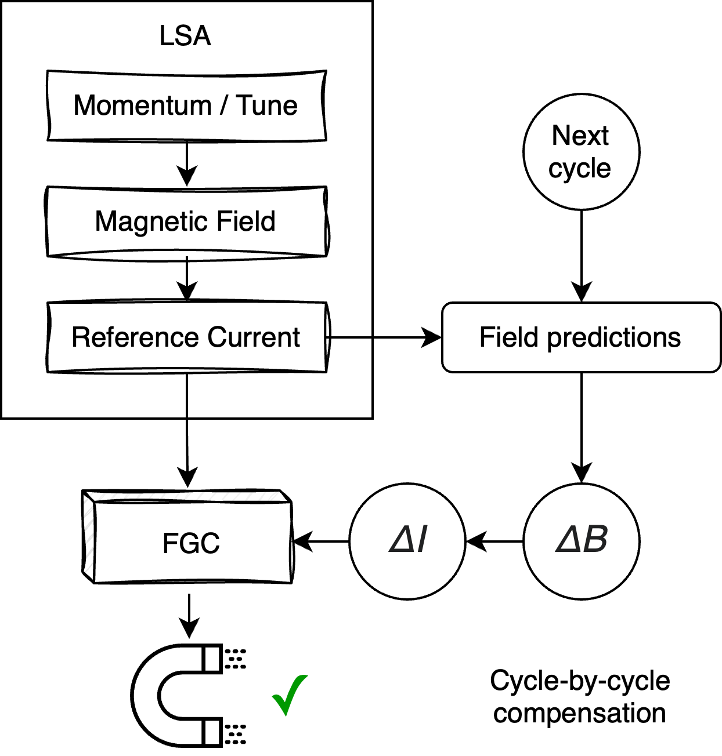
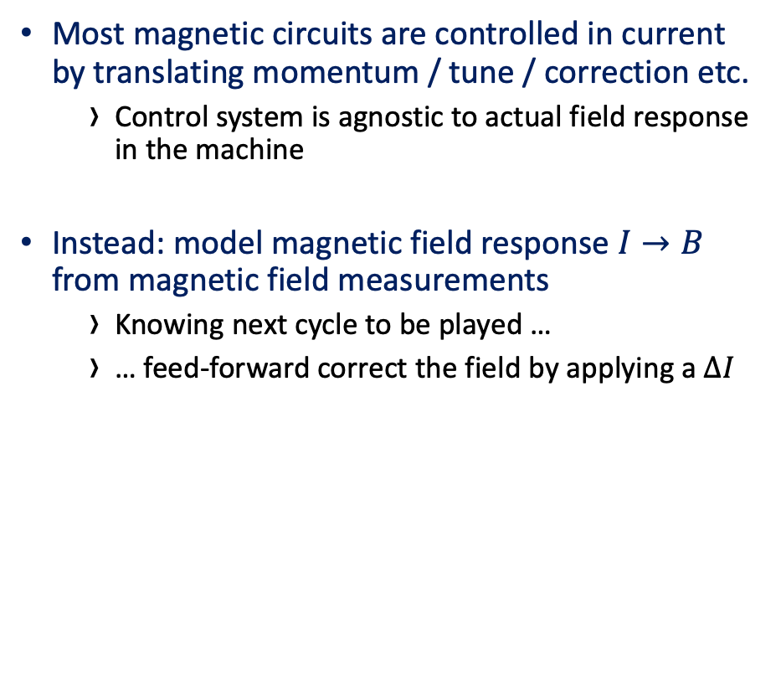
What if we could have reproducible fields…
Through feed-forward field compensation
Most magnetic circuits are controlled in current by translating momentum / tune / correction etc.
  Control system is agnostic to actual field response in the machine
Instead: model magnetic field response $I→B$ from magnetic field measurements
  Knowing next cycle to be played …
  … feed-forward correct the field by applying a $ΔI$

Slide 9
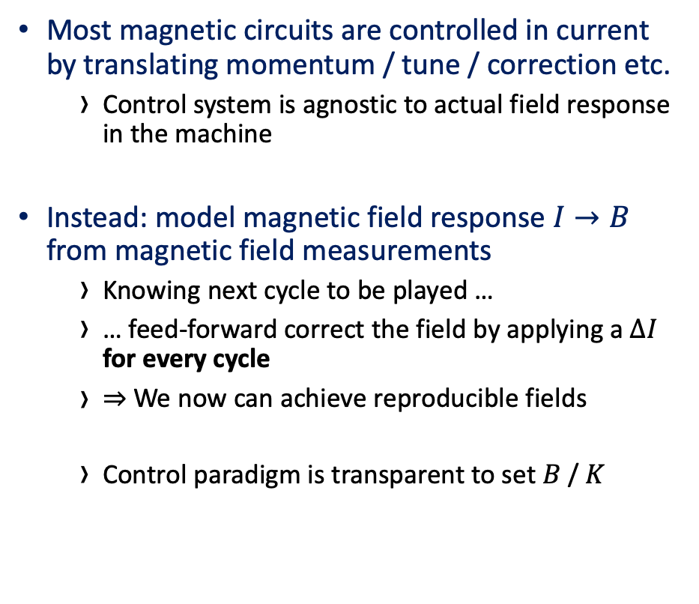
What if we could have reproducible fields…
Through feed-forward field compensation
Most magnetic circuits are controlled in current by translating momentum / tune / correction etc.
  Control system is agnostic to actual field response in the machine
Instead: model magnetic field response $I→B$ from magnetic field measurements
  Knowing next cycle to be played …
  … feed-forward correct the field by applying a $ΔI$ for every cycle
  $⇒$We now can achieve reproducible fields
  Control paradigm is transparent to set $B$ / $K$

Slide 10
What if we could have reproducible fields…
Through feed-forward field compensation
Most magnetic circuits are controlled in current by translating momentum / tune / correction etc.
  Control system is agnostic to actual field response in the machine
Instead: model magnetic field response $I→B$ from magnetic field measurements
  Knowing next cycle to be played …
  … feed-forward correct the field by applying a $ΔI$ for every cycle
  $⇒$We now can achieve reproducible fields
  Control paradigm is transparent to set $B$ / $K$
! N.B. Assume that all effects can be modeled by measuring field

Slide 11
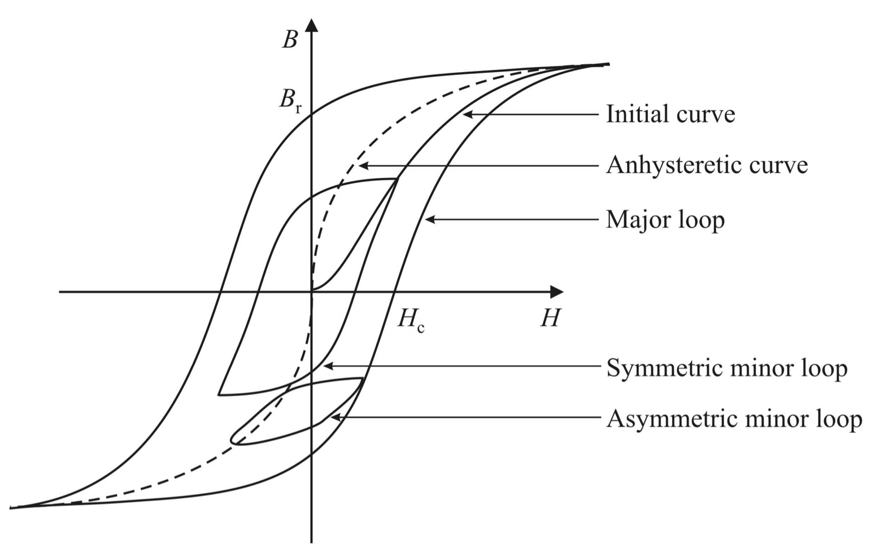
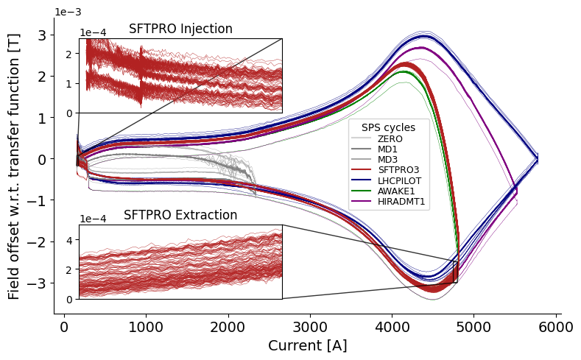
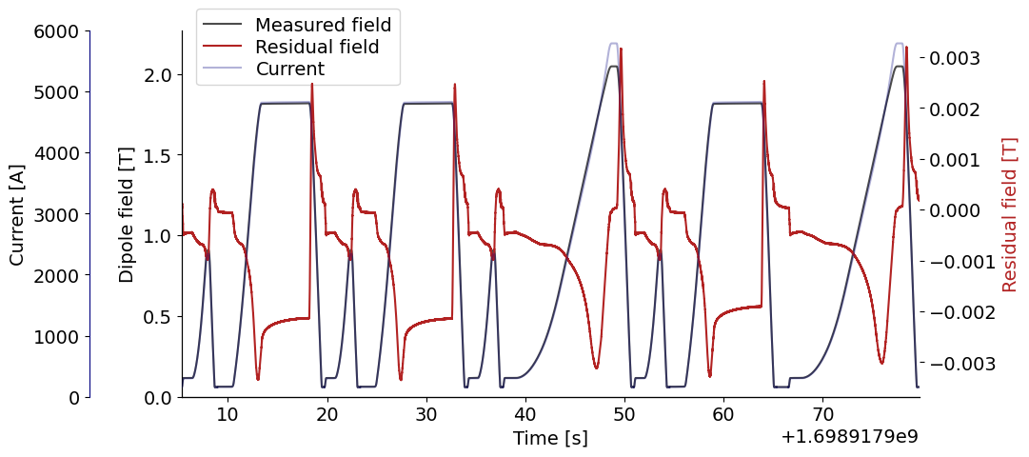
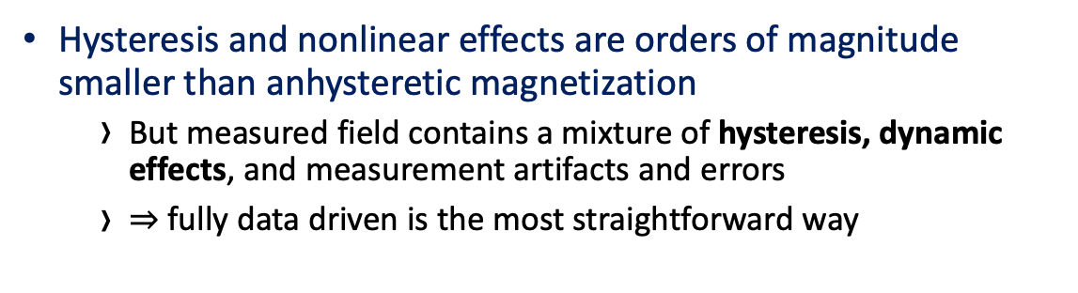
Hysteresis in the SPS main dipoles
Online measurements from the SPS
Reality
Expectations
Hysteresis and nonlinear effects are orders of magnitude smaller than anhysteretic magnetization
  But measured field contains a mixture of hysteresis, dynamic effects, and measurement artifacts and errors
  $⇒$ fully data driven is the most straightforward way
Notes:
* Uncompensated hysteresis restricts cycle sequences in all multi-cycling machines, and prevents going towards dynamic beam scheduling and other high-level operations optimization
Feed-back correction requires an online field measurement system infrastructure, and integrating into the power converters
Normally one models H to M or B
Main dipole data available
Time axis is actually important for modeling dynamic effects
Field measurements are sequences -> go for seq2seq models

Slide 12
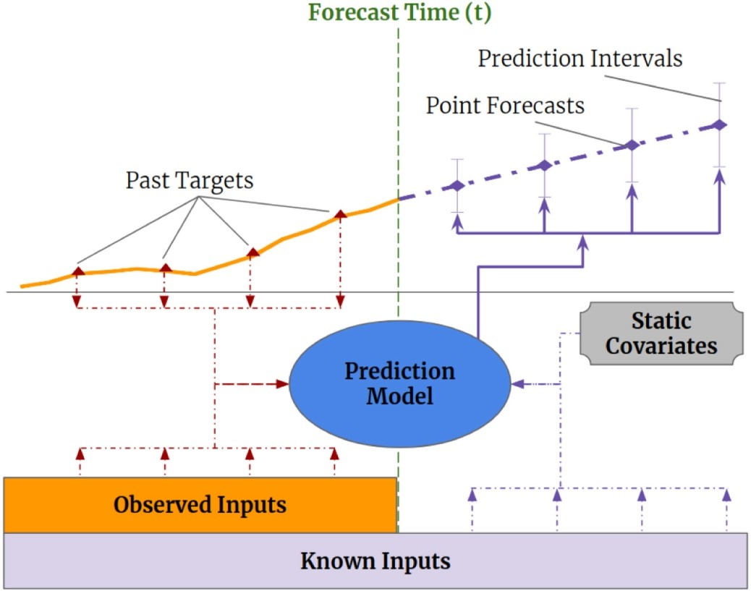
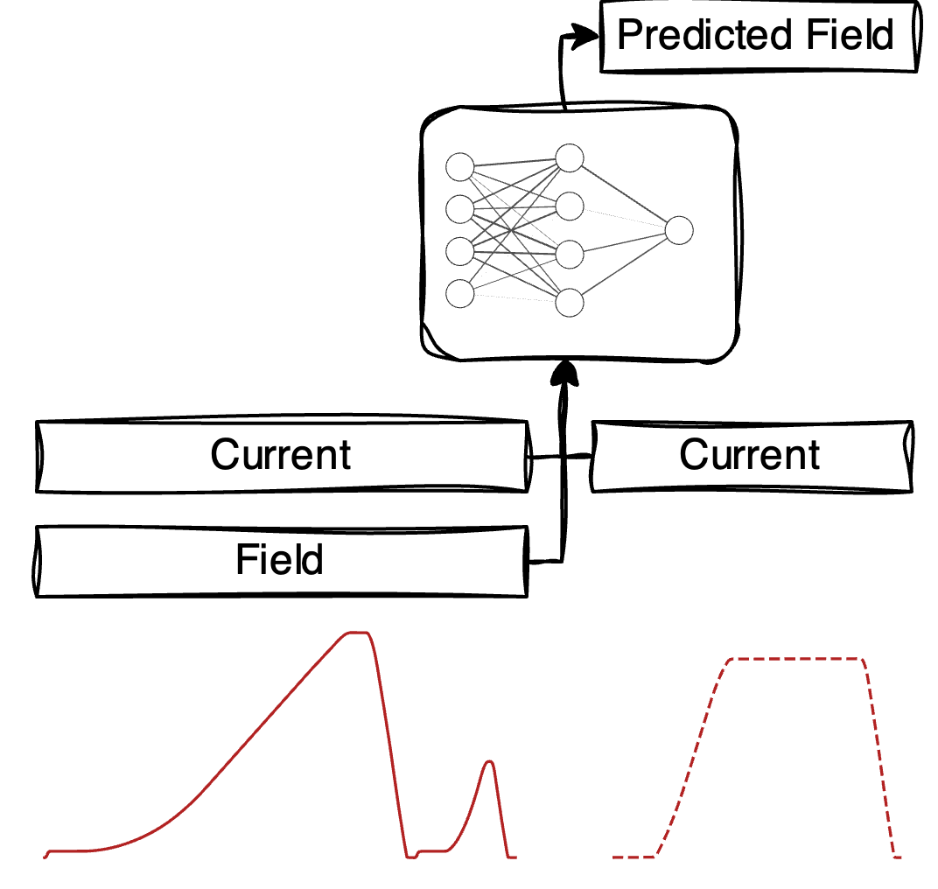

Transformers for Field (Hysteresis) Prediction
Temporal Fusion Transformer – or simply LSTM + attention
Encoder-Decoder style time series models are naturally suited for field-prediction task
  But long context and prediction windows ($≈1000$) prove challenging w.r.t. classic time series forecasting
  Models can be trained to predict every cycle in 1 pass (variable length prediction window)
Notes:
LSTMs unable to capture long-term dependencies, and propagate them through output state
Field predictions must take into accont the past current/field
PINNs difficult to use since there is no clear phenomenological model to solve
N-ODEs are difficult to tune, and DNOs are a hit or a miss)
Data is sampled at 1 kHz, and cycle lengths are around 3-50s – the model will process large amounts of data!
Even downsampled
Besides from current and field, we can input current derivative and relative time
During taining, we use measured current. During inference, we use programmed

Slide 13
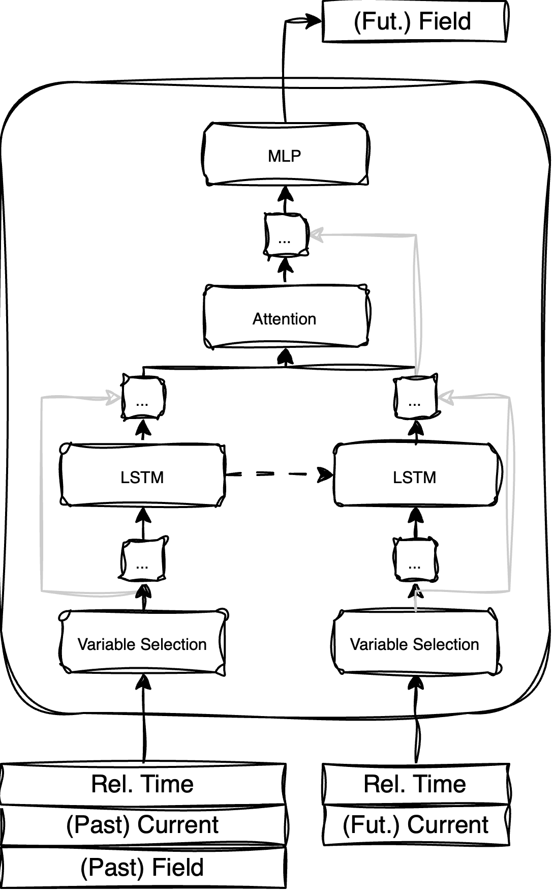
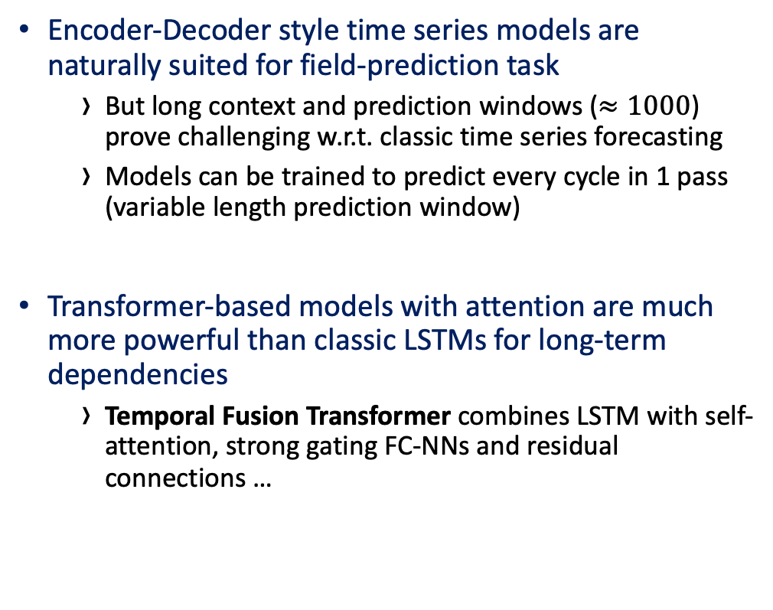
Transformers for Field (Hysteresis) Prediction
Temporal Fusion Transformer – or simply LSTM + attention
Encoder-Decoder style time series models are naturally suited for field-prediction task
  But long context and prediction windows ($≈1000$) prove challenging w.r.t. classic time series forecasting
  Models can be trained to predict every cycle in 1 pass (variable length prediction window)
Transformer-based models with attention are much more powerful than classic LSTMs for long-term dependencies
  Temporal Fusion Transformer combines LSTM with self-attention, strong gating FC-NNs and residual connections …
Notes:
Temporal fusion transformer is designed for pure time series, but does all that we want it to do
… but the task has no need for complex time series forecasting mechanics (static covariates, etc...)

Slide 14
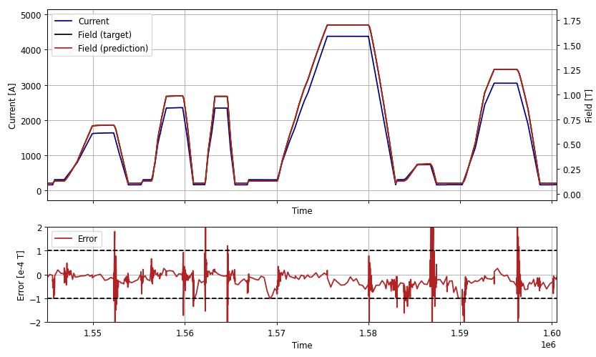
Fitting transformers on simulated hysteresis
An interlude…
Attention-based models need plenty of data to
train and generalize well
  Field measurements from operation can impossibly
  provide sufficient variety in data
Large amounts of pseudo-realistic, pseudo-random
waveforms can be generated and then simulated
  Jiles-Atherton and Flatley ODEs have
  implementations in Python / MatLab
  Pre-training learns common waveform shapes and
  generic hysteretic + dynamic behavior
Notes:
Generate large amounts of data on hysteresis simulation, with similar hysteretic vs. anhysteretic magneticization, add eddy current decays,
Pre-training is crucial for accurate and robust predictions – especially over long prediction horizons
Simulated data is noise-free and clean. Noise can easily be injected to inputs during training
First intended as a PoC for learning hysteresis – but we can re-use trained models for downstream

Slide 15
Fitting transformers on simulated hysteresis
An interlude…
Attention-based models need plenty of data to
train and generalize well
  Field measurements from operation can impossibly
  provide sufficient variety in data
Large amounts of pseudo-realistic, pseudo-random
waveforms can be generated and then simulated
  Jiles-Atherton and Flatley ODEs have
  implementations in Python / MatLab
  Pre-training learns common waveform shapes and
  generic hysteretic + dynamic behavior
✓ We can learn clean hysteretic data sufficiently well!
Notes:
Generate large amounts of data on hysteresis simulation, with similar hysteretic vs. anhysteretic magneticization, add eddy current decays,
Pre-training is crucial for accurate and robust predictions – especially over long prediction horizons
Simulated data is noise-free and clean. Noise can easily be injected to inputs during training
First intended as a PoC for learning hysteresis – but we can re-use trained models for downstream

Slide 16
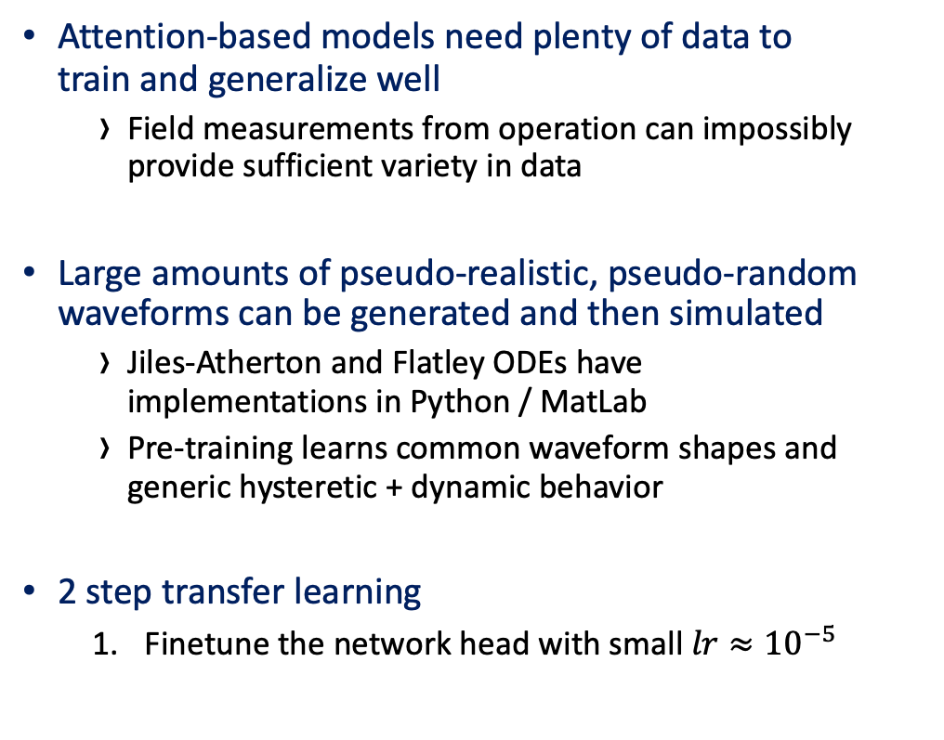
Transfer learning strategy for real hysteresis prediction
Making use of already trained models
Attention-based models need plenty of data to
train and generalize well
  Field measurements from operation can impossibly
  provide sufficient variety in data
Large amounts of pseudo-realistic, pseudo-random
waveforms can be generated and then simulated
  Jiles-Atherton and Flatley ODEs have
  implementations in Python / MatLab
  Pre-training learns common waveform shapes and
  generic hysteretic + dynamic behavior
2 step transfer learning
  Finetune the network head with small $lr≈{10}^{−5}$
Notes:
Take the pre-trained model and just train it on measured data

Slide 17
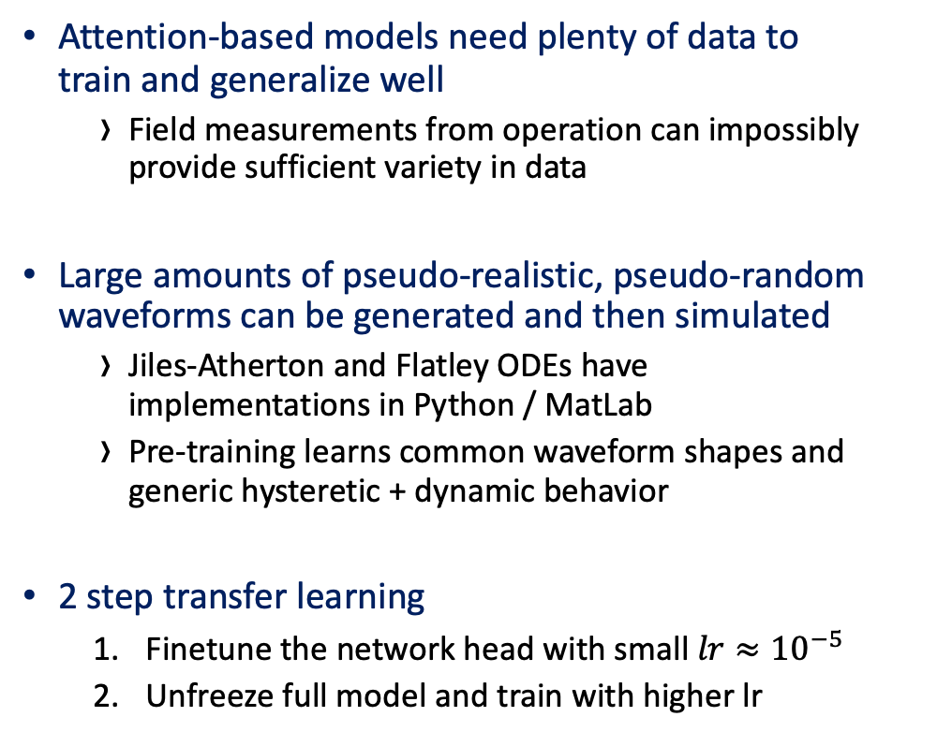
Transfer learning strategy for real hysteresis prediction
Making use of already trained models
Attention-based models need plenty of data to
train and generalize well
  Field measurements from operation can impossibly
  provide sufficient variety in data
Large amounts of pseudo-realistic, pseudo-random
waveforms can be generated and then simulated
  Jiles-Atherton and Flatley ODEs have
  implementations in Python / MatLab
  Pre-training learns common waveform shapes and
  generic hysteretic + dynamic behavior
2 step transfer learning
  Finetune the network head with small $lr≈{10}^{−5}$
  Unfreeze full model and train with higher lr
Notes:
Generate large amounts of data on hysteresis simulation, with similar hysteretic vs. anhysteretic magneticization, add eddy current decays,
Simulated data is noise-free and clean. Noise can easily be injected to inputs during training

Slide 18
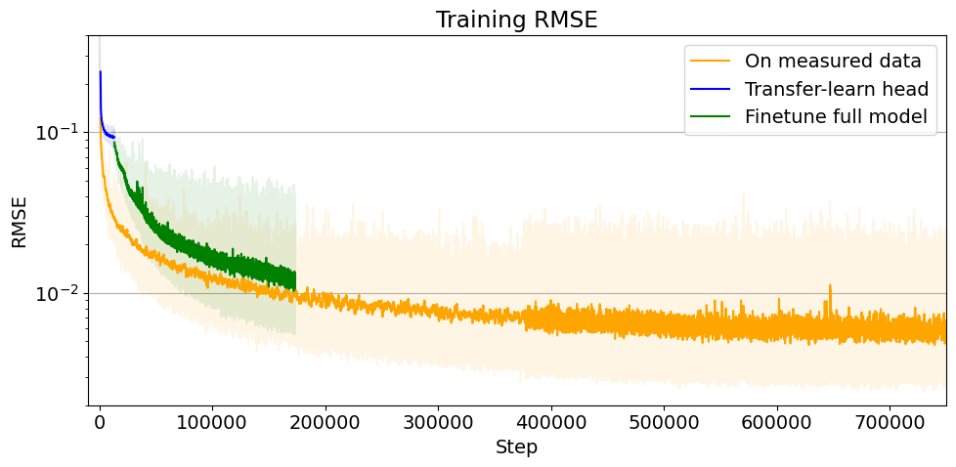
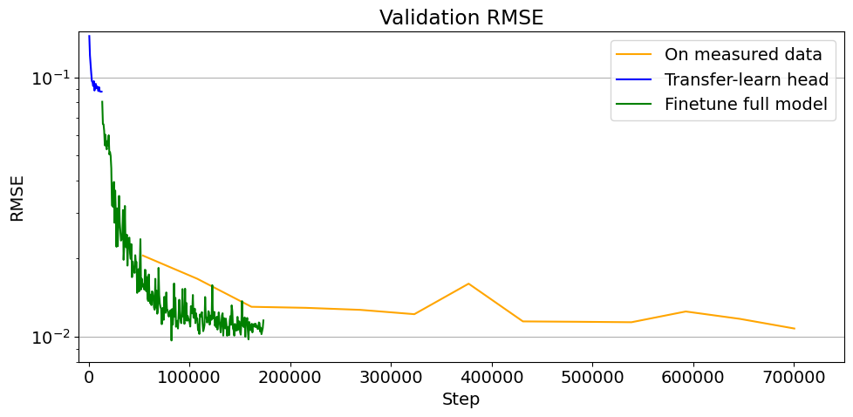
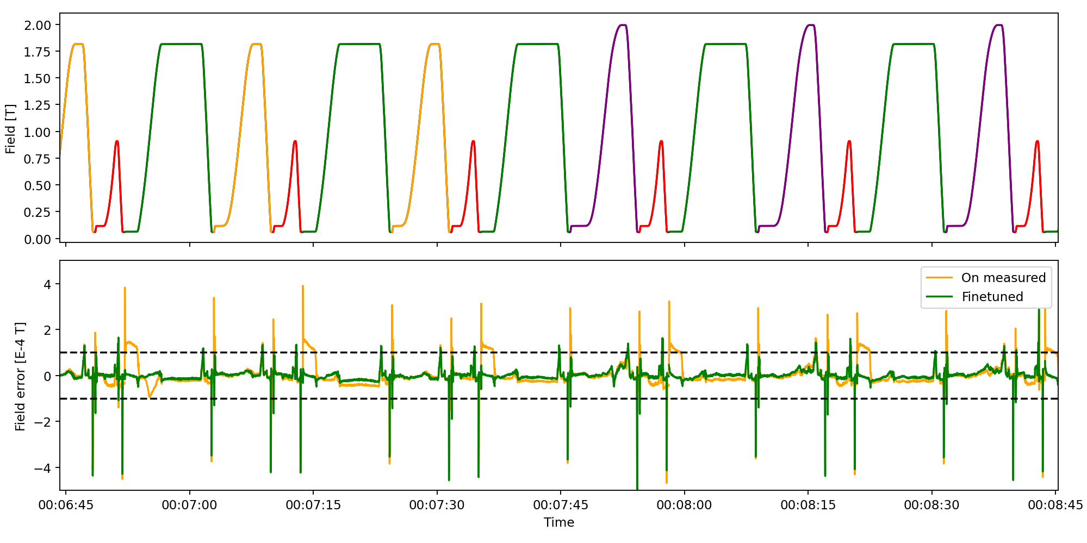
Finetuned transformer model predictions
Results
Transfer learning from the pre-trained model is significantly faster than directly measured data
  … the fine-tuned model marginally outperforms the model trained on only measured data in validation RMSE
  … but significantly more robust in longer autoregressive predictions
  Transfer learning opens new doors for transferring base model or finetuned model to other magnet families
<12h
RMSE [T] | On measured | Finetuned
Validation | 6.57e-5 | 3.38e-5
Unseen cycles | 9.39e-5 | 6.50e-5
Notes:
Transfer learning uses 1/20th of dataset (by timesteps) and more frequent validation
In this case, dataset is about 6h measurements

Slide 19
Attention mechanisms
Does the model learn hysteresis
Attention map, variable selection weights

Slide 20
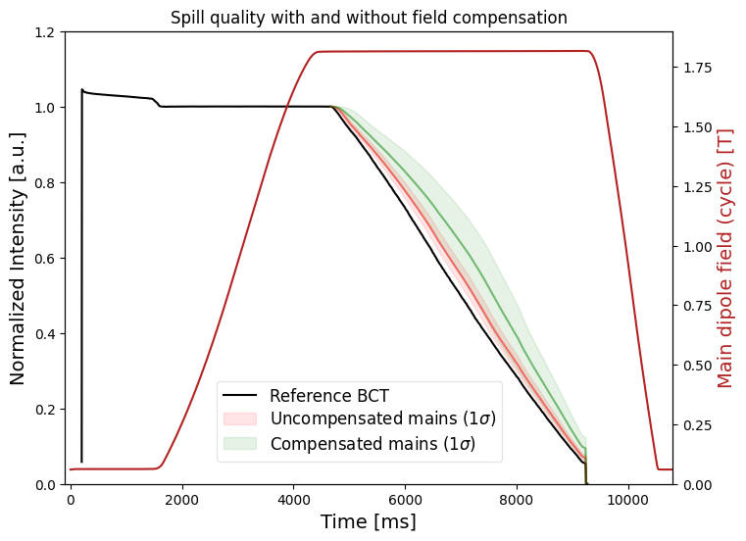

Operational results
Continuous field compensation on SPS fixed target cycle flat top
Cycle-by-cycle compensation on SPS fixed-target compensates extraction field sufficiently ($±3×{10}^{−4} T$)
  Keeps slow extracted spill stable, within margins due to quadrupole hysteresis
Compensation stable runs for long periods (12+ hours) with measured field as input for prediction
  … but autoregressive predictions and compensation runs stable for 1h+ test runs with changing cycle sequences, keeping extraction dipole field reproducible
  24/7 online predictions running since fall 2024
Notes:
Cycle-by-cycle compensation = continuous control
Quadrupoles are not compensated (yet!)
We have measured field as input for the main dipoles
Occasional mispredictions occur – but model corrects itself within 1-2 shots
Predictions are running 24/7 in the background since last fall

Slide 21
Outlook & conclusions
High-accuracy, purely data-driven magnetic field predictions for hysteresis compensation shows operationally useful in the CERN SPS …
  … and other multi-cycling synchrotrons at CERN lacking real-time field feedback
  Online field compensation being deployed to SPS main dipoles, and SPS main quadrupoles to come
  We are restricted to compensating effects seen on field
  Incorporating past knowledge is crucial for accurate prediction of future field
  Other decoder methods can be explored, like FNOs
  Resolution invariant decoders with transformer encoders
Transfer learning strategy simplifies incorporating new data as it becomes available …
  … as well as transferring the model to other magnet families
  Q: can we train a “foundation model” for different hysteresis?
Further efforts to improve field prediction accuracy and robustness
  Additional data-engineering on measured magnetic field is required to increase absolute accuracy
  Improved simulation can improve final model on measured data
  Model robustness is critical for continuous control
  Robust autoregressive predictions will be important for magnets without state input
Early tests in SPS show that dynamics should be studied from beam
  If we can decouple dynamics from measurements, we can use lower sampling rate data with other models

Slide 22
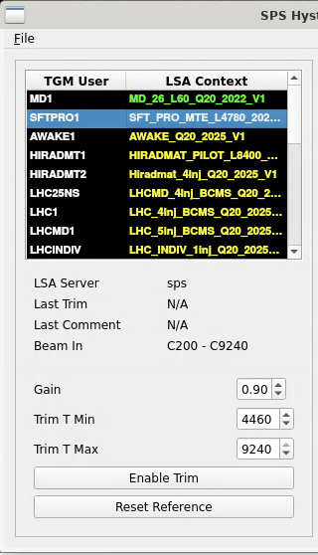
Outlook & conclusions
High-accuracy, purely data-driven magnetic field predictions for hysteresis compensation shows operationally useful in the CERN SPS
  Continuous efforts to improve field prediction accuracy and robustness
  Robust autoregressive predictions will be important for magnets without state input
Transfer learning strategy simplifies incorporating new data as it becomes available …
  … as well as transferring the model to other magnet families
  Q: can we train a “foundation model” for different hysteresis?
But is it operational …?
  Online field compensation being deployed to SPS main dipoles
  SPS main quadrupoles to come when lab measurements arrive
  Full-cycle and any cycle compensation, and removal of precycling cycles coming with improved model robustness and more measurements
Notes:
… and other multi-cycling synchrotrons at CERN lacking real-time field feedback
model robustness is critical for continuous control
We are restricted to compensating effects seen on field
Incorporating past knowledge is crucial for accurate prediction of future field
Other decoder methods can be explored, like FNOs
Resolution invariant decoders with transformer encoders

Slide 23
Extra slides

Slide 24

Field measurements for time series forecasting
Pre-processing of field measurements
Magnetic fields measured at 1 kHz online in the SPS for the main dipoles
  Data is plenty, but variety is limited to what operators play (which are often repeated sequences)
  Other magnets (quad+) must be measured in a lab
! Downsampling and preprocessing of measured data
  Effective sampling rate at 50 Hz gives balanced temporal resolution for dynamic effects …
  …but 50 Hz over 10 seconds is still 500 samples …
  Data engineering to isolate and enlarge hysteretic effects is required to improve numerical domain
Notes:
SPS main dipoles are measured
online by a B-Train system to an accuracy of 1-2e-5 T - this is a luxury!
More data is not necessarily good!
Too high downsampling results in aliasing and missing important (short-lived) features
Too low downsampling results in silly amounts of data
Since hysteresis is so small, significant data engineering is needed

Slide 25
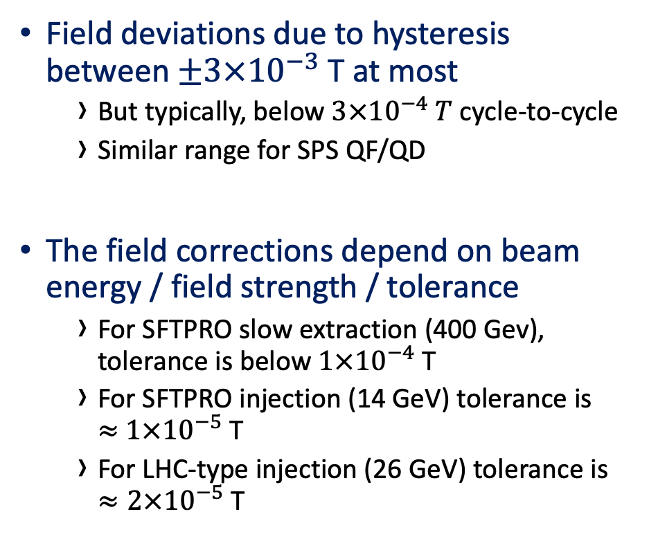
Analysis – Hysteresis in SPS main dipoles
Overview
Field deviations due to hysteresis between $±3×{10}^{−3}$ T at most
  But typically, below $3×{10}^{−4} T$ cycle-to-cycle
  Similar range for SPS QF/QD
The field corrections depend on beam energy / field strength / tolerance
  For SFTPRO slow extraction (400 Gev), tolerance is below $1×{10}^{−4}$ T
  For SFTPRO injection (14 GeV) tolerance is
  $≈$ $1×{10}^{−5}$ T
  For LHC-type injection (26 GeV) tolerance is
  $≈2×{10}^{−5}$ T
Notes:
which dp/p are allowed
tolerance at FT at 2e04

Slide 26
Magnetic measurements
Know
Measure dipole magnetic response with online B-train
  Problems with drift to reach desired accuracy, especially at SFTPRO FB
Lab measurements for quadrupoles, sextupoles, octupules
  Challenges to reach desired accuracy using induction coil (drift) or hall sensors (noise)
Accurate pulsed measurements very challenging in the lab
Power converter in lab is different from FGC
  Lab not entirely representative of SPS conditions
Notes:
B-train challenges with marker

Slide 27
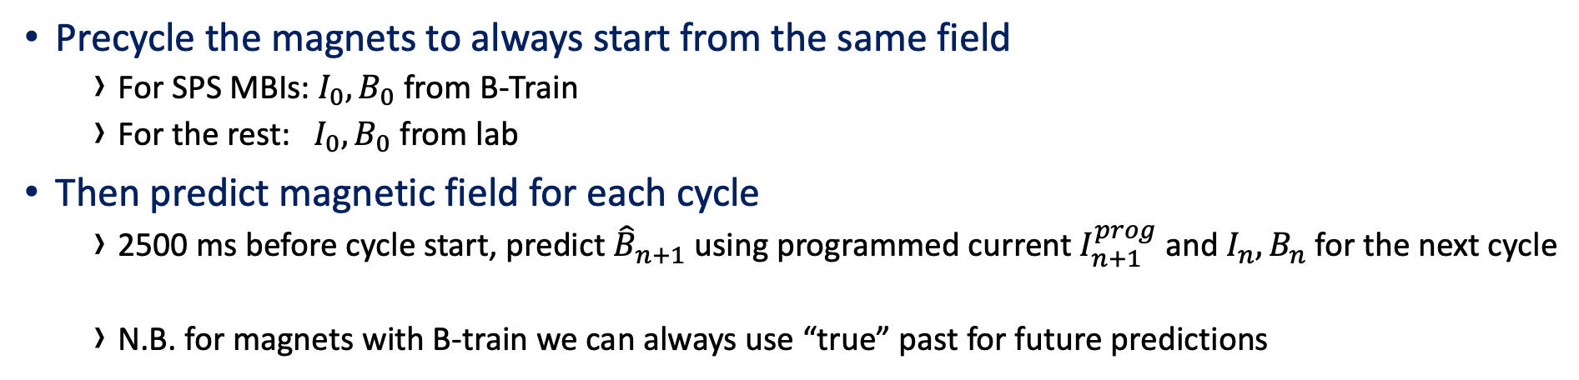
Cycle-by-Cycle Online inference
Predict
Precycle the magnets to always start from the same field
  For SPS MBIs: $I_{0},B_{0}$ from B-Train
  For the rest: $I_{0}, B_{0}$ from lab
Then predict magnetic field for each cycle
  2500 ms before cycle start, predict ${\hat{B}}_{n+1}$ using programmed current $I_{n+1}^{prog}$ and $I_{n}, B_{n}$ for the next cycle
  N.B. for magnets with B-train we can always use “true” past for future predictions
…
Precycle
Notes:
How long can we predict autoregressively
Special cases for dynamic economy cycles where we don’t know the machine mode 2500ms in advance
From timing system know which cycle is coming next, with 2500 ms forewarning
Previous ”state” is provided as input o network together with future programmed current, to give future field
Initial ”state” is provided by B-Train for MBIs, but must be bootstrapped with measurements for higher order magnets, probably with a precycle
Autoregressive predictions must be used since true past field is never known
We must feed the previous predicted field as “state” to the next prediction step
Predictions running on GPU in GUI
Predictions are also running on UCAP in parallel for future use
Challenges
Still require pre-cycle to start predictions in a known state, pre-cycle to be defined
Not known how long we can predict autoregressively – how long can we do without a pre-cycle
Initial tests suggest error does not tend to accumulate
Timing system does not correctly deliver the correct next cycle

Slide 28
Significant and consistent improvements on spill quality
Results
Evolution of spill quality over time, with autoregressive field predictions + compensation
  Corrections only on SFTPRO1 flat top, on every cycle
Reference taken at the beginning and unchanged throughout the MD
  Spill duty factor remains largely unchanged
  … But RMSE between reference and measured BCT is significant when field is poorly / uncorrected
Notes:
SPS QC values aren't sensitive enough, not a good enough metric
* we use RMSE between reference and measured BCT instead at flat top (since orbit information is not available)
* Significant improvements over baseline , even in the worst case
* MD used exotic supercycles (by accident) that would not be played in operations
* MD1 was present during tests, but we expect the same result without it

Slide 29
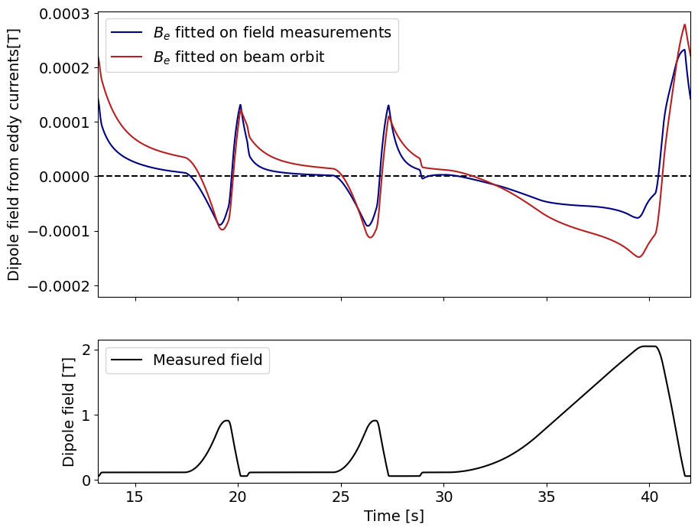
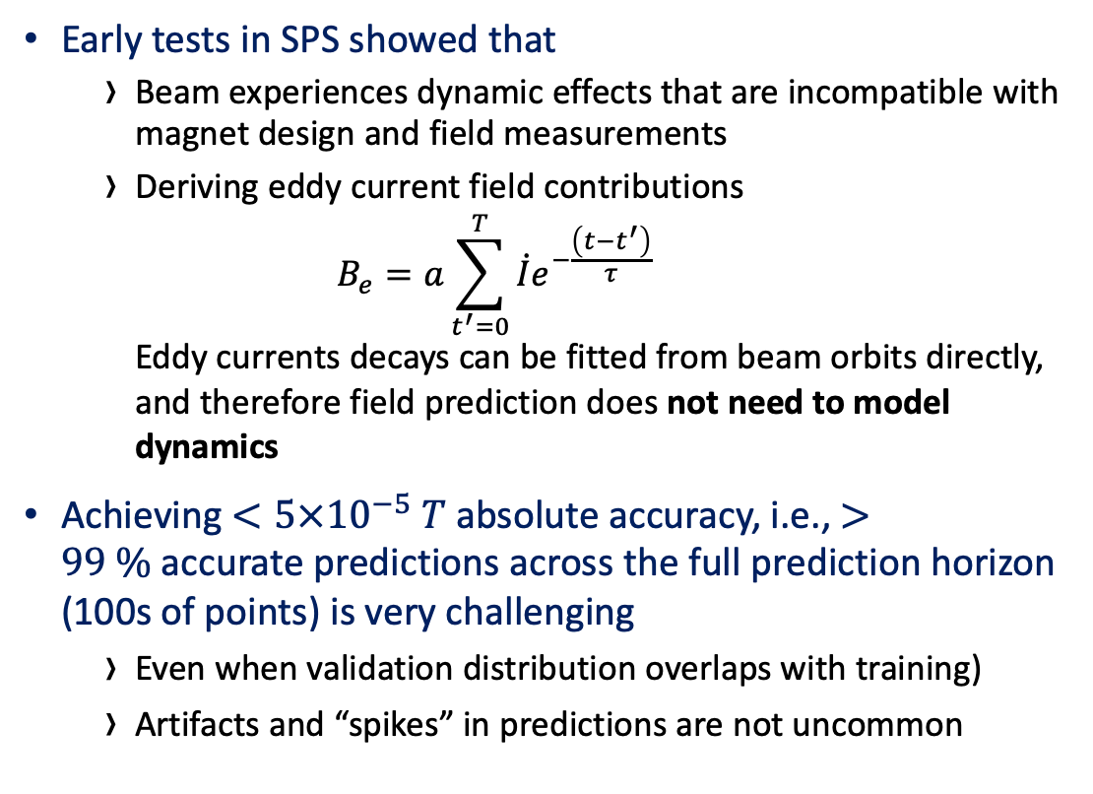
Dynamic effects will not need to be modeled
Early tests in SPS showed that
  Beam experiences dynamic effects that are incompatible with magnet design and field measurements
  Deriving eddy current field contributions
  $B_{e}=a\sum_{t^{′}=0}^{T}{\dot{I}e^{−\frac{\left(t−t^{′}\right)}{τ}}}$
  Eddy currents decays can be fitted from beam orbits directly, and therefore field prediction does not need to model dynamics
Achieving $<5×{10}^{−5} T$ absolute accuracy, i.e., $>99 \%$accurate predictions across the full prediction horizon (100s of points) is very challenging
  Even when validation distribution overlaps with training)
  Artifacts and “spikes” in predictions are not uncommon
Notes:
Not modeling dynamics presents additional problems: how to remove dynamic effects from measurements reliably, when they can come from more than 1 source (often 2+ contributions with different decays)

Slide 30
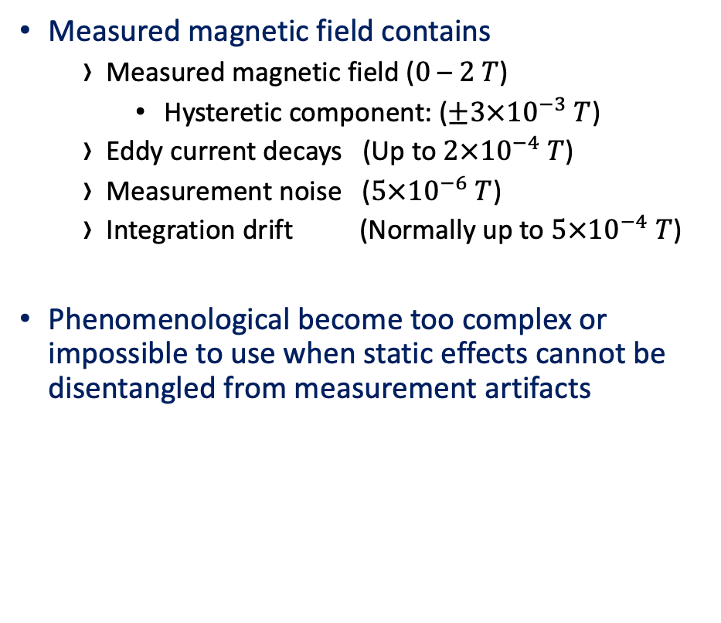
Technical requirements for a data-driven model
Must meet accuracy < 2e-5 T
For all points in a forecasting horizon
Must be able to capture dynamic effects as well as static effects
Must be able to predict data infinitely far into the future (autoregressive predictions) without state observations
Measured magnetic field contains
  Measured magnetic field ($0$ – $2 T$)
    Hysteretic component: ($±3×{10}^{−3} T$)
  Eddy current decays (Up to $2×{10}^{−4} T$)
  Measurement noise ($5×{10}^{−6} T$)
  Integration drift (Normally up to $5×{10}^{−4} T$)
Phenomenological become too complex or impossible to use when static effects cannot be disentangled from measurement artifacts

