Slide 1

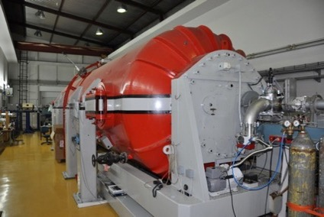
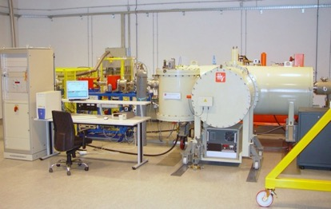
RBI accelerator facility;
Ion beam characterization of radiation detectors;
Detectors for HEP:
+ AIDA-Innova (Horizon Europe project)
+ EuroLabs (Horizon Europe project)
+ DRD3 (CERN collaboration)
Stjepko Fazinić, Milko Jakšić, Georgios Provatas,…
Laboratory for Ion Beam Interactions,
Division of experimental physics
Ruđer Bošković Institute, Zagreb, Croatia

Slide 2
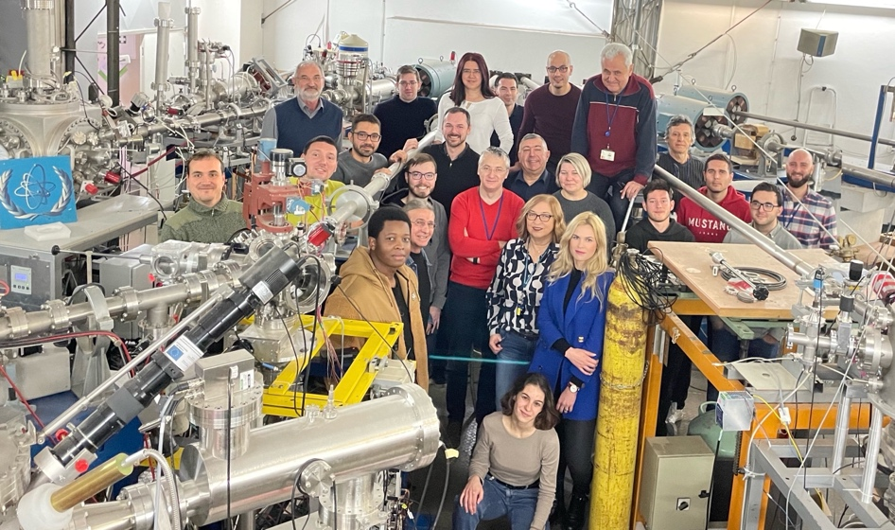
Staff, Laboratory for ion beam interactions:
Scientists (7+1): Milko Jakšić, Stjepko Fazinić, Iva Bogdanović Radović,
Tonči Tadić, Iva Božičević, Georgios Provatas, Matea Krmpotić, Zdravko Siketić (Head of Laboratory)
Postdocs (3): Sabrina Gouasmia, Marija Tkalčević, Kristina Tomić Luketić
Professional associates (3): Donny Domagoj Cosic, Fares Boussahoul, Željko Periša
Doctoral students (4): Toni Dunatov, Anja Mioković , Karla Ivanković Nižić, Matija Matijević
Technicians (3): Andro Kovačić, Zvonko Kolar, Dario Mičetić

Slide 3
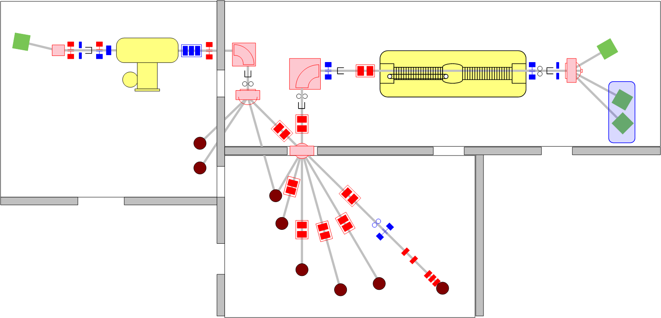
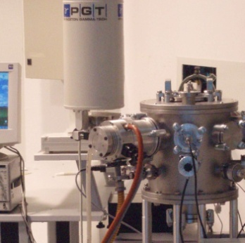
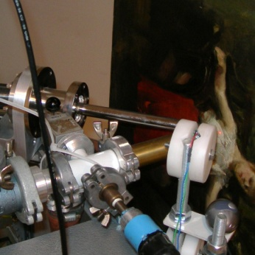
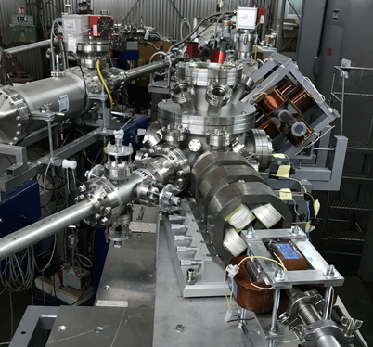
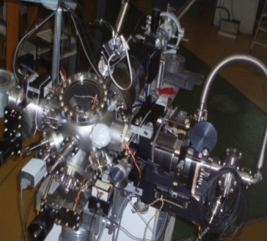
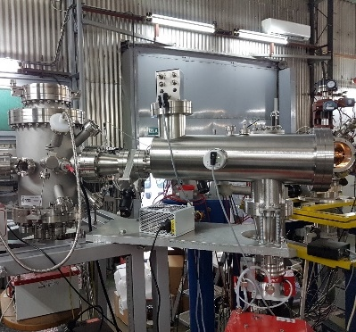
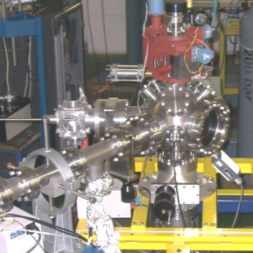
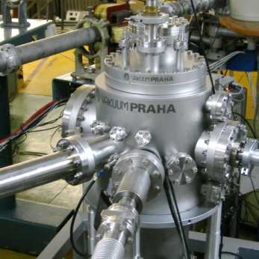
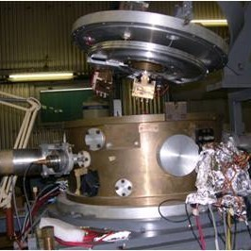
Facilities (today)
1.0 MV HVE Tandetron accelerator
6.0 MV EN Tandem Van de Graaff accelerator
PIXE/RBS
All LIBI end stations were constructed at RBI !
In-air PIXE
Dual µ-beam
Ion microprobe
Capillary MeV TOF-SIMS
TOF-ERDA
Channeling
Nuclear reactions
Dual beam,DiFu

Slide 4
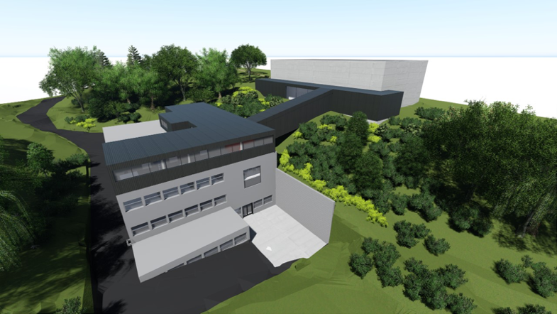
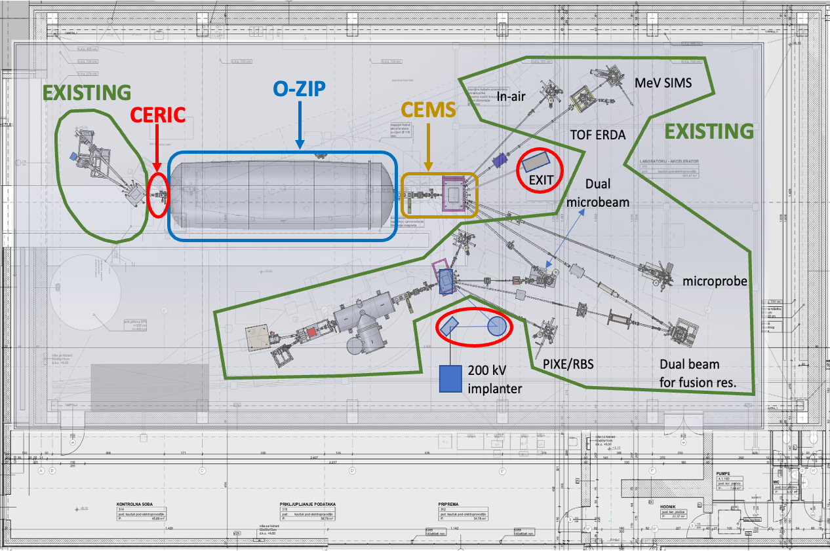
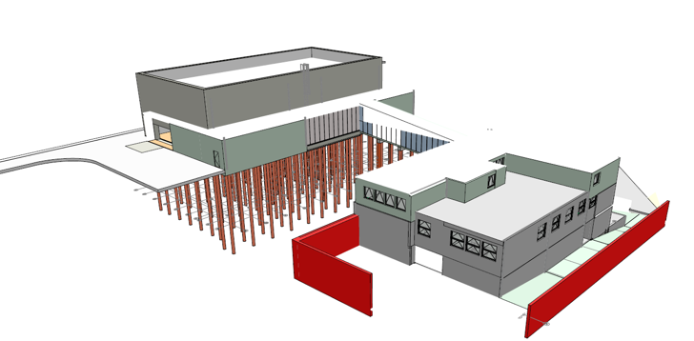
Facilities (soon)
Main funding sources:
O-ZIP project – building (3 MEur ) & accelerator (2.8 MEur)
CEMS project – Triplet + Switching magnet (400 kEur)
CERIC projects – Q-snout lens, EXIT, implanter (400 kEur)
Existing equipment (to be moved from old accelerator hall)

Slide 5
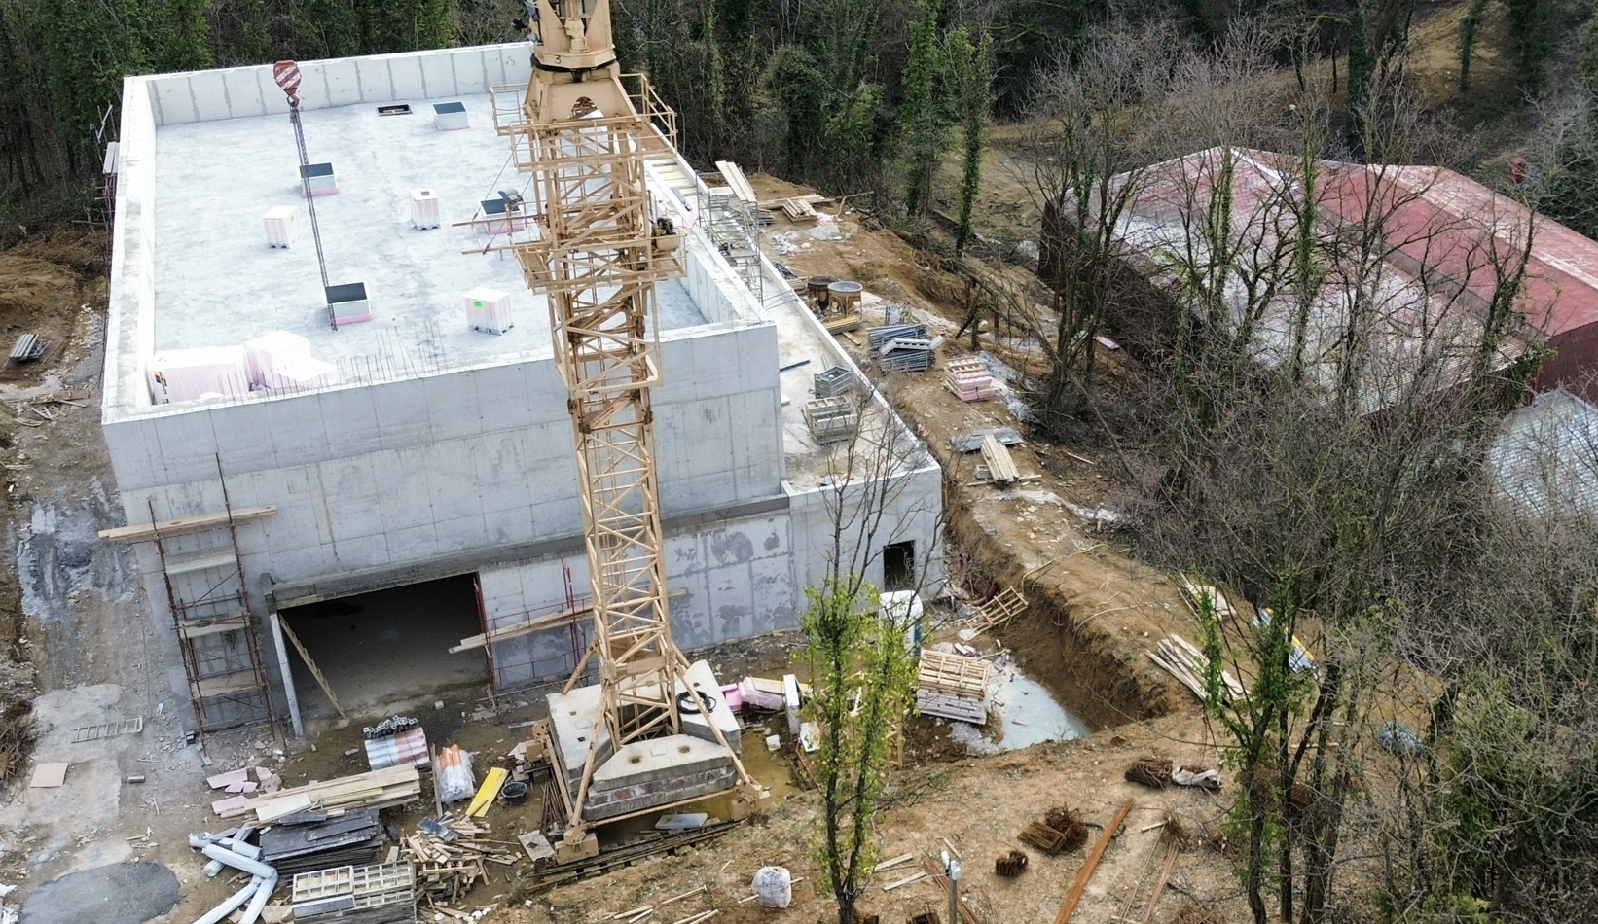

Facilities (soon)

Slide 6








Users:
Projects funding detector development:
Beam time (not influenced by Covid; earthquake, etc...):
Projects funding accelerator access:
Projects funding other labs’ activities:
IAEA/RBI
agreement
New Tandetron
accelerator
SPIRIT
FP7
AIDA
2020
RADIATE
H2020
EuroLabs

Slide 7
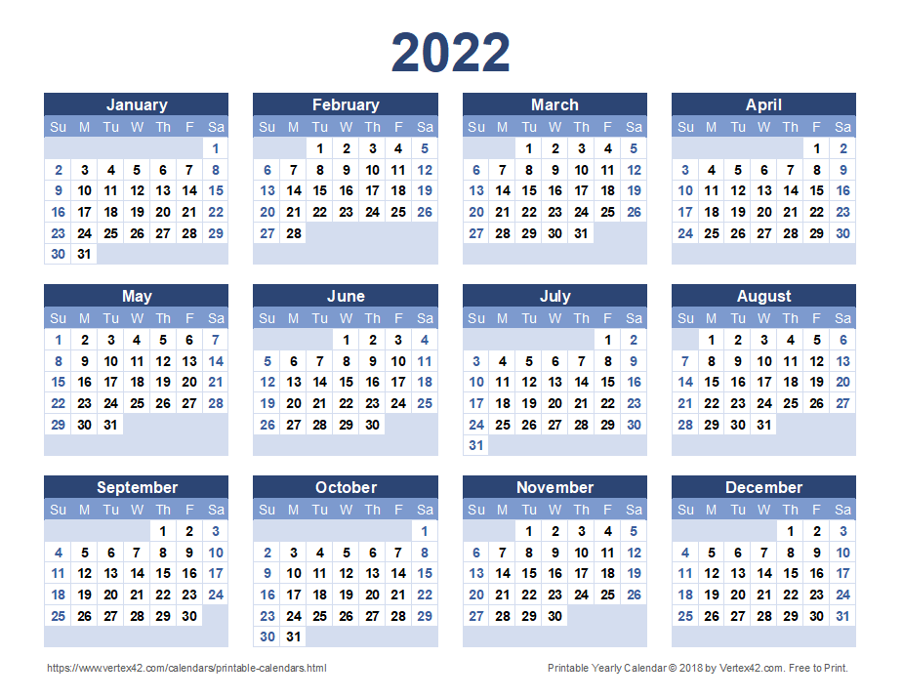
Foreign users (about 1/4 of total beam time):
Detectors (7)
Verona
Oh
Christinck
Irradiation (5)
Vittone
Analysis (5)
Camarda
Roldan
Camarda
Mitsi
Romanenko
Apra
Msimanga
D’Amico
Bilski
Verheij
Camarda
Lewis
Terentiev

Slide 8
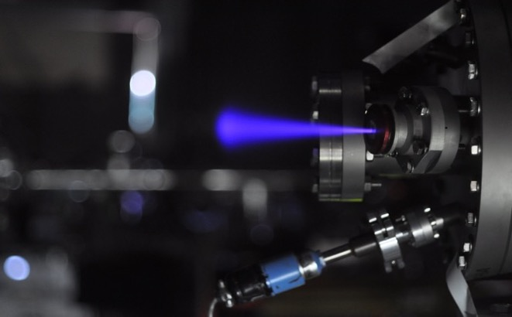
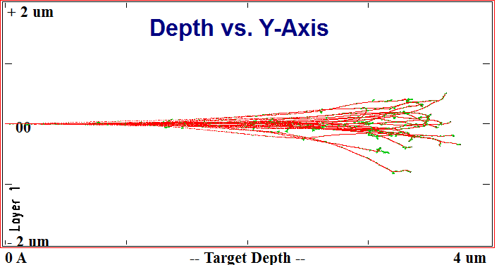
Ion Beam Induced Charge – IBIC
Ions maintain their direction in ‘z’
Every single ion creates charge carriers (& defects)
Ion microprobe gives (x,y) with 0.3 µm resolution, scanning areas up to 1 x 1 mm
Variety of ions - probing depths (z) from 1 to 700 µm
Variety of ionization densities !!
Ideal for solid state detectors !!
Silicon | I 127 | Si 28 | C 12 | He 4 | H 1
Range(µm) E=1 MeV | 0.37 | 1.13 | 1.6 | 3.5 | 16.3
Range (µm) E=10 MeV | 3.7 | 4.8 | 9.5 | 69.7 | 709

Slide 9

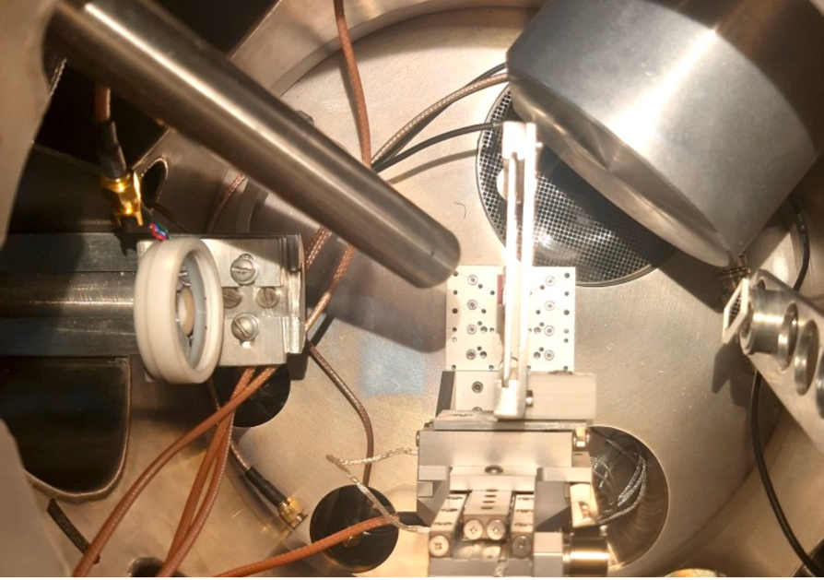
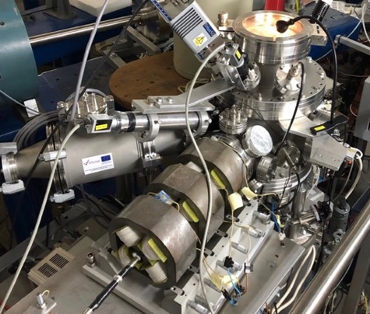
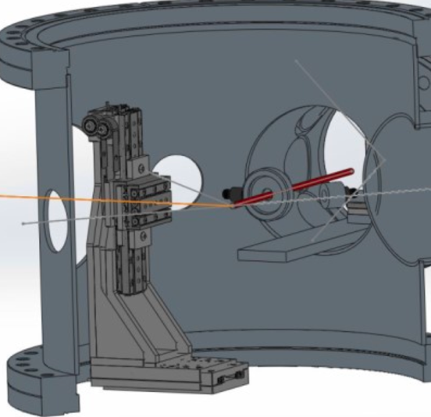
AIDAinnova
Task 4.2: Micro beam upgrade at the RBI accelerator facility
Upgrade the two existing ion micro-beam end stations:
Upgrade of both microprobes with precise target positioning systems
Sample cooling option for the old microprobe

Slide 10
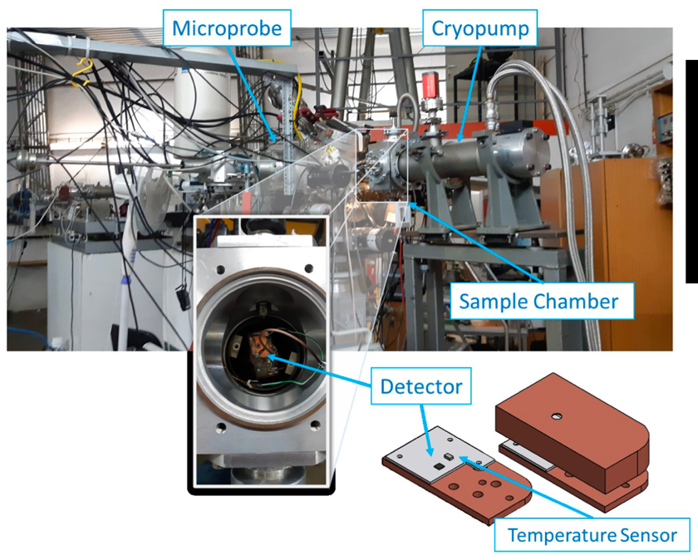
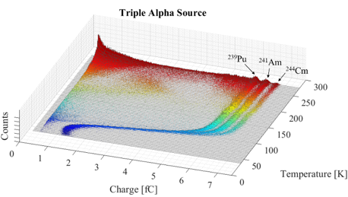
AIDAinnova
Task 4.2: Micro beam upgrade at the RBI accelerator facility
Upgrade the two existing ion micro-beam end stations:
Upgrade of both microprobes with precise target positioning systems
Sample cooling option for the old microprobe
  The lowest temperature achieved is 38 K !!
Operation at low temperatures
Pulse height deficit for ions at T<100 K
Important for diamond detectors operating at low temperatures

Slide 11


EuroLabs
(Advancement and Innovation for Detectors at Accelerators)
Following the success of previous transnational access projects
2015-2019 - Advanced European Infrastructures for Detectors at Accelerators
2020 – 2023 Research And Development with Ion Beams – Advancing Technology in Europe

Slide 12
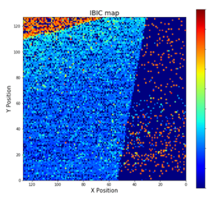
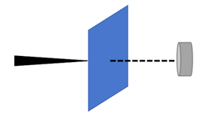
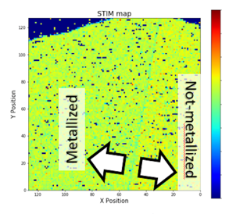
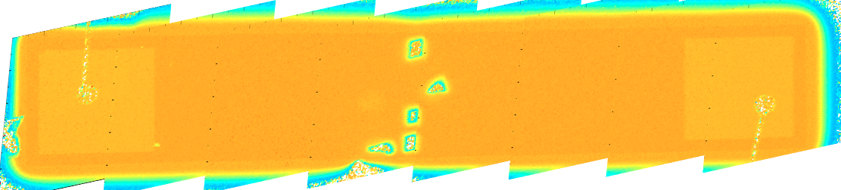
EuroLabs
(Advancement and Innovation for Detectors at Accelerators)
Funding the access for IBIC testing of detectors for HEP (2023-2026)
Proposals for the 23/24 period:
EURO-LABS-RBI-2003-001 (6-10.3.23.): Charge transport response of SiC sensors for harsh environment (completed)
EURO-LABS-RBI-2003-002 (8-12.5.23.): 3D characterization of large area single pad SiC detectors (completed)
EURO-LABS-RBI-2024-001 (12-16.2.24): Ion Position Sensitive Detector fabrication and Qualification (on-going).
EURO-LABS-RBI-2024-002 (15-19.3.24): Channeling Irradiation of Diamond and SiC 6H and 4H prototype crystals with MeV ⁷Li ions (planned).

Slide 13
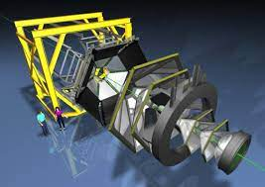
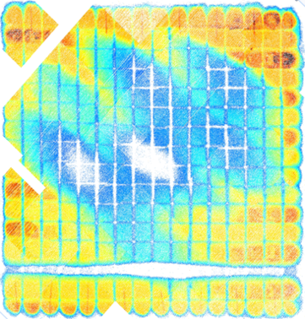
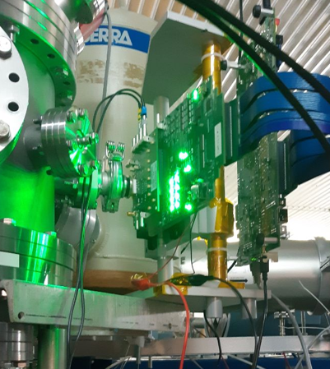
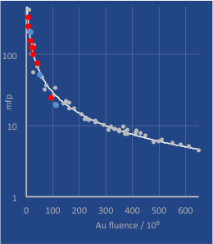
EuroLabs
(Advancement and Innovation for Detectors at Accelerators)
Funding the access for IBIC testing of detectors for HEP (2023-2026)
Opportunities (examples from past):
Effective intrepad distance in & gain supression in LGADs with Gregor Kramberger, IJS
Single event effects in monolythic pixel detectors (irradiated in air),
with R. Palomo Pinto, Uni. Seville
Radiation hardness of START detectors in HADES, with Jerzy Pietraszko (GSI)

Slide 14
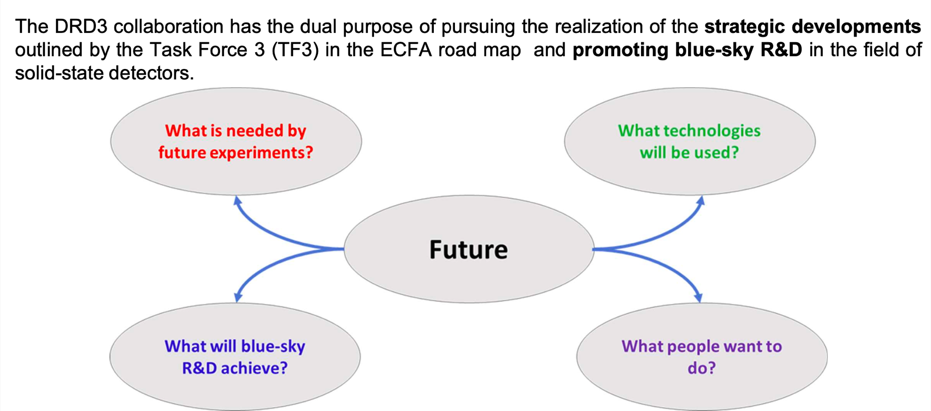
DRD3: CERN based R&D on solid state detectors collaboration (Andrey Starodumov & Georgios Provatas)

Slide 15
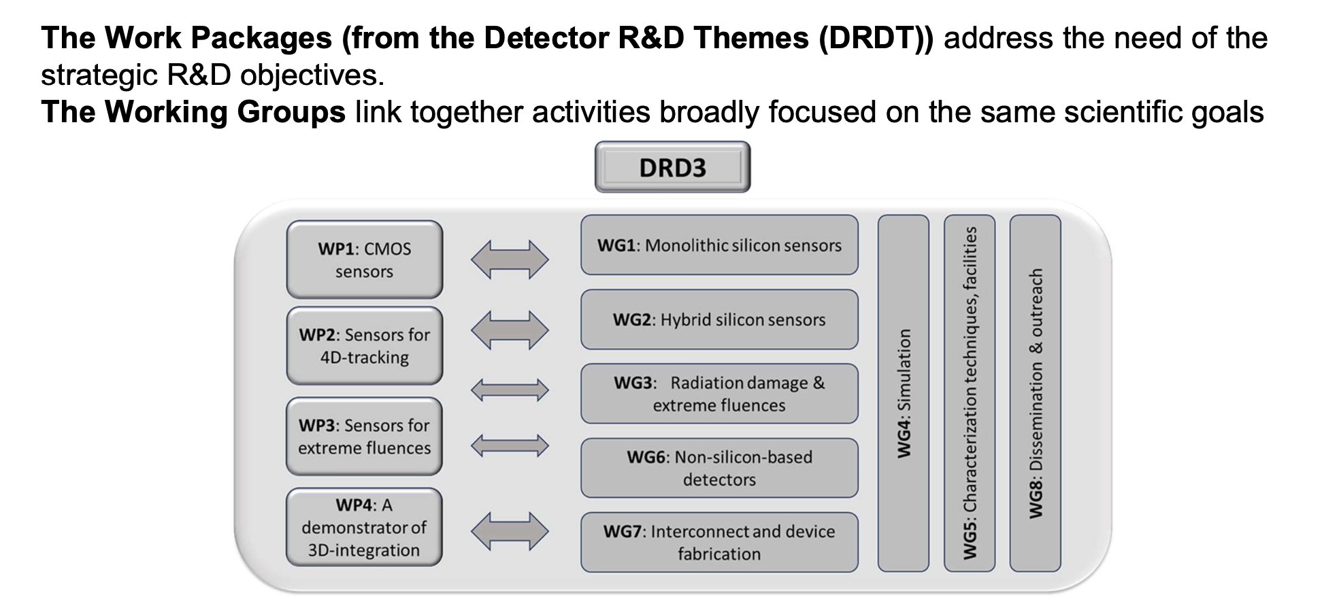
DRD3:Work Packages (WPs) and Working Groups (WGs)

Slide 16
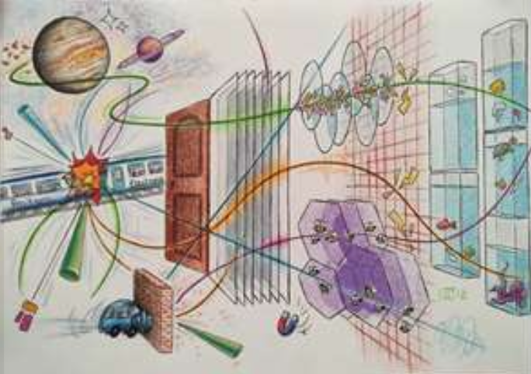
DRD3: Technological areas of IRB involvement
Radiation damage & ultrahigh fluences
New characterization techniques and facilities of common interest
Non-silicon semiconductor and other material studies
Dissemination and outreach

