Slide 1



Cherenkov Telescope Array (CTA) Activities in Croatia
CROHEP Meeting, February 2024, PMF - Zagreb
On behalf of the Croatian CTA Group
Nikola Godinović
University of Split - FESB

Slide 2
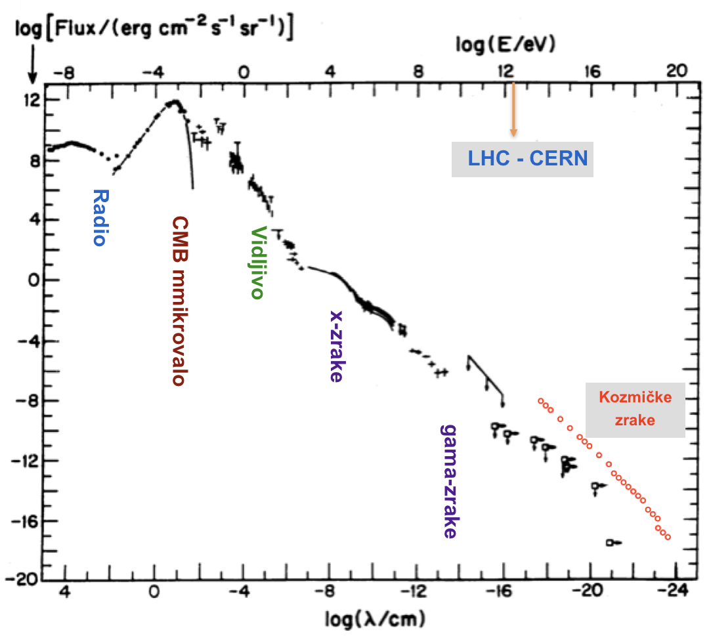
Messengers from the Universe – VHE gamma

Slide 3
Members of Croatian CTA Consortium
FESB – Split
Nikola Godinović
Damir Lelas
Toni Šarić
UNIRI
Dijana Dominis Prester
Marina Manganaro
Saša Mićanović
Tomislav Terzić
Mario Pecimkota
FER - Zagreb
Ana Babić
Željka Bošnjak
Petra Maruševec
UNIOS
Dario Hrupec
Jelena Štrišković
4 PhD students + 9 researchers

Slide 4
Imaging Atmospheric Cherenkov Telescope

Slide 5
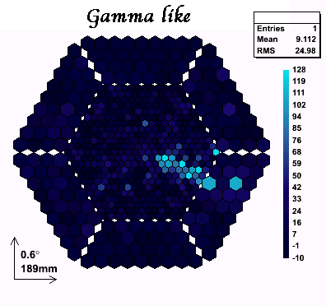
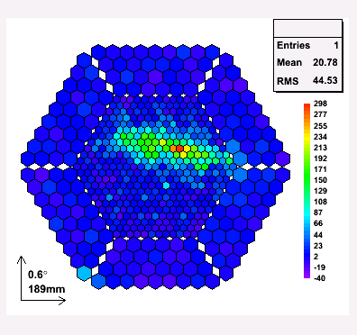
VHE gamma-ray events seen by MAGIC Camera
Camera of cca. 2000 pixels takes about up to 1000 images/s

Slide 6
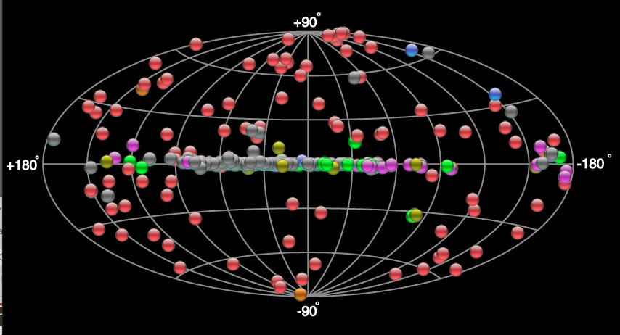
VHE gamma-ray astronomy
About 250 sources VHE gamma-rays sources is known, http://tevcat.uchicago.edu/

Slide 7
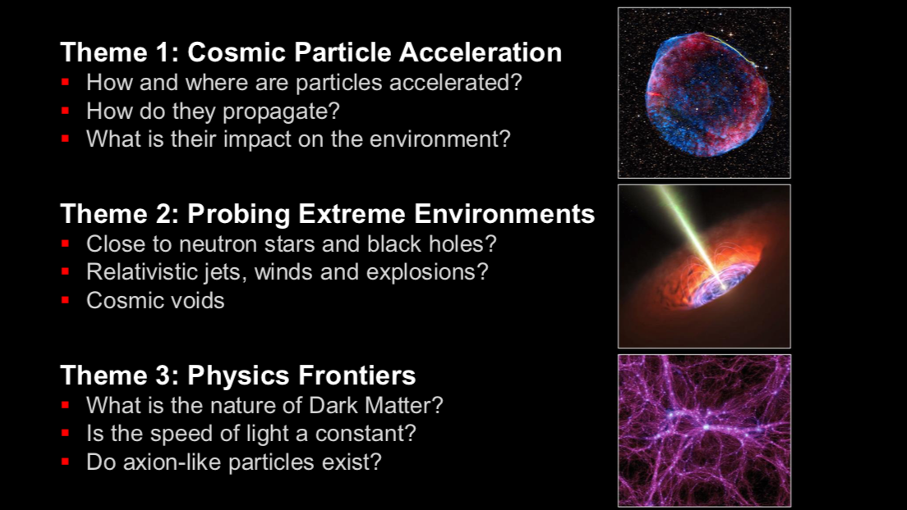
What studies could be done by VHE gamma-ray

Slide 8
VHE gamma-ray observatories in operation

Slide 9
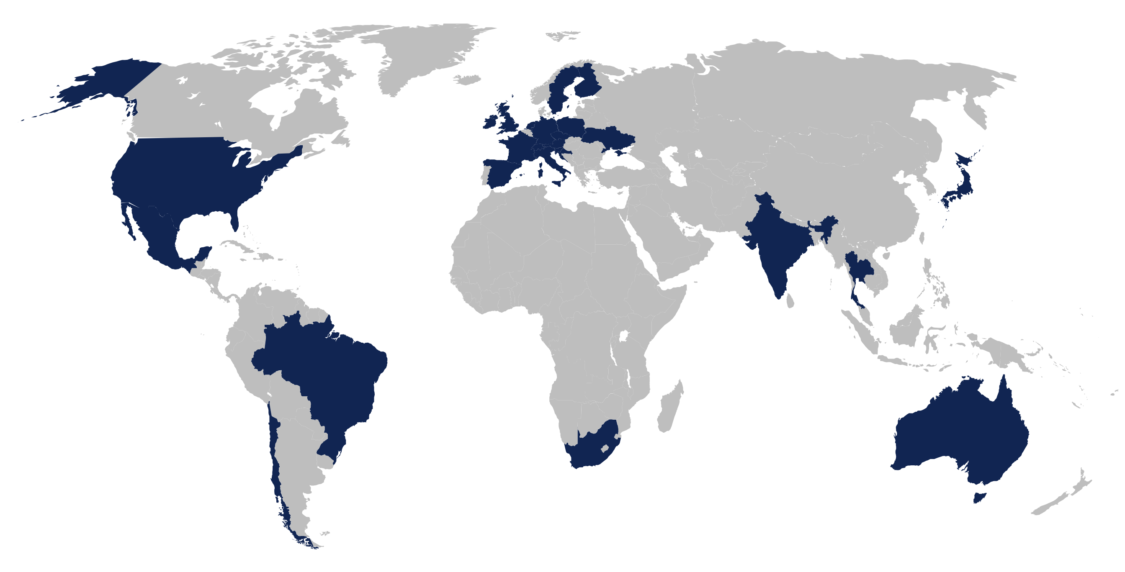
CTA Consortium
https://www.cta-observatory.org/
CTAC is a global effort with more than 1,500 scientists and engineers from about 150 institutes in 25 countries involved in the CTAO's science goals
The recently-released ASTRONET Science Vision and Infrastructure Roadmap 2022-2035 includes the CTAO as the top-ranked priority amongst new ground-based infrastructure projects.

Slide 10
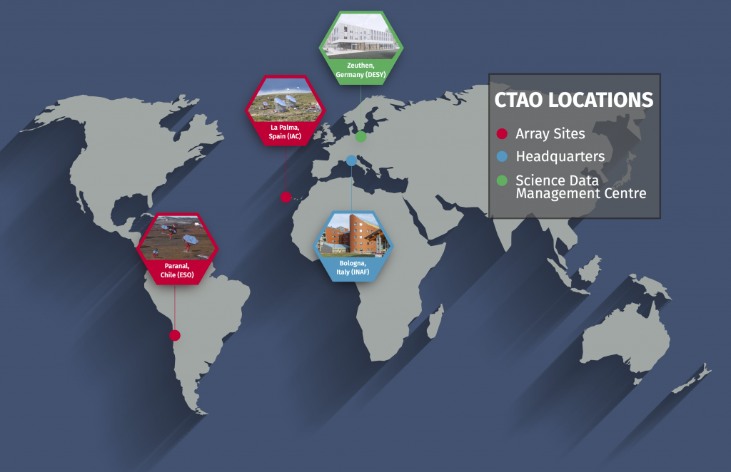
CTA sites and offices

Slide 11
North & South CTAO - how it will look
Three type of telescopes (20 GeV -300 TeV):
LST (20 GeV – 150 GeV)
MST (150 GeV – 5 TeV)
SST (5 TeV – 300 TeV

Slide 12
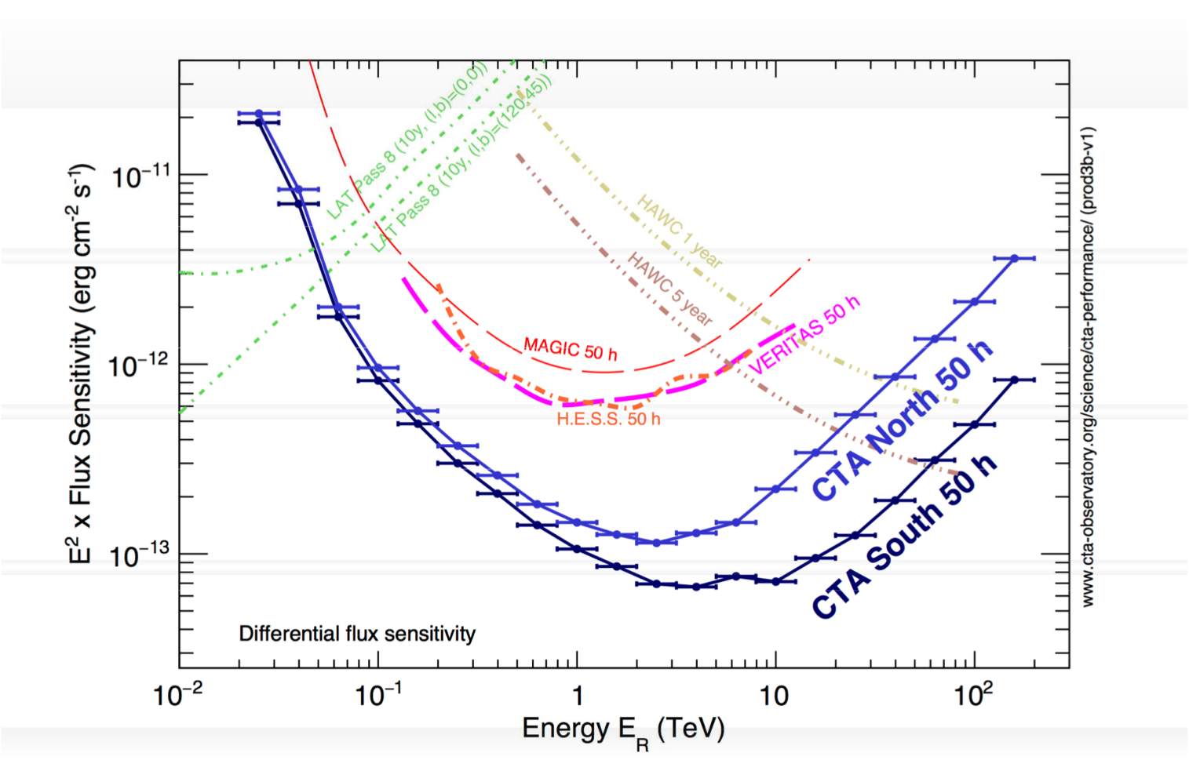
CTA Sensitivity (20 GeV – 300mTeV)

Slide 13
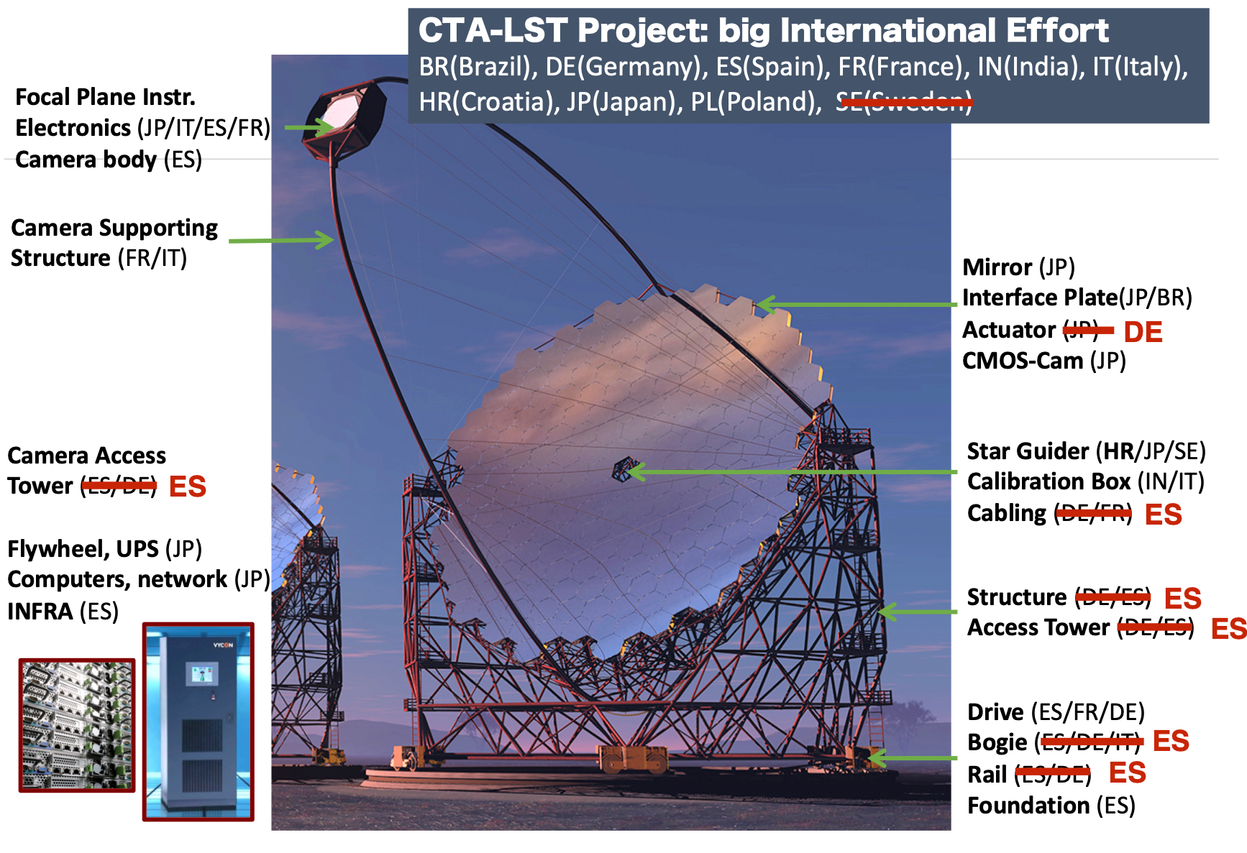

Croatian Contribution to CTA LST-1
Starguider & CDM
System for precise pointing measurement and correction

Slide 14
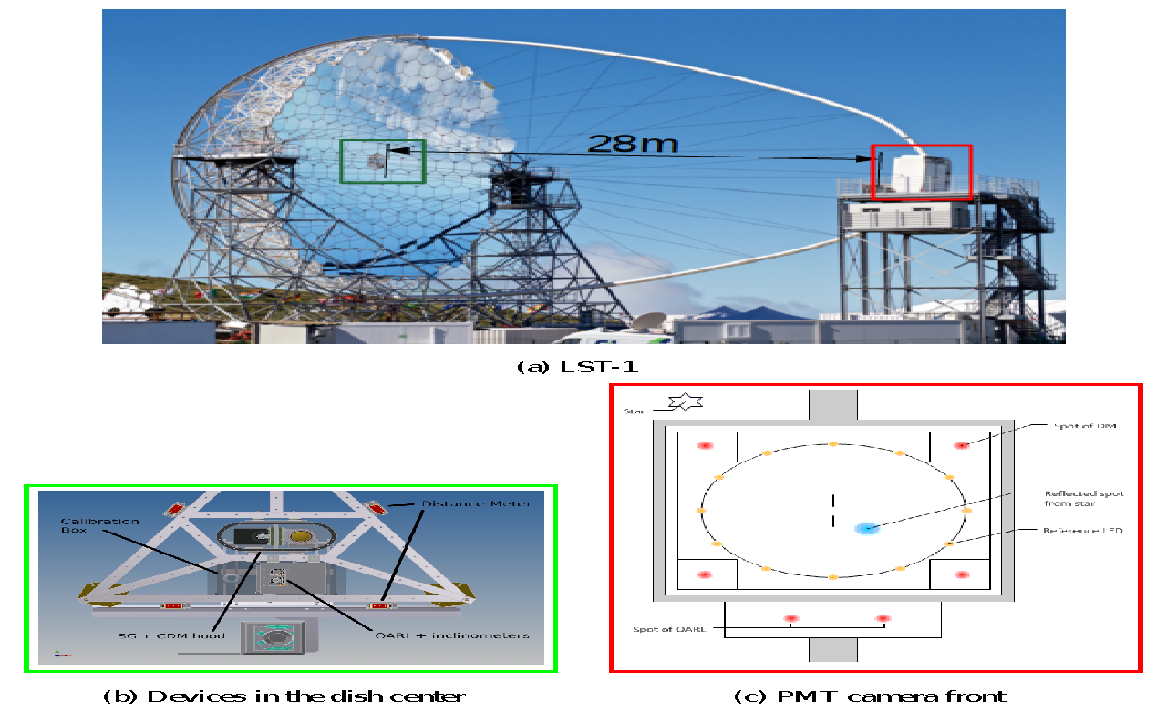
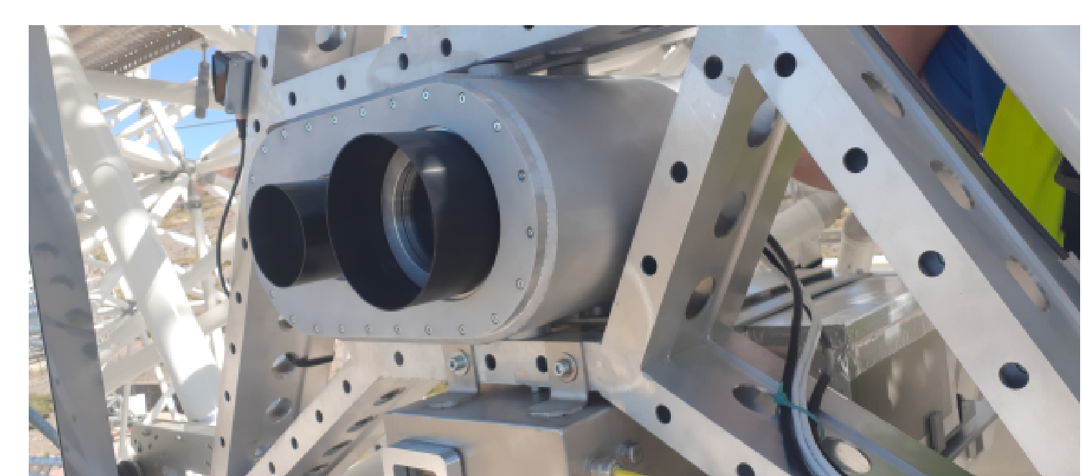
LST 1 – precise pointing system (14”)
100 tons
23 m
CDM
SG

Slide 15
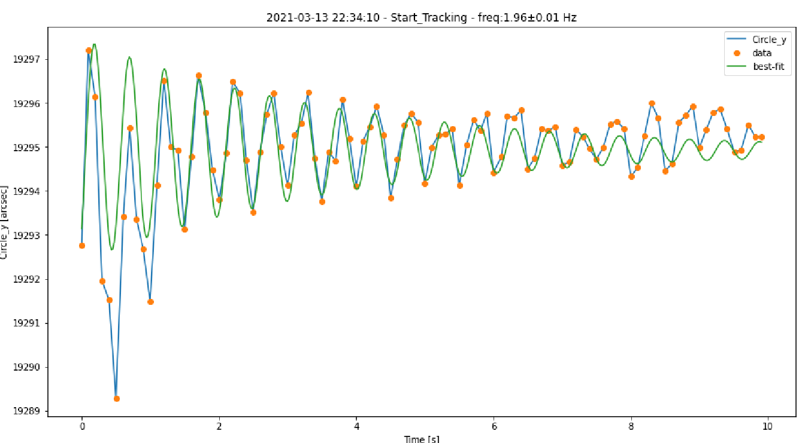
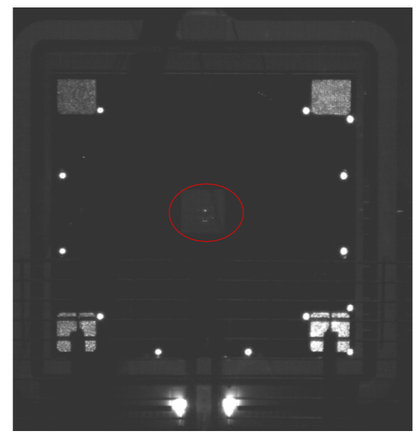
CDM meets design requirement
Darko Zarić (PhD)
The CDM fully meets the prescribed CTAC design requirements: it measures with accuracy of < 5” the displacement of the Cherenkov camera with a rate of 10 Hz

Slide 16
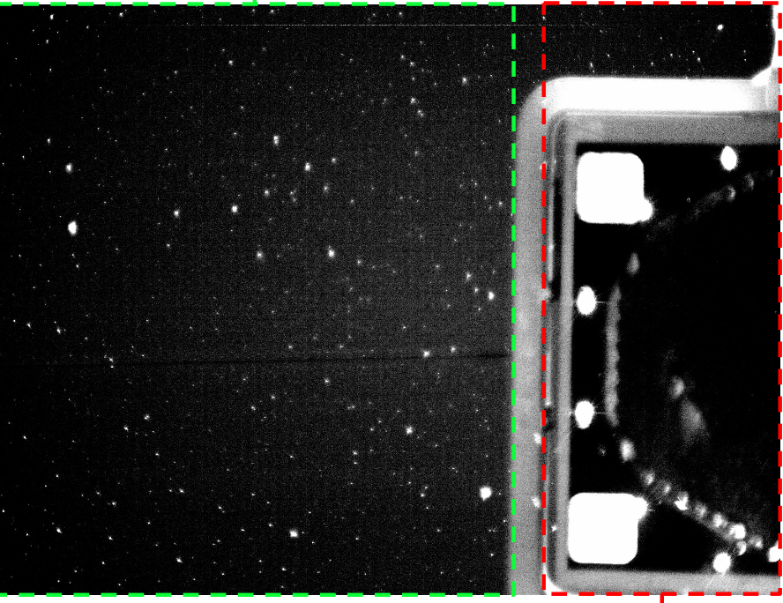
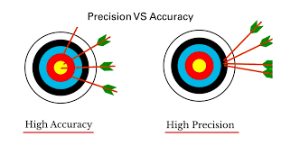




SG status & design issue!?
LST-1SG raw image
Sky coordinates of
Cherenkov camera
center => pointing
Obtained SG Precision:
SG FoV centre measured with precision < 5 arcsec.
LEDs centre measured with precision of 10 arcsec
Design requirements 14 arcsec
How to estmate accurascy of SG ie. calibrate it ?
Propose new desing for LST2-4

Slide 17
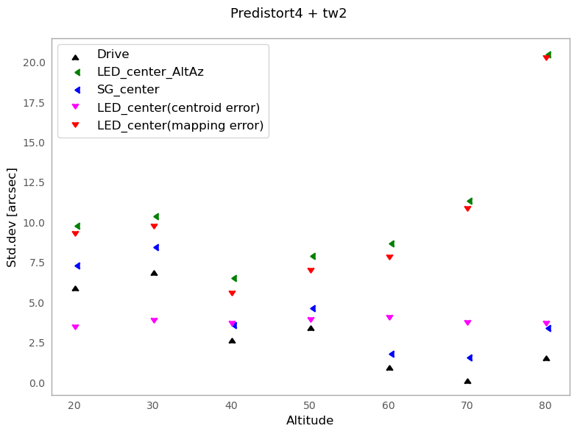

SG precision for SG FoV centre and LED centre
source of errors

Slide 18
SG Calibration Issue
SG makes a tilt angle with respect to the LST axis and the star to which telescope is pointing is not seen in SG
All current IACT telescope has SG optical axis parallel to the telescope optical axis and the star at which the telescope is pointing is visible in the SG FoV, making calibration method straightforward
Proposed method to calibrate LST-1 SG ( under discussion)
                Measure the tilt angle between SG and telescope axis.
        Knowing the tilt angle, it should be possible to point SG to a star, perform zenith and azimuth scan to create SG pointing model which should account for systematics errors affecting accuracy.
Systematic Errors in Current Set-up:
LEDs systematic errors | x-coordinate | y-coordinate
Displacement from centre | ? | ?
Half LEDs | 10’’ | 2’’
LEDs saturation | 110’’ | 15’’
DM reflected light | 3’’ | 6’’
Total | 110.5 ‘’ | 16.3’’
These systematic errors could be corrected by SG pointing model (SG calibration).

Slide 19
LST-1performance paper (Crab nebula)
H. Abe et al 2023 ApJ 956 80
The obtained LST-1 Crab spectrum is very close (within 10% in flux) to the MAGIC
Low energy threshold 30 GeV (design requirement 20 GeV) , angular resolution 40 - 60 arcsec (design requirement 14 arcsec)

Slide 20
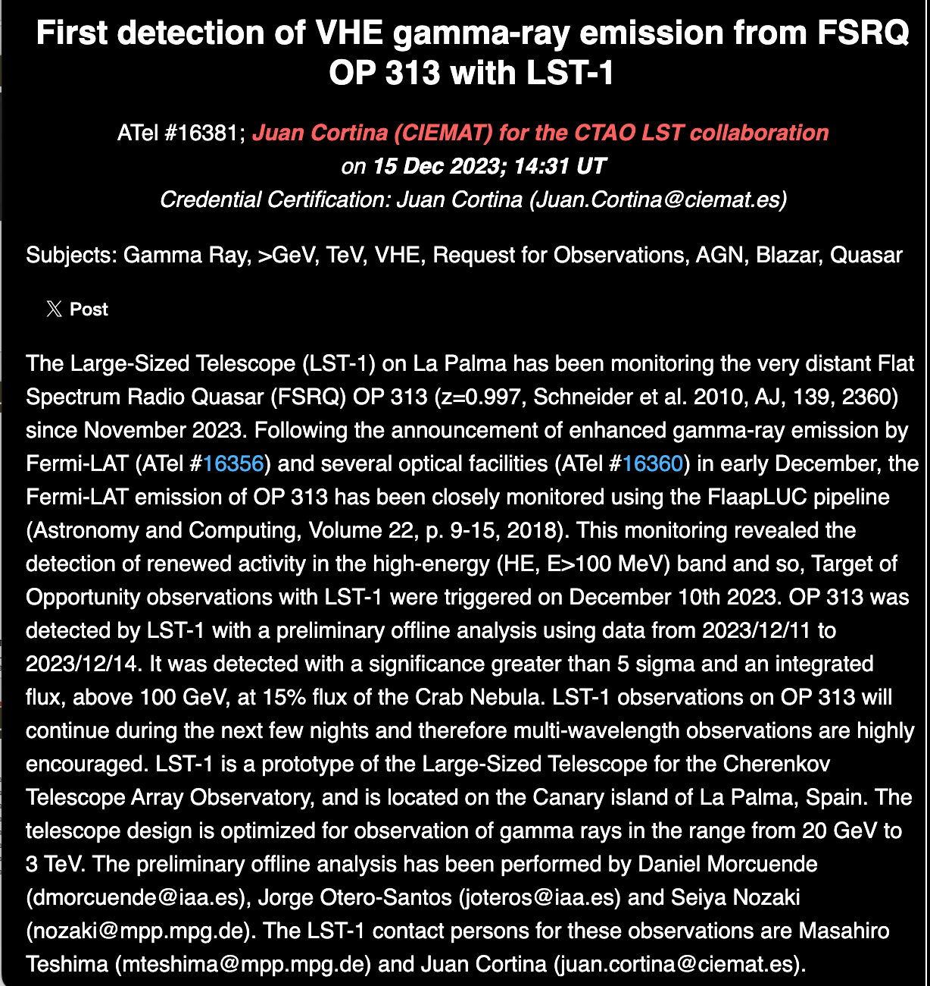
LST-1 Discovers the Most Distant AGN at Very High Energies
The most distant Active Galactic Nuclei (AGN) ever detected by a Cherenkov telescope, further showcasing the LST prototype’s exceptional performance while it is being commissioned
I was worth spending
10 MEur

Slide 21
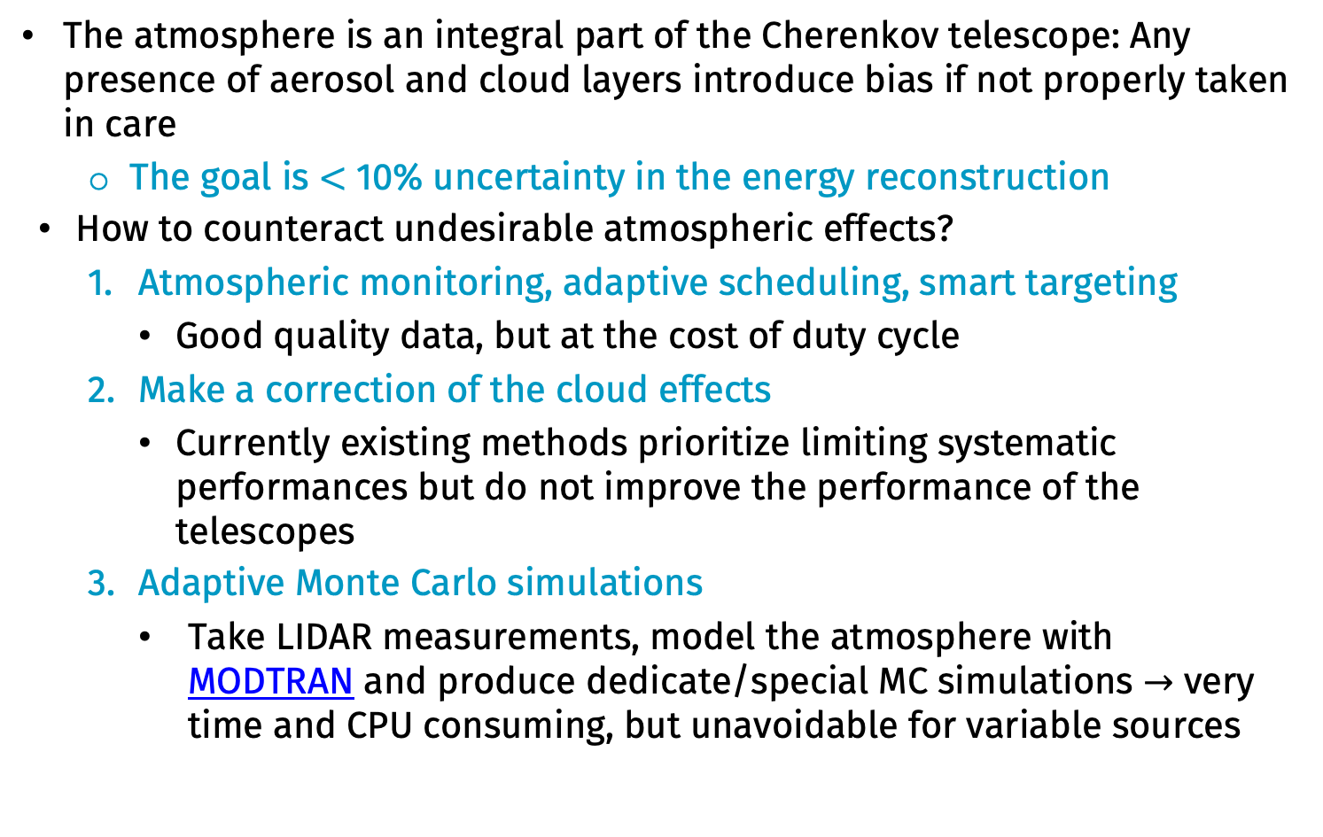
Atmospheric studies in CTA
The atmosphere is an integral part of the Cherenkov telescope: Any presence of aerosol and cloud layers introduce bias if not properly taken in care
  The goal is $<$ 10% uncertainty in the energy reconstruction
How to counteract undesirable atmospheric effects?
  Atmospheric monitoring, adaptive scheduling, smart targeting
    Good quality data, but at the cost of duty cycle
  Make a correction of the cloud effects
    Currently existing methods prioritize limiting systematic performances but do not improve the performance of the telescopes
  Adaptive Monte Carlo simulations
    Take LIDAR measurements, model the atmosphere with MODTRAN and produce dedicate/special MC simulations $→$ very time and CPU consuming, but unavoidable for variable sources
Mario Pecimotika, Saša Mićanović, Dario Hrupec

Slide 22
CTA-N flux sensitivity in the presence of clouds
Standard MCs lead to a significant additional degradation of flux sensitivity:
  by up to 30% at 100 GeV and up to 15% at 10 TeV compared to the case of adaptive MCs (depending on (T, H) of the cloud)
adaptive MCs
standard MCs
Mario Pecimotika, Saša Mićanović, Dario Hrupec

Slide 23
Crab Nebula SED – MAGIC + LST-1
Joint Poissonian maximum likelihood fit to the log-parabola spectrum
Standard MCs: At 140 GeV spectrum is underestimated by ≈ 40% and by 20% at 8 TeV compared to the reference spectrum
Adaptive MCs: less than 10% compared to reference spectra
Mario Pecimotika, Saša Mićanović, Dario Hrupec

Slide 24
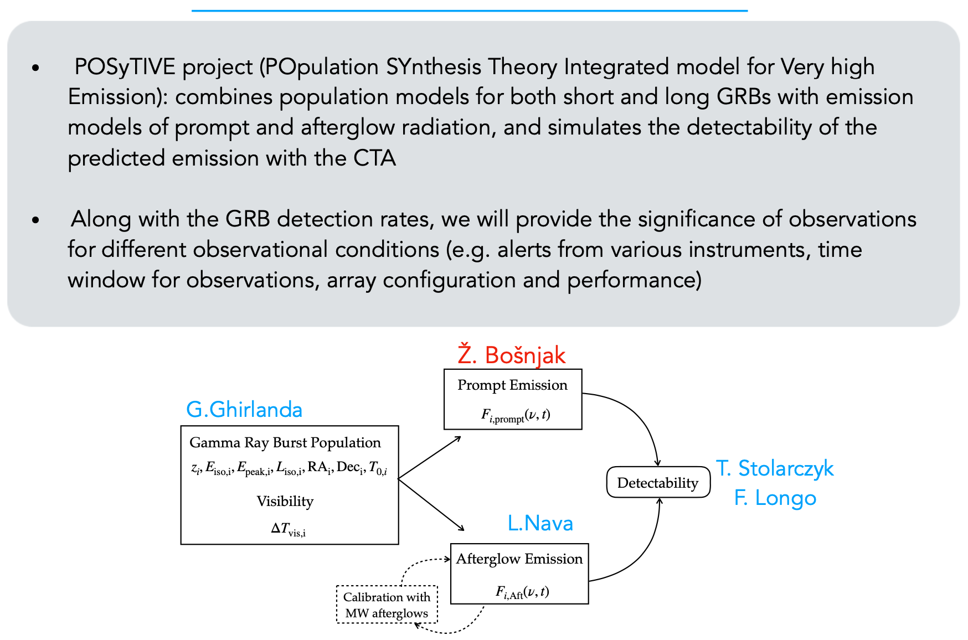
Detection rates and studies of gamma-ray bursts with the Cherenkov Telescope Array (Ž. Bošnjak, FER)

Slide 25
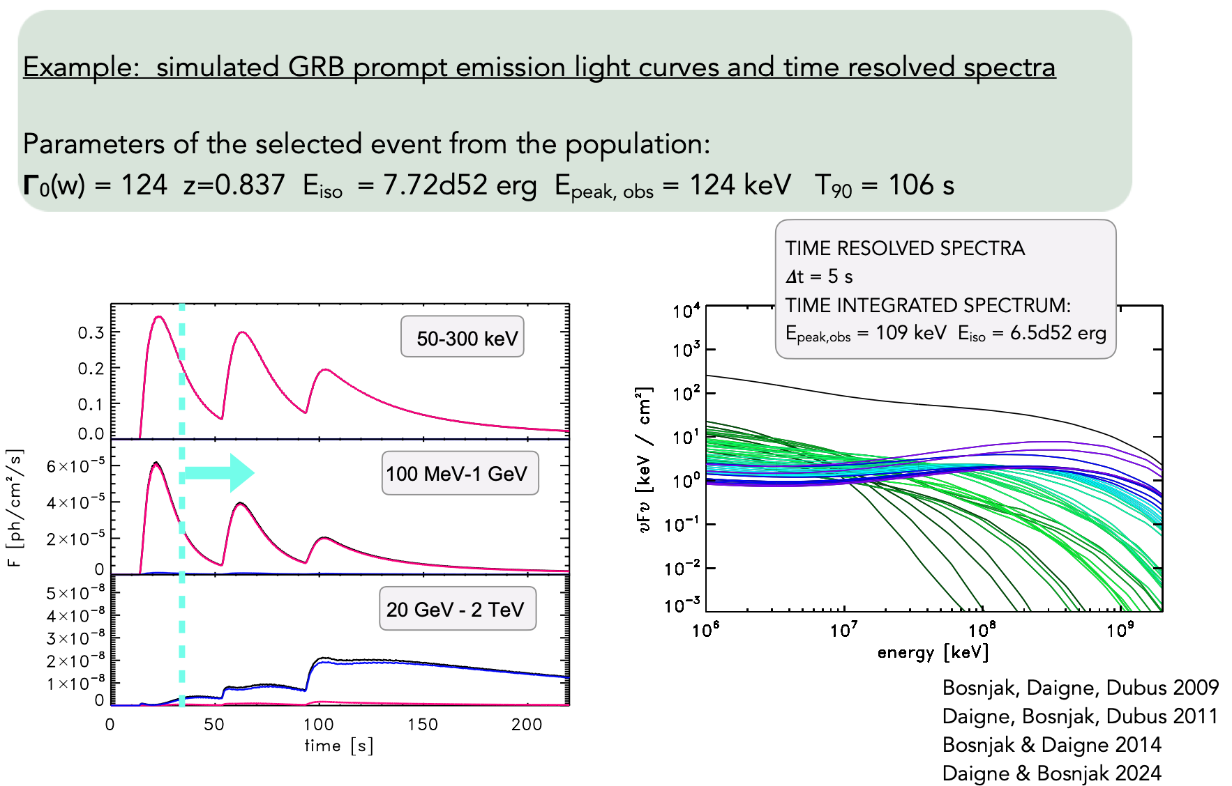
Detection rates and studies of gamma-ray bursts with the Cherenkov Telescope Array (Ž. Bošnjak, FER)

Slide 26
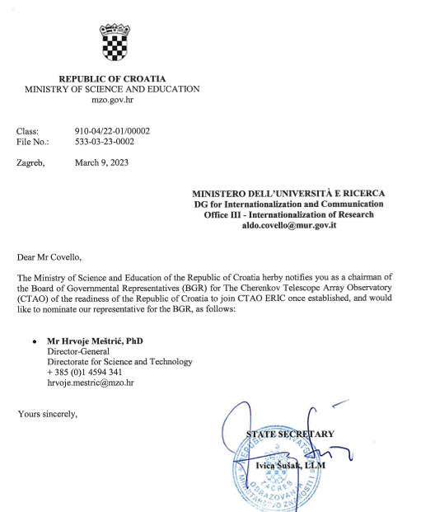
Croatia Applied to Join CTAO ERIC
CTAO ERIC is not yet established
Due to some legal issues
MZO is negotiating the Croatian funding contribution for full membership in CTAO ERIC
Hope, soon Croatia will become
CTAO ERIC member

Slide 27
Croatian Contribution to CTA/LST
FESB : Design, development, calibration, commissioning and maintenance of the system for precision pointing measurements and correction of LST-1 (Starguider (SG) & Camera Displacement Monitor (CDM)
UNIRI & UNIOS: Monte Carlo Simulations (Supercomputer "Bura" in Rijeka) - Telescope performance studies for CTA-North in dependence on the atmospheric transmission; Calculations of joint performance for LST & MAGIC; Feasibility study of hardware trigger between LST and MST
FER : Evaluation of different GRB emission models in the energy sensitivity range of the CTA telescope
Collaboration Board (CB): Nikola Godinović
Steering Committee of the Project LST-CTA: Dijana Dominis Prester, Nikola Godinović

Slide 28
Thanks

Slide 29
Backup

Slide 30
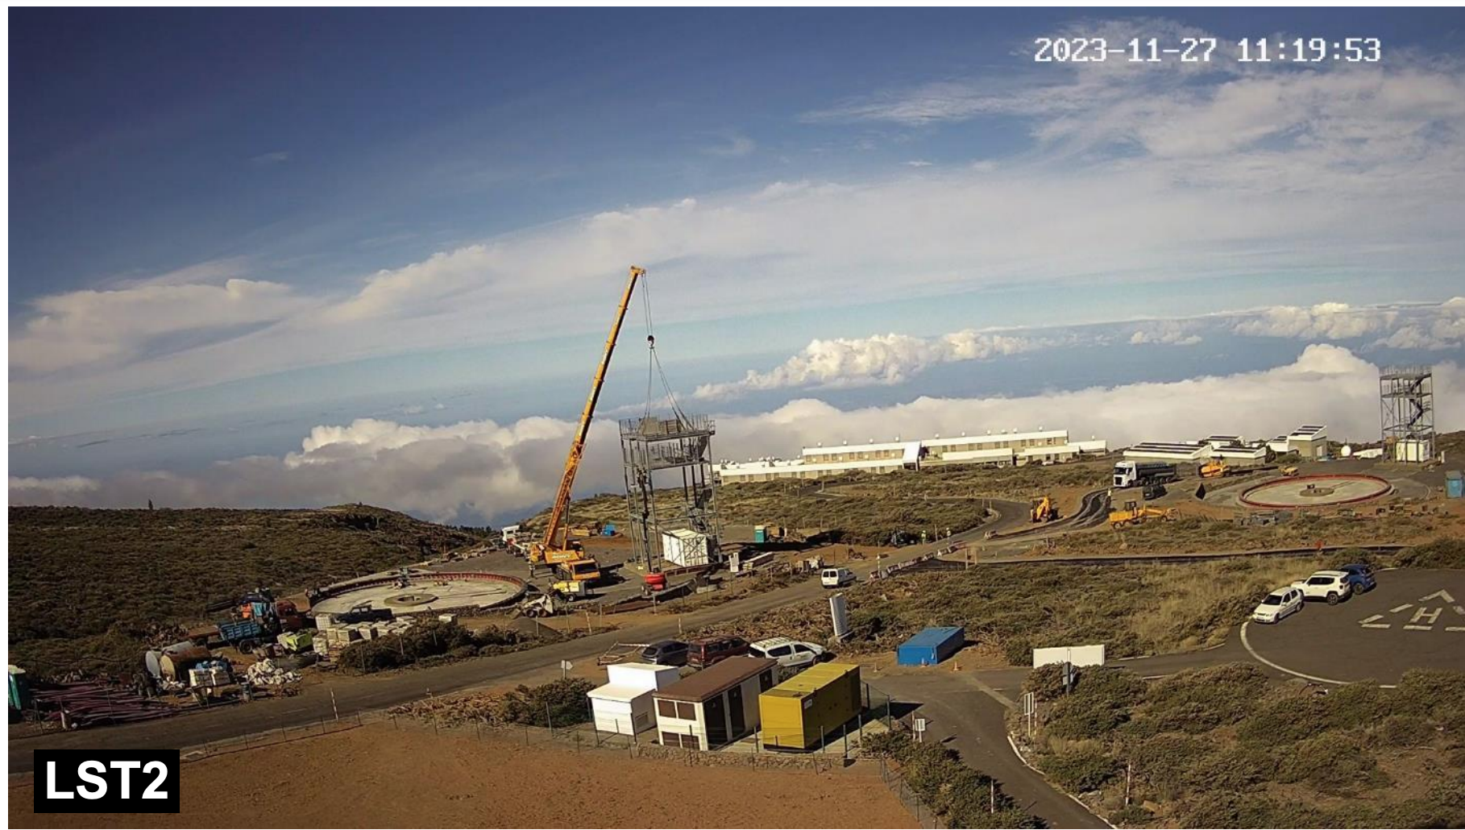
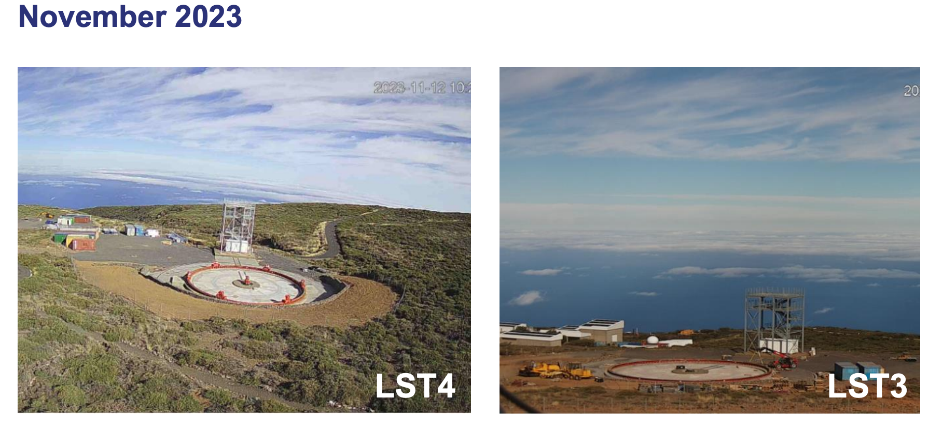
End of installation in 2025: LST4 June, LST3 August, LST2 October

Slide 31
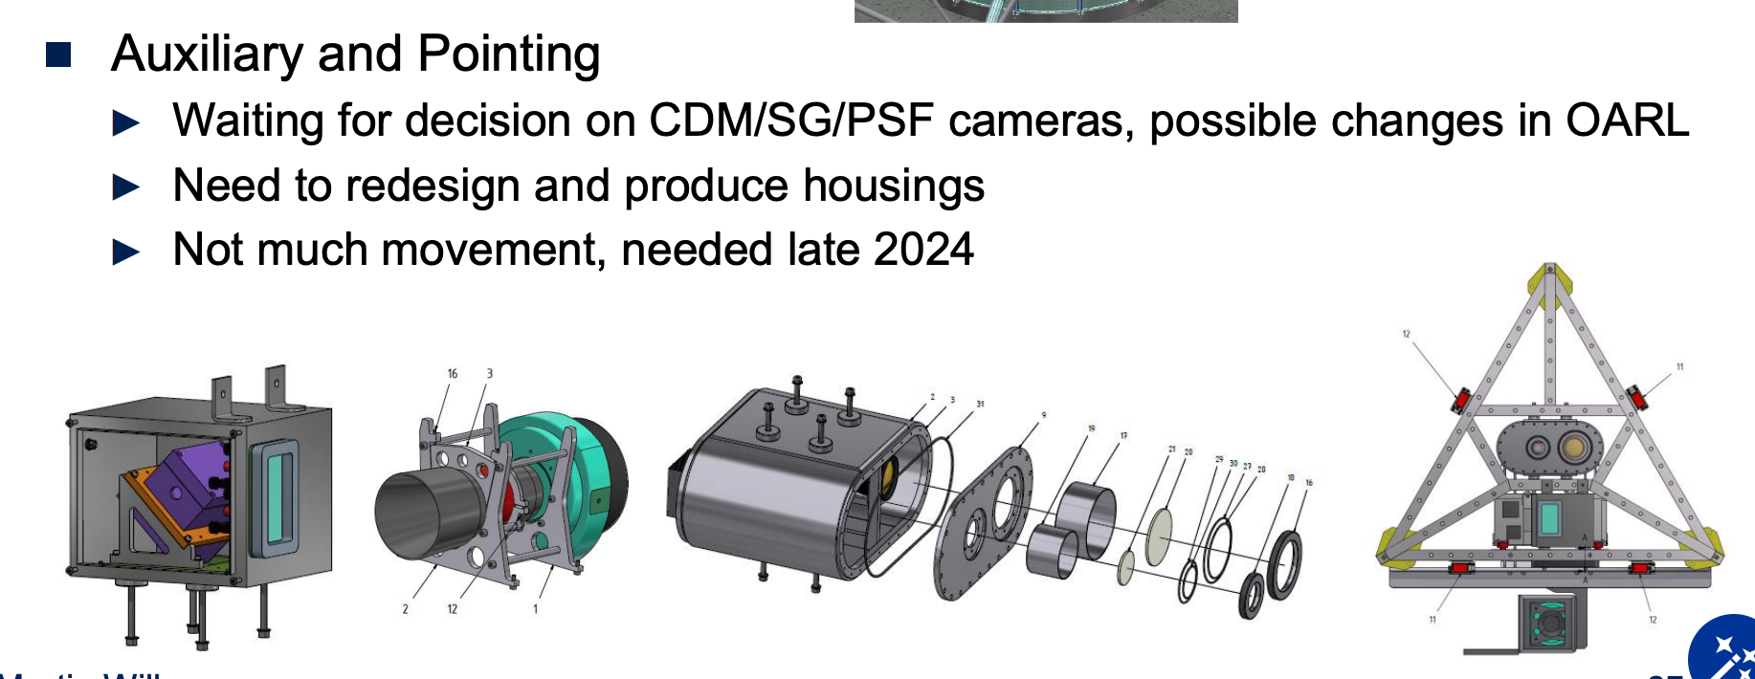
LST-1performance paper (Crab pulsar)
Crab pulsar phaseogram.
H. Abe et al 2023 ApJ 956 80

Slide 32
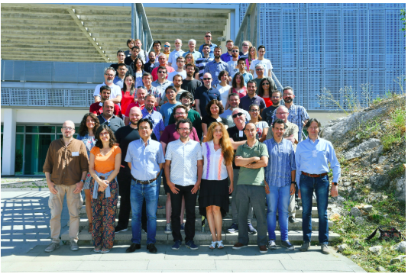
LST General Meeting, Rijeka, July 2019

