Slide 1
Transverse Beam Shaping with RF Cavities
Laurence Wroe (CERN, ATS-DO)
laurence.wroe@cern.ch
Steinar Stapnes, Andrea Latina, Rob Apsimon

Slide 2
Table of Contents
Making a Uniform Beam with Magnetic Fields
Making a Uniform Beam with RF Cavity Fields
Realising and Implementing a “Uniformiser” RF Cavity
Other Transverse Beam Shaping with RF Cavities
Next Steps and Discussions

Slide 3
Table of Contents
Making a Uniform Beam with Magnetic Fields
Making a Uniform Beam with RF Cavity Fields
Realising and Implementing a “Uniformiser” RF Cavity
Other Transverse Beam Shaping with RF Cavities
Next Steps and Discussions

Slide 4
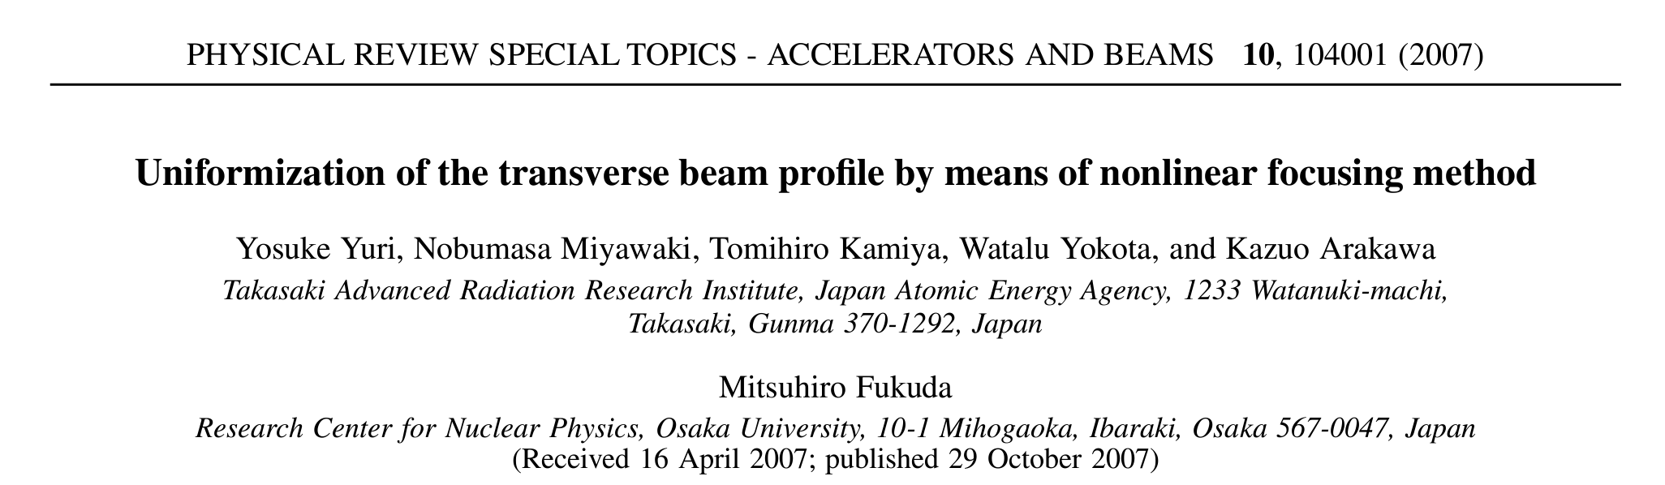
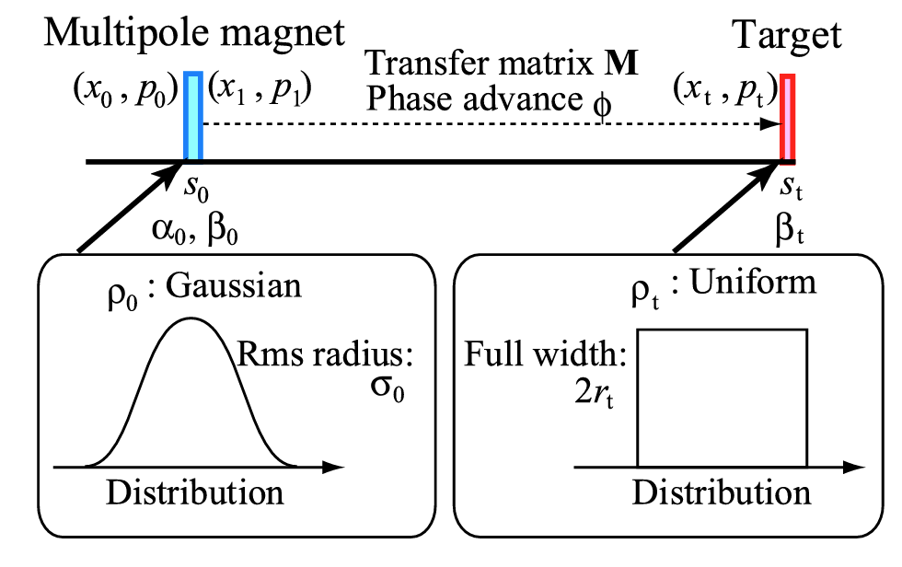
Initially?
  Beam with transverse Gaussian distribution goes though multipole magnet
Then?
  Accelerator optics, as described by M
Goal?
  Beam with uniform distribution at target

Slide 5
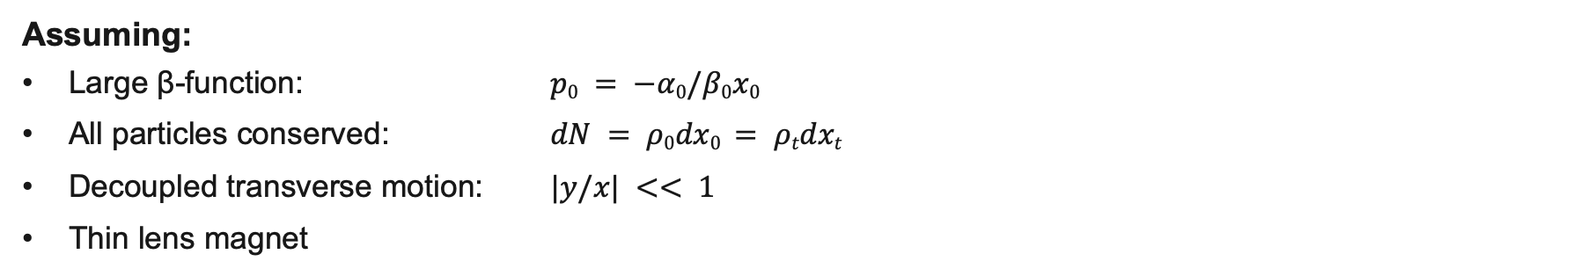
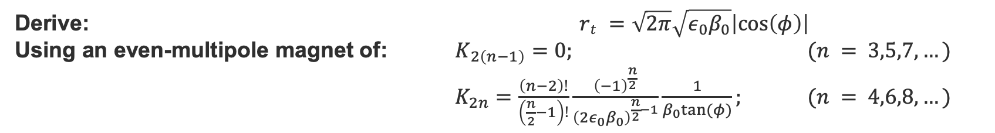
Brief Theory
Assuming:
  Large β-function: $p0 = −α0/β0x0$
  All particles conserved: $dN = ρ0dx0 = ρtdxt$
  Decoupled transverse motion: $|y/x| << 1$
  Thin lens magnet
Start with a Gaussian distribution: $ρ0 =\frac{N}{2πσ0}\exp\left(−\frac{x02}{2σ02}\right)$
want uniform: $ρt =\frac{N}{2r_{t}}$
Derive: $rt =\sqrt{2π}\sqrt{ε_{0}β_{0}}\left|cos\left(φ\right)\right|$
Using an even-multipole magnet of: $K_{2\left(n−1\right)}=0;$ $(n = 3,5,7,…)$
$K_{2n}=\frac{\left(n−2\right)!}{\left(\frac{n}{2}−1\right)!}\frac{{\left(−1\right)}^{\frac{n}{2}}}{{\left(2ε_{0}β_{0}\right)}^{\frac{n}{2}−1}}\frac{1}{β_{0}tan⁡(φ)};$ $(n = 4,6,8,…)$
Recursively find: $K_{2(n+2)}=−\frac{n−1}{ε_{0}β_{0}}K_{2n};$ $(n = 4,6,8,…)$

Slide 6
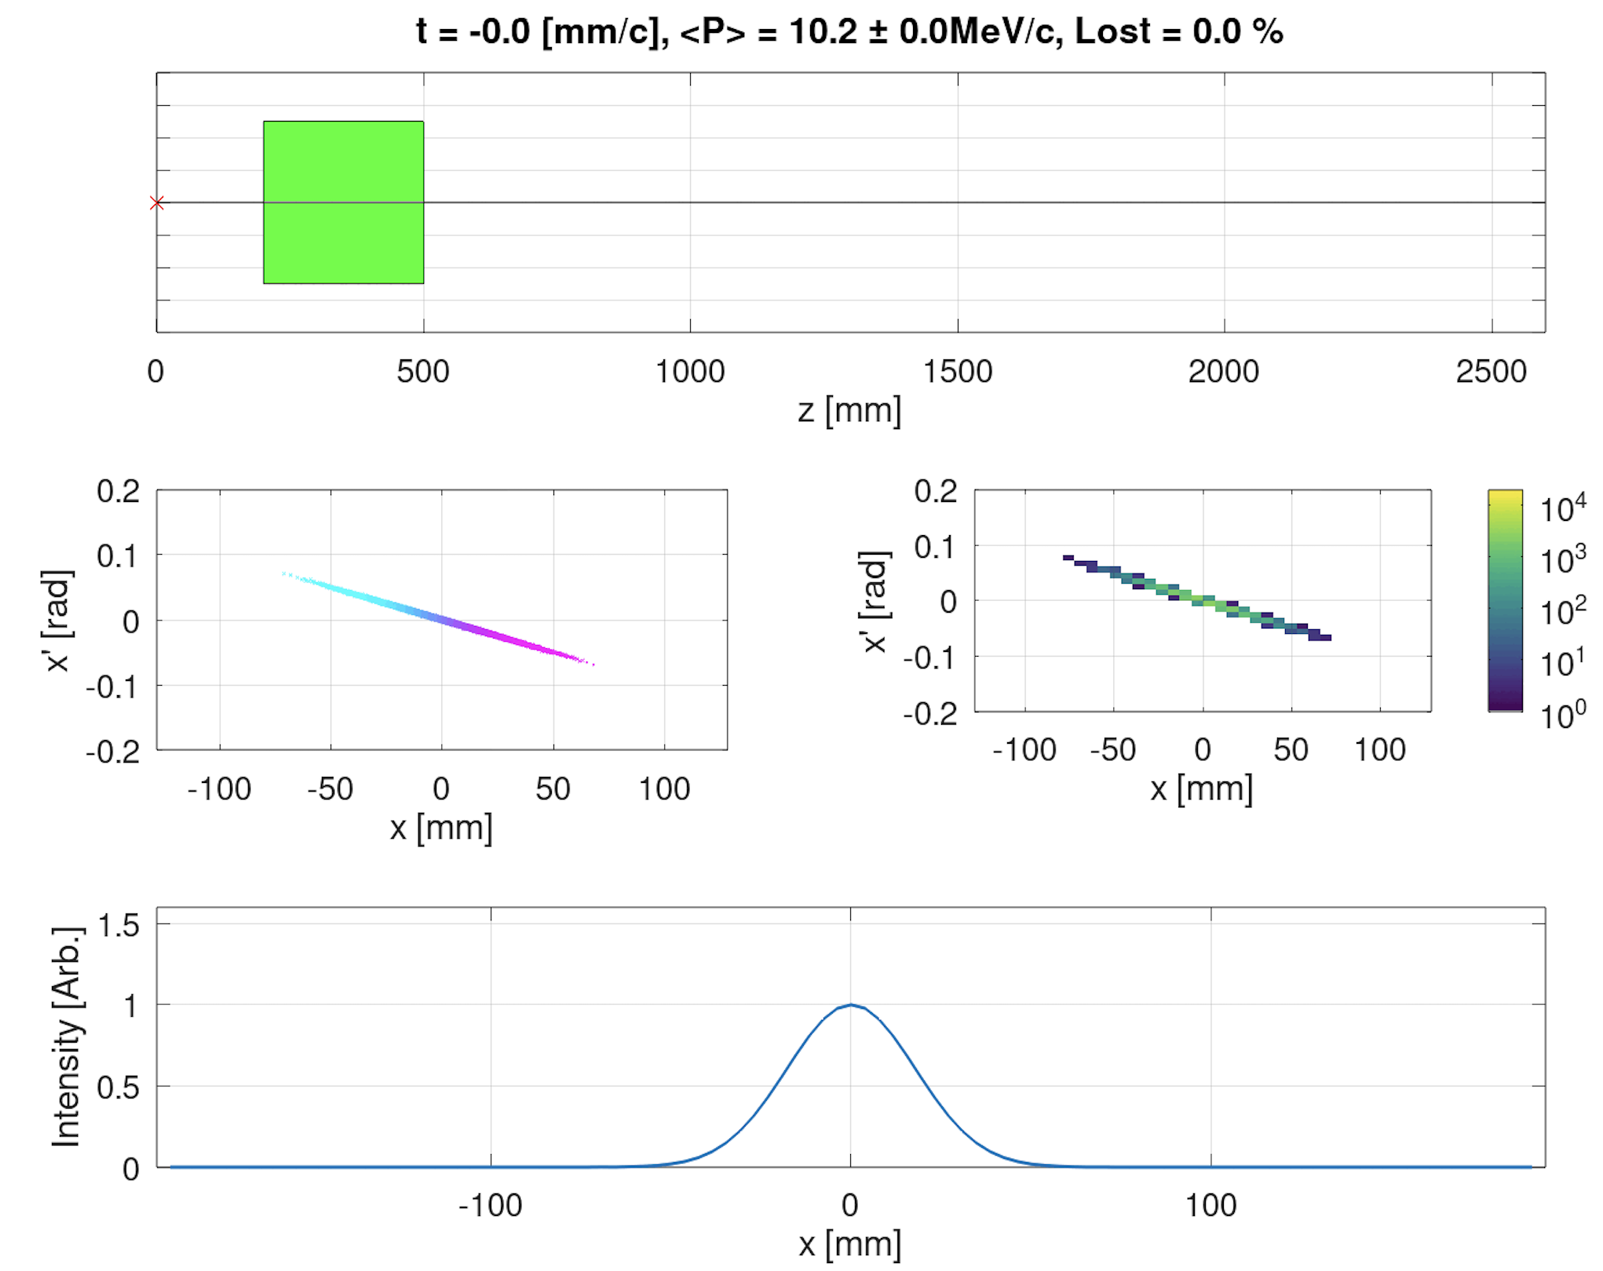
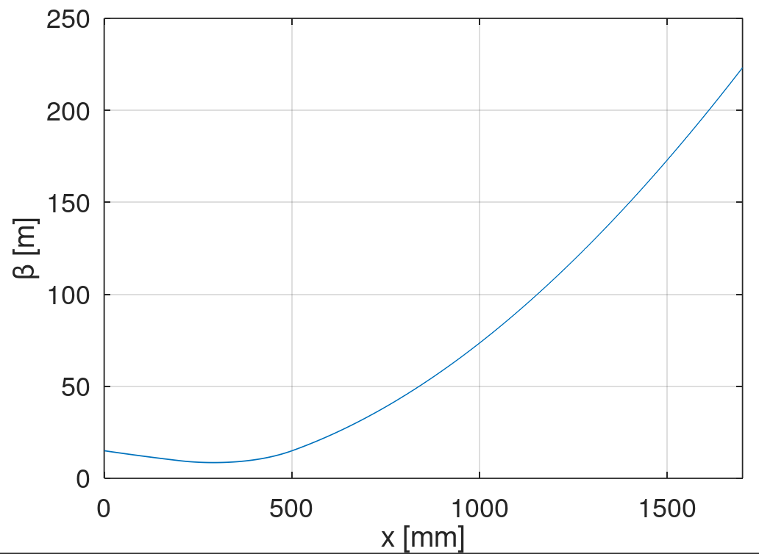

Investigate this with RF-Track
$$rt =\sqrt{2π}\sqrt{ε_{0}β_{0}}\left|cos\left(φ\right)\right|$$
Create a test beamline of $L$ = 1.7 m
  Initial conditions
  $p_{0}= 20 m_{e} \sim 10$MeV electrons
  $β_{0}=15$ m, $α_{0}=15$, $ε_{0}=21$ mm mrad
  Initially a 1D beam (only direction in x)!
  Add in a quadrupole to amplify $β$ and set $φ$~0
  $s_{q}$ = 0.2 m, $L_{q}$ = 0.3 m, $K_{q}=− 4.25$ m⁻¹
  So, obviously, Gaussian distribution goes to Gaussian…

Slide 7
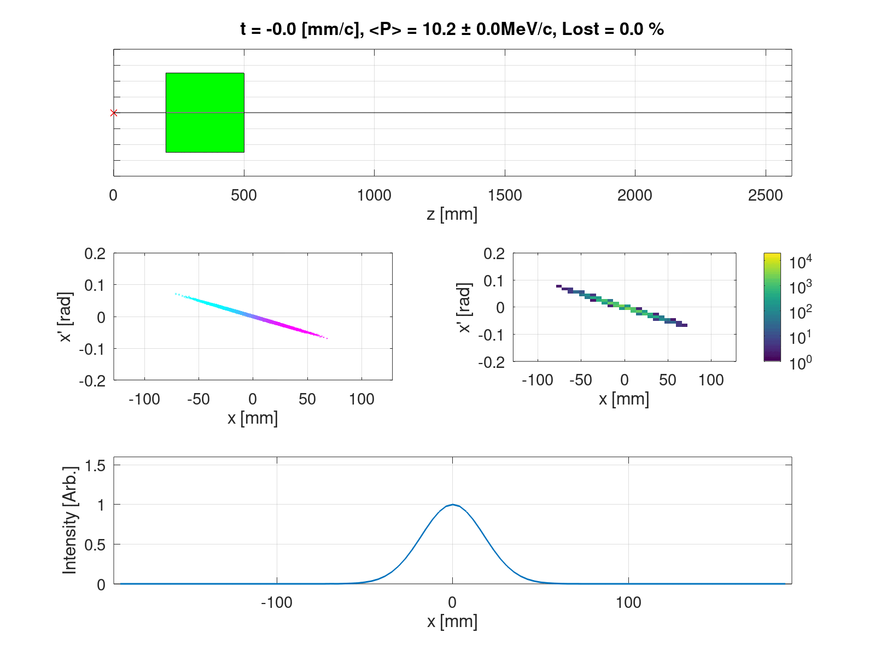
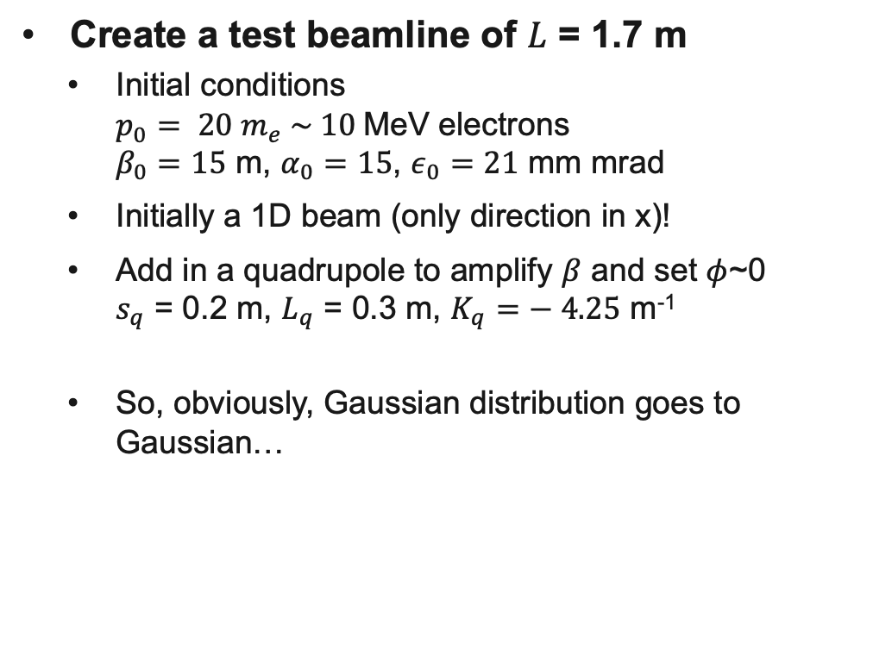
Investigate this with RF-Track
$$rt =\sqrt{2π}\sqrt{ε_{0}β_{0}}\left|cos\left(φ\right)\right|$$
Create a test beamline of $L$ = 1.7 m
  Initial conditions
  $p_{0}= 20 m_{e} \sim 10$MeV electrons
  $β_{0}=15$ m, $α_{0}=15$, $ε_{0}=21$ mm mrad
  Initially a 1D beam (only direction in x)!
  Add in a quadrupole to amplify $β$ and set $φ$~0
  $s_{q}$ = 0.2 m, $L_{q}$ = 0.3 m, $K_{q}=− 4.25$ m⁻¹
  So, obviously, Gaussian distribution goes to Gaussian…

Slide 8
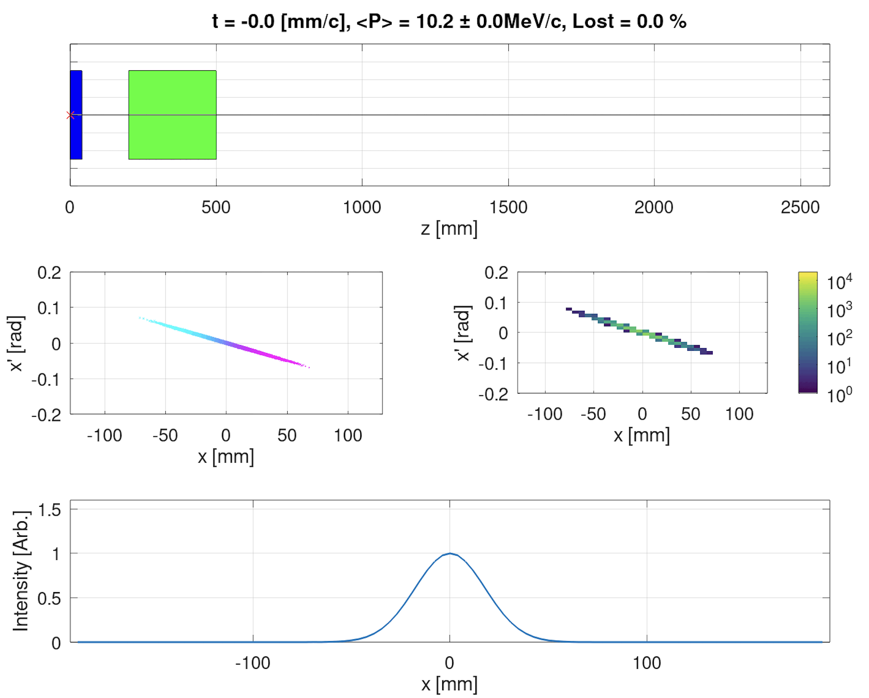
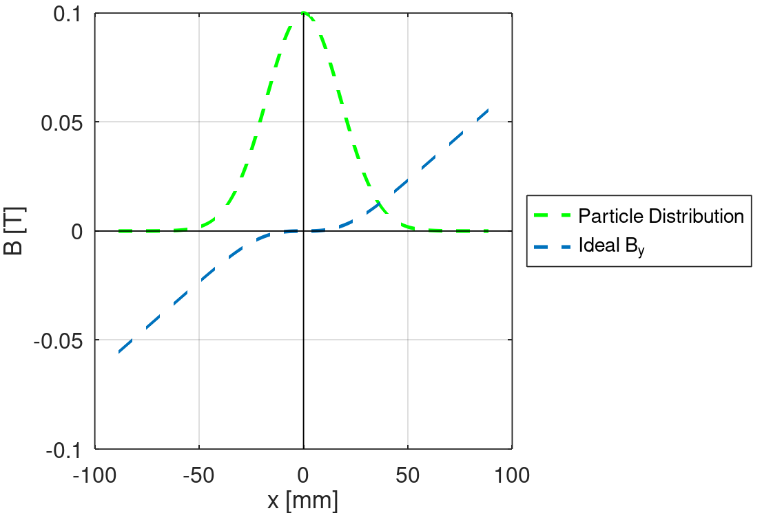


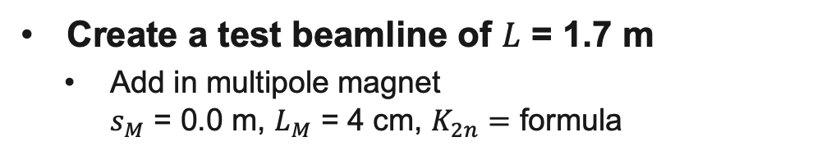
Ideal Multipole Magnet
$$K_{2n}=\frac{\left(n−2\right)!}{\left(\frac{n}{2}−1\right)!}\frac{{\left(−1\right)}^{\frac{n}{2}}}{{\left(2ε_{0}β_{0}\right)}^{\frac{n}{2}−1}}\frac{1}{β_{0}tan⁡(φ)};$$
Create a test beamline of $L$ = 1.7 m
  Add in multipole magnet
  $s_{M}$ = 0.0 m, $L_{M}$ = 4 cm, $K_{2n}=$ formula
Ideal field ($σ_{0}=17.75$ mm):

Slide 9
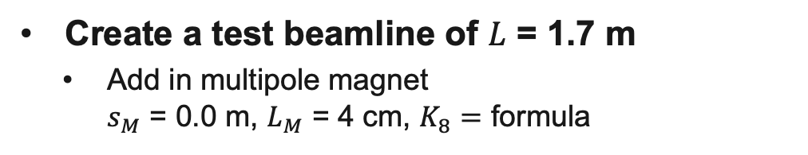
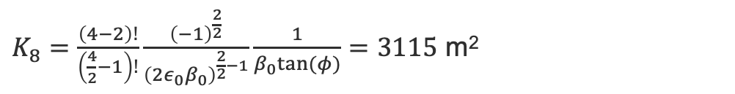
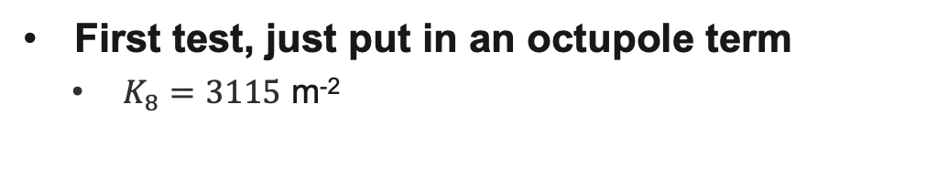
Just an octupole
$K_{8}=\frac{\left(4−2\right)!}{\left(\frac{4}{2}−1\right)!}\frac{{\left(−1\right)}^{\frac{2}{2}}}{{\left(2ε_{0}β_{0}\right)}^{\frac{2}{2}−1}}\frac{1}{β_{0}tan⁡(φ)}=3115$ m²
Create a test beamline of $L$ = 1.7 m
  Add in multipole magnet
  $s_{M}$ = 0.0 m, $L_{M}$ = 4 cm, $K_{8}=$ formula
First test, just put in an octupole term
  $K_{8}=3115$ m⁻²

Slide 10
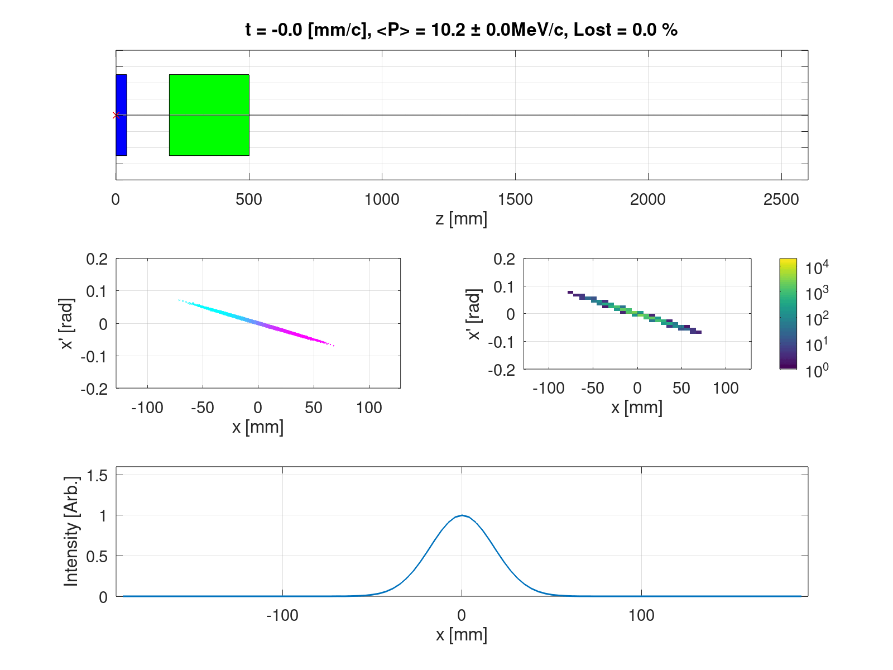
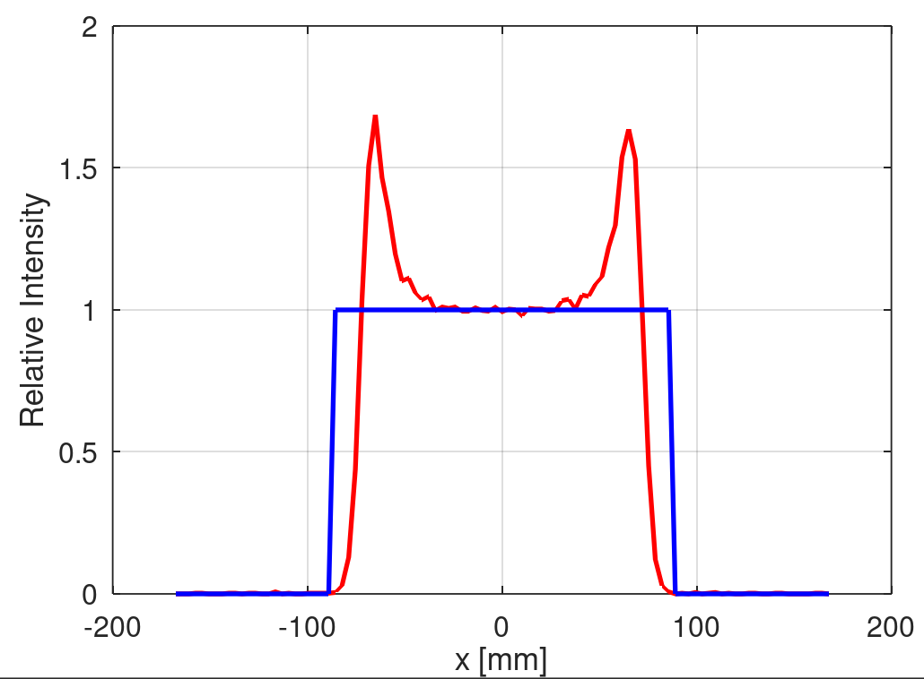
Just an octupole
$K_{8}=\frac{\left(4−2\right)!}{\left(\frac{4}{2}−1\right)!}\frac{{\left(−1\right)}^{\frac{2}{2}}}{{\left(2ε_{0}β_{0}\right)}^{\frac{2}{2}−1}}\frac{1}{β_{0}tan⁡(φ)}=3115$ m²
Create a test beamline of $L$ = 1.7 m
  Add in multipole magnet
  $s_{M}$ = 0.0 m, $L_{M}$ = 4 cm, $K_{8}=$ formula
First test, just put in an octupole term
  $K_{8}=3115$ m⁻²

Slide 11
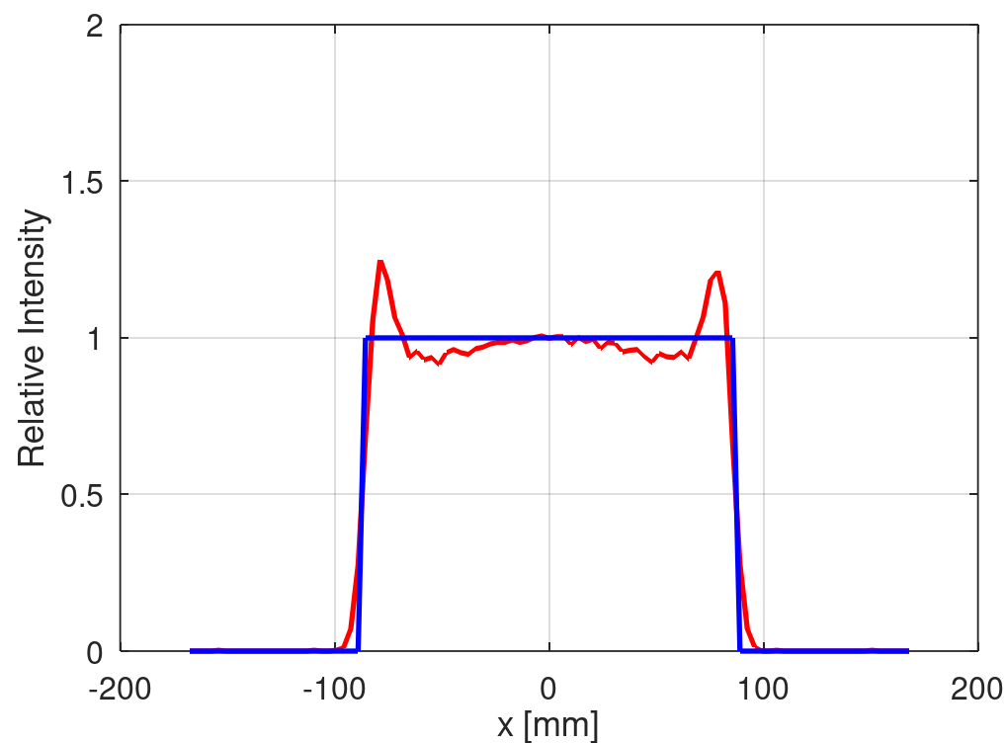
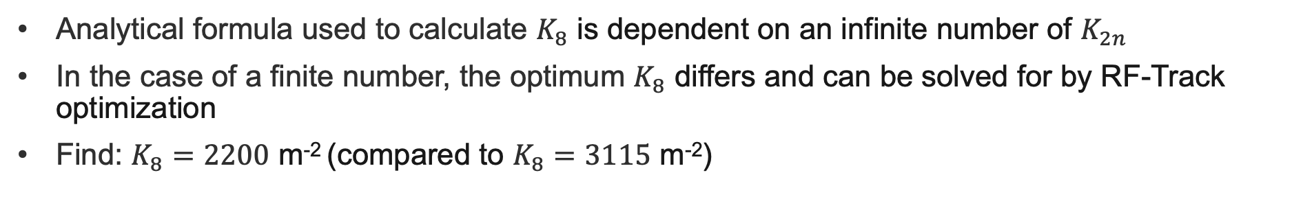
But we can get flatter with just octupole
Analytical formula used to calculate $K_{8}$ is dependent on an infinite number of $K_{2n}$
In the case of a finite number, the optimum $K_{8}$ differs and can be solved for by RF-Track optimization
Find: $K_{8}=2200$ m⁻² (compared to $K_{8}=3115$ m⁻²)

Slide 12
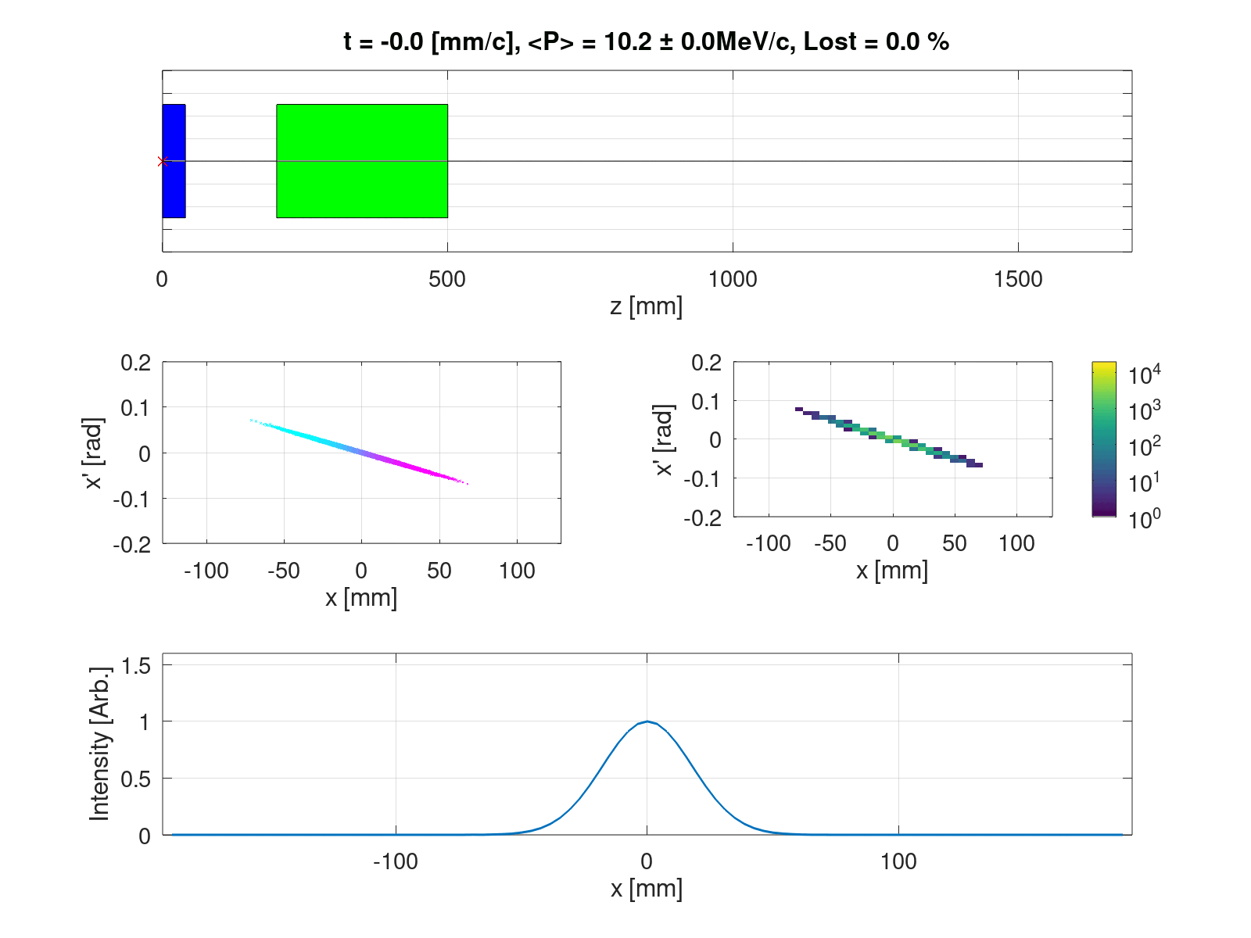
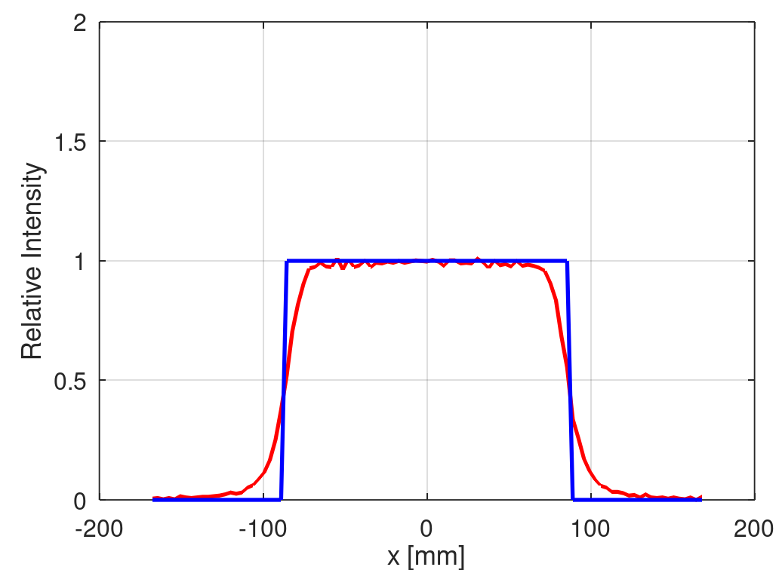
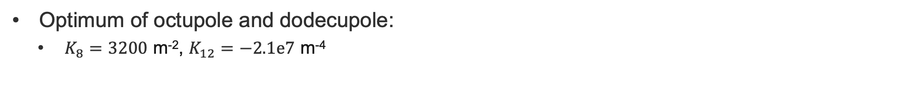
Let’s add more multipoles!
Optimum of octupole and dodecupole:
  $K_{8}=3200$ m⁻², $K_{12}=−2.1e7$ m⁻⁴

Slide 13
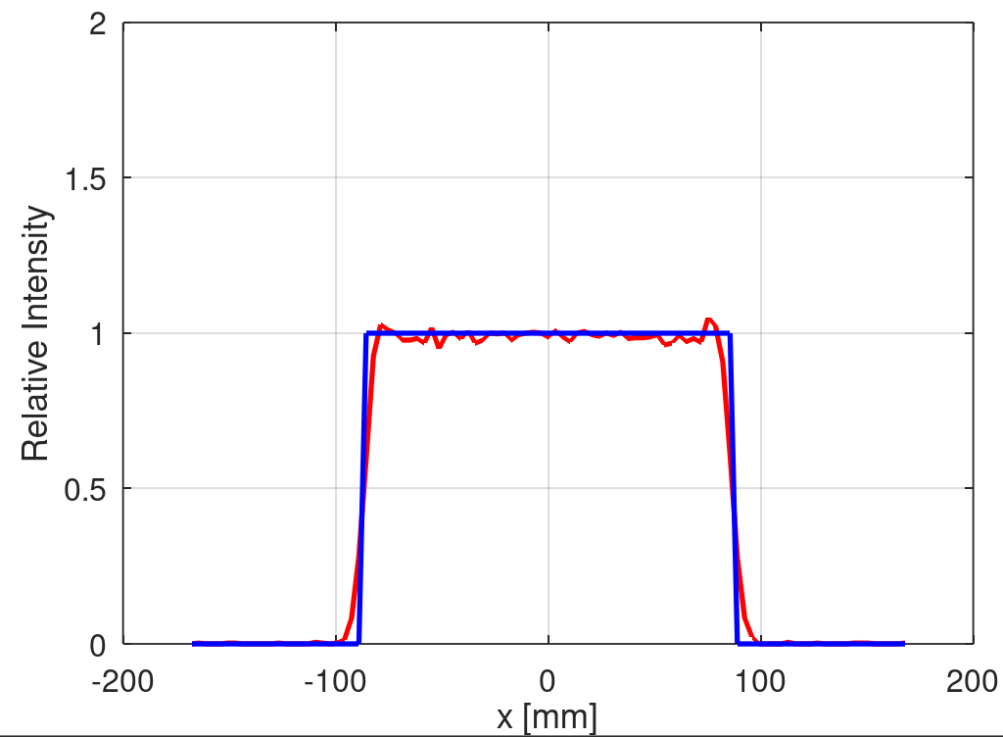
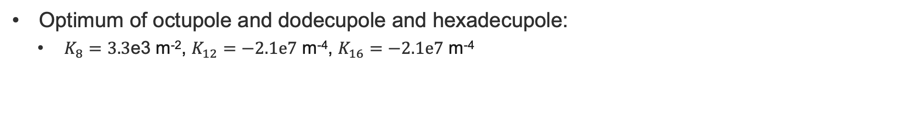
Let’s add more + more multipoles!
Optimum of octupole and dodecupole and hexadecupole:
  $K_{8}=3.3$e3 m⁻², $K_{12}=−2.1e7$ m⁻⁴, $K_{16}=−2.1e7$ m⁻⁴

Slide 14
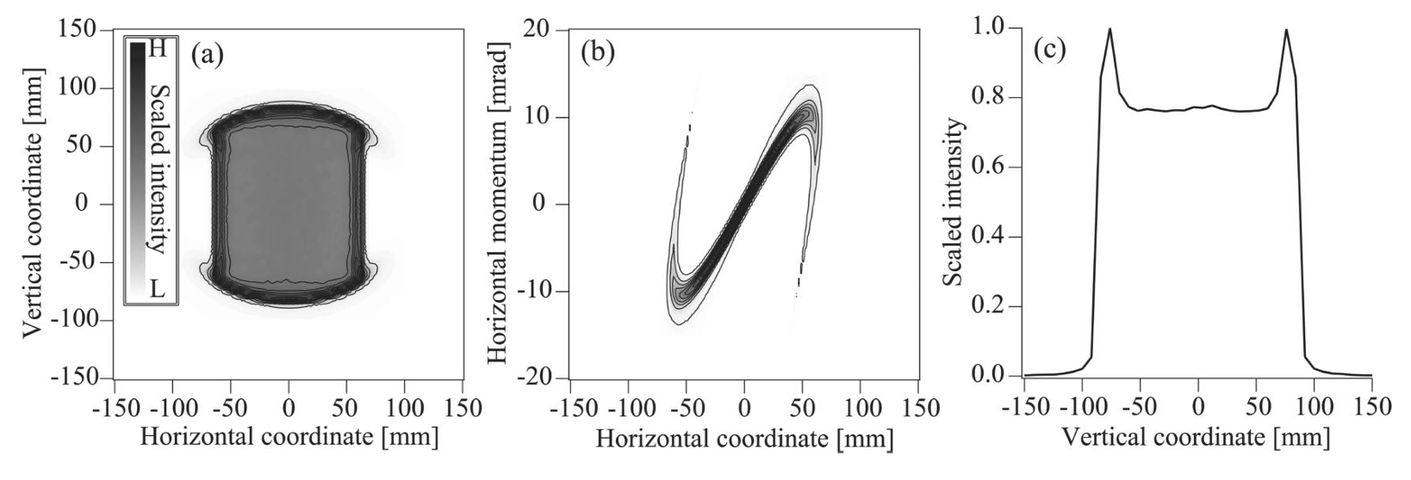
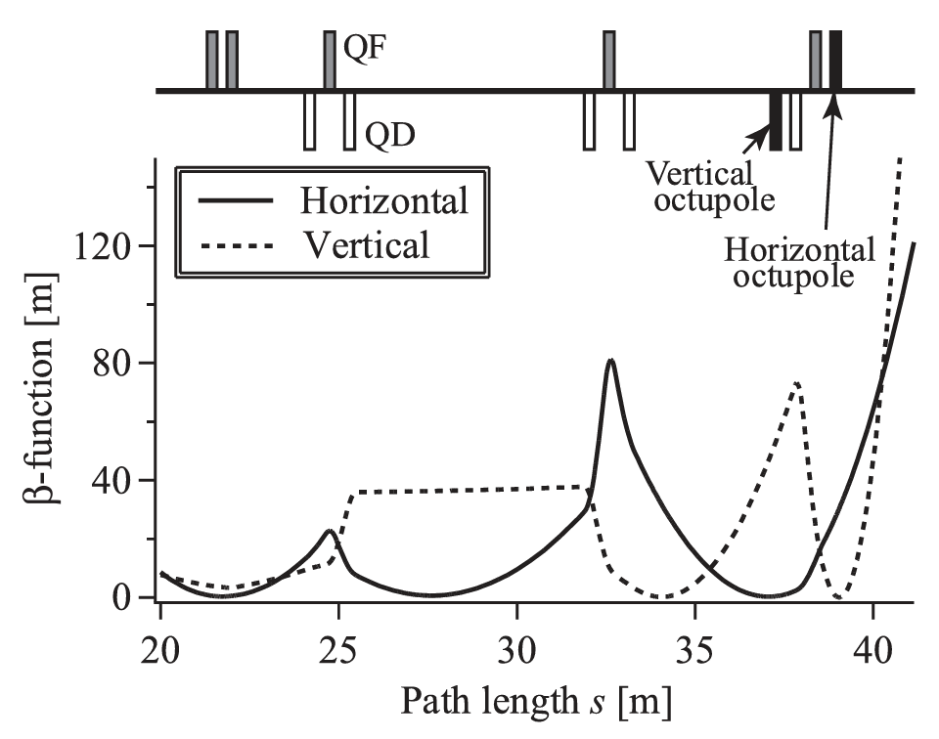
Conclusion from Magnet Study
Analytical prediction + RF-Track optimization works well
More multipoles = flatter beam
  BUT octupole + dodecupole + higher order magnetic fields are hard to incorporate in practice
For 2D flat beam, need two minima to place two multipole magnets
  This has been shown to work experimentally with octupoles - see right
  Horns can be collimated but lose charge
How about using RF cavities instead…?

Slide 15
Table of Contents
Making a Uniform Beam with Magnetic Fields
Making a Uniform Beam with RF Cavity Fields
Realising and Implementing a “Uniformiser” RF Cavity
Other Transverse Beam Shaping with RF Cavities
Next Steps and Discussions

Slide 16
RF Cavity Instead
RF cavity use not just limited to accelerating beams in the longitudinal direction
Also use to transversely deflect/kick/rotate/focus a particle beam
So let’s explore using it instead of the multipolar magnet
RF cavity

Slide 17
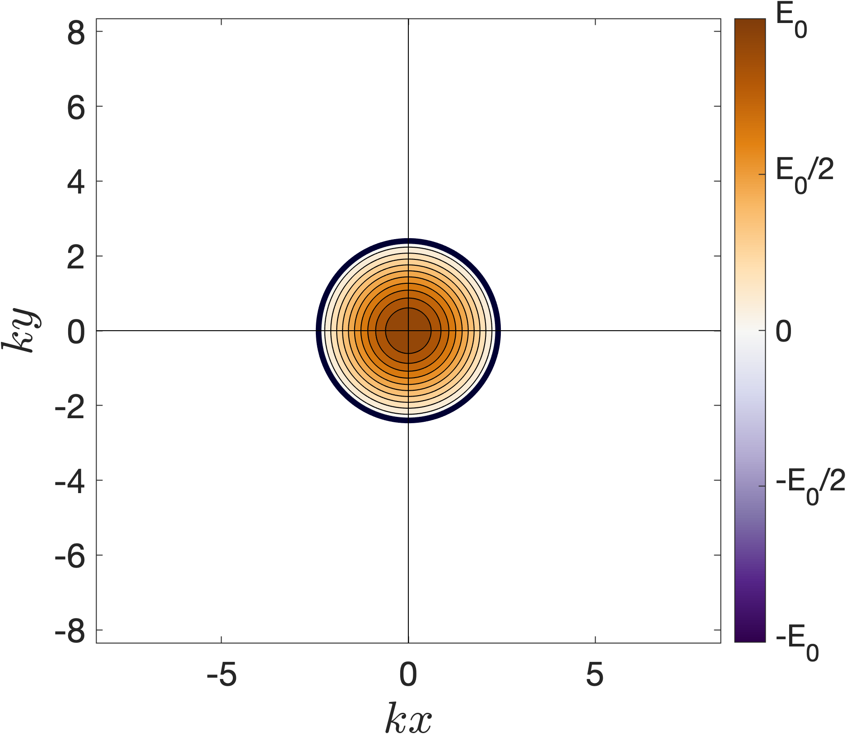
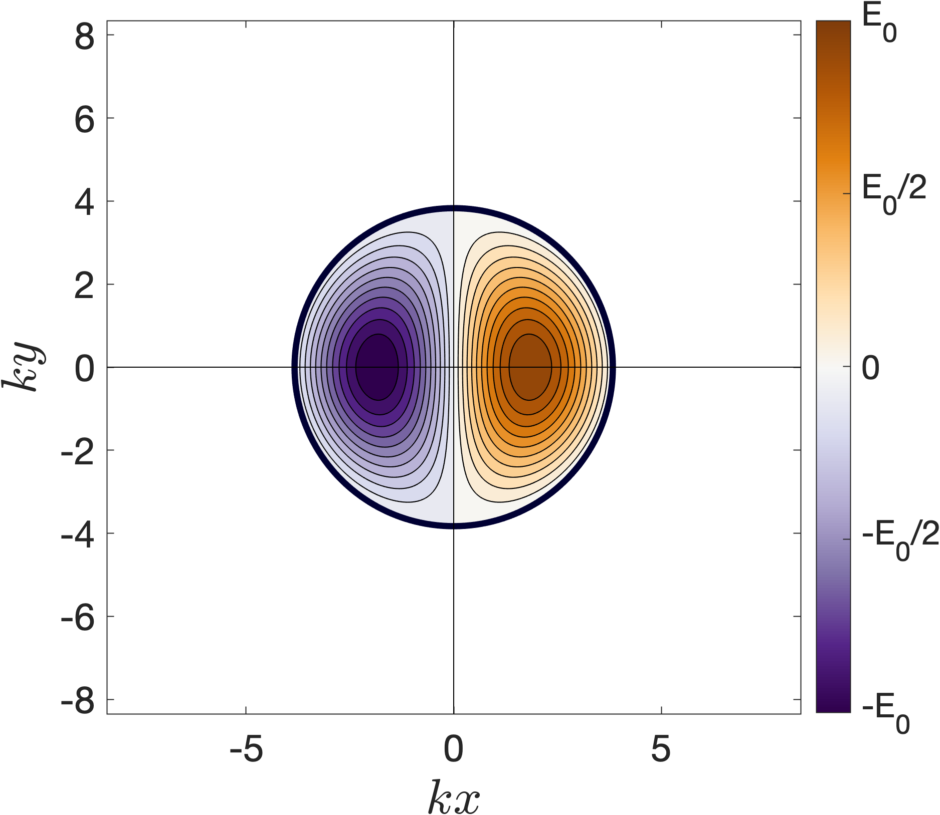
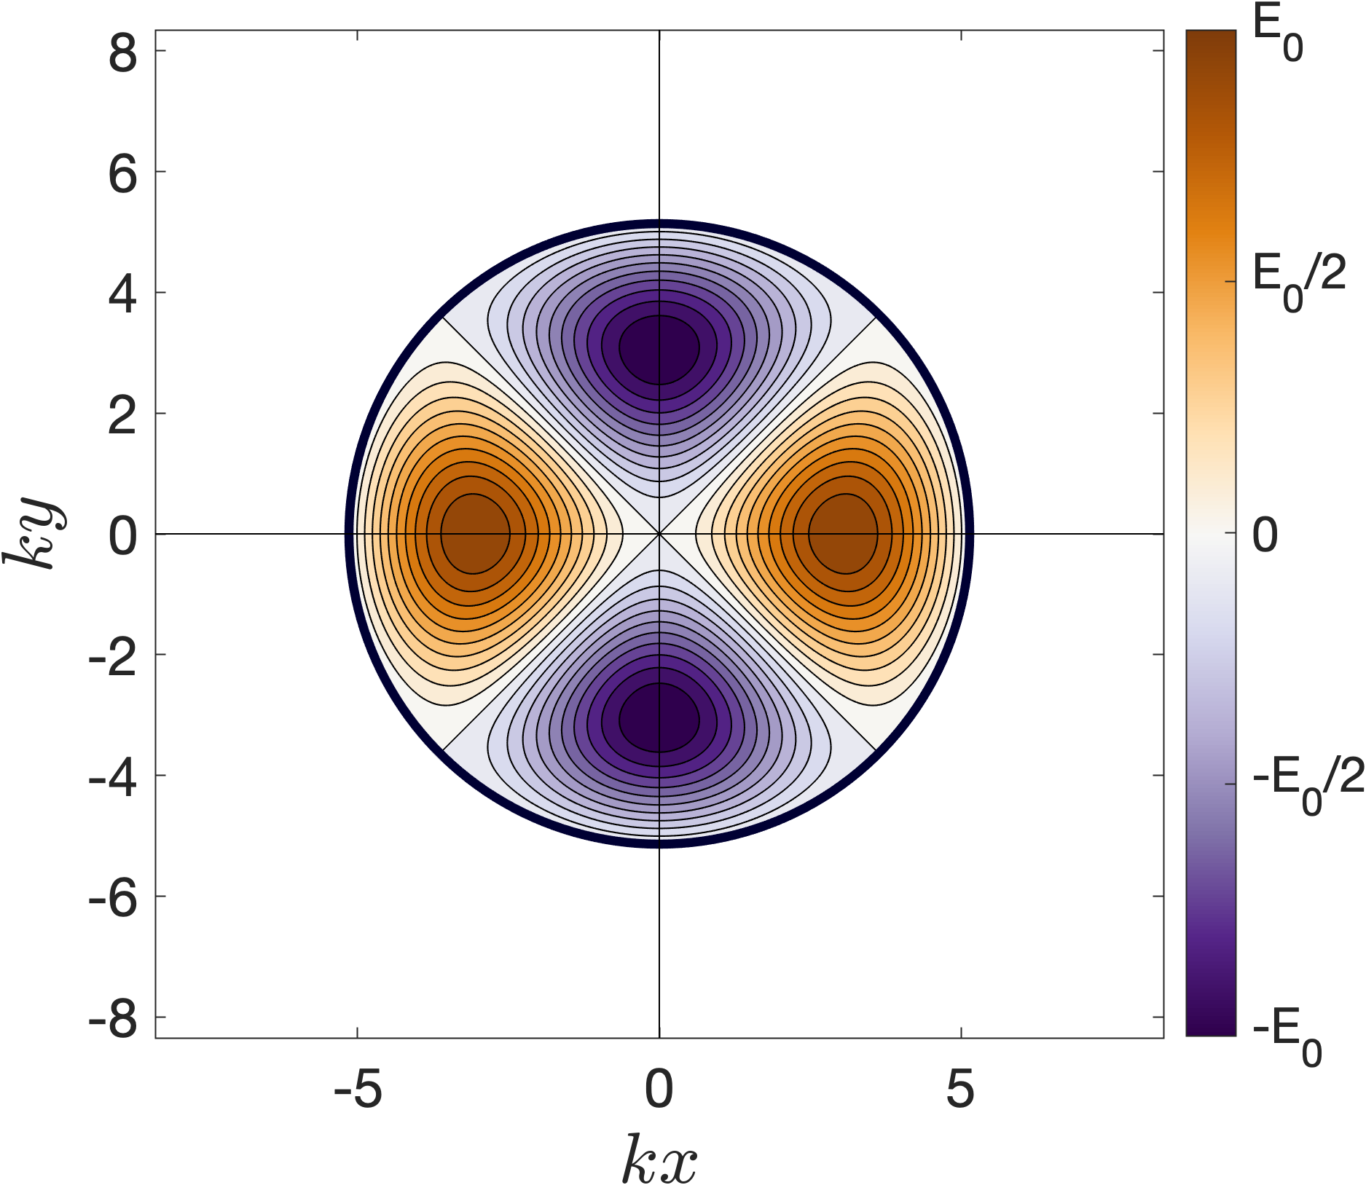
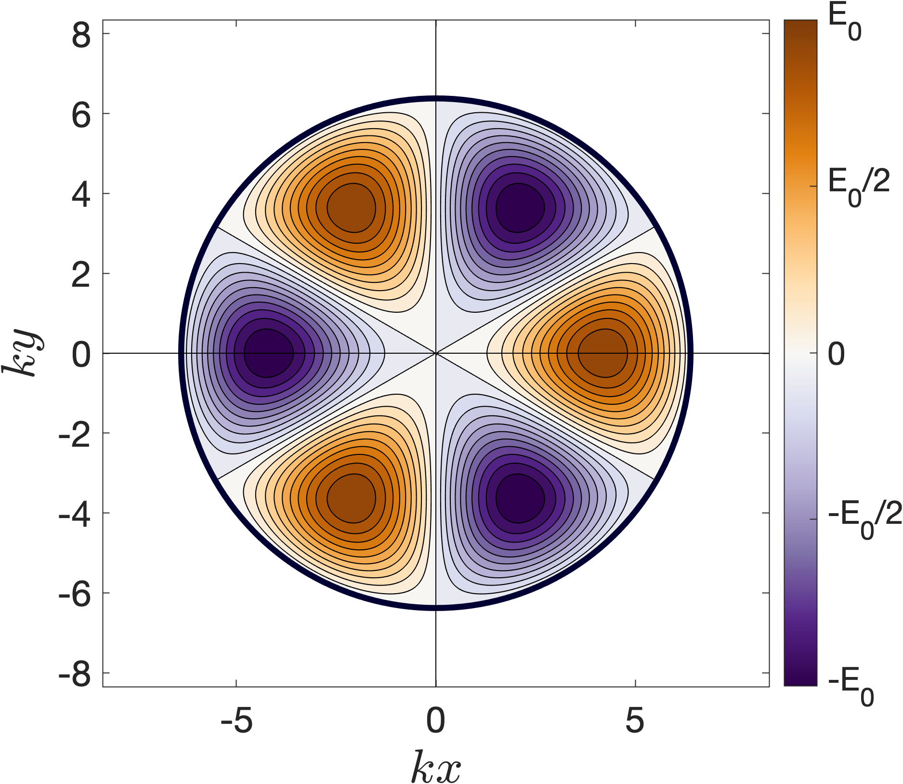
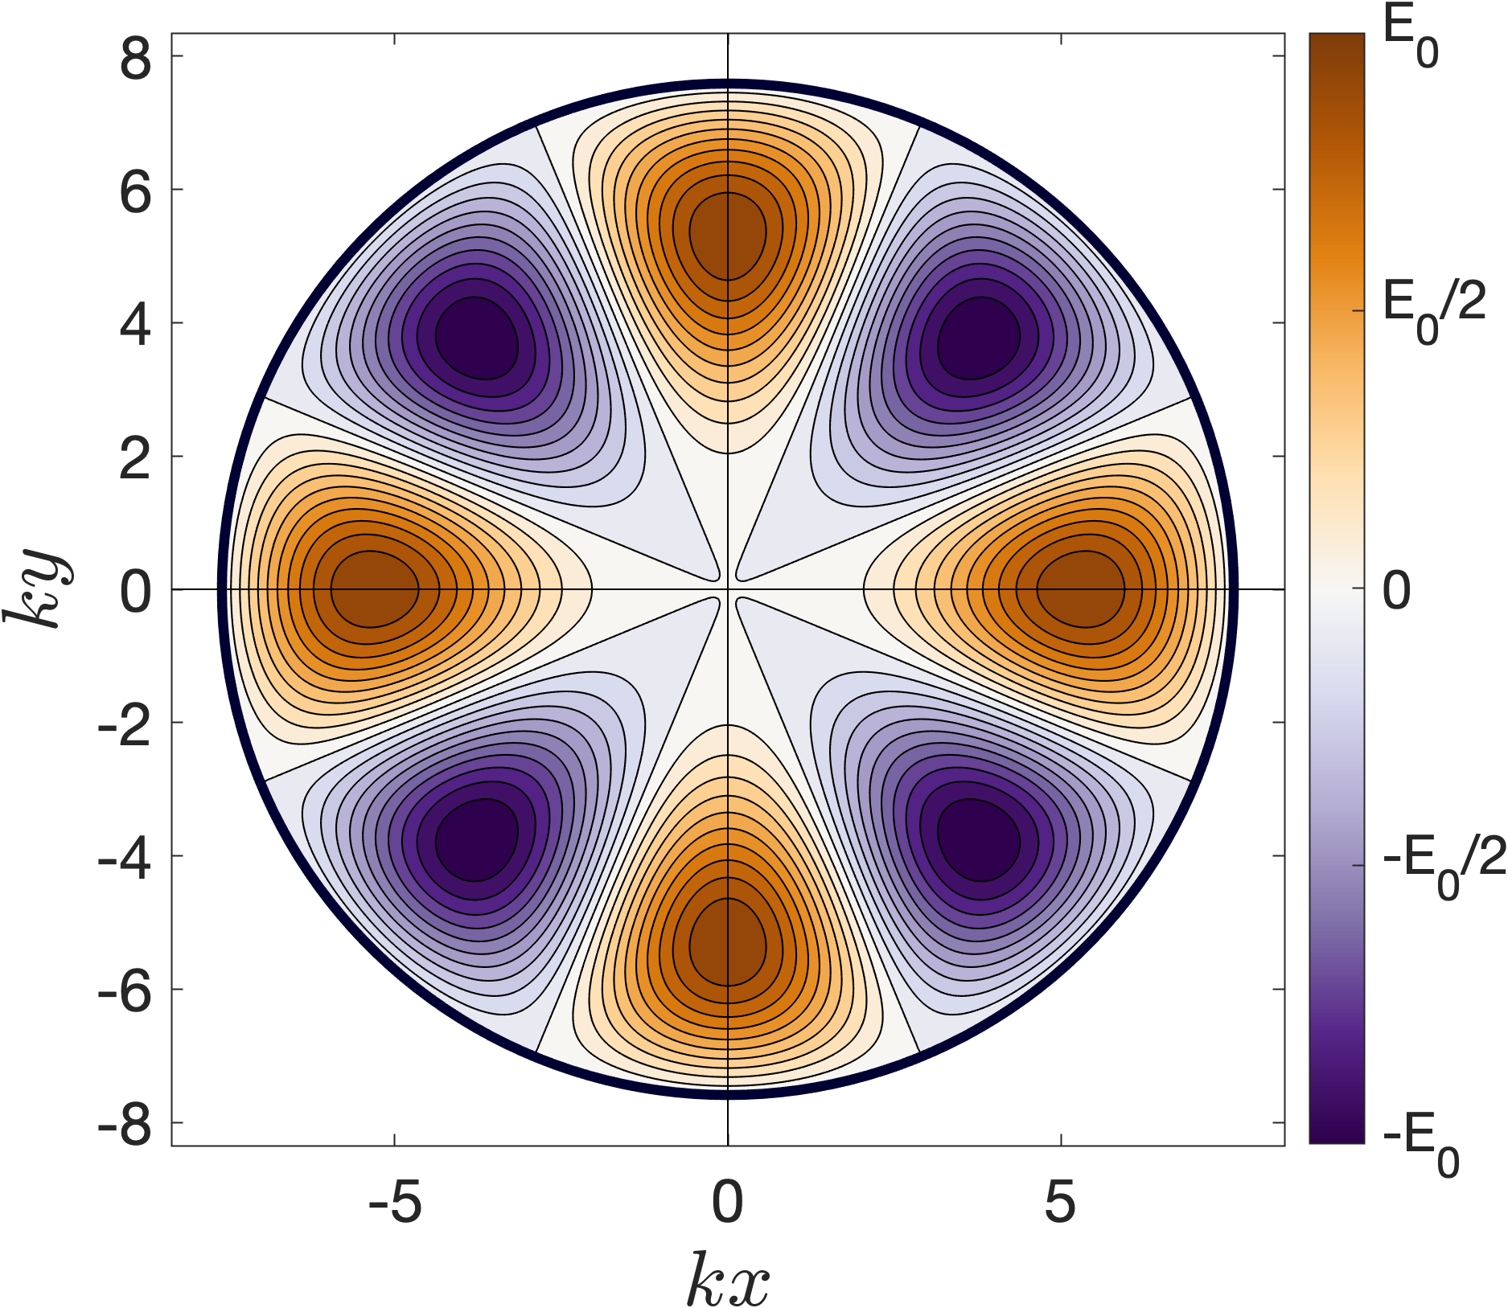
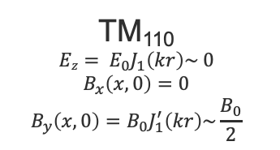
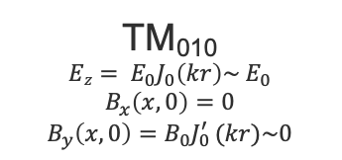
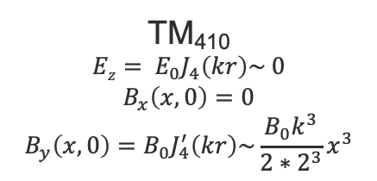
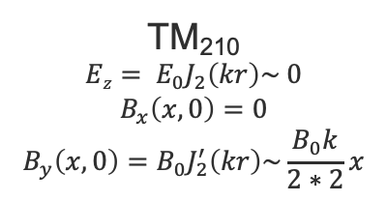
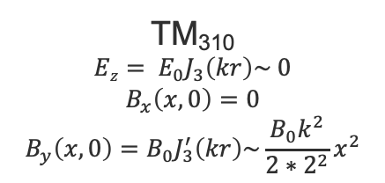
How? Look at pillbox cavity
RF cavity pillbox supports TM_{mnp} modes (and also TE_{mnp} – discussed later)
  m = azimuthal order
  n = radial order
  p = longitudinal order
TM₁₁₀
$$Ez= E_{0}J_{1}\left(kr\right)\sim 0$$
$$B_{x}\left(x,0\right)=0$$
$$B_{y}\left(x,0\right)=B_{0}J_{1}^{′}\left(kr\right)\sim \frac{B_{0}}{2}$$
TM₂₁₀
$$Ez= E_{0}J_{2}\left(kr\right)\sim 0$$
$$B_{x}\left(x,0\right)=0$$
$$B_{y}\left(x,0\right)=B_{0}J_{2}^{′}\left(kr\right)\sim \frac{B_{0}k}{2∗2}x$$
TM₄₁₀
$$Ez= E_{0}J_{4}\left(kr\right)\sim 0$$
$$B_{x}\left(x,0\right)=0$$
$$B_{y}\left(x,0\right)=B_{0}J_{4}^{′}\left(kr\right)\sim \frac{B_{0}k^{3}}{2∗2^{3}}x^{3}$$
TM₀₁₀
$$Ez= E_{0}J_{0}\left(kr\right)\sim E_{0}$$
$$B_{x}\left(x,0\right)=0$$
$$B_{y}\left(x,0\right)=B_{0}J_{0 }^{′}(kr)\sim 0$$
TM₃₁₀
$$Ez= E_{0}J_{3}\left(kr\right)\sim 0$$
$$B_{x}\left(x,0\right)=0$$
$$B_{y}\left(x,0\right)=B_{0}J_{3}^{′}\left(kr\right)\sim \frac{B_{0}k^{2}}{2∗2^{2}}x^{2}$$

Slide 18
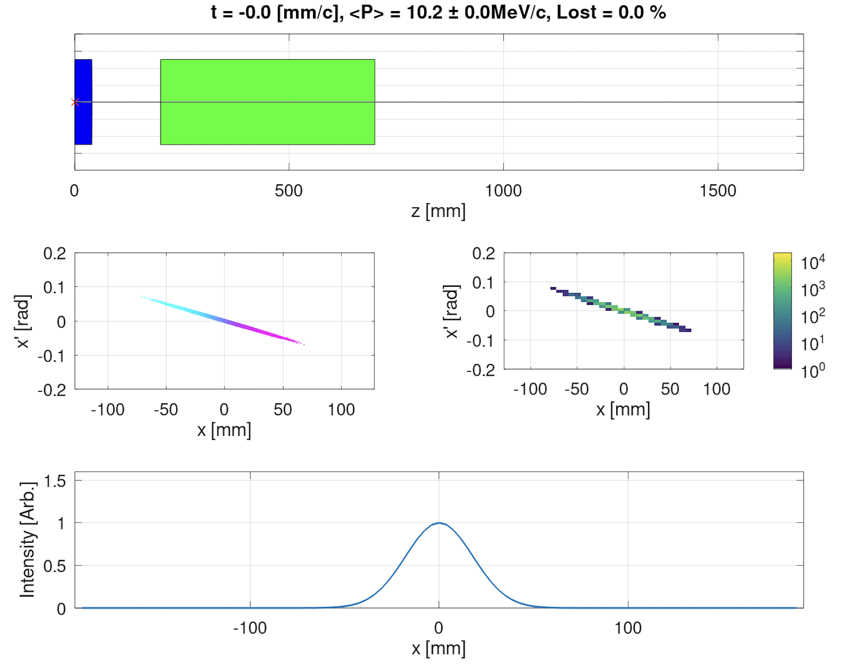
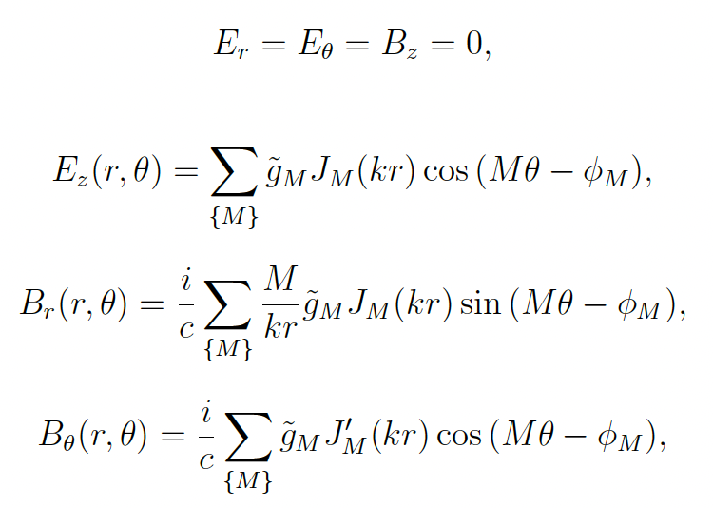

Tests with RF cavity fields
Same test beamline as before but..
  Add in multipolar RF cavity field
  $s_{M}$ = 0.0 m, $L_{RF}$ = 4 cm, ${\tilde{g}}_{M}=$ formula | optimized
  Fields as per below. Assume a static field with
  $k=\frac{ω}{c}=\frac{2πf}{c},=62.9$m⁻¹ ($f=3$GHz)

Slide 19
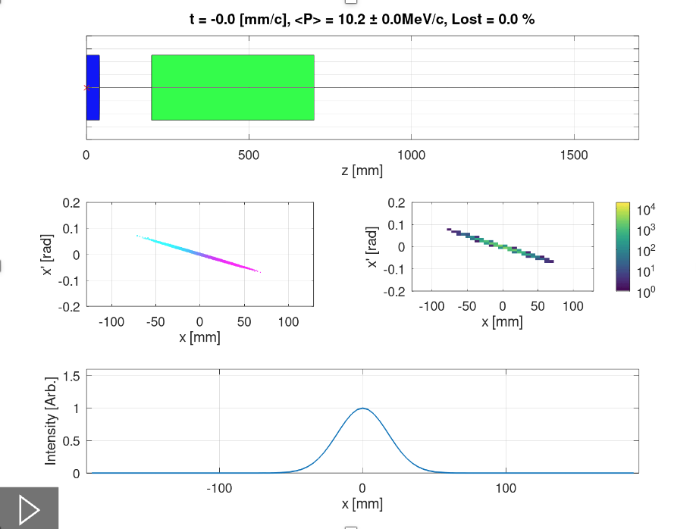
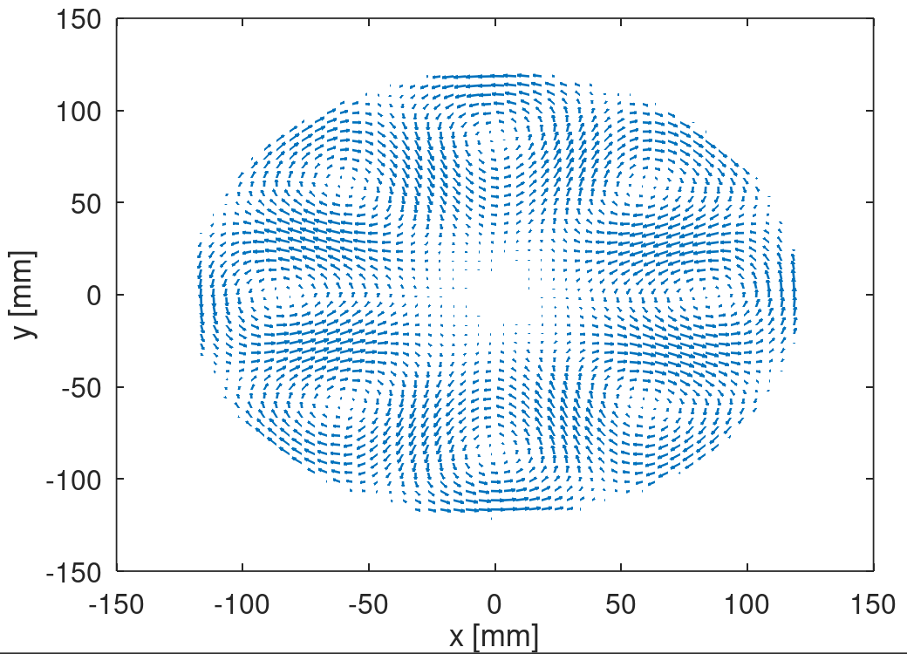


First Test - TM₄₁₀ mode
$$B_{r}\left(r,θ\right)=\frac{i}{c}{\tilde{g}}_{4}\frac{4}{kr}J_{4}\left(kr\right)sin\left(4θ\right)$$
$$B_{θ}\left(r,θ\right)=\frac{i}{c}{\tilde{g}}_{4}J_{4}^{′}(kr)\cos{(4θ)}$$

Slide 20
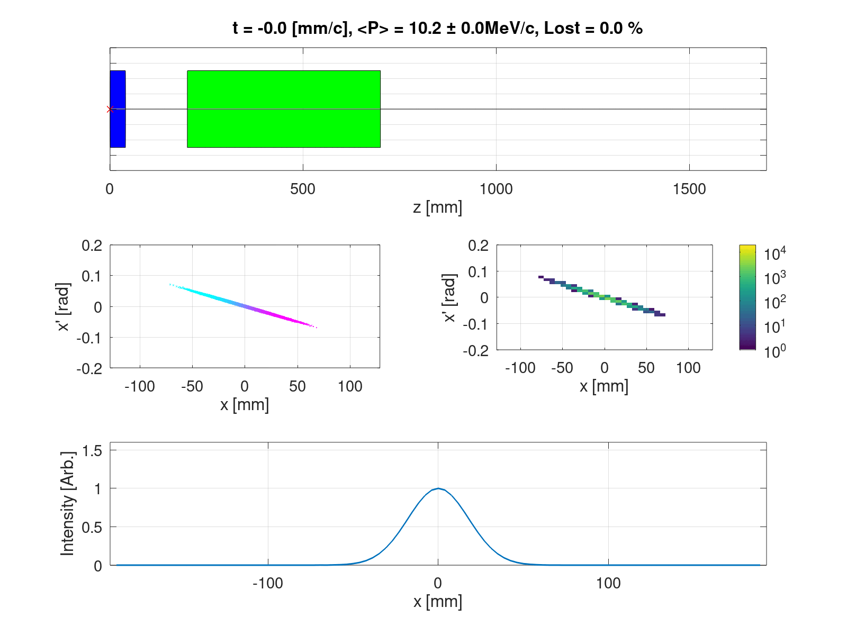
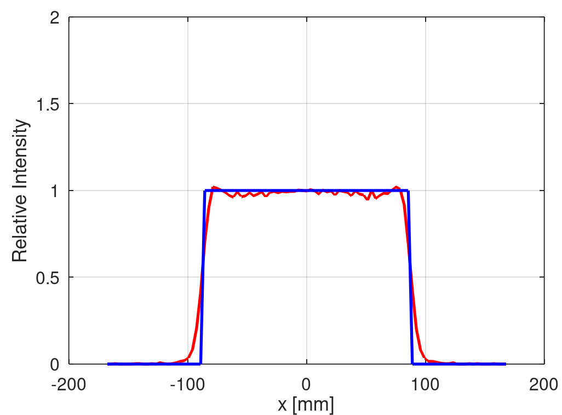
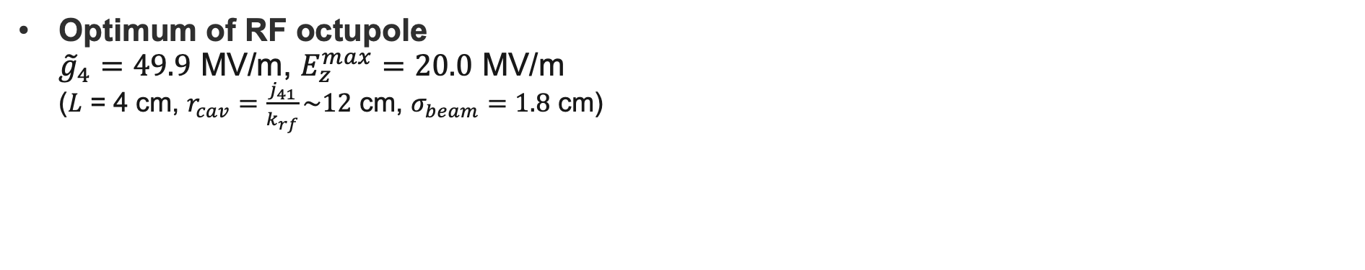
Just use an RF octupole - TM₄₁₀ mode
Optimum of RF octupole
${\tilde{g}}_{4}=49.9$ MV/m, $E_{z}^{max}=20.0$ MV/m
($L$ = 4 cm, $r_{cav}=\frac{j_{41}}{k_{rf}}\sim 12$ cm, $σ_{beam}=1.8$ cm)

Slide 21
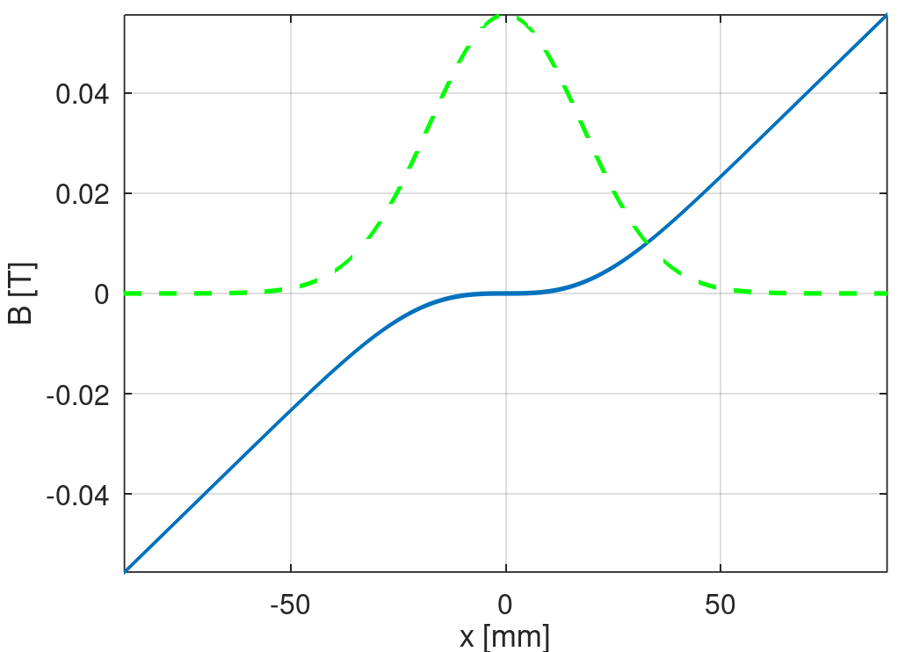
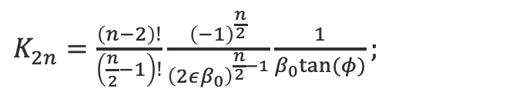
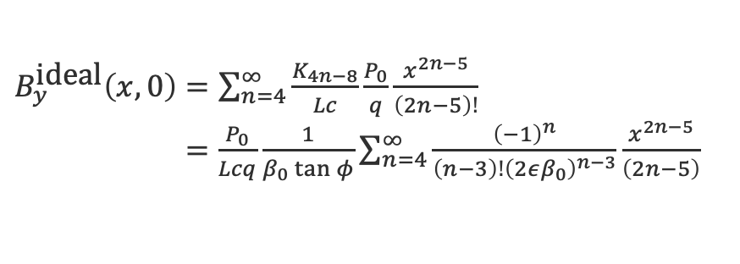
Why so much better than magnetic octupole?
Ideal magnetic field looks as follows
$K_{2n}^{ }=\frac{\left(n−2\right)!}{\left(\frac{n}{2}−1\right)!}\frac{{\left(−1\right)}^{\frac{n}{2}}}{{\left(2εβ_{0}\right)}^{\frac{n}{2}−1}}\frac{1}{β_{0}tan⁡(φ)};$
σ
$B_{y}^{\text{ideal}}\left(x,0\right)=\sum_{n=4}^{∞}{\frac{K_{4n−8}}{Lc}}\frac{P_{0}}{q}\frac{x^{2n−5}}{\left(2n−5\right)!}$
$=\frac{P_{0}}{Lcq}\frac{1}{β_{0}\tan{φ}}\sum_{n=4}^{∞}{\frac{{\left(−1\right)}^{n}}{\left(n−3\right)!{\left(2εβ_{0}\right)}^{n−3}}}\frac{x^{2n−5}}{\left(2n−5\right)}$

Slide 22
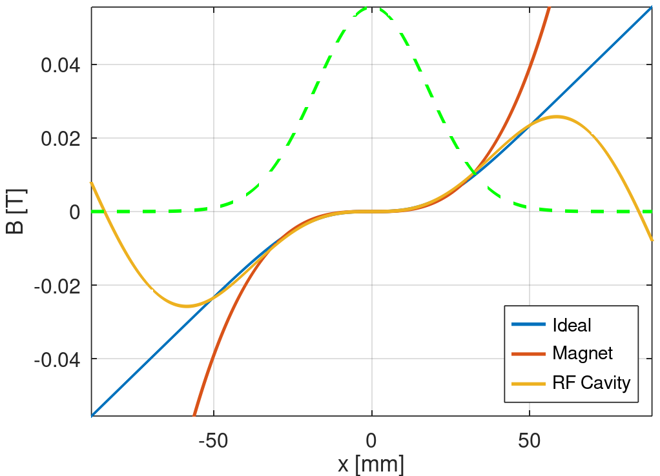

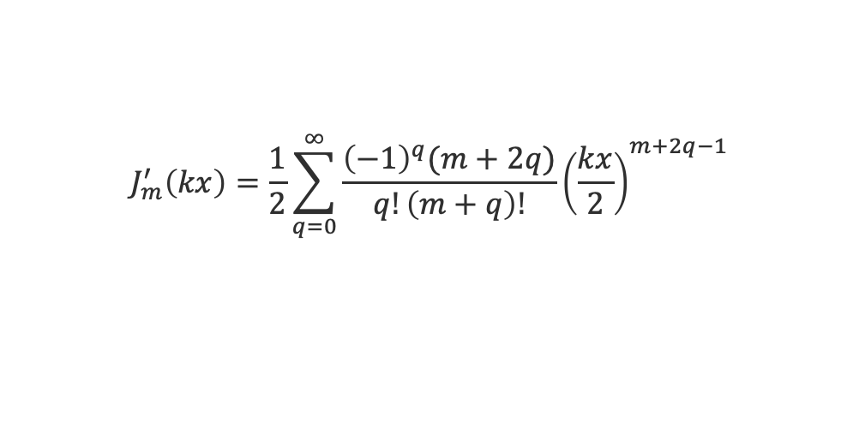
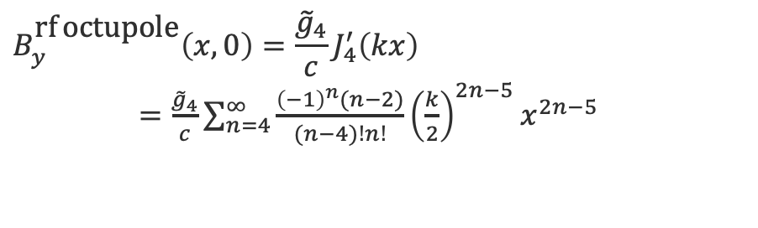

Why so much better than magnetic octupole?
Comparing the RF octupolar field to the magnetic octupole field
$B_{y}^{\text{ideal}}\left(x,0\right)=\frac{P_{0}}{Lcq}\frac{1}{β_{0}\tan{φ}}\sum_{n=4}^{∞}{\frac{{\left(−1\right)}^{n}}{\left(n−3\right)!{\left(2εβ_{0}\right)}^{n−3}}}\frac{x^{2n−5}}{\left(2n−5\right)}$
$B_{y}^{\text{magnet} \text{octupole}}\left(x,0\right)=\frac{P_{0}}{Lcq}K_{8}^{∗}\frac{x^{3}}{3!}$
$$J_{m}^{′}\left(kx\right)=\frac{1}{2}\sum_{q=0}^{∞}{\frac{{\left(−1\right)}^{q}(m+2q)}{q!\left(m+q\right)!}{\left(\frac{kx}{2}\right)}^{m+2q−1}}$$
$$B_{y}^{\text{rf} \text{octupole}}\left(x,0\right)=\frac{{\tilde{g}}_{4}}{c}J_{4}^{′}\left(kx\right)$$
$=\frac{{\tilde{g}}_{4}}{c}\sum_{n=4}^{∞}{\frac{{\left(−1\right)}^{n}(n−2)}{(n−4)!n!}}{\left(\frac{k}{2}\right)}^{2n−5}x^{2n−5}$

Slide 23





Why so much better than magnetic octupole?
$B_{y}^{\text{ideal}}\left(x,0\right)=\frac{P_{0}}{Lcq}\frac{1}{β_{0}\tan{φ}}\sum_{n=4}^{∞}{\frac{{\left(−1\right)}^{n}}{\left(n−3\right)!{\left(2εβ_{0}\right)}^{n−3}}}\frac{x^{2n−5}}{\left(2n−5\right)}$
$B_{y}^{\text{ideal}}$ series dependent on $\frac{{\left(−1\right)}^{n}}{{(2n−5)\left(n−3\right)!\left(εβ_{0}\right)}^{n−3}}$
$B_{y}^{\text{rf} \text{octupole}}$ series dependent on $\frac{{\left(−1\right)}^{n}(n−2)}{\left(n−4\right)!n!}{\left(\frac{k}{2}\right)}^{2n−5}$
$B_{y}^{\text{rf} \text{octupole}}\left(x,0\right)$ $=\frac{{\tilde{g}}_{4}}{c}\sum_{n=4}^{∞}{\frac{{\left(−1\right)}^{n}(n−2)}{(n−4)!n!}}{\left(\frac{k}{2}\right)}^{2n−5}x^{2n−5}$
We have freedom of choice in $ε, β_{0}, k$
  $k$ scales the radial variation in Bessel function, $ε \& β_{0}$ scale the beam size
In the perfect (obviously impossible) case, the ratio being 1 for all $n$ would ensure
$B_{y}^{\text{rf} \text{octupole}}$ = $B_{y}^{\text{ideal}}$
In any case, there is a clear dependence of the flatness of the beam that can be achieved with just an rf octupole, depending on the interplay of $ε, β_{0}, k$

Slide 24











f = 300 MHz
$({\tilde{g}}_{4}=33.9$ GV/m)
f = 3 GHz
(${\tilde{g}}_{4}=49.9$ MV/m)
f = 6 GHz
(${\tilde{g}}_{4}=7.0$ MV/m)
x^3 ratio is too strong relative to others
x^3 ratio is just right relative to others
x^3 ratio is too weak relative to others

Slide 25




Method 1: Optimising $ε, β_{0}, k$ for maximal flatness in the TM₄₁₀ mode
RF-Track to use $k$ as an optimizing variable, as well as ${\tilde{g}}_{4}$
(Practically, would fix $k$ and vary $β_{0}$ but simpler analysis here doing opposite)
For the test beam line, find the optimum to be:
$E_{z}^{peak}=$ 18.3 MV/m
${\tilde{g}}_{4}=4.60$e7 V/m
$f$ = 3.12 GHz
Already very close!

Slide 26









Method 2: Adding additional multipoles to refine the flatness in a TM_{{4,6,8,…}10} mode
$K_{2n}=\frac{\left(n−2\right)!}{\left(\frac{n}{2}−1\right)!}\frac{{\left(−1\right)}^{\frac{n}{2}}}{{\left(2ε_{0}β_{0}\right)}^{\frac{n}{2}−1}}\frac{1}{β_{0}tan⁡(φ)};$
To create uniformizing field, we need magnetic field like:
So we need an RF cavity that supports a TM_{{4,6,8,10,12,…}n0} mode. How?
Method exists for doing so…! Change the cavity cross-section
Fully described in PhD thesis, here examples:
$\frac{g_{2}}{g_{0}}$ = 0.5
$\frac{g_{2}}{g_{0}}$ = 5
  $\frac{g_{2}}{g_{0}}$ = 20

Slide 27







Method 2: Adding additional multipoles to refine the flatness in a TM_{{4,6,8,…}10} mode
To illustrate, use f = 300 MHz case where RF octupole is not so well-matched
$E_{z}^{peak}=$ 13.5 GV/m
${\tilde{g}}_{4}=3.4$e10 V/m
$E_{z}^{peak}=$ 4.2 TV/m
${\tilde{g}}_{4}=4.4$e10 V/m
${\tilde{g}}_{6}=−1.7$e13 V/m
$E_{z}^{peak}=$ 14 GV/m
${\tilde{g}}_{4}=3.3$e10 V/m
${\tilde{g}}_{6}=−1.1$e10 V/m
${\tilde{g}}_{8}=3.8$e10 V/m
$E_{z}^{peak}=$ 5.1 TV/m
${\tilde{g}}_{4}=$4.4e10 V/m
${\tilde{g}}_{6}=−$1.7e13 V/m
${\tilde{g}}_{8}=3.0$e12 V/m
${\tilde{g}}_{10}=1.8$e12 V/m

Slide 28


Method 3 (Briefly): Use a TE mode
Can also use a TE mode to provide the EM field that uniformises the beam
Here we note that TE modes must have a longitudinal component
Caveats:
Ignore longitudinal term which acts as a transit time factor
TE mode must be used at non-relativistic energy (else magnetic force cancels the electric force)

Slide 29





Method 3 (Briefly): Use a TE mode
Longer RF cavity (15 cm) so TE₄₁₁ mode existsat 3 GHz
$E_{z}^{peak}=$ 8.2 MV/m
${\tilde{g}}_{4}=1.6$e7 V/m
$f$ = 3 GHz
$E_{z}^{peak}=2.9$ MV/m
${\tilde{g}}_{4}=1.8$e7 V/m
$f$ = 4.05 GHz
$k$ optimised

Slide 30
Table of Contents
Making a Uniform Beam with Magnetic Fields
Making a Uniform Beam with RF Cavity Fields
Realising and Implementing a “Uniformiser” RF Cavity
Other Transverse Beam Shaping with RF Cavities
Next Steps and Discussions

Slide 31



Uniform Beam with RF Cavity Stocktake
Three methods:
  Tailor $ε, β_{0}, k$ in a TM₄₁₀ mode to get as flat as beam as possible
  If $ε, β_{0}, k$ are fixed and beam is not sufficiently flat, add more multipoles to make a TM_{{4,6,8,…}10} that can be supported by an azimuthally modulated cavity
  Either of the above but with a TE mode
Method 1 works nicely noting:
  $P \sim 10$MeV/c electron beam requires cavity w/ $E_{z}^{\text{peak}} =$20 MV/m in a $L =$4 cm structure with no transit time factor
    Expect transit time factor increase $E_{z}^{\text{peak}}$ by a third
    Longer structure reduce $E_{z}^{\text{peak}}$ by ratio of new length to 4 cm
  Space charge turned off, on-crest through a static field so E field is ignored, 1D uniform beam, no realistic cavity design with couplers etc

Slide 32



Implementing a field map
No beam pipe, just a 3 GHz TM₄₁₀ mode
Test was to check implementation of field map in RF-Track – coarse mesh and export but result is flat beam

Slide 33





Adding a beam pipe
Now add a ${r_{\text{pipe}}=48 \text{mm} (σ}_{0}=17.75$ mm) beam pipe
Field leaks into pipes but still get flat beam
Interesting that radius is smaller

Slide 34

Next Steps - Create a 2D uniform beam
No reason it shouldn’t work, but I need to develop the code to optimise for 2D flatness
  Adapt Andrea’s DEFT code
Plan for this proof of concept:
  Build a FODO testline
  Insert a multipole cavity in each of the x and y beta function minima
  Optimise for flatness
  Analyse the effect of finite y-dimension on the flatness of the beam that can be achieved

Slide 35
RF-Track Improvements
Andrea is implementing the ability to model TM_{{M}np} modes, including with a beam pipe
Ping has method for interfacing RF-Track with CST so can directly optimize RF-Track beam dynamics simulations with CST cavity designing

Slide 36
Table of Contents
Making a Uniform Beam with Magnetic Fields
Making a Uniform Beam with RF Cavity Fields
Realising and Implementing a “Uniformiser” RF Cavity
Other Transverse Beam Shaping with RF Cavities
Next Steps and Discussions

Slide 37
Uniform beam applications
Uniform irridation
  Radiotherapy
  Sterilisation
  Targets (spallation, isotope production, particle production)
Halo reduction of nanobeam collision
^Use octupoles to fold tails of beam in CLIC final focus system

Slide 38

Other beam shaping
The basis of the EM modes in RF cavities is well-described by Bessel functions
In theory, one can build any polynomial map out of Bessel functions as:
One can then determine the azimuthally modulated cavity that supports it

Slide 39



Other transverse beam shaping with RF cavity ideas
  Formation of hollow beams
    e.g. generate more muons by generating pions close to a target surface
  Formation of ‘linear’ beam
    e.g. provide a linear dose for testing detector?
  Formation of uniform momentum beam
  Tailoring of flat accelerating, dipole, quadrupole fields
    e.g. optimal flat accelerating field for cyclotron, tailored fields for FFAs/non-linear accelerators

Slide 40
Table of Contents
Making a Uniform Beam with Magnetic Fields
Making a Uniform Beam with RF Cavity Fields
Realising and Implementing a “Uniformiser” RF Cavity
Other Transverse Beam Shaping with RF Cavities
Next Steps and Discussions

Slide 41
Next steps and discussion
Uniform beam:
Finish 2D proof of concept
Make a more realistic cavity?
Detail an application of the idea in specific concept/accelerator
  What? Where?
Write into conference & journal paper
Any questions etc

