Slide 1
Recirculating Linacs (RLAs) and beam parameters at RLA-RCS transfer
Avni Aksoy

Slide 2
Collider Concept
Acceleration
from 0.25 GeV to 63 GeV
Short, intense proton bunch
Ionisation cooling of muon in matter
Acceleration to collision energy
Collision
Protons produce pions which decay into muons, muons are captured
Fully driven by muon lifetime

Slide 3
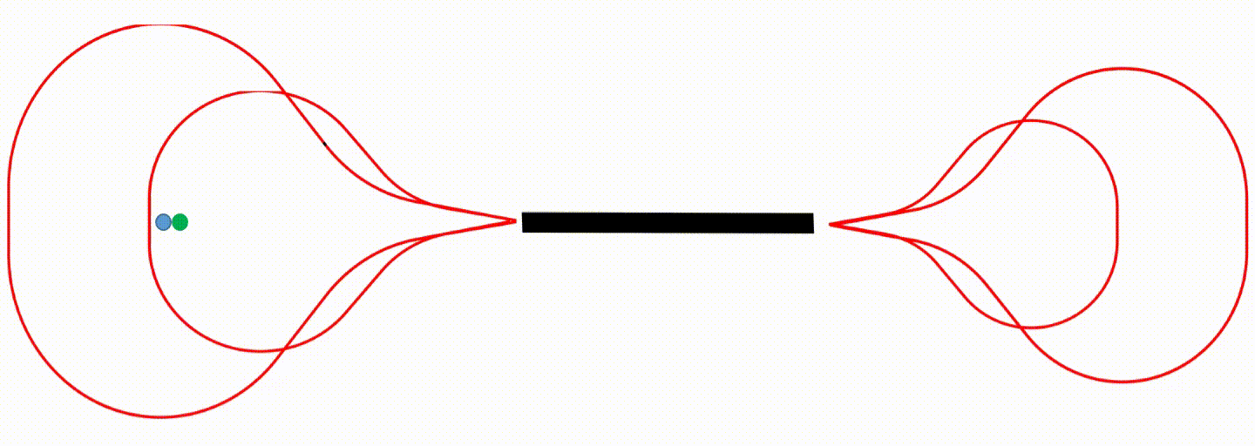
High efficient low cost acceleration for low energy Muons
Well known acceleration scheme in literature is ‘dogbone’ RLA proposed for a future Neutrino Factory (Alex Bogacz)
Single linac is used to accelerate consecutive µ- and µ+ bunches in one RF pulse with many passes
Independent arcs due to large energy variation between passes..

Slide 4
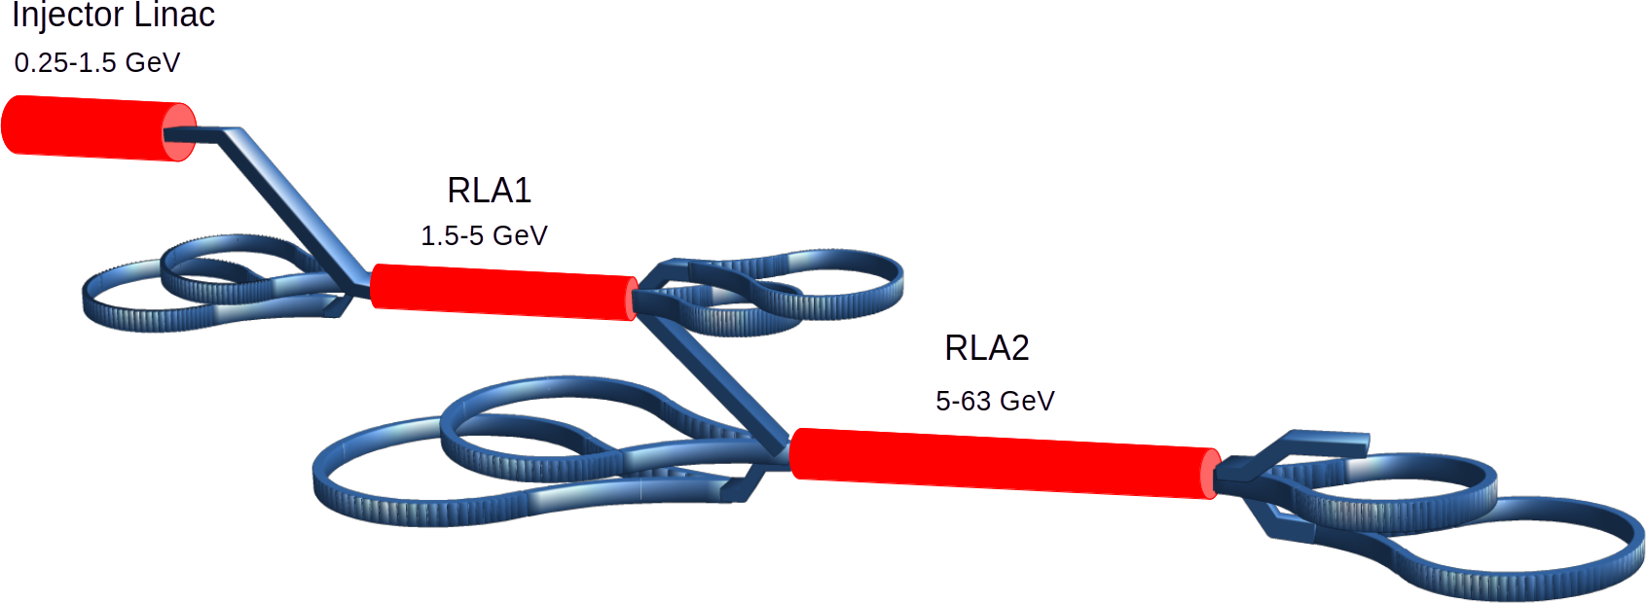
Low Energy Acceleration Layout

Slide 5
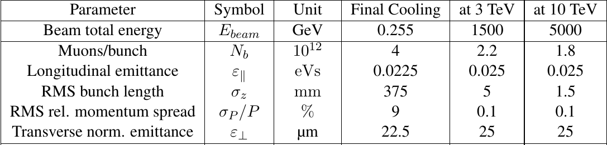
Beam Parameters along the acceleration chain
Very large energy spread
  Chromatic aberrations by quadrupoles at low energy
Both longitudinal and transverse emittance has to be preserved
  Quasi-Isochronous arcs are necessary (with flexible momentum compaction)
Two bunches with opposite charge
  Good matching for both bunches (i.e. round beam at injection/extraction to arcs)
Rapid acceleration
...
Very long bunch after final coolling (375 mm)
  One can use induction linacs in injection. However bunch needs to be compressed at least by factor 10.
10 % emittance growth in the transverse and longitudinal planes, both for 3 and 10 TeV.
  Very tight tolerance with given longitudinal emittance!

Slide 6
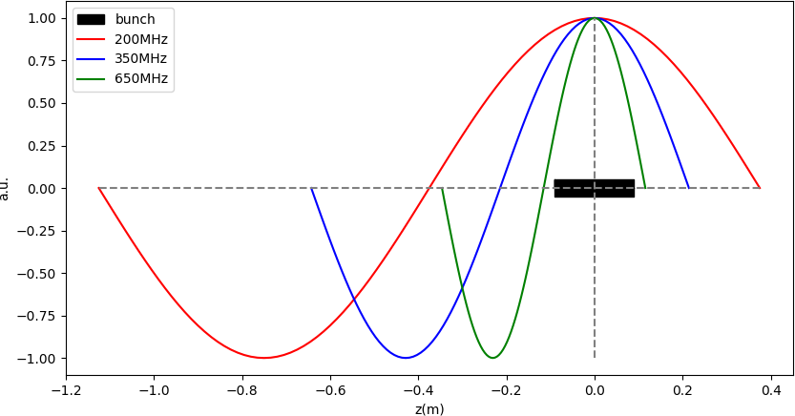
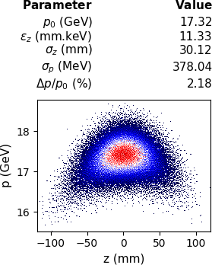
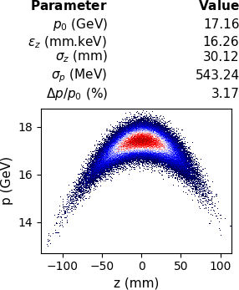
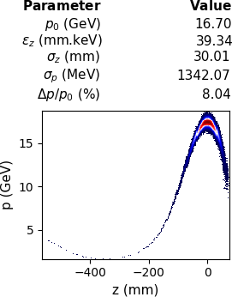
Choice of RF frequency
If we have RMS ~ 30 mm Gaussian bunch → 200 mm full length
Typically the total bunch length should be < 10% of λRF
To preserve longitudinal emittance lower frequency is preferable
Reasonable frequency would be SC 350 MHz cavity (LEP cavity)
200MHz
350MHz
650MHz

Slide 7
Previous study

Slide 8
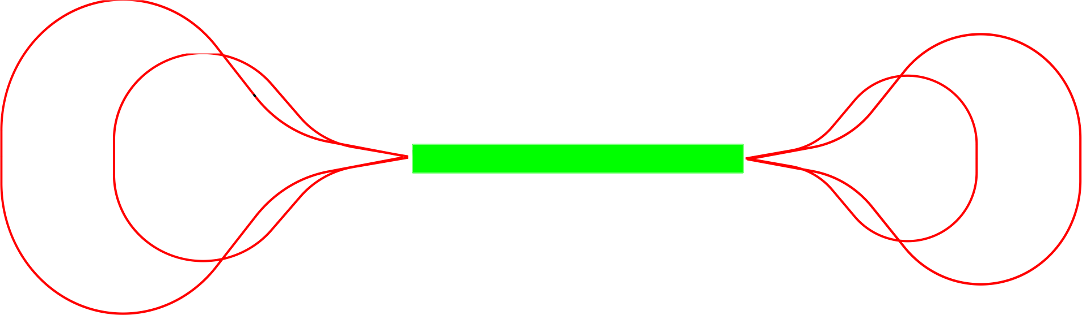
RLA2
The goal is accelerating two bunches (μ+,μ-) spaced by λRF (n-1/2) from 5 to 63 GeV
5-pass RLA 5-63 GeV
μ+
μ+
51.4 GeV
28.2 GeV
16.6 GeV
39.8 GeV
μ-
μ-
Energy gain : 11.6GeV / pass
Total acceleration time ~25 μs
  No RF parameters are possible to change within one RF pulse
Minimum number of pulsed magnets
  Preferred not to use any

Slide 9
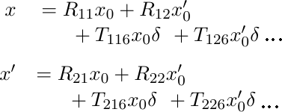
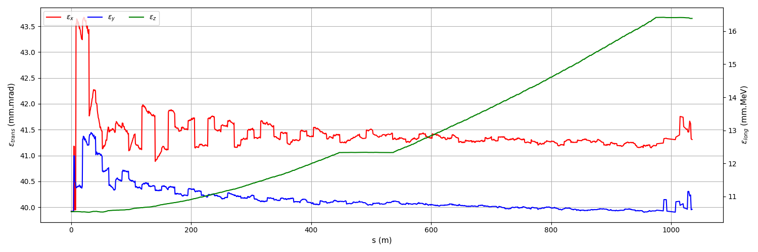
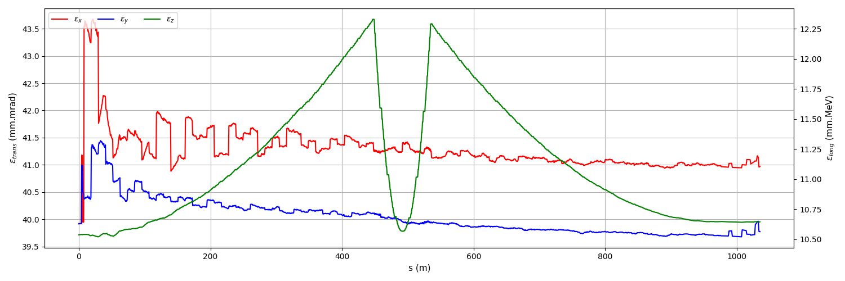
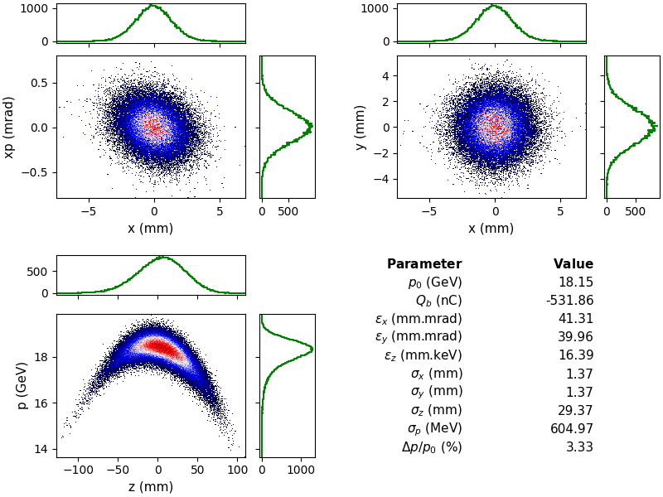
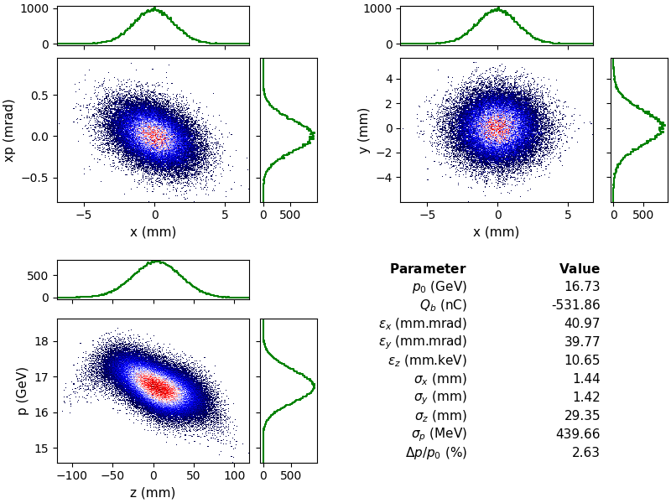
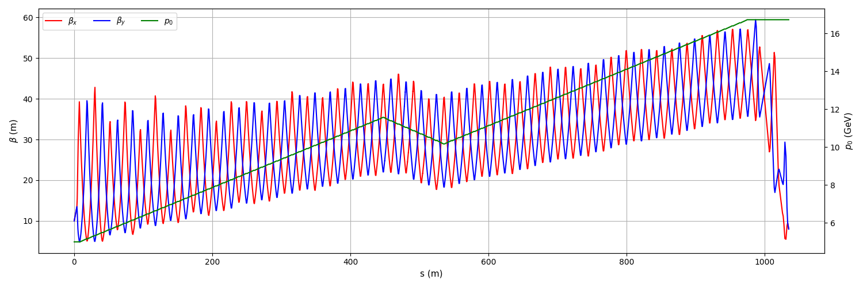
Beam Dynamics in Linac
Large initial energy spread causes emittance growth due to chromatic effects by quadrupoles
We need to use weak quadrupoles to preserve emittance
  Drawback: Sensitive to transverse wakefield effects
W/O linearizer
With linearizer

Slide 10
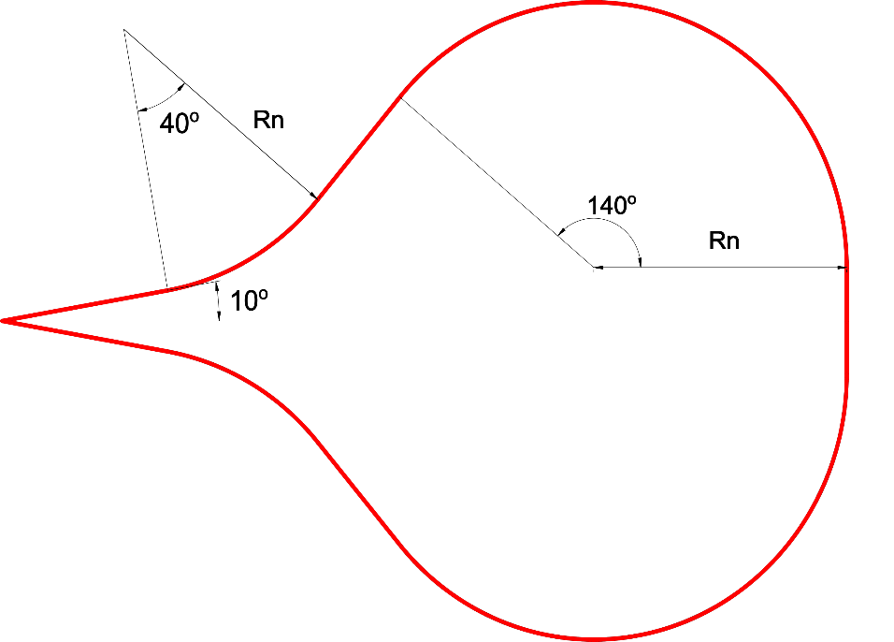
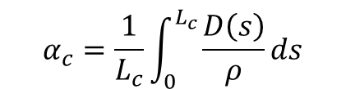
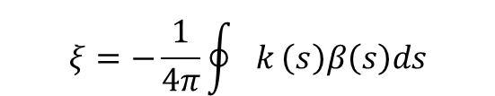

Droplet Arcs
Arcs consists of two symmetric sections (-50º and 140º) and total turn is 380º, net turn is 180º
The curvature changes with energy
Large energy acceptance
  we still have large energy spread at the exit of first pass
    σΔp ~ 500 MeV → σΔp/p 3% (16.6 GeV ± 1.2 GeV)
Longitudinal emittance ≤≥ bunch length needs to be preserved/controlled
  Small Momentum compaction factor (R56 ≈ L αc)
We also need small dispersion in bending magnets to preserve transverse emittance
Small betatron oscillation to minimize chromaticity
$$α_{c}=\frac{1}{L_{c}}\int_{0}^{L_{c}}{\frac{D\left(s\right)}{ρ}}ds$$
$$H=γ_{x}D_{x}^{2}+2α_{x}D_{x}D_{x}′+βD_{x}′^{2}$$
$$ξ=−\frac{1}{4π}\oint{k}\left(s\right)β\left(s\right)ds$$

Slide 11
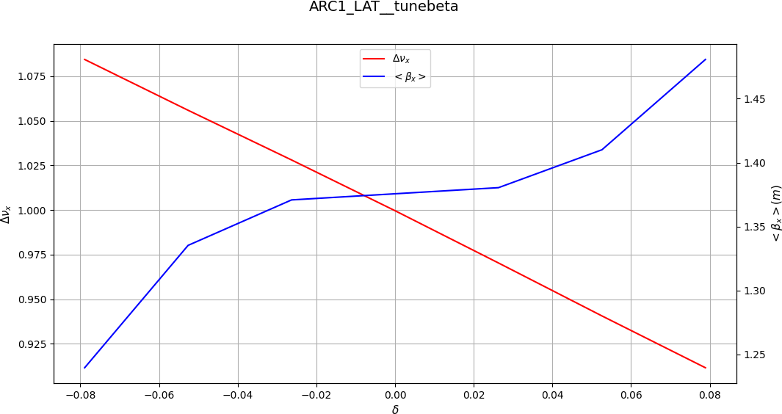
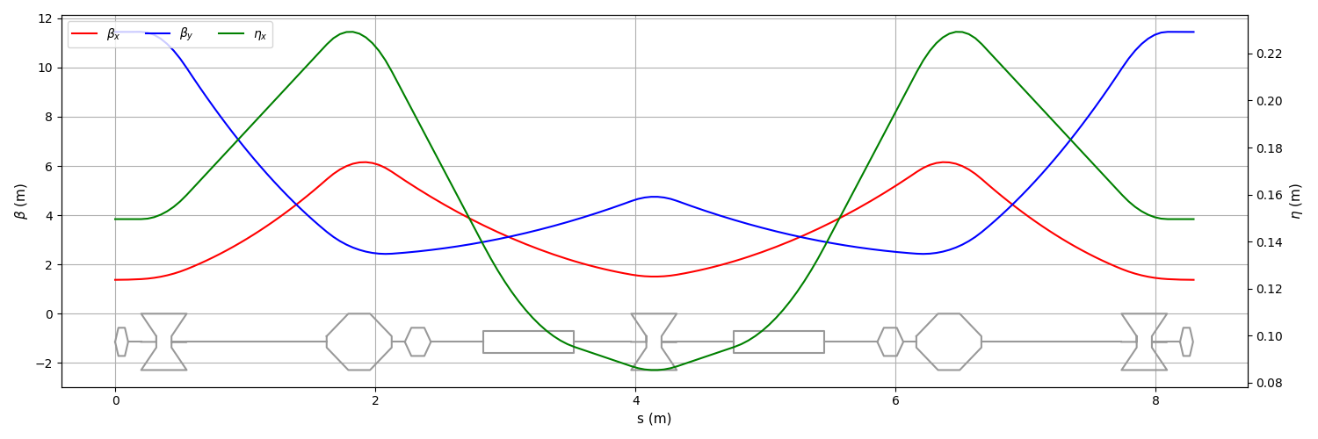
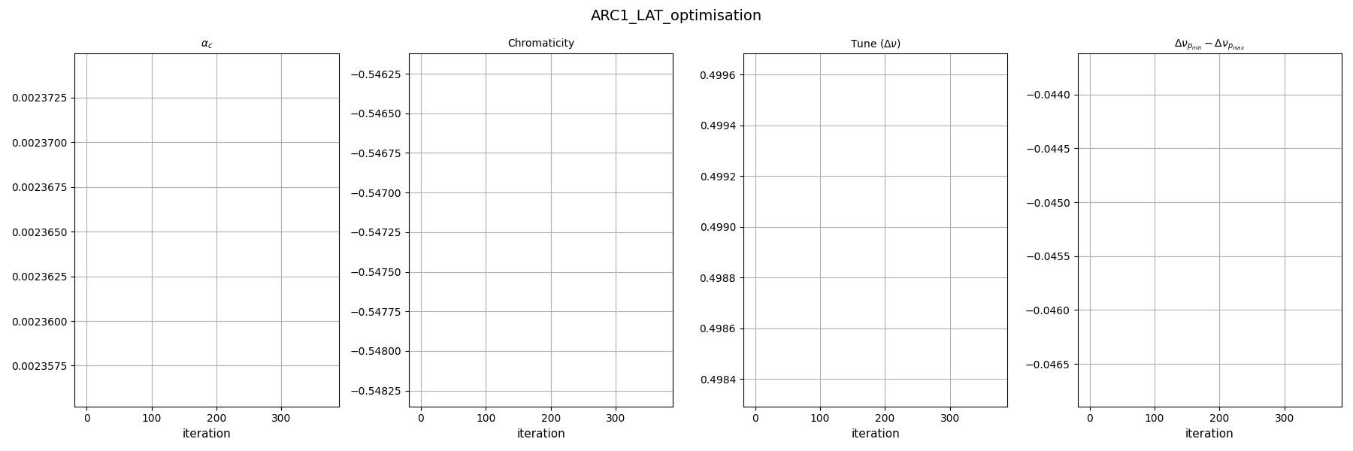
Basic arc cell
Different lattice configuration has been studied
  FODO, Triplet. TME : The sign of R₅₆ is fixed. Control of bunch length can be done only with RF.
DB(A) lattice allows to control R₅₆ with quadrupole strength as well as the chromaticity
To optimize individual arcs a tool (based on second order optics and tracking) has been developed
Basic cell of arcs
Bending angle/cell =10º
B_{max} =7T
Aperture =50mm

Slide 12
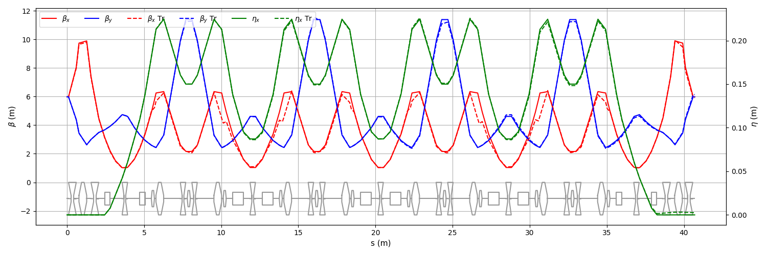
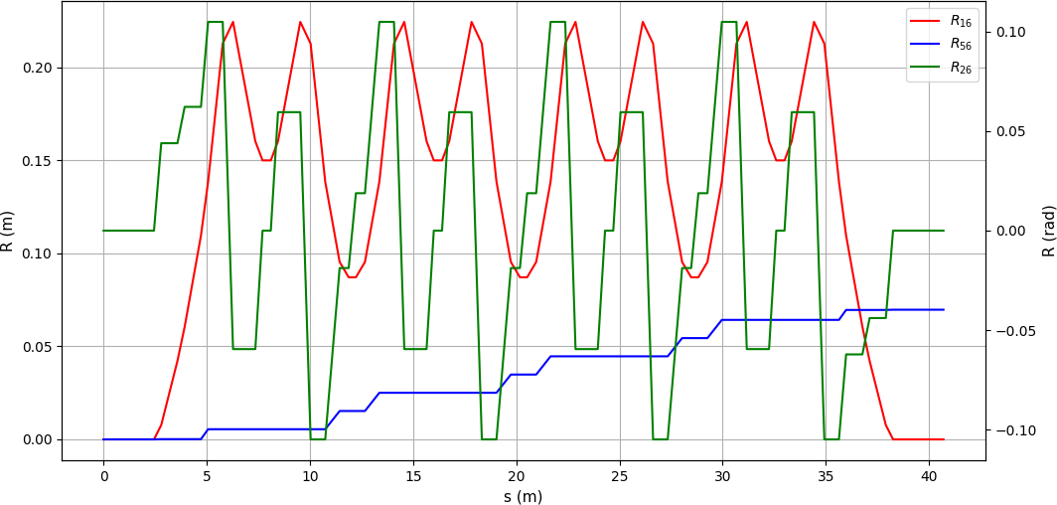
Arc Lattices
40º bending section of first arc
Dispersion suppression and matching
Basic cell
Dispersion is suppressed with half bending angle
Sextupoles are optimized with second order optics.

Slide 13
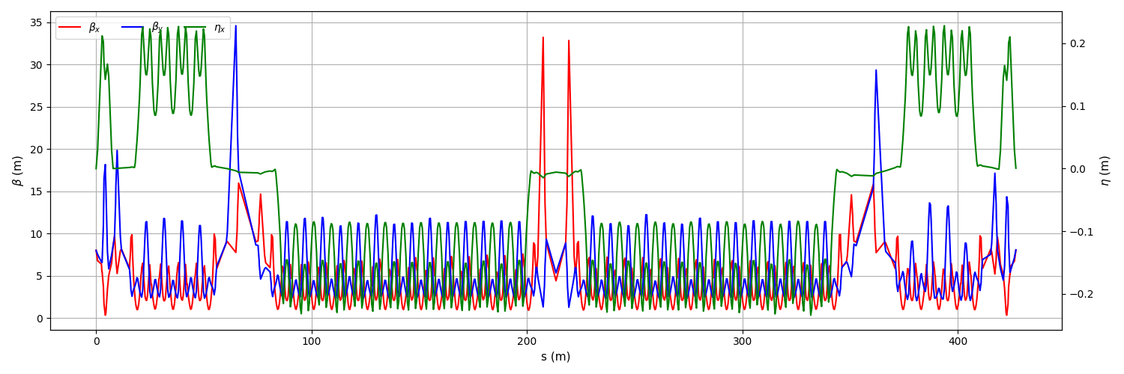
Beam dynamics in arcs
Start to end simulation in first arc (tracking)
Extraction
Straight section
µ-
40º bending
140º bending
By-pass section
µ+

Slide 14
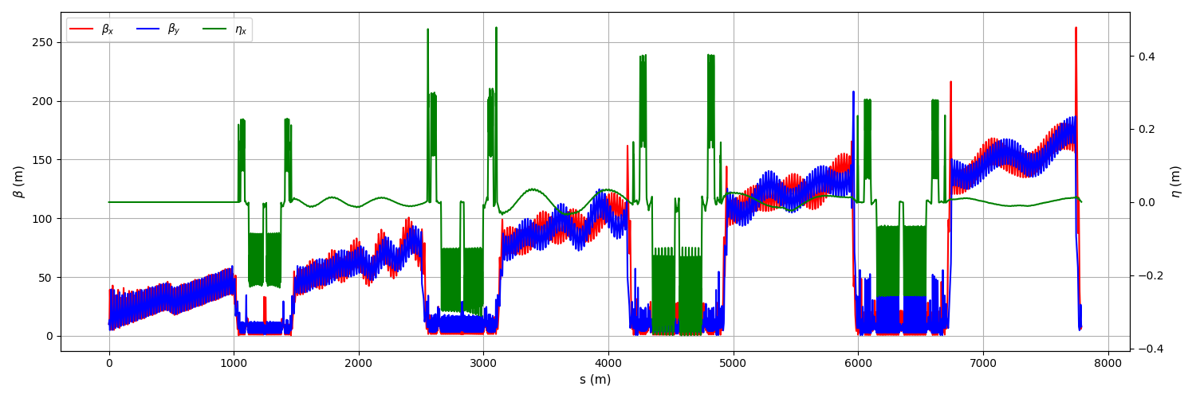
Start to end RLA2
1st pass
1st arc
2nd pass
….
4th arc
5th pass

Slide 15
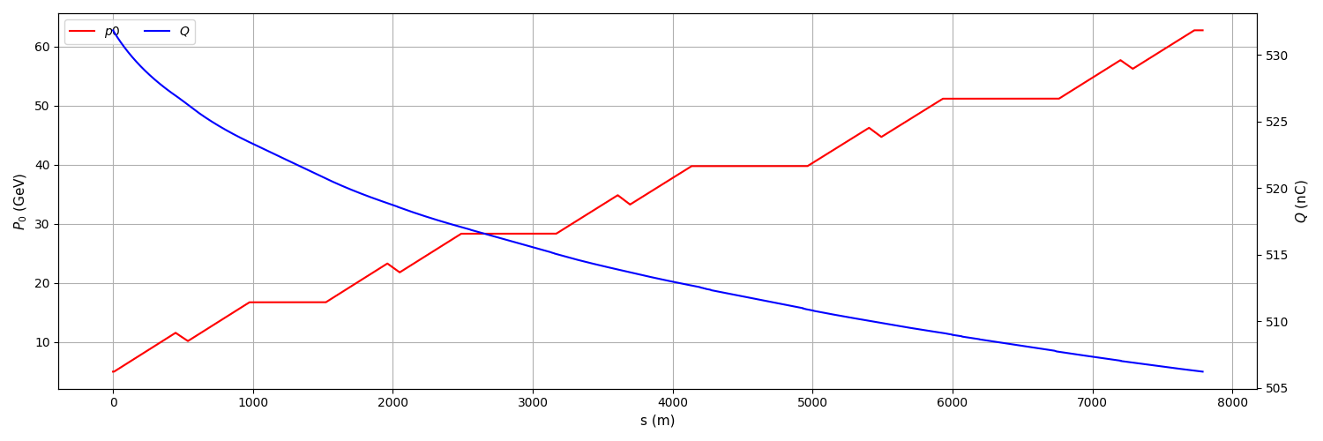
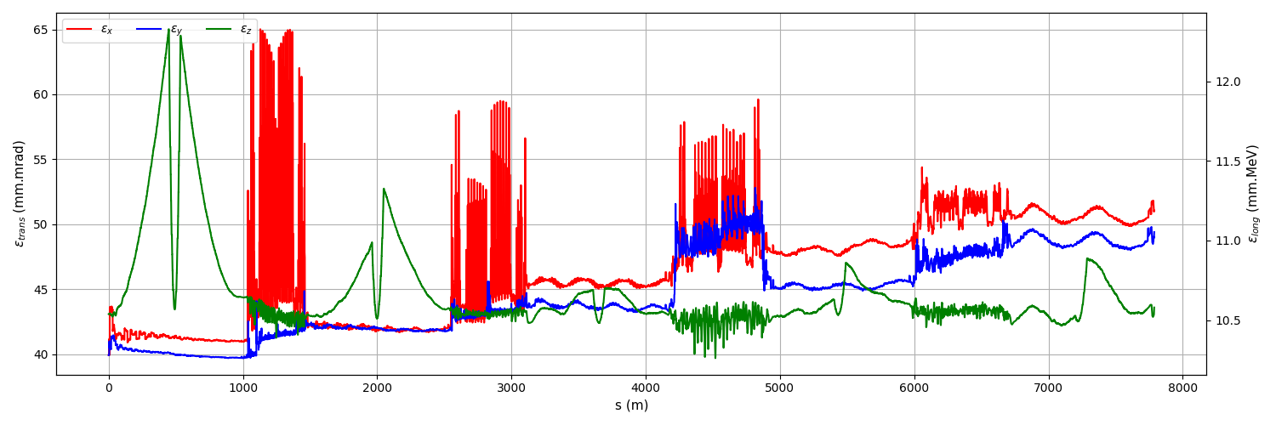
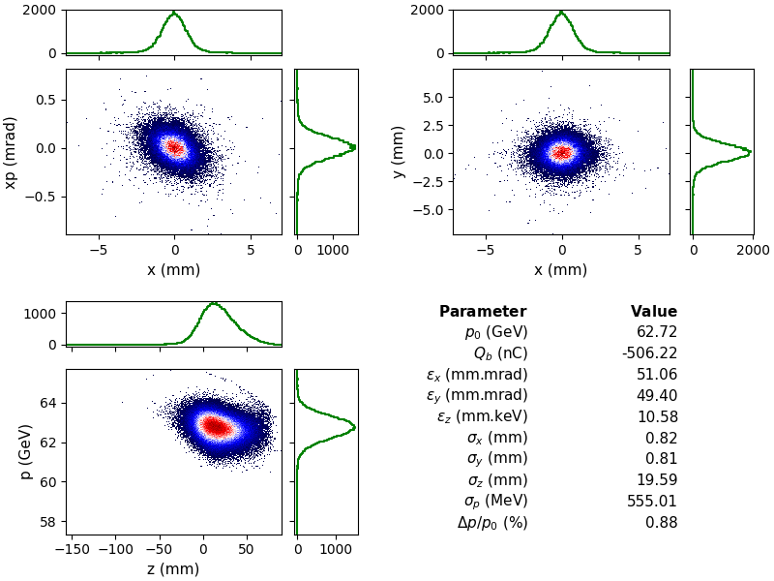
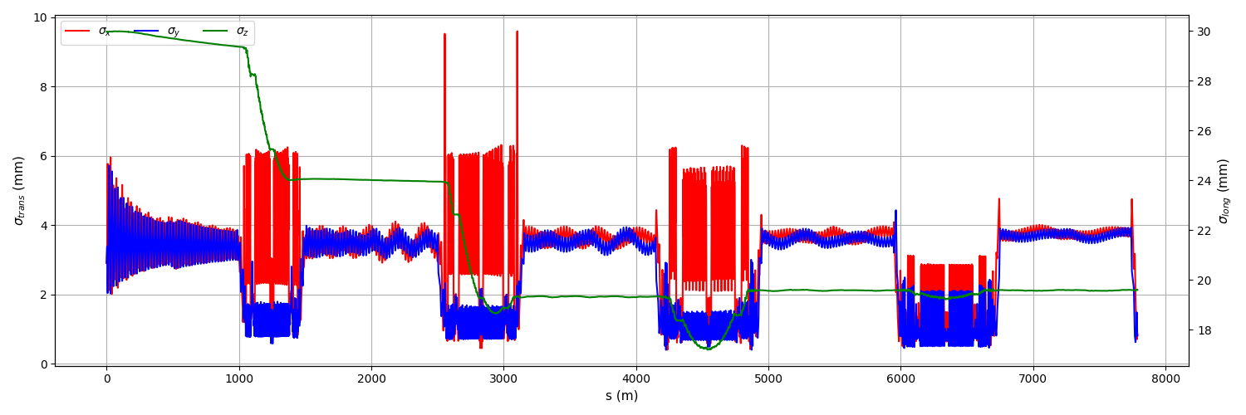
Start to end simulation for RLA2

Slide 16
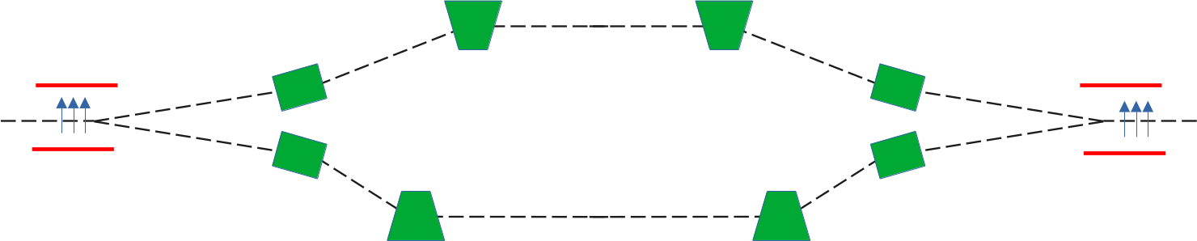
By-pass section
The phase of beam respect to RF is defined by the arc length.
  1 degree RF phase (@350 MHz) is 2.4 mm (0.85 mm for 1 GHz)
If the beam is injected off-energy to the arc it is impossible to adjust path length within ± several mm
  Which is unlikely possible due to beam loading
A chicane is necessary to adjust path length precisely
  It can also be used to exchange of position of preceding/following bunch
µ-
µ+
Electrostatic deflector
Bending magnet

Slide 17
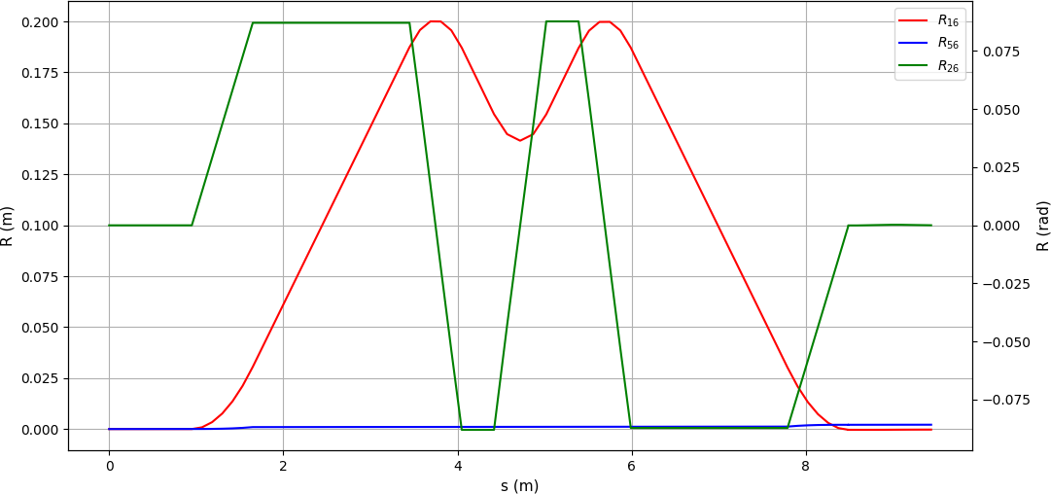
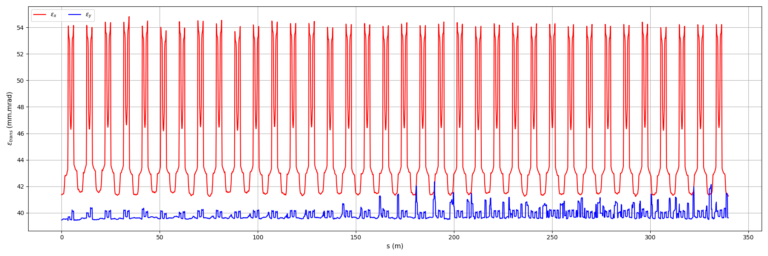
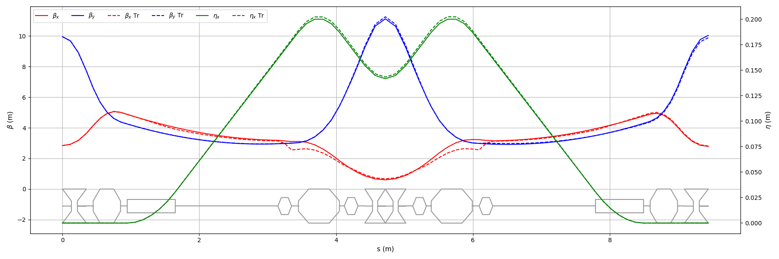
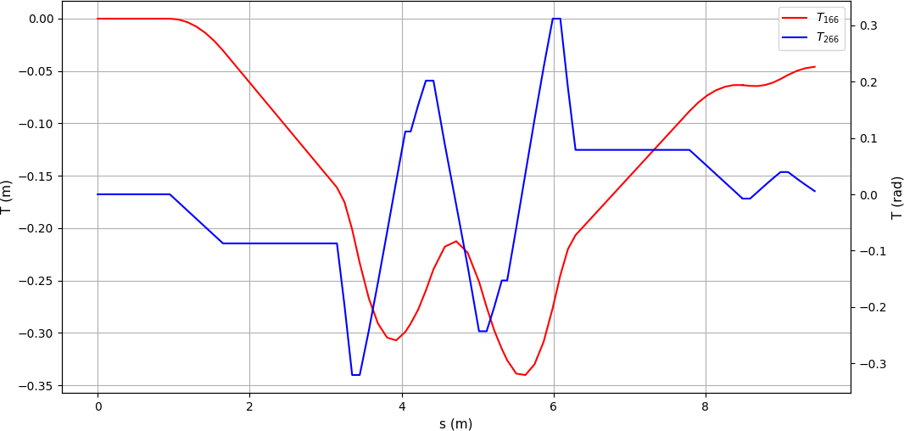
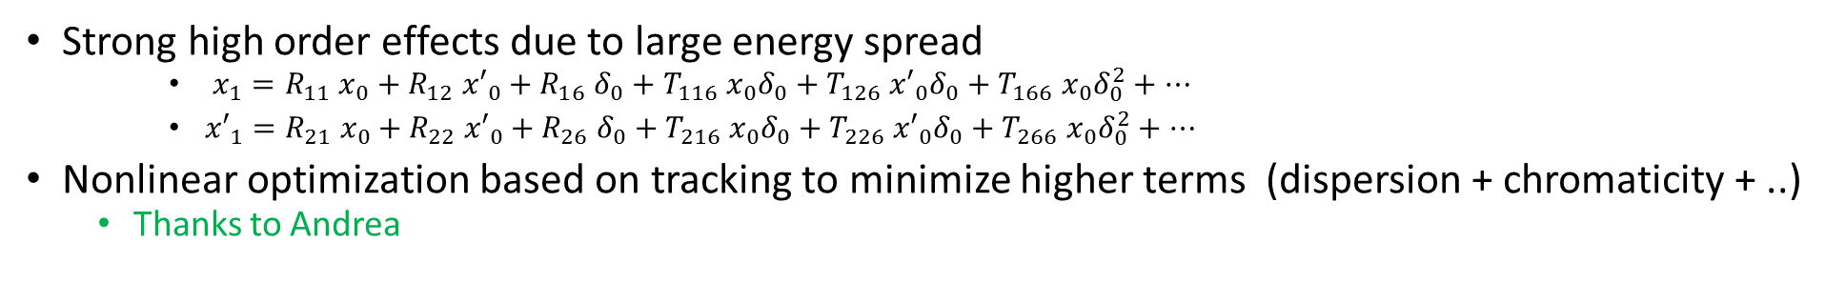
New DBA Lattice for Arcs
Strong high order effects due to large energy spread
    $x_{1}=R_{11} x_{0}+R_{12} {x′}_{0}+R_{16} δ_{0}+T_{116} x_{0}δ_{0}+T_{126} {x′}_{0}δ_{0}+T_{166} x_{0}δ_{0}^{2}+…$
    ${x′}_{1}=R_{21} x_{0}+R_{22} {x′}_{0}+R_{26} δ_{0}+T_{216} x_{0}δ_{0}+T_{226} {x′}_{0}δ_{0}+T_{266} x_{0}δ_{0}^{2}+…$
Nonlinear optimization based on tracking to minimize higher terms (dispersion + chromaticity + ..)
  Thanks to Andrea
Emittance evaluation for 360º turn

Slide 18
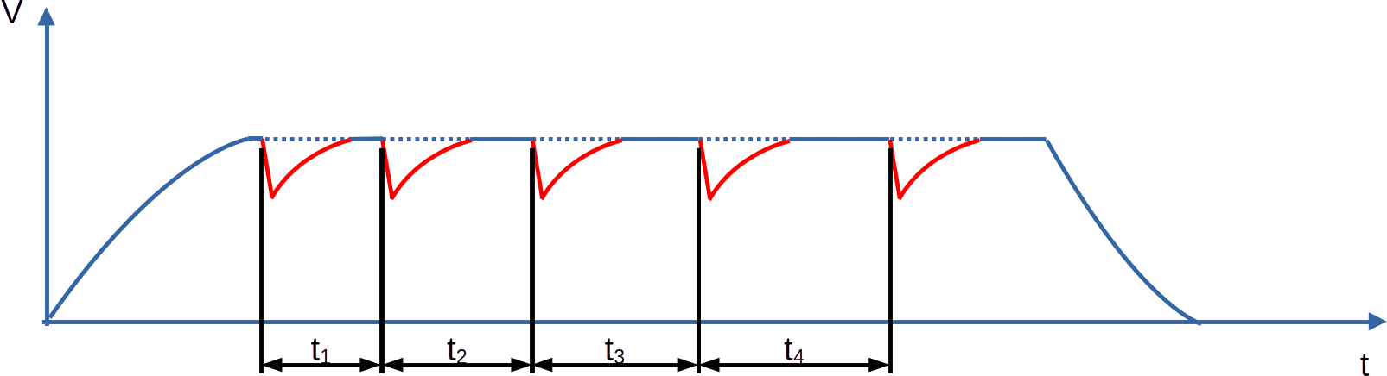
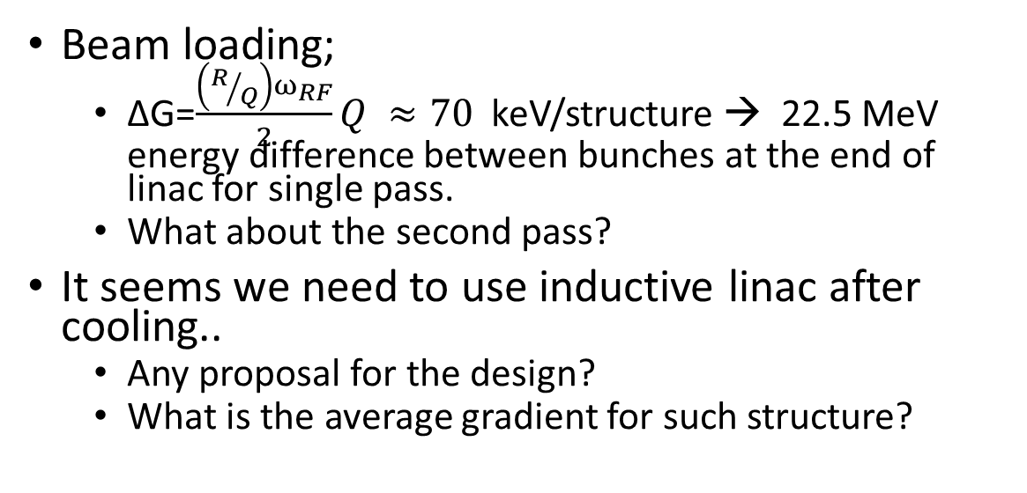
Questions
Simulation results:
  σ_{z}= 20 mm, δ_{p}= 0.9%
  What is the requirement for RCS1? (In the tentative parameters it was OK)
Is there any proposal for injection to RCS?
Beam loading;
  ∆G=$\frac{\left(R/Q\right)ω_{RF}}{2}Q ≈70$ keV/structure → 22.5 MeV energy difference between bunches at the end of linac for single pass.
  What about the second pass?
It seems we need to use inductive linac after cooling..
  Any proposal for the design?
  What is the average gradient for such structure?

Slide 19
Thanks for your attention

