Slide 1

Resonant Ultrasound Spectroscopy (RUS)
A Study of the Vortex Lattice Phase Diagram of Niobium
Swiss Physical Society meeting 2024
Dang Xuan Dang :: Ph.D. student
ETH Zurich, 10 September 2024
xuan.dang@psi.ch
Notes:
Thanks for your introduction.
Today, I will present first results that I obtained with a RUS setup that I built as part of my PhD project. I have measured the vortex phase diagram of the well known superconductor niobium and I hope to convince you that RUS is an excellent tool to study vortex dynamics.

Slide 2
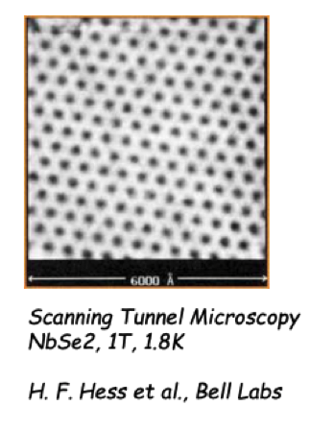
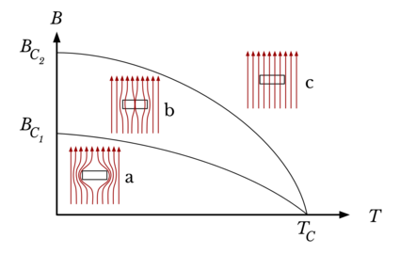
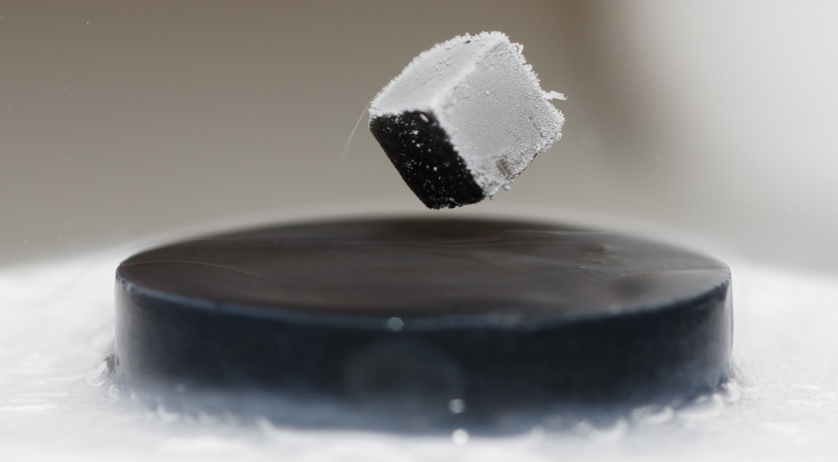
Vortex Matter in Superconductors
Repulsive interaction between vortices.
Type II superconductor
    𝜅 > 1/√2
    External magnetic field allows passing via quantised vortex lines
Pinning of vortex lines.
Notes:
Superconductivity is characterized by its ability to transport electric currents without resistance and by its ability to repel magnetic fields. Superconductors are perfect diamagnets. For a type II superconductor this definition is slightly altered.
When a type II superconductor experiences a magnetic field, it will allow for some magnetic flux to penetrate the superconducting phase. However, the field enters the superconductor only in flux quanta which are very localized lines.

Slide 3
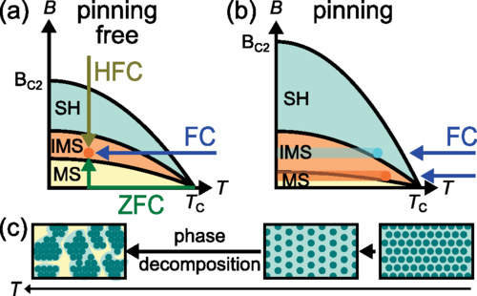
Vortex Matter in Niobium
T. Reimann et al Physical Review B 96, 144506 (2017)
Type II Superconductor
  Superconducting Transition Temperature 9.2K
  B_{c2} ~ 0.5T
Vortex matter in Niobium
  Immediate Mixed phase 0.1T < B < 0.2T
  Shubnikov phase
Notes:
Niobium is a conventional s-wave superconductor, and low k.
There is immediate mix phase can be observed by FC and ZFC, which shows vortex arrange like island, before end up filled out in Shubnikov phase.

Slide 4
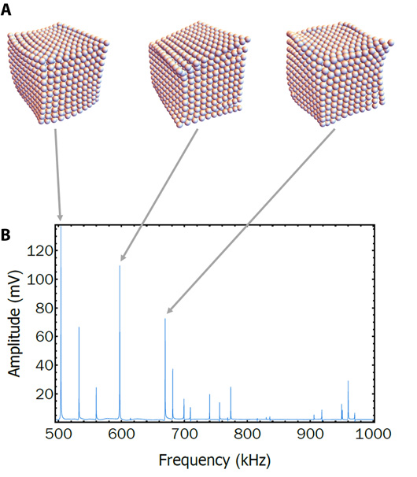
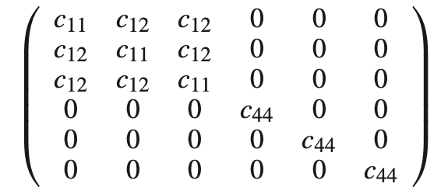
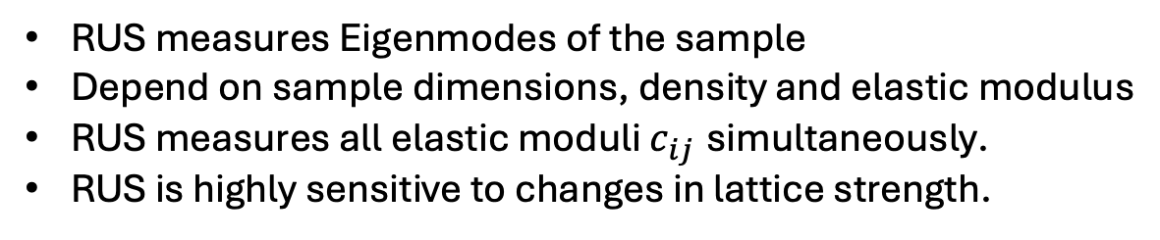
Resonant Ultrasound Spectroscopy (RUS) and
Elasticity of Crystals
RUS measures Eigenmodes of the sample
Depend on sample dimensions, density and elastic modulus
RUS measures all elastic moduli $c_{ij}$ simultaneously.
RUS is highly sensitive to changes in lattice strength.
S. Ghosh et al, Science advance. 6, 10 (2020)
For example:
BCC crystal has 3 components to the elastic tensor
c₁₁ .. compression
c₁₂ .. torsion
c₄₄ .. shear
Notes:
RUS spectra can identify all elastic moduli, which present in the list of resonant frequencies.
Each frequency can deform the crystal in serval elastic mode.
For example.

Slide 5
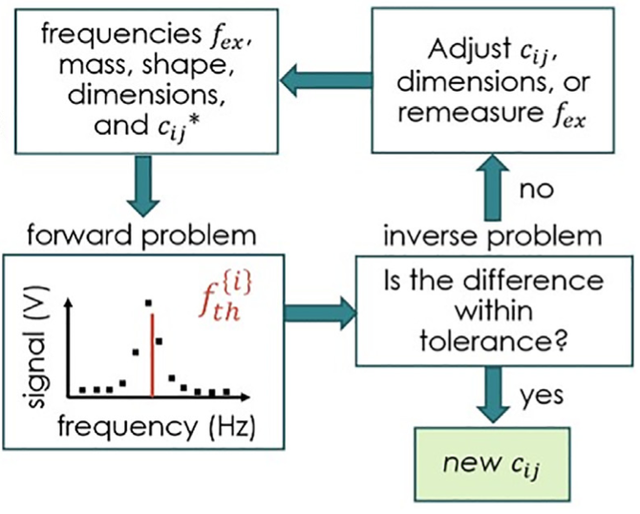
Spectrum computation
Adapt input parameters
Calculate Eigen frequencies
by Rayleigh-Ritz method.
Get the new initial c_{ij}*
J. Torres et al., JASA 151, 3547 (2022)
Compare calculation to experiment
Notes:
Model deal with the forward and inverse problem, while the problem enables the calculation resonant frequencies by give some physical properties.
The inverse problem can deal with determining the physical properties (here is elastic moduli) from resonant frequencies.

Slide 6
Spectrum computation
Adapt input parameters
We use the package RUScal
https://github.com/RUS-ORNL/RUScal
Calculate Eigen frequencies
by Rayleigh-Ritz method.
Get the new initial c_{ij}*
J. Torres et al., JASA 151, 3547 (2022)
Compare calculation to experiment
Notes:
Model deal with the forward and inverse problem, while the problem enables the calculation resonant frequencies by give some physical properties.
The inverse problem can deal with determining the physical properties (here is elastic moduli) from resonant frequencies.

Slide 7


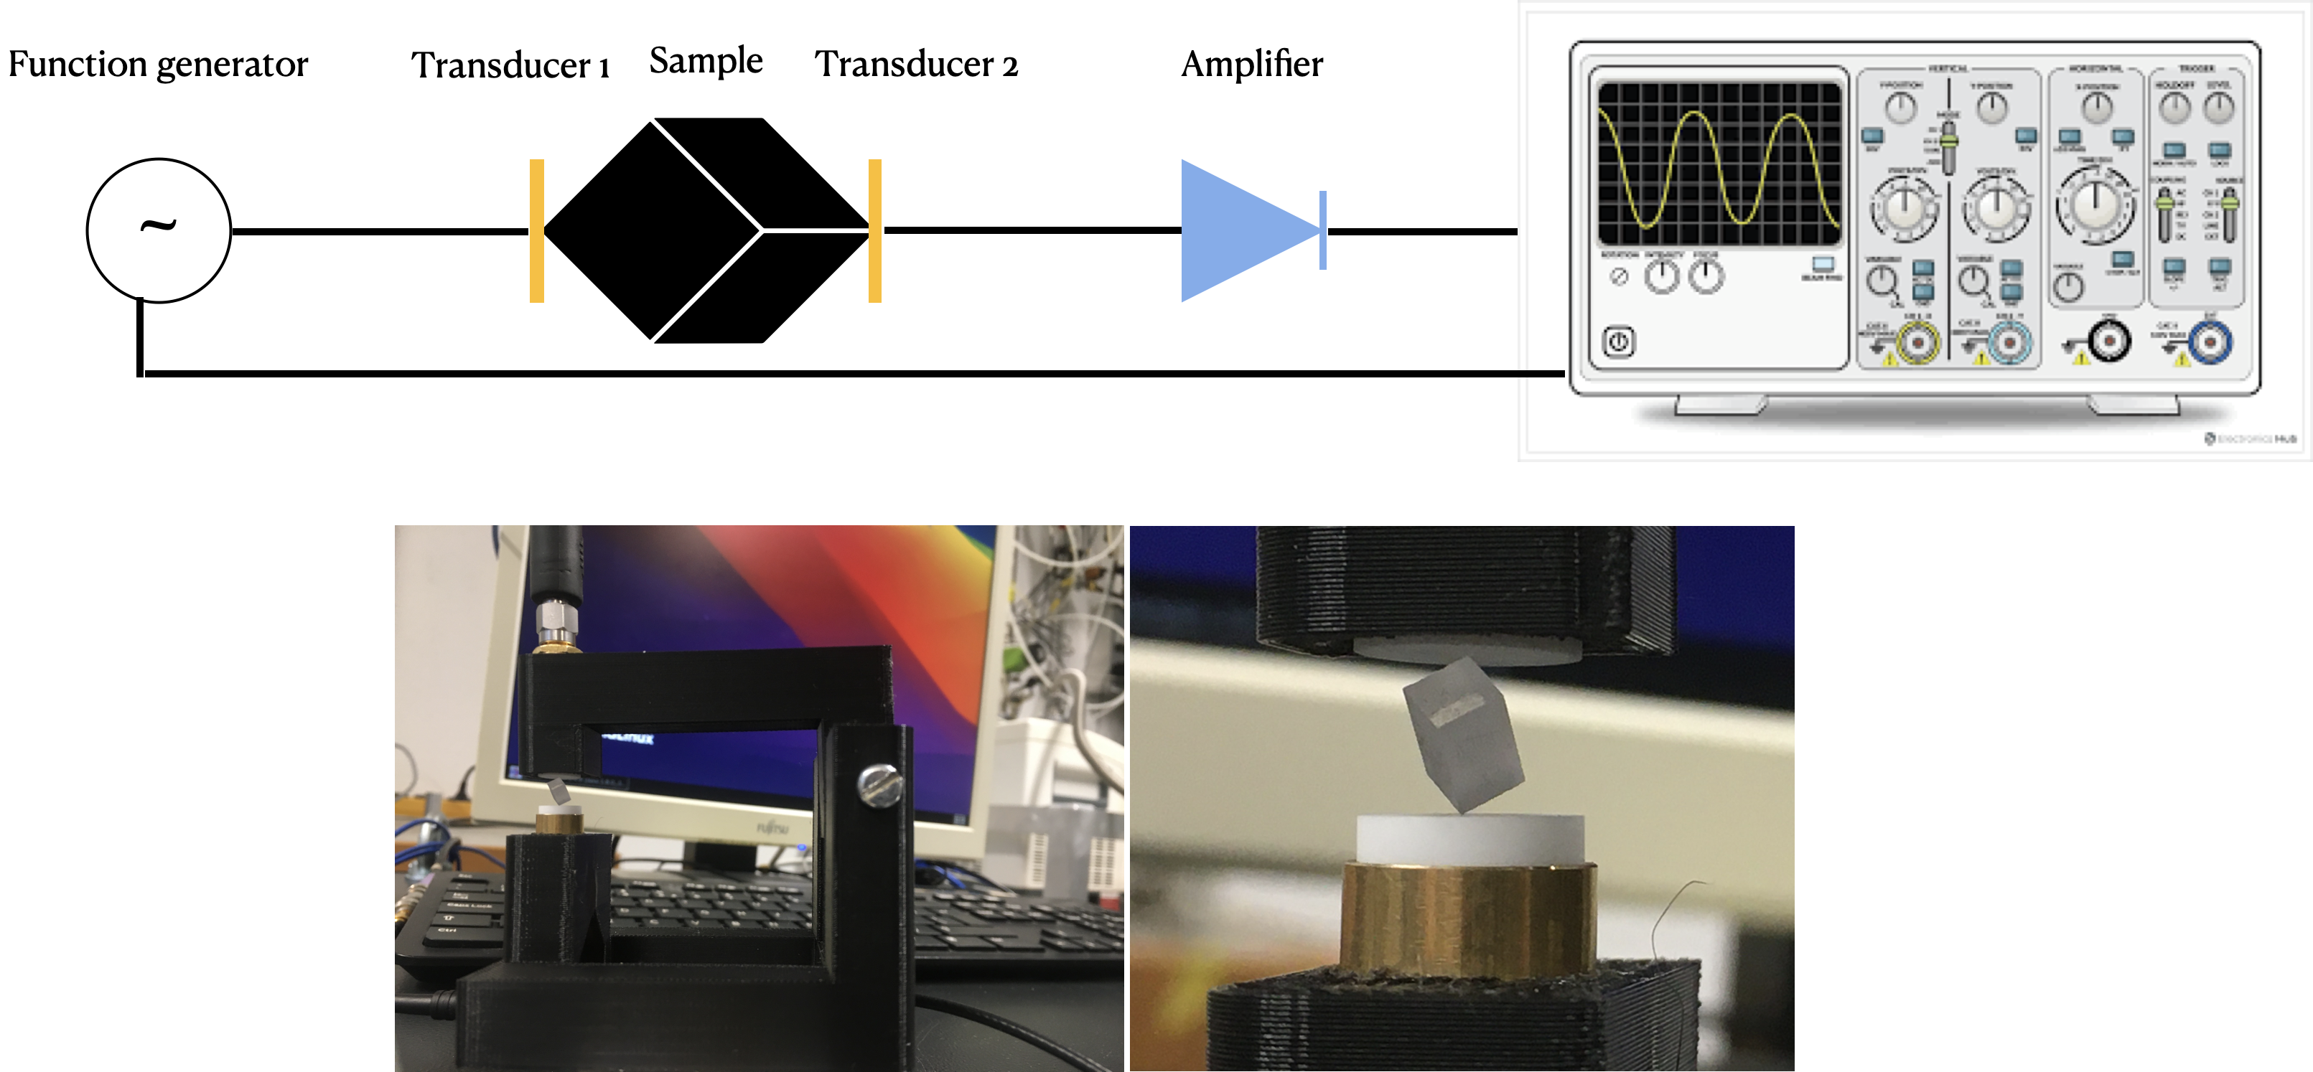
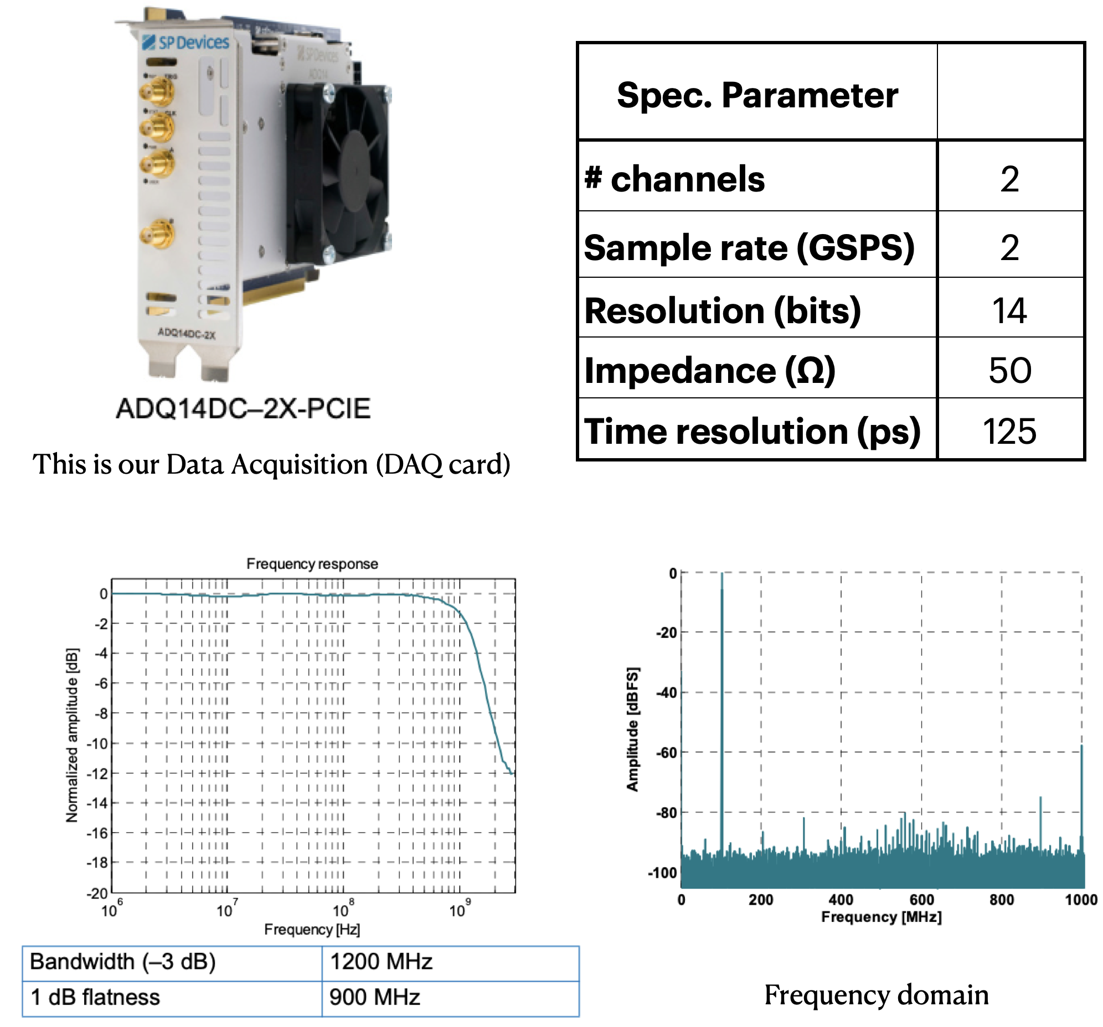
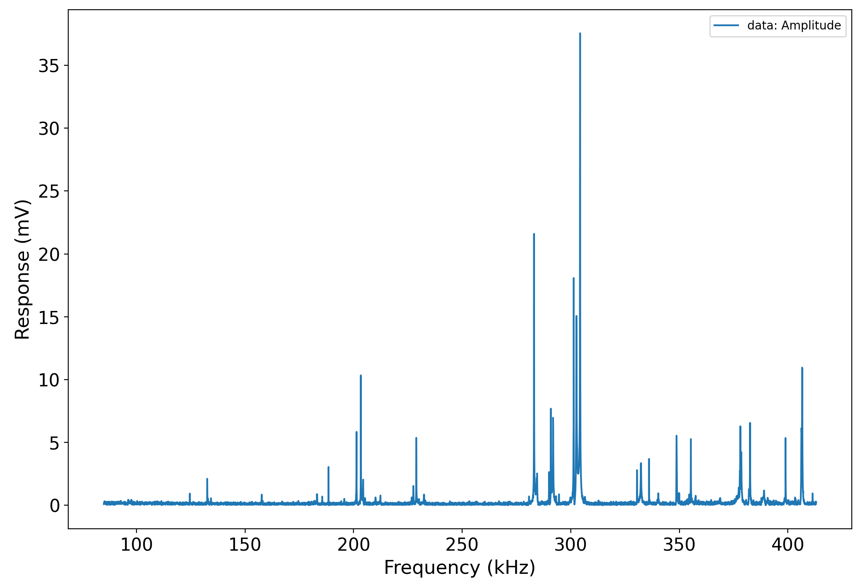
RUS experimental setup
Crystal is clampled by transmitter and receiver transducers.
F.G controls the frequency of excitation.
Amplifier gain the response signal.
DAQ records data and plotting in screen of PC.
Notes:
Single crystal was clamped by transmitted and receiver transducers.
The sound wave is propagated through crystal and signal was detected another corner.
Before recording, we gain the response by amplifier.

Slide 8
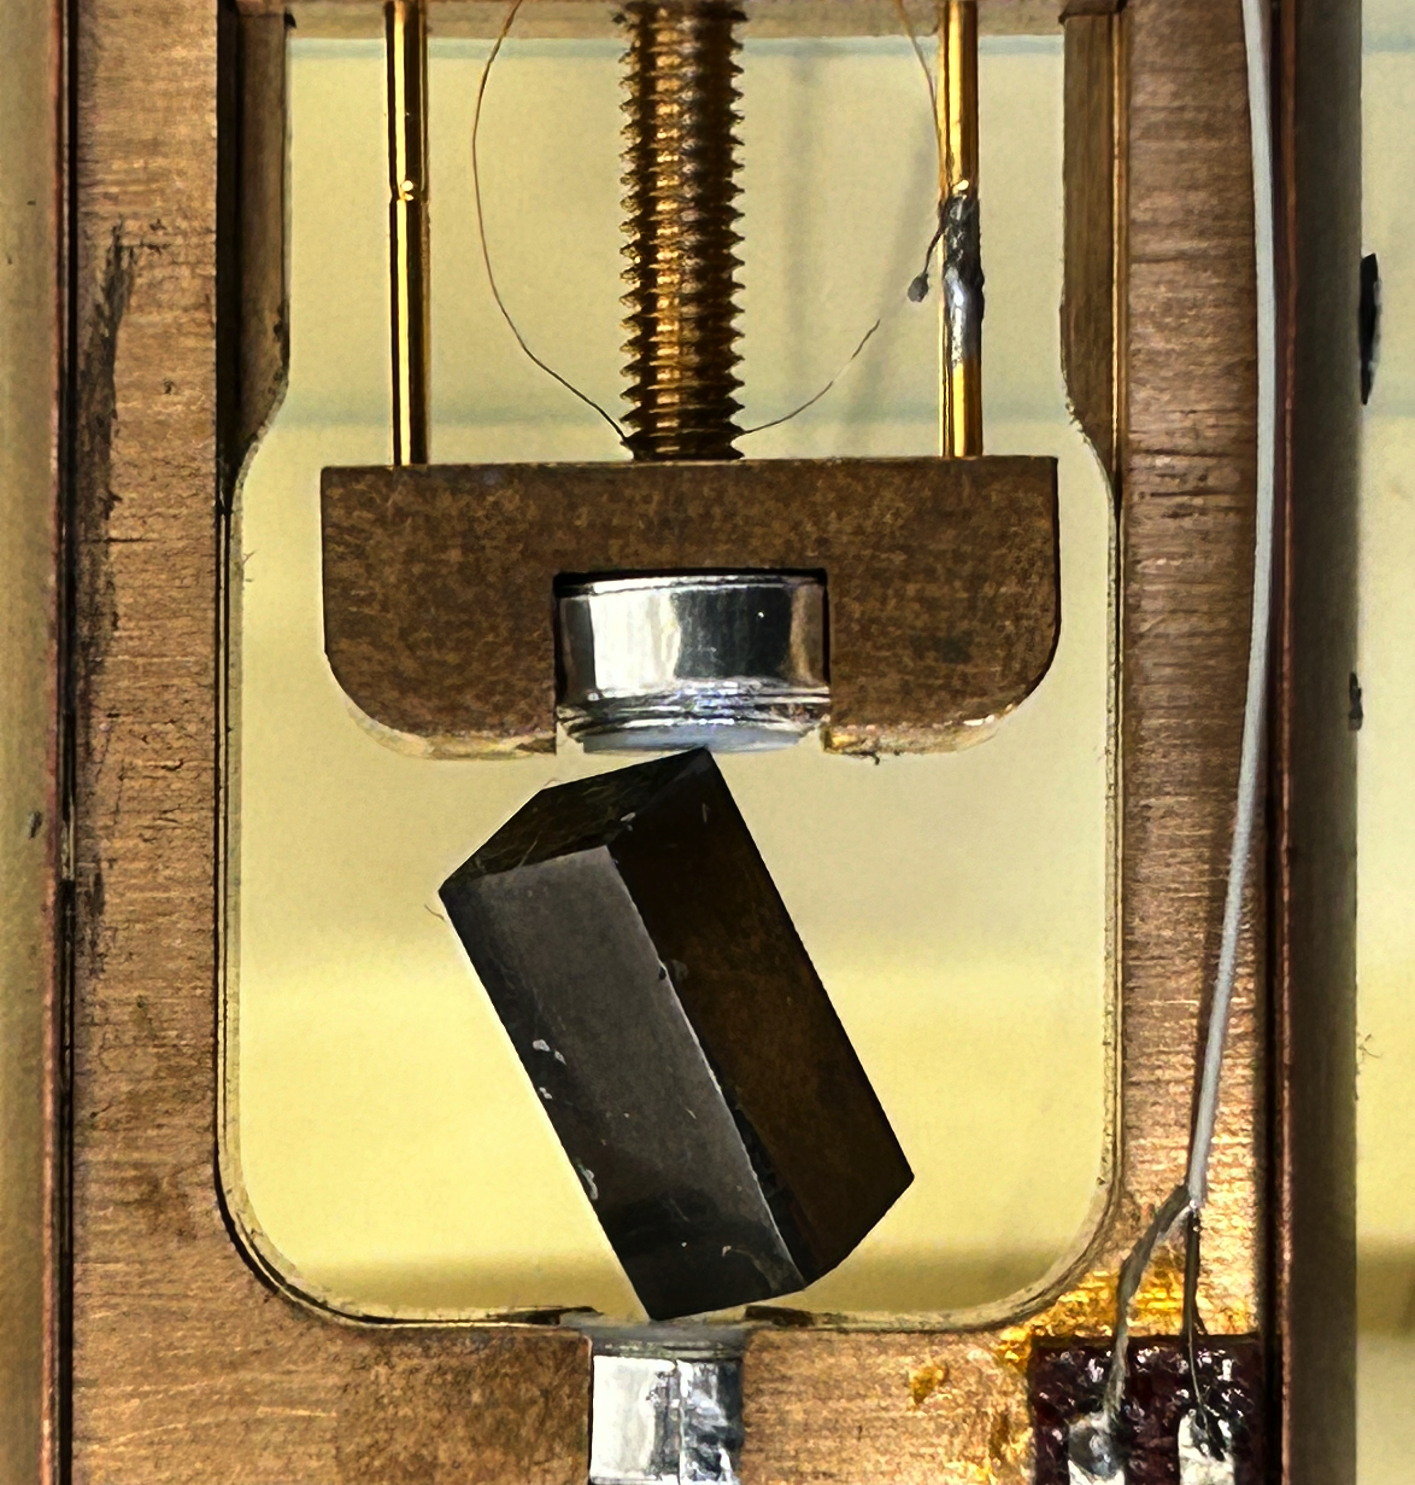
RUS Spectrum of Niobium (Nb)
Nb crystal in stick
Rectangular shape.
Dimensional: 3.84 x 4.10 x 9.40 mm³
Mass: 1.2528 g
c₁₁ = 245.6 GPa, c₁₂ = 138.7 GPa, c₄₄ = 29.3 GPa ^{(*)}
RUS spectrum of Nb at T = 16K
(*): By K. J. Carroll thesis, 1962

Slide 9
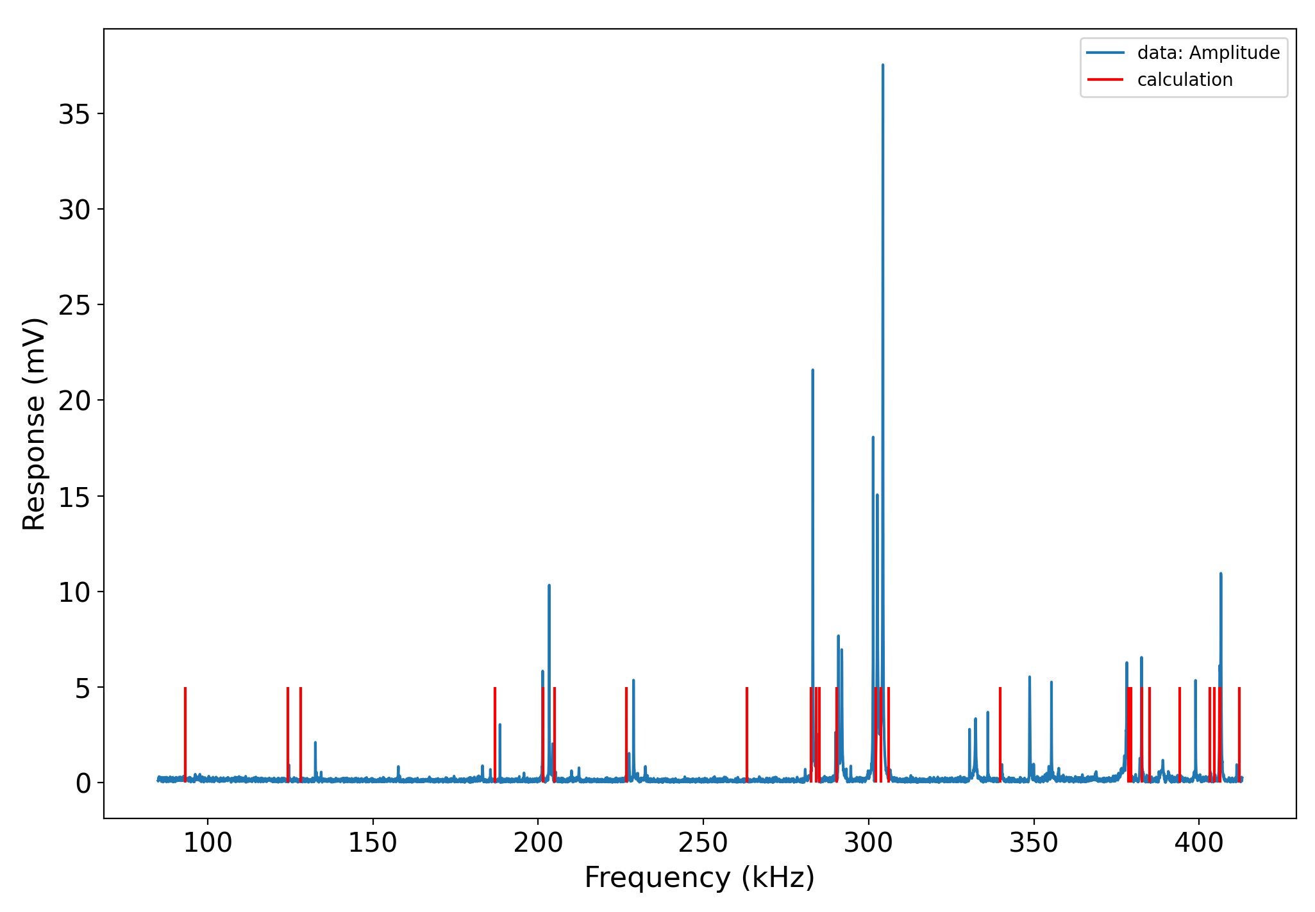
Comparison measured and calculated Spectrum
2 compression modes
1 shear mode
C₁₁ ~ 132.67
C₁₁ ~ 124.38
C₄₄ ~ 188.49

Slide 10
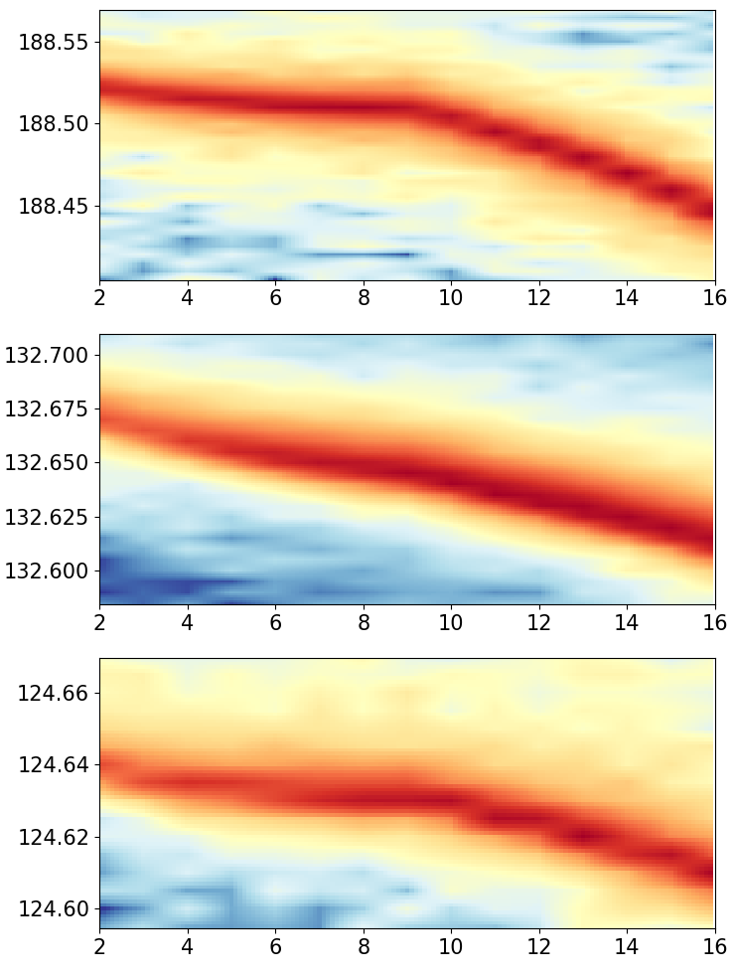
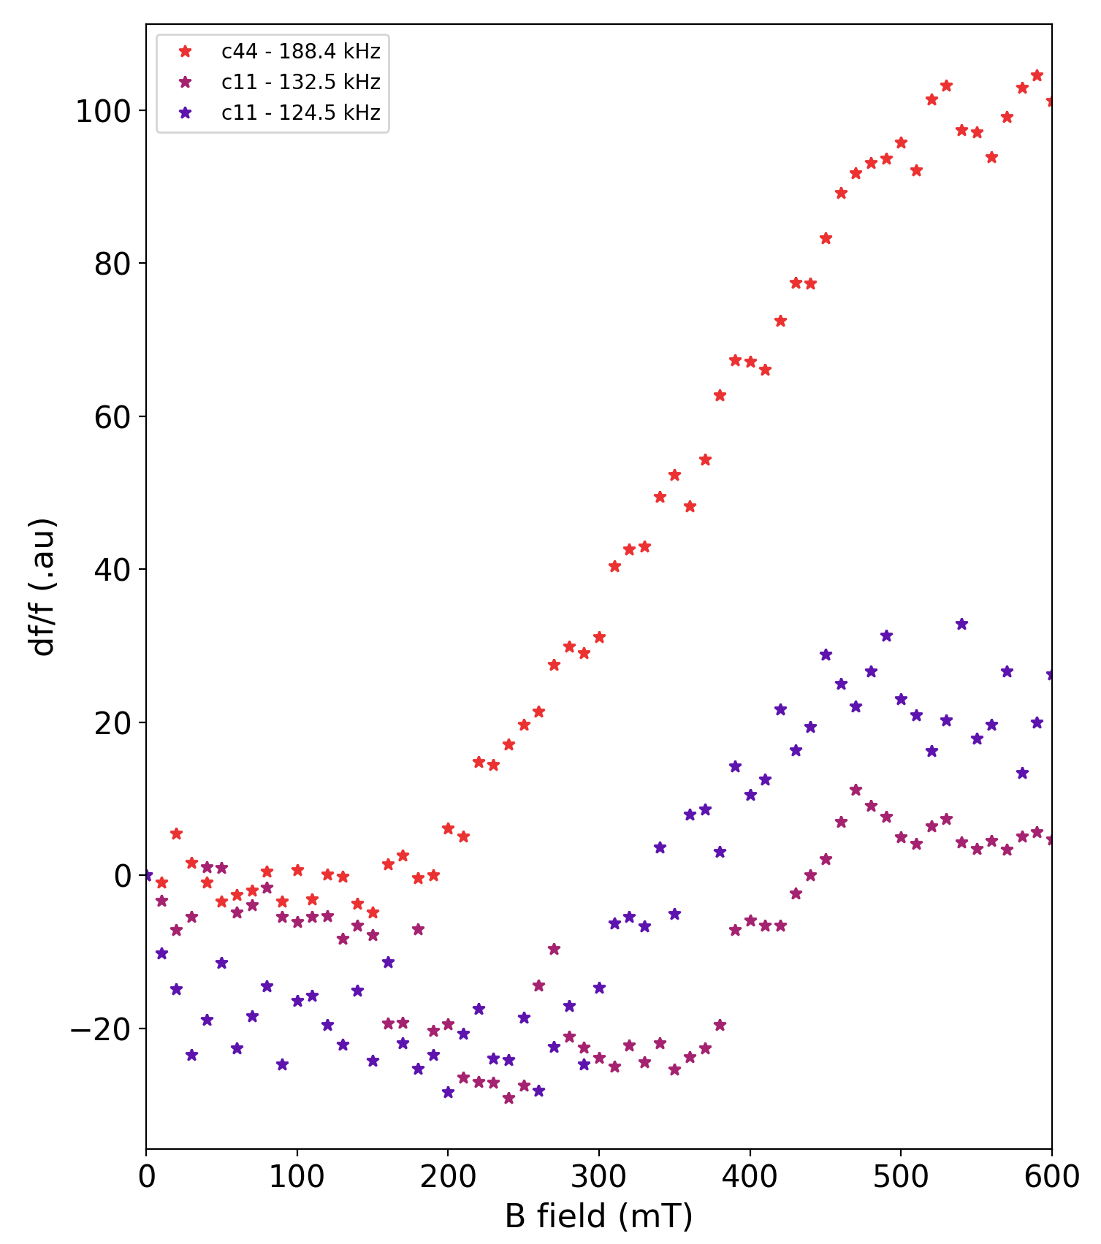
Eigenmodes as function of tuning parameters
B = 0 T
T = 2K
Frequency (kHz)
T_{c} ~9.25(7)K
Temperature (K)
Notes:
In term of cooling down the crystal, All resonant frequencies change the slope at temperature critical point cause of elastic sensitive to electron DOS.
In term of tuning the magnetic field, at 2K, dots of freq. show the responding when B field goes up to 600mT
However, they show the difference the sensitive response cause strong in coupling to vortex lattice.

Slide 11
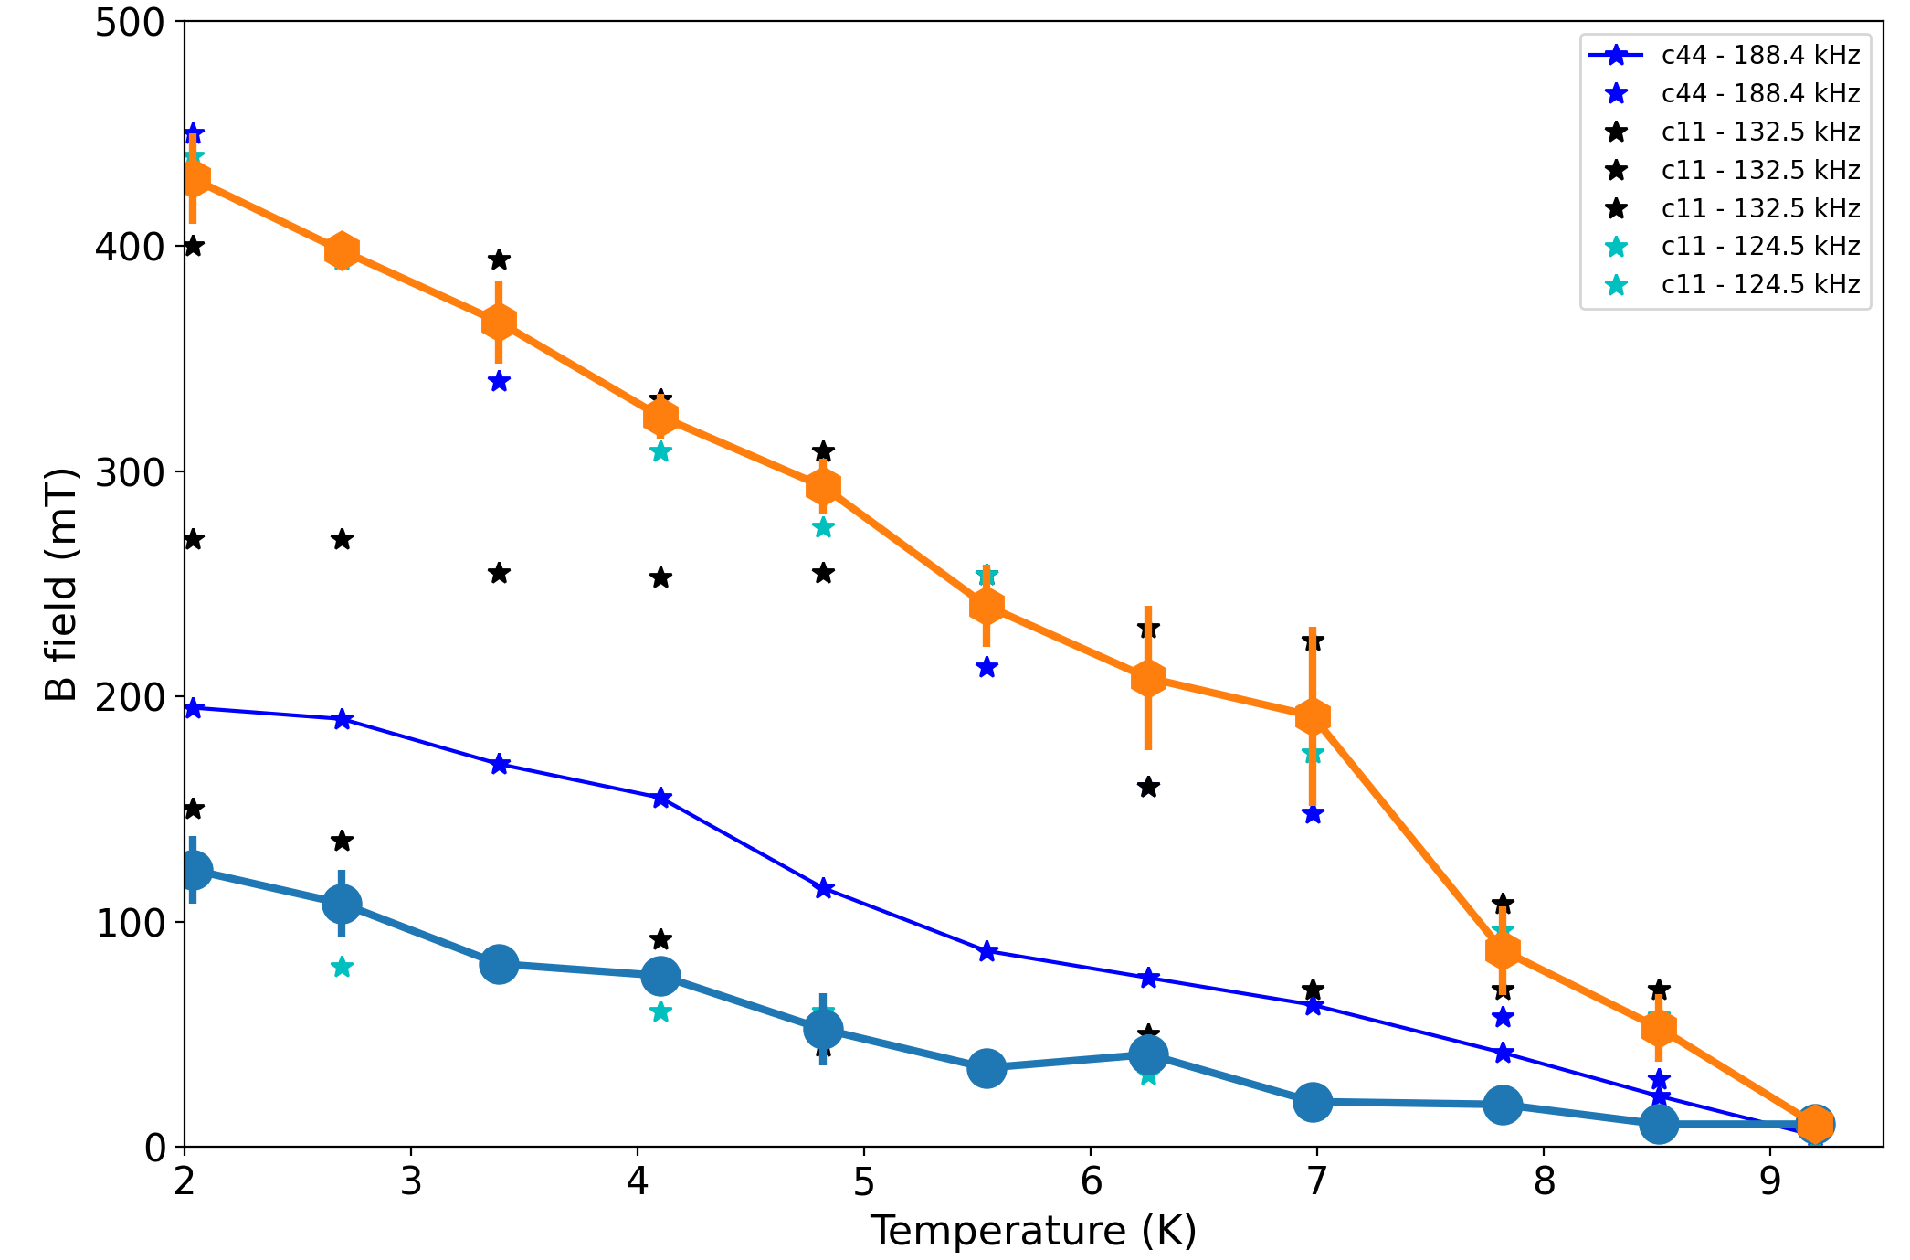
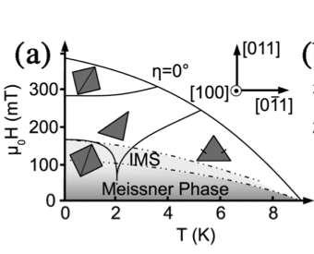
Phase transition of Niobium by RUS measurement.
S. Mühlbauer et al, PRL 102, 136408 (2009)
Shubnikov
IMS
Meissner
Notes:
Phase transition of Nb can be extracted by collect all the ZFC curve in the bias temperature range in 2K to 10K.
Our result is compare about with publication in 2009, which has done by neutron method.

Slide 12
Conclusion
Developed RUS experiment successful investigate the phase transition of Niobium cause the change of elasticity.
RUS useful tool for the investigation vortex phases and phase transitions

Slide 13

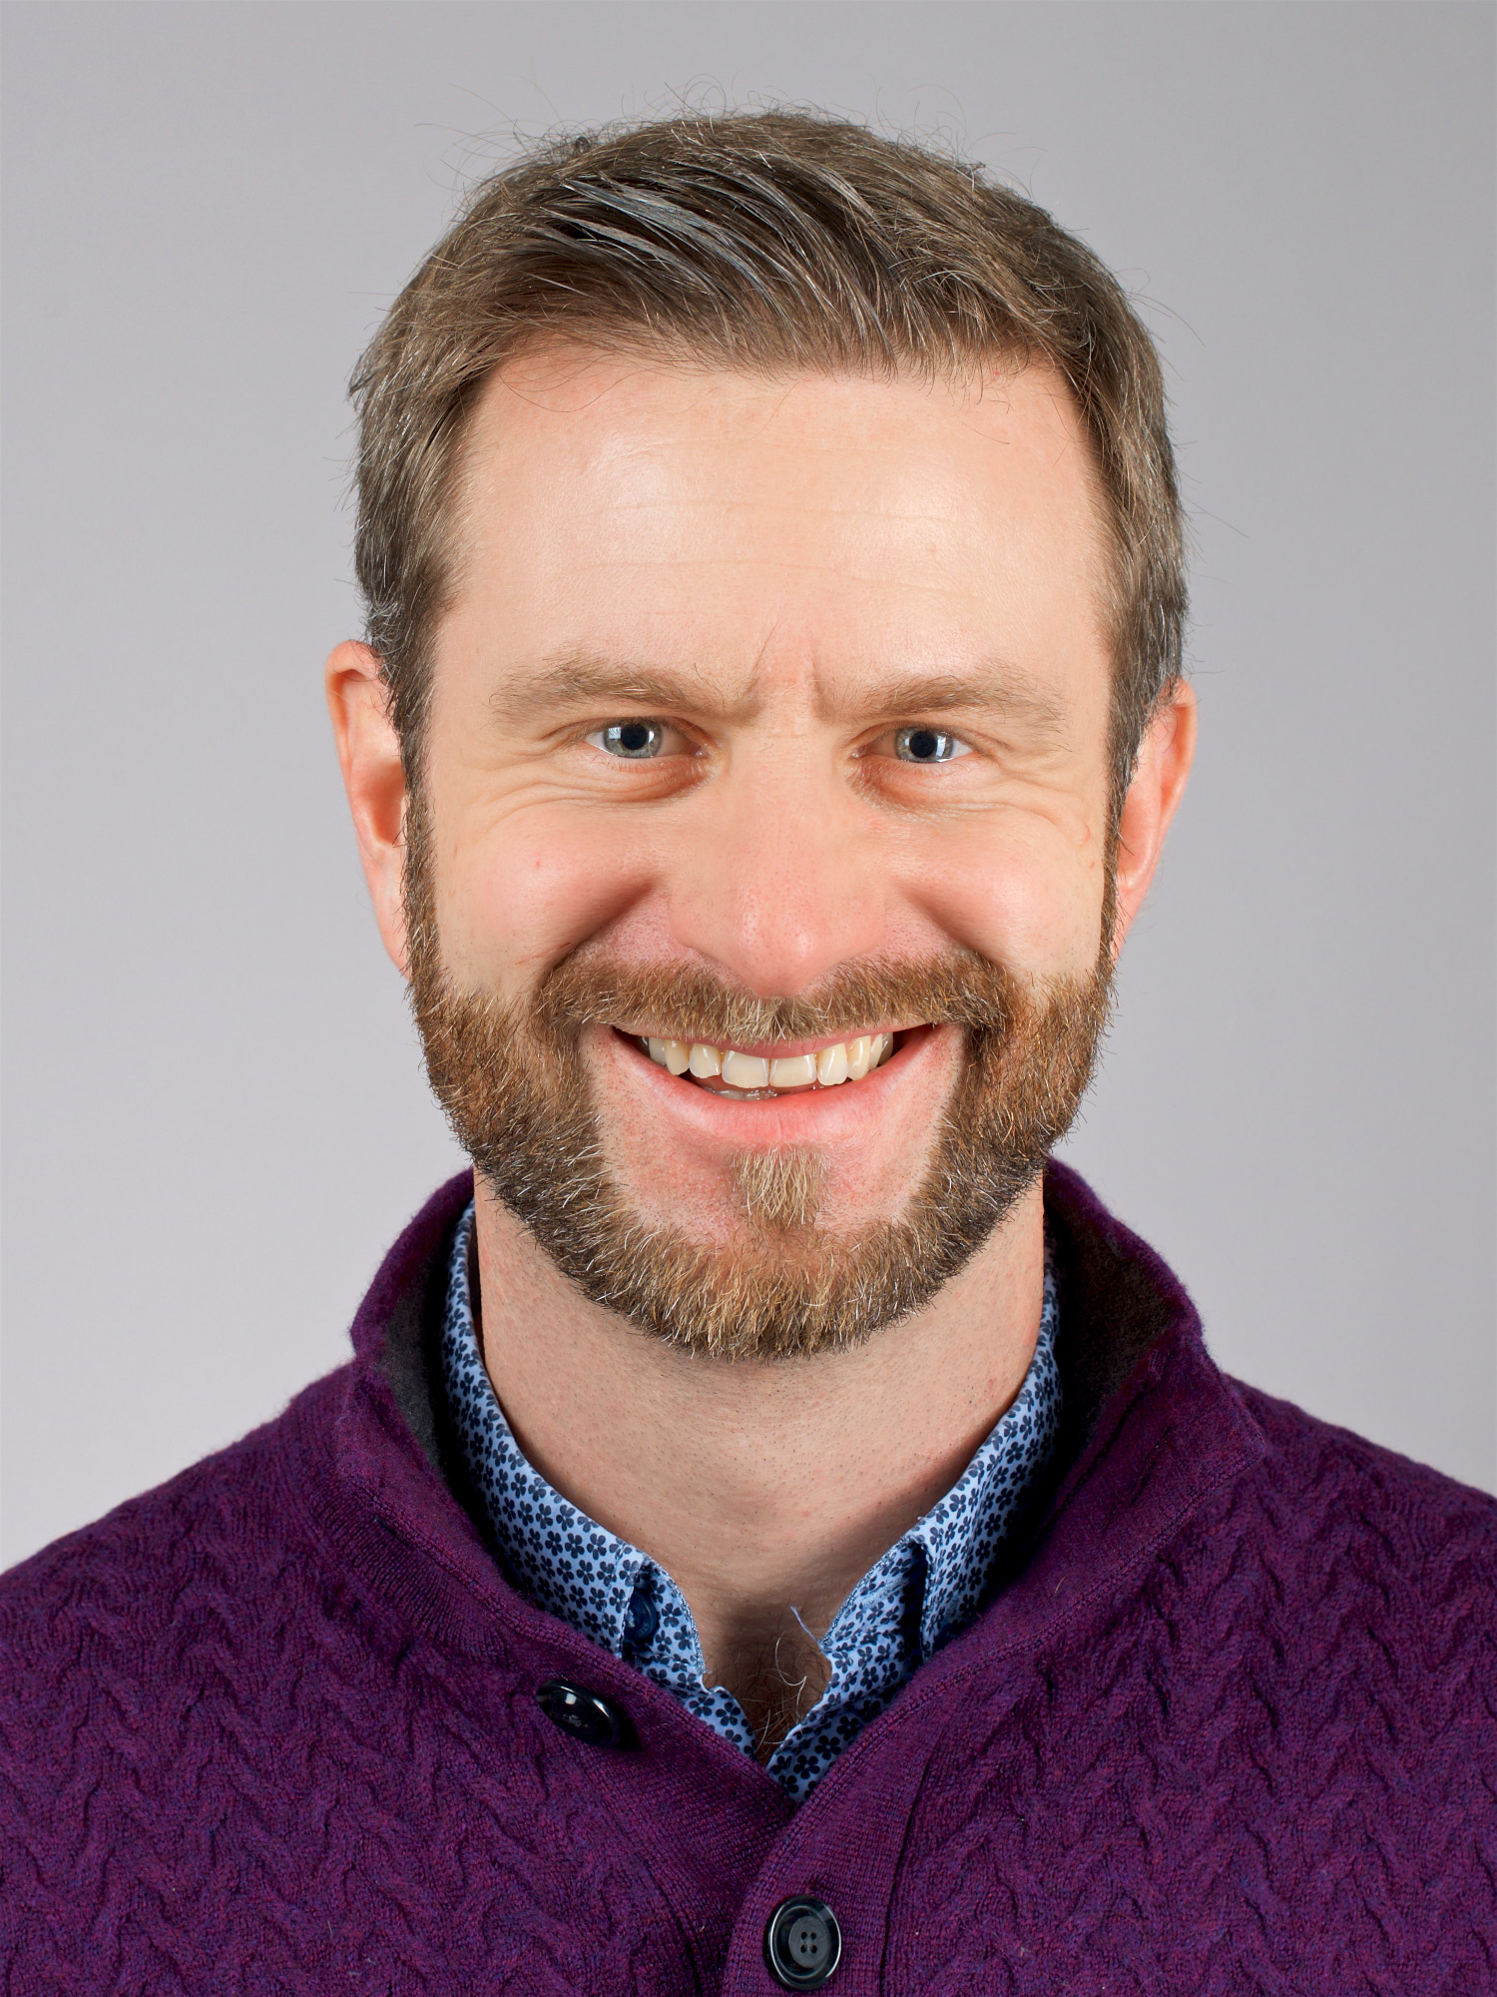

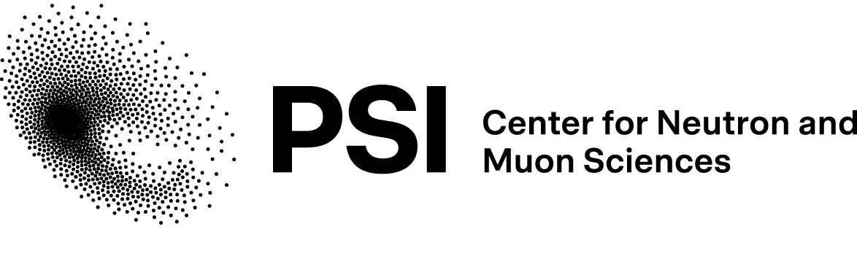

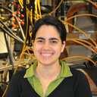
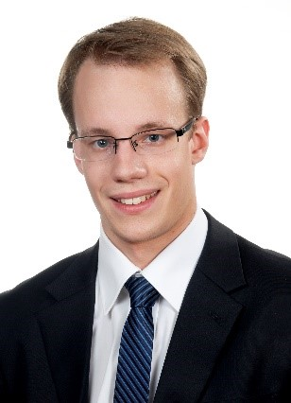
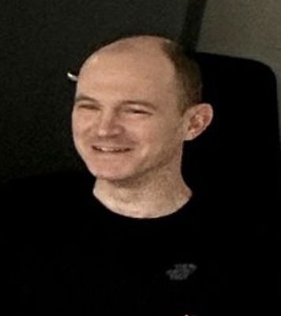
Acknowledgments
UZH
M. Janoschek
M. Bartkowiak
M. Zolliker
C. Klauser
J. Philippe
F. Fautz

Slide 14
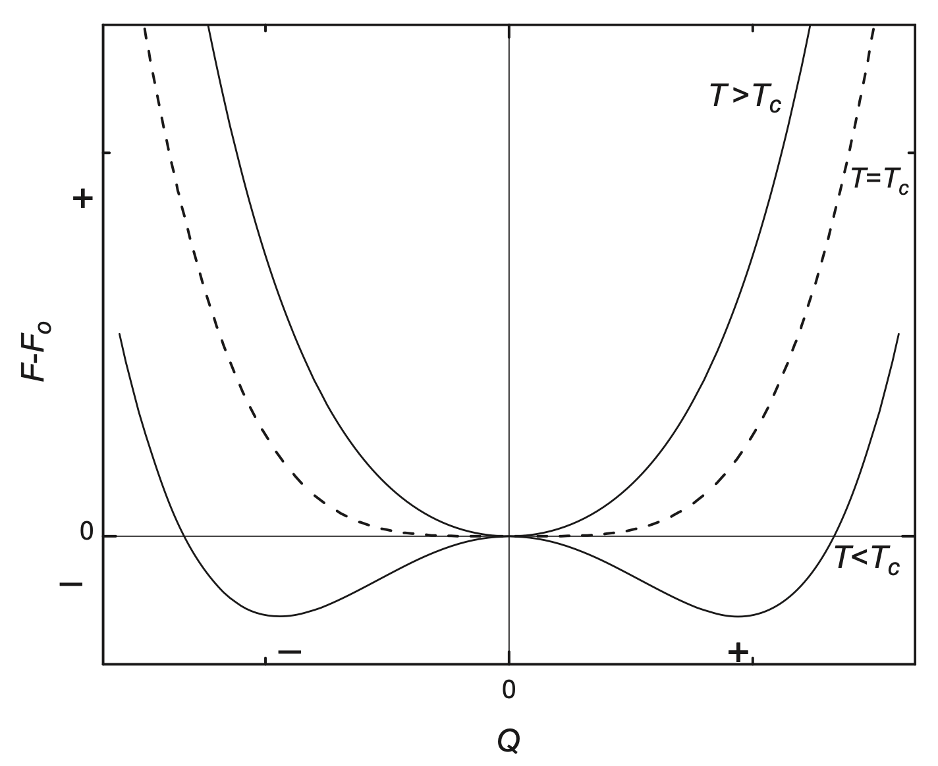
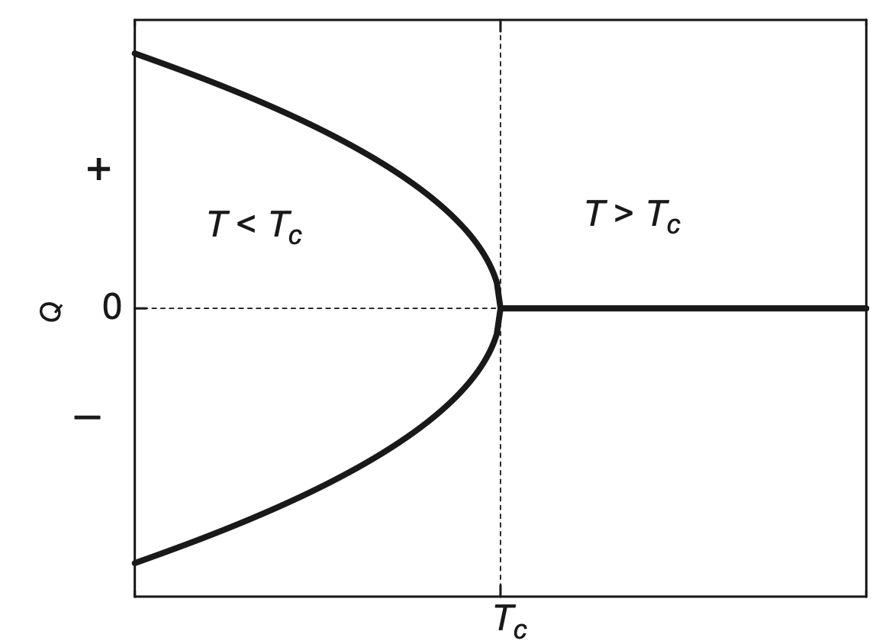
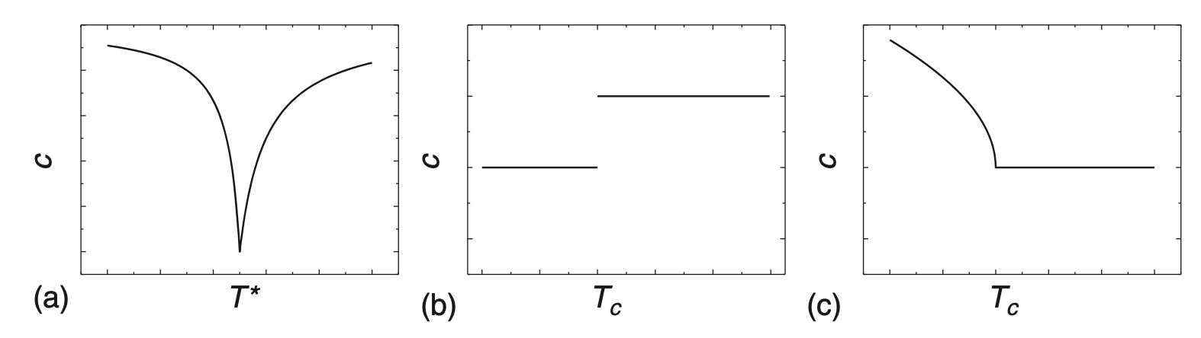



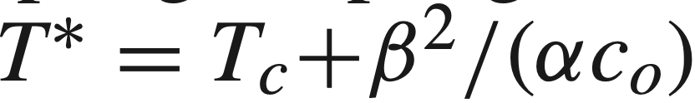
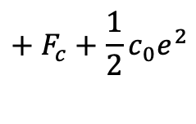
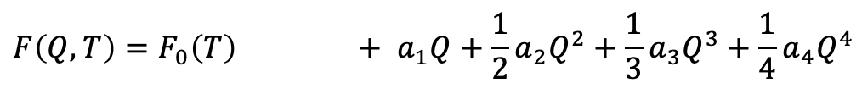
Supplementary Information
In the second-order phase transition, Landau theory:
$$F\left(Q,T\right)=F_{0}\left(T\right) + a_{1}Q+\frac{1}{2}a_{2}Q^{2}+\frac{1}{3}a_{3}Q^{3}+\frac{1}{4}a_{4}Q^{4}$$
$$+ F_{c}+\frac{1}{2}c_{0}e^{2}$$
Adding the term for order parameter (Q) and elastic strain (e) coupling (F_{c}) and elastic energy
Robert G. Leisure et al. Ultrasonic spectroscopy. chapter 5

Slide 15
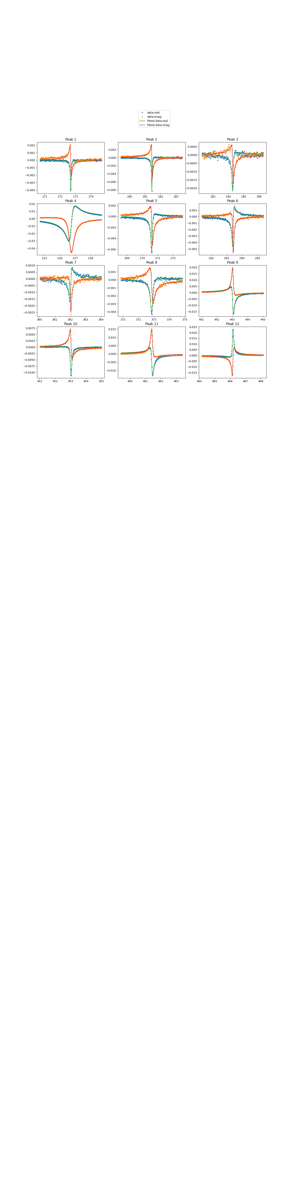
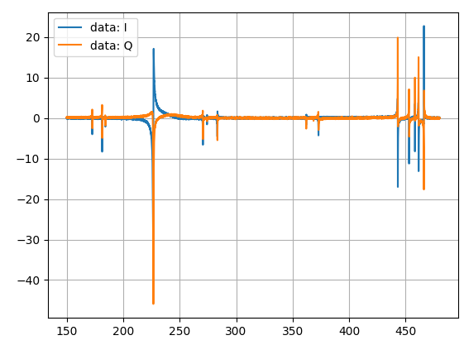
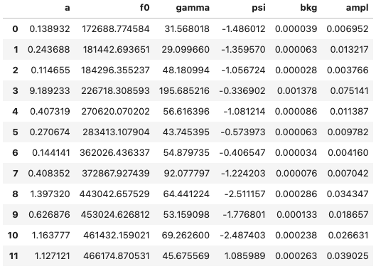
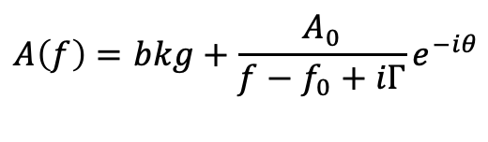
Supplementary Information
$$A\left(f\right)=bkg+\frac{A_{0}}{f−f_{0}+iΓ}e^{−iθ}$$

Slide 16
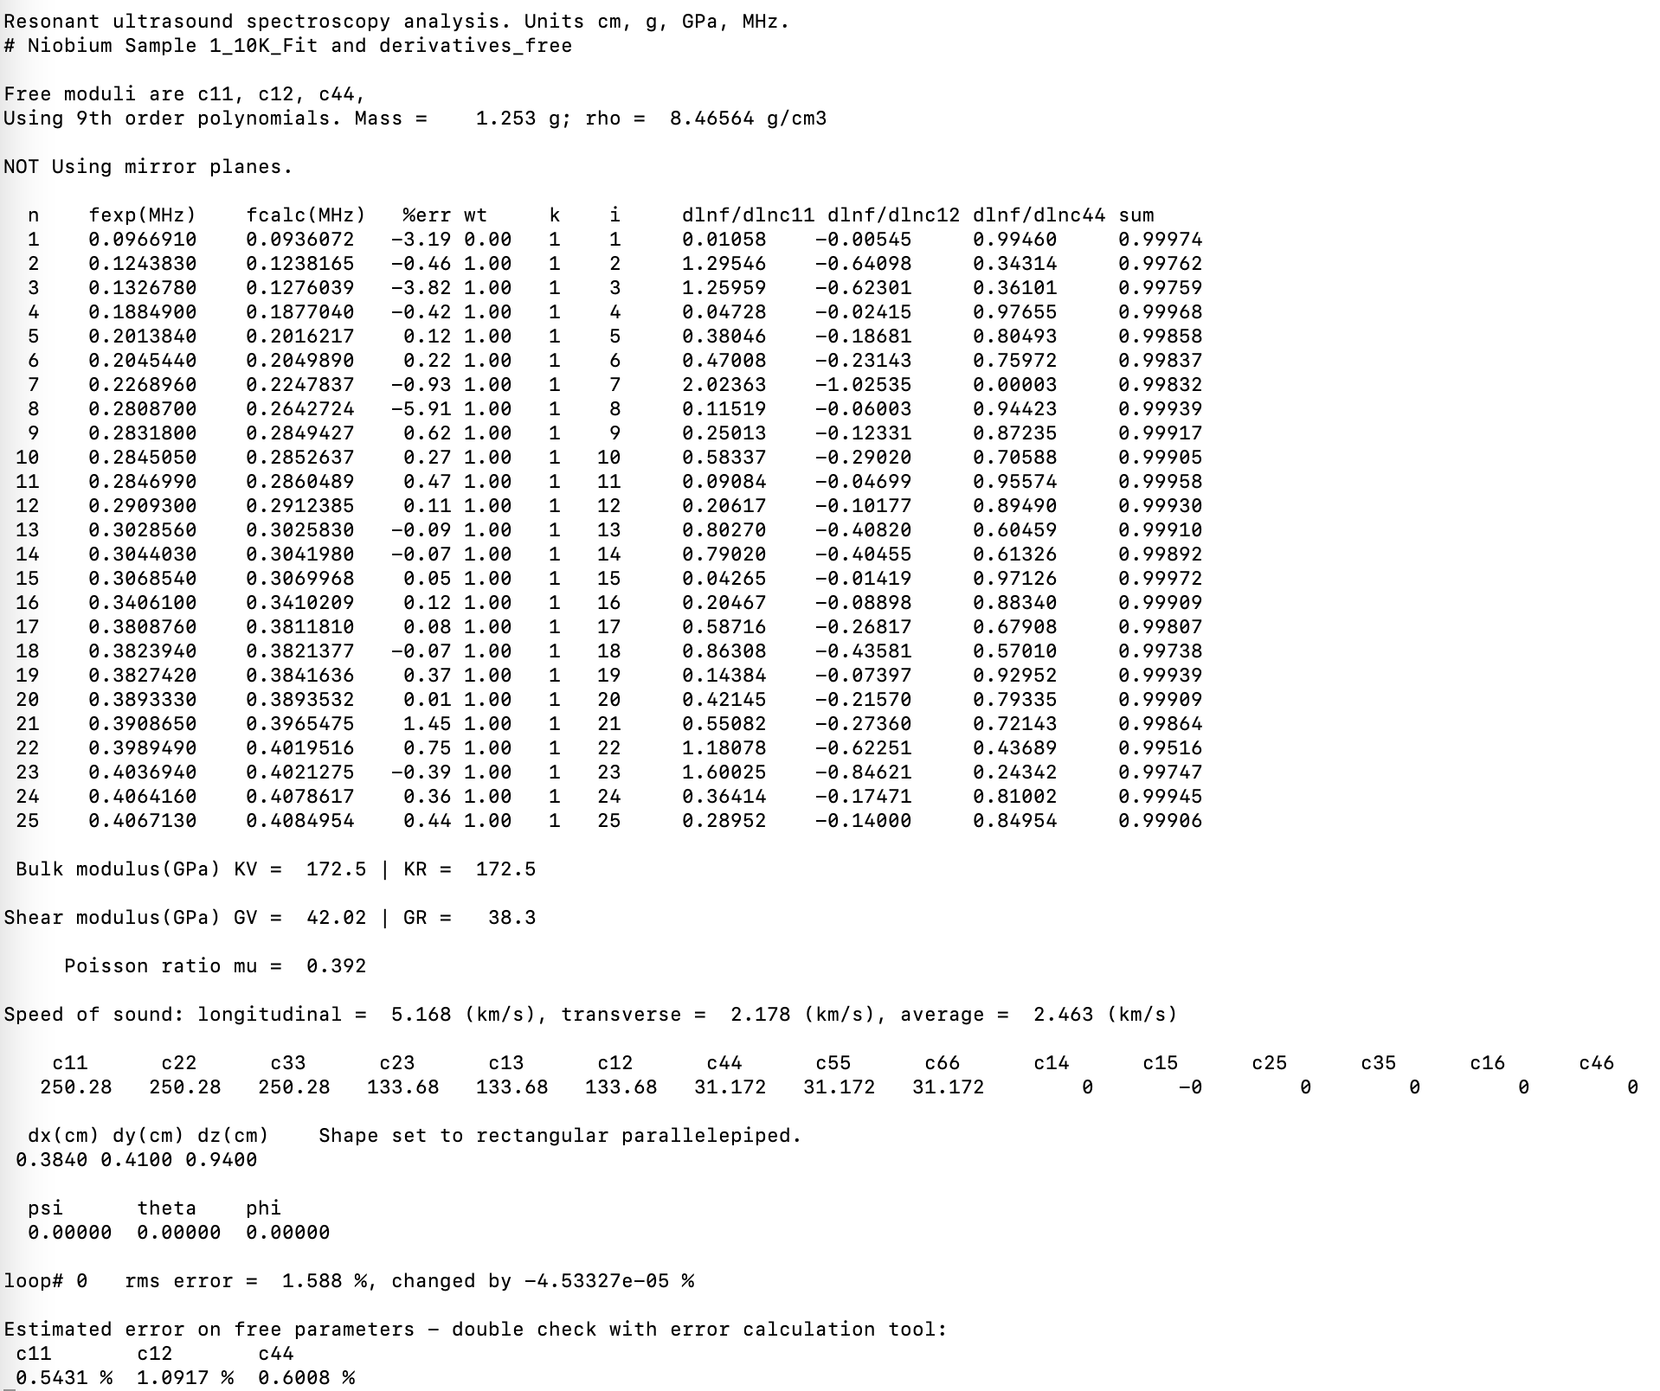


Elastic tensor computing

