Slide 1

NI HTS magnet projects at PSI
J. Kosse, D. Araujo, B. Auchmann, A. Brem, M. Duda, T. Michlmayr, H. Garcia Rodrigues
SPS2024
This work was performed under the auspices of and with support from the Swiss Accelerator Research and Technology (CHART) program

Slide 2
Contents
18 T technology demonstrator
18 T split solenoid
RIXS manipulator head magnet
Positron capture solenoid

Slide 3
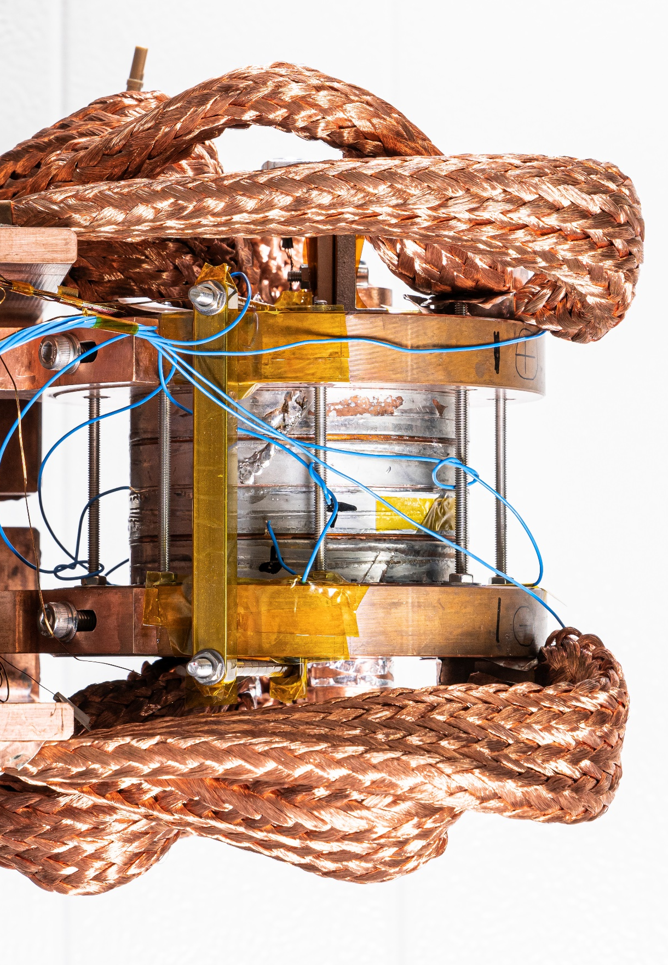
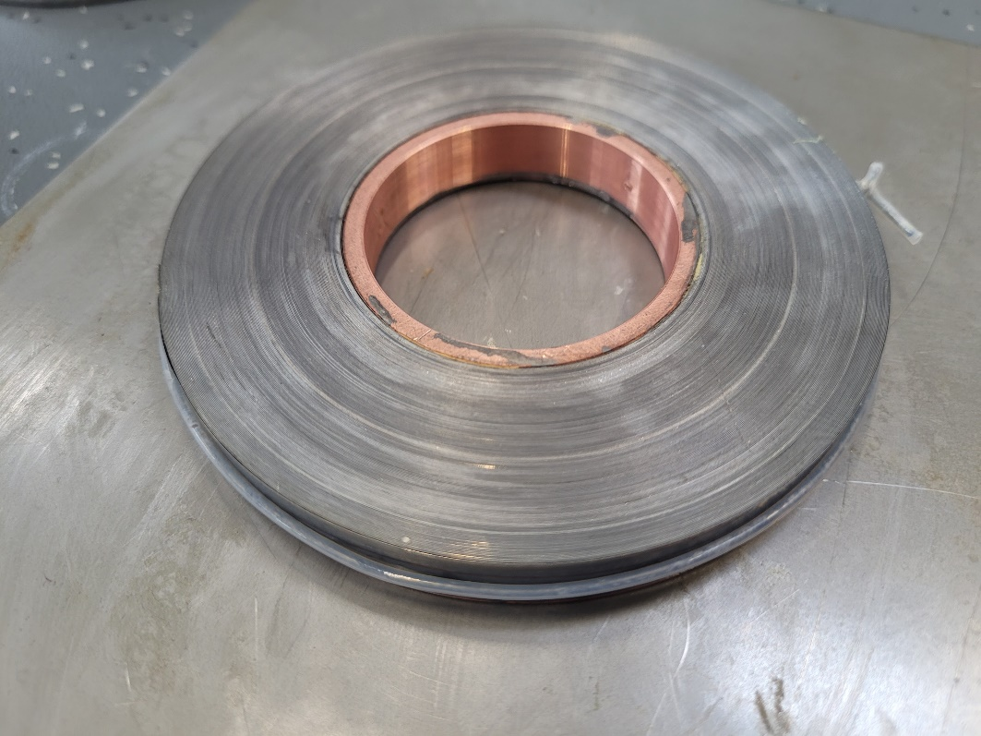
Non-insulated (NI) HTS
Single-layer pancake coil wound from bare HTS tape
Solder-impregnated
100 mm

Slide 4

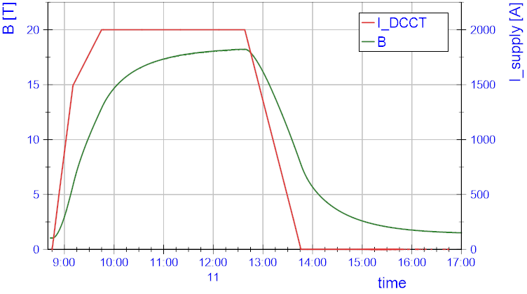
Non-insulated (NI) HTS Technology Solenoid
Rapidly develop infrastructure
via license agreement with
Tokamak Energy
18 T by PSI 4 stack at 2 kA, 12 K
4x 12 mm wide coil
Solder-potted
100 mm

Slide 5



Non-insulated (NI) HTS Technology Solenoid
NI coil electrical representation:
Inductor (HTS spiral path)
Resistor (turn-turn contact)
Charging time constant $τ=L/R$
Large NI magnets (large L) take a long time
18 T by PSI 4 stack at 2 kA, 12 K
$$L$$
$$R$$

Slide 6
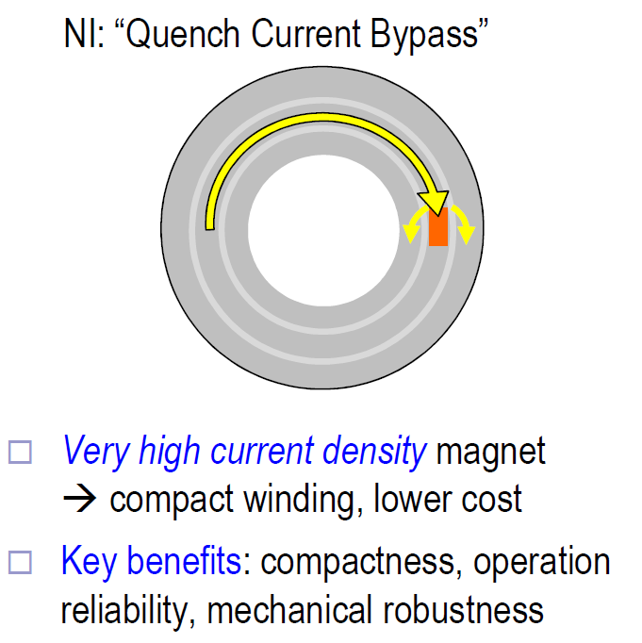
Non-insulated (NI) HTS Technology Solenoid
NI coil electrical representation:
Inductor (HTS spiral path)
Resistor (turn-turn contact)
Charging time constant $τ=L/R$
Large NI magnets (large L) take a long time
$$L$$
$$R$$
S. Hahn, D. Park, J. Bascuñán, and Y. Iwasa,
“HTS Pancake Coil without Turn-to-Turn Insulation,” IEEE TAS, 2011.

Slide 7
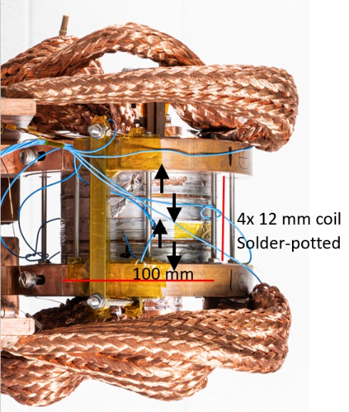
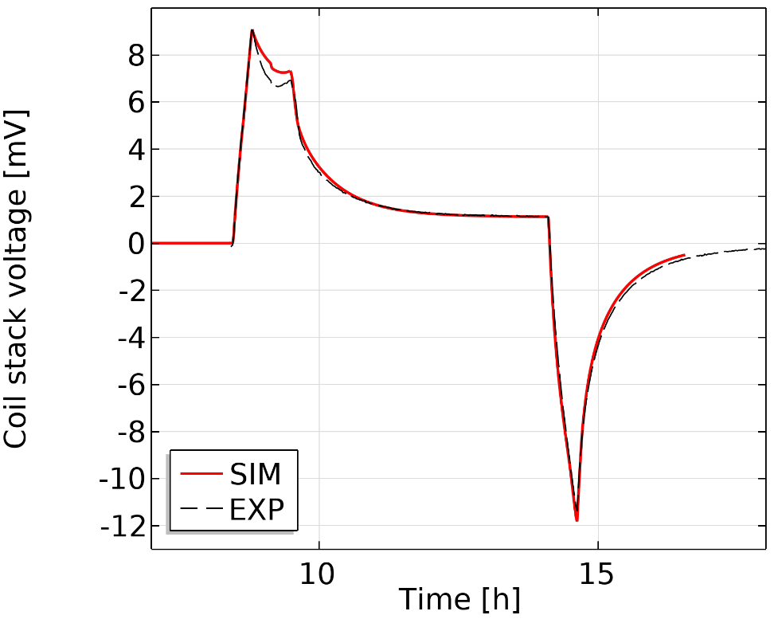
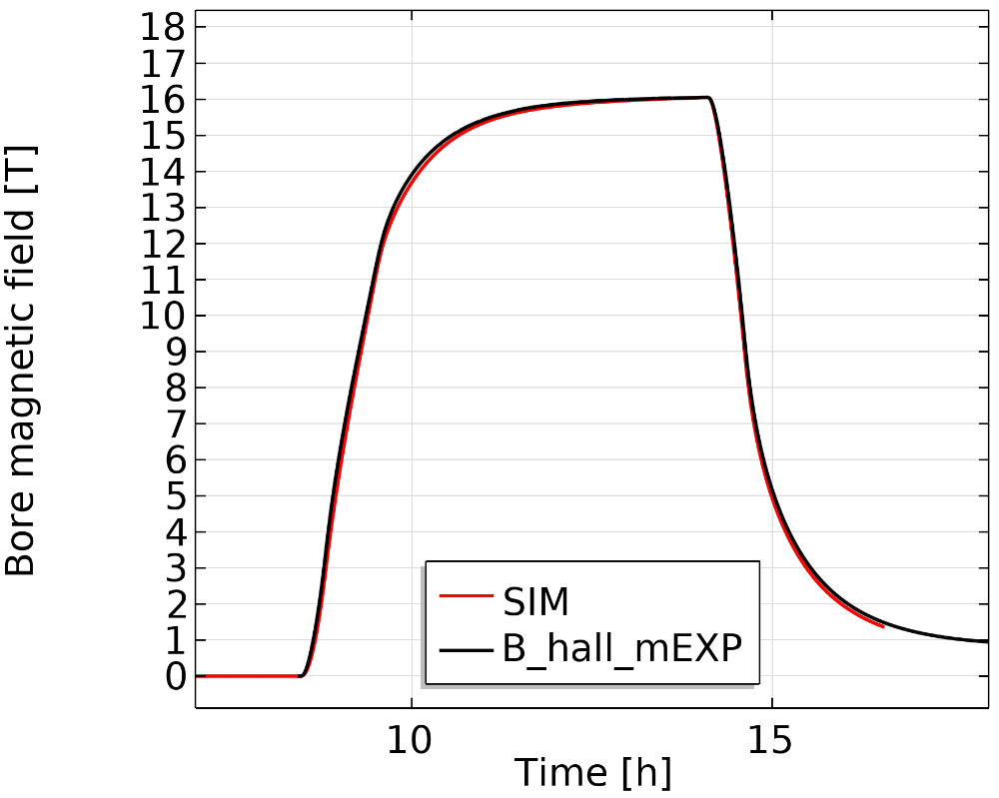
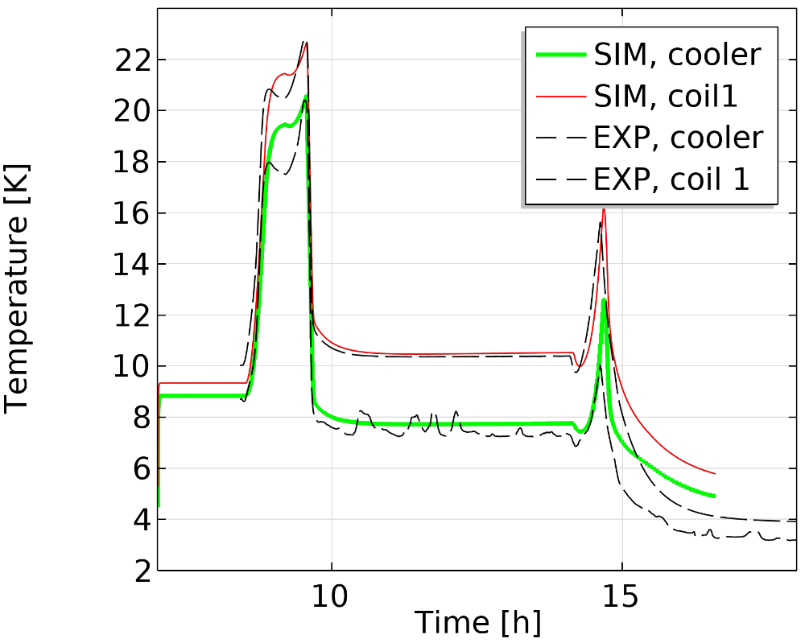

Experiment vs model
Turn-turn resistance used a fitting parameter
$$ρ_{turnturn}∝ρ_{copperRRR20}\left(B,T\right)$$
Works reasonably over a 15-77 K range
Example: 1.8 kA at 15 K in cryogen-free setup

Slide 8
Contents
18 T technology demonstrator
18 T split solenoid
RIXS manipulator head magnet
Positron capture solenoid

Slide 9
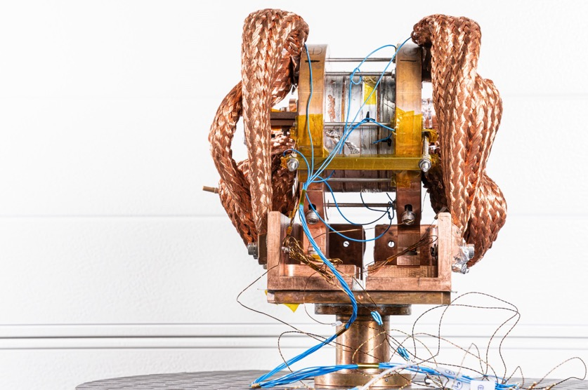
Split Solenoid for Neutron Scattering
10 mm split NI HTS solenoid
18 T NI HTS solenoid
Bore field 18 T at 2 kA, 12 K
4 coils
Predict with simulation
~Bore field 18 T at 1.8 kA
6 coils
10 mm

Slide 10
Contents
18 T technology demonstrator
18 T split solenoid
RIXS manipulator head magnet
Positron capture solenoid

Slide 11
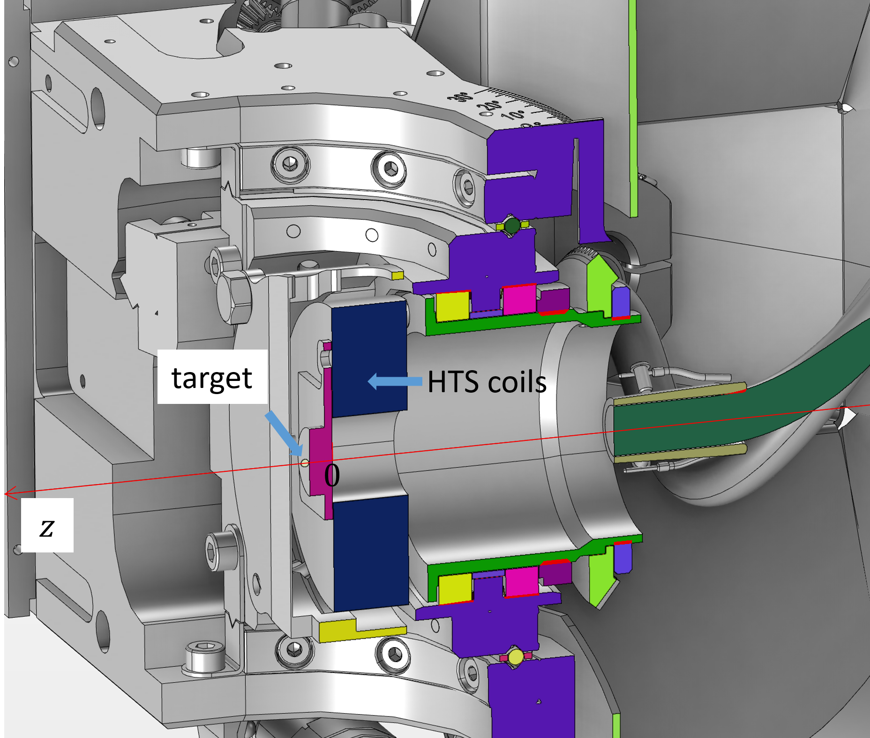
R’Equip RIXS Manipulator Solenoid
Planned upgrade of the manipulator used in the RIXS beamline at SLS for soft X-ray scattering experiments. Funded, planned to start design 11/24
Supply a high magnetic field (up to 6 T) on the target via compact solenoid
3.6 cm

Slide 12
Contents
18 T technology demonstrator
18 T split solenoid
RIXS manipulator head magnet
Positron capture solenoid

Slide 13

PSI Positron Production ($P^{3}$) Experiment @ SwissFEL
Aims to demonstrate high yield positron source in 2026. Relevant for FCC-ee
SwissFEL

Slide 14
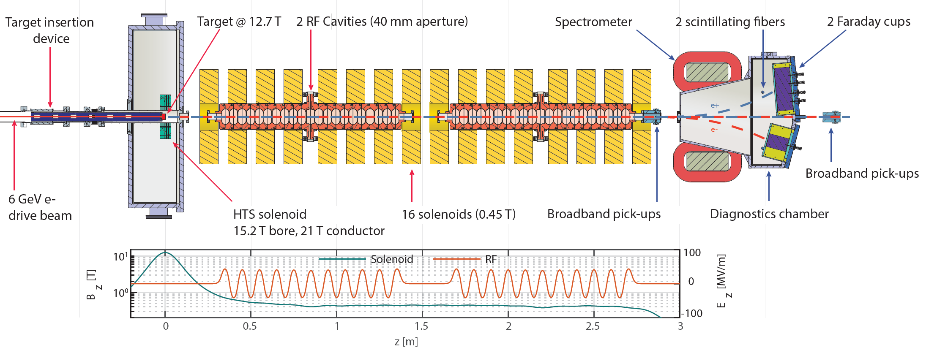
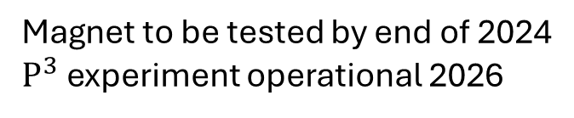
PSI Positron Production ($P^{3}$) Experiment
Aims to demonstrate high yield positron source
Magnet to be tested by end of 2024
$P^{3}$ experiment operational 2026
N. Vallis, https://doi.org/10.1103/PhysRevAccelBeams.27.013401

Slide 15
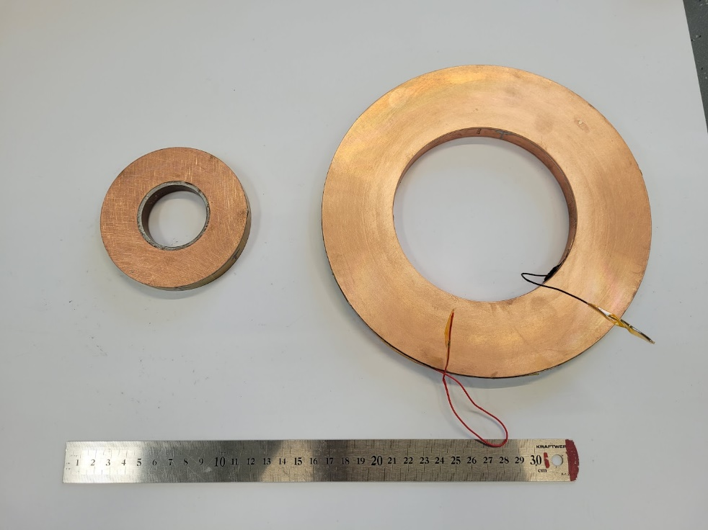
Upscaled version of 18 T PSI NI solenoid
18 T 50 mm cold bore
4 coils
Built & tested
15 T 72 mm warm bore
5 coils
Under construction

Slide 16
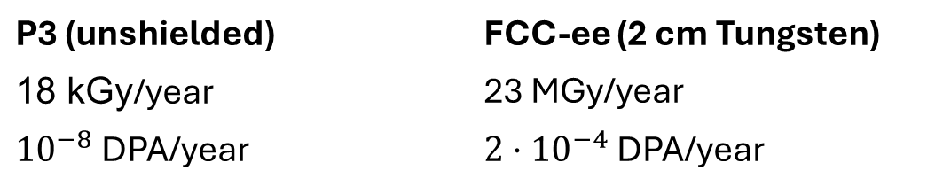
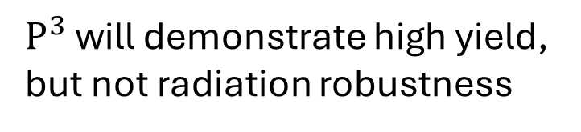
Radiation
$P^{3}$ will demonstrate high yield,
but not radiation robustness
P3 (unshielded) | FCC-ee (2 cm Tungsten)
18 kGy/year | 23 MGy/year
${10}^{−8}$ DPA/year | $2⋅{10}^{−4}$ DPA/year
B. Humann, doi:10.18429/JACoW-IPAC2022-THPOTK048

Slide 17
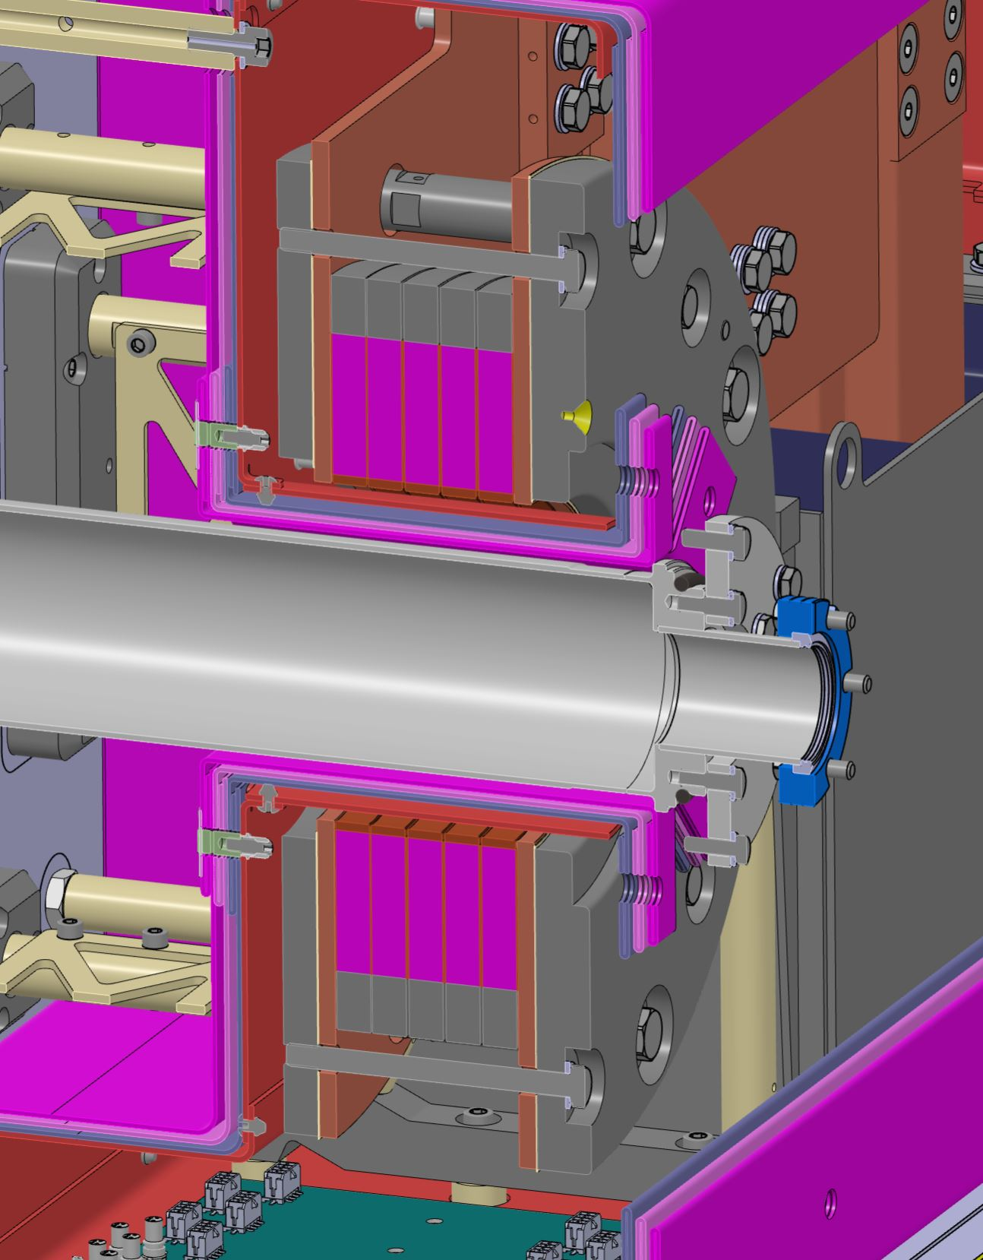
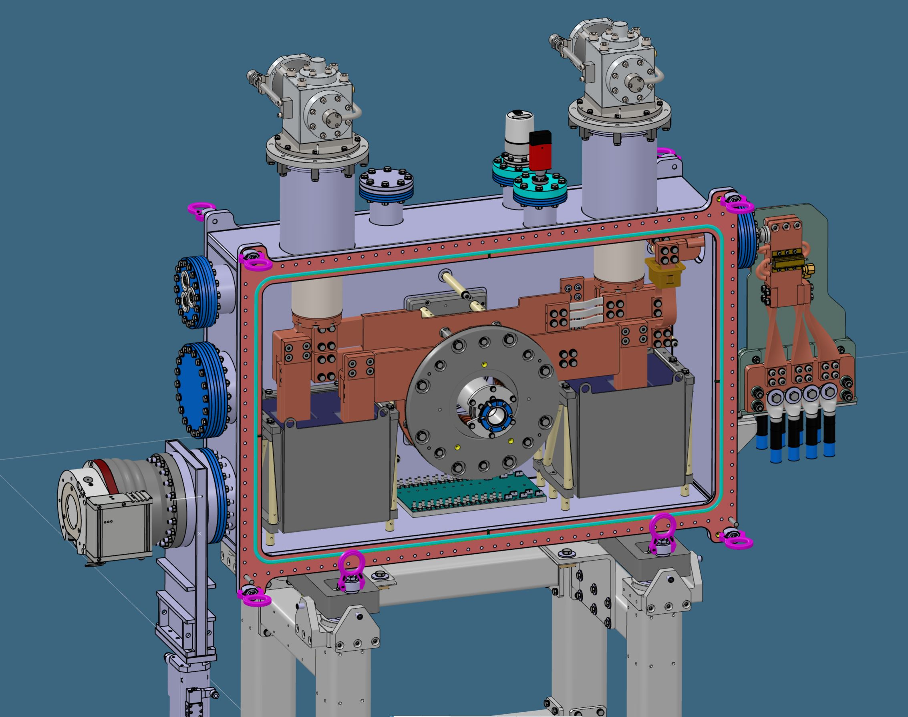

Conduction-cooled system
15 T bore, 20 T conductor @ 1.2 kA, 15 K
G10/SS support
Cryocooler
Current leads
Current terminals
Solenoid stack
HTS coils
72 mm
$$e^{−}$$
Target
1.07 m
Pb mass
Thermal shield
MLI

Slide 18
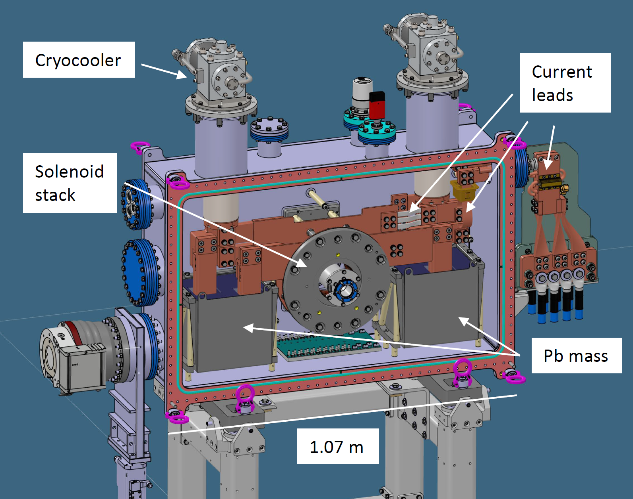
Fault scenario:
Coolers stop
R_turnturn
HTS path
Open circuit
Stored energy gets dissipated
in coils+buffers

Slide 19

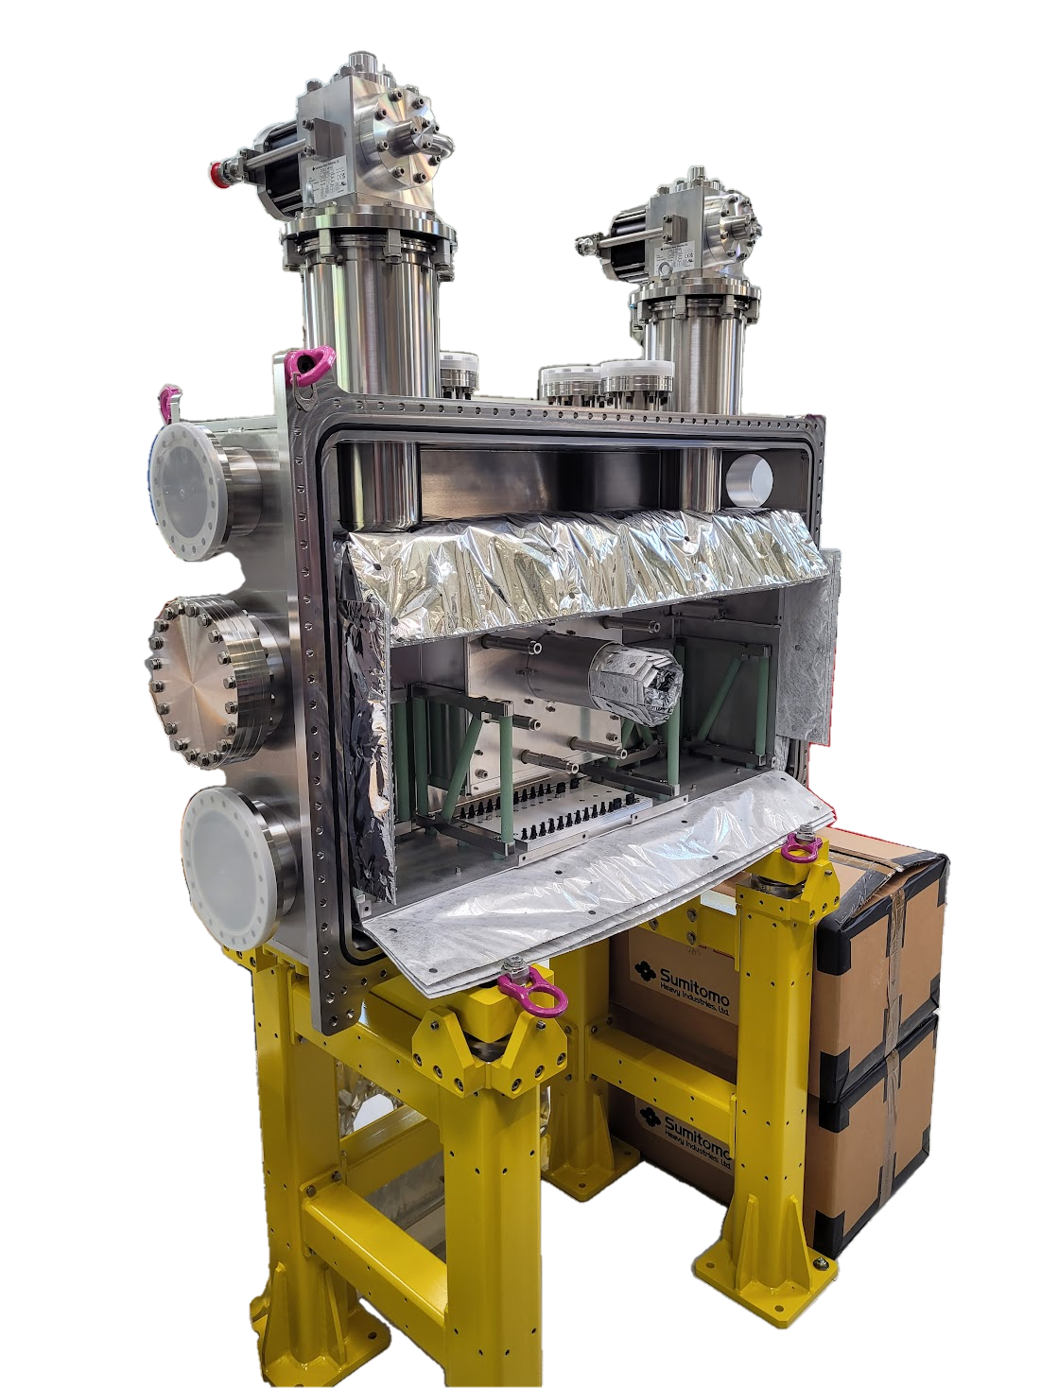
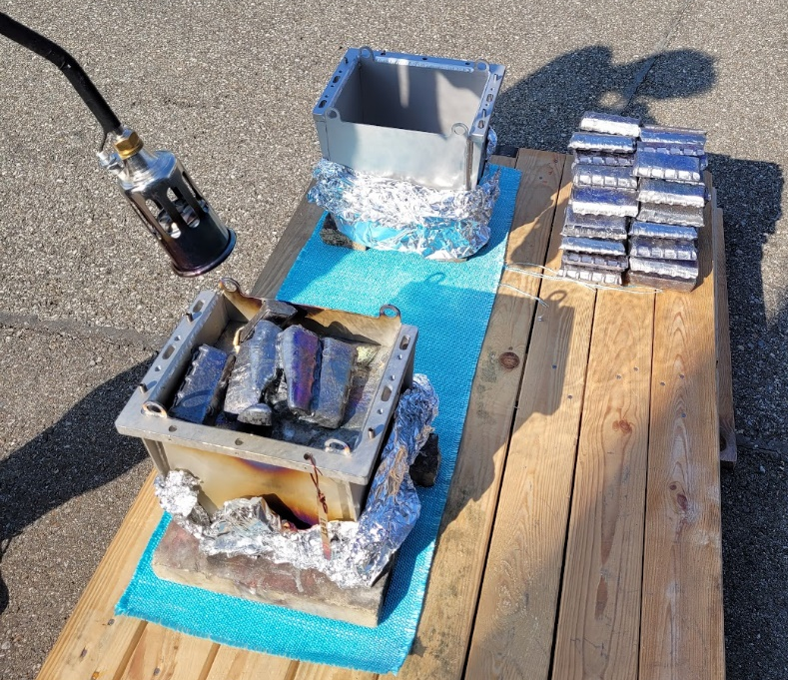
Magnet under construction
Cryostat being assembled
Coils being manufactured
Lead buffer casting

Slide 20
Conclusions
Several no-insulation HTS magnet projects ongoing at PSI
18 T split solenoid
RIXS manipulator compact solenoid
Positron capture solenoid
Leaning on experience gained via 18 T solenoid
No-insulation HTS magnets ideally suited for
DC applications
Loose magnetic field quality requirements
Compact solutions

Slide 21
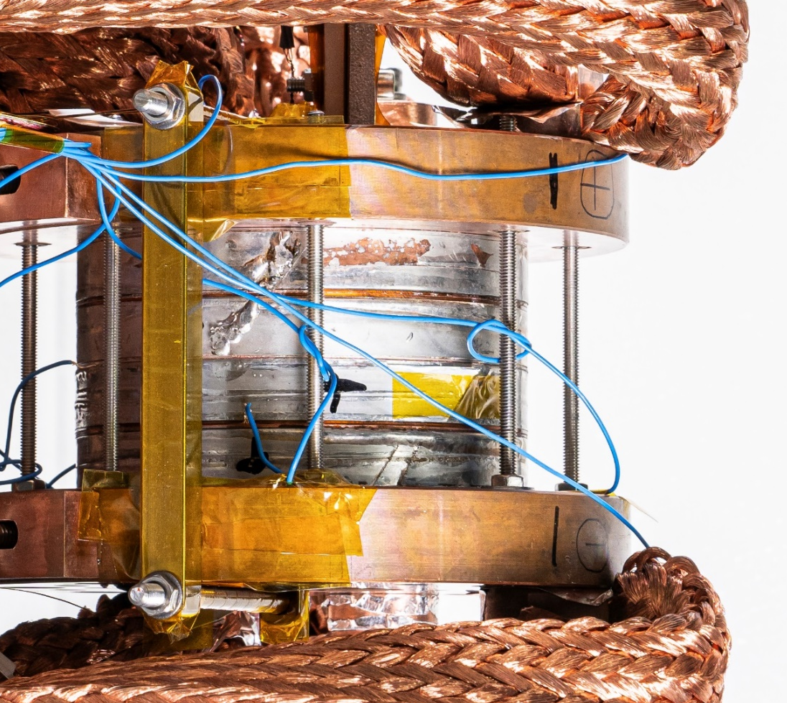



NI HTS Technology Solenoid
Single-layer solder-impregnated pancakes
modular
$+$ terminal
Axial joint
HTS tapes
Insulator
Current
$−$ terminal
100 mm
Rapidly develop infrastructure
via license agreement with
Tokamak Energy

Slide 22
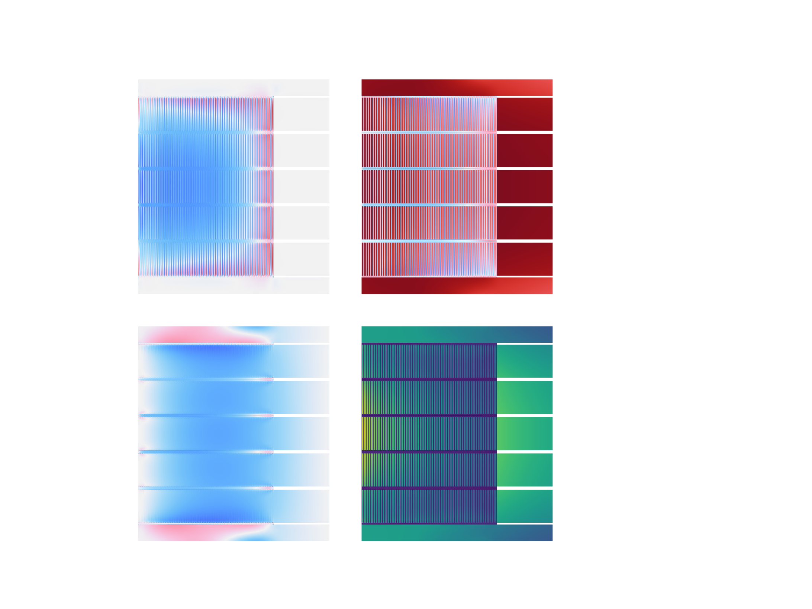
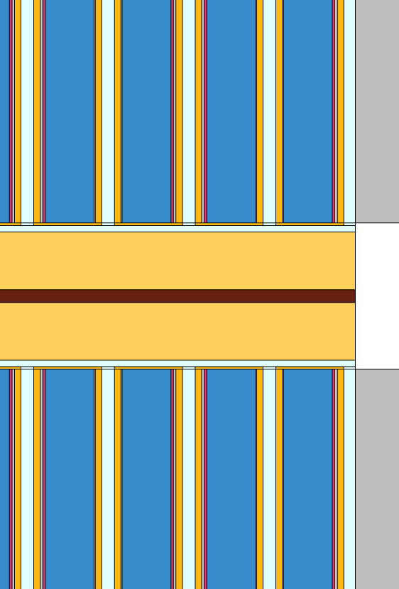
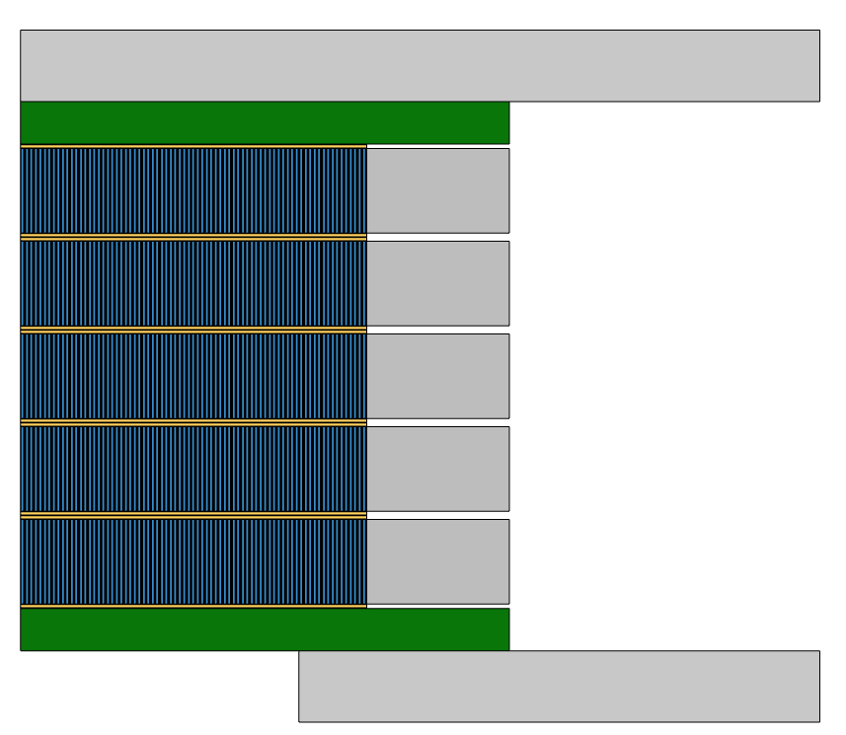
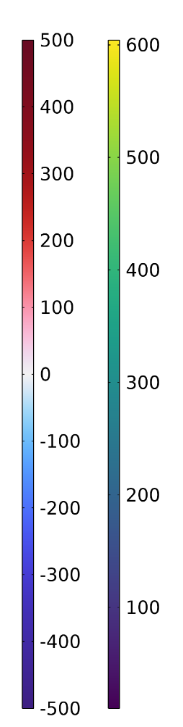


Mechanical
Axial
Hoop
Stress [MPa]
Stainless steel flange
$$z$$
Copper terminal plate
Frictional
interface
$r$
Field’s metal
Stainless steel
overband
Axial plate
HTS tapes
Radial
Mises
Tape structure explicitly modeled to capture
-differential thermal contraction
-plasticity
Max radial stress 2 MPa
Min axial stress -155 MPa
Max hoop stress (substrate) 450 MPa

Slide 23
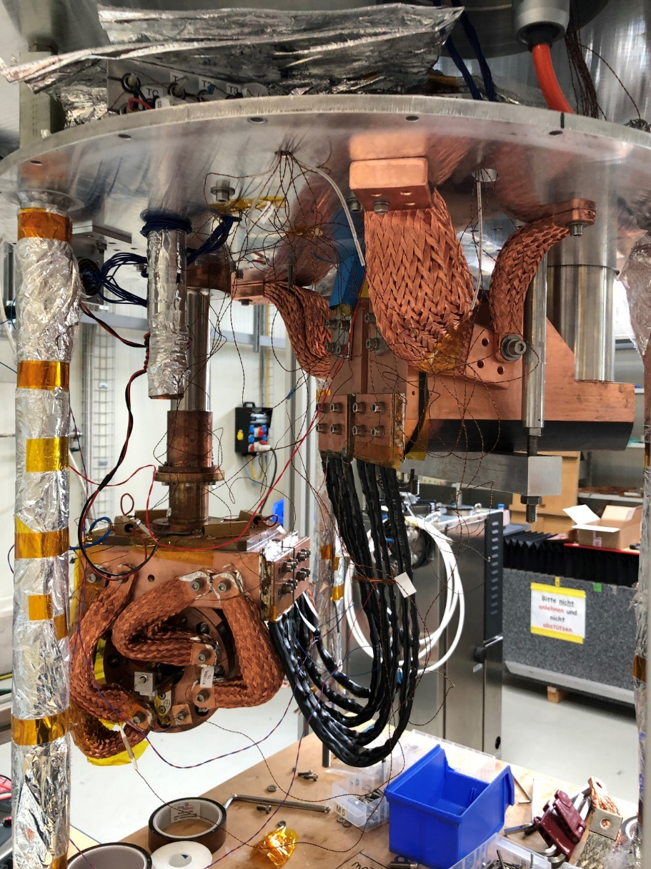
Cryogen-free test stand
2nd cryocooler
radiation shield
top plate
Central bore field [T]
1st cryocooler
4 K coldhead
stack of 4 NI HTS coils with
connectors
18 T by 4 stack at 2 kA, 12 K
HTS leads

Slide 24
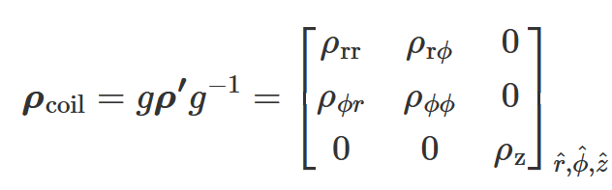
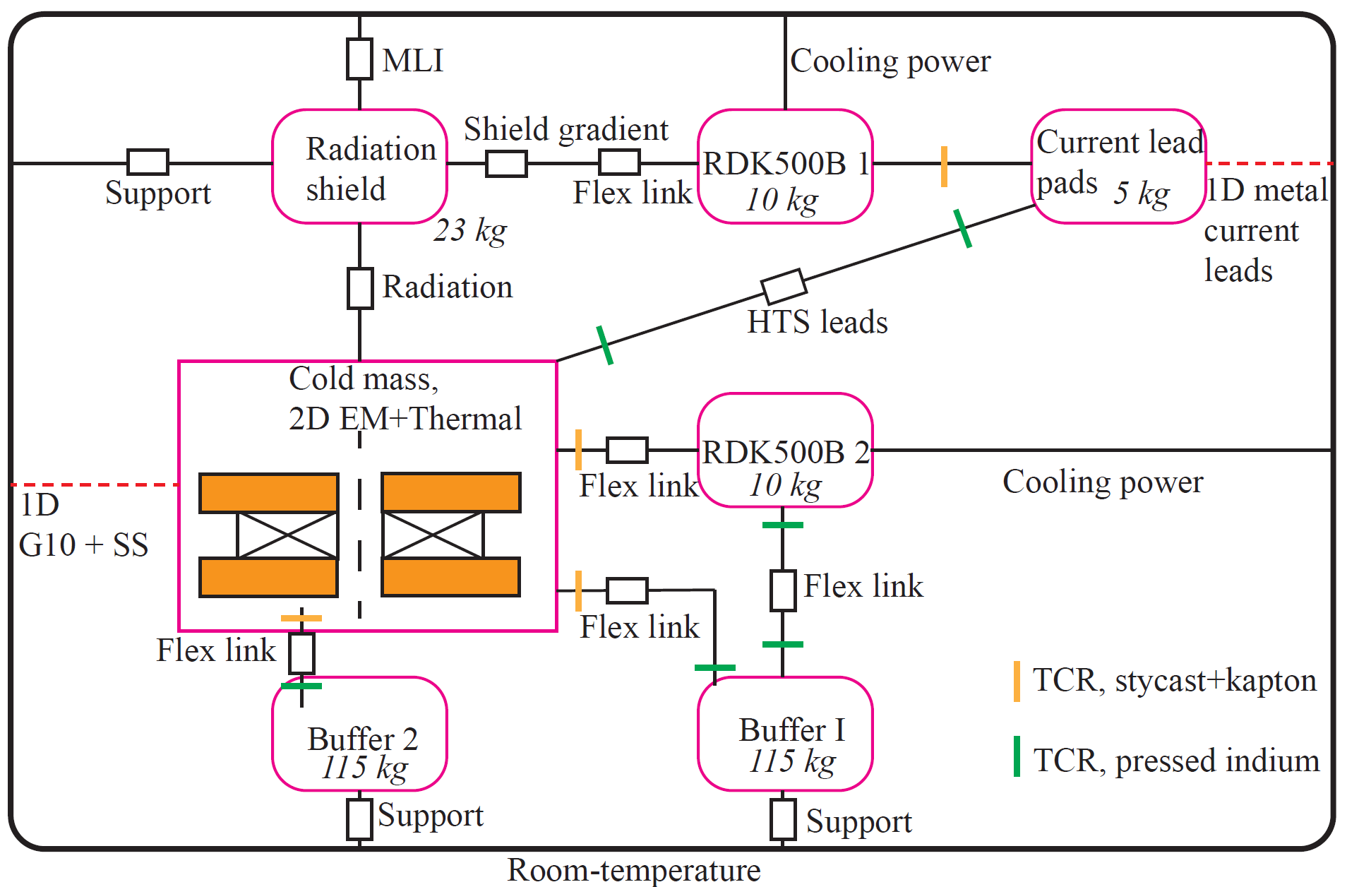
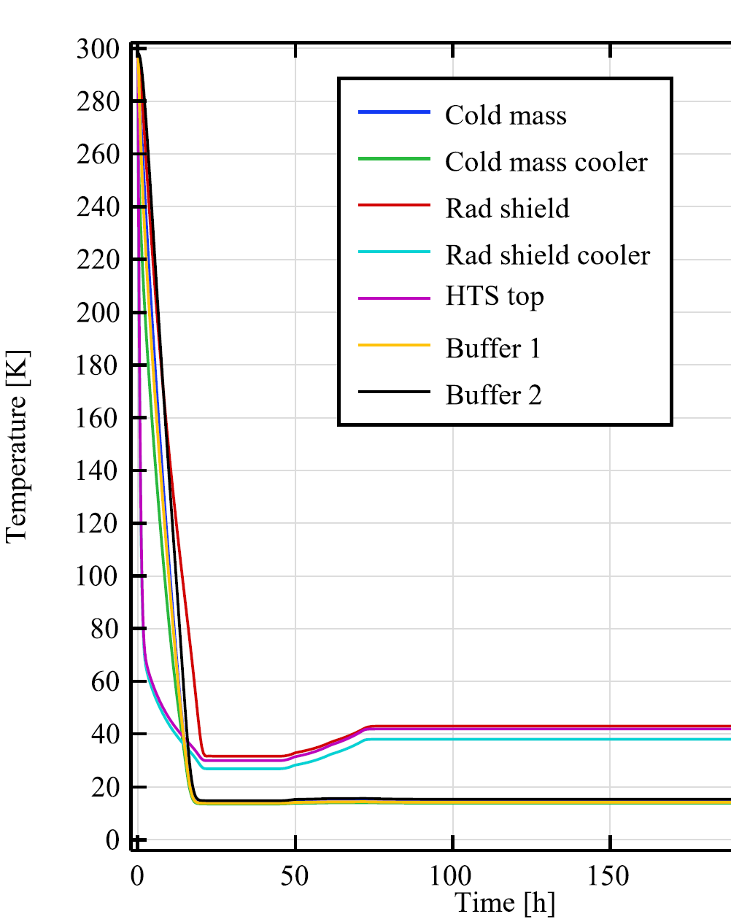

Electromagnet/thermal simulation
2D axisymmetric $H$-formulation,
homogenized winding pack,
Anisotropic resistivity matrix with off-diagonal terms
to account for the spiral nature of the coils [1]
+2D thermal
+ Lumped thermal network
[1] R Mateira, DOI 10.1088/1361-6668/ab9688

Slide 25
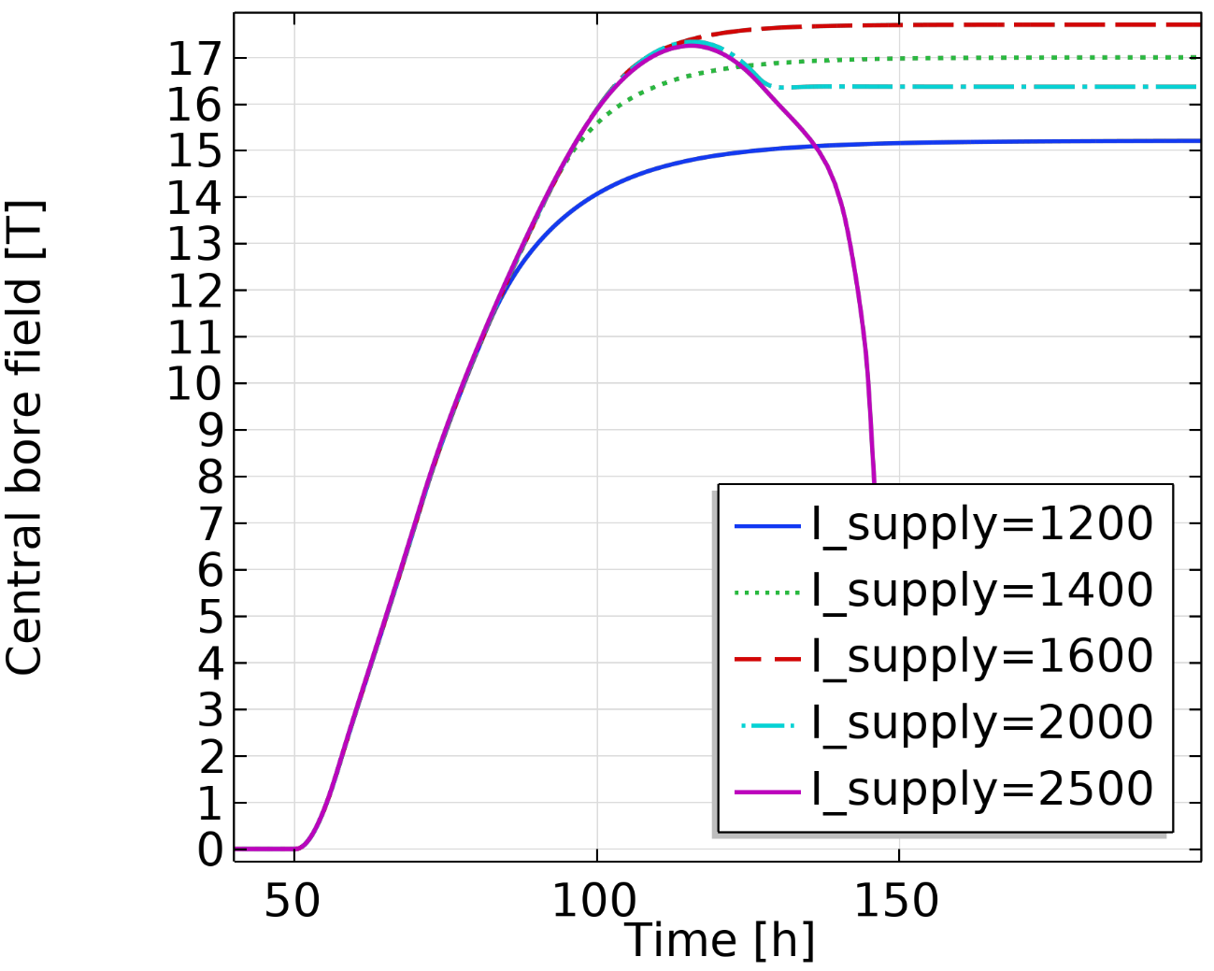
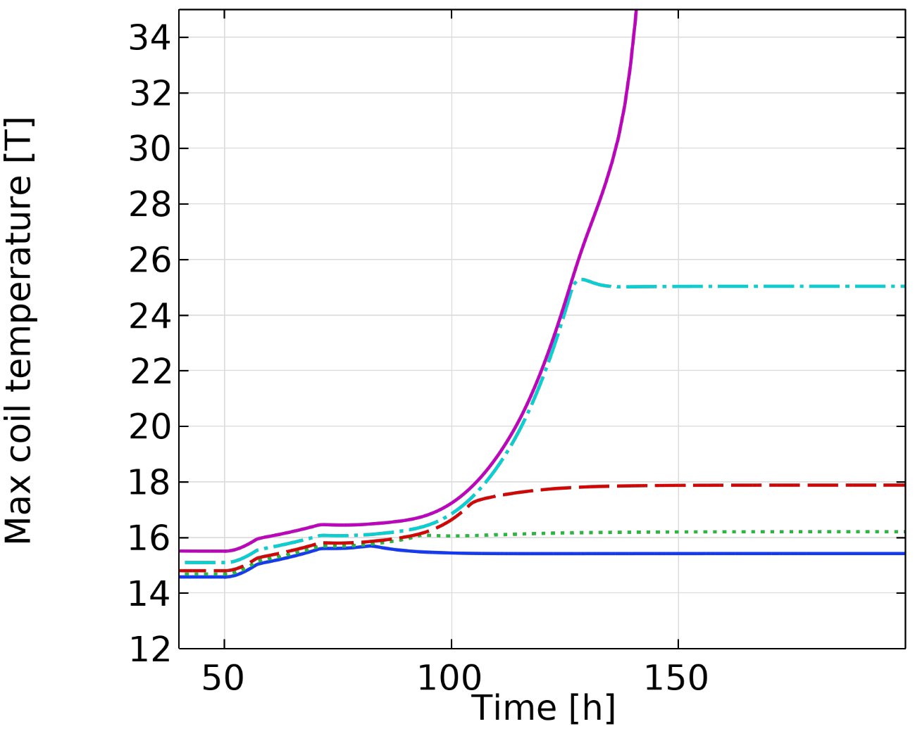
Predicted obtainable field strongly depends on thermal aspects
[K]
1200 A nominal
17 T reachable*, but magnet at risk of quenching during failure
*Not considering mechanical

Slide 26
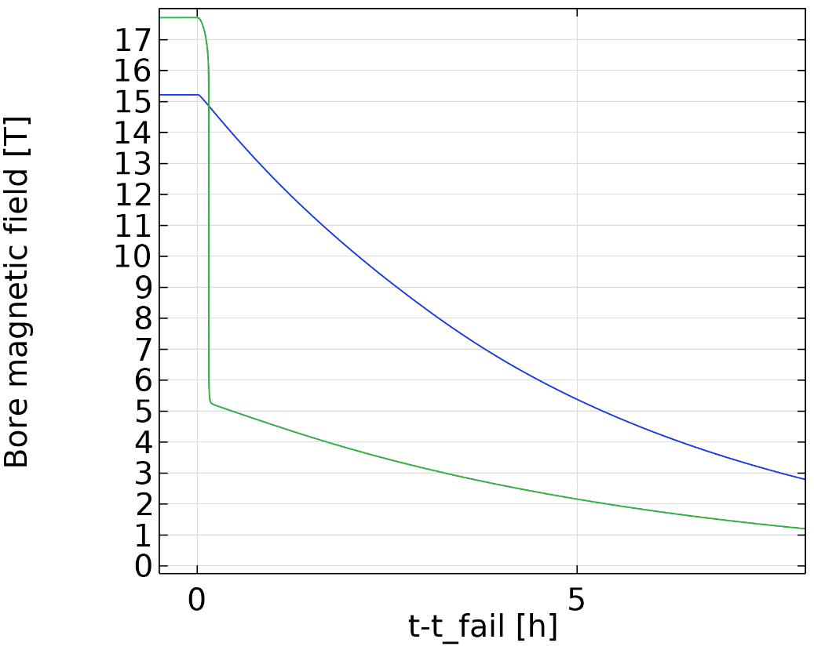
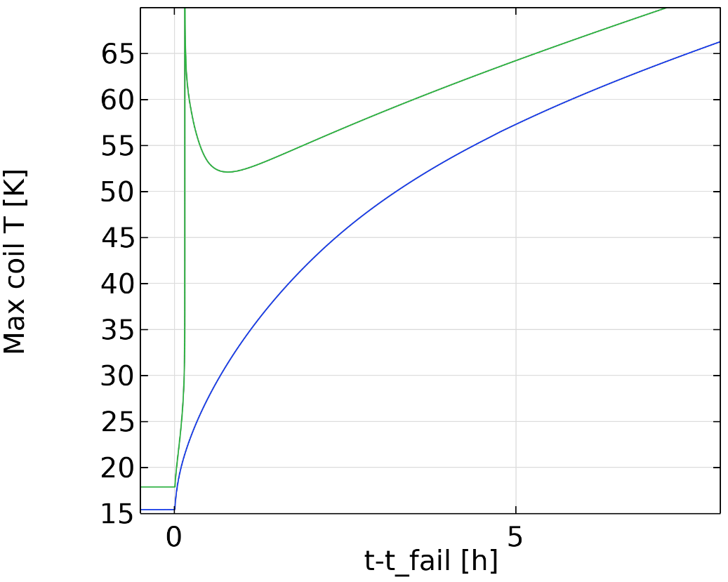
Buffer sizing
Quench
Slow ramp-down
Buffer size (220kg Pb) chosen by parametric study

