Slide 1
This slide was intentionally left blank

Slide 2

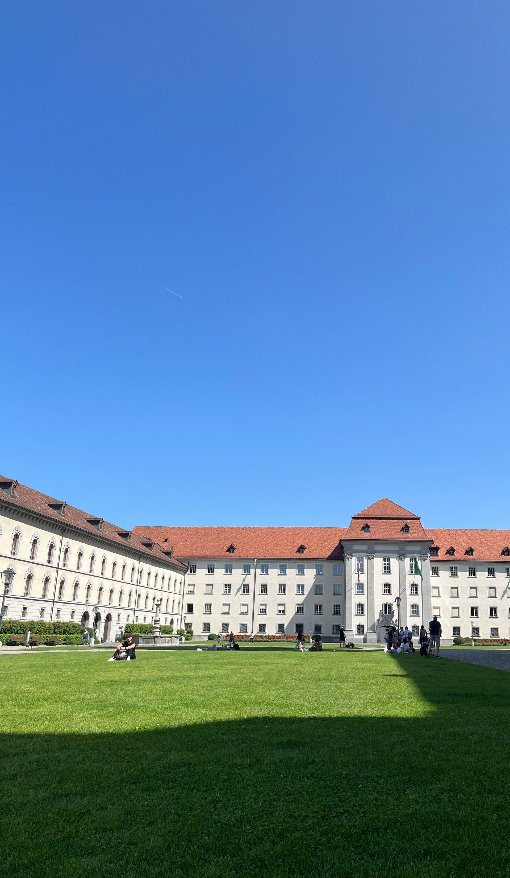
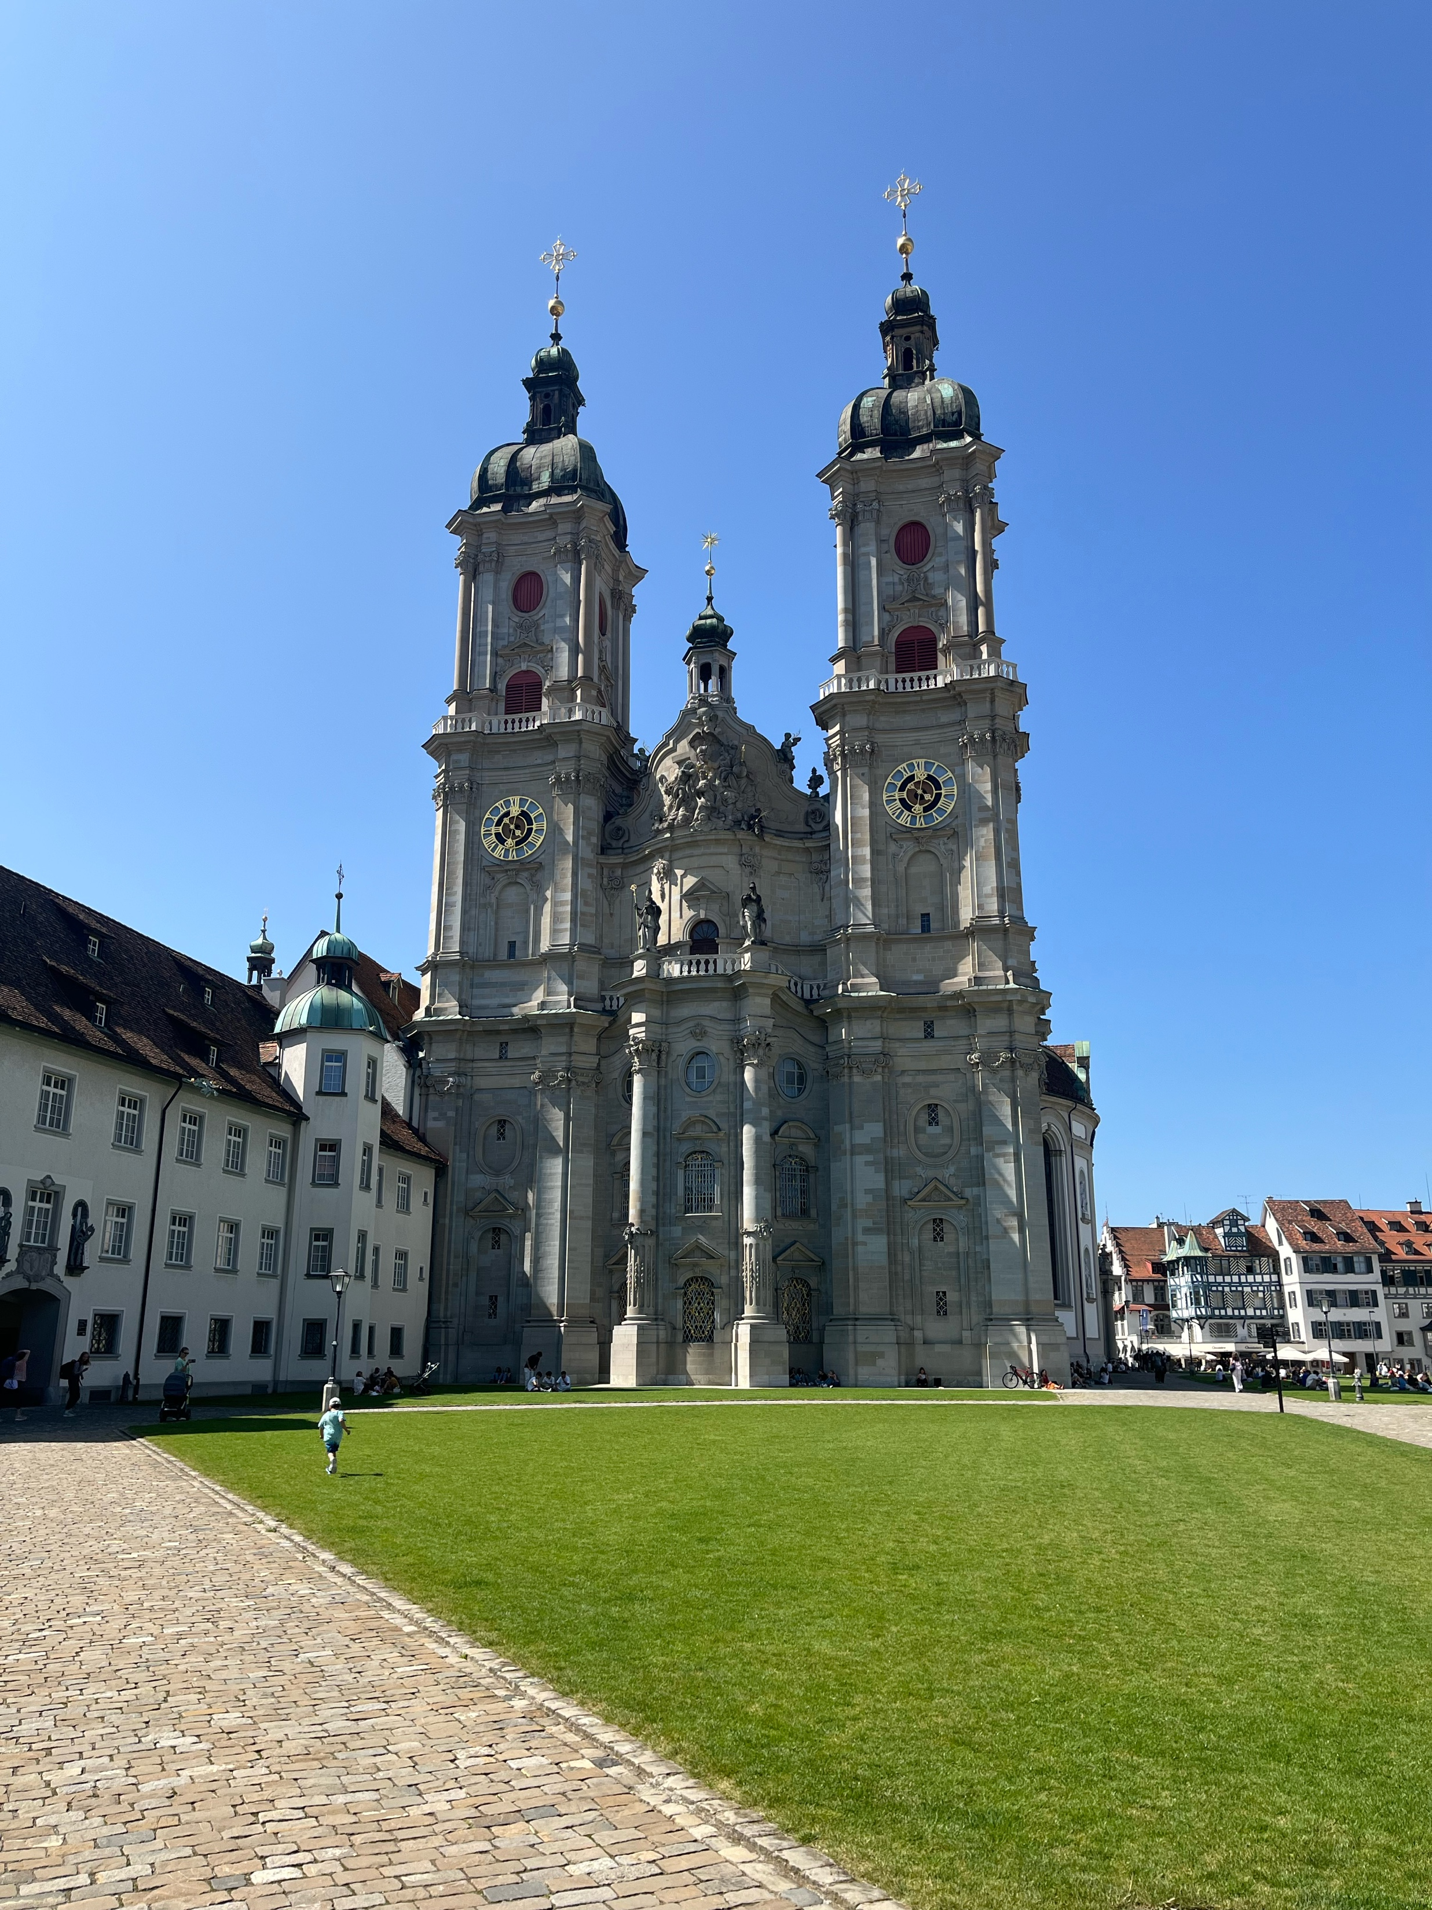
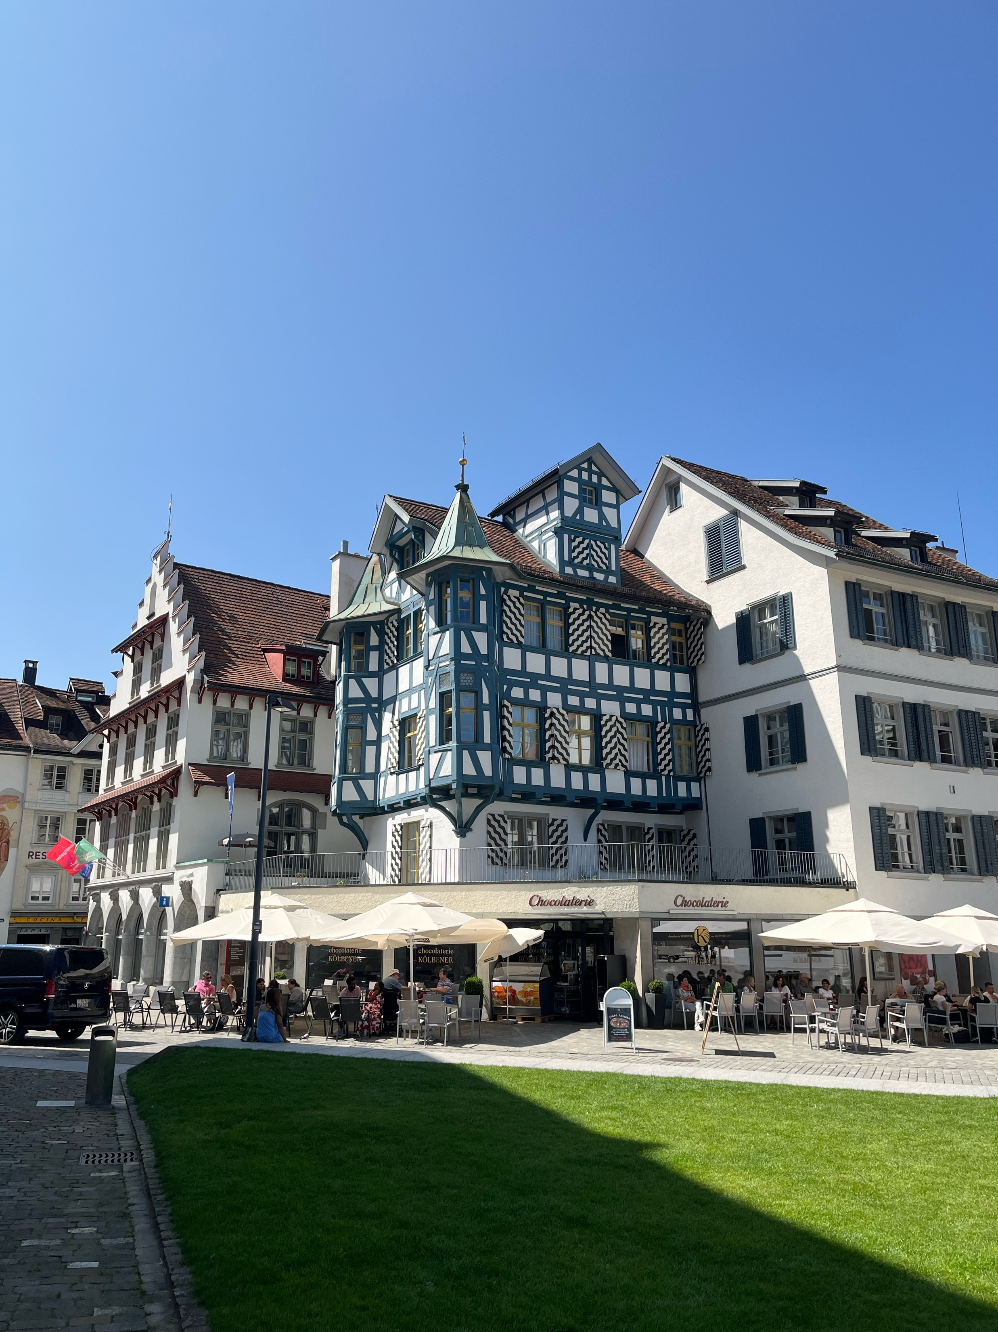

simplemaps.com/svg/country/ch#all
Notes:
I recently visited St. Gallen. I spent the afternoon walking around the old city under the hot summer sun. Once I became tired and thirsty, I decided I was done with my visit and walked back to the train station. There, people in uniforms found me and proposed me a free drink. How wonderful! Without doing anything extra, I had just what I needed. Today I will talk about a device that gives particles accelerators something they need … for free. This thing particle accelerators need is control of the energy spread of their beams … I think we should apply wakefield structures to control the energy spread of future particle accelerators.

Slide 3
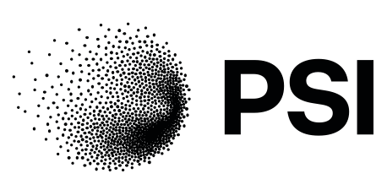

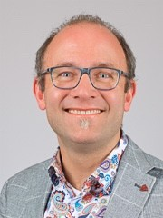


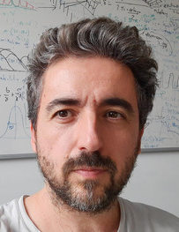
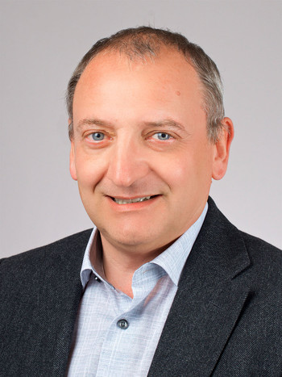

Rasmus
Ischebeck
Paolo
Craievich
Fabio
Marcellini
Sven
Reiche
Eduard
Prat
Mike
Seidel
Diagnostics & Instrumentation
Radio Frequency Systems
Beam Dynamics
Large Research Facilities
This project has received funding from the European Union’s Horizon Europe research and innovation programme under grant agreement No. 101079773
Notes:
My name is Evan Ericson. I am a PhD student at EPFL based at the Paul Scherrer Institute. I do research for the EuPRAXIA collaboration which aims to make a new type of particle accelerator based on plasma. I have been doing simulations for particle accelerators since 2018 and I have prepared the simulations I will show you today. I work at PSI because that is where the Swiss Free Electron Laser is located. I have worked with the people shown here because they are free electron laser experts. I study methods of manipulating and measuring the energy spread of particle beams because it impacts the performance of free electron lasers. Specifically, the correlated energy spread of the beams in the free electron laser determines the bandwidth of the machine.

Slide 4
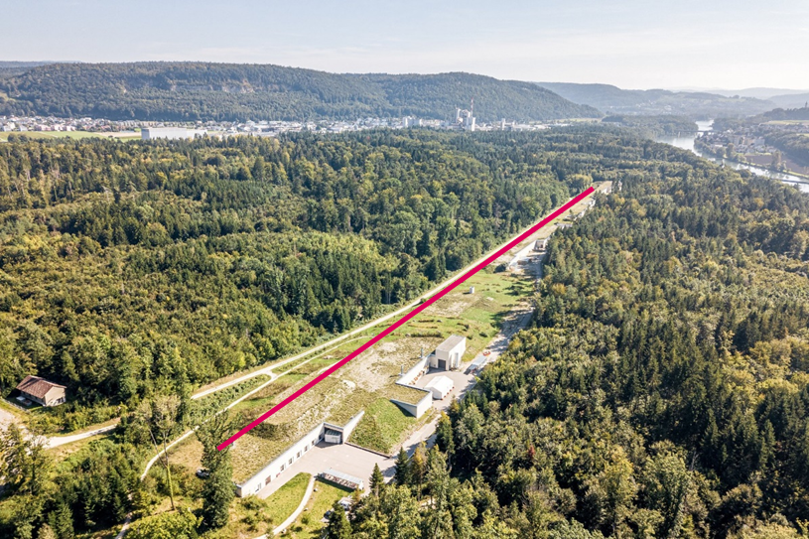
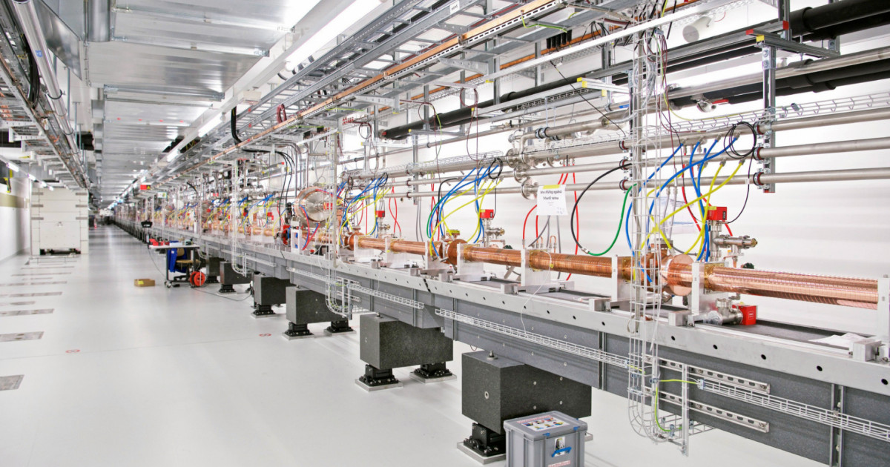
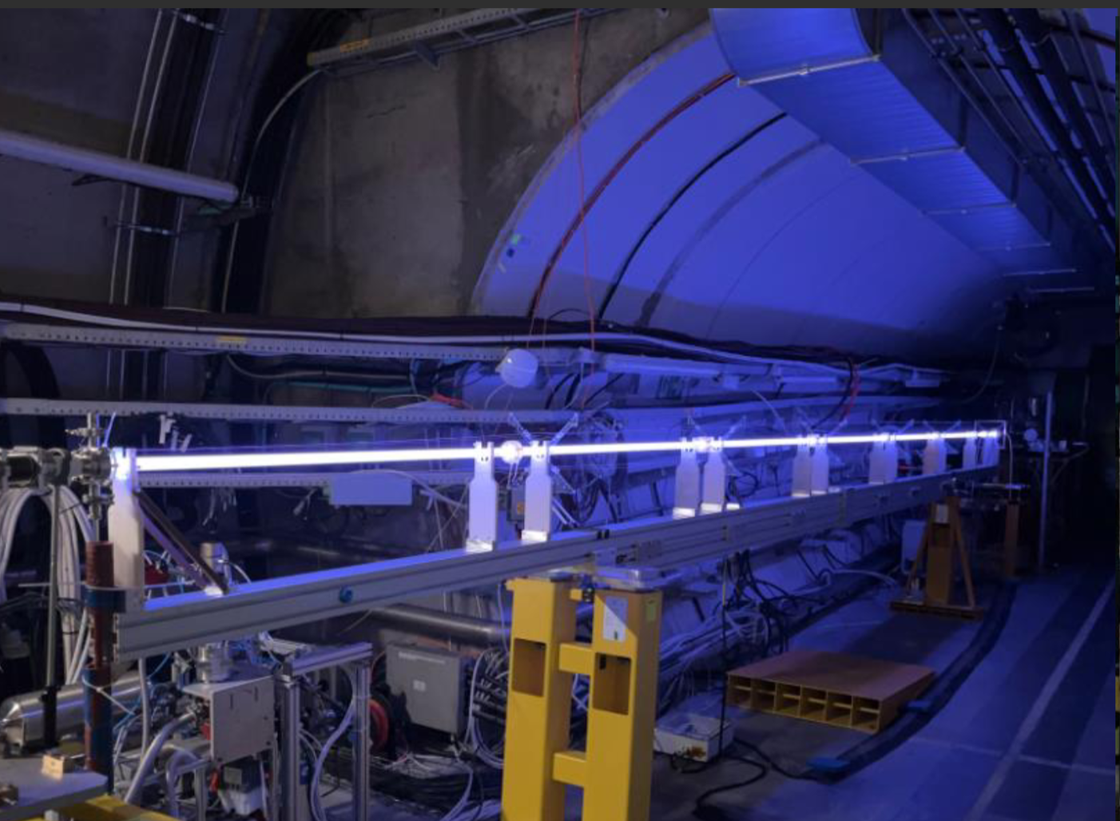
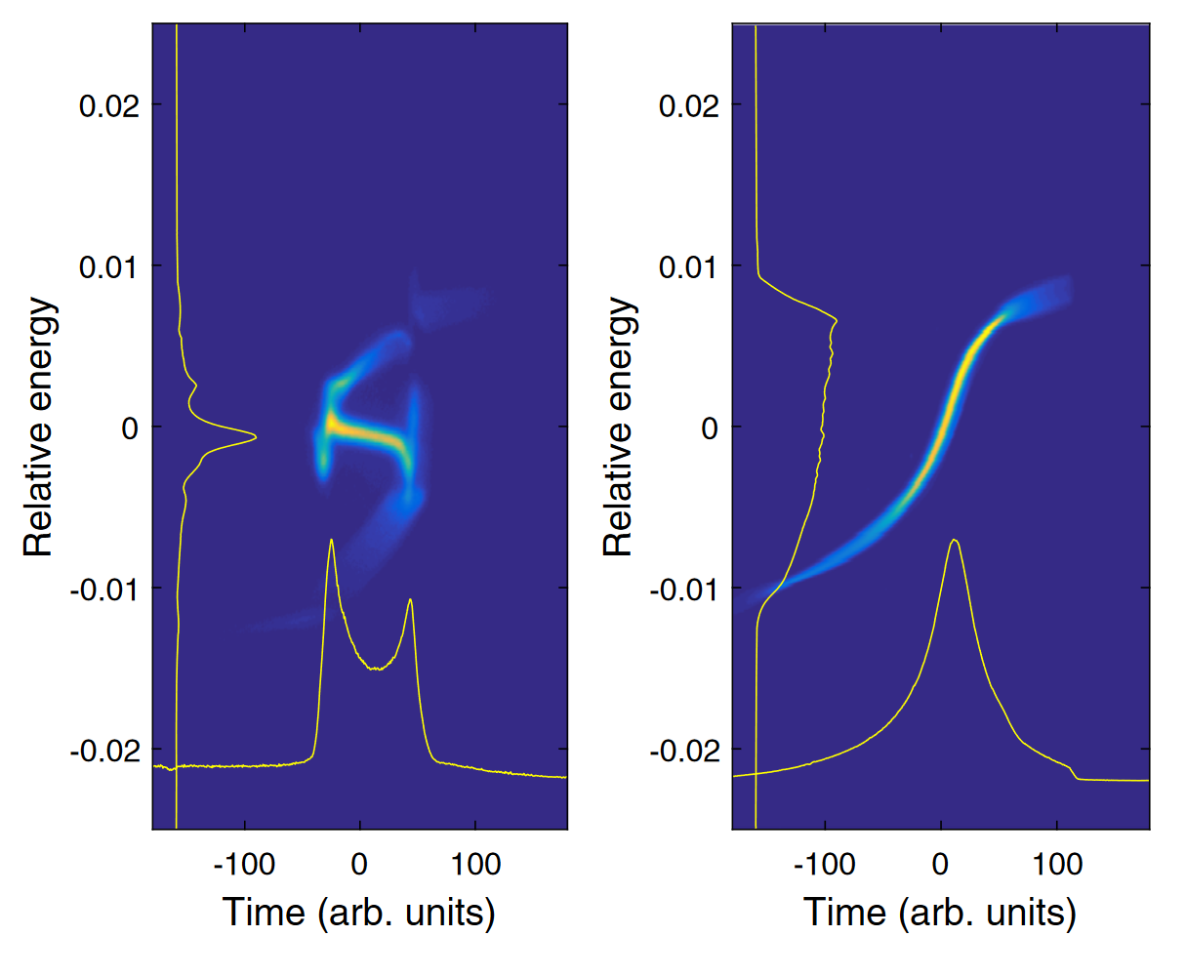
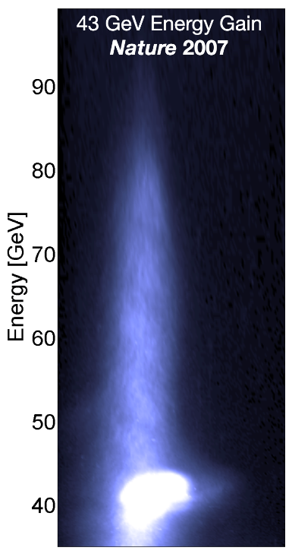
Marlene Turner
~ 30 MV/m
~ 1000 MV/m
Demonstration of Large Bandwidth Hard X-Ray Free-Electron Laser Pulses at SwissFEL, Prat, et al.
Energy doubling of 42 GeV electrons in a metre-scale
plasma wakefield accelerator, Blumenfeld, at al.
simplemaps.com/svg/country/ch#all
Notes:
SwissFEL is in the woods about 45 minutes from ETH. The complex is covered by grass so I’ve included this red line to show the size of the facility. The machine is about 750 m long. About 200 m is dedicated to the linear accelerator shown here as the copper tube. It is so long because the accelerating gradient of the linear accelerator is about 30 MV/m. A new type of accelerator based on plasma can reach up to 1000 MV/m. Using plasma instead of the conventional RF accelerators could reduce the size of future accelerator facilities. While these two technologies are different, they have similar challenges. RF linear accelerators produce beams with small energy spread. Some users require a large energy spread for their experiments. Plasma accelerators, on the other hand, naturally produce beams with very large energy spreads. This is an image from a plasma accelerators that doubled the energy of the beam from 40 to 80 GeV. However the beam had an energy spread of 40 GeV. One device could solve the problems of both RF and plasma accelerators.
https://www.sci.news/physics/science-bella-compact-particle-accelerator-electron-beam-record-breaking-energy-02330.html

Slide 5
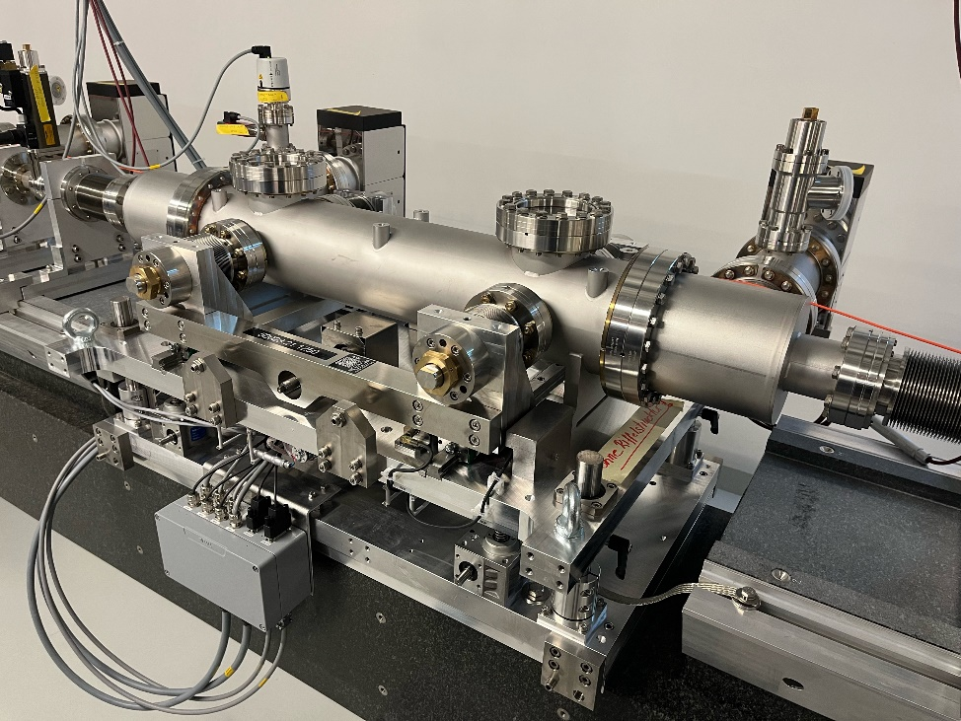
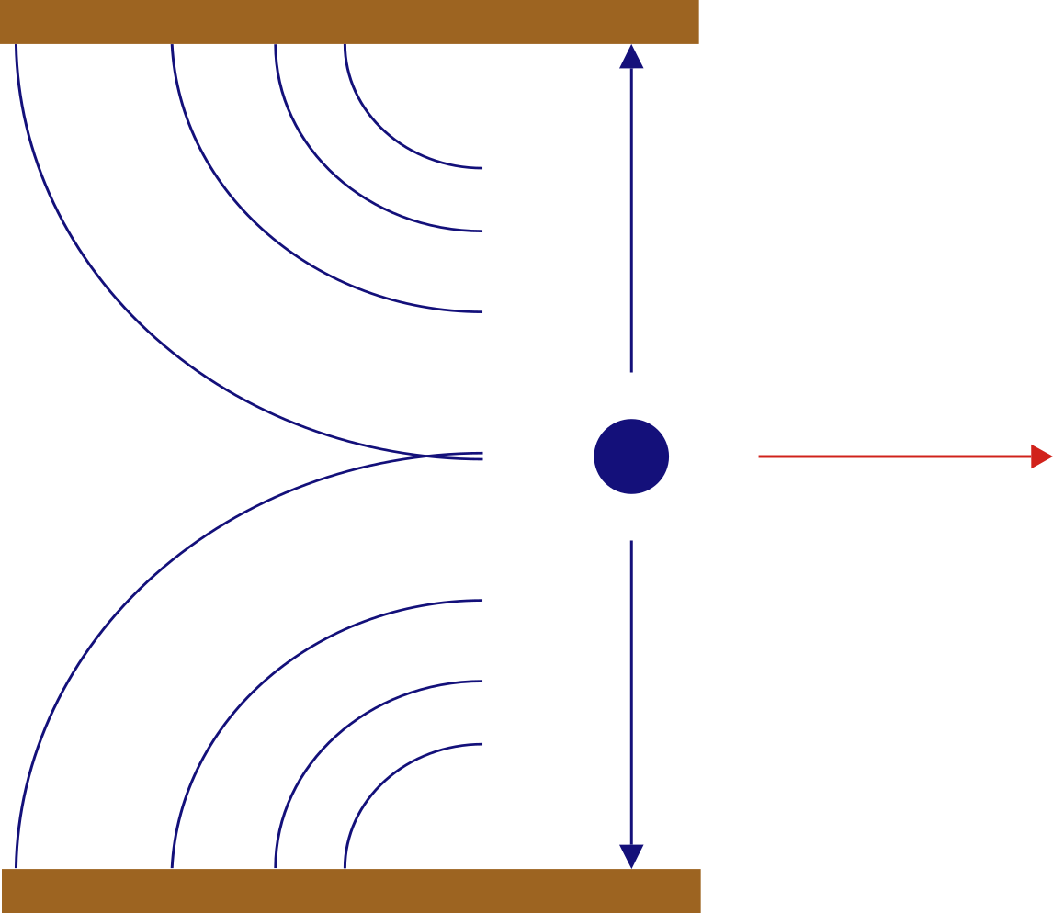
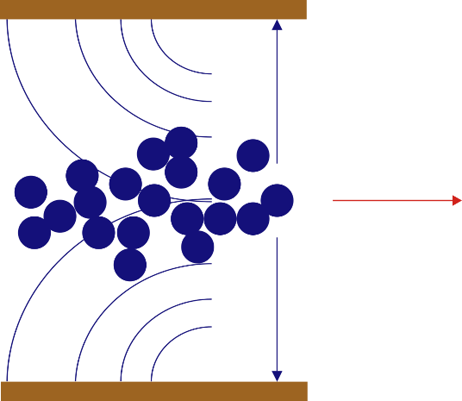
VACUUM
GAP
BEAM
DIELECTRIC
Notes:
At SwissFEL we use a wakefield structure to increase the energy spread of the beam. This photo shows it installed in a vacuum chamber in the accelerator. Inside the structure is simple: Two parallel dielectric plates are attached to two metal jaws whose separation can be varied. When the electrons are produced in the accelerator, their electric fields are directed radially outward. As they are accelerated, their fields become perpendicular to the direction of motion. If this beam is put inside of a perfectly conducting pipe, image charges in the material would be attracted to the surface and would propagate with the beam. If the beam is put inside of a dielectric material, the image charge will travel slower than the beam and produce fields that trail behind the beam. These fields are called wakefields. The fields produced by the head of a bunch can affect the particles in the tail. The amplitude of the fields depends on the material properties and gap of the device. The wakefields are inherently synchronized with the beam since the beam is affecting itself. The wakefields also do not require an external power source. In this sense, they come for free.

Slide 6
The effect of the wakefield structure depends on the input
Chirping for RF accelerator
E
E
tail
head
t
t
Dechirping for plasma accelerator
E
E
tail
head
t
t
Notes:
The wakefield structure can work in two ways. For RF accelerators that produce bunches with small energy spread, when a bunch passes through the wakefield structure, the wakefields generated by the head cause particles in the tail of the bunch to lose energy and the output beam has an increased energy spread. In the case of plasma accelerators with a large energy spread, the wakefields produced by the head cause the tail to lose energy and the energy spread of the beam is reduced. This effect is either called chirping of dechirping and it depends on the input beam. At SwissFEL we have an RF accelerator and we performed the Chirping experiment. We

Slide 7
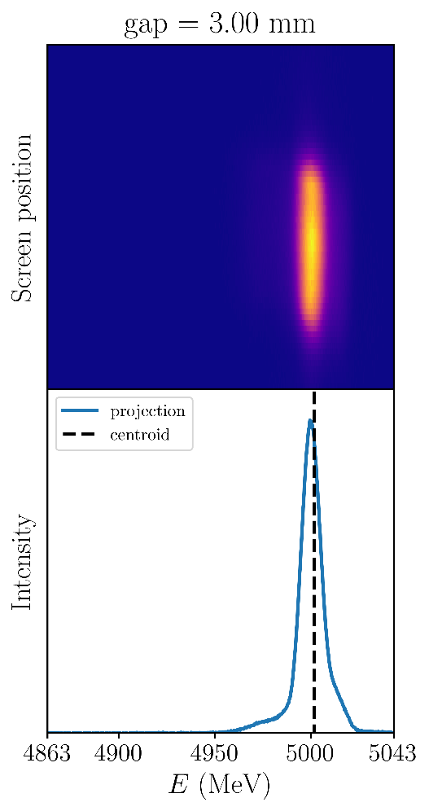
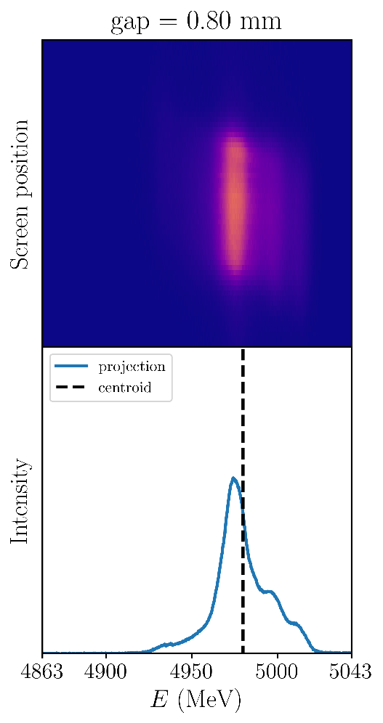
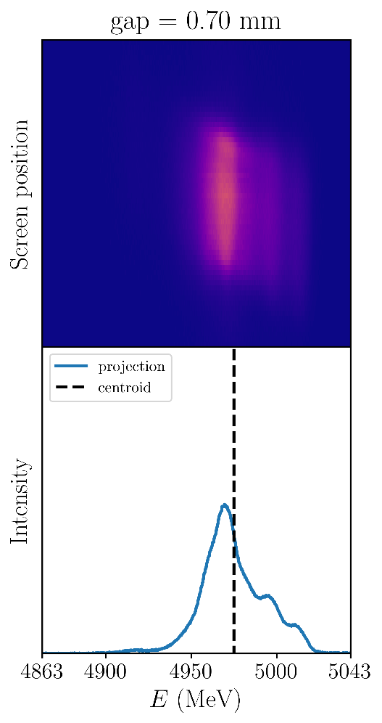
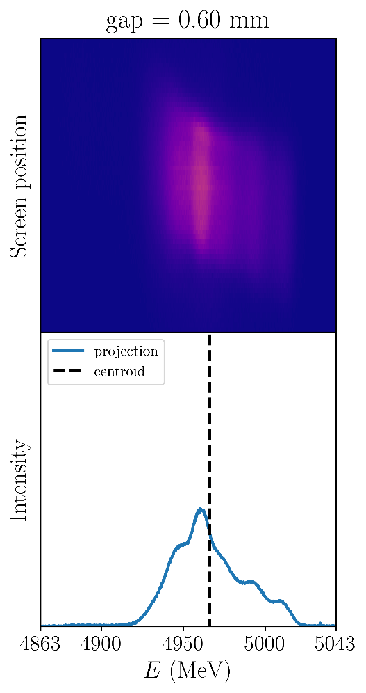
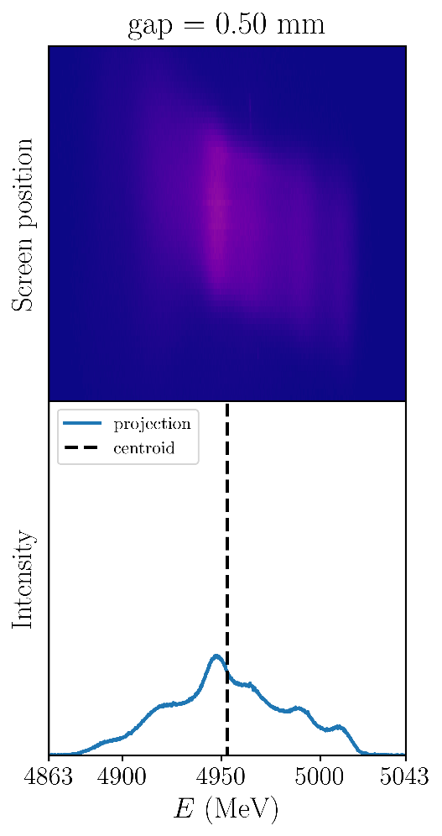
The wakefields change both the energy spread and centroid energy
Notes:
This is some data taken during the experiment. When the structure has a large gap, the energy distribution is narrow with a peak centered at 5 GeV. As the gap is decreased, the energy spread increases and the centroid of the distribution decreases. We did this measurement for three different bunch lengths. When operating the gap of the structure is adjusted until the desired bandwidth is obtained. A model of the structure did not exist and how the wakefields changes with gap was not well understood. I made a model of the wakefield structure by simulating the interaction of the beam with the structure in finite element software.

Slide 8
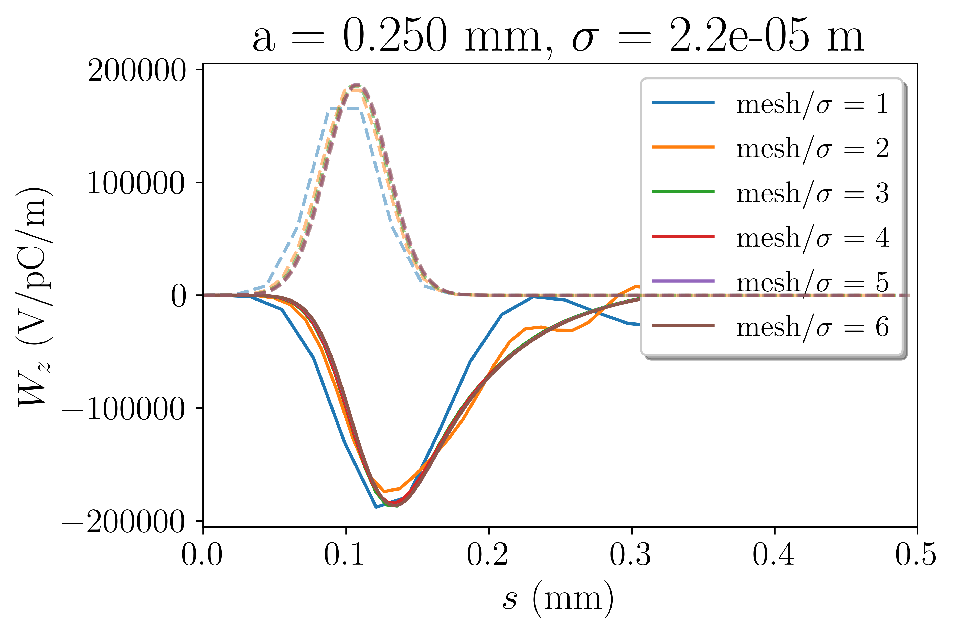
5 mesh elements per σ produces accurate wake potentials
Mesh setting determines how accurately the
Source
Boundaries
Electromagnetic fields
are represented in the simulation
Notes:
Simulating this interaction accurately was not straightforward. I needed to find the solver settings that were the least demanding as possible while still giving accurate predictions. I did mesh convergence checks which is a parameter that determines how finely the geometry and fields were discretized. I then found the minimum structure length that could be simulated while still giving accurate results. The wakefields are calculated as a finite sum of modal wake potentials. The number of terms to include in the sum was not immediately obvious to me. I found that after mode number 45 the wake potential does not change. Now that I had determined the settings, I could simulate the interaction.

Slide 9
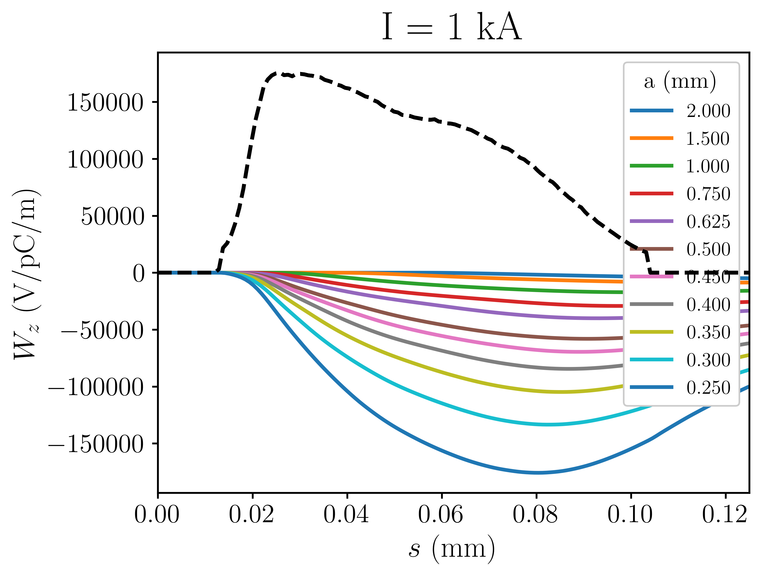
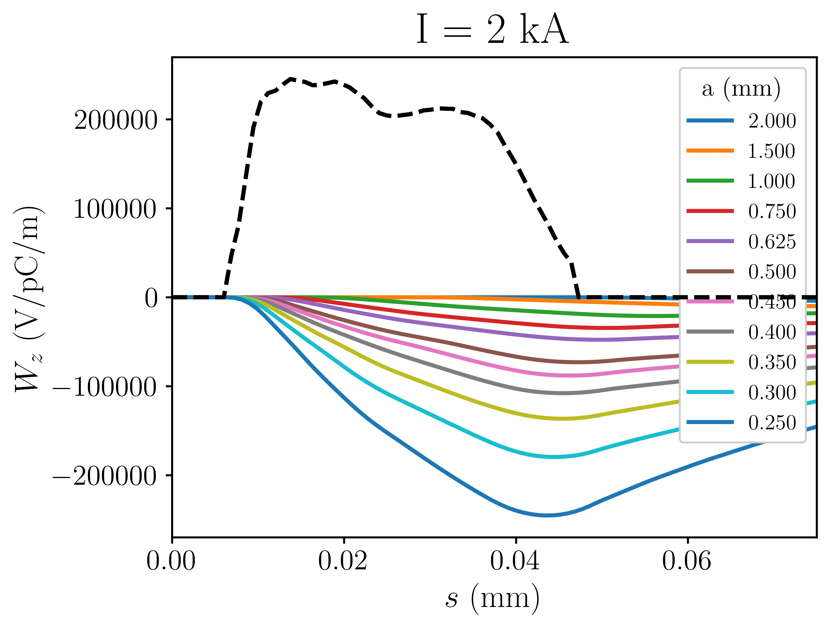
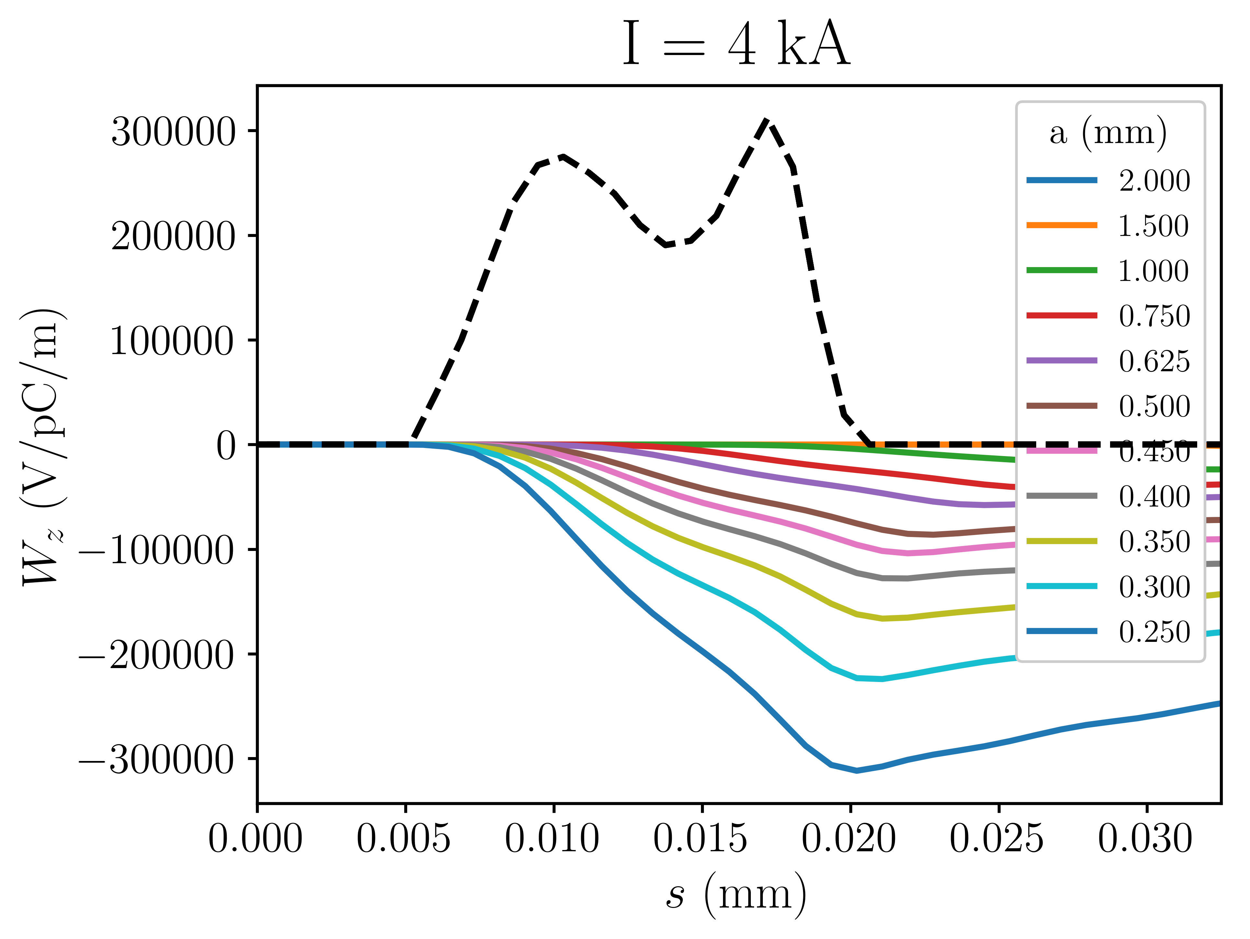
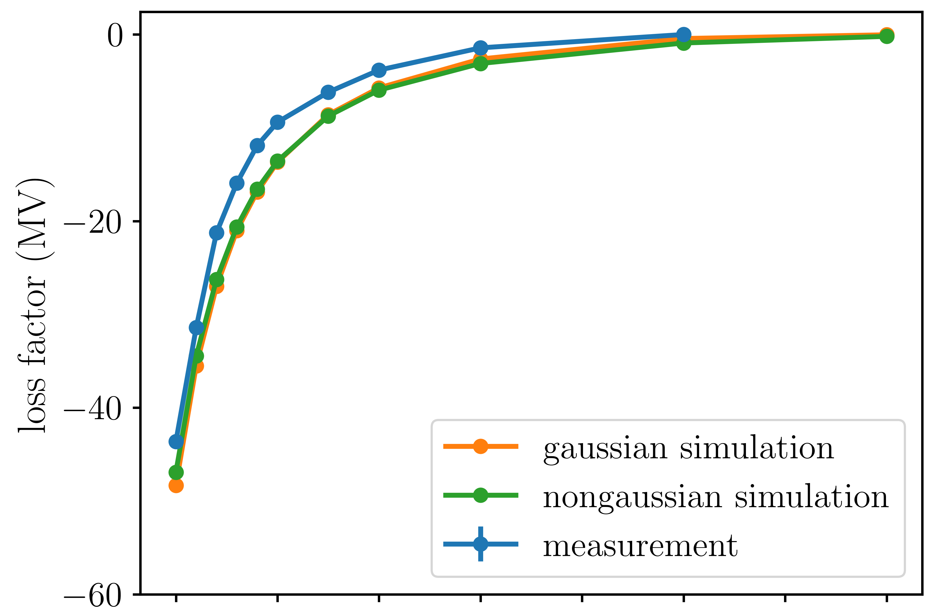
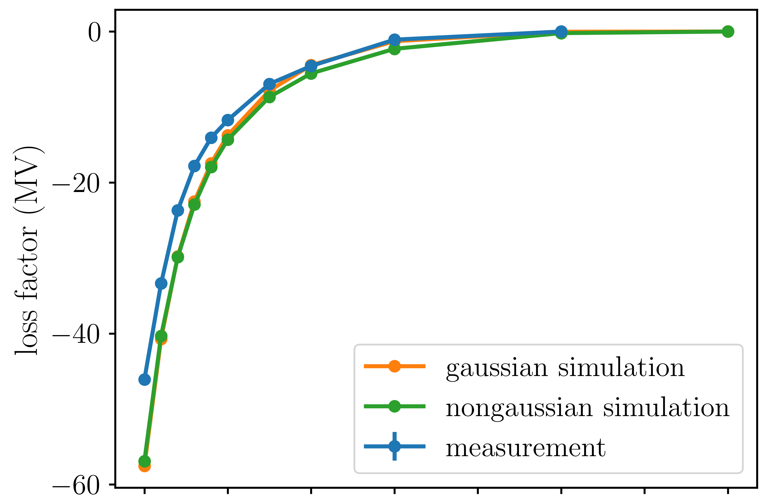
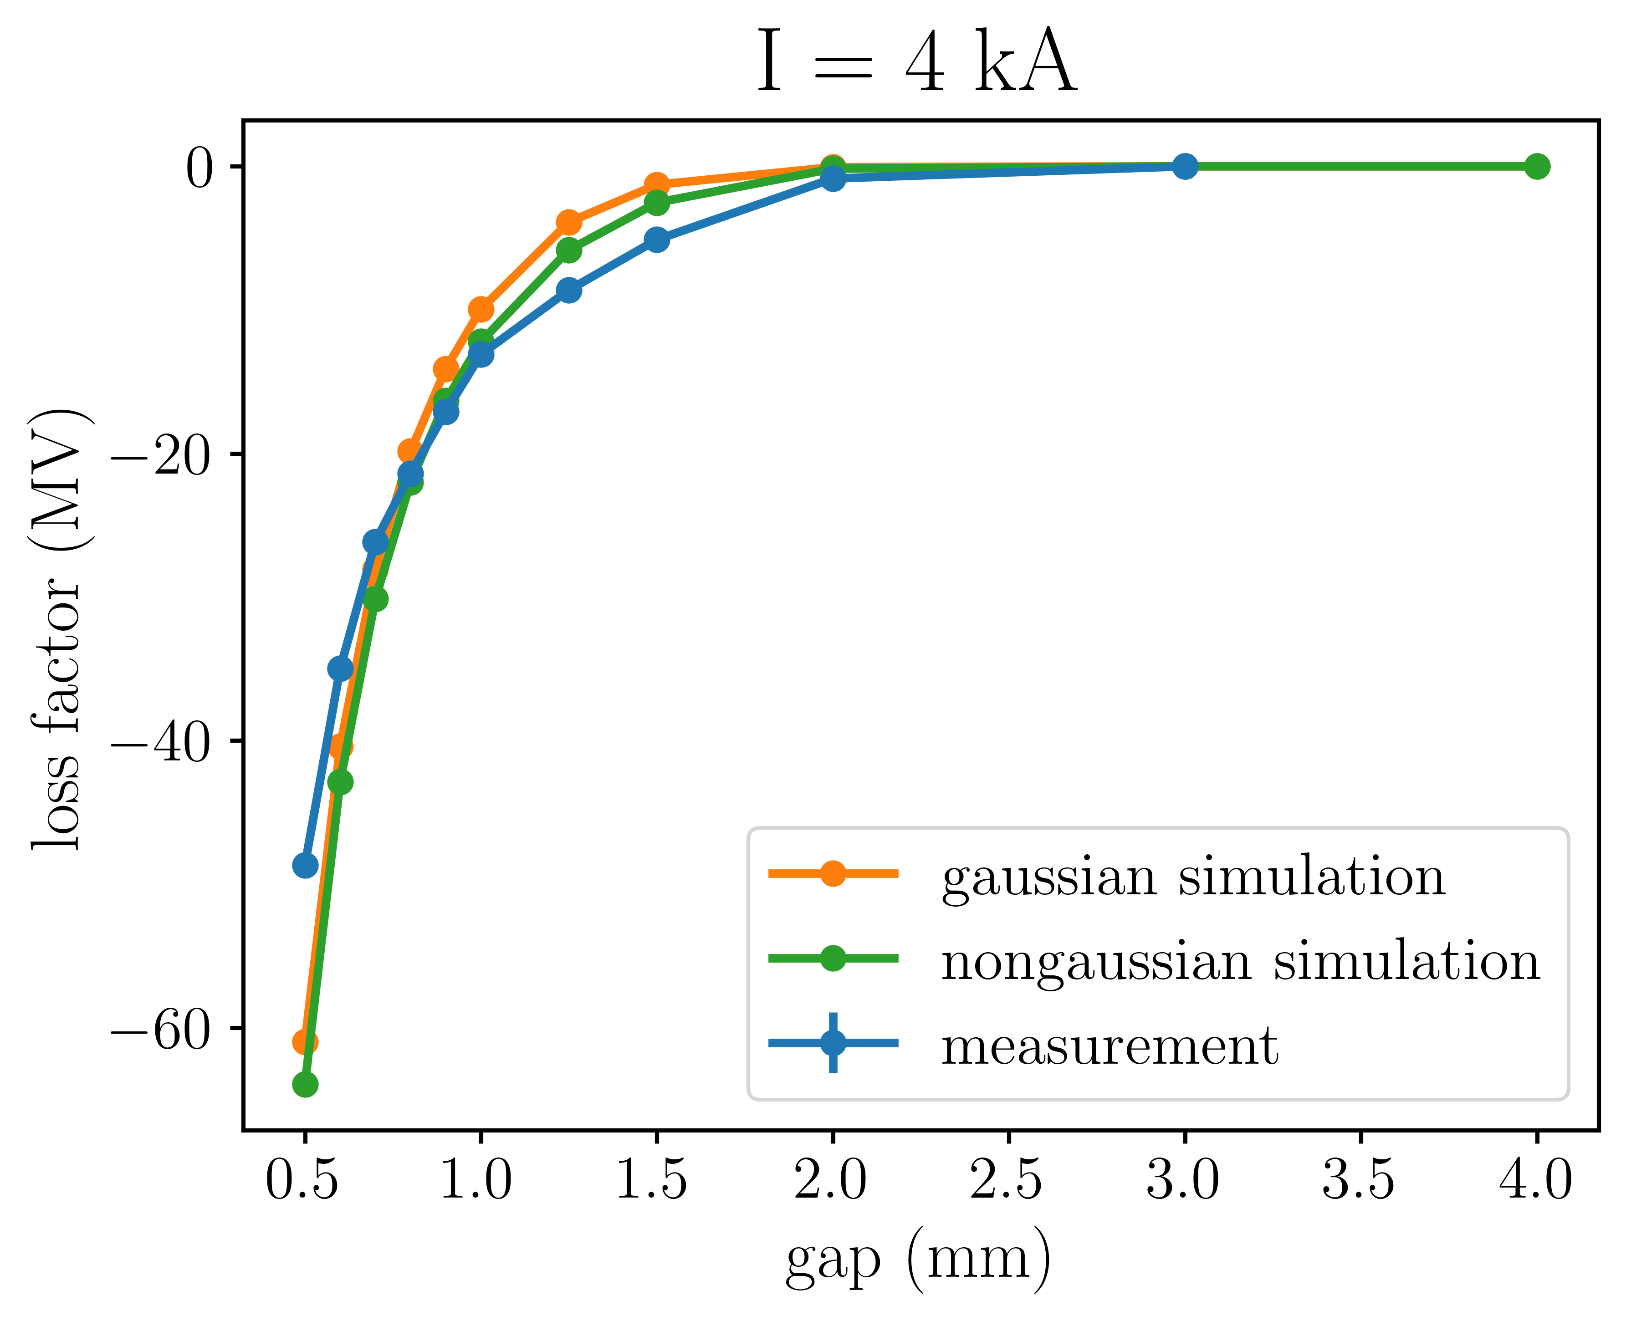
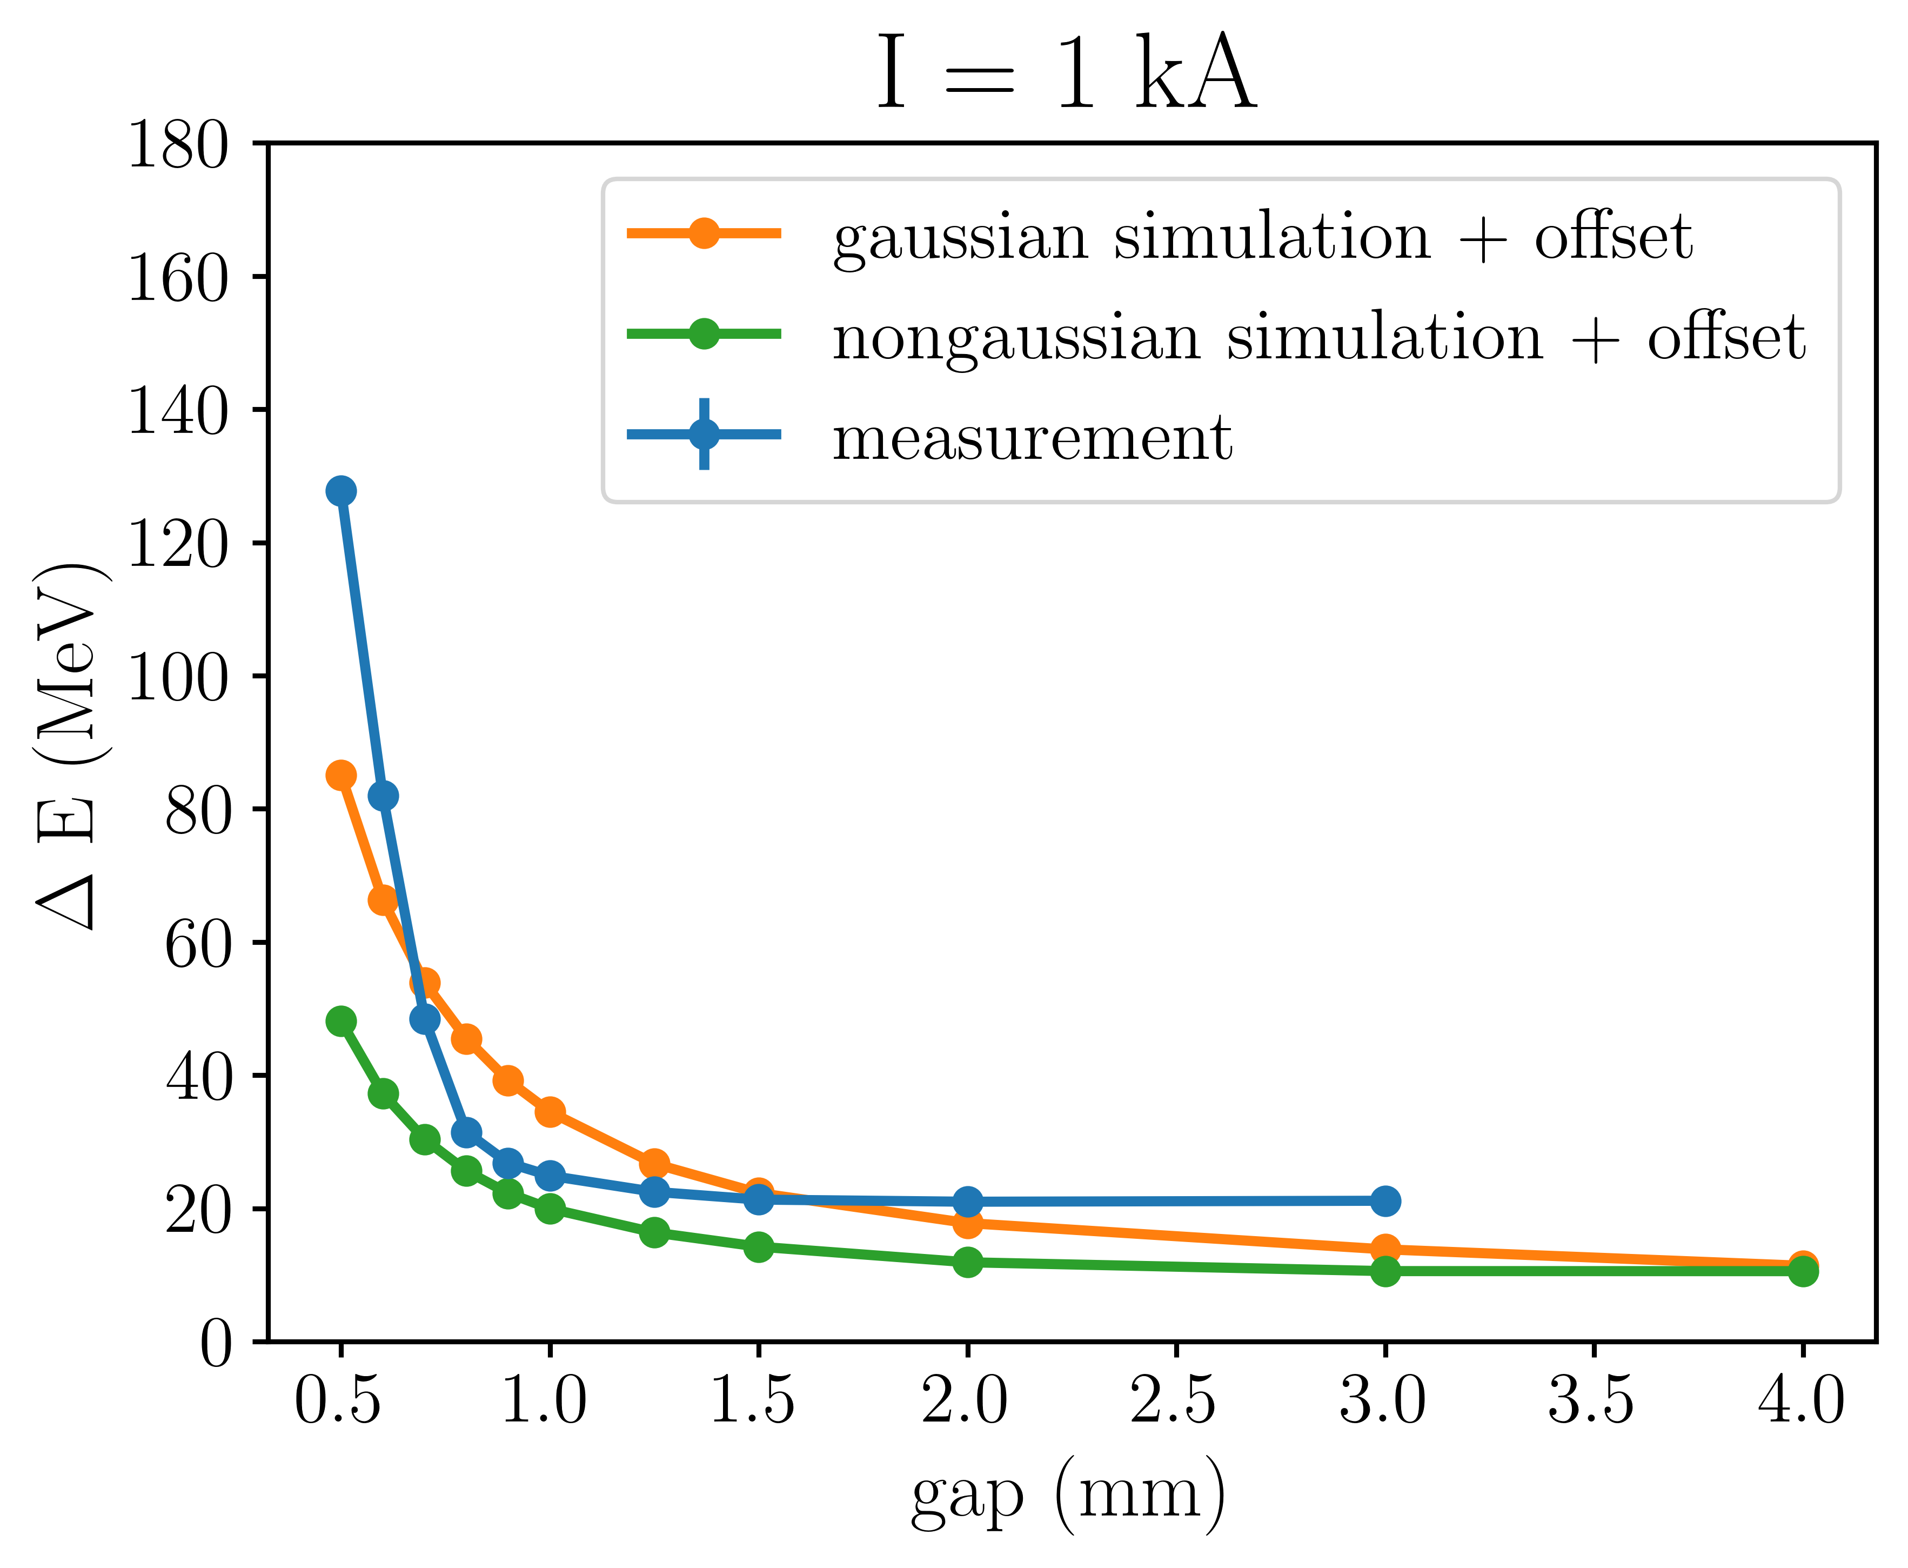
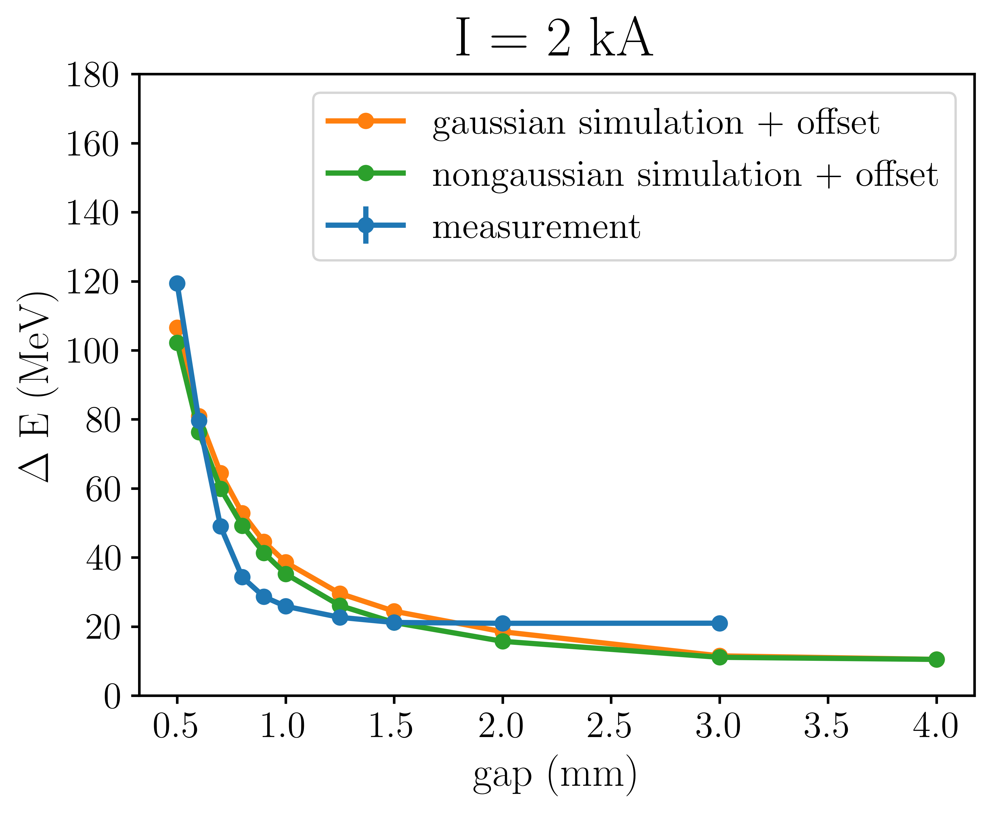
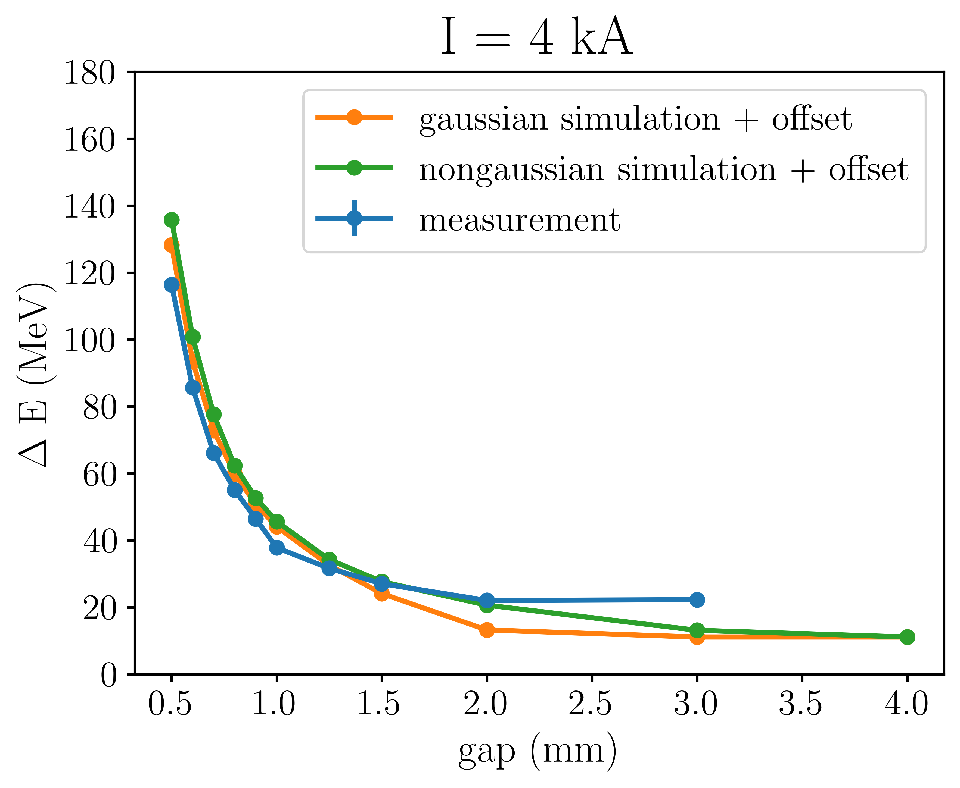
Notes:
The black dashed line represents the current distribution and each colored curved represents the resulting wake potential for a given structure gap. From these wake potentials I calculated the loss factor which is a measure of the change of the centroid energy of the beam and the energy spread of the beam. The blue curve show the values derived from the measurements. The orange and green show the values derived from simulations with gaussian and non-gaussian beams. The simulations follow the trend from the measurements. As the structure gap is closed, the centroid energy decreases and the energy spread increases. The data from the other bunch lengths are shown here.

Slide 10
Conclusion
We have demonstrated the manipulation of the longitudinal phase space of beams from a conventional accelerators using a wakefield structure
I think we should use wakefield structures to control the energy spread of future particle accelerators
Notes:
Our experiment used a conventional RF accelerators. I think we should use wakefield structures to control the energy spread of future particle accelerators. We intend to implement a wakefield structure at EuPRAXIA@SPARC_LAB to dechirp a beam from a plasma accelerator.

Slide 11
Extra slides

Slide 12
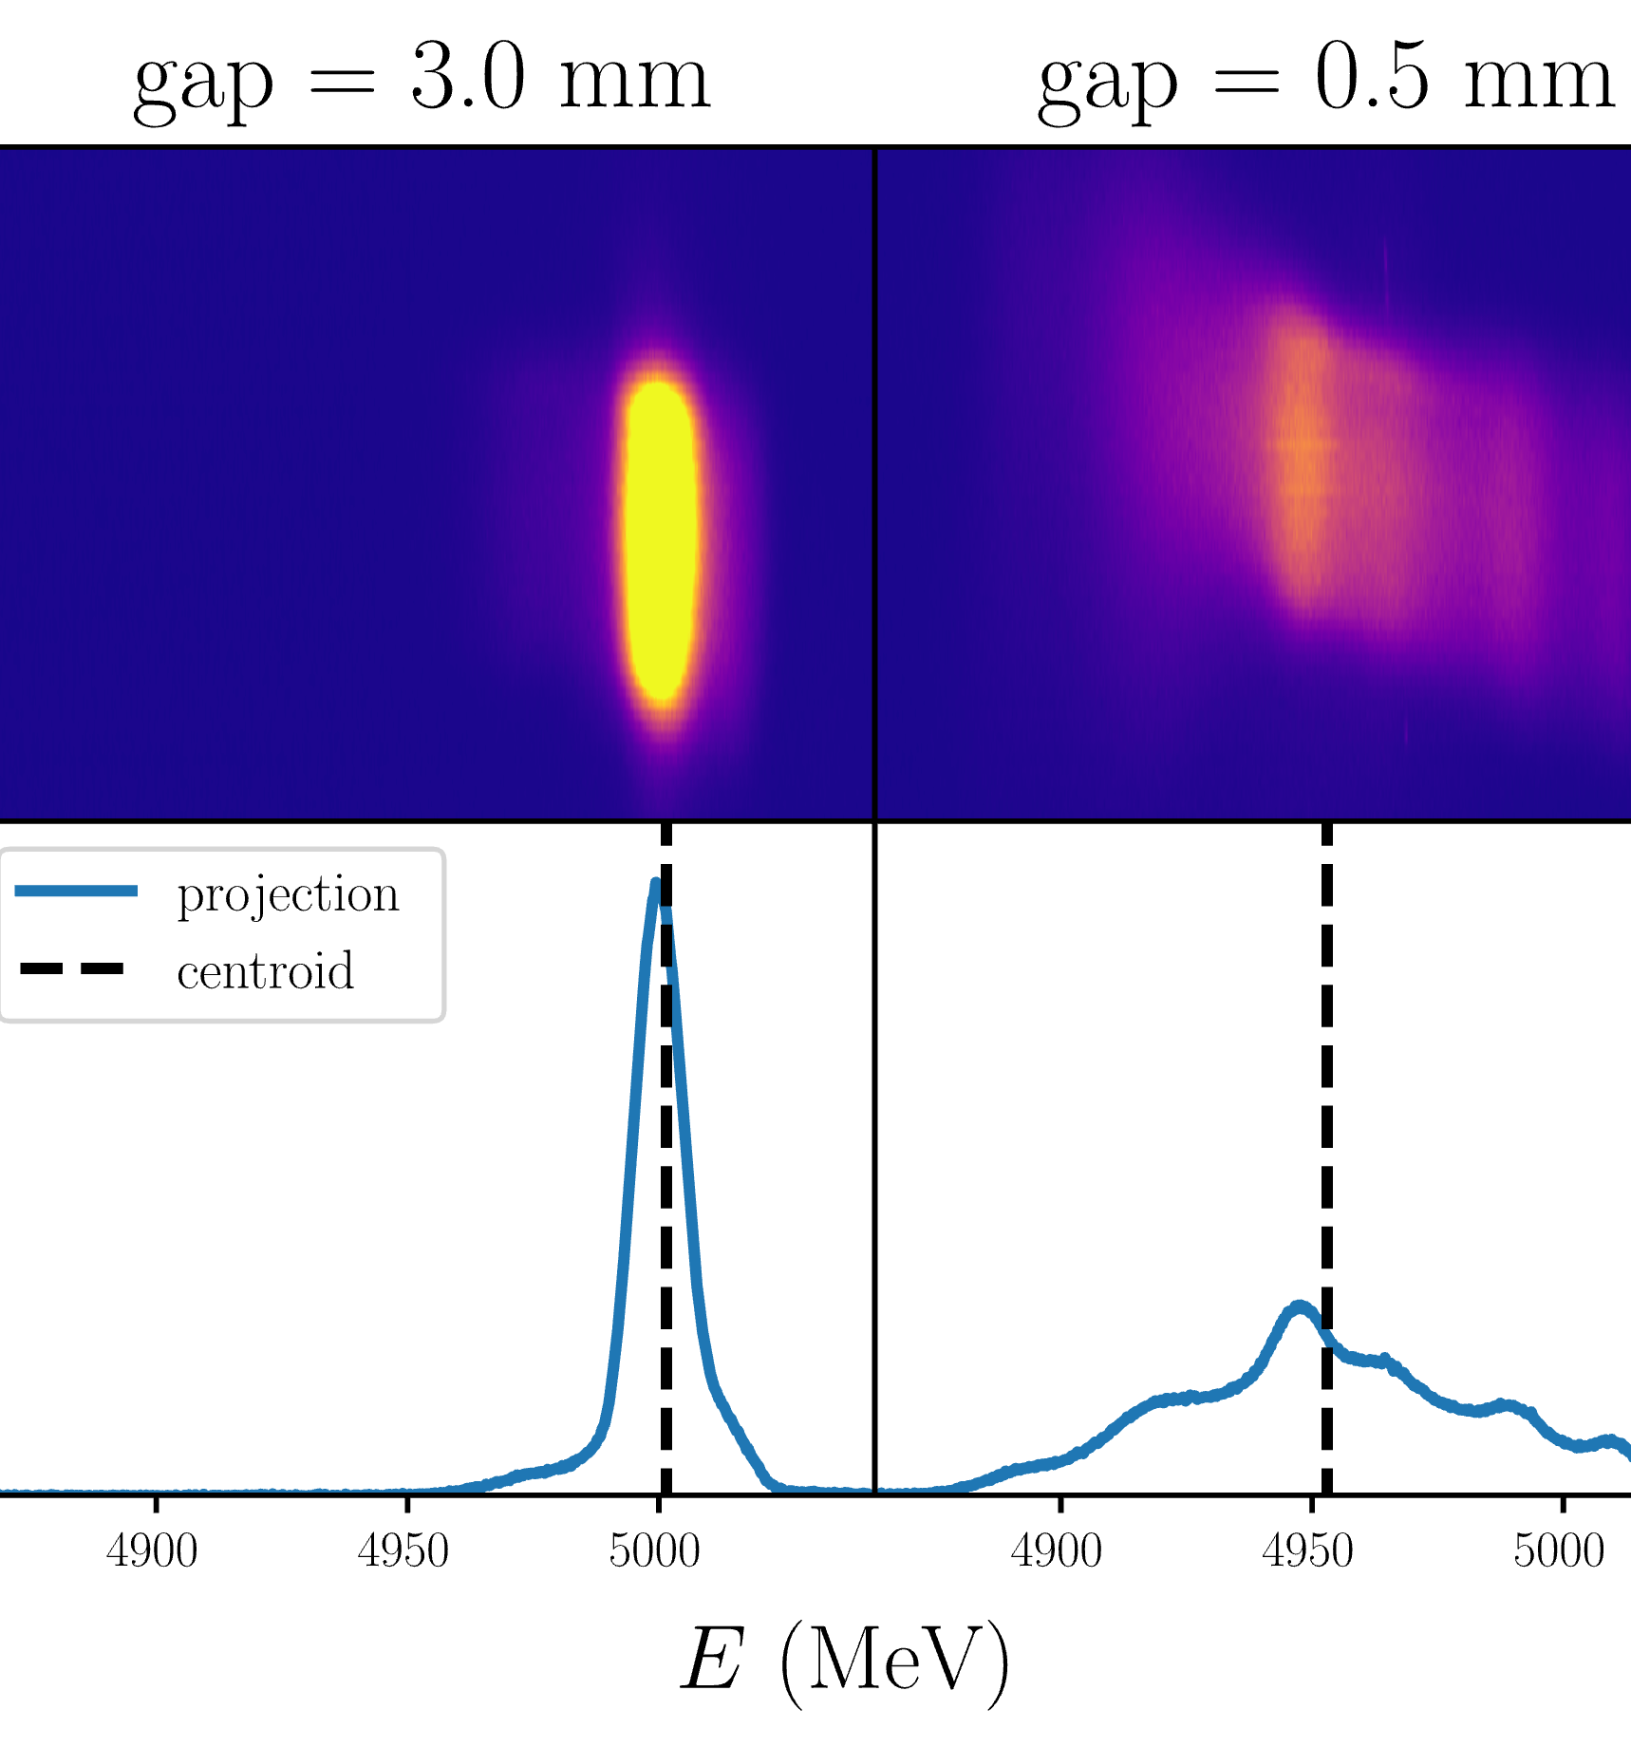
Controlling the electron beam energy at SwissFEL
Evan Ericson, Rasmus Ischebeck, Paolo Craievich,
Fabio Marcellini, Eduard Prat, Sven Reiche, Mike Seidel
Swiss Physical Society Annual Meeting 2024, September 13, 2024

Slide 13
Dechirping strength
head
tail
E
E
head
tail
head
tail
t
t
For gap = 0.5 mm, structure produces wake with slope of -26 MV/pC/m/mm
For 2*1 m structure, 200 pC bunch:
Bunches with -10.4 MV/um chirp can be dechirped

Slide 14
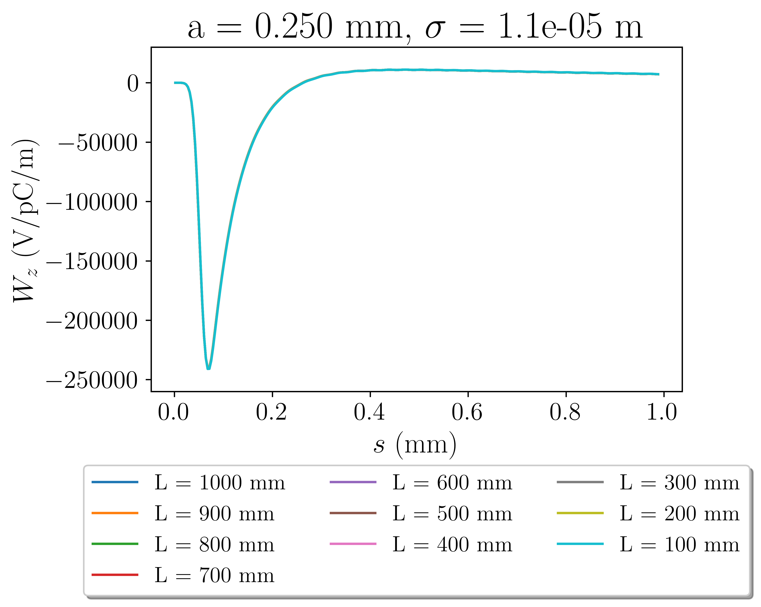
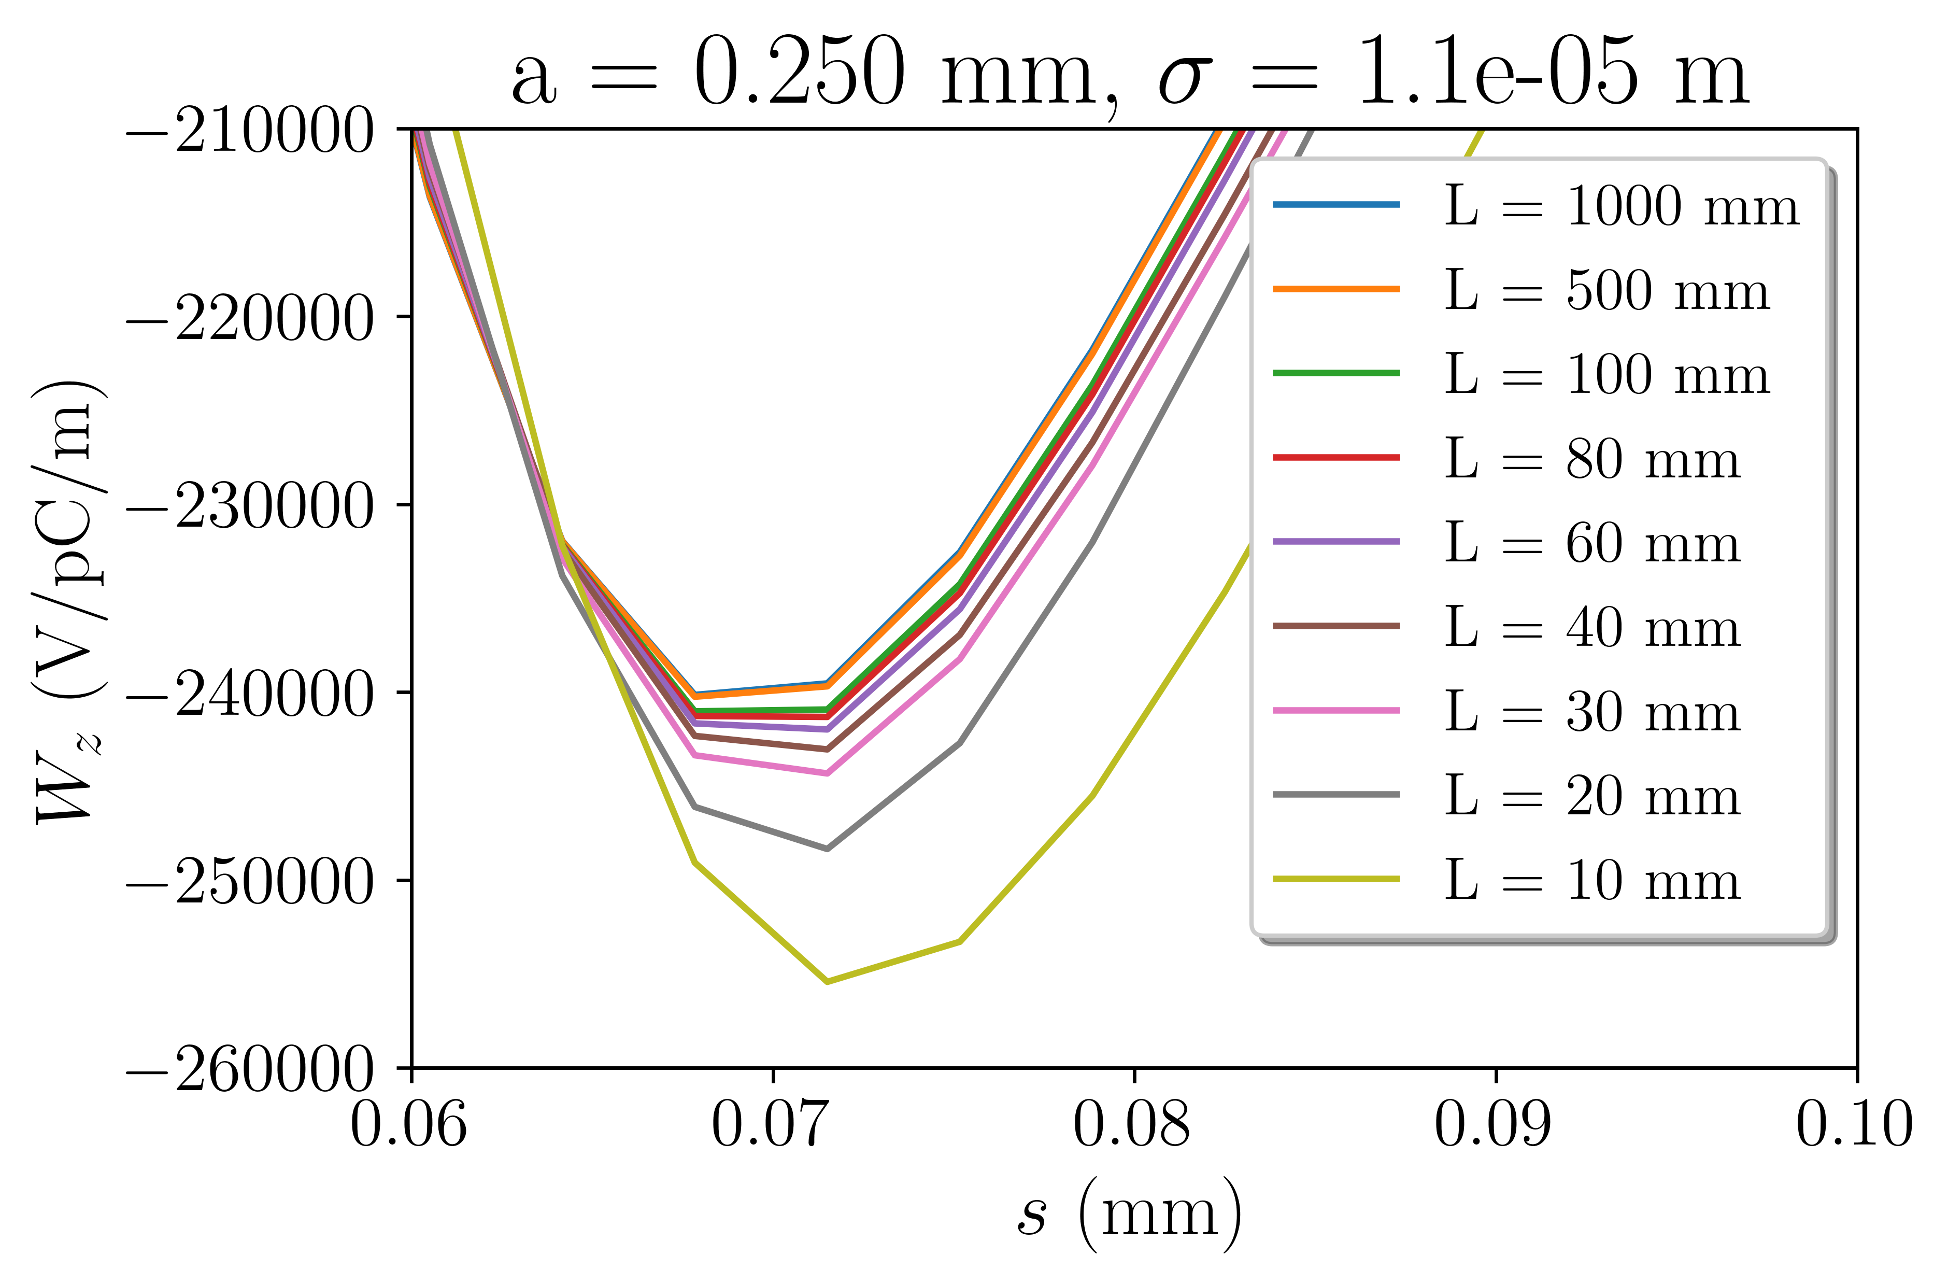
Less than a tenth of the structure needs to be simulated to obtain accurate wake potentials

Slide 15
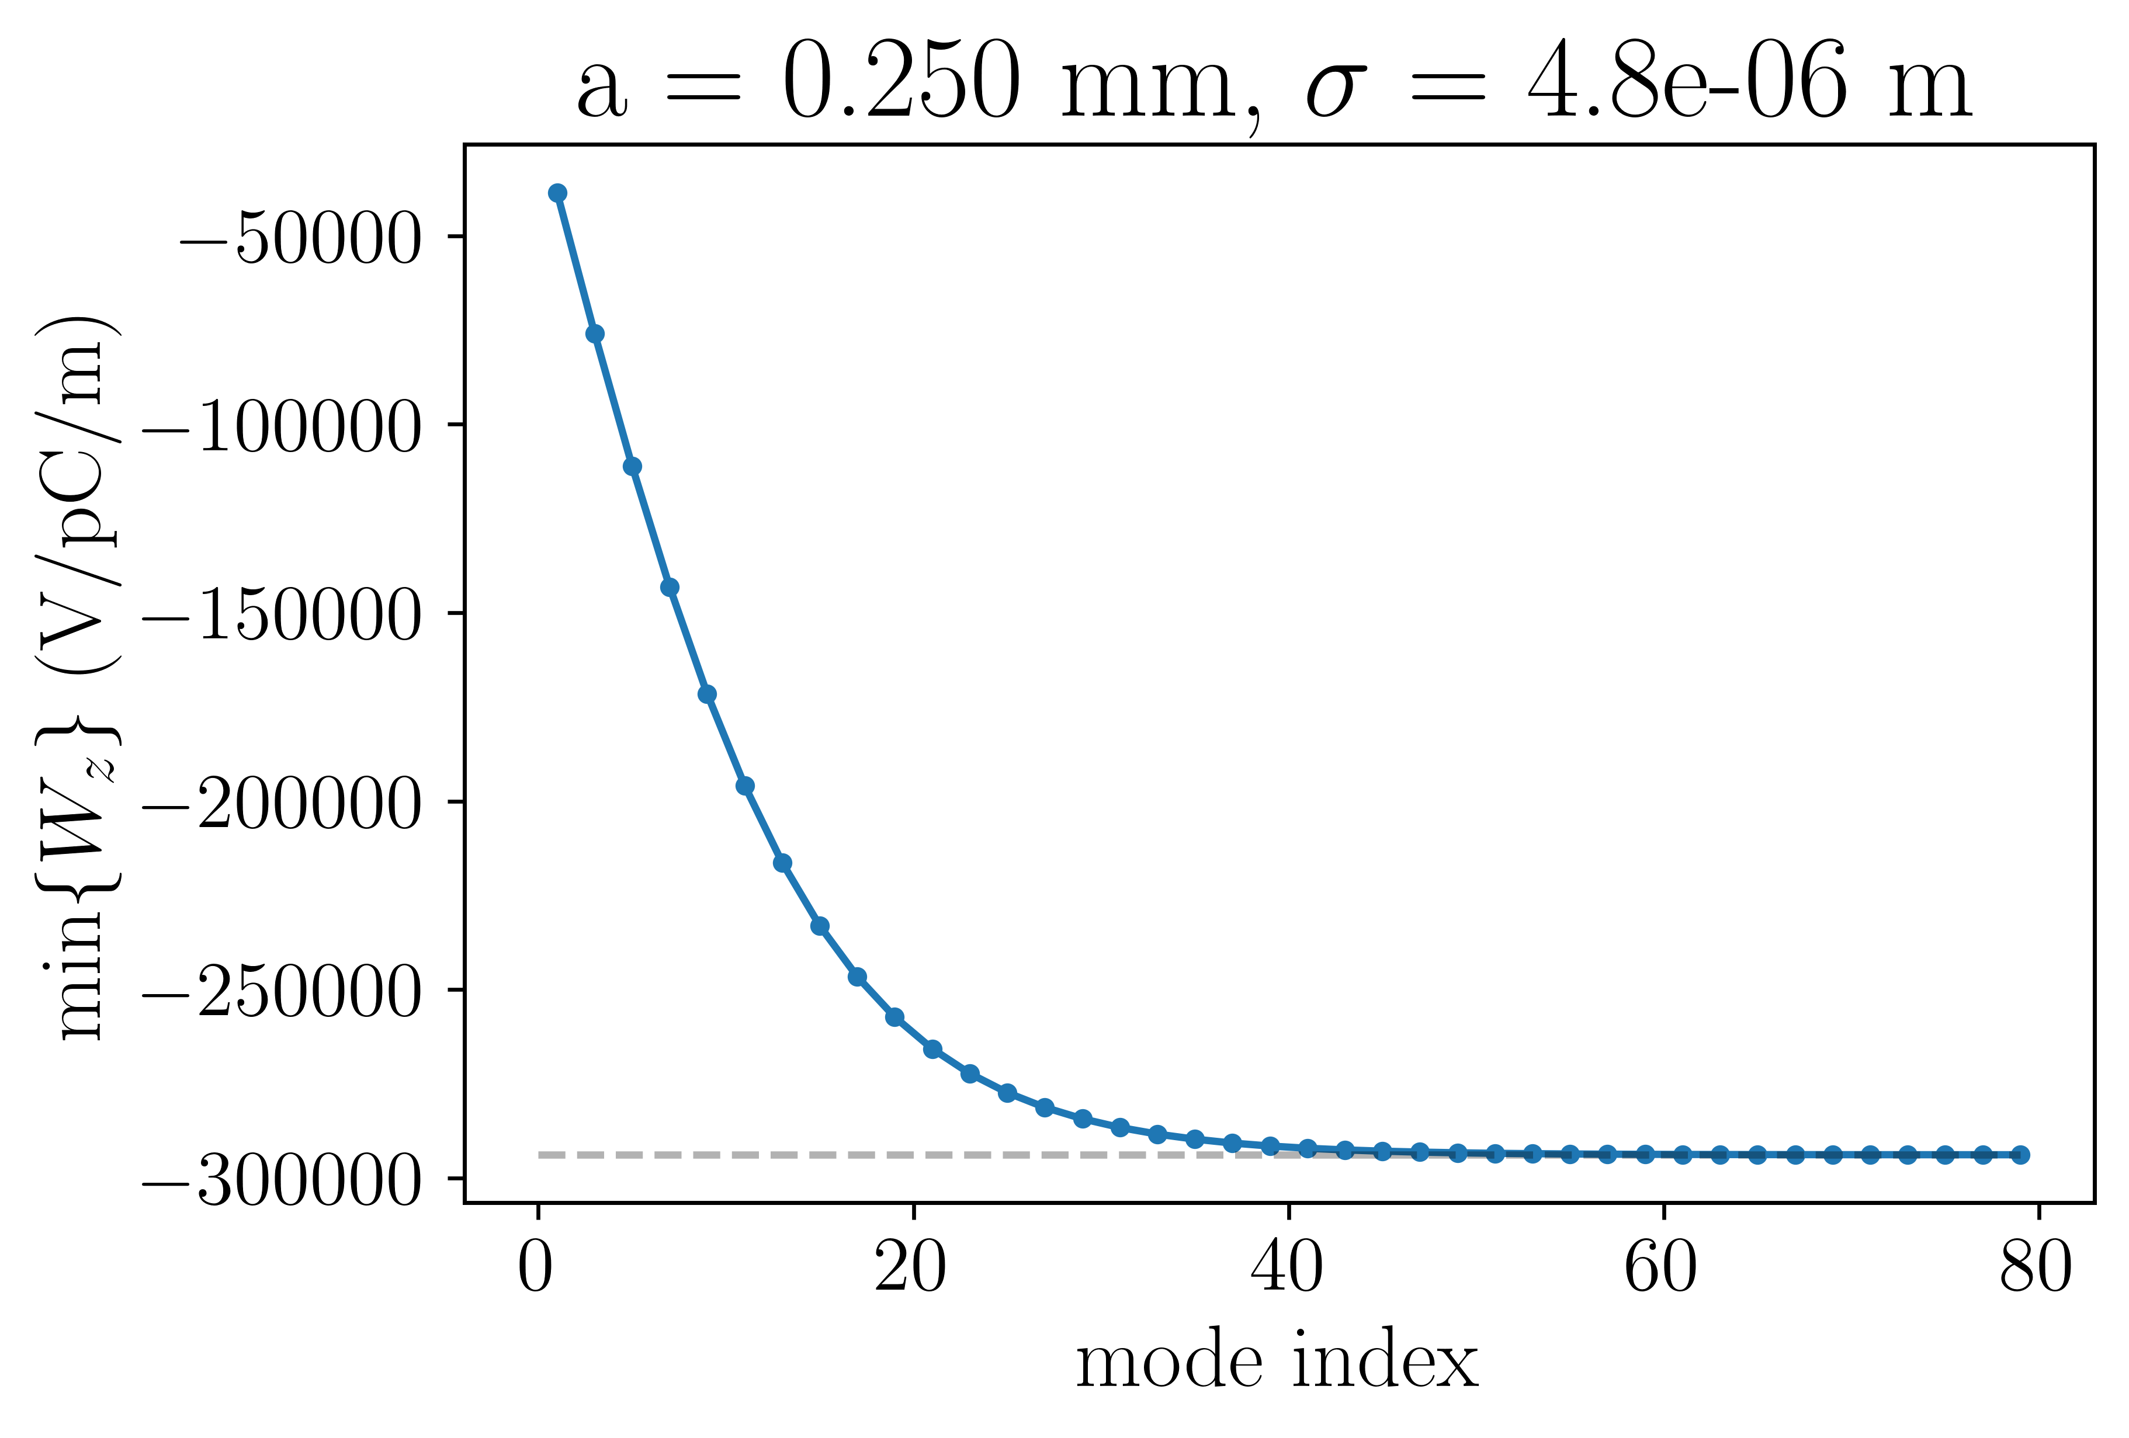
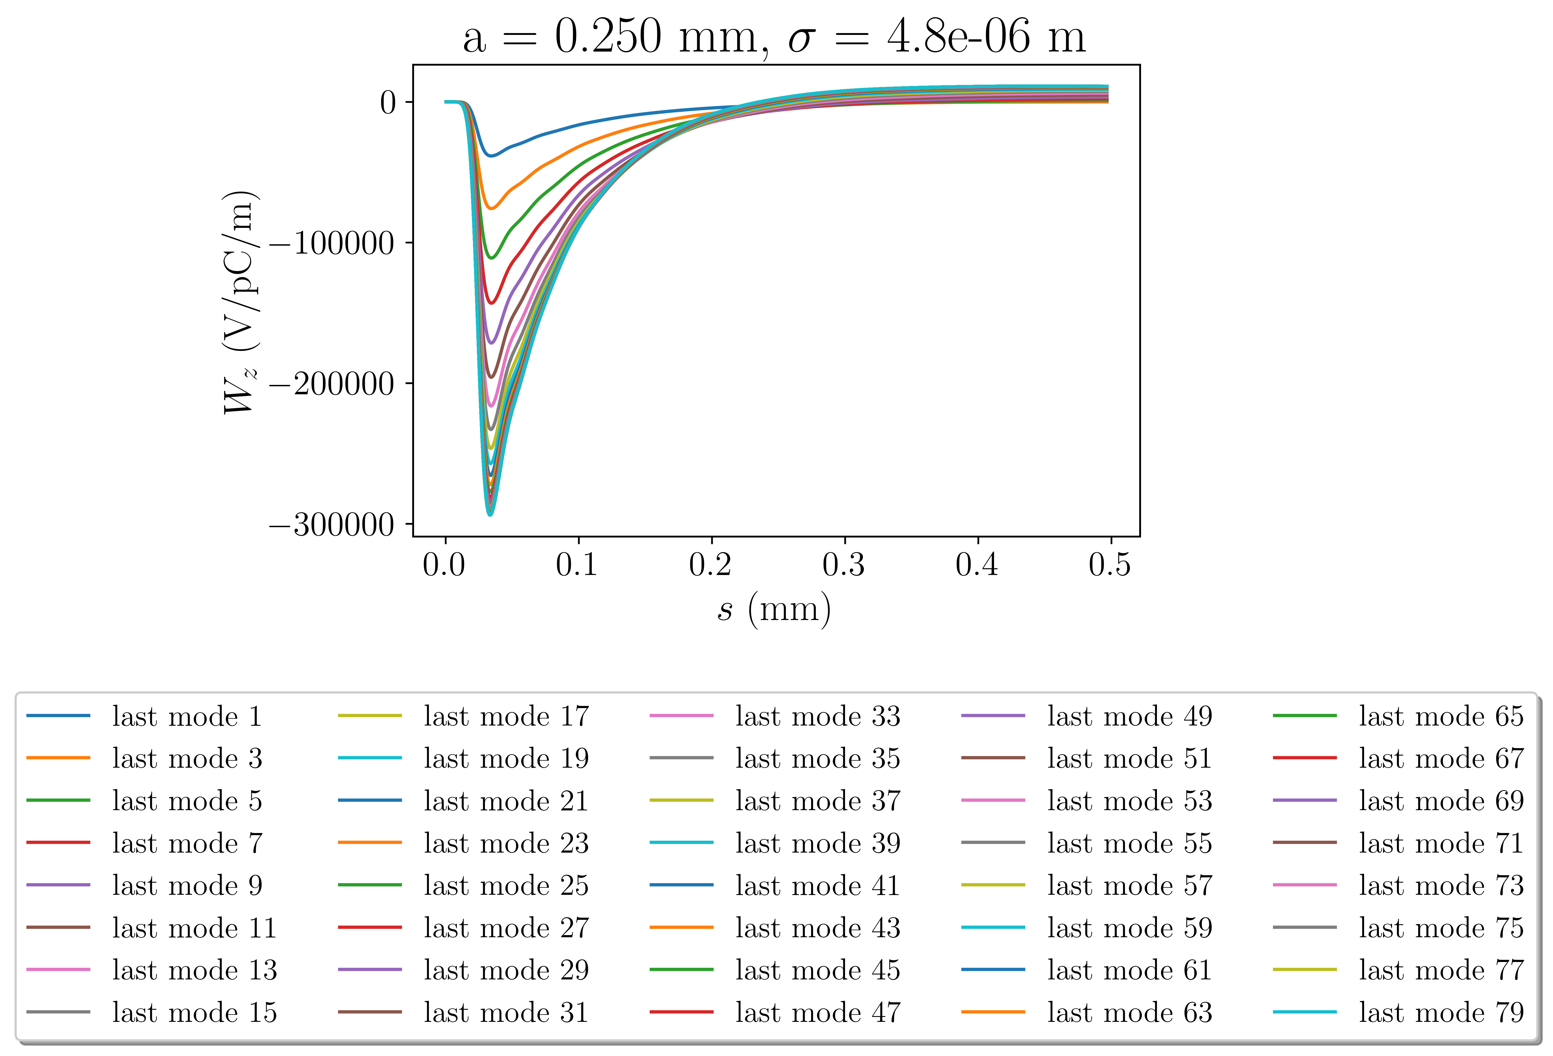
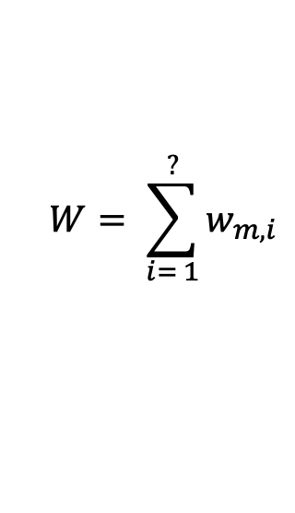
Wake potential does not change when including terms above index 45
$$W= \sum_{i= 1}^{?}{w_{m, i}}$$

Slide 16
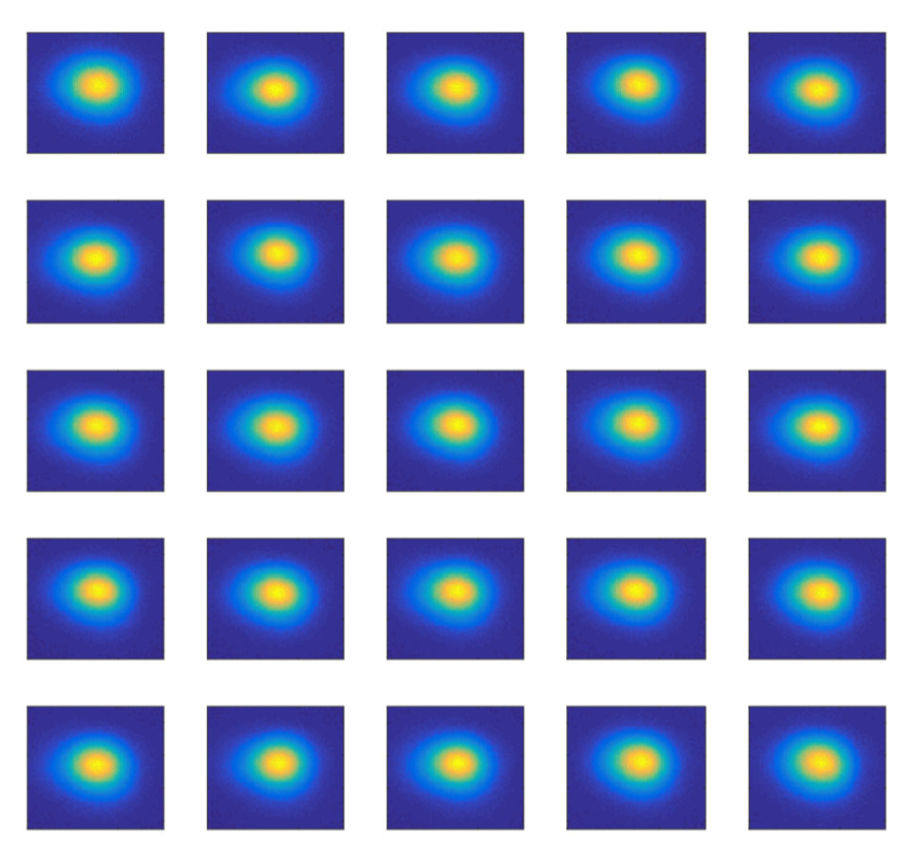
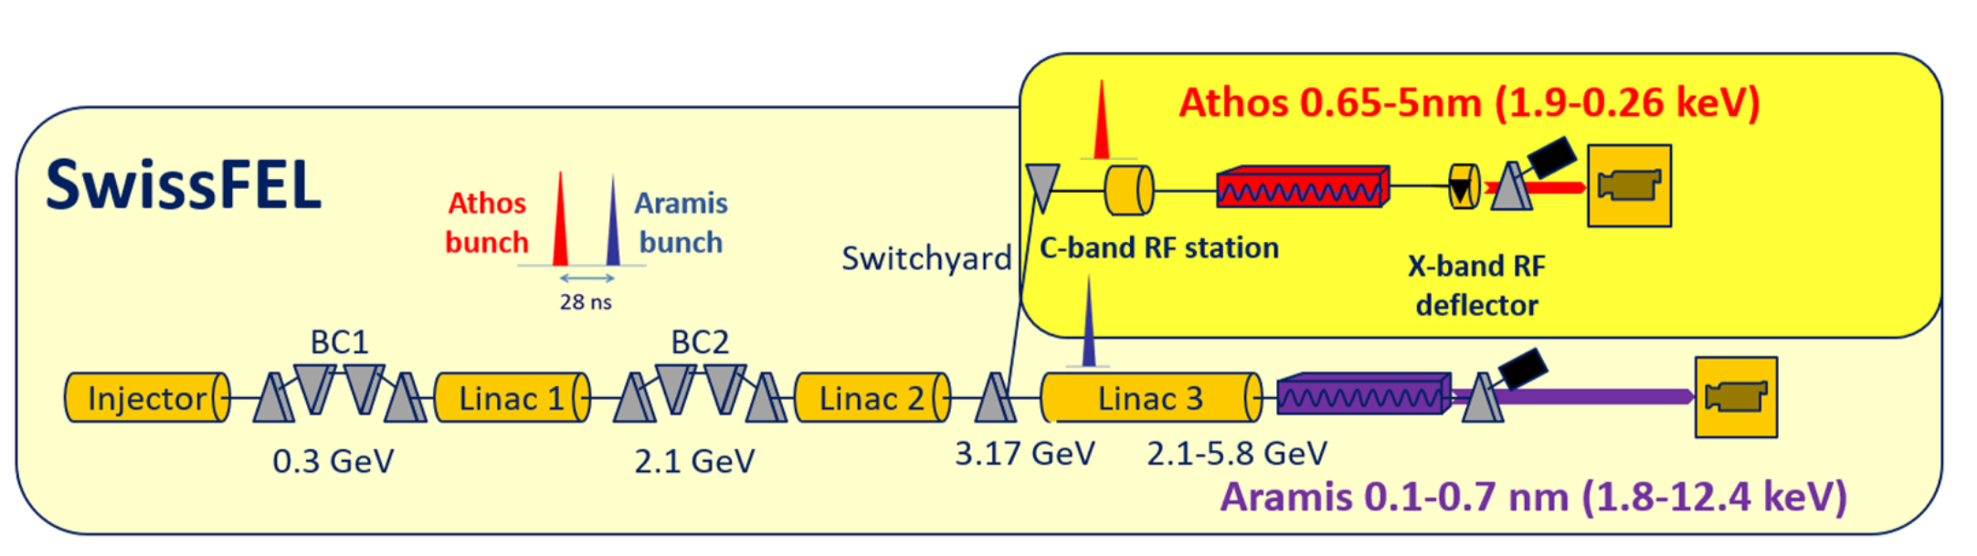
SwissFEL
Parameter | Value
Length | 740 m
LINAC frequency | 5.7 GHz (C-band)
Repetition rate | 100 Hz
Energy | up to 6.1 GeV
Bunch charge | 10 – 200 pC
Trajectory jitter | < 10% of beam size
Relative energy jitter | ~ 10⁻⁴
Arrival time jitter | < 10 fs
Slice emittance | 200 nm (for 200 pC)
Bunch length | < 1 fs – 50 fs
Courtesy: Eduard Prat

Slide 17
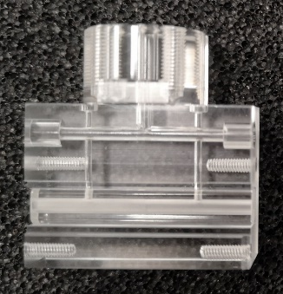
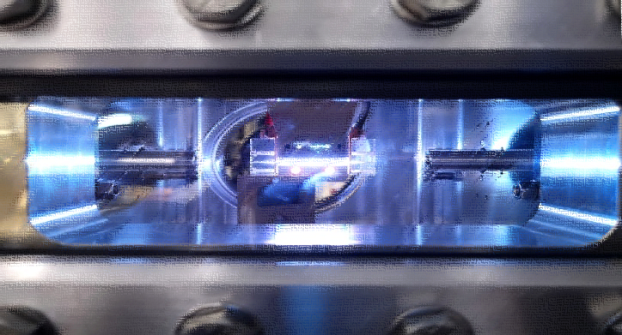
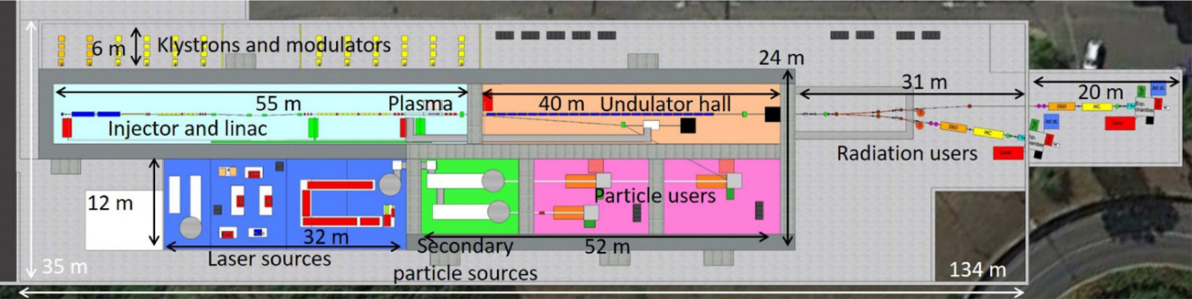
EuPRAXIA
Parameter | SwissFEL | EuPRAXIA [*]
Length | 740 m | 150 m
LINAC frequency | 5.7 GHz (C-band) | 11.9942 GHz (X-band)
Repetition rate | 100 Hz | ~ 50 Hz
Energy | up to 6.1 GeV | 1 – 1.2 GeV
Bunch charge | 10 – 200 pC | 30 – 50 pC
Trajectory jitter | < 10% of beam size | –
Relative energy jitter | ~ 10⁻⁴ | –
Arrival time jitter | < 10 fs | –
Slice emittance | 200 nm (for 200 pC) | 500 nm
Bunch length | < 1 fs – 50 fs | 10 fs
Presented by A Biagioni at EuPRAXIA-DN School April 2024
EuPRAXIA Conceptual Design Report, Assmann, et al.
[*] Presented by C Welch at EuPRAXIA-DN School April 2024

Slide 18
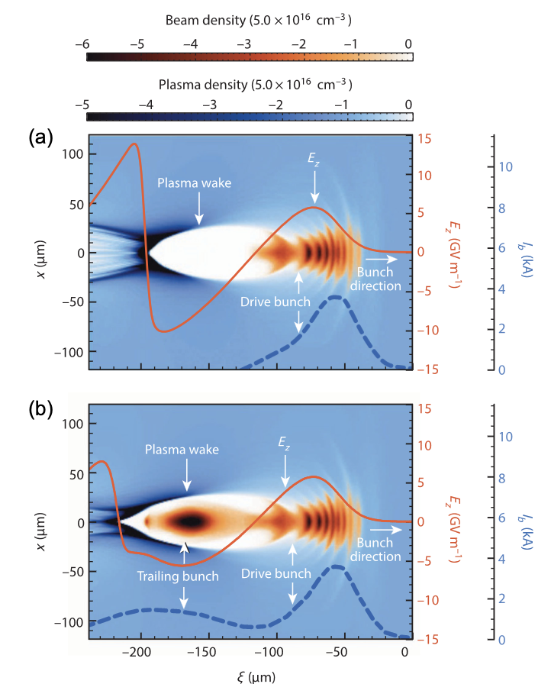
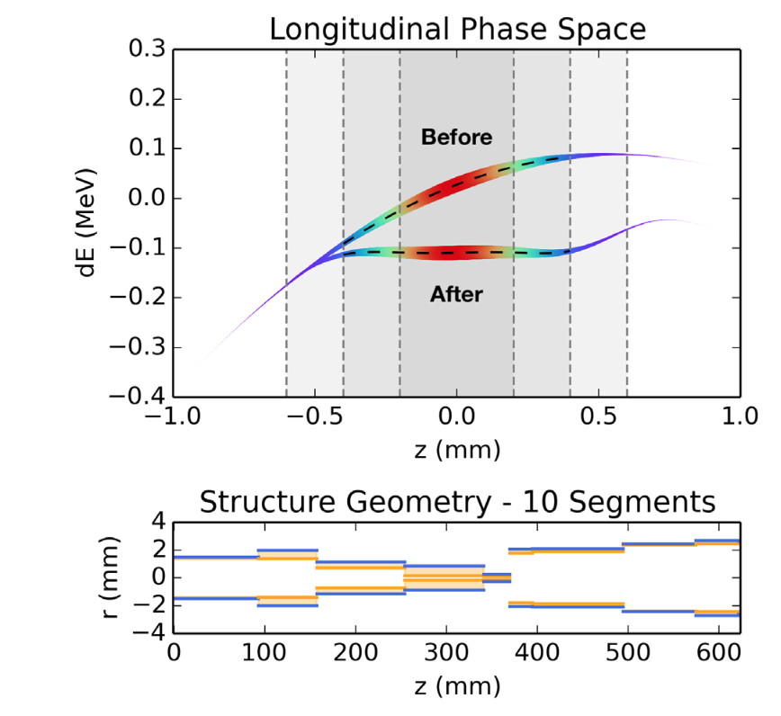
EuPRAXIA
Smaller accelerator may be less expensive and more sustainable
Challenge: produce beams with low energy spread
Small wavelength of plasma wake leads to large difference in acceleration of particles within a bunch with a finite length
The beam’s energy spread determines the bandwidth of the FEL
One possible solution is wakefield structures
Positron acceleration in plasma wakefields, Cao, et al.
Longitudinal phase space synthesis with tailored 3D-printable dielectric-lined waveguides, Mayet, et al.

Slide 19
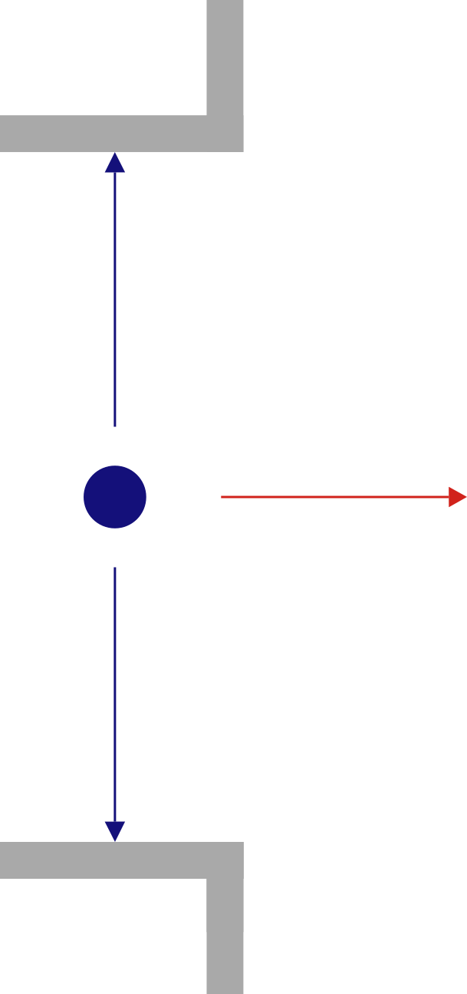
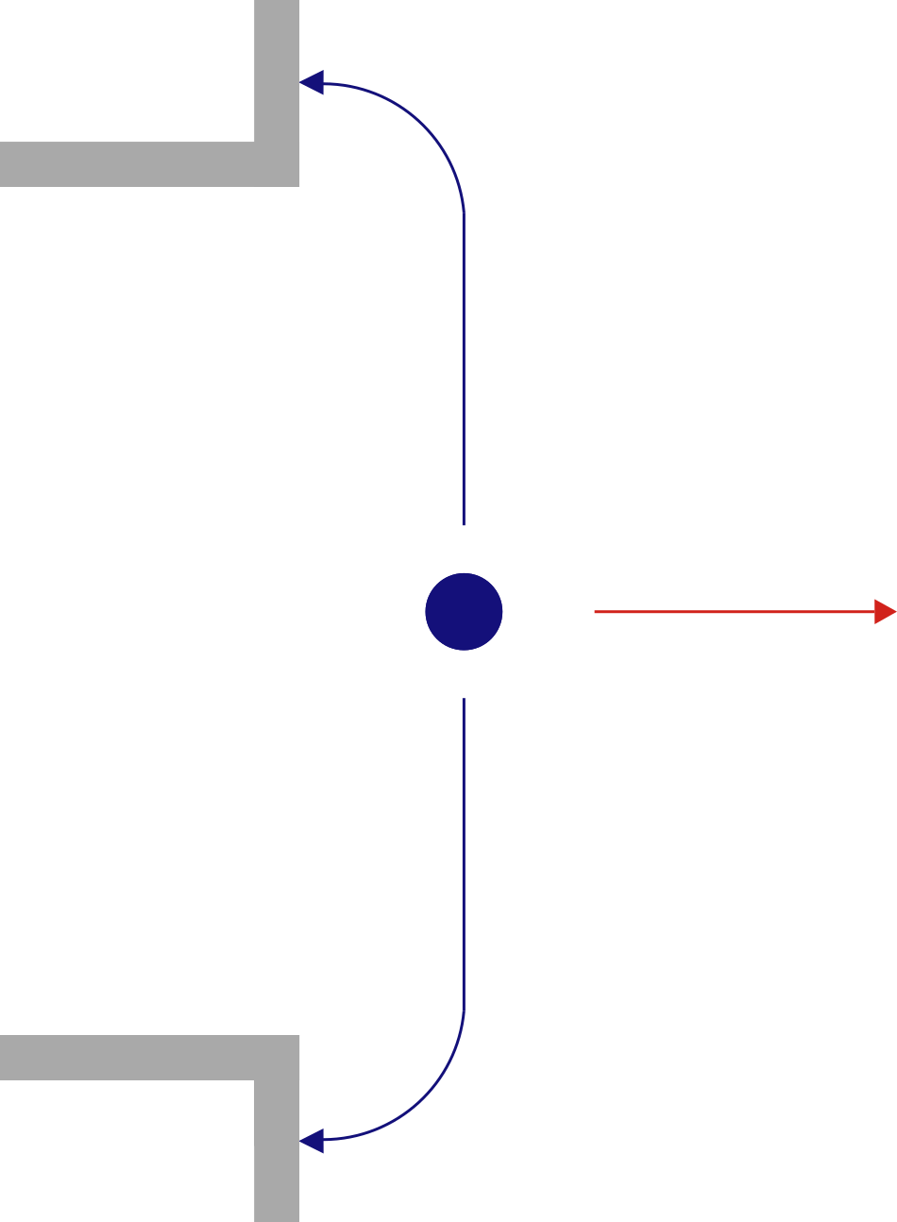
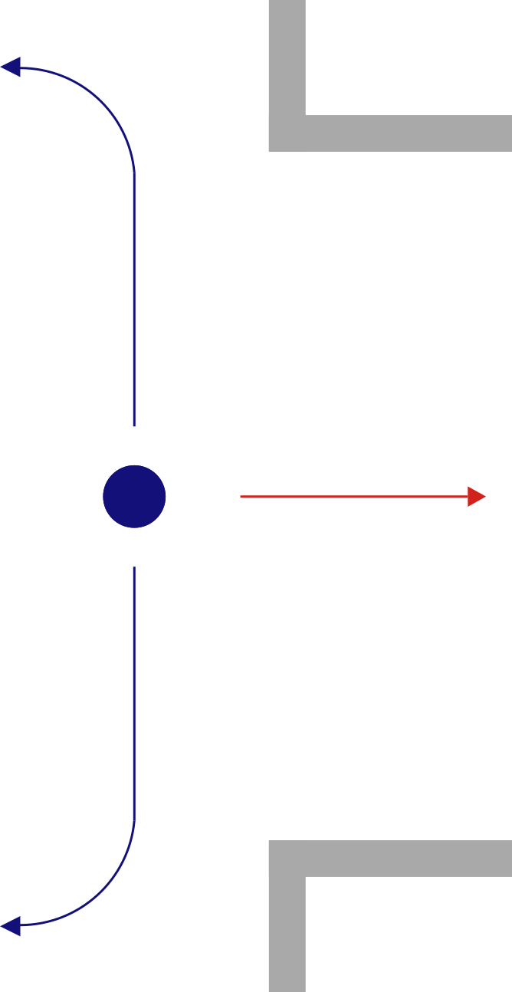
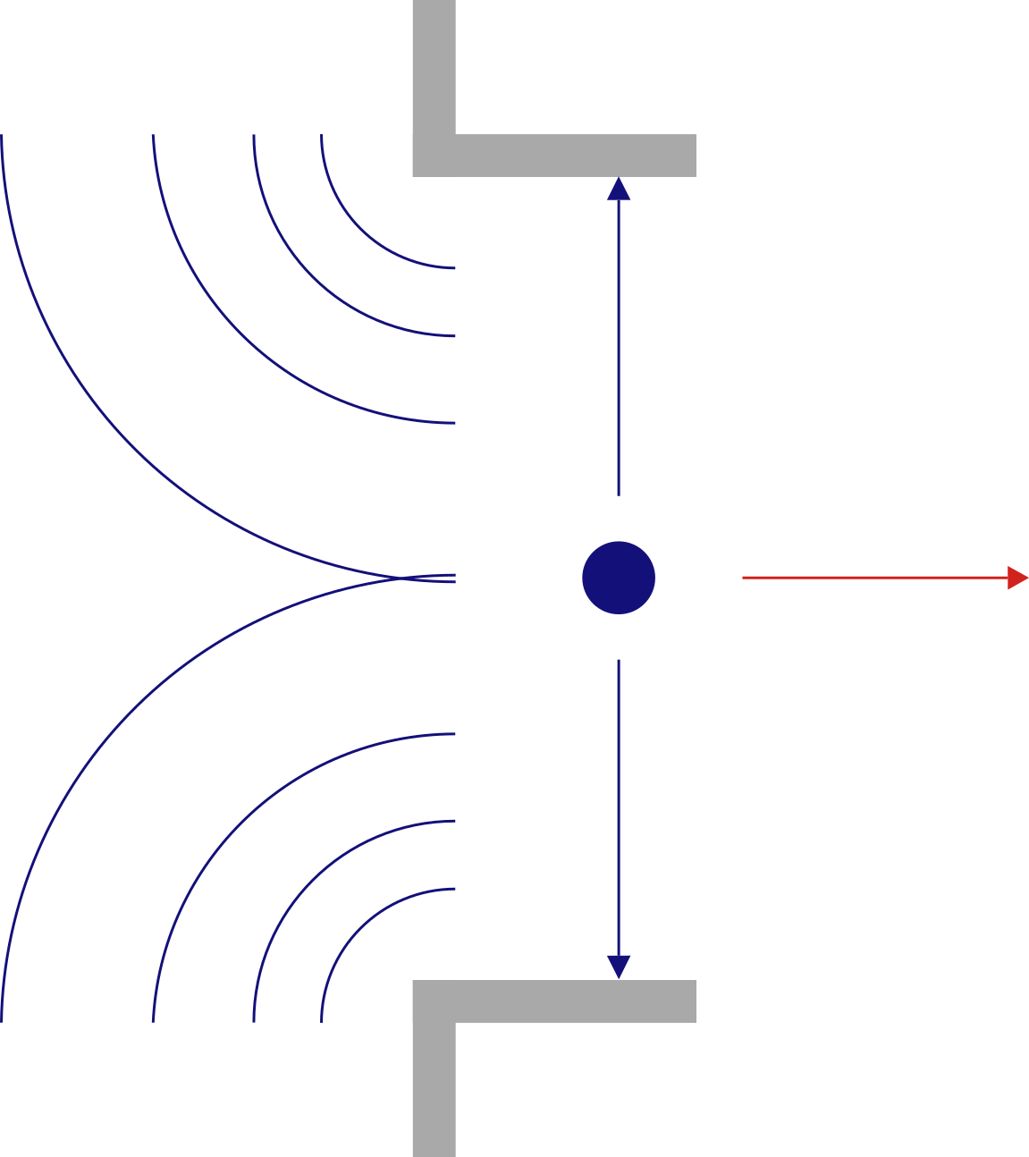
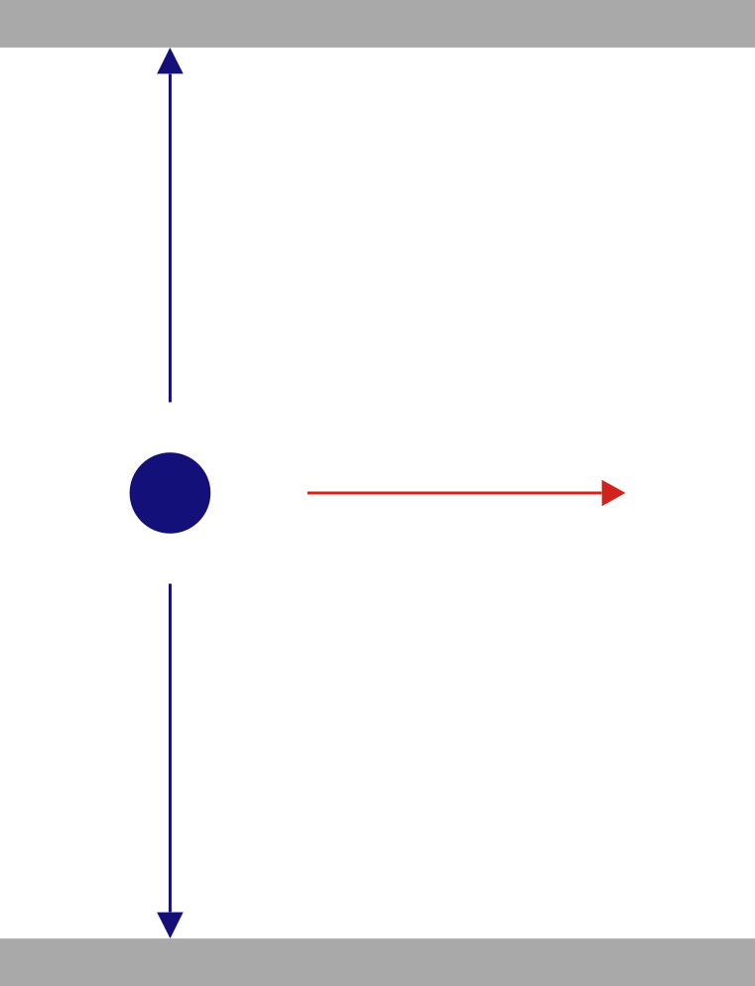
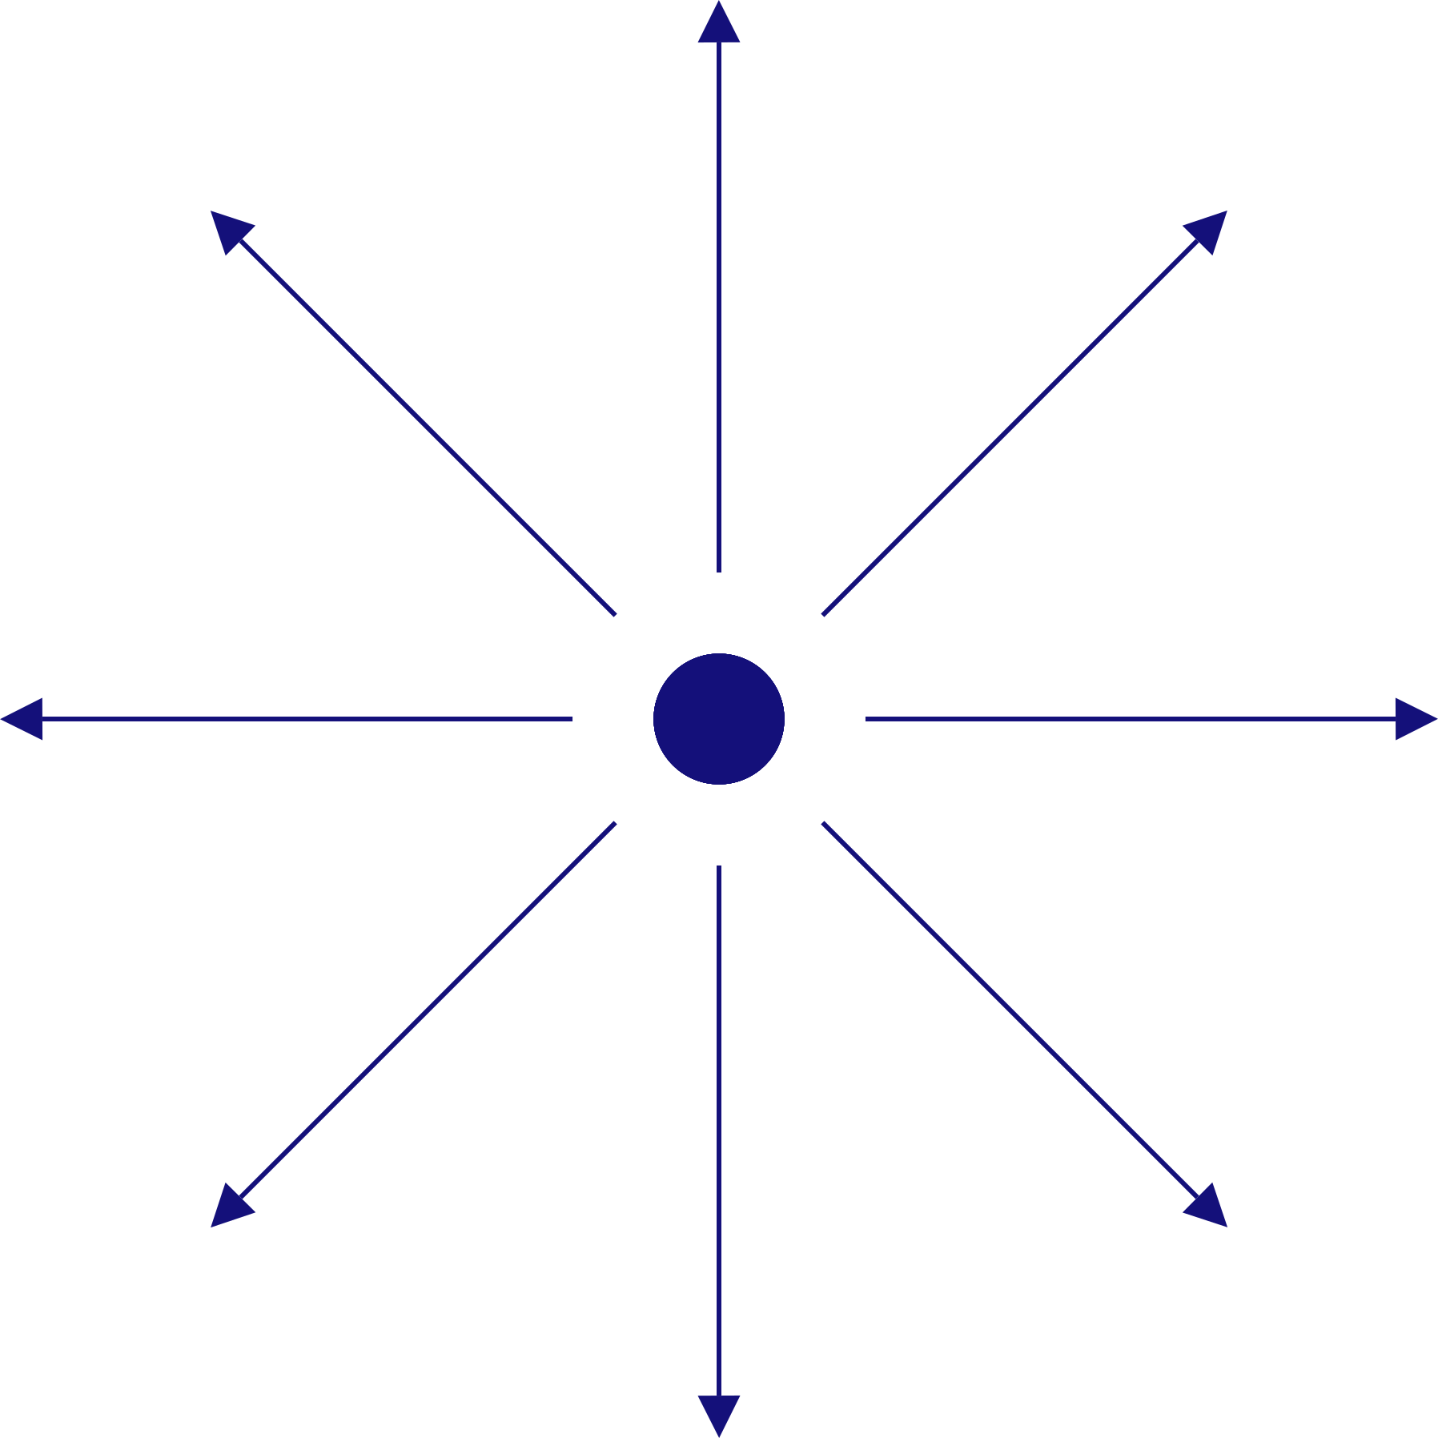
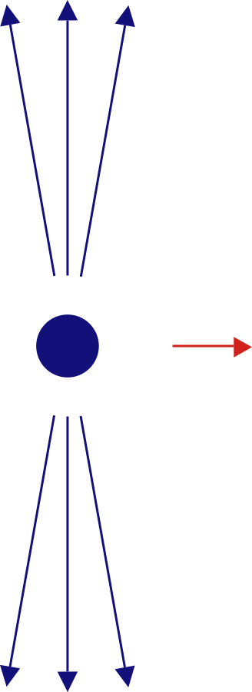

Wakefield structures
Geometric discontinuities of accelerator components produce wakefields
Finite conductivities of accelerator components produce wakefields
Fields are synchronized with the beam
No external power source required

Slide 20






Wakefield structures
 | Metallic | Dielectric
Flat
Round
Temporal profile measurements of relativistic electron bunch based on wakefield generation, Bettoni, et al.
Dielectric Wakefield Acceleration of a Relativistic Electron Beam in a Slab-Symmetric Dielectric Lined Waveguide, Andonian, et al.
Temporal profile measurements of relativistic electron bunch based on wakefield generation, Bettoni, et al.
Design of a cylindrical corrugated waveguide for a collinear wakefield accelerator, Siy, et al.

Slide 21





Wakefield structures
Theory of wakefields in a dielectric-lined waveguide, Park & Hirshfield
BNS damping, Novokhatski
Wake function:
$$w_{z}=−\frac{1}{q}\int_{z_{1}}^{z_{2}}{dz E_{z}}$$
Red witness particle experiences -400 V per pC in the drive beam per meter of structure
$$W_{z}=\int_{0}^{∞}{ds′ λ(s−s^{′})w_{z}(s^{′})}$$
Wake potential:

Slide 22



Wakefield structures
Peter Heimgartner
Flat slab dielectric passive structure with adjustable gap
Routinely used to make ultrashort pulses, adjust FEL bandwidth

Slide 23

w
Parameter | Value
half-gap, a | 0.25 mm – 1.5 mm
Length, L | 1 m
Width, w | 15 mm
Dielectric thickness, d | 0.4 mm
Alumina Permittivity, ε_{r} | ~ 10
beam
L
d
a

Slide 24



Sing bunch experiment
1 kA
2 kA
4 kA

Slide 25
Experiments that benefit from an increased FEL bandwidth
X-ray crystallography
X-ray emission spectroscopy
X-ray absorption spectroscopy
Stimulated Raman spectroscopy
Multiple wavelength anomalous diffraction
X-ray absorption near edge structure
  7050 eV – 7250 eV

