Slide 1
High Gradient Photoguns
for a Potential Upgrade to the SwissFEL
Thomas Geoffrey Lucas
Tenure-Track Scientist
Swiss Physical Society, September 2024

Slide 2
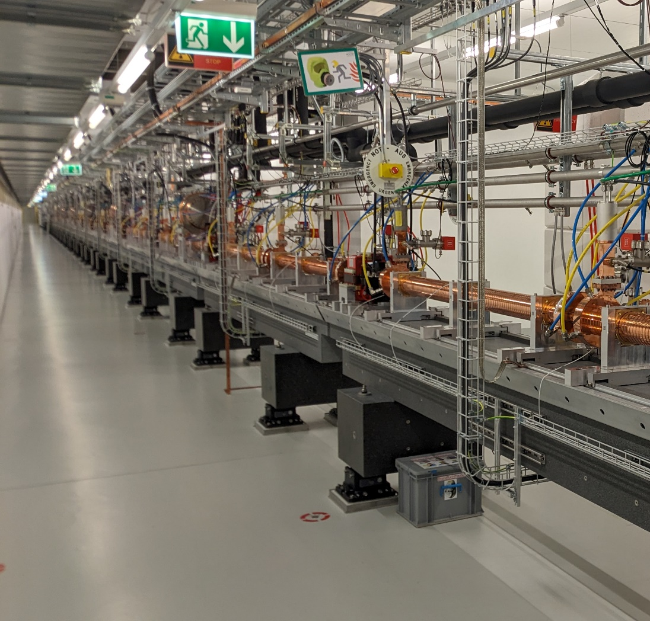
SwissFEL
XFELs are the current frontier for the time-solved analysis of atomic and molecular structures.
The X-ray brilliance is dictated by the electron beam brightness at the undulator. However, this electron beam brightness is primarily dictated by the electron source.
The brightness at the electron source represents the greatest brightness within the XFEL, which brings us to this project. Is it possible to generate a higher brightness electron beam for the SwissFEL to improve its performance?

Slide 3
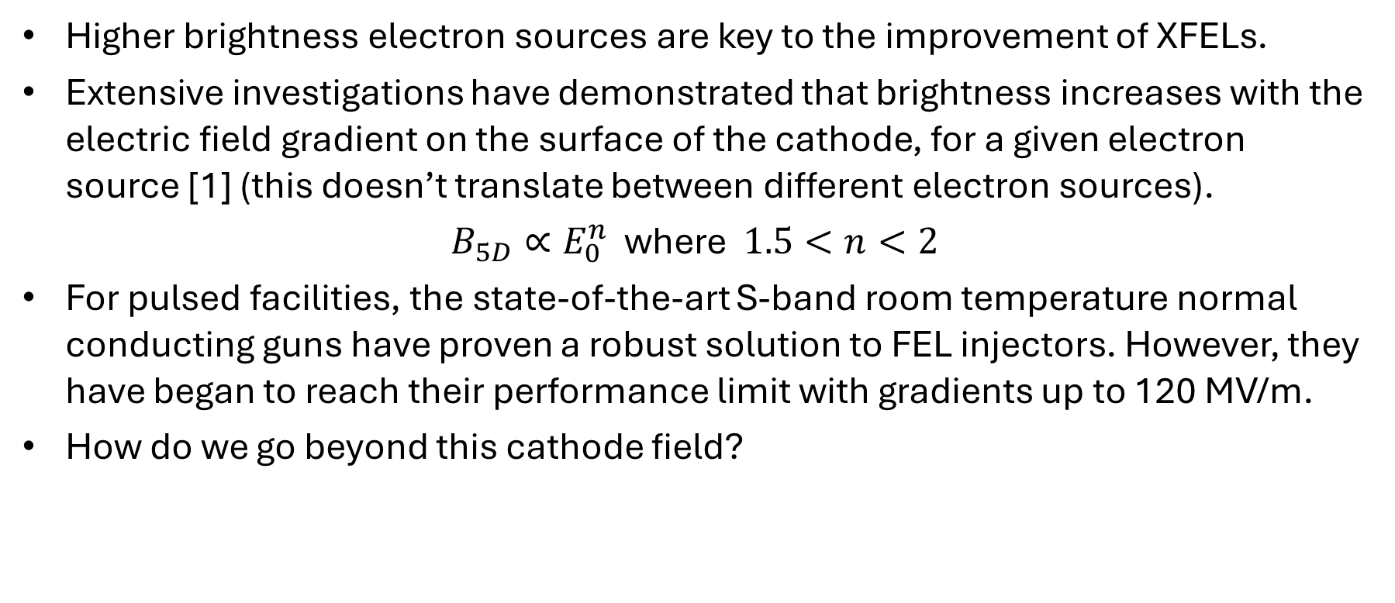
Beam Brightness and Cathode Electric Field
Higher brightness electron sources are key to the improvement of XFELs.
Extensive investigations have demonstrated that brightness increases with the electric field gradient on the surface of the cathode, for a given electron source [1] (this doesn’t translate between different electron sources).
$B_{5D}∝E_{0}^{n}$ where $1.5<n<2$
For pulsed facilities, the state-of-the-art S-band room temperature normal conducting guns have proven a robust solution to FEL injectors. However, they have began to reach their performance limit with gradients up to 120 MV/m.
How do we go beyond this cathode field?
J. B. Rosenzweig, Next generation high brightness electron beams from ultrahigh field cryogenic rf photocathode sources

Slide 4
How to achieve higher surface electric field gradients?
The physical mechanism driving RF breakdown still illudes the community. However, there’s much we’ve learnt in the generation of higher gradients.
These are some factors that well demonstrated evidence to allow higher gradients.
  Higher Frequencies [8]
  Shorter RF pulse lengths [4,5,6]
  Low Group Velocity [2,3,4]
More recently developing evidence
  New materials (CuAg) [6]
  Cryogenic Copper [7]
In this work we will exploit the first three techniques. However, this work could also be combined with these newly developing concepts if further evidence demonstrates their high gradient abilities.
A non-exhaustive list of references:
V. A. Dolgashev, Design Criteria for High-Gradient Radio-Frequency Linacs. Appl. Sci. 2023, 13(19), 10849
Dolgashev, V.; Tantawi, S. Effect of RF Parameters on Breakdown Limits in High-Vacuum X-Band Structures. In AIP Conference Proceedings; American Institute of Physics: College Park, MD, USA, 2003; Volume 691, pp. 151–165.
Wuensch, W. The Scaling of the Traveling-Wave RF Breakdown Limit; Technical Report; CERN: Geneva, Switzerland, 2006.
Grudiev, A.; Calatroni, S.; Wuensch, W. New local field quantity describing the high gradient limit of accelerating structures. Phys. Rev. Spec.-Top.-Accel. Beams 2009, 12, 102001.
Dolgashev, V.A.; Tantawi, S.G.; Nantista, C.D.; Higashi, Y.; Higo, T. High Power Tests of Normal Conducting Single Cell Structures. In Proceedings of the IEEE PAC 2007, Albuquerque, NM, USA, 25–29 June 2007; pp. 2430–2432.
Dolgashev, V.; Tantawi, S.; Yeremian, A.; Higashi, Y.; Spataro, B. Status of High Power Tests of Normal Conducting Single-Cell Standing Wave Structures. In Proceedings of the IPAC 2010, Kyoto, Japan, 23–28 May 2010; pp. 3810–3812.
Cahill, A.D.; Rosenzweig, J.B.; Dolgashev, V.A.; Tantawi, S.G.; Weathersby, S. High gradient experiments with X-band cryogenic copper accelerating cavities. Phys. Rev. Accel. Beams 2018, 21, 102002.
Kilpatrick,W.D. Criterion for vacuum sparking designed to include both rf and dc. Rev. Sci. Instrum. 1957, 28, 824–826.

Slide 5
High Gradient C-band RF Photoguns
Under the IFAST programme, a collaborative project between PSI and INFN has been undertaken to design and realise two new high gradient photoguns.
The aim is to demonstrate photoguns that can achieve gradients well in excess of 120 MV/m, which is the current state-of-the-art.
The two photoguns use two separate techniques to achieve these high gradients: the first design uses a more conventional technique of overcoupling to reduce the filling time while the second design uses for the first time travelling-wave technology in an RF photogun.

Slide 6

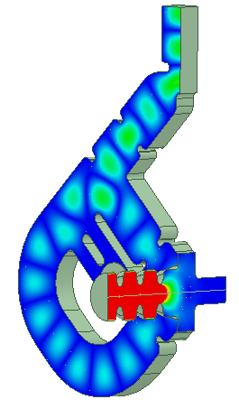
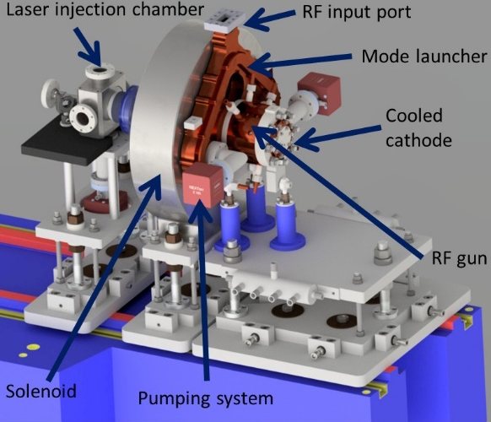
The C-band Standing-Wave Photogun
The first RF Photogun is a 2.5-cell standing-wave rf photogun with a coupling factor of 3 and a mode-launcher fed with four-port.
The novelty of this design is the use of clamping technology.
RF and mechanical design from INFN, Frascati.
Published here: https://journals.aps.org/prab/abstract/10.1103/PhysRevAccelBeams.26.083402

Slide 7
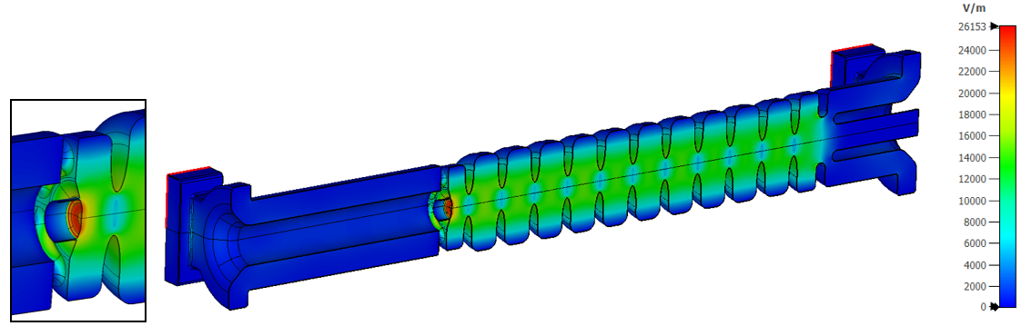
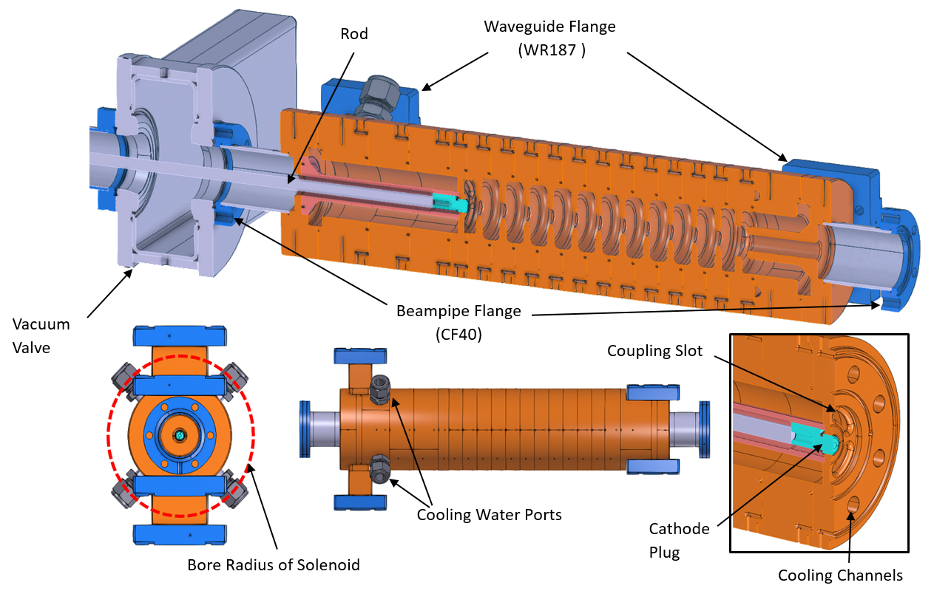
The C-band Travelling-Wave Photogun
An 11.5-cell Travelling-Wave RF Photogun with coaxial input and output couplers.
Designed with an exchangable cathode capability.
RF Design and mechanical design by PSI.
Published here: https://journals.aps.org/prab/abstract/10.1103/PhysRevAccelBeams.26.103401

Slide 8
Beam Dynamics Performance of Photoguns
Beam dynamics simulations of the two C-band guns and a pair of accelerating structures downstream.
Optimisation based on maximising peak current and minimising projected emittance (to also have good mismatch parameter).
 | TW Gun | TW Gun | SW Gun | SW Gun
Cathode Gradient | 135 | 200 | 160 | 180
Charge | 200 | 200 | 200 | 200
Peak current | 36 | 54 | 40 | 40
Central sliced Emittance | 0.136 | 0.13 | 0.18 | 0.16
Brightness | 1992 | 4978 | 1234 | 1562

Slide 9
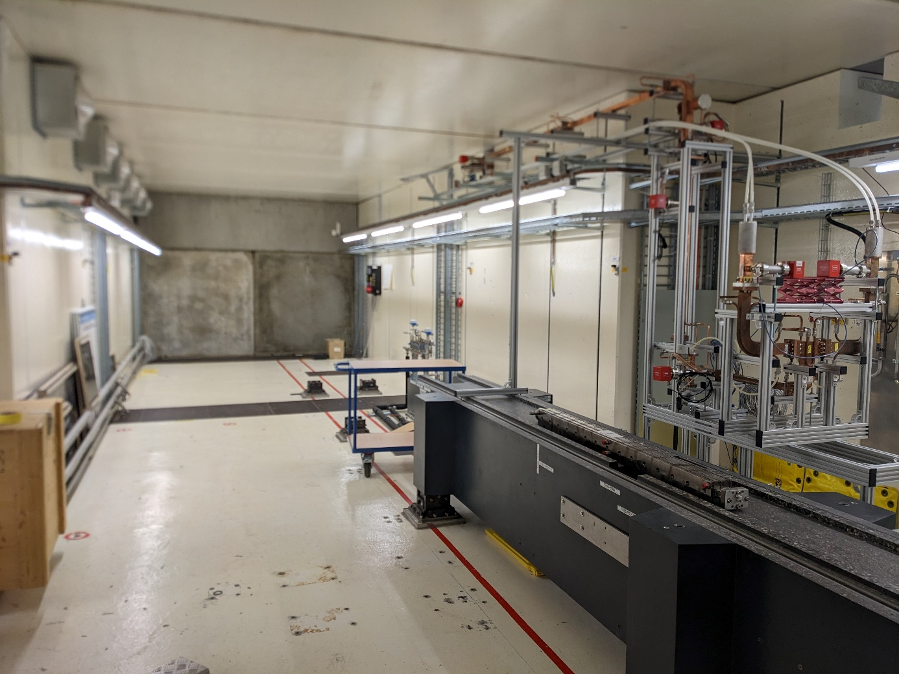
Low and High Power Testing Facilities
Low power testing capacity at both PSI and INFN.
A high power test stand has been realised at the Paul Scherrer Institut.
Test stand capable of testing TW devices up to 200 MW and SW devices up 20 MW.

Slide 10
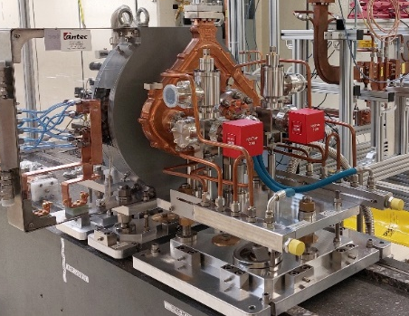
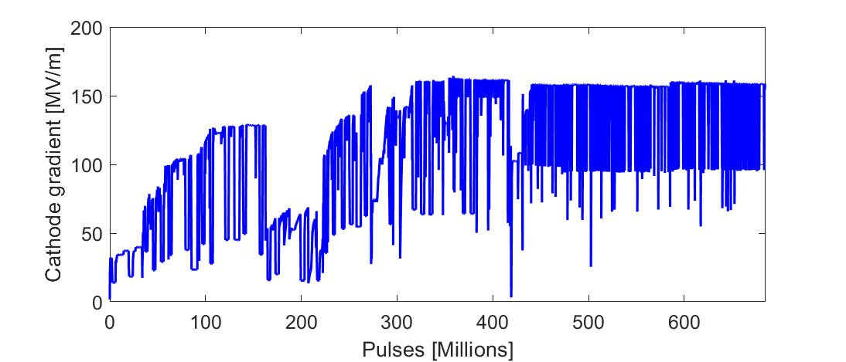
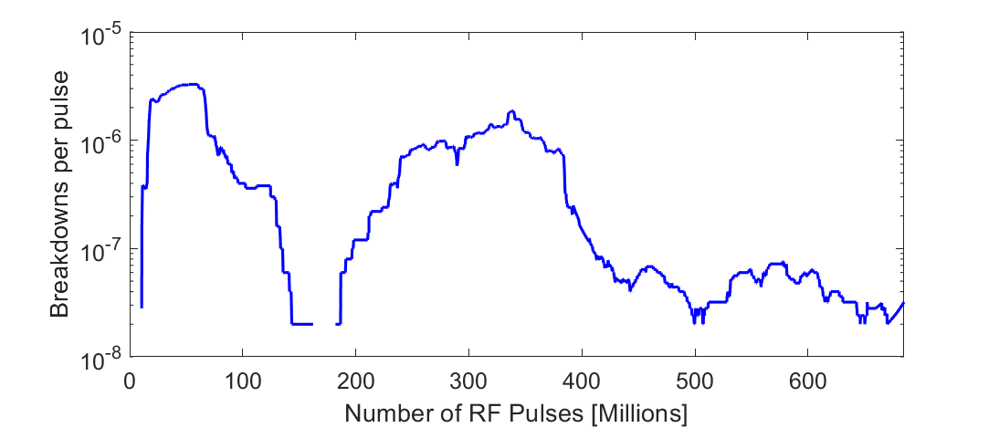
Realisation and Testing of SW Photogun
Realised by Comeb in Italy.
High power tests occurred at the PSI high power test stand.
No circulator but rather a highly attenuate line to reduce reflections to the klystron.
Conditioning progressed quickly to a gradient of 125 MV/m in approximately 2 weeks. After some waveguide conditioning, the ultimate gradient of 160 MV/m was reached in a little over a month. This gradient equates to a doubling of the brightness of SwissFEL.
At 100 Hz
~2 weeks

Slide 11
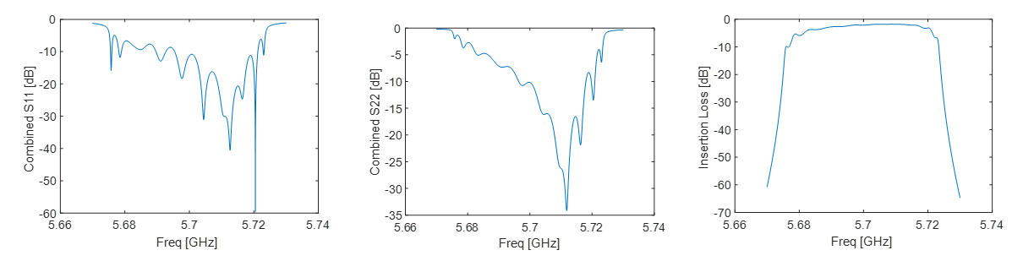
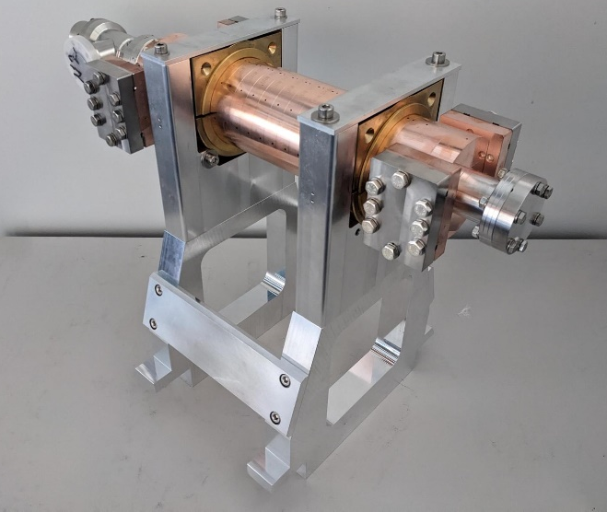
Realisation and Testing of TW Photogun
Low power testing performed demonstrated a well-tuned structure with a good transmit

Slide 12
Summary
Two new RF Photoguns have been realised under the IFAST collaboration. These use C-band technology and short filling times in the aim of generating very high cathode gradients.
One of these guns is the first ever Travelling-wave rf photogun ever realised.
First high power results have demonstrated great performance in a cathode gradient of 160 MV/m at 2 x 10⁻⁸ bpp and low power tests of the TW gun have confirmed it is ready for high power testing to begin in 2024.
Low power results of the TW gun has demonstrated that it is ready for high power testing which will begin in the coming months.

Slide 13
Acknowledgements
Funding: This project has received funding from the European Union’s Horizon 2020 Research and Innovation program under Grant Agreement No. 101004730.
Contibutors to the IFAST project:
RF Group: Paolo Craievich, Riccardo Zennaro, Jean-Yves Raguin and Fabio Marcellini.
The RF Section of PSI
David Alesini, Andrea Liedl, Luisa Spallino and Fabio Cardelli of INFN, Frascati.
All of PSI technical groups that contributed to the commissioning of the new test stand.

Slide 14
Thank you!
Any questions?

