Slide 1


Bulk High Temperature Superconducting Undulator
Swiss Accelerator Research and Technology
Field Optimization and Shimming
Carlos Gafa’, Alexandre Arsenault, Marco Calvi, John Durrell, Anthony Dennis, Nicholas Sammut, Andrew Sammut
Notes:
Hi, I will be presenting to you our progress in optimizing and shimming the novel high temperature superconducting undulator being developed at PSI.

Slide 2
Agenda
Introduction
Modelling framework
Sorting
Ferromagnetic pole shimming
End Field Optimization
Conclusion
Notes:
First, I will go over what is synchrotron radiation and undulators. Then, I will discuss our HTS modelling framework and how this was applied to sorting and shimming the HTSU

Slide 3
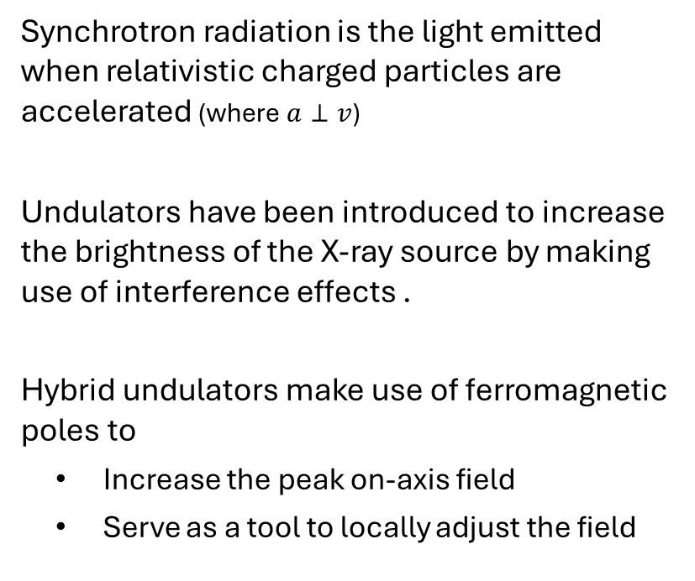
Introduction
Synchrotron radiation is the light emitted when relativistic charged particles are accelerated (where $a⊥v$)
Undulators have been introduced to increase the brightness of the X-ray source by making use of interference effects .
Hybrid undulators make use of ferromagnetic poles to
  Increase the peak on-axis field
  Serve as a tool to locally adjust the field
Ferromagnetic poles
gap
Electrons
On-axis field B_{y}
Permanent magnets
Undulator period
Traditional hybrid permanent magnet undulator
Notes:
So, synchrotron radiation is the light emitted when relativistic charged particles experience centripetal acceleration. This phenomenon is observed in storage rings where electron beams are kept in a circular closed loop.
To increase the brightness of this radiation special devices called undulators are build. These make use of periodic magnetic fields to introduce a series of oscillations in the electron’s path. Currently undulators make use of permanent magnets or electromagnets to generate this field and here we can see how a traditional permanent magnet undulator is organized.
We also note that in such an architecture, ferromagnetic poles are placed in between the magnets for two reasons; to increase the peak on-axis field and to serve as a tool to locally adjust the field.

Slide 4
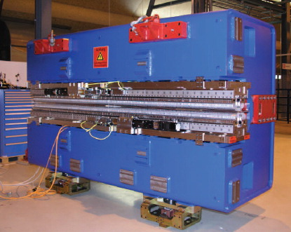
Introduction
To increase the energy of synchrotron radiation with enough flux; higher magnetic fields and shorter undulator period can be achieved using HTS bulks [T. Kii, 2006]
A record on-axis field of 2.1 T for a 10 mm period undulator has been demonstrated [K. Zhang, 2023]
HTS
Nb₃Sn @ 4.2K
NbTi @ 4.2K
PrFeB @77K
SmCo @300K
Traditional permanent magnet undulator
magnetic gap = 4mm
Notes:
To increase the energy of the emitted radiation from a undulator, while still having sufficient flux at high harmonics one needs to increase the peak on axis field of undulator’s magnetic field while decreasing the period. At short periods permanent magnets do not offer enough field strength to be usable and so the bulk HTS undulator was proposed. In 2023 a record field of 2.1 T at a 10mm period and 4mm gap was demonstrated on a short bulk HTS undulator sample, which exceeds the performance of current state of the art permanent magnet undulators.

Slide 5
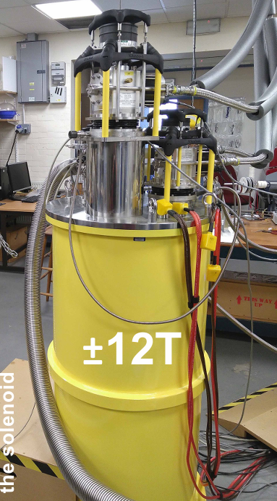
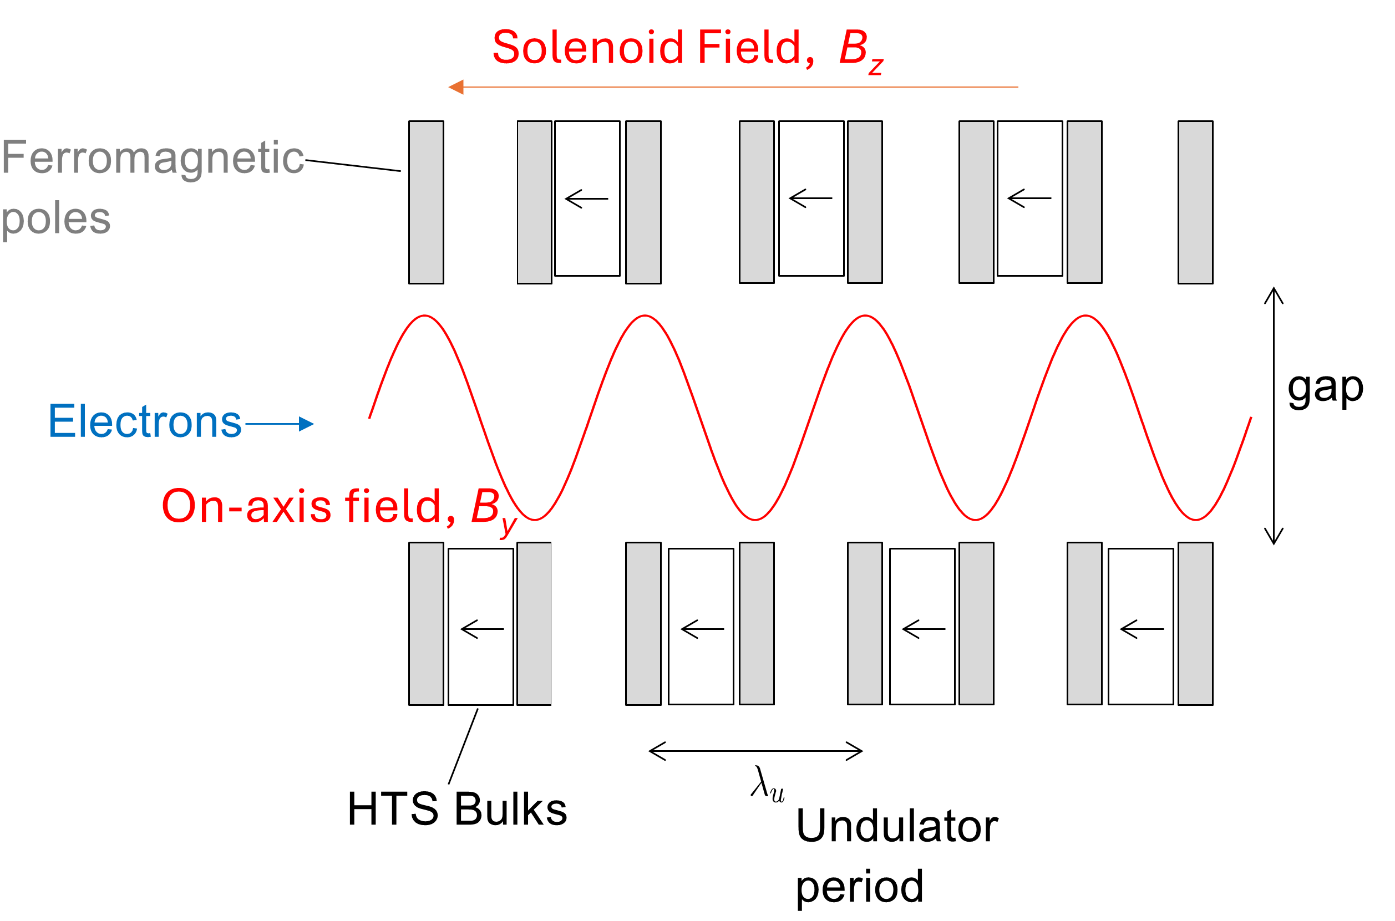
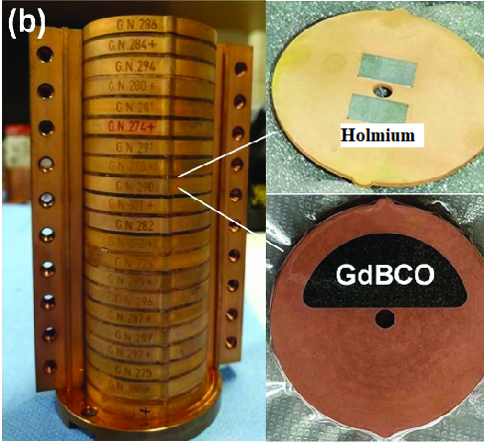
Introduction
Notes:
The HTS undulator will be built in the following staggered array configuration, and the magnetized using a FC magnetization by an external solenoid which is ramped from 10T to 0T at 10K. Here we can see our sample 20-bulk undulator which is used for testing at the university of Cambridge. Moreover, we will make use of holmium poles which were found to give a 0.1 T increase in the peak on-axis field compared to standard iron-cobalt poles at these temperatures.

Slide 6
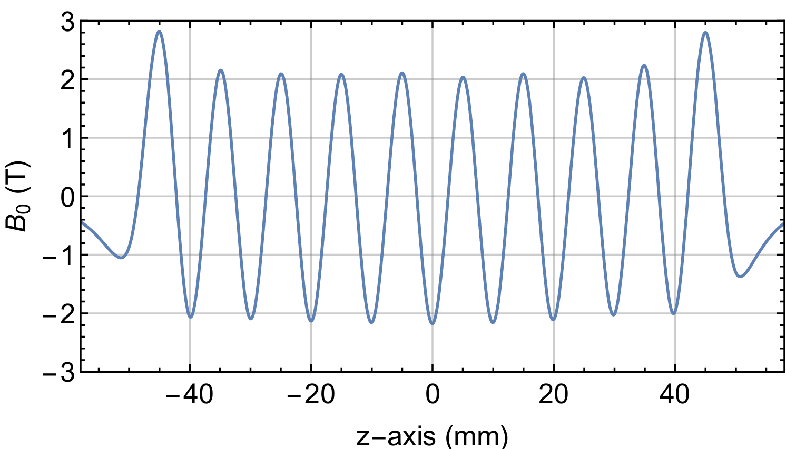
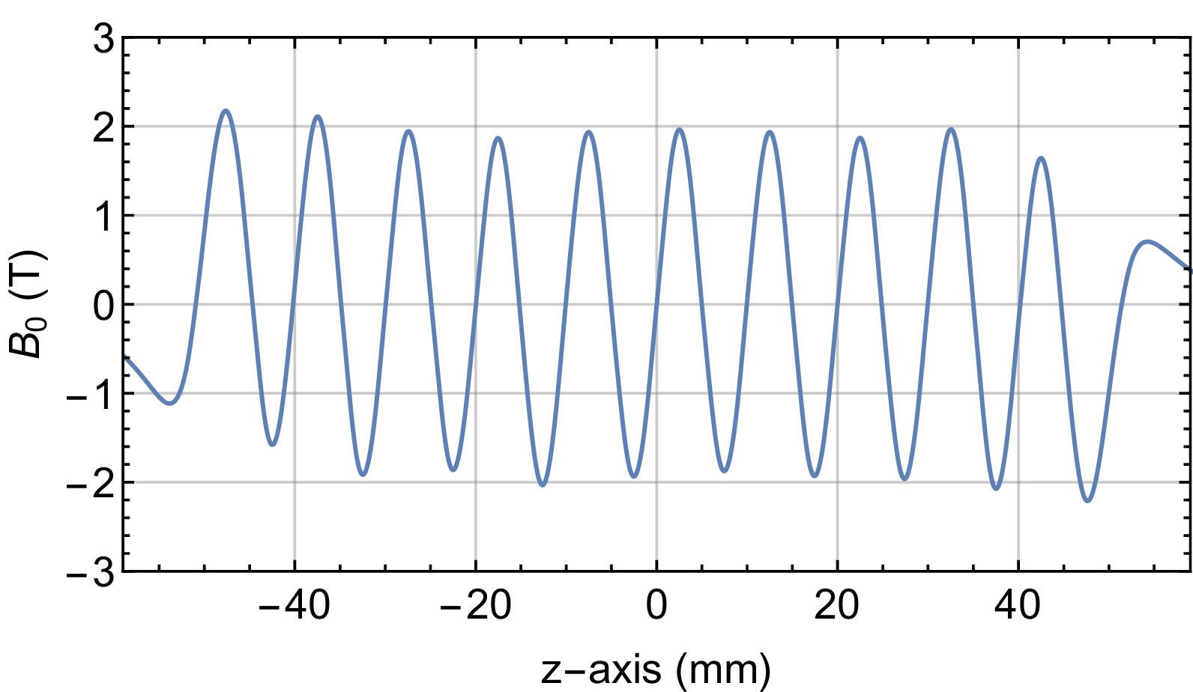
Introduction
Need to show that periodic field can be achieved; for high harmonics to be usable
Due to the growth process, the magnetic properties of HTS bulks can vary, leading to deviations from a periodic on-axis field
A periodic field is required to use the high harmonics of the emitted light
High quality Nippon steel bulks; Expensive, less errors
SDMG bulks; Cheaper, require more correction for periodic field
Notes:
Now, that we have demonstrated the ability of the HTS undulator to reach sufficiently high field, we must show that a periodic field can be achieved. Such periodicity is required for high harmonics to be usable, allowing interference effects to take place. Currently, differences between the bulks is resulting in an inhomogeneous field. This is observed in the following measured field profiles. Here we have high quality but economically unfeasible Nippon steel bulks which present with lower errors, than the SDMG bulks which will be used in the future.

Slide 7
Agenda
Introduction
Modelling framework
Sorting
Ferromagnetic pole shimming
End Field Optimization
Conclusion

Slide 8
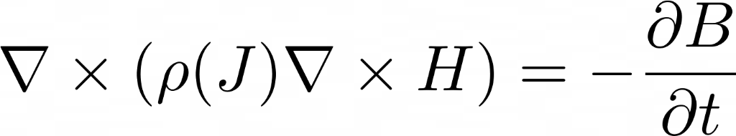
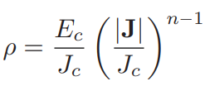
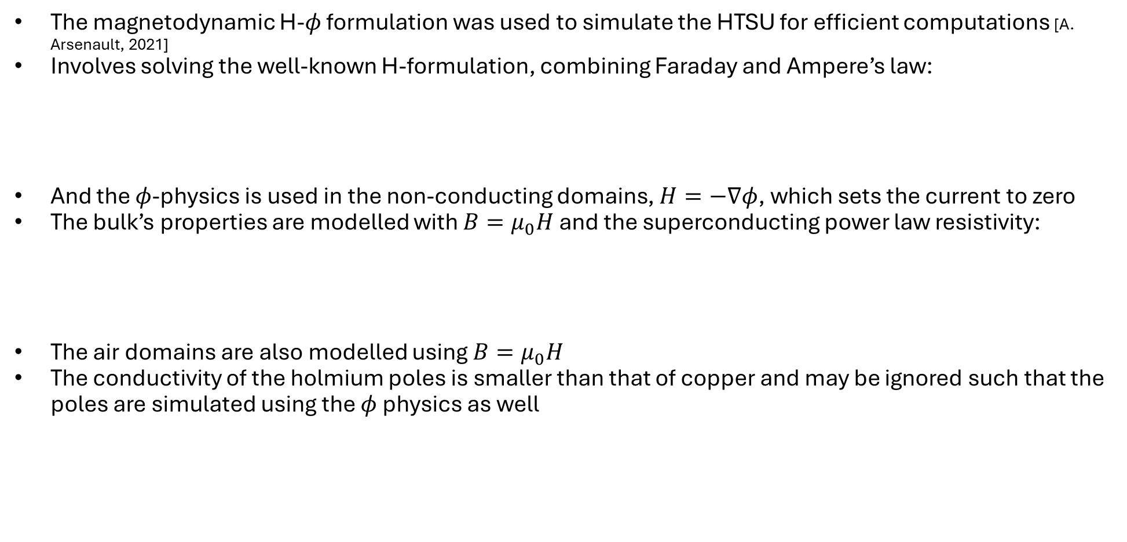
Modelling framework
The magnetodynamic H-$φ$ formulation was used to simulate the HTSU for efficient computations [A. Arsenault, 2021]
Involves solving the well-known H-formulation, combining Faraday and Ampere’s law:
And the $φ$-physics is used in the non-conducting domains, $H=−∇φ$, which sets the current to zero
The bulk’s properties are modelled with $B=μ_{0}H$ and the superconducting power law resistivity:
The air domains are also modelled using $B=μ_{0}H$
The conductivity of the holmium poles is smaller than that of copper and may be ignored such that the poles are simulated using the $φ$physics as well
Notes:
To model the HTS we make use of the magnetodynamic H-phi formulation. This solves for the magnetic field H in the combined Faraday and Ampere’s laws. Moreover, the phi physics is used in the nonconducting domains to decrease the number of degrees of freedom and improve the computational efficiency, by setting the current in these domains to zero a priori
The HTS bulk’s properties are modelled using a linear BH curve and the empirical resistivity power law
The linear BH curve is also used for the air domains.
Moreover, as conductivity of holmium is smaller than that of copper, which is already being ignored in our simulations, the poles will be simulated using the phi physics as well

Slide 9
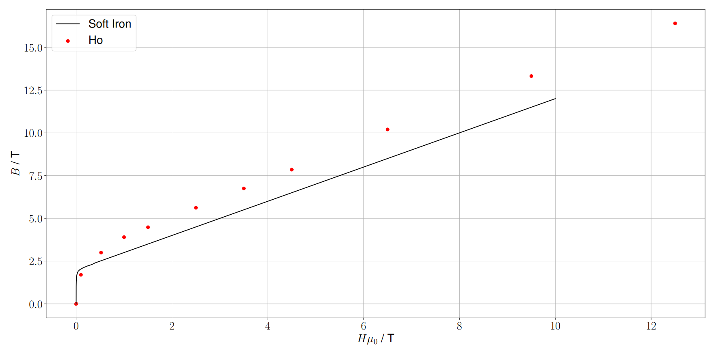
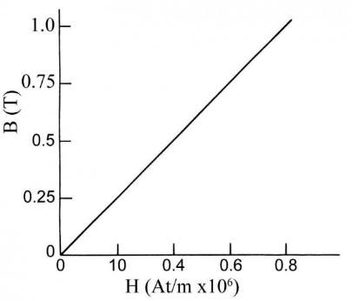
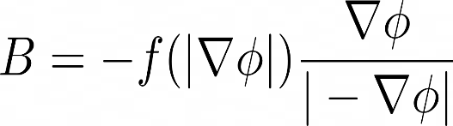

Modelling framework
Relationship between B and H
Air and HTS
Ferromagnet [M. Norsworthy, 2010]
  $$B=μ_{0}H=−μ_{0}∇φ$$
BH-Curve
Get Sign of Magnetic Field
Notes:
To do this the experimentally measured BH curve is used to model the pole’s relationship between B and H in faraday’s law. Here we see the non-linear BH-curve of holmium which has a higher saturation field than that of iron-cobalt.

Slide 10
Agenda
Introduction
Modelling framework
Sorting
Ferromagnetic pole shimming
End Field Optimization
Conclusion

Slide 11
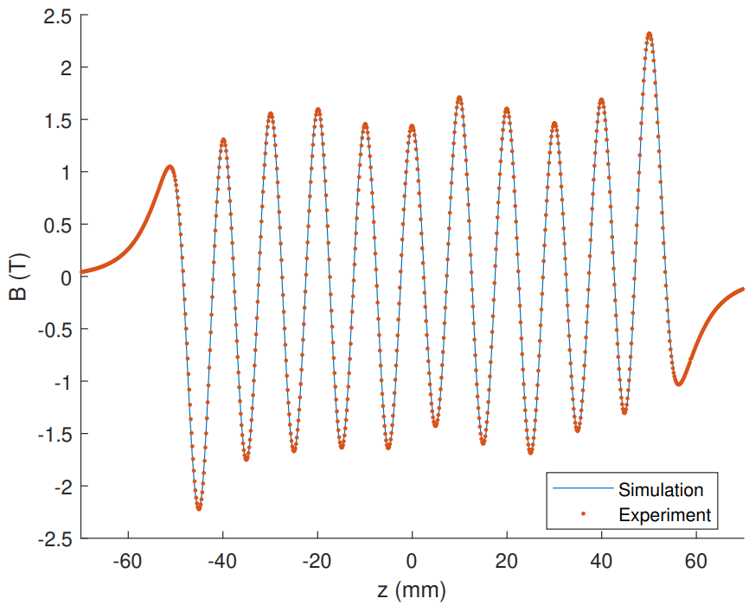
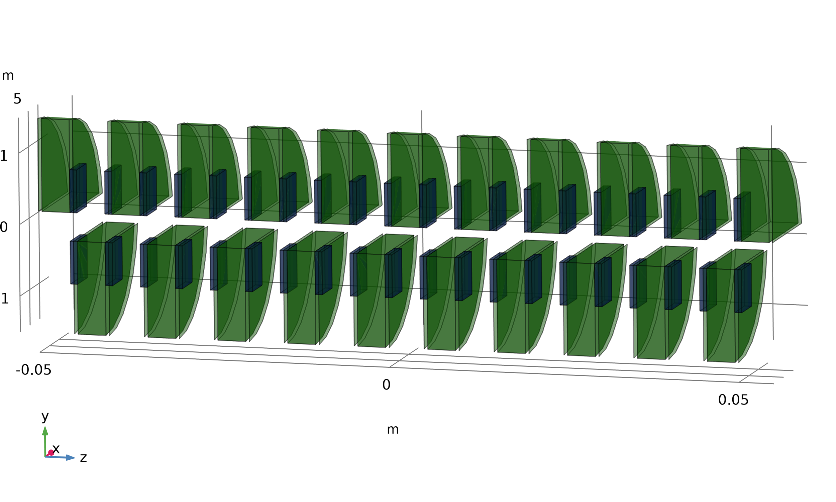

Inverse analysis and sorting
Sort bulks; global coarse adjustments to provide a better starting point for the shimming
The differences between the bulks are quantified by scaling their individual $J_{c}(B)$
Through several iterations, we can fit a scaling parameter for all bulks [R. Kinjo, 2022]
Notes:
The first step in our field optimization process is to sort the bulks in such a way that the field errors are reduced. This will act as a coarse knob which globally adjusts the field profile and serves to provide a better starting point for the shimming.
To sort the bulks we first need to quantify the differences between them. This is done by assigning a scaling parameter for each bulks critical current density, which is then found by fitting the simulated field profile to the measured one through several iterations using R. Kinjo’s inverse analysis method.

Slide 12
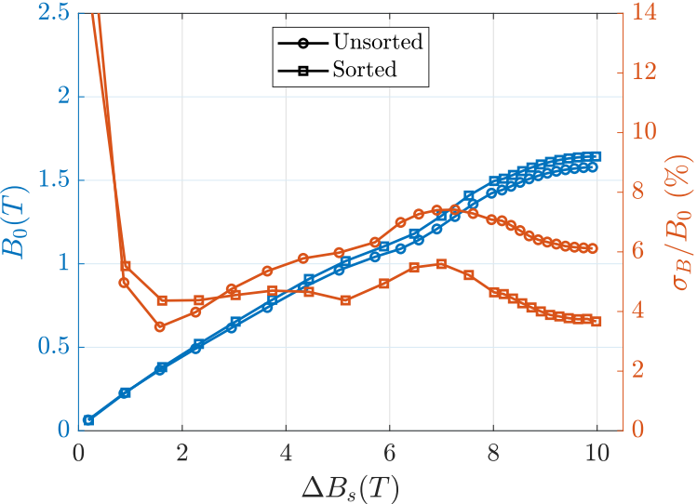
Inverse analysis and sorting
Bulks are paired such that strength between neighboring pairs is constant throughout
Using this sorting procedure, the field nonuniformity is reduced from 6% to 3.7% measured experimentally [A. Arsenault, unpublished]
The average peak field is also slightly increased in the process
Notes:
Once these scaling parameters are found, the bulks are sorted in such a way that the strength between neighboring pairs is constant throughout . This sorting was recently experimentally verified using a 20 SDMG bulk sample, where the peak-to-peak variance within the field profile was found to decrease to 3.7% from 6%. We also found a slight increase in the average peak, with such a sorting.

Slide 13
Agenda
Introduction
Modelling framework
Sorting
Ferromagnetic pole shimming
End Field Optimization
Conclusion

Slide 14
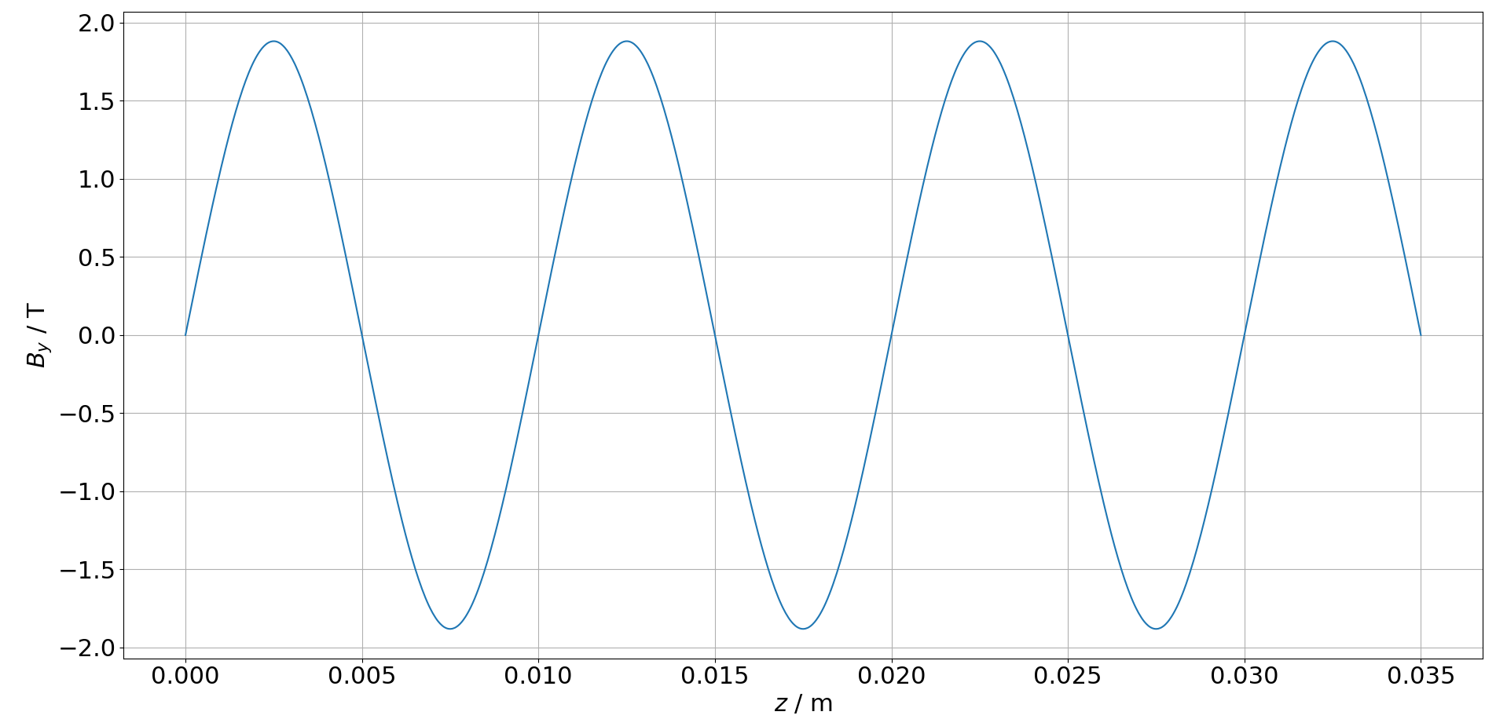
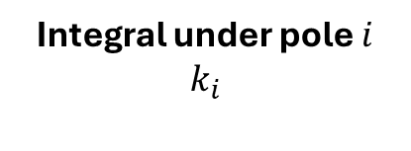
Ferromagnetic pole shimming
Shimming; fine local adjustments
The poles will be cut to reduce the integral under each corresponding peak to the average first field integral under all the peaks
Integral under pole $i$
$$k_{i}$$
On –axis field of 3.5 Periods, with no cuts and no field errors
Notes:
After the bulks are sorted the undulator is shimmed to make fine local adjustments to the field. To shim the undulator we will cut the poles to obtain a uniform field profile. The required cut on each pole is calculated such that the field integral under it is reduced to the average field integral, thereby minimizing the peak-to-peak errors.

Slide 15
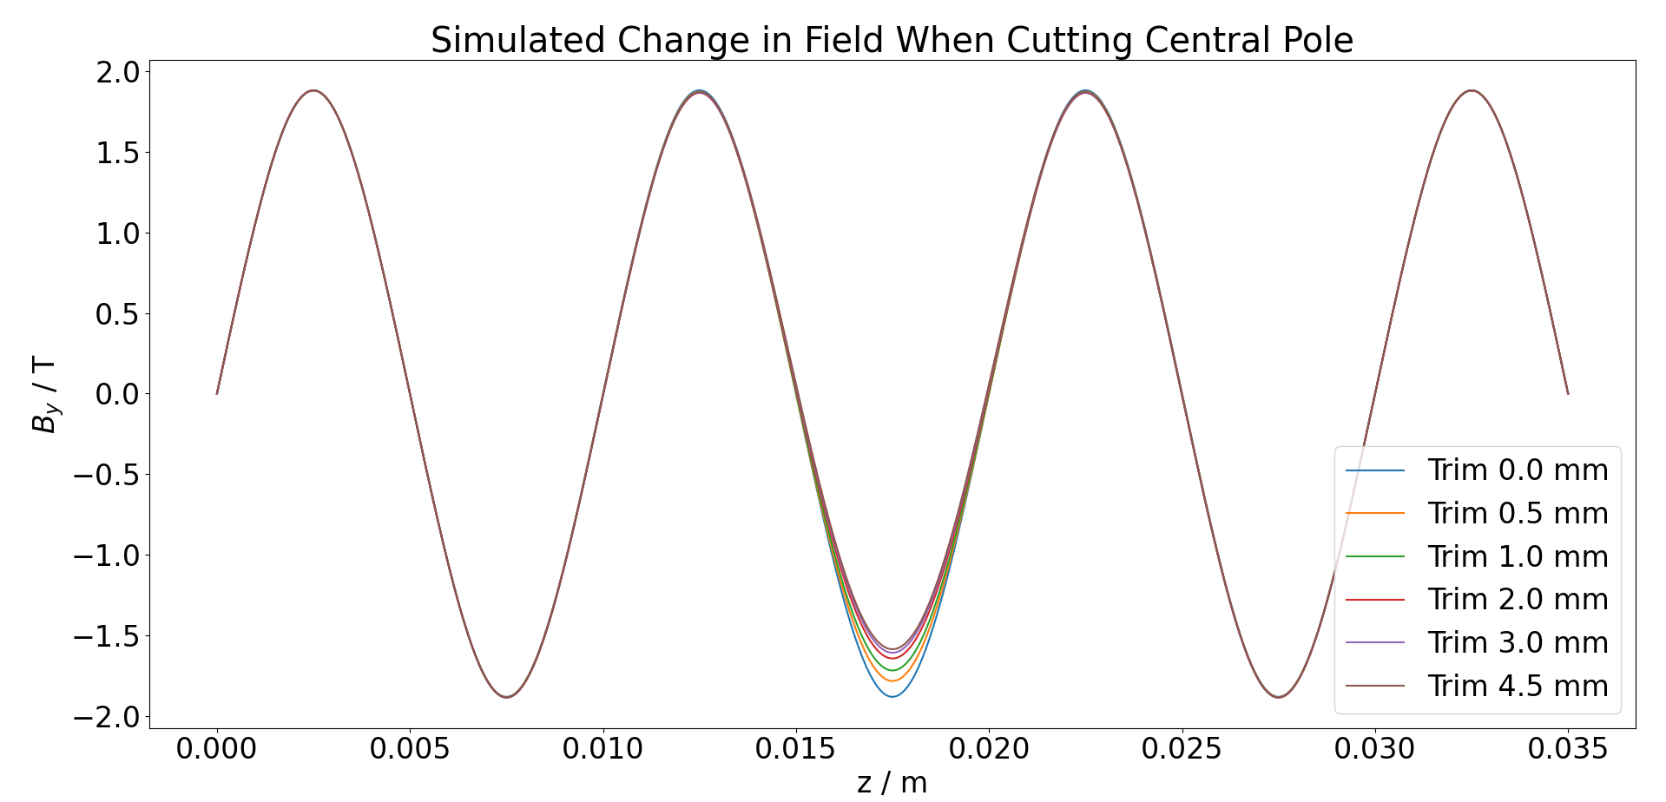
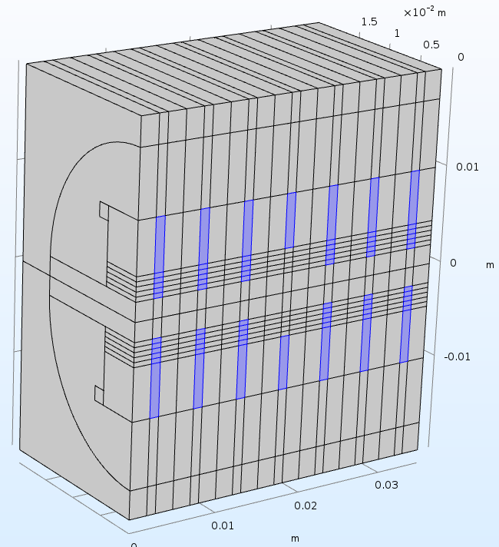
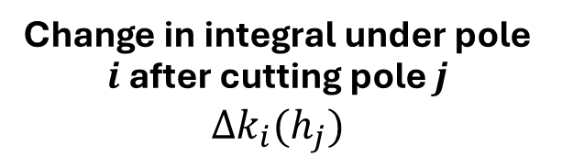

Ferromagnetic pole shimming
To calculate how much each pole should be cut, we first require a model which tells us how each peak changes after cutting its corresponding pole and its neighbors
Change in integral under pole $i$ after cutting pole $j$
$$Δk_{i}(h_{j})$$
Simulate cut at pole j
Cut at pole j by
$$h_{j}$$
Notes:
Then to calculate these cuts we first require a model which tells us by how much each peak changes after cutting its corresponding pole and its neighbors. Such a model is constructed by simulating a number of cuts on a pole and seeing the effect that this has on the peak under it and the first three neighbors.

Slide 16
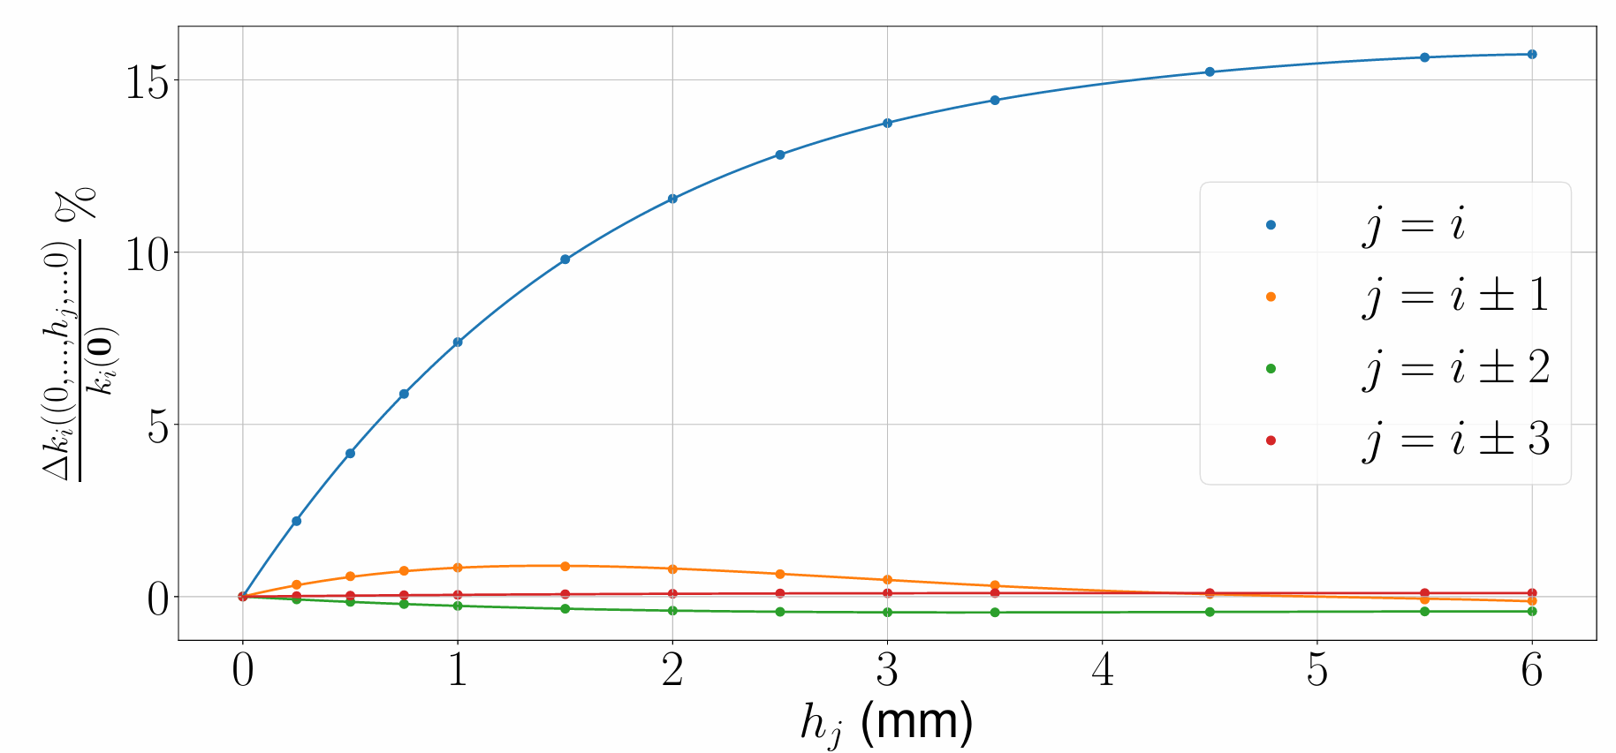

Ferromagnetic pole shimming
For each pole $i$ fit a 4th order polynomial $a_{ij} h_{j}^{4}+b_{ij} h_{j}^{3}+c_{ij} h_{j}^{2}+d_{ij} h_{j}=Δk_{i}$
Use coefficients to build circulant matrices ${\left(\underline{A}\right)}_{ij}=a_{ij}$,…, and let $\left(\underline{h}\right)=h_{j}$
The change in the integral between each two zeros $\underline{Δk}$ due to a set of cuts $\underline{h}$ is given by
$$\underline{A} {\underline{h}}^{4}+\underline{B} {\underline{h}}^{3}+\underline{C} \underline{h^{2}}+\underline{D} \underline{h}= \underline{Δk}(\underline{h})$$
1st Neighbor
Notes:
Here we can see how this field integral changes for the peak under the pole we are cutting and for the neighbors of this peak. As we can see this goes down quickly as the distance between the neighbors increases, and so we only consider the first 3 neighbors.
By fitting a polynomial through each of these curves and assuming that the neighboring effects can be linearly superimposed we can build the following matrix equation which tells us by how much each peak changes as a function of a set of cuts on all poles.

Slide 17

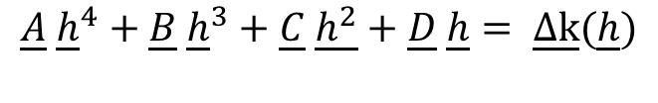
Simulation
$$\underline{A} {\underline{h}}^{4}+\underline{B} {\underline{h}}^{3}+\underline{C} \underline{h^{2}}+\underline{D} \underline{h}= \underline{Δk}(\underline{h})$$
This model is then combined with the experimentally measured field integral under each peak to build a cost function, which is minimized to obtain a set of cuts which decrease the peak-to-peak variance.
Cost Function $\underline{K}−\text{avg}\text{(}\underline{K})+\underline{Δk}(\underline{h})$
Minimize
Experiment
Cuts $\underline{h}$
$$\text{F}\text{irst} \text{field} \text{integral} \text{of} \text{each} \text{peak}\text{, }K_{i}$$
To avoid an overshoot these cuts will be damped and an iterative approach it taken
Dampen and iterate
Notes:
This model is then combined with the experimentally measured field integral under each peak to build the following cost function, which is then minimized to obtain a set of cuts h which decrease the peak-to-peak variance. To avoid an overshoot these cuts will be damped and an iterative approach it taken, where the dampened cuts are performed, and we remeasure to repeat the procedure. This is important as we cannot go back once the poles are cut.

Slide 18
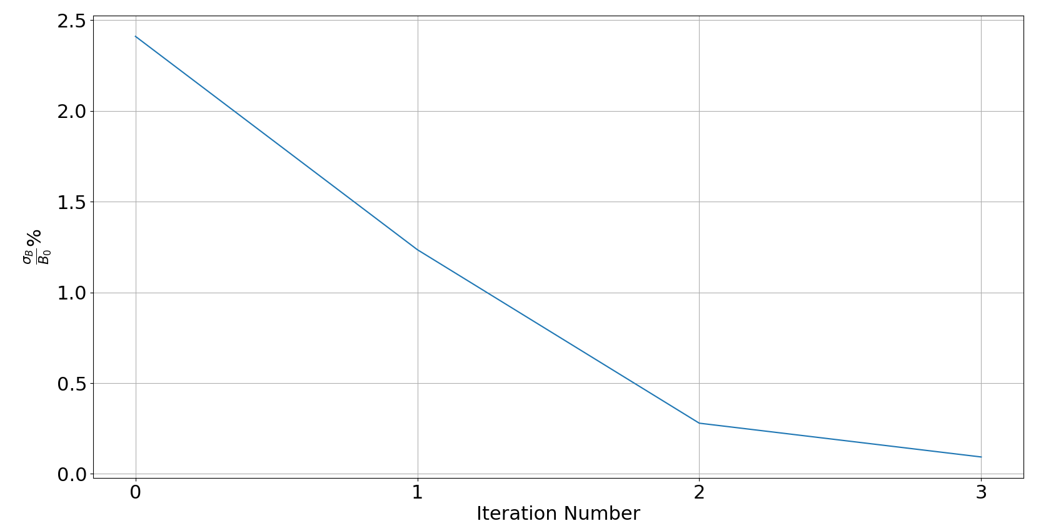
Ferromagnetic pole shimming
Tested using simulation where discrepancies were put on purpose to test robustness
With 3 iterations, we can reduce the error from 2.4% down to 0.2% by simulation
Target: 0.1% (If all parameters between model and simulated field are the same than we can go to 0% barring mesh errors)
0.6*Predicted cut
Notes:
This was tested using simulation where we observed that the field errors can be brough down to 0.2% after 3 iterations. Now our target is 0.1%, however, this was not achieved here as discrepancies between our simulations were put on purpose to ensure that the method is robust even if our simulations do not translate perfectly in real life.

Slide 19
Agenda
Introduction
Modelling framework
Ferromagnetic pole optimization
Ferromagnetic pole shimming
End Field Optimization
Conclusion

Slide 20
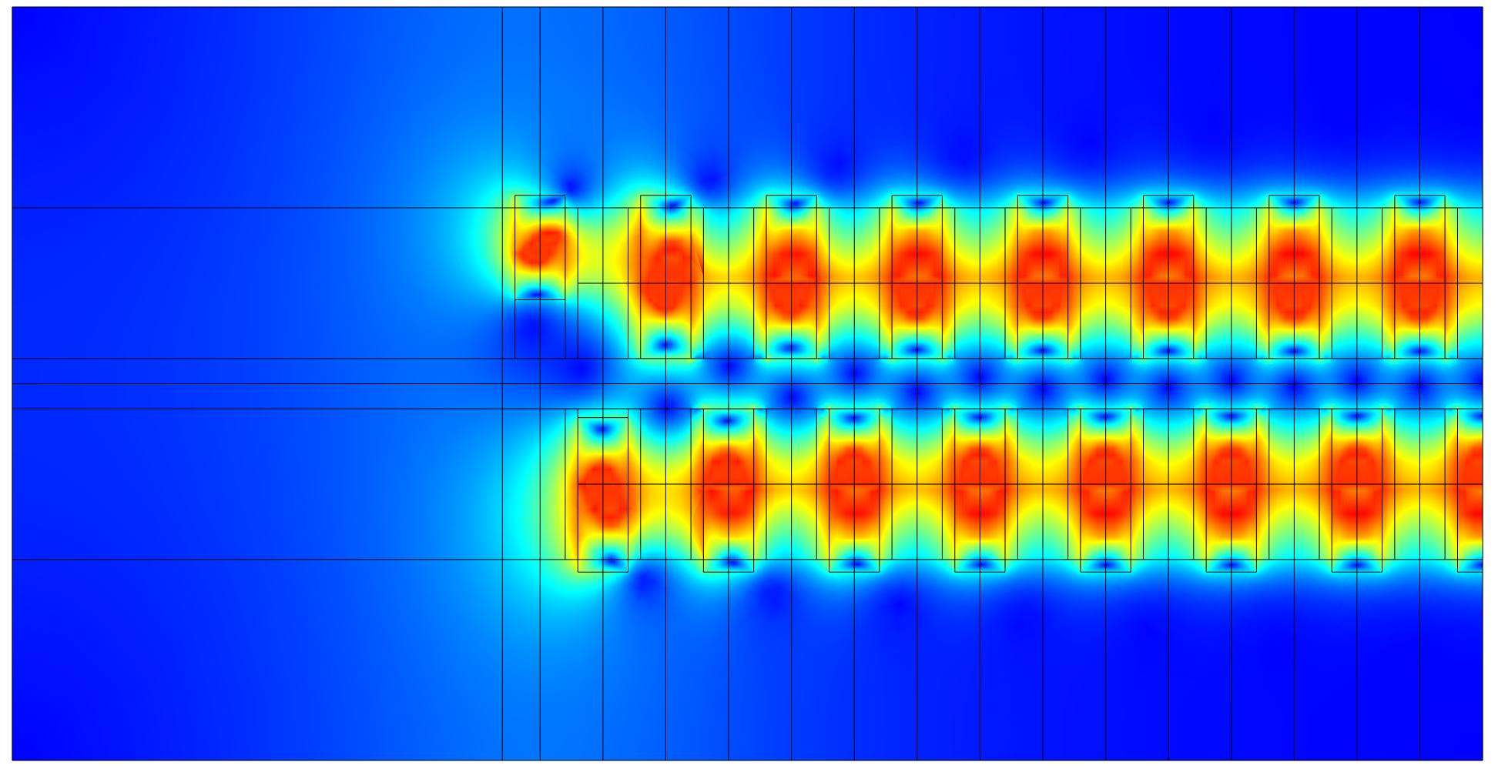

End Field Optimization
An undulator should be transparent for the electron beam:
Zero First and Second Field Integrals
Symmetric geometry $→$ Zero first field integral
Cut end bulks to correct for electron trajectory ($∝$ second integral); exit and oscillate on axis
First and second bulks are cut in 2D simulation
4 mm
0.3 mm
Notes:
To prevent the storage ring from being compromised an undulator should be transparent to the electron beam, this is achieved by setting the first and second field integrals to zero. In our case we will have a symmetric geometry and so the first field integral is automatically set to zero. Then to correct for the second field integral the end bulks will be trimmed to ensure that the beam oscillates and exits on axis.

Slide 21
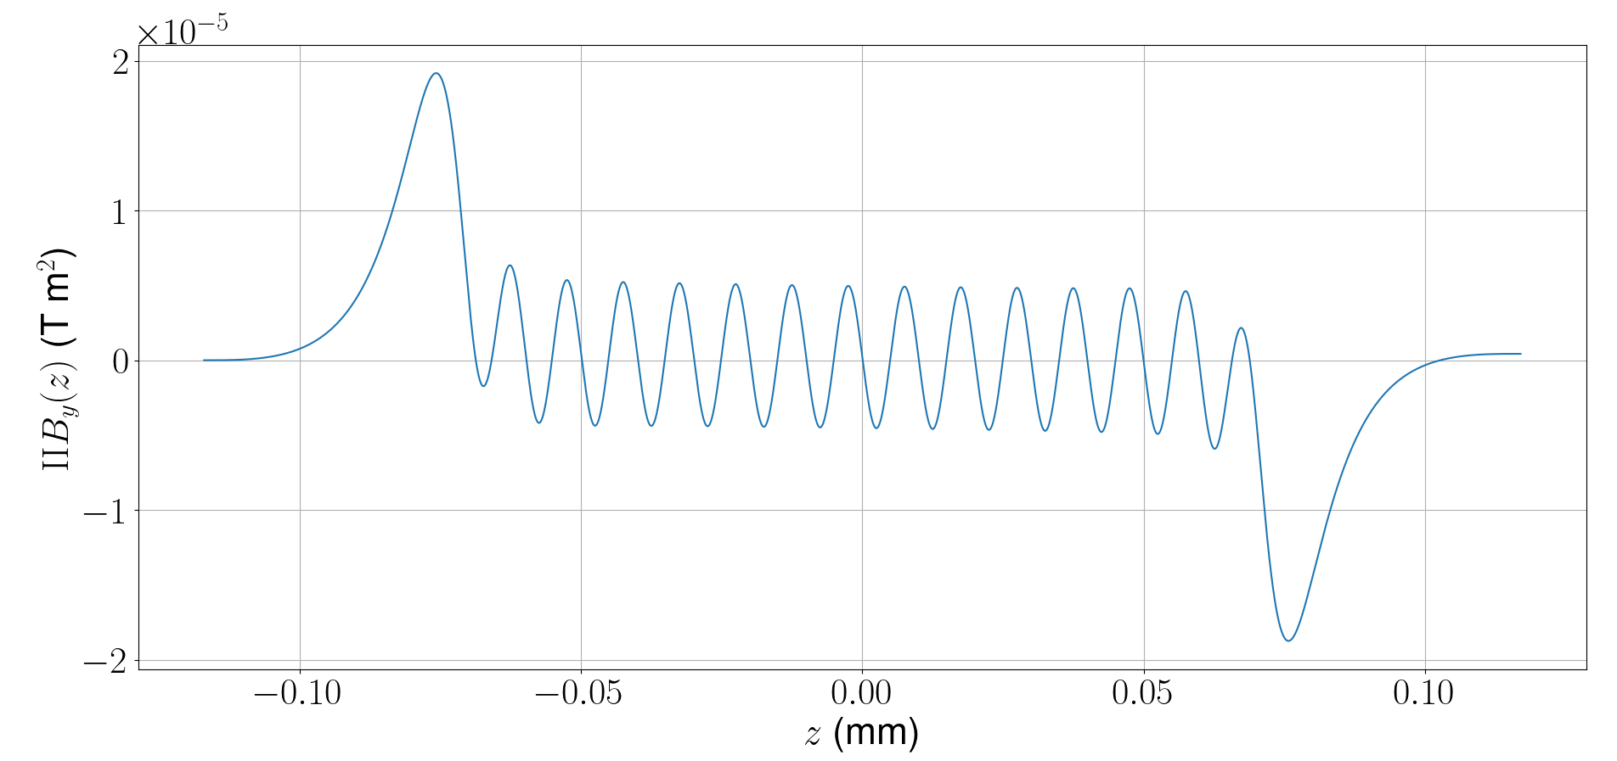
End Field Optimization
Simulated second field integral with the first two bulks trimmed in a 2D simulation
Second field integral over whole undulator is within acceptable tolerance
Notes:
This has been tested in a 2D simulation where we found that cutting the first two bulks is enough to confine the beam’s oscillations around the main axis. Further work is required to test this using a 3D simulation and in experiment.

Slide 22
Agenda
Introduction
Modelling framework
Ferromagnetic pole optimization
Sorting
Ferromagnetic pole shimming
End Field Optimization
Conclusion

Slide 23

Conclusion
The HTS undulator field is nonuniform due to the different properties of each bulk -> Need to improve the field quality
Bulks were sorted to decrease field errors from 6% to 3.7%
Finally, a pole cutting algorithm was developed to predict how much each pole should be cut to improve the field quality.
The pole shimming gives a more fine-tuned field optimization, where we show that the error can go from 2.4% to 0.2% in three iterations by simulations
Notes:
The HTS undulator has been shown to provide a high on-axis field at short periods. However, due to differences between the HTS bulks the field errors need to be decreased before it is usable, especially at high harmonics.
To do so, the bulks were sorted to decrease the field errors from 6% to 3.7%. Moreover, we propose a shimming method to cut the poles to further bring down this field errors.

