Slide 1

High Field Magnet Roadmap at PSI/CHART
Roadmap overview and progress report
Douglas Araujo¹, Bernhard Auchmann^{1,2}, Andre Brem¹, Michal Duda¹, Jaap Kosse¹, Thomas Michlmayr¹, Colin Müller¹, Henrique Garcia¹, Dmitry Sotnikov¹, Anna Stampfli¹, J. Van den Eijnden ¹, and Ariel Haziot²
¹Paul Scherrer Institute ²CERN
This work was performed under the auspices and with support from the Swiss Accelerator Research and Technology (CHART) program.
SPS Annual Meeting, Zürich, September 2024

Slide 2
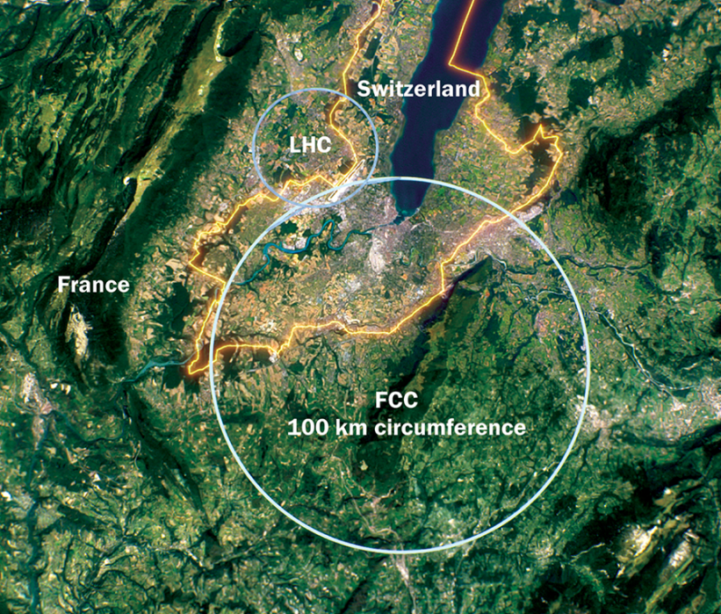
Agenda
High Field Magnets
Roadmap
Progress
High Temperature
Superconductors
Coming soon…

Slide 3
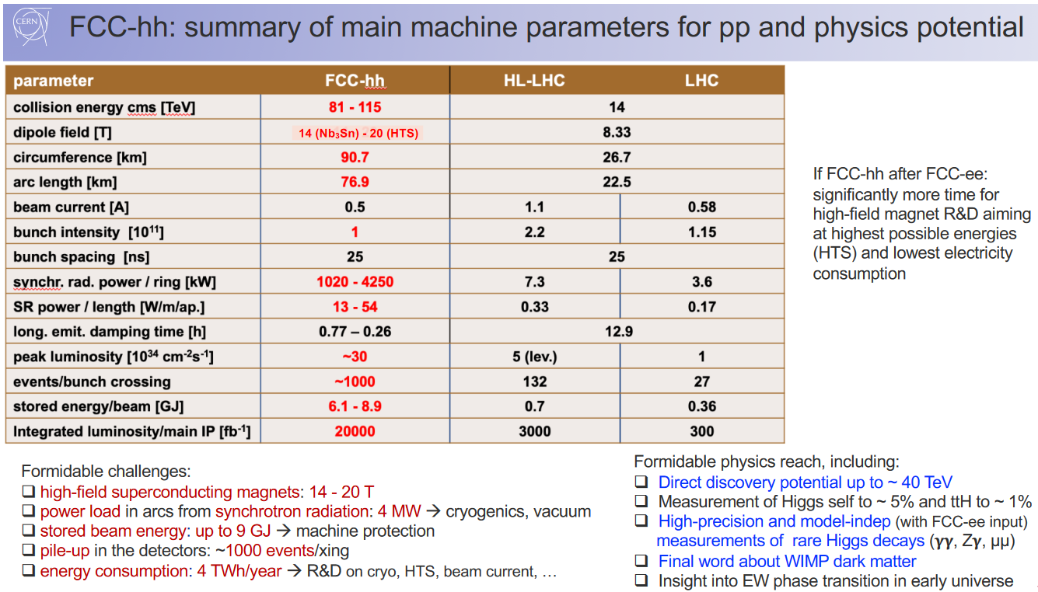

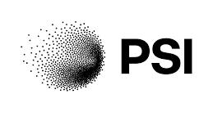
High Field Magnets
MagDev
https://www.psi.ch/en/cas/chart-magdev
https://indico.cern.ch/event/1298458/timetable/

Slide 4
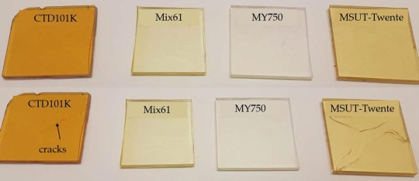
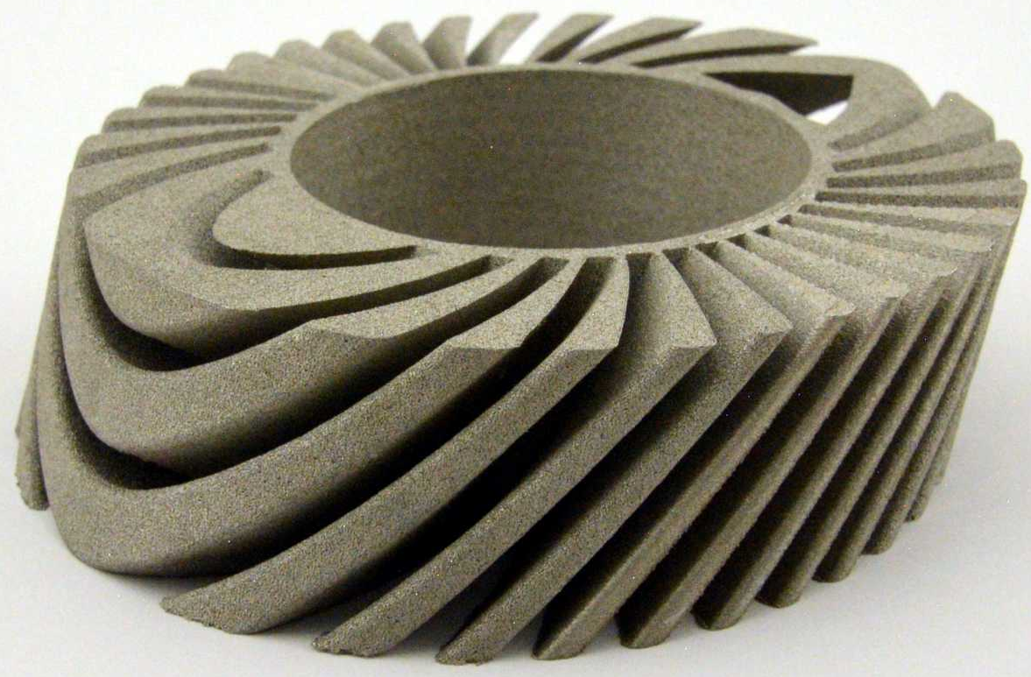
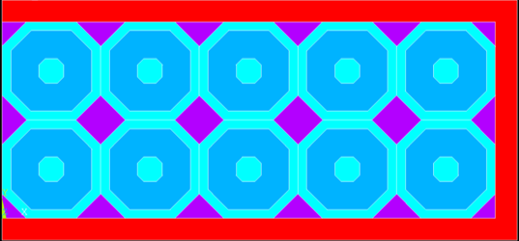
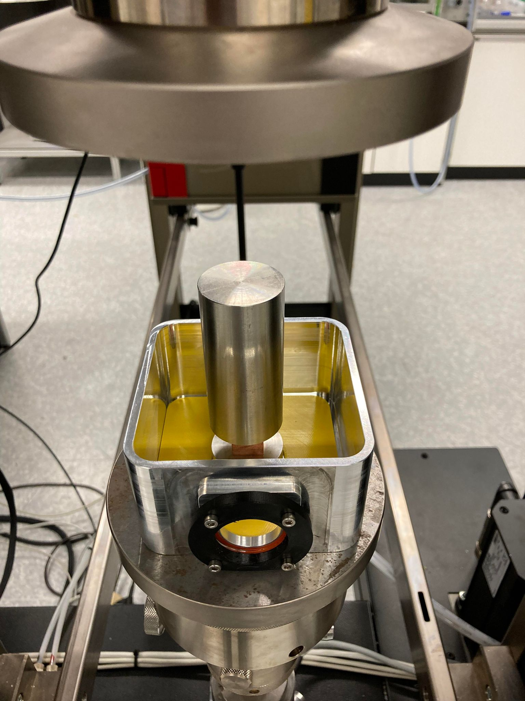
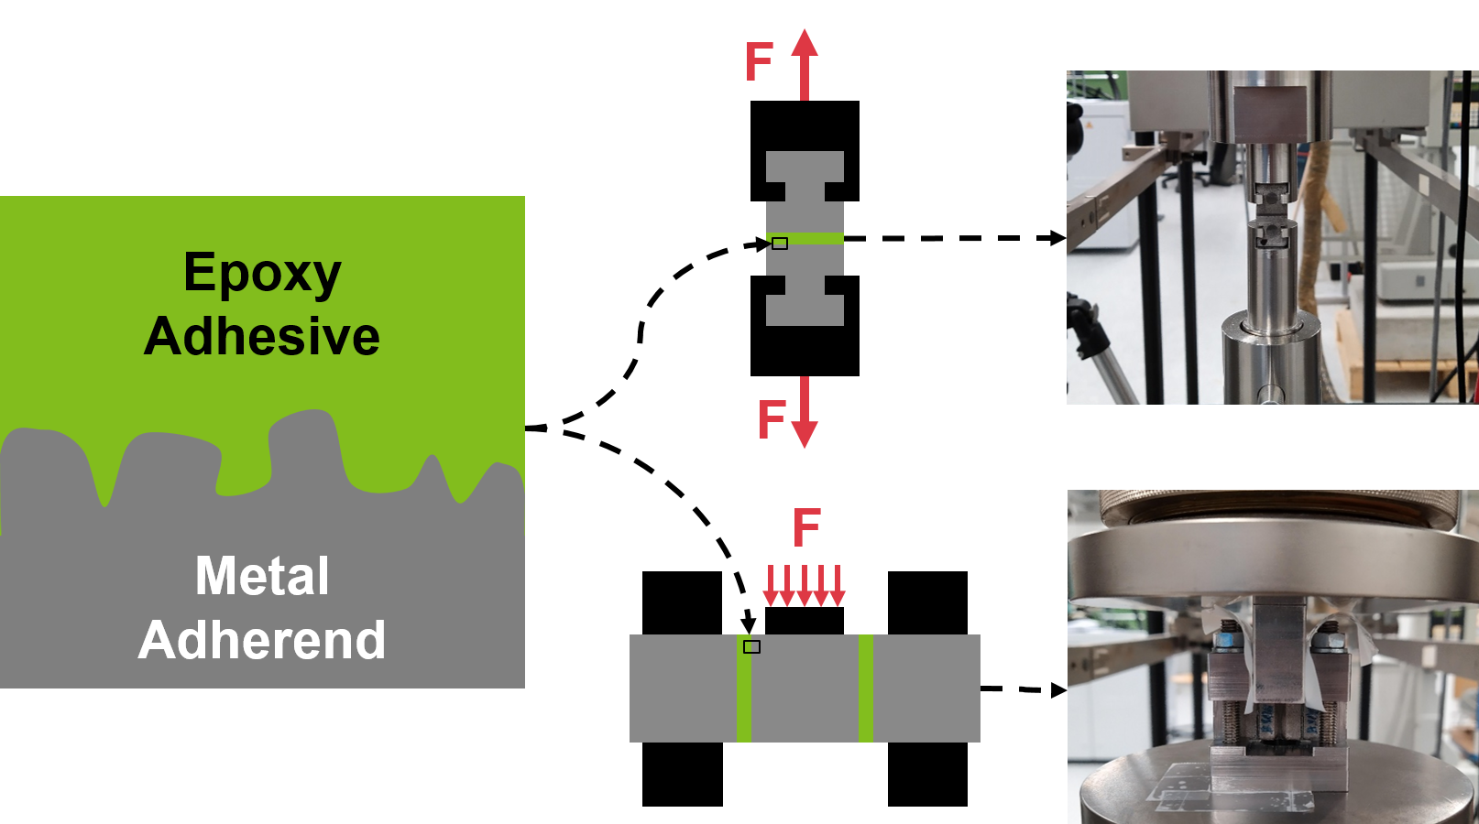
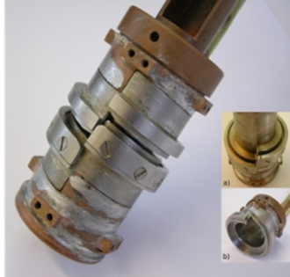


Roadmap | CHART Environment
https://chart.ch/chart-projects/
A. Brem
MagRes: resins
WireChar: conductor
MagComp: mechanics
MagAM: 3D printing
MagNum: numerics
J. Ferchow
M. Maciejewski
X. Kong
P. Müller
C. Senatore

Slide 5

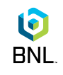
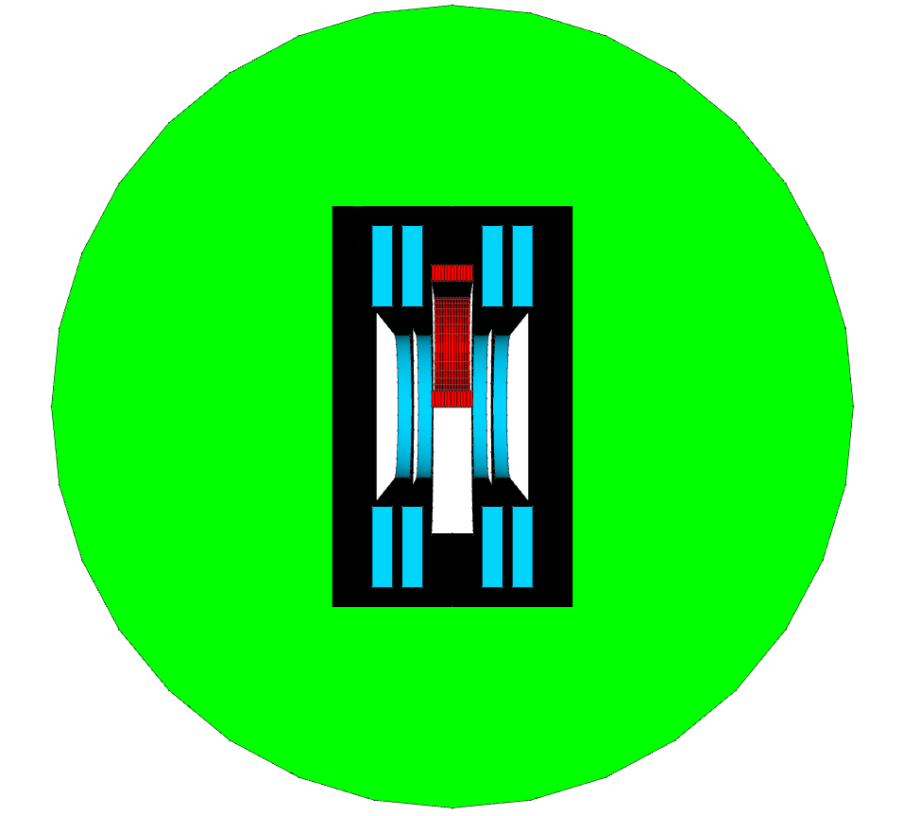
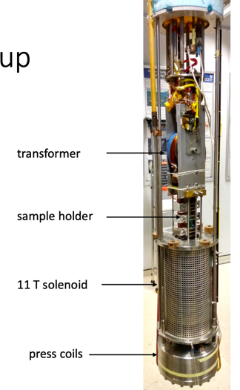
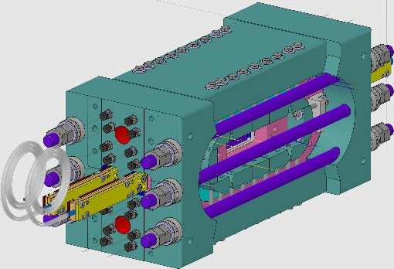
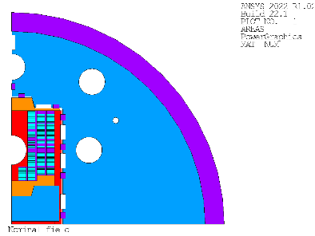
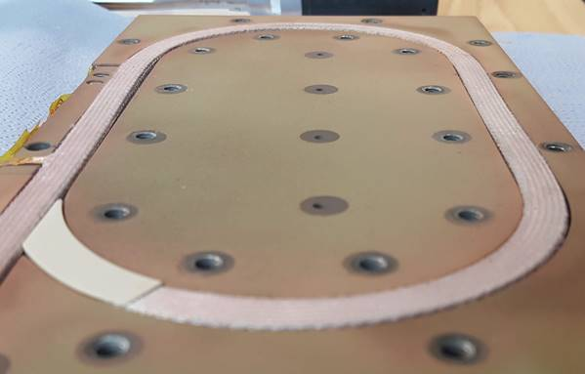
Roadmap | R&D Vehicles small samples
Sub scale SMCC
Big
BOX
BOX and cBOX
Multi turn
9 T background field, assessing
training and degradation
SMACC 13 T
11 T background field
Assessing training and degradation

Slide 6
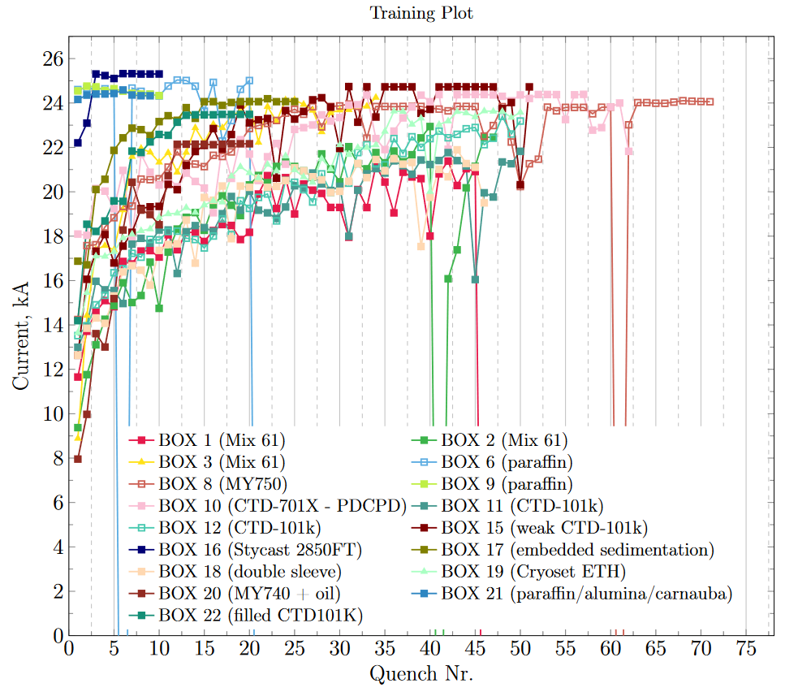
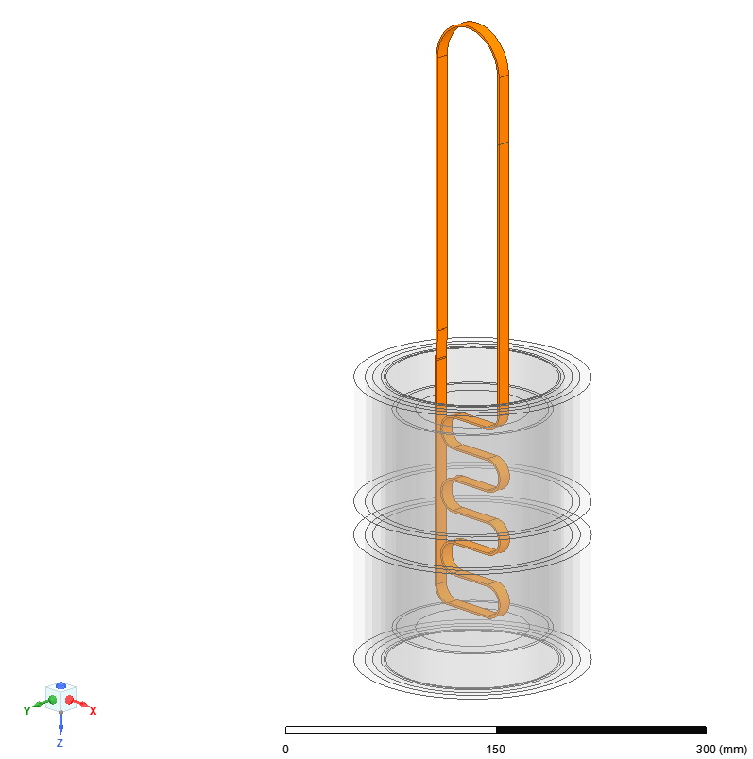
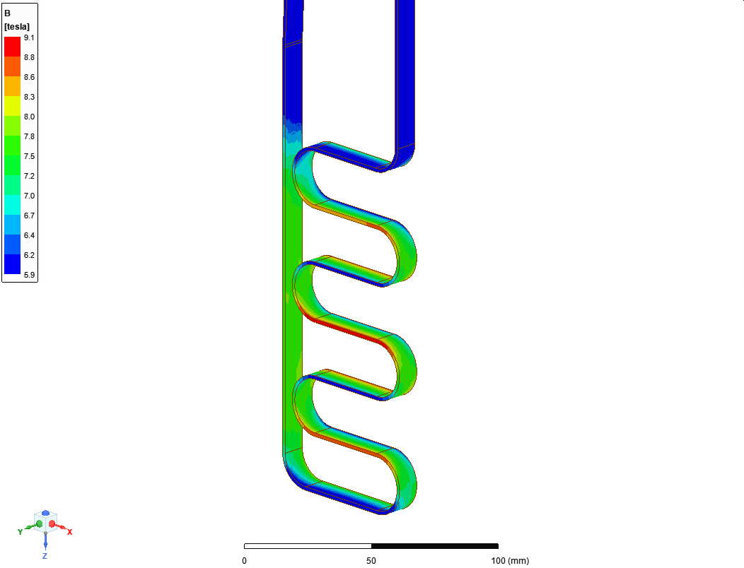
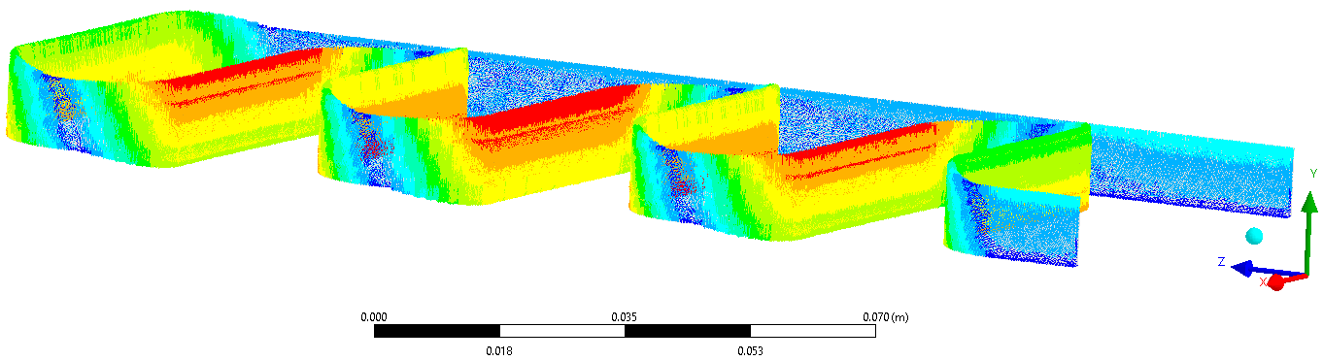
Standard BOX – addressing training in Nb₃Sn
I
Conductor
Courtesy, S. Olten et al.
Solenoid
F_{in}
F_{out}
evaluate impregnation systems
22 samples tested in the last 3 years

Slide 7
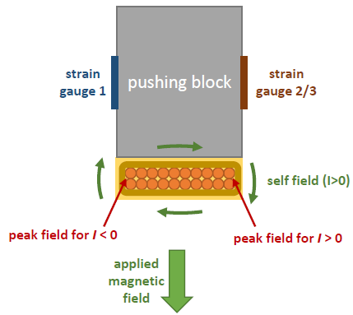
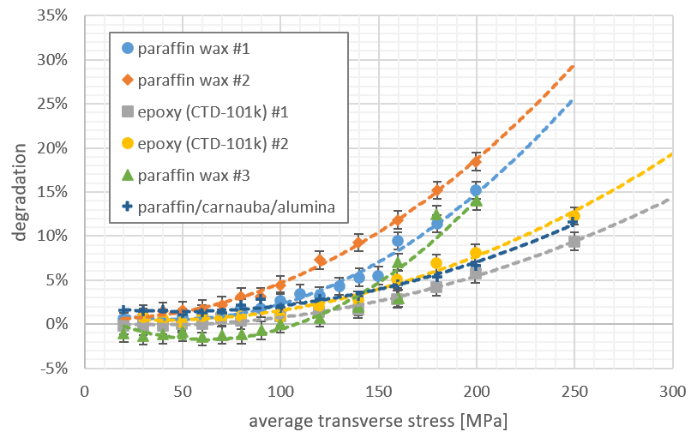
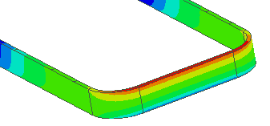
Compression BOX – degradation due to stress
Courtesy, S. Olten et al.
9.4 T
evaluate impregnation systems
reversible and irreversible degradation in external field
6 samples tested, 2 currently under testing

Slide 8
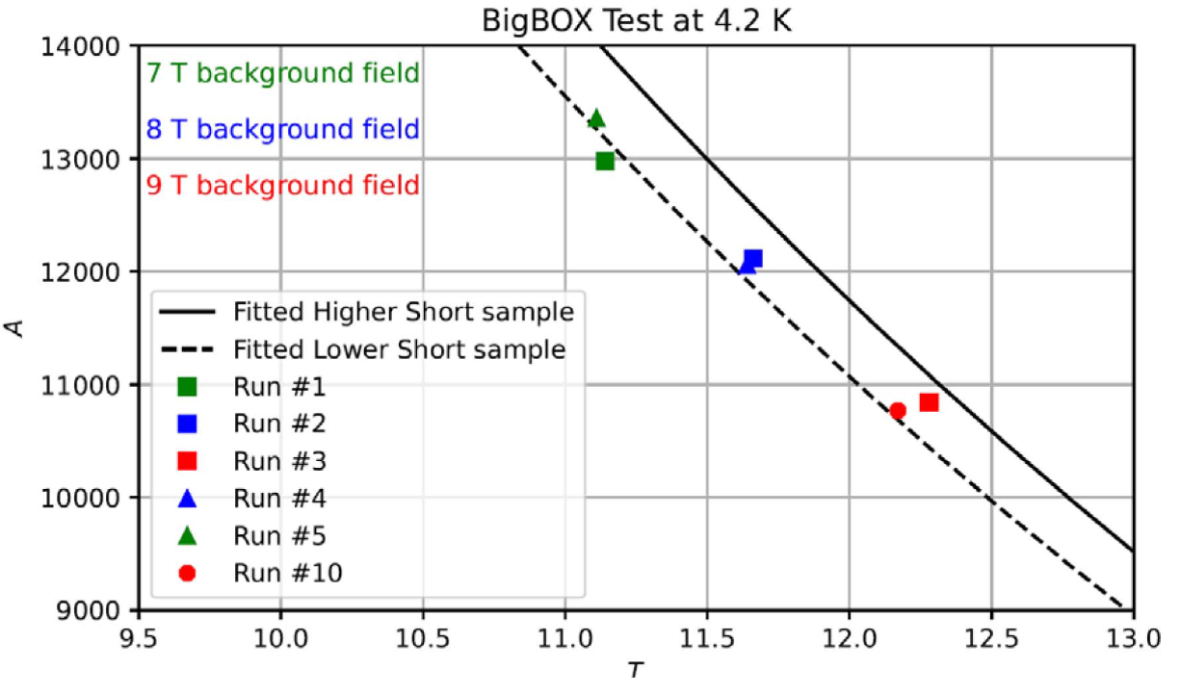
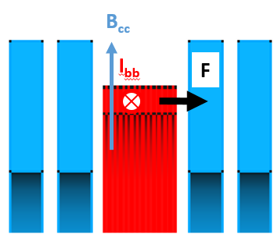
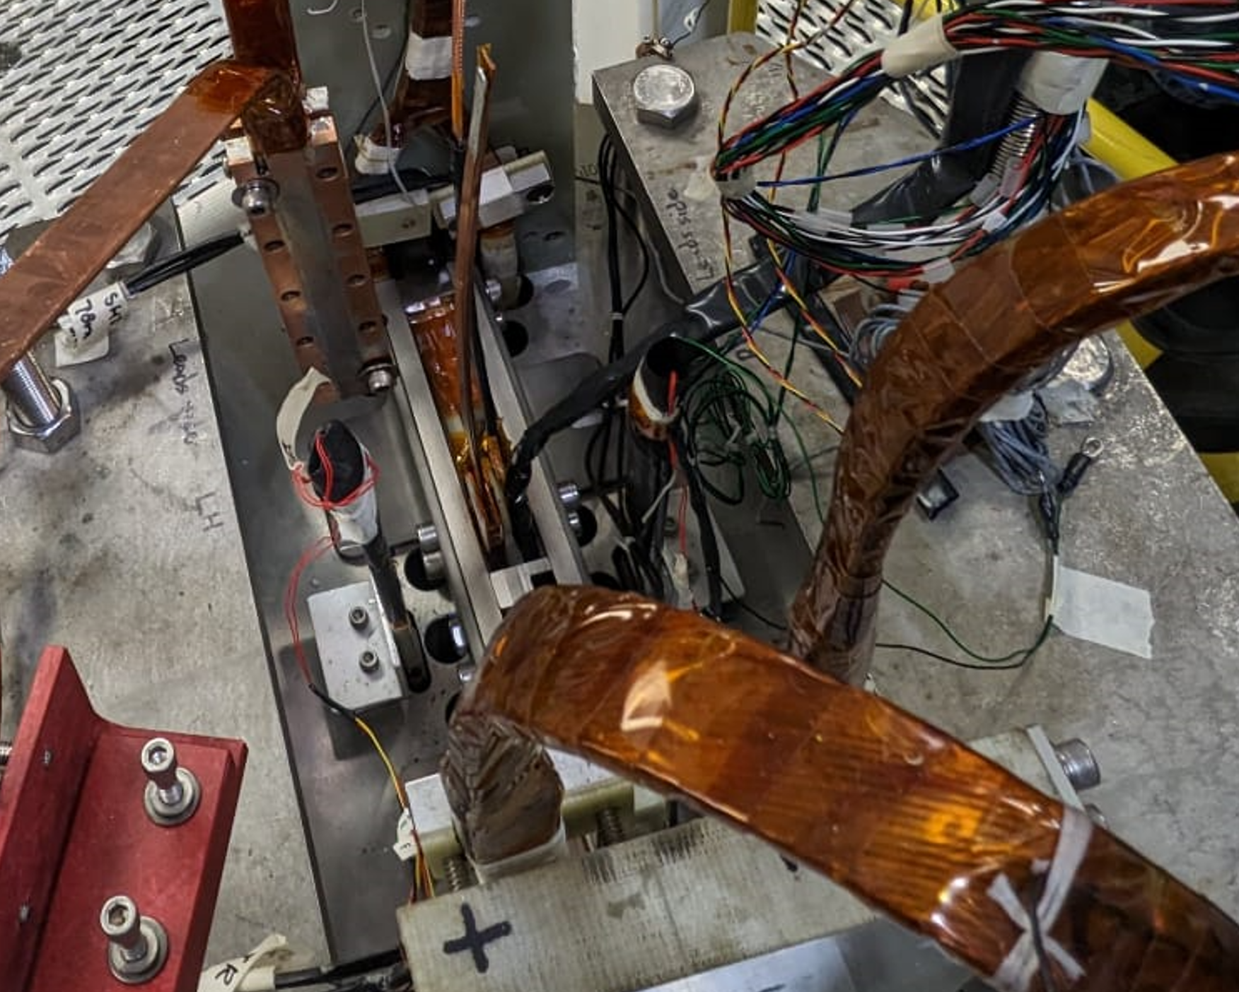
BigBOX: multi turn Nb₃Sn coil
Assessing coil performance
  Superconductor margin
  Conductor degradation
  Coil training behaviour
Validating technologies
  Preload free coil
  Interface conditions
  Wax and filled wax impregnated coils
  Stress-management
  Ceramic Insulation Coating
Test Results: 6 times power-up to short sample limit without training behavior
BigBOX2 (impregnated with filled-wax )was manufactured, delivered to BNL and it is waiting to be tested
Courtesy, M. Kumar et al.
DCC17
Magnet
BigBOX inside DCC17
Cross-section illustration

Slide 9
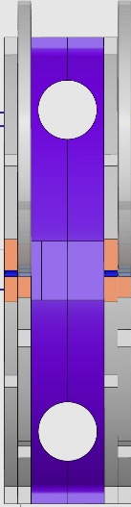
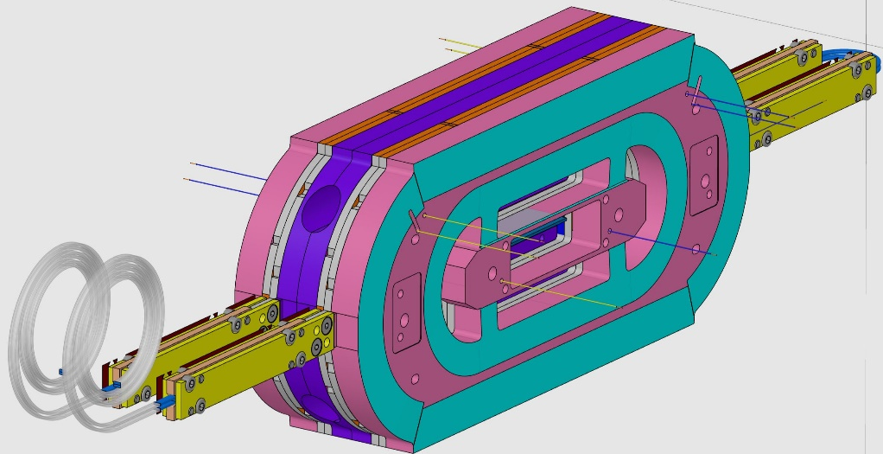
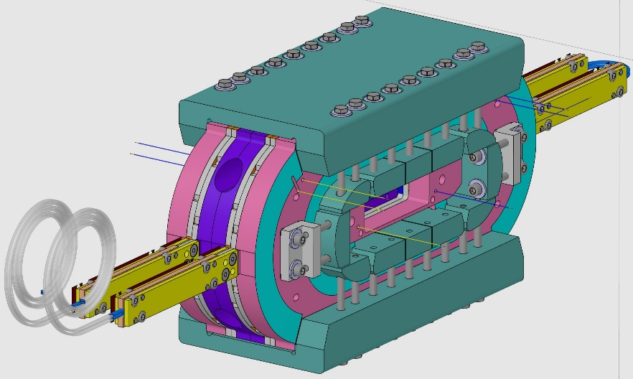
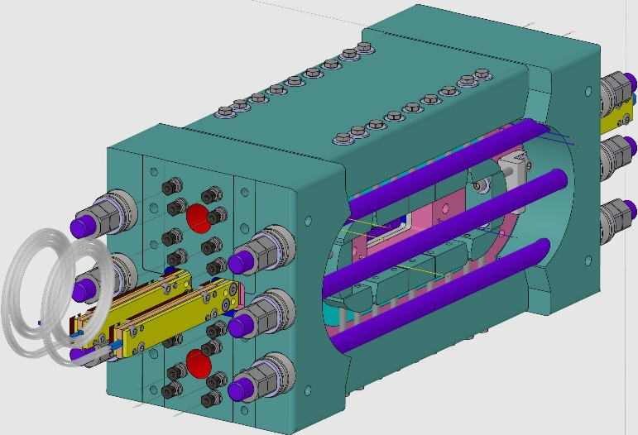
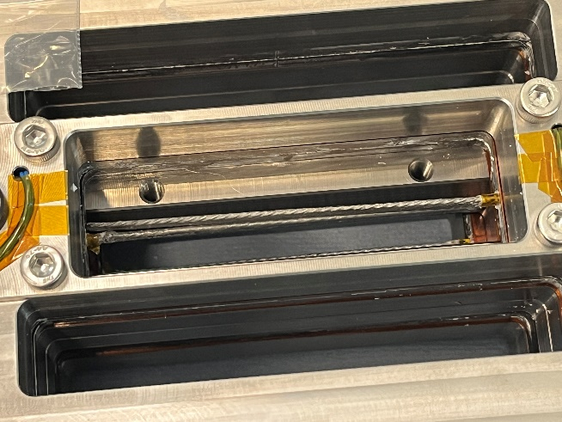
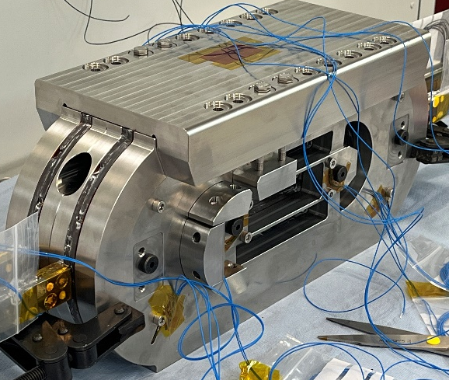
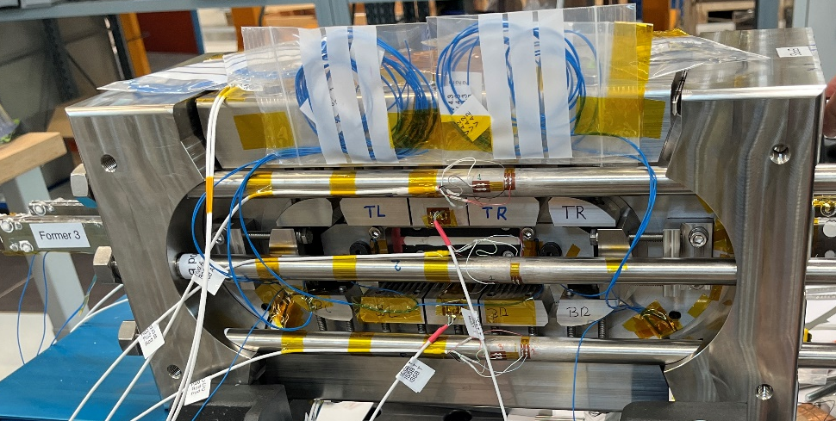
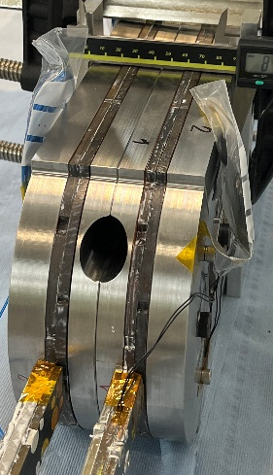

Subscale SMCC | Concept
4 common-coils, coil-pack assembly and splice region
Outer pads
End pads
Cable manufactured
by LBNL

Slide 10
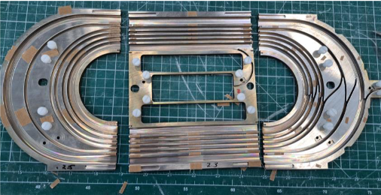
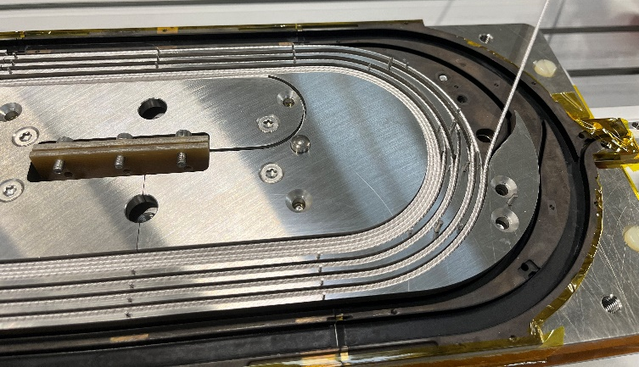
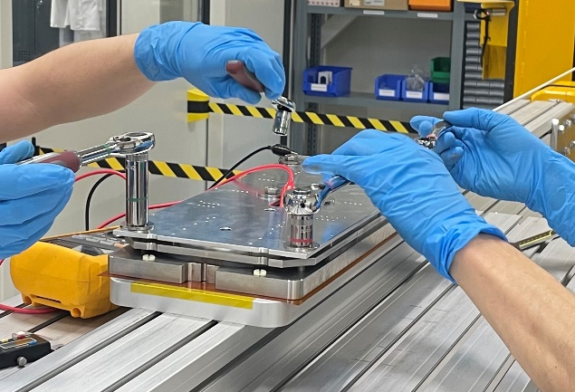
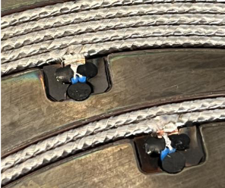
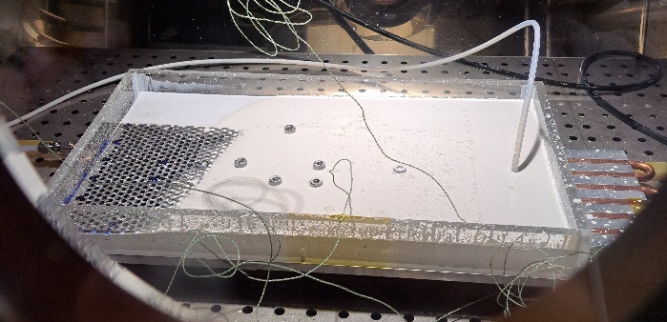
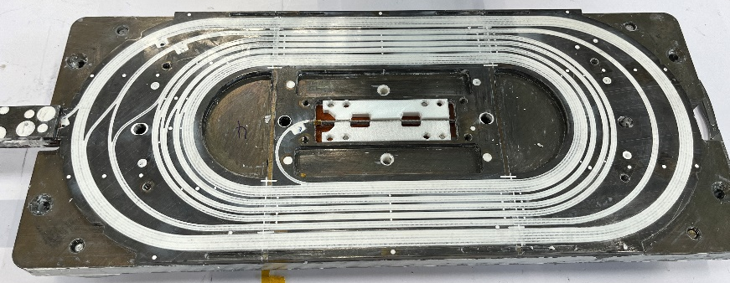
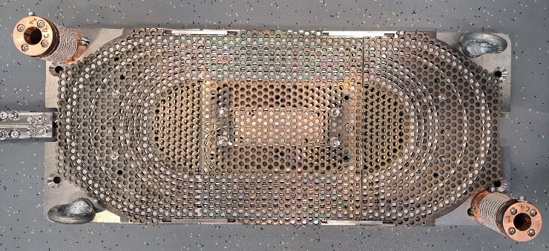
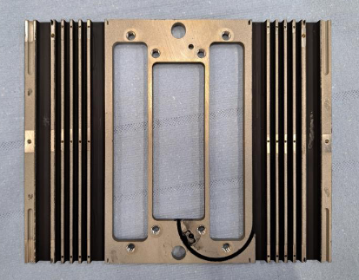

Subscale SMCC | Innovations
Stress-Management
Common-Coils Former
Winding Technique
Instrumentation routing
First stand alone impregnated with
Filled Wax system to be tested
Impregnation Technique
Re-use of tooling through winding,
reaction and impregnation
Former Coating
2 coils reacted at CERN, SMT Section
2 coils reacted at PSI

Slide 11
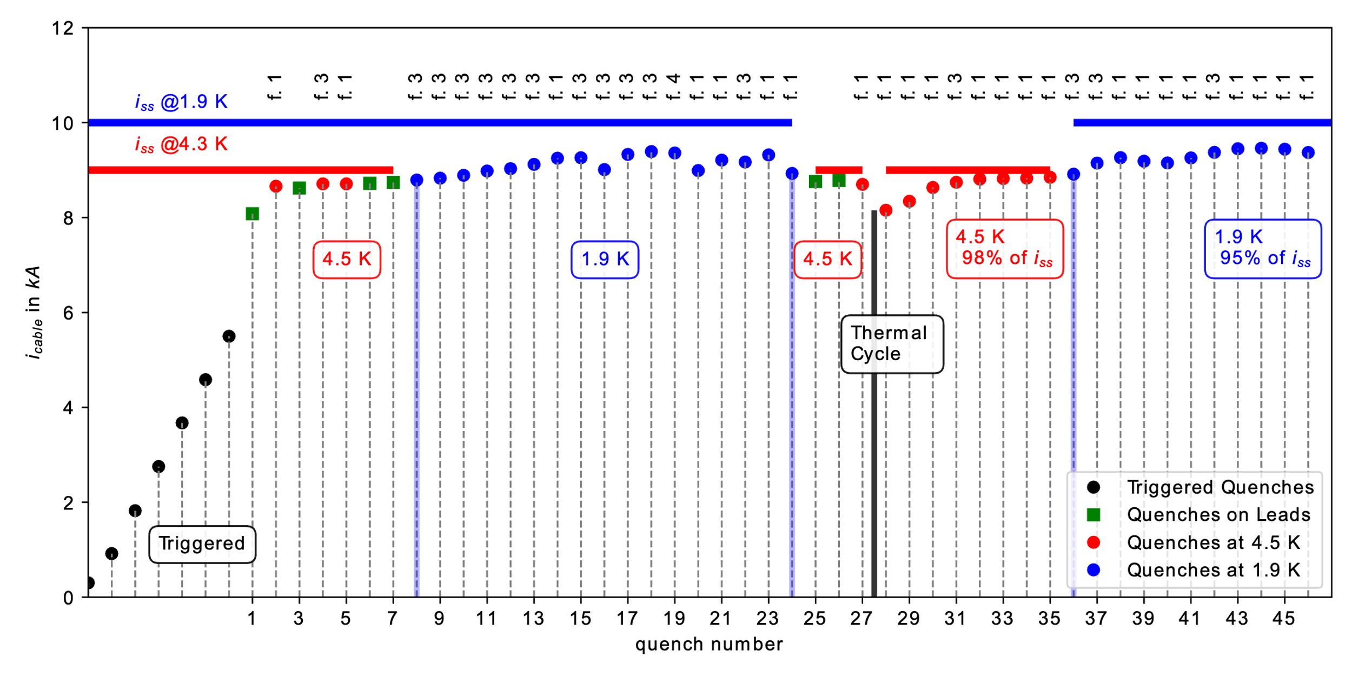
Performance | 22 | mm
T = 4.5 K | i_{ss} = 9.0 kA | i_{max} = 8.85 kA | B₀ = 4.9 T | B_{peak} = 6.04 T | I_{max}/i_{ss} = 0.98
T = 1.9 K | i_{ss} = 10.0 kA | i_{max} = 9.39 kA | B₀ = 5.2 T | B_{peak} = 6.41 T | I_{max}/i_{ss} = 0.94
Quench number
Courtesy, G. Willering et al.

Slide 12
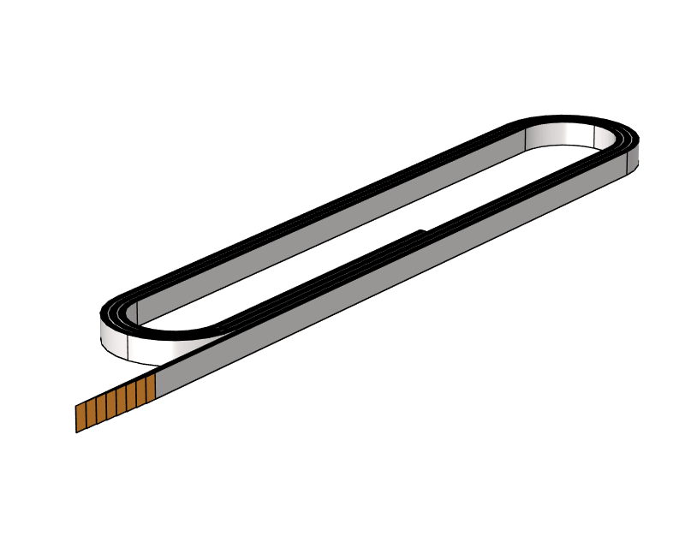
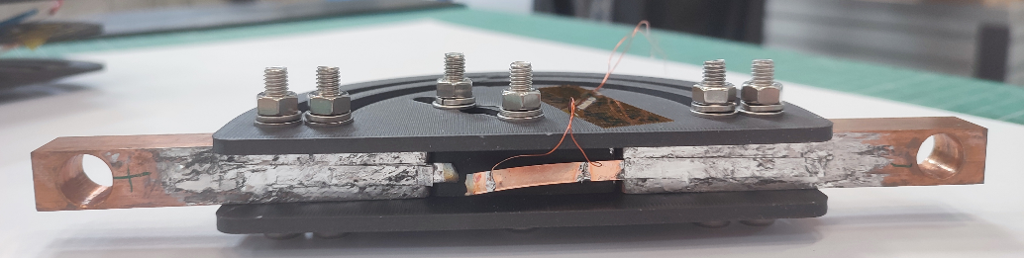
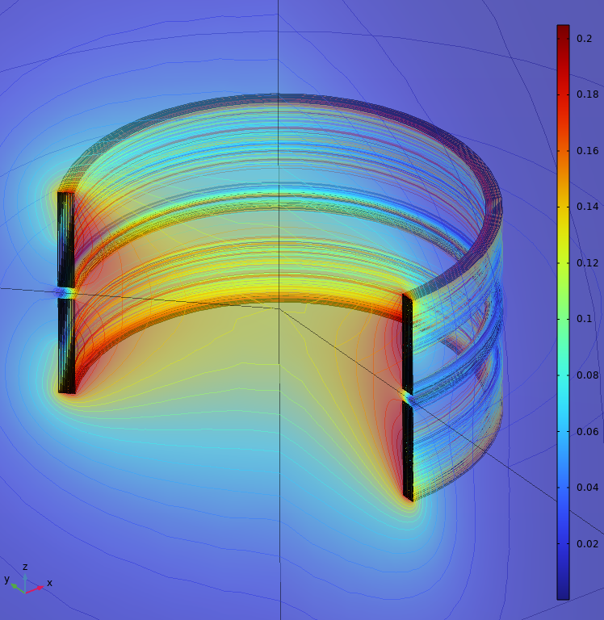
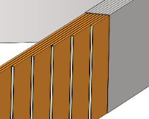
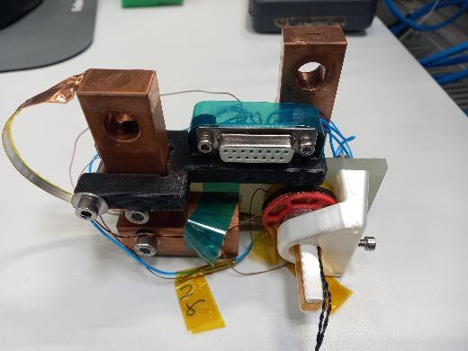
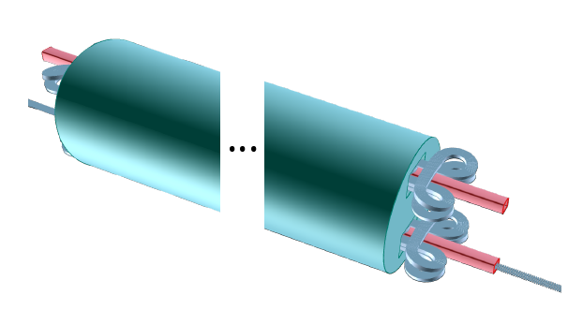
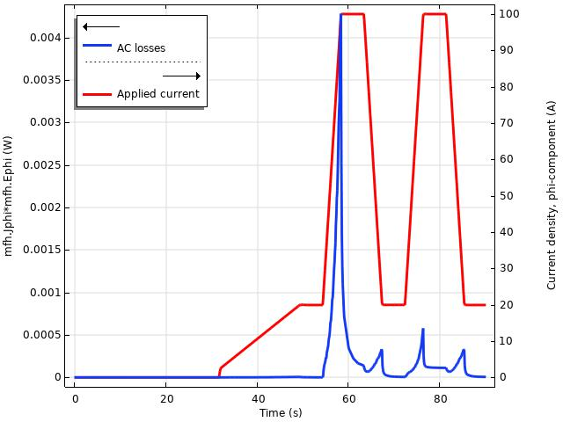
HTS Challenges and Opportunities
HTS technology
Modelling
HTS cable models
sensitive to mechanical strain
sensitive to thermal load
FEM software for electro-magnetics
postprocessing measured data
Soldered stack based - HTS cable
HTS coil manufacturing
HTS tape operation
Noise cancellation and Protection
Modelling validation
HFM concepts
14 T at 20 K
16 T at 20 K
AC losses prediction
Illustration from
Little beast engineering

Slide 13
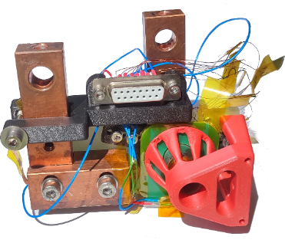









Production and measurements
Single tape
Pancake coils
Validation (w/ U. Twente)
Bending and twisting of tape:
Set of bending experiments showed degradation of HTS tapes
Twisting on 15-mm former for double pancake with 4-mm twist pitch (tape width)
Several samples of pancake production:
1 single tape pancake
2 double-tape stack pancake
1 single tape double pancake
Criteria for validation:
Voltage on coil (done)
AC losses (ongoing)
Magnetic field (ongoing)
Coil voltage validation
Results:
48 measurements done in LN2
Co-wound coil works for protection
Signal recorded to 1 uV

Slide 14









Modelling
HTS cable
14 T HTS dipole
16 T HTS dipole
HTS straight soldered stack cable has several benefits:
Shape fits to racetrack design
Fits to Block-coil and Common coil
Highest packing factor
Highest oriented critical current
Little Beast collaboration
Type: Block coil
Target field: 14 T
Temperature: 20 K
Goal: comparison with LTS projects
AC losses optimization
Type: Block coil
Target field: 16 T
Temperature: 20 K
Goal: getting AC losses prediction with different computation software
Comsol
Quanscient
Courtesy J. van Nugteren

Slide 15


Coming soon…
LTS and HTS samples for testing new impregnation systems, AC losses study and modelling validation
2024: LTS subSMCC2: testing new protection systems that could be suitable for both LTS and HTS
2025: HTS subSMCC3: insulated ReBCO - based cable
2025: SMACC: 13 T demonstrator with field quality

