Slide 1
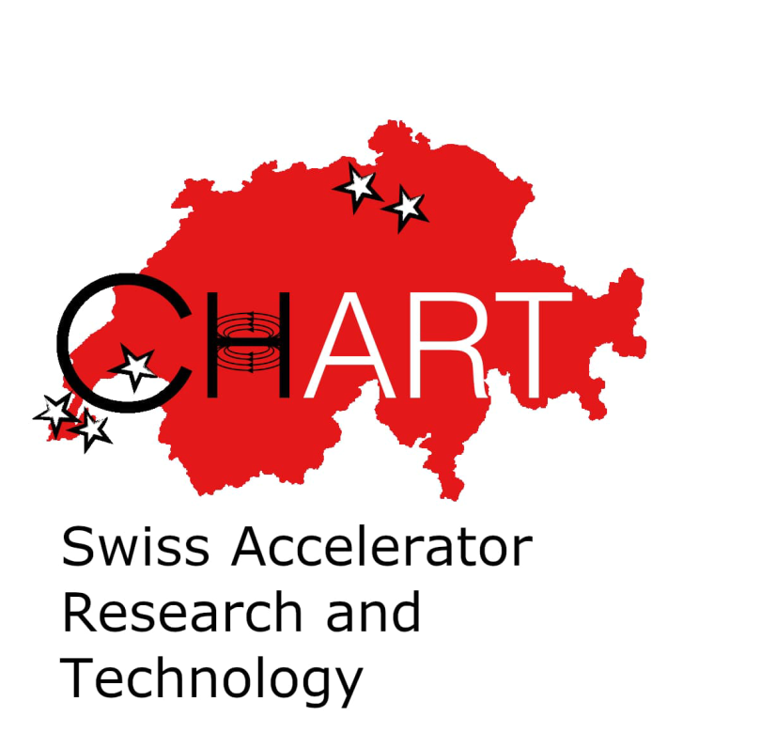
HTS4
Towards an energy-efficient FCC-ee
J. Kosse, J. Schmidt, B. Auchmann, A. Brem,
A. Thabuis, M. Koratzinos
SPS2024
This work was performed under the auspices of and with support from the Swiss Accelerator Research and Technology (CHART) program

Slide 2
Contents
HTS4 project goals
Hardware demonstrators
Cryogenic cooling & operating temperature
Powering

Slide 3
High temperature superconductors (HTS)
Superconducting devices can*
  Provide otherwise not achievable functionality
  Increase availibility
  Make operation more energy efficient
HTS compared to LTS opens up the design space,
both in terms of field and temperature
This project
2 T, 40 K
Magnetic field
HTS
LTS
Temperature
*Not always…

Slide 4
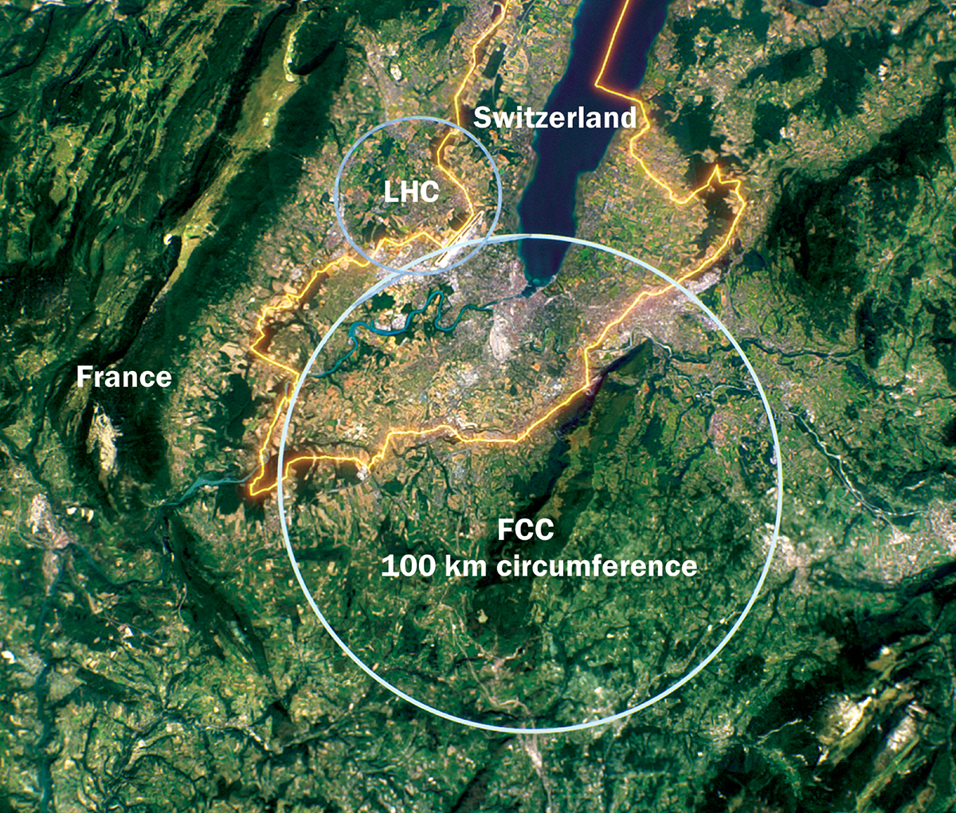
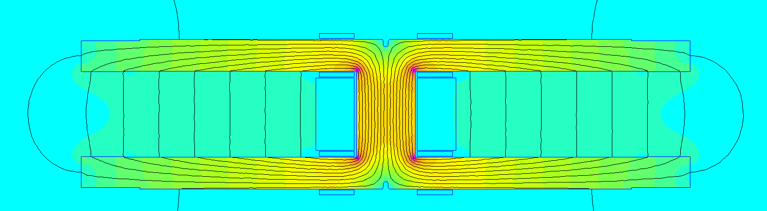
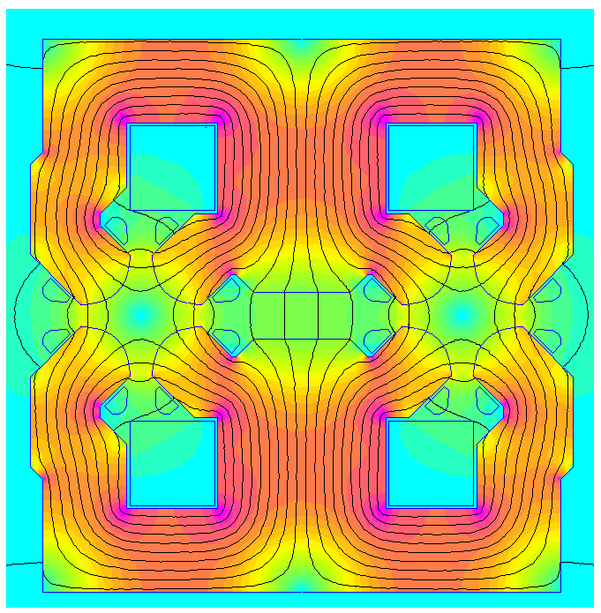
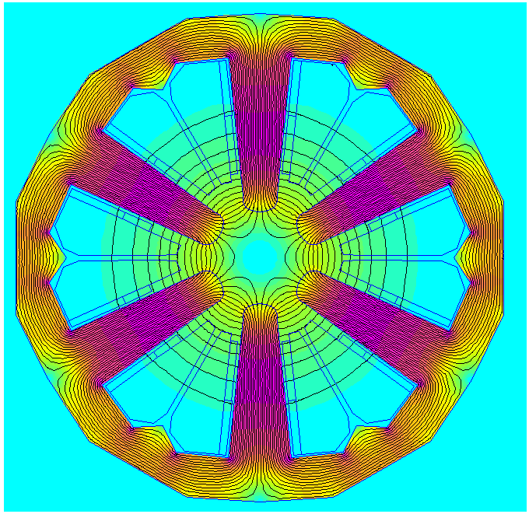

FCC-ee conceptual design
90-100 km ring with normal-conducting magnets
0.8 TWh
Dipole, L~25m
D
S
Q
1.4 TWh
1.3 TWh
D
S
Q
D
S
Quadrupole
Sextupole
Q
Synchrotron radiation loss $→$ 11.9 TWh
Q+S=short straight section (SSS), L~3-6 m
Jeremie Bauche, CERN, FCC week 2024

Slide 5
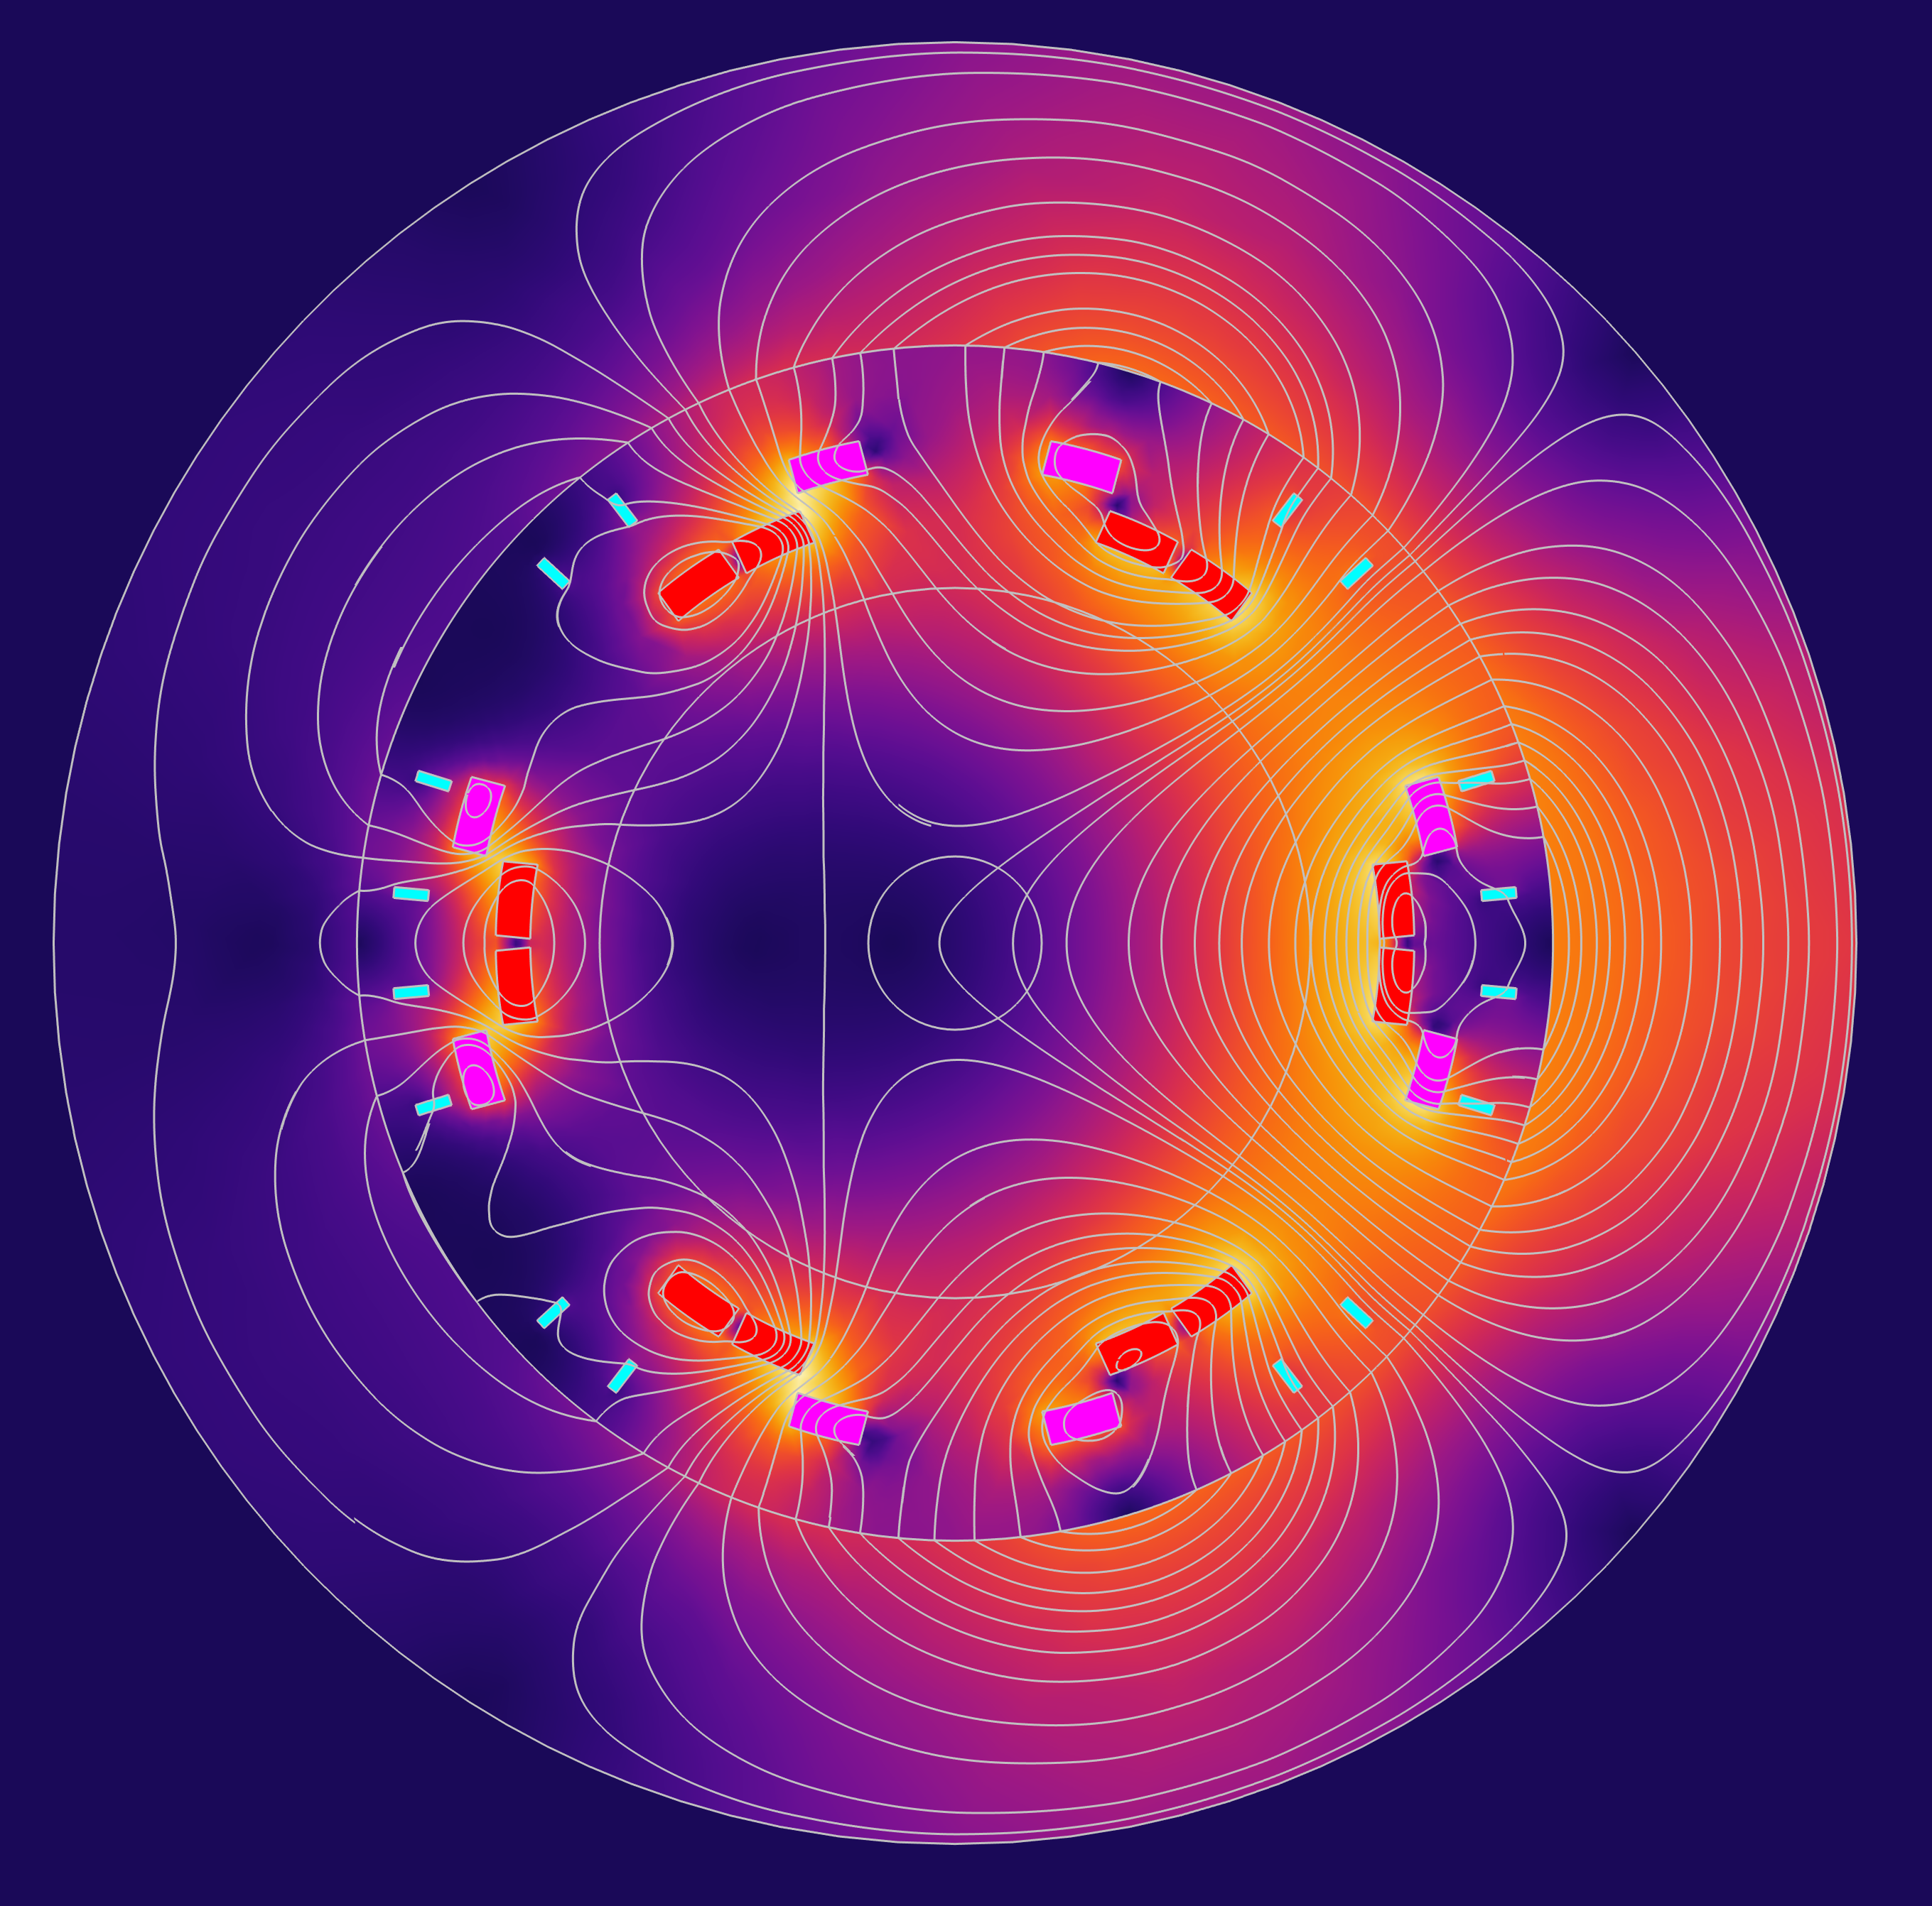
Proposal: HTS nested dip+sext+quad
HTS short straight section: HTS4
Save 2.8 TWh on joule heating in S+Q
Save 2 TWh on SR radiation
Pay ~ 1 TWh for cryocooling
~20% reduction
of total FCC-ee consumption
Gain optics flexibility
Cost competitive (?)
Iron
Quadrupole
Sextupole
Dipole
20 mm

Slide 6

Three related CHART projects
FCC-ee beam dynamics, EPFL
FCC-ee HTS short straight sections (HTS4), CERN/PSI
FCC-ee cryogenic power converter (CPES), ETHZ

Slide 7
Requirements
2900 SSS, double aperture,
spaced ~ 30 m from each other along 90 km tunnel
Optics requirements
dipole, sextupole, quadrupole independent
Combined function won’t work
Can’t rely on iron

Slide 8
Contents
HTS project goals
Hardware demonstrators
Cryogenic cooling & operating temperature
Powering

Slide 9
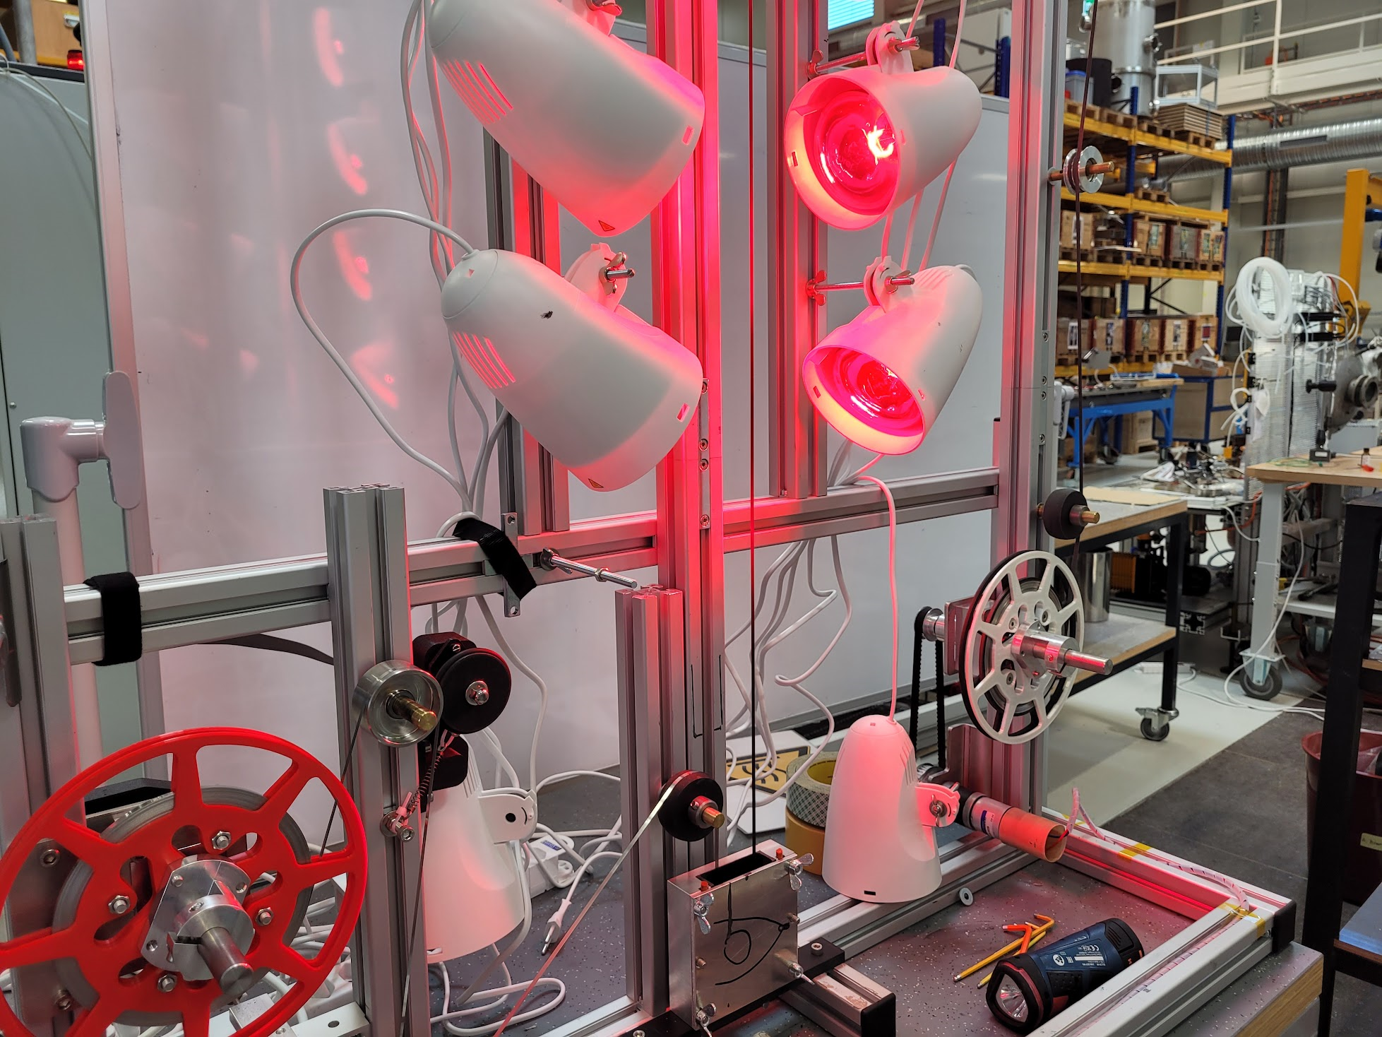
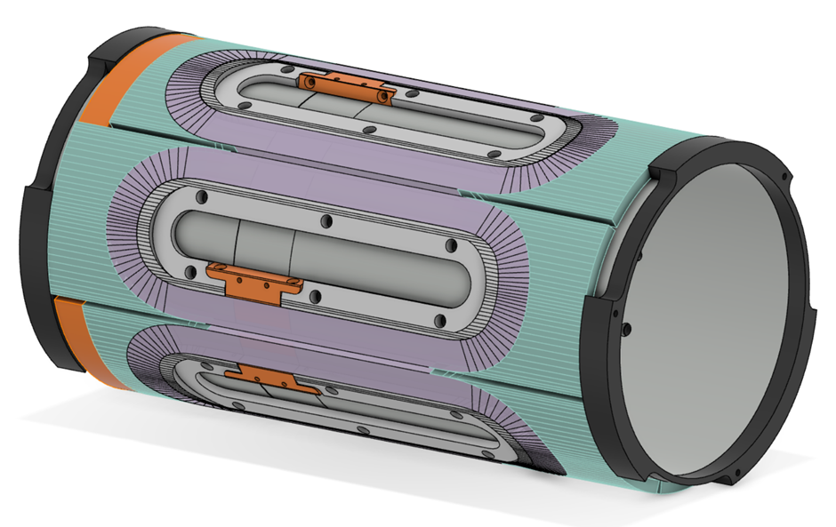
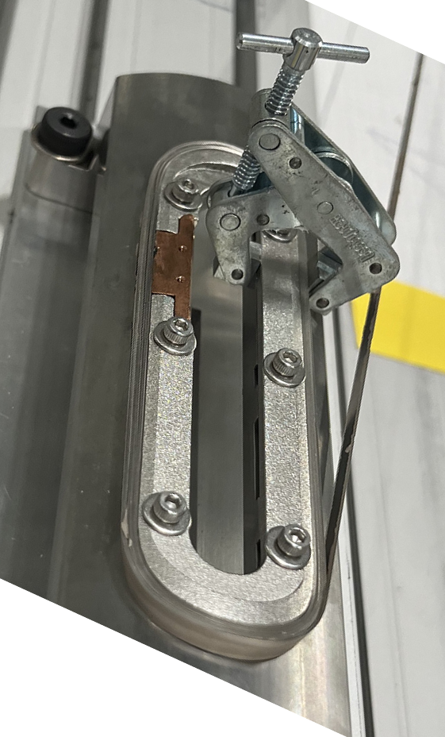
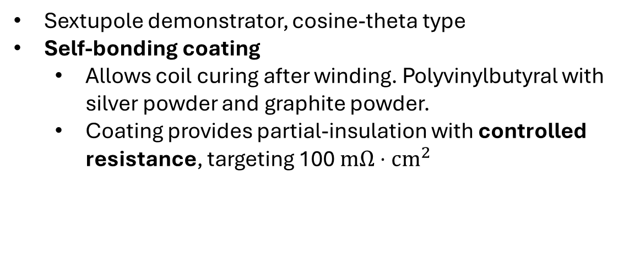
HTS4 hardware plans (1)
Sextupole demonstrator, cosine-theta type
Self-bonding coating
  Allows coil curing after winding. Polyvinylbutyral with silver powder and graphite powder.
  Coating provides partial-insulation with controlled resistance, targeting 100 $mΩ⋅cm^{2}$

Slide 10
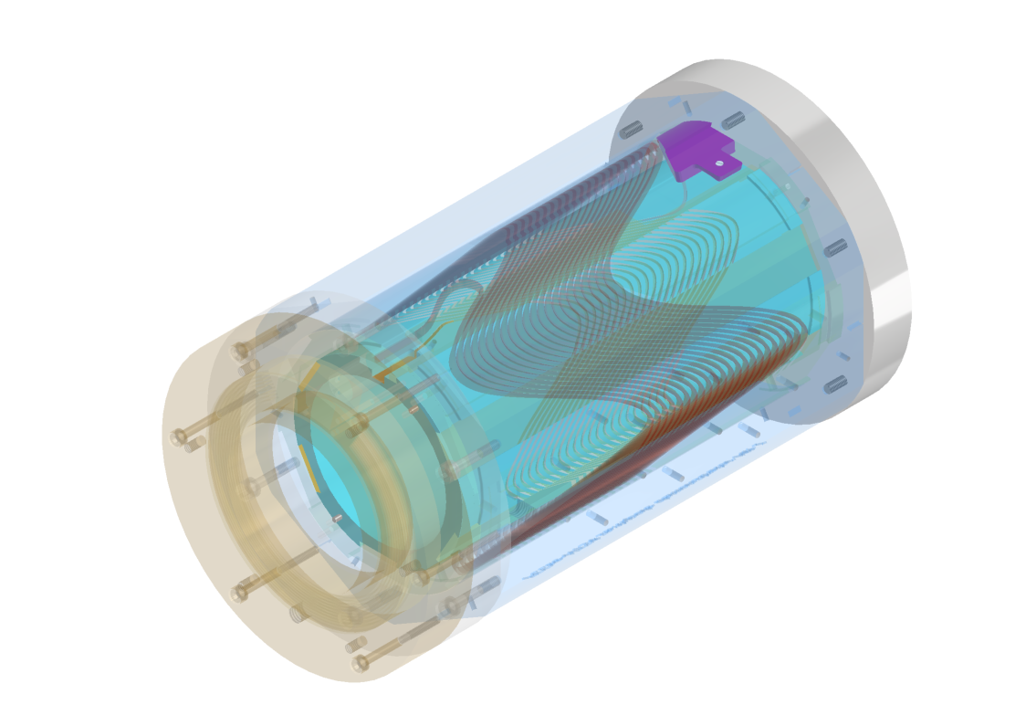
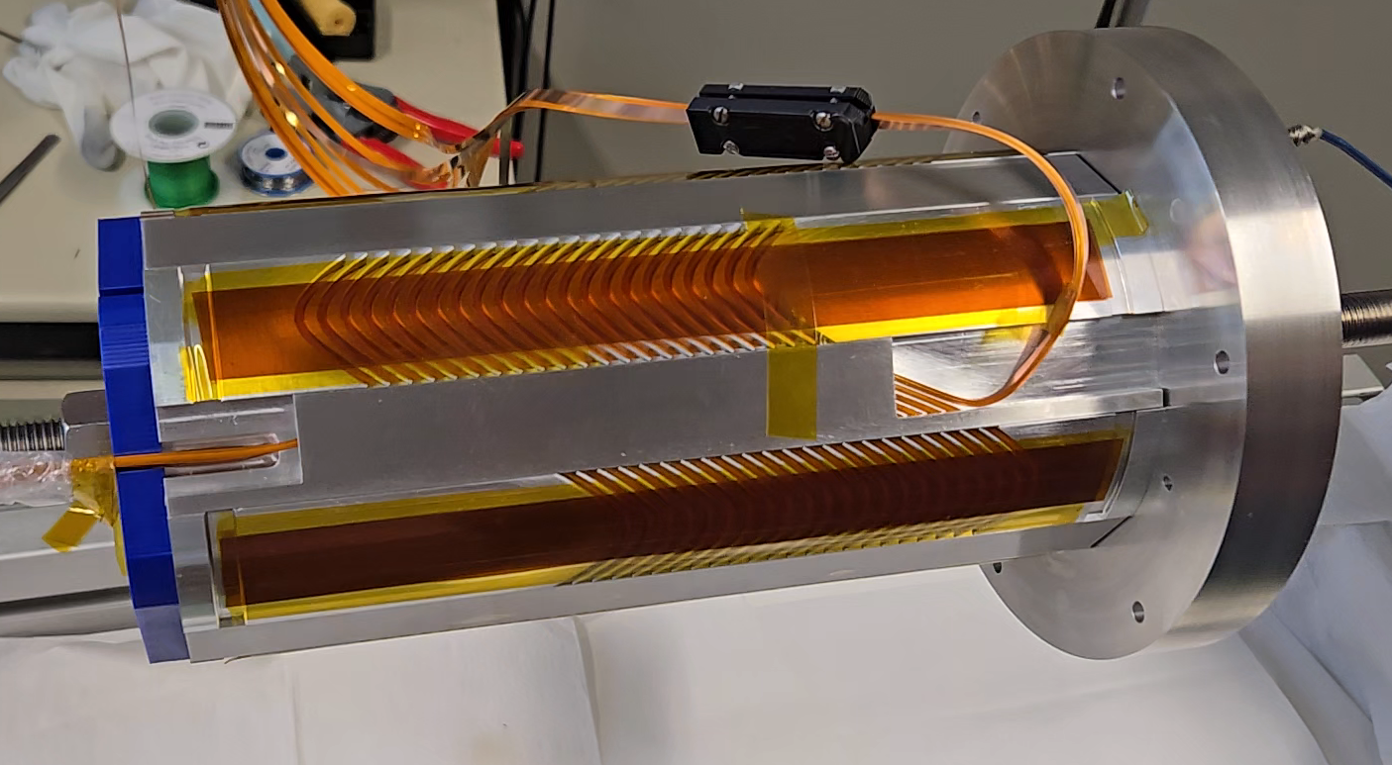
HTS4 hardware plans (2)
Sextupole demonstrator, canted-cosine-theta type
Insulated conductor
Wax impregnated

Slide 11
HTS4 hardware plans (3)
1-m prototype
  Technology choices to be based on lessons from the 2 demonstrators

Slide 12
Contents
HTS project goals
Hardware demonstrators
Cryogenic cooling & operating temperature
Powering

Slide 13
The optimum operating temperature
depends on the price of
electricity
HTS conductor
The sweet spot is around 40 K
across a wide range of costs

Slide 14
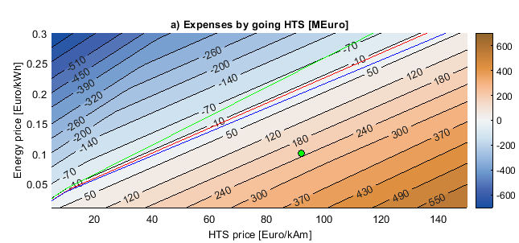

HTS vs NC option
$$Δcosts=Δ{costs}_{electricty}+Δ{costs}_{capital}$$
2023 estimate for CERN
2024 estimate
Cryocooler-based HTS SSS more expensive than room-temp option
… for now
*RF hardware saving not taken into account

Slide 15
Cooling
Route 1) Centralized cooling plant with distribution line
+Thermal switch to connect to each SSS
Route 2) Individual cooling of each magnet
Unknown: radiation aspects

Slide 16
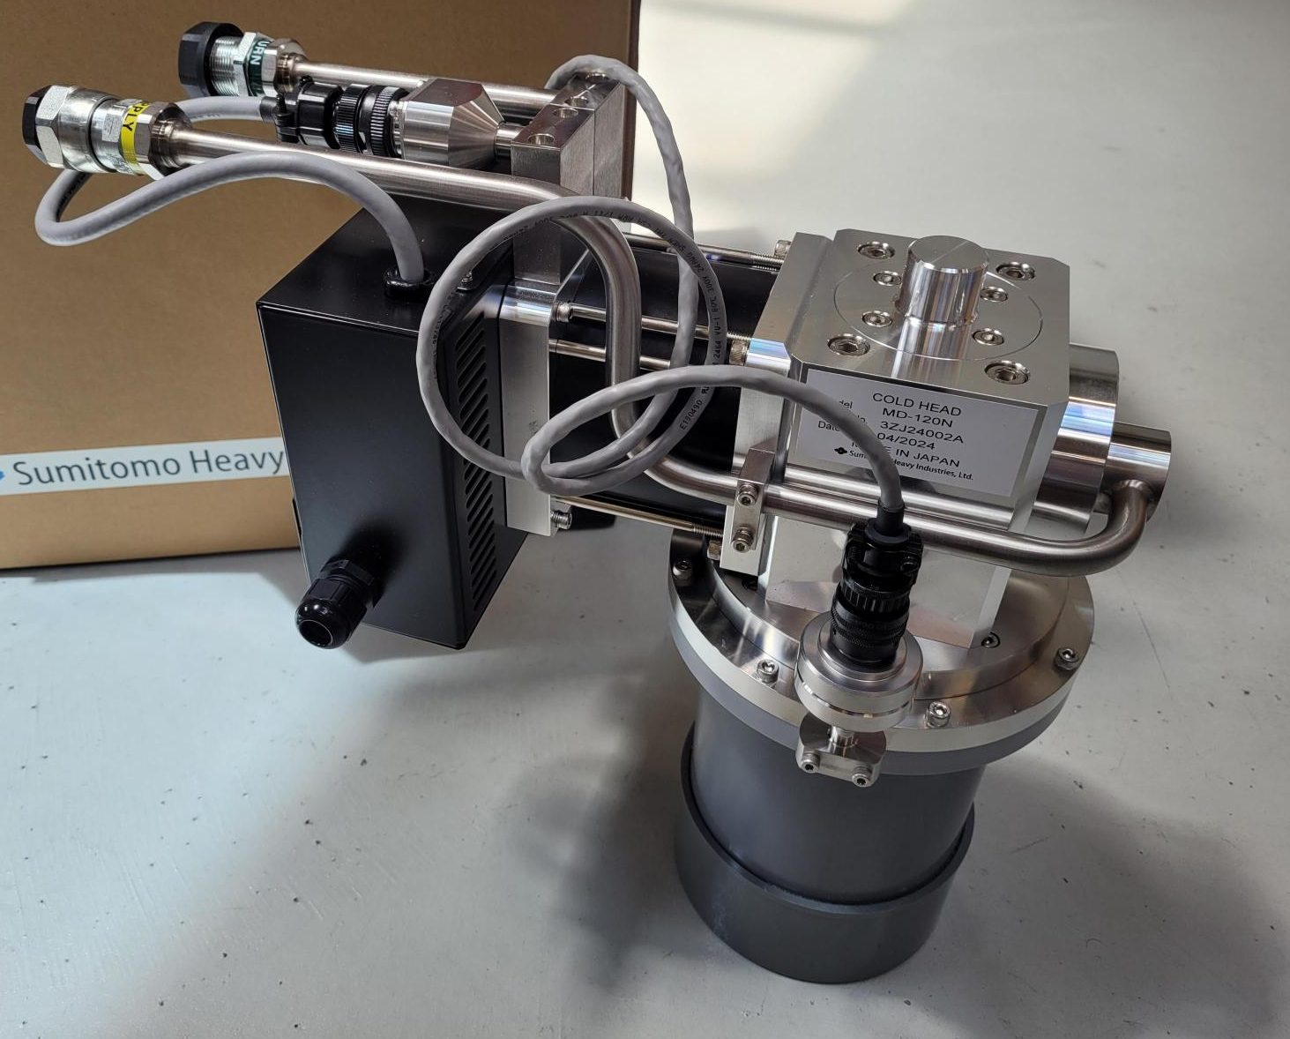
Cryocooler based option
Individual cooling of each magnets, via high-reliability
single-stage coolers+redundancy
Variable frequency operation
Cooling system (2900 magnets, 8700 coldheads)
Reliability (1 year) 0.9939
Availability (1 year) 0.9995
In-tunnel maintenance 300 FTE-days/year
Unknown: radiation aspects
10.1109/TASC.2023.3346847
Alternative: cryogenic distribution line

Slide 17
Contents
HTS project goals
Hardware demonstrators
Cryogenic cooling & operating temperature
Powering

Slide 18
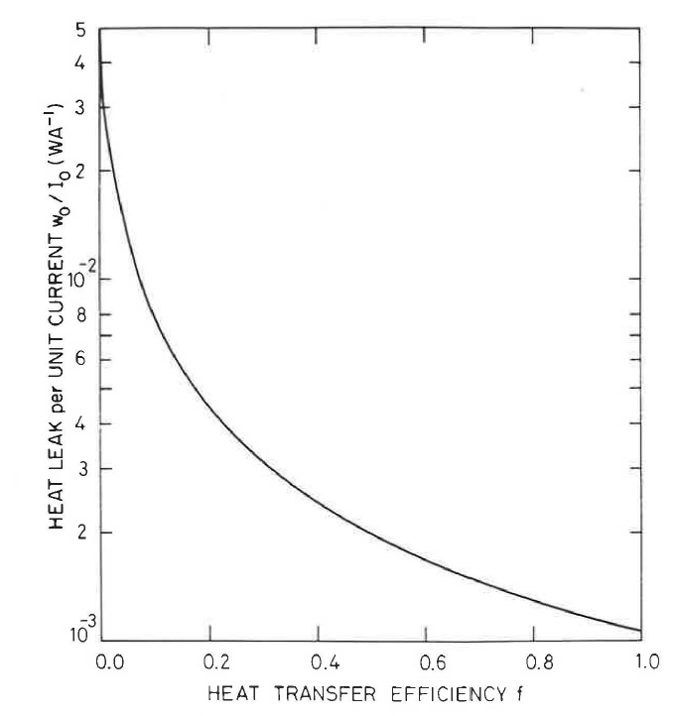
Current leads
High current conduction-cooled leads result
in a big heat load
E.g. 2 kA leads in PSI test stand need dedicated cryocooler
(7 kW power draw)
M. Wilson
Conduction-cooled
Gas-cooled

Slide 19
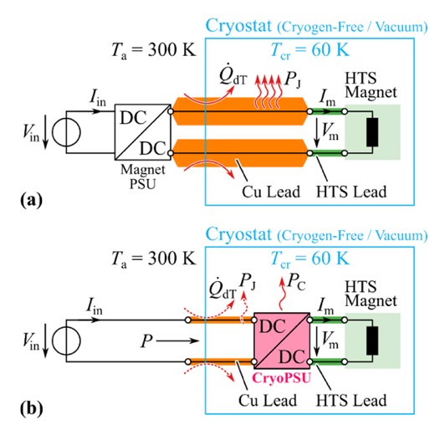
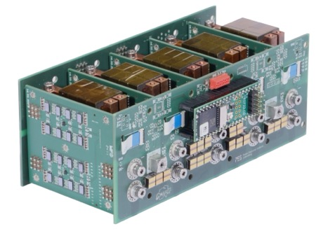
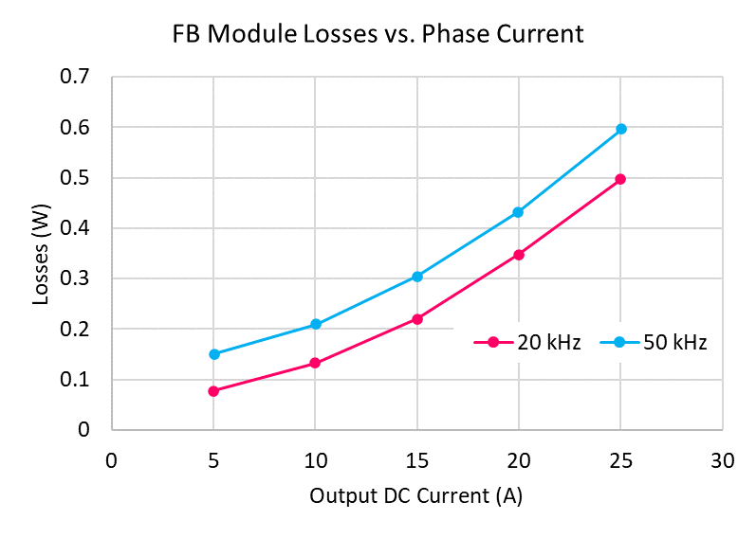
Cryogenic Power Electronic System
In support of FCCee HTS4, CPES
develops a cryogenic power supply
which, in its first iteration, may reduce
heat load to cold source by 70%.
First 5-phase 100-A demonstrator
successfully tested in LN2.
Next steps:
  low-temperature testing
  Reliability engineering
  Scale-up of I_{op}
  Societal Impact:
  Interest by Airbus in CPES collaboration.
  Follow-up projects should tackle:
  Availability + Maintainability = Dependability and
  Radiation hardness for FCC-ee
  and scaling to higher currents (10-20 kA range) for HFM
20 A:
347 mW
± 4.2 mW
Courtesy J. Huber, D. Zang. ETHZ

Slide 20
Conclusions
Moving from room-temp to HTS magnets can reduce FCC-ee power consumption significantly (~20%)
Demonstrators are under constructions
Cryocooler-based HTS short straight sections might be cost-effective in the future
But radiation might be a show-stopper
Cryogenic dc/dc convertor might make conduction-cooled systems much more energy efficient
Distributed cooling line is under investigation

Slide 21
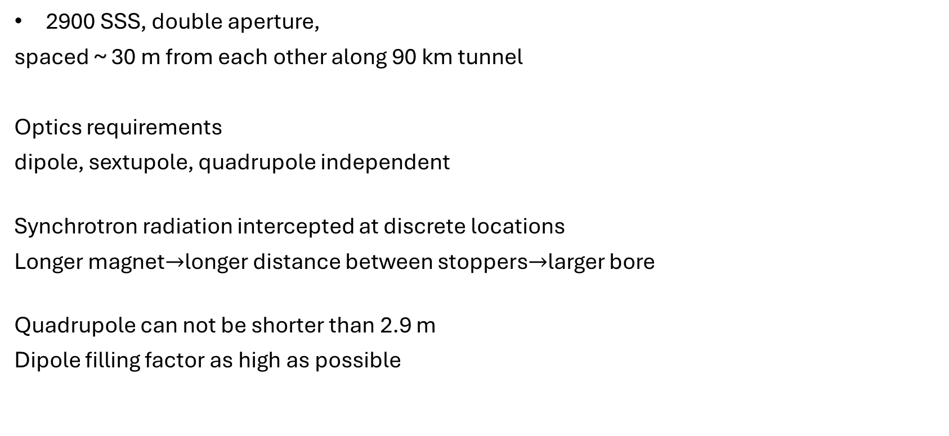
Requirements
2900 SSS, double aperture,
spaced ~ 30 m from each other along 90 km tunnel
Optics requirements
dipole, sextupole, quadrupole independent
Synchrotron radiation intercepted at discrete locations
Longer magnet$→$longer distance between stoppers$→$larger bore
Quadrupole can not be shorter than 2.9 m
Dipole filling factor as high as possible
Combined function won’t work
Individual power supply (=6x)
OR shared+trim
Make the magnet as short as possible
Dipole, quadrupole, sextupole
share the same axial space (nested)

Slide 22
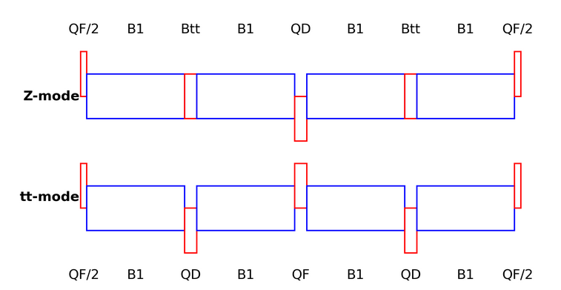
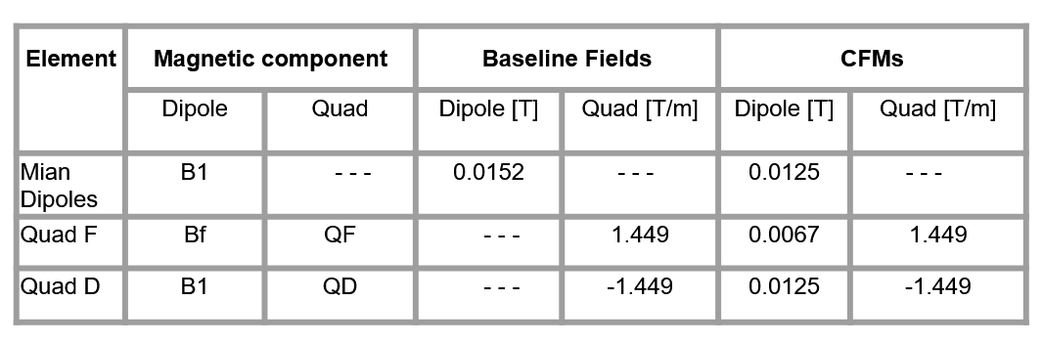
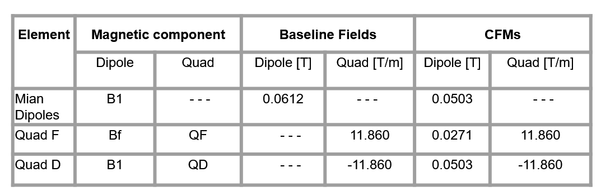


Requirements
Via EPFL (Leon Van Riesen-Haupt , Cristobal Garcia)
$$Z$$
Dipole x 4
Quad x 8
$$t\overline{t}$$

Slide 23
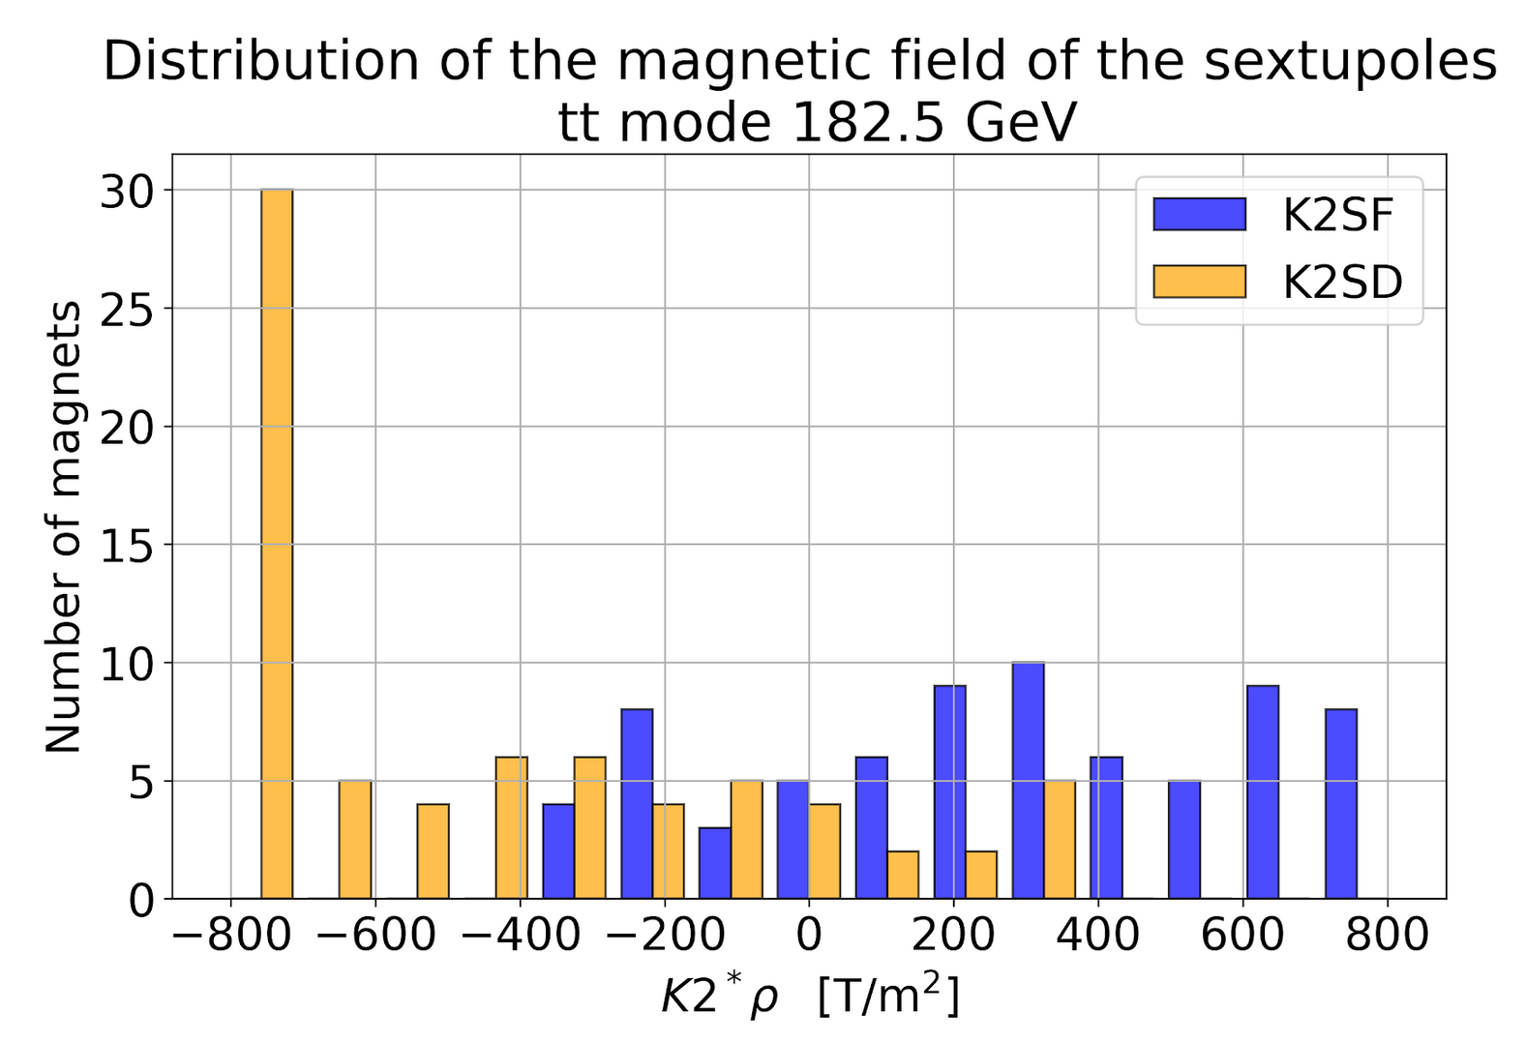
How about the sextupole?
Many different sextupole strengths
Configurations with less families
NOT actively studied
Via EPFL (Leon Van Riesen-Haupt,
Cristobal Garcia)

Slide 24
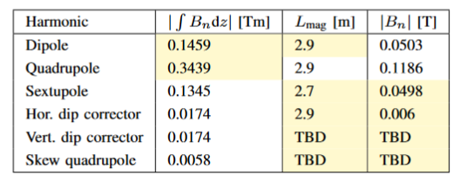
Requirements
Via EPFL/CERN
Quadrupole can not be made shorter (quadrupole synchrotron radiation)
$→$bad news for short but powerful independent harmonics

Slide 25
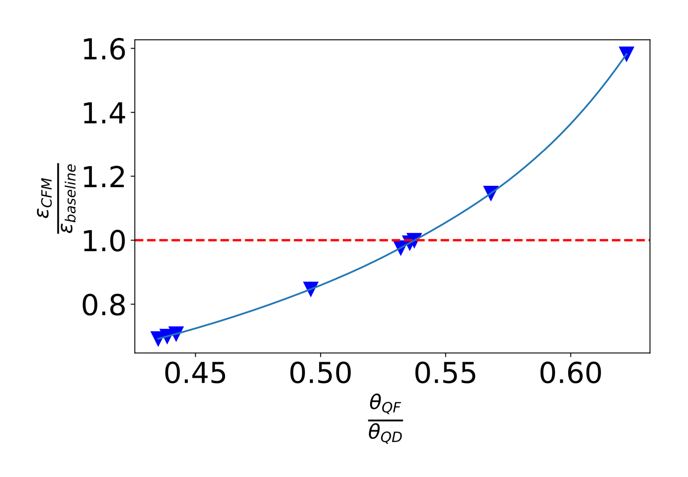
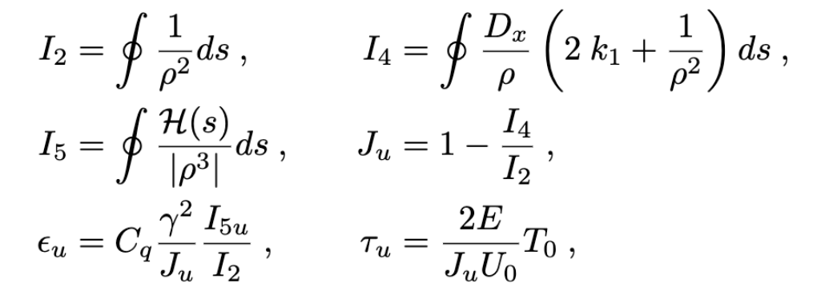
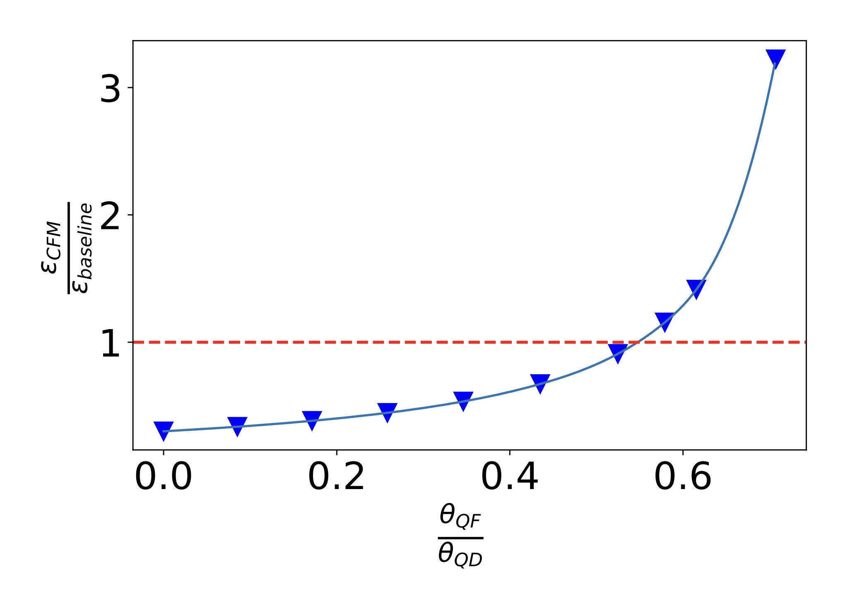
State of art
Z-mode
When CFMs are introduced into the lattice, the Damping Partition change due to the introduction of a dipolar component in the quadrupoles.
The problem comes from the radiation integral I4, that depends on the sign of K1.
We studied different ratios of bending angles in QF and QD CFMs
→ The ratio of fields (or bending angles) must be 0.53 to achieve the nominal emittance.
tt-mode

Slide 26
Proposal: HTS nested dip+sext+quad
HTS short straight section: HTS4
D
D
D
S
S
S
Q
S
Q
D
D
D
S
S
S
Q
S
Q
D
D
D
S
S
Q
S
S
Q
Save 2.8 TWh on joule heating in S+Q
Save 2 TWh on SR radiation
Pay ~ 1 TWh for cryocooling
~20% reduction
of total FCC-ee consumption

Slide 27
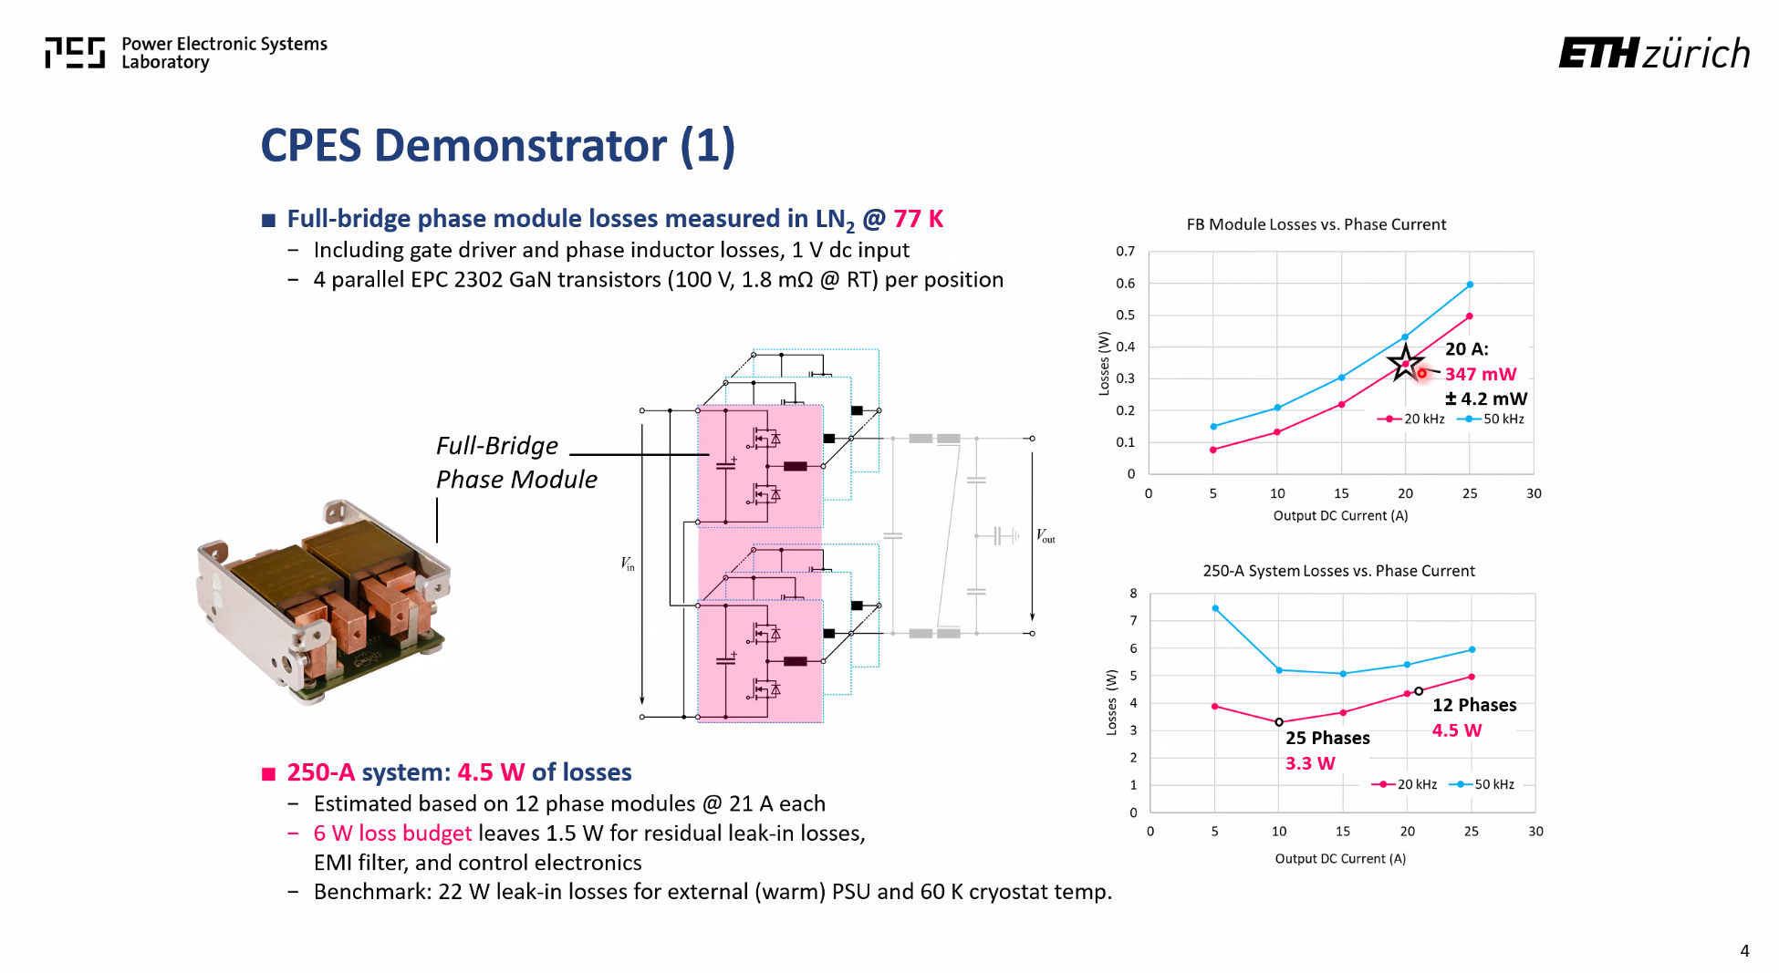
Cryogenic dc/dc convertor
5-10x more efficient than high-current leads
Unknown: radiation aspects
Jonas Huber et al, ETHZ
CHART project FCC-ee cryogenic power converter (CPES), ETHZ

