Slide 1
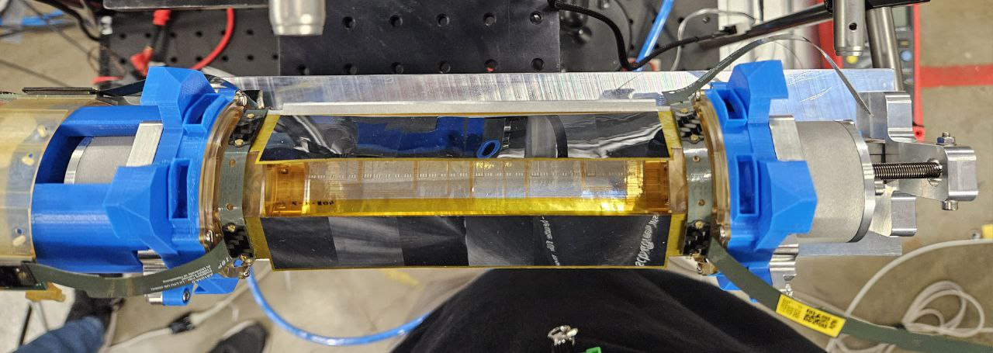
Production and Qualification of the Mu3e Vertex Detector
Thomas Christian Senger
On behalf of the Mu3e collaboration

Slide 2
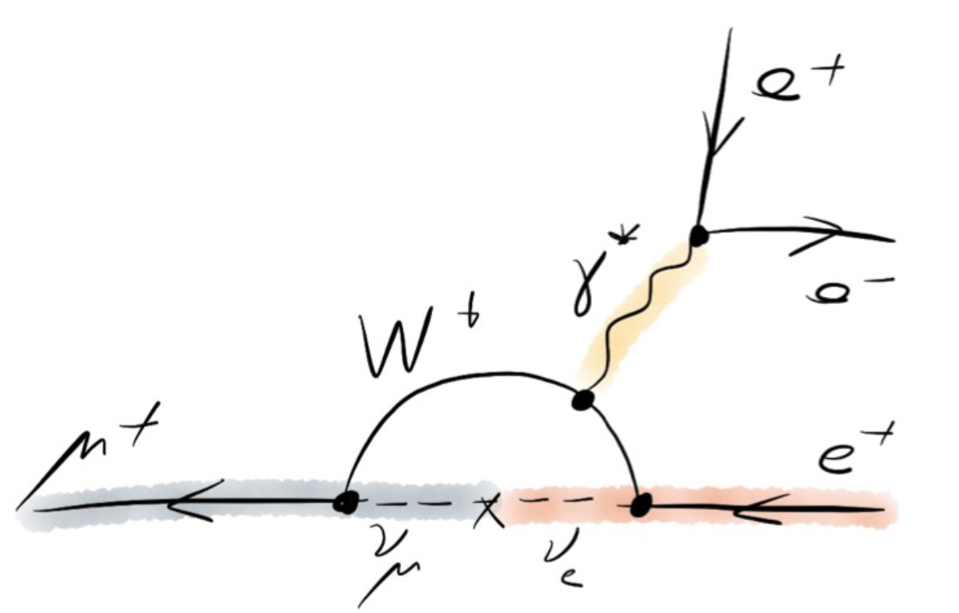
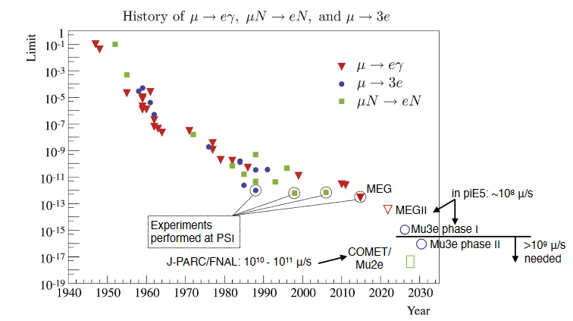
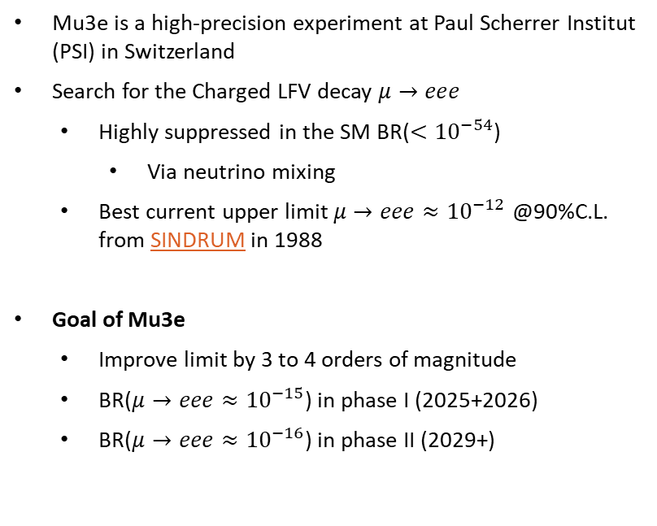
Probing the standard model with Mu3e
Mu3e is a high-precision experiment at Paul Scherrer Institut (PSI) in Switzerland
Search for the Charged LFV decay $μ→eee$
  Highly suppressed in the SM BR($<{10}^{−54}$)
    Via neutrino mixing
  Best current upper limit $μ→eee≈{10}^{−12}$ @90%C.L. from SINDRUM in 1988
Goal of Mu3e
  Improve limit by 3 to 4 orders of magnitude
  BR($μ→eee≈{10}^{−15}$) in phase I (2025+2026)
  BR($μ→eee≈{10}^{−16}$) in phase II (2029+)
Standard model decay via neutrino mixing

Slide 3
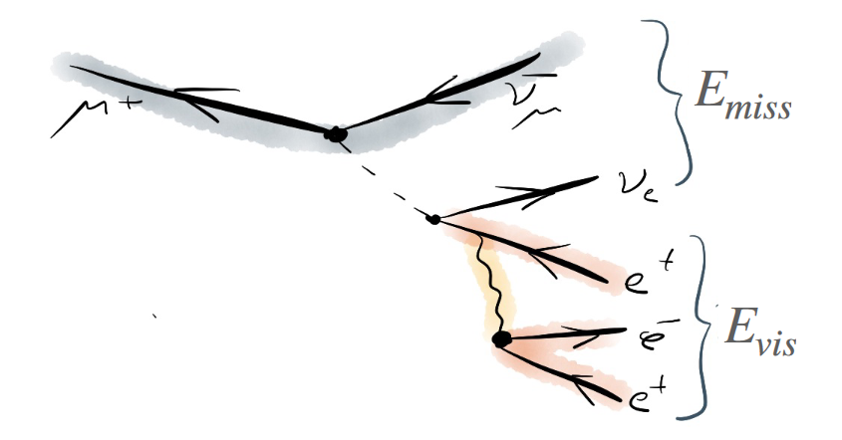
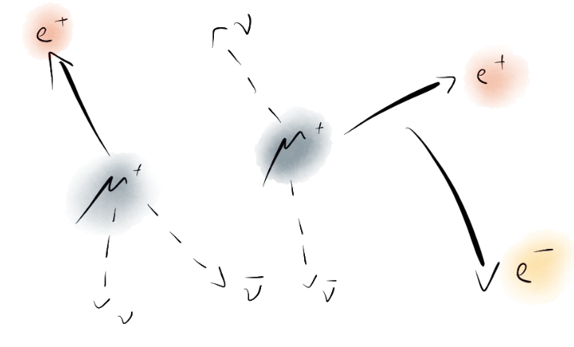
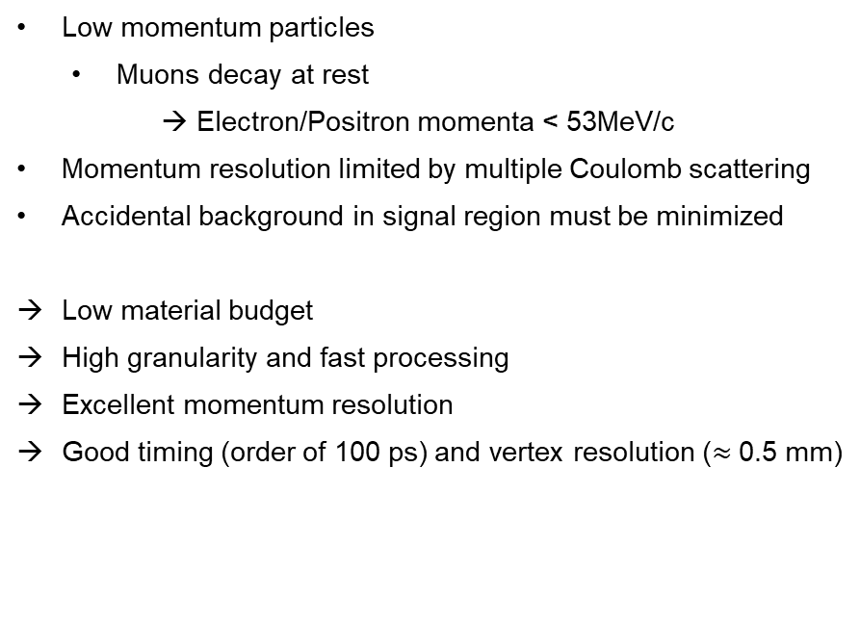
Experimental challenges
Low momentum particles
  Muons decay at rest
  → Electron/Positron momenta < 53MeV/c
Momentum resolution limited by multiple Coulomb scattering
Accidental background in signal region must be minimized
Low material budget
High granularity and fast processing
Excellent momentum resolution
Good timing (order of 100 ps) and vertex resolution ($≈$0.5 mm)

Slide 4
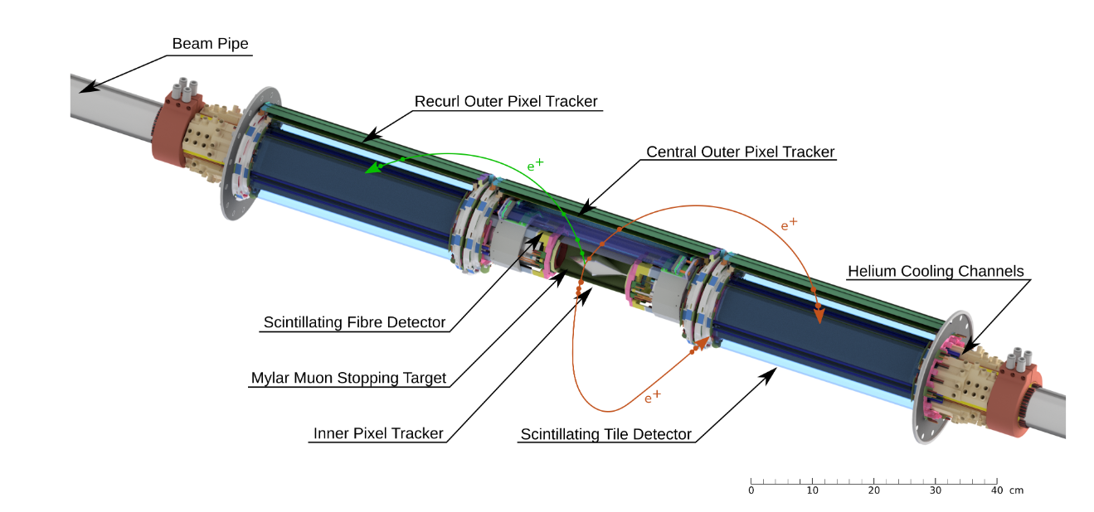
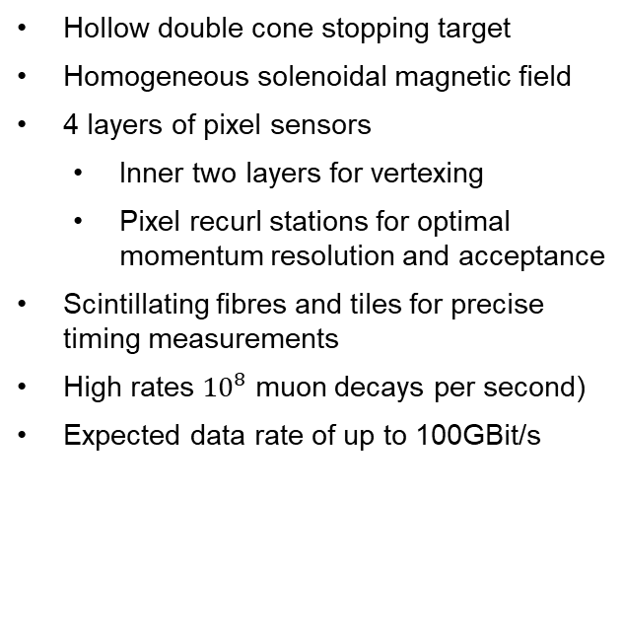
The Mu3e detector
Hollow double cone stopping target
Homogeneous solenoidal magnetic field
4 layers of pixel sensors
  Inner two layers for vertexing
  Pixel recurl stations for optimal momentum resolution and acceptance
Scintillating fibres and tiles for precise timing measurements
High rates ${10}^{8}$ muon decays per second)
Expected data rate of up to 100GBit/s

Slide 5
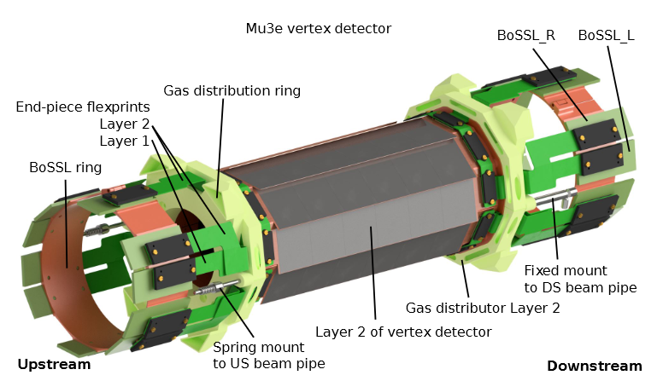
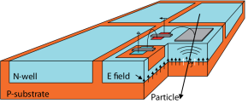
Mu3e Vertex Detector
Two layers of 50µm thin Mupix 11 pixel sensors
  High-Voltage Monolithic Active Pixel Sensor (HV-MAPS)
  Detection and Readout combined in one chip
  Fully digital 1.25Gbit/s LVDS output
  99% efficiency with less than 20ns time resolution
Mechanical support
  Aluminized Kapton foils HDI
  Sensors glued on foils + spTAB for electrical connection
DAQ to sensor connection via micro-twisted pair cables and other flexes produced with standard processes
Cooled by gaseous helium

Slide 6
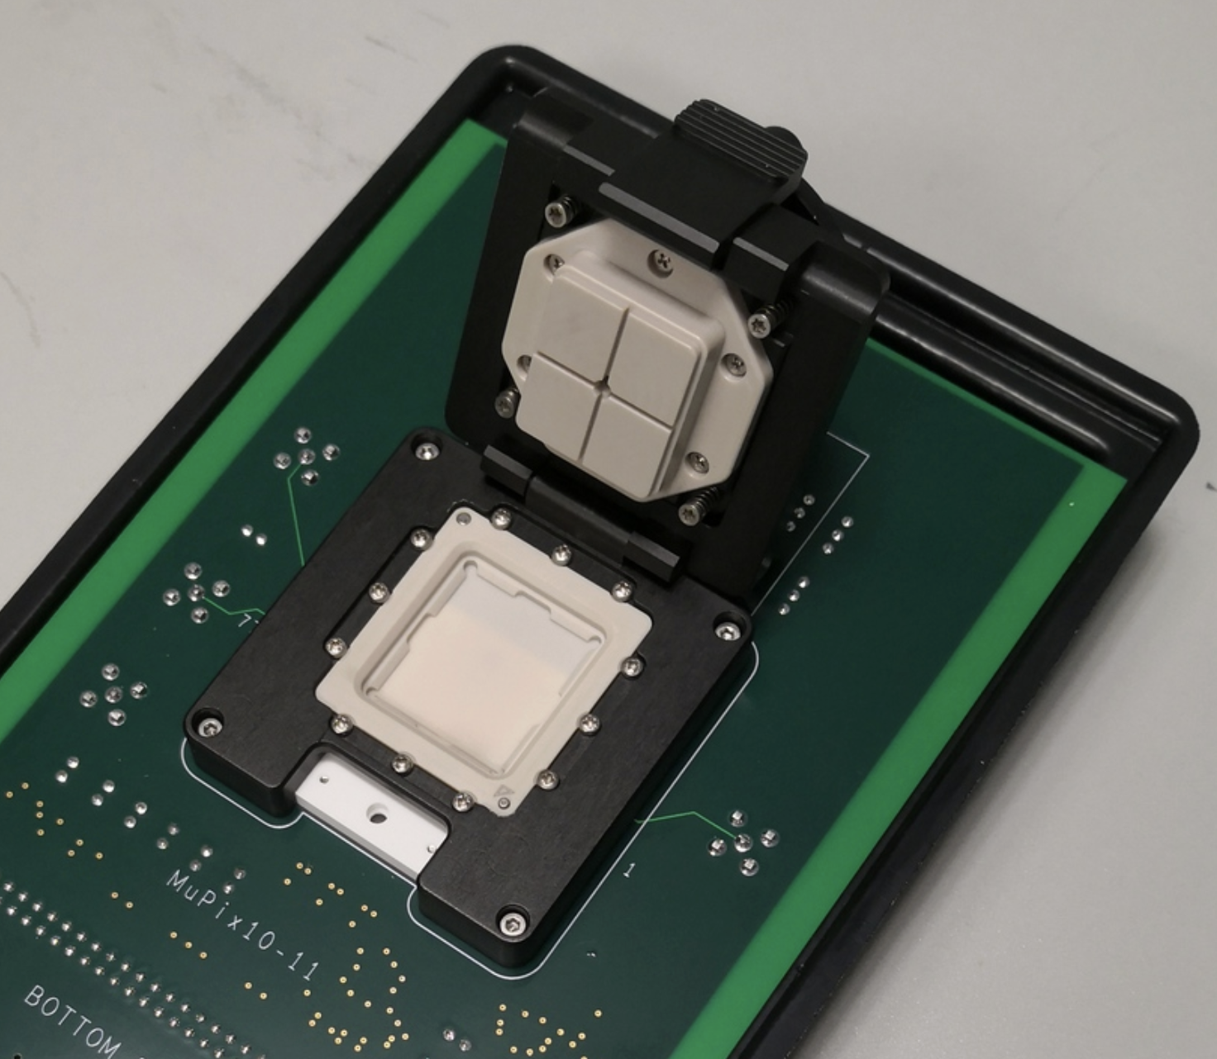
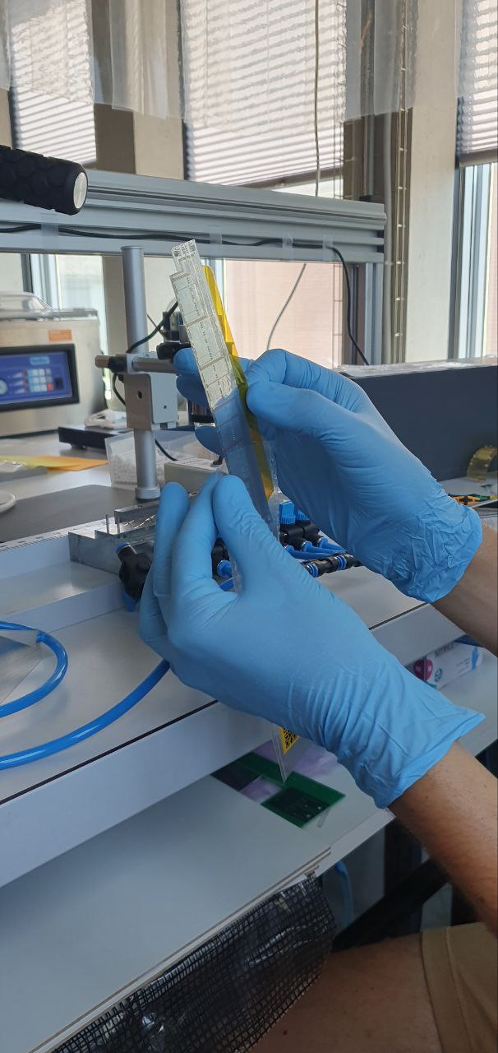
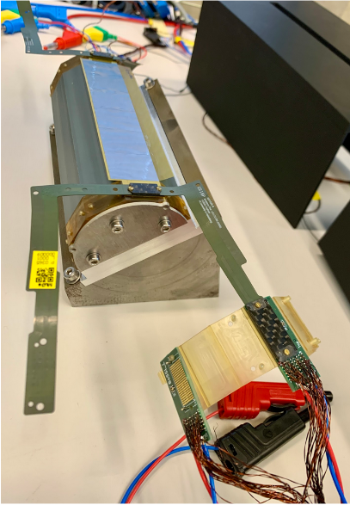
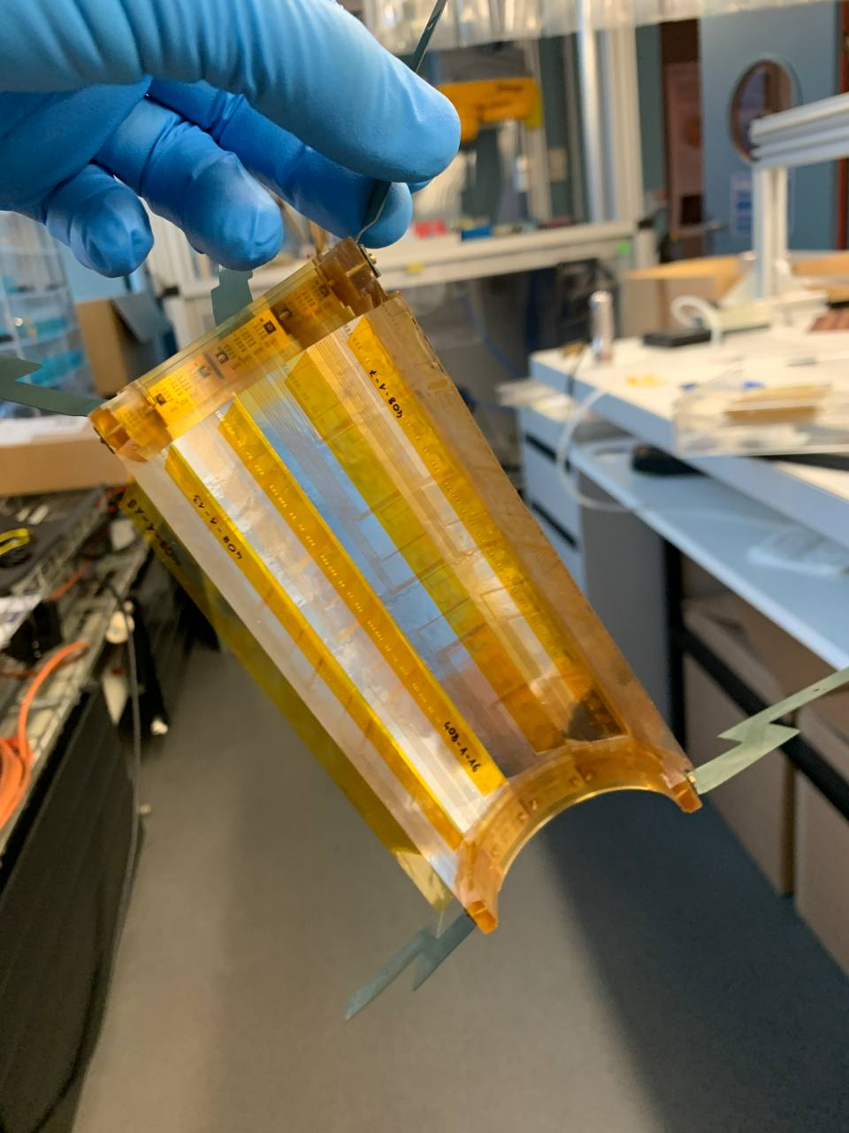
Construction of the Vertex Detector
Single Chip QC
Ladder Production
QC of Ladders and Services
Module assembly

Slide 7
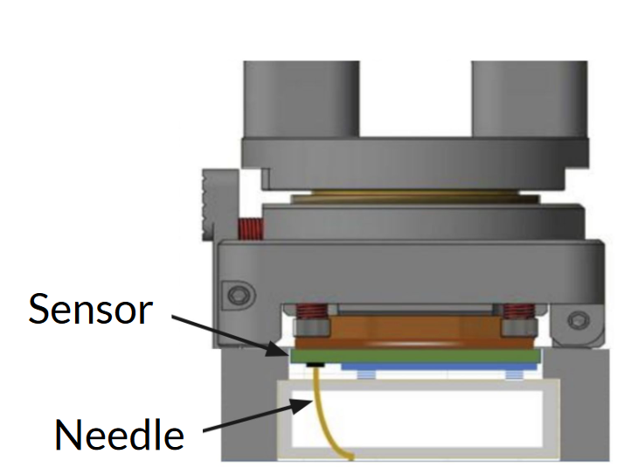
Manual Single Chip QC
Press down mechanism with contact needles
Single chip QC consisting of 8 electrical tests
  Basic electrical tests (IV, on chip voltage regulation, power consumption)
  LVDS link stability
  Noise scan
QC takes 30min per chip
Based on a grading scheme
Current chip yield of 50-60 % after single chip QC

Slide 8
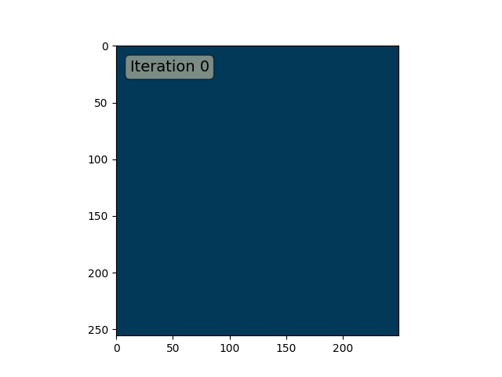
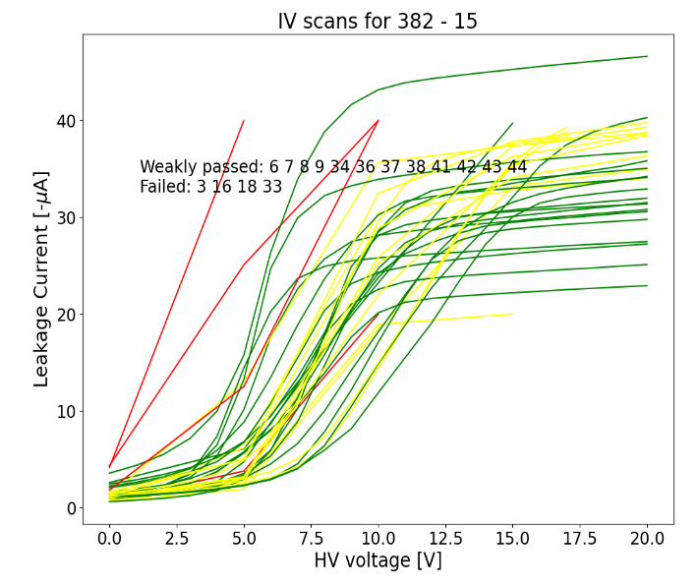
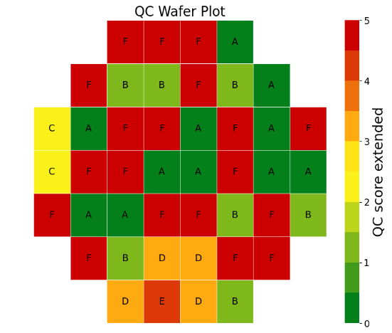
Manual Single Chip QC
Press down mechanism with contact needles
Single chip QC consisting of 8 electrical tests
  Basic electrical tests (IV, on chip voltage regulation, power consumption)
  LVDS link stability
  Noise scan
QC takes 30min per chip
Based on a grading scheme
Current chip yield of 50-60 % after single chip QC

Slide 9
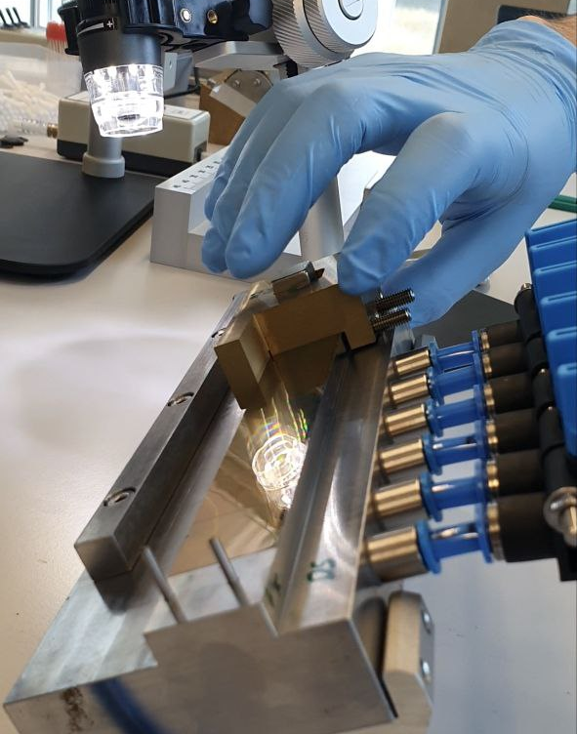
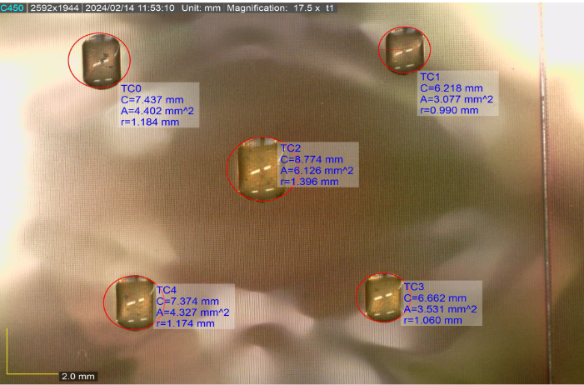
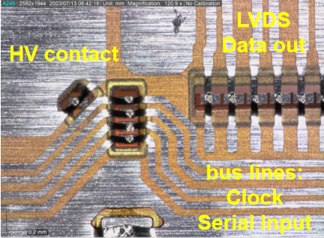
Ladder Production
Manual chip placement
Distribution of the glue on the Mupix sensors
spTAB connections from HDI to the MuPix chips

Slide 10
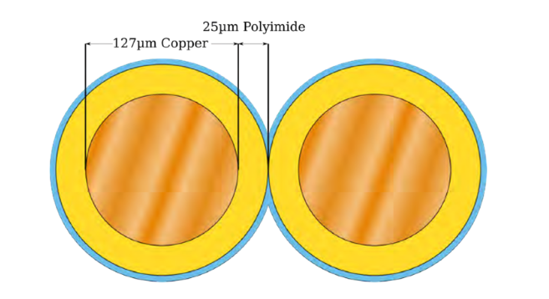
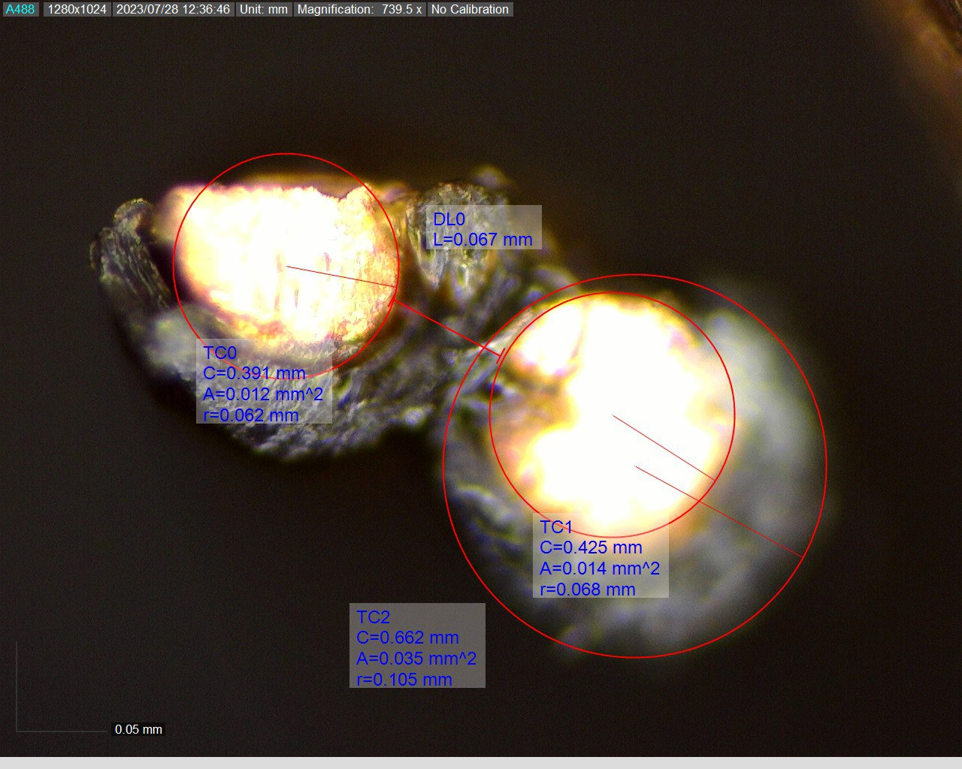
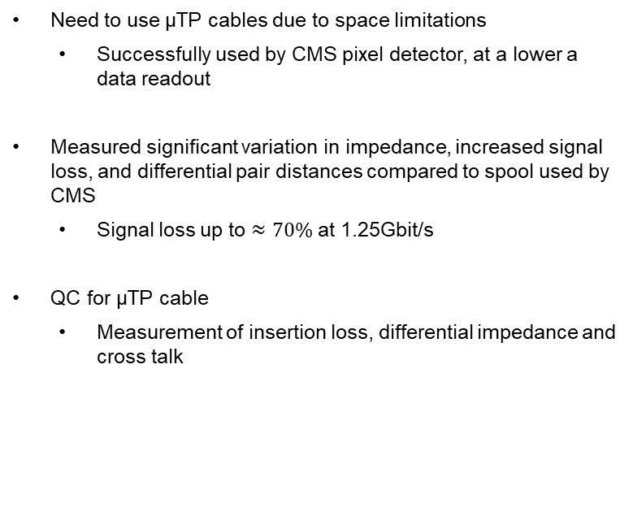
µTP cables
Need to use µTP cables due to space limitations
  Successfully used by CMS pixel detector, at a lower a data readout
Measured significant variation in impedance, increased signal loss, and differential pair distances compared to spool used by CMS
  Signal loss up to $≈70\%$ at 1.25Gbit/s
QC for µTP cable
  Measurement of insertion loss, differential impedance and cross talk

Slide 11
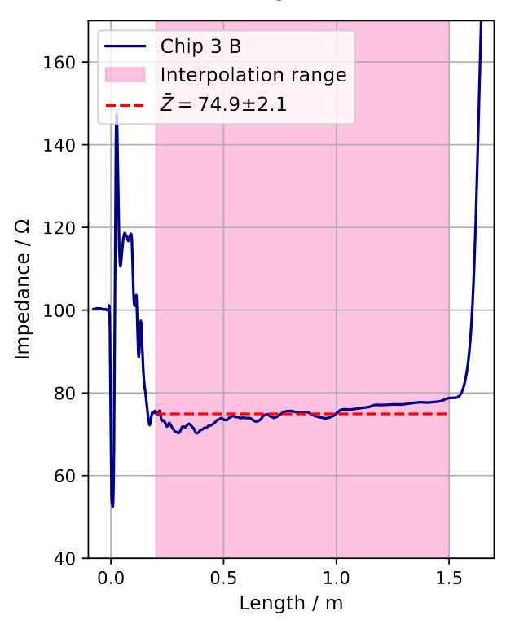
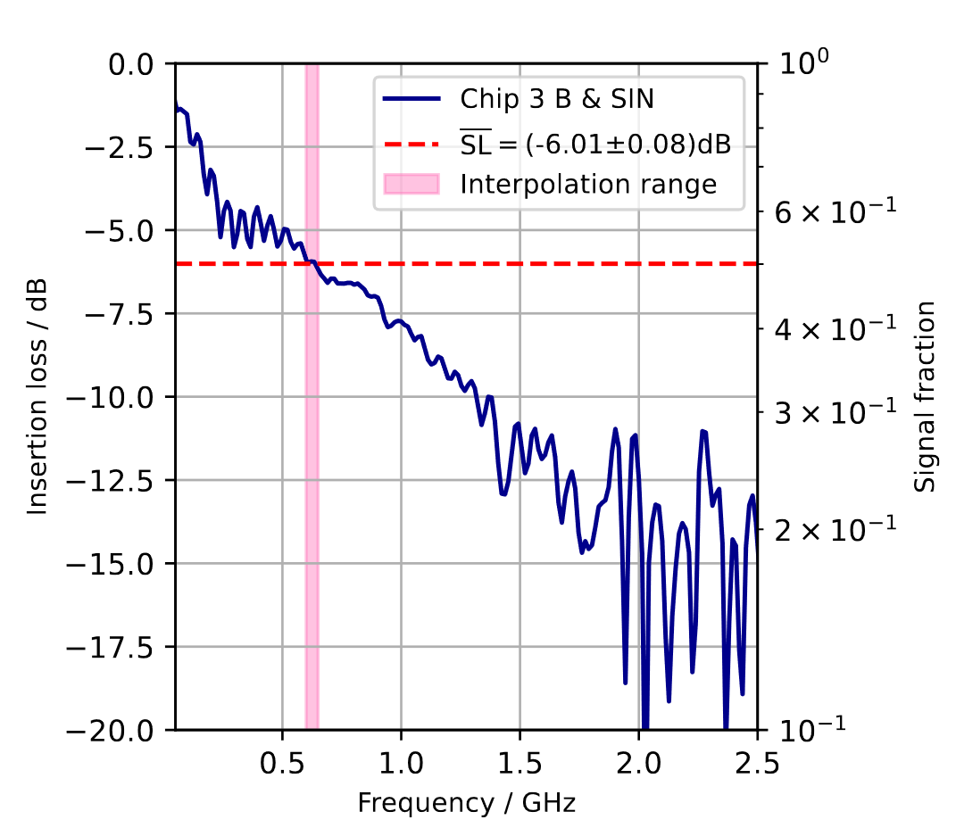
µTP cables
Need to use µTP cables due to space limitations
  Successfully used by CMS pixel detector, at a lower a data readout
Measured significant variation in impedance, increased signal loss, and differential pair distances compared to spool used by CMS
  Signal loss up to $≈70\%$ at 1.25Gbit/s
QC for µTP cable
  Measurement of insertion loss, differential impedance and cross talk

Slide 12
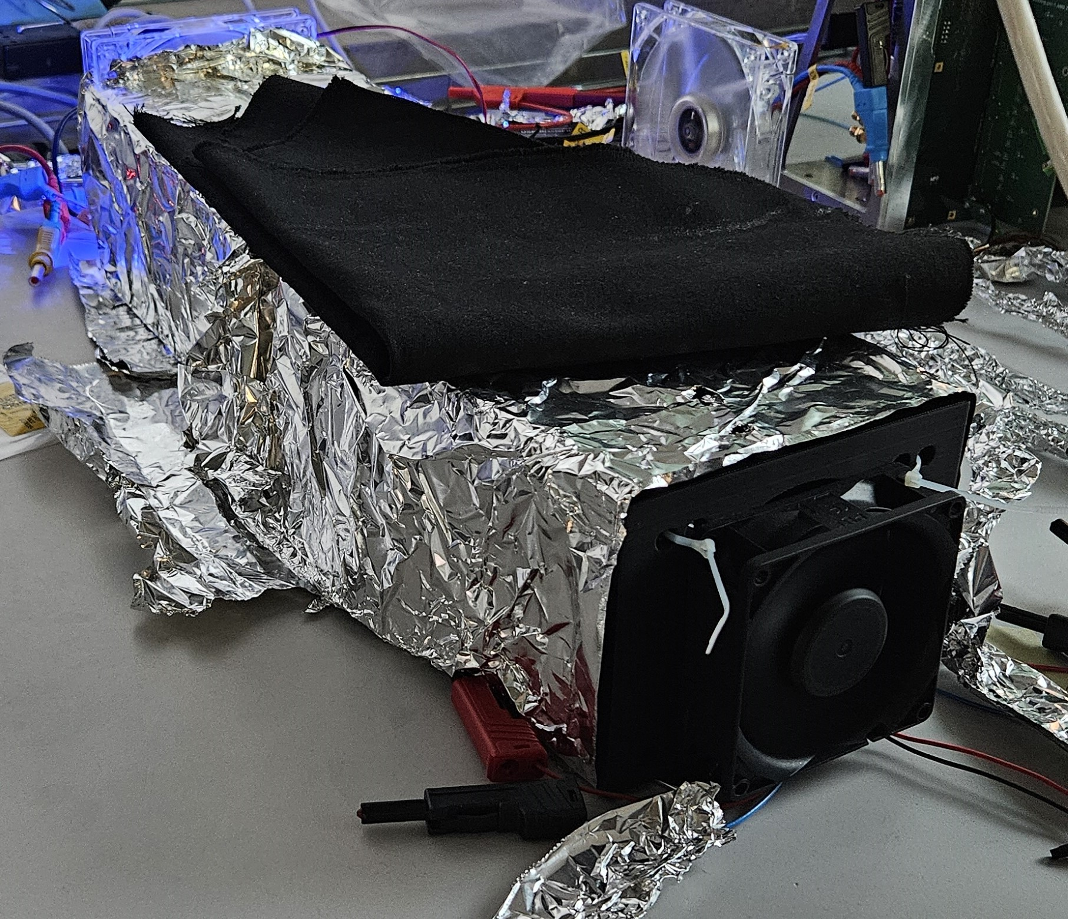
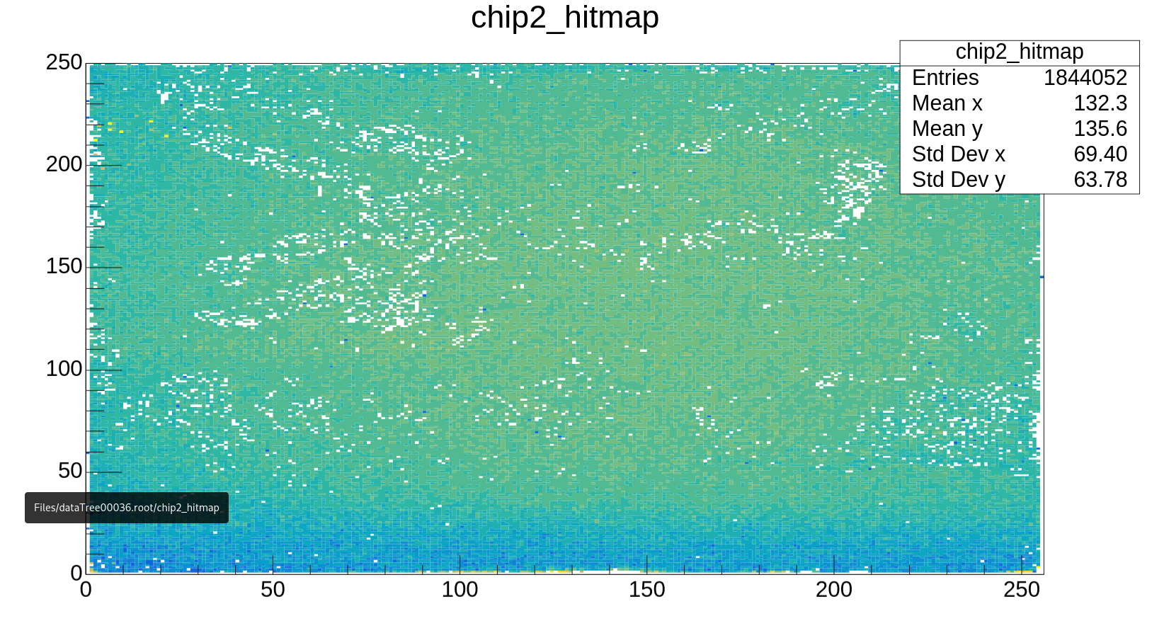
Ladder QC
Ladder placed a 3D printed box
  Cooled with two fans
  Shielded with aluminum foil
Ladder is connected via µTP to the FPGA
  All connections placed as in the final detector
  Only DC-DC-converter and HV boxes are replaced with comericial power supplies (Hamegs + Keithleys)
  Temperature readout through on chip temperature diode
Similar QC test procedure as for the single chip
  Additional signal transmission test
  Final source scan with applied noise masking at a low threshold
Takes ~6h per ladder
Goal is to find 18 good working ladders + spares

Slide 13
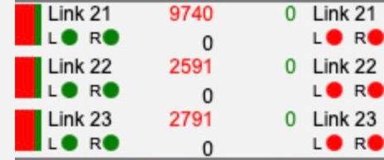
Signal transmission test
Challenge of errorfree links on a ladder
  8b10b encoding & disparity errors
  Crucial for a precision experiment
Different causes compared to single chip QC
  Light + Heat → high leakage current →noise
  Connections of various detector components
  Different voltage drops over a ladder
  No specific ladder DAC optimization
  High signal loss due to transmission through µTP cables
  only short connections used with single chips

Slide 14
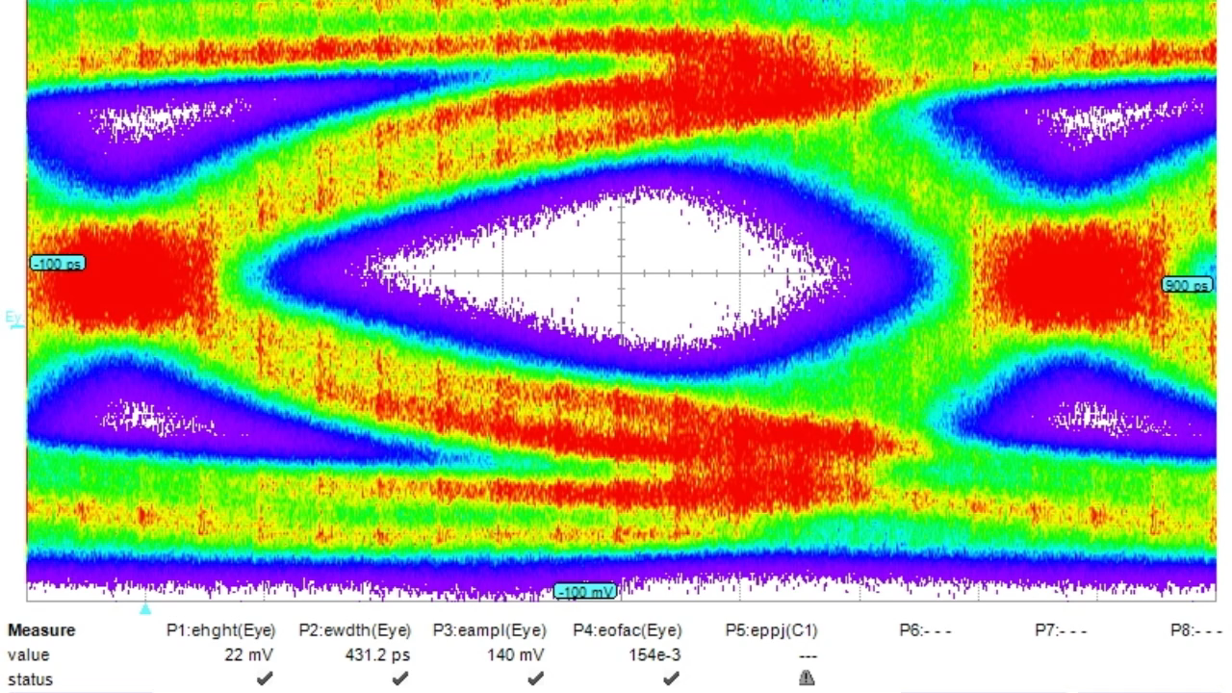
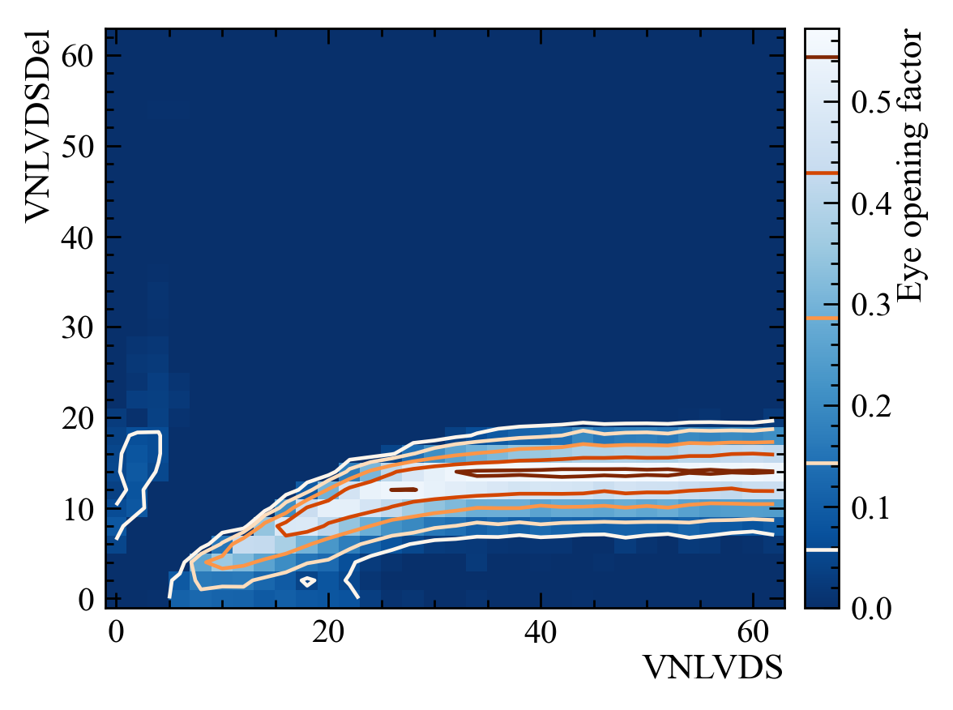
Signal transmission test
Chip internal peremphasis + signal amplication can recover the eye opening of transmitted chip data
Design of additional QC test
  µTP signal transmission studies show optimal transmission at preemphasis ~ 30% signal amplitude
Found plateau where error free transmission is possible
  With increase of preemphasis eye opening factor increases
  Signal amplitude dereases
3 dimensional scan in „plateau region“ for each chip
  Additional scan of another DAC for the regulation of the differential current logic

Slide 15
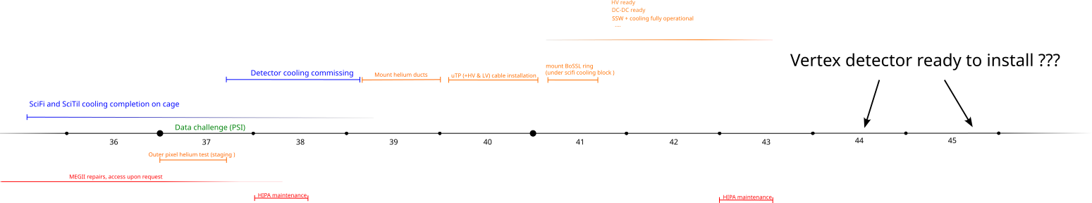
Current time line
Cosmic run with all services installed in November/December
  Development of calibration, monitoring and data taking routines
Tested seven wafers for production
Ladders are currently constructed and qualified
  Current ladder yield of <50% (preliminary)
Module construction in the first week of October
  Module QC (basic tests)
Services/Cooling and DAQ are currently being installed
Also other Detector components are installed
Yifeng will give an overview in the next talk
First beam data next year

Slide 16
Backup

Slide 17
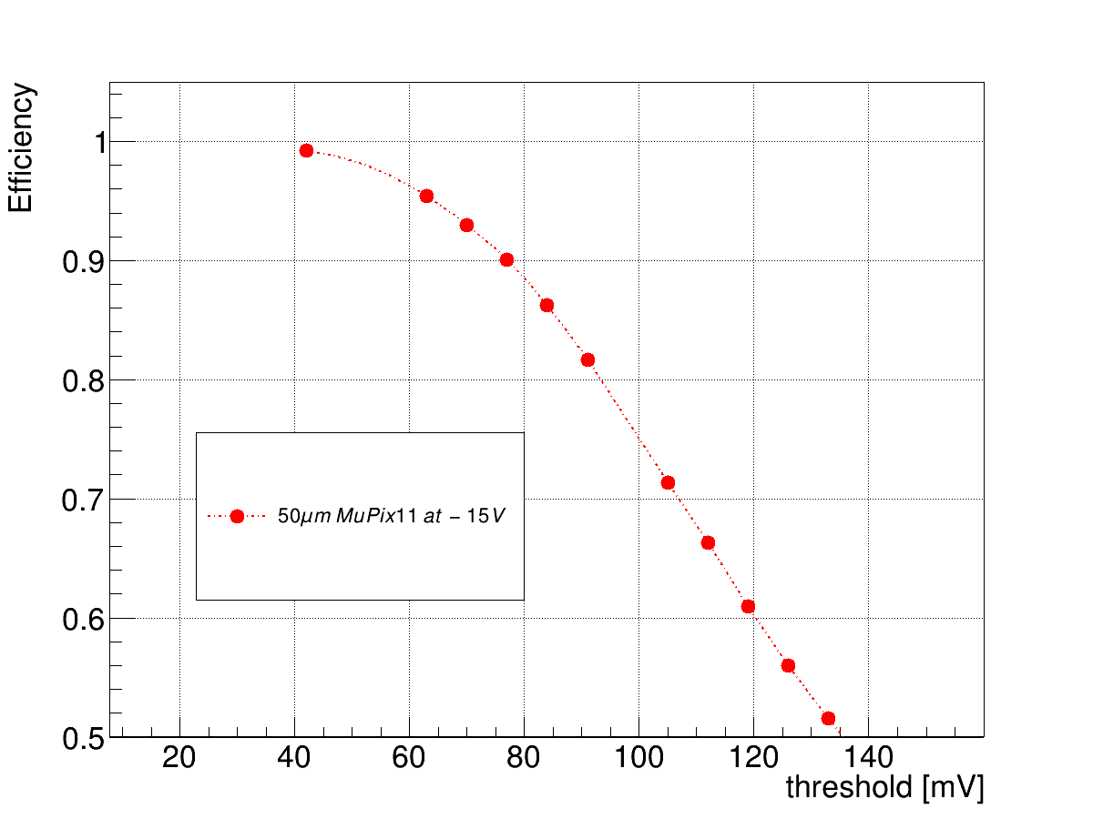
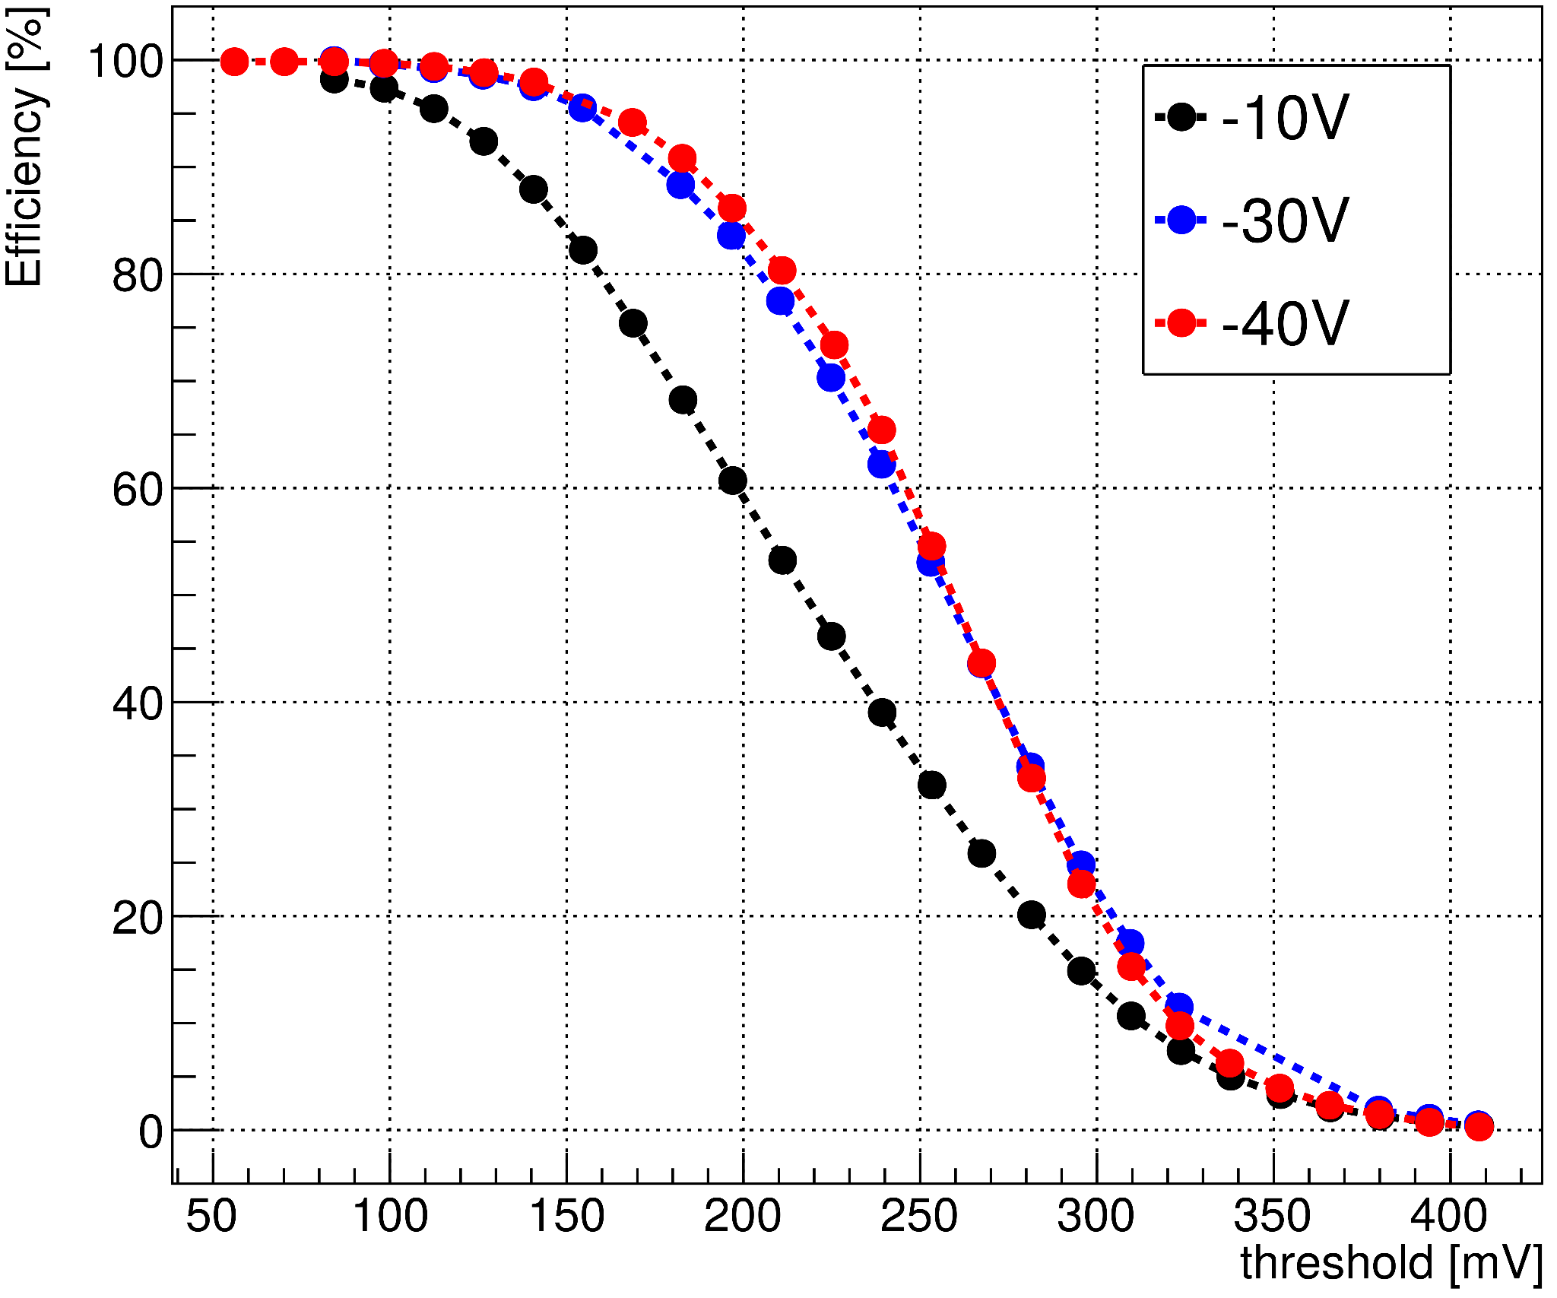
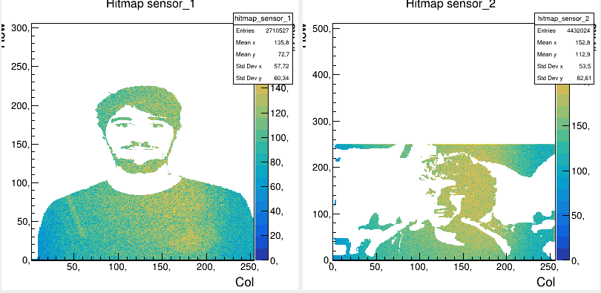
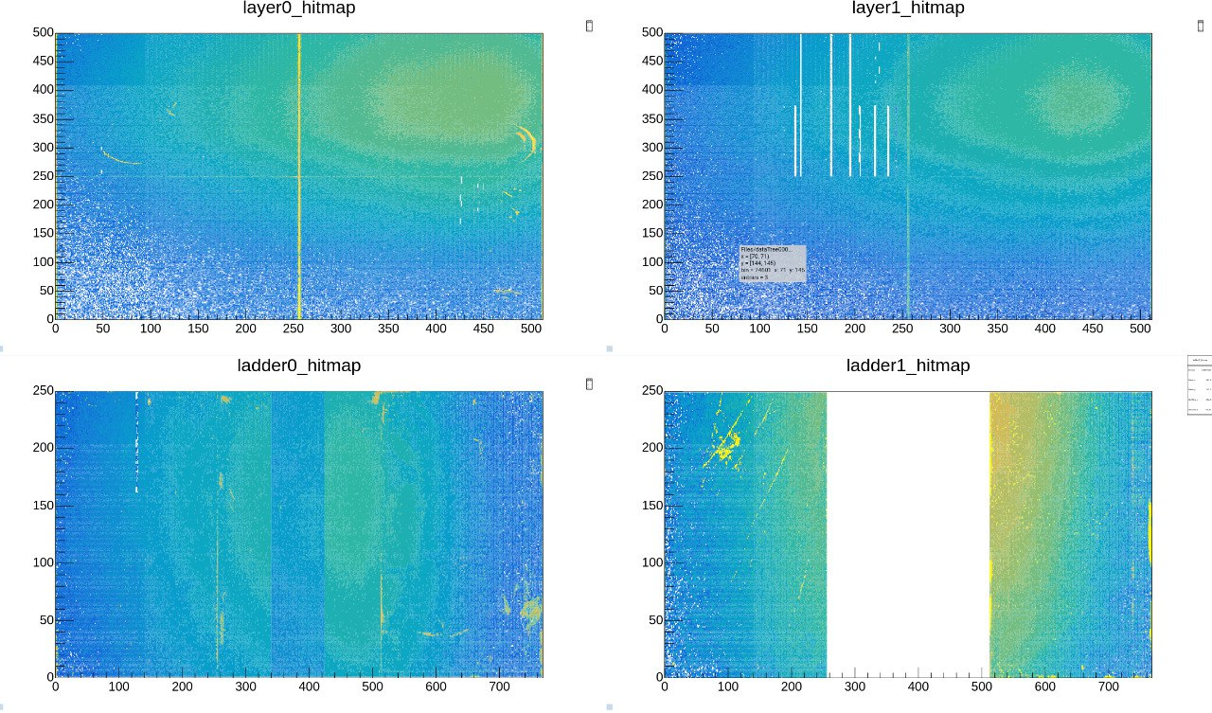
Testbeam at Desy in May and PSI in October 2023
50µm & 70µm single chip testbeam at Desy
  Demonstrated the capability of masking
  Efficiency studies showed capapility to go to efficiency of 99%
First testbeam with 2 operational ladders at PSI
  Beam clearly visible on ladder
  Correlation studies with 2 quad modules + scifi

