Slide 1

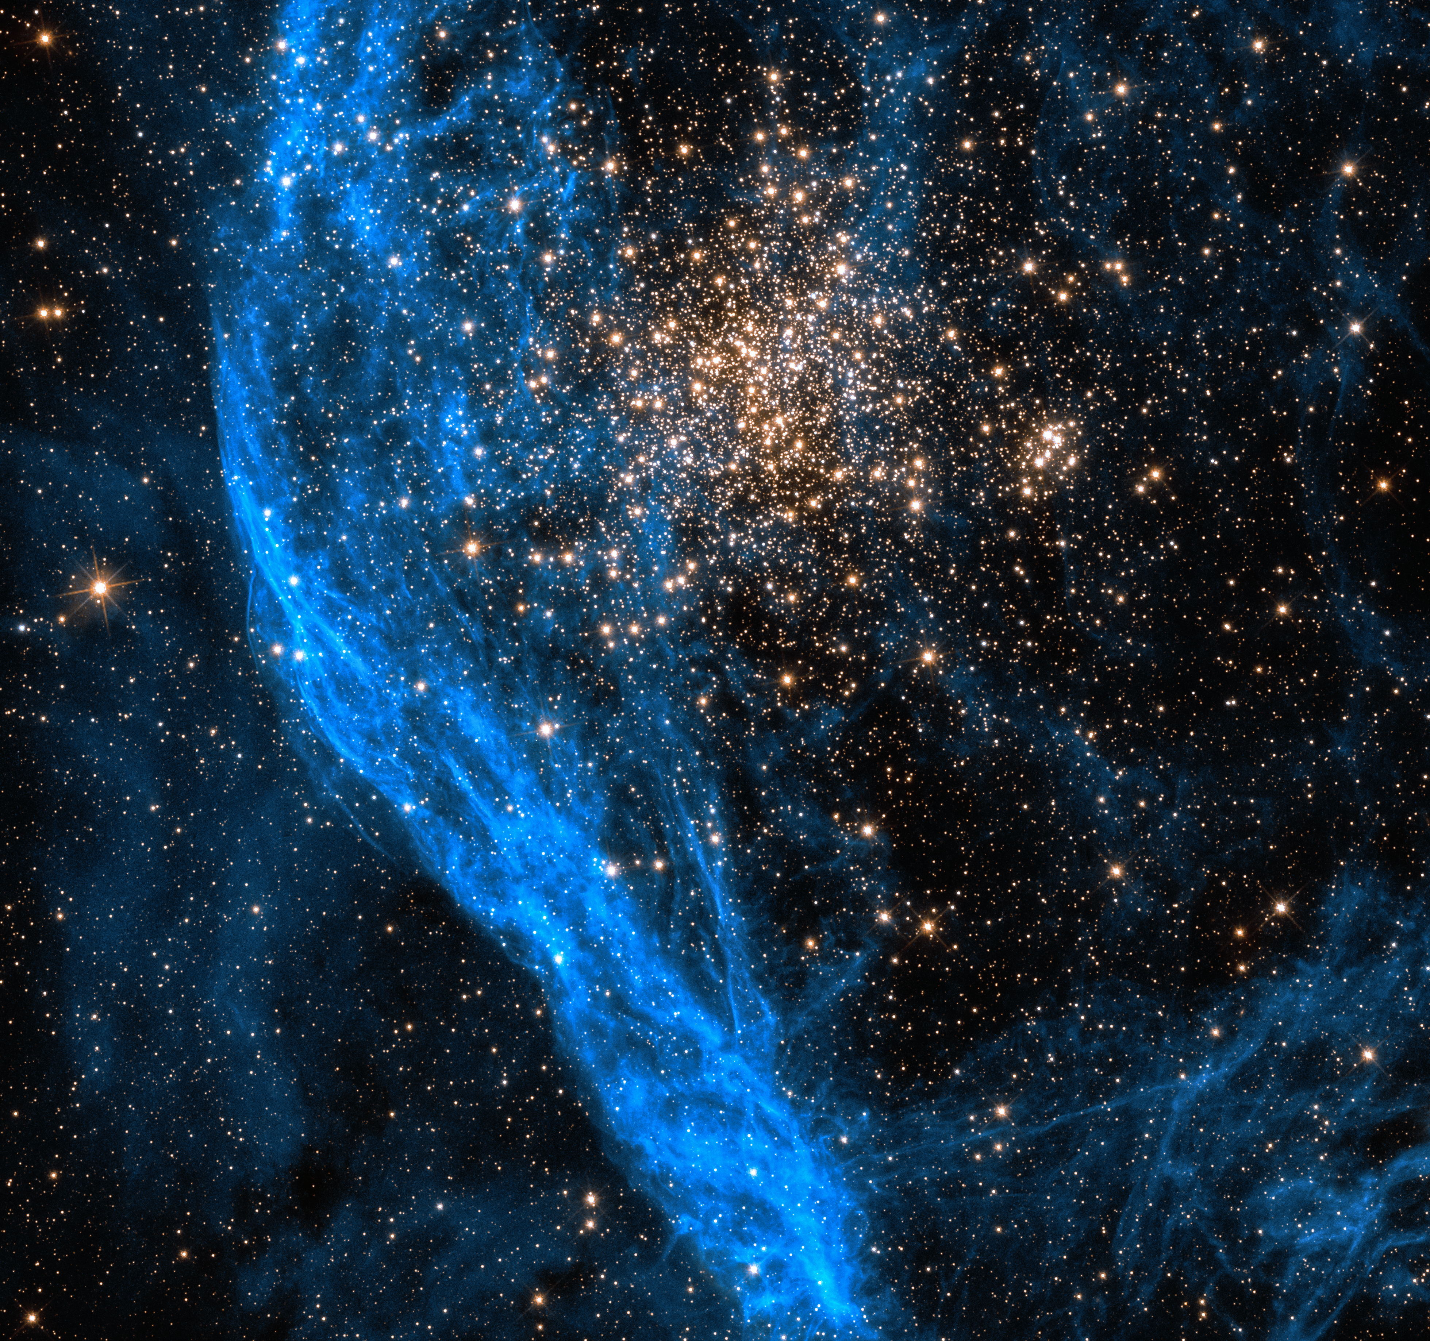
Radiation Hardness and Annealing Strategies
for SiPMs of the Terzina Telescope
on board the NUSES space mission
Swiss Physical Society
Annual Meeting 2024
Shideh Davarpanah
Supervisor: Prof. Dr. Teresa Montaruli

Slide 2
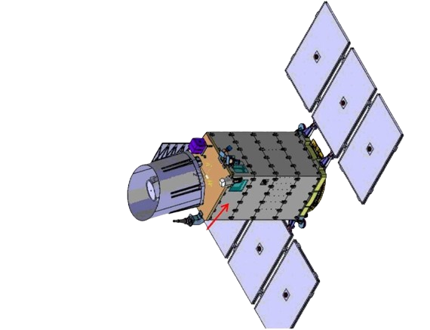


THE NUSES SPACE MISSION
Neutrino and Seismic Electromagnetic Signals
3 years mission
launch in mid-2026
Low Earth Orbit - 535 km
sun-synchronous
Technology pathfinder for New processing, Low power, High speed electronics of novel silicon photosensors and radiation hardness
ZIRÈ
Calorimeter - Low Energy fluxes
TERZINA
1st observation of Cherenkov light
emitted by atmospheric showers from
space!
ZIRÈ
TERZINA
to limb
1_{/10}
S. Davarpanah
Université de Genève

Slide 3
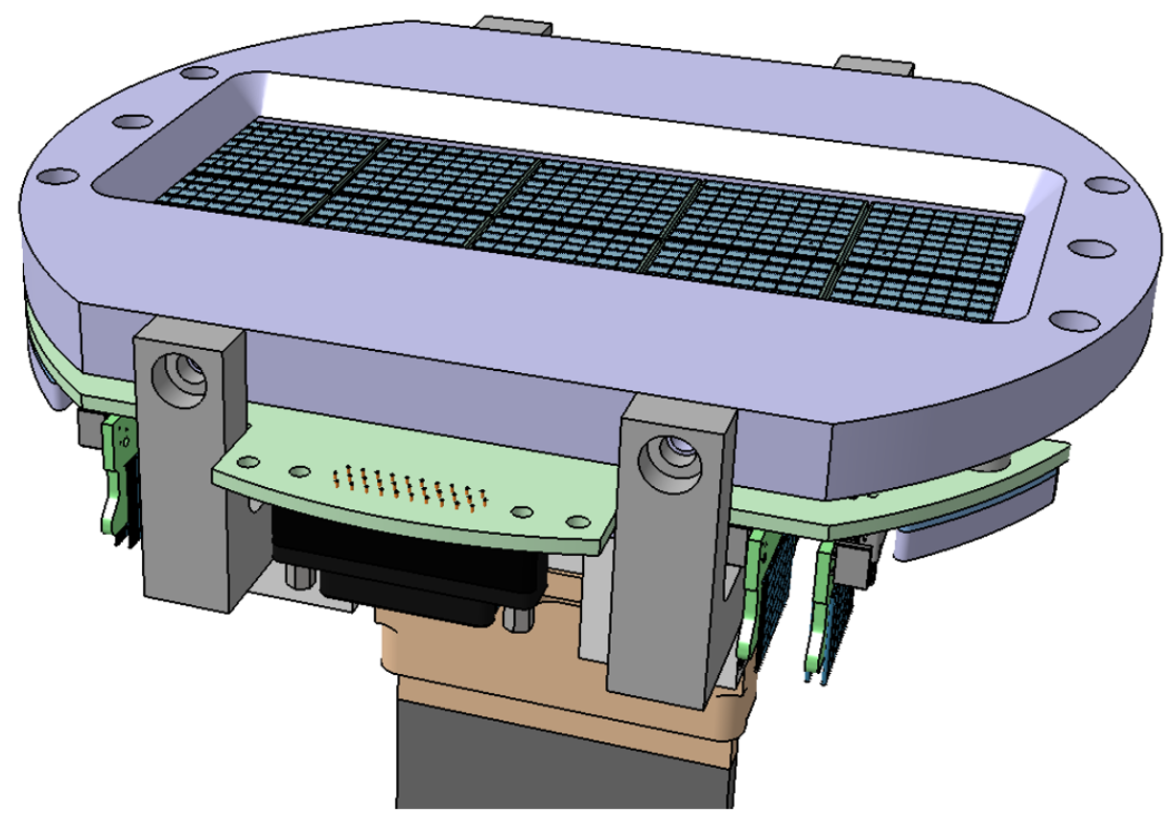
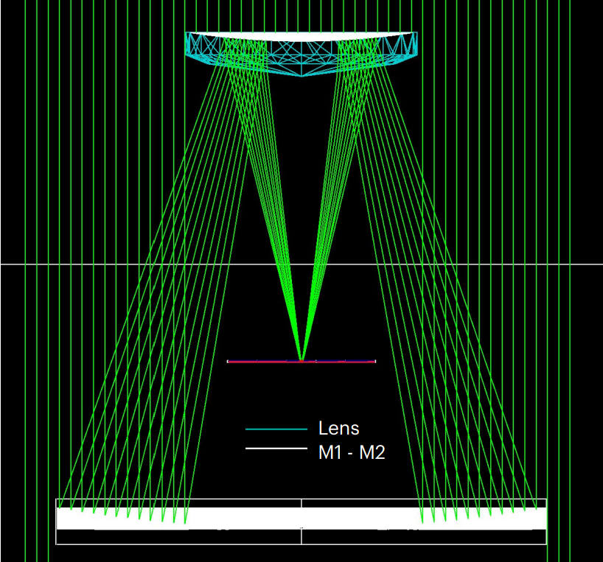
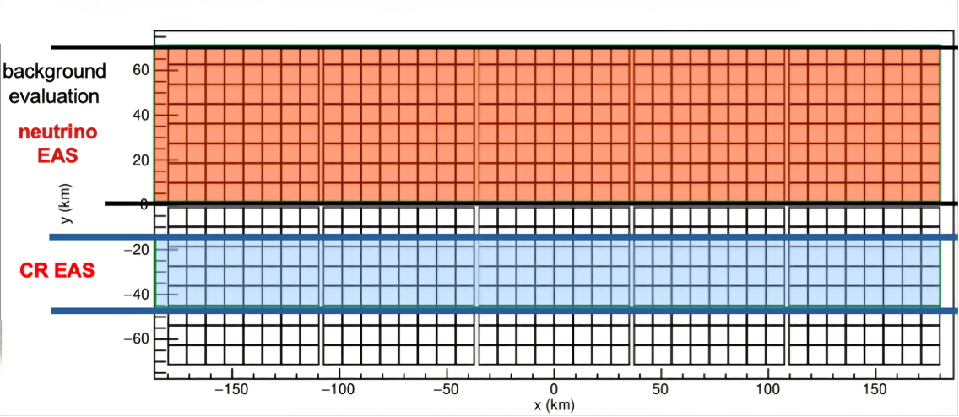
TERZINA DETECTOR
Schmidt–Cassegrain Telescope
2 x 5 = 10 tiles (each tile: 24.9 x 24.9 mm²)
each 8 x 8 pixels (each pixel: 3 x 3 mm²)
sensitive area for each pixel = 6.58 mm²
full camera size : 120 x 48 mm²
~ 450 mm
Martina D’Arco (talk on Friday)
Terzina Telescope: Pioneering the Detection of Cherenkov Light from Extensive Air Showers in Space
~ 430 mm
2_{/10}
S. Davarpanah
Université de Genève

Slide 4
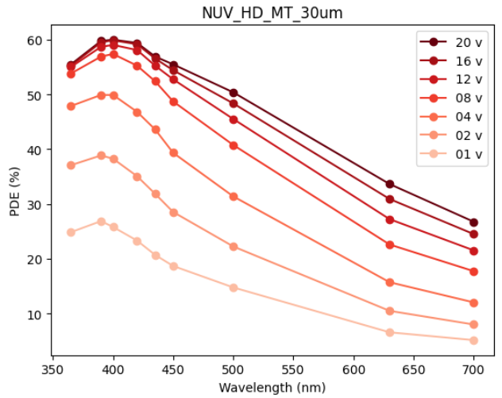
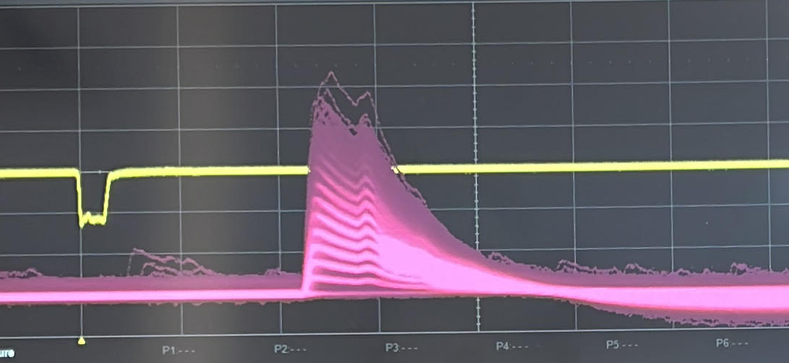

SiPM SPECIFICATION
FBK SiPM, 30 µm cell size, 3x3 mm²
Photon Detection Efficiency
Waveform sample for different bias voltages
Clear separation between amplitudes corresponding to the different number of photoelectrons
3_{/10}
S. Davarpanah
Université de Genève

Slide 5

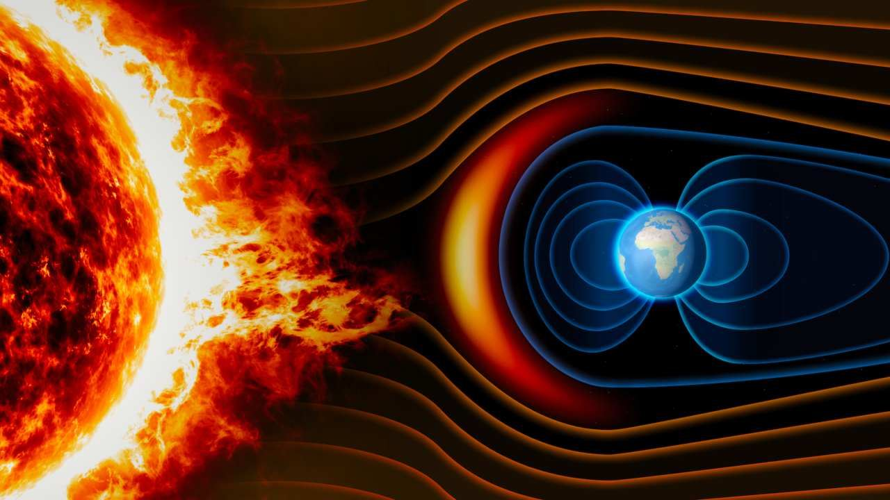
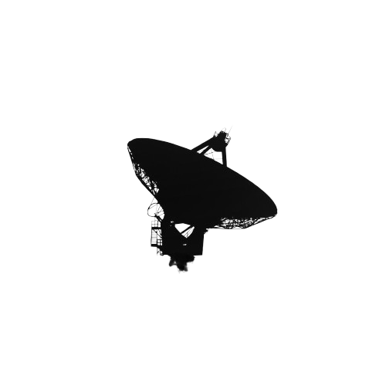

RADIATION BACKGROUND AT THE NUSES ORBIT
No atmospheric shield
e
p
Background radiation
Energy loss
Absorption
Multiple Scattering
Radiation damage
Sensor noise
Image quality
Energy threshold
trapped electrons, trapped protons, solar protons
Flux from SPENVIS
4_{/10}
S. Davarpanah
Université de Genève

Slide 6
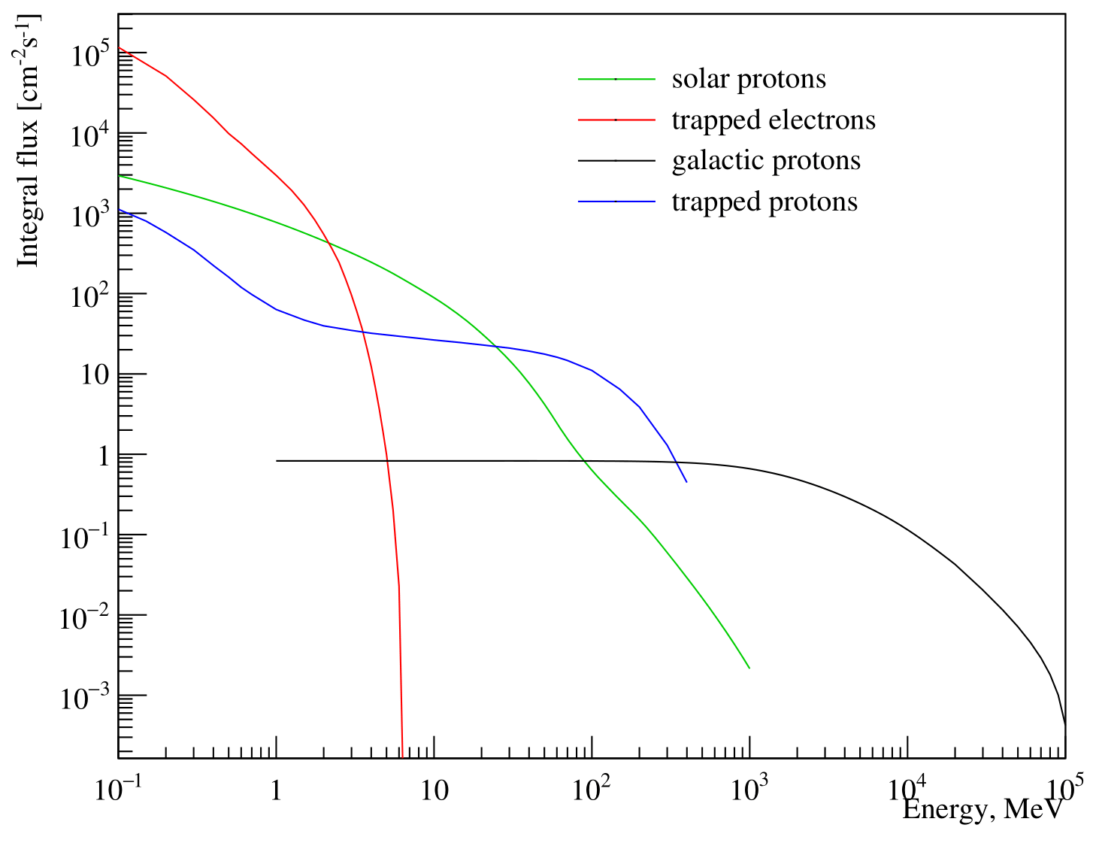
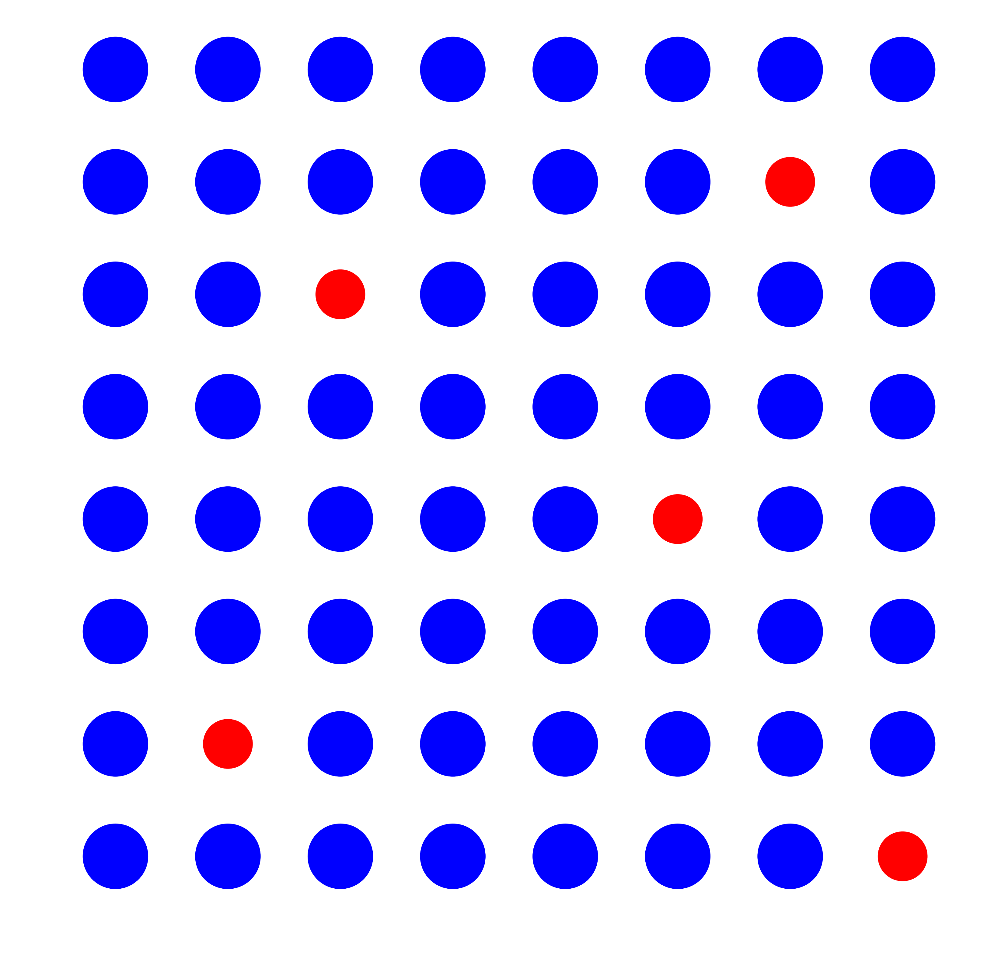
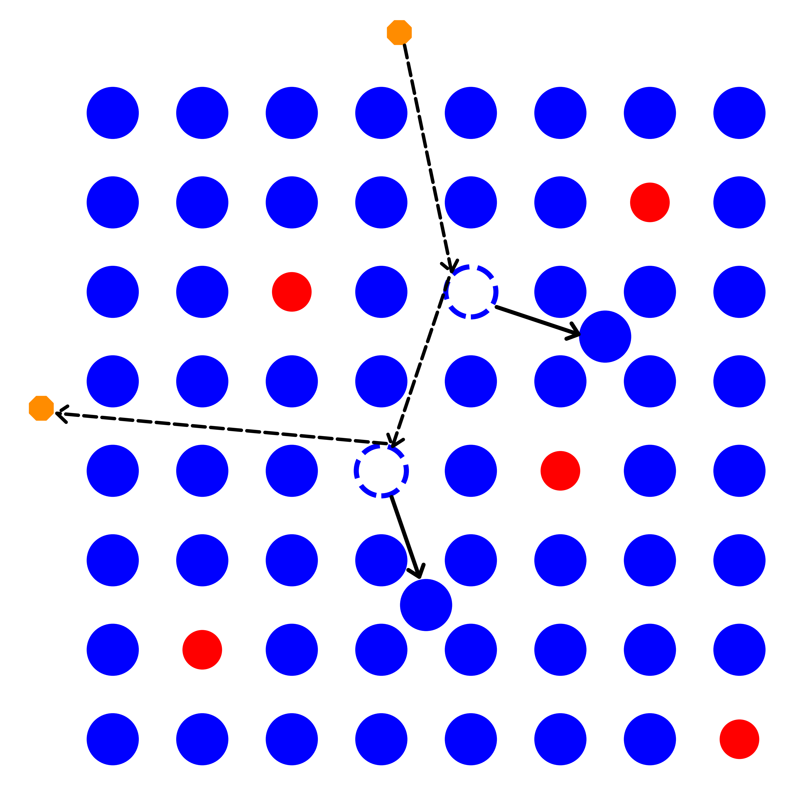
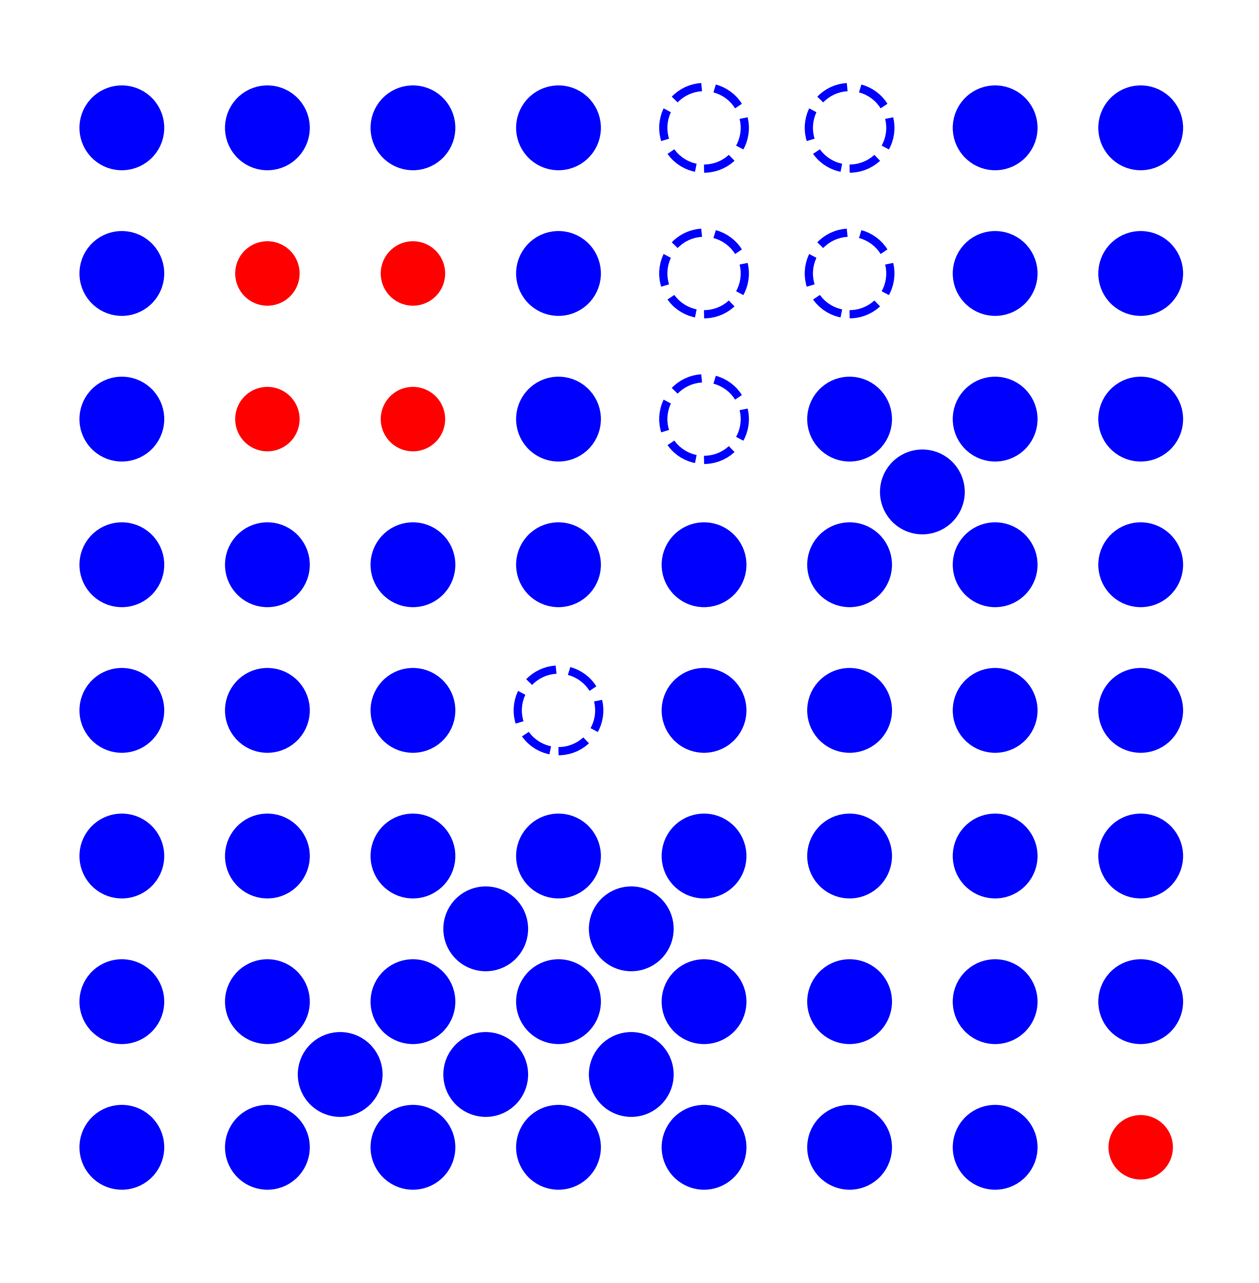
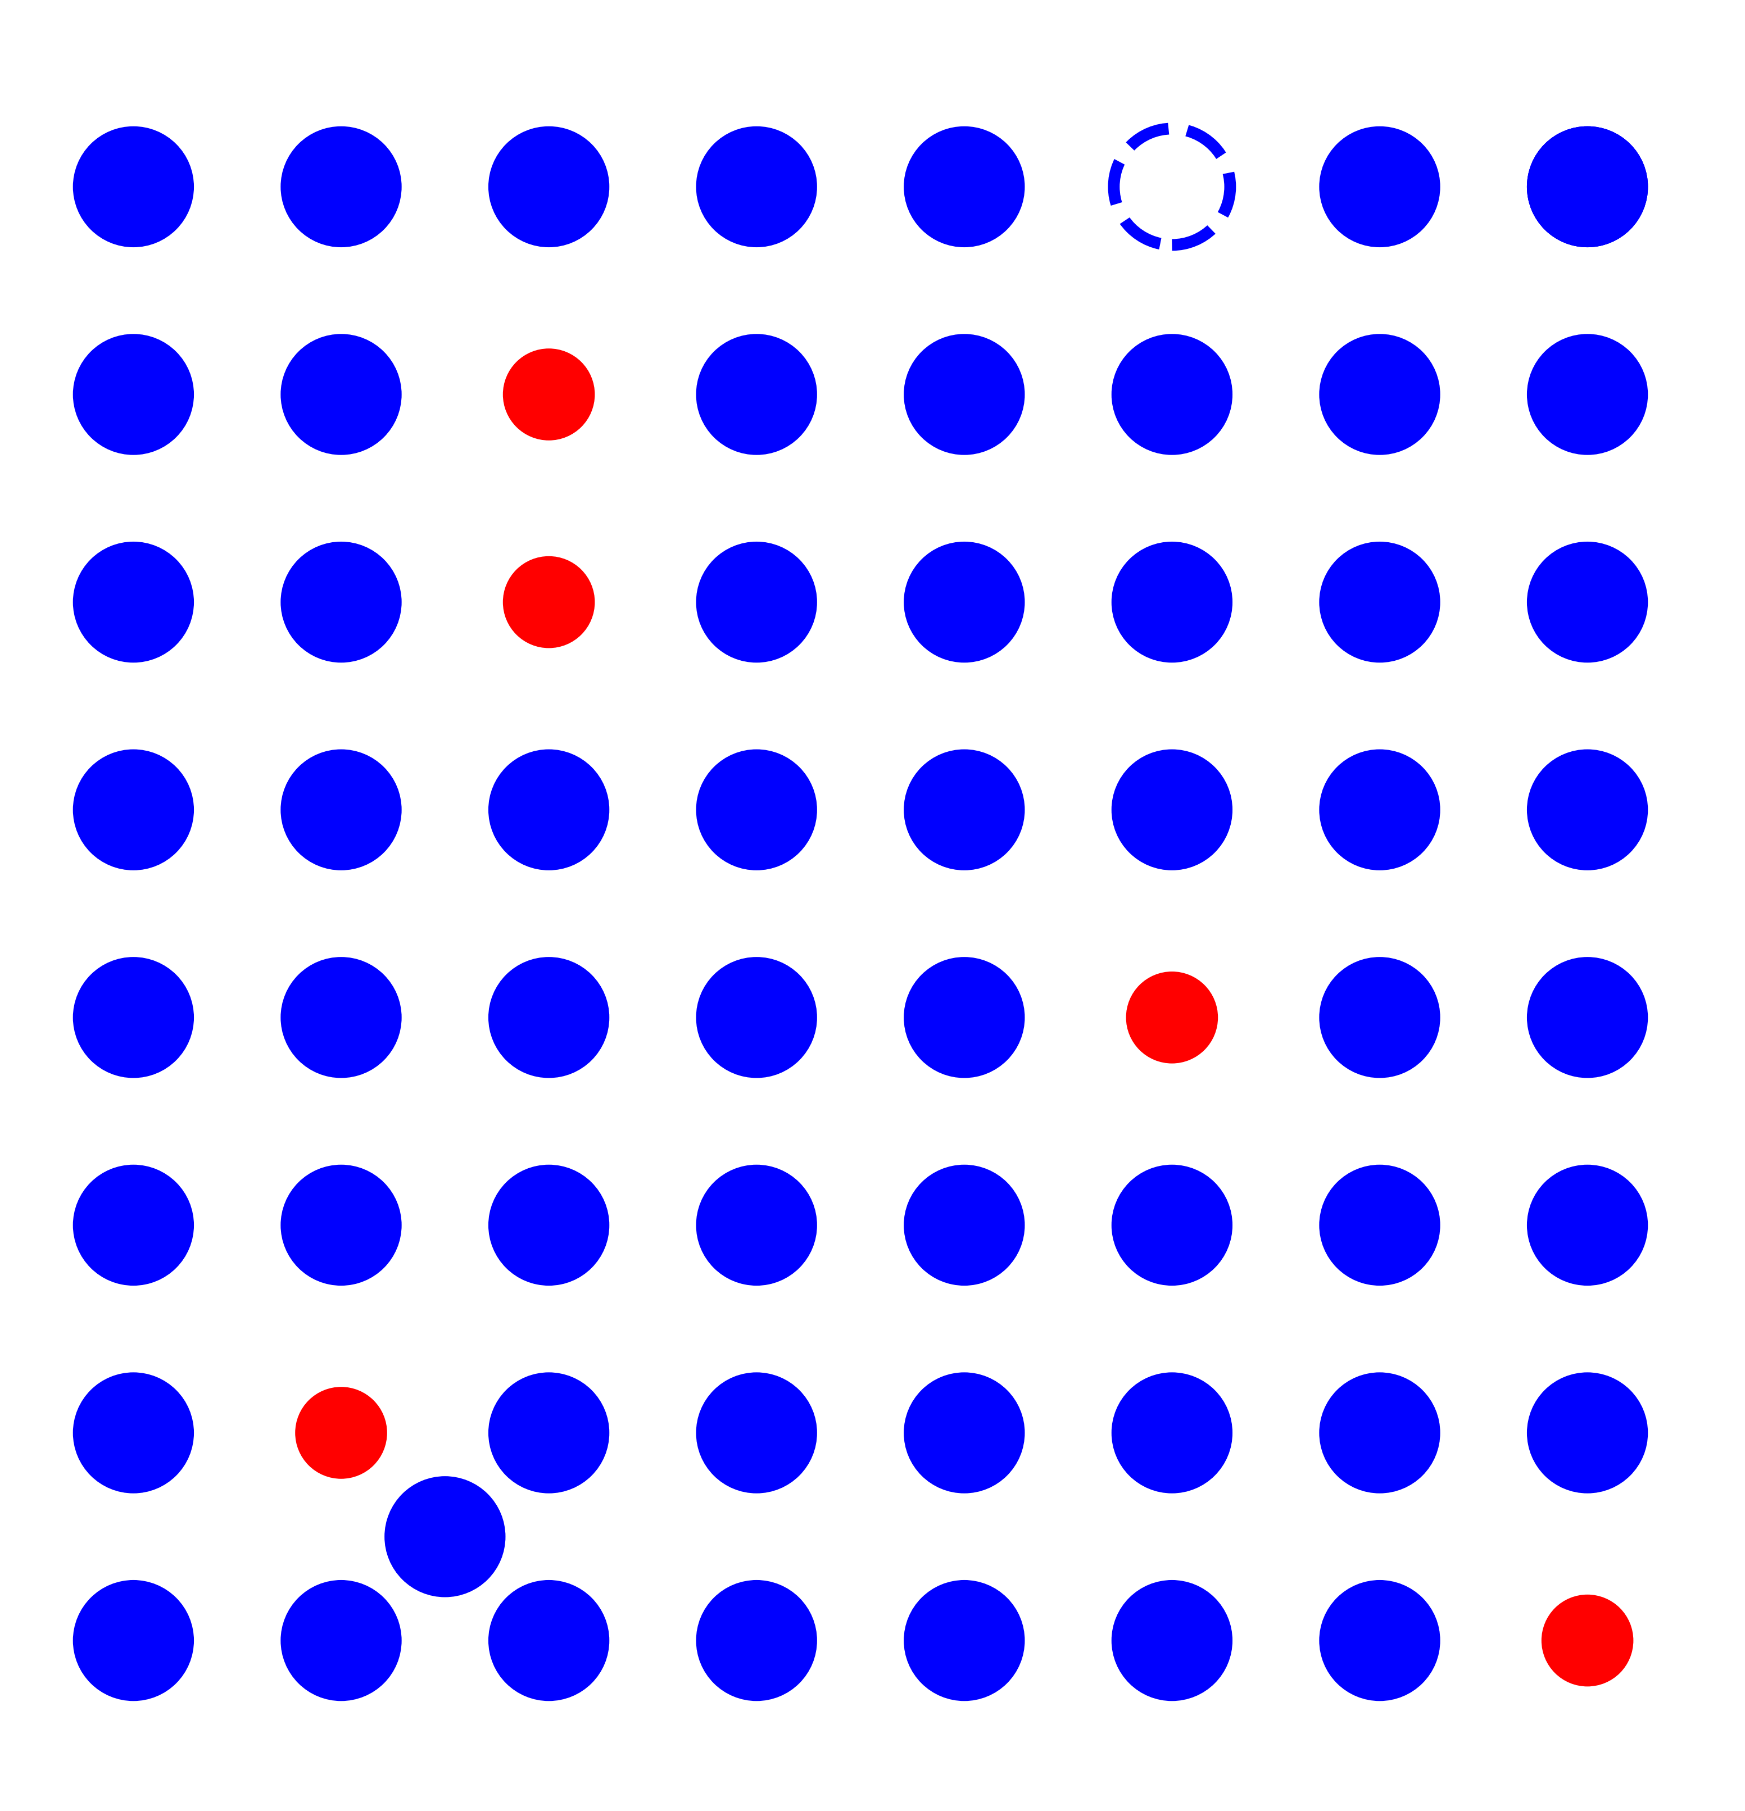
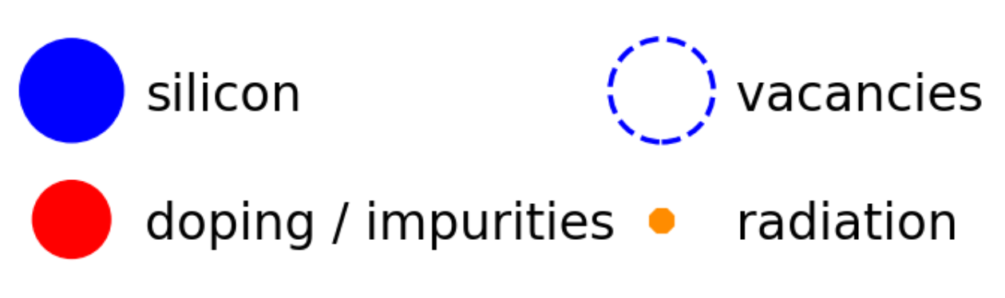
RADIATION DAMAGE AND ANNEALING
Silicon lattice before irradiation
Radiation damage (displacement, non-ionizing dose)
expected radiation background
Silicon lattice after irradiation (radiation hardness)
Silicon lattice after annealing
Radiation damage increase the Dark Count Rate
Mitigation: by heating them; measuring efficiency of treatment at temperature comparable to the power consumption
5_{/10}
S. Davarpanah
Université de Genève

Slide 7
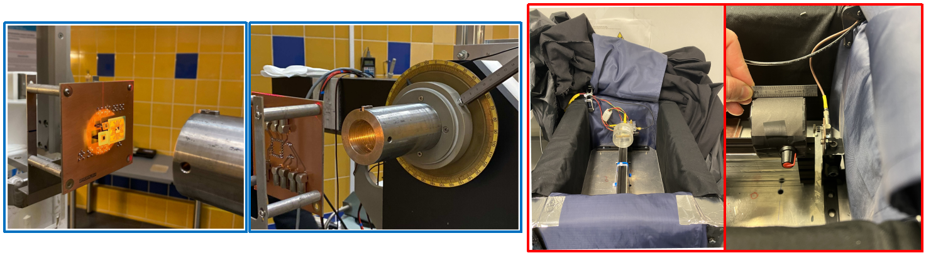
ELECTRON AND PROTON IRRADIATION CAMPAIGN
IV measurement during irradiation
FBK NUV-HD_MT ( 3x3 mm², 30um cell size )
Proton irradiation: 50MeV proton beam
Electron irradiation: β-source strontium-90, up to 2.2MeV
Realistic simulation with Geant4 gives us Non-ionizing dose
SiPM response to the irradiation
+
non-ionizing dose
+
SiPM specification
Dark Count Rate
6_{/10}
S. Davarpanah
Université de Genève

Slide 8


BACKGROUND MEASURMENT RESULTS
Inferred DCR per pixel for Terzina SiPMs sensitive area from IV measurement during the irradiation
$$DCR(10 ov, dose)∝\frac{I(10 ov, dose)}{Gain.q . s^{*}}∙\frac{Sensitive area}{T_{factor}},$$
$$s^{*} = \left\{\begin{aligned}1 {mm}^{2} for 1×1 SiPM \\ 9 {mm}^{2} for 3×3 SiPM\end{aligned}\right.$$
Electrons cause at least two orders of magnitude smaller change in the DCR compared to protons, despite the much higher fluence of trapped electrons
7_{/10}
S. Davarpanah
Université de Genève

Slide 9
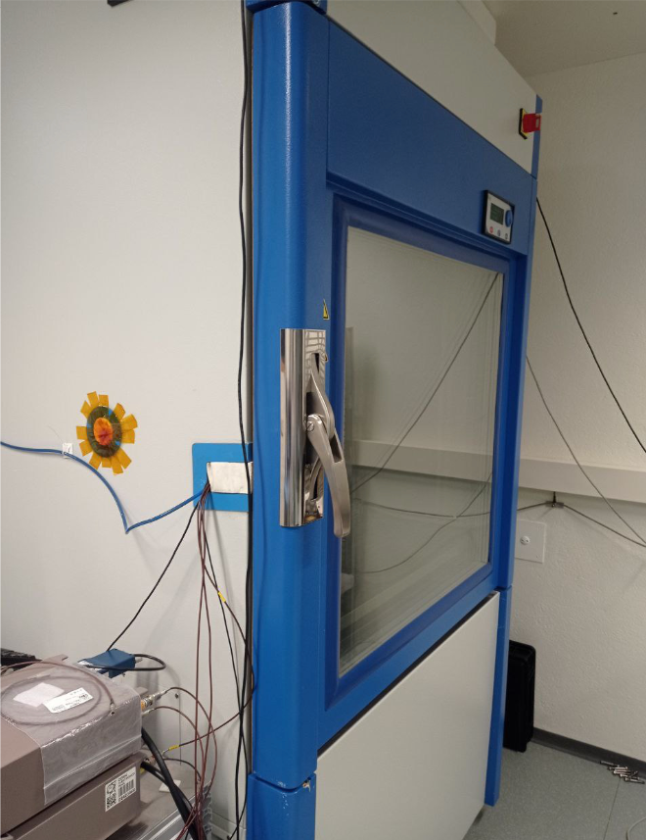
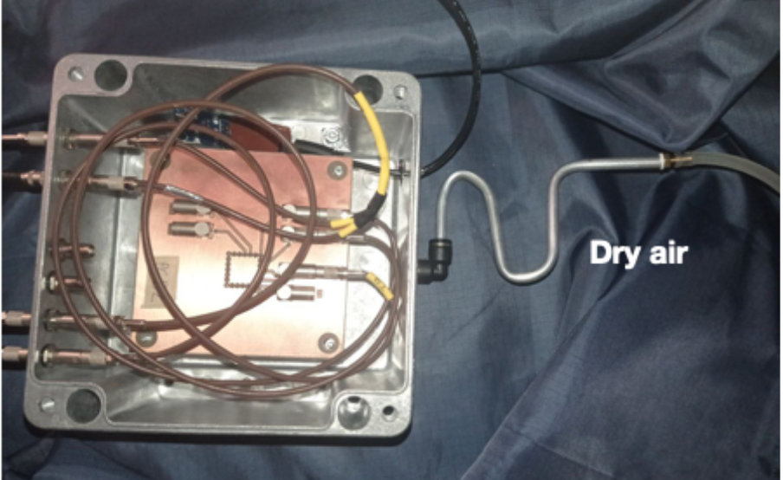
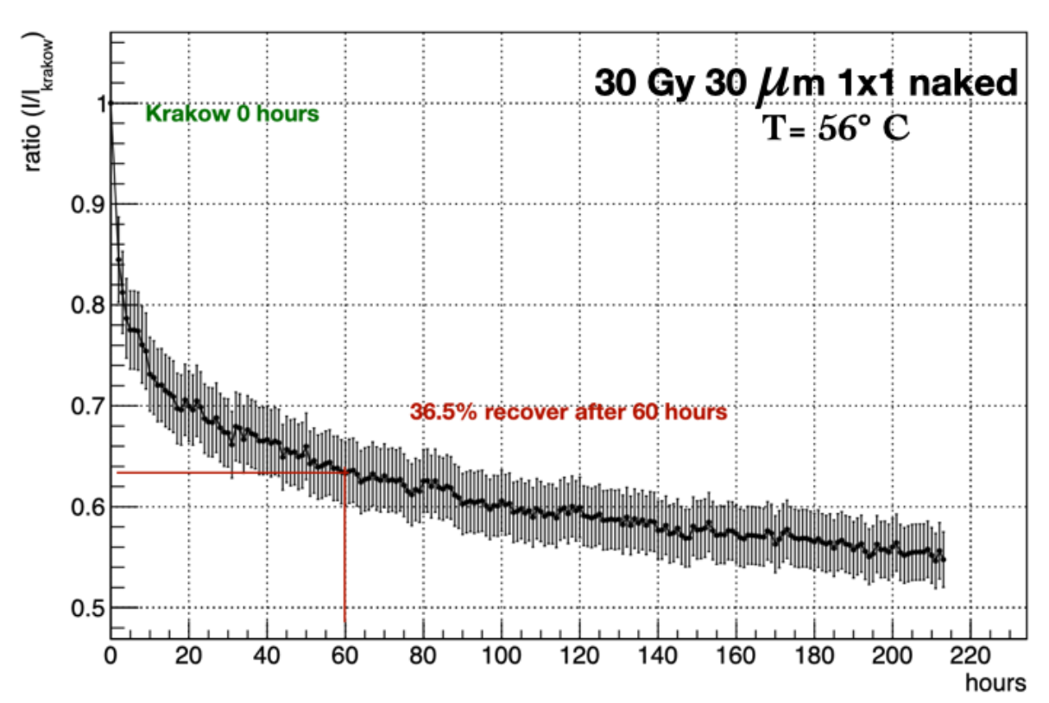
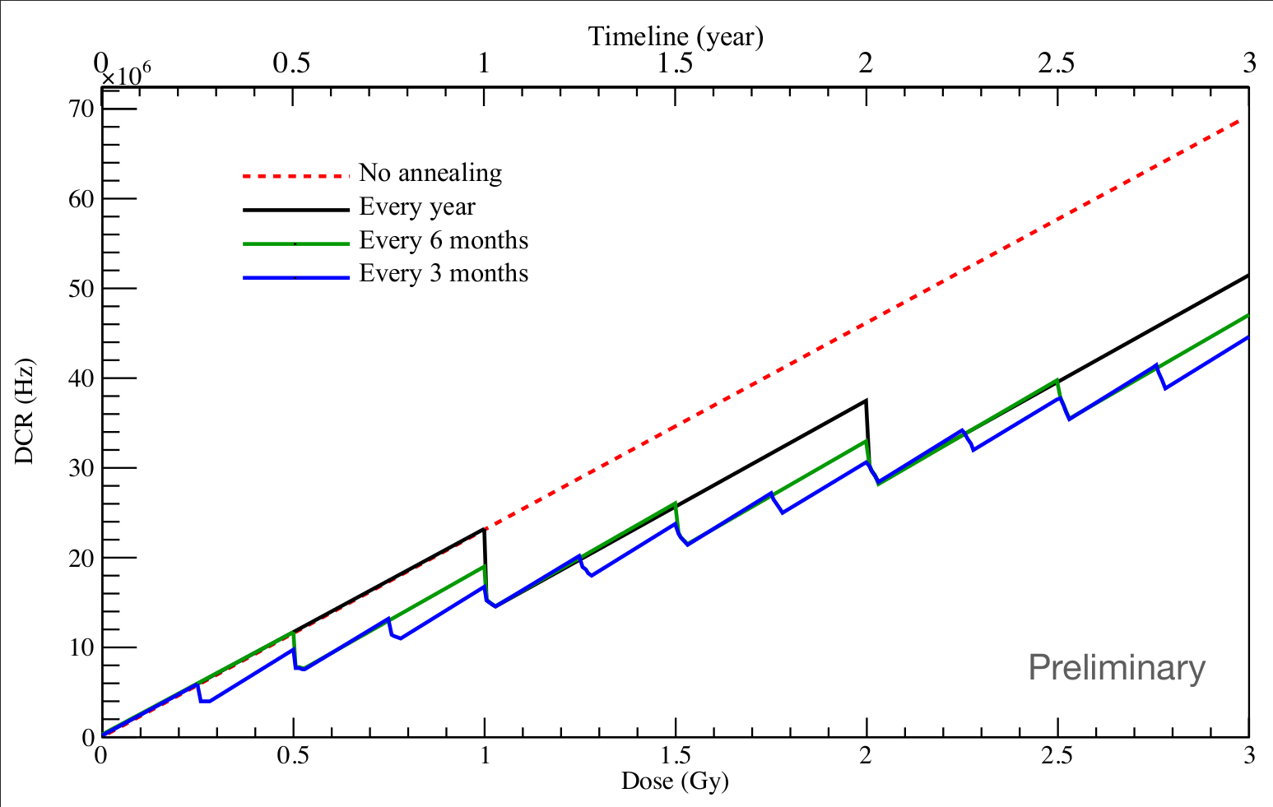
ANNEALING CYCLE
Annealing model
Placing the devices in a climatic chamber
at fixed temperature for a set period of time
Conclusion:
  at T > 50°C
  annealing cycle ~ 84 hours
  recovery up to 40%
8_{/10}
S. Davarpanah
Université de Genève

Slide 10
SUMMARY AND CONCLUSION
Terzina at LEO of 535 km
Irradiation of SiPMs and radiation damage
Higher fluence of trapped electrons, especially low-energy electrons
Protons cause at more change in the DCR compared to electrons
Annealing model
This information allows us to adjust the trigger energy threshold throughout the 3-year mission to optimize the observation of Cherenkov signals, ensuring the best signal-to-noise ratio.
9_{/10}
S. Davarpanah
Université de Genève

Slide 11
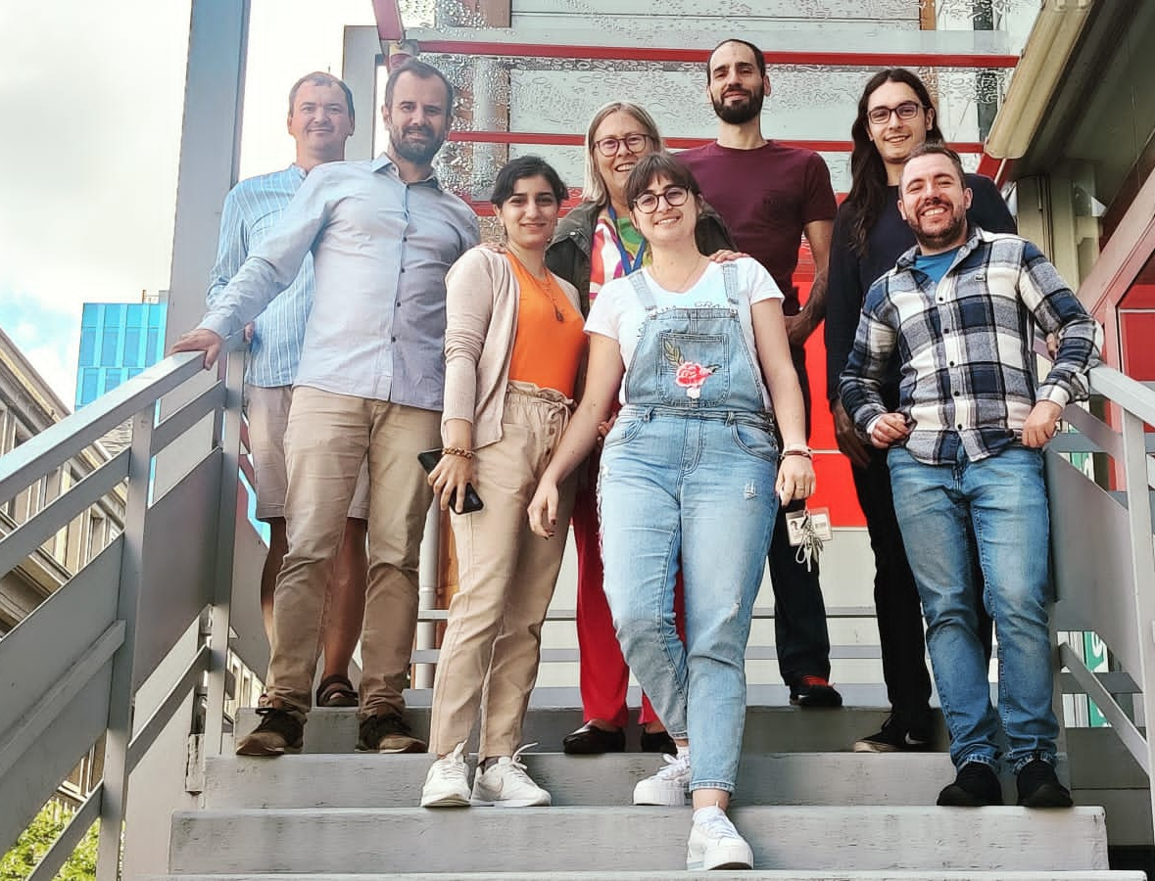
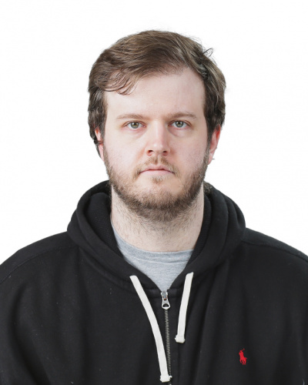
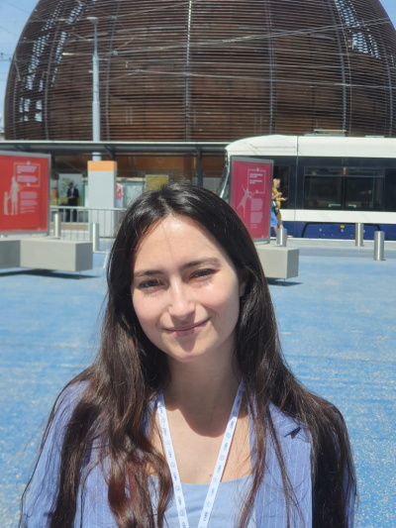
ACKNOWLEDGMENT
Dr. Christoph Toennis
Prof. Dr. Teresa Montaruli
Dr. Matthieu Heller
Dr. Leonid Burmistrov
Martina D'Arco
Dr. Caterina Trimarelli
10_{/10}
S. Davarpanah
Université de Genève

Slide 12
thank you for your attention!
Swiss Physical Society
Annual Meeting 2024
S
Shideh Davarpanah
Supervisor: Prof. Dr. Teresa Montaruli

