Slide 1


FCC-ee Orbit Correction and Polarization
Yi Wu, Léon Van Riesen-Haupt, Michael Hofer, Felix Carlier, Tatiana Pieloni, Mike Seidel
Acknowledgements to Desmond Barber, David Sagan, Jorg Wenninger, Werner Herr, Tobias Persson, Christian Carli, Frank Zimmermann
Work supported by the Swiss Accelerator Research and Technology (CHART)

Slide 2
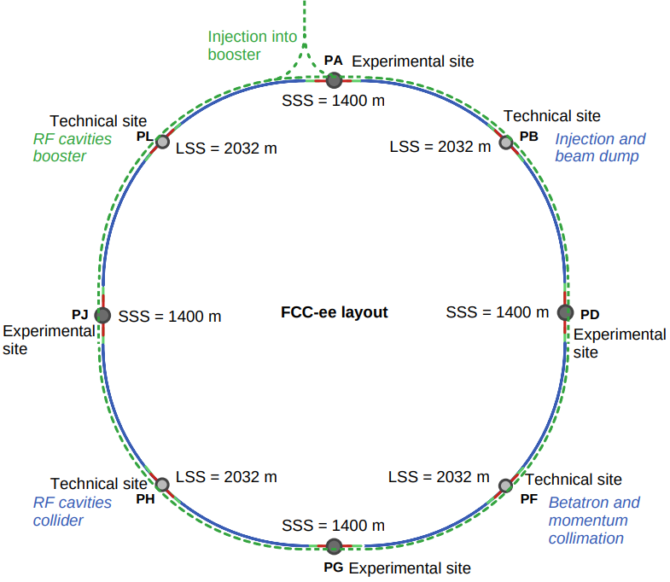
Energy calibration in the FCC-ee
Four operation center-of-mass energies
Z bosons (91 GeV) to top quark pairs (350-365 GeV)
High precision COM energy calibration
The current precision targets
4 keV at Z mass (1e-8) and 100 keV at W mass (1e-6)
Resonant depolarization is the only way to achieve this target

Slide 3
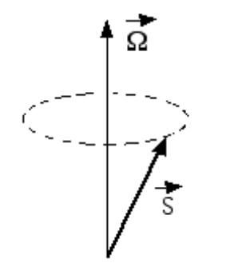
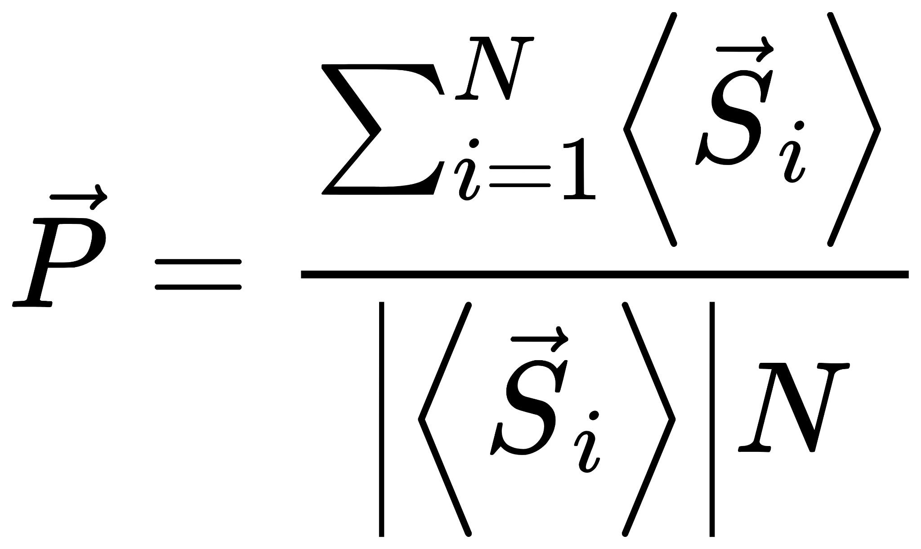
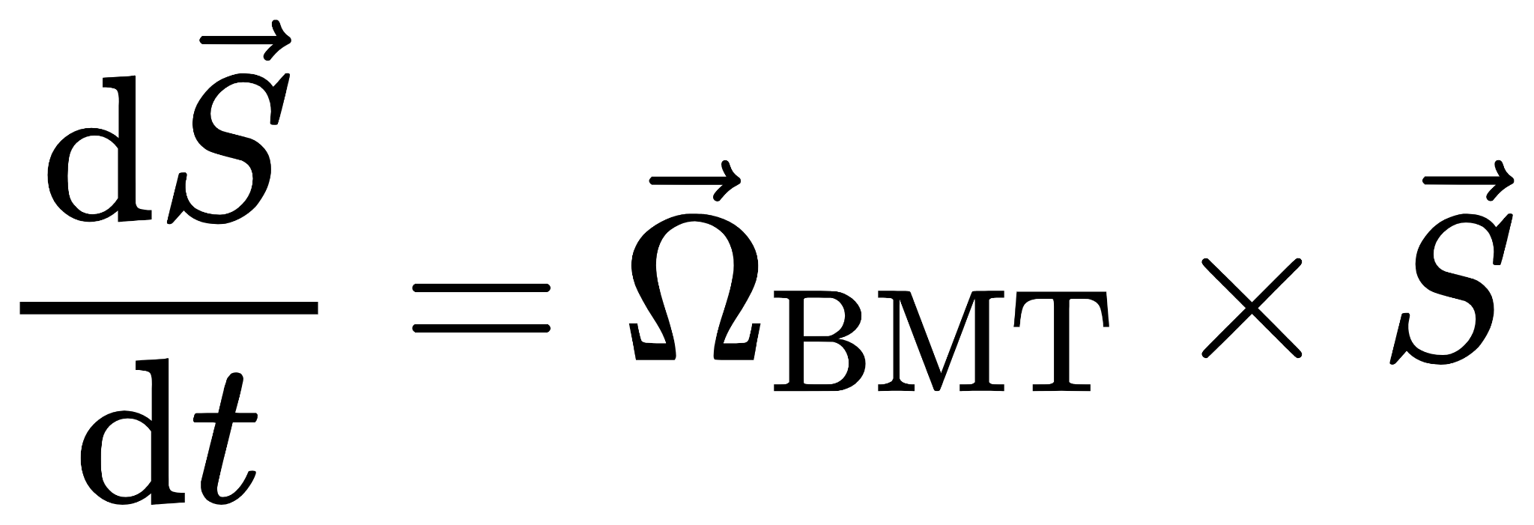
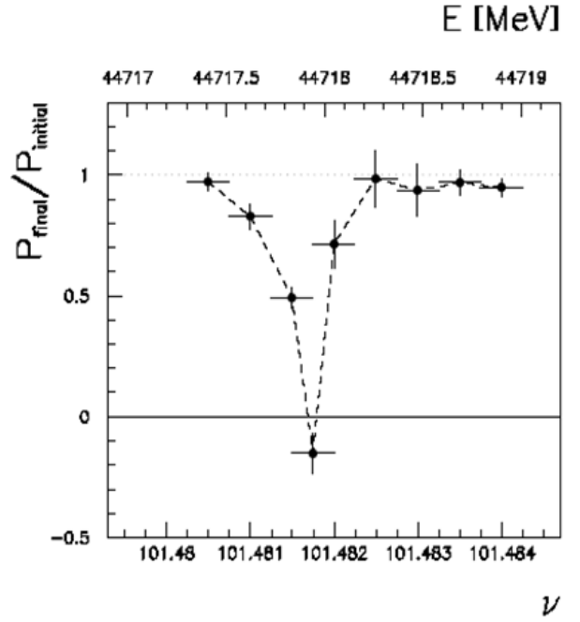
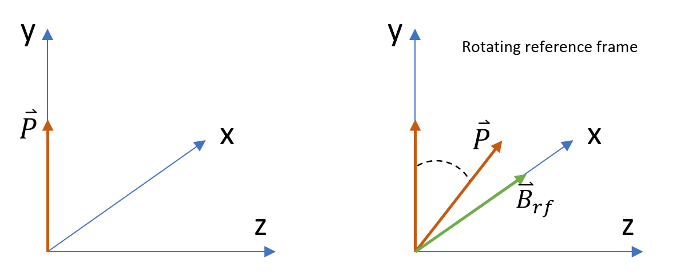
Resonant Depolarization
Thomas-BMT equation
resonance freq.
spin tune
𝜈₀≅ a𝛾
beam energy

Slide 4
Spin Polarization
Resonant depolarization requires a sufficient transverse spin polarization level
magnet
magnet
magnet
perfect flat ring
P ≈ 92.4%
0 closed orbit
magnet
magnet
magnet
non 0 closed orbit
real machine
P < 92.4%
How much?

Slide 5
Orbit Correction
Sources of errors that give non-zero orbit
  magnet misalignments, etc
Correction using
  small dipole correctors
  data from beam position monitors (BPM)
  linear matrices (SVD algorithm)
Corrections influenced by
  BPM errors, etc

Slide 6
Lattice
Based on FCC-ee Z lattice (at 45.6 GeV)
  1856 quadrupoles
  4 insertion regions with stronger magnets
Modified by adding
  1 BPM & 1 corrector next to each quad
928 Ver. corrector + 928 Hor. corrector
  sextupole knob to control all sextupole strengths proportionally

Slide 7
disregard the influence of sextupole feed-down and radiation
in MadX
sextupoles & rad off
arc, IR, BPM
add errors
SVD
correction
Qx/y matching at n_{th}, m_{th}, l_{th}…iteration
in case it hits resonance conditions
feed-down of strong sextupoles
recover sextupole strength by 5%
rad on
First order equilibrium polarization calculation based on linearized spin-orbit motion
final correction
Tao (Bmad)
This procedure works for most error seeds, but may not find a stable solution for some of them.
[*] Bmad Home Page https://www.classe.cornell.edu/bmad/

Slide 8
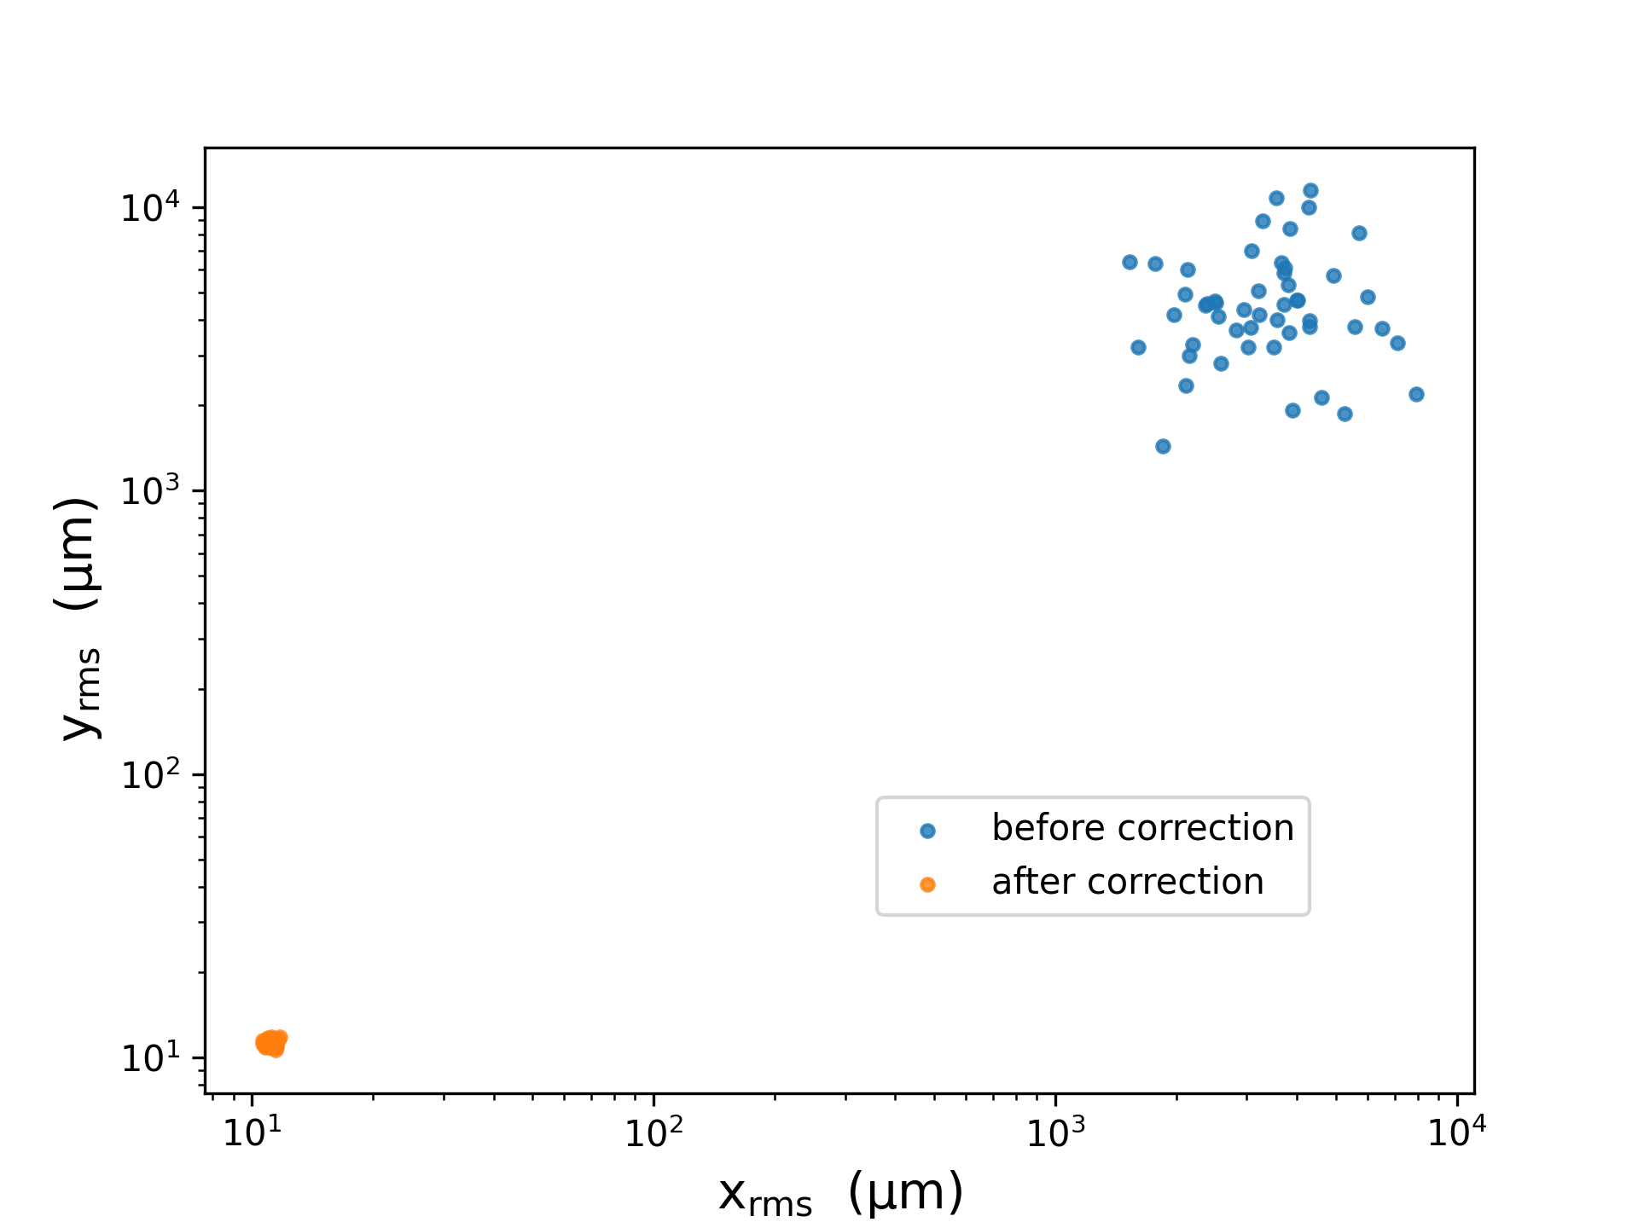
Misalignments in arc
50 seeds with 50µm random misalignment in arc
50 seeds

Slide 9
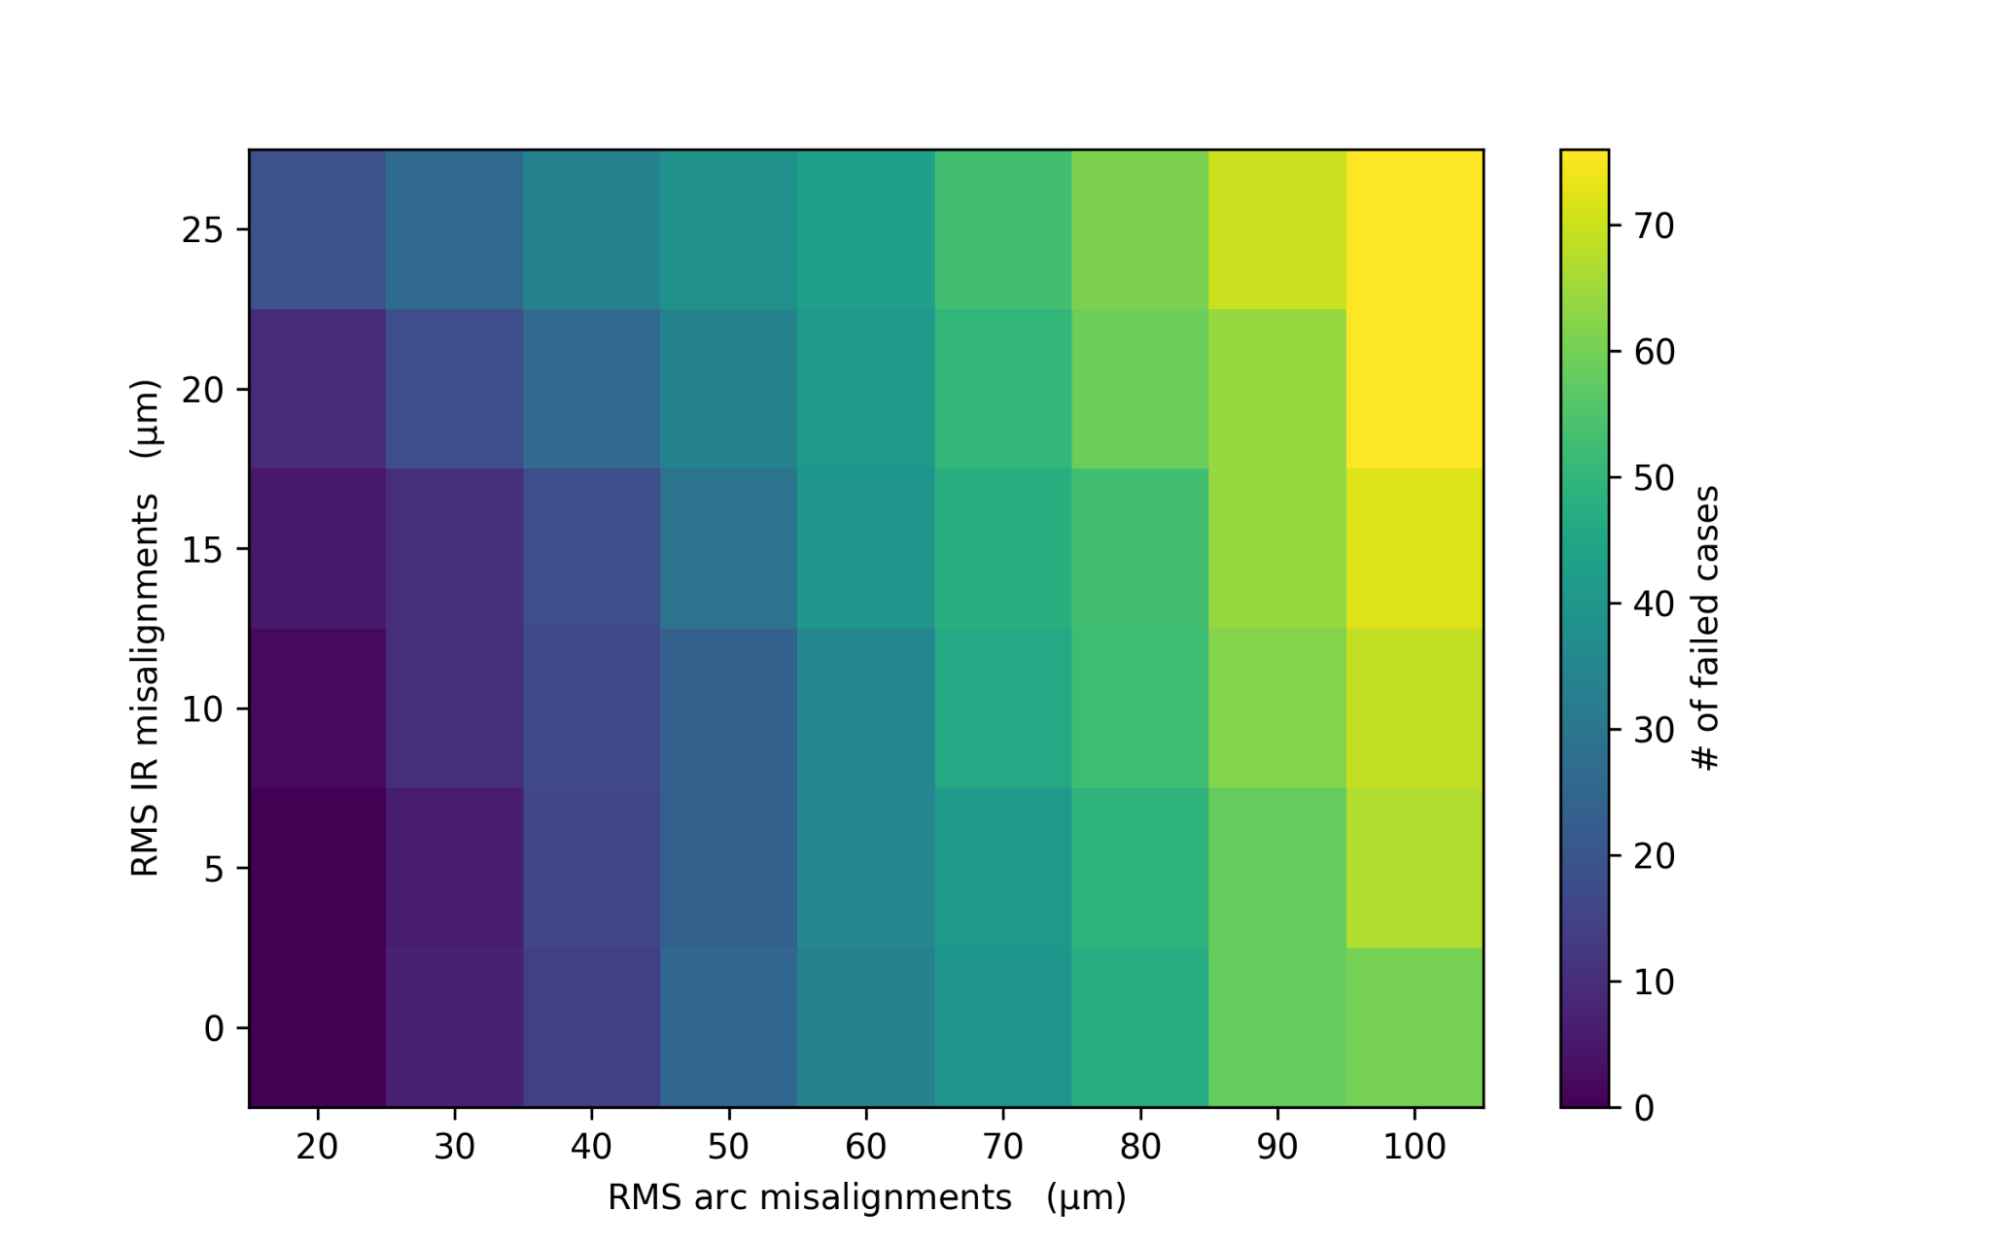
Misalignments in arc & IR
same 100 initial seeds for each square on the colormap
can be further improved
In general, IR misalignments have a bigger impact on closed orbit searching.

Slide 10
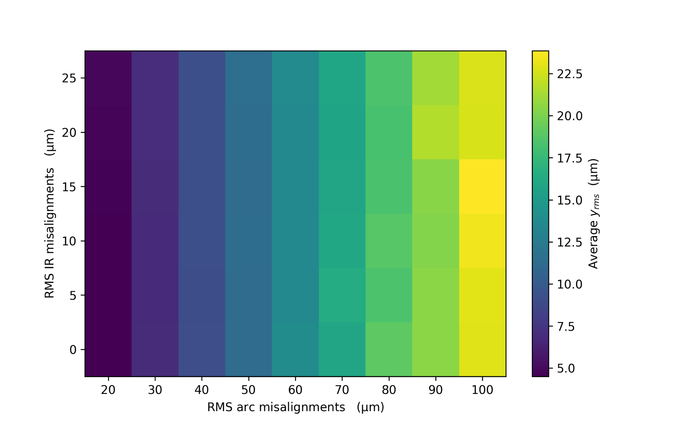
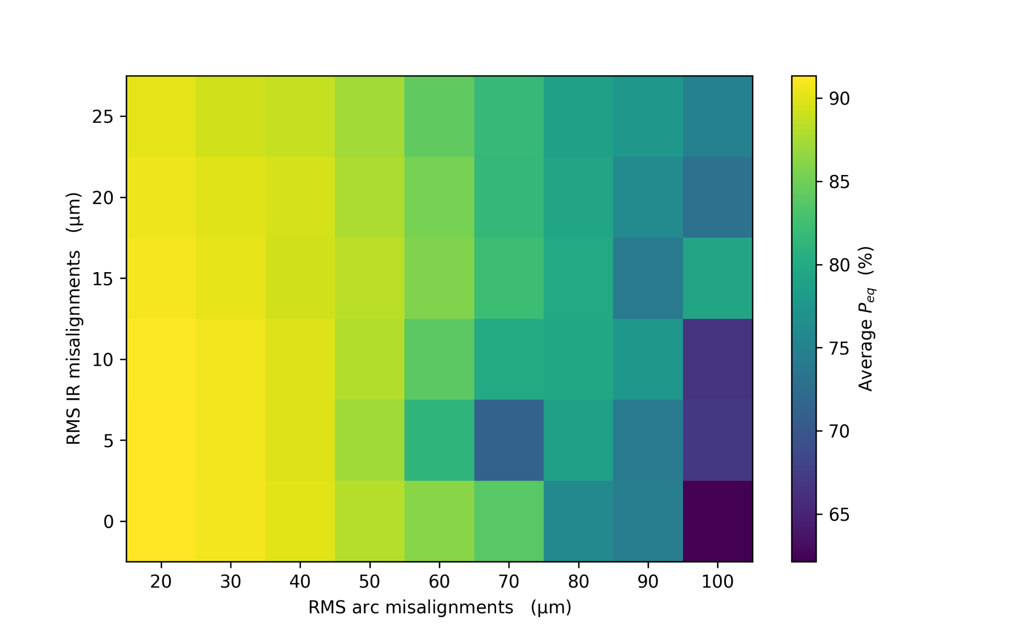
Misalignments in arc & IR
all survived seeds
average y_{rms} (µm)
average P_{eq} (%)
Arc misalignment level dominates the influence to final orbit and polarization

Slide 11
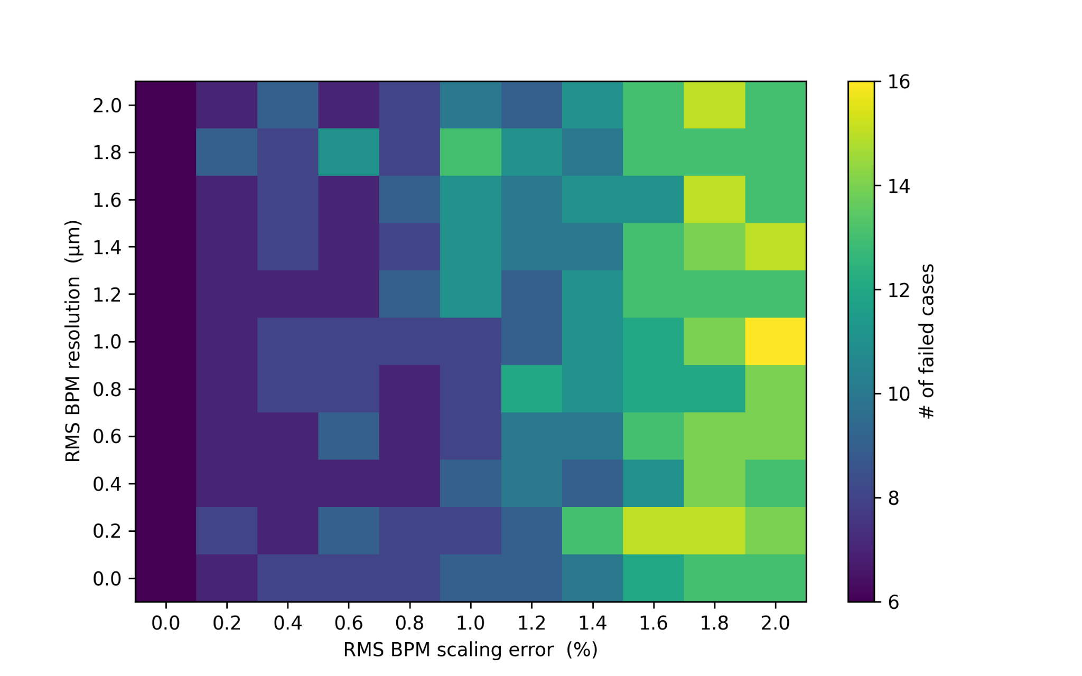
BPM scaling error and resolution
u_{read}=(1+0.01)u_{real} u=x,y
read error
same 50 initial seeds for each square on the colormap
+ 30µm misalign. in arc
+ 10µm misalign. in IR
Scaling error dominates the impact for closed orbit searching

Slide 12
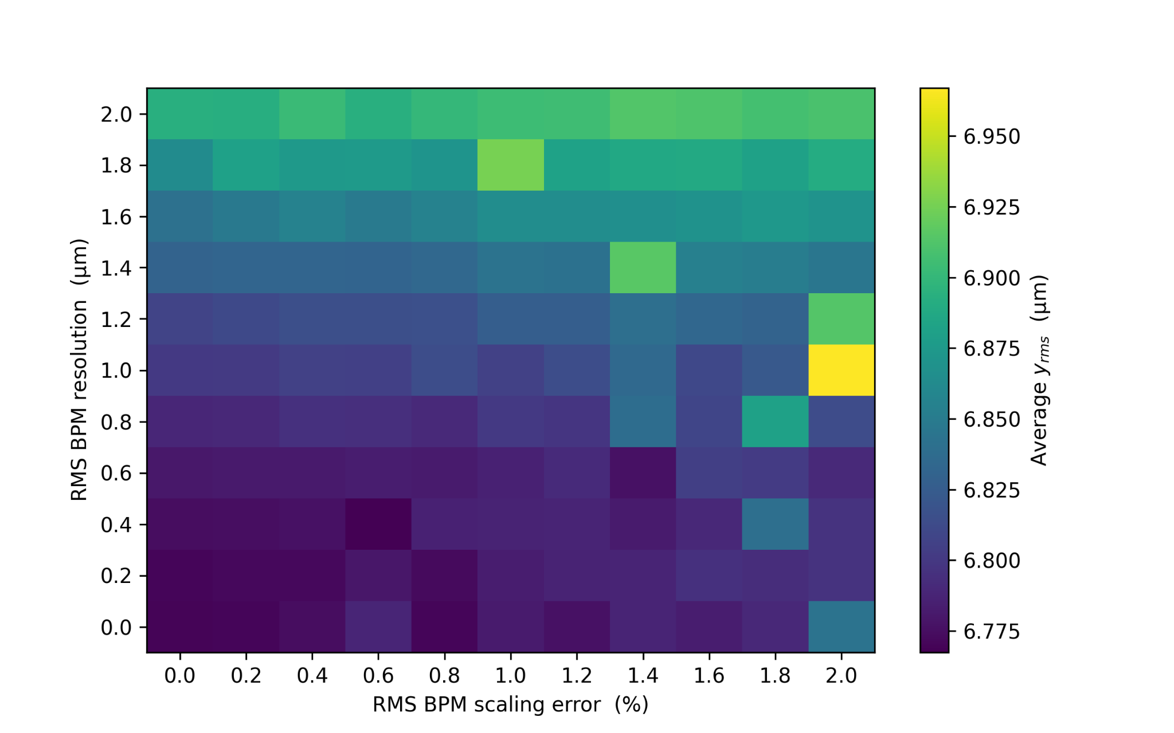
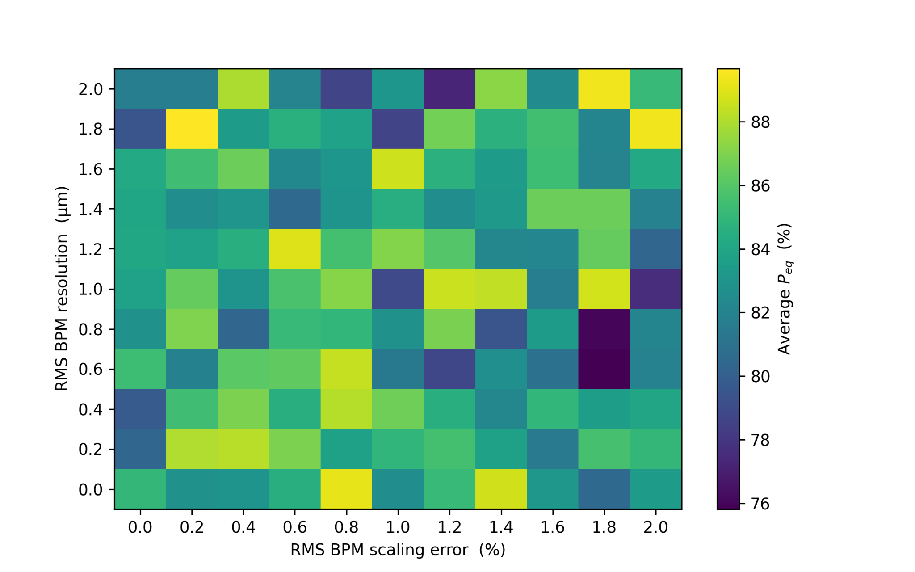
BPM scaling error and resolution
average y_{rms} (µm)
average P_{eq} (%)
Resolution dominates the impact on orbit
Random impact on P_{eq}

Slide 13
Closed Orbit Searching Result
200 seeds each case
Case | Misalignments (µm) |  | Failed percentage (%)
 | arc | IR
1 | 40 | 10 | 13.5
2 | 40 | 20 | 36
3 | 50 | 10 | 19
4 | 50 | 20 | 40
+100µrad arc dipole rolls
+ 1% random BPM scaling error + 1µm random BPM resolution + 5% random BPM missing
need a more stringent alignment procedure for IR

Slide 14
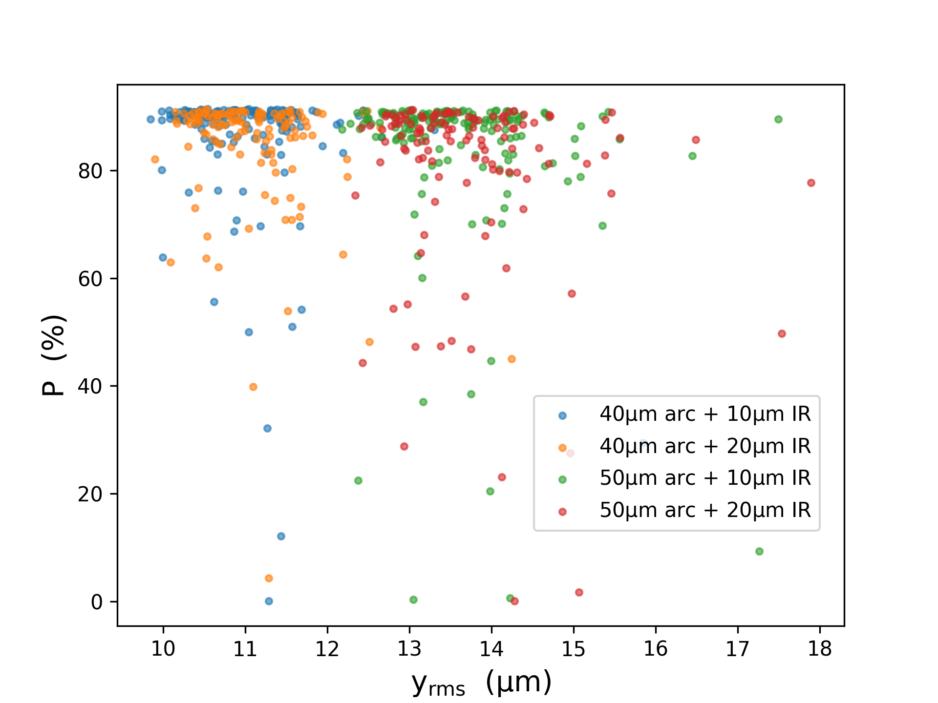

Slide 15
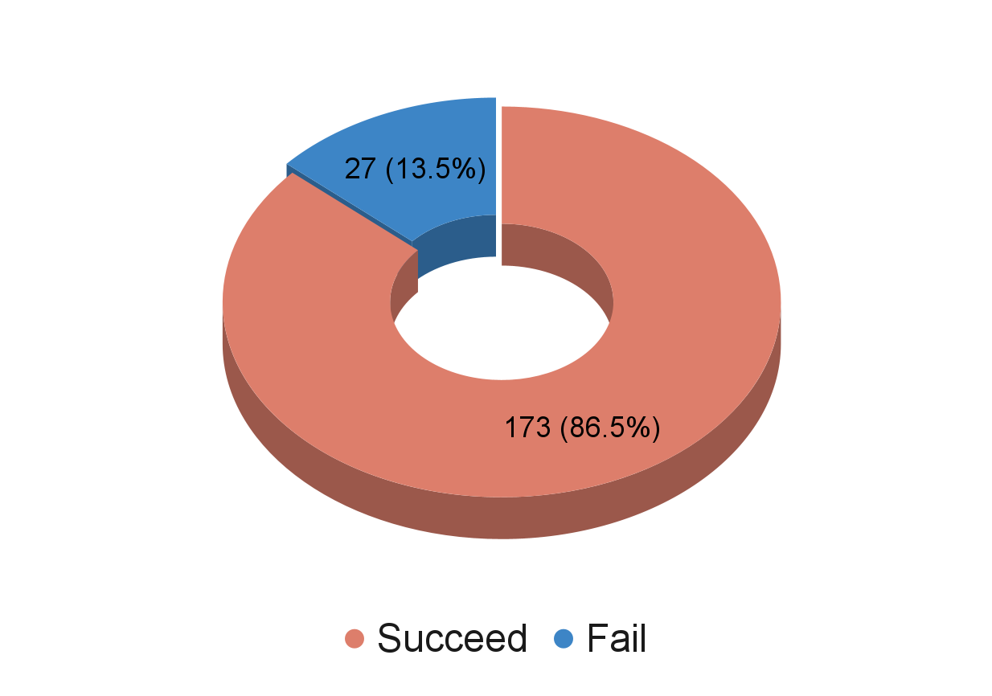
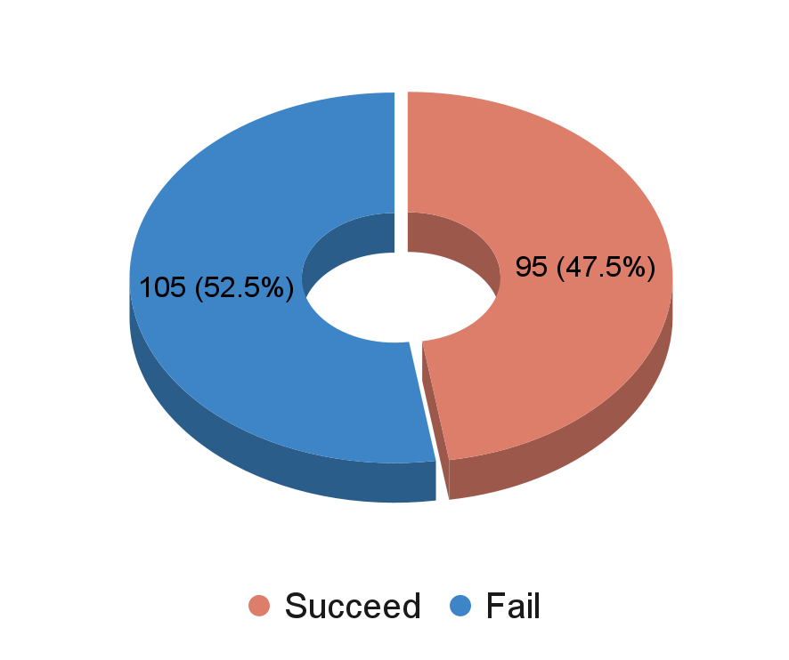
BPM misalignments
40µm arc misalignment
10µm IR misalignment
100µrad non IR dipole roll (DPSI)
5% random BPM missing + 1% BPM random scaling errors + 1µm BPM random resolution
BPM not misaligned
BPM misaligned together with quads
200 same seeds

Slide 16
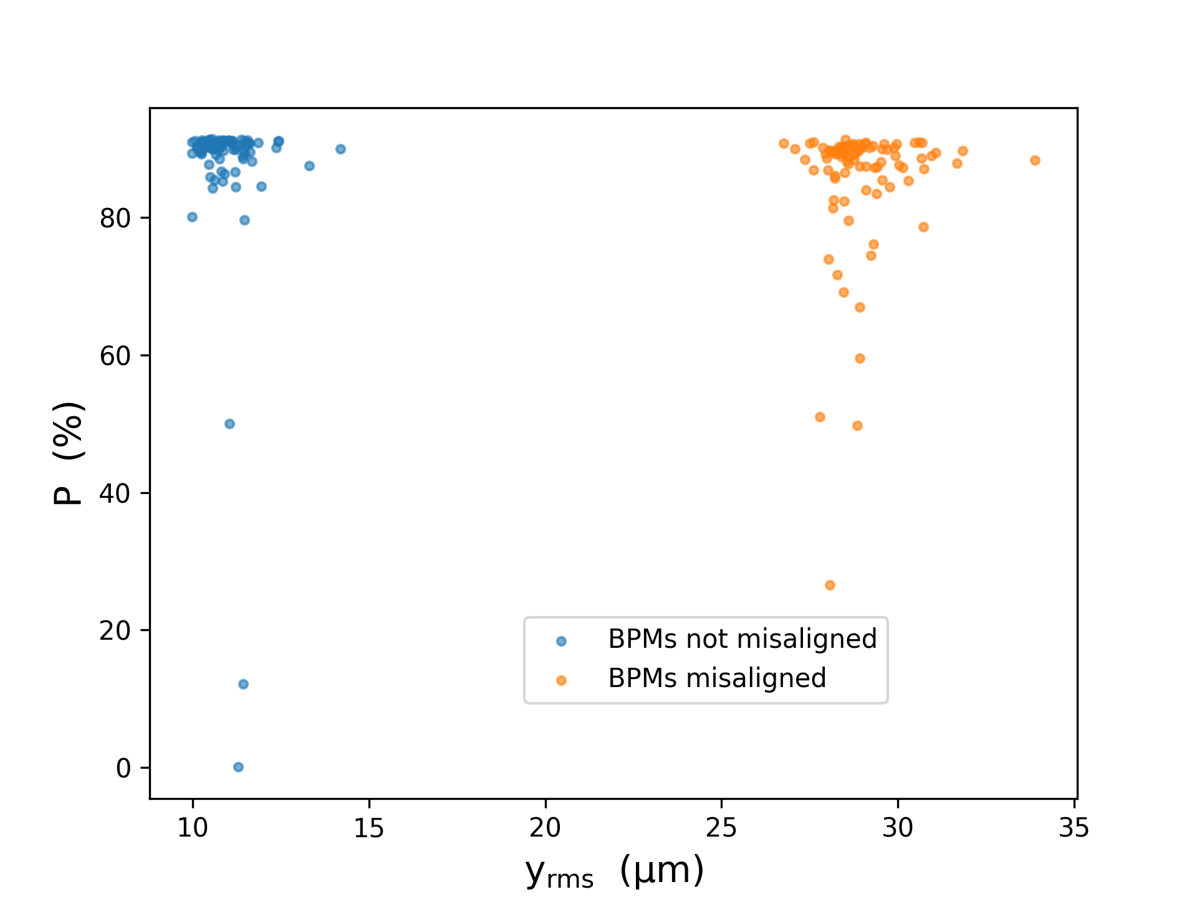
BPM misalignments
same 93 seeds
Big difference in residual orbits, larger variance in polarization

Slide 17
Conclusion
Outlook
Orbit and equilibrium polarization are primarily affected by misalignments in arc.
Closed orbit searching is main affected by misalignments in IR.
Influence of BPM errors has been investigated, among which the BPM misalignments have the most substantial impact
High polarization at Z energy can be achieved as long as tight alignment can be made.
Refine correction methods to also correct the optics and chromatic effects
Investigate realistic alignment models

Slide 18
Thank you!

Slide 19
Appendix

Slide 20
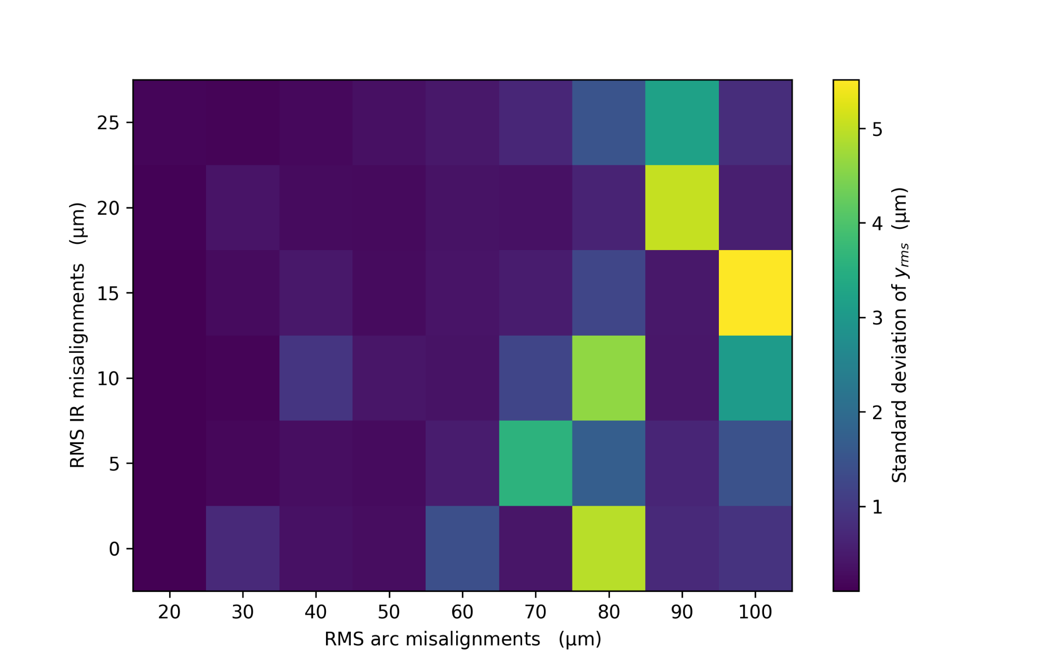
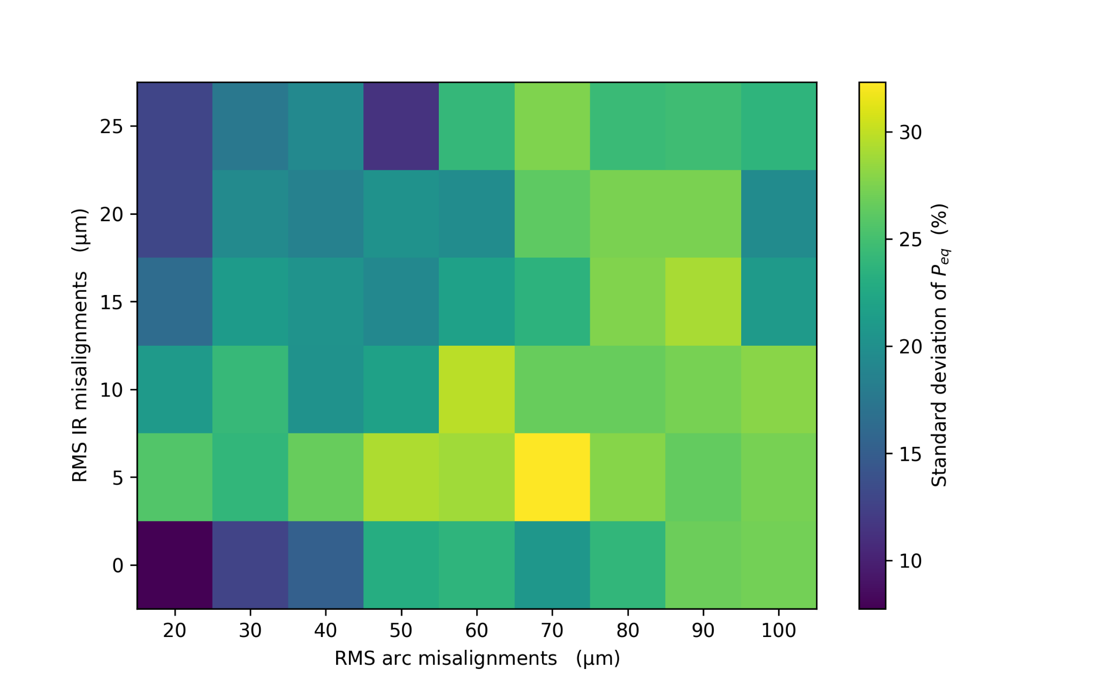
Misalignments in arc & IR
standard deviation of y_{rms} (µm)
standard deviation of P_{eq} (%)
Small variance in final orbits, large variance in P_{eq}

Slide 21
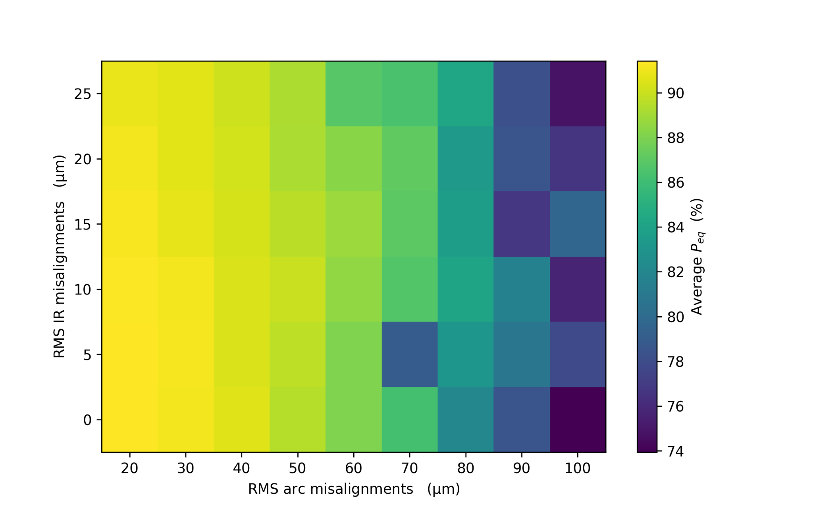
Misalignments in arc & IR
Using the seeds that survived in all scenarios

Slide 22
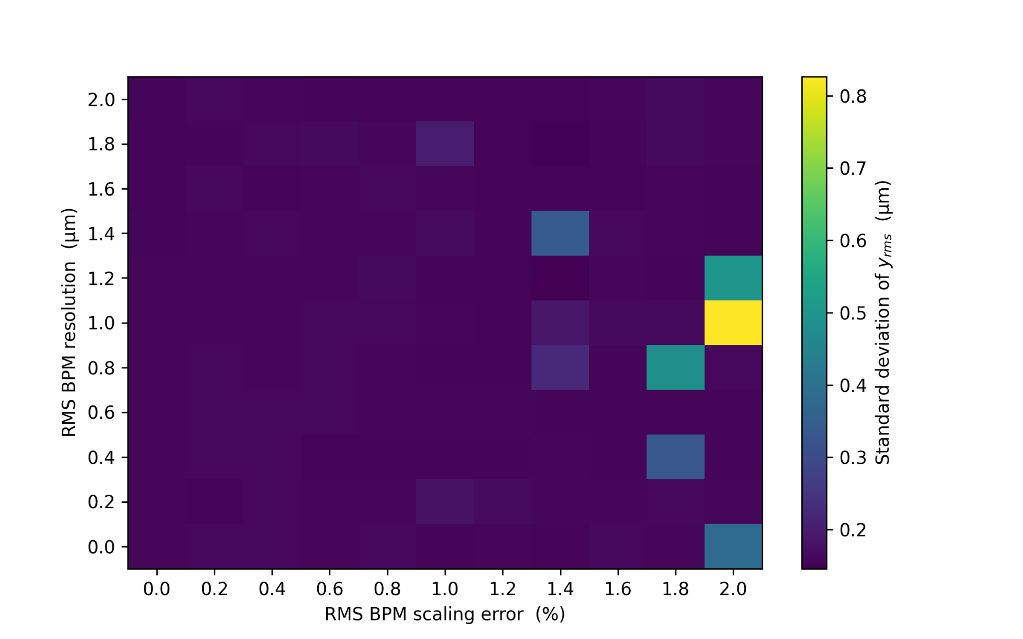
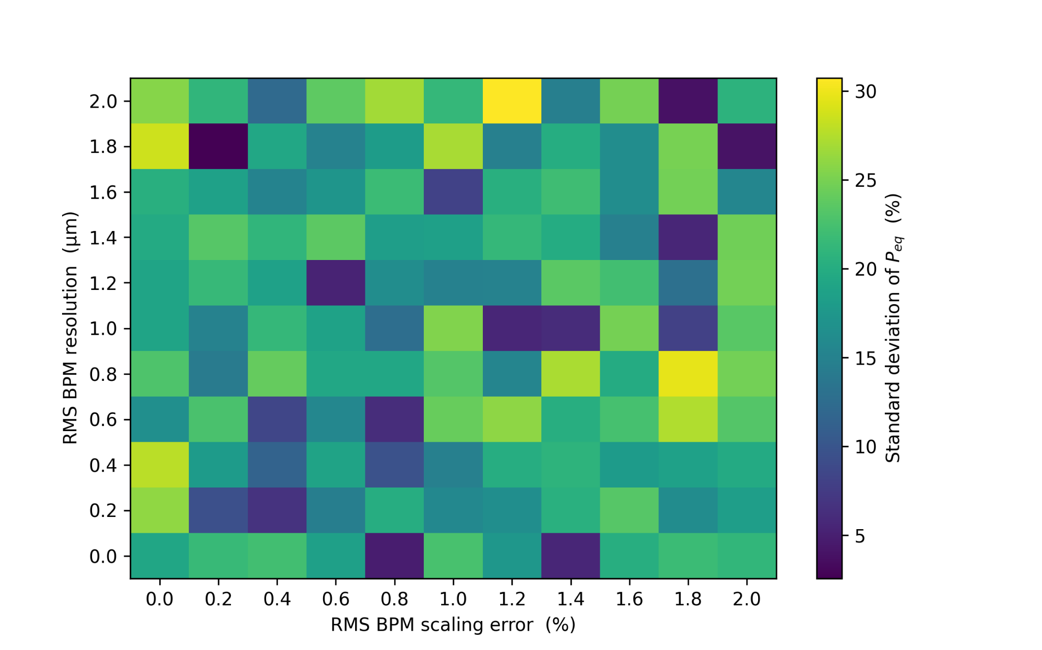
BPM scaling error and resolution
standard deviation of y_{rms} (µm)
standard deviation of P_{eq} (%)

