Slide 1
A PhD is not enough... How to prepare for a career in academia
Petra Rudolf
Zernike Institute for Advanced Materials p.rudolf@rug.nl

Slide 2

Title inspired by

Slide 3

Similar book more relating to Europe

Slide 4

After your PhD, there are many career options
Image from U.K. Diamond Light Source

Slide 5

What percentage of PhD graduates (on average) continue in academia?
Netherlands:
70% PhD graduates work outside academia
28% inside academia
only 2% unemployment
(source 2018 Rathenau Institute - The Impact of a PhD)

Slide 6
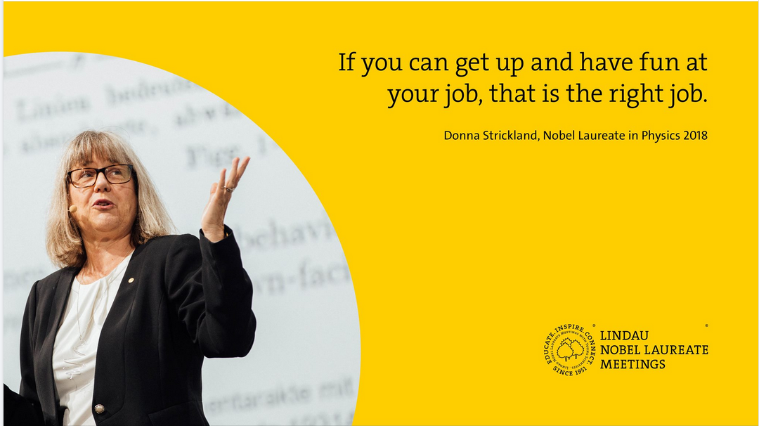
How to choose?

Slide 7
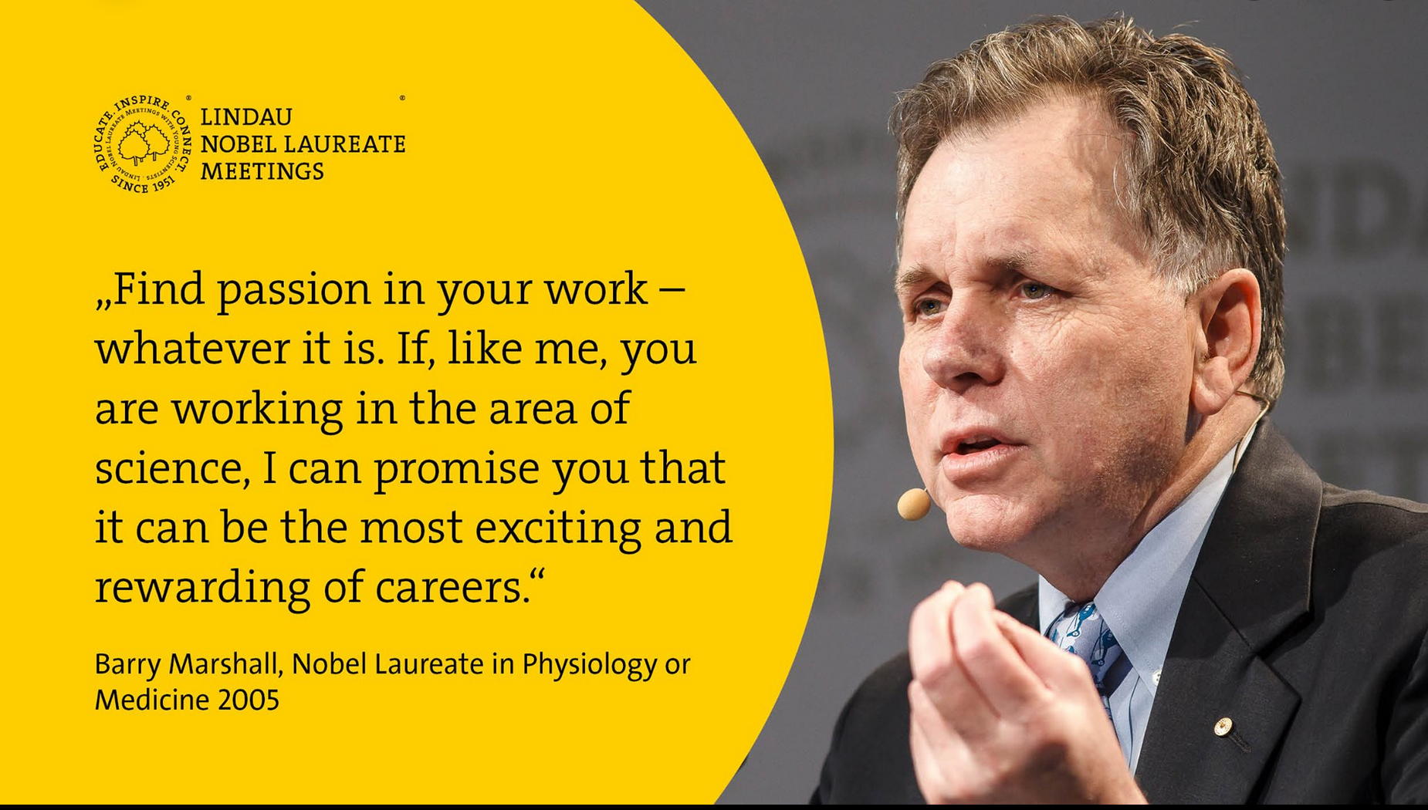
How to choose?

Slide 8
Do not decide against academia because
Your supervisor has not explicitly encouraged you to go for it.
“I don’t think you need to be extra smart for an academic career. Much more important is that you love research and teaching, how much time and effort want put into it and that you are not afraid to be alone.”
Notes:
Don’t be afraid to go for an academic career if you have been very successful in your PhD and you are decided that university is your future.
If you are good at research and you have publications, your supervisor will think it is obvious that you can do an academic career.

Slide 9
Do not decide against academia because
You think that a family and an academic career are incompatible.
Have a look at “Mothers in Science – 64 ways to have it all”
https://royalsociety.org/~/media/Royal_Society_Content/about-us/equality/2011-06-15-Mothers-in-Science.pdf

Slide 10
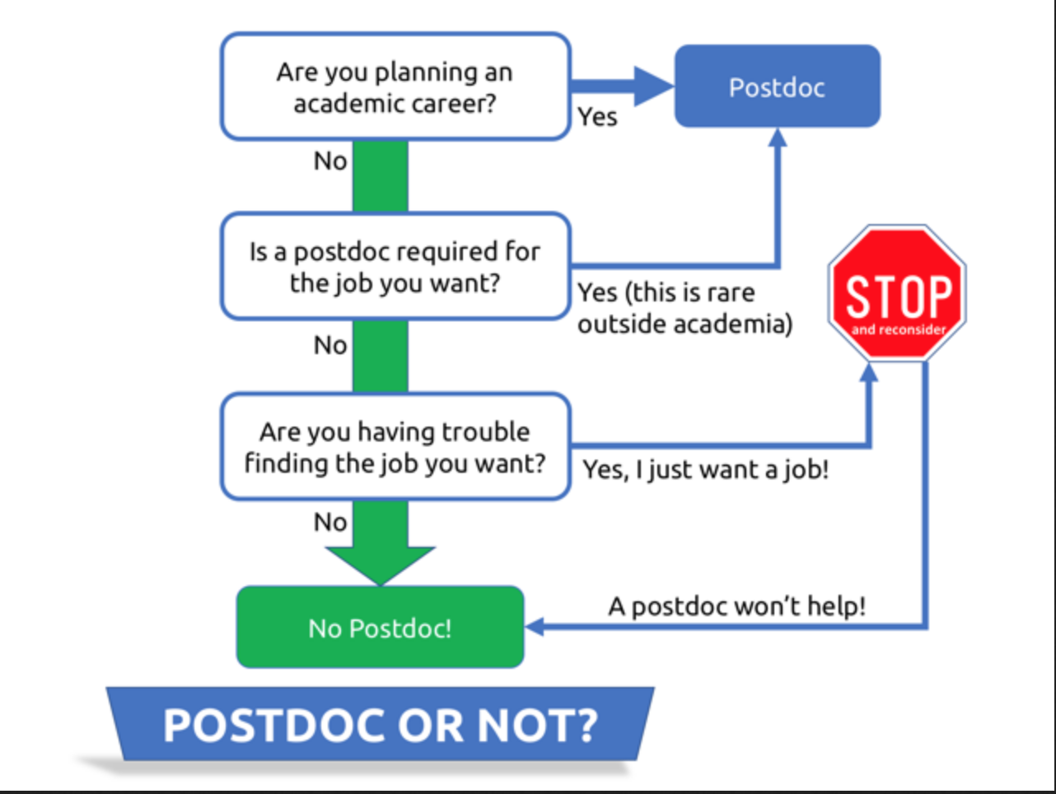
After PhD – go for a postdoc ?
http://blogs.nature.com/naturejobs/2018/03/26/the-autopilot-postdoc/

Slide 11
Academic career: After PhD – go for a postdoc !
You will be selected on the basis of your research competence
What do you need to get out?
Experience with different research environment
Experience with new techniques/new research topic
Recognition of your ideas
Network of future collaborators
Notes:
What do you need to get out – experience with a different environment and if you are successful there, you have shown that it is you who is good and not just the group where you did your PhD. Theme of your postdoc research: you need to be productive and deliver in terms of publications so don’t change too much with respect to your PhD – stay with same theme but use new techniques/methods or stay with the same techniques but change theme. Don’t change both otherwise you have to learn too much to be productive.

Slide 12
Which supervisor? Which place?
Experience with different research environment – many universities require postdoc abroad for tenure track assistant professor candidates
Experience with new techniques/new research topic – going to work with a “hot shot” has advantages and disadvantages…
Recognition of your ideas/topic – going to work with a junior professor has advantages and disadvantages…
Network of future collaborators – you meet more people in “famous places”
Notes:
what are the most important criteria based on which to chose the postdoc? Go to work for a well known but not too famous person – if you work for a star, people will too easily assume that all the work you did is coming from his/her ideas and not your own. Working for a very young “boss” can be problematic because he/she needs visibility him/herself so the person will go to a conference to tell about your results instead of sending you to talk about it – make agreements to gain visibility! Go to a place where you meet lots of bright people because the ones you play tennis with or you have a beer with will be your collaborators for the next 20 years. This is why places like Ivy league universities in the USA or Cambridge/Oxford are good places to go – the research is no different since scientists cook with water there as well, but you meet lots of bright colleagues.

Slide 13
How to apply
There are more postdoc positions than good applicants: check websites of Learned Societies and https:/euraxess.ec.europa.eu/
Check website of potential supervisor, institute
Contact former PhD students/postdocs
To get selected: Motivation letter (see https://motivationletter.net/motivation-letter-for-postdoc/), interview
Or get your own funding …
Notes:
There are more postdoc positions than good candidates right now, so check the Euraxess website, the websites of learned societies in your field, Academic Transfer if you want to work in the NL, Once you have found an announcement you like, check out the website of the potential supervisor and the institute to get a good idea of the environment. Contact former PhD students/postdocs to ask about the place, the atmosphere in the group. To get selected you will have to write a motivation letter: make it specific, say why you exactly fit the advertised profile. Prepare for the interview by reading about the field and the group where you want to go.
Alternatively you can also try to find your own funding – then you have the liberty to go where YOU want and to do what YOU want – of course in discussion with the potential supervisor.

Slide 14
Many possibilities for applying for funding
EU Marie Curie Individual Fellowships
(National) Foundations: USA-Fulbright program, UK-Newton International Fellowships, NL-VENI, Germany-Humboldt Fellowship, SNSF-Postdoctoral Fellowship, Switzerland, ….
Individual Universities/research institutions: Harvard, MIT, Stanford, Cornell, ETH Zürich, Trinity College Dublin, Max Planck Society, Univ. of Münster, Germany…
First think of where you want to go, then search for the right funding…
Notes:
Also for applying for your own funding there are many possibilities: the EU Marie Curie Individual Fellowships, where you can apply once per year, or the FWO/FNRS postdoctoral fellowships for junior and senior researchers. There are also many national research funds that offer similar 2 or 3 year fellowships and I just listed a few examples. Also individual universities or research institutes can have open calls where you can propose a project, again I give only some examples. In general: you should first think where you want to go and then search for the right funding. Even if you don’t get the fellowship the envisioned supervisor might hire you anyway because during the discussions of your proposal s/he has learnt to appreciate you.

Slide 15
Apply for a grant
Read the instructions and follow them carefully
Learn how to write a Grant proposal (free) https://www.hfsp.org/node/5761 The Art of Grantmanship
Be sure to be ready 1-1.5 months before deadline
Establish a mock committee for feedback
Think of who will be judging …
Remember: older people like to help young people, so don’t be afraid to ask for help
Notes:
Probably writing a research programme if you want to apply for your own funding will be the first time you apply for a grant. My first advice is to read carefully the instructions given by the fellowship granting body and follow them scrupulously. Good guidance on how to write a grant proposal can be found for free on the webpage of Human Frontiers, that grants fellowships for interdisciplinary projects that involve Life Sciences. The Guideline are called “The Art of Grantmanship” and you can download them from the website indicated here. Very important in the writing is that you have some idea who will be judging because if the committee comprises members of different disciplines who will have to write an introduction that convinces each of them that your proposal is exciting and worthwhile doing. Also be sure that you can get feedback on your proposal, so be sure to have finished writing it well before the deadline and ask people with similar profiles as those who will be in the committee to shoot on your proposal. If there is enough time, others can help you and you have time to improve. Don’t be afraid to ask for help. Remember: older people like to help younger people.

Slide 16
Find a good mentor/supervisor !
Apart from giving scientific guidance, s/he should
provide training in presentation of results, paper writing
find funding / help you find funding
teach you how to write successful proposals
teach you the « rules of the game » and how to change it
introduce you to important professional contacts
give you challenging assignments and opportunities
provide constructive feedback on unsuccessful proposals or interviews
give you credit, and advocate you in the academic community
If you don’t get these things from your supervisor/ mentor, ask for them. If you still don’t get them, try someone/somewhere else.
Notes:
Then you are in the place and you do your research – you will be happy but you should also make sure that your supervisor gives you what you need in addition to scientific guidance. He or she has to help you further improve your competences. Here is a list of things that you should get from your supervisor and that you need to grow during your postdoc. So if you don’t get them from your supervisor – ask for them and if you still don’t get them find someone else who helps you: a mentor or different mentors.

Slide 17
Make publicity for yourself
Future employers, people who nominate you for prizes, organizers of conferences have to find you
Setup your profile on ORCID (with miniCV etc) and make it public
Be on googlescholar, publons, researchgate,…
Even better: have your own website

Slide 18
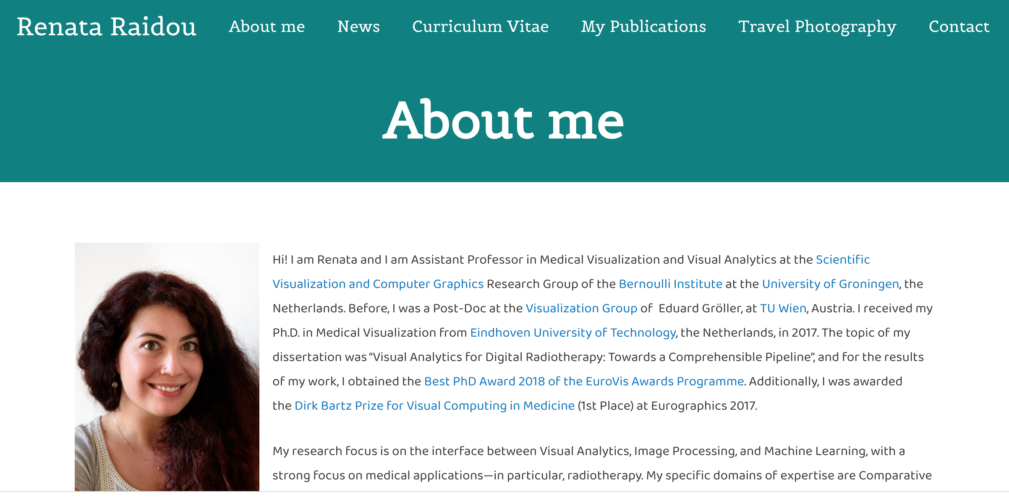
Missing: what I am particularly proud of
Notes:
The tab “What I am particularly proud of” should contain results you would like to present at a conference as an invited talk or things you would like to get a prize/award for.

Slide 19
Make publicity for yourself
Future employers, people who nominate you for prizes, organizers of conferences have to find you
Setup your profile on ORCID (with miniCV etc) and make it public
Be on googlescholar, publons, researchgate,…
Even better: have your own website
But also: Google thyself. Want to see what your prospective employer can see? Follow tips on https://www.sciencemag.org/careers/2020/01/applying-your-dream-science-job-google-thyself

Slide 20
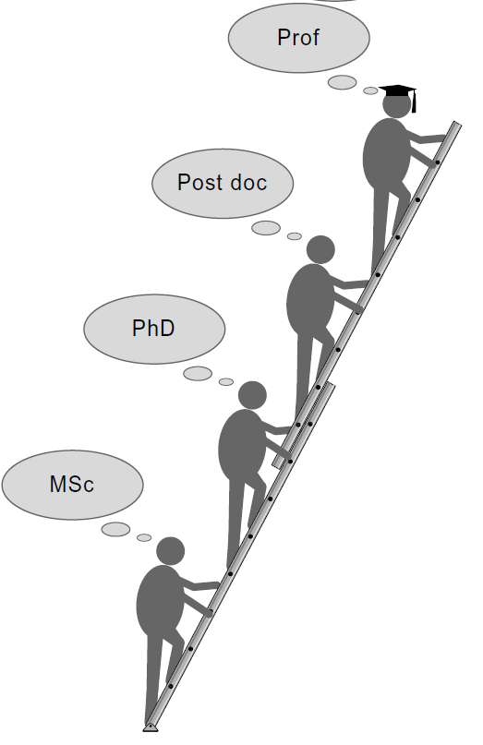
Next step tenure track assistant professor…
postdoctoral researcher vs tenure track assistant professor
Differences in capabilities demonstrated by your CV
Differences in tasks
Differences in how your “boss” cares about YOUR career
Undergrad
student
Notes:
If you apply for postdoc the only thing which is considered is whether you fit the project, for TT a much broader profile is required
A university professor does research, teaching and service to the community & society, a postdoc only needs to bring the project he she is hired on to success.
You postdoc “boss” has the success of his/her project as first priority, not necessarily this coincides with what is best for YOUR career.

Slide 21
Your CV
Good publications – expectations vary per field (physics about 2-3/year as PI)
What else?
Notes:
Publications are crucial – they show that you are good and not only the group you work in. Being productive in different environments is a very important criterion for your future employer.

Slide 22
Your CV
From an advertisement: APPLICANTS MUST HAVE:
- a Ph.D and post-doctoral experience, preferably in different research institutions (Dutch applicants should have minimally 2 years post-doctoral experience outside the Netherlands).
- publications in first rate international scientific journals
- experience in supervising research projects
- the ability to successfully compete for external research funding
- affinity to teaching
- evidence of international recognition
When deciding on application: Difference in behaviour men/women!
Notes:
But other competences are required as well. Studies show that men and women have a different behaviour when they apply: Women typically apply only when they satisfy ALL criteria of a job announcement, men typically apply when they satisfy at least 50% of the criteria – don’t wait until you satisfy 100% of the criteria, you might be considered too old!

Slide 23
During your postdoc
help supervising bachelor, master and PhD students
show leadership: start a journal club, organize a workshop
do outreach in schools, participate in open days
participate in competitions (3Minutesthesis, Famelab, Dance your PhD, young speakers contest…) – you will learn speaking techniques and a better talk makes you attractive as invited speaker later and improves your teaching
apply/ask to be nominated for prizes/awards
apply for any type of money you can: access to large facilities or computer time, travel grants for conferences, …
do some teaching during your postdoc and if possible also some teaching training
Notes:
If you are at a national lab where there are no students, try to attract summer interns
Concerning prizes and awards: look on the websites of people who are older than you, what they got. Don’t think “I’m not good enough” – the other people nominated are also at the very beginning of their career! Remember: people who are in selection committees are the same people who suggest invited speakers for conferences, so if you do not get the prize you might still get an invitation to speak at a conference!
This is quite a shopping list. Don’t forget that your research and most of all writing papers is your first priority but make a little time for as many of these bullet points as you can. If you apply and a competing candidate is as good as you as far as research is concerned, scoring on these points will make the difference.

Slide 24
The announcement
https://www.academictransfer.com/en/296980/tenure-track-assistant-professor-experimental-nanophysics-10-fte/
First details about research qualification, then:
As an Assistant Professor you will:
• set up and develop your own research line and research group
• supervise PhD students
• acquire external funding
• promote the societal relevance of your research
• teach in and contribute to the development of the degree programmes of the School of Science and Engineering, especially courses with Physics and Applied Physics content
• contribute to the organisation of the faculty, for example by participating in working groups and committees, in the domains of teaching, research and management.
Notes:
The tasks of an assistant professor are quite varied – let’s look at the job announcement again.
For the NL: Structuurrapport/profile report gives you useful info on how the position is embedded in the institute and what is exactly expected from the candidate – ask for it from the institution where you apply.

Slide 25
The motivation letter
Not longer than 2 pages
Demonstrate that you tick many of the boxes
Extra plusses if they hire you?
Show that you have checked the website of University XX, talk to the person indicated for information, know the country…
Once more: apply even if you don’t tick ALL the boxes!

Slide 26
CV and motivation letter
See for ex. https://hwpi.harvard.edu/files/ocs/files/gsas-cvs-and-cover-letters.pdf
Three parts: 1) Why are you writing?
2) Why do you fit the job description? these include a paragraph about your dissertation/current research, one about your future research plans, and one or two about your teaching experience/interests/approach/courses you could offer.
3) Say what you attach, that you would appreciate explaining personally & thank for time and consideration

Slide 27
Research statement
Have a good research programme, well thought through, innovative, visionary. Concrete for the first 5 years, general outlook for later. With whom are you planning to collaborate at XX, in the country, Europe-wide, worldwide?
For tips see: “Sell yourself and your science in a compelling personal statement” Nature | Vol 593 | 6 May 2021 | 153 https://www.nature.com/articles/d41586-021-01101-z
https://grad.ncsu.edu/news/2020/04/how-to-construct-a-compelling-research-statement/
https://www.evalantsoght.com/2022/02/phd-talk-for-academictransfer-how-to-write-a-research-statement.html

Slide 28
Teaching statement
Try to be non trivial when explaining your teaching philosophy. Also: What would you like to teach (look at programmes of university where you apply)? How would you organize your course? How do you think you can make your course particularly attractive? Mention your experience. Don’t forget supervision of bachelor and master students during their final projects.
Guide about teaching statements https://cft.vanderbilt.edu/guides-sub-pages/teaching-statements/
https://www.evalantsoght.com/2022/04/phd-talk-for-academictransfer-how-to-write-a-teaching-statement.html

Slide 29
The interview with the committee
prepare your lecture well and try it out in front of a critical public;
If you give it online make sure before that there are no technical problems;
think of who will be in the audience and tailor your presentation for it;
prepare for possible questions from committee members.
This is not a conference presentation so results are less important than packaging and leaving the right impression.
Do not talk longer then you are allowed to talk.
Notes:
The lecture is also a way to check whether you can teach. Make it didactic, use different means – be interactive with your public, use the blackboard to explain something extra to show that you have flexible teaching techniques, do a poll,…

Slide 30
The interview
Do your homework, i.e. know the answers to the following questions:
Why do you apply for this position?
Why do you think you are the ideal candidate for this position?
Why XX and not Cambridge or who knows what?
Notes:
Try out an interview with your supervisor/ mentor – they will explain to you how certain answers are interpreted by a selection committee.

Slide 31
The interview
Be prepared to answer:
Why should we pursue this research at XX (name of univ.)?
Who are your competitors worldwide on this subject?
Why do you think you have a competitive edge? What are the risks involved in this research and what is your plan B for each risk?
How many people do you need to carry out this programme?
What sort of funding do you plan to apply for to get these people?
What facilities/instrumentation do you need to carry out this programme? What sort of funding do you plan to apply for to get these facilities/instrumentation?
What will be the title of your first grant proposal?
Notes:
Important also body language: even if only one person asks you the question, look at other committee members when you answer to keep them involved and to fix their attention on you.

Slide 32
The interview
Show that you have a vision for your future development:
Be prepared to answer:
How big do you want your group to be in 5 and in 10 years? Why this size?
How do you plan to organize the supervision of your PhDs and postdocs?
If you realize that your PhD student is not up to the task you have assigned to him/her, what do you do?
If you realize that your PhD student is not doing the task you have assigned to him/her, but pursues other issues which are however giving very good results, what do you do?

Slide 33
The interview
About you as a person:
“How would a close colleague of yours describe you?”
What will be the biggest challenge in coming to XX?
- You can be invited to do a SWOT analysis or to name your strongest and your weakest points.
Note: Obviously you should present your weak point as a strength as well!
- What will be your biggest challenge if you come here?
Notes:
For the SWOT analysis, I came up with answers like "I tend to be a perfectionist, which obviously can slow down the scientific production but it also makes sure that my data are 100% reliable and papers are very comprehensive, which are two qualities which helped to establish my reputation.”
Try to think of a challenge which does not reflect negatively on your commitment to the new job: nice answers I have heard were “adapting to the Dutch weather”, or “getting used to the flat countryside” or “learning to use a bike as main means of transport”

Slide 34
Interviews with individual committee members
Do your homework….
Make the interviewer aware that you have done your homework…
Ask questions…
Notes:
Obviously the best is if you also know something about the institution where you apply from a person who has worked there or you know things typical for the country. So try to talk to someone who works in the country where you are applying, or ask questions to the person indicated in the announcement, for ex. about what % of your time you are expected to teach because this can vary greatly: in Belgium I had 300 contact hours with students per year, here it max 2 courses for an assistant professor in my faculty. On the other hand, in Belgium it was left to your own ambition how many PhD students you had while in Groningen in the natural sciences: you are expected to “deliver” about 1 PhD student every two years to cover the cost of your salary as associate professor, 1 PhD student/year as full professor, so you need to have a group of a corresponding size…

Slide 35
Negotiating the offer
Wage gap: in the NL – see LNVH report
Female scientists at the 14 Dutch universities earn on average €799 per month less (before tax) than their male colleagues, i.e. 13,7%.
You will be told that you cannot negotiate – not true!
Get training in negotiation or train with your mentor
Talk to colleagues, find out what others get…
Ask nat.l network of female professors (LNVH) for help: www.lnvh.nl
Make sure that the conditions for promotion and when it will happen are crystal clear and written in your contract!
Notes:
Remember: if you don’t ask you don’t get… Make your startup last as long as possible: ask for completely furnished offices (including computer) for your students, ask for language courses, moving expenses, housing paid from the university for the first 6 months so that you do not have to pay for two households yourself, special rules for taxes…

Slide 36
Starting…
The first 6 months determine your image for the next 20 years to come.
Find a mentor who teaches you the ropes of that faculty, that university…
Find a guardian angle who becomes your advocate in the community and makes sure you get invitations to national events and to give colloquia/seminars at other universities.
Be pro-active, learn the local language (politics is done in the local language).
Notes:
If you learn the local language fast (it does not have to be perfect but you have to be able to understand both in meetings and from letters & email) this will have a very positive effect on your career!!!

Slide 37

Don’t isolate yourself but reach out to others
"Getting into the practice of saying no saves space for smarter yesses. Your time is your most valuable asset. Don’t spend it doing someone else’s job." Elaine Welteroth

Slide 38

Good luck!
The future is bright for women (and men) in Science!
Notes:
Student numbers have doubled in the last 20 years and this trend continues, so there are many openings for jobs – don’t believe people who tell you that getting into academia is very hard. What is true is that you have to do the right things during your postdoc to be an attractive candidate and of course if you have no publications from your postdoc it will be difficult to convince people to believe in your research capabilities.

Slide 39
Thank you for your attention
More reading: https://www.science.org/content/article/should-i-do-postdoc-former-postdocs-share-their-stories
Book advice:
Federico Rosei and Tudor Johnston, Survival Skills for Scientists, World Scientific;
Peter J. Feibelman, A PhD is not enough: a guide to survival in science, Basic Books
Ritsert Jansen, Funding Your Career in Science Cambridge University Press

