Slide 1
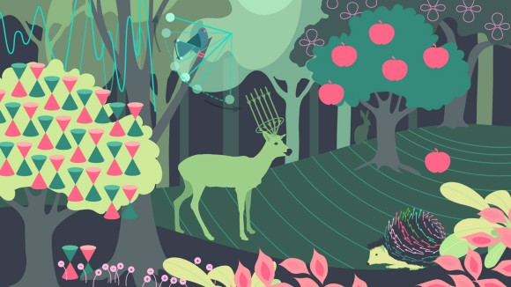
Sustainability in Physics Education for BSc/MSc
https://www.nature.com/collections/egagaacfba
Tomoko MURANAKA, PhD
EFPL

Slide 2







Urgent research topics! : Energy, Pollution, Water, …
Why Sustainability in Physics Education?
Deep understanding of nature
Transversal skill: required by society
Responsibility: major consumer of planet’s resources.
Mandatory course of general sustainability:
University / Faculty level of coordination.
How to integrate to the courses and what are Challenges?
Optional course:
Study plan is already FULL
Courses are “packed” for specialisation.
Add-on to existing courses:
Proper materials and contents are required.

Slide 3
Student’s Voice
"Do you have any suggestions on how this course could further integrate aspects of sustainability (environmental or societal)?"
No sense. This is pure physics course!
It’s already the case. It’s enough.
Add sustainability contents in exercises
Simulate forest fire
AI safety, data centre operation and its impact
Thermodynamics by case study
Wind turbine, PV as TP topics with a clear sustainability context
LN2 usage (some students play with it!)
Stop printing exercises. We can see online.
More natural light in the room
Less air conditioner
Talk about environmental cost when compare different technologies
More female course assistants

Slide 4
Opportunities and needs for lecturer’s
Material Sharing platform
  Sustainability context and contents of lab & programming exercises (PV, Heat Pump, …).
  National level exchange which permits a development of educational contents based on local data (ex. MeteoSwiss Open Government Data (OGD)).
  Contents developer’s visibility increases.
  SPS could help?
Option: Project based course
  Field work, ex. Physique dans la Forêt, F. Bouquet, Univ. Paris-Saclay

Slide 5
References
Nature Series: Physics and Sustainability https://www.nature.com/collections/egagaacfba
Singh, V. How to teach climate change in a physics classroom. Nat Rev Phys 5, 200–201 (2023). https://doi.org/10.1038/s42254-023-00573-4
Sustainability Education 101 self-learning course https://sustainabilityinacademia.org/news/sustainability-education-101/
Physique dans la Forêt, F. Bouquet, Univ. Paris-Saclay https://qpes2023.sciencesconf.org/444090/document

