Slide 1








Influence of Oxygen Source on the High Magnetic Field Behavior of Nb₃Sn Wires Manufactured via Internal Oxidation
Gianmarco BOVONE, Florin BUTA, Francesco LONARDO, Marco BONURA, and Carmine SENATORE
Department of Quantum Matter Physics, University of Geneva, Switzerland
Department of Nuclear and Particle Physics, University of Geneva, Switzerland
David LeBoeuf and Xavier Chaud
CNRS - LNCMI Grenoble, France
Camelia N. BORCA and Thomas Huthwelker
PSI, Phoenix Beamline, Switzerland
Simon C. HOPKINS and Thierry BOUTBOUL
CERN, Switzerland

Slide 2
Outline
Why low temperature superconductors have still their word to say!
The internal oxidation process
Enhancement of Nb₃Sn superconducting properties
High magnetic field measurements (done and to do)
Morphological overview of Nb₃Sn and precipitates
FACULTY OF SCIENCES
DEPARTMENT OF QUANTUM MATTER PHYSICS
FACULTY OF SCIENCES
DEPARTMENT OF QUANTUM MATTER PHYSICS
3
1

Slide 3
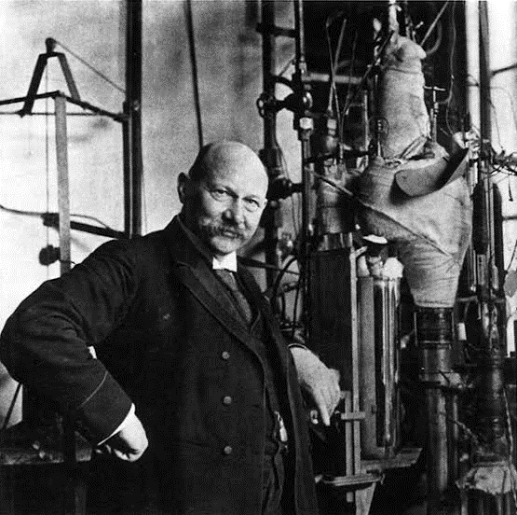
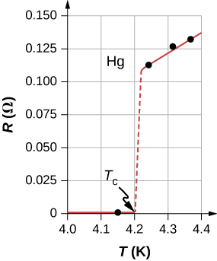
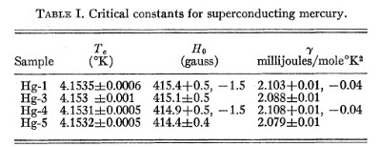
Magnetic field for material research and materials for high-magnetic fields
Discovery of superconductivity in 1911
Superconductivity will make possible high-field magnets soon!
“The solution of the problem of obtaining a field of 100000 Gauss (10 T) could then be obtained by a coil of say 30 cm in diameter and the cooling with a plant which could be realized in Leiden with a relatively modest financial support”
H. K. Onnes, 3rd International Congress on Refrigeration (1913)
OK, maybe not so soon!
Heike Kamerlingh Onnes
- Wilson M. N. IEEE TAS (2012) 22 3
- Finnemore D. K. et al. Physical Review 118 1 (1960)
FACULTY OF SCIENCES
DEPARTMENT OF QUANTUM MATTER PHYSICS
FACULTY OF SCIENCES
DEPARTMENT OF QUANTUM MATTER PHYSICS
3
2
Notes:
Cambia imagine tape

Slide 4
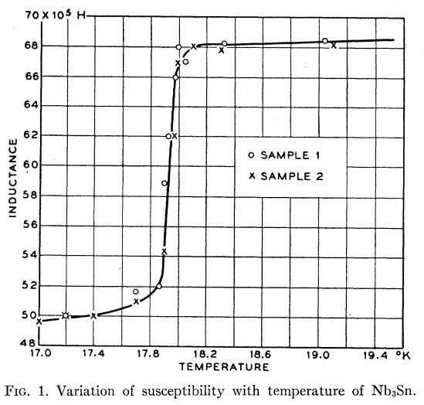
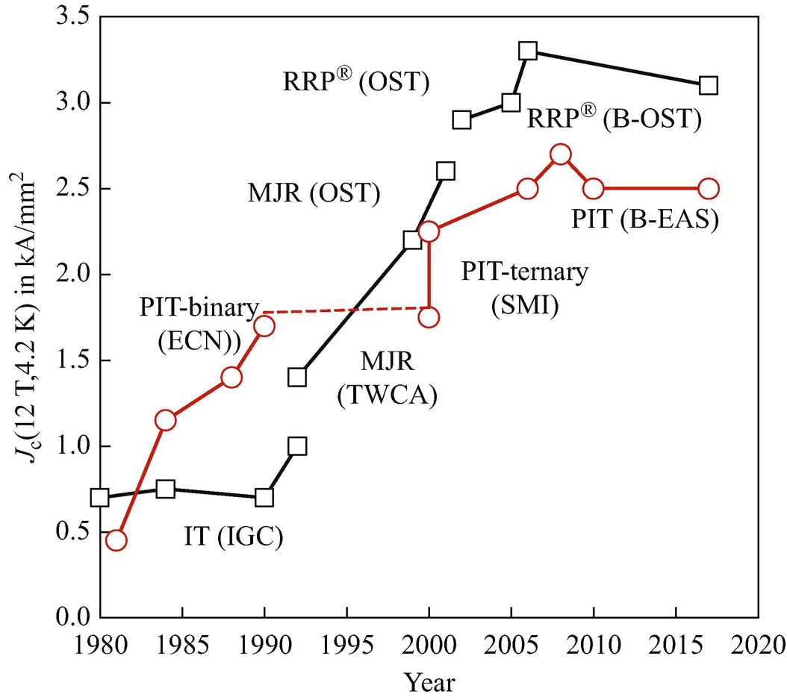
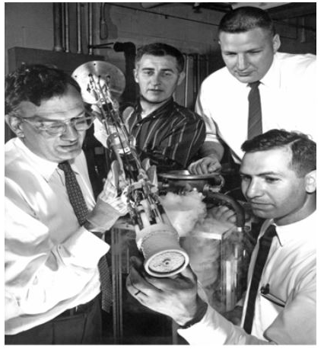
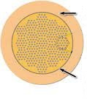

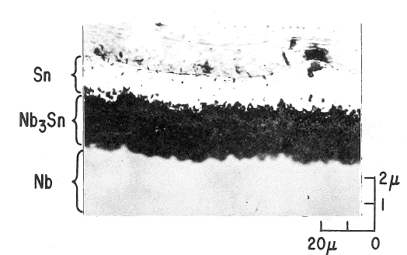
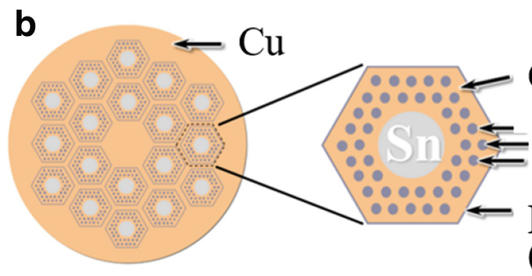
Nb₃Sn: an old material still to be unraveled
Bronze wire
Superconducting properties discovered in 1954
Cu
First Nb₃Sn magnet to generate 10 T (1963)
Rod-type wire manufacturing process (e.g. RRP)
Initially fabricated as tape
Magnet, fabricated and tested by: L. Martin, C. Bruch, M. Benz and C. Rosner (left to right)
Cu
NbTa filaments
- Matthias B. T. et al. Physical Review 95.6 (1954): 1435.
- Rosner H. et al. IEEE-CSC ESAS Eur. Supercond. News Forum. No. 9. (2012)
- Barzi E and Zlobin A.V. Nb₃Sn Wires and Cables for High-Field Accelerator Magnets(2019)
Nb or Ta barrier
FACULTY OF SCIENCES
DEPARTMENT OF QUANTUM MATTER PHYSICS
FACULTY OF SCIENCES
DEPARTMENT OF QUANTUM MATTER PHYSICS
3
3

Slide 5
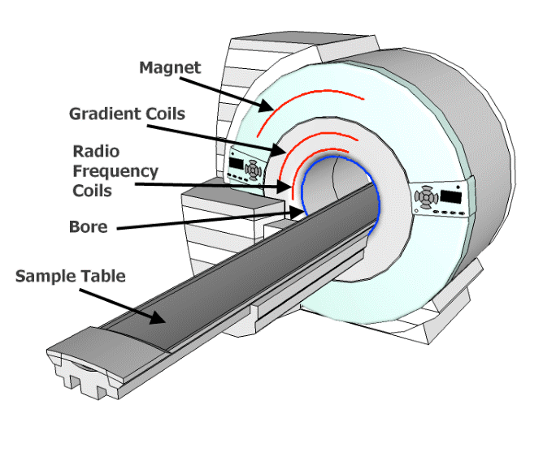
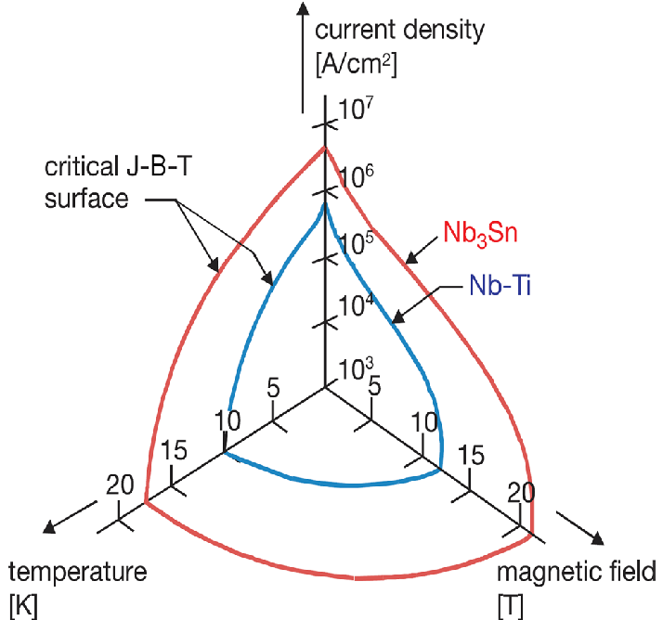
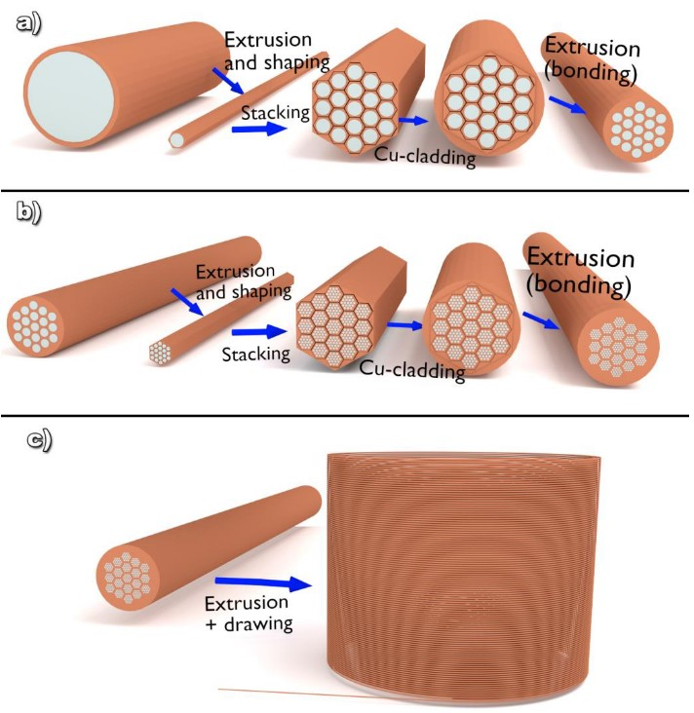
The dominion of Low Temperature Superconductors
Nb-Ti has lower properties compared to Nb₃Sn, but is easier to wind and manufacture
Since then, Nb-Ti is the backbone of MRI magnets
The Niobium-Titanium alloy (Nb-Ti) was discovered to be a superconductor in 1965, two years after the first Nb₃Sn magnet operating at 10 T
Nb-Ti is and alloy, ductile
Nb₃Sn is an intermetallic compound, brittle
FACULTY OF SCIENCES
DEPARTMENT OF QUANTUM MATTER PHYSICS
FACULTY OF SCIENCES
DEPARTMENT OF QUANTUM MATTER PHYSICS
3
4
Notes:
LTS dominates applications… menzionare duttile e brittle
Grafico performance NbTi – Nb3Sn

Slide 6
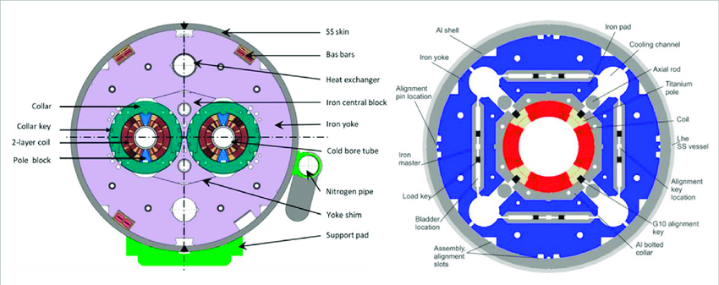
The dominion of Low Temperature Superconductors
Hi Luminosity LHC quadrupole magnet
LHC dipole magnet
LHC had to be updated using Nb₃Sn magnets to have a higher beam focus and enhance the number of collisions
Fabricated using NbTi wires
Fabricated using Nb₃Sn wires
FACULTY OF SCIENCES
DEPARTMENT OF QUANTUM MATTER PHYSICS
FACULTY OF SCIENCES
DEPARTMENT OF QUANTUM MATTER PHYSICS
3
5
Notes:
Ripensare un po a sta slide…

Slide 7
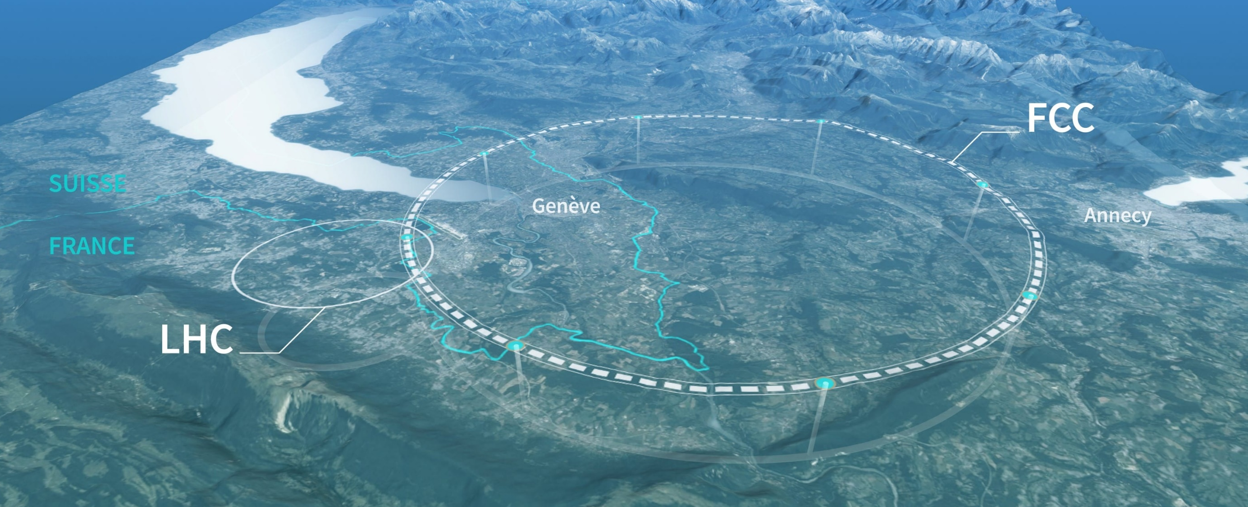
The future of Nb₃Sn
FCC-hh
100 km, 16 T
100 TeV (c.o.m.)
~10’000 tons Nb₃Sn
LHC
27 km, 8.33 T
14 TeV (c.o.m.)
1’300 tons NbTi
Doubling the operating current density reduces the superconductor area to one-third!
B [T] | 16
J_{op} [A/mm²] | 300
w [mm] | 76
A_{coil} [mm²] | 20’000
16
600
38
7’000
2x
How to enhance the J_{c} of Nb₃Sn?
- Parrell et al. AIP Conf. Proc. 711 (2004) 369
- Boutboul et al., IEEE TASC 19 (2009) 2564
FACULTY OF SCIENCES
DEPARTMENT OF QUANTUM MATTER PHYSICS
FACULTY OF SCIENCES
DEPARTMENT OF QUANTUM MATTER PHYSICS
3
6

Slide 8
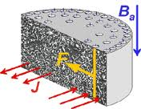
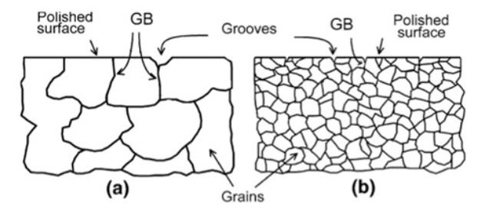
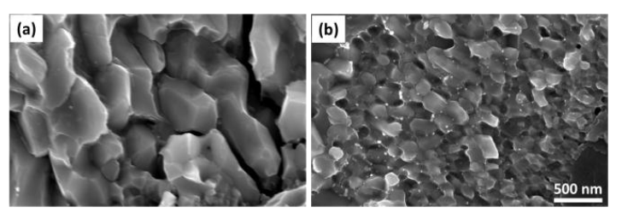

Nanometrical control of Nb₃Sn grains
The pinning mechanism in Nb₃Sn is due to grain boundary pinning, and grain refinement can enhance J_{c}
Movement of flux lines causes dissipation, detrimental for power applications. The flux line lattice must remain pinned to pinning centers (e.g., grain boundaries, or defects)
Grain refinement induced by ZrO₂ precipitation
Higher the pinning force, higher the critical current density
$$J_{c}=\frac{f_{p}}{φ_{0}}$$
The process is called Internal Oxidation
FACULTY OF SCIENCES
DEPARTMENT OF QUANTUM MATTER PHYSICS
FACULTY OF SCIENCES
DEPARTMENT OF QUANTUM MATTER PHYSICS
3
7

Slide 9
Internal oxidation process
What happens during heat treatment
Cu
Cu
NbTa with ternary element (Zr or Hf)
Nb or Ta barrier
During heat treatment, grains continue to grow and join together when their boundaries are in contact
FACULTY OF SCIENCES
DEPARTMENT OF QUANTUM MATTER PHYSICS
FACULTY OF SCIENCES
DEPARTMENT OF QUANTUM MATTER PHYSICS
3
8

Slide 10
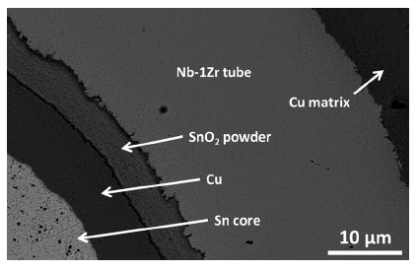
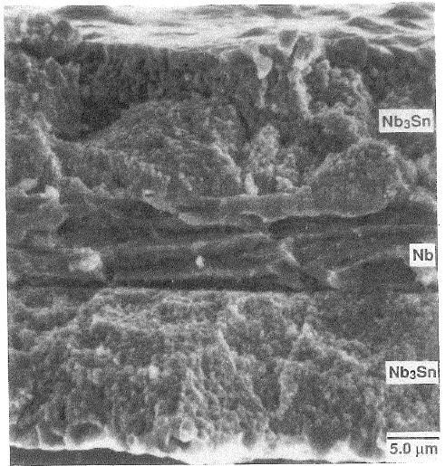
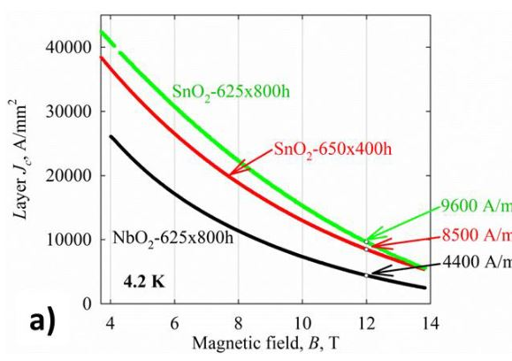
Internal oxidation process
The first wire with internal oxidation was fabricated in 2014, using a separate oxygen source to allow wire deformation
What happens during heat treatment
Cu
NbTa with ternary element (Zr or Hf)
Nb or Ta barrier
Oxide
Oxygen
Low performances at high field
Oxygen reacts with the third element (with a higher affinity for oxidation)
First proposed in 1968 for tape samples due to the easier introduction of oxygen. It was “impossible” to implement in round conductors: oxygen in alloy is detrimental to wire deformation
ZrO₂ (or HfO₂) nanoparticles prevent grains from joining together, keeping the grain size small
- Benz M. G. Transaction of the Metal. Soc. of AIME 242 (1968)
- Xu X. et al. Applied Physics Letters 104.8 (2014): 082602)
FACULTY OF SCIENCES
DEPARTMENT OF QUANTUM MATTER PHYSICS
FACULTY OF SCIENCES
DEPARTMENT OF QUANTUM MATTER PHYSICS
3
8

Slide 11
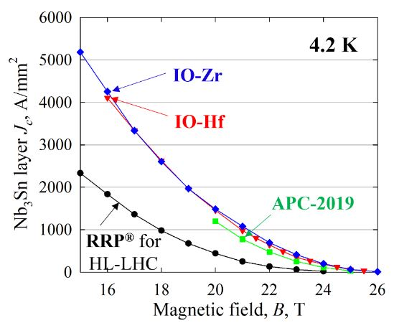
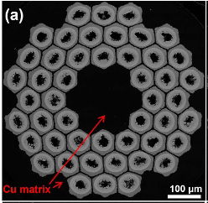
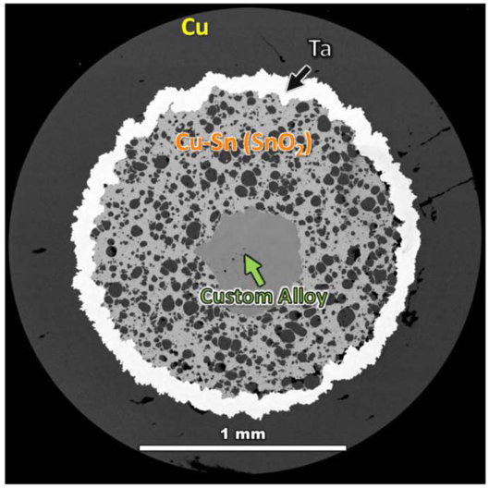
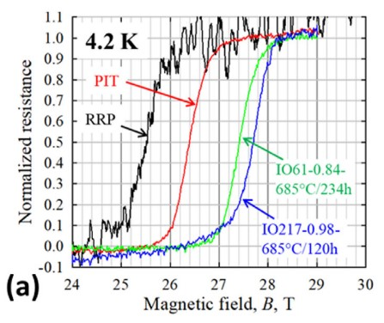
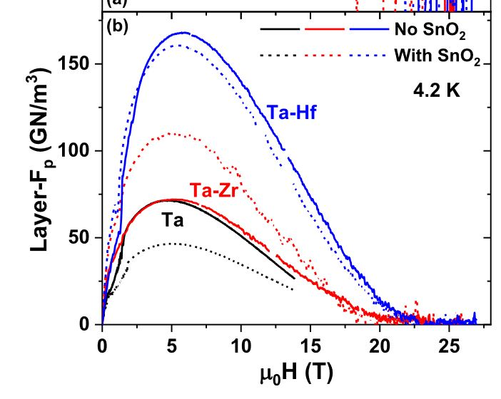
Evolution of layer J_{c} at high magnetic field
New wires designs
Multifilamentary wires
Introduction of Ta in Nb alloy
Enhancement of J_{c}, F_{p} (max) and B_{c2}
FACULTY OF SCIENCES
DEPARTMENT OF QUANTUM MATTER PHYSICS
FACULTY OF SCIENCES
DEPARTMENT OF QUANTUM MATTER PHYSICS
3
9

Slide 12
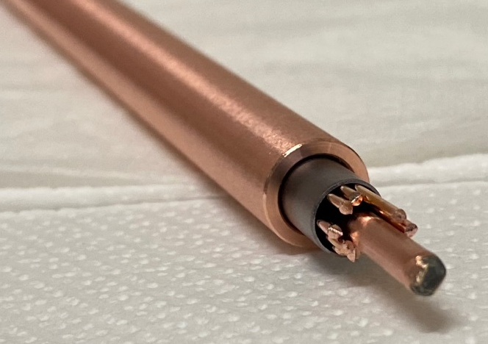
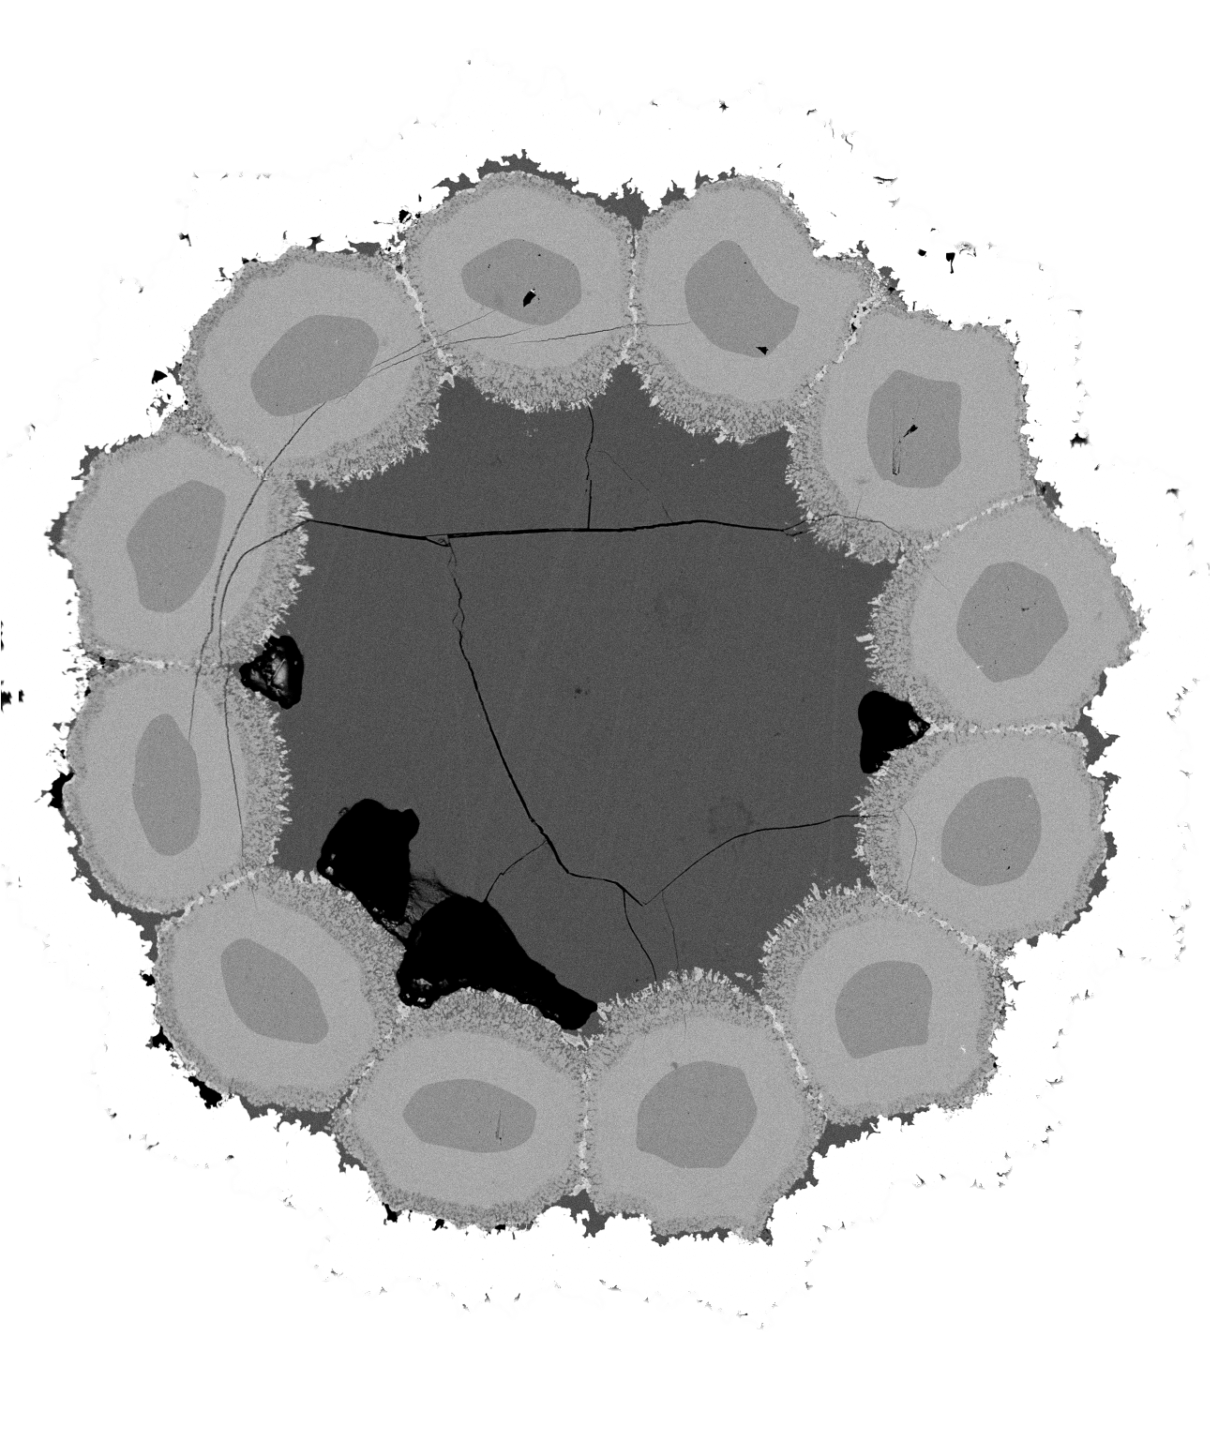
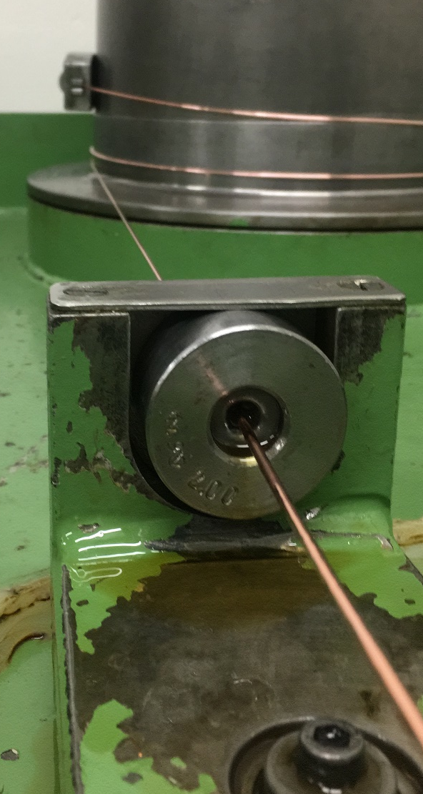
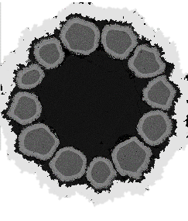
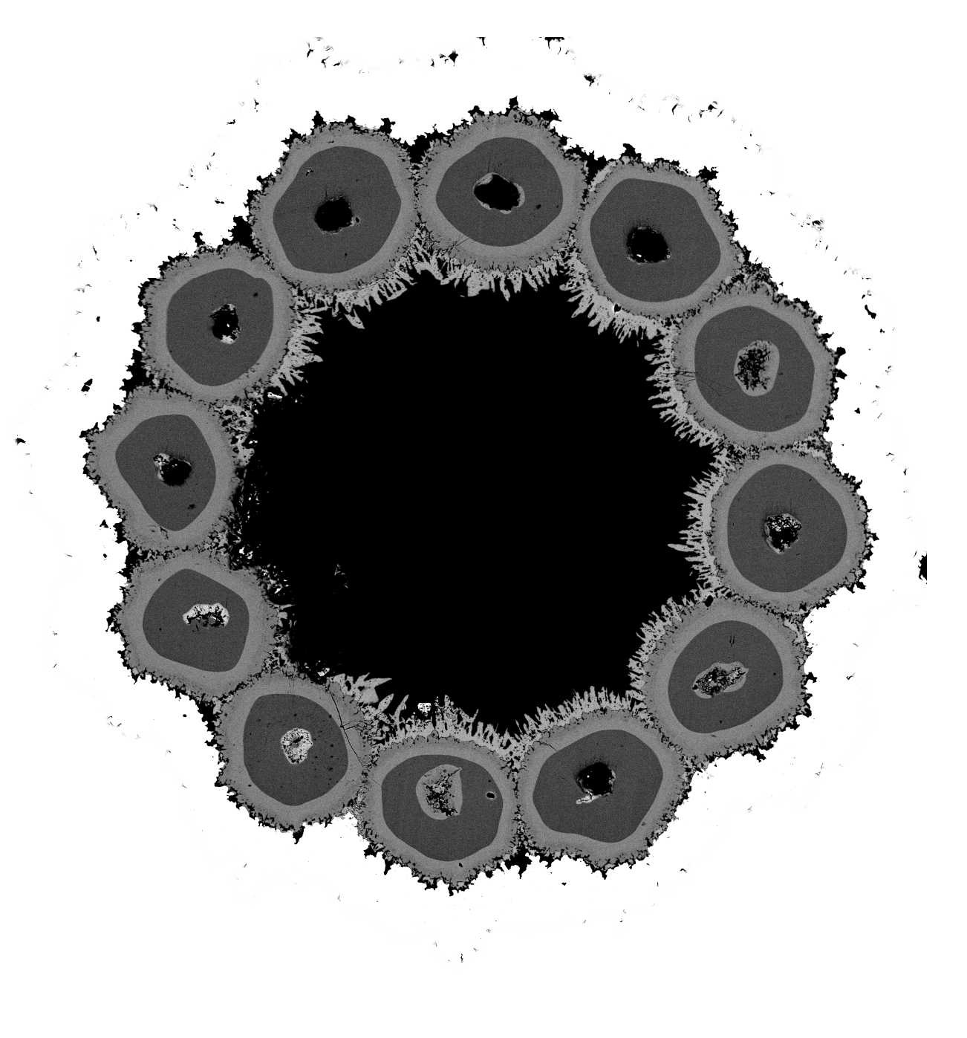
Simplified multifilamentary wires layout and fabrication process
Cu OFE
Nb filaments in Cu jacket
Ta Barrier
Sn core in Cu jacket
AnnularOS
CoreOS
Alloys:
Nb, 7.5%^{wt} Ta
Nb, 7.5% ^{wt} Ta, 1% ^{wt} Zr
Nb, 7.5% ^{wt} Ta, 2% ^{wt} Hf
Oxide powder between the Nb-alloy filament and the copper jacket
Oxide powder inside the Nb-alloy filaments
FACULTY OF SCIENCES
DEPARTMENT OF QUANTUM MATTER PHYSICS
FACULTY OF SCIENCES
DEPARTMENT OF QUANTUM MATTER PHYSICS
3
10

Slide 13
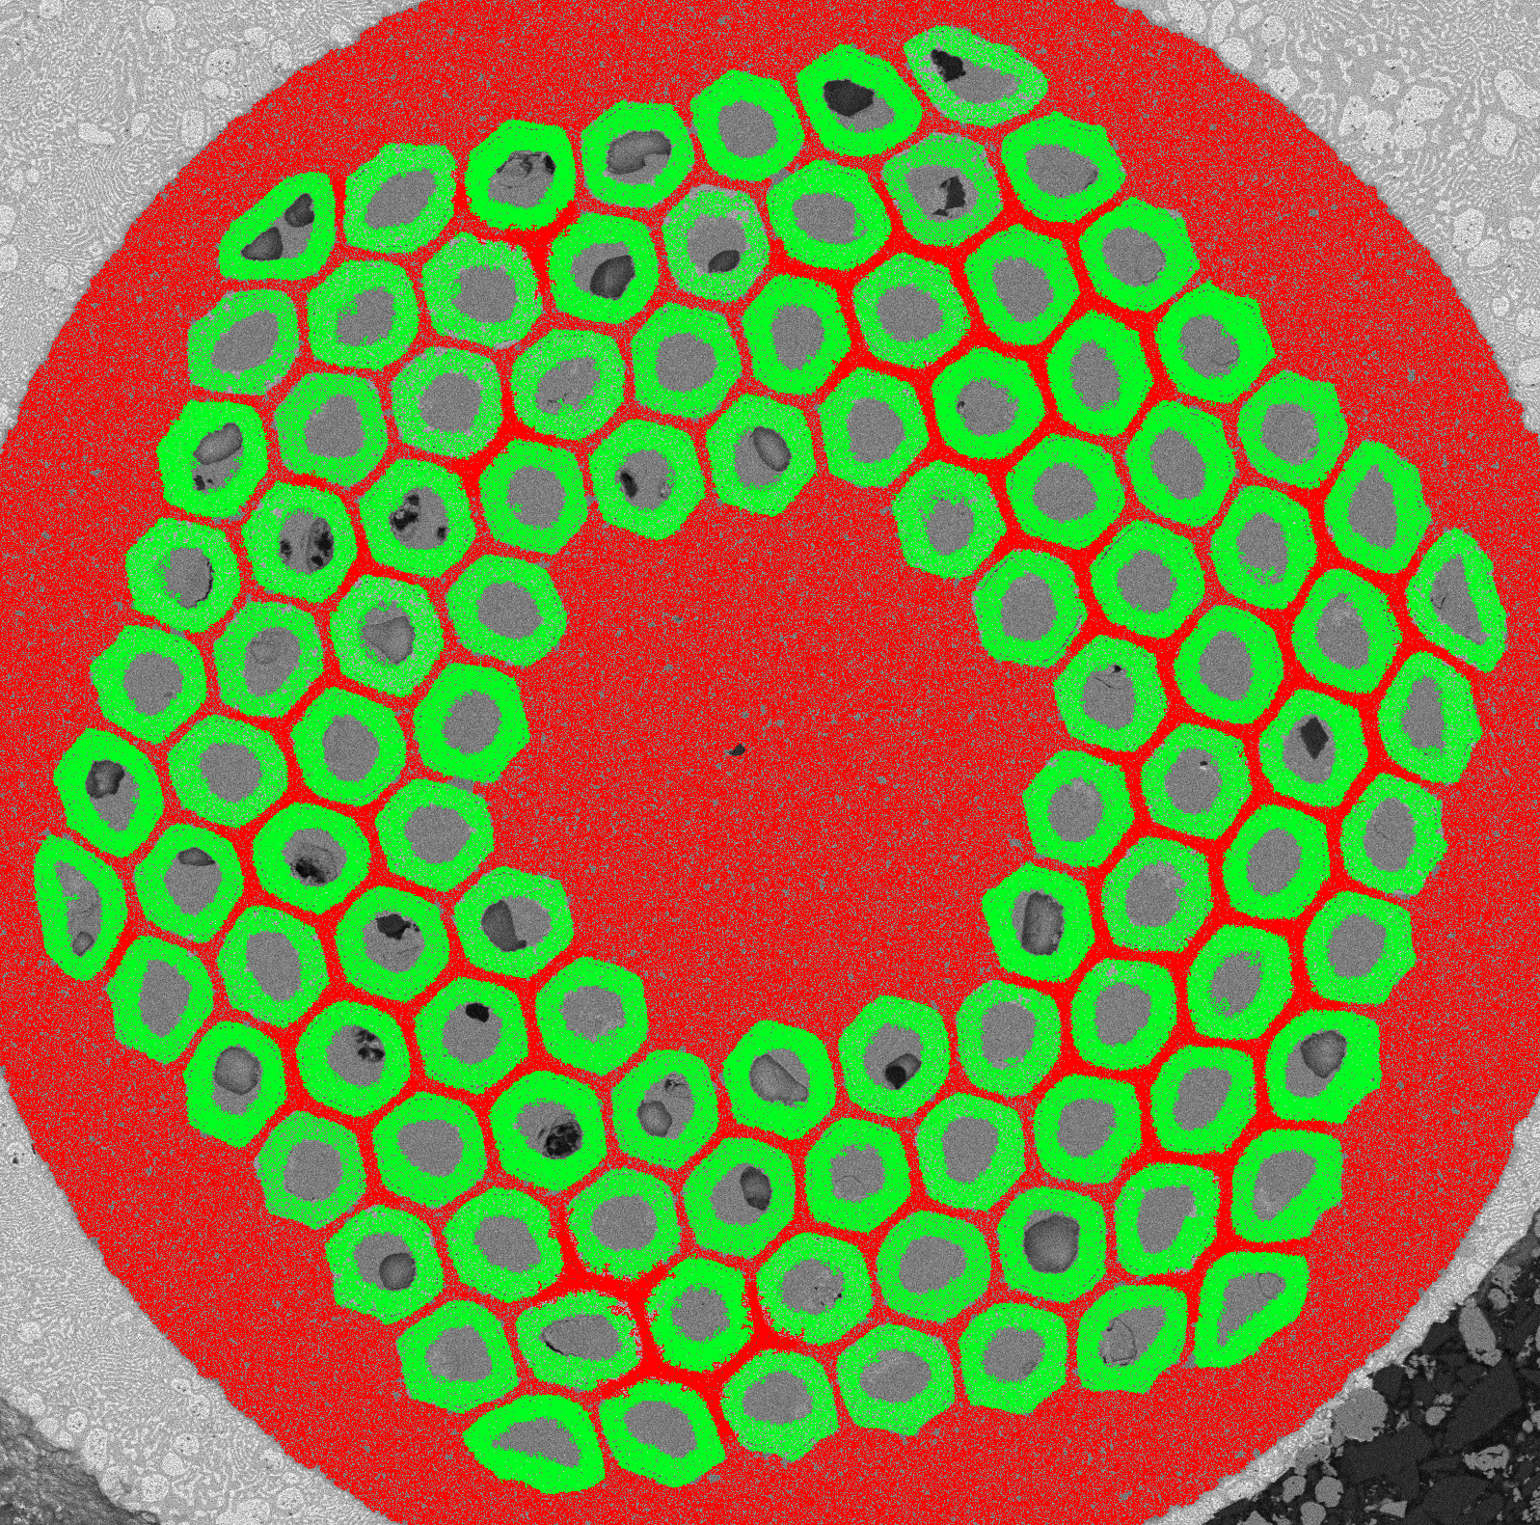
Effects of the internal oxidation on the superconducting properties
The FCC target for layer J_{c} is calculated based on the area fraction of reacted Nb₃Sn in a typical rod-type wire
Layer J_{c} above FCC target of 2500 A/mm², at 4.2 K and 16 T
Bovone G. et al. Superconductor Science and Technology 36.9 (2023): 095018.
FACULTY OF SCIENCES
DEPARTMENT OF QUANTUM MATTER PHYSICS
FACULTY OF SCIENCES
DEPARTMENT OF QUANTUM MATTER PHYSICS
3
11

Slide 14
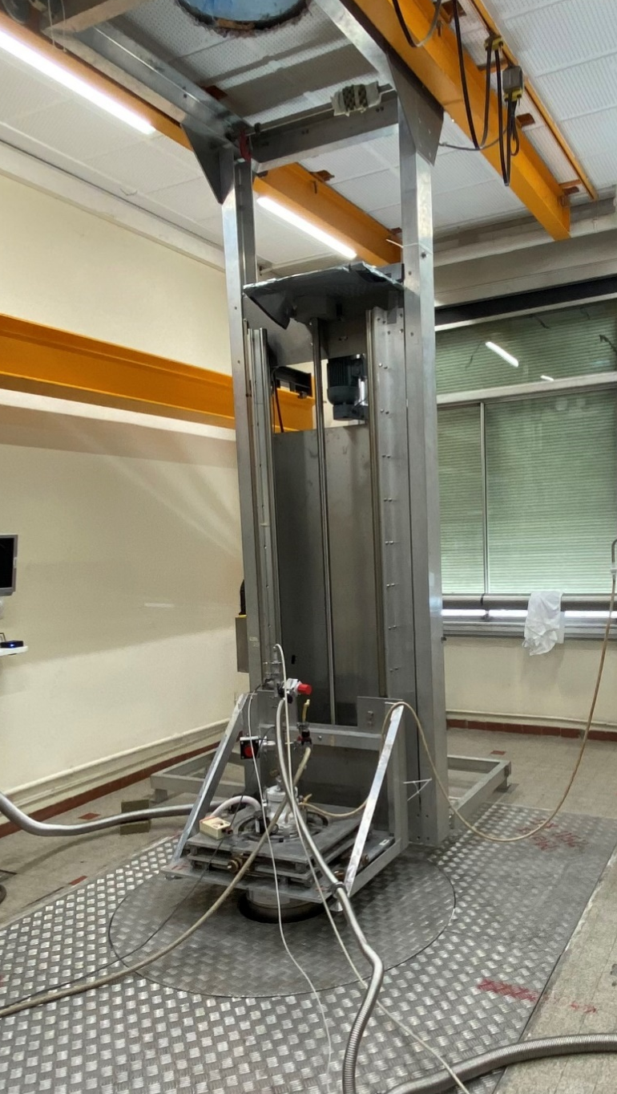
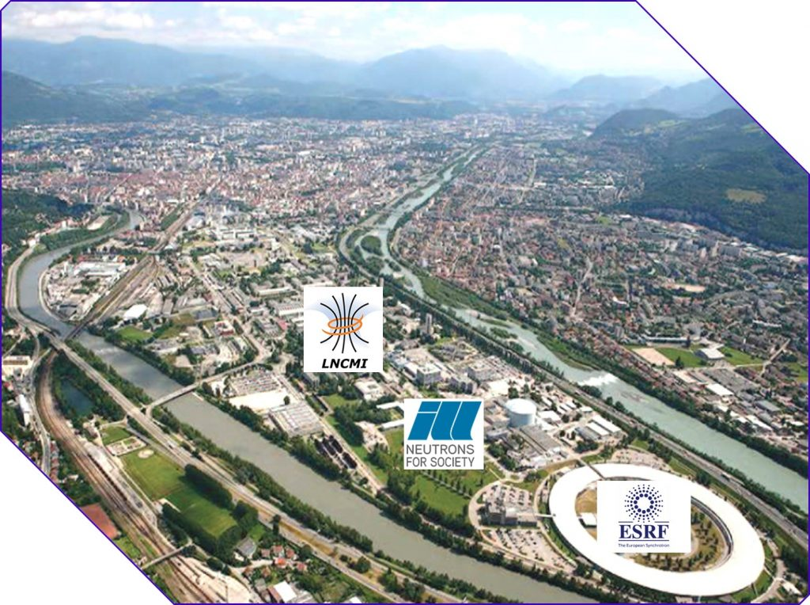

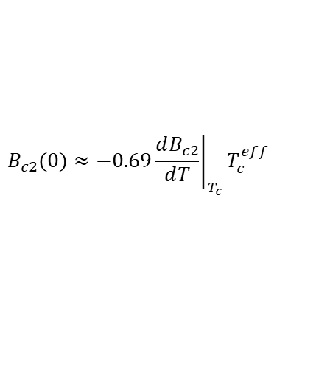

High magnetic field measurements
High-field measurements were performed at the Laboratoire National des Champs Magnétiques Intenses (LNCMI) in Grenoble
Magnetic field in Geneva limited to 19 T
1
2
3
4
WHH Model
Thermometer 1
Thermometer 2
$$B_{c2}(0)≈−0.69{\left.\frac{ⅆB_{c2}}{ⅆT}\right|}_{T_{c}}T_{c}^{eff}$$
Bc₂ results at low magnetic fields overlap with measurements in Geneva, but high-field results are higher than extrapolated values
$$B_{c2}\left(T\right)=B_{c2}(0)\left(1−{\left(\frac{T}{T_{c}}\right)}^{1.52}\right)$$
FACULTY OF SCIENCES
DEPARTMENT OF QUANTUM MATTER PHYSICS
FACULTY OF SCIENCES
DEPARTMENT OF QUANTUM MATTER PHYSICS
3
12

Slide 15
B_{c2} enhancement
Nb alloy | B_{c2} (T) 4.2 K, 99 % R no-OS | B_{c2} (T) 4.2 K, 99 % R Core-OS | B_{c2} (T) 4.2 K, 99 % R Annular-OS
Nb 7.5%^{wt} Ta 1%^{wt} Zr | 28.0 ± 0.60 | 28.97 ± 0.38 | 29.20 ± 0.38
Nb 7.5%^{wt} Ta 1%^{wt} Hf | 28.9 ± 0.56 | 29.0 ± 0.36 | 29.32 ± 0.36
Nb 7.5%^{wt} Ta | 28.01 ± 0.85 | N/A
Very high B_{c2} values measured for samples with internal oxidation
T = 4.2 K
FACULTY OF SCIENCES
DEPARTMENT OF QUANTUM MATTER PHYSICS
FACULTY OF SCIENCES
DEPARTMENT OF QUANTUM MATTER PHYSICS
3
13
Notes:
Qualche foto della probe

Slide 16



Pinning mechanism
M(H) loop from VSM SQUID in the temperature range 4.2 -14 K and B_{c2} from R(B) (1 % criteria)
Increase the grain boundary density i.e. refine the grain size
pinning force F_{P}
Additional of artificial pinning centers i.e. modify the pinning mechanism
Grain boundary pinning
Point defect pinning
$$F_{p}=J_{c}×B$$
0.2$B_{c2}$
Grain boundary pinning
0.33$B_{c2}$
Point defect pinning
magnetic field B
Modification of pinning mechanism when an oxygen source is added in presence of Hf and Zr
FACULTY OF SCIENCES
DEPARTMENT OF QUANTUM MATTER PHYSICS
FACULTY OF SCIENCES
DEPARTMENT OF QUANTUM MATTER PHYSICS
3
14
Notes:
Qualche foto della probe

Slide 17
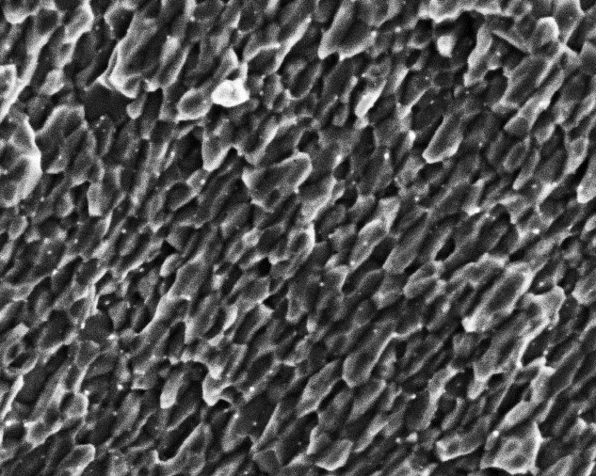

What drives the enhancement?
$$F_{p}=J_{c}×B$$
110 nm
Hf-noOS
100 nm
45 nm
Enhancement of B_{c2}
J_{c} enhancement due to precipitated oxides
Nb₃Sn grain size reduction induced by precipitates (HfO₂)
Modification of the pinning mechanism
Hf-annularOS
100 nm
Bovone G, et al. Superconductor Science and Technology 36.9 (2023): 095018
FACULTY OF SCIENCES
DEPARTMENT OF QUANTUM MATTER PHYSICS
FACULTY OF SCIENCES
DEPARTMENT OF QUANTUM MATTER PHYSICS
3
15
Notes:
Rivedere animazioni line Fp

Slide 18
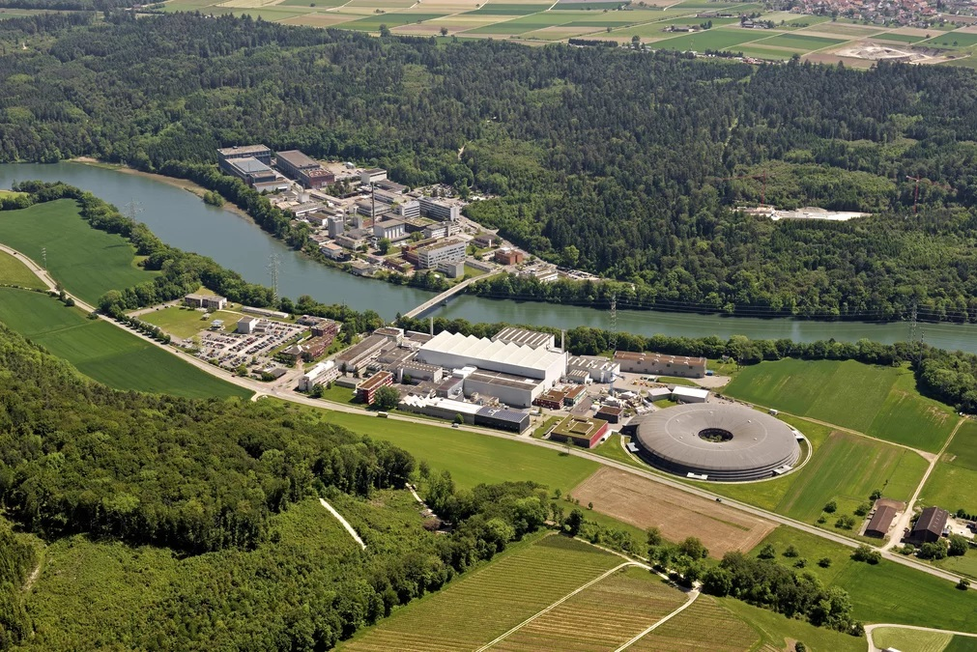
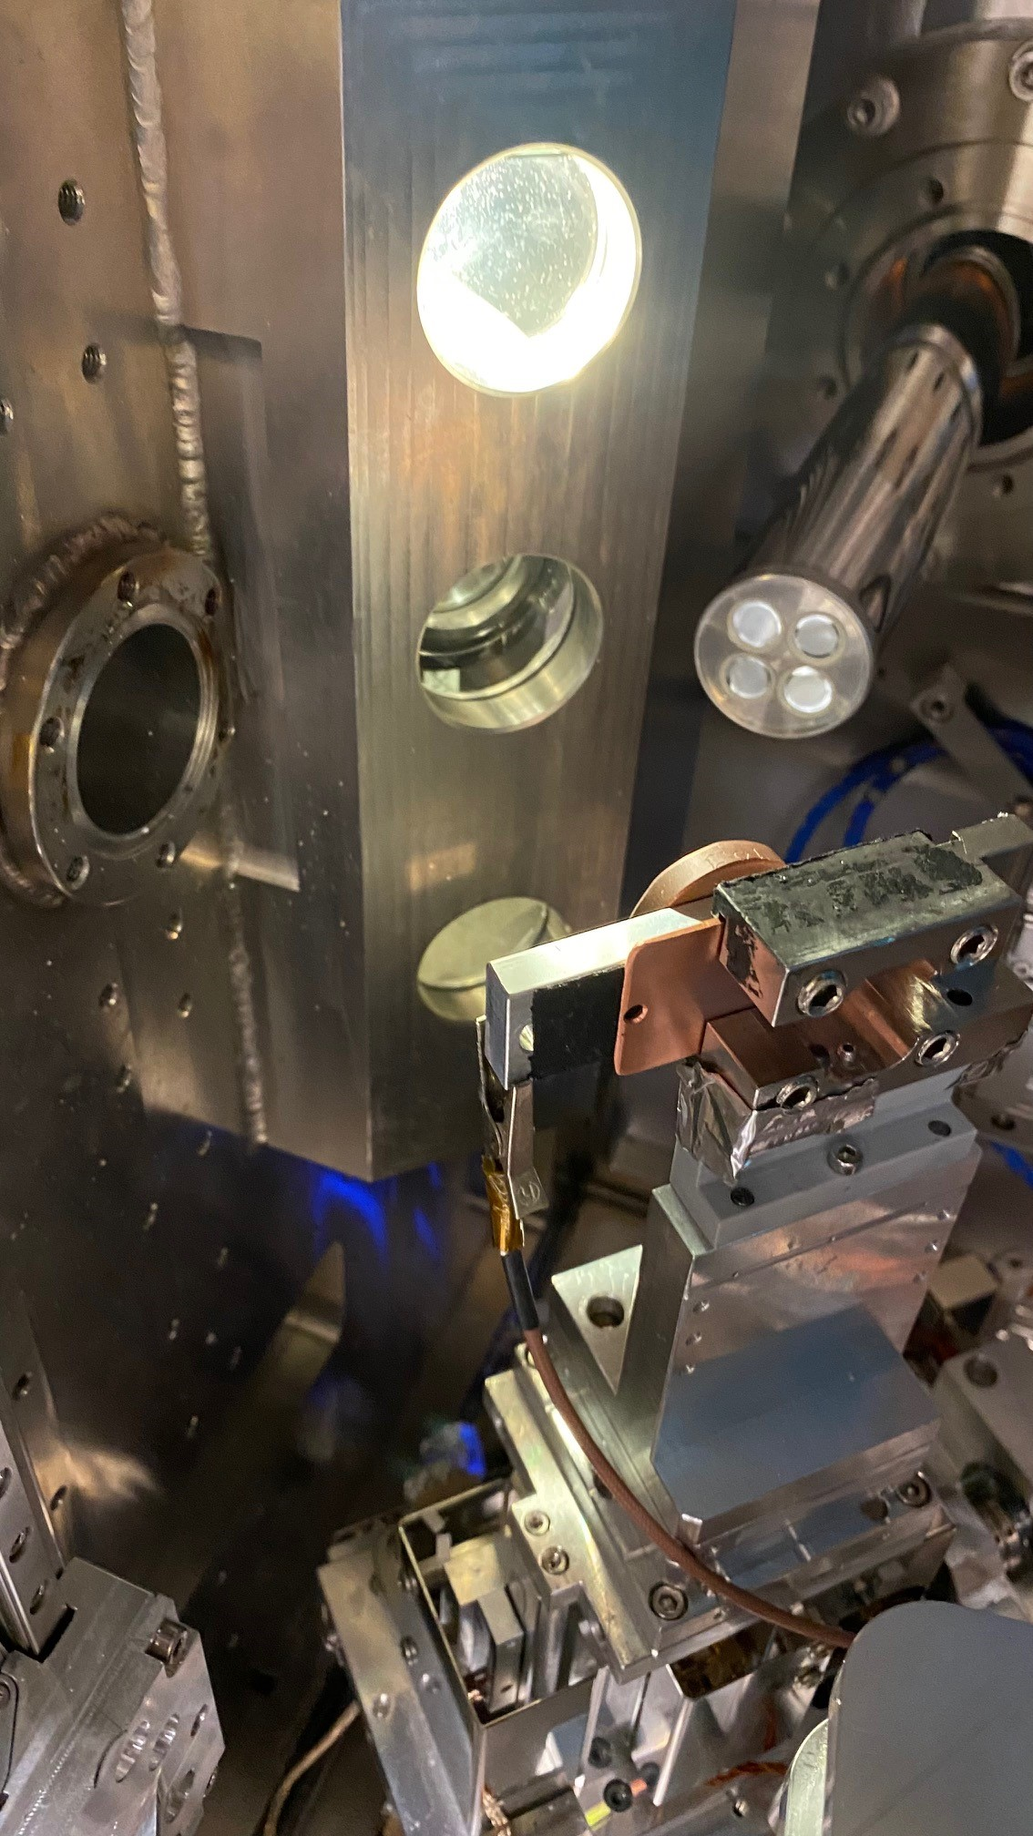
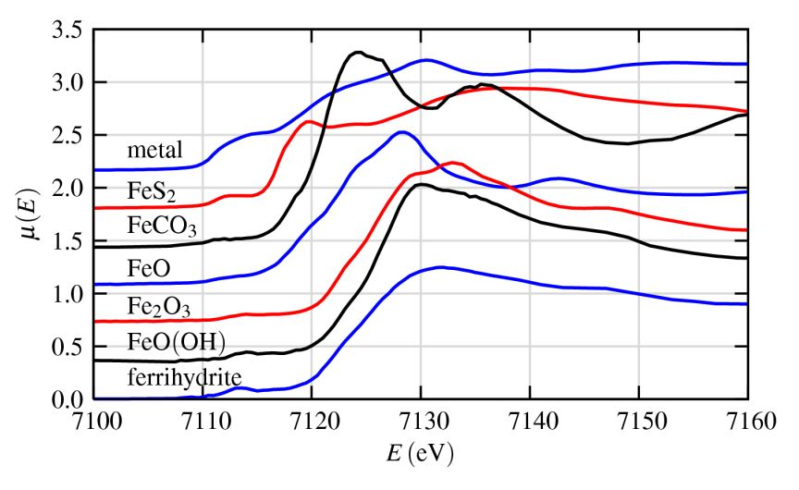
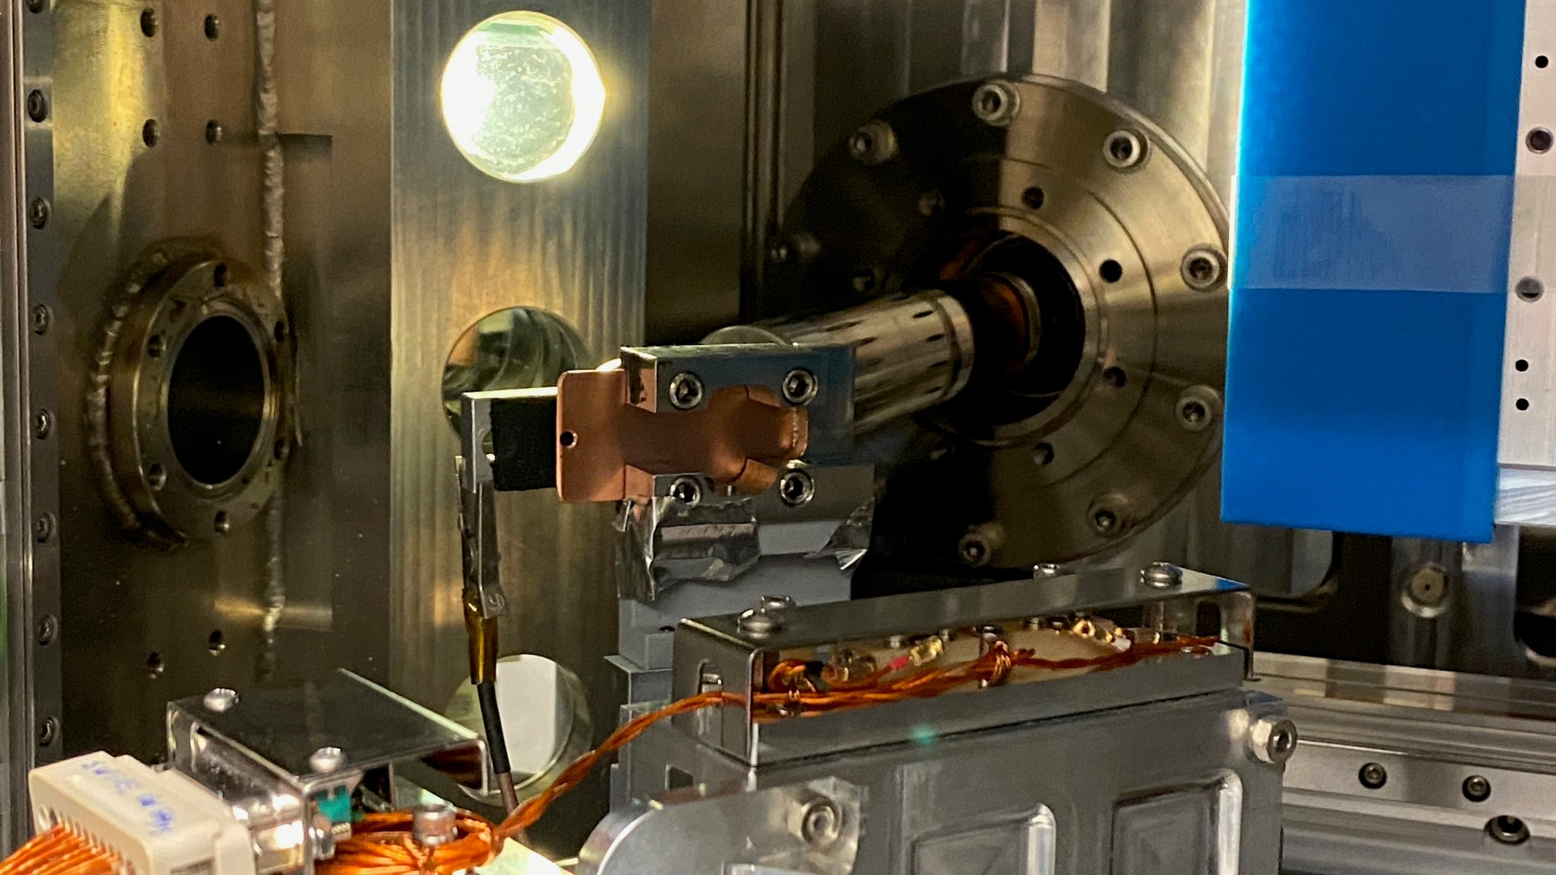
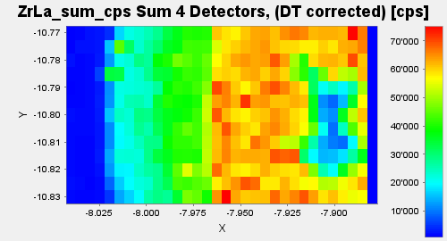
XANES investigation on precipitates
Nb₃Sn reaction layer
Zr – coreOS
Zr L₃ edge
Atomic specific technique, sensitive to the chemistry and to crystal environment
O diffusion
direction
SnO₂
Two peak fingerprint suppressed
Investigation of Zr spectrum in different region of the reacted (and unreacted) wires
5
1
Phoenix Beamline
ZrO₂–like spectrum found only in Nb₃Sn! Different Zr spectrum in residual alloy, despite oxygen diffusion
Bovone G et al. IEEE Transactions on Applied Superconductivity 34.3 (2024),6000205.
FACULTY OF SCIENCES
DEPARTMENT OF QUANTUM MATTER PHYSICS
FACULTY OF SCIENCES
DEPARTMENT OF QUANTUM MATTER PHYSICS
3
16
Notes:
Logo nuovo PSI

Slide 19
What did we learn from XANES?
Zr in Nb₃Sn is fully oxidised to ZrO₂
Zr in the residual alloy is not in the form of ZrO₂, but changes in the spectra suggest modifications induced by oxygen diffusion. Clusters?
ZrO₂ precipitates due to the lower solubility of Zr and O in Nb₃Sn compared to Nb
FACULTY OF SCIENCES
DEPARTMENT OF QUANTUM MATTER PHYSICS
FACULTY OF SCIENCES
DEPARTMENT OF QUANTUM MATTER PHYSICS
3
17
Notes:
Aggiungere una slide di summary su XAS

Slide 20
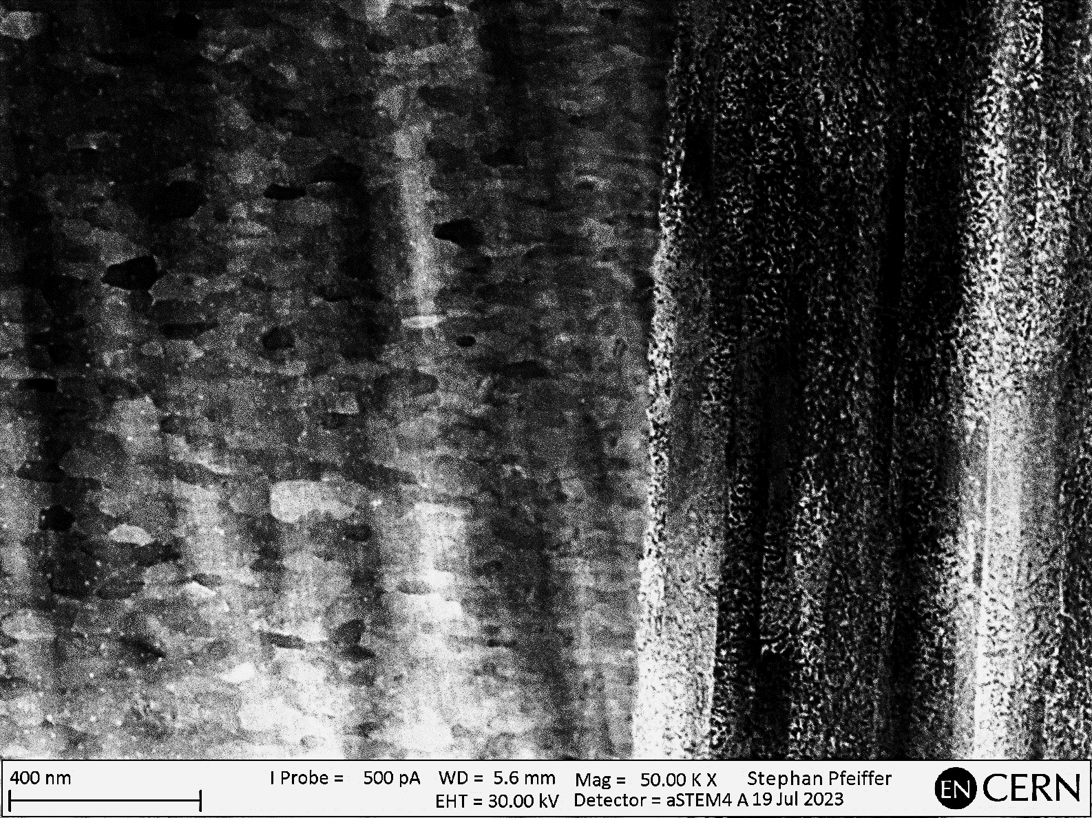
Precipitates at the interface
Nb₃Sn – residual alloy interface
No observable precipitates and no ZrO₂ fingerprint from XAS. However, Zr-O clusters may be present
Nb₃Sn
No observable ZrO₂ in the Nb₃Sn area next to the residual alloy interface. Are the precipitates too small to be detected with the microscope used?
Residual alloy
Uniform distribution of ZrO₂ precipitates
Courtesy of Stephan Pfeiffer, CERN
Hall, Ernest L., et al. MRS Online Proceedings Library (OPL) 205 (1990).
FACULTY OF SCIENCES
DEPARTMENT OF QUANTUM MATTER PHYSICS
FACULTY OF SCIENCES
DEPARTMENT OF QUANTUM MATTER PHYSICS
3
18
Notes:
Se non ci sto con I tempi taglio

Slide 21
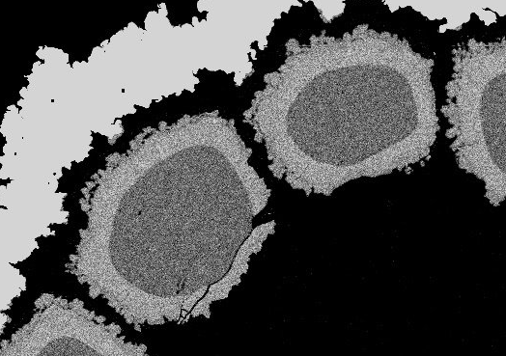
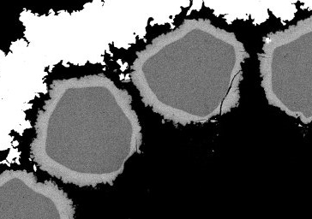
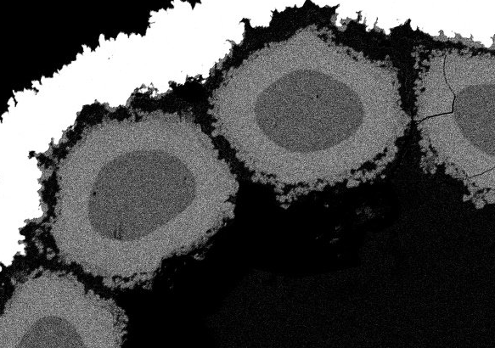
Heat treatment optimization:
reaction layer thickness
With OS
700 °C × 50 h
Heat treatment (HT):
550°C × 100 h + 650°C × 200 h
No OS
With OS
50 µm
700 °C × 100 h
50 µm
50 µm
Drastic reduction of Nb₃Sn layer thickness when OS is added
Higher temperature to enlarge Nb₃Sn layer thickness keeping grain size low
Significant increase of layer thickness at 700 °C
50 µm
FACULTY OF SCIENCES
DEPARTMENT OF QUANTUM MATTER PHYSICS
FACULTY OF SCIENCES
DEPARTMENT OF QUANTUM MATTER PHYSICS
3
19
Notes:
Scrivere del fit usato con formula

Slide 22
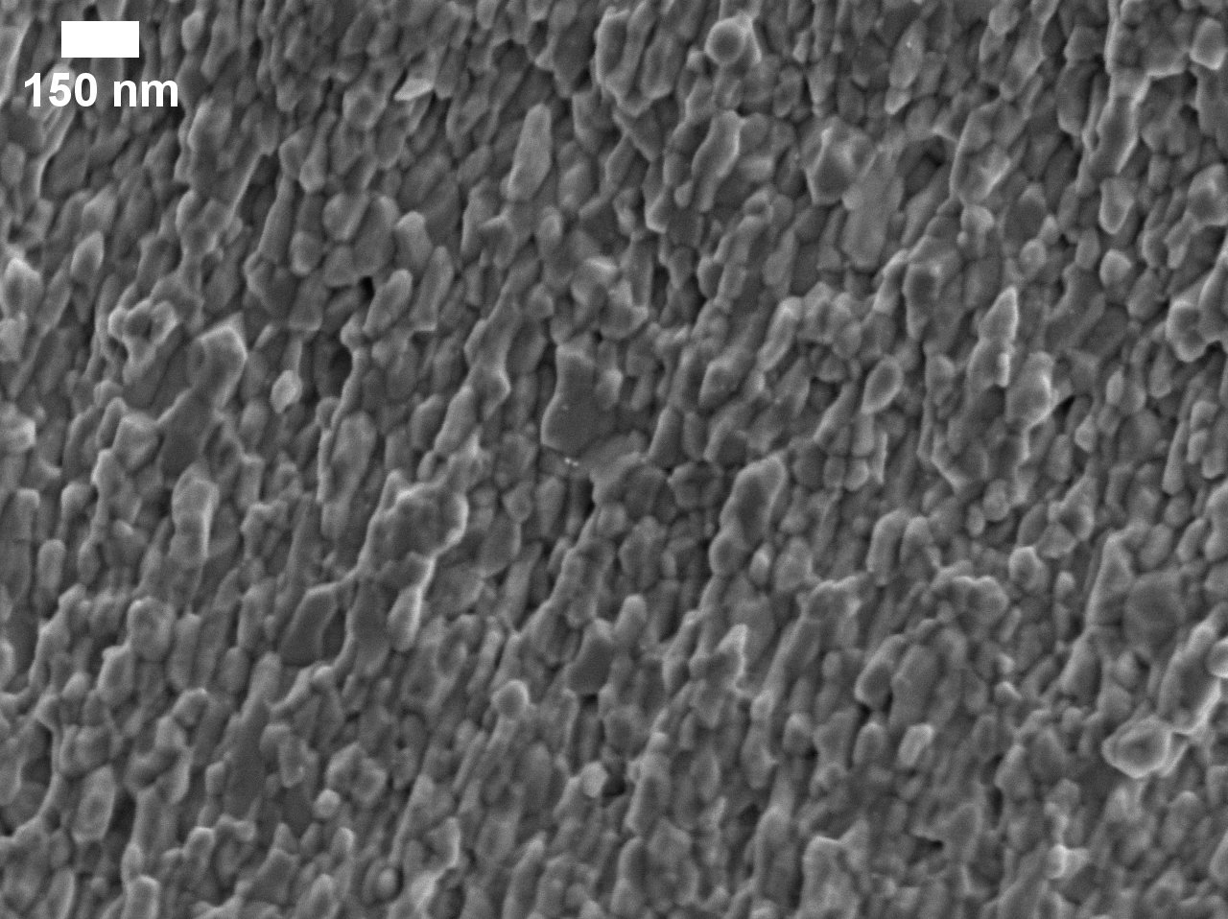
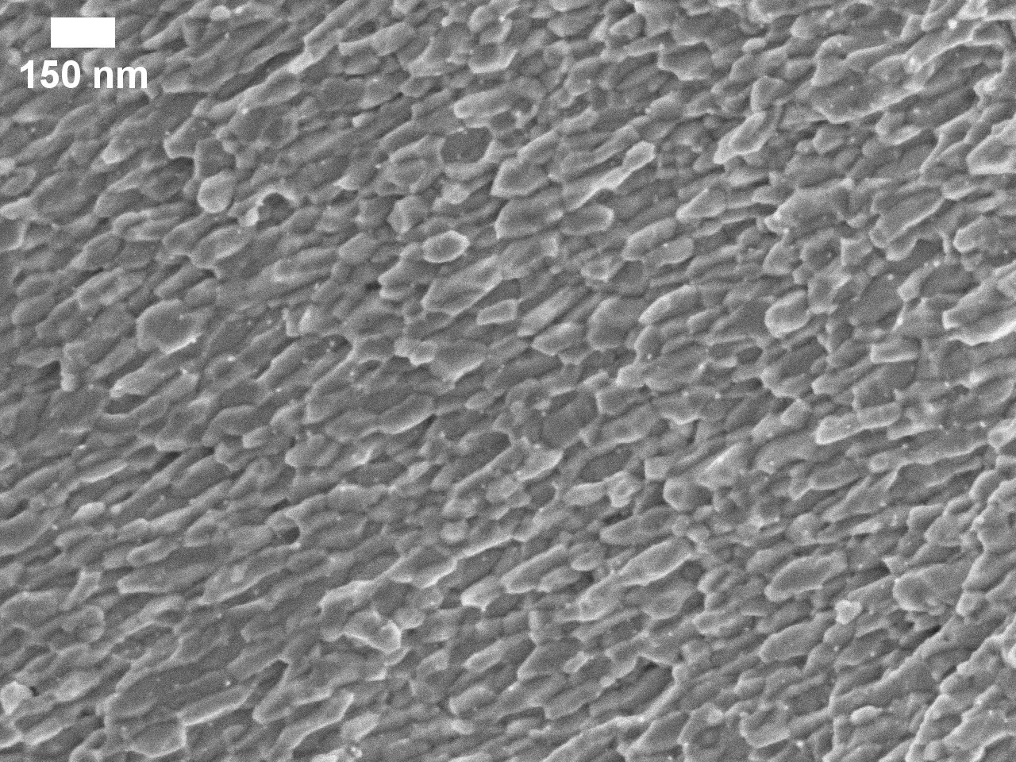
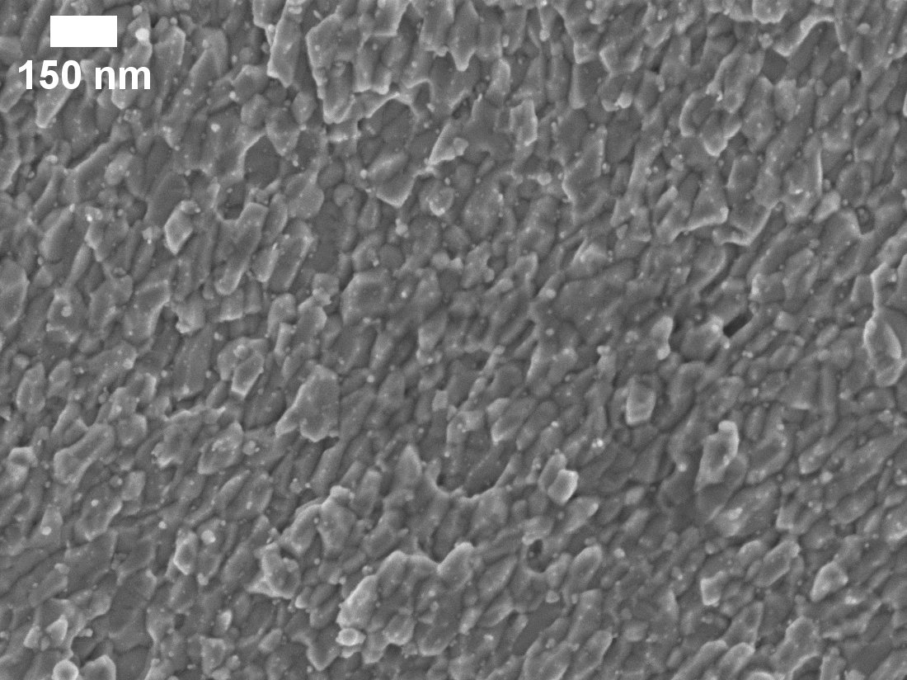
Heat treatment optimization:
reaction layer thickness
With OS
700 °C × 50 h
56 nm
Heat treatment (HT):
550°C × 100 h + 650°C × 200 h
No OS
With OS
52 nm
150 nm
110 nm
50 µm
700 °C × 100 h
50 µm
50 µm
58 nm
Drastic reduction of Nb₃Sn layer thickness when OS is added
Higher temperature to enlarge Nb₃Sn layer thickness keeping grain size low
Significant increase of layer thickness at 700 °C, but modest grain growth
Significant increase of layer thickness at 700 °C
50 µm
FACULTY OF SCIENCES
DEPARTMENT OF QUANTUM MATTER PHYSICS
FACULTY OF SCIENCES
DEPARTMENT OF QUANTUM MATTER PHYSICS
3
19

Slide 23
Heat treatment optimization:
layer-J_{c}
F_{p} (max) shift to 0.2 when HT at 700°C
Why J_{c} is lower despite the small grain size?
Criterion 0.1 µV cm⁻¹
Lower interaction between flux lines and precipitates due to size mismatch
Lonardo F. et al. IEEE Transactions on Applied Superconductivity 34.5 (2024), 6000305
FACULTY OF SCIENCES
DEPARTMENT OF QUANTUM MATTER PHYSICS
FACULTY OF SCIENCES
DEPARTMENT OF QUANTUM MATTER PHYSICS
3
20
Notes:
Cambiare spiegazione

Slide 24

Problems in pinning mechanism analysis
To determine the pinning mechanism, we need to precisely locate the position of the F_{p} peak in the reduced field (b)
$$b=\frac{B}{B_{c2}}$$
FACULTY OF SCIENCES
DEPARTMENT OF QUANTUM MATTER PHYSICS
FACULTY OF SCIENCES
DEPARTMENT OF QUANTUM MATTER PHYSICS
3
21
Notes:
Mettere le istereresi per far capire meglio il discorso.

Slide 25
Problems in pinning mechanism analysis
At 4.2 K the loop doesn’t close. We need to extrapolate
At high temperature the hysteresis loop closes (B_{c2})
Or use B_{c2} values measured with different techniques
To determine the pinning mechanism, we need to precisely locate the position of the F_{p} peak in the reduced field (b)
New campaign for VSM measurements up to 30 T at EMFL in Nijmegen
$$b=\frac{B}{B_{c2}}$$
FACULTY OF SCIENCES
DEPARTMENT OF QUANTUM MATTER PHYSICS
FACULTY OF SCIENCES
DEPARTMENT OF QUANTUM MATTER PHYSICS
3
21
Notes:
Mettere le istereresi per far capire meglio il discorso.

Slide 26
Conclusions
We successfully enhanced the layer J_{c} above the FCC specifications, record-high B_{c2} and change of pinning mechanism (point defect) when Oxygen Source is present, for wires reacted at 650 °C
X-Rays Absorption Near Edge Structure (XANES) on Nb₃Sn wires with and without OS show the presence of ZrO₂ only in the Nb₃Sn layer and not in the unreacted alloy
The layer J_{c} (16 T, 4.2 K) is strongly enhanced by the shift of F_{p}(max) to a higher magnetic field, due to B_{c2} enhancement and/or a modified pinning mechanism
Internal oxidation is the most effective way to reduce grain size, enhance B_{c2} and modify the pinning mechanism
Despite its “age”, Nb₃Sn can still play a role in the future generation of high magnetic field magnets
FACULTY OF SCIENCES
DEPARTMENT OF QUANTUM MATTER PHYSICS
FACULTY OF SCIENCES
DEPARTMENT OF QUANTUM MATTER PHYSICS
3
22

Slide 27
Thank you for your attention

Slide 28
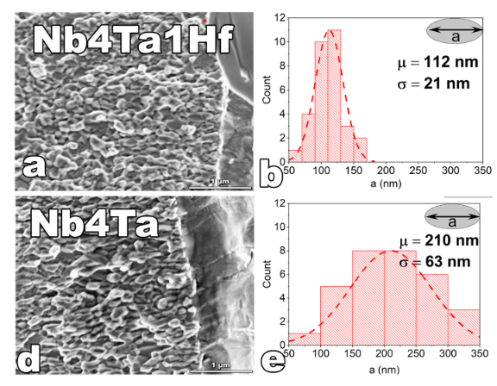
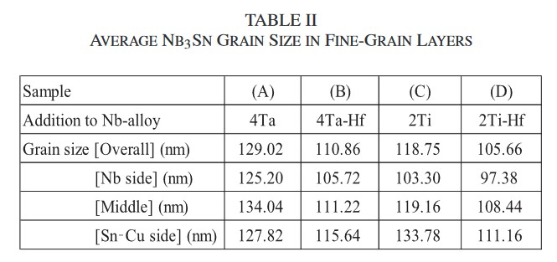
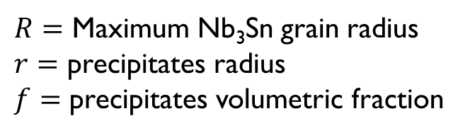

But are precipitates necessary?
Precipitates reduce Nb₃Sn grain size through the Zener drag effect
$R=\frac{4r}{3f}$
$R=$ Maximum Nb₃Sn grain radius
$r=$ precipitates radius
$f=$ precipitates volumetric fraction
Hf-noOS
100 nm
Some groups observed grain refinement without the addition of an oxygen source
Is the refinement observed here enough to reach the FCC target?
- Bovone G et al. IEEE Transactions on Applied Superconductivity 34.3 (2024),6000205.
- Xu X et al. Scripta Materialia 186 (2020): 317-320.
- Asai K et al. IEEE Transactions on Applied Superconductivity 34.5 (2024), 8600105
- Balachandran S et al. Journal of Alloys and Compounds 984 (2024): 173985.
Hf-annularOS
100 nm
FACULTY OF SCIENCES
DEPARTMENT OF QUANTUM MATTER PHYSICS
FACULTY OF SCIENCES
DEPARTMENT OF QUANTUM MATTER PHYSICS
3
21

Slide 29
How to reach the FCC target
B_{c2} value and pinning mechanism play a role in the enhancement of J_{c} (16 T, 4.2 K)
Samples that overcome the FCC target
Shift of F_{p}(max) towards higher field largely enhance the layer J_{c}
Refinement window with only Hf addition
FCC target
Samples with internal oxidation below FCC target
Not only grain refinement enhance the layer J_{c} (16 T, 4.2 K)
- Bovone G et al. Superconductor Science and Technology 36.9 (2023): 095018
- Lonardo F et al. IEEE Transactions on Applied Superconductivity (2024).
- Xu X et al. Scripta Materialia 186 (2020): 317-320.
- Xu X et al. arXiv preprint arXiv:1411.5397 (2014)
- Godeke A. Superconductor Science and Technology 19.8 (2006): R68.
- Fischer C. Master’s Thesis Univ. of Wisconsin-Madison (2002).
- Balachandran S et al. Superconductor Science and Technology 32.4 (2019): 044006.
FACULTY OF SCIENCES
DEPARTMENT OF QUANTUM MATTER PHYSICS
FACULTY OF SCIENCES
DEPARTMENT OF QUANTUM MATTER PHYSICS
3
22

Slide 30
Combined behavior
The FCC target at 16 T and 4.2 K is reached when both grain size is refined and F_{p}(max) is shifted at higher magnetic field
Internal oxidation is fundamental to reach the FCC target due to grain refinement, B_{c2} enhancement, and modification of pinning mechanism
- Balachandran S et al. Superconductor Science and Technology 32.4 (2019): 044006.
- Xu X et al. Scripta Materialia 186 (2020): 317-320..
- Fischer C. Master’s Thesis Univ. of Wisconsin-Madison (2002).
- Bovone G et al. Superconductor Science and Technology 36.9 (2023): 095018
- Lonardo F et al. IEEE Transactions on Applied Superconductivity 34.5 (2024), 6000305
- Xu X et al. arXiv preprint arXiv:1411.5397 (2014).
FACULTY OF SCIENCES
DEPARTMENT OF QUANTUM MATTER PHYSICS
FACULTY OF SCIENCES
DEPARTMENT OF QUANTUM MATTER PHYSICS
3
23

