Slide 1
The route to attosecond pulses
Anne L’Huillier, Physics Department, Lund University, Lund, Sweden

Slide 2
Outline
High-order harmonic generation
Attosecond light pulses
Attosecond physics

Slide 3
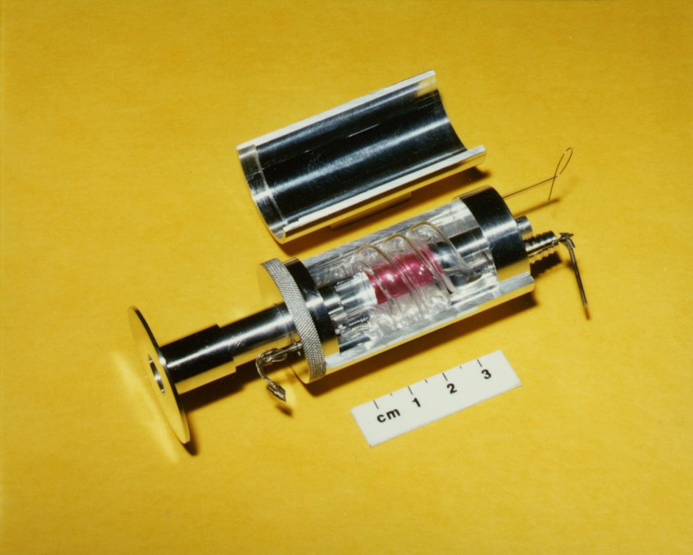


The invention of the laser
Nonlinear optics
Lejournal.cnrs.com
New frequencies
Maiman, Nature, 187, 493 (1960)
Franken et al, Phys. Rev. Lett. 7, 118 (1961)

Slide 4
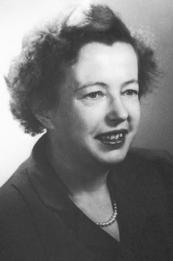
Atoms in strong laser fields
Xe²⁺
Multiphoton processes
@NobelPrize.org
Predicted in 1931 by
Maria Goeppert-Mayer
Xe⁺
Voronov et al. Sov. Phys. JETP (1966)
Agostini et al. Phys. Rev. Lett. 42, 1127 (1979)
L’Huillier et al. Phys. Rev. A 27, 2503 (1983)
Above-threshold
-ionization
Multiple ionization
Excitation
Ionization

Slide 5


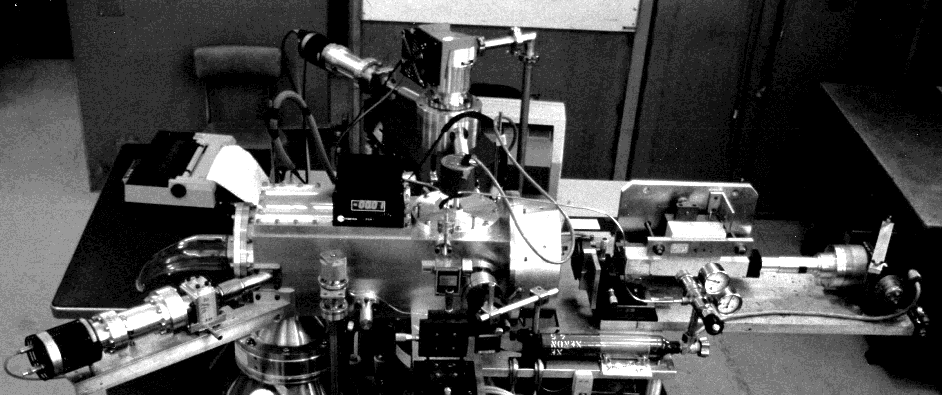
Fluorescence?
Grating
Intense laser pulse
Detector
Atoms
G. Mainfray C. Manus
Nd-YAG 1 μm 40 ps
Amplifiers
Perpendicular detection
Grating
Oscillator
I >10¹³ W cm⁻²
Lens
Detector

Slide 6
High-order harmonic generation (HHG)
Argon
Ferray et al. J. Phys B 21, L31 (1988)
McPherson et al. JOSA B 4, 595 (1987)

Slide 7
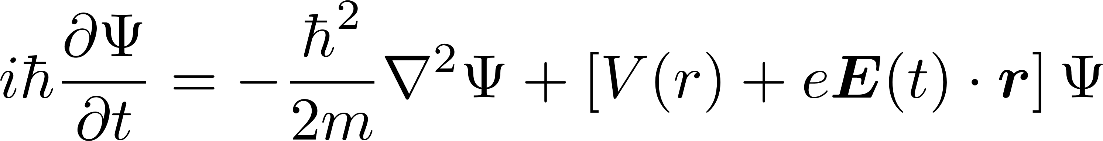
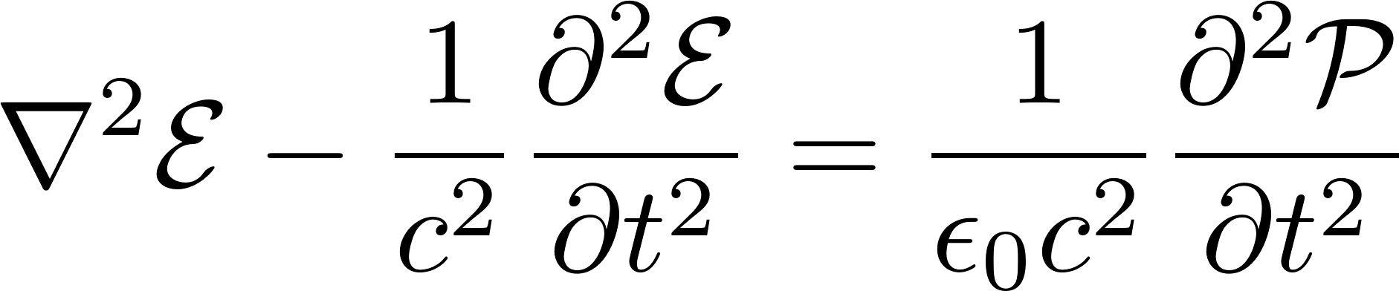
Atomic physics and nonlinear optics
Single-atom response
Many-atom response
Schrödinger equation
Maxwell equations Wave equation
Atomic potential
Laser-atom interaction
Generated field
Medium Polarization
Kulander and Shore, Phys. Rev. Lett. 62, 524 (1989)
L’Huillier, Schafer and Kulander, Phys. Rev. Lett. 66, 2200 (1991)

Slide 8
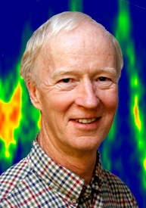
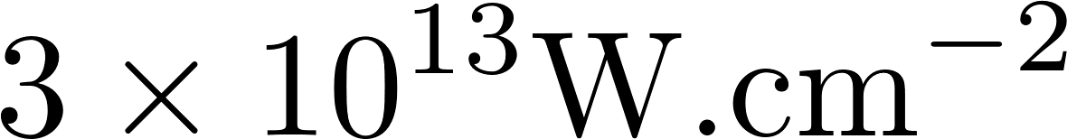
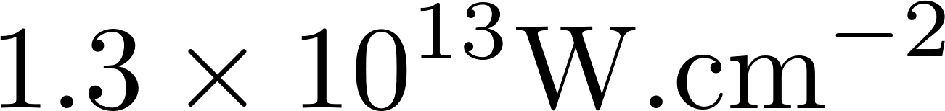
Numerical simulations
Strong field atomic physics
Strong field nonlinear optics
Xe
Kulander and Shore, Phys. Rev. Lett. 62, 524 (1989)
L’Huillier, Schafer and Kulander, Phys. Rev. Lett. 66, 2200 (1991)

Slide 9
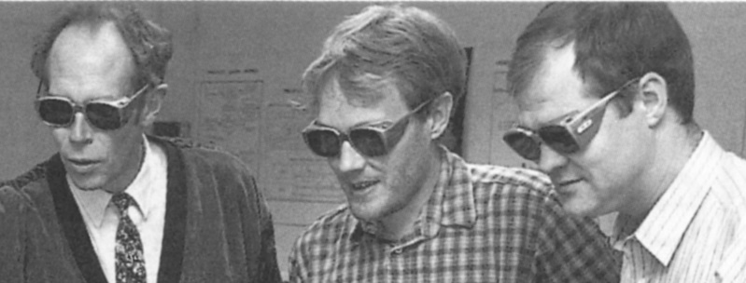



Progress in laser technology (I)
Chirped Pulse Amplification
Strickland, Mourou, Opt. Comm. 55, 447 (1985)
Sune Svanberg Anders Persson Claes-Göran Wahlström
G. Mourou
Donna Strickland
Titanium sapphire (Ti:S)
Moulton, J. Opt. Soc. Am. B 3, 125 (1986)
Kerr-lens mode-locking
Spence, Kean and Sibbett, Opt. Lett. 16, 42 (1991)
2018
“for their method of generating high-intensity, ultra-short optical pulses”
Terawatt Ti:S laser @ Lund Laser Centre
@NobelPrize.org

Slide 10
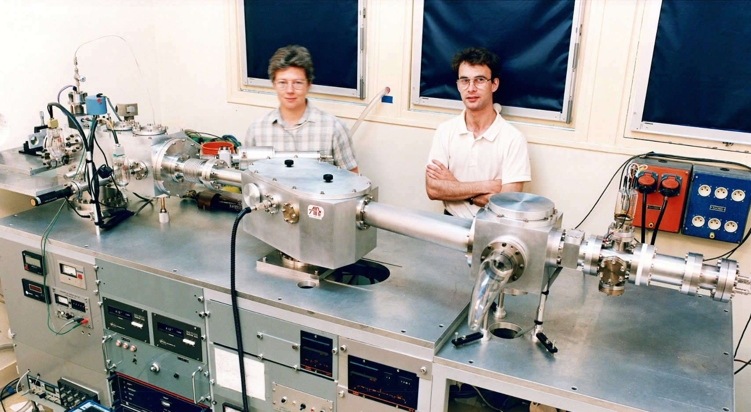

Progress in instrumentation
Nd:Glass laser 1 ps 1 shot/minute
L’Huillier and Balcou, Phys. Rev. Lett. 70, 774 (1993)
Ti: Sapphire 200 fs 10 Hz
Wahlström et al., Phys. Rev. A 48, 4709 (1993)
ALH
Ph. Balcou
P. Salières

Slide 11
Outline
High-order harmonic generation
Attosecond light pulses
Applications

Slide 12
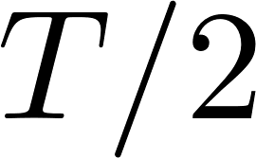
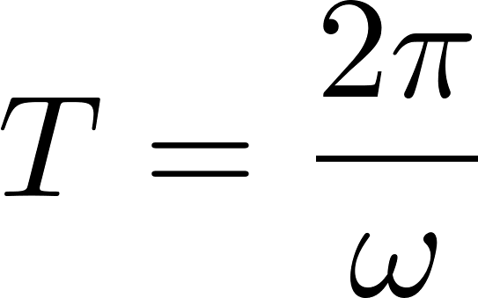


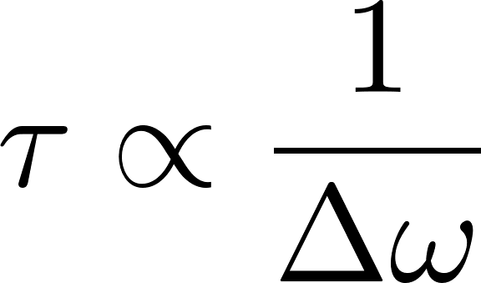

Attosecond pulses?
High frequency
+
Broad bandwidth
+
Are the harmonics phase-locked?
=
Farkas and Toth,
Phys. Lett. A 168, 447 (1992)
Harris, Macklin and Hänsch,
Opt. Comm. 100, 487 (1993)

Slide 13
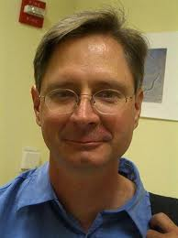
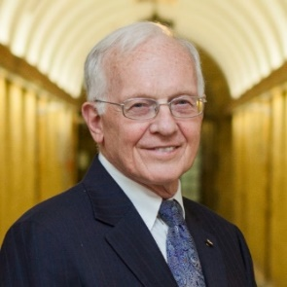


Progress in understanding: Strong field atomic physics
The three-step model
Return time
100 as
Kulander et al. Proc. SILAP, Han-sur-Lesse (1993)
Return energy 10 eV
Corkum Phys. Rev. Lett. 71, 1994 (1993)
Lewenstein et al. Phys. Rev. A 49, 2117 (1994)

Slide 14
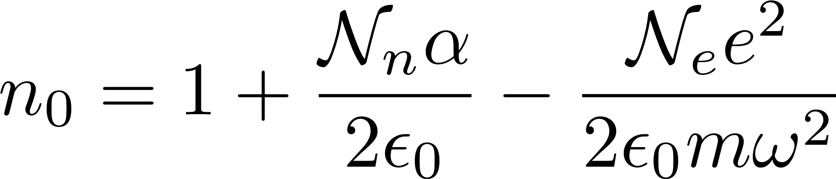
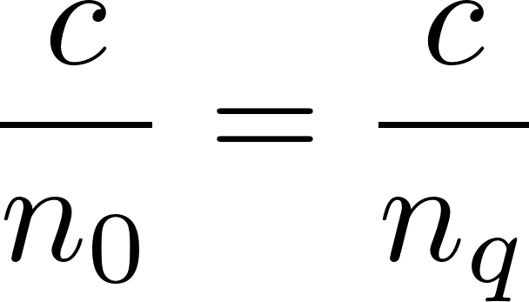
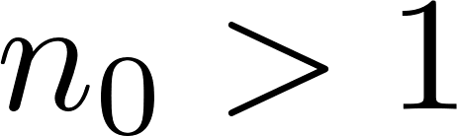
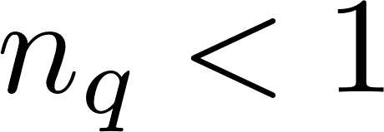
Progress in understanding: Phase matching
Phase velocity of the fundamental = Phase velocity of the harmonic fields
Degree of ionization = a few %
Influence of focusing
Attwood, ”X-ray and extreme ultraviolet radiation”, 2017

Slide 15
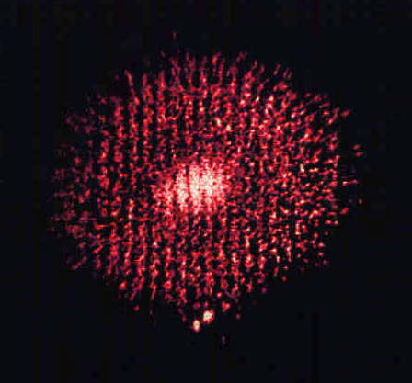
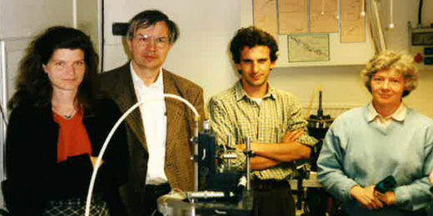
Progress in experiment: Short and long trajectories
Harmonic 15
Two harmonic sources
Detector
One harmonic source
Short and long trajectories
ALH
Mette Gaarde
Ted Hänsch
Marco Bellini
Claire Lyngå,
Claes-Göran Wahlström
Bellini et al. Phys. Rev. Lett. 81, 297 (1998)

Slide 16





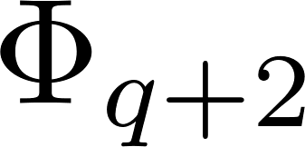
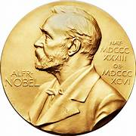
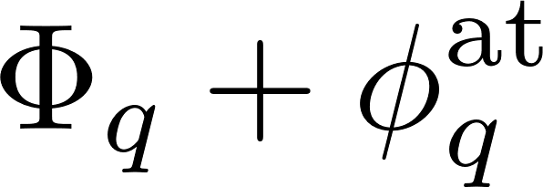

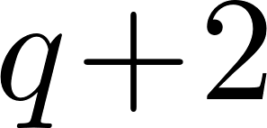
First measurement of attosecond pulses in a train
E
RABBIT
Side-band
Pierre Agostini
Véniard et al., Phys. Rev. A 54, 721 (1996)
Paul et al., Science 292, 1689 (2001)

Slide 17
Progress in laser technology (II)
Few-cycle laser pulses (< 10 fs)
Hollow fiber compression
Chirped mirrors
Measurement and control of the Carrier-Envelope Phase
Nisoli et al. Opt. Lett. 22, 522 (1997)
Kärtner et al., Opt. Lett. 22, 831 (1997)
Telle et al. Appl. Phys. B 69, 327 (1999)

Slide 18
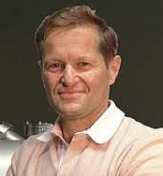
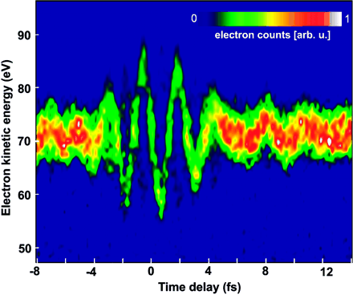
First measurement of isolated attosecond pulses
Streaking camera
-eA
Ferenc Krausz
p_{i}
τ=250 as
Henstchel et al., Nature 414, 509 (2001)
Goulielmakis et al., Science 305, 1267 (2004)

Slide 19
Outline
High-order harmonic generation
Attosecond light pulses
Applications
Atomic Spectroscopy
Industrial application

Slide 20
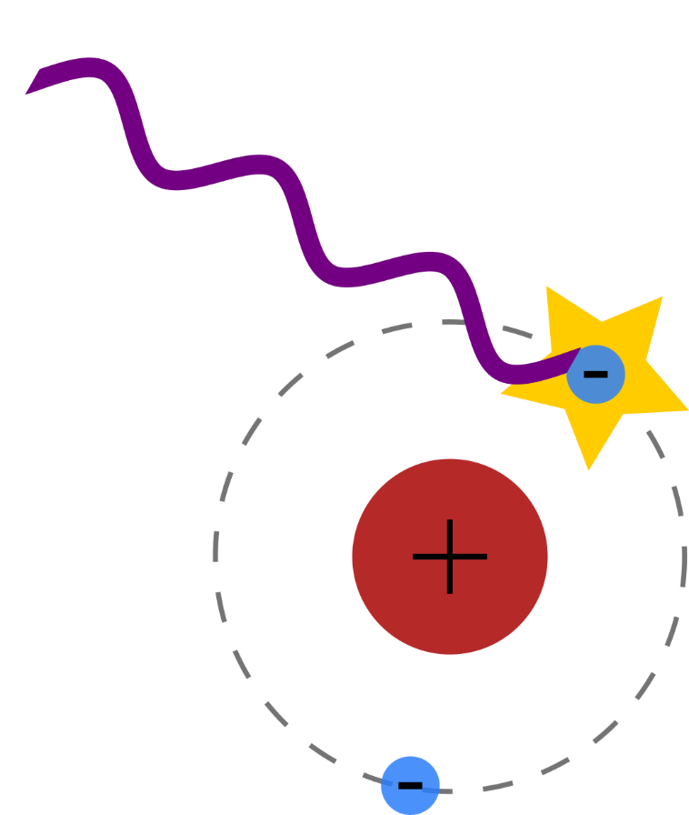
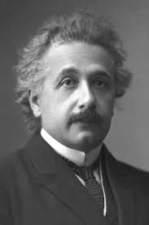
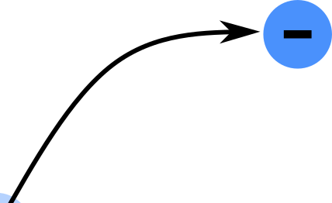
Temporal dynamics of photoionization
A. Einstein
What are the wave/quantum properties of the photoelectron?
“for his services to Theoretical Physics, and especially for his discovery of the law of the photoelectric effect”
Photoelectric effect
Hertz 1887
Einstein 1905
1921
@NobelPrize.org

Slide 21
Measuring the phase of a photoelectron
Non-resonant
attosecond excitation
Resonant harmonic
excitation
Discrete state
Cavalieri et al., Nature 449, 1029 (2007)
Schultze et al., Science 328, 1658 (2010)
Klünder et al., Phys. Rev. Lett. 106, 143002 (2011)
Haessler et al. Phys. Rev. A 80, 011404 (2009)
Kotur et al., Nat. Comm. 7, 10566 (2016)
Gruson et al., Science 354, 734, (2016)

Slide 22
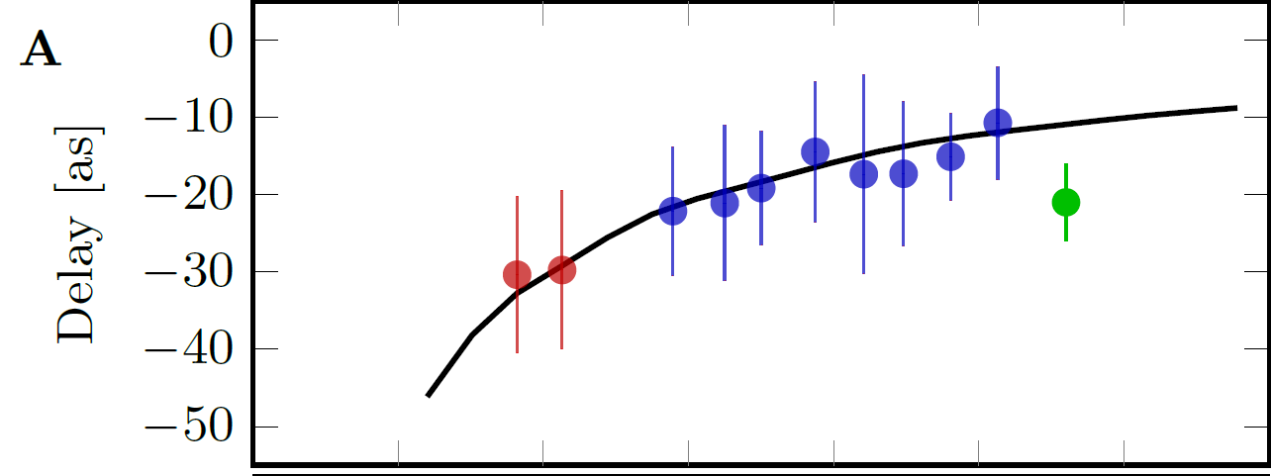
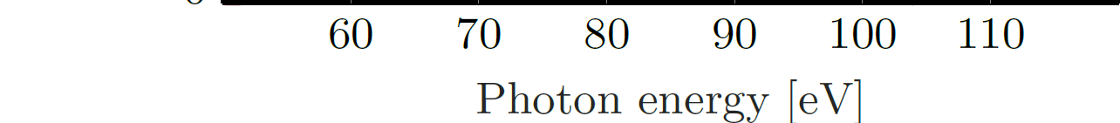
Differences in photoionization time delays
Ne 2s and 2p ionization
Ar 3s and 3p ionization
Schultze et al., Science 328, 1658 (2010)
Isinger et al., Science 358, 893 (2017)
Klünder et al., Phys. Rev. Lett. 106, 143002 (2011)
Alexandridi et al., Phys. Rev. Res. 3, L012012 (2021)

Slide 23
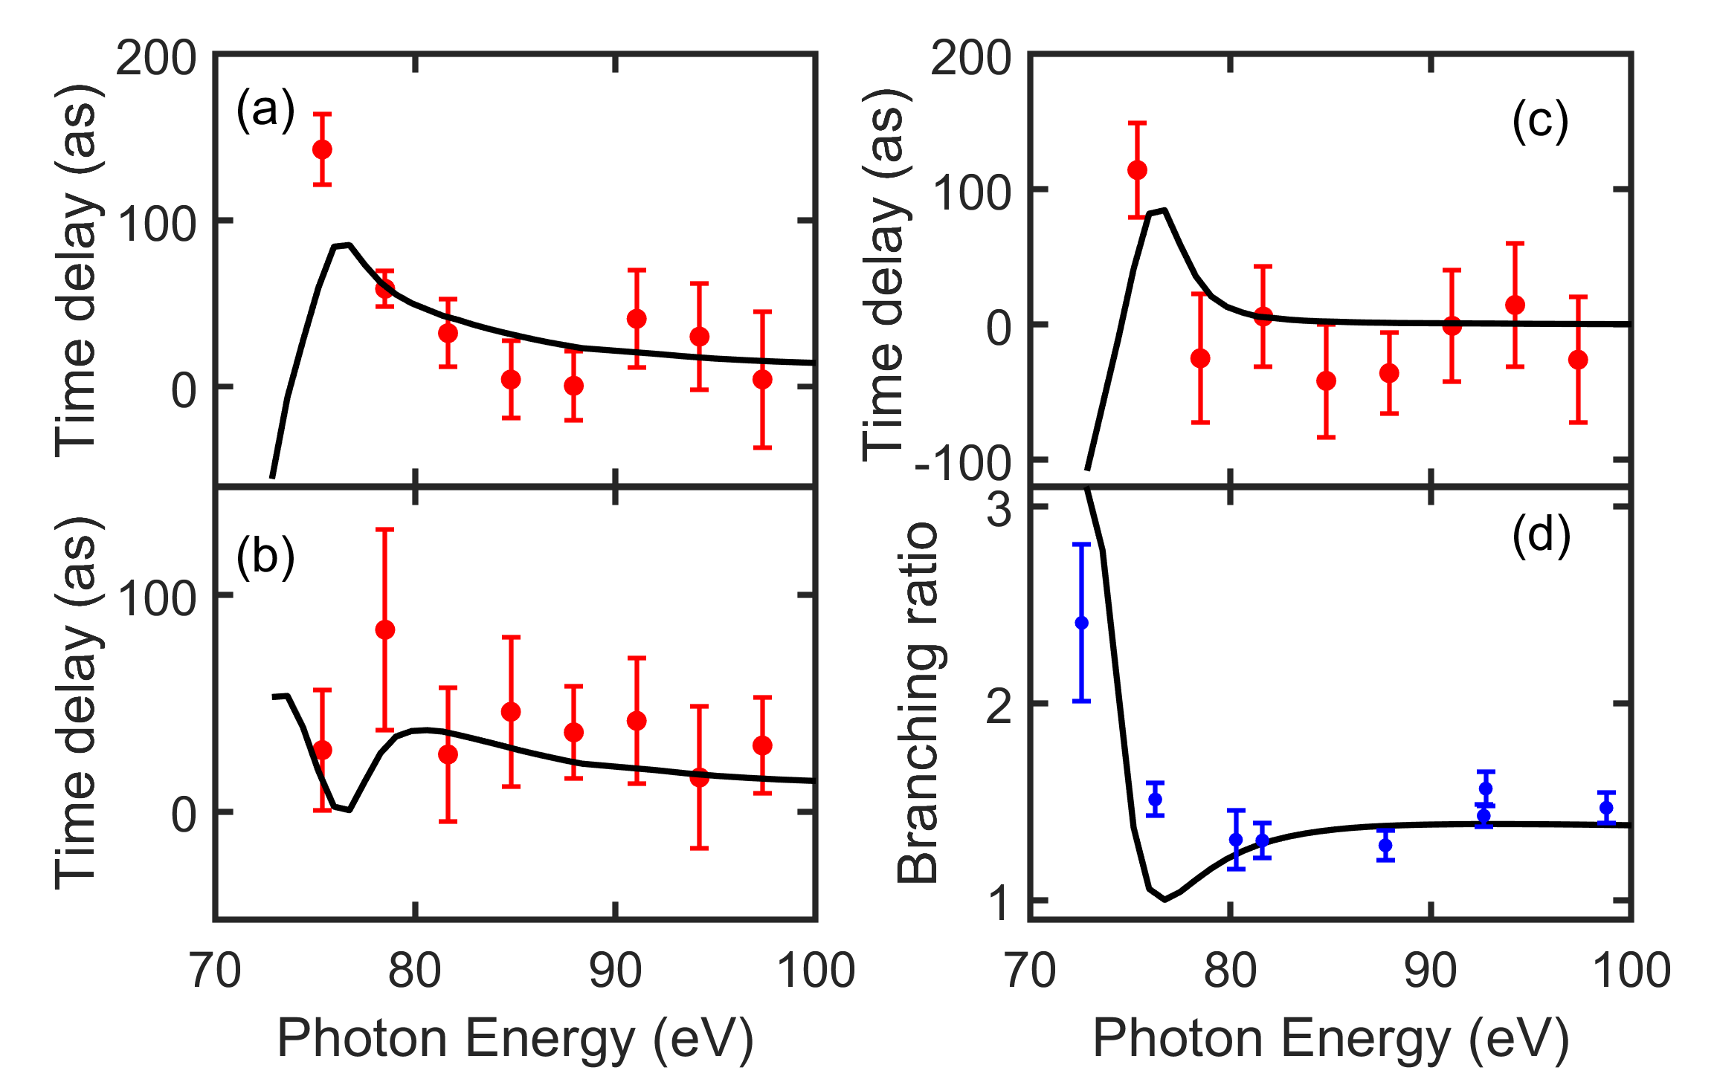
Photoionization time delays
Xe 4d shell ionization
Spin-orbit interaction
Angular distributions
Giant dipole resonance
Heuser et al., Phys. Rev. A 94, 063409 (2016)
Fuchs et al., Optica 7, 154 (2020)
Peschel et al., Nat. Comm. 13, 5205 (2022)
Measurement of the density matrix of a photoelectron
Bourasssin-Bouchet et al., Phys. Rev. X 10, 031048 (2020)
Laurell et al., Phys. Rev. Res. 4, 033220 (2022)
Laurell et al., arxiv.org/abs/2309.13945
Zhong et al., Nat Comm 11, 5042 (2020)

Slide 24
Progress in laser technology (III)
Ytterbium laser @1030 nm
10 -100 W, 200 fs
Post-compression in a multipass cell
High repetition rate > 100 kHz
High average power
Hönninger et al, Appl. Phys. B 69, 3 (1999)
Schulte et al., Opt. Lett. 41, 4511 (2016)
Viotti et al., Optica 9, 197 (2022)

Slide 25
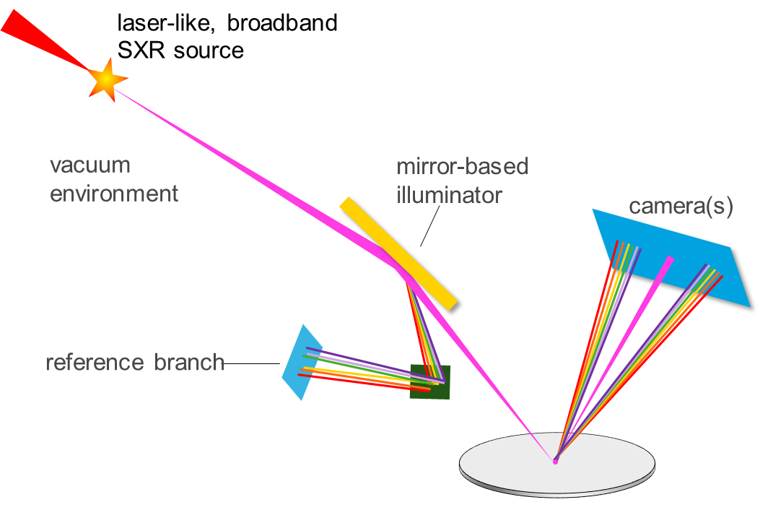
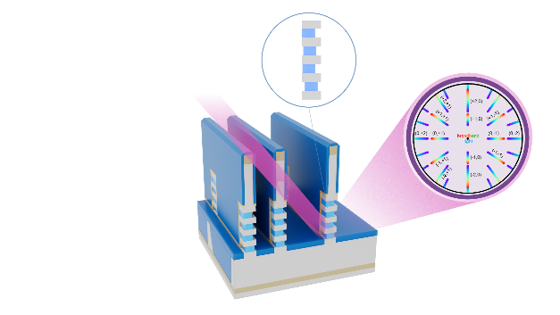

Application in semiconductor industry
HHG source (7-17 nm)
Metrology of chips based on soft X-ray scatterometry
Laser
3D structure
Mirror-based
illuminator
Camera
Pupil space
detection
Reference branch
Courtesy
300 mm silicon wafer
Supplier of lithography and metrology machines to the semiconductor industry
Porter et al., Proc. SPIE 12496, Metrology, Inspection and Process Control, XXXVII, 1249611 (2023)

Slide 26
Next chapter in attosecond science
Atomic spectroscopy
Attosecond chemistry
Condensed matter physics
Industrial applications
Ultrafast quantum dynamics
Applications in many fields
Attosecond sources via HHG: XUV range, low energy/pulse (nJ), often in a train
Attosecond sources via FEL: X-ray range, high energy/pulse (μJ), isolated
Wigner distribution

Slide 27
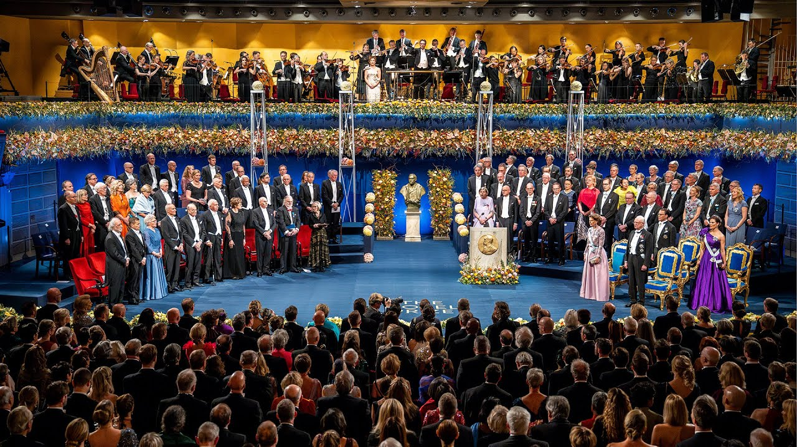
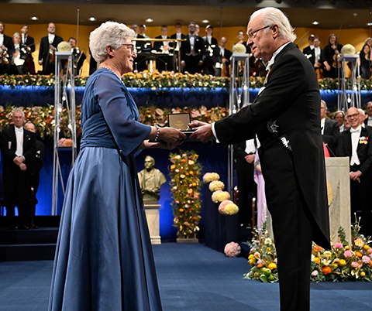
The prize ceremony

Slide 28
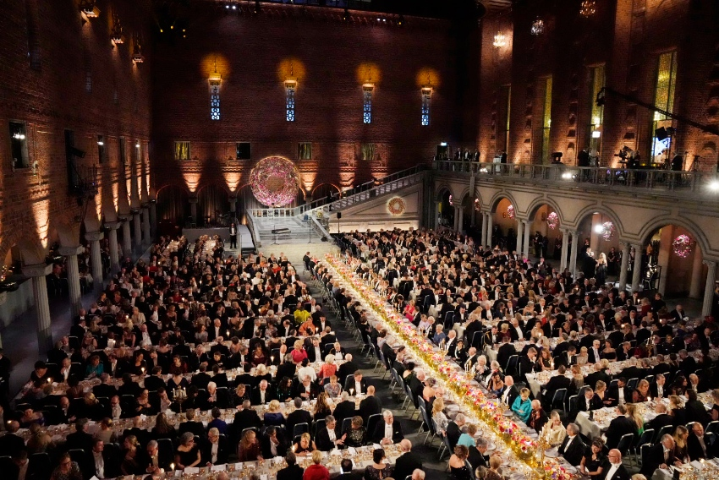

The Nobel banquet

Slide 29
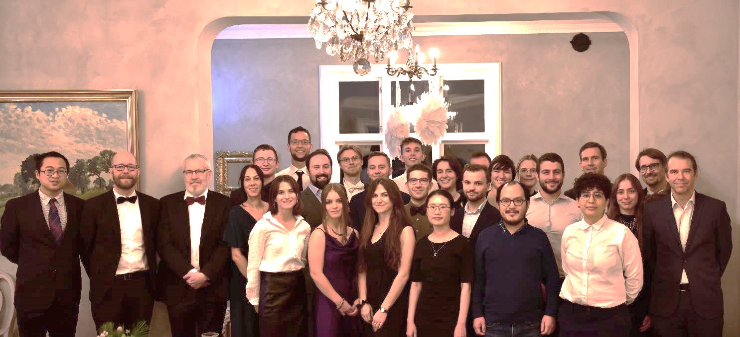





Thank you!
Johan Mauritsson
Per Eng-Johnsson
Cord Arnold
Mathieu Gisselbrecht
Anne-Lise Viotti
David Busto
Thank you!

