Slide 1

AD/ELENA FACILITY
ADTC Meeting
15th February 2024
2023-2024 YETS follow-up

Slide 2
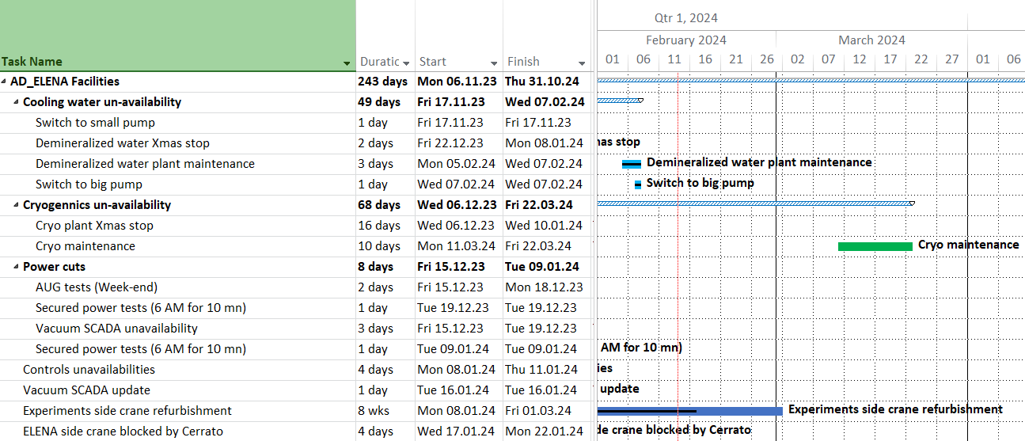
Planned services disruptions
New dates
09/03 – 24/03
For info: Fire brigade training in AD ring on Sat 17/02
Planning available at
https://oss-coordination.web.cern.ch/gantt/latest?facilities=AD/ELENA&scale=week&worktypeproject=

Slide 3
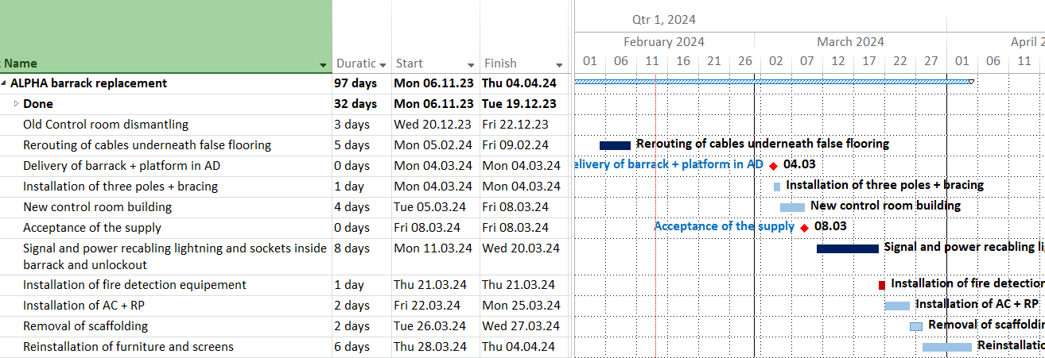
ALPHA barrack replacement

Slide 4
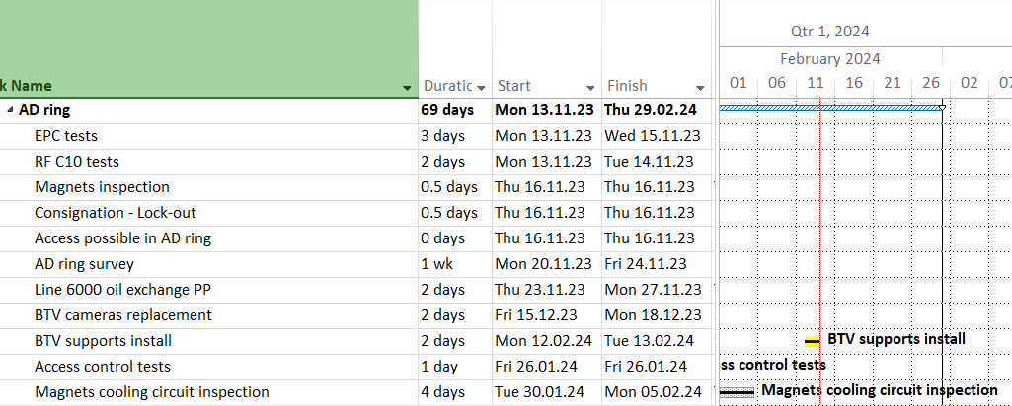
AD ring general

Slide 5
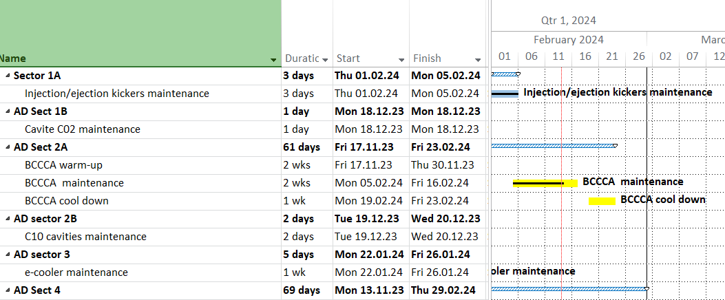
AD sectors 1A-1B-2A-2B-3

Slide 6
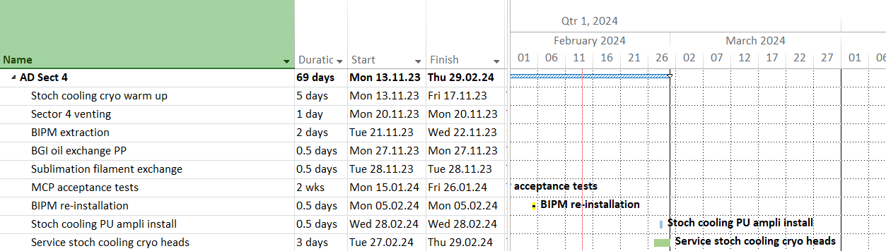
AD sector 4 - general
New date

Slide 7
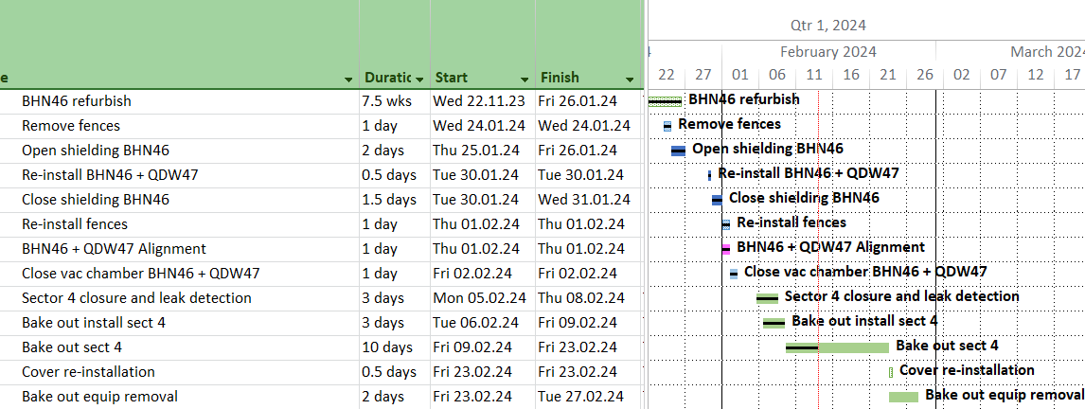
AD ring sector 4 – BHN46
New date !

Slide 8
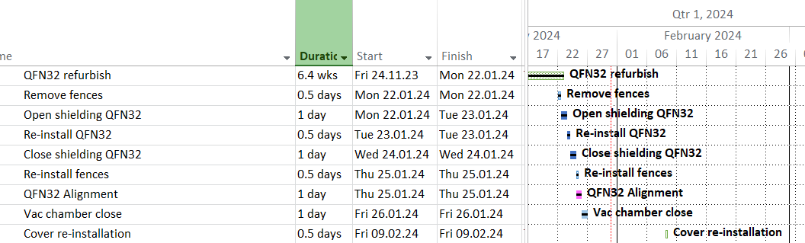
AD ring sector 4 – QFN32
New date !

Slide 9
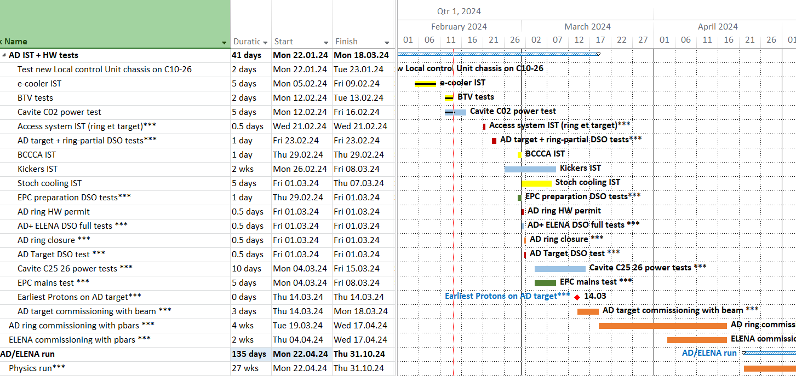
AD re-commissioning
??

Slide 10
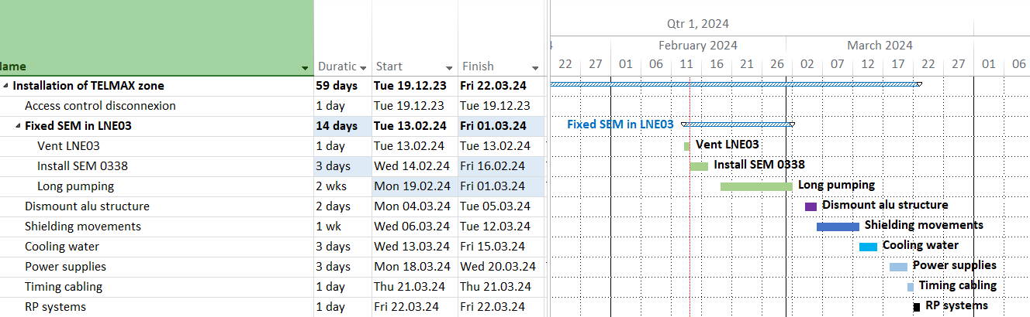
ELENA

