Slide 1
CERN IPMC: Update
On behalf of the CERN xTCA/IPMC Team

Slide 2
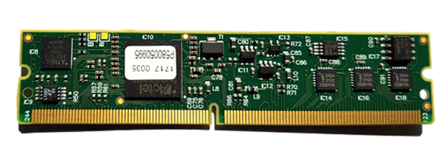
IPMC Cards
IPMC:
Current availability:
IPMC Version V3 (two UARTs): ~50
IPMC Version V4 (three UARTs): ~300
New production:
In 2023 a batch of 500 cards (V4) was manufactured
In early 2024 ATLAS and CMS have run a large campaign to estimate their future needs of CERN IPMCs
We are currently producing another batch of ~1000 cards to satisfy the communicated needs until 2028
They will be available in Q3 2024
No further batches planned
Purchasing procedure:
Send an email to epesebe-ipmc-purchase@cern.ch, containing experiment, project, number and version of IPMCs, and budget code: 1 IPMC = 200 CHF.

Slide 3
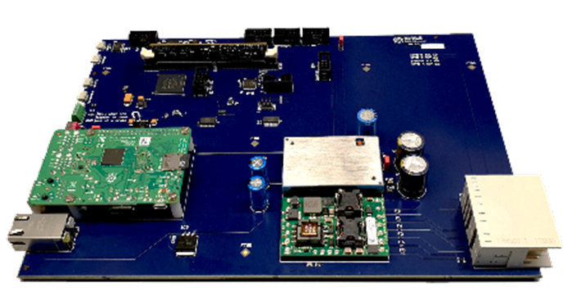
IPMC Tester
IPMC Tester:
For desk-top testing
(this is how we test the IPMC cards)
For in-shelf tests
As a development kit
Current availability:
CERN has a few IPMC Testers for sale.
You can buy one for 1500 CHF
Final production:
Another 10 IPMC Testers were built (for EP/ESE internal use)
Plan to run full-crate tests: stress tests of IPMC software and ShelfManager, investigate system aspects.

Slide 4
IPMC benchmarks - 1
ATCA shelf
External PC
Network
Freescale
SPICOMM
Cortex-M3
ShMM 700
top
IPMB
Wireshark
SOC
Sensor
…… * ~50-100
I2C
IMPC
…… * 14

Slide 5
IPMC benchmarks - 2
Goal:
Understand the maximum message frequency as well as the location of the bottleneck
Run benchmarks with the same S/W as will be used by ATLAS-DCS:
Snmpget (Linux)
Check if / how the performance depends on:
Type of sensor
Parallel execution of snmpget commands
Speed of host computer
Etc.

Slide 6
IPMC benchmarks - 3
The main results:
Reading one value via snmpget takes of the order of 70 ms
  Reading the same sensor via “clia” on the ShMM700 takes ~12 ms
The speed of the host PC plays a small role
The bottleneck seems to be the overhead of the SNMP commands in combination with the low performance of the ShMM700
What can be done:
Alternatives to snmpget (ipmitool, EasySNMP) have a similar performance
nVent seems to have a SDK that bypasses SNMP. Not available at CERN (no license)
It seems we have to live with the limitation

Slide 7
IPMC Support
Web site (https://cern-ipmc.web.cern.ch):
Documentation, software, remote compilation (requires login, now also works with 2FA), link to Discourse
Discourse forum (https://cern-ipmc-forum.web.cern.ch):
Check/read the existing topics.
If you cannot find anything on your issue, create a new topic.
Alternatively, send an email to cernipmc.webapp@cern.ch:
The email will also create a new topic in Discourse.
Support team: Markus Joos, Stefan Haas, Ralf Spiwoks
CERN has a support contract with PigeonPoint Systems (PPS):
We escalate issues to PPS, if we cannot solve them ourselves.

Slide 8
Questions?
Contact: epesebe-xtca-support@cern.ch

